Slide 1
LSST Risk Management Overview Charles (Chuck) F. Claver LSST Systems Engineer LSST Preliminary Design Review August 29-September 2, 2011

Slide 2
Risk Management Objectives
Establish a defined structured process for identifying, assessing, and managing risks.
(see LSST Risk Management Plan)
Provide ongoing risk assessment throughout the project life cycle:
Identify and monitor risk drivers
Develop and execute risk mitigation strategies
Monitor mitigation progress
Manage risks to acceptable levels or retire them

Slide 3
Risk Management Team
Members:
Project Manager
Project Systems Engineer
Subsystem Managers
Subsystem Systems Engineers
Other subsystem leads
Activities:
Risk Identification
Risk Analysis and Assessment
Risk Mitigation Plans
Risk Monitoring

Slide 4
Risk management methodology comes from established practices
Risk score based on Budget, Schedule, & Performance impacts and Probability of occurrence.
Two assessments are made: Current State and Expected Residual after mitigation at the start of construction.
Periodically updated and reviewed to track mitigation progress and reassess current risks
Total Risk Exposure is Calculated: Impact * probability
Each subsystem and Systems Engineering track their risks
Top 10 from each subsystem & SE forms the Major Threats List
Risk Management Plan: LPM-20

Slide 5
Risks characterization
Risks identification includes:
Unique identifier – subsystem + number (eg DM-31)
Control – Can the risk be targeted for mitigation by the project?
Title specific to the risk identified
Affected WBS
Responsible person
Detailed description in an IF-THEN format providing trigger and consequence
Current assessment
Mitigation description
Post-mitigation Assessment
Cost estimate to correct the risk should it materialize

Slide 6
Scoring the risks
Impact Scoring: | Impact level | Cost Impact | Schedule Impact | Performance Impact | Impact Score
 | Insignificant | <$30k | <0.5 months | Not detectable | 1
 | Minor | $30-200k | 0.5 - 1.5 months | Subsystem requirements | 2
 | Moderate | $200k-1.5M | 1.5 - 3 months | Level 2 rqt., SRD Design specs | 3
 | High | $1.5M-10M | 3 - 6 months | Level 1 rqt., SRD Minimum specs | 4
 | Critical | >$10M | >6 months | Primary science missions | 5
Probability Scoring: | Impact level | Probability | Probability Score
 | Rare | <1% | 1
 | Unlikely | 1-5% | 2
 | Possible | 5-25% | 3
 | Likely | 25-67% | 4
 | Almost Certain | >67% | 5

Slide 7
Risks registry entries
All risks have an owner
Project System | Risk ID | Can Be Targeted | Risk Title | WBS # | Description | Owner | Appearance Time Frame
SE | 1 | Partly | Delay in Camera Delivery in Chile | 3 | IF the Integration of the Camera at SLAC falls behind schedule forcing a delay in shipping it to Chile, THEN the start of System Integration and Test will be delayed leading to a delay in start of operations. | C. Claver | Construction
Is this risk within our control to target for mitigation?
The “If-Then” risk statement format captures both the trigger and consequence

Slide 8
Each risk has 2 assessments: current and post mitigation
Current Assessment
Probability Score | Cost Impact Score | Schedule Impact Score | Performance Impact Score | Risk Exposure (Calculated)
3 | 5 | 5 | 1 | 10.2 | Moderate
Mitigation Action
PRIMARY: Work with Camera to for early identification of schedule slip potential. Develop strategies with the camera to accelerate final testing before shipping. SECONDARY: The camera can be shipped to Chile without a fully populated FPA.
Post-Mitigation Assessment: Residual Risk
Probability Score | Cost Impact Score | Schedule Impact Score | Performance Impact Score | Risk Exposure (Calculated)
2 | 2 | 2 | 2 | 4.0 | Insignificant

Slide 9
Project tracks 304 risks in 6 registers & Current top risks
Systems Engineering (includes Commissioning)
34 risks tracked
Top risk: IF the Integration of the Camera at SLAC falls behind schedule forcing a delay in shipping it to Chile, THEN the start of System Integration and Test will be delayed leading to a delay in start of operations.
Telescope and Site
106 risks tracked
Top risk: IF wavefront estimation algorithm does not meet performance requirements, THEN image quality error budget may not be met.
Data Management
40 risks tracked
Top Risk: IF the computing power required by the Data Release Production exceeds the baseline estimate by a large factor (factor of 2 or more) THEN early data releases cannot cover the full area and/or depth of the survey
Camera
115 risks tracked
Top Risk: IF the CCDs do not simultaneously meet key requirements (flatness, read noise, crosstalk, diffusion PSF), THEN the camera will not meet the throughput and image quality allocations or degradation of faint images in u-band may occur

Slide 10
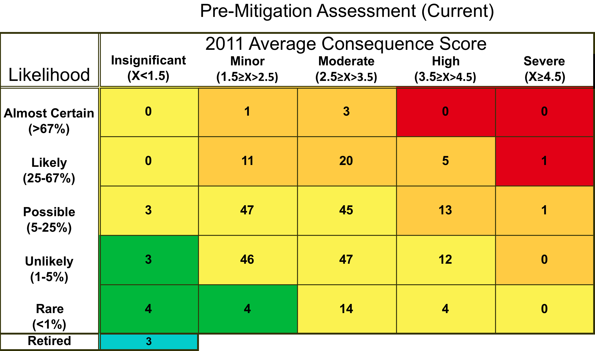
Current LSST Risk Count

Slide 11
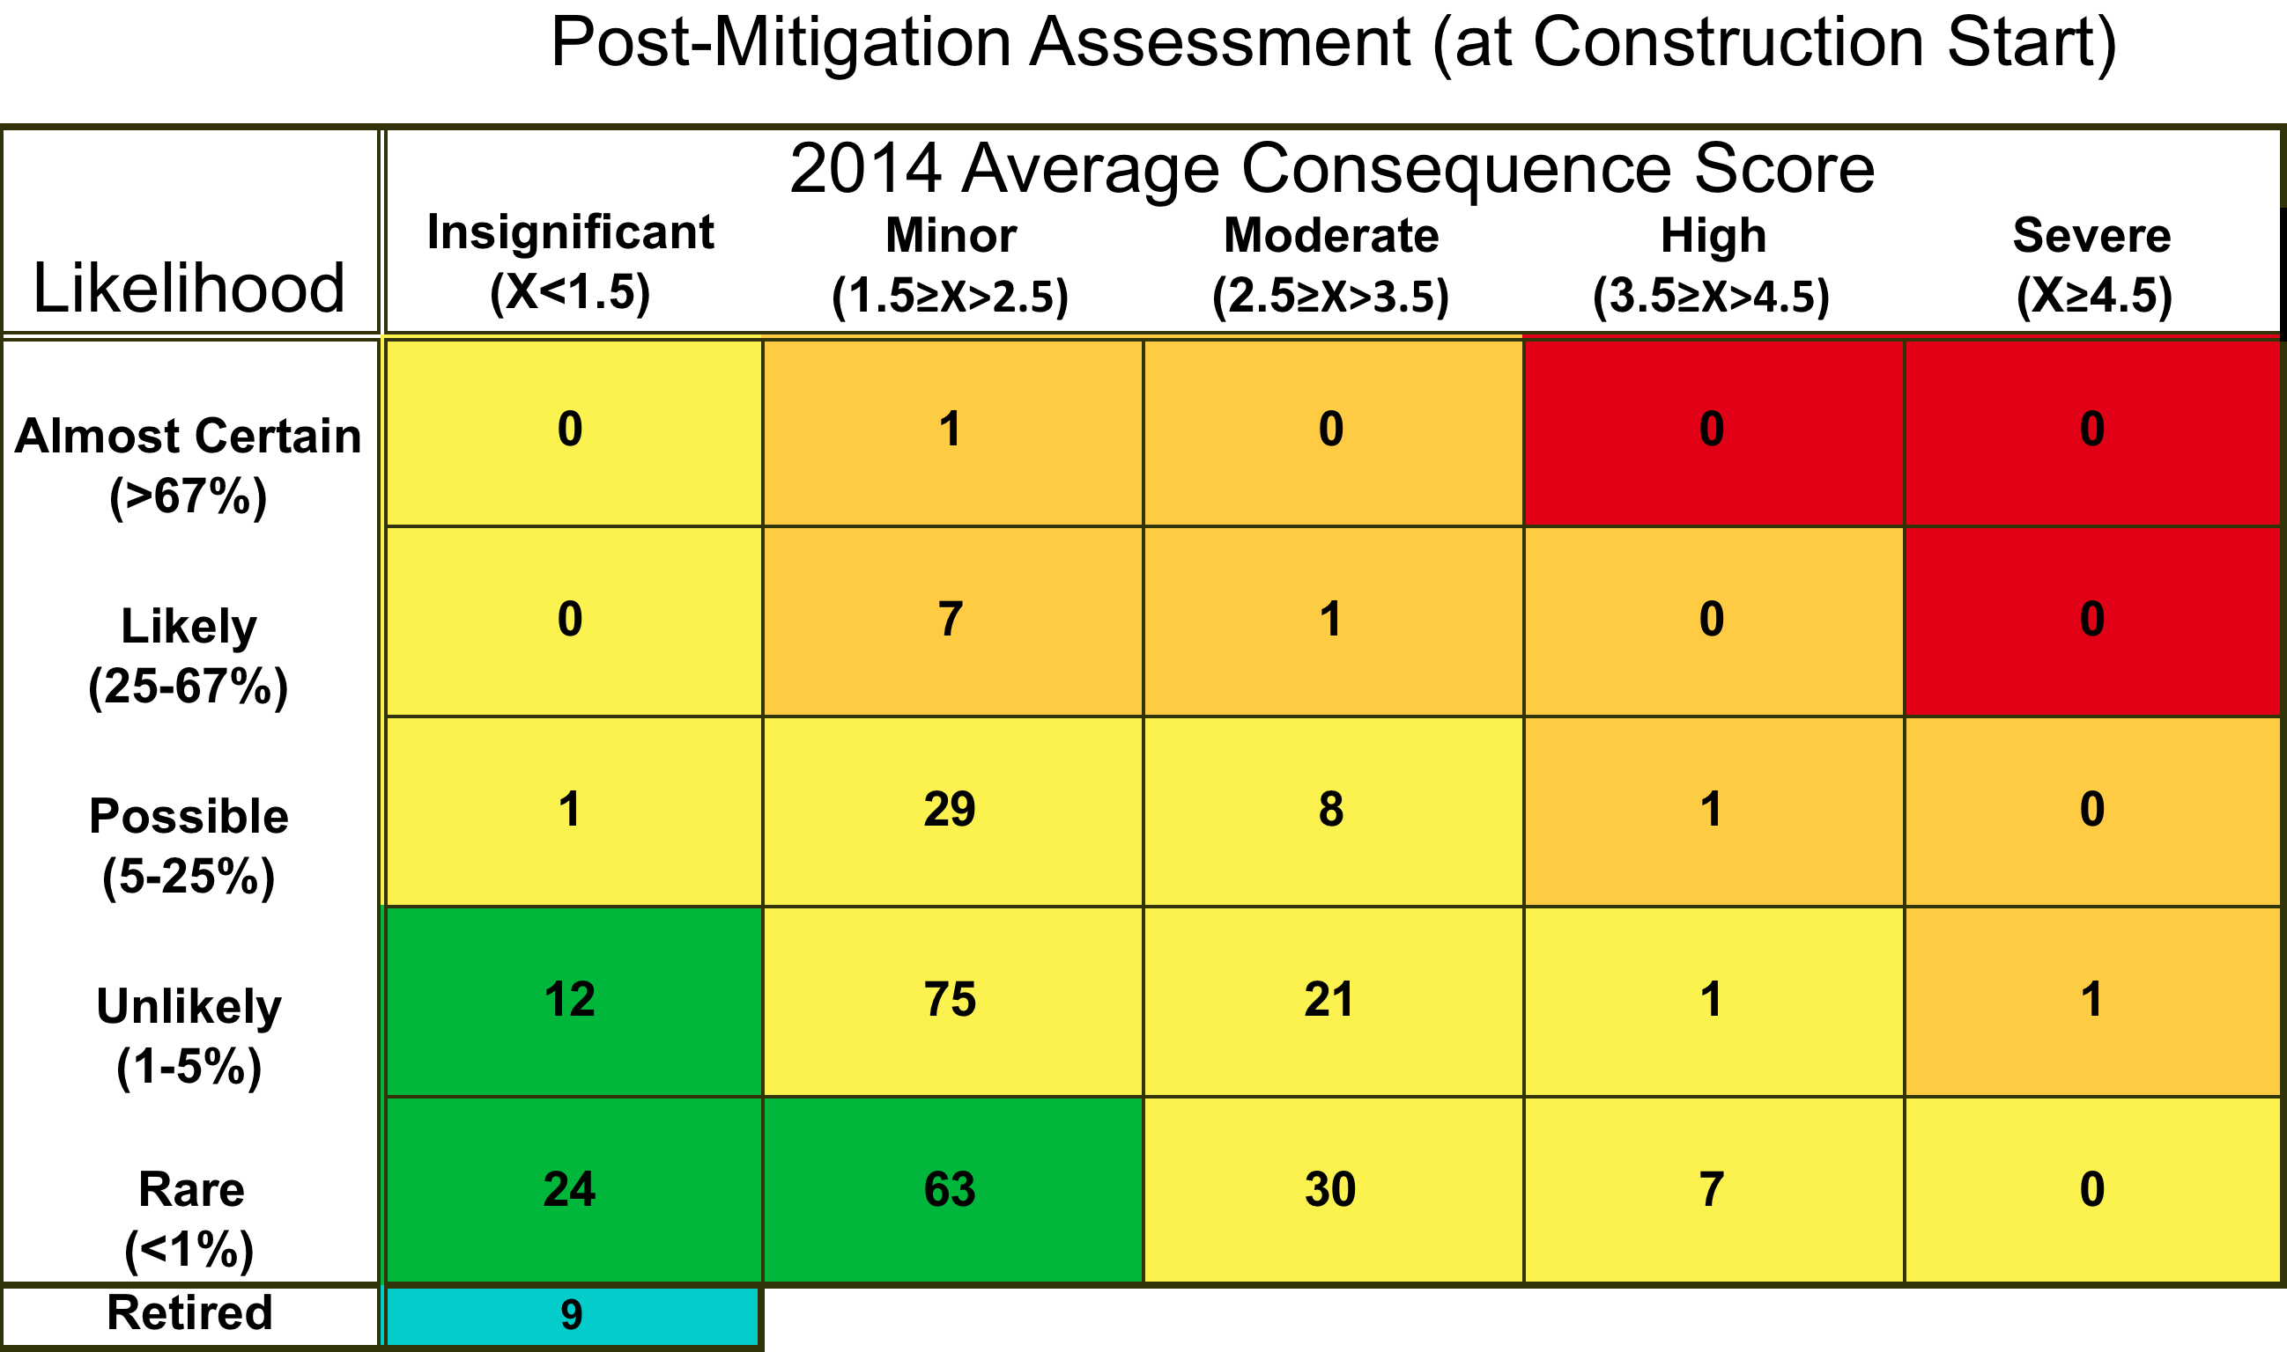
Construction Start (2014) Risk Count

Slide 12
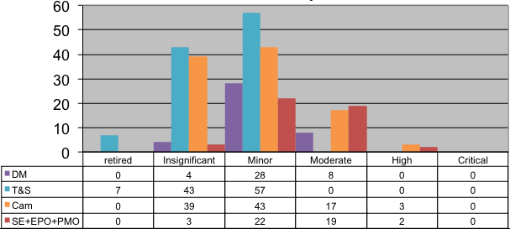
Current risk distribution by WBS

Slide 13
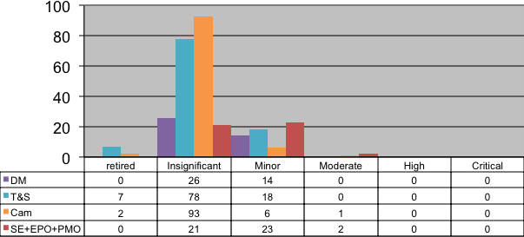
Start of construction risk distribution by WBS

Slide 14
Current Estimated Cost of MREFC Risk Exposure
WBS | Number of Risks | Probability Weighted Cost Exposure ($1K, Base year)
1.0 PMO | 6 | 1980
2.0 Data Management | 40 | 36267
3.0 Camera | 115 | DOE contingency
4.0 Telescope and Site | 103 | 9257
5.0 Education & Public Outreach | 6 | 317
6.0 Commissioning (+ Sys. Eng) | 34 | 21190
Total | 304 | 69088
7 month schedule contingency @ $2M/ month |  | 14000
Total Risk Exposure |  | 83088

Slide 15
Estimated Cost of MREFC Risk Exposure at Construction Start
WBS | Number of Risks | Probability Weighted Cost Exposure ($1K, Base year)
1.0 PMO | 6 | 1438
2.0 Data Management | 40 | 11265
3.0 Camera | 115 | DOE contingency
4.0 Telescope and Site | 103 | 14371
5.0 Education & Public Outreach | 6 | 73
6.0 Commissioning (+ Sys. Eng) | 34 | 10685
Total | 304 | 37832
7 month schedule contingency @ $2M/ month |  | 14000
Total Risk Exposure |  | 51832
Total MREFC risk exposure is ~70% of PMCS base year contingency estimate.

Slide 16
Pre-Post Mitigation Direct Cost Exposure Comparison
WBS | Pre-Mitigation | Post-Mitigation | Exposure Reduction
1.0 PMO | 1980 | 1438 | -542
2.0 Data Management | 36267 | 11265 | -25002
4.0 Telescope and Site | 17067 | 14371 | -2696
5.0 Education & Public Outreach | 317 | 73 | -244
6.0 Commissioning (+ Sys. Eng) | 12807 | 10685 | -2122
Total | 68438 | 37832 | -30606

Slide 17
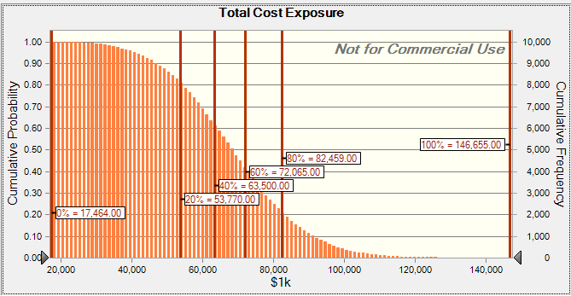
Monte Carlo Analysis of Current Risk Cost Exposure
All risk in MREFC request
Mean = $68.3M
Median = $67.9M
80% = $82.5M

Slide 18
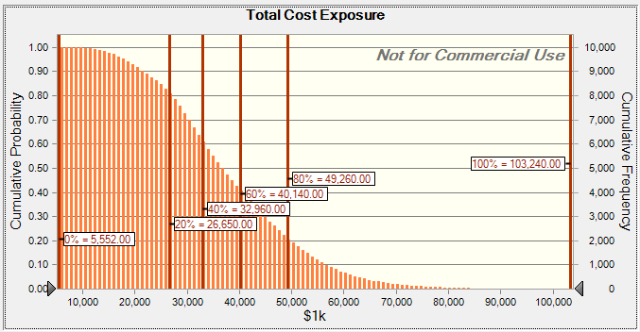
Monte Carlo Analysis of Cost Exposure Over All Risks in MREFC Request
All risk in MREFC request
Mean = $37.9M
Median = $36.2M
80% = $49.3M

Slide 19
Top Project Wide Risks at Construction Start
WBS | Risk Description | Relative Risk Score
6.0 Comm. | IF commissioning progresses slower than planned, THEN the schedule contingency will be expended and start of operations is delayed. | 12.4
1.0 PMO | IF federal agency budgets are lower than planned during the construction phase, THEN project will be delayed and staff will be hard to fund and retain and project will need to be re-scoped. | 11.0
3.0 Cam. | IF the CCDs cannot be positioned co-planar to within several microns p-v across a raft, THEN the camera focal plane image quality requirements will not be met. | 10.8
1.0 SysEng | IF the system performance budgets are not complete, THEN significant rework may be needed to meet system level performance requirements. | 9.2
2.0 DM | IF the computing power required by the Data Release Production exceeds the baseline estimate by a large factor (factor of 2 or more), THEN early data releases cannot cover the full area and/or depth of the survey | 9.0
4.0 T&S | IF vendor interest in construction contracting is limited due to market conditions and remote, unusual nature of project, THEN moderate cost impact is possible. | 8.8

Slide 20
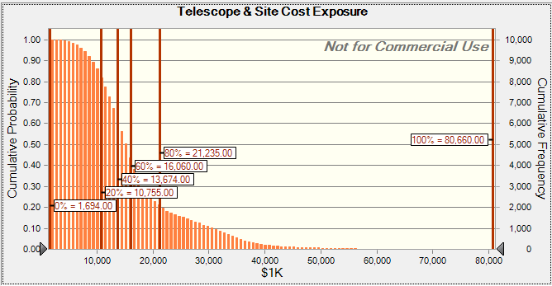
Current Telescope & Site Risk Cost Exposure
Telescope & Site Risks
Mean = $17.0M
Median = $14.9M
80% = $21.2M

Slide 21
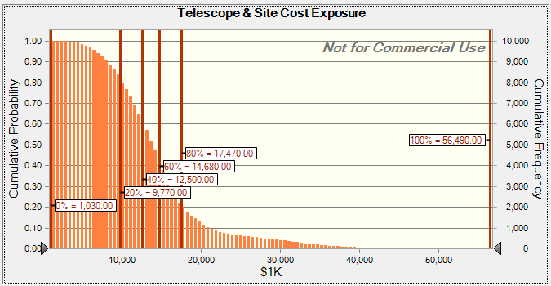
Telescope & Site Risk Cost Exposure at Construction Start
Telescope & Site Risks
Mean = $14.4M
Median = $13.6M
80% = $17.5M

Slide 22
Top Telescope & Site Risks at Construction Start
WBS | Risk Description | Relative Risk Score
4.3 | IF vendor interest in construction contracting is limited due to market conditions and remote, unusual nature of project, THEN moderate cost impact is possible (6 similar bid jeopardy risks for major contracts). | 8.8
4.1 | IF the Facility/Dome Interface is not respected by contractors, THEN overall schedule is impacted. | 8.8
4.5 | IF the dome motion during an exposure creates vibration coupling between dome and telescope above allocation in error budget, THEN image quality error budget may not be met. | 6.0
4.1 | IF serious currency fluctuations between the Chilean Peso and the Dollar happen, THEN moderate cost increase affecting contract prices is possible | 5.7
4.5 | IF Dome is not delivered on time, THEN integration schedule will be delayed (3 similar schedule risks for delivery of key subsystems). | 5.7
4.4 | IF mount can not reach acceleration and speed needed to maintain the cadence of the survey, THEN the cadence of the survey will not be achieved. | 5.2

Slide 23
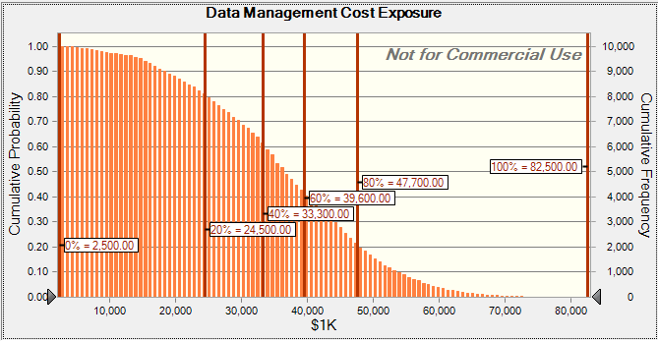
Current Data Management Risk Cost Exposure
Data Management Risks
Mean = $36.3M
Median = $36.3M
80% = $47.7M

Slide 24
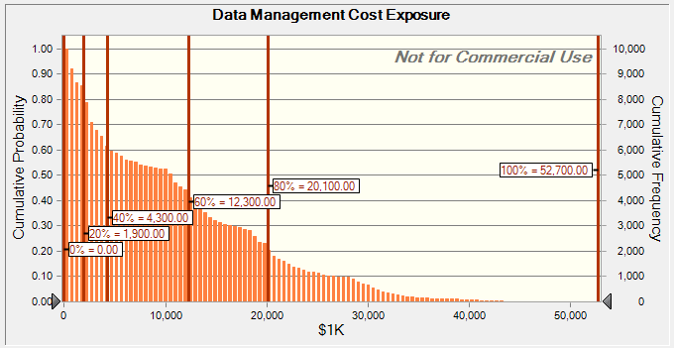
Data Management Risk Cost Exposure at Construction Start
Data Management Risks
Mean = $11.2M
Median = $10.4M
80% = $20.1M

Slide 25
Top Data Management Risks at Construction Start
WBS | Risk Description | Relative Risk Score
2.4 | IF the computing power required by the Data Release Production exceeds the baseline estimate by a large factor (factor of 2 or more), THEN early data releases cannot cover the full area and/or depth of the survey. | 9.0
2.2 | IF the productivity of the programming team is lower than estimated due to geographical distribution THEN milestones will be delayed and software maturity will be less than desired when commissioning begins. | 8.0
2.4 | IF the Data Release Production is insufficiently mature when operations begin, THEN the rate of software enhancements and bug fixes will preclude the production of a Data Release with a single version of the software, reducing the scientific integrity of the Data Release | 7.0
2.7 | IF the Archive Center computing infrastructure is insufficiently reliable THEN the throughput of data through the Data Release Production will be reduced, delaying the release of data products | 7.0
2.6 | IF the science database system does not support the actual pipeline load and query load from user, THEN the scientific usefulness of the survey will be reduced. | 7.0

Slide 26
Top Camera Risks at Construction Start
WBS | Risk Description | Relative Risk Score
3.0 | IF the CCDs cannot be positioned co-planar to within several microns p-v across a raft, THEN the camera focal plane image quality requirements will not be met. | 10.8
3.0 | IF the CCDs do not simultaneously meet key requirements (flatness, read noise, crosstalk, diffusion PSF), THEN the camera will not meet the throughput and image quality allocations or degradation of faint images in u-band may occur. | 7.2
3.0 | If CCS D&D lacks sufficient personnel, THEN some camera subsystem development will run behind schedule or over budget, and will not be tested properly before deployment. | 6.9
3.0 | IF the camera does not have a coordinated design for thermal management, THEN the CCS will not be able to maintain thermal stability. | 6.2
3.0 | IF CCS interface standards are not in place in time THEN subsystem development will be incoherent, complicating and delaying camera integration. | 5.2

Slide 27
CCD Performance Risk Mitigation Plan (Risk ID CA1)
NSF CoDR
NSF PDR
NSF FDR
CD-1 Review
CD-2 Review
CD-3 Review
Start Camera I&T
Camera Verification
PreShip Review
CD-4
Technology study
Understand and model device characteristics
Study contract – 3 vendors
Receive working sensors
Technology choice
Establish test lab at BNL
Critical
IF the CCDs do not simultaneously meet key requirements (flatness, read noise, crosstalk, diffusion PSF), THEN the camera will not meet the throughput and image quality allocations.
Full-Spec Sensor Prototype
Multivendor competition
Fabricate sensor meeting all LSST specifications
e2v funded to develop full-spec science sensor & mechanical package
Mech samples received
First operable test samples received Sep 2010
First fully tested operable samples Oct 2011
ITL/STA delivered mech package and test device
First fully tested operable samples Oct 2011
High
Risk Exposure
Moderate
Minor
First Article Fabrication, Yield Runs & Raft Integration
Full Fabrication & Acceptance Process Finalization
Prototype Raft
Demonstrate yield and quality control
Ramp up test capability within LSST collaborating institutions
Insignificant
Current Assessment
Fiscal Years
2007
2010
2011
2012
2013
2014
2015
2016
2017
2018
2019
Notes:
27

Slide 28
Risk Related Questions Raised by the Committee
18) Does Table 8.8 contain all of the key risk areas or just a sample? It is a little surprising that most areas have the same number of key risks (2).
Answer:
Table 8.8 is in fact a sampling of the top 2 risks in key technical areas of the project. The LSST risk registers currently track >300 risks, both technical and programmatic.

Slide 29
Risk Related Questions Raised by the Committee
19) p 175 mentions a Risk Register. Table 8-8 only lists technical risks. Is there a more complete register covering all risks - cost, schedule, hazard, HR, supplier, interface, etc.?
Answer:
Yes, the complete LSST Integrated Risk Register is available for the Committee. The risks include the following kinds of risks:
Technical;
Bid jeopardy on large procurements;
Interfaces; and
Schedule slips
As presented in the preceding charts the project tracks a wide range of risks. Nearly all of the top risks at the start of construction are programmatic risks.
Hazards are tracked separately by the LSST Safety Committee (see LSST Safety Plan).

Slide 30
Risk Related Questions Raised by the Committee
21) Discuss any risks during pre-construction that could have a negative impact on the construction schedule.
Answer:
The most significant technical risk in the pre-construction phase is the development of the Camera sensors. If an additional round of prototyping were needed then this could delay the initiation of the sensor procurement contract and could lengthen the Camera construction schedule. We believe that through the D&D efforts that the remaining technical risks are well in hand and do not pose a significant risk to the construction schedule. However, there are real programmatic risks that could significantly impact the construction schedule, namely: 1) Funding required to staff the project to the necessary levels needed at the start of construction; 2) Funding the final design-build procurement strategy for the Dome, Mount and M2 fabrication so that these contracts can be released at their required early start dates; and 3) Synchronizing the funding profiles and schedules of the DOE and NSF.
Discussion of these risks will be made available during the Project Management breakout session.

Slide 31
Risk Related Questions Raised by the Committee
22) If there is any current dispute, claim or litigation which could have a material adverse effect on program costs, provide a discussion.
Answer:
There are currently no disputes, claims or litigation issues facing the project.
It is common for large telescope projects to encounter environmental permitting issues that result in litigation. The LSST Project has received all of its necessary permitting to proceed with construction in Chile. The process and permitting has been approved by the NSF.

Slide 32
End of charts

