Slide 1
LSST Camera
Camera Body and Shutter Sub-System Status
Marco Oriunno
LSST Camera CB&S Sub-System Manager, SLAC
NSF/DOE Joint Status Review
Aug 27th - 30th , 2019

Slide 2
Outline
Shutter
  Introduction and Scope
  Technical Status
Camera Body
  Introduction and Scope
  Technical Status
Risks and Mitigations Status
Hazards and Transition to Commissioning/Operation
Programmatic Status
  Organizational Structure
  Cost and Schedule Performance Status
Summary
Supporting Material
  Key Documents
  Past Review recommendations
  BCR summaries
Message box example for short highlighted messages.

Slide 3
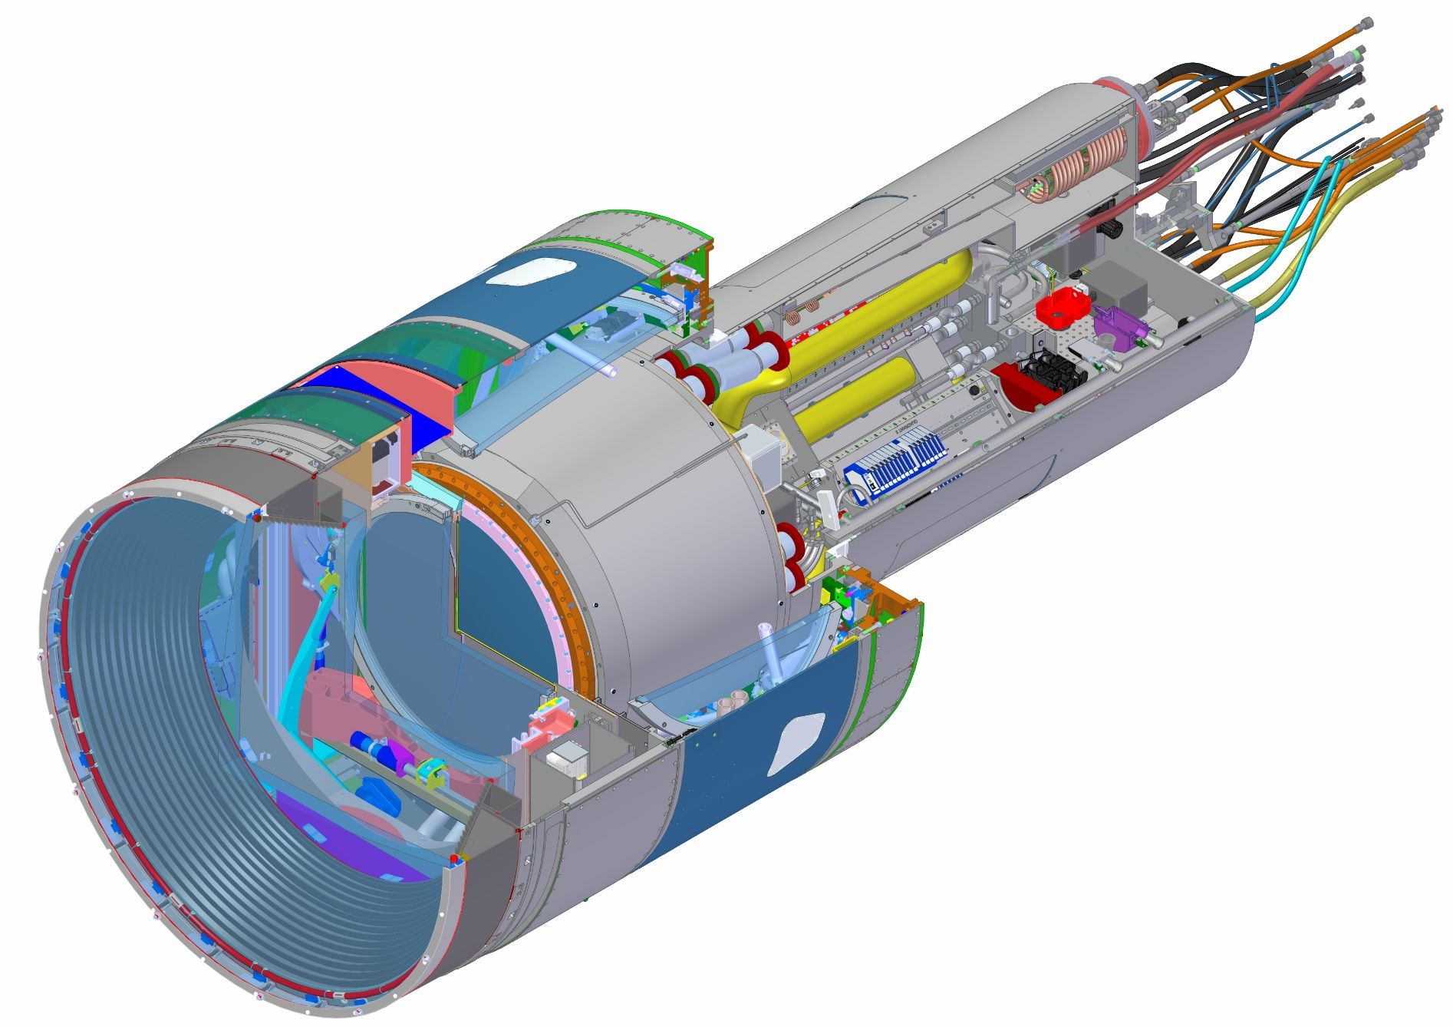
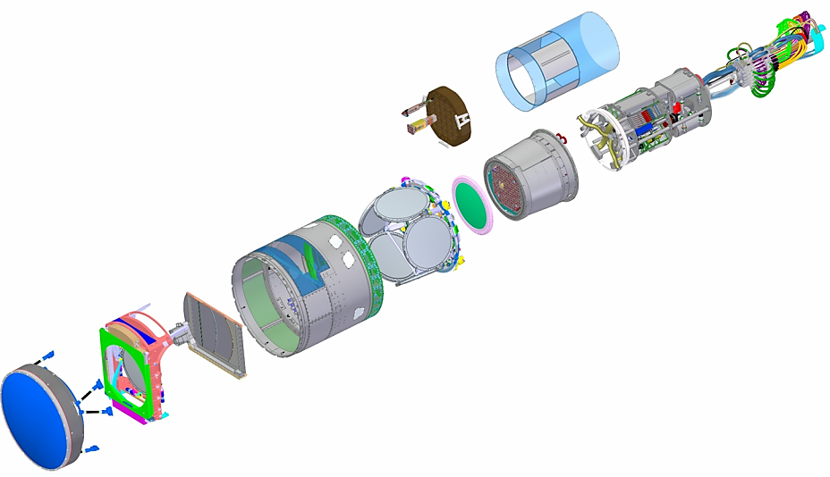
LSST Camera Elements
Bulkhead and Cable Wrap
UT Shell
Corner Raft Tower
Science Raft Tower
Sensors
HeX & Vacuum
Camera Body
Shutter
Assembly
Auxiliary Electronic
L1/L2
Assembly
Utility Trunk
Structure
Purge Cabinet
Cryostat
Assembly
L3
Filter and Filter Changer
Assembly

Slide 4
Scope and Technical Status
Shutter

Slide 5
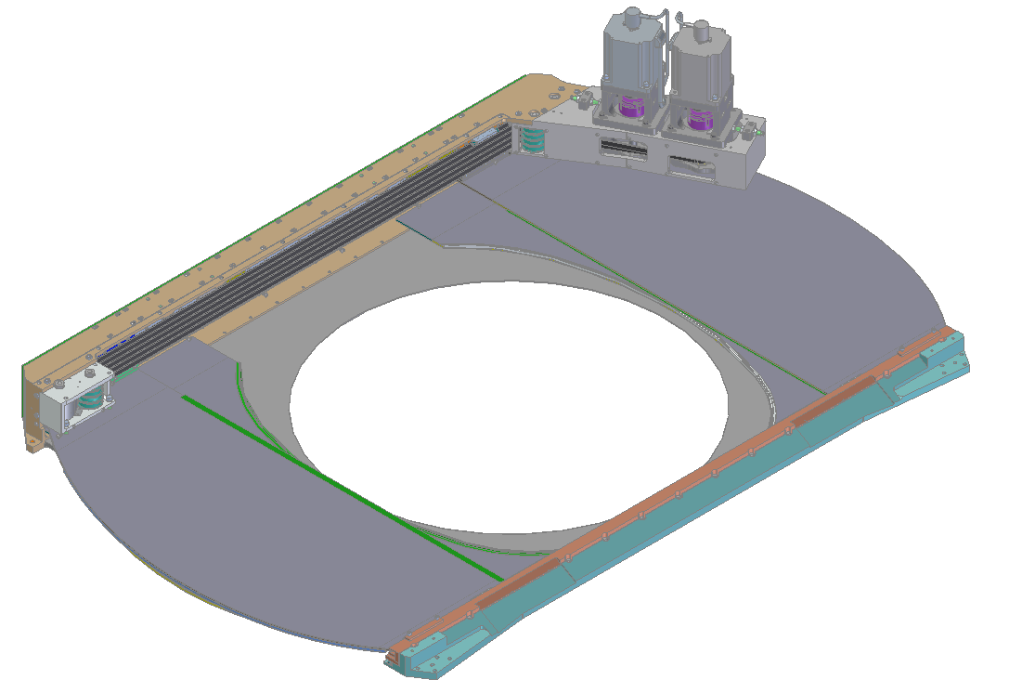
Shutter unit with shrouds removed
Stepper Motor w/ Capstan Drive
(1 motor drives 1 blade stack)
Drive Module
Timing Belts
(drive blades on a common rail)
X+ Blade Stack
(CF sandwich construction)
Idler Module
Garage Plate
(L3 side; ‘cools’ L3
X- Blade Stack
(CF sandwich construction)
Shutter Module –Filter Garage, Shrouds, Motor Cooling Removed

Slide 6
Deliverables list
Two Shutter Assemblies equipped with blades and mechanisms
Integrated Motion Controls
Interfaces with the Camera Control System, the Camera Protection System and the Auxiliary Electronics
Fixtures and Test Equipment
Test stand equipped with LEDs to test and verify the compliance of the light tightness requirement on the prototype and on the final assembly any time they are rebuilt or calibrated on the Summit
Independent Engineering Control Unit used for the test, the Integration at SLAC, the calibration and the development on the summit
Maintenance tool used on the summit to install or extract the shutter from the Camera Body for yearly scheduled or unscheduled maintenance.

Slide 7
Shutter - since last review
      Verification and Testing of the prototype
        Light absorption
        Life Duration
        Electronics
        Motion Control
      Final Blades Manufacturing
      Manufacturing Readiness Review 1/16/2019
      Parts Procurement, completed
      Assembly, in progress

Slide 8
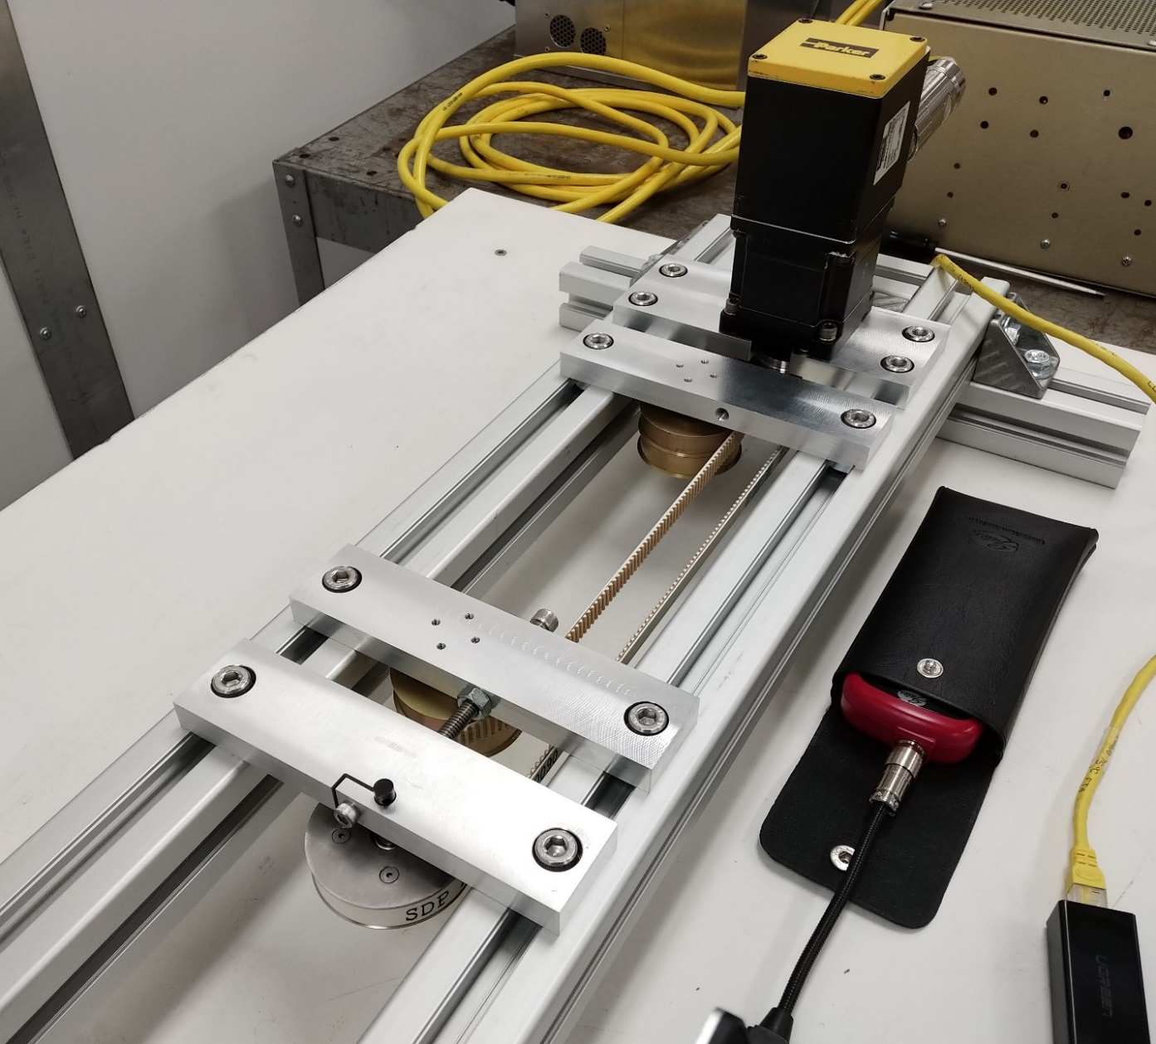
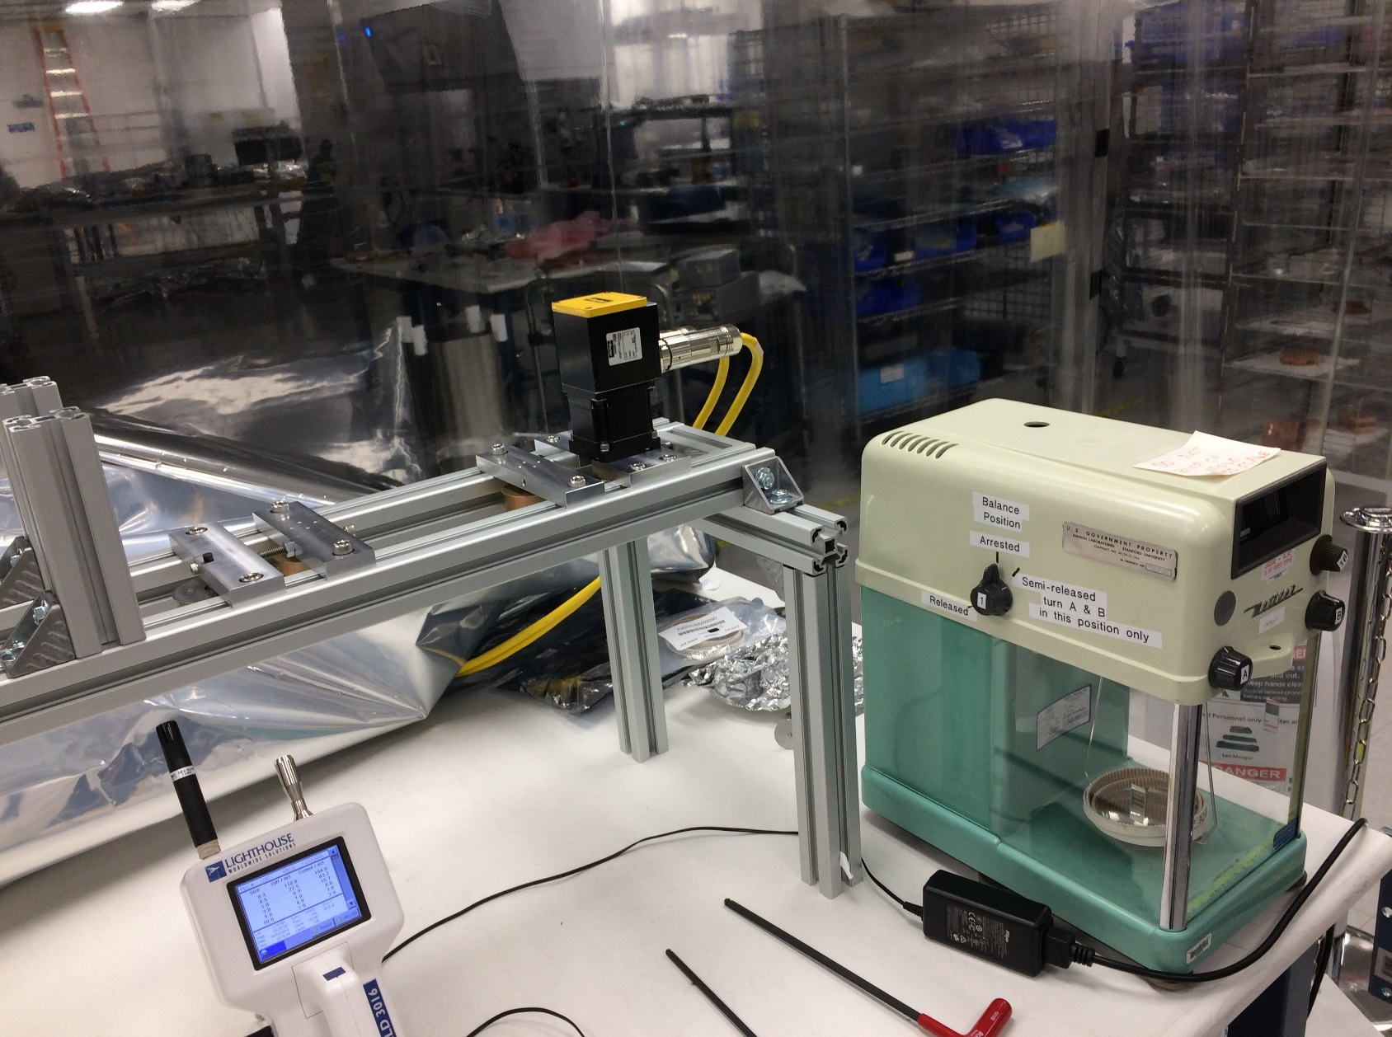
Alternate Belt Material
Bench test for measuring mass loss of the belts (using a precise balance milligram scale) – In the Clean Room in Bldg 33
Using a salvaged/repurposed Motor and Control system w/ pulleys from original Prototype
Current configuration uses the ‘low dust’ generating belt, the belt stock is unavailable in the TruMotion line (custom manufacturing run will need to be made to test in this condition)
Results are within the spec= 0.22mg per 10,000 shutter cycles (req. asks < 60mg for 10,000 cycles)
Measurements done weighing the belt before and after the test
Monitored particulate fallout using an available particle counter
Belt path is ‘close’ to actual build
Configuration in Clean Room

Slide 9

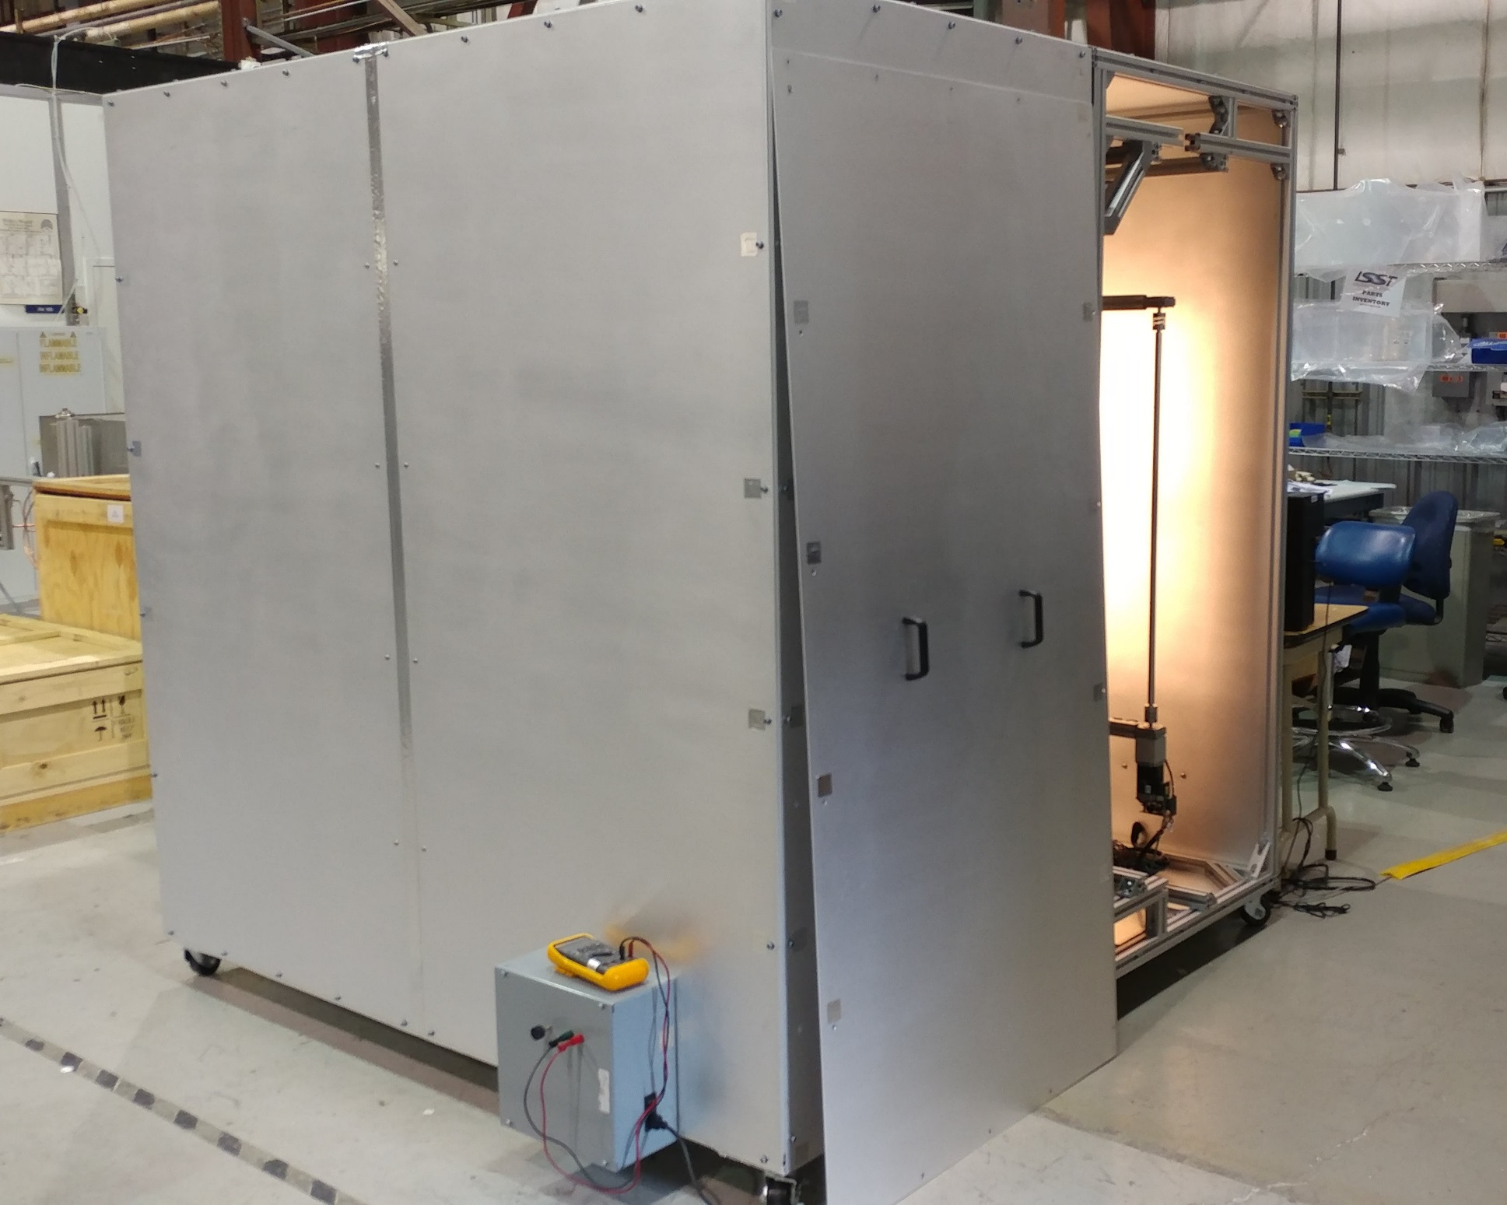
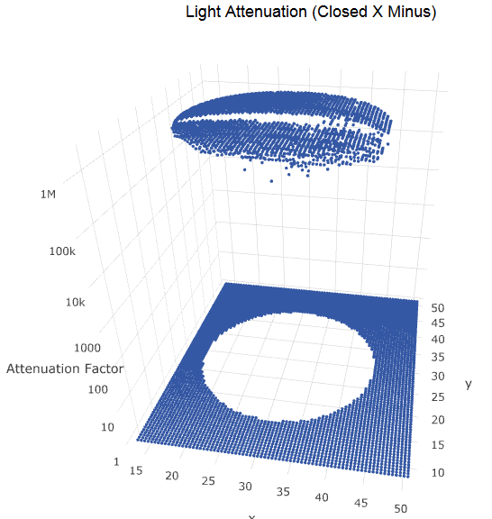
Light Box – Flat Field Testing
Light leak testing on prototype blades confirmed that the design meets req# C-SHUT-029, attenuation factor > 10⁴ . Consistently measures more than 10⁵
Measured
Requirements
Light Box Test Unit constructed – complete w/ XY Scanner and Flat Field Source

Slide 10
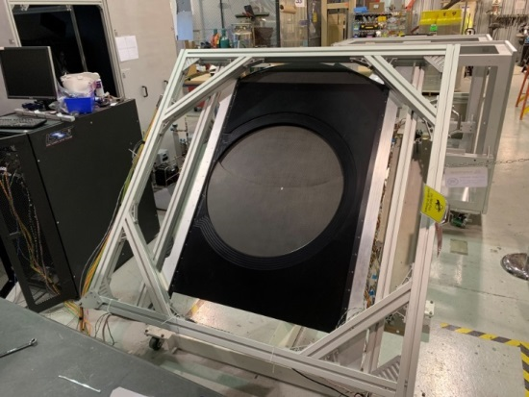
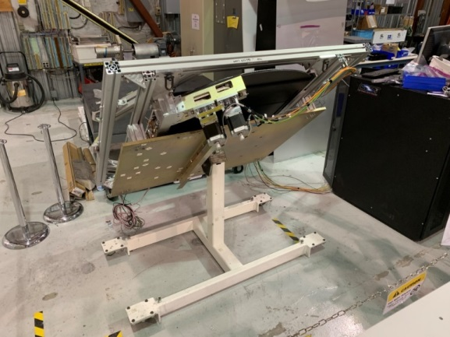
Life Duration Test
C-SHUT-024 | The shutter shall be designed for at least 1E6 open/close cycles per year.
The exposure cycle is made of 0.98 sec opening motion path, 15 second exposure (suppressed in the test), 0.98 sec closure.
Each open/close cycle in this tests consists of:
  0.90 seconds opening motion + 0.90 second closing motion (starts 0.40 second after first blade moves)
  0.10 second dwell time. Total time per open/close cycle: 1.4 seconds (~30 days for 1.8 M cycles)
First run at horizontal configuration: ~400k cycles
Second run at 45 deg tilt configuration: ~1.8M cycles
  No sign of mechanical failure from initial inspection
  Motion path stable, no sign of drift or hysteresis

Slide 11
Shutter Electronics

Slide 12
Shutter Instrumentation and Controls Overview
The Shutter of 2 Blade Stacks, ‘locally’ controlled by PLC/Motion controller (Beckhoff system)
  Issues low level commands to the motors and brakes
  Monitors hall-effect sensors, motor (status/position), brake status, limit switch status
  Processes hall-effect sensor data locally for both safety scenarios (i.e., avoiding blade crashes) and trajectory information to be sent to the CCS via the HCU
  Motors include incremental encoders, position loop is closed locally
High level commands (ie exposure commands) are issued from a dedicated Hardware Control Unit (HCU), that receives commands from the camera control system (CCS)
  Provides high level commands to the Beckhoff
  Embedded board level PC, common across all camera subsystems
  Communication between the Shutter System and CCS is through the HCU

Slide 13
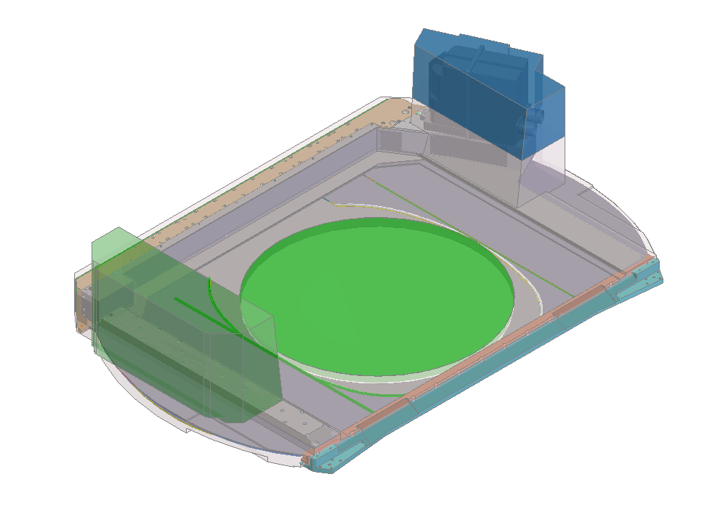
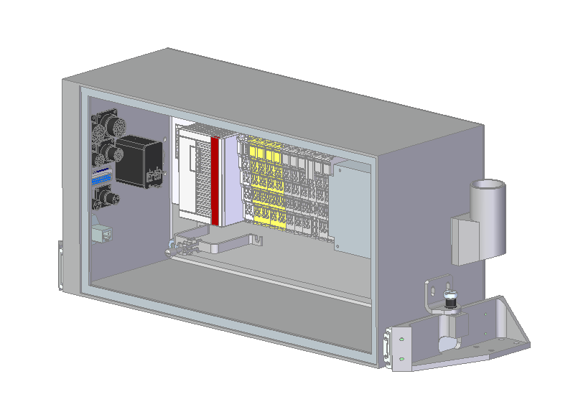
Shutter Electronics Overview
Shutter Electronics (i.e., HCU, Controller, Drives, I/O) is located in a removable enclosure mounted to the Filter Garage Plate
HCU
High Lvl CCS Control Interface
Control System
Controller
I/O Terminals
Motor Terminals
Purge Outlet for Enclosure cooling
Shutter Electronics Volume
Bulkhead Connections
Pwr/Signal/Comm
(removed for both Autochanger and Shutter install/extraction)
~10 kg
Extraction Rails (for servicing)
Interface Bracket to Garage Plate
Shutter Electronics Enclosure (front panel removed)

Slide 14
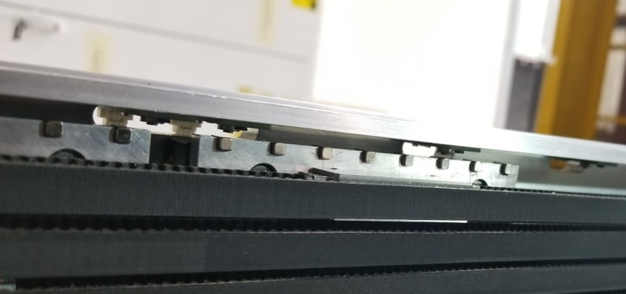
Shutter Electronics – Strongback
2 stepper motors with incremental encoders
15 hall-effect switches mounted on custom PCB distributed along the Strongback
8 magnets per blade carriage
4 limit switches (not shown) – 2 home and 2 deployed switch (1 each per blade stack)
Rotary Encoders
PCB mounted Hall Effect Switch locations
(for trajectory knowledge and safety)
Hall–Effect Switch
Magnet ‘Train’
Travel Direction (X)
Blade Carriage
Magnet Train passing by Hall switches
Shutter Manufacturing Readiness Review, January 2019

Slide 15
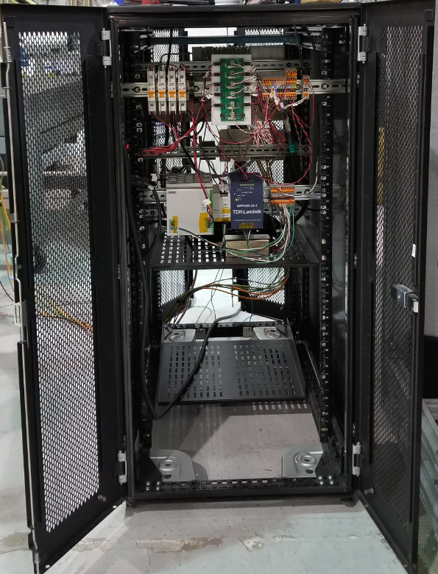
Auxiliary Shutter Engineering Control Unit
Shutter Engineering Control Unit
    Power supply to power shutter components, controller, and HCU
    Copy of production controller and terminals
    Extra Beckhoff terminals for diagnostics (voltmeter, thermocouples, extra i/o)
    Used for developing and testing shutter software and functionality on the bench

Slide 16
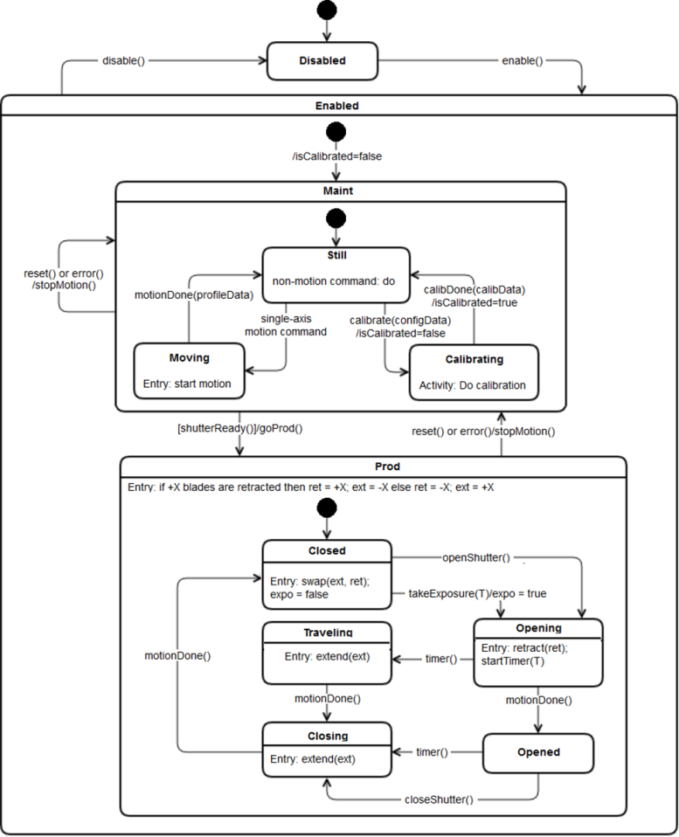
Manual for CCS Shutter System LCA-16765
Monitoring
  Alerts
  Configuration
  Telemetry
  PLC State Machine
  States
  Variables
  Named Guard Conditions
  Events
  Actions
  Standard “motorplatform” commands from CCS
CCS State Machine
  Top-Level State Diagram
  States
  Events
  Actions
  Mid- and Low-Level State Diagram
  States
  Variables
  Named Guard Conditions
  Events
  Action
PLC Protection Logic
Communication between CCS and Beckhoff PLC task
Representation of Messages
Generic Motorplatform Interface

Slide 17

Motion Control – Requirements (Prototype Testing)
Blade Motion Uniformity :
C-SHUT-002 | The accuracy of shutter exposure duration shall be <50 ms
C-SHUT-066 | The exposure duration shall be known within 300 ms with a goal of knowing the duration to 5 ms
Shutter Exposure Timing:
C-SHUT-006 | The shutter shall be able to obtain a single exposure with effective minimum exposure time of no more than 1 s, with a goal of an effective minimum exposure time of 0.1 s.
C-SHUT-007 | The shutter shall support exposures as long as one hour.
Hall-Effect Sensor Motion Profile:
C-SHUT-008 | The shutter open time shall be 0.98 s or less with a goal of 0.9 s.
C-SHUT-009 | The shutter close time shall be 0.98 s or less with a goal of 0.9 s.
Power Requirements:
C-SHUT-051 | The shutter shall use no more than 88.4 W average power for standard no-slew visits.
C-SHUT-052 | The shutter shall use no more than 531 W peak power.

Slide 18
Shutter Procurement Status

Slide 19
Procurement status - Completed
Shutter parts
  Procurement started in October 2018
    Strongbacks
    Garage plates
    Mechanisms
    Electronics
  Completed June 2019
    Slide guides, special order with long lead time, 14 weeks
    Aeroglaze painting of the blades

Slide 20
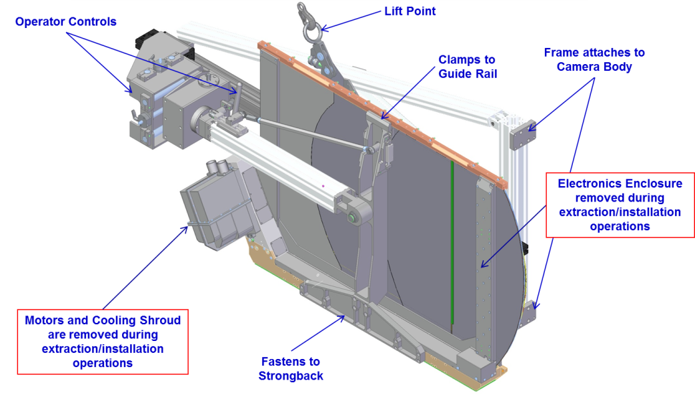
Insertion Tool – Dwg. Released, Parts Procured
Shutter units get swapped out on the telescope every year
  2 Shutter units are built and delivered, providing a standby unit ready for installation
  Each unit is fully modular, to allow for complete swap-out in a day-shift access
  The bench-top assembly and test stand will be used for repairing, servicing, refurbishing, and re-testing the swapped out unit, so it is ready for quick re-integration if needed

Slide 21
Shutter Blades Procurement
Last of the large Camera procurements > $200k
Contract Awarded on 2/27/2018 with same vendor of the prototype blades (San Diego Composites)
Phase I
  Preliminary Manufacturing Plan received 3/26/2018
  Raw material procured at Nippon (Jp)
  Prepreg Impregnated at PAZT (USA)
  Trial panel completed and inspected 9/20/2018
Phase II
  Some delay due to the assessment of minor defects in the fabric
  Delivered 1/30/2019

Slide 22
Prototype Accomplishments
Original Blade prototyping effort was completed on 8/29/2016, with bond process trials complete by June 2017
Installed in the Shutter prototype used to verify :
  The Light Attenuation factor, Req. C-SHUT-29
  The life duration, Req. C-SHUT-24
Blades Features Validated by Prototype :
  Mass
  Stiffness and Strength
  Flatness
  Manufacturing processes
  Chicane bonding
  Drive bracket bonding
  Guide bracket bonding

Slide 23
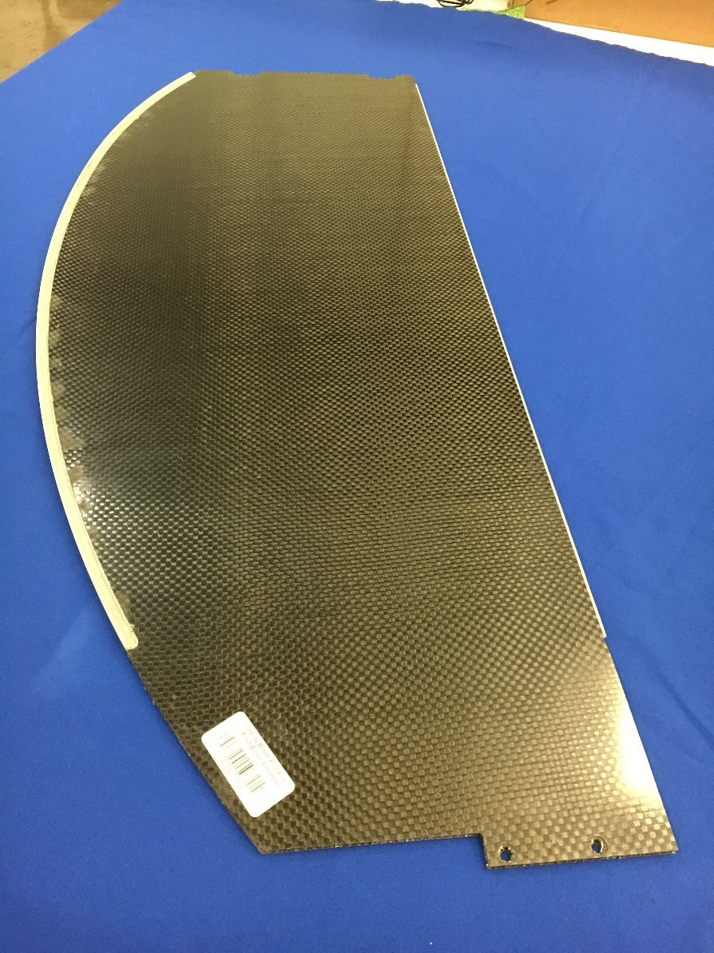
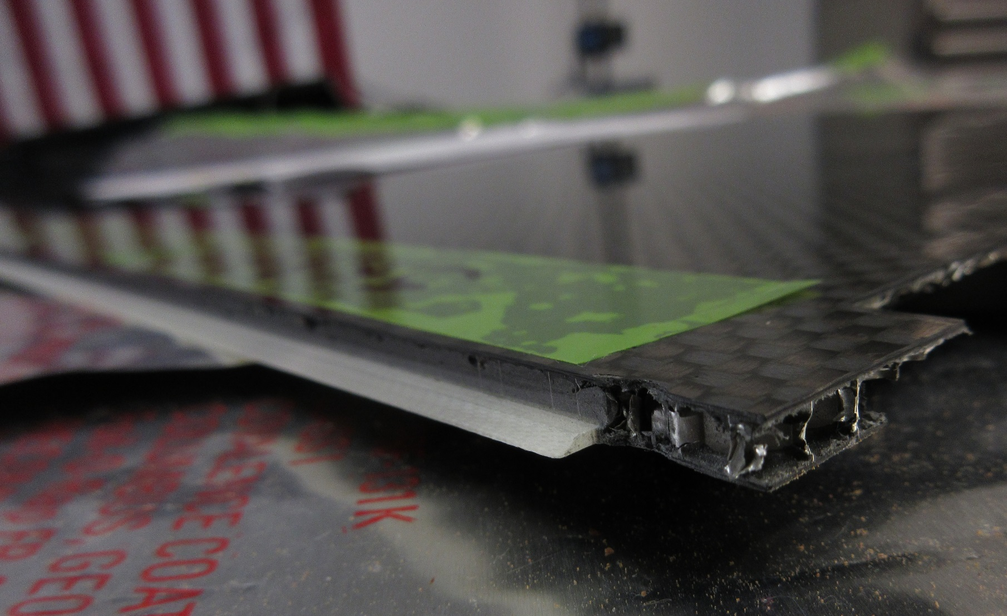
Trial Panel – Phase I
San Diego Composites has the Production Blade contract, to deliver 2 sets of production blades, complete with leading / trailing edge features.
Current Status:
  Completion of a full-size process trial; delivered complete inspection report
  Defective fabric issues currently being addressed
Results of the process trial:
  Thickness w/in tolerance- Requirement:4.5mm (+0.3 -0.0) Measured: 4.75mm
  Flatness w/in tolerance- Requirement: 0.75mm Measured: 0.3mm
  SDC has demonstrated they can repeat processes shown on the Prototype Blade development
Full-Size Process Trial Blade; @ SDC
Knife Edge Machining; @ SDC

Slide 24
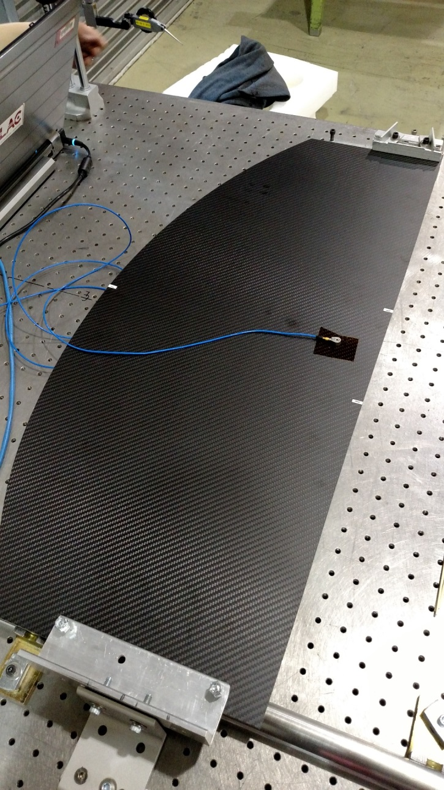
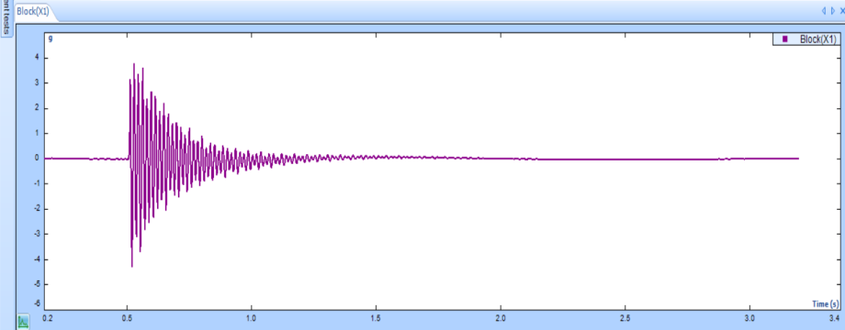
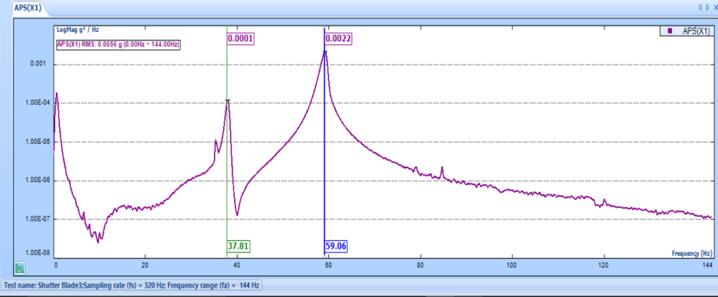
Blade modal and structural tests completed and FEA model correlated
Blade stiffnesses were measured to finalize bracket bonding tolerances and guide wear test load definition
Vibration frequencies determined by modal testing
Test results were used for correlating the FEA model (within 1-2% of measured value)
Leading Blade
Modal Testing
Modal test results
37.8 Hz; 59 Hz

Slide 25
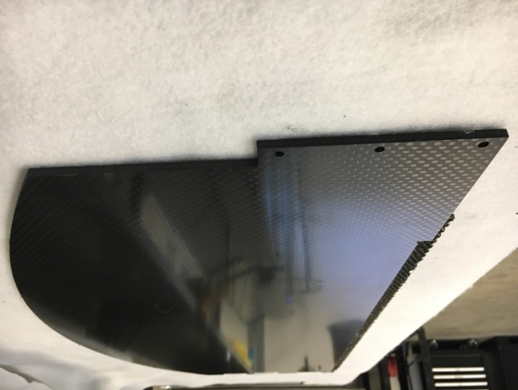
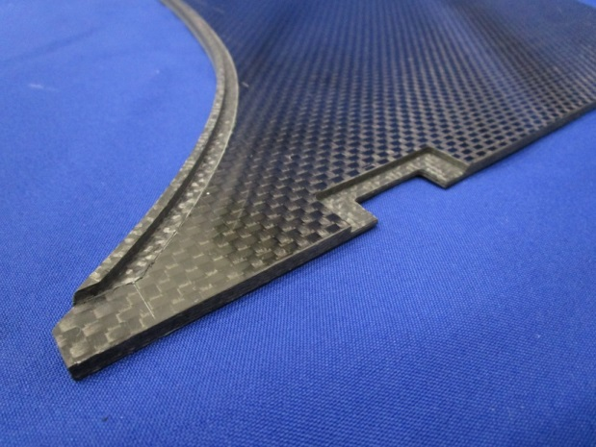
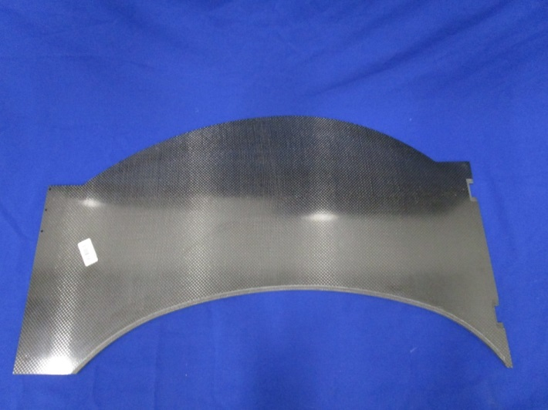
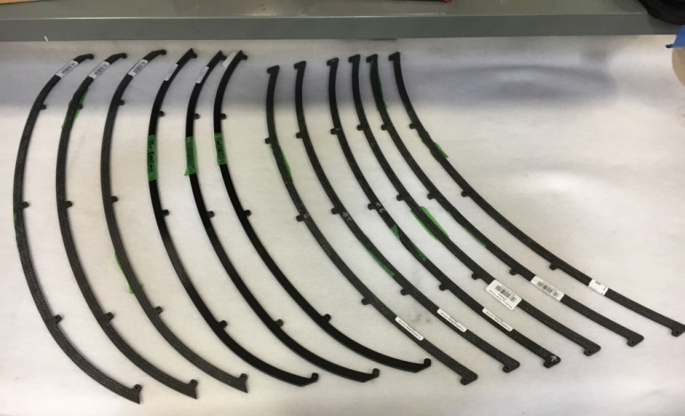
Final Production Blades Ready
Bonded Blade
Blade before the bonding with the edges
Edges
Bonded Blade

Slide 26

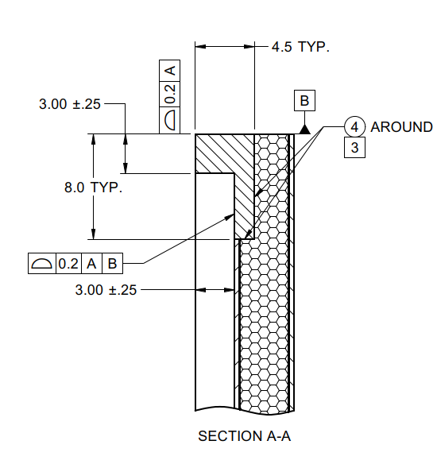
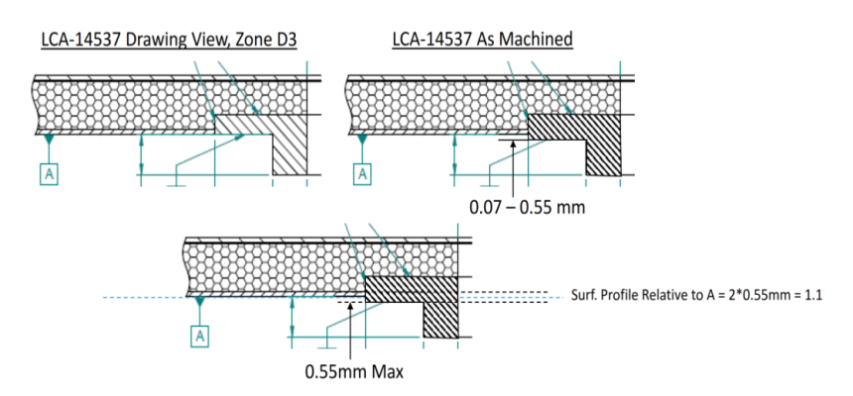
Blade Metrology Inspection
All dimensions conform to the fabrication drawings
One Non-Conformity : systematic error probably due to a misunderstanding of the Datum
Visual inspection looks satisfactorym, the chicane flushes with the CF skin

Slide 27
Shutter Assembly Status
All assembly procedures released
All blades (two sets) have been bonded
Strongbacks and Motor Drive Assemblies completed
In Progress
  Assembly with the Garage Plates and the Linear Guide
  Installation of the blades
  Integration with the Electronic Boxes

Slide 28
Pending - Shutter Maintenance Procedures
With the exception of the swapping procedure which is very specific to the summit operation, all the maintenance procedures are a subset of the assembly procedures.
Inspect and service Shutter (on telescope)
Remove shutter (on telescope)
Integrate shutter (on telescope)
Perform shutter limited functional test (on telescope)
Perform shutter aliveness test (on telescope)
Perform shutter full functional test (on telescope)
Perform shutter run-in test (in clean room)
Remove shutter shrouds and filter garage plate (in clean room)
Replace shutter shrouds and filter garage plate (in clean room)
Remove/replace shutter belts (in clean room)
Lubricate shutter bearings (in clean room)

Slide 29
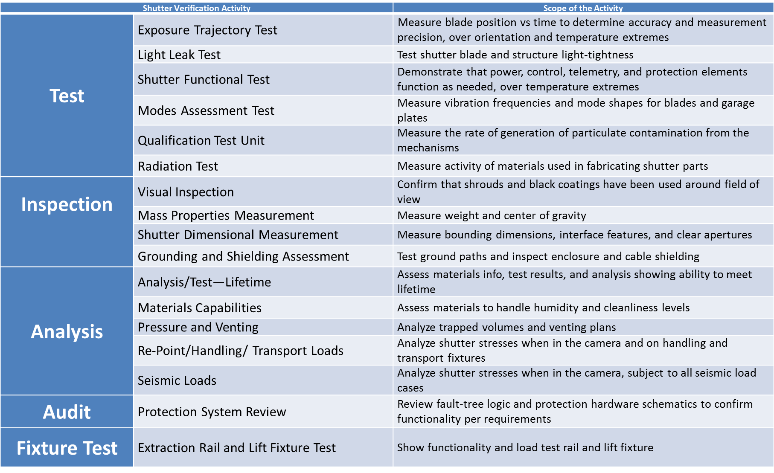
Pending -LCA-15066, Verification Test Plan
It describes plans for verifying we meet shutter requirements as laid out in LCA-56, “Shutter Specification”

Slide 30
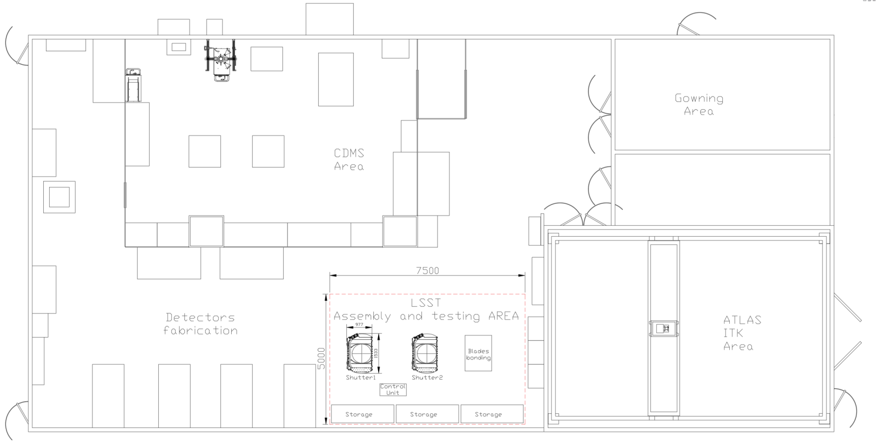
Blg.33 – Assembly and Testing Area
State of the Art Multi-Program Clean Room ISO 6
Used for the assembly and testing of the LSST Cryostat

Slide 31
Camera Body

Slide 32
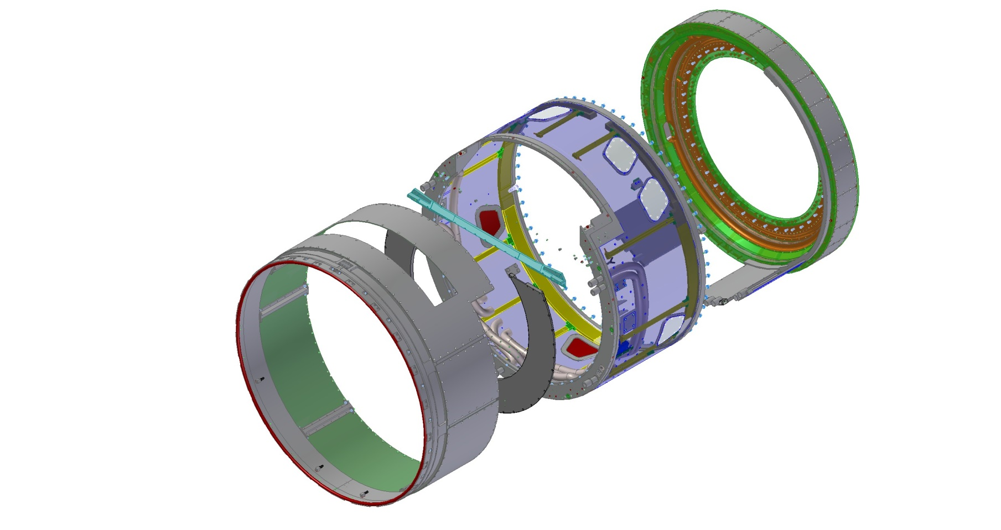
Camera Body Deliverable
Camera body hardware provides structural support for the rest of the Camera
This includes accurately locating interface features for subsystem hardware attachment
Backflange
Mechanism purge ducting to components
Shroud
Camera Housing
Camera volume purge lines and manifolds in housing

Slide 33
News since last review
Camera Body
  Manufacturing Readiness Review 10/31/2019
  Housing Fabrication and Assembly
  Shroud Fabrication and Assembly
  Shroud painting
  Purge System
    Purge Cabinets assembly
    Testing and Verification

Slide 34
Camera Body deliverables – Status
Hardware Deliverables
Back flange assembly | Flange with bay covers, purge manifolds and lines
Camera housing assembly | Housing, front flange support rail and baffle plate; Camera volume purge manifolds and lines; Cable and duct supports; Instrumentation (accel’s and mic) and read-out
Shroud assembly | Structure and cover plates; seal to L1-L2 assembly (all pre-mounted to housing)
Purge ducting and fittings | Purge ducting, fittings, instrumentation in camera volume
Camera volume purge cabinet | Purge cabinet and ducting in UT
Mechanism purge cabinet | Purge cabinet and ducting in UT
Fixtures and Test Equipment
Camera lift fixture | Camera lift fixture and attach hardware
Blank-off plates | Back flange and shroud blank-off plates to seal camera volume | X
Back flange shipping container | Container for shipping back flange to Paris

Slide 35
Camera Housing & Shroud fabrication
Camera Housing components were manufactured at Keller Technology Corporation, Buffalo, NY:
  Camera Housing, Support rail, Baffle plate. All now in cleanroom ready for assembly
Four month schedule delay due to difficulties at the fabrication site, to achieve the required roundness
Smaller components have been manufactured locally at
IMT Precision, Hayward, CA
Camera Housing Assembled and Tested (Pressure & Flow, Metrology, Mass Properties)
Shroud made at IMT Precision, Hayward, CA
  Delivered
  Sub-assembly bonded
  Sent out for Aeroglaze painting
Lift tool fabricated and tested. It will be used by I&T for the handling of the Camera Body

Slide 36
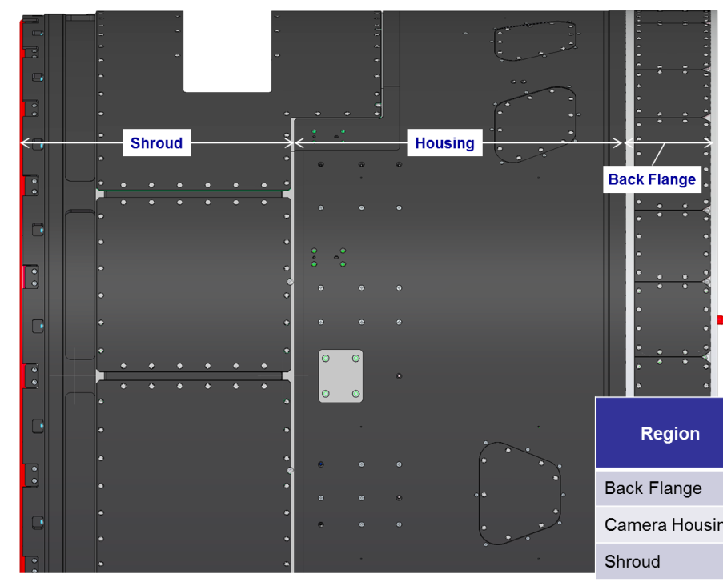
NCR, deviation approved – Unpainted regions
CAM-REQ-0034, Reflective surface treatments
  Specification: Reflective surfaces near the main beam shall either be shielded by light baffles, painted flat black or treated/shaped to minimize scattering.
Requested deviation to this requirement, allowing for up to 5% of the surface area to remain unpainted.
  This deviation applies solely to the camera housing, shroud, and back flange outer surfaces
Rationale for request
  The fractional area coverage of unpainted regions is 3.8% of the total area
  The unpainted regions consist of Screw heads, Seams between panels and Lift bracket attach points

Slide 37
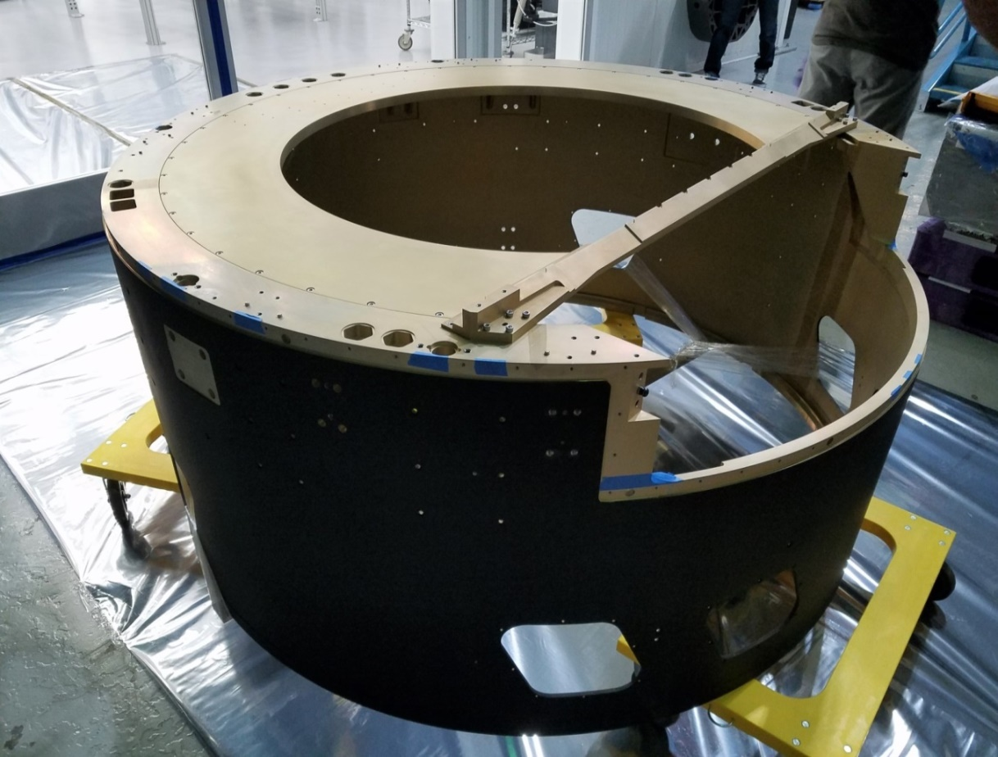
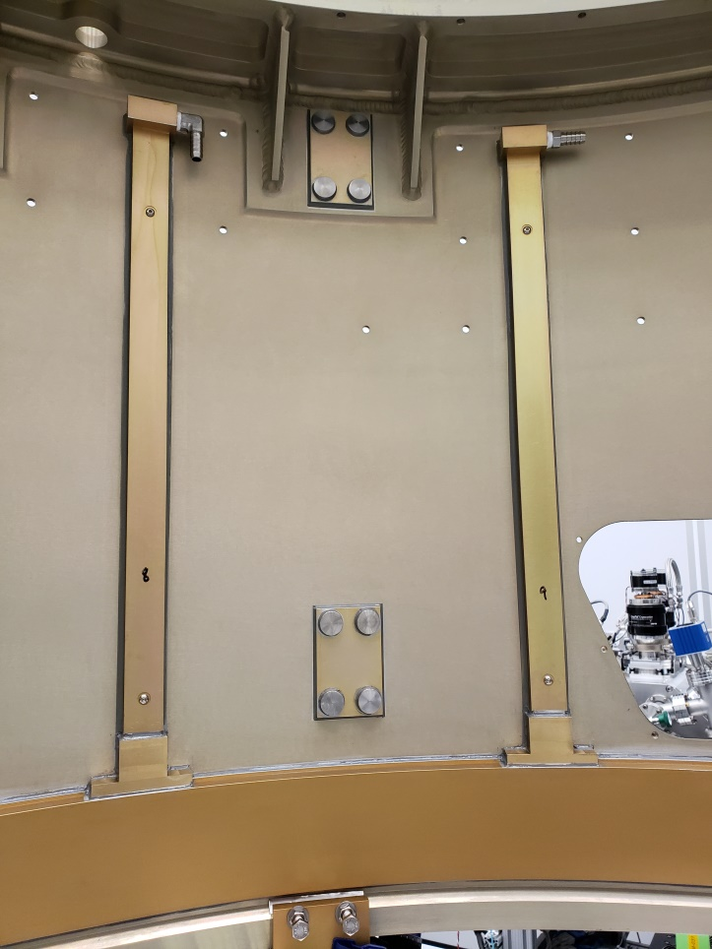
Camera Housing and Shroud Assembled
Bonded Shroud
Camera Housing Assembled

Slide 38
Purge System

Slide 39
Deliverable and Capabilities
There are two purge systems to provide thermal control and purge functionality. They both located in the Utility trunk, connected with hoses and ducts to the Camera Body Main Volume. They are integrated and controlled by the Camera Control System
  Mechanism Purge System: Directly cool heat dissipating components in enclosures in the Shutter, Auto Changer and Carousel components in the Back Flange
  Camera Volume Purge System: Controls temperature of Camera Housing, L1, and L3, and flushes air through the Camera Volume

Slide 40
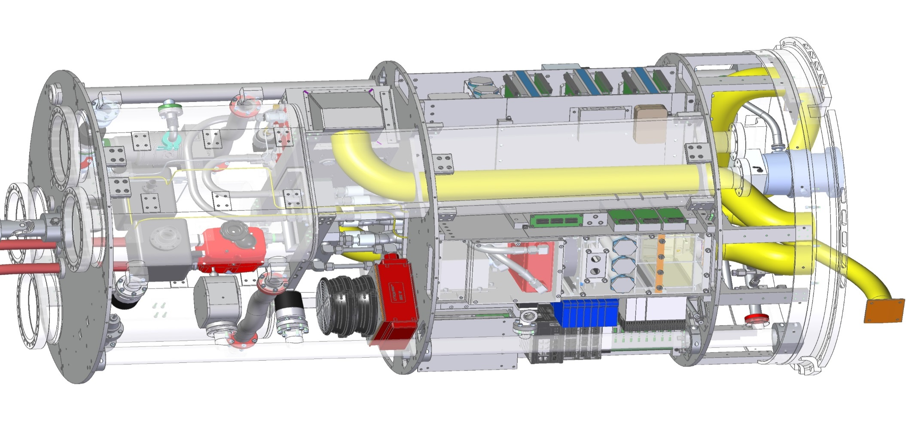
Purge Kit Assembly in Utility Trunk
Volume Purge Cabinet is in Quadrant 3 in Quad. Box Assembly
Mechanism Purge Cabinet is in Top End Area
Mechanism Purge Cabinet
Volume Purge Cabinet

Slide 41
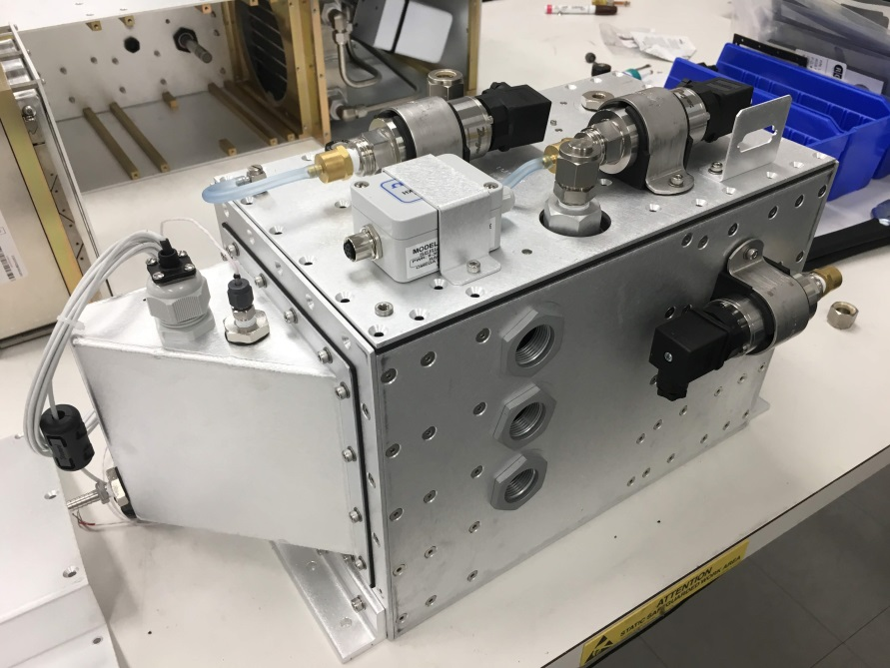
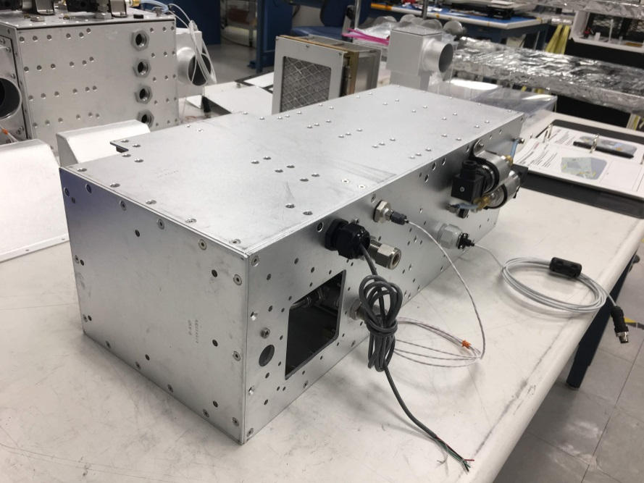
Purge Cabinets – Status
  Mechanism and Volume Purge have been both assembled
  Integration with the Camera Control System done, Manual and ICD document released LCA-17500
  Verification and Testing in progress
  Acceptance Review and Hand-off to I&T, end of July
Mechanism Purge Cabinet
Volume Purge Cabinet

Slide 42
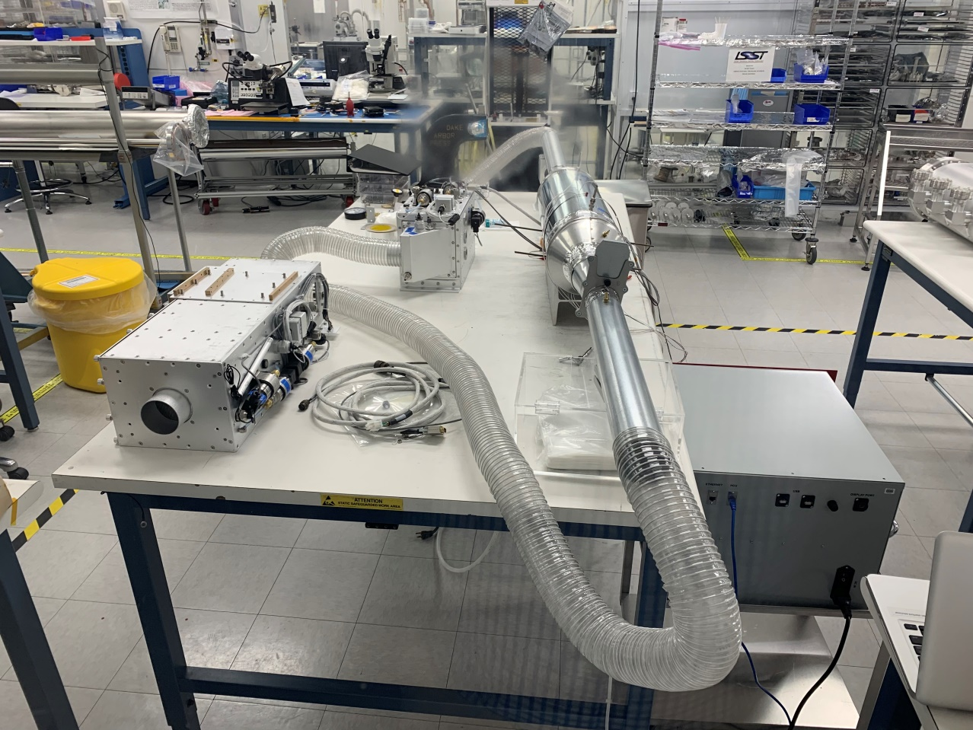
Mechanism Purge Cabinet under testing

Slide 43
Outstanding Risks and Mitigations

Slide 44
Definition of Risk and Risk Analysis
Risk can be defined as an undesirable event during project execution that negatively affects program goals for performance, cost or schedule.
Risk management is the ongoing process of comprehensively assessing project risks.
Camera Risk Management Plan (LCA-29-A) defines the methodology to manage our risks
Definition of Risk Probability
Pts | Likelihood of Occurrence | Approximate Probability | Description of Probability
1 | Rare | <1% | Likelihood of occurrence is not credible
2 | Unlikely | 1-5% | Not reasonably expected to occur
3 | Possible | 5-25% | Possible, or difficult to assess the chance of occurrence
4 | Likely | 25-67% | Very likely that an adverse event will occur
5 | Highly Probable | >67% | High probability that an adverse event will come to pass
Definition of Risk Impact
Pts | Severity of Impact | Description of Impact
Cost Impact
1 | Insignificant | Overrun of cost of < $30K, recoverable with project contingency
2 | Minor | Overrun of cost of $30k - $200K, recoverable with project contingency
3 | Moderate | Overrun of cost of 200k - $1.5M, with significant impact on contingency
4 | High | Overrun of baseline cost of $1.5M - $10M, with re-baseline required
5 | Critical | Overrun of baseline cost of >$10M, with project in jeopardy
Schedule Impact
1 | Insignificant | Degradation of schedule margin to project critical path by < 2 wks
2 | Minor | Degradation of schedule margin to project critical path by 2 wks to 1.5 months
3 | Moderate | Degradation of schedule margin to project critical path by 1.5 to 3 months
4 | High | Degradation of schedule margin to project critical path by 3 to 6 months
5 | Critical | Degradation of schedule margin to project critical path by > 6 months
Performance Impact
1 | Insignificant | No effect on ability to meet requirements; minor design changes needed
2 | Minor | Minor excursion from subsystem requirement, but compensated elsewhere
3 | Moderate | Level 2 and/or SRD design specification exceeded
4 | High | Level 1 and/or SRD minimum specification exceeded
5 | Critical | Unable to achieve any of the primary science missions
→Quasi-quantitative process to assign objective values to probability of occurrence and impact of occurrence aspects of risk.
Total Impact:
(0.50*Cost Impact) + (0.33*Schedule Impact) + (0.33*Performance Impact)
→Risk Score:
Risk Probability * Total Impact

Slide 45
Standardized risk management processes
Risks are tracked in the Camera Risk registry, Document LCA-30
Risk exposure is assessed and tracked at regular intervals since 2010 (initial assessment)
Actively planning mitigation to burn down risks and monitor progress
  Current status: 23 total risks identified
    8 risks are actively being mitigated
    15 are closed or accepted due to design changes or mitigation completion
Mitigations are budgeted in the scope of work
After budgeted mitigation (Post-Mitigation) is performed, residual risk is analyzed
The top 3 active risks are shown below:
  CBM-047: Camera body seal integrity (Minor)
  The test flow on the camera housing showed no leaks. We need to repeat the test with the Shroud
  Risk will close after testing the Housing with the Shroud
  CBM-048: Purge cabinet functionality (Minor)
  The Purge cabinets have been assembled and tested with a dummy load to verify the performances
  Risk will close after assembly and testing of the Units
  CBM-037: Shutter Blades Clearance (Insignificant)
  The clearance has been measured on the prototype and it sufficient to operate the Shutter safely. The prototype went through 1.4 M cycles without problems
  Risk will close after the final testing
Active CB&S risks

Slide 46
Hazards

Slide 47
Hazard Analysis
Hazards can be defined as a failure of a component, system or function that could lead to personnel injury or damage to hardware

Slide 48
Top 5 hazards and mitigation
Title | Hazard Description | Severity | Probability | Risk Value | Risk Category | Mitigation Strategy | Mitigation Description | Severity | Probability | Risk Value | Risk Category | Verif Method | Verification Plan
Camera volume low-oxygen | The camera volume is enclosed and could be oxygen-deficient and a hazard for personnel accessing camera | 2 | C | 6 | Serious | Eliminate hazard | 1. Use air for the purge gas; 2. Use compressed air for make-up air | 4 | E | 20 | Low | Inspection | 1. Confirm that air purge has been used
Coolant leak in purge unit | Coolant is used for cooling purge air in the purge unit, located in the utility trunk; if a coolant line leaks, it could contaminate many camera components | 2 | C | 6 | Serious | Safety feature | 1. Use high-integrity fittings for glycol lines 2. Make the purge unit cabinet water-tight; 3. Add a hygrometer in the purge unit (provided by Aux Elec. MPM to provide monitoring and shut-off function) | 2 | E | 15 | Medium | Test | 1. Leak test purge unit coolant lines; 2. Verify that purge unit is water-tight; 3. Test functionality of hygrometer
Camera Volume Purge Cabinet reheater overcurrent | If the re-heater in the CVP cabinet shorts to ground or over-heats, it could start an electrical fire in the utility trunk | 2 | C | 6 | Serious | Safety device | 1. Use over-current protection on the heater power supplies (Aux. Elec.) 2. Add smoke detectors in Utility Trunk interlocked to power supplies (Aux. Elec.) | 2 | E | 15 | Medium | Test | 1. Test that over-current protection circuit functions
Camera Volume purge system filter failure | Purge system failure blows contaminated air into camera volume | 2 | C | 6 | Serious | Safety feature | 1. Use HEPA-rated filters, designed for long-duration clean room operation 2. Use blower with stall pressure lower than the rated pressure differential of the filter 2. Monitor and trend airline flow | 2 | E | 15 | Medium | Audit | 1. Confirm that filters used are rated for clean rooms the stall pressure of the blower
Housing structural failure | The camera housing and back flange provide the primary structural support for the camera; over-stressing or failure of one structural element could result in large-scale damage or collapse | 1 | D | 8 | Serious | Eliminate hazard | 1. Use multiply-redundant bolted connections to ensure that no single failure can endanger the camera structure; 2. Design back flange and housing with conservative factors of safety, even under seismic loads, per LCA-280, "Camera Mech Std's" | 2 | E | 15 | Medium | Process control | 1. Use FEA analysis to set bolt limit loads; analyze pre-load per LCA-280; 2. Verify bolt torques during assembly;

Slide 49
Programmatic Status

Slide 50
Tier 1 Previous Review - Subsystem organization
Change from standing army model to a flexible team deployed on specific tasks
M.Oriunno, CAM and Procurement
Van Xiang, Lead EE, Prototype validation
J. Ku, Lead ME, Assembly and Testing
I. Kravtsov, Mech. Design
T. Nieland or D.Khiel, Techs
Martin Nordby
Systems Integration Mgr.
Marco Oriunno
Subsystem Manager
Antone Bullock
Lead designer
Stuart Metcalfe
Camera Body
Lead engineer
Derek Chow
Purge System
Lead engineer
John Ku
Shutter
Lead engineer
Van Xiong
Controls
Lead Engineer
Igor Kravtsov
Shutter
mechanical designer
Tom Nieland / David Kiehl
Shutter
S&E associate

Slide 51
CB&S Performance as of June 2019
Camera Body SPI (CPI) = 0.95 (0.73)
Shutter SPI (CPI) = 0.90 (0.76)
WBS Level | Control Account | BCWS | BCWP | ACWP | SV | SPI | CV | CPI
3.06.01 | Camera Body | $2,394,664 | $2,271,807 | $3,128,667 | ($122,857) | 0.95 | ($856,860) | 0.73
3.06.01.01 | Camera Body Integration and Management | $372,966 | $372,966 | $431,436 | $0 | 1.00 | ($58,469) | 0.86
3.06.01.02 | Camera Body Development | $2,021,698 | $1,898,840 | $2,697,231 | ($122,857) | 0.94 | ($798,391) | 0.70
3.06.02 | Shutter | $3,029,660 | $2,721,808 | $3,581,992 | ($307,852) | 0.90 | ($860,184) | 0.76
3.06.02.01 | Shutter Integration and Management | $199,110 | $199,110 | $160,839 | $0 | 1.00 | $38,270 | 1.24
3.06.02.02 | Shutter | $2,830,551 | $2,522,698 | $3,421,153 | ($307,852) | 0.89 | ($898,455) | 0.74

Slide 52
CB&S Estimate to complete status
Comprehensive estimate at completion performed on 5/2019 (performed monthly)
WBS | Description | Budgeted | EAC | Variance
3.06.01 | Camera Body | $2,394,664 | $3,248,231 | ($853,567)
3.06.01.01 | Camera Body Integration and Management | $372,966 | $442,961 | ($69,994)
3.06.01.02 | Camera Body Development | $2,021,698 | $2,805,271 | ($783,573)
3.06.02 | Shutter | $3,029,660 | $3,806,200 | ($776,539)
3.06.02.01 | Shutter Integration and Management | $199,110 | $170,776 | $28,334
3.06.02.02 | Shutter | $2,830,551 | $3,635,424 | ($804,873)

Slide 53
3.06.01.02 Camera Body Schedule and Cost variance
Variance Explanation:
  SPI improved to 0.93
  CPI has stayed flat, at around 0.73 :
    Shortage of technical support set with higher priority on Camera tasks with shorter float.
    The development of the Interface with CCS took longer than expected. The additional cost has been captured in the EAC and mitigated with cost optimization of other tasks
    Additional Labor required to address manufacturing problem encountered by the vendor. Increase of costs of the parts compared to the BoE
    Variance Impact:
      About two months delay
Corrective Action:
  Few remaining tasks before hand-off to I&T
  Sub-system account near to being closed

Slide 54
3.06.02.02 Shutter Schedule and Cost variance
Variance Explanation:
  SPI has stayed flat, at around 0.83 for 4 months recovering from previous four months < 0.80
    Additional labor required to complete the Interface with the CCS and to lay down the infrastructure required by CCS in the clean room of the bldg.33 for the Verification & Testing Plan
    Delays with the procurement of catalog parts not carried in stock and with external contractors
    The completion of the Light attenuation Test and the preparation of the Life Duration test required more labor. Additional labor was required to complete the Light Absorption Test and to prepare the Shutter Prototype for the Life Duration Test
    Variance Impact:
      Three months delay
Corrective Action:
  Redistribute the effort of key manpower to other task (hibernation) avoiding running cost due to standing army effect

Slide 55
Shutter - Schedule

Slide 56
Camera Body & Purge - Schedule

Slide 57
Schedule and Milestones to completion
Milestones | Finish Date
Shutter
Assembly | 28-Aug-19
Verification and Testing | 1-Oct-19
Acceptance Review and Hand-off to I&T | 10-Oct-19
NEED: Shutter for I&T | 8-Dec-19
Camera Body and Purge
Purge Cabinets Verification and Testing | 9-Aug-2019
Camera Housing & Shroud assembly | 16-Aug-2019
Verification and Testing | 30-Aug-2019
Acceptance Review and Hand-off to I&T | 06-Sept-2019
NEED: Camera Body for I&T | 16-Sept-2019

Slide 58
Summary
Camera Body assembly completed.
  Back Flange shipped to France in June 2018
  Camera Housing and Shroud completed.
  Verification and testing after the Shroud return from painting
  Project completion and hand off to I&T expected early September 2019
Shutter Prototyping validated
  Shutter Prototyping validated. Verified almost all the requirements
  Procurement completed. All the parts received
  Assembly of two shutters has started
  Verification and testing end of July
  Acceptance review and hand-off to I&T end of August 2019

Slide 59
Supporting Material

Slide 60
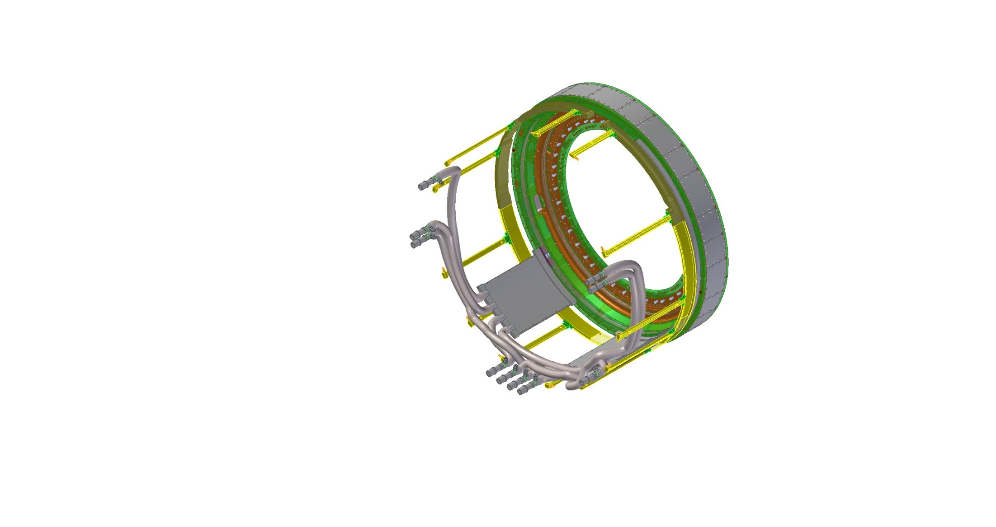
Camera Body w/ Purge Kit

Slide 61
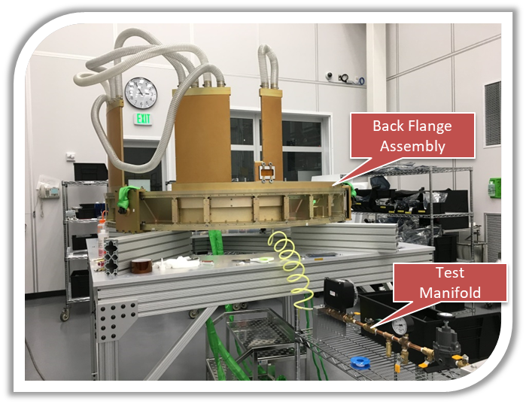
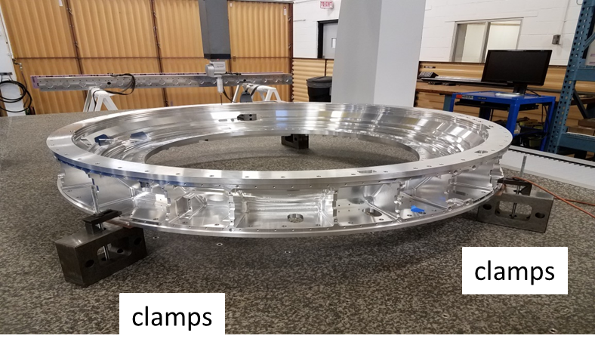
Verification Test - Pressure and Purge System
Back Flange Integrated with the Purge Line and Tested.
Handed to I&T and shipped to France for the mounting of the Carousel
The Housing and the Back Flange will be mounted together once the BF returns from France
Hoses to seal system

Slide 62
CB&S Baseline Changes since CD-2
BCR-001, FY15 rate update: no scope changes (12/2014)
BCR-017, Vendor Award Update (10/2015)
  Aligned budget with contracted cost of prototype blade
  $41K increase in cost to 3.06.02.02
BCR-020, Shutter ETU Development (11/2015)
  Added scope to shutter prototype test plans, especially to cover additional needs for personnel to run a broader scope of tests than originally envisioned
  $216K increase in cost to 3.06.02.02
BCR-021, FY16 rate update: no scope changes (12/2015)
BCR-029, New scope, filter 3 mm move (5/2016)
  Added scope to Shutter to allow for re-design associated with increasing space for shutter to relax high-risk constraints and tolerance
  $19K increase in cost to 3.06.02.02
BCR-031, Addition of 2nd Back Flange Scope (7/2016)
  Added scope to fabricate a second back flange for Carousel early integration, reducing risk to carousel and I&T of re-integrating it at SLAC
  $258K increase in cost to 3.06.01.02

Slide 63
CB&S Baseline Changes since CD-2 (cont.)
BCR-036, Shutter FDR Replan (9/2016)
  Re-scheduling of FDR to occur before full-up prototype is built
  $47K reduction in cost to 3.06.02.02
BCR-039, Camera Re-org: no scope or organizational changes (10/2016)
BCR-040,CBM testing scope per LCN-1681 (10/2016)
  Added test time to more completely verify purge system performance
  $67K increase in cost to 3.06.01.02
BCR-044, FY17 rate update: no scope changes (1/2017)
BCR-054, AWARD of Back Flange Contract (5/2017)
  Align budget with contracted cost of back flange
  $36k net increase in cost to 3.06.01.02
BCR-056, Camera Housing Award and Scope Update (6/2017)
  Align budget with contracted cost of back flange
  $35K net increase in cost to 3.06.01.02
BCR-062, Change CAM Camera Body & Shutter (10/2017)
There were also some BCRs to cover planning package conversion to activities, that are not included in the above list

Slide 64
CB&P requirements and flow-down
Camera body and purge system requirements originate from 4 sources
  Flow-down from higher-level requirements derived from science and system specifications
  LSST system-level interface agreements
  Camera-level plans and standards
    Mechanical standards
    Camera hardware protection plan
    Grounding and shielding plan
    Contamination control plan
  Camera internal interface agreements
    Interface control documents
    Interface definition drawings
These are all flowed down to LCA-55, the “Camera Body and Purge System Specification”
LSST Science Req’s Doc (SRD)
“physics req’s doc’s”
LSST System Req’s (LSR)
Observatory System Spec (OSS)
LSST project control
DM Req’s
LSE-59: Camera Requirements
Tel & Site Req’s
OCS Req’s
“engineering spec’s”
System Interface Control Documents
LCA-48: Camera Specification
Camera Plans and Standards
Camera control
LCA-55: Camera Body & Purge Spec
Camera Subsystem Specifications
LCA-13604: Purge System Spec

Slide 65
Camera body and purge system requirements
LCA-55, the “Camera Body and Purge System Specification” includes 6 general classes of requirements:
  Functional, misc.: control ranges, lifetime, materials
  Allocations: power, mass
  Protection system functional: operational safety
  Environments: humidity, pressure, and temperature ranges
  Structural: operational, handling, and seismic loads
  Interfaces
The subsystem provides structural support and purge cooling for multiple subsystems, so many requirements address these interface needs of the supported subsystem component
  Structural support
  Placement of interfacing elements, along with allowed tolerances
  Purge air flow rates and cooling capacity needs
  Filtering and cleanliness of purge air flow through the camera volume

Slide 66
Requirements verification process planning
LCA-10807, “Camera Body and Purge System Verification Test Plan” describes plans for verifying we meet camera requirements as laid out in LCA-55, “Camera Body Specification”
In the LCA-55 specification, each requirement is flagged with the planned verification method, then the verification activity name is also shown
  Test: functional and/or performance test of the element in its final configuration, or using interfacing systems with facsimile or demonstration-unit hardware or software.
  Inspection: visual inspection or mechanical measurement
  Analysis: component or system-level analysis showing that the unit as mathematically modeled meets a requirement
  Analysis/Test: component or system-level analysis, either using the results of earlier test hardware to correlate the mathematical model or using results of discrete unit tests in support of broader analysis
  Demonstration: simple functional test showing that a functional capability is met
  Audit: review of manufacturing process control records to show that a delivery or process requirement is met

Slide 67
Camera Body requirements verification activities
Verification Activity | Scope of the Activity
Analysis - Camera Body Lifetime | Camera body component and materials lifetime analysis
Analysis - Camera Body Material/ Design | Camera body materials and design details associated with contamination, grounding, charged particles
Analysis – Camera Body Environmental Capabilities | Camera body temp step and humidity ranges
Analysis - Modal Analysis | Camera body modes
Analysis - Pressure Loads | Camera body pressure ranges, venting analysis, and wind loading
Analysis - Working Loads | Camera body operational, re-pointing, and handling load ranges
Analysis - Transport Loads | Camera body transport load ranges
Analysis - Seismic Loads | Camera body load ranges
Mass Properties Measurement - Camera Body | Camera body weight, center of gravity
Visual Inspection | Camera body coating and light emissions
Dimensional Measurement – Camera Body | Camera body rotator interface, stayclears, subsystem interface features
Analysis - Camera Body Interface Verification | Structural interfaces and ICD reqs to other subsystems
Back Flange Flow Test | Pressure, leak, and flow test of back flange purge channels
Camera Housing and Shroud Flow Test | Pressure, leak, and flow test of housing and shroud purge channels
Camera Housing Instrumentation Test | Check functionality of accelerometers, temperature monitors, and microphone

Slide 68
Purge System requirements verification activities
Verification Method | Scope of Verification Activity
Analysis - Purge System Lifetime | Purge system component and materials lifetime analysis
Analysis - Purge System Materials/ Design | Purge system materials and design details associated with contamination, grounding, charge particles
Analysis – Purge System Environmental Capabilities | Purge system temp step and humidity ranges
Mass Properties Measurement - Purge Cabinets | Purge cabinet and ducting weight
Analysis – Mechanism Purge System Interface Verification | Thermal/flow interfaces and ICD reqs to other subsystems
Analysis – Camera Volume Purge System Interface Verification | Flow rates and heat transfer/thermal behavior within the camera volume and across the L1 and L3 lenses
Audit - Purge System Safety | Protection logic and connectivity and assessment of failures and their impacts
Mechanism Purge Cabinet Functional Test | Control of humidity, temp range, pressure, venting; control; power draw; safety; operational temp ranges
Camera Volume Purge Cabinet Functional Test | Control of humidity, temp range, pressure, venting; control; power draw; safety; operational temp ranges

Slide 69
Verification Matrix LCA-16771 (from req.s document LCA-55)

Slide 70
Verification Procedures
The following Testing Procedures have been identified. Verification and Testing will required to collect the evidences for the acceptance and the hand off to I&T. Their release does not hold the assembly of the Shutters
Camera Housing and Shroud
  Mass Properties Measurement - Camera Body LCA-16599
  Dimensional Measurement – Camera Body LCA-16777
  Back Flange Flow Test LCA-15795
  Camera Housing and Shroud Flow Test LCA-16773
  Camera Housing Instrumentation Test LCA-16778
Purge System
  Mechanism Purge Cabinet Functional Test LCA-16774
  Camera Volume Purge Cabinet Functional Test LCA-16775
  Mass Properties Measurement – Purge Cabinets LCA-16776
  Camera Volume Purge Pressure Calculations LCA-17284
  Camera Mechanism Purge Pressure Calculations LCA-17285

Slide 71
Purge System Design & Capabilities
There are two purge systems to provide thermal control and purge functionality
  Mechanism Purge System: Directly cool heat dissipating components in enclosures in the Shutter, Auto Changer and Carousel components in the Back Flange
  Camera Volume Purge System: Controls temperature of Camera Housing, L1, and L3, and flushes air through the Camera Volume
Purge system function | Requirement
Remove process heat from the shutter, auto changer, and carousel | Feedback controlled cooling of forced air High flow rate air for good heat convection off electronics and motors
Drive the camera housing and L1 lens to track the target dome temperature | Heat and cool purge air to control housing and L1 temperatures Provide adequate parallel air cooling channels for good thermal coupling and heat transfer
Blow “warm,” dry air over the air-side of the L3 lens to prevent frosting | Re-heat the purge air to maintain target temperature Dry the air and monitor humidity
Maintain a clean, dry camera volume | Dry the air to reduce condensation risk Filter air for particulates and VOCs Provide flow rate adequate for clean-room type cleanliness levels
Reduce the likelihood of natural convection cells within the camera volume | Deliver air at flow rates high enough to disturb natural convection cells, especially across the L3 lens

Slide 72
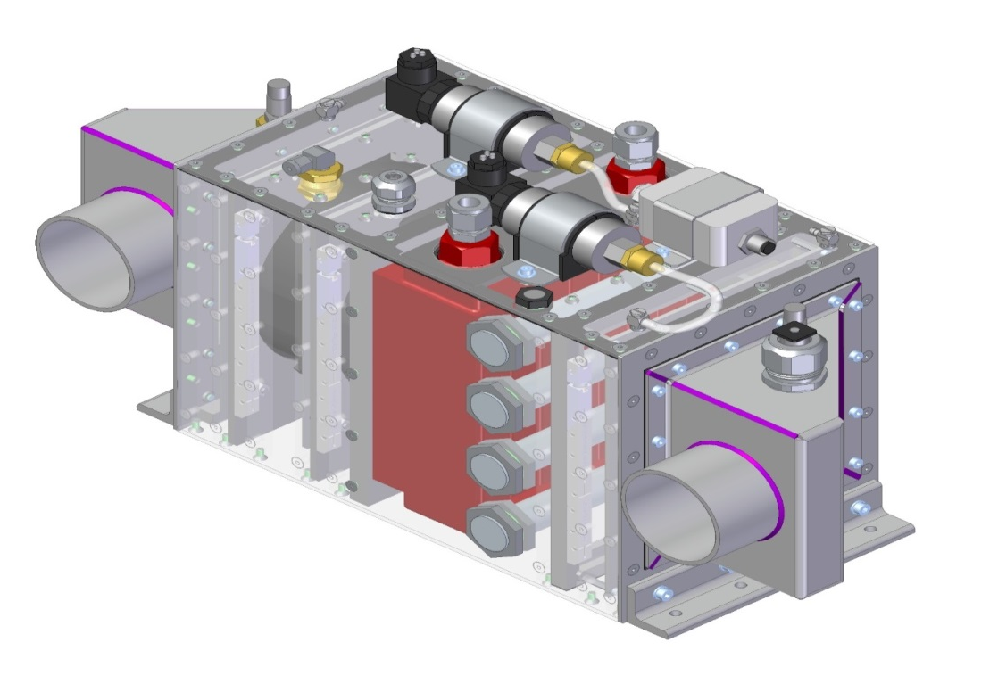
Mechanism Purge Cabinet - LCA-14440
Volume Purge Cabinet is essentially a box that contains following primary components:
Two fans (one is redundant) for moving air to cool downstream sub-systems
Air-to-Liquid Heat Exchanger
Desiccators for drying air
Air Filter (for particulates)
Instrumentation (pressure, flow, temperature)

Slide 73
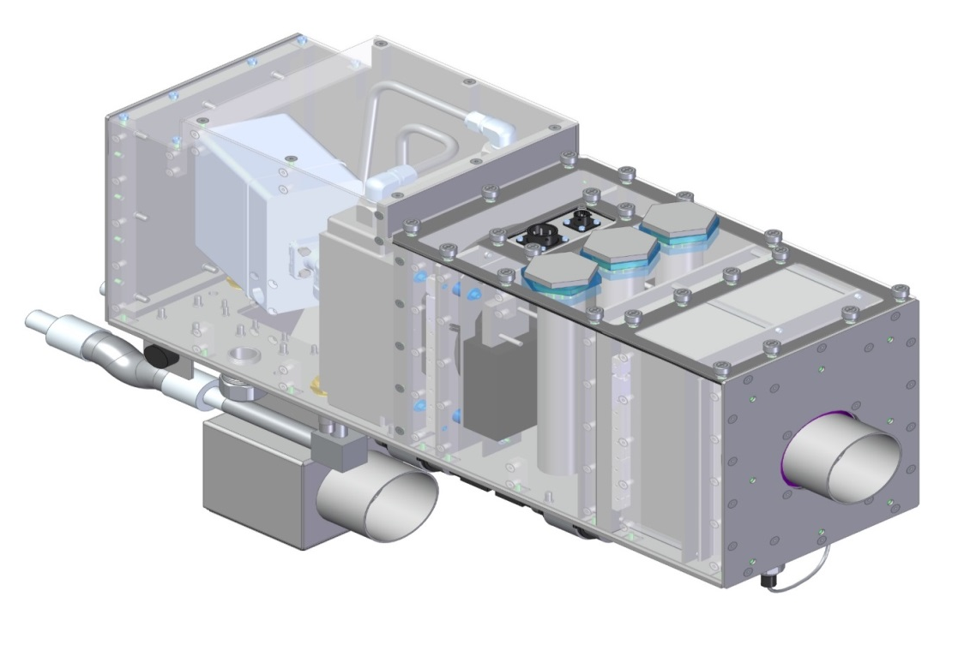
Volume Purge Cabinet - LCA-14323
Volume Purge Cabinet is essentially a box that contains following primary components:
One replaceable fan for moving air to cool downstream sub-systems
Air-to-Liquid Heat Exchanger
Two-Way Actively Modulated Valve (for controlling coolant flow rate and air temp)
Air Heaters (for raising air temp)
Desiccators for drying air
Air Filter (for particulates)
Charcoal Filter (for VOCs)
Instrumentation (pressure, flow, temperature)

Slide 74
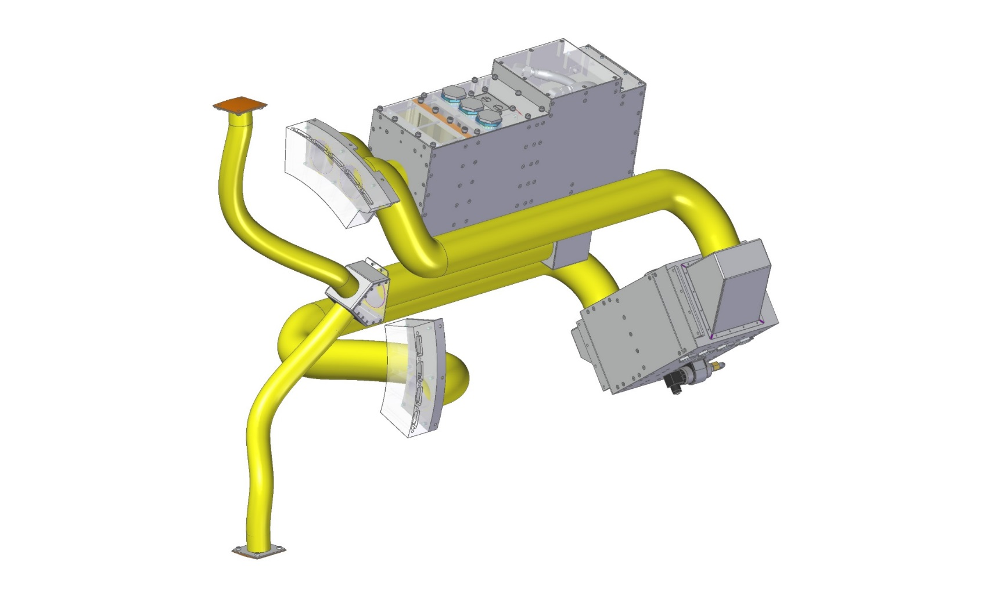
Purge Kit Assembly, Isolated View - LCA-14471
Volume Purge Cabinet
Volume Purge Return Fitting 1
Supply Manifold
Ducts
Wye Return Duct
Volume Purge Return Fitting 2
Return Manifold
Mechanism Purge Cabinet

Slide 75
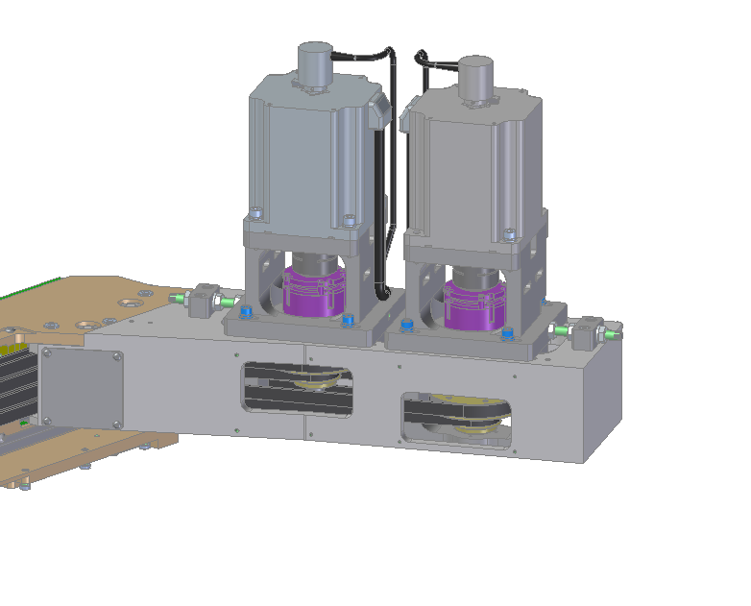
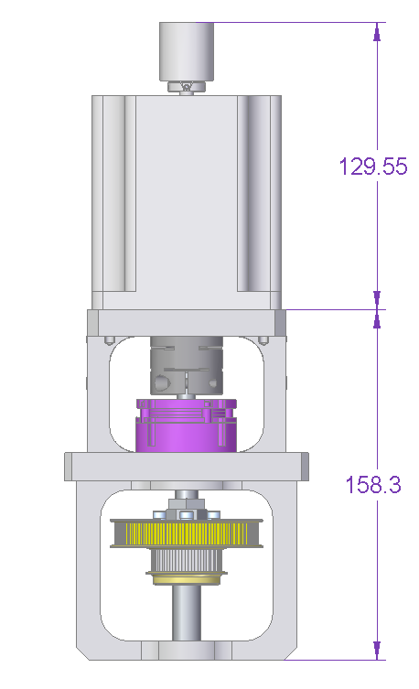
Drive Train – Drive Module Details
Capstan Drive – 2 different diameter pulleys (68T, 34T) allow synchronized driving of both blades in a stack
Encoder; 1000 CPR resolution-incremental
Stepper Motor; 48V, 5A; 2.2Nm @ 450RPM; Nema 34
Split Line – Motor is removed from Drive Module for servicing
Coupling
Brake; 24V, .3A; Power-Off; 1.1Nm holding
Drive Module
Shaft; Bearing supported, double shear
Capstan Drive; 68T/34T GT2 Pulleys-pinned; Shaft-Loc Coupling
Blade Stack Drive Module

Slide 76
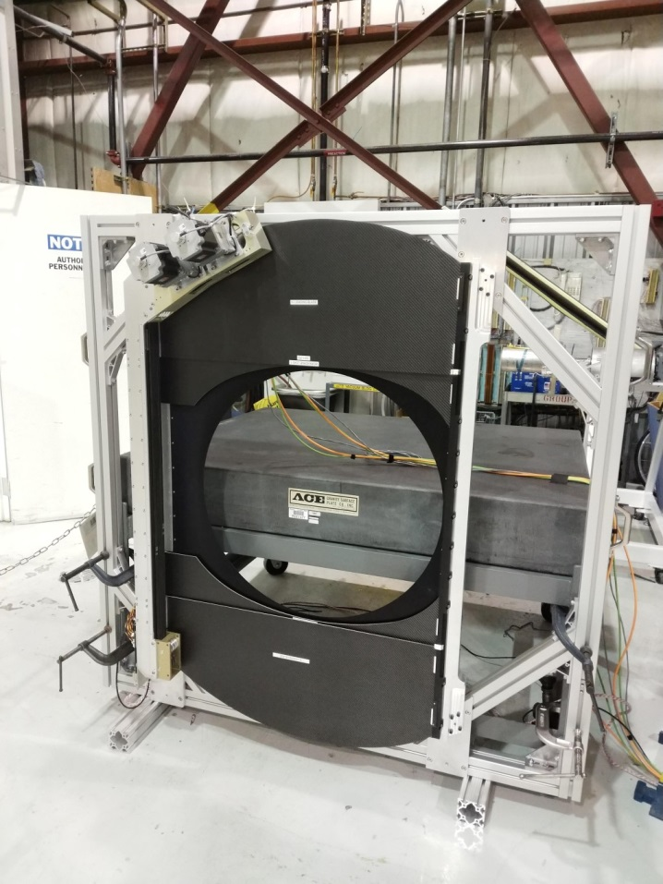
Shutter prototype
Full Drive Train : strong back, motors, motion control switches
Simplified Garage Plate: only mechanical features. The final version will have a more complex duct features to control thermally L3
Final linear rail design
Prototype blades with knife edges and chicane bonded at SLAC.

Slide 77
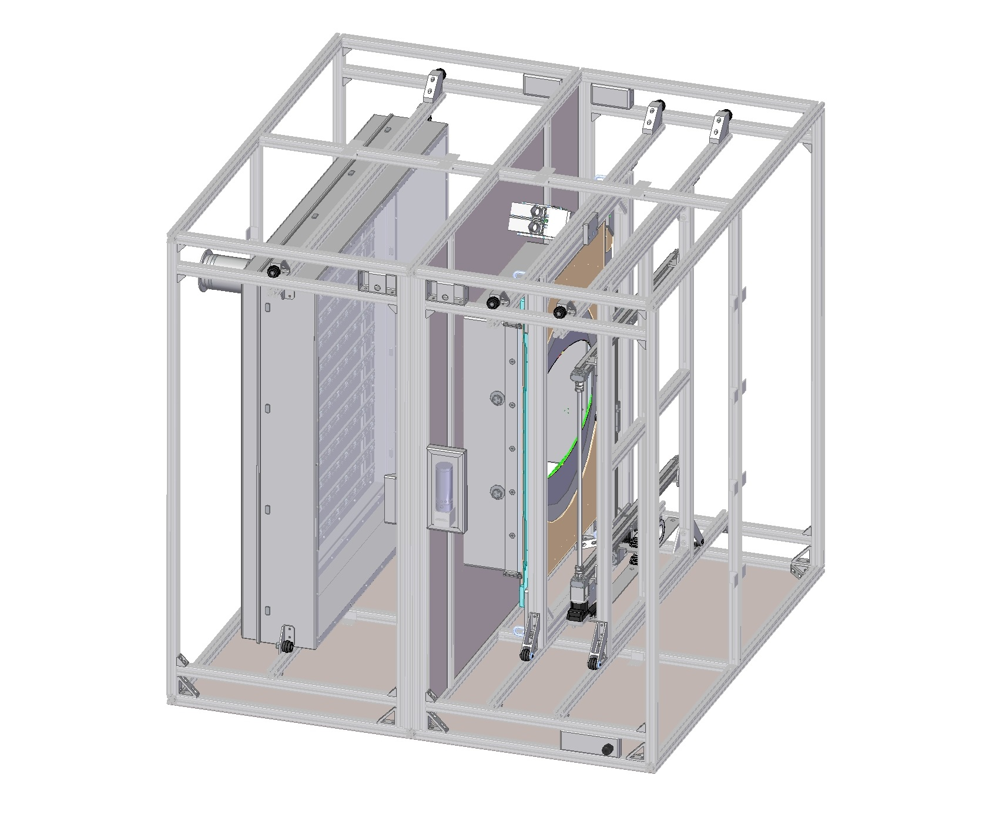
Shutter Light Box Test Unit
C-SHUT-030 | When exposed to diffuse light, the closed camera shutter shall attenuate the light flux by 10,000
Flat Field Light Source
(LED Array)
Support Frame for Exterior Light Tight Paneling
Shutter
(oriented vertically)
2x Diffuser Panel
(Not Shown)
Photosensor on XY Stage
(measuring light leak)
Baffle Region
Light Box Test Unit (Exterior Panels not shown)

Slide 78
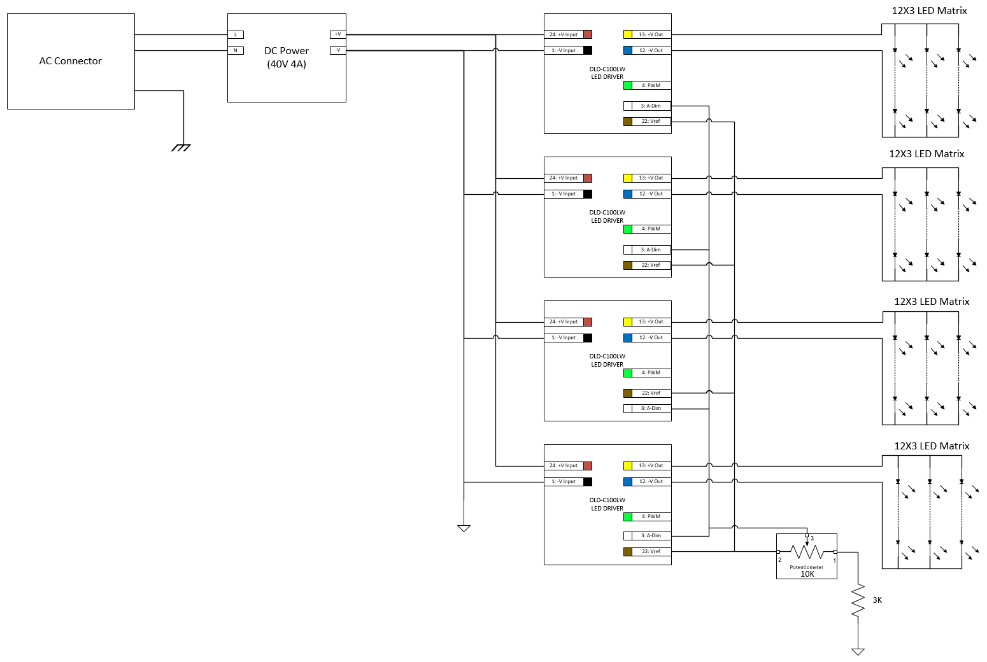
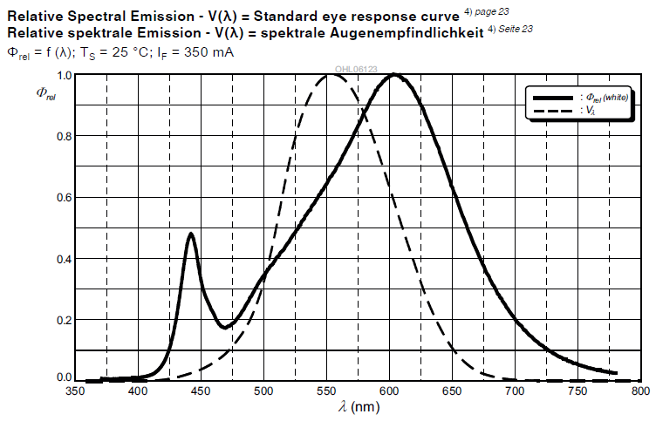
Shutter Light Box Test Unit – Flat Field Source
OSRAM White Warm White LED
LCWW5AM-JZKY-4U9X-Z

Slide 79
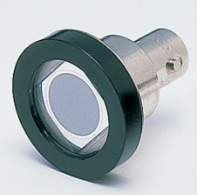
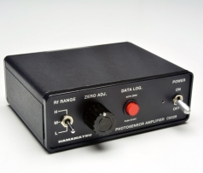





Shutter Light Box Test Unit – Detector setup
Hamamatsu Si
photodiode S2281-01
Hamamatsu Photosensor
Amplifier C9329
Collimated to 4.5 degree
Spectral Response
Offset drift : $±0.5$ mv/day
Light Leak Note - https://confluence.slac.stanford.edu/x/EJ1iDg

Slide 80


Shutter Light Box Test Unit – Scan result
Raster image
created from scan
Scale for value returned by photosensor amp
Shutter Open (light OFF)
1x10⁻² V
Increasing y
Increasing y
inch
Increasing x
Increasing x

Slide 81

Shutter Light Box Test Unit – Scan result cont.
Shutter Open (light ON)
V
inch

Slide 82


Shutter Light Box Test Unit – Scan result cont.
Shutter Closed X Plus
1x10⁻² V
inch

Slide 83


Shutter Light Box Test Unit – Scan result cont.
Shutter Closed X Minus
1x10⁻² V
inch

Slide 84

Shutter Light Box Test Unit – Scan result cont.
All data points within the shutter aperture are well over the 10K attenuation requirement
Measured: >100k
Interactive graph: https://confluence.slac.stanford.edu/x/EJ1iDg
NOTE: Data points outside the shutter aperture forced to a value of 1 to easily identify values within the aperture

Slide 85



Shutter Electronics - Enclosure
Purge/Cooling Air Inlet
Purge/Cooling Air Outlet
Control System / IO / Mtr Drives
HCU
PC104 Form
Interface Bracket to Garage Plate
Rail Slide
(for servicing)
Space for bus bars, breakers, DCDC converter, etc.
CX5130 (Controller)
Beckhoff terminals
Versalogic Lion (HCU)

Slide 86

Shutter Electronics – Electrical Diagram
Shutter Electronics receive power and communication from the Utility Trunk:
    24V (Clean) – dedicated for Beckhoff controller
    24V (Clean) – To 5V DC/DC for HCU
    24V (Clean) – for Beckhoff terminals and sensors
    24V (dirty) – Brakes
    48V (dirty) – Motors
    Ethernet line to a network switch
    Interlock signal from the Master Protection Module

Slide 87


Life Duration Test
Motion profile: after 100 cycles after 1.7 million cycles
mm
mm
Difference in position reported by encoder and hall sensor:
after 100 cycles after 1.7 million cycles
mm
mm

Slide 88
Beckhoff Configuration
CX5130
Embedded PC
EL9570 Capacitance Terminal
EL7047 Stepper Terminal
EL9570 Capacitance Terminal
EL7047 Stepper Terminal
EL2622 Relay Output
EL9184 Potential Distribution Terminal
EL1819 HD Digital Input Terminal
EL6688 External Sync
Drive Axis
Hall Switches
Clock
Changed from CX5120 to CX5130:
  Faster processor: 20% faster – 1.46 GHz to 1.75 GHz
  Dual Core: 1 core for PLC & NC tasks, 1 core for Windows
  Larger controller: 124mm x 100mm x 92mm to 142mmx 100mm x 92mm

Slide 89

Shutter Electronics – Timing Module
IEEE 1588 synchronization system
  Supports Ethernet-based time protocols:
    PTPv1 (IEEE 1588-2002)
    PTPv2 (IEEE 1588-2008)
Already bought
  Not tested yet
  Will require CCS support
    Set up PTP server
    This will help with verifying timing functionality
Beckhoff EL6688
External synch module

Slide 90
Motion Control

Slide 91










S-Curve Motion Profile
$$(0.9\sec{ })$$
$$= 7407.4 (mm/\sec^{2}){ }$$
$$=1666.7 (mm/\sec^{ }){ }$$

Slide 92


S-Curve Shutter Motion
Position
Velocity
Acceleration
Jerk
S-Curve motion profile observed by Beckhoff’s scope tool
Parameters:
Stroke Length: $750 mm$
Max Velocity : $1666 mm/s$
Max Accel : $7407 mm/s^{2}$
Max Jerk : $32922mm/s^{3}$

Slide 93

Hall-Effect Sensor Motion Profile
Red – Motion profile generated from motor encoder
Blue – Motion profile generated from hall-effect sensors (0.1 s offset from encoder generated motion profile)
X (mm)
Time (sec)

Slide 94

Hall-Effect Sensor Motion Profile
Motion profile generated from hall switch matches to the one from the encoder
X (mm)
Time (sec)

Slide 95

Blade Motion Uniformity
C-SHUT-002 | The accuracy of shutter exposure duration shall be <50 ms
C-SHUT-066 | The exposure duration shall be known within 300 ms with a goal of knowing the duration to 5 ms
Motion profile of the two leading blade after 1 sec exposure
Exported data points to Excel; difference in X after 1 second:
-Largest difference of 99.6 microns
-Average difference of 6.2 microns
X (mm)
1 Second
Time (sec)

Slide 96

Shutter Exposure Timing
C-SHUT-006 | The shutter shall be able to obtain a single exposure with effective minimum exposure time of no more than 1 s, with a goal of an effective minimum exposure time of 0.1 s.
C-SHUT-007 | The shutter shall support exposures as long as one hour.
C-SHUT-006 :
Motion profile of both blades after 0.10 second exposure (see image to right)
C-SHUT-007 :
Exposure time is stored in data type TIME.
Data type TIME is of 32 bit in steps of 1 ms.
Lower bound: 0 ms
Upper bound: 4294967295 ms (~49.7 days)
X (mm)
0.10 second
Time (sec)

Slide 97

Hall-Effect Sensor Motion Profile
C-SHUT-008 | The shutter open time shall be 0.98 s or less with a goal of 0.9 s.
C-SHUT-009 | The shutter close time shall be 0.98 s or less with a goal of 0.9 s.
C-SHUT-008:
X-minus blade opens shutter
Start motion : 28.8846 second
End motion : 29.7838 second
Duration : 0.8992 second
C-SHUT-009:
X-plus blade closes shutter
Start motion : 30.8838 second
End motion : 31.7890 second
Duration : 0.9052 second
X (mm)
Time (sec)

Slide 98



Power Requirement cont.
C-SHUT-051 | The shutter shall use no more than 88.4 W average power for standard no-slew visits.
C-SHUT-052 | The shutter shall use no more than 531 W peak power.
mm
Avg. Pwr / visit = 56W
Peak Pwr = 146W

Slide 99


Power Requirement
Beckhoff EL3602
Differential input
Shunt Board
EL3602 reads differential voltage across known resister on shunt board
Each channel corresponds to different component on shutter (motor 1, motor2, controller, etc…)
Calculate power usage with : Power = Voltage * Current
Shunt board and Beckhoff EL3602 is only available on the stand-alone Shutter Engineering Control Unit (SECU)
Limited room inside shutter electronic enclosure
Auxiliary Electronic already monitors current and voltage of each subsystem

Slide 100

Software Protection
Excerpt from hazard list LCA-15
Verification for mitigation requires running protection certification test
  Certification test will be developed on prototype shutter while production shutter is being built
  Certification test will need to be run on each production shutter

Slide 101
Software Protection
Motion Protection Logic
If permit from Auxiliary Electronic is not present, cannot perform any motion
If Shutter not homed, cannot perform any motion except homing routine
If Shutter not calibrated, motion cannot exceed a pre-set speed
If difference between position reported by encoder and hall sensor are greater than a pre-specified distance, then stop current motion and prevent further motion
If limit switch trips, disable further motion in the specified direction
Other protection related tasks
Code review
Protection verification test plan

Slide 102

Corrective actions from the prototype blades
Baseline
Modification
Facesheet Layup
+45 deg Fabric
-10 deg Unitape
+10 deg Unitape
Facesheet Layup
0 deg Fabric
0 deg Unitape
0 deg Fabric
Film Adhesive
Solid CF End Fitting
Film Adhesive
Baseline
Modification
Facesheet Layup
+45 deg Fabric
-10 deg Unitape
+10 deg Unitape
Facesheet Layup
0 deg Fabric
0 deg Unitape
0 deg Fabric
Solid CF End Fitting
Removed Syntactic Foam from film cure
Modification

Slide 103

Blade prototyping helped define design details to improve manufacturability
Facesheet layup was modified to produce a more balanced ply orientation, to improve handling for sandwich panel cure/processing, resulting in a flatter panel
Syntactic backing foam for machining of the core has been removed from the sandwich cure cycle; this was a potential contributor to the panel bow
Modified blade stack-up to allow for increase in flatness tolerance to 0.75mm (from 0.2 mm)
Changed manufacturing processes
  Cure cycle
  Checks for ply alignment
  Graphite slip sheet + Caul Plate
Final blades were flat to 0.25 - 0.5 mm
Flatness Measurement at SLAC

Slide 104


LSST Shutter Blade Shipping Plan
The following materials will be used:
Double Wall Pads, ¼” Thick, 275 lb Test
Flashbreaker‐1‐1 Polyester Tape with Silicone Adhesive
Soft Packaging Foam, Open Cell, ½” Thick
MIL‐PRF‐131 bagging material
Custom Wood Shipping Crate, 1” Thick Foam‐Lined Interior
Packaging Procedure
The proposed packaging procedure is adapted from the procedure used to previously ship the Protoype LSST Shutter Blades, fabricated on a previous contract. For each blade, AC will fix the blade against a rigid corrugated pad using Flashbreaker 1 tape used around the part perimeter. SDC will then place a single layer of ½” thick soft packaging foam between the LSST Shutter Blade and a second, “top” corrugated pad. The corrugated pad will be oversized such that no part of the LSST Shutter Blade will be within 1‐inch of the corrugated pad boundary.
Flashbreaker tape used to fix the top and bottom corrugated pads together. The entire assembly will be bagged and sealed within a MIL‐PRF‐131 bag to prevent FOD and minimize moisture intrusion during transportation.
Each LSST Shutter Blade will be sandwiched and bagged individually. Each bagged part will be stacked in a custom‐fabricated wooden shipping crate with 1” foam lining in its interior. Foam dunnage will be used to fill any empty volume to prevent part motion during transportation. The wooden crate lid will be fastened using wood screws prior to shipment.

Slide 105
Shutter Assembly Procedures
Bond blade bracket: align blade and mount bracket and bond bracket in place; install bracket; check final alignment (tooling: blade bracket alignment/support fixture)
Bond blade tip: align slide pad bracket and bond in place; mount slide pads; check final alignment (tooling: bonding support fixture)
Assemble and test motor drive assembly: mount capstan assembly and drive bearings into pulley housing; install brake, coupling, and motor; check alignment and test system (bearing loading tools and clean arbor press)
Assemble bearings into pulleys: clean parts; install bearings into pulleys (tooling: tooling and clean arbor press)
Assemble idler pulley stack into pulley housing: assemble with wave washers (tooling: )
Assemble and test shutter electronics enclosure: load enclosure with electronics and cable it up; test assembly to confirm functionality; connect motor drive assemblies to SEE and test the entire system
Assemble strong back: mount linear rail and check alignment; mount idler pulley stacks; mount motor mount bracket; install blade mounts on carriages; check alignment (tooling)
Mount and align drive system: mount motor drive assemblies; install and tension timing belts; test-run carriages; inspect and align carriages; check and adjust belt tension
Install and test instrumentation: mount Hall-Effect switches; mount limit switches; wire up switches and check functionality; run functional tests; run H-E alignment tests and drive system break-in tests
Mount blades and test: mount blade stacks; run shutter to check blade positioning; measure leading blade positions to establish zero points;
Mount and align guide rail: mount guide rail and check alignment; test-install L3- and filter-garage plates and strong back and motor shrouds; inspect gaps and position of rail; remove filter-garage plate and shrouds (tooling: shutter assembly frame, … )
Complete shutter assembly: install filter-garage plate and shrouds; connect up L3 garage plate and shroud air systems and test; install shutter electronics enclosure and run cabling; measure weight and center of gravity

Slide 106
Test Procedure: Exposure Trajectory
    Requirements already validated on the prototype. Only required as QC verification procedure for the final assemblies
    Test Description
Measure the exposure accuracy over the full travel of the shutter blades with the addition of a remote position monitor set up at one end of travel.
Comparisons of blade position versus time, as measured by the external reference measurement and shutter Hall-Effect sensors and shaft encoders.
Testing is performed with the Shutter in three configurations: on the bench, oriented at its extremes of attitude, and in an environmental chamber to test over its full operating temperature range.
Test Set-up and Equipment
Testing is performed in three configurations:
  On the bench: mounted to the positioning table, but horizontal in a nominally upside-down orientation.
  Positioned at extremes of its orientations: using the positioning table to re-orient the unit to horizon-pointed orientation and extremes of rotator rotation angles.
  Installed in an environmental chamber: shutter is bagged and filled with GN2, and located in a chamber while on the positioning table
For cold-testing, the shutter is mounted in its positioning stand and wheeled into a commercial freezer. The entire shutter is bagged in a shroud and back-filled with nitrogen or very dry air, to ensure there is no water condensing on the shutter at the cold test temperatures.
Blade trajectory is verified with the initial bench-top testing and the Keyence external position sensors
No external measurement is needed to track blade position for the subsequent orientation and cold-chamber tests. This will be tracked using the Hall-Effect switches and motor shaft encoders.
Data Acquisition
During the test, the shutter is fully controlled by its Hardware Control Unit (HCU) and Camera Control System (CCS) test stand. This is also used for capturing position telemetry from the remote position monitor to allow for synchronous data collection and accurate reconstruction of shutter motion.

Slide 107
Test Procedure: Light Leak
    Requirements already validated on the prototype. Only required as QC verification procedure for the final assemblies
    Test Description
The light-tightness of the fully-assembled Shutter unit is verified in this test. The requirement specifies a light attenuation value average per unit of area behind the Shutter. Thus, the test involves comparing closed versus open light levels at points covering the entire field of view. This full coverage ensures that all possible avenues for stray light are checked and verified to meet the attenuation specification.
Test Set-up and Equipment
Light leaks are tested with the Shutter mounted in the light box test unit(*). On the incoming side, a diffuse light screen is used to provide nominally uniform light levels across the entire field of view. The requirements on uniformity are very loose, since light levels are measured as part of the test. These lights are covered by a light-tight shroud to ensure that light levels are uniform and not affected by changes in ambient room light.
On the outgoing side of the Shutter, a photodiode is used to measure light levels. This is mounted on an XY-stage that is rastered across the entire field of view with the Shutter open and closed. The entire stage and photodiode system is enclosed in a separate shroud to isolate it from ambient light
Data Acquisition and Analysis
Lighting and XY-stage control and photodiode light level and stage position are handled with an integrated controller. This is a stand-alone commercial controller.
Light level data is captured in a discrete grid of locations, then base “dark” levels subtracted and the open and closed levels compared to assess the level of attenuation
Expected Results and Evidence of Compliance
Light attenuation map: map of light attenuation by square centimeter of the entire region downstream of the shutter, showing leak attenuation amount as a function of (X, Y) position. Results can be presented graphically to assess the degree of attenuation as a function of position. This allows for evaluation of any possible reduced attenuation levels around the perimeter of the blades and at blade overlap to characterize any systematic variations.
* The test box unit will be kept in High Bay Area of the building 33, where it is actually, because it is large and difficult to clean for the clean room standard. The Shutter will be moved out in the High Bay Area and tested in the box outsied the clean room. The procedure to keep the shutter clean need to be developed.

Slide 108
Test Procedure: Shutter Functional
Test Description
All Shutter capabilities are tested and functional requirements are verified in this test. The test runs the Shutter through its full set of operations to show that all interfaces to the CCS and protection system are functioning as required. This also verifies Shutter power is within allocations and that Shutter telemetry is captured and transferred as required.
The test also includes testing of start-up, shut-down, and engineering mode functionality.
Equipment
Shutter functional testing is accomplished with the Shutter on its assembly and test stand. This allows for it to be re-oriented through its full range of motion. No additional test equipment is expected.
An abbreviated functional test is also performed with the shutter in the environmental chamber. This will verify that the shutter can survive its survival temperature, turn on, and come up normally over its full temperature range.
Data Acquisition and Analysis
The Shutter HCU and CCS test stand manage all operations during functional testing. No additional telemetry or control is expected to be used.
Expected Results and Evidence of Compliance
Functional test report: results suitable for verification of requirements are gleaned from the telemetry captured by the Shutter HCU. Many requirements are verified by simple functional demonstration, while others require modest post-processing.

Slide 109
Test Procedure: Modes Assessment
    Test Description
This test verifies that Shutter vibration modes meet minimum frequency requirements. It also is used to assess rough mode shapes for primary modes of the blades and garage plates and to correlate the finite-element analysis (FEA) model against the results.
Test Set-up and Equipment
This test uses the Shutter assembly in its assembly and test stand. Accelerometers are mounted to various components in the Shutter and read out with a dedicated commercial data acquisition system designed for high frequency read-out and amplifying of the accelerometer signals in phase.
This test is performed both with the blades stopped and during opening and closing operations to track mode frequencies, shapes, and any dynamic coupling
Data Acquisition and Analysis
Time-varying accelerations are captured by the acquisition system then is uploaded for further processing. Here, accelerations are transformed into frequency and phase domains to assess natural frequencies and mode shapes. This is also needed to develop damping and transfer function to assess any possible coupling between drive system dynamics and Shutter blade vibration modes.
Modes Assessment Test Report:
  Verification of minimum frequencies is accomplished by simple comparison of vibration frequencies with requirements
  Mode shapes, magnitudes, and damping data used to correlate the Shutter FEA model.
  Transfer functions and higher-frequency modal data to optimize the drive control system to mitigate against any possible amplification of drive system modes in the Shutter blades themselves

Slide 110
Test Procedure: Radiation
    Test Description
Measure levels of activity in shutter parts and materials. This tests the static shutter only, and can be performed on the full assembly, or on constituent parts during assembly. As parts are received, they will be tested, to reduce the risk of a test failure requiring significant assembly re-work.
Test Set-up and Equipment
Use a Geiger counter to measure residual radioactivity of materials used in fabricating shutter components.
Data Acquisition and Analysis
None other than recording counts per unit of time for the various parts.
Expected Results and Evidence of Compliance
Add the measured count rate for the various parts to the bill of material data associated with the shutter unit.

Slide 111
LCA-16648, Shutter Verification Matrix (excerpt)
 | LCA-16648-A: Shutter Verification Matrix |  |  |  | Verification Test Plan |  |  | Verification Evidence
Deliverable / Requirement | Req Id | Requirement Title | Requirement | Comments | Verif. Method | Verification Detail | Reference Documents | Summary of Evidence | Reference to Evidence | NCR No.
1. Header |  |  | General Requirements
2. Requirement | C-SHUT-002 | Exposure duration accuracy | The accuracy of the shutter exposure duration shall be < 50 milli-seconds | Applies for all shutter orientations per C-SHUT-036 | Test | Exposure Trajectory Test |  | Blade Position Report; Blade trajectory report; Position vs time data
2. Requirement | C-SHUT-066 | Exposure duration knowledge | The exposure duration shall be known to within 300 msec with a goal of knowing the duration to 5 msec, rms. | This provides the required knowledge of 2% rms for the standard exposure of 15 seconds | Test | Exposure Trajectory Test |  | Blade Position Report; Blade trajectory report; Position vs time data
2. Requirement | C-SHUT-006 | Min exposure time capability | The shutter shall be able to obtain a single exposure with an effective minimum exposure time of no more than 1 second, with a goal of an effective minimum exposure time of 0.1 seconds |  | Test | Exposure Trajectory Test |  | Blade Position Report; Blade trajectory report; Position vs time data
2. Requirement | C-SHUT-007 | Max exposure time capability | The shutter shall support exposures as long as one hour |  | Test | Exposure Trajectory Test |  | Blade Position Report; Blade trajectory report; Position vs time data
2. Requirement | C-SHUT-008 | Max opening time | The shutter open time shall be 0.98 seconds or less with a goal of 0.9 seconds | The time to turn-on and initialize is not included | Test | Exposure Trajectory Test |  | Blade Position Report; Blade trajectory report; Position vs time data
2. Requirement | C-SHUT-009 | Max closing time | The shutter close time shall be 0.98 seconds or less with a goal of 0.9 seconds | The time to turn-on and initialize is not included | Test | Exposure Trajectory Test |  | Blade Position Report; Blade trajectory report; Position vs time data
2. Requirement | C-SHUT-028 | Clear field of view | When open, the shutter and all of it constituent parts shall not obscure the field of view | Field of view and stay-clear regions are defined in LCA-73, Shutter IDD. | Inspection | Shutter Dimensional Measurement |  | Dimensional Inspection Report
2. Requirement | C-SHUT-029 | Light scattering | All components with a direct view of the field of view of the internal light cone as defined in LCA-10333 shall either be shielded by light baffles, treated/shaped to minimize scattering, or coated flat black. Paint with a BRDF (Bidirectional reflectance distribution function) equal to or lower than the BRDF of LORD Aeroglaze Z306 coating is acceptable. |  | Inspection | Visual Inspection |  | Visual Inspection Log
2. Requirement | C-SHUT-030 | Light-tightness | When exposed to diffuse light, the closed camera shutter shall attenuate the light flux by 10,000 when averaged over any square centimeter as measured at a distance of 75.04 mm in the +z direction from the interface plane defined on the Shutter Interface Definition Drawing (LCA-73). |  | Test | Light Leak Test |  | Light Attenuation Map
2. Requirement | C-SHUT-068 | Light emissions | Use of electronic components emitting in wavelengths between 300 to 1200 nm shall be minimized. Any such component shall be shielded to prevent light from leaving the shutter |  | Test | Light Leak Test |  | Light Attenuation Map
2. Requirement | C-SHUT-001 | Lifetime | The shutter shall be designed for an operating lifetime of 15 years. | Includes margin for assembly, integration, and test prior to delivery | Test/Analysis | Analysis--Lifetime |  | Bill of Materials
2. Requirement | C-SHUT-024 | Design cycles | The shutter shall be designed for at least 1E6 open/close cycles per year | 4 exposures per minute, 12 hours per day, 300 nights. Rounded up to 1E6 | Test/Analysis | Analysis--Lifetime |  | Bill of Materials
2. Requirement | C-SHUT-025 | Min maintenance cycle | The Shutter shall be designed for a time between planned preventative maintenance of > 1 yr |  | Test/Analysis | Analysis--Lifetime |  | Bill of Materials |  | 111

Slide 112
Response to 2018 NSF/DOE Status Review
No Camera Body or Shutter recommendations

