Slide 1
DOE LSST CAMERA EVMS Craig Brackett LSST Camera/PMCS Lead NSF/DOE Joint Status Review August 27-30, 2019

Slide 2
Outline
SLAC Certified PM System Overview
System Overview
Schedule Assumptions/Development
PMCS Project Documents/Tools
Message box example for short highlighted messages.

Slide 3
Certified PM System is documented by controlled procedures
Message box example for short highlighted messages.

Slide 4
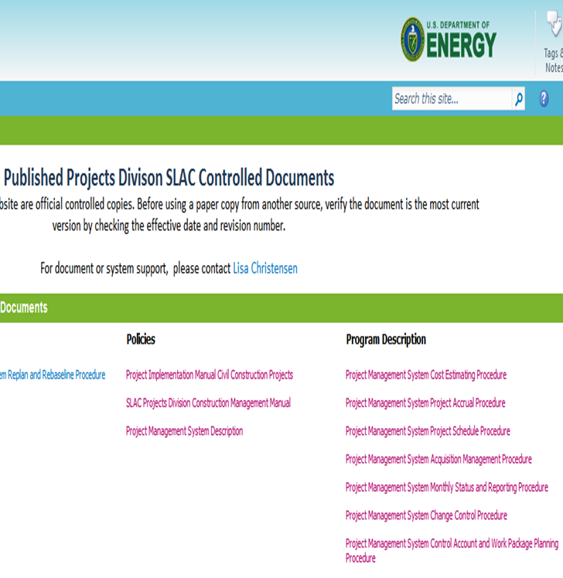
Certified PM System is documented by controlled procedures
Message box example for short highlighted messages.

Slide 5
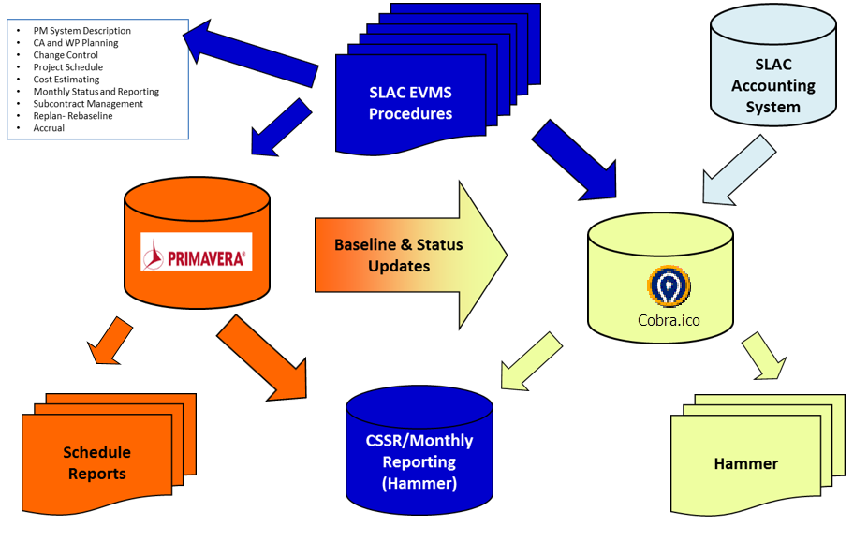
System Overview (Tools & Processes)
Message box example for short highlighted messages.

Slide 6
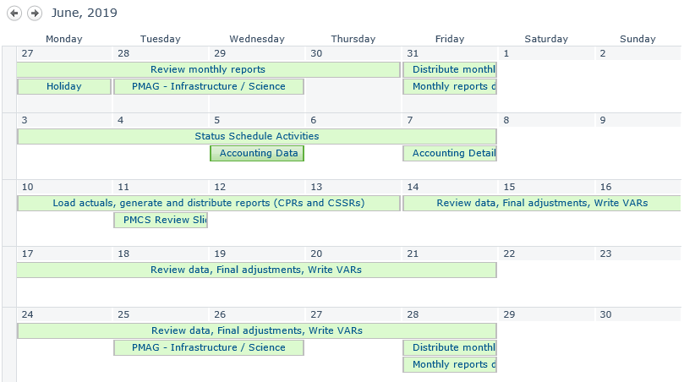
System Overview (Monthly PMCS Calendar)
Message box example for short highlighted messages.

Slide 7
Project Schedule Assumptions
Message box example for short highlighted messages.

Slide 8
Project Schedule is Well Developed
Message box example for short highlighted messages.

Slide 9
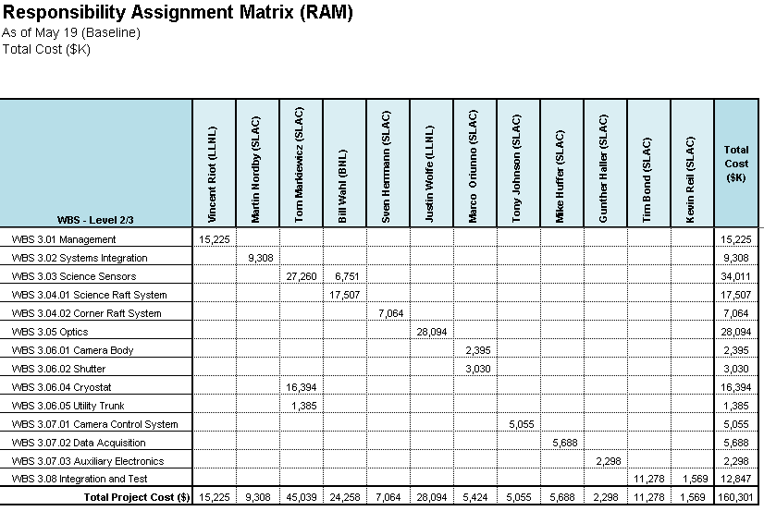
PMCS Project Documents/Tools Responsibility Assignment Matrix (Summary RAM)
Message box example for short highlighted messages.

Slide 10
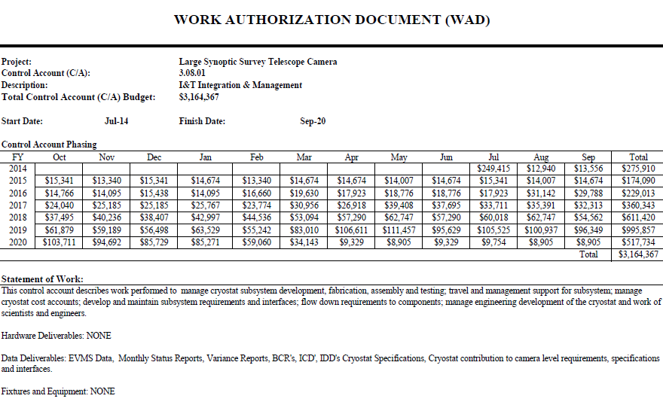
PMCS Project Documents/Tools - Work Authorization Document (WAD)
Message box example for short highlighted messages.

Slide 11
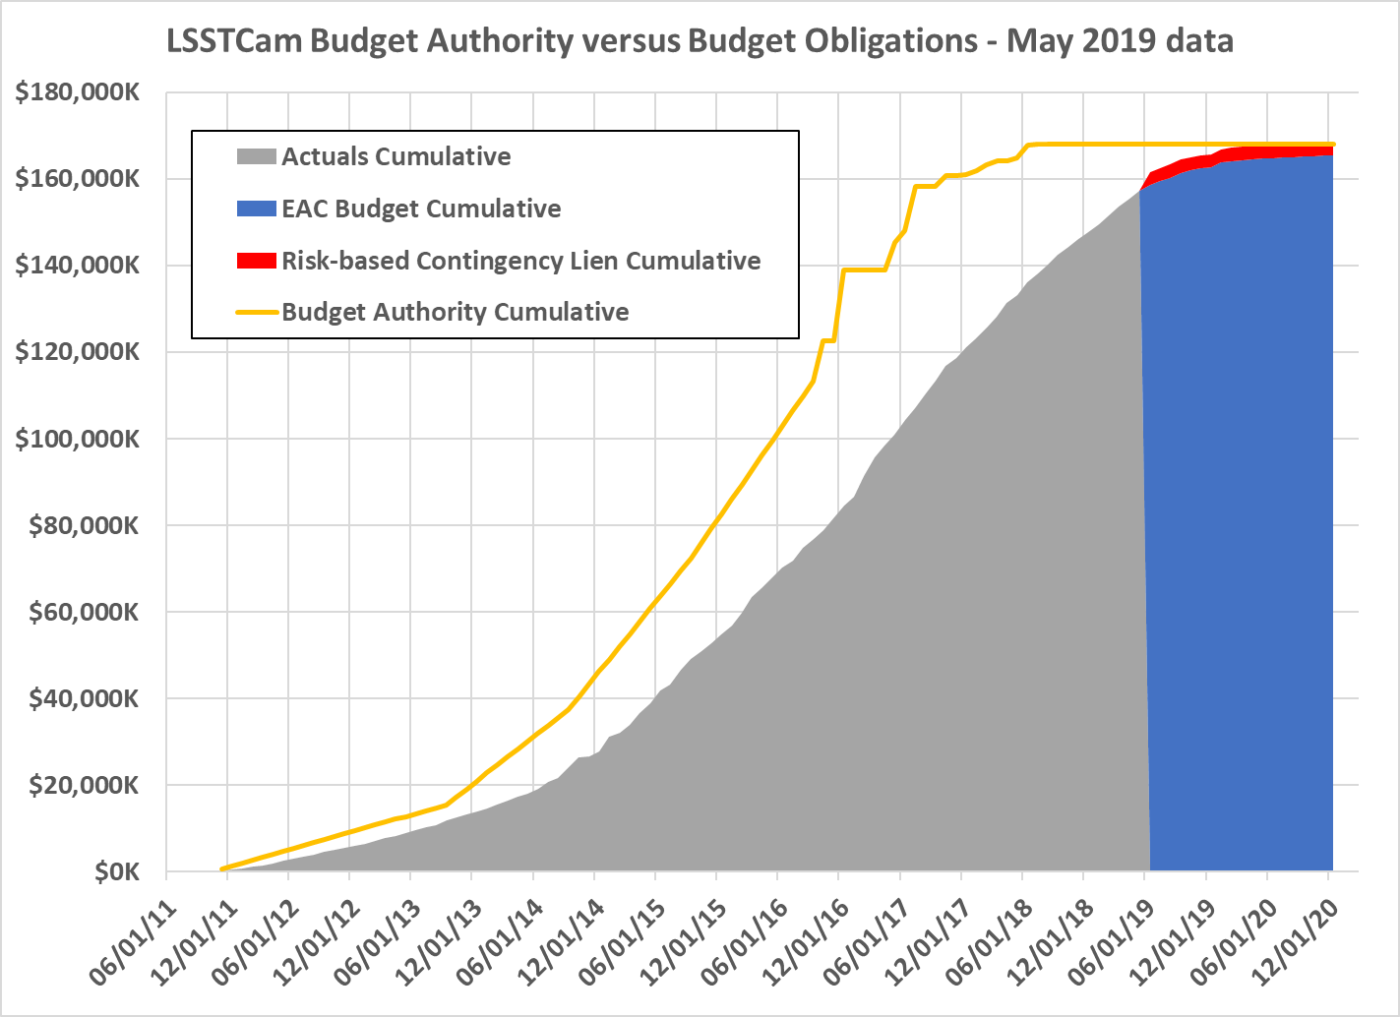
PMCS Project Documents/Tools - Budget and Funding Analysis

Slide 12
PMCS Project Documents/Tools - CSSR Report May-19
Message box example for short highlighted messages.

Slide 13
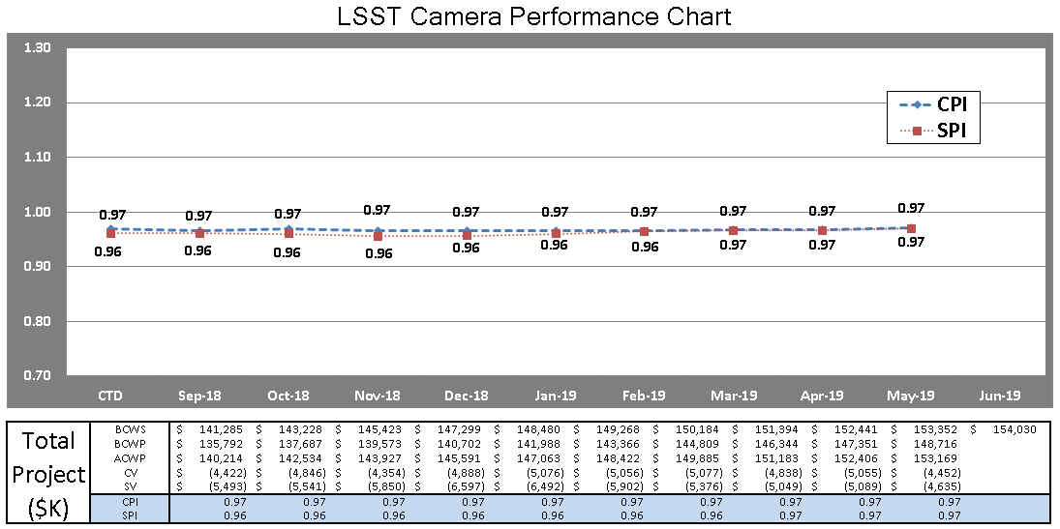
PMCS Project Documents/Tools - Trend Chart

Slide 14
PMCS Project Documents/Tools - Look Ahead Data

Slide 15
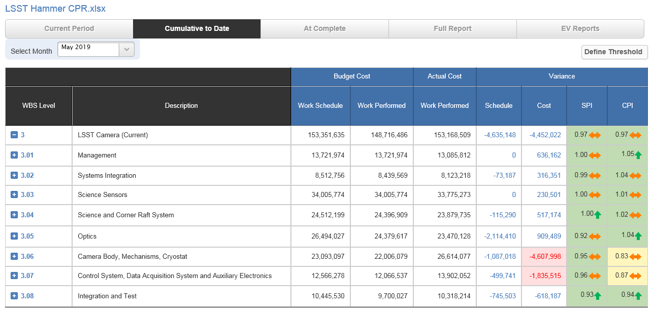
PMCS Project Documents/Tools - Hammer CPR
Message box example for short highlighted messages.

Slide 16
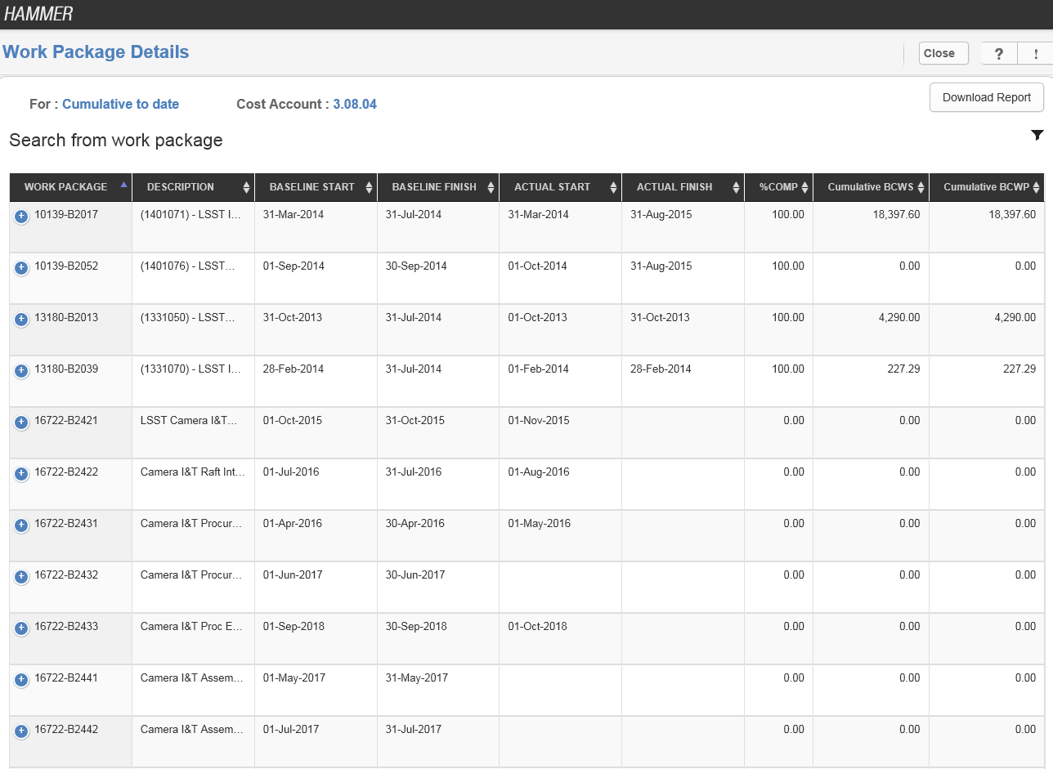
PMCS Project Documents/Tools - Hammer Work Package Details
Message box example for short highlighted messages.

Slide 17
PMCS Project Documents/Tools - Hammer Variance Reporting
Message box example for short highlighted messages.

Slide 18
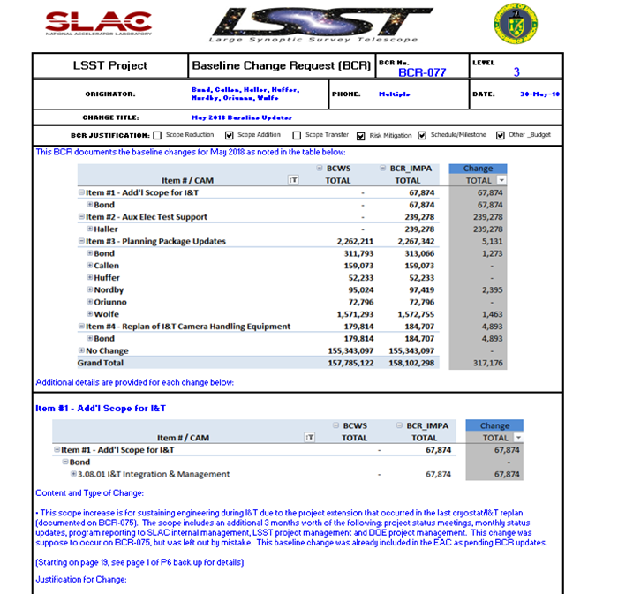
PMCS Project Documents/Tools - BCR Form

Slide 19
PMCS Project Documents/Tools - EAC Process
EAC are updated in accordance with the SLAC PM system description
EAC are reviewed and updated on a monthly basis (as needed)
Variance data and performance indicators are used to assess and validate current EAC
Based on assessment, CAM’s can request to update EAC
A Comprehensive EAC is performed annually
FY20 planned for Oct19
EAC changes are controlled and approved by the project Director/manager
An EAC substantiation form is used to approve and document all EAC updated
Substantiation forms include ETC Details and Reasons for Change
Message box example for short highlighted messages.

Slide 20
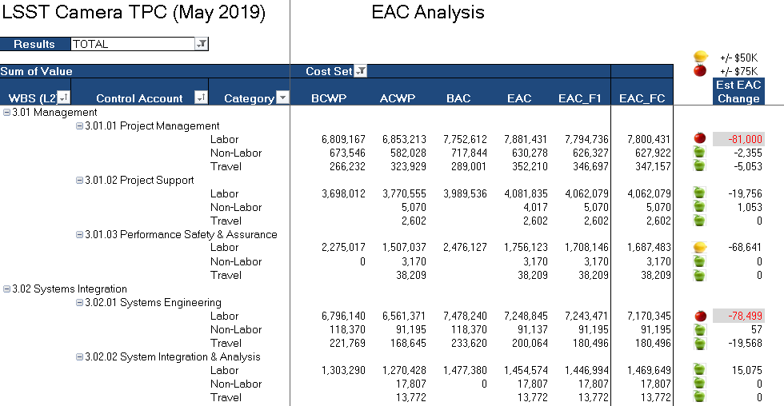
PMCS Project Documents/Tools - EAC Analysis

Slide 21
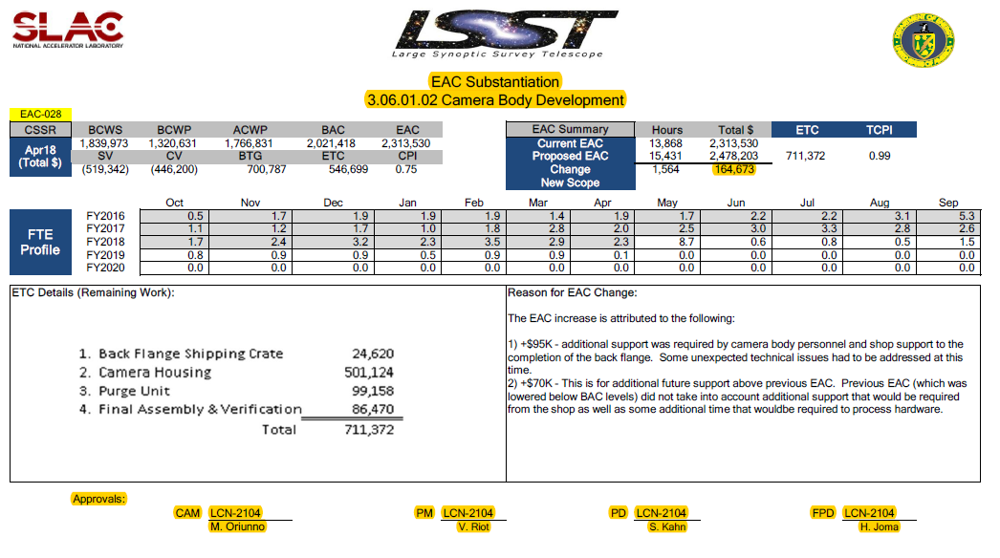
PMCS Project Documents/Tools - EAC Substantiation Form
Message box example for short highlighted messages.

Slide 22
LSST Camera Project is Using PMCS
LSST is using a PM System that has been successfully implemented on several projects across SLAC
LSST management team is using the PM system to manage it’s baseline and variances are being effectively managed
Message box example for short highlighted messages.

Slide 23
End of Presentation

