Slide 1
DOE LSST Commissioning EVMS Craig Brackett LSST Camera/PMCS Lead NSF/DOE Joint Status Review August 27-30, 2019

Slide 2
Outline
SLAC Certified PM System Overview
System Overview
Schedule Assumptions/Development
PMCS Project Documents/Tools
Message box example for short highlighted messages.

Slide 3
Certified PM System is documented by controlled procedures
Message box example for short highlighted messages.

Slide 4
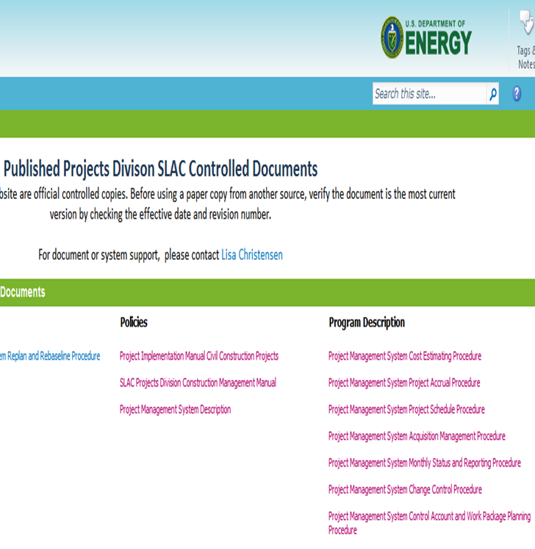
Certified PM System is documented by controlled procedures
Message box example for short highlighted messages.

Slide 5
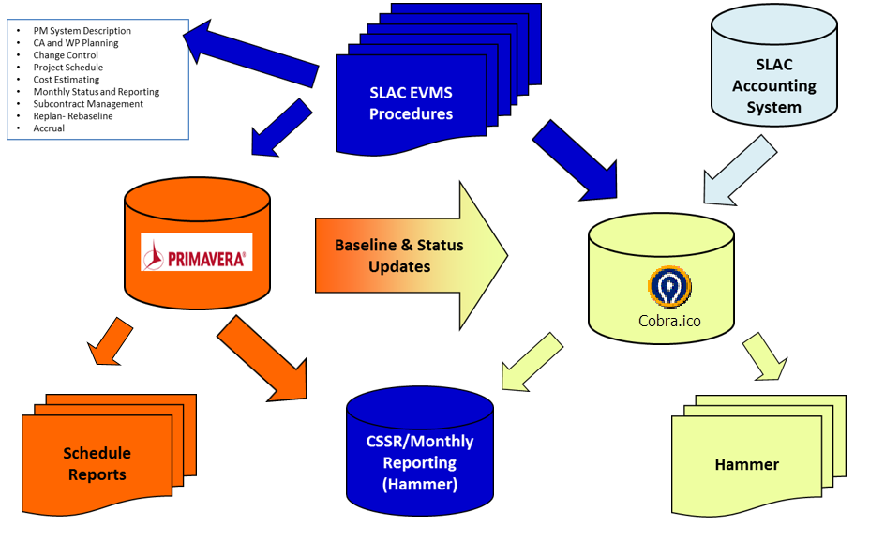
System Overview (Tools & Processes)
Schedule baseline and progress is all processed within the NSF P6 system
Message box example for short highlighted messages.

Slide 6
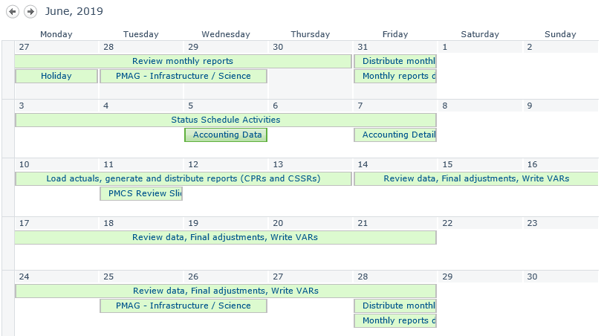
System Overview (Monthly PMCS Calendar)
Message box example for short highlighted messages.

Slide 7
Project Schedule Assumptions/Development
DOE Commissioning is baselined and tracked with the NSF master resource loaded schedule
DOE activities are resource loaded and are separate from NSF activities
All changes are under configuration control
Resource loaded activities are based on CAM developed BOE
Schedule is logically linked
Message box example for short highlighted messages.

Slide 8
PMCS Project Documents/Tools - CSSR Report May-19
Message box example for short highlighted messages.

Slide 9
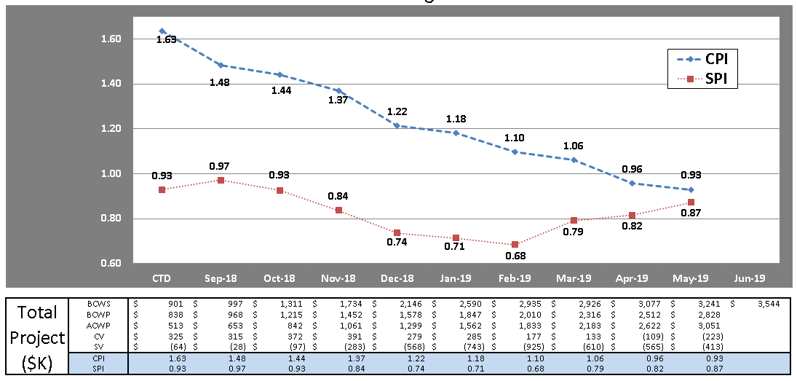
PMCS Project Documents/Tools - Trend Chart

Slide 10
PMCS Project Documents/Tools - Hammer CPR
Message box example for short highlighted messages.

Slide 11
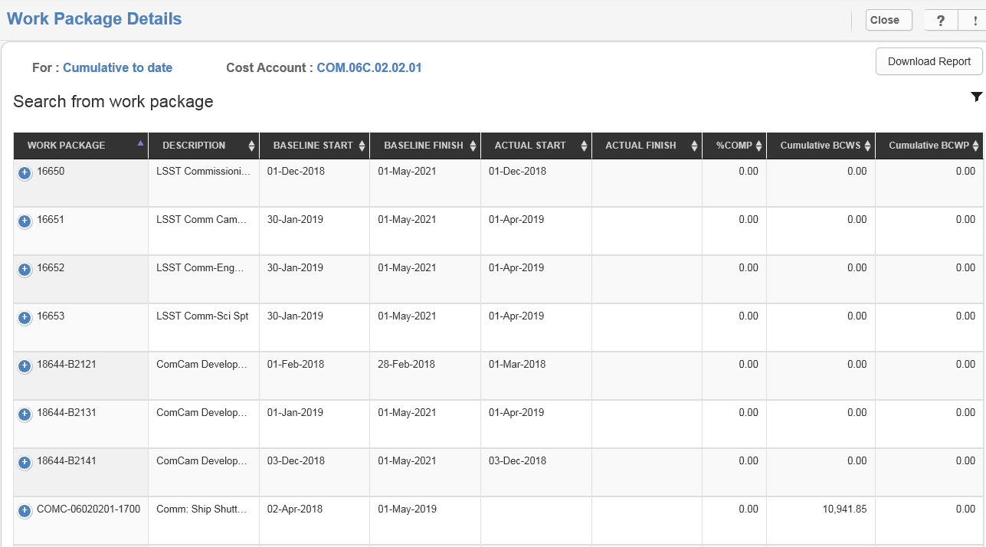
PMCS Project Documents/Tools - Hammer Work Package Details
Message box example for short highlighted messages.

Slide 12
PMCS Project Documents/Tools - Hammer Variance Reporting
Message box example for short highlighted messages.

Slide 13
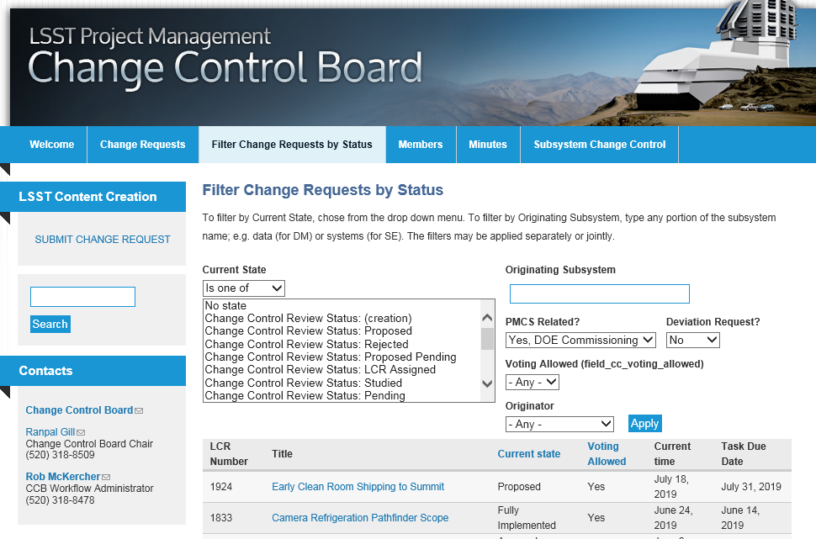
PMCS Project Documents/Tools - Changes Documented on LCR’s

Slide 14
PMCS Project Documents/Tools - EAC Process
EAC are updated in accordance with the SLAC PM system description
EAC are reviewed and updated on a monthly basis (as needed)
Variance data and performance indicators are used to assess and validate current EAC
Based on assessment, CAM’s can request to update EAC
A Comprehensive EAC is performed annually
First one is planned for FY20 in Oct19
EAC changes are agreed upon with project management and documented on the EAC change log
Message box example for short highlighted messages.

Slide 15
LSST Commisioning Project is Using PMCS
LSST is using a PM System that has been successfully implemented on several projects across SLAC
LSST management team is using the PM system to manage it’s baseline and variances are being effectively managed
Message box example for short highlighted messages.

Slide 16
End of Presentation

