Slide 1
Camera Systems Integration
Martin Nordby
Camera Systems Integration Manager, SLAC
NSF/DOE Joint Status Review
August 27-30, 2019
R2

Slide 2
Systems Integration Break-Out Agenda
Status of actions from 2018 Review recommendations
Requirements and interface management
Integrated design and analysis
Subsystem verification and acceptance
Camera verification plans

Slide 3
Status of Actions from 2018 Review Recommendations

Slide 4
Recommendations from 2018—2.1 Heat Exchangers
“Increase oversight of heat exchanger vendor for remainder of the fabrication/testing period….”
  Reply 1: Refrigeration team has continued visiting the vendor to assess manufacturing process
  Reply 2: A local consultant was contracted to provide on-site weekly oversight at the vendor
  Current status of contract for final heat exchangers:
    Escalated to involve direct involvement of camera chief engineer and SLAC lead mechanical engineer
    Part drawings were fully scrubbed to improve manufacturability
    Assembly drawings augmented to include detailed manufacturing instructions to remove ambiguity
    Statement of Work re-written to clearly define deliverables, test parameters, and performance
    Balance of I&T and Pathfinder units have all been delivered, then successfully cleaned, re-worked as needed, and fully assembled and tested at SLAC
      I&T heat exchangers are in-use to support cryostat testing
      Pathfinder heat exchangers are completing assembly and testing now
    Final cold heat exchanger units delivered and have tested out well
    Final cryo heat exchanger units being assembled at vendor now, with weekly oversight, roughly monthly site visits, and review of in-process steps and test data to authorize work continuation

Slide 5
Recommendations from 2018—2.2 Vacuum
“Continue the tiger team effort to explore technical solutions for achieving the cryostat vacuum requirements within a time frame commensurate with the current I&T plan”
  Reply 1: The tiger team effort completed its work as planned in late August, 2018
  Reply 2: An LCN was generated to capture the conclusions, design and operation changes, and cost and schedule impacts of the tiger team recommendations. This was approved.
  Current status of vacuum system improvements:
    Dry-out plan developed, equipment procured and installed, and the system automated. This dries out cryostat contents using cryo and cold plate trim heaters, pumping and purging cryostat with warm N2
    Bake-out plan developed and implemented, heating the cryo plate and CCDs to 40C, the cold plate and REBs to 60C, and the outer housing, L3, and back flanges to 40C
    Vacuum and control system schematics updated to include additional on-camera holding pumps
    Implementation of the dry-out and bake-out plans was completed by December 2018 and tested successfully in February 2019
    Implementation of additional on-board holding pumps planned as part of final camera integration steps in April, 2020

Slide 6
Recommendations from 2018—2.3 Focal Surface
“…Develop an aerial image best focal surface to Focal Plane Array Error Budget and compare to CBE sensor flatnesses, positions, and angles.”
  Reply 1: Several documents generated during the design process and definition of the requirement flow down have been collected and are available to the review committee. The list of relevant documents to be provided is listed below:
    Document-7866 (08/20/2009): Focal Plane surface height (aka non-flatness) distributions and their effect on image size and ellipticity
    Document-7824 (07/29/2009): A parametric model for LSST's PSF: Optical design version 3.2
  Current status of detector plane surface measurements:
    Raft- and cryostat-level flatness metrology systems have been fully validated by the I&T team at SLAC
    This includes construction of a best-fit focal plane surface from test results
    This will be used as part of the first round of 13 RTM testing in Sep-Oct 2019
    Image Quality error budget is being updated to include as-built errors and their effect on IQ errors

Slide 7
Requirements and Interface Management

Slide 8
Agenda: requirements and interface management
Requirements and system-level interface management
Camera internal interfaces and connectivity
Interface early verification

Slide 9
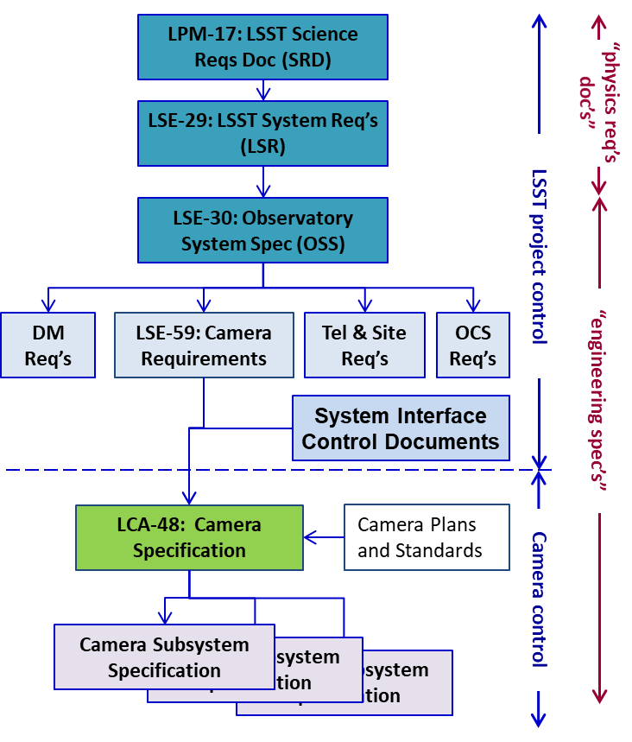
Requirements flow-down
Camera and subsystem requirements have been developed with observatory-level analyses of science performance and component design
LCA-48, “Camera Specification” contains requirements derived from 3 sources:
  Observatory-level requirements
  System-level interface agreements
  Camera plans
As hardware is fabricated and delivered, subsystem verification efforts ensure that requirements are met
  Un-met requirements are flagged in NCRs and evaluated for impacts at higher levels

Slide 10
Subsystem specifications capture all requirements
10 subsystem specifications completely capture lower-level requirements
All requirements are clearly defined:
  Each requirement has a unique ID and is checked for clarity and separability
  Flow-down analysis and validation are also
  captured
    In many cases, this flow-down analysis
    provides the starting point for defining
    test requirements and any pre-test analysis
Verification methodology has been identified for
each requirement: audit, analysis, inspection,
demonstration, test
  Beyond this, discrete verification activities
  have been identified for each requirement
Camera Subsystem Specifications
LCA-57 | Science Raft and Sensor Specification
LCA-53 | Corner Raft Specification
LCA-52 | Optics Specification
LCA-49 | Exchange System Specification
LCA-56 | Shutter Specification
LCA-55 | Camera Body Specification
LCA-50 | Camera Control System Specification
LCA-10872 | Auxiliary Electronics Specification
LCA-51 | Cryostat Specification
LCA-54 | Data Acquisition System Specification

Slide 11
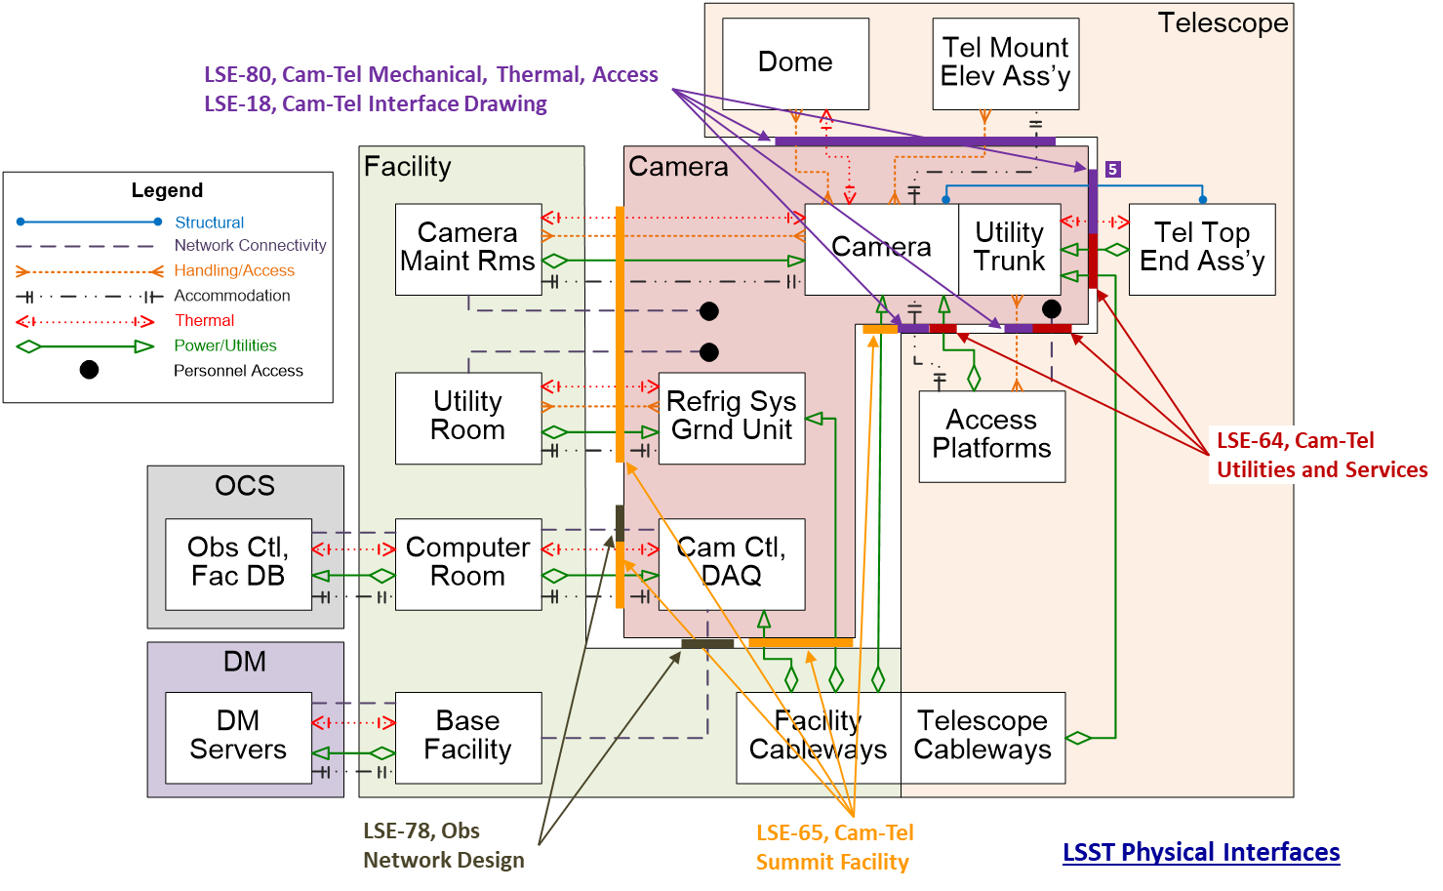
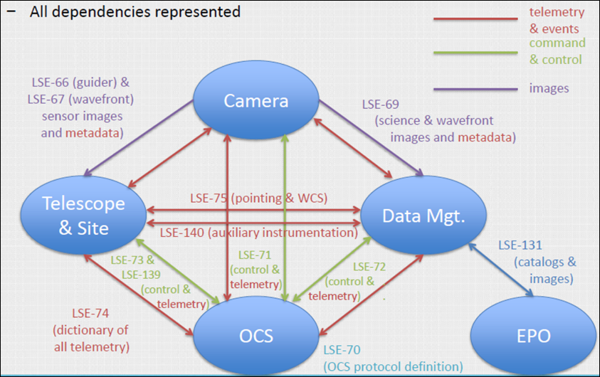
System-level interfaces governed by ICDs
Requirements are derived from interface agreements, then flowed to the Camera Specification and lower-tier subsystem specifications as needed
Early interface verification work and cross-subsystem reviews have been on-going as hardware is built
LSST Physical Interfaces
LSST Logical Interfaces

Slide 12
Interface verification has been going on for a while
Early interface and system validation work has already taken place
Pathfinders have been built to provide more complete verification of key interfaces
  CCS pathfinders: calibration telescope and ComCam use CCS control software (currently operational on the summit)
  Telescope rotator: spare unit at SLAC for camera system-level testing (currently operational at SLAC)
  Refrigeration pathfinder: for field-testing the integrated system on the summit (planned to ship to the summit in early fall)
ComCam will provide full end-to-end system verification

Slide 13
Internal interfaces are also managed
Interface connectivity has been captured in block diagrams and delineated for:
  Structural connections and mounts
  Thermal interfaces and heat transfer
  Logical command, telemetry, power
Interface control documents (ICDs) and interface definition drawings (IDDs) between the subsystems define:
  Connections and hand-off points
  Stayclear regions and boundaries
  Deliverables between subsystems
  Requirements
Structural Block Diagram
Thermal Block Diagram

Slide 14
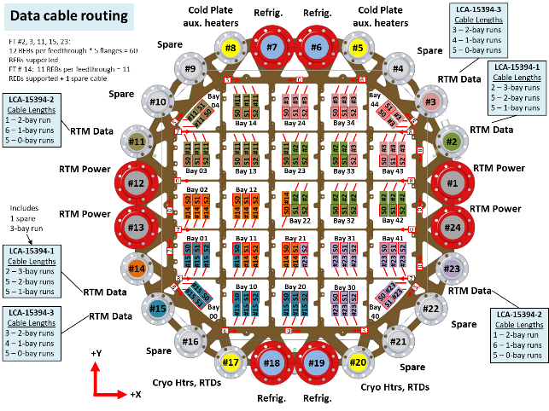
Connectivity also managed using key system layouts
Canonical system layouts augment and more completely address the lower level interface details that can’t practically be captured in the more formal documentation
System layouts, each owned by an individual:
  LCA-10793, Camera Electrical Connectivity Diagrams
  LCA-10803, Electrical Component List
  LCA-10759, Camera Grounding Diagram
  LCA-13381, Detector Plane Layout
  LCA-16591, Cable Routing in the Cryostat
  LCA-16645, Camera Body Line Layout
  LCA-10335, Loaded Utility Trunk Assembly
As hardware is being built, we address these documents along with inspection data, to review interface issues as they arise

Slide 15
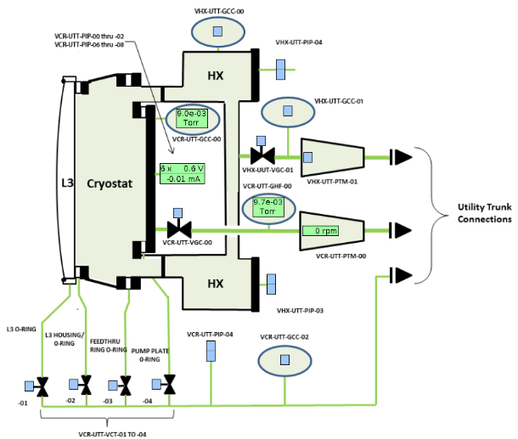
Interface early verification: Camera controls
Camera control system software is being used for running verification tests across many subsystems
Raft tower testing at BNL, on SLAC test stands, and early ETU testing in the cryostat (in use)
Cryostat vacuum pumping system pre- and post-delivery operations and monitoring (in use)
Cryostat refrigeration system compressor cabinet operations for I&T testing (in use)
Filter exchange system prototype and production units (in use)
Purge system verification test stand (in use)
Shutter verification test stand
(nearly ready for operation)
CCS GUI for vacuum system operation

Slide 16
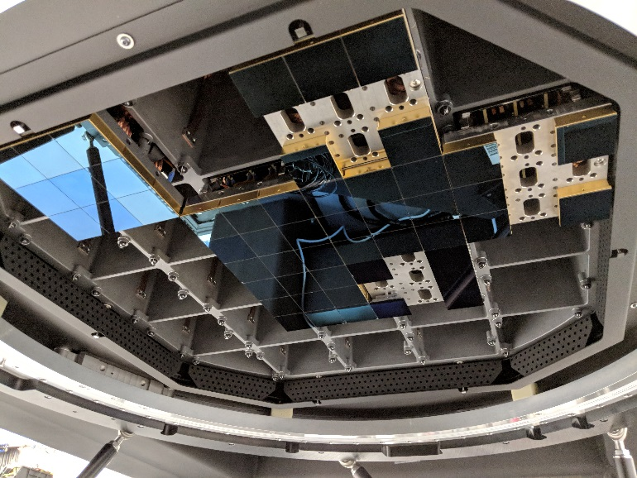
Interface early verification: Cryostat
Cryostat – Raft Tower interfaces have been mocked-up and involved in early verification activities for multiple years (all work is complete)
  Raft tower mock-ups with first-article grid
  Cryostat mock-up with mechanical test rafts
  Real cryostat with MTRs
  Real cryostat with engineering test units
Real cryostat with production raft towers – integration started in mid-July
L3 end of cryostat showing MTRs and ETUs

Slide 17
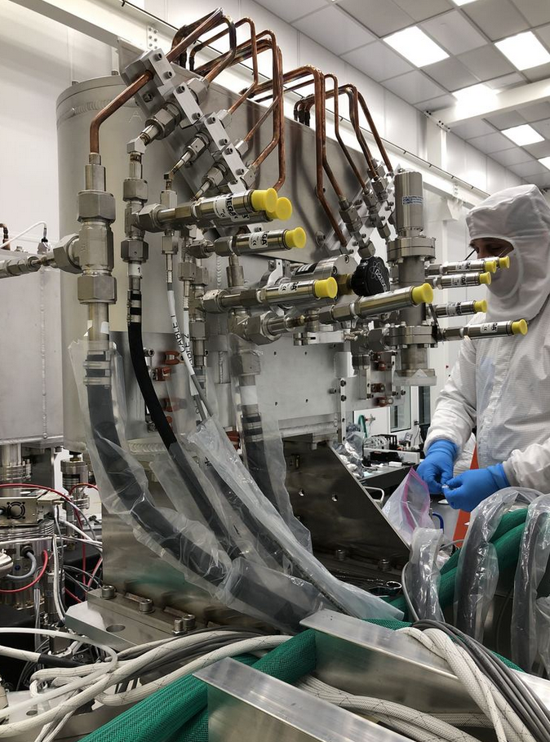
Interface early verification: Refrigeration System
Refrigeration system test unit plans
  I&T Refrig. Cabinets with cryostat and dummy heat loads (in use)
  I&T Refrig. Cabinets with cryostat and production raft towers
  TMA Refrig. Cabinets with pathfinder unit in summit facility
  TMA Refrig. Cabinets with pathfinder unit on telescope
  I&T Refrig. Cabinets with full camera in summit facility
  TMA Refrig. Cabinets with full camera on telescope
I&T heat exchanger mounted to cryostat

Slide 18
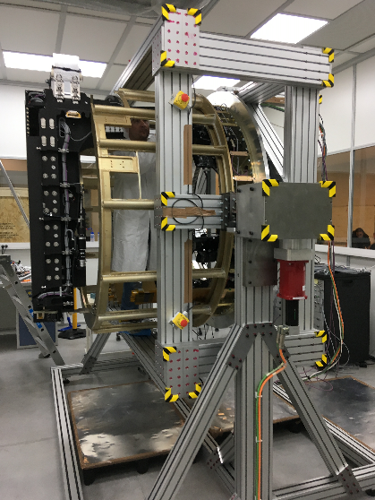
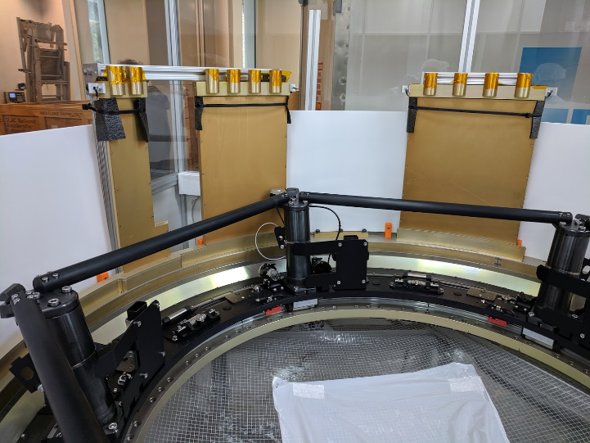
Interface early verification: Exchange System
Carousel – Camera Body interface
  Prototype carousel with back flange mock-up (assembly and check-out complete)
  Production unit carousel with final back flange (assembly and verification testing complete)
Auto Changer – Camera Body
  Prototype auto changer with L2
  and camera housing mock-up
  (assembly and check-out complete)
  Production auto changer with
  volume mock-ups
  (assembly complete,
  verification testing underway)

Slide 19
Summary: requirements and interface management
Requirements have been flowed down and are being managed as part of the Camera configuration baseline
Both system-level and internal interfaces are controlled both by formal ICDs and detailed connectivity and layout diagrams and models
Multiple camera systems have been involved in early mock-up and now interface verification activities for some time

Slide 20
Integrated Design and Analysis

Slide 21
Agenda: integrated design and analysis
System-level budgets, allocations, and updates with as-built values
Systems-level analysis

Slide 22
Systems-level budgeting tools are still in use
Systems-level analysis tools used for:
Developing predictions of expected system-level behavior
Dividing up and flowing down system-level requirements to subsystem allocations
Tracking roll-up of as-built values
Image Quality Error (LCA-17)
Mass Properties (LCA-119)
Throughput (LCA-18)
Defective Pixel Budget (LCA-10074)
Read Noise (LCA-32)
Linearity Budget (LCA-10067)
Gain Stability (LCA-10065)
Assembly and Alignment Tolerances (LCA-10147)
Power (LCA-275)
Camera Thermal Budget (LCA-10156)
Filter Stability (LCA-152)
Crosstalk (LCA-10033)
Timing (LCA-28)

Slide 23
Adding as-built values to system budgets
These system-level budgeting tools continue to be used, as designs are completed and hardware is manufactured and tested
  Monitoring predicted performance based on the latest input from subsystem tests and analysis
  Tracking margin held at the camera level, to evaluate camera-level risks
  Analyzing camera-level impact of higher-level requirements changes flowing to the camera
  Analyzing the flow-up impact of a subsystem missing an allocation requirement
Ultimately, these as-built roll-ups for completed systems will provide data points, along with camera system-level testing, to verify that the fully-integrated camera meets its higher level requirements

Slide 24
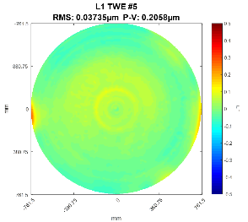
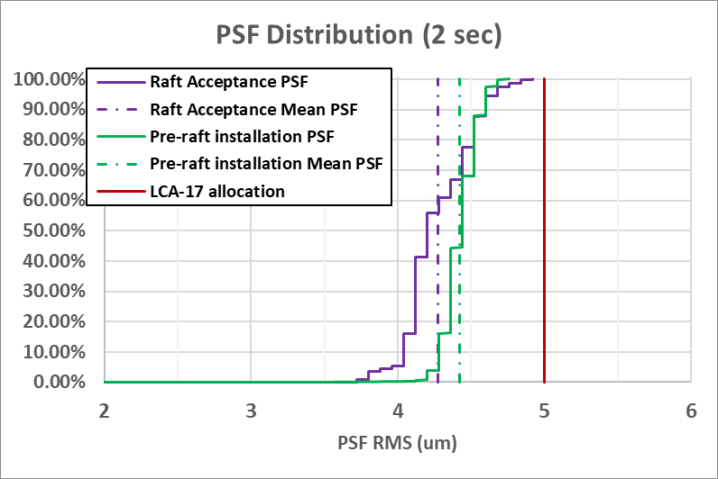
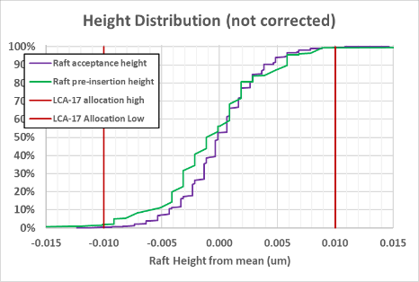
Image Quality Error (LCA-17) as-built roll-up
LCA-17 | Req | Design Estimate | Current Estimate
Image quality FWHM (arcsec) | 0.300 | 0.229 | 0.245
IQ errors from optical and dimensional measurements of as-built lenses
Up-to-date rolling mean of sensor charge diffusion
Flatness of delivered raft sensor assemblies (including sensor flatness contribution)

Slide 25
Mass budget (LCA-119) as-built roll-up
Mass and center of gravity have been allocated and tracked for the duration of the project
Currently, 32% of the mass budget is verified mass of delivered components
(8% in Aug, 2018)
Total margin is 96.9 kg against a budget of 3060 kg
(3.1% margin)

Slide 26
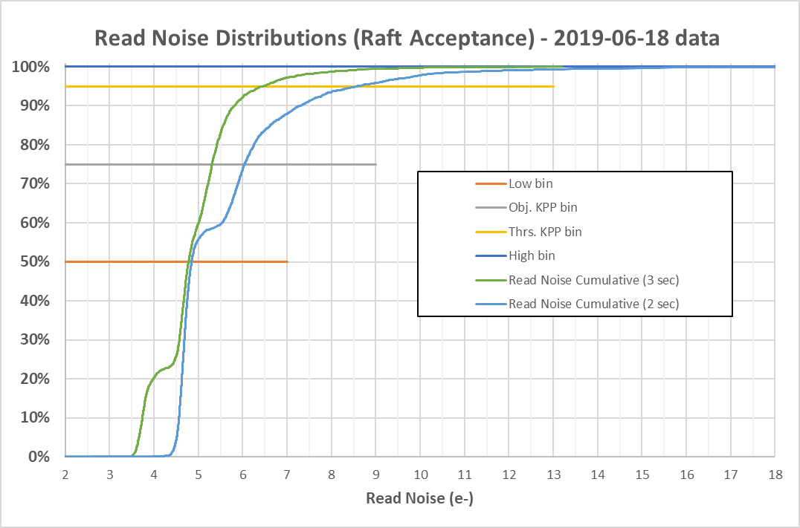
Read noise (LCA-32) and defective pixels (LCA-10074)
Read noise and defective pixel counts are measured as part of electro-optical testing, and tallied and tracked at raft acceptance
LPM-262 modifies our camera requirement, to allow for a fraction of the channels to have higher read-out noise, while still meeting our KPP
For the canonical 2-second read-out time,
read noise continues to track well within
LPM-262 requirements
Read Noise (e-) | LSE-59 Req. | LPM-262 Req. | 2sec readout | 3sec readout
7 | 100% | 50% | 87.9% | 97.2%
9 |  | 25% | 7.9% | 2.3%
13 | 0% | 20% | 3.4% | 0.5%
18 | 0% | 5% | 0.7% | 0.0%
Defective pixels | 2% | N/A | 0.2% | 0.2%
Read noise distribution on raft acceptance

Slide 27
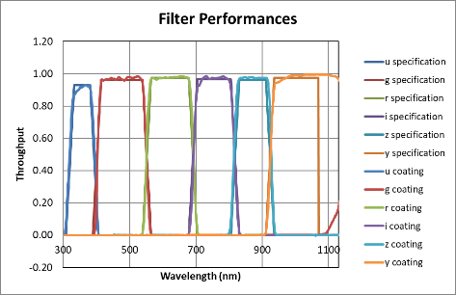
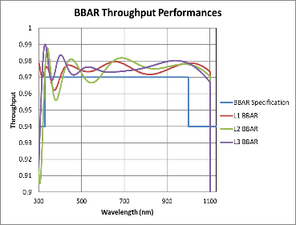
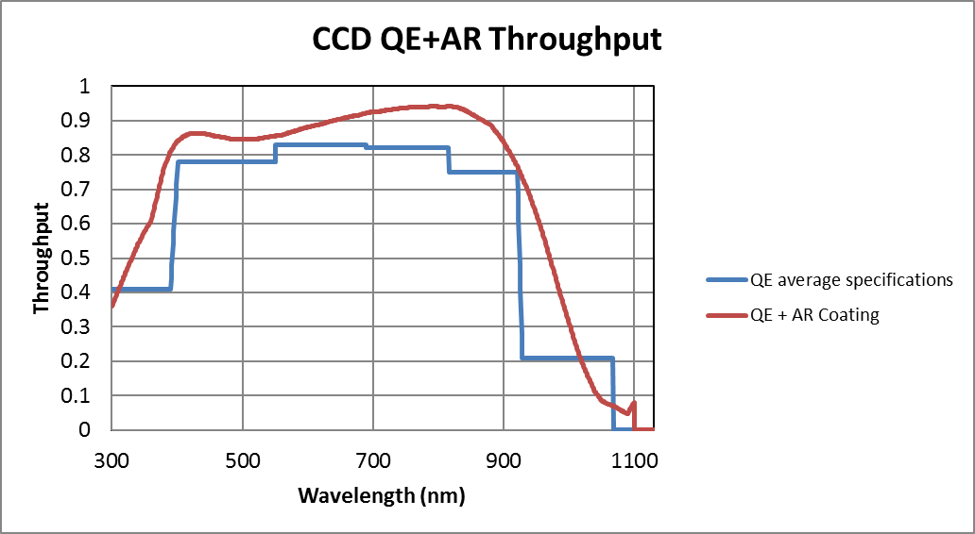
Throughput budget (LCA-18)
Throughput has been tracked using prototype test results, then final verification test data of production optics and coatings
Throughput | u | g | r | i | z | y
Requirement | 0.065 | 0.170 | 0.135 | 0.097 | 0.065 | 0.024
Design | 0.106 | 0.237 | 0.172 | 0.140 | 0.092 | 0.047
Prototype/as built | 0.102 | 0.219 | 0.168 | 0.126 | 0.095 | 0.045
Filter coating witness sample runs
Throughput roll-up table
As built QE
As built L1, L2 and L3

Slide 28
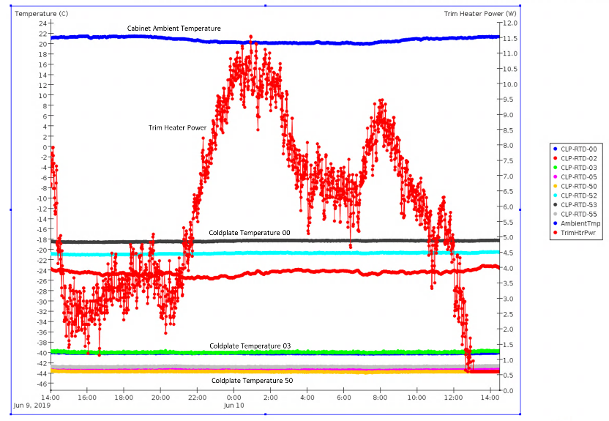
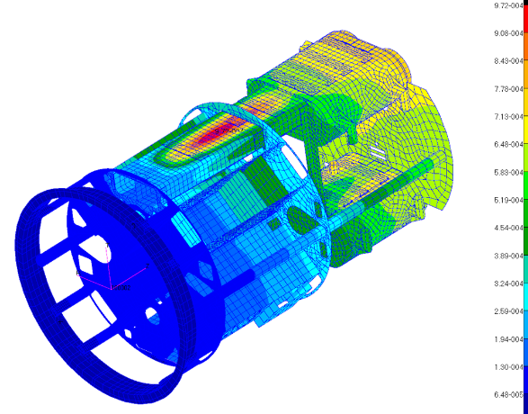
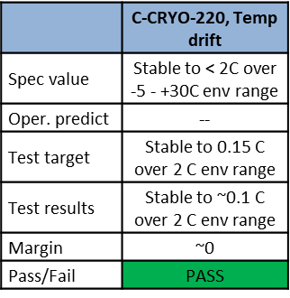
Analyses used for assessing budgets and changes
These budgets have been used in conjunction with system-level analyses which have been continuously updated since before the CD-1 Review:
  Integrated structural analysis model (NASTRAN)
  Integrated 3D CAD model (Solid Edge)
  Observatory optical model (Zemax)
  Camera lens and cryostat thermal models (ANSYS)
  Cryostat integrated thermal model (ANSYS)
Cryostat thermal modeling was used for developing test predicts and assessing verification test data for refrigeration system
Integrated camera structural model used for analyzing Utility Trunk stresses and deflections

Slide 29
Summary: integrated design and analysis
System-level budgets and analysis tools were developed early in the camera development cycle and remain an integral part of our means of technically managing the project
These tools have helped in assessing the impacts of changes to—and non-compliance with—camera and subsystem level requirements throughout the development process
As subsystem hardware is being delivered, we are now using these budgeting tools to track our compliance to high-level allocations by tracking the roll-up of as-built values of subsystem units

Slide 30
Subsystem Verification and Acceptance

Slide 31
Agenda: subsystem verification and acceptance
Technical reviews
Subsystem verification/acceptance process
Status on accepted subsystem units
NCR process and status

Slide 32
Review status and emphasis on safety
Technical reviews have provided a sound
structure to the development process for
the life of the project, for assessing
subsystem readiness
Transitioning to assembly, integration, and
test (AI&T), this has shifted towards process
and equipment reviews, emphasizing
personnel and equipment safety
Design reviews: ramped down considerably
Manufacturing reviews: held since 2016
Notice-to-proceed reviews:
  On-location safety reviews
  Authorizes first application of power for subsystem hardware testing
  NTP reviews held for every change in hardware configuration
Review Type | FY16 | FY17 | FY18 | FY19 (to date)
Preliminary Design Review, Test Definition Review | 3 | 5 | 2 | 1
Final Design Review, Equipment Procurement Review | 9 | 7 | 5 | 2
Manufacturing Readiness Review, Test Readiness Review | 6 | 5 | 5 | 4
Notice-to-Proceed Safety Review | 0 | 0 | 4 | 11
Integration Readiness Review | 0 | 0 | 2

Slide 33
Hazards analysis remains a focus
Recently, we have sharpened the focus on protection and process control by re-scrubbing camera and subsystem hazards with an emphasis on operating and support hazards and protection system functionality
LCA-15, “Camera Hazard List” was developed and originally delivered at CD-1 in draft form
  We updated this for CD-2 and CD-3, as well as at every major subsystem review, to ensure that hazards and controls remained current as the design evolved
  This included complete scrubbing of the entire list prior to CD-2 and the Camera FDR
  We completed a third complete scrubbing process early in FY19
    This includes all post-FDR subsystem changes to hardware
    We are particularly emphasizing operating and support hazards
  Now, all hazards and controls go through a final update prior to Acceptance Reviews
Planning for safe manufacturing and operations remains a core piece of every review
  Hazards and controls are addressed at every design review
  Work planning and control, operations and support hazards a particular focus at MRRs, TRRs

Slide 34
Acceptance and pre-ship reviews
We complete the equipment review process as subsystem units are being completed, tested, and queued up for delivery to I&T
Acceptance reviews
  These are held to walk through the results of all verification activities associated with the unit being delivered
Pre-ship reviews
  I&T convenes this review, to ensure that all processes, equipment, and space are in place to ship and receive the unit
  This is done even for hardware units at SLAC, to ensure that the transfer of responsibility from the subsystem to I&T is understood and nothing gets lost in the transfer

Slide 35
Acceptance materials are clearly delineated
Requirements verification matrix
  Verification Test Plan which lists verification evidence and links to the evidence (reports, data sheets, …)
  Includes verification of subsystem requirements and those from Camera Plans and Standards
  Also includes verification of subsystem interfaces, using test crates, stand-alone CCS modules, and inspection as appropriate to the subsystem
Hazard mitigation verification
  Verifies that all applicable hazards identified in the Camera Hazard List and the Camera Hardware Protection Protocol List have been mitigated
Operations and Maintenance procedures
  A complete set of all procedures needed to operate and maintain the delivered assembly
Completed Assembly and Test procedures
  Completed assembly and test procedures for the hardware/ software being delivered
Updated drawings and schematics
  Bill of materials and a complete set of approved part and assembly drawings for the delivered assembly
Closure of Requests for Action
  Evidence of closure for all related requests for action from past reviews

Slide 36
Subsystem unit acceptance
Unit acceptance preparation is in progress for all subsystems, with emphasis on upcoming near-term deliveries
  All but 2 Verification Test Plans are complete, with testing on-going for multiple units
The timing of deliveries is governed by subsystem scheduling

Slide 37
Status of subsystem unit acceptance and delivery
Following is a quick update on subsystem components that have already been accepted and delivered to I&T
We also have talks prepared to provide status on subsystems with components that are still in the works, including:
  DAQ, CCS
  Filter Exchange System, Camera Body and Purge, Shutter, Optics, Utility Trunk

Slide 38
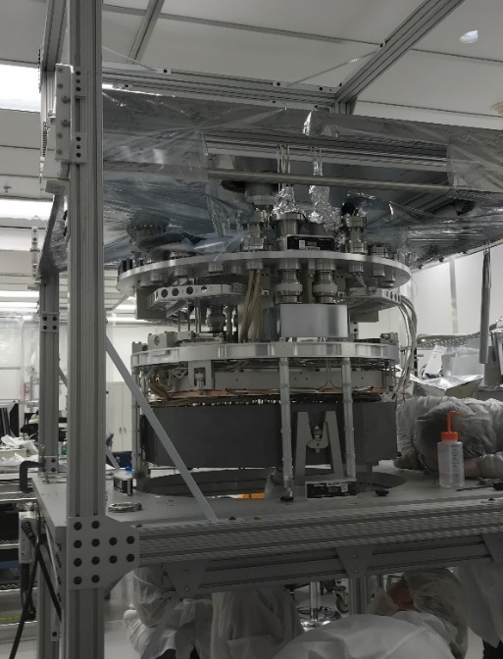
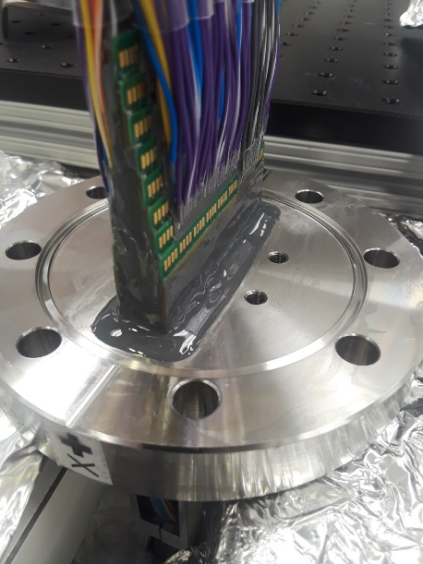
Cryostat
Cryostat is complete and was accepted in late 2018
It was integrated into the Bench for Optical Testing (BOT) and remains the focus of most I&T activities
Over the past 6-9 months, final and test-integrations of subsystem hardware have verified many cryostat interfaces
  L3 Optical Flat
  Raft tower modules: mechanical
  test rafts and engineering test units
  Optical transition module
  feedthroughs
  Vacuum pump plate
Power feedthroughs are completed,
tested, and installed in the cryostat
Power feedthrough detail
Cryostat internals prior to final integration step

Slide 39
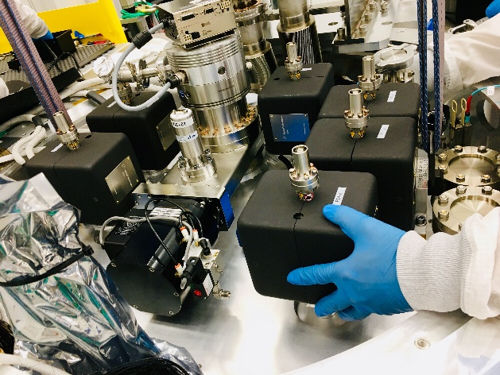
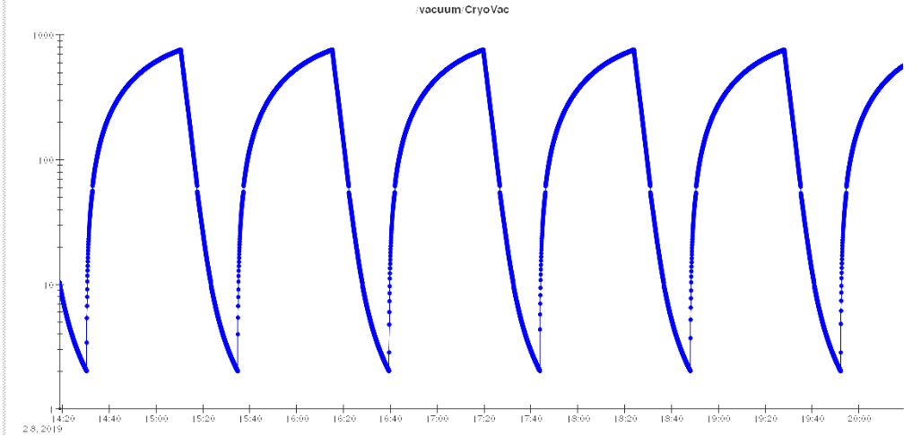
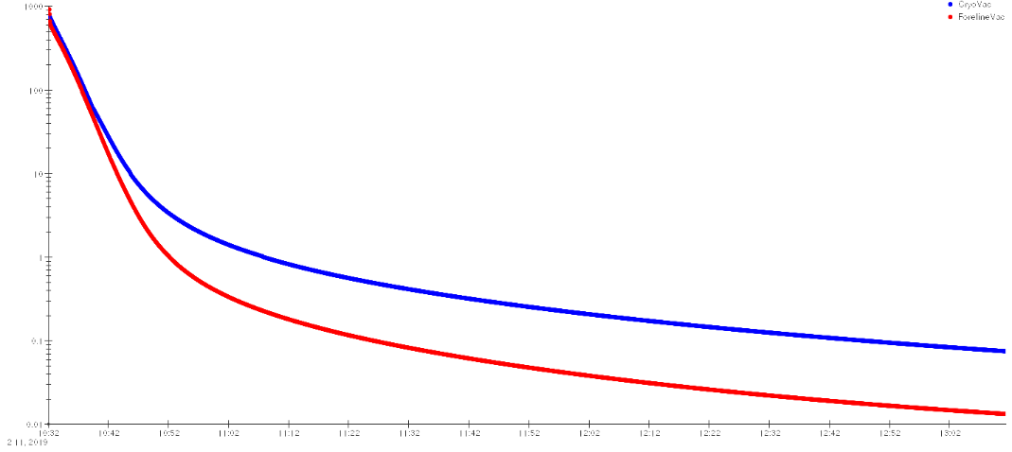
Cryostat vacuum system
The cryostat pump plate was completed and accepted Nov 2018
The vacuum system performs well, and experience gained has been
incorporated into standard operating and maintenance procedures
  Pump/purge system to quickly dry out the cryostat contents
  prior to pumping down with the turbo
  Vacuum pump-down, ion pump operation, and venting
  (Protection PLC logic and protocols were fully tested)
Cryostat pump plate
CCS vacuum plot of pumpdown
CCS pressure plot of pump/purge cycling

Slide 40
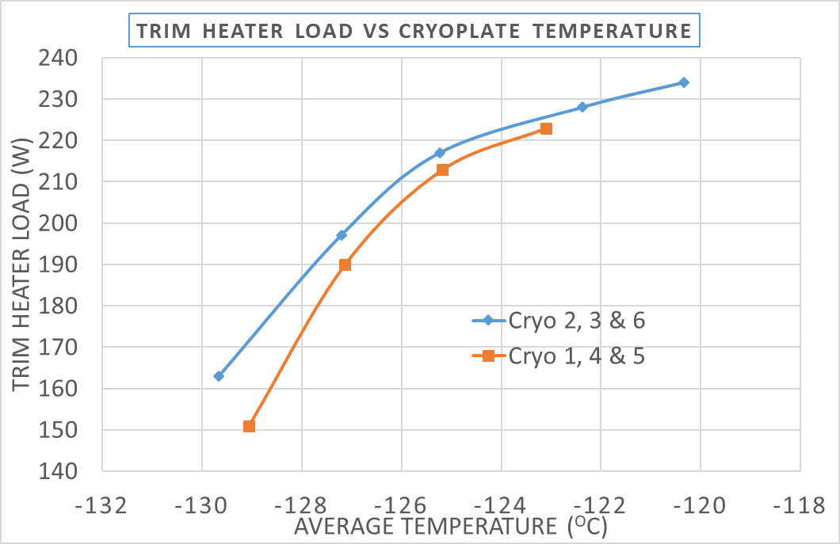
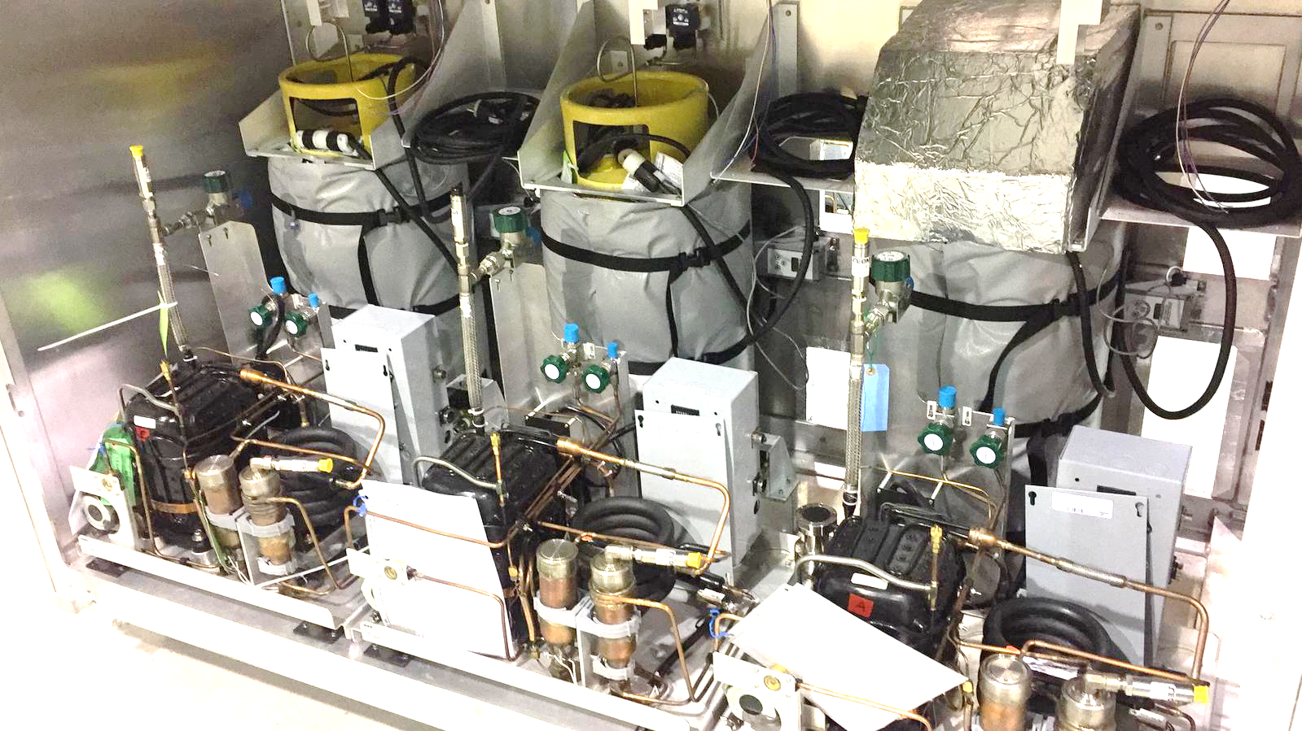
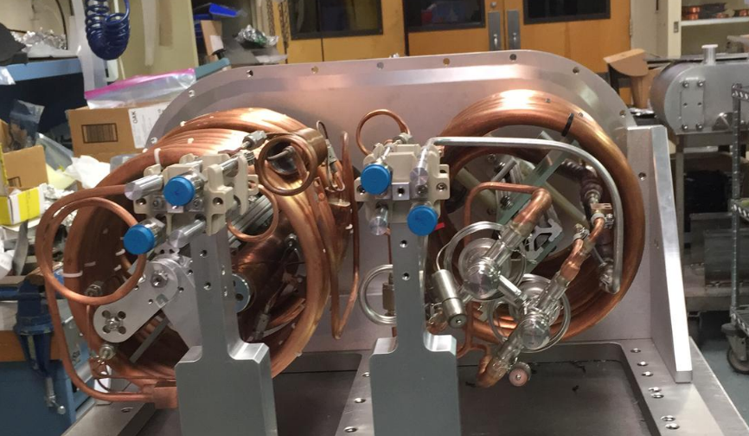
Refrigeration system
Refrigeration system for I&T use was completed and tested in June, 2018
Tests demonstrate that both cryo and cold systems operate with margin on their needed cooling capacity
I&T cryo compressor cabinet
I&T heat exchanger

Slide 41
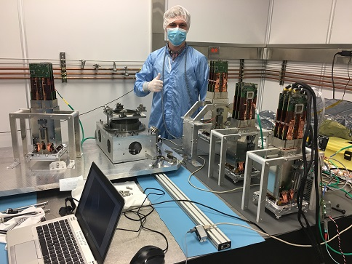
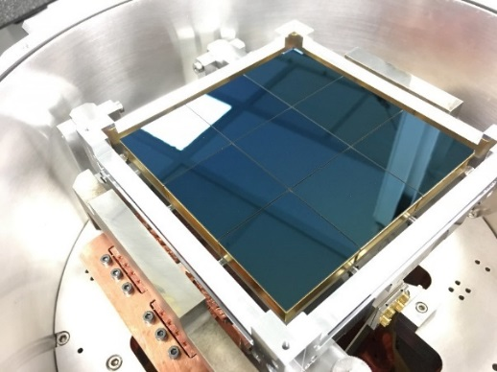
Science raft towers
22 science rafts have been accepted and delivered to SLAC
Raft and raft tower cleaning is nearing completion, ahead of the scheduled need-dates for integration
  Remaining cleaning scope is fully transferred to I&T subsystem
Completed raft towers under test
Raft with e2V sensors in test stand

Slide 42
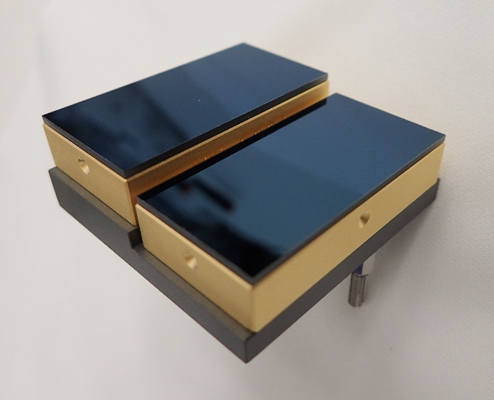
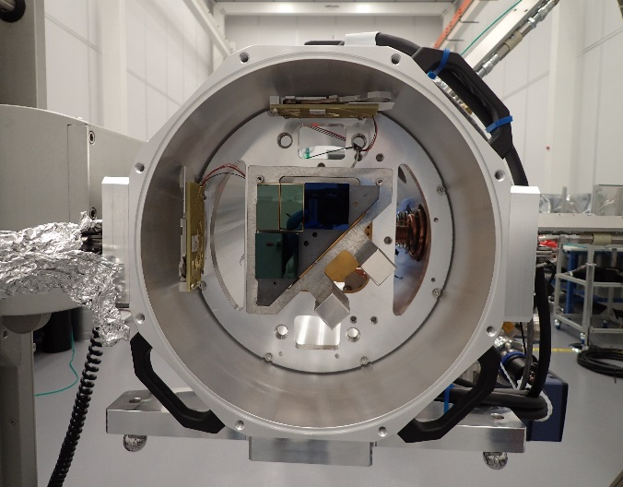
Corner raft towers
Corner raft assembly is complete at SLAC
Final verification testing is underway now
Planning for an acceptance review is in the works now
Wavefront sensor stepped stack
Corner raft tower module in test stand

Slide 43
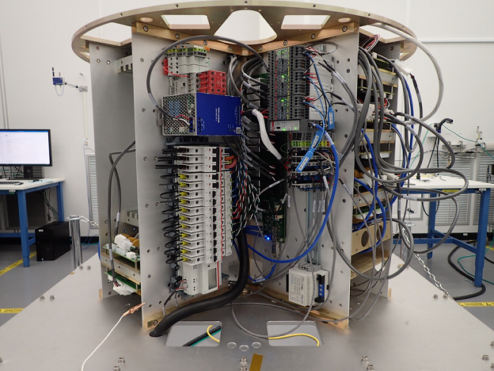
Auxiliary electronics
Auxiliary electronics were assembled in the Quad Box and largely completed
Aux Electronics team has also provided support for developing functionally-equivalent test stands for subsystem hardware testing
  Vacuum system pump plate
  Refrigeration system
  Purge system
  Shutter
  Power feedthroughs
Verification testing is complete and Acceptance Review is imminent
Quad box loaded with system electronics components

Slide 44
Non-compliance reporting
Non-compliances are captured and dispositioned using the camera eTraveler system
Hardware level NCRs are generated for:
  In-process non-compliances: assembly or test errors
  Test failures: verification test anomalies or failures requiring re-work or changes
  Non-compliances affecting interfaces: including impacts, if any
In addition, we also generate so-called “system-level” NCRs to capture:
  Accepted waivers: captures that a non-compliance has been addressed with a waiver
  Delayed or postponed work: flags an area where further work is needed, possibly after delivery or when a mating component from the same subsystem becomes available
  Verification shortfalls: identifies known holes in unit verification with the agreed-to course of action

Slide 45
NCRs and the acceptance process
Hardware NCRs have typically already been addressed and closed out by the acceptance review, but can also be re-visited or closed then
If a potential system-level non-compliance is identified during the review (accepted waivers, delayed or postponed work, or verification shortfalls) then a technical resolution and path forward is discussed with appropriate stake holders
Once a solution is agreed upon, an NCR is generated to capture the approved path forward
The NCR is approved and recorded within the verification matrix, after the Acceptance Review, but before the Pre-Ship Review
At shipment, I&T accepts responsibility to close all remaining open NCRs associated with the hardware
25-Jul-2019 Snapshot of Camera NCR status

Slide 46
NCRs and risk posture
The NCR reporting and approval process also captures increases in risk due to the non-compliance
Some elevated risks are accepted by approving NCRs by using as-is
Other non-compliances are addressed, but a non-trivial residual risk remains of downstream impacts coming from the non-compliance
  The residual risks associated with these non-compliances are captured in the I&T risk registry and discussed at our Risk Review Board
  This is the arena where we balance any immediate impact and residual risk with the often diminishing returns of mitigating the non-compliance and the cost and schedule impacts
5 non-compliances have spawned such risks—all deemed to be low risk
  Guide sensor glows
  Lost #2-56 washer in the cryostat
  Shorted cold plate trim heater (1 out of 36)
  RTD/heater cable ground contact inside the cryostat
  Residual particulates on the cryostat front float shroud

Slide 47
Summary: subsystem requirements verification
We have implemented a clear, yet flexible process for verifying units prior to delivery, and an acceptance and pre-ship mechanism to reduce the risk of something falling through the cracks
This process is being used now, as subsystem units are verified, accepted by the project, and delivered to I&T
Non-compliance reporting is being used for tracking hardware fabrication and testing issues, but also to capture verification process shortfalls and subsequent hardware dispositioning as well as increases in risk posture going forward

Slide 48
Camera Verification

Slide 49
Agenda: camera verification
Status of camera verification planning
Flowing verification up to LSST

Slide 50
Camera verification planning is well advanced
LCA-283, Verification Test Plan has been in development since 2011
This defines
  The method planned for verifying every requirement and interface in LCA-48, the Camera Spec.
  A description of the test equipment and test process
  Expected data reduction to demonstrate compliance with requirements
It also served as the jumping off point for defining performance requirements for key test equipment and processes
  55Fe ring
  Bench for optical testing (BOT)
  Camera calibration optical bench (CCOB) thin- and wide-beam projectors
  Focal plane metrology system
  Camera survey and alignment
All are complete and validated, and in support of electro-optical testing in the cryostat

Slide 51
Requirements verification flow-up
As subsystem hardware is ready to be accepted, the subsystem lays out the process for—and evidence of—all requirements that have been verified
  This is reviewed and accepted by the I&T group, system engineering, project management, and the project scientist
  For I&T, accepting the hardware also means accepting:
    All data and measurements associated with subsystem requirements verification
    All risks associated with any requirements not fully (or yet) verified
    All hazards and controls associated with the hardware
For ~35% of the camera requirements, verification is being performed at the subsystem level
  The camera team relies on the lower level verification evidence, recognizing its applicability in verifying higher-level camera requirements
  Many of these requirements involve sensor and optics performance parameters—these are thoroughly tested on subsystem hardware testing, but cannot be repeated in the camera assy

Slide 52
Re-verification and interface closure
I&T testing also serves to re-verify requirements, either intentionally or incidentally
  These tests have been developed in conjunction with subsystem leads
  There has already been a focused effort with subsystems to work through any discrepancies in test processes, equipment, and results
  This re-verification process is going on now with science raft towers that are delivered to I&T, then re-verified
Integration and testing of camera hardware also involves closing out interfaces when hardware from multiple subsystems is married together
  Subsystem interface requirements are among the requirements being verified prior to delivery, but the interfacing components are actually brought together during the integration process
  In general, our goal is to capture possible interface problems early, flag them as risks, and work at the subsystem level, with I&T, to address them

Slide 53
Flowing verification up to LSST
Our model parallels our subsystem delivery mechanism
  Finalize verification plans, and get approval and buy-in on the process and data to be generated
  Complete verification activities, and develop short reports for each class of requirement
  Develop verification evidence sheets to capture this
We are working with LSST S.E. to map this process into their plans for capturing verification processes in MagicDraw

Slide 54
Summary: camera verification planning
The camera S.E. and I&T teams have been working together since CD-1 to develop and flesh out details of camera verification plans and test processes
I&T test equipment has been developed and validated with a clear understanding of test needs, to ensure that they are ready to execute full-system testing as the camera starts coming together
Work continues with the LSST S.E. team with a goal of smoothly transitioning camera verification activities

