Slide 1
LSST Camera
Optics Sub-System Status
Justin Wolfe
LSST Camera Optics Sub-System Manager
NSF/DOE Joint Status Review
August 27-30, 2019

Slide 2
Outline
Introduction and Scope
Technical Status
Recent Accomplishments & Notable Outcomes
  Recent Accomplishments and Technical Status
  Verification and Validation Activities
  Remaining work and Challenges
Risks and Mitigations Status
Hazards
Programmatic Status
  Organizational Structure
  Cost and Schedule Performance Status
  Upcoming Major Milestones
Summary
Supporting Material
  Key Documents
  Past Review recommendations
  BCR summaries

Slide 3
Introduction and Scope

Slide 4
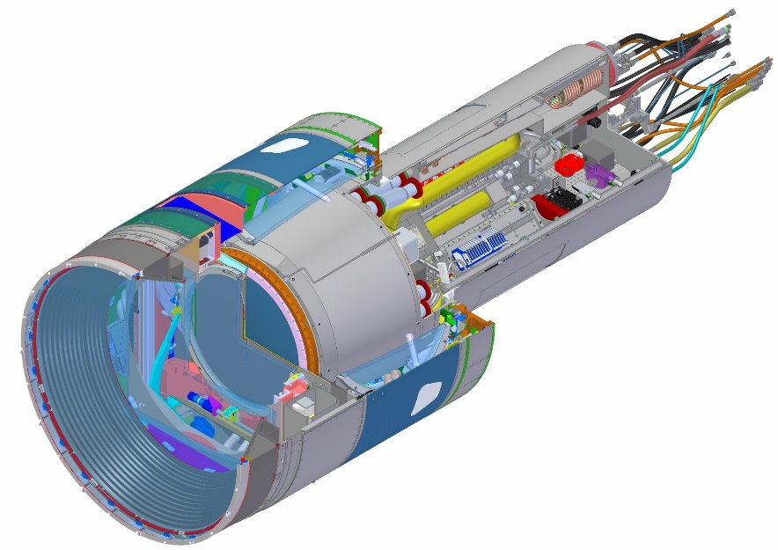
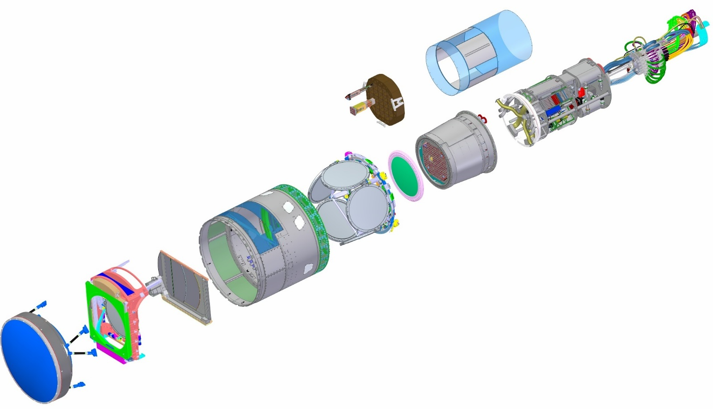
Major Camera Elements
WBS | Baseline ($K) | % complete
3.06.05 Utility Trunk | $1,385 | 69%
WBS | Baseline ($K) | % complete
3.04.02 Corner Raft Tower | $7,064 | 99%
WBS | Baseline ($K) | % complete
3.04.01 Science Raft Tower | $17,507 | 99%
WBS | Baseline ($K) | % complete
3.03 Sensors | $34,011 | 100%
WBS | Baseline ($K) | % complete
3.07.02 Aux Electronics | $2,298 | 100%
WBS | Baseline ($K) | % complete
3.06.01 Camera Body | $2,395 | 95%
WBS | Baseline ($K) | % complete
3.06.04 Cryostat | $16,394 | 98%
WBS | Baseline ($K) | % complete
3.06.02 Shutter | $3,030 | 90%
3.05.04 L3 Lens Assembly
3.05.02 Filters (6)
WBS | Baseline ($K)
3.06.03 Filter Exchange System | Contributed
WBS | Baseline ($K) | % complete
3.01 Management | $15,225 | 90%
3.02 Systems Integration | $9, 308 | 91%
3.05 Optics | $28,094 | 87%
3.07.01 Control System | $5,055 | 89%
3.07.02 Data Acq Sys | $5,688 | 93%
3.08 Integration and Test | $12,847 | 76%
TOTAL | $158,103 | 92.8%
3.05.03 L1-L2 Lens Assembly

Slide 5
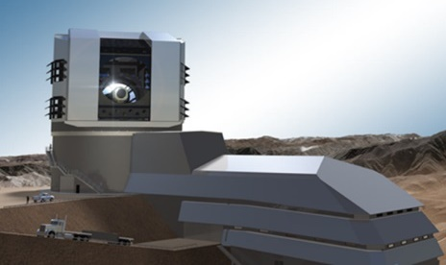

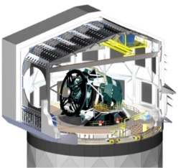
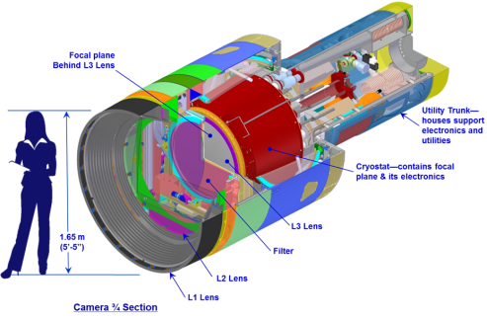
Optics Subsystem is responsible for three major Camera components: the L1-L2 Assembly, L3 Assembly and Filters
Telescope Site
3.05.04 L3 Lens Assembly
3.05.02 Filters (6)
3.05.03 L1-L2 Lens Assembly
Camera

Slide 6
Recent Accomplishments & Notable Outcomes

Slide 7
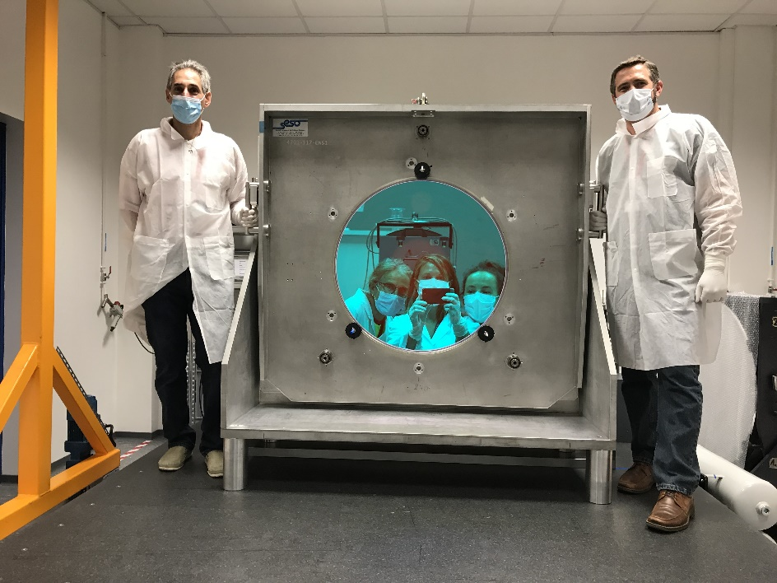
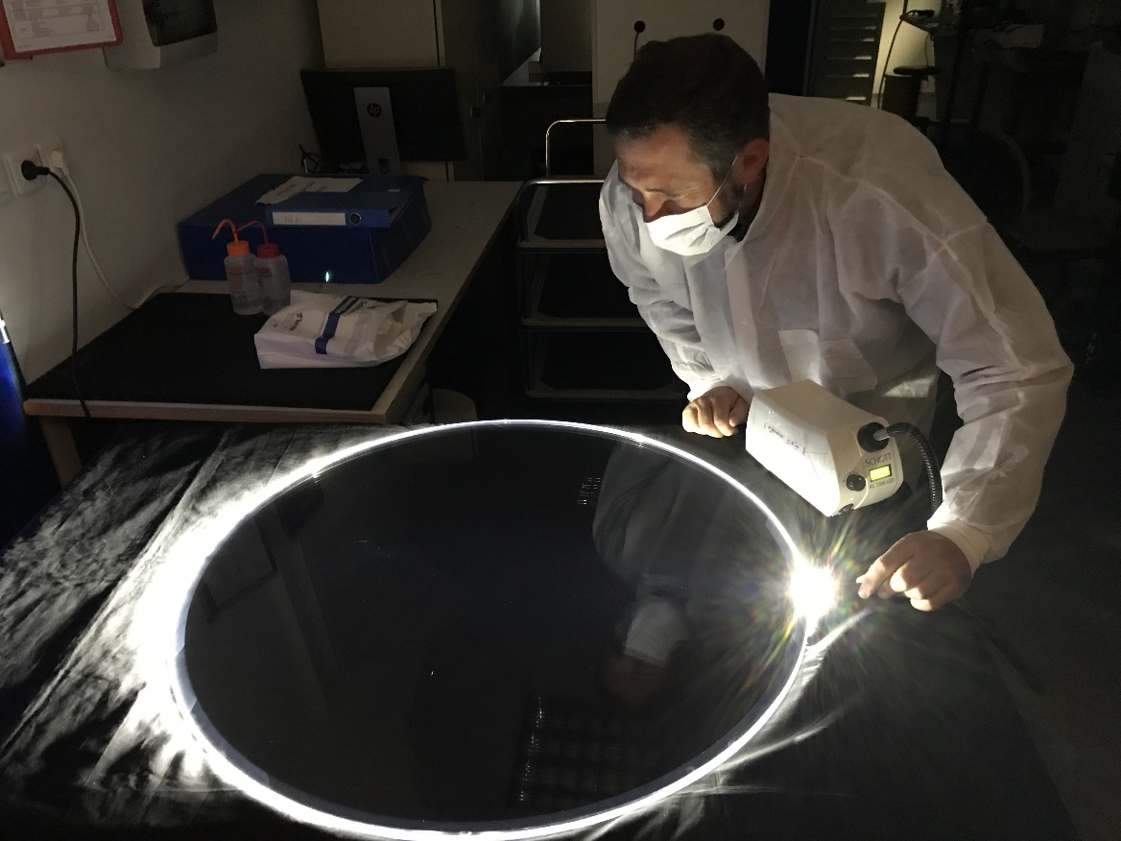
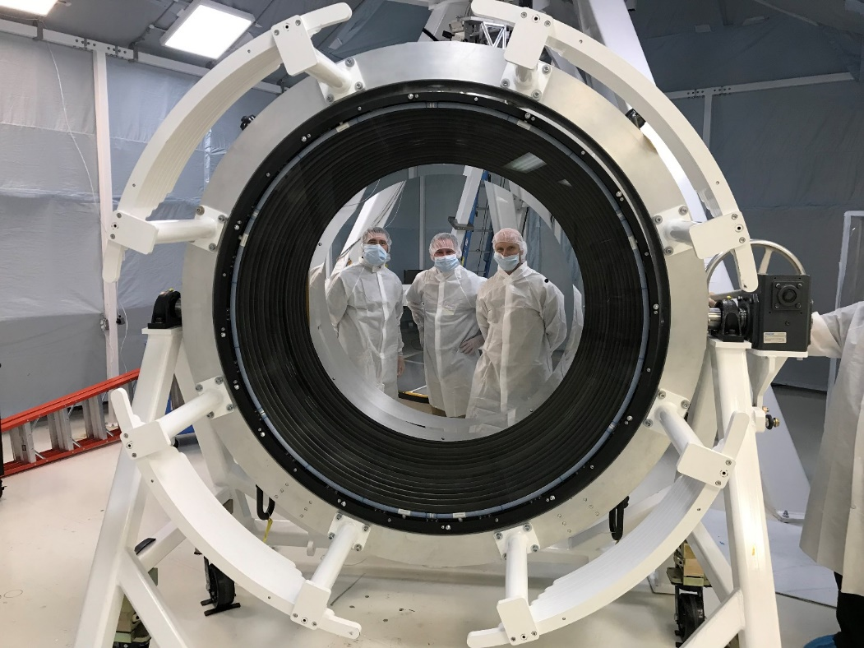
Optics Progress in 2018-2019
Wavefront testing of r-band coated filter
L1 and L3 Broad Band AR coating complete (L2 in early 2018)
L1-L2 integration, assembly, and testing complete
L3 integration and testing complete
r-band and i-band filter substrates have been received
r-band filter coating has been applied
z-band filter inspection
z filter inspectio
L3 TWE Testing
L1/L2 structure inspection

Slide 8
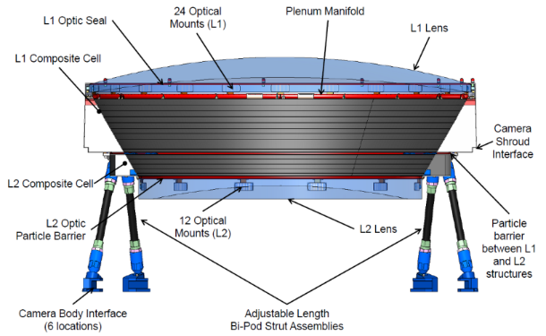
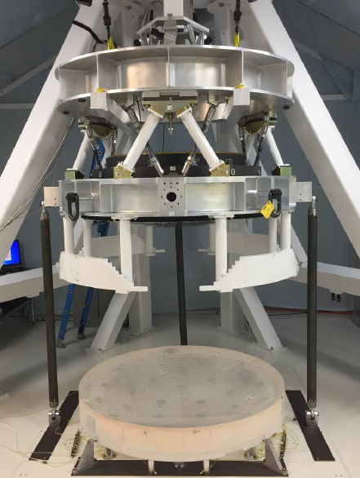
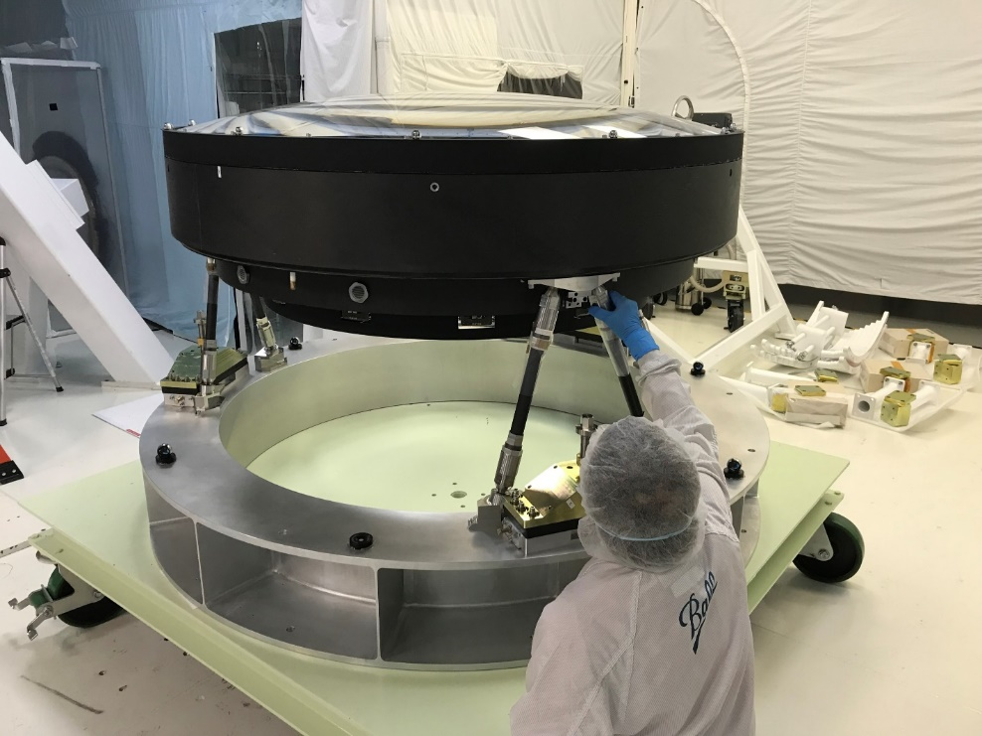
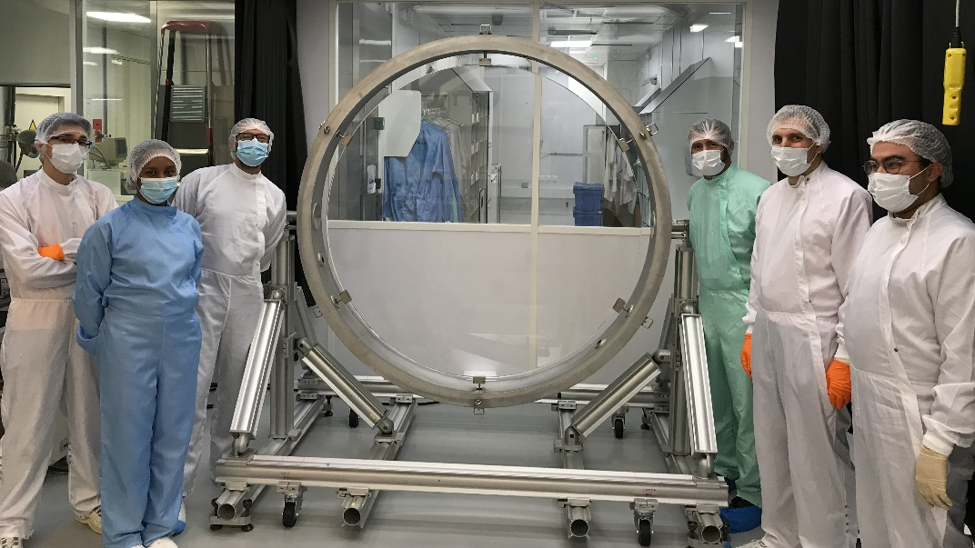
L1-L2 Assembly design/fabrication status
L1-L2 fabrication and integration is complete
  L1-L2 assembly is ready for shipment from Tucson
L1 Coating was completed in late 2018
L1 Bonding was completed in Feb 2019
L1-L2 alignment and testing was completed in June 2019
L1/L2 Assembly undergoing
final TWE test
BATC
L1 ready for Coating
Adjusting Bi-pod Struts
Notes:
8

Slide 9
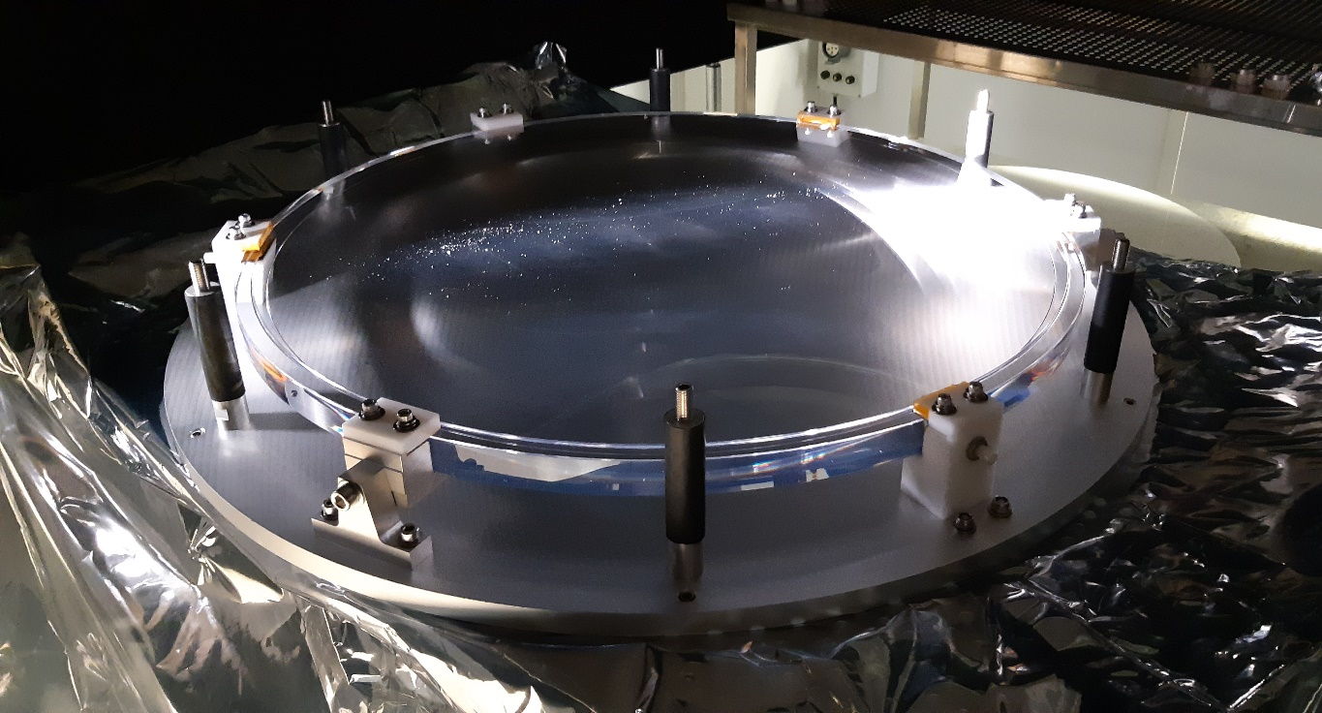
L3 Assembly design/fabrication status
L3 fabrication and integration is complete.
  Components are ready to ship following acceptance and return from holiday in France
L3 BBAR coating completed in
L3 assembly completed in July 2019.
  Wavefront performance meets requirements after mounting
L3 vacuum and safety test completed in July 2019
L3 assembly prepared for measurement
L3 assembly in optical testing
L3 at coating vendor
Test Window in Inspection
L3 assembly under thermal vacuum test

Slide 10
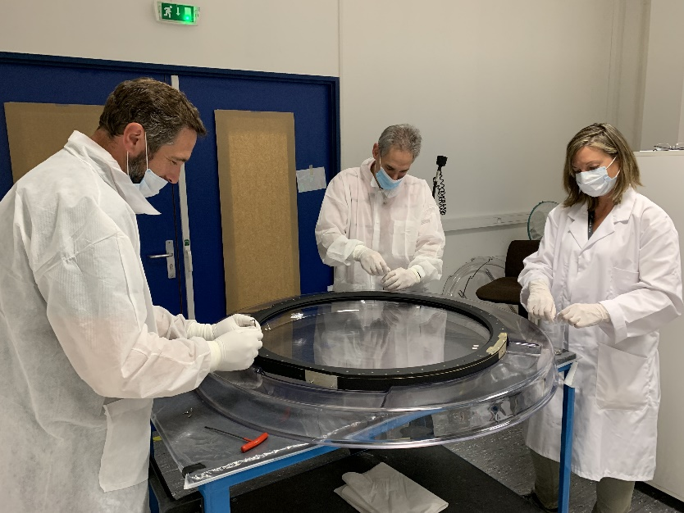
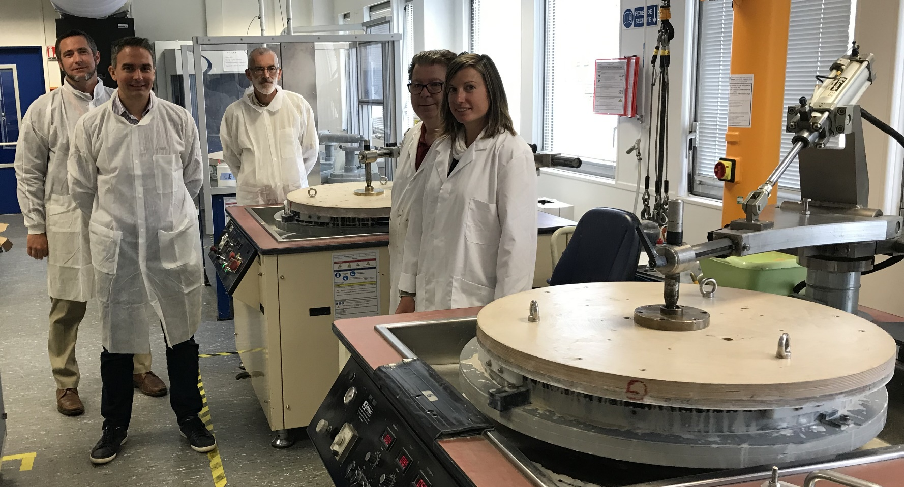

Filter Substrate Fabrication Status
r and i filter substrates have been received.
  All filter substrates have met imaging performance requirements
z filter substrate fabrication has been completed.
y filter substrate is in final polishing steps
u and g filter substrates are in polishing and proceeding very well. (These are the easiest).
All frame mounting hardware has been received
Mounted wavefront testing showed mounting
does not notably alter wavefront performance.
Testing i band filter in mount
Polishing of u and g band filters
z filter inspection

Slide 11
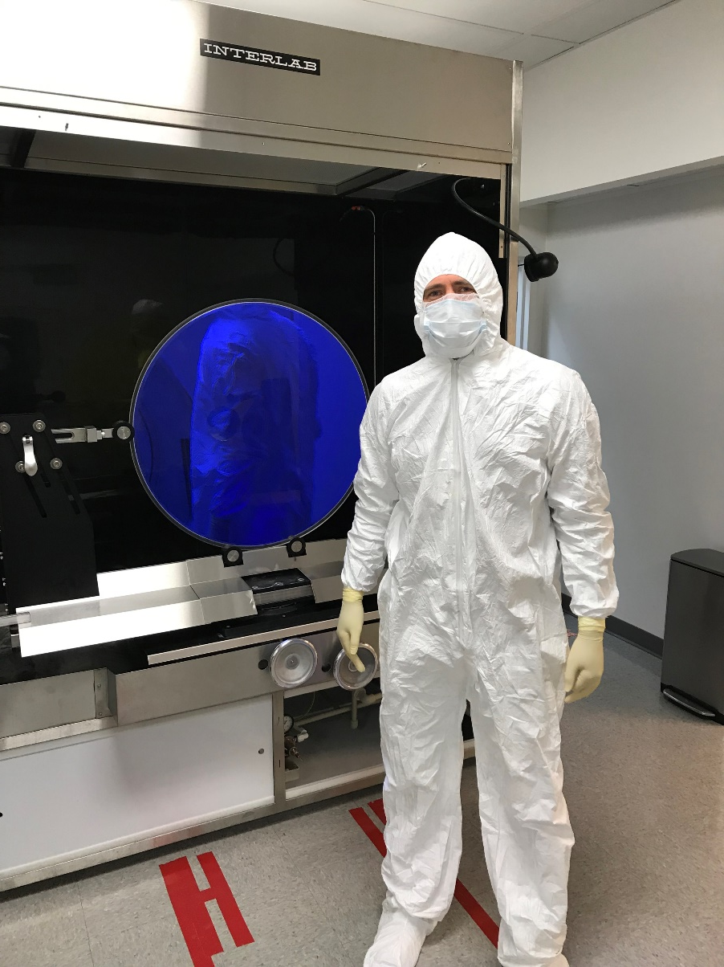
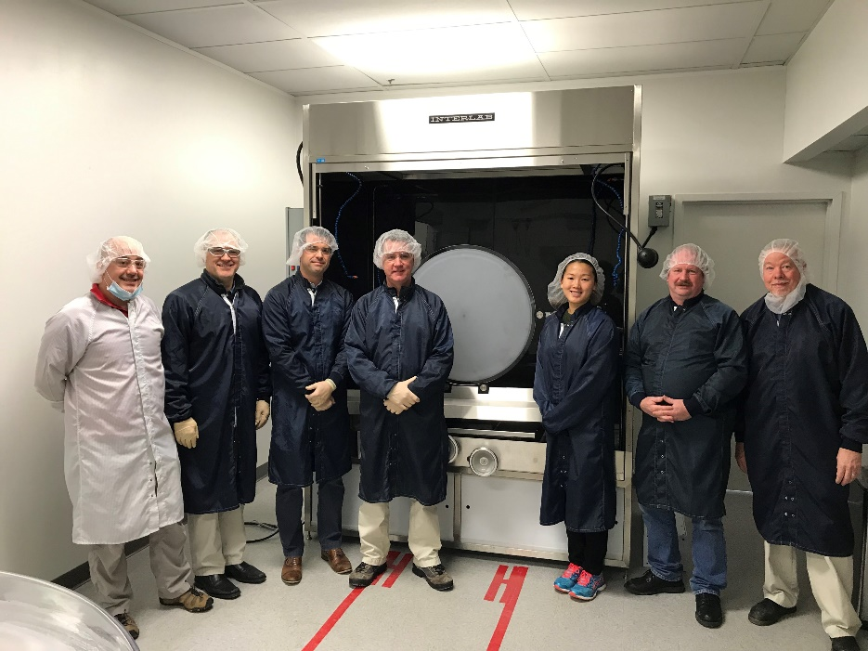
Filter Coating status
First article filter (r-band) coating completed on 3/29/2019
  Spectral performance is good. (Full aperture measurement is still in process). Delayed due to system instability and to make wavefront measurement.
Final sub-scale samples (u-band) completed in January February 2019.
Dry runs of all handling and cleaning steps were completed.
Spectral Measurement System (for measuring full aperture performance) is in place but not yet qualified.
Inspection of r band filter after coating
Sub-scale sample performance
Witness samples
Materion Coating chamber

Slide 12
Risks and Mitigations

Slide 13
Definition of Risk and Risk Analysis
Risk can be defined as an undesirable event during project execution that negatively affects program goals for performance, cost or schedule.
Risk management is the ongoing process of comprehensively assessing project risks.
Camera Risk Management Plan (LCA-29-A) defines the methodology to manage our risks
Definition of Risk Probability
Pts | Likelihood of Occurrence | Approximate Probability | Description of Probability
1 | Rare | <1% | Likelihood of occurrence is not credible
2 | Unlikely | 1-5% | Not reasonably expected to occur
3 | Possible | 5-25% | Possible, or difficult to assess the chance of occurrence
4 | Likely | 25-67% | Very likely that an adverse event will occur
5 | Highly Probable | >67% | High probability that an adverse event will come to pass
Definition of Risk Impact
Pts | Severity of Impact | Description of Impact
Cost Impact
1 | Insignificant | Overrun of cost of < $30K, recoverable with project contingency
2 | Minor | Overrun of cost of $30k - $200K, recoverable with project contingency
3 | Moderate | Overrun of cost of 200k - $1.5M, with significant impact on contingency
4 | High | Overrun of baseline cost of $1.5M - $10M, with re-baseline required
5 | Critical | Overrun of baseline cost of >$10M, with project in jeopardy
Schedule Impact
1 | Insignificant | Degradation of schedule margin to project critical path by < 2 wks
2 | Minor | Degradation of schedule margin to project critical path by 2 wks to 1.5 months
3 | Moderate | Degradation of schedule margin to project critical path by 1.5 to 3 months
4 | High | Degradation of schedule margin to project critical path by 3 to 6 months
5 | Critical | Degradation of schedule margin to project critical path by > 6 months
Performance Impact
1 | Insignificant | No effect on ability to meet requirements; minor design changes needed
2 | Minor | Minor excursion from subsystem requirement, but compensated elsewhere
3 | Moderate | Level 2 and/or SRD design specification exceeded
4 | High | Level 1 and/or SRD minimum specification exceeded
5 | Critical | Unable to achieve any of the primary science missions
→Quasi-quantitative process to assign objective values to probability of occurrence and impact of occurrence aspects of risk.
Total Impact:
(0.50*Cost Impact) + (0.33*Schedule Impact) + (0.33*Performance Impact)
→Risk Score:
Risk Probability * Total Impact

Slide 14
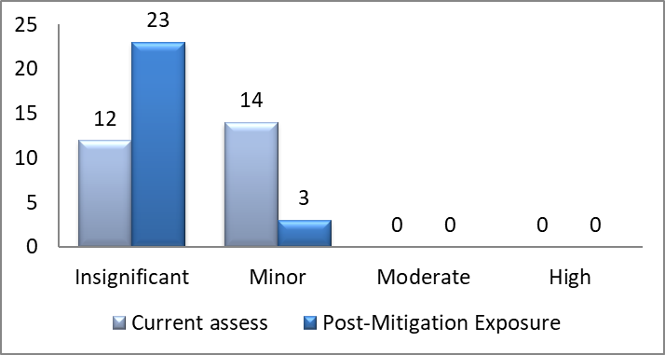
Standardized risk management processes are used to manage CB&S risks
Risks are tracked in the Camera Risk registry, Document LCA-29
Risk exposure is assessed and tracked at regular intervals since 2010 (initial assessment)
Actively planning mitigation to burn down risks and monitor progress
  Current status: total risks identified
    26 risks are actively being mitigated
    19 are closed or accepted due to design changes or mitigation completion
Mitigations are budgeted in the scope of work
After budgeted mitigation (Post-Mitigation) is performed, residual risk is analyzed
Selected top risks are shown below:
Opt-025: Filter coating failure (Minor Risk)
  No filter coating runs have failed to date.
  Full test runs are performed before each coating
Opt-020: Filter metrology system qualification (Minor risk)
  Verification testing is underway.
  System has demonstrated all requirements, working on stability and bug elimination.
Opt-026: Filter breaking during fabrication
  Handling at TSESO is reviewed every time we visit.
  3 optics are finished with handling at TSESO and the other 3 are in the lowest risk stages.
Opt-039: Filter delivery (Minor Risk)
  First article substrate and coating are complete
  All substrates are progressing well

Slide 15
Optics top 10 risks as of May 2019
Risk Title | Risk Description (if/then) | Prob ability | Cost | Schd | Perf | Current Exposure | Prob ability | Cost1 | Schd1 | Perf1 | Residual Exposure
Filter Coating Failure | IF a filter coating run fails THEN the filter coating will not meet all specifications | 3 | 2 | 4 | 3 | Minor | 2 | 2 | 4 | 3 | Minor
L3 Position | IF the L3 frame does not hold the optic in place to required levels THEN the image quality may suffer | 3 | 3 | 3 | 2 | Minor | 1 | 3 | 3 | 3 | Insignificant
Filter delivery | IF Filters are delayed during production, THEN schedule and cost impacts will be incurred. | 4 | 2 | 3 | 1 | Minor | 4 | 2 | 3 | 1 | Minor
Filter coating metrology | IF the filter coating vendors do not have the metrology needed to conduct verification needed (in particular in out-of band) THEN we may not know how the filter performs until in operation | 3 | 2 | 3 | 3 | Minor | 1 | 2 | 5 | 3 | Insignificant
Filter coating damage due to stress | Stress on the filter may damage the coating in the form of delamination or micro-cracks | 2 | 4 | 4 | 3 | Minor | 1 | 3 | 4 | 4 | Insignificant
Lens BBAR coating damage due to stress | Stress on the lenses due to pressure may damage the BBAR coating in the form of delamination or micro-cracks | 2 | 3 | 4 | 4 | Minor | 1 | 4 | 4 | 4 | Insignificant
L1-L2 composite structure | IF L1-L2 composite structure has structural aging issues THEN image quality could be impacted half way through the survey (lifetime issue) | 3 | 2 | 2 | 3 | Minor | 1 | 2 | 2 | 3 | Insignificant
L3 pressure null test | IF the L3 lens wavefront test does not properly account for "test" versus "use" conditions, THEN it may degrade the camera image quaility. | 3 | 2 | 2 | 3 | Minor | 1 | 2 | 2 | 3 | Insignificant
L1-L2 settling time and acceleration loads | IF the L1-L2 response is not fully understood THEN L1-L2 may not settle in time for proper image quality performances | 2 | 3 | 4 | 3 | Minor | 1 | 3 | 4 | 3 | Insignificant
Filter O-ring compression set | IF the filter o-ring takes a larger compression set than estimated, THEN the filter may move outside of its positional requirements and potential damage the Filter. | 3 | 2 | 1 | 3 | Minor | 3 | 1 | 1 | 2 | Insignificant

Slide 16

Optics Key Risks Retired/Accepted
  Opti-021: IF the single witness sample vendor selected does not meet specifications in their planned iterations THEN the cost and/or schedule and/or performance may be impacted.
    Vendor demonstrated all bands on sub-scale samples
  Opt-037 IF coating run yields a poor performing coating, THEN there will be schedule/cost/performance impacts.
    All BBAR coatings are complete and perform well
  Opt-014: IF L3 fabrication is more expensive/longer schedule than baselined THEN the project may not have enough contingency to complete the work on time and budget
    L3 is complete on budget and will be delivered prior to need date.
  Opt-038: IF lens is damaged during the coating period, THEN schedule and cost impacts will be incurred
    All lens coatings are complete with no damage.
Opt-028: IF L3 (L1, L2) can not be coated within the 6 month schedule winodw. THEN L3 (L1, L2) coating maybe delayed and additional costs incurred.
    L3 completed in a timely fashion

Slide 17
Hazards

Slide 18
Hazard Analysis
Hazards can be defined as a failure of a component, system or function that could lead to personnel injury or damage to hardware.
  Hazards are NOT risks.

Slide 19
Hazards are fully identified and mitigated
Type | Title | Hazard Description | Severity | Probability | Risk Value | Risk Category | Mitigation Strategy | Mitigation Description | Severity1 | Probability1 | Risk Value1 | Risk Category1 | Verif Method | Verification Plan
Struc | Filter glass fracture | Damage to filter glass due to loads imparted on it during a hand-off of the exchange system | 3 | D | 14 | Medium | Control hazard | Design Filter frame to prevent overstress - Frame interfaces to carousel and changer truck are very close, so any overload would not affect the filters; switches prevent out-of-sequence actuation that would lead to an overload | 3 | E | 17 | Medium | Test | Test switches to ensure protection; analyze frame at max overload force
Therm/Cryo | Excessive raidative cooling of L3 lens | If the radiative cooling off of L3 were significantly more than predicted, the lens may cool down, Ultimately, embrittling the glass or causing thermal contraction beyond the range of accommodation of the perimeter gasket. In either case, this may generate stresses in the glass above allowable limits which could ultimately result in failure | 1 | E | 12 | Medium | Eliminate hazard | Analysis of the black-body radiative cooling, which is the maximum radiative heat transfer possible, shows only slightly more cooling than the nominal condition. Thus, we are already designing for near-worst-case conditions, and even the worst-case temperatures possible do not pose a hazard to the lens | 4 | E | 20 | Low | Review | 1-Assure thermal modeling of L3 assembly design for extremes of temperature and pressure. 2-Test at operational temperatures and pressures
Matl's | Damage to sixth filter in storage | If the off-camera filter is not stored in a controlled environment, then it could be scratched or its coating irretrievably damaged | 3 | C | 11 | Medium | Control hazard | Store off-line filter in the Manual Changer under a purge to physically and environmentally protect it | 3 | E | 17 | Medium | Audit | Check that Manual Changer use and storage procedures are used
Press/Vac | Compromise of L2-L2 shipping container during transport | If the L1-L2 shipping container is subject to low external pressures during transport by air, then the pressure differential could damage the container | 3 | C | 11 | Medium | Safety device | Install a pressure-relief valve on the L1-L2 shipping container to moderate pressure differences during flight | 3 | D | 14 | Medium | Inspection | View installed PRV on container
Struc | L1-L2 Assembly strut failure | Buckling or structural failure of a strut tube, either due to overloading of the CFC tube or de-bonding or shear failure at the adhesively bonded end fittings | 2 | D | 10 | Medium | Control hazard | Design strut tube with large factor of safety in accordance with Mech Standard LCA-280 against buckling for operational and handling loads | 2 | E | 15 | Medium | Test | Acceptance test, Qual test and destructive test strut tubes; proof load test all struts
Top 5 Hazards

Slide 20
Integrated Safety Management practices are applied and hazards are tracked
Hazards are tracked in the Camera Hazard registry, Document LCA-15
Hazards are identified at regular intervals
There are currently 10 hazards in the hazard registry for optics
Highest hazards are related to the camera system controls
Risk Assessment Value | Mishap Risk Category | Acceptance Criteria
1-5 | High | Not Acceptable
6-9 | Serious | Require decision by LSST Project Office
10-17 | Medium | Require decision by Camera Project Manager
18-20 | Low | Acceptable without Review

Slide 21
Programmatic Status

Slide 22
Optics Organization (2018-2019)
Optics Sub-System Manager
Justin Wolfe
Filter Production
Simon Cohen
Filter Assembly and Integration
Francisco Arredondo
Contract Administrator
Angela Tanner
Mechanical Engineering
Jeremy Huckins
Optical Engineering
Brian Bauman

Slide 23
Optics Summary Schedule

Slide 24
Optics Performance as of May 2019
Control Account | BCWS | BCWP | ACWP | SV | SPI | CV | CPI
3.05.01 Optics Integration & Management | $2,146,712 | $2,146,712 | $2,030,860 | $0 | 1.00 | $115,852 | 1.06
3.05.02 Filters | $5,279,072 | $4,607,838 | $4,727,299 | ($671,235) | 0.87 | ($119,461) | 0.97
3.05.03 L1-L2 Assembly | $15,699,651 | $14,632,442 | $13,953,502 | ($1,067,209) | 0.93 | $678,941 | 1.05
3.05.04 L3 Assembly | $3,368,591 | $2,992,624 | $2,758,467 | ($375,966) | 0.89 | $234,157 | 1.08
Total | $26,494,027 | $24,379,617 | $23,470,128 | ($2,114,410) | 0.92 | $909,489 | 1.04

Slide 25
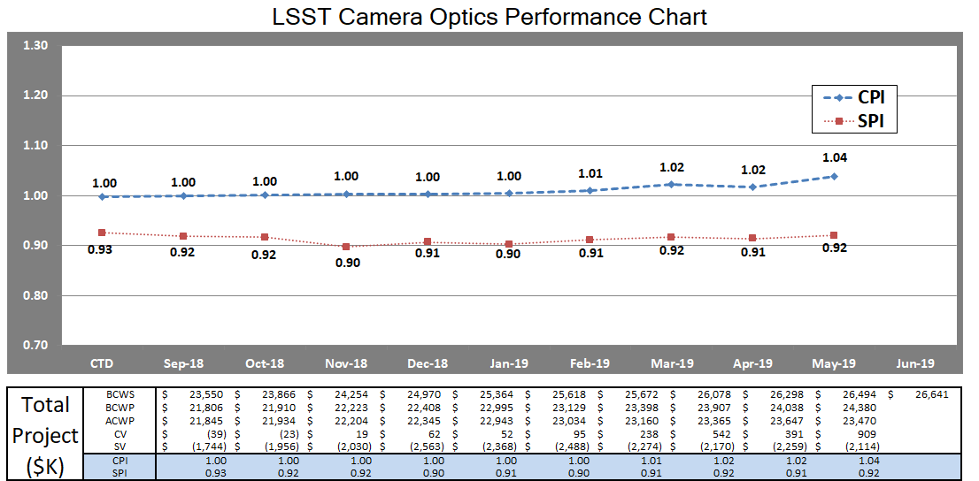
Optics performance trend
CPI is running high as resources have not been applied to Filters as the coating has been delayed due to SMS system delays.
Bump in CPI in May due to error in report from LLNL. Corrected in June.
Final delivery of L1/L2 assembly and L3 assembly in August will recover almost all schedule variance.

Slide 26
Optics Estimate to complete status
Comprehensive estimate at completion performed on 10/2018 (performed yearly)
No additional updates were done
Control Account | BAC | EAC | VAC | % Comp
3.05.01 Optics Integration & Management | $2,308,419 | $2,259,726 | $48,693 | 93%
3.05.02 Filters | $6,717,533 | $6,864,753 | ($147,220) | 69%
3.05.03 L1-L2 Assembly | $15,699,651 | $15,536,262 | $163,390 | 93%
3.05.04 L3 Assembly | $3,368,591 | $3,417,134 | ($48,543) | 89%
Total | $28,094,194 | $28,077,875 | $16,319 | 87%

Slide 27
Upcoming Major Milestones – 6 month look ahead
Milestones | Forecast Finish Date
3.05.02 Filter Assembly
COMP: Filter Coating - 1st Filter | October 16, 2019
COMP: 1st Filter Coated and Ready for Integration | November 27, 2019
3.05.03 L1-L2 Assembly
COMP: L1-L2 Assembly - I&T Phase 5 | July 31, 2019
3.05.04 L3 Assembly
COMP: Camera L3 Lenses Ready for I&T | July 29, 2019

Slide 28
Summary

Slide 29
Summary
An experienced team is available to complete the scope of work.
L1-L2 Assembly is complete and ready to ship
L3 Assembly is complete and ready for final review and shipment
Remaining Risks have been identified and are being actively managed.
Hazards are actively managed and reviewed for commissioning and operation planning
Budget and schedule are being managed and are consistent with project guidelines.

Slide 30
Supporting Material

Slide 31
Key Documents are Available on “Additional Docs” Tab in Confluence
Key Documents & Reviews for the corner raft subsystem can be found at (contact the camera point of contact for access):
  https://confluence.slac.stanford.edu/display/LSSTCAMREV/Home
This site contains:
  Project Documents
  Design and Allocated Baseline Documents
    Specifications
    ICDs
    Design Documents
  Cost and Schedule Baseline
  Design Reviews & Relevant Presentations
    Preliminary Design Review
    Other reviews
  Focused Topics

