Slide 1
Filter Exchange System Status
Pierre Karst
Filter Exchange System Manager – IN2P3
NSF/DOE Joint Status Review
August 27-30, 2019

Slide 2
Outline
Introduction and Scope
Technical Status
Recent Accomplishments & Notable Outcomes
  Recent Accomplishments and Technical Status
  Verification and Validation Activities
Risks and Mitigations Status
Hazards
Programmatic Status
  Organizational Structure
  Schedule
  Upcoming Major Milestones
Summary
Supporting Material
  Key Documents
  Past Review recommendations

Slide 3
Introduction and Scope

Slide 4
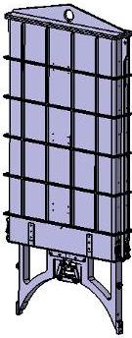
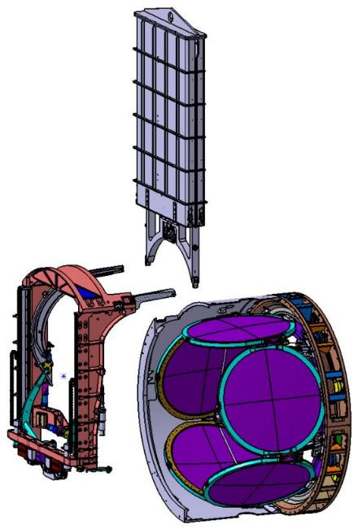
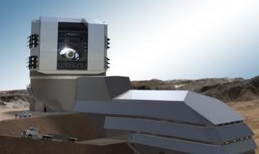
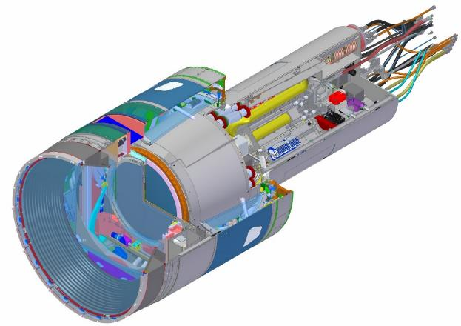
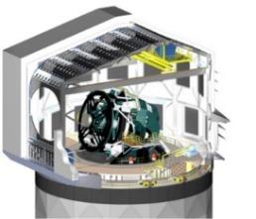
The Filter Exchange System
Filter Loader
Filter Control System
Auto Changer
Carousel
Off-line filters in carousel
Filter at On-line position

Slide 5
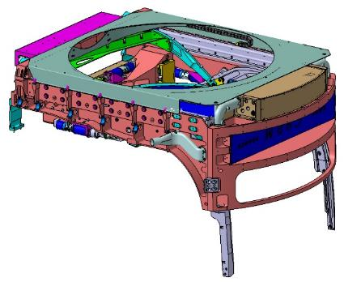
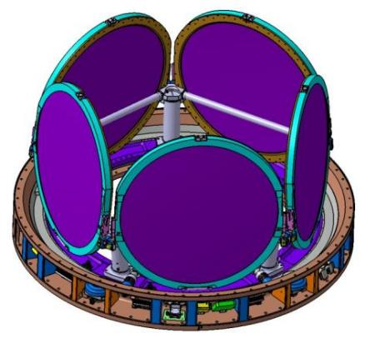
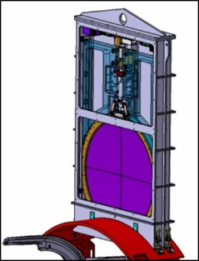
Overview
Auto Changer (3.06.03.01)
Hold the filter in the Field view
Move the Filter to/from the Hand-off position with the carousel
Move the filter to/from the Hand-Off position with the Loader
Filter Loader (3.06.03.02)
Extract/insert a filter from/into the Camera
Provide a clean environment for the Filter handling and storage
Carousel (3.06.03.03)
Keep available from 1 to 5 filters
Move a filter To/From the Hand-Off position with the Auto Changer

Slide 6
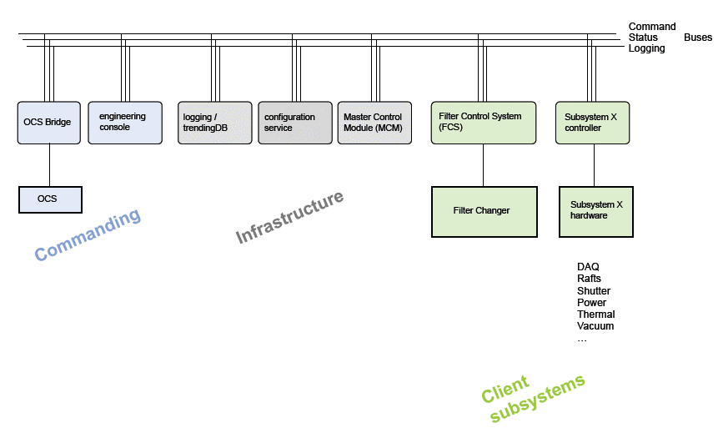
Filter Control System and Camera Control System Overview
The Filter Control System is a module of the Camera Control System. It was designed at the same time and with the same tools.

Slide 7
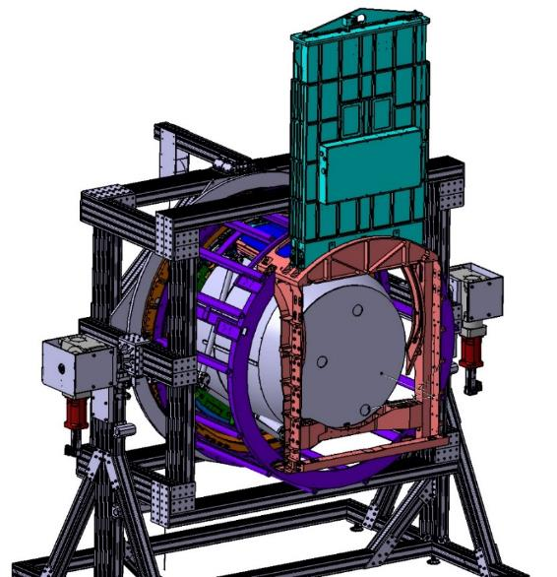
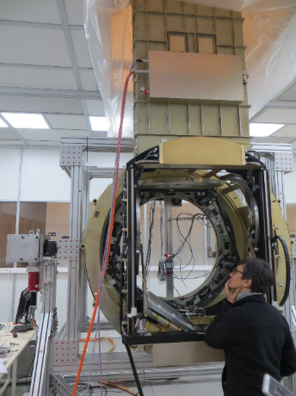
Full Scale Prototypes and Test Bench
Verification and Validation
The set-up is composed of a full scale prototype of each sub-system and a Camera Simulator (Test Bench)
First Step : Assembly (Complete)
Assembly and adjustment of the complete Filter Exchange System
Second Step : Function Tests (Complete in Sep 2019)
Mechanisms, instrumentation, Control System and Protection system.
On all the angular positions and with all the filter combinations (+ test load)
Third Step : Long-duration Test
(Results expected in 2020)
Cycling Behavior
Contamination
Maintenance
Camera Simulator Design
The 3 prototypes on the Camera Simulator

Slide 8

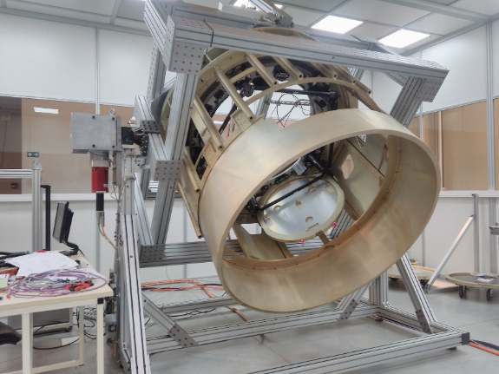
Filter Exchange System Technical Status
The Filter Loader
WBS | % complete
3.06.03 Exchange System | 90%
3.06.03.01 Auto Changer | 100%
3.06.03.02 Filter Loader | 100%
3.06.03.03 Carousel | 100%
The Auto Changer
The Camera Simulator (Test Bench and Dummy Camera Body) is complete
The Carousel

Slide 9
Recent Accomplishments & Notable Outcomes

Slide 10
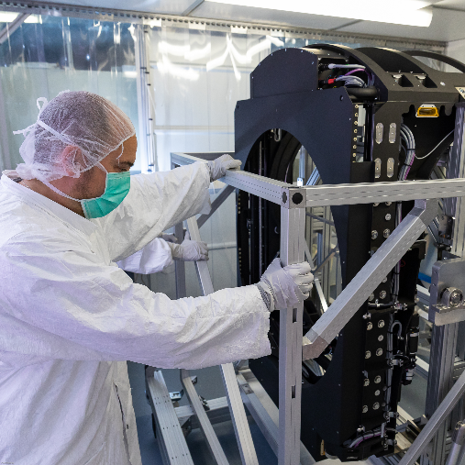
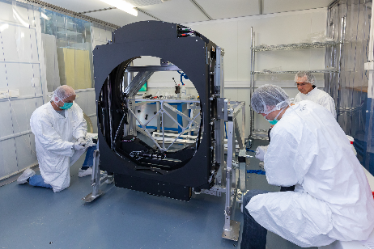
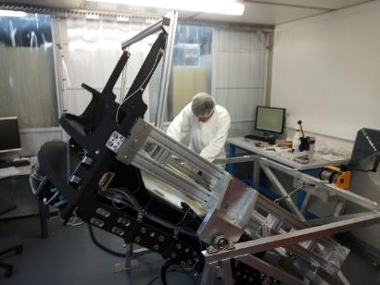
Auto Changer progress in 2018-2019
Prototype unit : Fully assembled and tested (Stand-alone test, cold test, combined tests)
Final unit :
  The Assembly and the Stand-alone tests are complete
  The combined test with the Filter Loader is complete
  Further work (Summer 2019):
    Cold Test (early Aug 2019)
    Combined test with the Carousel
Auto Changer on Stan-alone Test Bench
Auto Changer on Stan-alone Test Bench
Auto Changer on the Transport Clean Box

Slide 11
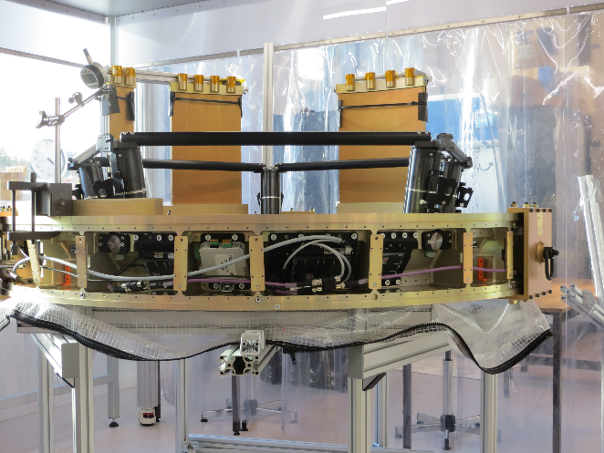
Carousel progress in 2017-2018
Prototype : Assembled and tested at 90 %.
Final Carousel :
  The assembly is complete
  The tuning and the validation tests are in progress.
Further work :
Complete the validation test (rotation fine tuning)
Combined test with the Auto Changer
Carousel in the Back Flange

Slide 12
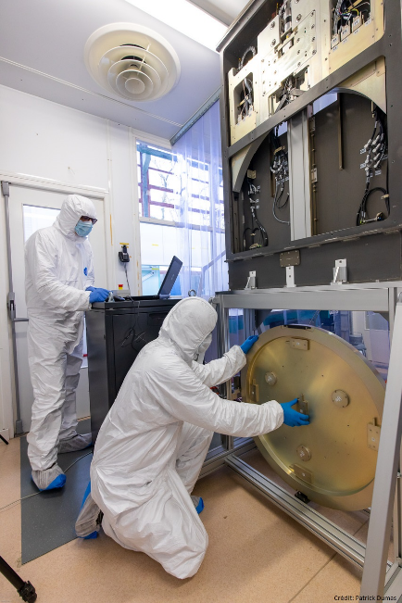
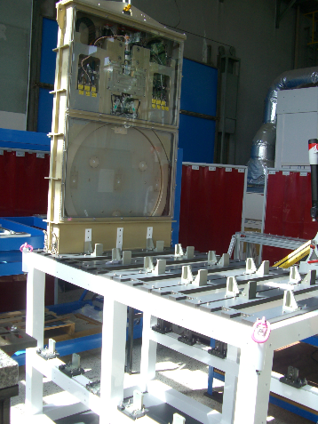
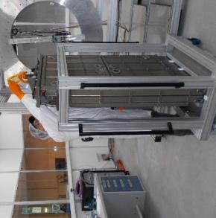
Loader progress in 2017-2018
Prototype unit : Fully assembled and tested (Stand-alone test, cold test, combined tests)
Final unit :
  The assembly and the Stand-alone tests are complete
  The Cold test at -15°C is complete
  The combined test with the Auto Changer is complete
Ancillary Tools :
  The Loader cart is available
  The Bench Top Stand is available
  The Storage box is assembled and painted.
    The last adjustments are in progress
    The tests with the Loader prototype are in progress
Filter Loader
Bench Top Stand and Dummy Filter
Filter Loader Cart
Storage Box

Slide 13
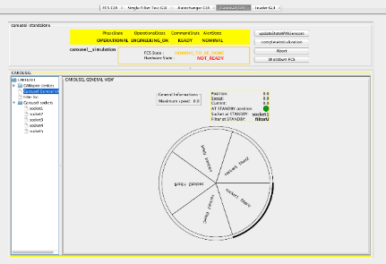
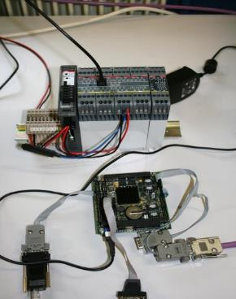
Filter Control System progress in 2018-2019
  Local Protection System
    Loader has been fully tested with and without LPS (python scripts)
    Auto Changer has been partially tested with LPS
    Display Status coming from the Local Protection System on the FCS console.
  Software for Carousel : (write code and tests)
    Reading of all clamp sensors, for the 5 sockets for PROTO
    Unclamping for PROTO
    Read data of the devices connected to the field bus (CANOpen)
    Adapt code to FINAL carousel and tests on FINAL AC
  Software for Auto Changer :
    Check LPS status before actions
    Rewrite process of opening and closing online clamp controllers on FINAL AC have encoder, so the process of opening and closing have changed and a homing is to be done at start up.
    Adapt code to FINAL Auto Changer and tests on FINAL AC
  Software for loader
    Adapt speed to go up and down depending if a filter is there or not
    Adapt code to FINAL loader and tests on FINAL loader
  Combined tests with PROTO
  Command and setup of 4 HCU
  All along the year, refactoring of the code :
    To adapt to new versions of the CCS Toolkit,
    To make the code easier to read and maintain, and more secure.
FCS Simulator
FCS uploaded in the PC104

Slide 14
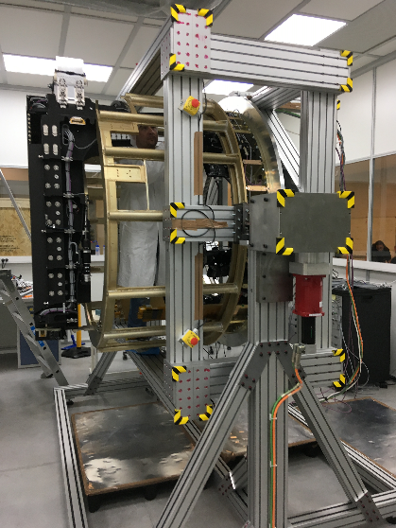
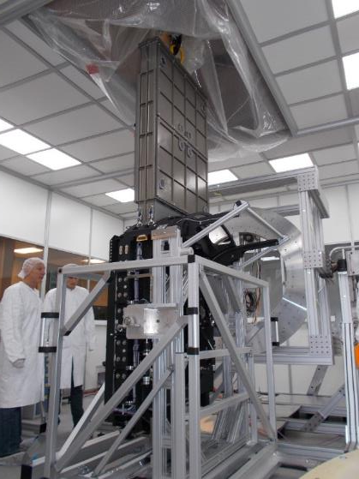
Verification and Validation activities status
The Loader and the Auto Changer are available, the stand-alone tests are complete.
The Dummy Camera Body, a dummy cryostat and the Dummy filters are available on the test Bench.
The Carousel is assembled on the Back Flange
Test Loader/Auto Changer :
  The alignment of the Loader with the Auto Changer is done.
  The Filter Hand-off is verified and validated.
Combined Test :
  The Carousel is assembled on the Back Flange.
  The Auto changer is mounted and aligned on the Test Bench.
  All the system has been mechanically tested with 5 filters on the carousel.
Further work is expected on fine tuning of the system behavior and the control/command (see next page). The optimization of the system needs one extra month.
Carousel
Loader
Dummy Camera Body
Auto Changer
Auto Changer
Combined Test Auto Changer/Filter Loader
Auto Changer and Carousel on the Test Bench

Slide 15
Verification and validation activities : further work
Carousel
  Validation of the protection system
  Validation of the electrical properties
  Qualification of the rotation under load (5 filters + maximum un-balance configuration)
  Qualification of a set of spare clamps
Auto Changer
  Fine tuning of the On-Line Clamping
  Implementation of the new controller configuration for the brakes of the on-line clamps
Safety System
  Validation in all the configurations including power down/up and shutdown of the FCS.
Filter control System (FCS)
  Command of the Filter Loader with the common software
  Resolving issues with the CANbus (signals not sent, homing doesn’t work)
  Implementation and validation of the high level commands (MoveAndClampFilterOnline or SetFilter)
  Testing and Measuring of the system performance (time) with the high level commands

Slide 16
Risks and Mitigations

Slide 17
Definition of Risk and Risk Analysis
Risk can be defined as an undesirable event during project execution that negatively affects program goals for performance, cost or schedule.
Risk management is the ongoing process of comprehensively assessing project risks.
Camera Risk Management Plan (LCA-29-A) defines the methodology to manage our risks
Definition of Risk Probability
Pts | Likelihood of Occurrence | Approximate Probability | Description of Probability
1 | Rare | <1% | Likelihood of occurrence is not credible
2 | Unlikely | 1-5% | Not reasonably expected to occur
3 | Possible | 5-25% | Possible, or difficult to assess the chance of occurrence
4 | Likely | 25-67% | Very likely that an adverse event will occur
5 | Highly Probable | >67% | High probability that an adverse event will come to pass
Definition of Risk Impact
Pts | Severity of Impact | Description of Impact
Cost Impact
1 | Insignificant | Overrun of cost of < $30K, recoverable with project contingency
2 | Minor | Overrun of cost of $30k - $200K, recoverable with project contingency
3 | Moderate | Overrun of cost of 200k - $1.5M, with significant impact on contingency
4 | High | Overrun of baseline cost of $1.5M - $10M, with re-baseline required
5 | Critical | Overrun of baseline cost of >$10M, with project in jeopardy
Schedule Impact
1 | Insignificant | Degradation of schedule margin to project critical path by < 2 wks
2 | Minor | Degradation of schedule margin to project critical path by 2 wks to 1.5 months
3 | Moderate | Degradation of schedule margin to project critical path by 1.5 to 3 months
4 | High | Degradation of schedule margin to project critical path by 3 to 6 months
5 | Critical | Degradation of schedule margin to project critical path by > 6 months
Performance Impact
1 | Insignificant | No effect on ability to meet requirements; minor design changes needed
2 | Minor | Minor excursion from subsystem requirement, but compensated elsewhere
3 | Moderate | Level 2 and/or SRD design specification exceeded
4 | High | Level 1 and/or SRD minimum specification exceeded
5 | Critical | Unable to achieve any of the primary science missions
→Quasi-quantitative process to assign objective values to probability of occurrence and impact of occurrence aspects of risk.
Total Impact:
(0.50*Cost Impact) + (0.33*Schedule Impact) + (0.33*Performance Impact)
→Risk Score:
Risk Probability * Total Impact

Slide 18
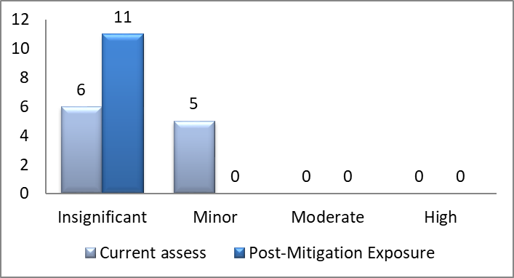
Standardized risk management processes are used to manage Exchange System risks
Risks are tracked in the Camera Risk Registry, Document LCA-30
Risk exposure is assessed and tracked at regular intervals since 2010 (initial assessment)
Actively planning mitigation to burn down risks and monitor progress
  There are 16 active risks in the risk registry for the Filter Exchange System and an additional 23 risks are closed due to design changes or mitigation completion.
Mitigations are budgeted in the scope of work
After budgeted mitigation (Post-Mitigation) is performed, residual risk is analyzed
The top 3 risks are shown below:
  EXCH-029: IF the Auto Changer sheds particles during operation, THEN L2 and Filters throughput will be degraded (Minor Risk)
    Test materials and lubricant in clean environment.
    Risk will close after the long duration tests with the full scale prototypes.
  EXCH-046 : Filter change Time (Minor Risk)
    Measure the step duration during the test
    Optimize the sequence with simultaneous actions
    Increase the communication speed
    Risk will close after the combined test
  EXCH-036 : Broken mechanisms during transportation and handling (Minor Risk)
    Check the insurance
    Divide into several shipments as possible
    Risk will close after the shipment arrives at SLAC

Slide 19
Filter Exchange System top 10 risks as of June 2019
Risk Title | Risk Description (if/then) | Prob ability | Cost | Schd | Perf | Current Exposure | Prob ability1 | Cost1 | Schd1 | Perf1 | Residual Exposure
Auto Changer particulate generation | IF the Auto Changer sheds particles during operation, THEN L2 and Filters throughput will be degraded | 3 | 2 | 2 | 2 | Minor | 3 | 1 | 1 | 1 | Insignificant
Filter Change Time | If some filter change steps take a too long time, then the system will not meet the filter change time specification, forcing modification of the driving device and modification of the control/command architecture | 3 | 1 | 3 | 2 | Minor | 1 | 1 | 1 | 1 | Insignificant
Broken mechanisms during transportation and Handling | If a major part or mechanism are broken or lost during the transportation or the handling, THEN It cannot be replaced quickly and the integration will be shifted | 2 | 2 | 4 | 1 | Minor | 1 | 1 | 3 | 1 | Insignificant
Carousel ring gear failure | IF the Carousel ring gear fails from pitting, scuffing, or breakage, THEN Carousel rotation capability would be lost, significantly impacting observing | 2 | 2 | 3 | 2 | Minor | 1 | 1 | 1 | 1 | Insignificant
Auto Changer lifetime and wear | IF Auto Changer components wear, THEN we will need more down time to troubleshoot and repair | 2 | 2 | 3 | 2 | Minor | 1 | 1 | 2 | 1 | Insignificant
Filter attach latch | IF the filter latch mechanism does not operate reliably, THEN the subsequent re-design will have a big impact on the entire system, given that we are out of room | 2 | 2 | 2 | 2 | Insignificant | 2 | 2 | 1 | 1 | Insignificant
Carousel particulate generation | IF Carousel moving parts generate tiny wear particles or shed lubricant, THEN dust and lubricant could contaminate the optics | 2 | 2 | 1 | 3 | Insignificant | 1 | 1 | 1 | 2 | Insignificant
Carousel clamp | IF Carousel clamp does not function reliably, THEN exchange capability may be severely limited | 2 | 2 | 2 | 2 | Insignificant | 2 | 2 | 1 | 1 | Insignificant
Impossible alignement of the Filter sub-systems | If the sub-system can not be together aligned. THEN all the sub-systems need to be dismounted for the adjustment and the modification, the camera integration will be shifted. | 2 | 1 | 2 | 1 | Insignificant | 2 | 1 | 2 | 1 | Insignificant
Carousel circular rail failure | IF the Carousel circular THK rail system fails or jams, THEN filter exchange capability would be lost | 1 | 1 | 4 | 2 | Insignificant | 1 | 1 | 1 | 1 | Insignificant

Slide 20
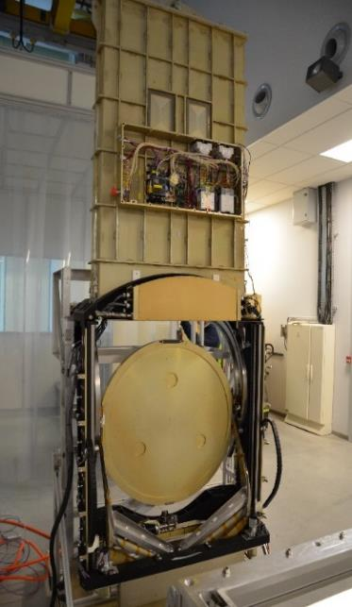
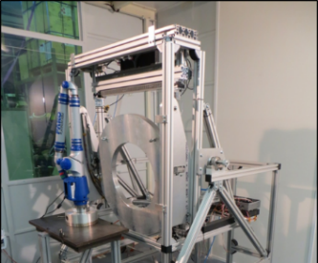
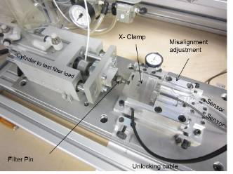
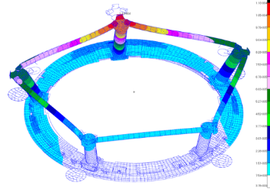
Filter Exchange System risk mitigations have been implemented
Construction of prototypes of components and test :
  Single filter test : validation of the filter hand-off Carousel/Auto changer.
  Carousel Clamps with a dedicated test bench.
Construction of the full scale prototypes :
  Stand-Alone tests and improvement of the design (stiffness, filter position accuracy, clamping).
  Proof test under load and validate the margins.
  Perform the Alignment and test the filter Hand-off.
Detailed FEA models :
  Estimate the filter stiffness and freeze the design as soon as possible.
  Stress Analysis for each sub-system.
Construction of dummy filters and a dummy Camera Body :
  Tests at various angles.
  Combined tests.
  Long-duration test for measuring the wear rates.
  Validate the maintenance plan.
Filter Hand-off between the Loader Prototype and the Auto Changer Prototype
Carousel Filter Clamp test Bench
Carousel FEA Analysis
Filter Hand-off test Carousel/Auto Changer

Slide 21

Filter Exchange System Key Risks Retired/Accepted
  EXCH-013 IF the Auto Changer and Carousel cannot reliably hand off filters, THEN we would be forced into re-design that would very likely impact operational capability of the system
    All modifications done on both clamps, the positioning of the Auto Changer has been adjusted, the clamping parameters are well defined (speed and adjusting of the pins). The Hand-Off can be done at any angle.
  EXCH-041 If the full scale prototype is not ready in time for the validation of the design, then the design updating and the purchase of the final unit component will be delayed. The final units will not be delivered in time for the integration into the camera.
    The filter Hand-off with the Auto Changer has been validated. The tests with the prototype are finished
  EXCH-048 The lead time for the THK linear rails of the final Auto Changer is now 46 weeks, If there is not any other solution than buying new rails, then the Final Auto Changer delivery will be delayed.
    The THK rails have been delivered earlier than foreseen in June 2018.
  EXCH-044 If the Back Flange is not available in time at LPNHE, the Carousel assembly in France will be delayed and the Carousel integration in the Camera will be delayed.
    The Back Flange has been delivered in July 2018, this does not impact the Carousel schedule.

Slide 22
Hazards

Slide 23
Hazard Analysis
Hazards can be defined as a failure of a component, system or function that could lead to personnel injury or damage to hardware.
  Hazards are NOT risks.

Slide 24
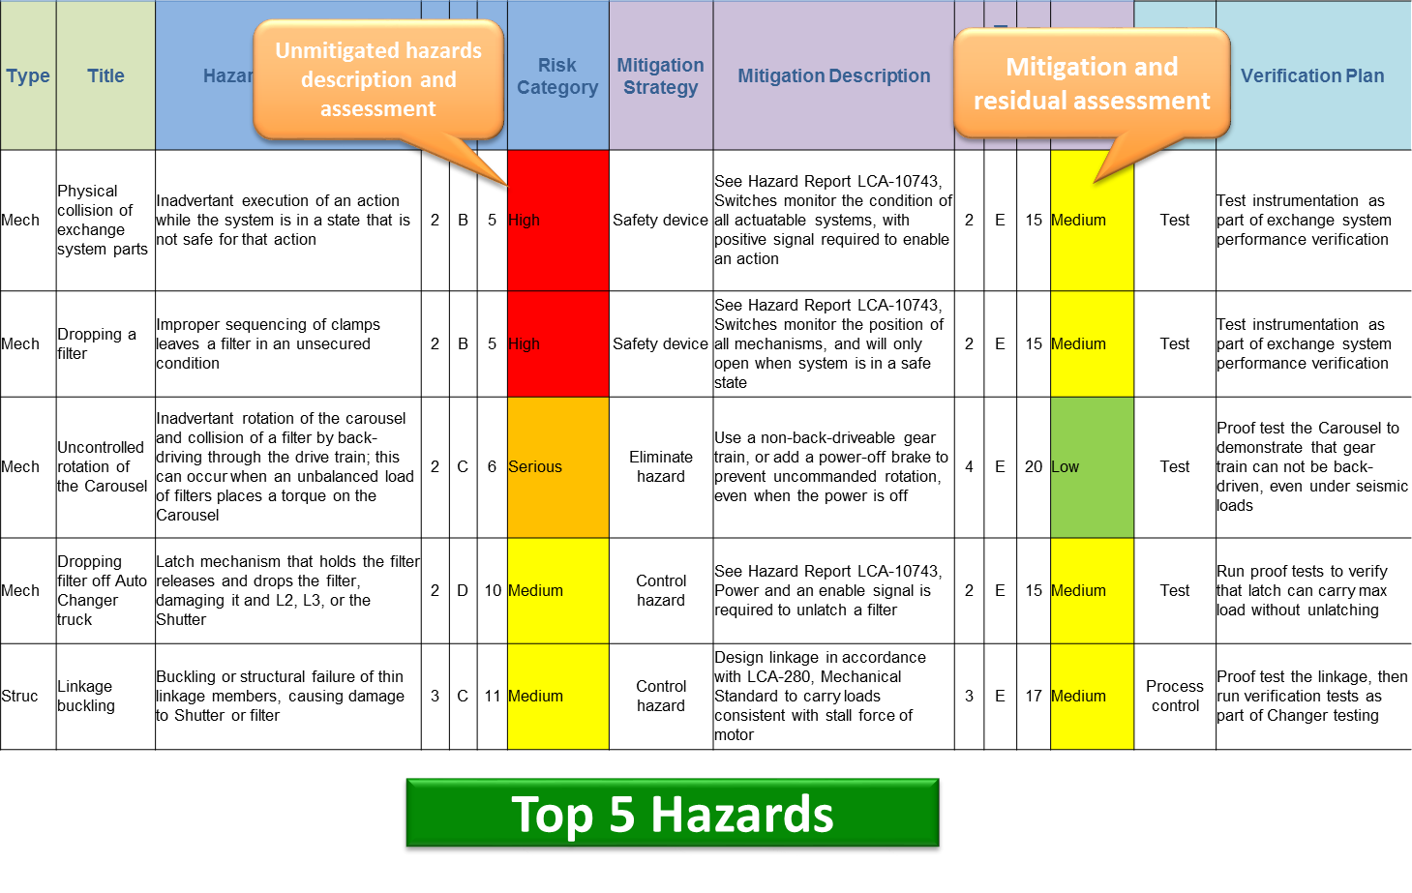
Hazard are fully identified and mitigated

Slide 25
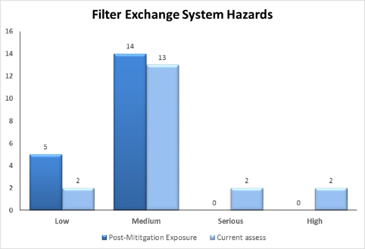
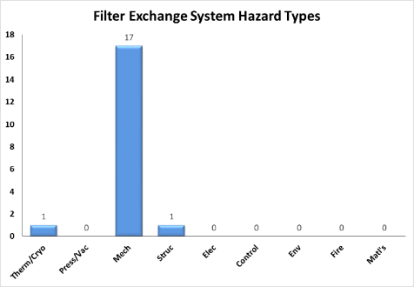
Integrated Safety Management practices are applied and hazards are tracked
Hazards are tracked in the Camera Hazard registry, Document LCA-15.
Hazards are identified at regular intervals.
There are currently 19 hazards in the hazard registry for the Filter Exchange System.
Highest hazards are related to dropping a filter or collision.
Risk Assessment Value | Mishap Risk Category | Acceptance Criteria
1-5 | High | Not Acceptable
6-9 | Serious | Require decision by LSST Project Office
10-17 | Medium | Require decision by Camera Project Manager
18-20 | Low | Acceptable without Review

Slide 26
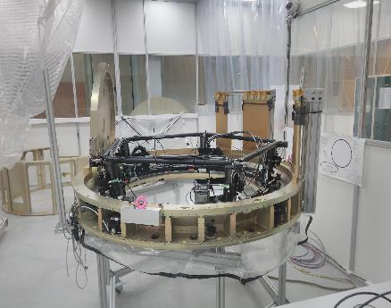
Filter exchange system safety Incident
What happened
  The person entered into the stay-clear area while the carousel was rotating and his right arm was caught by a (rotating) clamp and compressed between the clamp and the (static) chimney.
  A colleague immediately pressed the emergency switch, and the person was able to free his arm.
  The colleague called the local firemen and the person was fully conscious when he was rapidly taken to the nearest hospital.
  Both the person and his colleague (and the whole team) were under deadline stress.
The carousel was idle, until the safety measures are approved, with a re-start 5/28/2019.
The safety measures implemented to correct for the incident:
  Rigid plastic foils (800mm in height) placed vertically on the largest radius of the stator.
  6 emergency switches placed every 60 degrees on the stator.
  one extra lockable switch placed besides the control keyboard.
  a rotating lamp indicating the motor power status
  The switches cut the motor power, without any intervening software.
Chimneys
clamp

Slide 27
Programmatic Status

Slide 28

Filter Exchange System Management
Filter Exchange System
Project Manager. : P. Karst
Project Scientist: P. Antilogus
System Engineering: P. Karst
Science support : P. Antilogus, E. Gangler
Quality Assurance : P. De Lamberterie
Carousel
LPNHE (Paris)
Tech.: D. Laporte
Sc.: P. Antilogus
Filter Control System
APC (Paris)
Tech.: F. Virieux
Sc.: E. Aubourg
AutoChanger
CPPM (Marseille)
Tech.: A. Marini
Sc.: D. Fouchez
Filter Loader
LPSC (Grenoble)
Tech.: F. Vezzu
Sc.: C. Renault
Test Bench
LPCC (Clermont)
Tech.: H.Croizet
Sc.: E. Gangler
IN2P3 – Filter Exchange System Management

Slide 29
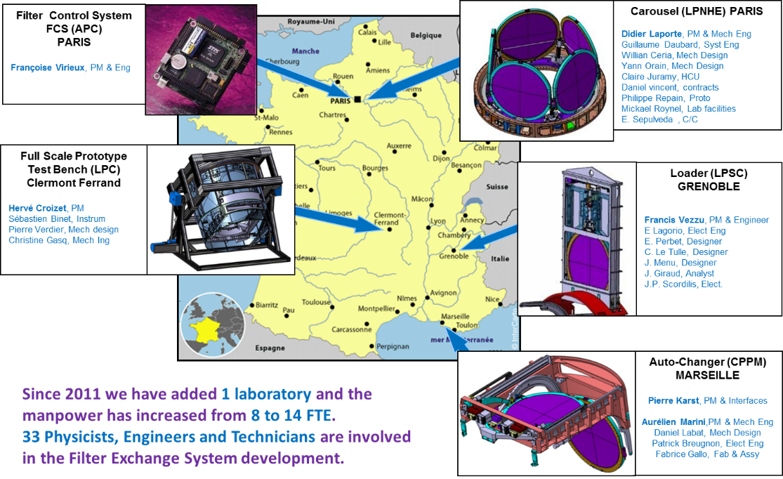
IN2P3 Team
Françoise Virieux, PM & Eng
Alexandre Boucaud, Eng

Slide 30
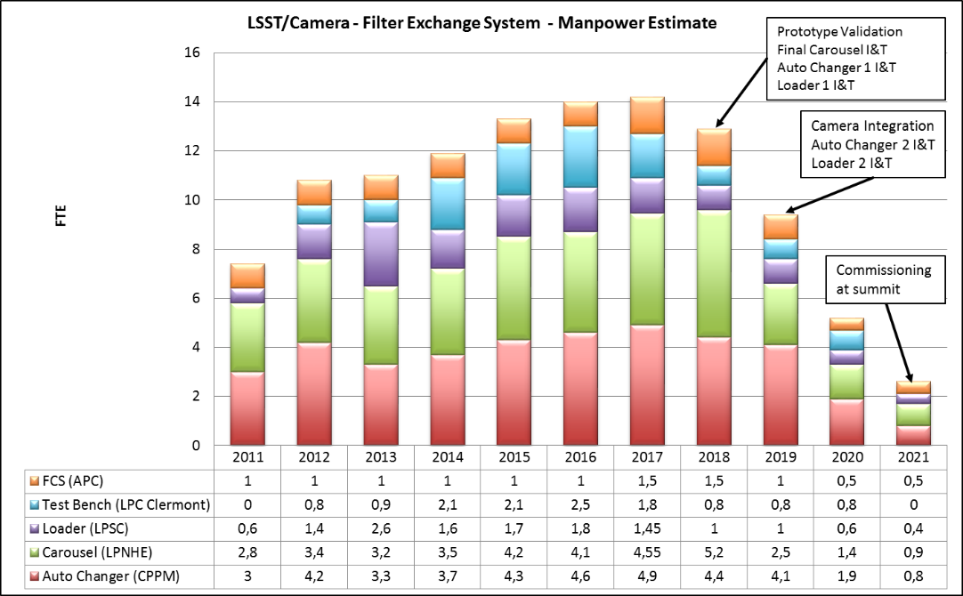
Filter Exchange System: Manpower

Slide 31
Filter Exchange System Summary Schedule

Slide 32
Upcoming Major Milestones – 6 month look ahead
Milestones | Forecast Finish Date | Expected Finish Date
3.06.03.01 Auto Changer
AVAIL: Ready for Integration – Auto Changer | Oct 10,2019 | Dec 2, 2019
3.06.03.02 Filter Loader
AVAIL: Ready for Integration – Filter Loader | Oct 10,2019 | Dec 2, 2019
AVAIL: Ready for Integration – Production Filter Blocks | Jul 15, 2019 | Jul 15, 2019
3.06.03.03 Carousel
Integration and Test - Carousel | Aug 19, 2019 | Sep 27, 2019
AVAIL: Ready for Integration – Carousel | Oct 10,2019 | Nov 11, 2019
Due to the needed work left to be done on the Filter control System and the fine tuning, the finish dates are delayed of one month.
But this is still within the schedule float of the project although it is expected to be critical path in August.

Slide 33
Summary

Slide 34
Summary
The full scale prototypes have been fully assembled and tested in 2018.
The Assembly and the Stand-Alone Test of the Filter Loader and the Auto Changer are complete
The Stand-alone Test of the Carousel is on track to be complete in early August 2019.
Remaining Risks have been identified and are being actively managed.
Hazards are actively managed and reviewed for commissioning and operation planning.
After the accident, the Safety Review report confirms that :
  The root cause of the accident is understood.
  The corrective actions have been defined and applied.
  Improvement to the safety system and procedures will prevent incident at SLAC and on the summit
One extra month is needed to provide a fully qualified system.
Budget and schedule are being managed and are consistent with project guidelines.

Slide 35
Supporting Material

Slide 36
Key Documents are Available on “Additional Docs” Tab in Confluence
Key Documents & Reviews for the Filter Exchange System can be found at (contact the camera point of contact for access):
  https://confluence.slac.stanford.edu/display/LSSTCAMREV/Home
This site contains:
  Project Documents
  Design and Allocated Baseline Documents
    Specifications
    ICDs
    Design Documents
  Cost and Schedule Baseline
  Design Reviews & Relevant Presentations
    Preliminary Design Review
    Other reviews
  Focused Topics

Slide 37
Response to 2017 NSF/DOE Status Review
No Filter Exchange System specific recommendations

Slide 38
Filter Exchange System MRR review Response
MRR was conducted in June 2017
  2 Tier 1 action items
    All Tier 1 have been closed
    Key Items were:
      Generate a clear schedule for test stand, clean room, and all hardware units: show how prototype,FU-1 and FU-2 units for carousel, auto changer, and loader mount, de-mount, and use the clean room(s) at LPNHE, including commissioning the room to ISO-7 cleanliness. Show that this schedule supports delivery of FU-1 units to I&T as needed, and investigate viability of securing a second clean room for pre-assembly of carousel
      Lay out the LPNHE clean room with major components in it: show evolution of clean room floor space with major equipment and assembly steps, to show that crane access through hole in the roof is Document adequate to allow for all crane lifts. How will large, heavy equipment be moved, since most large movers are hydraulic and not clean.
  33 Tier 2 action items
    8 Tier 2 items closed

Slide 39
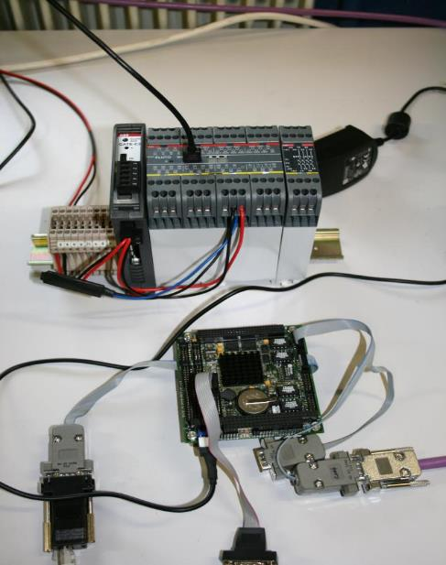
Filter Exchange System Status Summary
Filter Control System (APC)
Design :
  CCS is used in the US (with all the test benches for the CCDs and the rafts)
  FCS tested on the Single Filter Test at CPPM since 2012 (500 filter exchanges)
  The simulator Code of the Exchange System is written and tested for the 3 sub-systems in the Stand-alone mode and for the whole system.
  Verification and Validation plans are defined
FCS for the Test benches: The software is tested with the hardware prototypes at CPPM and at LPSC.
Further work in the next months :
  Software for the Carousel at LPNHE
  Define the software for the long-duration tests.
  Taking into account of the various tests for improving the software.

