Slide 1
LSST Camera: I&T Subsystem
Tim Bond
I&T Subsystem Manager (SLAC)
NSF/DOE Joint Status Review
July 30 2018

Slide 2
Presentation Outline
Introduction and Scope
Technical Status
  Recent Accomplishments & Notable Outcomes
  Upcoming Major Milestones
  Remaining Work and Challenges
  Verification and Validation Activities (supplemental talk by Roodman)
Risks and Mitigations Status
Hazards Status
Programmatic Status
  Organizational Structure
  Cost and Schedule Performance Status
  Upcoming Major Milestones
Summary
Supporting Material
  Key Documents
  Past Review
  BCR / EAC Details
  I&T Process Development
Message box example for short highlighted messages.

Slide 3
Introduction and Scope

Slide 4
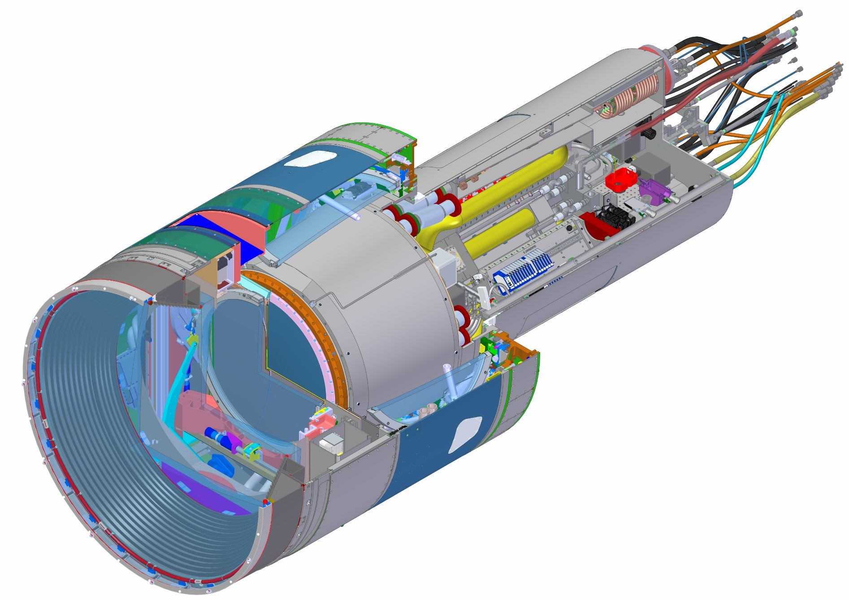
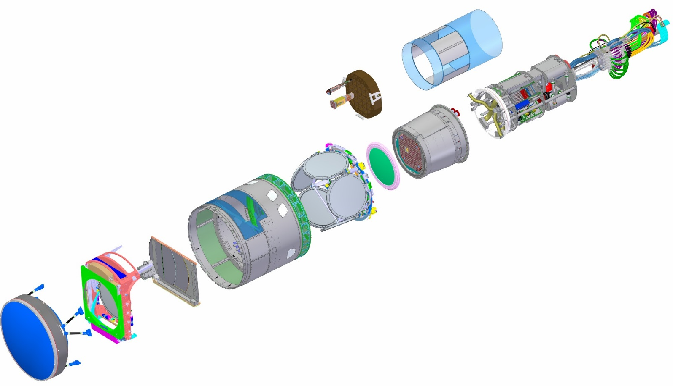
Major Camera Elements
WBS | Baseline ($K) | % complete
3.06.05 Utility Trunk | $1,385 | 69%
WBS | Baseline ($K) | % complete
3.04.02 Corner Raft Tower | $7,064 | 99%
WBS | Baseline ($K) | % complete
3.04.01 Science Raft Tower | $17,507 | 99%
WBS | Baseline ($K) | % complete
3.03 Sensors | $34,011 | 100%
WBS | Baseline ($K) | % complete
3.07.02 Aux Electronics | $2,298 | 100%
WBS | Baseline ($K) | % complete
3.06.01 Camera Body | $2,395 | 95%
WBS | Baseline ($K) | % complete
3.06.04 Cryostat | $16,394 | 98%
WBS | Baseline ($K) | % complete
3.06.02 Shutter | $3,030 | 90%
3.05.04 L3 Lens Assembly
3.05.02 Filters (6)
WBS | Baseline ($K)
3.06.03 Filter Exchange System | Contributed
WBS | Baseline ($K) | % complete
3.01 Management | $15,225 | 90%
3.02 Systems Integration | $9, 308 | 91%
3.05 Optics | $28,094 | 87%
3.07.01 Control System | $5,055 | 89%
3.07.02 Data Acq Sys | $5,688 | 93%
3.08 Integration and Test | $12,847 | 76%
TOTAL | $158,103 | 92.8%
3.05.03 L1-L2 Lens Assembly

Slide 5
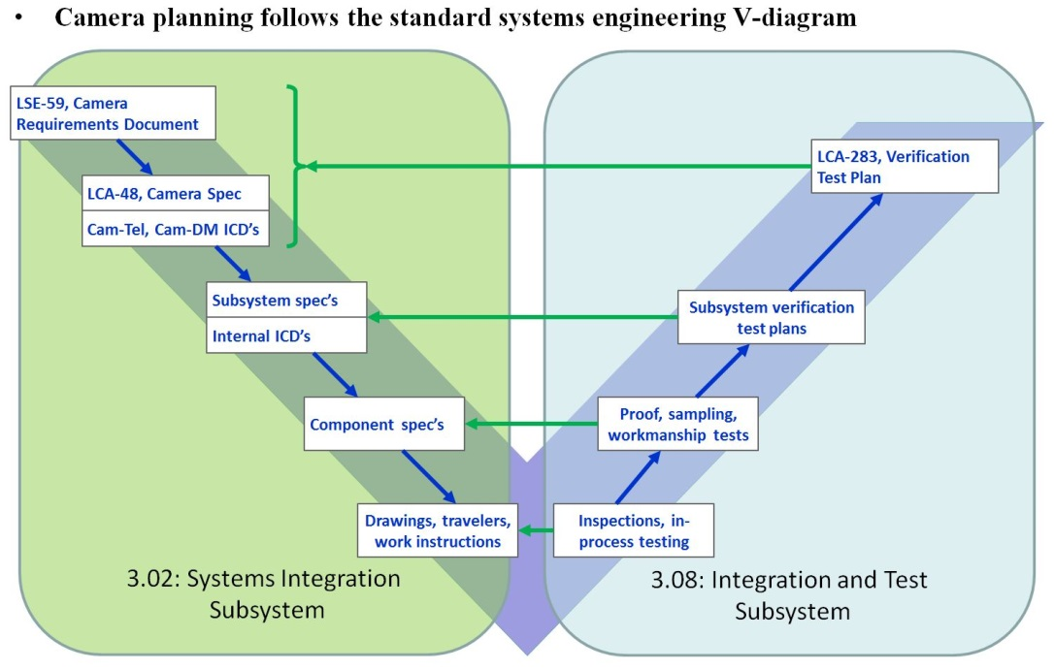
I&T Subsystem / Systems Engineering
The LSST Camera design and development process incorporates an extremely thorough Systems Engineering process, but unlike many similar projects, the I&T Subsystem is not a subgroup of the overall Systems Engineering group.
As can be seen in the familiar Systems Engineering “V-diagram” the LSST Camera model has divided the necessary sets of tasks amongst two individual subsystems.
Tasks on the left side of the lifecycle diagram that are realized in the early design and development phases of the Camera are allocated to the Systems Integration Subsystem (3.02).
Tasks associated with the receiving and verifying of actual hardware are shown on the right side of the diagram and have been allocated to the I&T Subsystem (3.08).

Slide 6
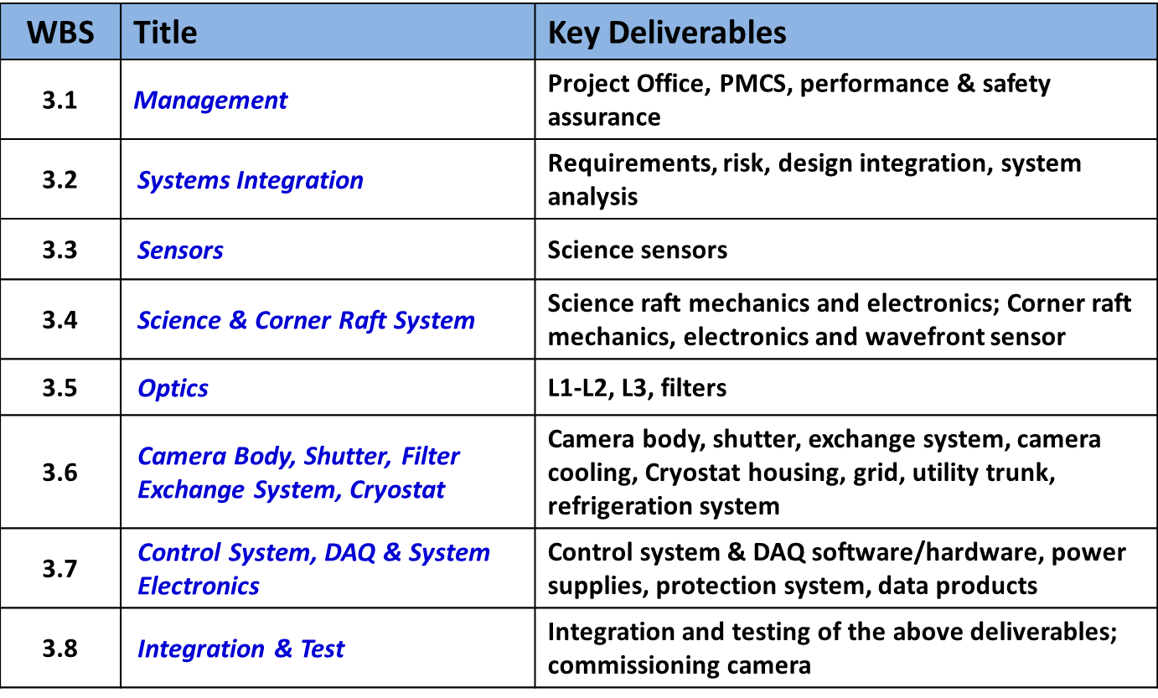
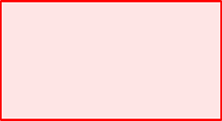
I&T Subsystem – Scope Overview
L2 WBS:
I&T Entry in WBS Dictionary (LCA-125).
    This WBS element captures the effort to manage development and execution of the Camera Integration and Test Plans, including upgrading facilities and equipment at SLAC, designing and fabricating integration and test fixtures and equipment for Cryostat and Camera integration.

Slide 7
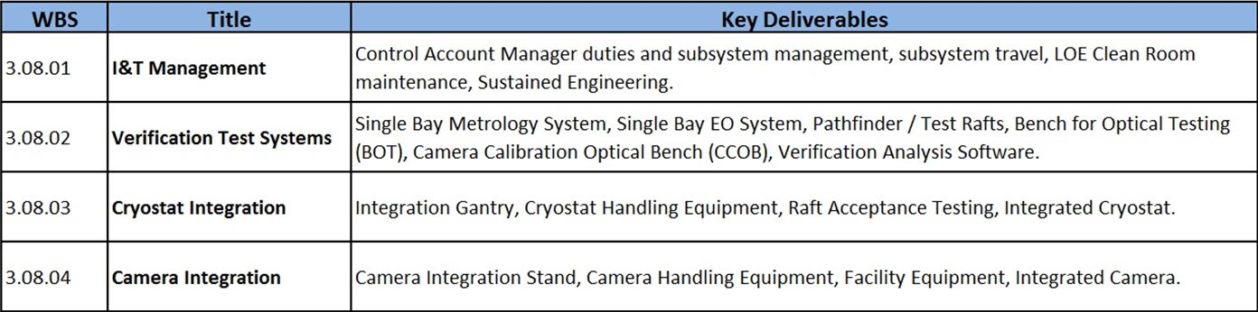
I&T Subsystem – Scope Overview
L3 WBS with the “key” deliverables identified.
The majority of the actual effort for the final LSST Camera assembly and testing takes place in the following WBS elements:
    3.08.03 – Integrated Cryostat.
    3.08.04 – Integrated Camera.

Slide 8
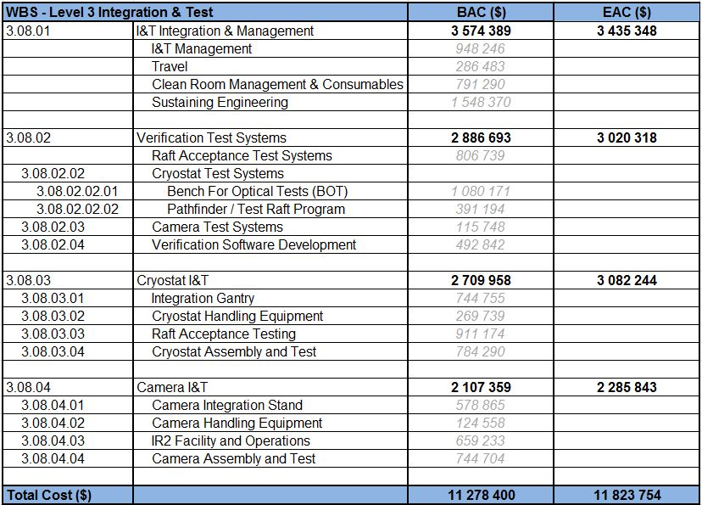
I&T Subsystem – Scope Breakdown
L3 WBS broken down by cost for reference.

Slide 9
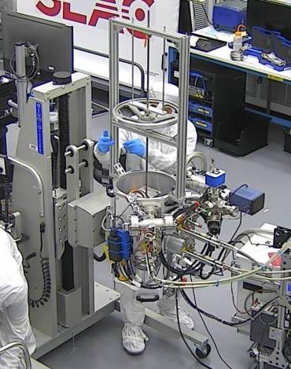
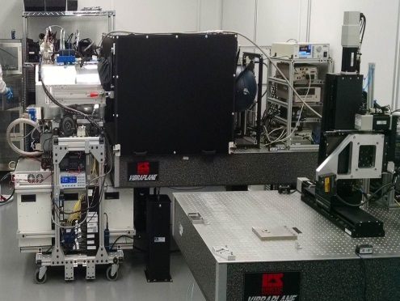
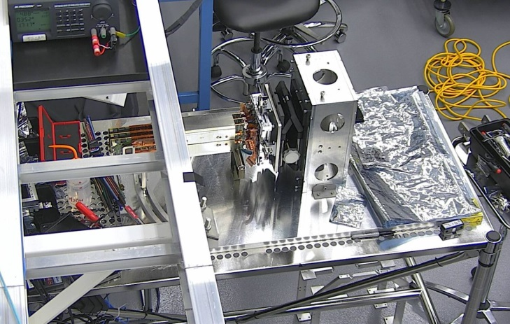
I&T Subsystem – Support Equipment Development
Science Raft Verification (Support Equipment)
I&T performs a complete reverification of the individual Science Rafts once they arrive at SLAC.
I&T utilizes test stands similar to those used at BNL (with some minor modifications) – TS5, TS6, TS7, and TS8.
The first Science Raft arrived at SLAC on Nov 20/2017 (we have since been receiving them at roughly a 1 month cadence).

Slide 10
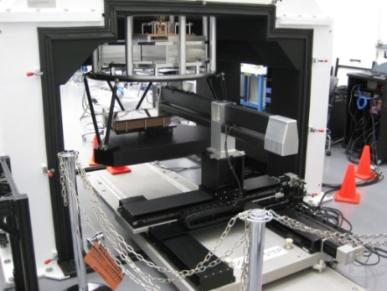
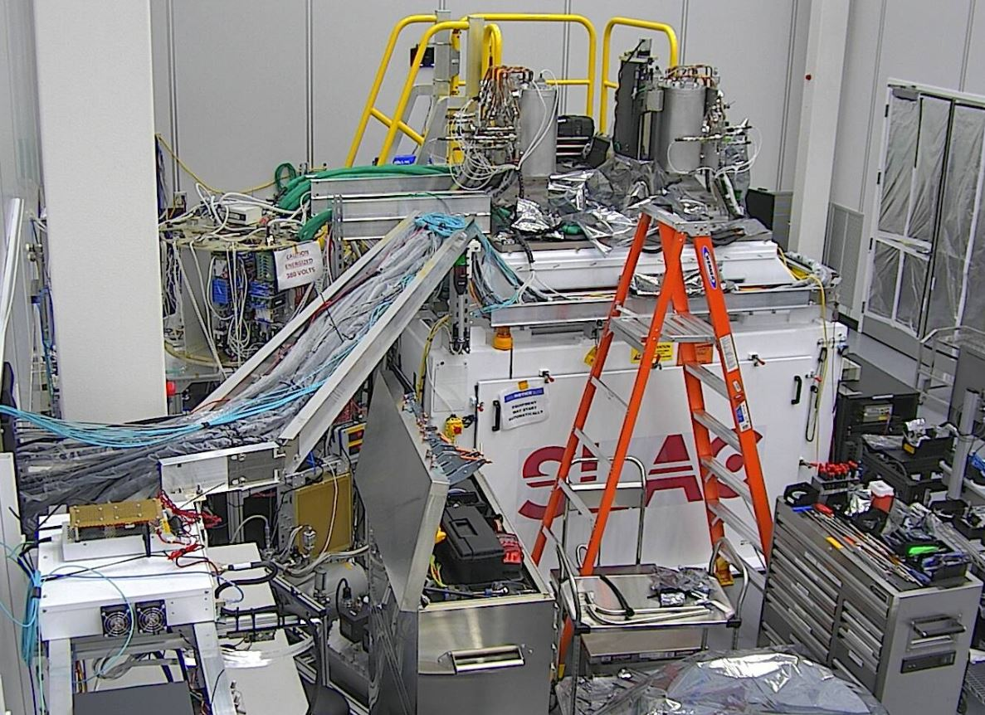
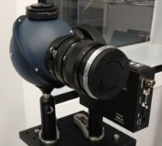
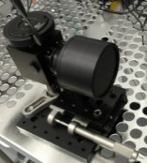
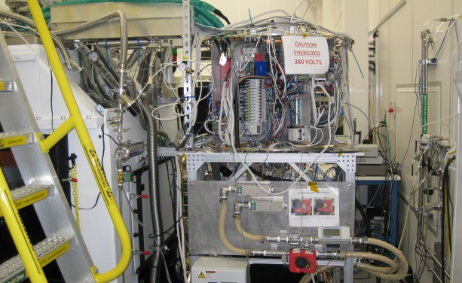
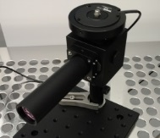
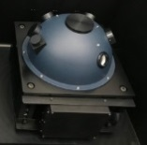
I&T Subsystem – Support Equipment Development
Cryostat Integration (Support Equipment I)
Bench for Optical Testing (BOT):
    Main support structure for the Cryostat during raft integration and EO testing.
    Provides a suite of 4 EO test heads for RTM characterization.
    Provides the hardware for performing full focal plane metrology.
Quad-box Support Stand.
    Temporary stand for Quad Box during I&T prior to
    installation of the Utility Trunk.
    Provides structural support, power, cooling water
    and cable routing to the Cryostat.

Slide 11
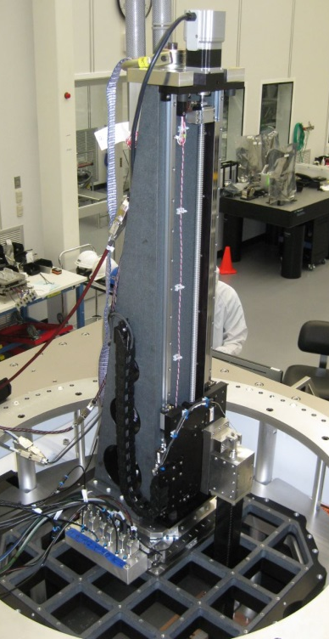
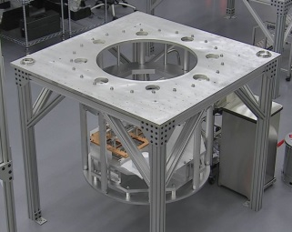
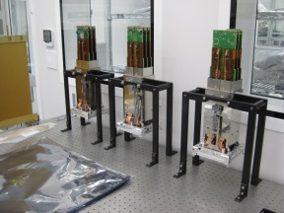
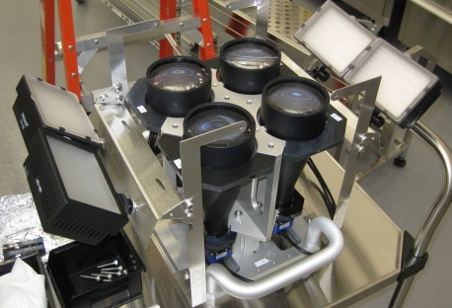
I&T Subsystem – Support Equipment Development
Cryostat Integration (Support Equipment II)
Raft Integration Gantries (IG) + Related hardware:
    Two flavors of gantry: Corner Raft-specific and Science Raft-specific.
    Raft installation dedicated Camera Monitoring System.
    Suite of 5 Mechanical Test Rafts.
    Full cryostat mock-up (9 bay version).
Cryostat Handling Fixture (still in fabrication).
    Used to tip the final Cryostat horizontal for Utility trunk installation.

Slide 12
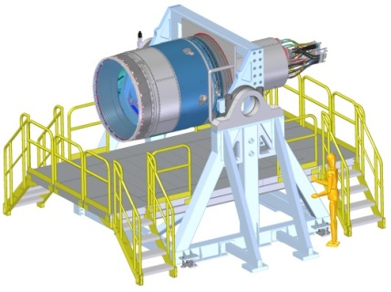
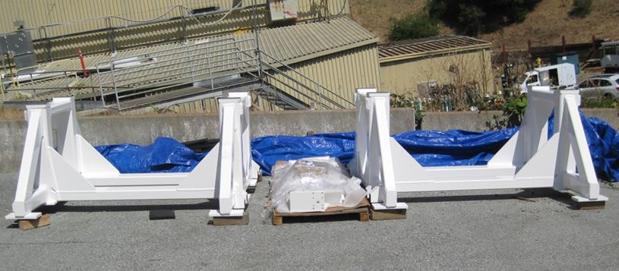
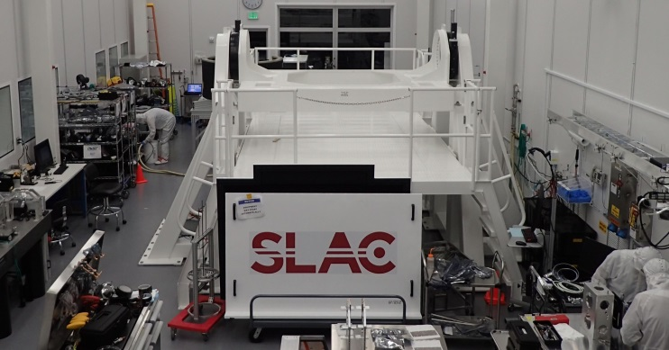
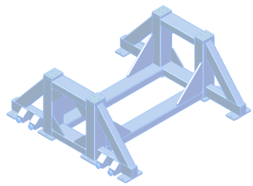
I&T Subsystem – Support Equipment Development
Camera Integration (Support Equipment)
Camera Integration Stand:
    Used for the assembly of the main Camera components.
    Largest fixture in the clean room and allows reorientation of the full Camera for multiple operations.
Camera Saddle Stands:
    Just arrived at I&T from fabrication Vendor (July).
    Used to support the Camera Body as the Cryostat is installed.
    Also used to support the fully integrated Camera during shipping to Chile.

Slide 13
I&T Subsystem – Camera Verification
Camera requirements from Camera Specification: LCA-048.
    Many camera requirements are verified at the sub-system level and the appropriate information is delivered to I&T with the hardware.
    Remaining I&T verified Camera requirements fall into several general categories:
      Electro Optical tests (BOT- EO configuration & CCOB).
      Focal Plane Metrology tests (BOT-Metrology configuration).
      Survey & Alignment tests.
      System Dynamics / Mass Properties tests.
      Cryostat & Camera Functional tests.
Brief overview given in the Camera I&T Plan: LCA-40.
Details described in Camera Verification Test Plan: LCA-0283.
Aaron Roodman to give full talk on this subject…

Slide 14
Technical Status

Slide 15
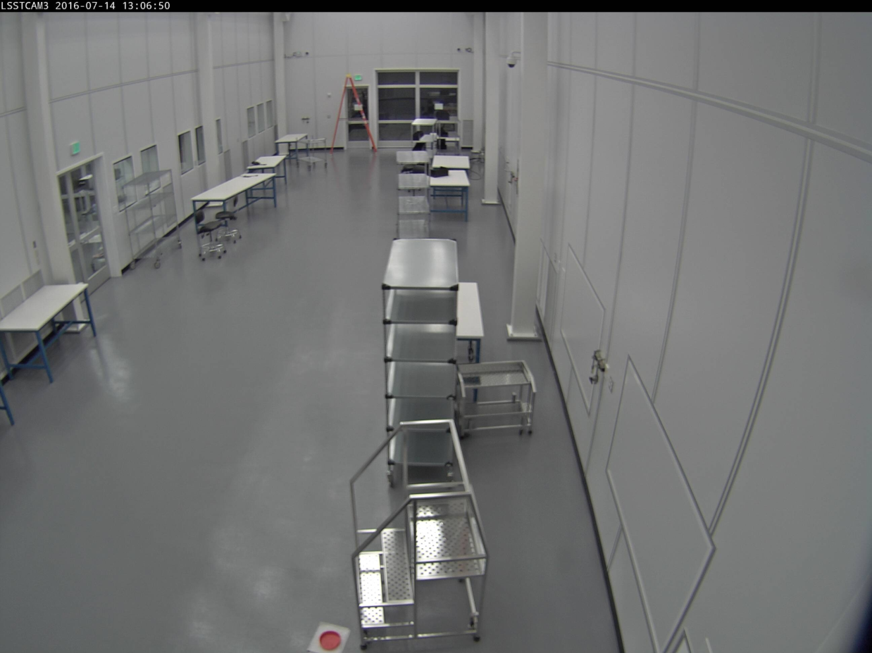
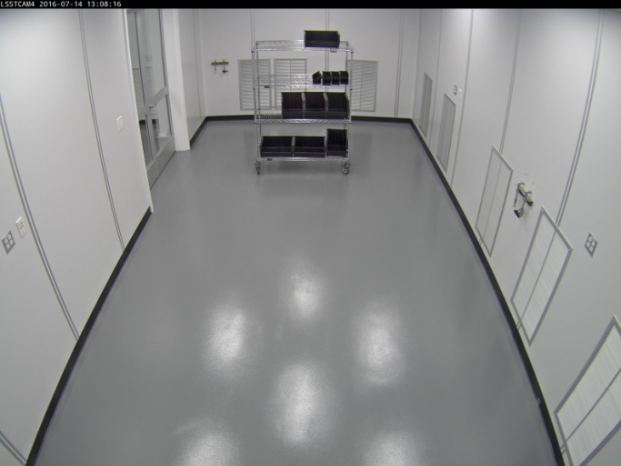
Camera I&T Facility – 2016 REVIEW

Slide 16
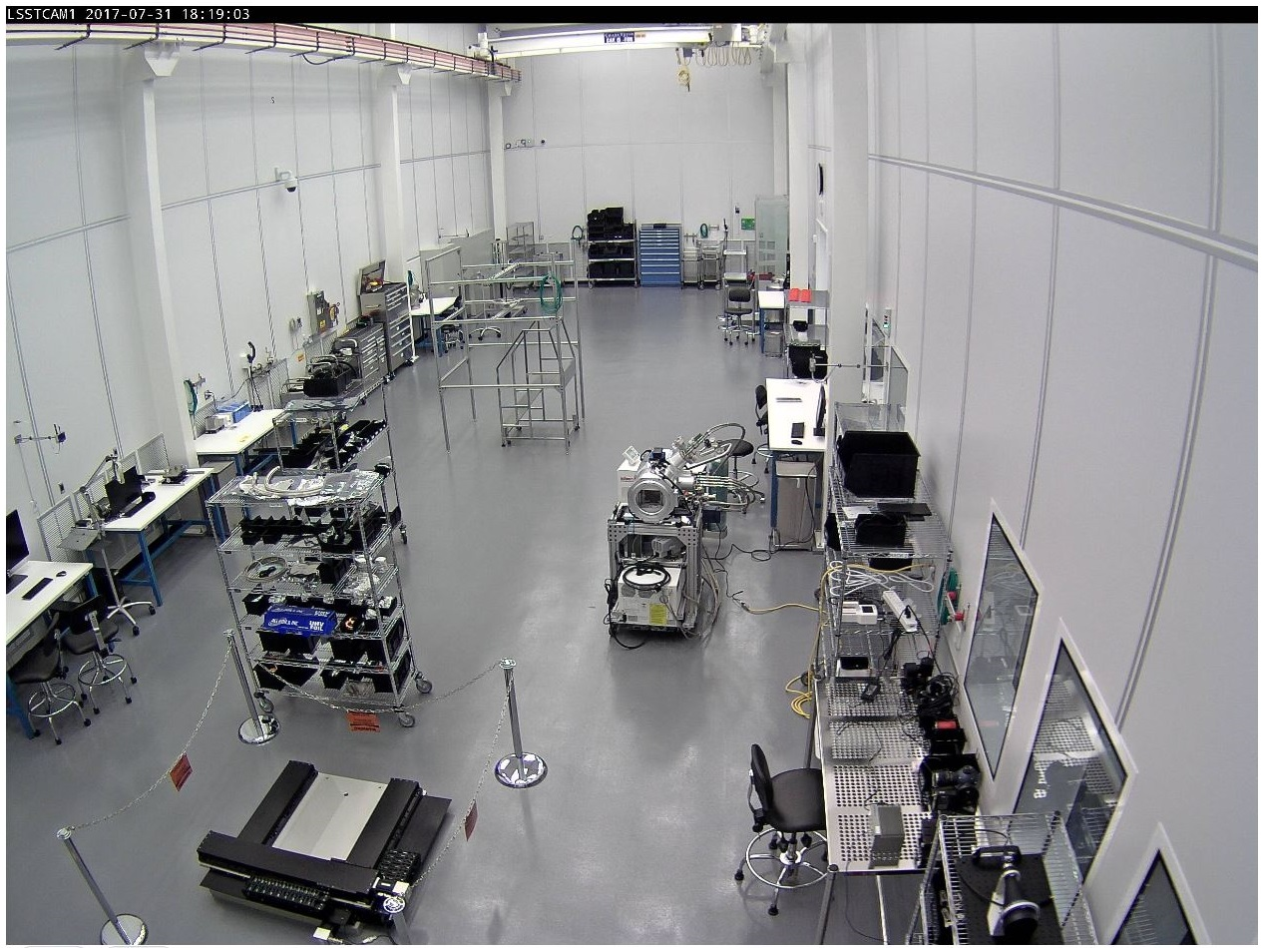
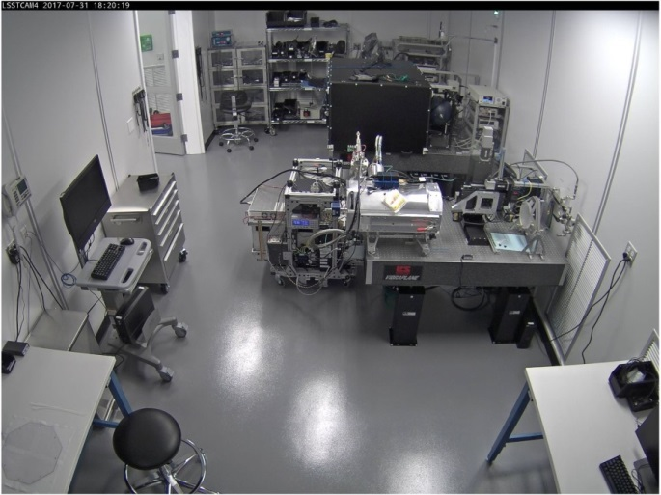
Camera I&T Facility – 2017 REVIEW

Slide 17
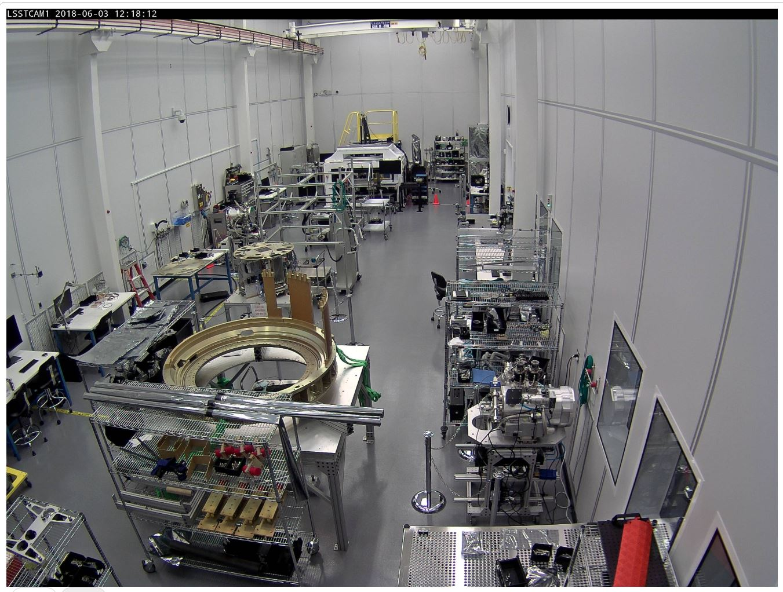
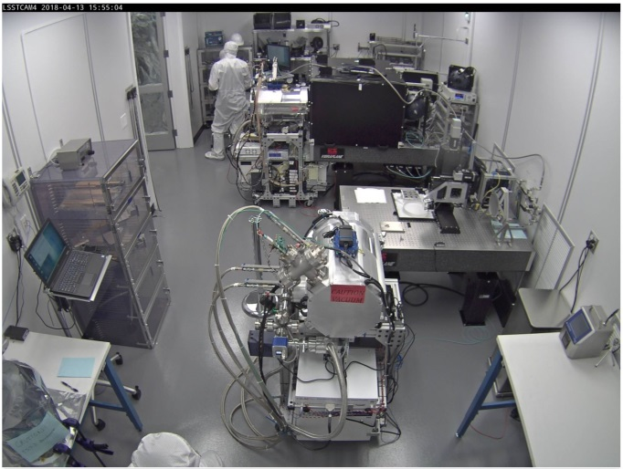
Camera I&T Facility – 2018 REVIEW

Slide 18
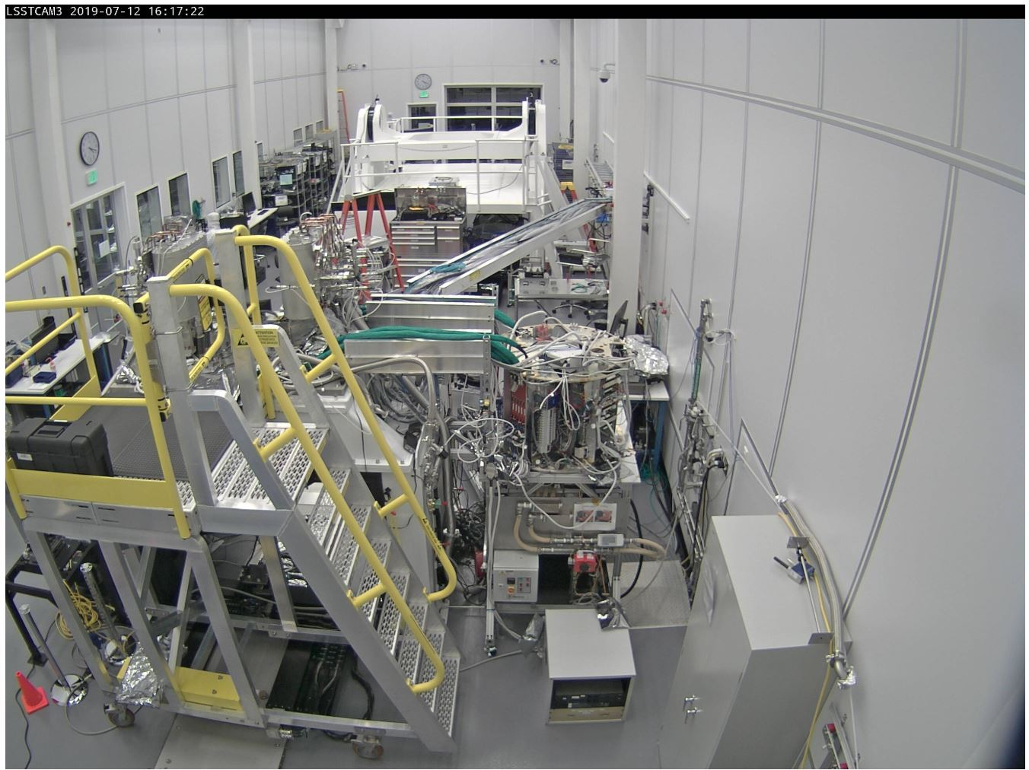
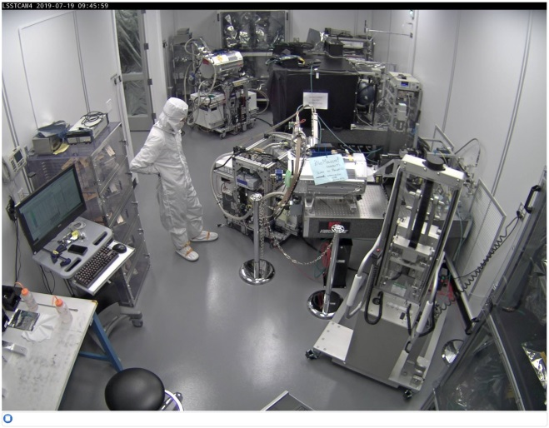
Camera I&T Facility – 2019 REVIEW

Slide 19
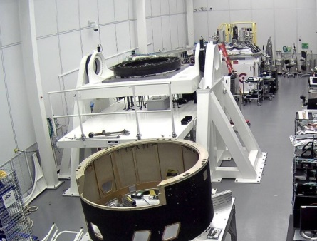
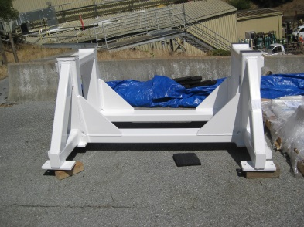
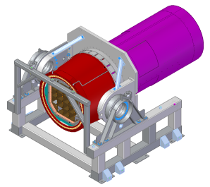
Major Procurements Status:
I&T’s largest procurements are less significant in cost compared to some of the other Camera Hardware; however,
  COMPLETED IN PREVIOUS YEARS:
  BOT – XY(θ) stages:
    Precision XY(θ) Stage @ ~$70k total.
  BOT – Main Structure / Chassis:
    Large weldment @ ~$76k total.
  Integration Gantries (IG):
    2 large custom precision stages @ ~$114k total.
  Cryostat Waffle Plate:
    Custom granite mounting plate for IG @ ~$30k total.
  -----------------------------------------------------------------------------
  Camera Integration Stand: (COMPLETED THIS YEAR)
    Main structure + access stands + control system @ ~$146k total.
  Camera Saddle Stands: (COMPLETED THIS YEAR)
    2 large weldments provided to I&T and Commissioning @ ~$41k total.
  Cryostat Integration Stand: (IN PROGRESS – Aug delivery)
    Last scheduled major procurement to arrive @ ~$38k total.

Slide 20
Major Milestones Accomplished
Science Raft & Corner Raft Acceptance / Re-Verification .
    We have all 22 Science Rafts on site and we are in the process of re-verifying our 11th Raft.
      The delivery of these rafts from BNL was a significant schedule risk for I&T (IT-001) that has now been retired.
      Re-verification efforts here at SLAC unearthed several issues – the most significant being particulate contamination that was resulting in a loss of channels.
      As a result of the comprehensive cleaning and repairing efforts that were undertaken, hardware in now in place (TS6) and a significant amount of knowledge and skill regarding the Science Raft assembly and disassembly processes has been transferred to the SLAC staff.
      REMAINING CONCERN:
        We will need to re-verify another 11 rafts in a 3-4 month period (~1 per week cadence). But this is becoming less of a concern with a second TS7 now about to come on line.
    We have all 4 Corner Rafts in hand and have begun installing them into the Cryostat.
      The timing of the corner raft testing was identified early as a possible issue with I&T schedule (IT-027) due to the shared use of TS8.
      This risk has been significantly reduced with the CR delivery now complete.

Slide 21
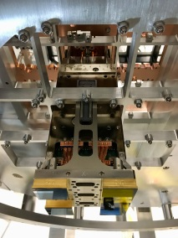
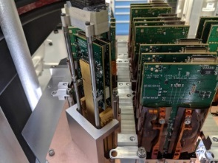
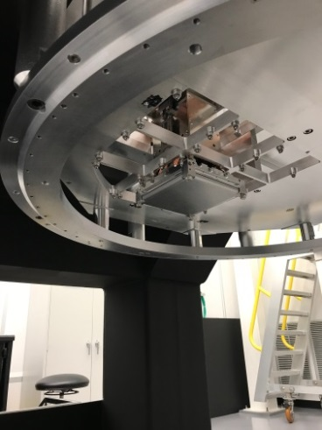
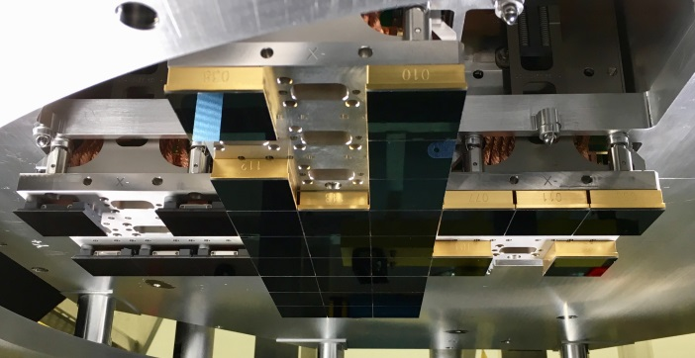
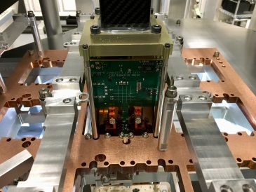
Major Milestones Accomplished
Completed Pathfinder / Test Raft integration (July 2018).
    Extensive use of BOT and Integration Gantries with the Cryostat Mockup and 5 Mechanical Test Rafts.
    This allowed full system verification of I&T equipment prior to having the real Cryostat available.
    Preliminary testing of metrology systems.
      Able to mount the reference flat / hex table to the Cryostat Mock-up.
      Performed metrology with a single MTR in Cryostat Mock-up.

Slide 22
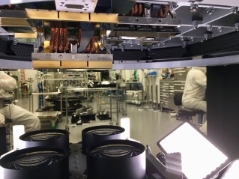
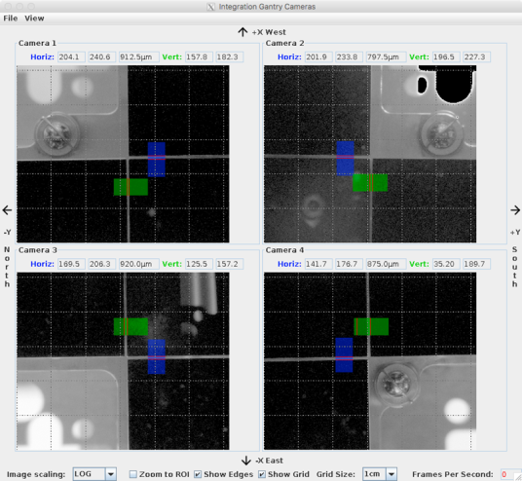
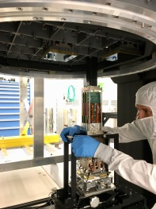
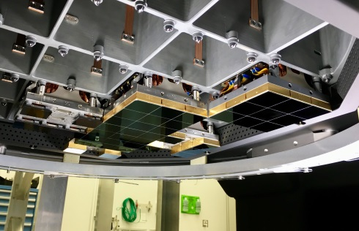
Major Milestones Accomplished
Completed final verification of the Raft insertion/removal processes with the real Cryostat prior to using production rafts (Sept 2018).
    Complete installation of 5 MTRs and 2 ETUs into real Cryostat.
    Included removal of the 5 MTRs from the Cryostat.
    Confirmed use of both types of gantries (Science and Corner Raft) in both insertion and removal configurations.
    Confirmed the use of the telecentric Camera Monitoring Systems.
    Full vetting of the process eTravelers for future production runs.

Slide 23
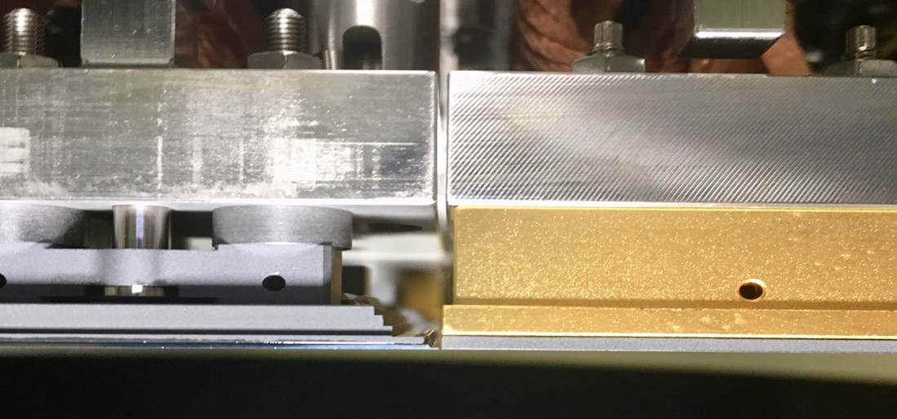
Major Milestones Accomplished
CONFIRMED our ability to safely install (and remove) both Science and Corner Rafts to the extremely tight tolerances specified.

Slide 24
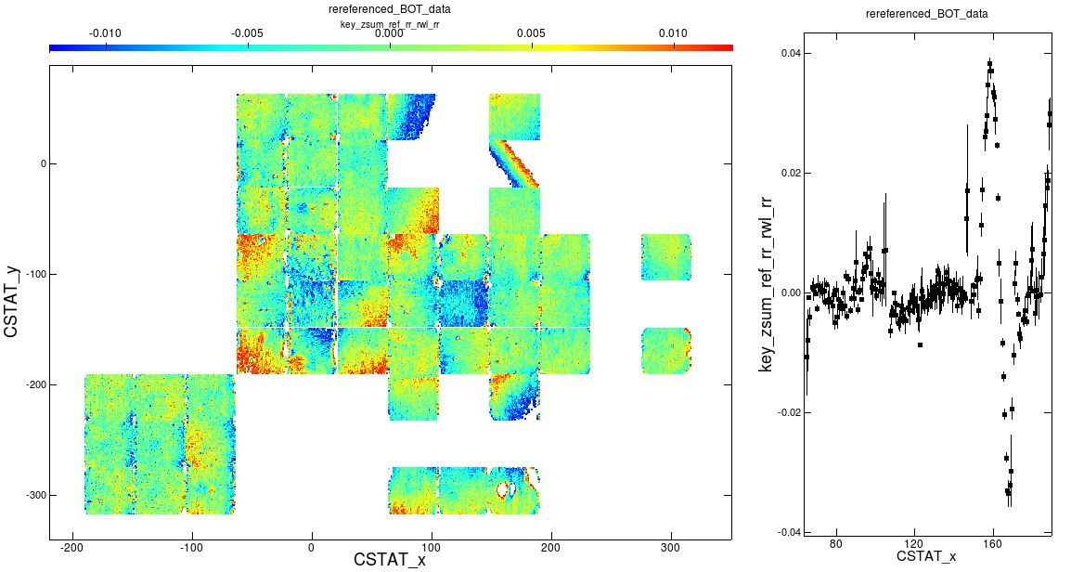
Major Milestones Accomplished
Completed verification of the full BOT Metrology system (Sept 2018).
    Final verification of the BOT metrology process with 7 rafts inserted.
    Confirmed use of metrology hardware and preliminary use of the stitching algorithms necessary for multiple reference flat location measurements.
    Consistent results shown with sub-micron resolution.
Completed verification of the 4 BOT
Electro-optical heads (Apr 2019).
    Final verification of the EO Heads:
      Flat field.
      Single spot.
      X-talk.
      Image projector.
    Used with 2 ETUs installed and the
    Cryostat vacuum and cooling systems
    in operation (2 Cold + 2 Cryogenic).
    EO Results - Subject of talk by
    Aaron Roodman.

Slide 25
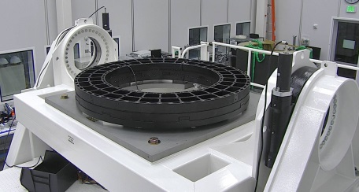
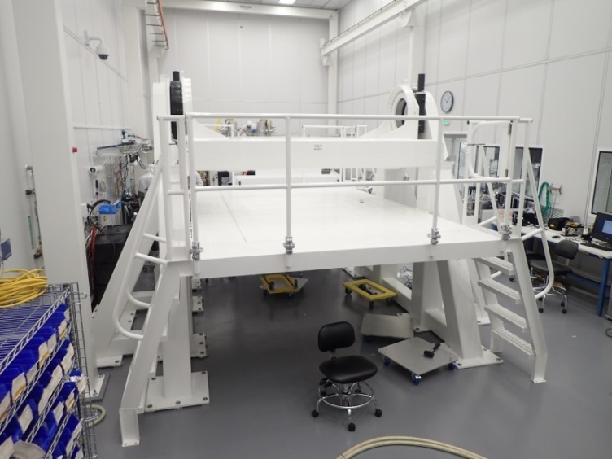
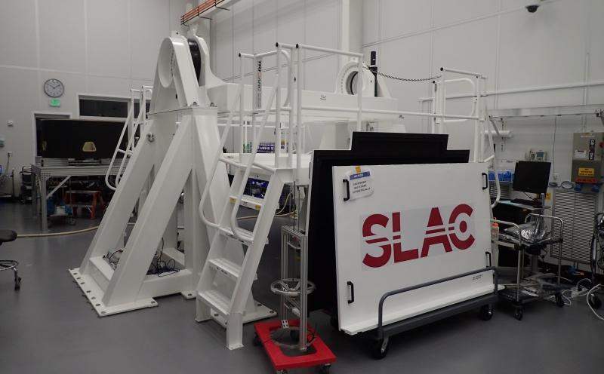
Major Milestones Accomplished
Completed EPR for Camera Integration Stand (Sept 2018).
    All action items addressed and some refinement work was performed to reduce the overall cost of the main weldment structure.
    Procurement process initiated immediately after for main weldment.
Taken Delivery of Completed CIS Structure (Mar 2019).
    Major deliverable for the Clean Room infrastructure.

Slide 26






Major Milestones Accomplished
Completed EPR for Camera Saddle Stand, Cryostat Lift Fixture, and Cryostat Handling Stand (Dec 2018).
    All action items addressed and procurement processes completed.
Taken Delivery of Saddle Stands (July 2019).
    Major deliverable for the Clean Room infrastructure.
Taken Delivery of Cryostat Handling Fixture (In progress - Aug 2019).
    Major deliverable for the Clean Room infrastructure.

Slide 27





Major Milestones Accomplished
Taken delivery of the completed Cryostat, Cryostat Vacuum Systems, and Cryostat Cooling & Refrigeration Systems (Aug 2018 - June 2019).
    Cryostat Structure arrived Aug 2018.
    Cryostat Vacuum Systems arrived Dec 2018.
    Two Cryostat Refrigeration cabinets and HX#1 arrived Feb 2019.
    Remaining Cryostat Refrigeration cabinets and HX#2 arrived May 2019.

Slide 28





Major Milestones Accomplished
Taken delivery of the completed Cryostat Power Feedthroughs and have installed them onto the Cryostat (May 2019).
    Includes 4 production versions and 2 spares.
    Installation was completed, vacuum integrity verified and connectivity was confirmed.
Taken delivery of the completed Optical Transfer Modules (OTMs) and have installed them onto the Cryostat (May 2019).
    Includes 6 production versions and 3 spares.
    Installation was completed, vacuum integrity verified and data transfer rates were confirmed.

Slide 29
Major Milestones Accomplished
Cryostat Operation (Vacuum Systems).
    Pump-down time:
      To reduce the pump-down time, we perform approximately 80 pump & purge cycles with warm N2 and the internal cryostat heaters activated (50-65 minutes each) – with roughing pump only.
      Without P-P, turbo pump vacuum flattens out midway through 4th scale, but with P-P, turbo pump vacuum flattens out midway through 5th scale – a significant improvement (on the order of 10s of days in total pumping time).
      With operation of the pumping system (with P-P) we have reduced the I&T risk related to possible excessive pump-down time (IT-011).
      We can routinely achieving pump-down to 5th scale in roughly 3 days.
    All of the vacuum system’s final control electronics has been provided by Aux Electronics Subsystem and has been vetted in these operations (mounted in it’s final configuration within the Quad Box).
    We have also performed a successful operation of the ion pumps with the turbo pump off to prove their ability to hold vacuum (note: cooling systems were also activated during this test).
    With cooling systems running we are achieving vacuum at low enough levels (well below 10⁻⁶) that we are no longer concerned about the reduced life of the ion pumps that occur when running at higher pressures.
    REMAINING CONCERNS:
      We will need to pump down on substantially more hardware with the full raft compliment installed (although this is somewhat alleviated by the fact that we have already pumped on all of the associated cabling).

Slide 30

Major Milestones Accomplished
Cryostat Operation (Cooling Systems).
    We have been able to operate the cooling systems with all power/control provided by the final Quad Box electronics (Aux Electronics Subsystems deliverable) and controlled by CCS (CCS Subsystem deliverable).
    Verified operation of the associated Hardware Protection System.
    KEY Parameters:
      Operation of the cooling systems has demonstrated that they are in fact meeting (or exceeding) their “key” primary cooling requirements:
        Able to maintain cold systems temperature of -41$°$C with ~800W cooling (little colder than the 30$°$ to 40$°$C called for in the specification).
        Able to maintain temperature stability to < 2$°$C over the environmental range of -5$°$ to +30$°$C.
      Operation of the cryogenic systems has demonstrated that they are meeting their “key” primary cooling requirements:
        Able to achieve a cryogenic temperature in the range of -125 $°$ to -135 $°$C when subjected to a heat load of 83W/circuit (498 W).
        Able to demonstrate a temperature stability of +/- 1.5 $°$C over 136 W thermal load range.
    We have been able to significantly reduce the risk associated with the full refrigeration system testing (IT-037) to “minor” levels with the completion of the ETU testing phase.
    REMAINING CONCERNS:
      We are confident that our testing results will scale to the fully populated Cryostat case, but this is not absolutely assured.
      We encountered a capacity reduction issue that we were able to overcome by cycling compressor operation. We have since implemented a phased starting process that should ensure do not encounter this issue again in the future, but the first test of this will be when we complete the 9+4 raft installation (Sept 2019).

Slide 31
Major Milestones Accomplished
Cryostat Operation (ETU / BOT Testing).
    We have performed two separate campaigns using the following subsystem deliverables:
      Cryostat (+ Vacuum System + Cooling Systems).
      Power Feedthroughs & Optical Transfer Modules (OTMs).
      Quad Box populated with the necessary Aux Electronics Subsystem deliverables
      CCS (all necessary software and associated control interfaces).
      DAQ (all hardware and fiber optic networks necessary).
    These campaigns used non-production Science Rafts - Engineering Test Units (ETUs) to confirm operation of the BOT Electro-optical heads and all of the associated support and readout electronics.
    These campaigns occurred with the cryostat evacuated and cooled to final operational parameters.
      BOT/ETU Run #1: During the period of 3/17 to 4/13, we acquired 16 817 images.
      BOT/ETU Run #2: During the period of 6/5 to 6/10, we acquired 14 874 images.
    The images acquired demonstrated the following functionality:
      BIAS images show reasonable noise
      DARK images show little or no stray light
      Fe55 produce x-ray hits in both rafts
      FLAT illuminates both rafts
    REMAINING CONCERNS:
      We are confident in our hardware and our processes but we are definitely looking forward to demonstrating the CCS’s and DAQ’s ability to scale to the larger formats necessary.

Slide 32


Major Milestones (Upcoming)
Taken delivery of L2-L2 (Expected Aug 13th 2019).
    Arguably our largest, most expensive, and most fragile component.
    Includes handling fixtures and shipping containers.
    Acceptance review completed (July 2019)
    Will remain in storage in the clean room until needed mid-2020.

Slide 33


Major Milestones Accomplished
Have begun installation of the first 9 production Science Rafts and the 4 production Corner Rafts (July 2019).
    As of 8/1/2019 we have 4 Corner rafts installed and expect to have at least 1 more Science Raft installed by the time of the review.

Slide 34
Upcoming Major Milestones – Cryostat Track
Complete the Installation of first 9 Science Rafts (Aug 2019).
    First 9 Science Rafts in focal plane, ready for testing.
Complete EO/Metrology Testing of first 9 Science Rafts (Oct 2019).
    Electro-Optical and Metrology tests of the partially populated focal plane.
Complete Installation of all 21 Science Rafts + 4 Corner Rafts (Nov 2019).
    All Science Rafts and Corner Rafts in focal plane, ready for testing.
Complete EO/Metrology Testing of full focal plane (Jan 2020).
    Electro-Optical and Metrology tests of the fully populated focal plane.
Assembly of the Cryostat with the Utility Trunk (Mar 2020).
Integration of the Cryostat into the Camera (May 2020).

Slide 35
Upcoming Major Milestones – Camera Track
Completed IRR for Camera I&T (Oct 2019)
    All Camera assembly processes verified and approved.
    Work assembling the Camera is approved to proceed.
Take Delivery of Carousel with Back Flange (Oct 2019)
    Scheduled need date of Oct 10/2019.
Take Delivery of Auto changer (Nov 2019)
    Scheduled need date of Nov 4/2019.
Take Delivery of Shutter (Dec 2019)
    Scheduled need date of Dec 18/2019.
Integration Cryostat into Camera (May 2020).
Integration of L1-L2 onto Camera (June 2020).
    Scheduled need Date of May 20/2020

Slide 36
Risks and Mitigations Status

Slide 37
Definition of Risk and Risk Analysis
Risk can be defined as an undesirable event during project execution that negatively affects program goals for performance, cost or schedule.
Risk management is the ongoing process of comprehensively assessing project risks.
Camera Risk Management Plan (LCA-29-A) defines the methodology to manage our risks.
Pts | Likelihood of Occurrence | Approximate Probability | Description of Probability
1 | Rare | <1% | Likelihood of occurrence is not credible
2 | Unlikely | 1-5% | Not reasonably expected to occur
3 | Possible | 5-25% | Possible, or difficult to assess the chance of occurrence
4 | Likely | 25-67% | Very likely that an adverse event will occur
5 | Highly Probable | >67% | High probability that an adverse event will come to pass
Definition of Risk Probability
Pts | Severity of Impact | Description of Impact
Cost Impact
1 | Insignificant | Overrun of cost of < $30K, recoverable with project contingency
2 | Minor | Overrun of cost of $30k - $200K, recoverable with project contingency
3 | Moderate | Overrun of cost of 200k - $1.5M, with significant impact on contingency
4 | High | Overrun of baseline cost of $1.5M - $10M, with re-baseline required
5 | Critical | Overrun of baseline cost of >$10M, with project in jeopardy
Schedule Impact
1 | Insignificant | Degradation of schedule margin to project critical path by < 2 wks
2 | Minor | Degradation of schedule margin to project critical path by 2 wks to 1.5 months
3 | Moderate | Degradation of schedule margin to project critical path by 1.5 to 3 months
4 | High | Degradation of schedule margin to project critical path by 3 to 6 months
5 | Critical | Degradation of schedule margin to project critical path by > 6 months
Performance Impact
1 | Insignificant | No effect on ability to meet requirements; minor design changes needed
2 | Minor | Minor excursion from subsystem requirement, but compensated elsewhere
3 | Moderate | Level 2 and/or SRD design specification exceeded
4 | High | Level 1 and/or SRD minimum specification exceeded
5 | Critical | Unable to achieve any of the primary science missions
Definition of Risk Impact
→Quasi-quantitative process to assign objective values to probability of occurrence and impact of occurrence aspects of risk.
Total Impact:
(0.50*Cost Impact) + (0.33*Schedule Impact) + (0.33*Performance Impact)
→Risk Score:
Risk Probability * Total Impact

Slide 38

I&T Subsystem Specific Risks
Risks are tracked in the Camera Risk registry, Document LCA-29.
Risk exposure is assessed and tracked at regular intervals since 2010 (initial assessment).
Actively planning mitigation to burn down risks and monitor progress.
  Current status: 61 total risks identified.
    50 risks are active (11 are obsolete or complete).
      36 are actively being worked.
      14 are holding (future work) or accepted (no future work).
Mitigations are budgeted in the scope of work.
After the budgeted mitigation is performed, the Post-Mitigation residual risk is analyzed/tracked.
The current top 12 risks are shown below:
  SUBSYSTEM SCHEDULE RISKS:
  IT-022: CCS Schedule.
  IT-017: Back Flange Schedule.
  IT-047: Corner Raft Deliverables Schedule.
  IT-033: Utility trunk utilities available during BOT activities.
  TECHNICAL RISKS:
  IT-031: RTM Performance Degradation.
  IT-045: Metal Particulate Contamination.
  IT-010: Camera Level Noise.
  IT-030: Camera Housing Fit-up to Back Flange.
  IT-032: Refrigeration System Maintenance During I&T.
  PROGRAMMATIC RISKS:
  IT-023: Sustaining Engineering.
  IT-023: I&T Manpower.
  IT-027: Overburdened TS8 at SLAC.

Slide 39

I&T Subsystem – Top 12 Risks

Slide 40
Top - I&T Subsystem Risks
TOP I&T “TECHNICAL” RISKS:
IT-031: RTM Performance Degradation
  IF RTM performance degrades over time (flex cable failure, RTD failure, Sensor Glow) THEN RTM may have to be de-integrated and refurbished.
This particular risk is being addressed via attempted early diagnostics of any of the potential problems identified.
All RTM’s are re-verified individually when they arrive at I&T – both electro-optically and metrologically.
In addition to being re-verified upon arrival, there are several iterations of verification during the I&T process, thus affording opportunities to address possible issues should they arise.
    Full EO testing and metrology runs are performed after 9 rafts are installed
    Full EO testing and metrology runs are performed once all of the rafts are installed (prior to installing L3)
Additional efforts have gone into verifying the raft de-integration process from the cryostat using the integration gantries.
The I&T Group has also developed significant knowledge and resources that would allow it to perform RTM disassembly and servicing on short notice, if required.

Slide 41


Top - I&T Subsystem Risks
TOP I&T “TECHNICAL” RISKS:
IT-045: Metal Particulate Contamination
  IF metal particulate are generated or present inside the cryostat THEN additional efforts will be required for decontamination and re-verify.
This particular risk has been somewhat realized and is the subject of significant efforts both at BNL and at SLAC (see BCR-086: RTM refurbishment Replan).
In Sept 2018, it was noticed that several of the rafts in the I&T reverification process were presenting “missing channels” compared to the original BNL testing. Further investigation revealed a contamination issue on the backs of the RSA plates (and in some cases upon the sensor’s exposed wire bonds themselves) that would pose a significant problem in the future if not addressed.

Slide 42
Top - I&T Subsystem Risks
TOP I&T “TECHNICAL” RISKS:
IT-045: Metal Particulate Contamination
  IF metal particulate are generated or present inside the cryostat THEN additional efforts will be required for decontamination and re-verify.
SLAC and BNL mobilized and developed a three-pronged approach for addressing the issue:
    Determine and minimize the source of the particulate.
    Comprehensively clean and repair all of the effected rafts.
    Protect the sensitive areas with shields or covers.
Dedicated protective covers were added to the backs of the RSAs to help minimize the impact of any possible future contamination events.
As a result of the comprehensive cleaning and repairing efforts that were undertaken, a significant amount of knowledge and skill regarding the Science Raft assembly and disassembly processes has been transferred to the SLAC staff.
Processes were developed for cleaning of the two different types of RSA assemblies:
    ITL: a cleaning process was developed at SLAC and can be performed again on short notice if required.
    E2V: this particular cleaning process requires the use of a wire bond expert at BNL and could be handled by that expert again in the future should the need arise.
Current re-verification efforts have revealed a recovery of the lost channels identified.

Slide 43
Top - I&T Subsystem Risks
RISKS RELATED TO LATE DELIVERY FROM OTHER SUBSYSTEMS:
IT-017: Back Flange Schedule
  IF the back flange is delayed THEN integration of the carousel and/or camera body will be delayed. Second shift can help mitigate.
IT-022: CCS Schedule
  IF CCS software is not fully tested prior to verification testing THEN significant delays in test program could occur. Additional support of CCS development during I&T may be required.
IT-033: Utility trunk utilities available during BOT activities - Schedule
  IF the Utility Trunk utilities are not available during BOT testing due to maintenance issues or capabilities shortfalls, then BOT testing will be delayed.
IT-047: Corner Raft Deliverables Schedule
  IF Corner Raft tower delivery is delayed, THEN the I&T schedule and camera delivery will be delayed.
Essentially we have to hold these risks until the delivery dates for the corresponding hardware at which point the risk will retire.
Some of these have been realized and the I&T schedule has been adjusted or altered to help accommodate:
    CCS – I&T has prepared to move forward with BOT testing using a “2 raft” CCS system that has been vetted in the past. Should the “9 raft” system not be available, we can move forward with an improvised BOT testing schedule.
    Corner Raft delays – I&T is prepared to complete the “9 raft” testing with a reduced number of corner rafts if necessary. The additional Corner Rafts will be installed in the second phase of raft installation and testing will be completed with the full Cryostat.

Slide 44
Top - I&T Subsystem Risks
“NEW RISKS” RELATED TO UNEXPECTED RECENT EVENTS AND DRIVEN BY SCHEDULE:
IT-058: Missing Fastener Washer
  IF the lost washer is in the Cryostat THEN it could damage the focal plane.
IT-059: Loss of Trim Heater
  IF the trim heaters develop short circuits THEN control authority and cool down may be impaired.
IT-060: Guide Sensor Glow
  IF the Guide sensors glow ends up polluting the focal plane with spurious light THEN performance may be impacted.
IT-061: Heater Shroud Ground Short
  IF the heater and RTD cable shroud connects cryo and cold together and to the cryostat shell THEN ground could be created and read noise impacted.
Essentially there are risks that have been identified late in the I&T process and mitigations/dispositions are being driven by the Camera schedule.
They have been evaluated extensively, and the determination is that we need to proceed “at risk” (given the current schedule constraints).
They have been added to the Risk Registry as a matter of record and will serve as a “lien” on the budget contingency should they become an issue in the future.

Slide 45

Key Risks Retired (or Reduced Significantly)
  IT-001: Science Raft Schedule.
    IF Science Raft tower delivery is delayed, THEN the I&T schedule and camera delivery will be delayed.
      Risk Retired (completed).
      All Science Rafts have been delivered from BNL as of July 1/2019.
  IT-014: Cryostat Deliverables.
    IF the cryostat assembly (and/or associated parts) are delayed in their availability to I&T THEN mechanical integration of RAFT towers into the cryostat will be.
  IT-015: Refrigeration Deliverables.
    IF the I&T refrigeration system is delayed THEN Science Raft integration cannot proceed as scheduled.
      Risk reduced significantly - holding.
      The major components of this hardware have been delivered and are in use.
      Risk has reduced significantly and will close with the final deliverables within Utility Trunk.
  IT-006: Raft Tower Collision.
    IF rafts/sensors collide with neighbors during integration, THEN additional sensors/rafts would need to be procured and assembled.
      Risk reduced significantly (to minor) – currently “working” this risk and will complete in Dec 2019.
      See slides below for details…

Slide 46
“Past” Top - I&T Subsystem Risk
IT-006: Raft Tower Collision.
  IF rafts/sensors collide with neighbors during integration, THEN additional sensors/rafts would need to be procured and assembled.
This particular risk had been what we considered to be our most serious/significant risk. It has been thoroughly studied and currently addressed by multiple mitigation approaches.
    Added high quality /resolution monitoring cameras with edge detection to implement closed loop visual tracking of the critical clearances.
    Added and developed two separate IG designs through to EPR for purposes of determining best possible HW / actuation system available for the job.
    Implemented a Mechanical Test Raft / Cryostat Mockup program for thorough vetting of the IG hardware systems and associated process.
    Performed extensive trial runs with the real Cryostat and the MTRs performing both insertions and extractions.
    Have inserted, tested and removed 2x Engineering Test Units (ETUs) that have operational (engineering grade) sensors on them.
This risk is held until all raft installation is complete and then retired (Dec 2019).

Slide 47




RISK IT-006: Raft Tower Collision
The Integration Gantry needs to reach through the back of the cryostat.
Attaches to the middle of an RTM.
620 mm draw of RTM into final position.
~1 mm spacing over the majority of the draw into the cryostat.
< 500 um spacing near the end of the draw.

Slide 48

RISK IT-006: Raft Tower Collision
500 microns spacing - “nominally”
250 micron spacing - “bad cases”
125 micron spacing - “absolute worst case”

Slide 49

RISK IT-006: Raft Tower Collision
500 microns spacing - “nominally”
250 micron spacing - “bad cases”
125 micron spacing - “absolute worst case”

Slide 50
Hazards Status

Slide 51
Hazard Analysis
Hazards can be defined as a failure of a component, system or function that could lead to personnel injury or damage to hardware.
  Hazards are NOT risks.

Slide 52


I&T Subsystem - Hazards Details
The severity of the current registered hazards can be categorized as follows:
I&T has been actively mitigating these Hazards to an acceptable level (Medium or Low):
Operational and Commissioning hazards
  We have been identifying and actively tracking the risks that will be inherited from the subsystems as they hand off their deliverables to I&T.
  This includes hazards for the integration and test phase here at SLAC, as well as the hazards that will be passed on to the Commissioning and Operations teams when we deliver the camera to LSST.

Slide 53

I&T Subsystem - Hazards Registry
Top 6 Hazards – Post Mitigation

Slide 54

I&T Subsystem - Hazards Registry
Top 7-16 Hazards – Post Mitigation

Slide 55
I&T Subsystem - Hazards Details
Hazards are identified at regular intervals and tracked in the Camera Hazard registry, Document LCA-15.
Mitigations are established for hazards to reduce hazard risk to acceptable levels (medium or lower).
There are currently 38 hazards in the hazard registry for the I&T Subsystem.
Current registered Hazards can be categorized as follows:
Number | Type | Description, e.g.
6 | Materials | Spraying refrigerant
3 | Thermal/Cryo | Burns from hot surfaces
8 | Environmental | Oxygen deficiency from N₂
3 | Electrical | Shock, startle hazard
4 | Pressure/Vacuum | Rupture, implosion
10 | Mechanical | Crushing from entrapment
3 | Structural | Injury from falling equipment
1 | Fire | Burns, smoke inhalation

Slide 56
I&T Subsystem – Processes in Place
In addition to the individual Hazards (and Risks) that I&T has targeted, there are also a significant number of ancillary activities that I&T undertakes in an effort to reduce the likelihood of an unexpected incident.
  Hold daily “Tailgate Meetings” (8:00am) to serve as work release for that days activities in the Clean Room – attendance mandatory.
  Perform auditing of Clean Room entry to confirm conformance to the days work release.
  Perform a daily 1 hour Quality Control audit in the Clean Room (by the Lead Technician) prior to the tailgate meeting – any violations are dealt with that day.
  Hold “Plan of the Week” – weekly I&T meeting (Mon 9:00am) used to give a higher level view of all I&T activities occurring in the coming week and the near future.
  Hold a variety of “Notice-To-Proceed” reviews at key times and dates prior to undertaking any new significant activities.
  Perform dry-run / Pathfinder operations for vetting of processes and equipment.
  Establish extremely detailed eTravelers that require thorough approvals prior to performing any processes on Camera hardware.
  Adhere to a thorough NCR process with all required approvals necessary prior to implementation of proposed solutions or proceeding with any related work.

Slide 57
I&T Subsystem – Events / Incidents
Raft Contamination Issue: During I&T reverification activities, it was discovered that several Science Rafts were exhibiting missing channels in excess to that what was previously seen in the BNL verification testing.
  A “stop work order” was issued and both the SLAC I&T Team and the BNL Science Raft Team mobilized to aggressively investigate and address the issue.
  An external committee of experts was convened and a thorough review of all past activities and processes were audited. Recommendations were also presented to the committee for dispositioning.
  All recommendations made by the two teams and the reviewing committee were implemented in BCR-086. A very thorough “Raft Refurbishment Program” was immediately undertaken.
  OUTCOME: Very positive results with the side effect of having built a wealth of experience in dealing with the handling of Science Raft Hardware and non-lubricated hardware/fasteners in general.
Crane Incident involving a RTM-022: There was a clean room incident involving the crane and one of the Science Rafts being removed from its shipping Bell Jar.
  A “stop work order” was issued, and all clean room activities were halted until a thorough assessment completed.
  A detailed investigation of the incident took place and it was determined that several coincidental process and hardware flaws conspired to allowing for the actual incident to occur.
  After the incident, the phased ramping up of Clean Room operations took upwards of a week for full Clean Room activities to resume (including Lab level approvals to proceed).
  OUTCOME: The damage to the raft was assessed as minor, and full recovery took less than two weeks. A possible improvement in our crane operation process was discovered, and the mitigation to that flaw has been implemented not only in crane operations, but to many other I&T Critical Hardware activities.

Slide 58
Programmatic Status

Slide 59
I&T Organizational Chart
I&T Management
Engineering Manager / CAM: Tim Bond
Scientist: Aaron Roodman
Deputy Scientist: Kevin Reil
I&T Core Engineering Team
Lead Mechanical Engineer: Travis Lange
Mechanical Engineer: Scott Newbry
Mechanical Engineer: Boyd Bowdish
Mechanical Engineer: Vincent Lee
Electrical Engineer: Stephen Cisneros
Junior Mechanical Engineer: Hannah Pollek
Mechanical Engineer: Margaux Lopez (to Commissioning)
Mechanical Engineer: Diane Hascall (to Commissioning)
I&T Software / Physicist Support
Staff Scientist: Stuart Marshall
Staff Scientist: Andy Rasmussen
Staff Scientist: Yousuke Utsumi
Staff Scientist: Homer Neil
Staff Scientist: Seth Digel
Staff Scientist: Jim Chiang
Sr. Staff Scientist: Tony Johnson (CCS support)
Sr. Staff Scientist: Mike Huffer (DAQ support)
Sr. Staff Scientist: Richard Dubois
I&T Core Technical Team
Facilities Management: Jeff Tice
Mechanical Technician: Mike Silva
Mechanical Technician: Andy Hau
Mechanical Technician: Tom Nieland
Safety Officer: Joe Kenny
I&T CCOB Team (Grenoble - FR)
CCOB Lead: Aurelien Barrau (IN2P3)
CCOB Physicist: Christophe Vescovi (IN2P3)
CCOB Engineer: Myriam Vigliore (IN2P3)
CCOB Engineer: Jean-Stephane Ricol (IN2P3)
CCOB Engineer: Marion Moneuse (IN2P3)
The I&T Team leverage their technical efforts from other Camera subsystem team members as well as many additional people at SLAC, BNL, LLNL, and IN2P3.

Slide 60

Subsystem Staffing Profile
We were somewhat slow to come up to required staffing levels but are positioned very well for moving forward during the next two years. We have taken advantage of staff transitioning to Commissioning to accommodate past schedule peaks and valleys.

Slide 61

I&T Subsystem Performance (as of May 2018)
I&T Cumulative SPI = 0.92 (JSR 2018=0.89 & JSR 2017=0.79)
I&T Cumulative CPI = 0.90 (JSR 2018=0.86 & JSR 2017=0.86)
High Level SCHEDULE summary
    SPI has improved despite some challenging staffing issues (significantly understaffed and we allowed some developments to be delayed in order to accommodate).
High level COST summary:
    CPI has improved – many of the costs associated with the development of our support equipment have reached completion and overruns have been captured in the Nov 2016, Nov 2017, and Nov 2018 Comprehensive EAC (see details in appropriate section below).

Slide 62

I&T Performance Trend
SPI = 0.92: improved early in the year and has been holding fairly steady.
CPI = 0.90: has been slowly improving over the course of the year.

Slide 63
I&T Subsystem Variance Analysis – 3.08.01
I&T Management
    SPI=1.00 ; CPI=1.02 – (improved from SPI=1.00 ; CPI=0.96)
    SV = $0k
      This is a “level of effort” account ($0k variance by definition).
    CV=+$39k
      Small positive cost variance (at the level of “noise” compared to the ~$2.4M already spent in this account).

Slide 64
I&T Subsystem Variance Analysis – 3.08.02
Verification Test Systems
    SPI=0.96 ; CPI=0.95 – (worsened slightly from SPI=0.98 ; CPI=0.97)
    SV = -$111k
      All of this variance can be attributed to late Camera verification analysis software development - behind schedule awaiting completion of the Camera HW.
    CV = -$151k
      This variance has many contributors including overruns on the BOT development, overruns on the Cryostat Mock-up hardware, and unplanned servicing of the Raft Verification Test Stands.
        -$92k of this was captured in the Oct 2018 Comprehensive EAC.
        -$59k of this variance is related to recent overruns in the BOT development activities and may need to be captured in a future EAC change.

Slide 65
I&T Subsystem Variance Analysis – 3.08.03
Cryostat I&T
    SPI=0.85 ; CPI=0.87 – (improved from SPI=0.78 ; CPI=0.79)
    SV = -$312k
      $79k - from delays in Cryostat assembly due to late Cryostat delivery.
      $73k – due to delayed Science Raft Acceptance Testing held up by Raft verification issues.
      $160k – due to Cryostat Handling Equipment development efforts delayed by staffing issues.
    CV= -$259k
      -$311k past variance due to cost overruns associated with difficulties with the Raft Integration Gantry.
        -220k of this was substantiated in the Comprehensive Nov 2017 EAC.
        -91k of this was substantiated in the Comprehensive Nov 2018 EAC.
      $87k of this overrun is associated with difficulties occurring in the Cryostat assembly.
        87k of this was submitted in a Mar 2019 EAC update.

Slide 66
I&T Subsystem Variance Analysis – 3.08.04
Camera I&T
    SPI=0.80 ; CPI=0.72 – (improved from SPI=0.68 ; CPI=0.63)
    SV = -$310k
      -$90k is due to delays in completion of the Camera Integration Stand. This was previously delayed due to staffing constraints. Staffing remains an issue, but variance is expected to improve in the next few months.
      -$220k is due to delays in starting the assembly of the Camera Body with the Back Flange – due to be delivered from IN2P3 in late September 2019.
    CV=~-$494k
      This variance is mainly due to cost overruns associated with the completion of the IR2 Clean Room (this includes finishing construction of the clean room and populating/outfitting the clean room). Also some of this variance is due to cost overruns on the Camera Integration Stand structure.
        -$278k of this was substantiated in the Comprehensive Nov 2016 EAC.
        -$144k of this was substantiated in the Comprehensive Nov 2017 EAC.
        -$90k of this was substantiated in the Comprehensive Nov 2018 EAC.
      Note that $62k of the cost variance is due to rate changes and this was also substantiated in the Comprehensive Nov 2018 EAC.

Slide 67

I&T Subsystem Estimate to Complete
Comprehensive estimate at completion performed on 10/2018 (performed yearly).
Some smaller additional updates were done for individual cost accounts.
EAC key drivers:
Substantial savings in project management account due to an identified reduction in the total needed Sustained Engineering efforts.
Cost over-runs on the IG design and development (3.08.03).
Cost over-runs on the Clean Room completion (3.08.04).

Slide 68

I&T Summary Schedule

Slide 69

Upcoming Milestones – 12 Month Look Ahead

Slide 70
Summary

Slide 71
Summary
An experienced team has been assembled to integrate and test all of the Camera Subsystem deliverables.
All of the higher-level I&T flow sequences have been methodically developed.
All large procurements are complete.
The development of all I&T support and handling equipment has been completed or is in the final stages of completion.
All of the I&T verification activities have been well planned, and the appropriate hardware prototypes have been completed.
Risks have been identified and are being actively managed.
Hazards are being actively managed. Hazards that are inherited from the other subsystems are being tracked and reviewed for commissioning and operation planning.
Budget and schedule are being managed and are consistent with project guidelines.
“I&T is fully prepared to integrate and test the LSST Camera as designed”.

Slide 72
Supporting Material – Key Documents

Slide 73
I&T Key Documents
I&T Documents are Available on “Additional Docs” Tab in Confluence.
Key Documents & Reviews for the I&T subsystem can be found at:
  https://confluence.slac.stanford.edu/display/LSSTCAMREV/Home
  Contact the Camera point of contact for access.
This site contains:
  Project Documents
  Design and Allocated Baseline Documents
    Specifications
    ICDs
    Design Documents
  Cost and Schedule Baseline
  Design Reviews & Relevant Presentations
    Preliminary Design Review
    Other reviews
  Focused Topics

Slide 74
Supporting Material – Past Reviews

Slide 75
Response to Past NSF/DOE Status Review
No I&T Subsystem specific recommendations.

Slide 76

I&T Past Review Responses
There has been 1 major review with the I&T subsystem in the past year – the combined Integration Gantry TRR / BOT TRR / Cryostat IRR. All action items from this June 2018 review have been addressed:
Cryostat I&T Integration Readiness Review (June 2018):
    Completed lift cart proof test and validation testing.
    Completed RGA and procedure validation testing of Fe55 ring.
    Completed seismic analysis of Quad Box support stand.
    Updated integration gantry hazards and mitigations.
    Designed specialized tools to hold fasteners.
    Completed plans for testing and retro-fit of RTMs to address de-integration problems.
    Developed standardized gantry motion protocols for each bay.
    Held 2 follow-on hold point pre-start reviews to confirm that all tier 1 and tier 2 RFAs have been closed.
    Defined and documented the process for I&T utilization of "paper" travelers and eTravelers.
    Developed list of qualified, trained personnel to handle critical hardware and equipment.

Slide 77
Supporting Material – BCR / EAC Details

Slide 78
3.08.01: I&T Management – BCR/EAC Trail
BAC = $3 574 k ----- ΔBAC = +$508k (From PMB Start)
The major contributors to this total are:
  $113k - BCR-023: I&T Replan (Feb 2016) - see slide #45 - #47.
  $149k - BCR-075: Standing Army updates.
  $68k - BCR-077: Standing Army updates (missed in BCR-075).
  $32k – BCR-080: Additional Scientific Intern Support
  $121k - BCR-086: RTM Remediation Replan.
EAC = $3 435 k ----- Predicted VAC = +$139k
EAC-014: FY17 Comprehensive EAC Update (-$30K).
      Costs associated with multiple additional reviews and 2016 I&T Re-plan efforts.
EAC-021a: FY18 Comprehensive EAC Update (+$253k).
      +$58k overruns in management effort (increase from 40% to 50% level).
      -$327k reduction due to reduced levels of Sustained Engineering.
      $16k due to project wide rate changes and previous overruns.
EAC-033: FY19 Comprehensive EAC Update (-$30k).
      Costs associated 2 month project extension
EAC-029: Labor overruns due to management effort over the allocated 50% FTE (-$115k).
EAC-039: Efficiencies in use of Clean Room manager and savings in travel (+$66k).

Slide 79

3.08.01: I&T Management – BCR/EAC Trail

Slide 80
3.08.02: Verification Test Systems – BCR/EAC Trail
BAC = $2 887 k ----- ΔBAC = +$96k (From PMB Start)
The major contributors to this total are:
  $235k - BCR-023: I&T Replan (Feb 2016) - see slide #45 - #47.
  -$264k - BCR-28, BCR-33, BCR-34: Use of previously developed TSx Science Raft Test Systems from BNL.
  -$51k - BCR-039: LSST Camera Reorganization – the reclassification of ME effort.
  $23k – BCR-051: Missing scope (Leak Cart and a TS-6 for raft disassembly/re-assembly at SLAC).
  $33k - BCR-070: Augmented BOT testing processes.
  $25k - BCR-072: Upgrade of ETU#1 REB4 boards to REB5 boards.
  $25k - BCR-076: Servicing and Maintenance of both TS7 refrigerant systems.
EAC = $3 020 k ----- Predicted VAC = -$134k
EAC-002: Apr 2015 EAC Update (+$99K).
      Returned due to removal of Camera final integrated image quality testing efforts.
EAC-014: FY17 Comprehensive EAC Update (+$92K).
      Returned due to saving on Junior Mechanical Engineer salary.
EAC-021a: FY18 Comprehensive EAC Update (-$269k).
      Due to increased efforts/costs related to the BOT development and the Cryostat Mock-up.
EAC-023: Correction of accounting error in previously processed BCR-070. (+$30k).
EAC-029: Completion of the BOT and the Cryostat Mockup (-$27k).
EAC-033: FY19 Comprehensive EAC Update (-$92k).
      $40k Due to additional materials needed to complete the BOT.
      $22k due to increased efforts/costs related to servicing verification test stands.
      $30k due to increased efforts/costs related to servicing BOT.

Slide 81

3.08.02: Verification Test Systems – BCR/EAC Trail

Slide 82
3.08.03: Cryostat I&T – BCR/EAC Trail
BAC = $2 710 k ----- ΔBAC = +$367k (From PMB Start)
The major contributors to this total are:
  -$346k - BCR-023: I&T Replan (Feb 2016) - see slide #45 - #47.
  +$72k - BCR-001, BCR-021, BCR-044, BCR-67, BCR-83: Impacts from project wide rate updates.
  -$67k - BCR-039: LSST Camera Reorganization – the reclassification of ME effort.
  +$85k - BCR-070: Augmented Gantry testing processes.
  +$111k - BCR-084, BCR-088, BCR-089: Science Raft Reconstruction.
  +$457k - BCR-086: RTM Remediation (contamination).
EAC = $3 082 k ----- Predicted VAC = -$372k
EAC-014: FY17 Comprehensive EAC Update (-$220K).
      Due to increased efforts/costs related to completing the Integration Gantry design and development.
EAC-021a: FY18 Comprehensive EAC Update (-$276k).
      $201k Due to increased efforts/costs related to completing the Integration Gantry design and development.
      $75k due to project wide rate changes.
EAC-029: Labor underrun by use of Scientists (contributed) and Junior Engineers (+$135K).
EAC-031: Integration Gantry TRR / IRR action items (-$72K).
EAC-033: FY19 Comprehensive EAC Update (+$11k).
      Due to efficiencies in RTM reverification efforts.
EAC-039: Cryostat and Quad Box completion efforts by I&T staff. (-$87k).

Slide 83

3.08.03: Cryostat I&T – BCR/EAC Trail

Slide 84
3.08.04: Camera I&T – BCR/EAC Trail
BAC = $2 107 k ----- ΔBAC = -$38k (From PMB Start)
The major contributors to this total are:
  -$30k - BCR-023: I&T Replan (Feb 2016) - see slide #45 - #47.
  +$0k - BCR-001, BCR-021, BCR-044, BCR-67, BCR-83: Impacts from project wide rate updates.
  -$45k - BCR-031: Addition of 2nd Backflange Scope.
  -$57k - BCR-039: LSST Camera Reorganization – the reclassification of ME effort.
  +$49k - BCR-049: Bldg#33 and Bldg#660 Security updates.
  +$49k – BCR-051: IR2 Clean Room dedicated vacuum testing / leak cart.
  +$100k - BCR-071: IR2 Services Upgrades.
  -$154k - BCR-082: Descope of Camera Saddle Stand fabrication.
EAC = $2 286 k ----- Predicted VAC = -$178k
EAC-014: FY17 Comprehensive EAC Update (-$278K).
      Due to increased efforts/costs related to completing the IR2 Clean Room.
EAC-021a: FY18 Comprehensive EAC Update (-$206k).
      -$144k increase due to additional increased efforts/costs related to completing the IR2 Clean Room.
      -$62k due to project wide rate changes.
EAC-033: FY19 Comprehensive EAC Update (+$239k).
      -$61k Due to increased costs for procurement of the Camera Integration Stand weldment.
      -$30k Due to increased costs for redesign of Camera Integration Stand weldment to simplify.
      +$343k due to moving of effort to IN2P3 funding account.

Slide 85

3.08.04: Camera I&T – BCR/EAC Trail

Slide 86
Supporting Material – I&T 2016 Replan Details

Slide 87

I&T Subsystem: BCR-023
I&T BCR-023 (Feb 2016) - REPLAN
  Major I&T Subsystem Baseline Change Request incorporating a lot of significant changes to the I&T WBS.
    +$764k of new scope
    -$375k of scope transfer
    -$138k budget reductions (bottoms up estimates)
  Total increase in budget of $251k

Slide 88
I&T Subsystem: BCR-023
New Scope ($764k):
  Addition of missing scope to build the shipping container and to prepare the instrument for shipment: +$280k.
  Addition of missing scope for ongoing Clean Room Facility operations (incl. maintenance, janitorial, and consumables): +$163k.
  Addition of missing scope for clean room management support through FY2020: +$150k.
  Addition of missing scope to build a cryostat “mock-up” for process verification of the raft integration: +$111k.
  Addition of missing scope for I&T Subsystem Management FY2020: +$59k
Scope transfer ($375k):
  Vacuum qualification systems (MTF): -$201k.
    Scope/budget transferred to Systems Integration.
    $29k remains for hot N2 purge HW.
  Integration Gantry HCU: -$174k
    Scope budget transferred to CCS.
Budget reduction (-$138k):
  Based on a bottoms up review of the existing plan and technical process changes.
  New Basis of Estimate (BOE) established.
    All of the equipment handling and testing systems that are being developed by I&T were re-planned (new activities established) and re-estimated (new estimates for both effort and M&S).
    All of the I&T process activities (i.e. assembly and testing sequences) have been re-planned based on the flow diagrams and the estimates of the effort for the identified activities refined.

Slide 89
Supporting Material – I&T Process Development

Slide 90
I&T Process Development
I&T has produced highly detailed schematic work flow diagrams for all assembly and test processes:
  Enabled us to identify exactly where in the I&T sequence individual camera components are needed and/or expected.
  Identified where all the individual verification tests occur within the assembly flow sequence.
  Identified all individual components or subassemblies very specifically (i.e. by drawing #).
  Includes all deliverables from individual subsystems.
    Camera components.
    Any additional fixtures required specific to the subsystem.
    I&T developed fixtures and equipment.
    Temporary “engineering” level operating or test equipment.
  Captured onto formal drawings and added to LSST Camera configuration control system.
    LCA-11685: Camera Integration and Test Flow Diagram (live document).
    LCA-15106: Camera Integration and Test eTraveler Flow Chart.
Helps us to identify additional elements needed from subsystems and to ensure they were identified in the appropriate ICD/IDD with I&T.

Slide 91

Science Raft Verification – Processes
I&T’s Science Raft Verification processes were internally developed and were subject to a dedicated Integration Readiness Review (IRR) performed in Sept 2017.
This figure captures all of the possible states that a raft may exist in while proceeding through the I&T acceptance testing / re-verification sequence. This flow diagram is currently under revision control (LCA-15106).

Slide 92

Science Raft Verification - eTraveler List
An example screen shot of our Science Raft Re-verification eTraveler confluence page - listing the first 15 of the 35+ total necessary eTravelers identified, and also providing links to the eTraveler and their current status:

Slide 93


Cryostat Integration – Processes
I&T’s Cryostat Integration processes were internally developed and were subject to a dedicated Integration Readiness Review (IRR) performed in July 2018.
This figure captures the assembly and testing flow sequences that the Cryostat will proceed through during the I&T phase of the Camera schedule. This flow diagram is currently under revision control (LCA-11685).

Slide 94

Cryostat Integration – P6 Resolution
In most cases, the resolution was further improved to capture and match the P6 estimates for both the durations and the required efforts necessary to complete the individual tasks. In a few cases, the P6 estimates had to be replanned to match the new higher fidelity estimates.

Slide 95


Cryostat Integration – eTraveler Identification
Finally – the list of activities was broken down into individual procedures and processes. Each of these were developed into its own process document (EXCEL) or an eTraveler (both requiring submission through the appropriate approvals process).

Slide 96

Cryostat Integration – eTraveler List
Example screen shot of our eTraveler confluence page - listing several of our necessary Cryostat Integration eTravelers, and also providing links with their current status.

Slide 97

Camera Integration – Processes
I&T’s Camera Integration processes are currently being developed and will be subject to its own dedicated Integration Readiness Review (IRR) – to be held in Oct 2019.
This figure captures the assembly and testing flow sequences that the Cryostat will proceed through during the I&T phase of the Camera schedule. This flow diagram is currently under revision control (LCA-11685).

Slide 98

Example eTraveler: INT-SR-INT-01 v4
The eTraveler contains highly detailed procedures for process along with all information necessary to perform the activity.
Example “screen shots” from a typical eTraveler are shown below:

Slide 99

Example eTraveler: INT-SR-INT-01 v4
The eTraveler contains highly detailed procedures for process along with all information necessary to perform the activity.
Example “screen shots” from a typical eTraveler are shown below:

