Slide 1
Camera Risk and Opportunity Management
Vincent Riot
LSST Camera Project Manager
Karl Flick
LSST Camera Risk Manager
NSF/DOE Joint Status Review
August 28, 2019

Slide 2
Outline
Risk Processes
  Risk Documentation
  Risk Review Board
  Risk Registry
Current Risk Statistics
Risk Impact Model
Summary

Slide 3
LSST Camera Project Risk Processes: Risk Documents
The Risk Management Plan is consistent with agency and institution requirements:
  DOE O413.3B, “Project Management for the Acquisition of Capital Assets”
  DOE G413.3-7A, “Risk Management Guide”
    Aligned with ISO and PMI Standards
  SLAC-I-PMO-005-R000, “SLAC Risk Management Plan”
The Risk Management Plan is consistent with overall project requirements:
  LCA-29-E, “LSST Risk Management Plan”
  Camera Risks that impact the Observatory system cost, schedule or performance are promoted to the Observatory Risk Registry

Slide 4
Definition of Risk and Risk Analysis for normalization
Risk can be defined as an undesirable event during project execution that negatively affects program goals for performance, cost or schedule.
Risk management is the ongoing process of comprehensively assessing project risks.
Camera Risk Management Plan (LCA-29-A) defines the methodology to manage our risks.
Definition of Risk Probability
Pts | Likelihood of Occurrence | Approximate Probability | Description of Probability
1 | Rare | <1% | Likelihood of occurrence is not credible
2 | Unlikely | 1-5% | Not reasonably expected to occur
3 | Possible | 5-25% | Possible, or difficult to assess the chance of occurrence
4 | Likely | 25-67% | Very likely that an adverse event will occur
5 | Highly Probable | >67% | High probability that an adverse event will come to pass
Definition of Risk Impact
Pts | Severity of Impact | Description of Impact
Cost Impact
1 | Insignificant | Overrun of cost of < $30K, recoverable with project contingency
2 | Minor | Overrun of cost of $30k - $200K, recoverable with project contingency
3 | Moderate | Overrun of cost of 200k - $1.5M, with significant impact on contingency
4 | High | Overrun of baseline cost of $1.5M - $10M, with re-baseline required
5 | Critical | Overrun of baseline cost of >$10M, with project in jeopardy
Schedule Impact
1 | Insignificant | Degradation of schedule margin to project critical path by < 2 wks
2 | Minor | Degradation of schedule margin to project critical path by 2 wks to 1.5 months
3 | Moderate | Degradation of schedule margin to project critical path by 1.5 to 3 months
4 | High | Degradation of schedule margin to project critical path by 3 to 6 months
5 | Critical | Degradation of schedule margin to project critical path by > 6 months
Performance Impact
1 | Insignificant | No effect on ability to meet requirements; minor design changes needed
2 | Minor | Minor excursion from subsystem requirement, but compensated elsewhere
3 | Moderate | Level 2 and/or SRD design specification exceeded
4 | High | Level 1 and/or SRD minimum specification exceeded
5 | Critical | Unable to achieve any of the primary science missions
→Quasi-quantitative process to assign objective values to probability of occurrence and impact of occurrence aspects of risk.
Total Impact:
(0.50*Cost Impact) + (0.33*Schedule Impact) + (0.33*Performance Impact)
→Risk Score:
Risk Probability * Total Impact

Slide 5

LSST Camera Project Risk Processes: Risk Registry
Risk Registry: Identification, Assessment, Mitigation Planning, Status, and Modeling
The LSST Camera Risk Registry (LCA-30) is the Project’s risk-tracking repository :
  Specific discrete risks/opportunities are identified.
  Qualitative assessment is recorded/tracked for current and post-mitigation (residual) levels.
  Mitigation planning and status for each identified risk is tracked directly in the Risk Registry.
  A transfer column has been added to track whether risk applies to commissioning
  Registry is fully filter/sortable to aid in tracking / reporting cost and schedule risk drivers and associated mitigations, for all identified risks.
Quantitative Assessment and Modeling:
  Potential cost and schedule impact ranges are calculated and tracked in the registry
  Cost and schedule impact ranges are applied directly to schedule and cost Monte Carlo models to develop discrete risk contingency estimates.

Slide 6
LSST Camera Project Risk Processes: Risk Review Board
Risk registry is updated monthly by Camera sub-system managers prior to the Risk Review Board meeting
The registry changes are consolidated and discussed during the RRB meeting:
  Review top 10/watch list
  Discuss risk / opportunity status
  Review update to risk exposure
  Review proposed new risks/opportunities
  Review risks that are proposed to be completed
  Review unfunded risks for pre-approval to generate a change notice for addition to the baseline via a BCR
  Review risk-related action items
Commissioning risks (while managed by the project) are reviewed as well and project risk reviewed for transfer

Slide 7
LSST Camera Project Risk Processes: Risk Review Board
Risk Normalization and Verification:
  LSST Director (Steve Kahn): provides senior management insight and supports Observatory-level impact assessments.
  Camera Project Manager (Vincent Riot): approves/rejects recommendations of the Board.
  Camera Production Manager (Lydia Young): reviews risk assessments for issues on the floor and works with the camera scientist and subsystem managers to provide additional risk information, as needed.
  Camera Scientist (Steve Ritz): evaluates impacts to system performance and science requirements.
  Camera Subsystem Managers: collect subsystem risks for submission to the risk coordinator. Represent the subsystem in evaluating risk trade-offs, proposing mitigation alternatives and mitigation recommendations.

Slide 8
LSST Camera Project Risk Processes: Risk Review Board
Risk Process and Tracking:
  Camera Project Risk Manager (Karl Flick): assists in the execution, technical oversight and coordination of risk management activities.
  Camera Project Manager (Vincent Riot): maintains up-to-date Risk Registry and action items for the RRB, tracks changes, and records RRB decisions.
  Project Administration PMCS (Craig Brackett): oversees risk and mitigation schedule impact.

Slide 9
LSST Camera Project Risk Processes: Risk Review Board
Risk Identification, Assessment, Mitigation:
  Performance and Safety Assurance Manager (J. Kenny), Chief Electrical Engineer (Gunther Haller), Chief Mechanical Engineer (Martin Nordby), Computing Coordinator (Richard Dubois):
    Assess risks associated with safety and process control issues and evaluate reliability studies in light of identified risks
  Subsystem Managers: collect subsystem risks for submission to the risk registry. Represents the subsystem in evaluating risk trade-offs, proposing mitigation alternatives and mitigation recommendations.

Slide 10
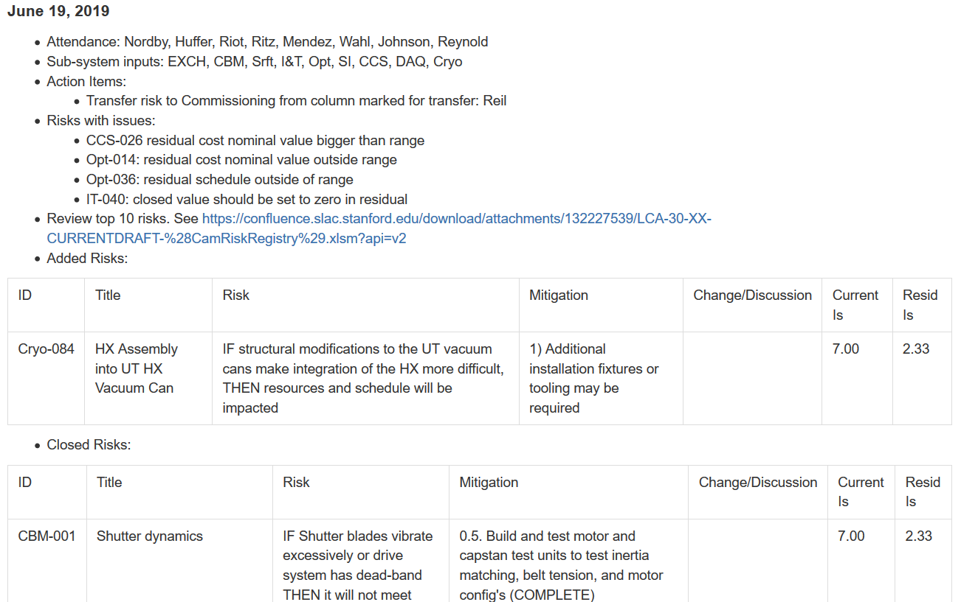
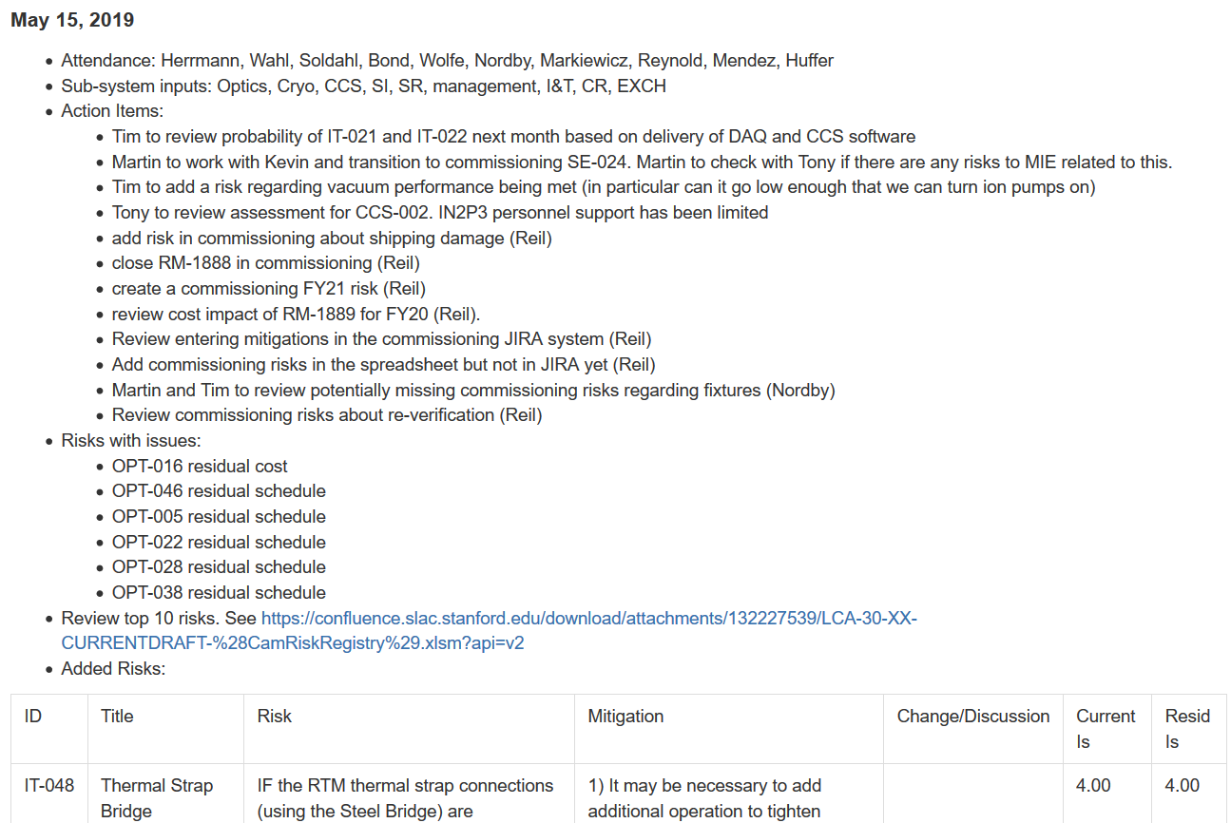
LSST Camera Project Risk Processes: Risk Review Board
Action items from any meetings relevant to risks are captured in Confluence.
  Risk management action items
  Top 10 risks
  Activities needed to execute risk mitigations.
  New, closed, updated risks

Slide 11
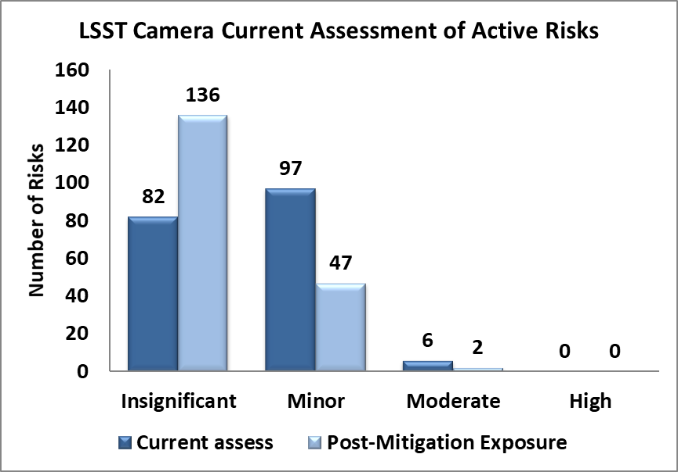
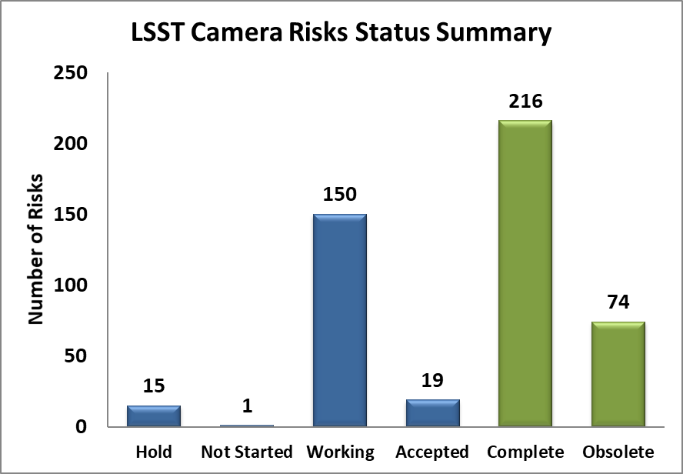
LSST Camera Project Risk: Current Risk Statistics
Camera risks are documented in the risk registry, LCA-30, and have been monitored starting prior to CD-1 review
Current status: 475 total risks identified
  Managing 185 active risks / opportunities or accepted risk (residual risk present and no further mitigation planned)
  290 are closed (risk was mitigated) or obsolete (risk is no longer applicable, and mitigations are not needed due to design updates.)
I&T Flow Mitigations
Filter Exchange shipping

Slide 12
LSST Camera Project Risk: Risk evolution
  Active Risks at CD-3, July 2017, May 2018, May 2019:
Post Mitigation Assessed Impact | CD-3 | July 2017 | May 2018 | May 2019
Insignificant | 128 | 258 | 379 | 424
Minor | 43 | 139 | 75 | 49
Moderate | 3 | 28 | 3 | 2
High | 0 | 2 | 0 | 0
  18 new risks identified since May 2018
  50 risks retired since May 2018
  19 risks are accepted (no more mitigations identified)
Mitigation Status | CD-3 | July 2017 | May 2018 | May 2019
Hold | 8 | 14 | 16 | 15
Not Started | 9 | 4 | 1 | 1
Working | 157 | 208 | 179 | 150
Accepted | N/A | 6 | 21 | 19
Complete | 84 | 123 | 168 | 216
Obsolete | 51 | 72 | 72 | 74
Totals: | 309 | 427 | 457 | 475

Slide 13
Camera top 10 risks as of May 2019
Risk Title | Risk Description (if/then) | Prob ability | Cost | Schd | Perf | Current Exposure | Prob ability | Cost | Schd | Perf | Residual Exposure
RTM performance degradation | IF RTM performance degrades over time (flex cable failure, RTD failure, Sensor Glow) THEN RTM may have to be de-integrated and refurbished | 4 | 3 | 3 | 3 | Moderate | 3 | 3 | 3 | 3 | Moderate
Metal Particulate Contamination | IF metal particulate are generated or present inside the cryostat THEN additional efforts will be required for decontamination and re-verify. | 4 | 3 | 3 | 2 | Moderate | 2 | 3 | 3 | 2 | Minor
Standing Army Costs 6 months | If the camera is late on elements, THEN standing army costs will be needed to complete the project | 4 | 3 | 4 | 1 | Moderate | 4 | 3 | 4 | 1 | Moderate
DAQ Schedule | IF full DAQ is not available when final RAFTs are integrated THEN final camera verification cannot occur until it becomes available. | 5 | 2 | 3 | 1 | Moderate | 5 | 2 | 2 | 1 | Minor
ITL sensor integrated performance | IF ITL sensors cannot be operated when integrated in a raft with adequate performance THEN the project will not be able to deliver the camera successfully | 4 | 2 | 2 | 3 | Moderate | 3 | 2 | 2 | 3 | Minor
Sustaining Engineering | IF the current program plans do not maintain personnel with adequate technical knowledge, THEN the technical staff may not be available to support issues that arise during I&T. | 4 | 3 | 2 | 1 | Minor | 4 | 3 | 2 | 1 | Minor
Filter Coating Failure | IF a filter coating run fails THEN the filter coating will not meet all specifications | 3 | 2 | 4 | 3 | Minor | 2 | 2 | 4 | 3 | Minor
Late scope changes | IF subsystems come with late changes to CCS interface scope, THEN CCS-provided software modifications will be required | 5 | 2 | 2 | 1 | Minor | 4 | 2 | 2 | 1 | Minor
L3 Position | IF the L3 frame does not hold the optic in place to required levels THEN the image quality may suffer | 3 | 3 | 3 | 2 | Minor | 1 | 3 | 3 | 3 | Insignificant
Contributed Labor | IF the CCS relies on substantial amounts of contributed labor and if that contributed labor fails to materialize, fails to deliver the expected software, or delivers software that does not meet the requirements THEN additional on-project manpower may be needed to compensate. | 3 | 3 | 4 | 1 | Minor | 4 | 2 | 3 | 1 | Minor
Communication problems | The camera is a distributed project; IF communication is not adequate, THEN poorly-understood interfaces could lead to delays, cost increases or reduction in performance | 3 | 3 | 3 | 2 | Minor | 2 | 3 | 2 | 1 | Insignificant

Slide 14
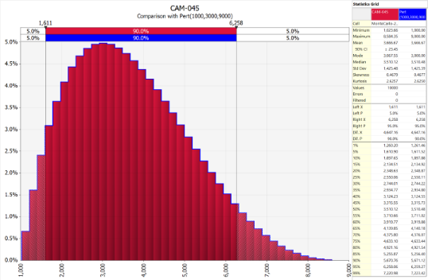
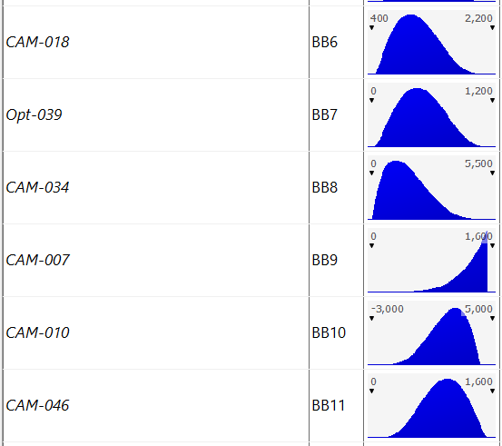
LSST Camera Project Risk: Risk / Opportunity Impact Model
Risk Modeling Methodology:
    Model includes both risk and opportunity.
    Monte Carlo Simulation using Palisade “@RISK7” software.
    All active risks with mitigated cost severity of greater than “Insignificant” levels included in analysis (70 risks).
    Three data points used in pert analysis for each cost risk: Minimum, Expected, Maximum.
    Pert (Beta) curve used for each data point, anchors at 5% and 95%
    Post-mitigation expected impact values are used for each case.
    80% confidence is used to assess potential impact to contingency.

Slide 15
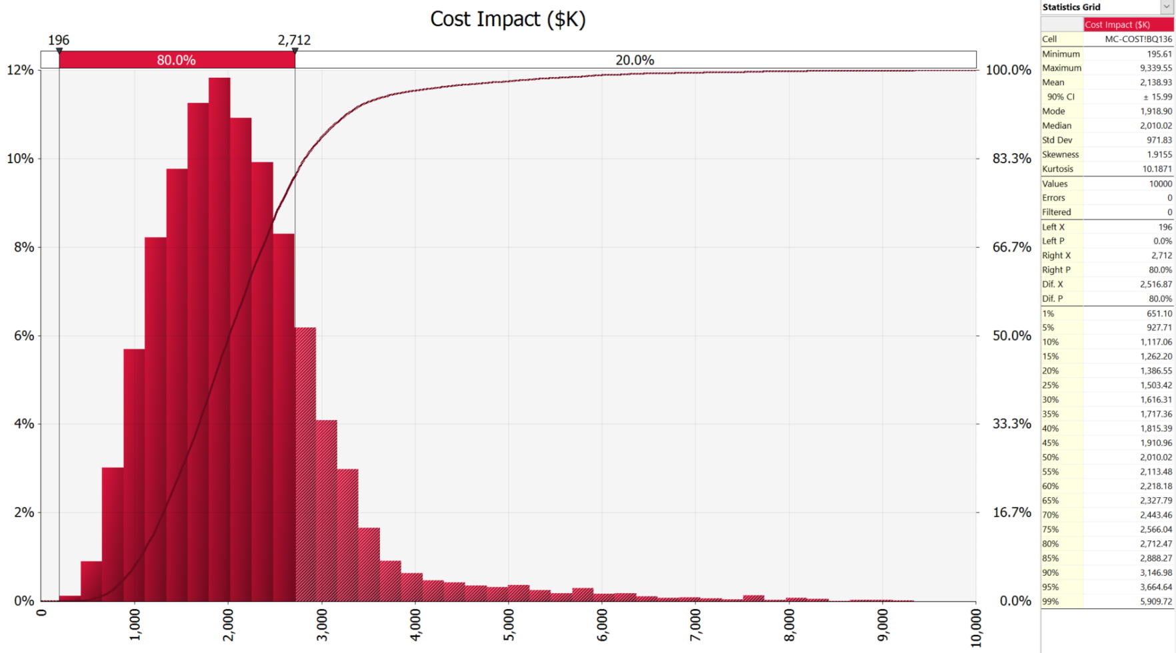
LSST Camera Project Risk: Cost Impact Model

Slide 16
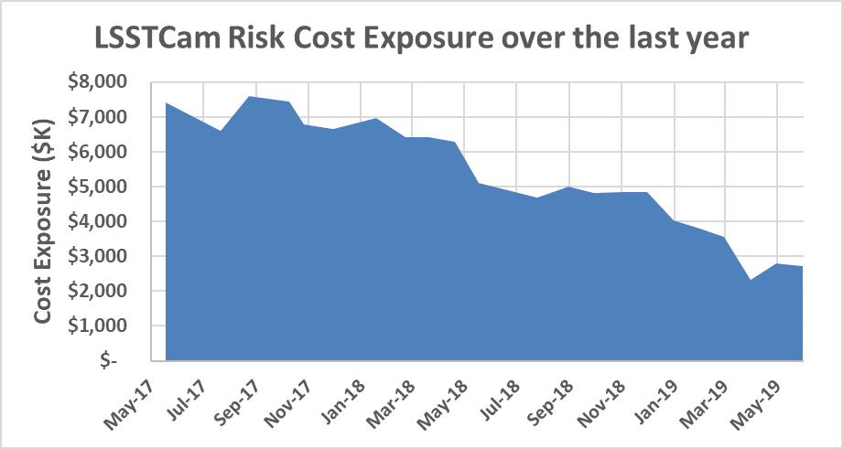
LSST Camera Project Risk: Cost Impact Model with time
Risk-based cost exposure has been declining in the past year

Slide 17
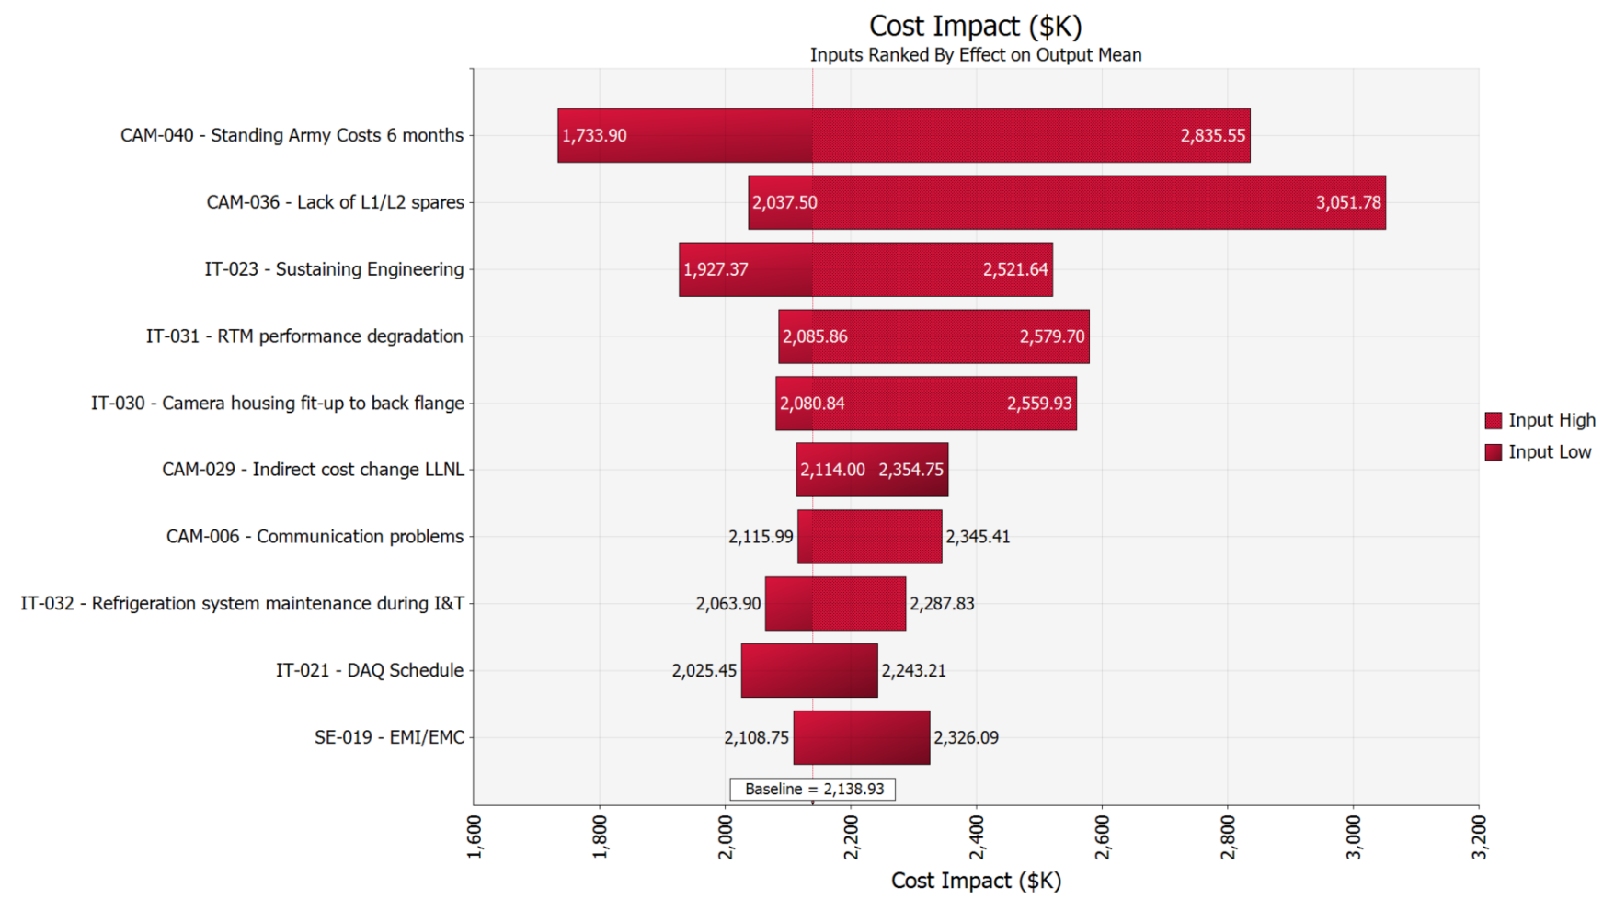
LSST Camera Project Risk: Cost Sensitivity

Slide 18
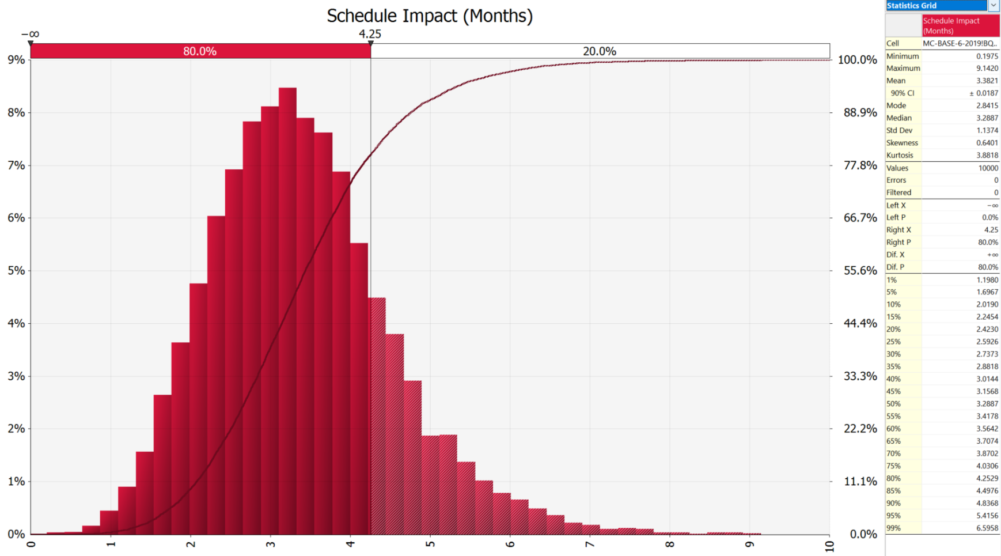
LSST Camera Project Risk: Schedule Impact Model

Slide 19
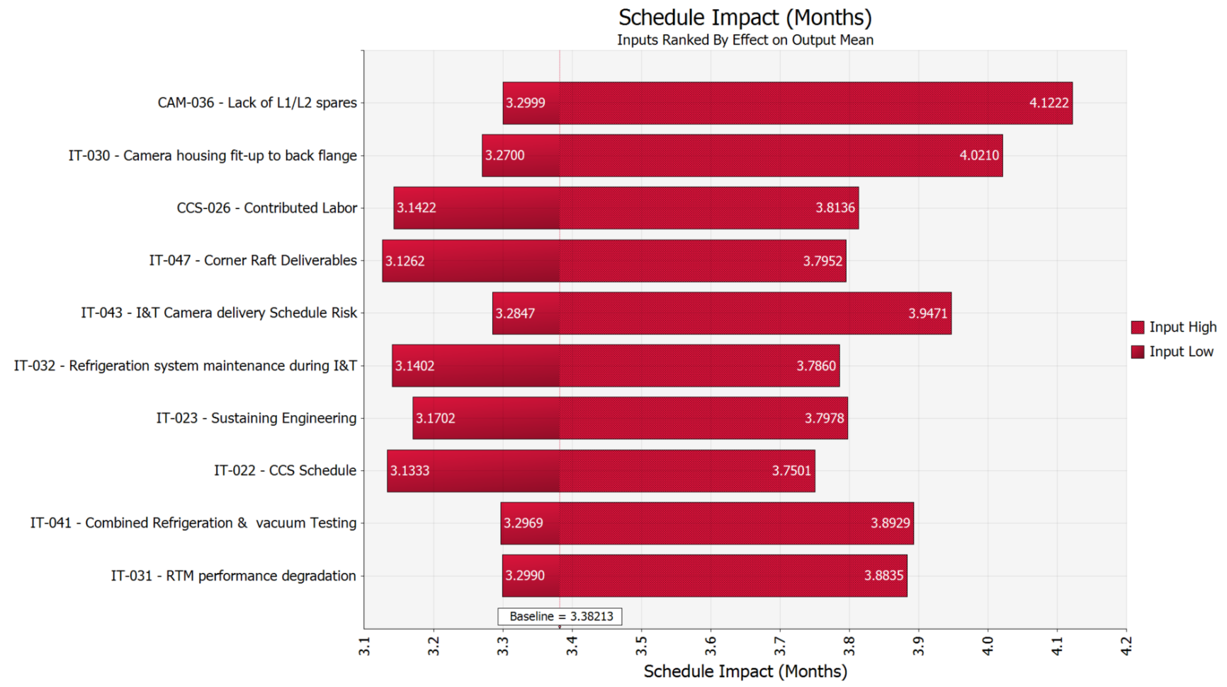
LSST Camera Project Risk: Schedule Sensitivity

Slide 20
LSST Camera Project Risk: Summary
The Camera risk management process is mature, standards-based, active and integrated into the project, with regular monthly review.
Managers and sub-system managers are engaged in this process.
The project is mitigating risks and has planned and captured the mitigations in the cost and schedule.
The highest risks to the project have been successfully mitigated to acceptable levels to date.
The project is > 90% complete and many mitigations have been completed with many risk impacts limited to the residual exposure.
Confidence Analysis suggests that we have limited but still mostly adequate contingency.

Slide 21
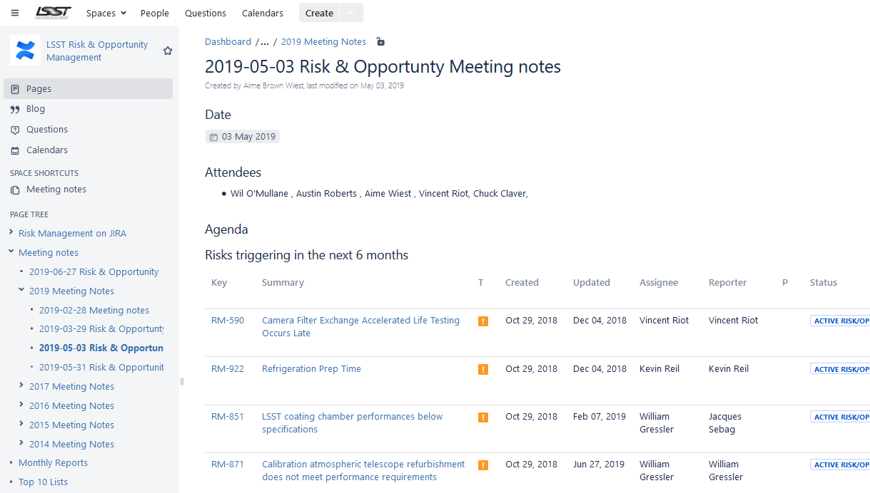
Commissioning Risk Management
Commissioning risks are tracked in JIRA with all the MREFC risks (https://jira.lsstcorp.org/issues/?jql=project%20%3D%20RM%20AND%20component%20%3D%20%22DOE%20Funded%20Commissioning%22)
DOE-funded activity related risks are tagged for filtering
Project has a monthly Risk Review Board with attendance from the Camera/DOE commissioning leadership.
Risk and Opportunity Meetings are tracked in confluence

Slide 22
DOE Commissioning top 10 risks
Risk Title | Risk Description (if/then) | Probability | Risk Score | Probability Weighted Cost
Contributed Labor - See CAM-CCS-026 for example. | IF research funded individuals do not fill expected roles THEN new hires may be needed. | 25%-50% | 12 | 381.1
Major Camera Servicing | IF the camera needs to be removed from the telescope and work interior to the cryostat is needed to perform servicing THEN schedule contingency will be used. | 10%-25% | 9 | 173.4
ITL Integrated Performance - See CAM-049 | IF CAM-049 risks is not closed THEN commissioning will carry risk. | 25%-50% | 8 | 314.5
Camera Damage during Shipping | A poorly designed shipping container or poor logistical planning could result in shipping damage. | 25%-50% | 8 | 296
Accelerated Camera MIE Roll Off | IF the camera MIE project needs to downsize their FTE count and key persons will be lost THEN DOE commissioning may need to accelerate ramp up. | 25%-50% | 8 | 222.37
Minor Camera Servicing | IF the camera needs to be removed from the telescope to perform servicing THEN schedule contingency will be used. | 50%-75% | 5 | 129.15
Extended On Telescope Camera Work | IF the required on-telescope camera maintenance and procedures take longer than planned THEN additional down-time and resources will be needed. | 75%-100% | 5 | 79.2
Moderate Camera Servicing | IF the camera needs to be removed from the telescope and partially dissassembled to perform servicing THEN schedule contingency will be used. | 25%-50% | 4 | 151.7
Refrigeration ICD mismatch - See CAM-Cryo-056 | IF late refrigeration system changes occur THEN modification of TMA/Camera interfaces may be needed. | 25%-50% | 4 | 148
Excessive travel costs | IF all planned travel requires hotel accomodations THEN travel budget may be used before completion. | 25%-50% | 4 | 148

Slide 23
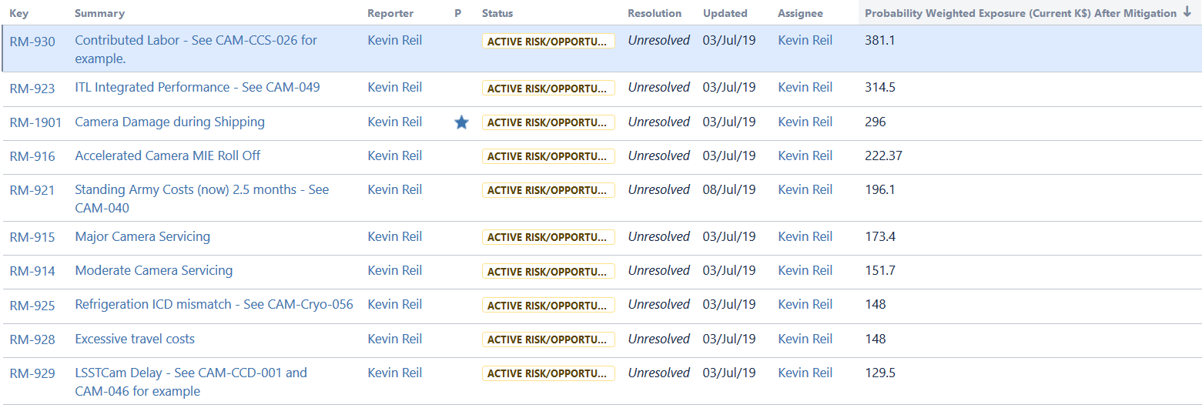
DOE funded commissioning top probability weighted cost risks
Cost exposure of all Commissioning DOE tagged risks: $3,015K

Slide 24
LSST DOE Commissioning Risk: Summary
The Commissioning risk management process is mature, standards-based, active and integrated into the project, with regular monthly review.
Managers and sub-system managers are engaged in this process.
The project is mitigating risks and has planned and captured the mitigations in the cost and schedule.
The Camera MIE project has a process in place to transfer risks to the commissioning register.
A simple analysis (probability weighted exposure) is used to estimate the risk exposure level and potential contingency needs from the DOE funding source
Schedule analysis is combined in the full project schedule Monte-Carlo

