Slide 1
Camera responses to 1st day questions NSF/DOE Joint Director’s Review August 7, 2019

Slide 2
Response to questions
We would like to hear more about the debris, the identified sources, how the mitigations address them. In addition, what tests have been done to ensure you have identified all the sources?
Debris was analyzed via SEM and demonstrated to originate from bare fastener engaging Ni Plated copper walls (generated during assembly and in fixtures). The raft materials, and assembly and handling procedures, were re-assessed for potential to create debris.
See the external committee review report (LCA-17271 posted on the breakout committee site) from November 2018.
See the remediation plan (LCN-2281). Rafts were cleaned and made less susceptible.
See the following two slides from the plenary.
The debris issues that we experienced were primarily internal to the rafts, which have been cleaned, shipped, rotated, re-inspected and re-tested after the remediation (10 rafts to dates have undergone this successfully).

Slide 3
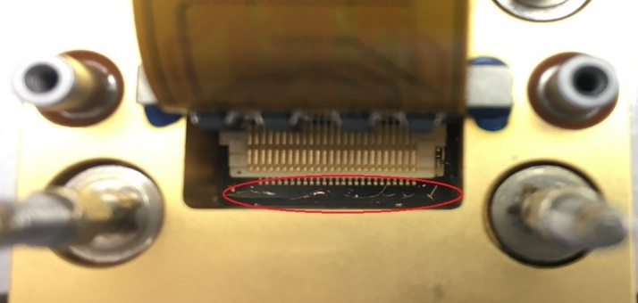
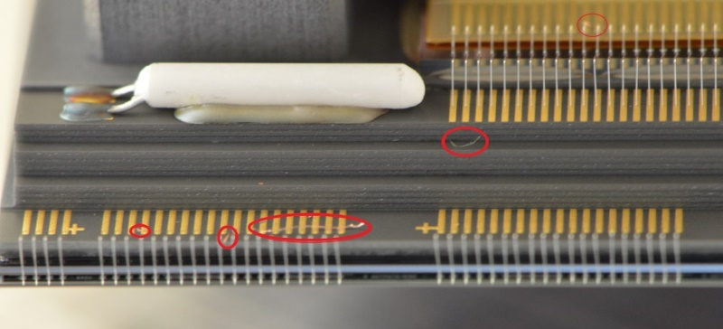
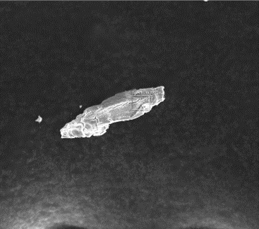
We experienced contamination on the rafts in the fall of 2018
Summary
0.5% of the pixels were identified as lost in November 2018 (requirement is <2%)
External review was conducted on 11/16/2018 to address plan
The observed pixel loss problems were consistent with shorts caused
by conductive particulates which was visually confirmed.
The most likely source was debris from Ni plated tapped holes, and perhaps from thermal conduction braids.
The debris was too prevalent to ignore, and removal of the debris was necessary.
ITL sensor particulate contamination example
E2v sensor particulate contamination example
Particle shape | Composition | Match | ~%
Shaving | Copper + Nickel + trace Al in some case | Appear to match sidewall REC shavings | 50%
Blob/Shaving | Phosphor bronze | Could come from grounding brush or alligator grounding clip | 10%
Blob/Shaving | Copper | Could come from non-plated copper pieces | 10%
Blob/Shaving | Aluminum | Appear to match A-Frame fixture particle | 10%
Fibers | Copper | Appear to match thermal straps particle. Not high quantities. | Rare.
Organic particles |  | Likely from cleaning process (expected) | 20%

Slide 4
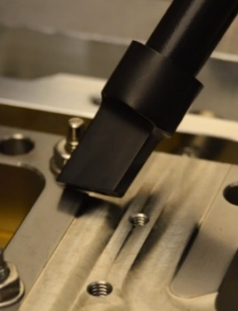
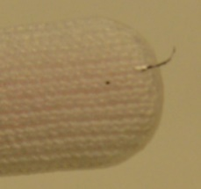
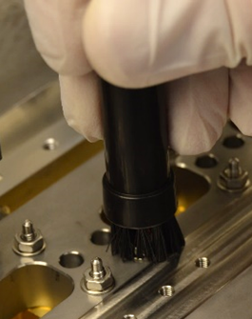
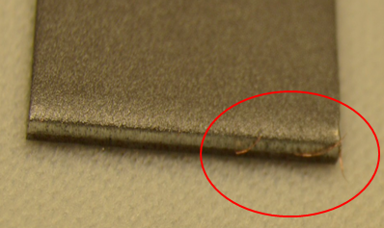
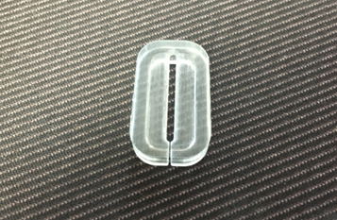
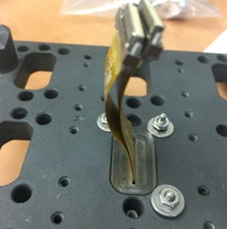
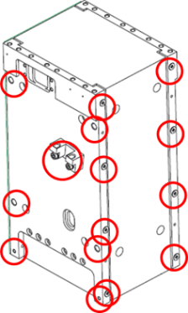
Three-prong approach was implemented successfully
Clean
Different for e2v Sensors and ITL sensors
ITL cleaning using vacuum and Q-Tip
e2v cleaning using wirebond equipment by an expert at BNL who has significant wirebond experience including the removal of particulates
Protect
In‐system shields (“pocket covers”) developed for permanent protection (see image on right)
During assembly processes (vacuum/shield) being developed
Prevent
Retrofit high generating areas:
Wherever possible, upgrade with coated inserts on raft components and fixtures that have high-risk holes
Retrofit with dicronite coated fasteners on raft hardware and fixtures where possible
Dissipative Q-Tip cleaning
(Effective)
ESD Vacuum cleaning
(not very effective on sensors)
Magnet cleaning
(effective for some particles)
Sensor pocket cover
Hole Title | Original Dimension | Current Engagement | Threads | Heli-Coil | New Engagement | Threads
A | M3X0.5-6H THRU | 4.34 mm | 8.68 | 1D M3 Heli-Coil | 3 mm (-1.34) | 6
B | M6X1-6H THRU | 6.32 mm | 6.32 | 1D M6 Heli-Coil | 4.48 mm (-1.84) | 4.48
C | M3X0.5-6H THRU | 2.82 mm | 5.64 | 2.5D M3 Heli-Coil | 6.82 mm (+4) | 13.64
D | M3X0.5-6H x 8 | 4.3 mm | 8.6 | 1.5D M3 Heli-Coil | 4.3 mm | 8.6
E | M3X0.5-6H THRU | 3.5 mm | 7 | 1D M3 Heli-Coil | 3 mm (-0.5) | 6

Slide 5
Response to questions
Have you changed the orientation of the camera since they installed some of the rafts? This could dislodge more debris and the washer and also check for other potential surprises due to orientation changes.
The full cryostat has not been rotated since rafts have been installed because it is not possible to rotate in its current configuration.
The debris issues that we experienced were primarily internal to the rafts, which have been cleaned, shipped, rotated, re-inspected and re-tested after the remediation (10 rafts to dates have undergone this successfully).
The washer is a risk that we are tracking and we will take this into account as procedures are finalized prior to rotating the cryostat.

Slide 6
Response to questions
We would like to hear about the refrigeration clogging issue. What are the plans and potential additional problems as you scale up dealing with a full focal surface...
This will be discussed in the breakout.
This does not affect the cold system. When the cryo system is off, and the HeX are in the vertical orientation as on the BOT for an extended time, oil drains down into the cryoplate and sits. This causes a clogging if we switch the system on, because of the oil viscosity and the cold refrigerant flow. The simple solution involves pre-heating the cryoplate with the trim heaters to ~40deg C then starting the compressors, leaving the trim heat on feedback so the cryoplate stays warm at the setpoint temperature (~40C) while the refrigerant circulates and washes out the oil. When done, we turn off the feedback and allow the cooldown to proceed.
Each circuit has been tested successfully already with expected load and by group of 3 circuits for cryo and both circuits for cold. The next test is with 9 rafts. The procedures are in place and will be further tested.
A concern is operation on the summit, which is mitigated by the refrigeration pathfinder exercise to be conducted by the commissioning team next year.

Slide 7
Response to questions
What are the plans for scaling up the DAQ speed to account for the full focal surface?
Any potential issues there?
To be discussed in the breakout. We are receiving from the vendor a solution that will be implemented prior to the 21 rafts test in Q2 FY20. This does not impact the upcoming 9-raft test.

Slide 8
Response to questions
Please explain the schedule for filter testing, production and delivery in detail.
When do the filters get installed on the camera.
Detailed schedule will be presented during the breakout.
First filter is expected to be available Q2FY20 and only needed in Q4FY20 (100 days of float).
Remainder of the filters expected to be available Q3FY20 but not needed until Q1 FY21 (100 days of float) and could be delayed even further until after the camera has shipped without significant impacts.
Also, Explain the shutter assembly testing and delivery schedule in detail.
The shutter assembly and test is under way and expected to complete end of Q4FY19. The need date is end of Q1FY20 (45 days of float). More details on the schedule and technical status is available in the shutter breakout talk.

Slide 9
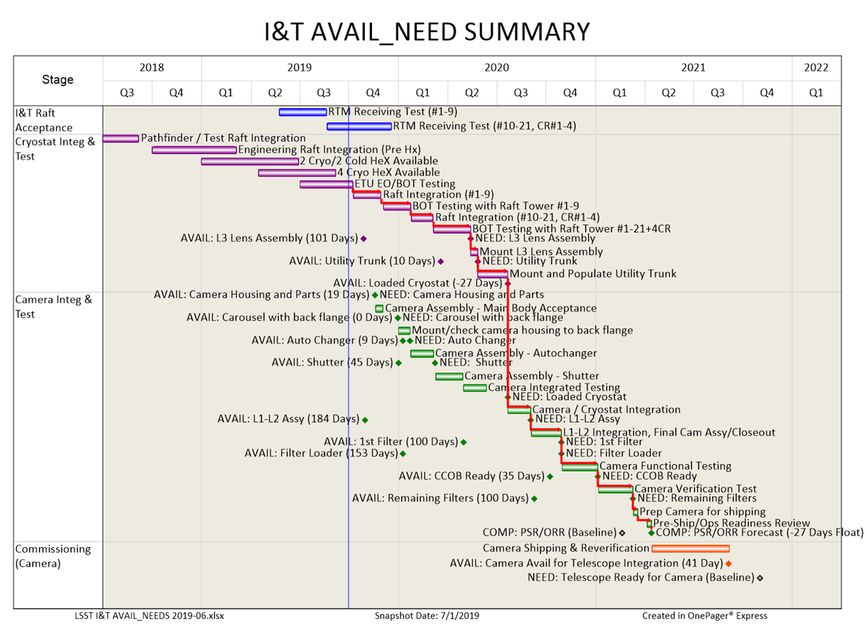
Main needs and schedule status to I&T (Consistent with June 2019 forecast data)

Slide 10
Response to questions
Camera Shipping plans - what parts go as an assembly what parts are shipped separately and how is this managed, how are shipments tracked, accepted stored on site.
See Camera shipping presentation (commissioning breakout)
Camera will ship without the L1-L2 assembly attached, on a custom support stand, in a standard 20-ft shipping container via a chartered aircraft.
Optical filters, L1-L2 assembly and auxiliary hardware will be shipped in standard 20-ft shipping containers. The L1-L2 vendor-provided inner container is planned to be re-used.
Final design for the shipping approach is expected in Q2FY20.

