Slide 1
LSST Camera Status
Vincent Riot
LSST Camera Project Manager
NSF/DOE Joint Status Review
August 27, 2019

Slide 2
Outline
Introduction and Scope
Technical Status
  Recent progress and achievement
  Past issues resolution
  Remaining concerns
Performance Verification
Risk Management and ESH summary
Cost and Schedule Status (May 2019 month end)
  Past performance
  Forecast and estimate to completion
  Contingency management
Upcoming Milestones and Summary
Message box example for short highlighted messages.

Slide 3
Introduction and Scope

Slide 4
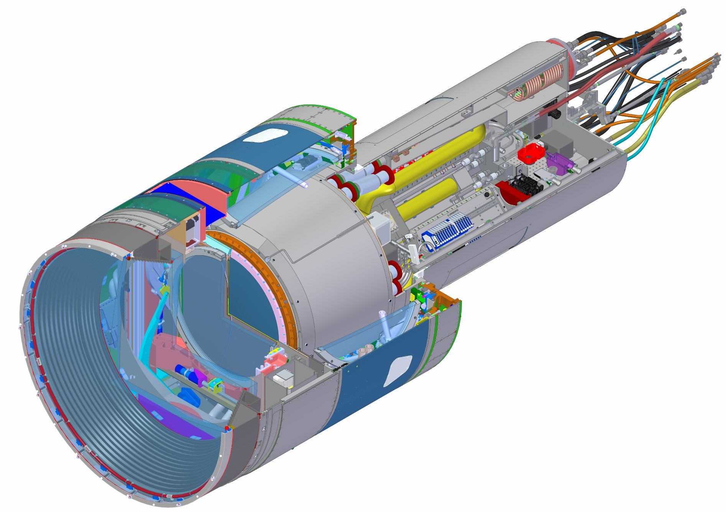
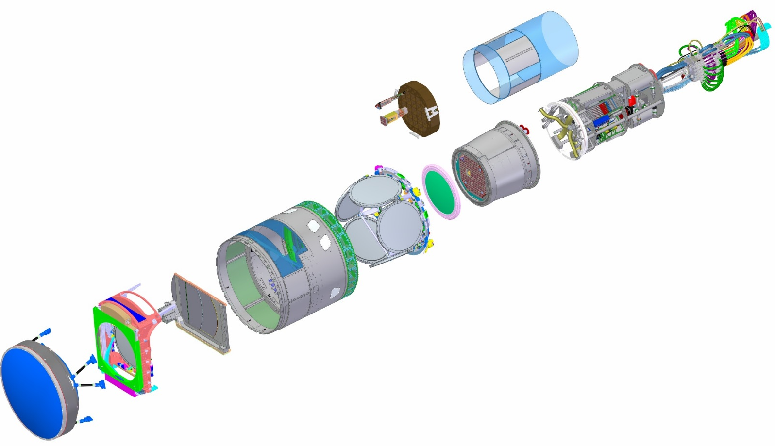
Major Camera Elements
WBS | Baseline ($K) | % complete
3.06.05 Utility Trunk | $1,385 | 69%
WBS | Baseline ($K) | % complete
3.04.02 Corner Raft Tower | $7,064 | 99%
WBS | Baseline ($K) | % complete
3.04.01 Science Raft Tower | $17,507 | 99%
WBS | Baseline ($K) | % complete
3.03 Sensors | $34,011 | 100%
WBS | Baseline ($K) | % complete
3.07.02 Aux Electronics | $2,298 | 100%
WBS | Baseline ($K) | % complete
3.06.01 Camera Body | $2,395 | 95%
WBS | Baseline ($K) | % complete
3.06.04 Cryostat | $16,394 | 98%
WBS | Baseline ($K) | % complete
3.06.02 Shutter | $3,030 | 90%
3.05.04 L3 Lens Assembly
3.05.02 Filters (6)
WBS | Baseline ($K)
3.06.03 Filter Exchange System | Contributed
WBS | Baseline ($K) | % complete
3.01 Management | $15,225 | 90%
3.02 Systems Integration | $9, 308 | 91%
3.05 Optics | $28,094 | 87%
3.07.01 Control System | $5,055 | 89%
3.07.02 Data Acq Sys | $5,688 | 93%
3.08 Integration and Test | $12,847 | 76%
TOTAL | $158,103 | 92.8%
3.05.03 L1-L2 Lens Assembly

Slide 5
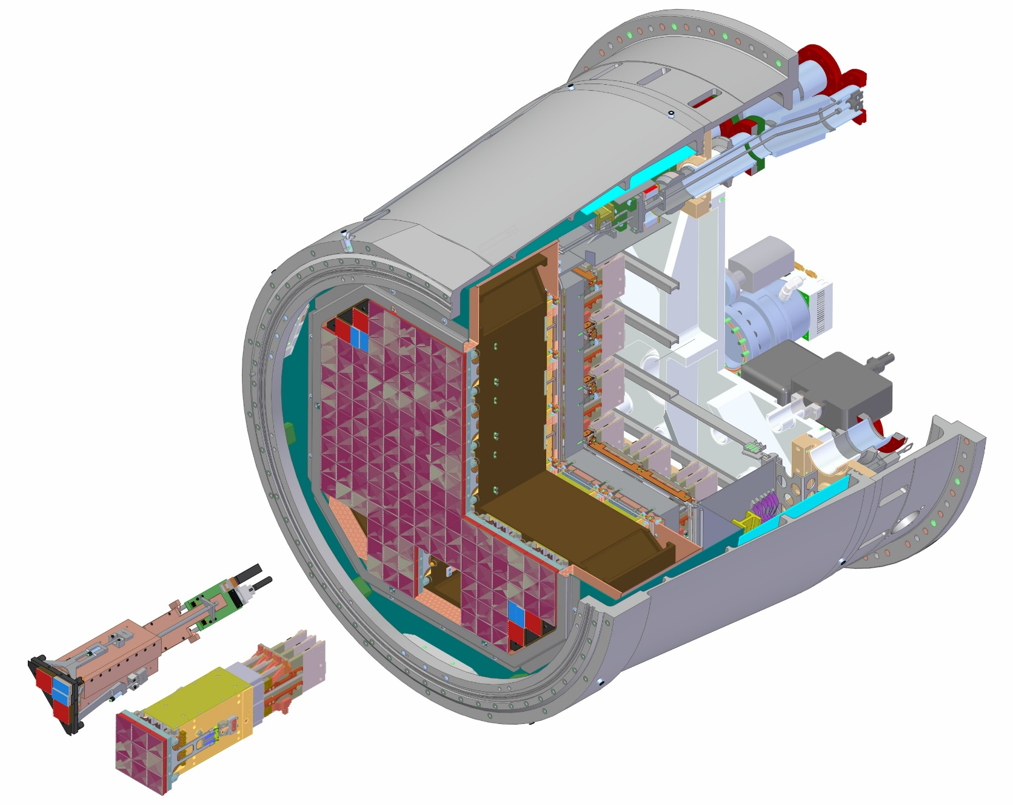
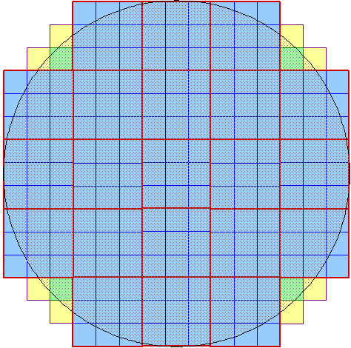
Rafts and Cryostat/Refrigeration are at the core of the camera
4 Corner areas for wavefront sensing (green) and guiding (yellow).
Cryostat Housing
3X3 CCD “RAFT”
Detector plane I&T assembly
21 rafts make up the science array
Science Raft
Corner Raft
Cryo and Cold Plates
Grid support structure
Sensors

Slide 6
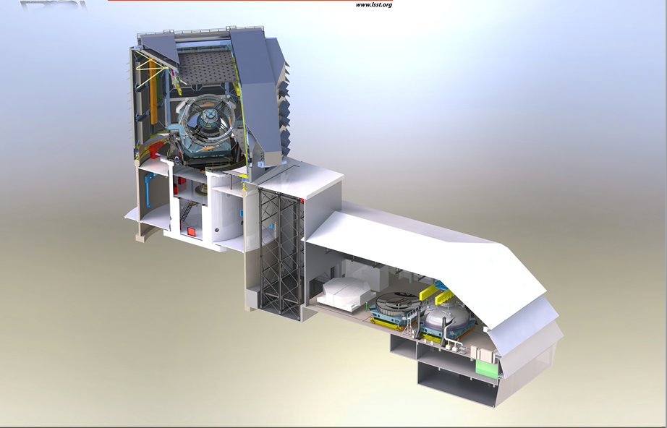
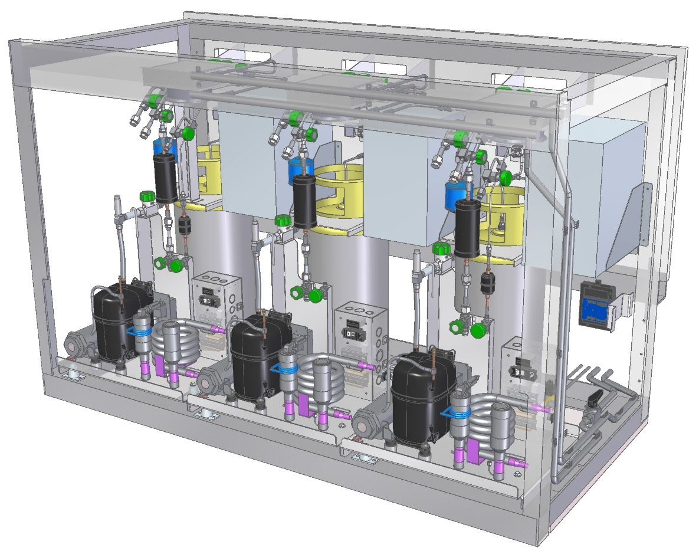
Location of Camera Off-Telescope Components
Camera Clean Room & White Room
Camera Maintenance Equipment
Refrigeration Compressor Cabinets (2x)
Control Room
Camera Data Acquisition System DAQ computer, Data storage
Camera Control System
Computer rack
Machinery Room
Refrigeration system ground unit
Maintenance Compressor chassis

Slide 7
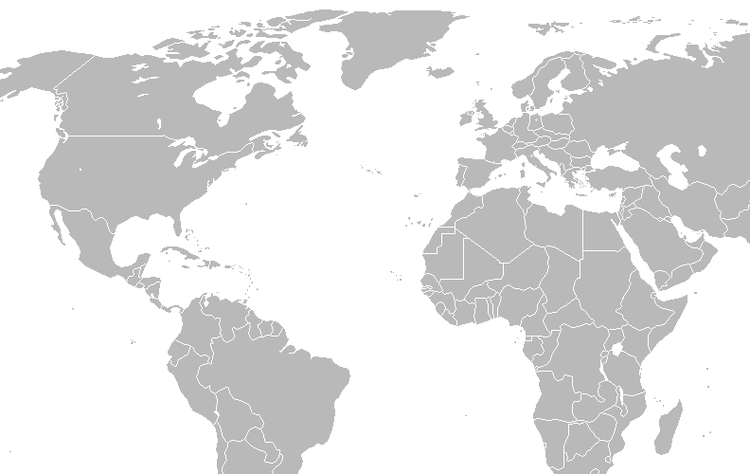
LSST Camera Activities spanned the world
Ball Aerospace (L1-L2 design and Integration)
Boulder, CO
Corning (Optics Fused Silica)
Corning, NY
Harvard University (Corner Raft, Science Raft)
Cambridge, MA
Teledyne E2V (CCD)
Chelmsford, UK
Engineered Ceramic Materials (Grid, Raft baseplates)
Moosinning, Germany
Lawrence Livermore National Laboratory (Management, Optics)
Livermore, CA
Materion (Filter Coating)
Buffalo, NY
LPNHE/IN2P3 (Electronics, Carousel)
Paris, France
Brookhaven National Laboratory (Science Rafts)
Upton, NY
APC/IN2P3 (Filter control system, CCS)
Paris, France
LPSC/IN2P3 (Filter Loader, Optical test bench)
Grenoble, France
UPenn (Electronics)
Philadelphia, PA
REOSC (BBAR coating)
Saint-Pierre-du-Perray, France
Thales SESO (L3 assembly and filters optics)
Aix-en-Provence, France
UC Santa Cruz (Management)
Santa Cruz, CA
Arizona Optical System (L1, L2 optics fabrication and test)
Tucson, AZ
LPC/IN2P3 (Filter Test Bench)
Clermont, France
CPPM/IN2P3 (Filter Autochanger)
Marseille, France
SLAC National Laboratory (Management, Camera Body and Mechanism, DAQ, CCS, I&T)
Menlo Park, CA
Imaging Technology Laboratory (CCD)
Tucson, AZ
Vanguard Space Technologies/Alliance Space Systems (L1-L2 composite structure)
San Diego, CA

Slide 8
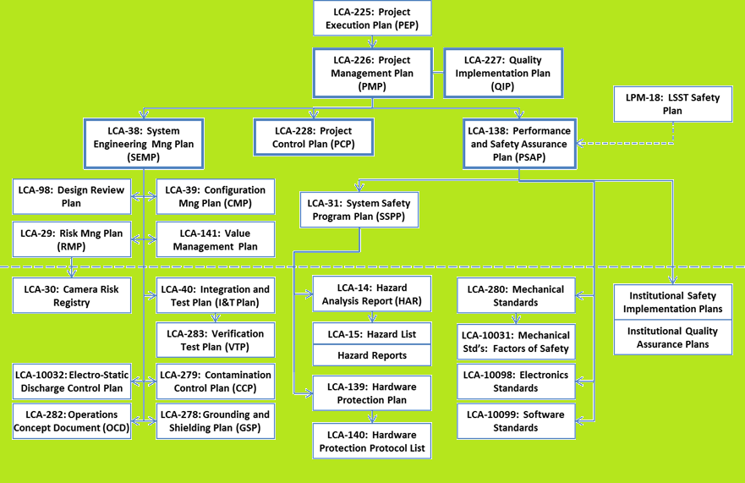
Camera plans and standards are used to manage all aspects of the project
Project Management
Performance and Safety Assurance
Technical Management
Camera Plans and Standards

Slide 9
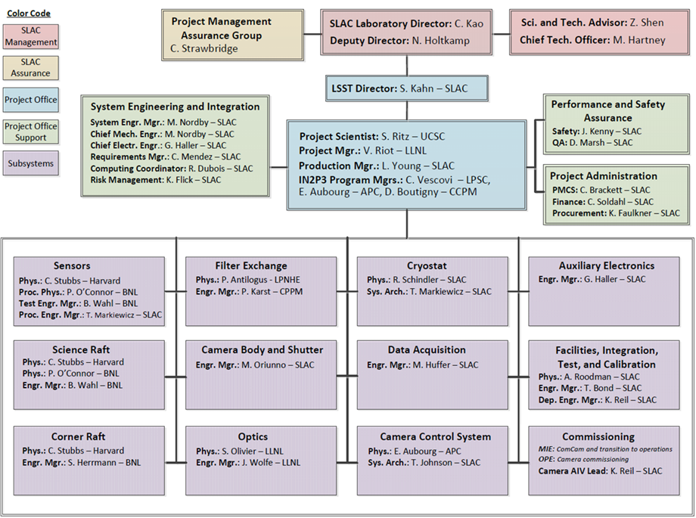
Project Organizational Chart has been mostly stable as the project ramped down
As Sensor sub-system and Cryostat sub-system ramped down with deliveries, Tom Markiewicz has helped close out cryostat activities and has replaced Alice Callen.
Stuart Marshall has taken on the role of “Camera Operation Scientist” during Integration in IR2. In this role, Stuart is responsible for arranging, coordinating and maintaining oversight all of the operational activities involving final camera hardware during the I&T Phase of the project here at SLAC. He reports to the I&T Physicist in this role.

Slide 10
Closeout of several sub-system are in progress
WBS (L2,L3) | Number of Control Accounts | Closed Control Accounts
3.01 Management | 3 | 0
3.02 Systems Integration | 2 | 0
3.03 Science Sensors | 5 | 2
3.04.01 Science Raft Systems | 7 | 4
3.04.02 Corner Raft Systems | 5 | 2
3.05 Optics | 4 | 0
3.06.01 Camera Body | 2 | 0
3.06.02 Shutter | 2 | 0
3.06.04 Cryostat | 6 | 2
3.06.05 Utility Trunk | 2 | 0
3.07.01 Control System | 3 | 0
3.07.02 Data Acq Sys | 2 | 0
3.07.03 Aux Elec | 2 | 0
3.08 Integration and Test (3.08.06 ComCam) | 6 | 1
Total | 51 | 11
Sub-system closeout process has been setup.
No sub-system has fully closed under the process, but several are well advanced (see sub-system in green) and expected to complete the process by the end of September.
Sub-system in the process of closing do not have a breakout. This plenary talk and the system integration breakout talk covers any technical items to be presented on these sub-systems

Slide 11
Technical Status

Slide 12
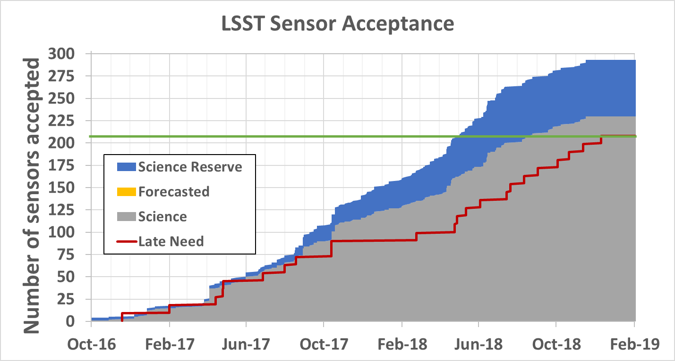
LSST Science Sensor procurement is complete
Accepted from Vendor
Vendor | Received | Science Grade | Reserve | Engineering Grade
e2v | 125 | 121 | 4 | 0
ITL | 256 | 109 | 59 | 88
Total | 381 | 230 | 63 | 88
Baseline (208)
Threshold KPP (170)
Closeout process status
Closeout Item | Status | Comment
WBS deliverables | Done
Acceptance package |  | Needs to complete for unused sensors
Closure of Non-Conformances |  | Needs to complete for unused sensors
Closure of Action Items | Done
Transfer Risks | Done
Lesson’s learned | Done | See LCA-17337
Drawings and documents |  | Being reviewed
Close control accounts |  | 2 out of 5 closed
Close corrective actions | Done
Final Design report | Done
Current Spare Summary (unused by project)
Vendor | Science Grade | Science Grade noise sensitivity | Reserve / Small issues* | Engineering Grade / Severe Issues
e2v | 2 | 0 | 3 | 1
ITL | 0 | 22 | 38 | 58
Total | 2 | 22 | 41 | 59
*Small issues include dead channels, CTE issues, Metrology issues, Cosmetic issues, higher noise

Slide 13
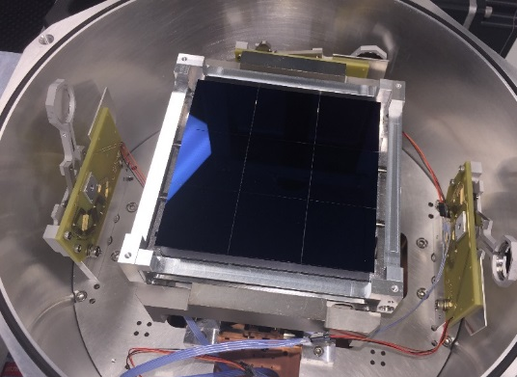
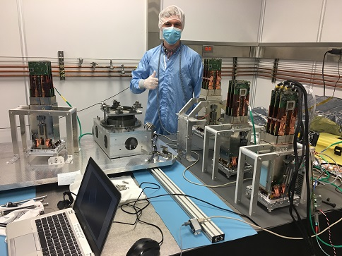
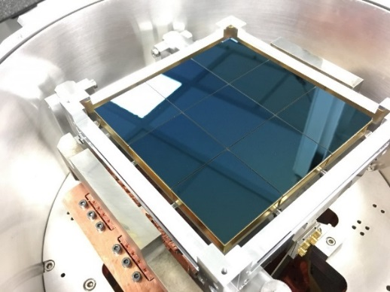
Science Raft Production is complete
RTM6 in test Dewar (e2v sensors)
22 science rafts have been accepted and delivered to SLAC
RTM4
RTM2
RTM1
ETU2
Closeout process status
Closeout Item | Status | Comment
WBS deliverables | Done
Acceptance package | Done
Closure of Non-Conformances |  | In the process of transferring to I&T
Closure of Action Items |  | In progress
Transfer Risks | Done
Lesson’s learned | Done | See LCA-17337
Drawings and documents |  | In progress for final redlines
Close control accounts |  | 4 out of 7 closed
Close corrective actions | Done
Final Design report |  | Review needed for updates
RTM8 (ITL sensors)

Slide 14
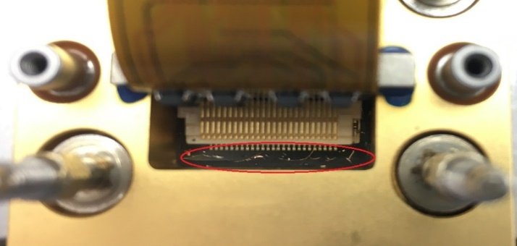
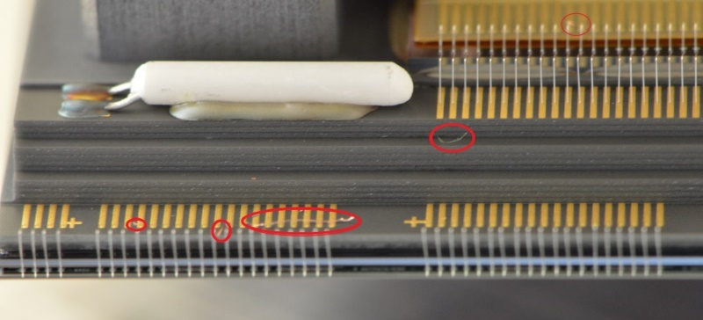
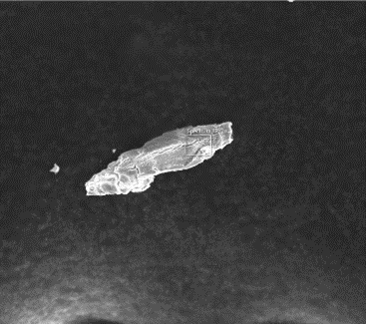
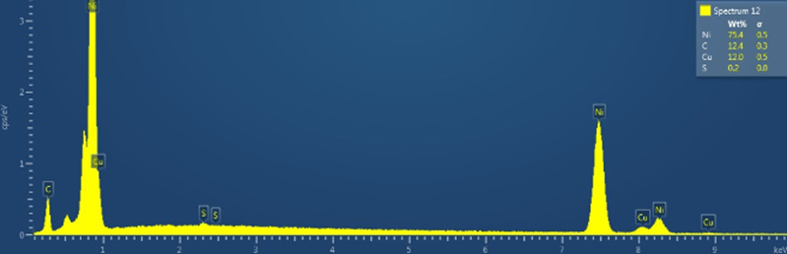
We experienced contamination on the rafts in the fall of 2018
Summary
  0.5% of the pixels were identified as lost in November 2018 (requirement is <2%)
  External review was conducted on 11/16/2018 to address plan
  The observed pixel loss problems were consistent with shorts caused
  by conductive particulates which was visually confirmed.
  The most likely source was debris from Ni plated tapped holes, and perhaps from thermal conduction braids.
  The debris was too prevalent to ignore, and removal of the debris was necessary.
ITL sensor particulate contamination example
E2v sensor particulate contamination example
Particle shape | Composition | Match | ~%
Shaving | Copper + Nickel + trace Al in some case | Appear to match sidewall REC shavings | 50%
Blob/Shaving | Phosphor bronze | Could come from grounding brush or alligator grounding clip | 10%
Blob/Shaving | Copper | Could come from non-plated copper pieces | 10%
Blob/Shaving | Aluminum | Appear to match A-Frame fixture particle | 10%
Fibers | Copper | Appear to match thermal straps particle. Not high quantities. | Rare.
Organic particles |  | Likely from cleaning process (expected) | 20%

Slide 15
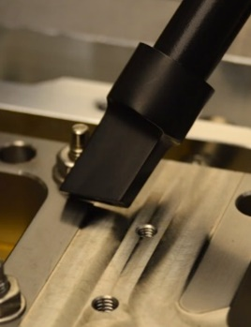
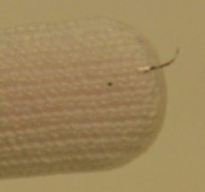
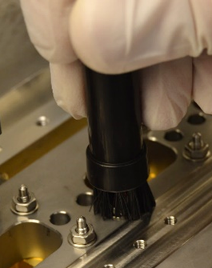
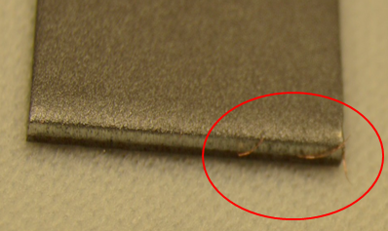
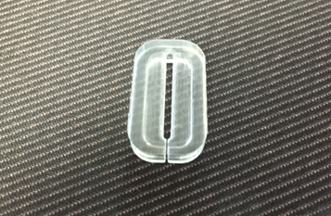
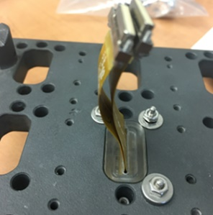
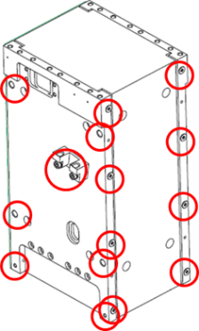
Three-prong approach was implemented successfully
Clean
  Different for e2v Sensors and ITL sensors
  ITL cleaning using vacuum and Q-Tip
  e2v cleaning using wirebond equipment by an expert at BNL who has significant wirebond experience including the removal of particulates
Protect
  In‐system shields (“pocket covers”) developed for permanent protection (see image on right)
  During assembly processes (vacuum/shield) being developed
Prevent
  Retrofit high generating areas:
    Wherever possible, upgrade with coated inserts on raft components and fixtures that have high-risk holes
    Retrofit with dicronite coated fasteners on raft hardware and fixtures where possible
Dissipative Q-Tip cleaning
(Effective)
ESD Vacuum cleaning
(not very effective on sensors)
Magnet cleaning
(effective for some particles)
Sensor pocket cover
Hole Title | Original Dimension | Current Engagement | Threads | Heli-Coil | New Engagement | Threads
A | M3X0.5-6H THRU | 4.34 mm | 8.68 | 1D M3 Heli-Coil | 3 mm (-1.34) | 6
B | M6X1-6H THRU | 6.32 mm | 6.32 | 1D M6 Heli-Coil | 4.48 mm (-1.84) | 4.48
C | M3X0.5-6H THRU | 2.82 mm | 5.64 | 2.5D M3 Heli-Coil | 6.82 mm (+4) | 13.64
D | M3X0.5-6H x 8 | 4.3 mm | 8.6 | 1.5D M3 Heli-Coil | 4.3 mm | 8.6
E | M3X0.5-6H THRU | 3.5 mm | 7 | 1D M3 Heli-Coil | 3 mm (-0.5) | 6

Slide 16
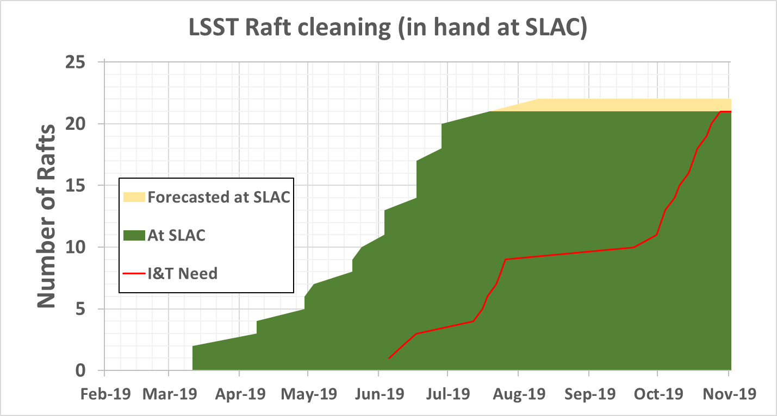
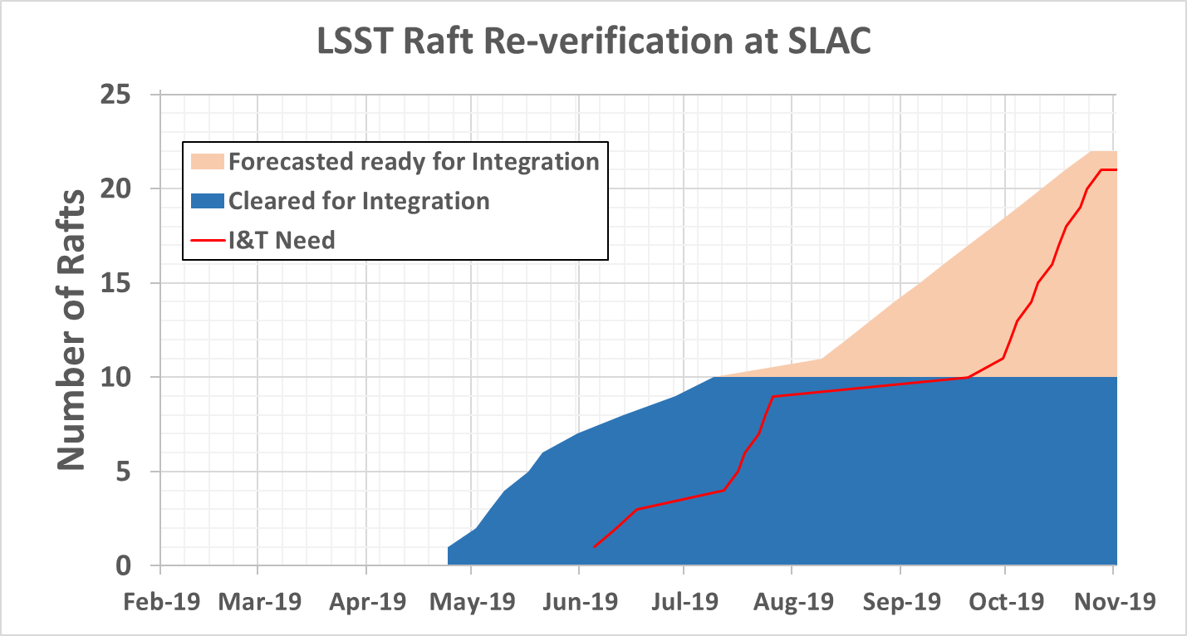
Some of the raft refurbishment scope in I&T sub-system remains
Raft refurbishment at SLAC is well ahead of need date
1 ITL rafts remain to be cleaned at SLAC

Slide 17
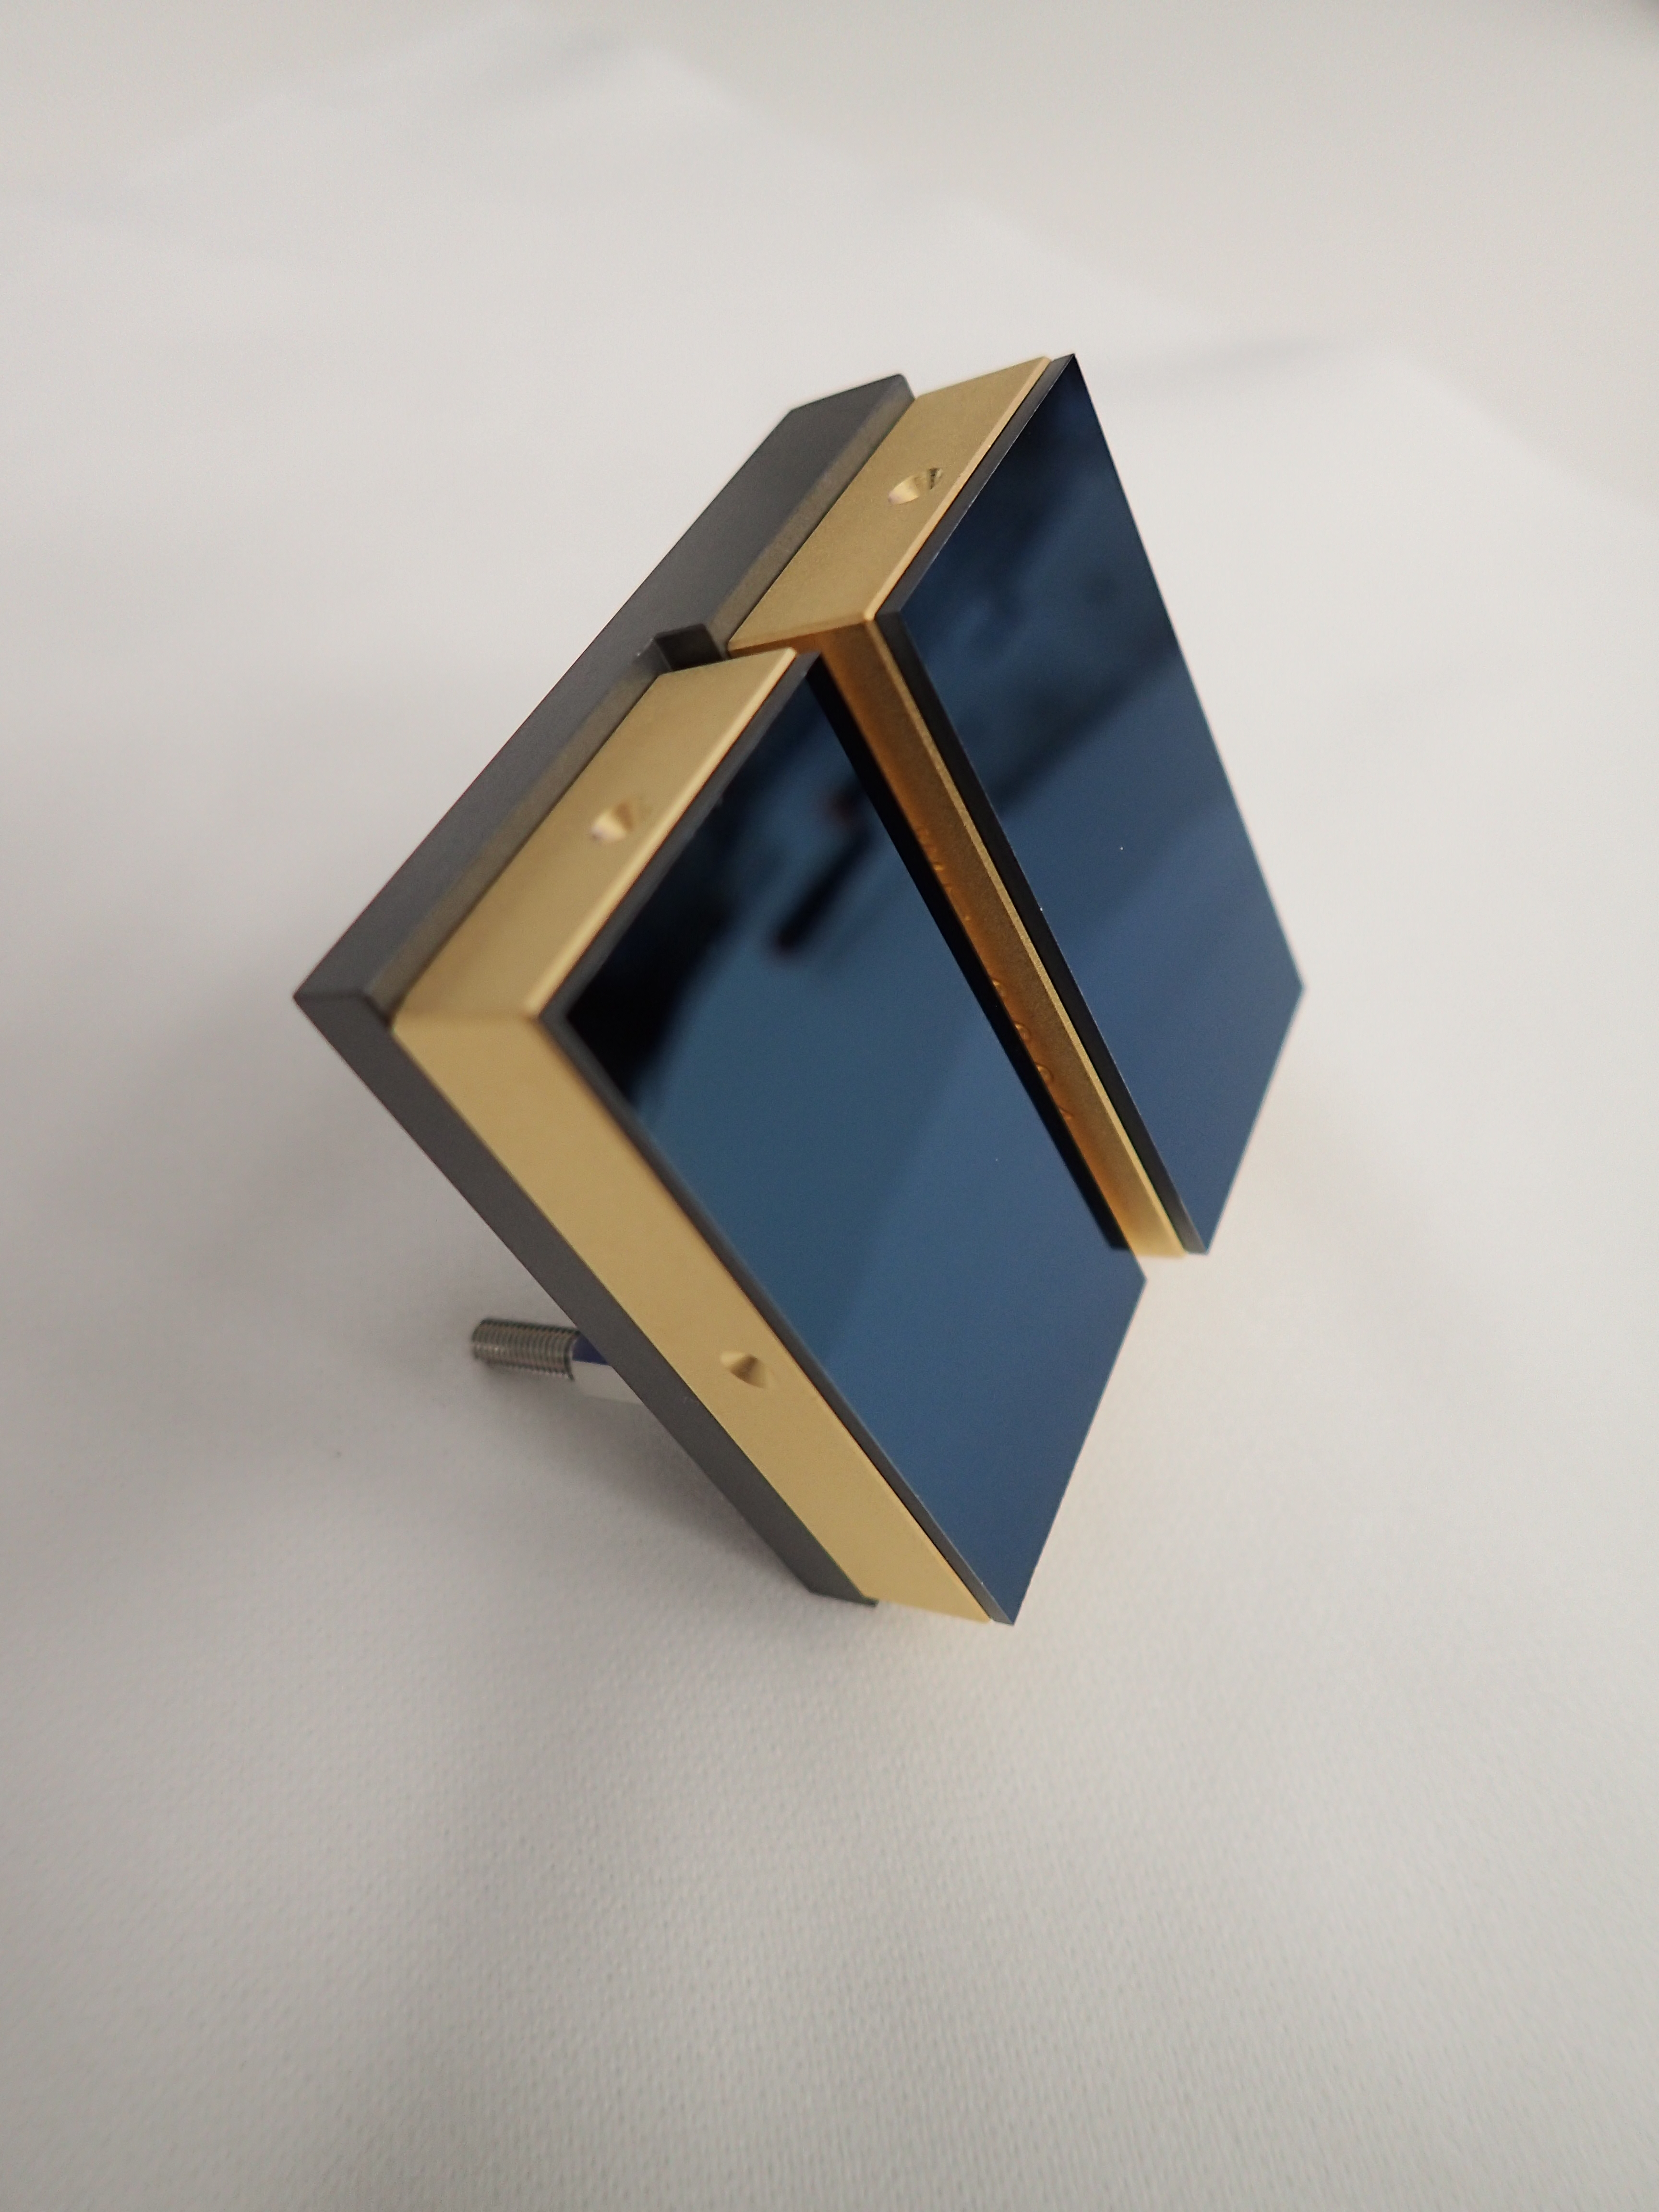
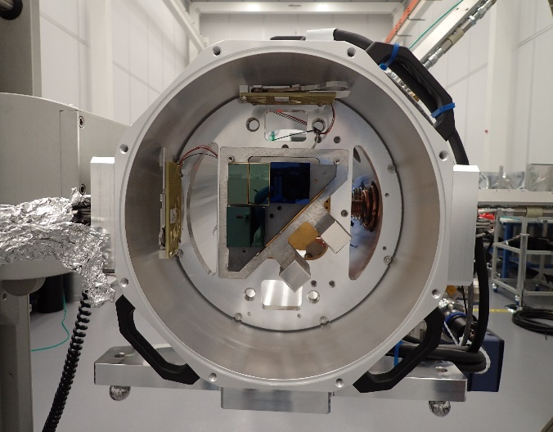
Corner raft status
Assembled WFS
All production corner rafts plus a spare were assembled successfully using reserve sensors for guiders to maximize science focal plane quality
4 production corner rafts were fully tested.
Performance degradation due to using reserve sensors for guiders was assessed and deemed acceptable (elevated read noise between 9e- to 15e-, “glow” defects, minor metrology excursions)
Production Corner Raft in test chamber
Closeout Item | Status | Comment
WBS deliverables | Done
Acceptance package |  | In progress
Closure of Non-Conformances |  | In progress
Closure of Action Items |  | In progress. 87 out of 90 closed
Transfer Risks |  | In progress
Lesson’s learned | Done | See LCA-17337
Drawings and documents |  | In progress
Close control accounts |  | 2 out of 5 closed
Close corrective actions | Done
Final Design report |  | Review needed for updates

Slide 18
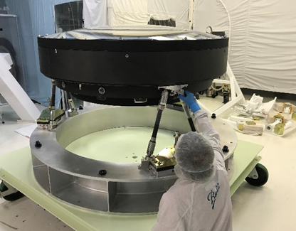
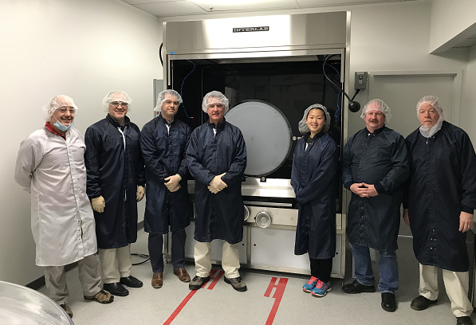
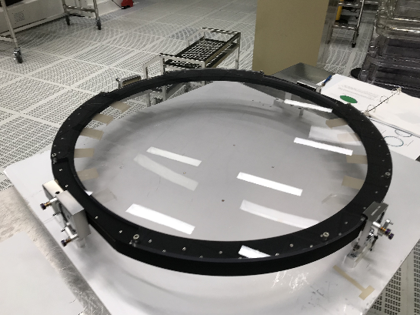
Optics status
L1-L2 assembly during inspection
Recent accomplishments
  L1-L2 completed. Acceptance review performed 7/22/2019, delivery expected 8/13/2019.
  L3 assembly and test complete. Acceptance review conducted 7/29/2019
  Coating R&D effort completed. R-band production filter coated
Upcoming work
  Resolve L1 cover residual issue
  Closeout L1-L2 and L3 scope of work
  Complete assembly and coating of the filters
Remaining Issues
  Filter coating is still a risk until completed
  Filter coating performance measurement on full size part is still a challenge
See Camera Optics Breakout talk (Wolfe)
Team in front of r-band coating chamber
i-band filter in its mount prior to coating

Slide 19
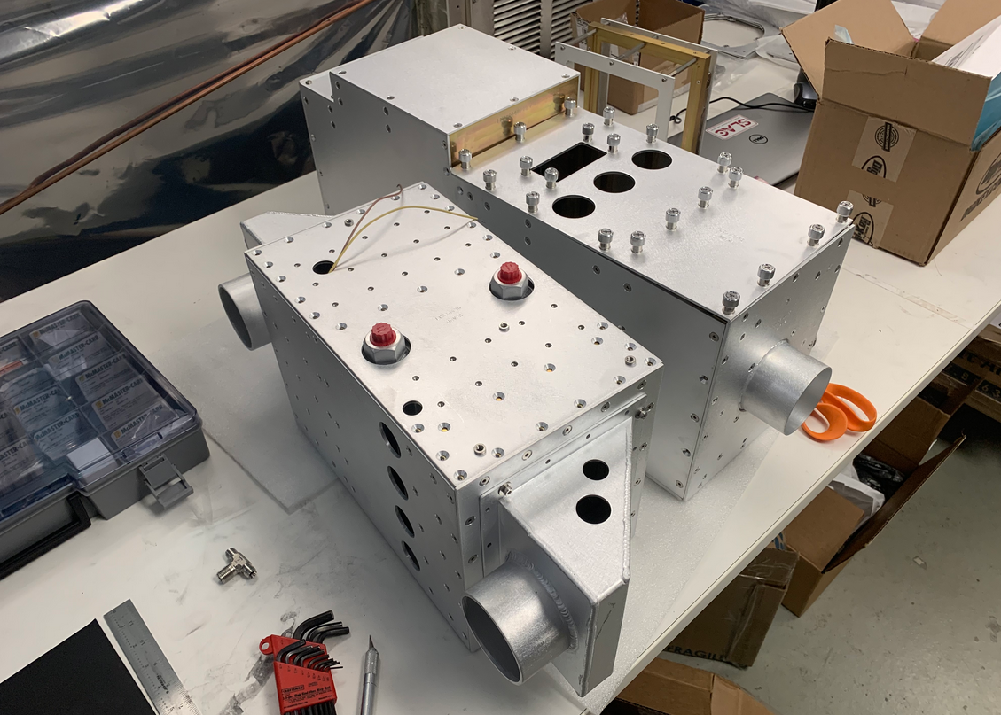
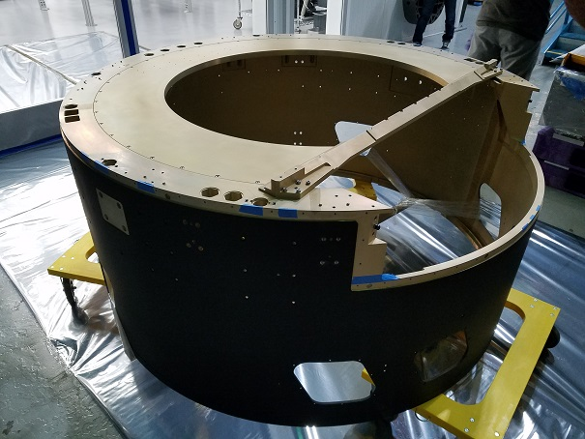
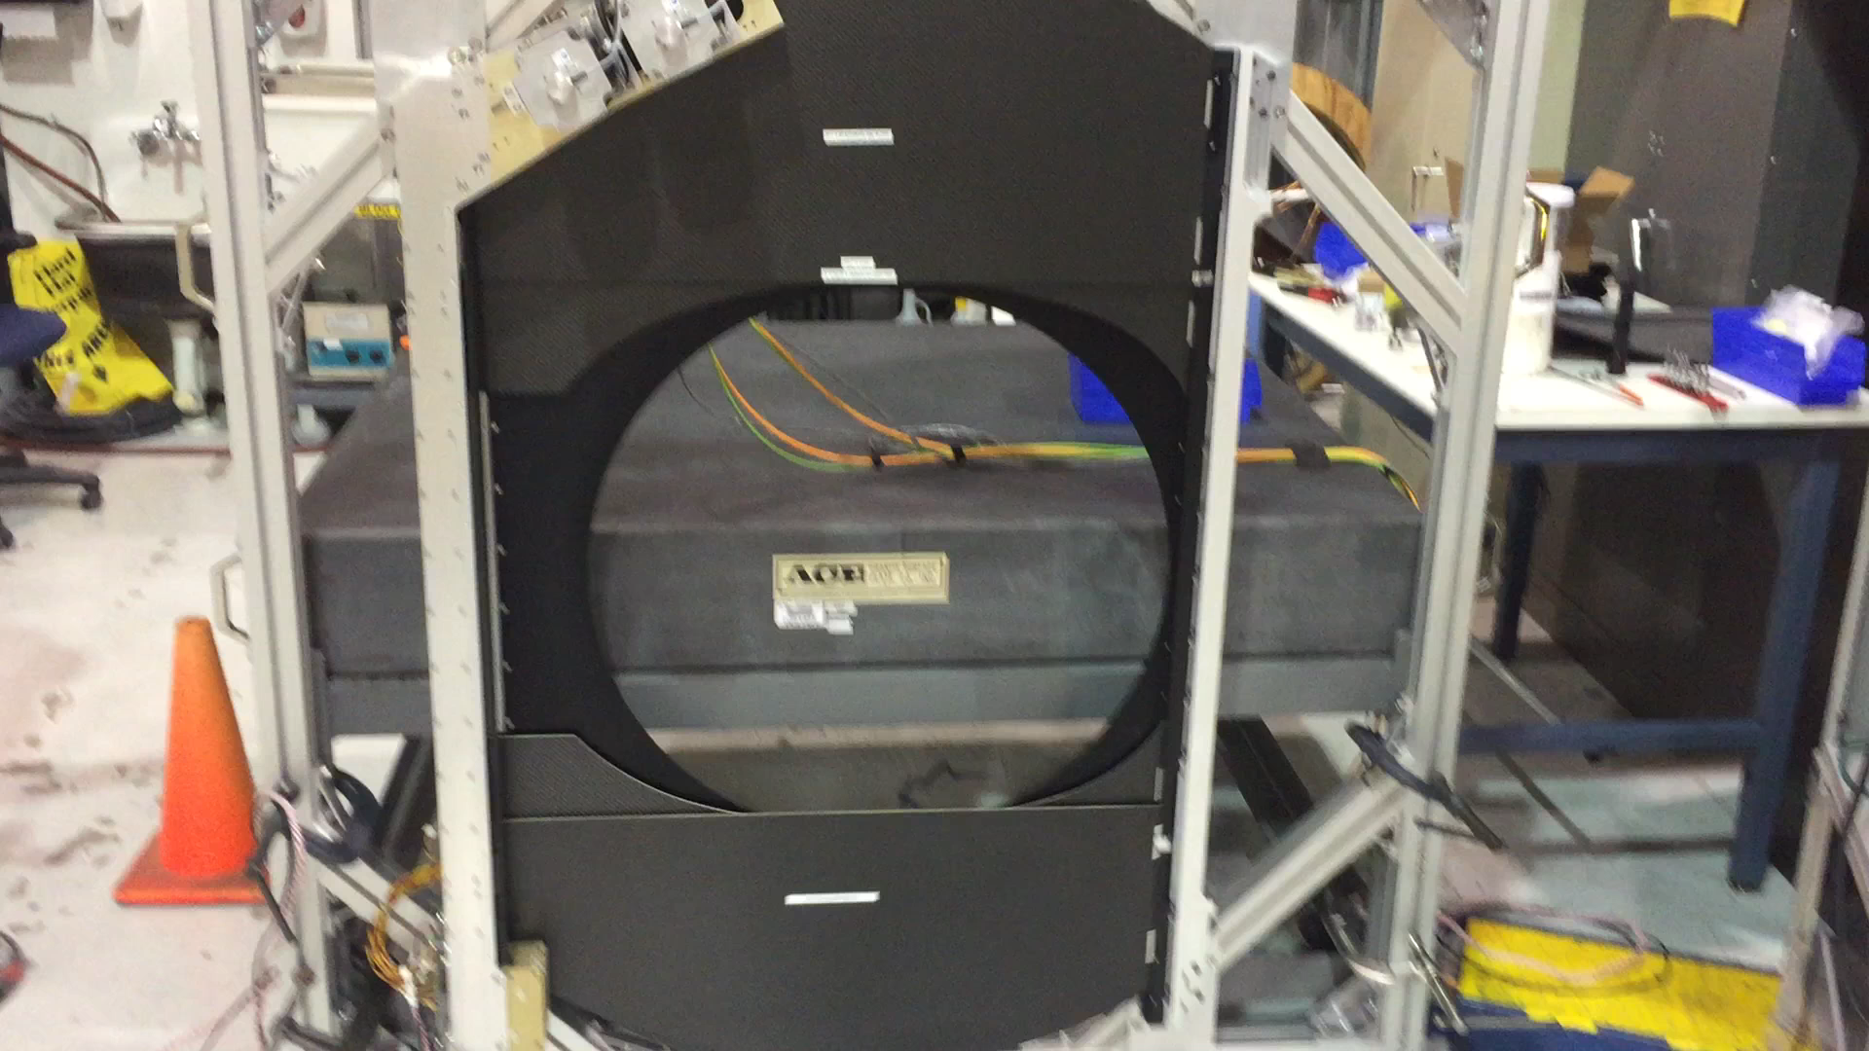
Camera Body and Shutter progress
Recent accomplishments
  Camera back-flange delivered to filter exchange team
  Camera Body housing and purge system complete
  Shutter prototype testing complete
  Shutter assembly started (all hardware is in hand)
Remaining work
  Complete fabrication and test of the two shutters and the insertion fixture
  Complete acceptance of the camera Body system
Camera Body Purge system
Camera Body Housing
See Camera Body & Shutter Breakout talk (Oriunno)
Shutter prototype

Slide 20
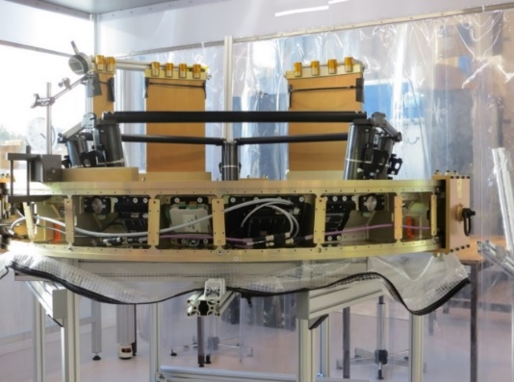
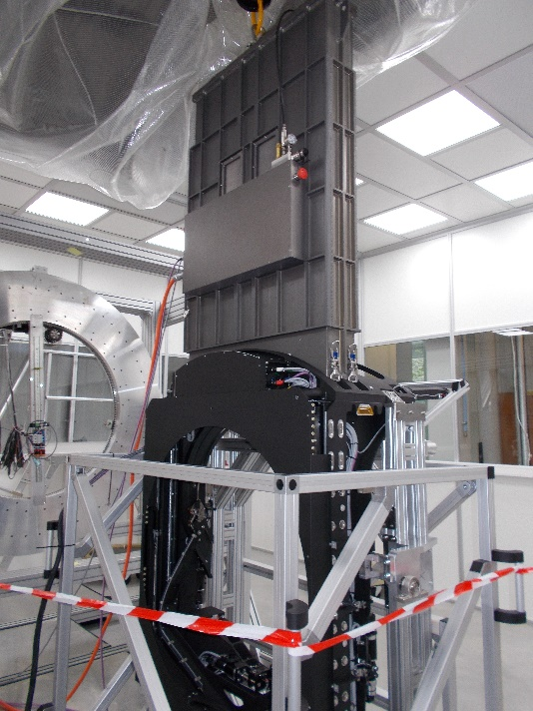
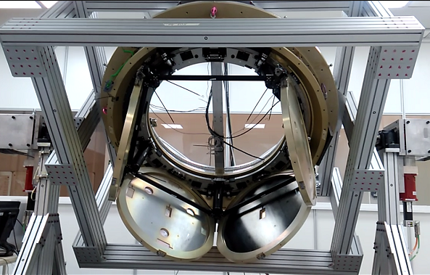
Filter Exchange System Progress (IN2P3)
Recent accomplishments
  Production carousel, manual loader and auto-changer assembled and testing well advanced
Remaining Issues
  Software optimization (currently delaying delivery at SLAC to 11/2019)
  Complete acceptance testing in IN2P3
  System now critical path after a safety incident
Upcoming work
  Complete assembly of spare auto-changer
  Ship Carousel, Loader and Auto-changer to SLAC
Production Carousel
Production Filter loader on production auto-changer in paris
Safety Incident (see ESH section)
See Camera Exchange System Breakout talk (Nordby/Karst)
Prototype carousel

Slide 21
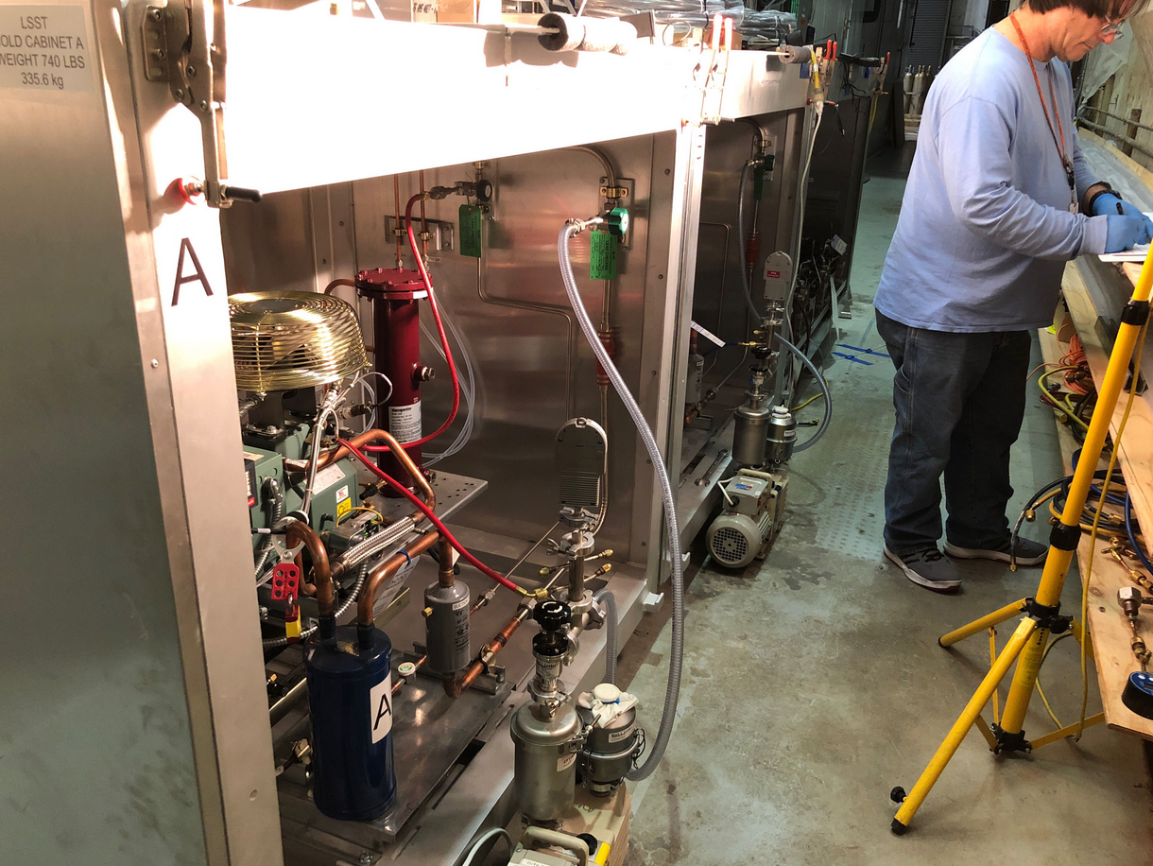
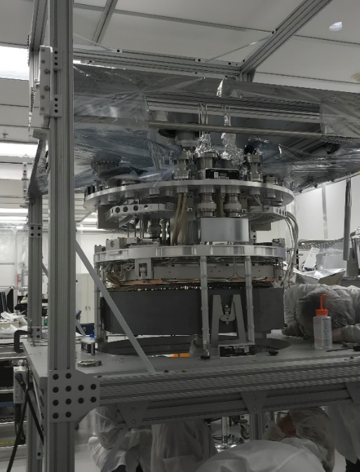
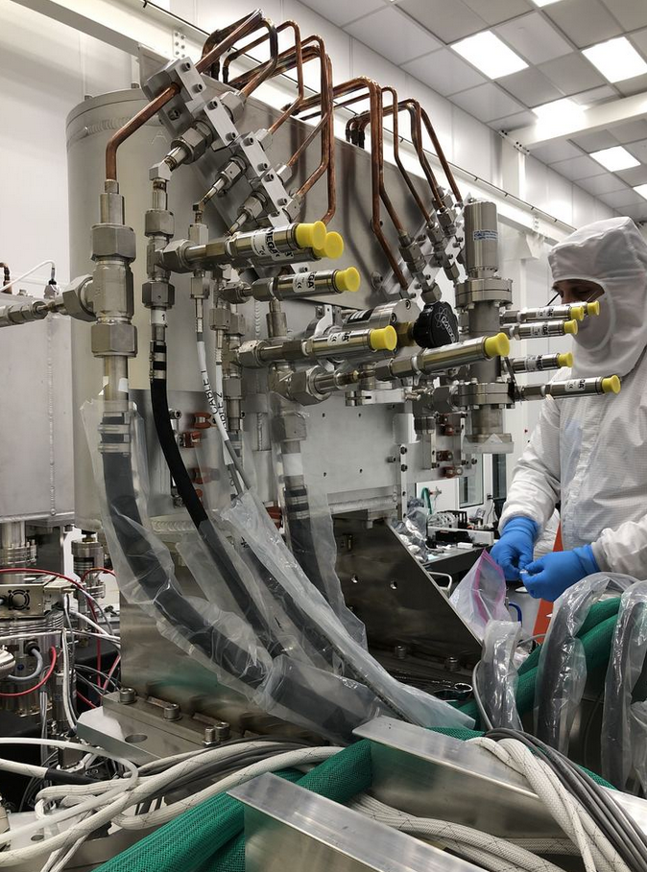
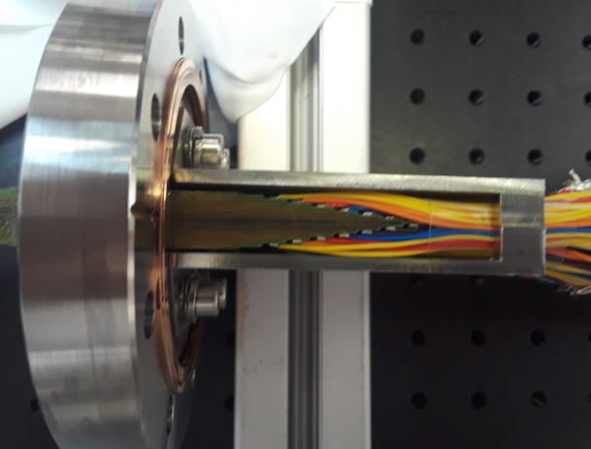
Cryostat effort is mostly complete
Recent accomplishments
  Cryostat complete and accepted
  Refrigeration for I&T use completed and tested demonstrating adequate capacity
  Vacuum system completed and accepted with good performance to date
  Power feedthroughs completed and installed in cryostat
Remaining work
  Complete fabrication of the final heat exchangers to be installed in the utility trunk (2 of the 8 circuits have been received at SLAC so far)
  Complete acceptance of the on-telescope refrigeration cabinets.
  Complete the utility trunk manufacturing and assembly
Remaining Risks
  Pumping time once all rafts are installed → N2 Pump/Purge procedure has worked well so far to reach adequate vacuum in ~ 2days
  Refrigeration maintenance especially during re-starts → capillary de-clog procedure successful so far
Refrigeration cabinet commissioning
Assembled cryoplate, cold plate and grid prior to insertion in housing
I&T heat exchanger installation on cryostat
See Camera UT Breakout talk (Markiewicz)
500 wire power feedthrough (4 needed)

Slide 22
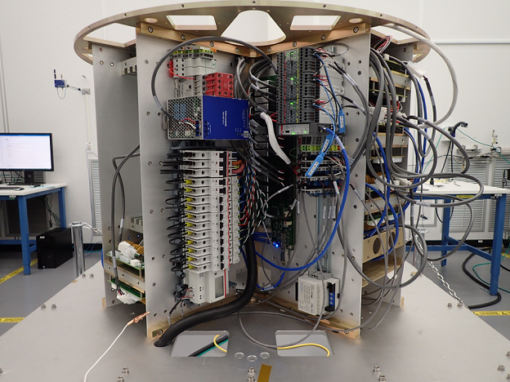
Auxiliary electronics scope is mostly complete
Closeout process in progress. Sub-system has stayed open to address various cabling and wiring issues discovered during early testing in I&T with the refrigeration system and the engineering rafts
Closeout process status
Closeout Item | Status | Comment
WBS deliverables | Done
Acceptance package | Done
Closure of Non-Conformances |  | In the process of closing
Closure of Action Items |  | In progress
Transfer Risks |  | In progress
Lesson’s learned | Done | See LCA-17337
Drawings and documents |  | In progress
Close control accounts |  | none closed yet
Close corrective actions | Done
Final Design report |  | Review needed for updates
Utility trunk quad box during assembly

Slide 23
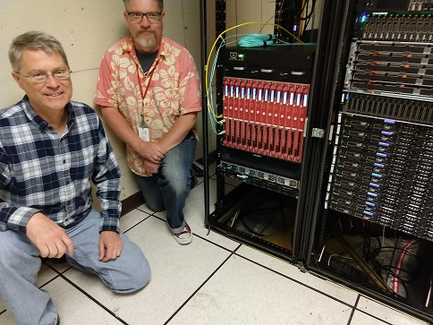
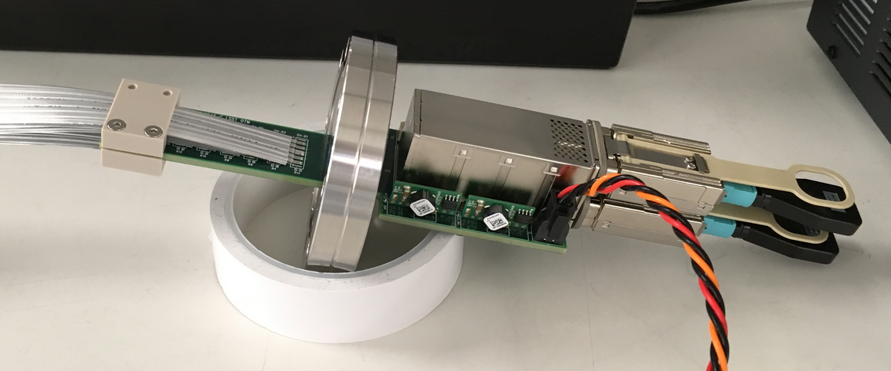
Data Acquisition and Camera Control System progress
DAQ hardware deployed in the SLAC Control Room
Recent accomplishments
  Optical rear transition modules (OTM) completed and installed in the cryostat.
  DAQ version 4 released and deployed supporting multiple raft synchronized readout although not at full speed yet for all 21 rafts
  Camera Control System Implementation in support of raft testing, I&T testing, shutter testing, filter exchange testing, refrigeration testing completed
Upcoming work
  Support the 9-raft test
  Implement the guider DAQ
  OCS to CCS bridge
Remaining Risks
  DAQ scaling from 16 rafts to full camera from a performance standpoint (multicast issue with the switch) needs to be resolved by Q2 FY20
See Camera DAQ and CCS Breakout talks (Huffer, Johnson)
Production OTM

Slide 24
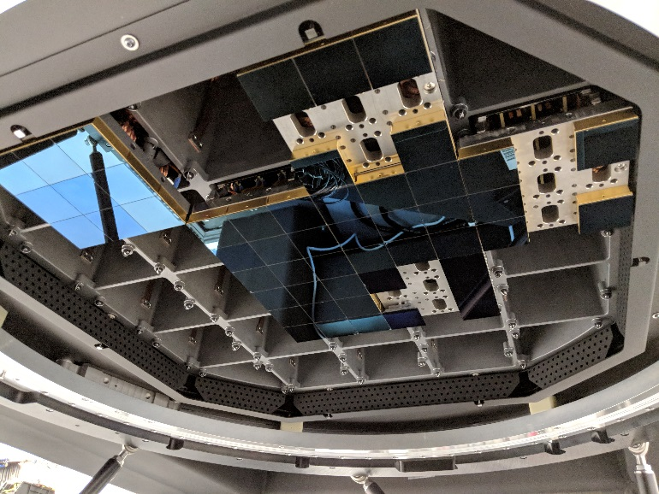
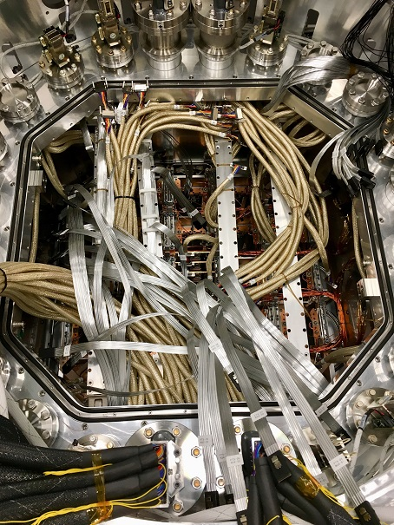
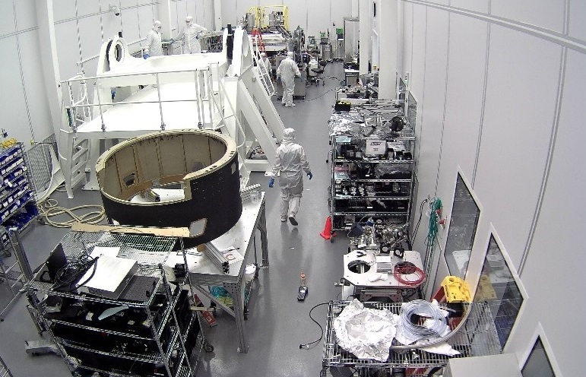
Integration and test activities progress
Recent accomplishments
  2 Engineering Raft testing Complete
  Cabling installation complete
  Vacuum system performance demonstrated with ion pumps
  Refrigeration testing complete
  Integration Stand installed in IR2
  First production rafts inserted in July
Upcoming work
  Raft insertion until Q2 FY20.
  Camera Integration start Q1 FY20
Remaining Risks
  Raft performance in full system environment
  Refrigeration maintenance
  Schedule of remaining deliveries (final DAQ, filter exchange, shutter, utility trunk)
See Camera I&T Breakout talk (Bond)
5 mechanical rafts and 2 engineering rafts inserted in the production cryostat
Power feedthrough Installation
Camera Integration Stand

Slide 25
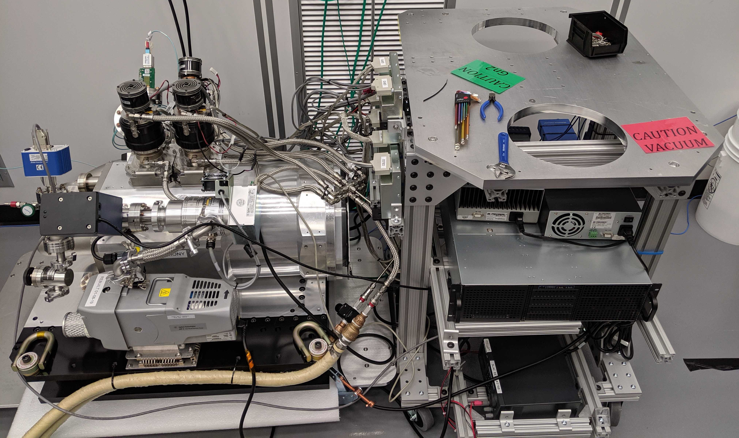
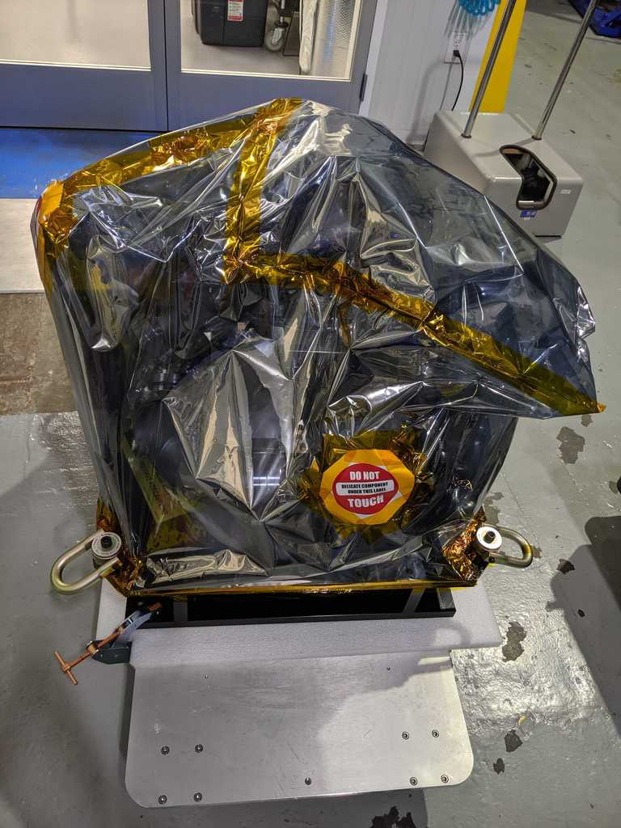
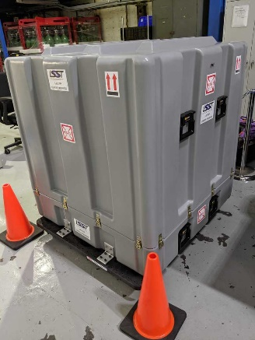
ComCam has been delivered to the project
ComCam at SLAC during acceptance
Project level acceptance and pre-ship review completed 5/30/2019
No action items remaining
ComCam has shipped to Tucson 6/19/2019
ComCam packed for shipping
Closeout process status
Closeout Item | Status | Comment
WBS deliverables | Done
Acceptance package | Done
Closure of Non-Conformances | Done
Closure of Action Items | Done
Transfer Risks | Done
Lesson’s learned | Done | See LCA-17337
Drawings and documents | Done
Close control accounts |  | 1 closed out of 2
Close corrective actions | Done
Final Design report | Done

Slide 26




Recent anomalies and associated risks
Guider sensor glows
  Measurement showed no measurable light on neighboring sensors.
  Mitigation if impacts are found later is to turn off the affected sensors (3 out of 8).
Lost 2-56 washer in the cryostat at time of insertion of the feedthrough.
  Every attempt was made to find the threaded retaining washer (it is likely not inside the cryostat).
  Root cause corrected by adding an additional securing nut.
  We have approved proceeding without having found it and keeping it in mind in our procedures.
Shorted 1 cold trim heater out of 36
  No root cause identified for sudden short during one of the cooldowns but possibly caused by the retaining metal clip used. Heater clips cannot be accessed anymore.
  Heater disabled at the power supply and power supply moved to Utility trunk accessible space to allow access while on the telescope.
RTD/Heater cable ground contact
  Intermittent potential ground loop due to shields touching at the feedthrough.
  Mitigation is to make it a permanent known ground loop.
Residual particulate on the cryostat shroud
  Best effort clean up completed. Number of particle of concern (large metallic) is small.
  Already in place intra raft particulate mitigation applies to other particulate mitigations (pocket covers).
See Camera I&T Breakout talk (Bond)

Slide 27
Performance Verification

Slide 28
Project level requirements management supports flow down and verification
LCA-00038, “System Engineering Management Plan” describes processes for requirements management
Camera and subsystem requirements have been developed in conjunction with observatory-level analyses of science performance and component design
LCA-48, “Camera Specification” contains requirements derived from 3 sources:
  Observatory-level requirements
  System-level interface agreements
  Camera plans
LCA-283, “Camera Verification Plan” contains the verification against LCA-48
LPM-17: LSST Science Reqs Doc (SRD)
“physics req’s doc’s”
LSE-29: LSST System Req’s (LSR)
LSE-30: Observatory System Spec (OSS)
LSST project control
DM Req’s
LSE-59: Camera Requirements
Tel & Site Req’s
OCS Req’s
System Interface Control Documents
“engineering spec’s”
LCA-48: Camera Specification
Camera Plans and Standards
Camera control
Camera Subsystem Specification
Camera Subsystem Specification
Camera Subsystem Specification

Slide 29


Camera sub-systems have a well defined acceptance process to I&T
Formal acceptance of completion:
  Authorizes: authorizes the sub-system to claim completion of the deliverable
  Pre-requisite: completion of all travelers and analysis needed as evidence to demonstrate compliance against requirements per the Verification Test Plan. For non-compliant requirements an approved NCR must be secured.
Pre-ship Review :
  Authorizes: shipment of the sub-system or delivery of the deliverable to I&T
  Pre-requisite: completion of “acceptance of completion”, completion of shipping plan, completion of shipping logistics. Review of provisional NCRs action items/corrective actions and approval.
Delivery acknowledgement:
  Authorizes: N/A
  Pre-requisite: Deliverable (hardware/software) arrival at IR2
I&T readiness acceptance:
  Authorizes: integration of component into the camera
  Pre-requisite: I&T-conducted test completed and evidence that results are within acceptable range for integration

Slide 30

The Camera has an integrated non-conformance process
All non-conformance is documented in the camera eTraveler online system as camera NCRs:
  Deviation from approved procedures during manufacturing or test process
  Incidents requiring stop work or re-work
  Deviation from requirements at time of sub-system acceptance or vendor acceptance
All Camera level non-conformance impacting the LSST observatory are also reported as an LCR in the Tucson-based system:
  All Optics deviations including non-requirement related (optics is an integrated design)
  All deviations from requirements at time of sub-system acceptance or vendor acceptance that would impact compliance against ICDs or LSE-59
  All waivers addressing foreseen deviation in the future (these do not have an eTraveler NCR until hardware is complete)
Sub-System | Camera NCRs | Project LCRs
Camera | 1 | 1
Camera Body and Shutter | 14 | 1
Corner Raft | 3 | 2
Cryostat | 64 | 1
Data Acquisition | 4 | 0
Exchange System | 0 | 0
I&T | 10 | 0
Optics | 23 | 17
Science Raft | 605 | 10
Utility Trunk | 28 | 0

Slide 31


Key Performance Parameters Verification
KPPs were defined to keep the Camera requirements self-contained
KPPs constrain requirement trade-offs within the LSST project
Objective KPPs will not be fully met for the combination of readout time, readout noise and number of pixels but threshold will be met.
Description of Scope | Threshold KPP | Objective KPP
Field of view coverage (square degrees) | > 9.3 | > 9.6
Pixel size | 0.2 arcsec | 0.2 arcsec
Number of pixels | > 2.6 Gigapixels | > 3.2 Gigapixels
Array readout time | < 3 seconds | < 2 seconds
Sensitivity range | 320-1050 nm | 320-1050 nm
Shutter minimum exposure time | < 2 seconds | < 1 second
Readout electronic noise, single exposure | < 13 electrons | < 9 electrons
Threshold KPPs will be met

Slide 32







On track to meet LSST project camera key performance based on as-built or prototype results to date
LCA-17 | Requirement | Design Estimate | Current Estimate
Image quality FWHM (arcsec) | 0.300 | 0.229 | 0.248
As built CCD charge diffusion to date
Raft contribution to focal plane flatness to date
L1 and L2 performance
Read Noise (e-) | LSE-59 requirement | LPM-262 deviation | 2sec readout | 3sec readout
7 | 100% | 50% | 87.9% | 97.2%
9 |  | 25% | 7.9% | 2.3%
13 | 0% | 20% | 3.4% | 0.5%
18 | 0% | 5% | 0.7% | 0.0%
Defective pixels | 2% | N/A | 0.2% | 0.2%
Read noise distribution on raft acceptance
Filter coating witness sample runs
Throughput | u | g | r | i | z | y
Requirement | 0.065 | 0.170 | 0.135 | 0.097 | 0.065 | 0.024
Design | 0.106 | 0.237 | 0.172 | 0.140 | 0.092 | 0.047
Prototype/as built | 0.102 | 0.219 | 0.168 | 0.126 | 0.095 | 0.045
As built QE
As built L1, L2 and L3

Slide 33
Risk Management and ESH summary

Slide 34
Definition of Risk and Risk Analysis for normalization
Risk are defined as an undesirable event during project execution that negatively affects program goals for performance, cost or schedule.
Risk management is the ongoing process of comprehensively assessing project risks.
Camera Risk Management Plan (LCA-29-A) defines the methodology to manage our risks
Definition of Risk Probability
Pts | Likelihood of Occurrence | Approximate Probability | Description of Probability
1 | Rare | <1% | Likelihood of occurrence is not credible
2 | Unlikely | 1-5% | Not reasonably expected to occur
3 | Possible | 5-25% | Possible, or difficult to assess the chance of occurrence
4 | Likely | 25-67% | Very likely that an adverse event will occur
5 | Highly Probable | >67% | High probability that an adverse event will come to pass
Definition of Risk Impact
Pts | Severity of Impact | Description of Impact
Cost Impact
1 | Insignificant | Overrun of cost of < $30K, recoverable with project contingency
2 | Minor | Overrun of cost of $30k - $200K, recoverable with project contingency
3 | Moderate | Overrun of cost of 200k - $1.5M, with significant impact on contingency
4 | High | Overrun of baseline cost of $1.5M - $10M, with re-baseline required
5 | Critical | Overrun of baseline cost of >$10M, with project in jeopardy
Schedule Impact
1 | Insignificant | Degradation of schedule margin to project critical path by < 2 wks
2 | Minor | Degradation of schedule margin to project critical path by 2 wks to 1.5 months
3 | Moderate | Degradation of schedule margin to project critical path by 1.5 to 3 months
4 | High | Degradation of schedule margin to project critical path by 3 to 6 months
5 | Critical | Degradation of schedule margin to project critical path by > 6 months
Performance Impact
1 | Insignificant | No effect on ability to meet requirements; minor design changes needed
2 | Minor | Minor excursion from subsystem requirement, but compensated elsewhere
3 | Moderate | Level 2 and/or SRD design specification exceeded
4 | High | Level 1 and/or SRD minimum specification exceeded
5 | Critical | Unable to achieve any of the primary science missions
→Quasi-quantitative process to assign objective values to probability of occurrence and impact of occurrence aspects of risk.
Total Impact:
(0.50*Cost Impact) +(0.33*Schedule Impact) + (0.33*Performance Impact)
→Risk Score:
Risk Probability * Total Impact

Slide 35
Definition of Risk and Risk Analysis for normalization
Risk can be defined as an undesirable event during project execution that negatively affects program goals for performance, cost or schedule.
Risk management is the ongoing process of comprehensively assessing project risks.
Camera Risk Management Plan (LCA-29-A) defines the methodology to manage our risks
Definition of Risk Probability
Pts | Likelihood of Occurrence | Approximate Probability | Description of Probability
1 | Rare | <1% | Likelihood of occurrence is not credible
2 | Unlikely | 1-5% | Not reasonably expected to occur
3 | Possible | 5-25% | Possible, or difficult to assess the chance of occurrence
4 | Likely | 25-67% | Very likely that an adverse event will occur
5 | Highly Probable | >67% | High probability that an adverse event will come to pass
Definition of Risk Impact
Pts | Severity of Impact | Description of Impact
Cost Impact
1 | Insignificant | Overrun of cost of < $30K, recoverable with project contingency
2 | Minor | Overrun of cost of $30k - $200K, recoverable with project contingency
3 | Moderate | Overrun of cost of 200k - $1.5M, with significant impact on contingency
4 | High | Overrun of baseline cost of $1.5M - $10M, with re-baseline required
5 | Critical | Overrun of baseline cost of >$10M, with project in jeopardy
Schedule Impact
1 | Insignificant | Degradation of schedule margin to project critical path by < 2 wks
2 | Minor | Degradation of schedule margin to project critical path by 2 wks to 1.5 months
3 | Moderate | Degradation of schedule margin to project critical path by 1.5 to 3 months
4 | High | Degradation of schedule margin to project critical path by 3 to 6 months
5 | Critical | Degradation of schedule margin to project critical path by > 6 months
Performance Impact
1 | Insignificant | No effect on ability to meet requirements; minor design changes needed
2 | Minor | Minor excursion from subsystem requirement, but compensated elsewhere
3 | Moderate | Level 2 and/or SRD design specification exceeded
4 | High | Level 1 and/or SRD minimum specification exceeded
5 | Critical | Unable to achieve any of the primary science missions
1 | Insignificant | Overrun of cost of < $30K, recoverable with project contingency
2 | Minor | Overrun of cost of $30k - $200K, recoverable with project contingency
3 | Moderate | Overrun of cost of 200k - $1.5M, with significant impact on contingency
→Quasi-quantitative process to assign objective values to probability of occurrence and impact of occurrence aspects of risk.
Total Impact:
(0.50*Cost Impact) +(0.33*Schedule Impact) + (0.33*Performance Impact)
→Risk Score:
Risk Probability * Total Impact

Slide 36
Definition of Risk and Risk Analysis for normalization
Risk can be defined as an undesirable event during project execution that negatively affects program goals for performance, cost or schedule.
Risk management is the ongoing process of comprehensively assessing project risks.
Camera Risk Management Plan (LCA-29-A) defines the methodology to manage our risks
Definition of Risk Probability
Pts | Likelihood of Occurrence | Approximate Probability | Description of Probability
1 | Rare | <1% | Likelihood of occurrence is not credible
2 | Unlikely | 1-5% | Not reasonably expected to occur
3 | Possible | 5-25% | Possible, or difficult to assess the chance of occurrence
4 | Likely | 25-67% | Very likely that an adverse event will occur
5 | Highly Probable | >67% | High probability that an adverse event will come to pass
Definition of Risk Impact
Pts | Severity of Impact | Description of Impact
Cost Impact
1 | Insignificant | Overrun of cost of < $30K, recoverable with project contingency
2 | Minor | Overrun of cost of $30k - $200K, recoverable with project contingency
3 | Moderate | Overrun of cost of 200k - $1.5M, with significant impact on contingency
4 | High | Overrun of baseline cost of $1.5M - $10M, with re-baseline required
5 | Critical | Overrun of baseline cost of >$10M, with project in jeopardy
Schedule Impact
1 | Insignificant | Degradation of schedule margin to project critical path by < 2 wks
2 | Minor | Degradation of schedule margin to project critical path by 2 wks to 1.5 months
3 | Moderate | Degradation of schedule margin to project critical path by 1.5 to 3 months
4 | High | Degradation of schedule margin to project critical path by 3 to 6 months
5 | Critical | Degradation of schedule margin to project critical path by > 6 months
Performance Impact
1 | Insignificant | No effect on ability to meet requirements; minor design changes needed
2 | Minor | Minor excursion from subsystem requirement, but compensated elsewhere
3 | Moderate | Level 2 and/or SRD design specification exceeded
4 | High | Level 1 and/or SRD minimum specification exceeded
5 | Critical | Unable to achieve any of the primary science missions
→Quasi-quantitative process to assign objective values to probability of occurrence and impact of occurrence aspects of risk.
Total Impact:
(0.50*Cost Impact) +(0.33*Schedule Impact) + (0.33*Performance Impact)
→Risk Score:
Risk Probability * Total Impact
1 | Insignificant | Degradation of schedule margin to project critical path by < 2 wks
2 | Minor | Degradation of schedule margin to project critical path by 2 wks to 1.5 months
3 | Moderate | Degradation of schedule margin to project critical path by 1.5 to 3 months

Slide 37


LSST Camera Project Risk: Current Risk Statistics
Camera risks are documented in the risk registry, LCA-30, and have been monitored starting prior to CD-1 review
Current status: 475 total risks identified
  Managing 185 active risks / opportunities or accepted risk (residual risk present and no further mitigation planned)
  290 are closed (risk was mitigated) or obsolete (risk is no longer applicable, and mitigations are not needed due to design updates.)
I&T Flow Mitigations
Filter Exchange shipping

Slide 38
LSST Camera Project Risk: Risk evolution
  Active Risks at CD-3, July 2017, May 2018, May 2019:
Post Mitigation Assessed Impact | CD-3 | July 2017 | May 2018 | May 2019
Insignificant | 128 | 258 | 379 | 424
Minor | 43 | 139 | 75 | 49
Moderate | 3 | 28 | 3 | 2
High | 0 | 2 | 0 | 0
  18 new risks identified since May 2018
  50 risks retired since May 2018
  19 risks are accepted (no more mitigations identified)
Mitigation Status | CD-3 | July 2017 | May 2018 | May 2019
Hold | 8 | 14 | 16 | 15
Not Started | 9 | 4 | 1 | 1
Working | 157 | 208 | 179 | 150
Accepted | N/A | 6 | 21 | 19
Complete | 84 | 123 | 168 | 216
Obsolete | 51 | 72 | 72 | 74
Totals: | 309 | 427 | 457 | 475

Slide 39
Camera top 10 risks as of May 2019
Risk Title | Risk Description (if/then) | Prob ability | Cost | Schd | Perf | Current Exposure | Prob ability | Cost | Schd | Perf | Residual Exposure
RTM performance degradation | IF RTM performance degrades over time (flex cable failure, RTD failure, Sensor Glow) THEN RTM may have to be de-integrated and refurbished | 4 | 3 | 3 | 3 | Moderate | 3 | 3 | 3 | 3 | Moderate
Metal Particulate Contamination | IF metal particulate are generated or present inside the cryostat THEN additional efforts will be required for decontamination and re-verify. | 4 | 3 | 3 | 2 | Moderate | 2 | 3 | 3 | 2 | Minor
Standing Army Costs 6 months | If the camera is late on elements, THEN standing army costs will be needed to complete the project | 4 | 3 | 4 | 1 | Moderate | 4 | 3 | 4 | 1 | Moderate
DAQ Schedule | IF full DAQ is not available when final RAFTs are integrated THEN final camera verification cannot occur until it becomes available. | 5 | 2 | 3 | 1 | Moderate | 5 | 2 | 2 | 1 | Minor
ITL sensor integrated performance | IF ITL sensors cannot be operated when integrated in a raft with adequate performance THEN the project will not be able to deliver the camera successfully | 4 | 2 | 2 | 3 | Moderate | 3 | 2 | 2 | 3 | Minor
Sustaining Engineering | IF the current program plans do not maintain personnel with adequate technical knowledge, THEN the technical staff may not be available to support issues that arise during I&T. | 4 | 3 | 2 | 1 | Minor | 4 | 3 | 2 | 1 | Minor
Filter Coating Failure | IF a filter coating run fails THEN the filter coating will not meet all specifications | 3 | 2 | 4 | 3 | Minor | 2 | 2 | 4 | 3 | Minor
Late scope changes | IF subsystems come with late changes to CCS interface scope, THEN CCS-provided software modifications will be required | 5 | 2 | 2 | 1 | Minor | 4 | 2 | 2 | 1 | Minor
L3 Position | IF the L3 frame does not hold the optic in place to required levels THEN the image quality may suffer | 3 | 3 | 3 | 2 | Minor | 1 | 3 | 3 | 3 | Insignificant
Contributed Labor | IF the CCS relies on substantial amounts of contributed labor and if that contributed labor fails to materialize, fails to deliver the expected software, or delivers software that does not meet the requirements THEN additional on-project manpower may be needed to compensate. | 3 | 3 | 4 | 1 | Minor | 4 | 2 | 3 | 1 | Minor
Communication problems | The camera is a distributed project; IF communication is not adequate, THEN poorly-understood interfaces could lead to delays, cost increases or reduction in performance | 3 | 3 | 3 | 2 | Minor | 2 | 3 | 2 | 1 | Insignificant

Slide 40
Hazard Analysis
Hazards can be defined as a failure of a component, system or function that could lead to personnel injury or damage to hardware. They are managed in LCA-15 and hazard reports.
Hazards are NOT risks but some of them are risks.
Hazard Severity Classification
Class | Description | Potential Consequences
1 | Catastrophic | Injury: may cause death or permanently-disabling injury
 |  | Property damage: near-complete loss of camera system
 |  | Environment: irreversible severe environmental damage
2 | Critical | Injury:severe injury, occupational illness, or permanent partial disability
 |  | Property damage: major damage to system; loss of major subsystem(s)
 |  | Environment: significant reversible environmental damage
3 | Marginal | Injury: minor injury or occupational illness
 |  | Property damage: minor damage to camera or subsystem, recoverable with minimal impact on program
 |  | Environment: mitigatable environmental damage, where restoration activities can be accomplished
4 | Negligible | Injury: minor first aid treatment; personal health not affected
 |  | Property damage: more than normal wear and tear; easily recoverable within scope of standard maintenance
 |  | Environment: minimal environmental damage
Mishap Risk Assessment Value |  | Severity
 |  | 1—Catastrophic | 2—Critical | 3—Marginal | 4—Negligible
Probability | A—Frequent | 1 | 3 | 7 | 13
 | B—Probable | 2 | 5 | 9 | 16
 | C—Possible | 4 | 6 | 11 | 18
 | D—Remote | 8 | 10 | 14 | 19
 | E—Improbable | 12 | 15 | 17 | 20
Hazard Probability Level
Level | Frequency of Occurrence | Definition
A | Frequent | Likely to occur often in the life of the Camera (X > 10⁻¹)
B | Probable | Will occur several times in the life of the Camera (10⁻¹ > X > 10⁻²)
C | Possible | Likely to occur sometime in the life of the Camera (10⁻² > X > 10⁻³)
D | Remote | Unlikely but possible to occur in the life of the Camera (10⁻³ > X > 10⁻⁶)
E | Improbable | So unlikely, it can be assumed occurrence may not be experienced
Mishap Risk Categories
Risk Assessment Value | Description
1-5 | High
6-9 | Serious
10-17 | Medium
18-20 | Low

Slide 41


The project is implementing Integrated Safety Management in its day-to-day activities
Tail gate meetings conducted at SLAC (IR2 and B33) and BNL clean rooms prior to start of activities
Acceptance process includes verification of proper implementation of all hazard mitigations per LCA-15
Safety review conducted prior to any key sub-system being turned on
Quarterly Hazard review board meeting run by LSST camera safety coordination
Commissioning and operation hazards coordinated with the broader project via workshops
Safety Review Minute example

Slide 42


Filter exchange system safety Incident at IN2P3/LPNHE (Paris)
What happened
  LPNHE employee entered into the stay-clear area while the carousel was rotating and his right arm was caught by a (rotating) clamp and compressed between the clamp and the (static) chimney.
  Co-worker immediately pressed the emergency switch, and employee was able to free his arm.
  Coworker called the local firemen and employee was fully conscious when he was rapidly taken to the nearest hospital.
  Both workers (and the whole team) were under deadline stress.
The carousel was idle, until the safety measures upgrades were approved, and work re-started 5/28/2019.
The safety measures implemented at IN2P3 and to be transferred at SLAC and the summit when applicable:
  Rigid plastic foils (800mm in height) placed vertically on the largest radius of the stator.
  6 emergency switches placed every 60 degrees on the stator.
  One extra lockable switch placed beside the control keyboard.
  A rotating lamp indicating the motor power status
  The switches cut the motor power, without any intervening software.
Carousel configuration at time of accident
Chimneys
clamp
Carousel safety upgrades

Slide 43



The project has had several moving incidents
A few incidents occurred during handling
  Refrigeration compressor sliding off pallet in May 2019
  Science raft collision with Bell Jar during removal in July 2019
QA and Human performance training conducted in May 2019
Safety stand-down and safety all-hands meeting in July 2019

Slide 44
Cost and Schedule Status

Slide 45
Camera Cost and Schedule performance (May19)
Camera cumulative SPI: 0.97
Camera cumulative CPI: 0.97
WBS (L2,L3) | BCWS ($k) | BCWP ($k) | ACWP ($k) | SV ($k) | SPI | CV ($k) | CPI
3.01 Management | $13,722 | $13,722 | $13,086 | $0 | 1.00 | $636 | 1.05
3.02 Systems Integration | $8,513 | $8,440 | $8,123 | $(73) | 0.99 | $316 | 1.04
3.03 Science Sensors | $34,006 | $34,006 | $33,775 | $0 | 1.00 | $231 | 1.01
3.04.01 Science Raft Systems | $17,448 | $17,394 | $17,005 | $(54) | 1.00 | $389 | 1.02
3.04.02 Corner Raft Systems | $7,064 | $7,003 | $6,875 | $(62) | 0.99 | $128 | 1.02
3.05 Optics | $26,494 | $24,380 | $23,470 | $(2,114) | 0.92 | $909 | 1.04
3.06.01 Camera Body | $2,395 | $2,272 | $3,129 | $(123) | 0.95 | $(857) | 0.73
3.06.02 Shutter | $3,030 | $2,722 | $3,582 | $(308) | 0.90 | $(860) | 0.76
3.06.04 Cryostat | $16,284 | $16,063 | $18,759 | $(221) | 0.99 | $(2,697) | 0.86
3.06.05 Utility Trunk | $1,385 | $950 | $1,144 | $(435) | 0.69 | $(194) | 0.83
3.07.01 Control System | $4,611 | $4,476 | $4,753 | $(135) | 0.97 | $(278) | 0.94
3.07.02 Data Acq Sys | $5,657 | $5,301 | $6,011 | $(356) | 0.94 | $(710) | 0.88
3.07.03 Aux Elec | $2,298 | $2,289 | $3,138 | $(9) | 1.00 | $(848) | 0.73
3.08 Integration and Test | $10,446 | $9,700 | $10,318 | $(746) | 0.93 | $(618) | 0.94
Total | $153,352 | $148,716 | $153,169 | $(4,635) | 0.97 | $(4,452) | 0.97

Slide 46

Camera Trend Data shows a stable performance as it reaches completion

Slide 47

Main needs and schedule status to I&T (Consistent with May 2019 forecast data)

Slide 48
Camera Critical Paths
Raft integrations (-18 days in May data and -27 days in June data)
DAQ/CCS software (2 days in May data, -27 days in June data) is now on critical path after technical issues with DAQ on scaling the multicast. Current temporary solution allows up to 16 rafts full speed and all 21 raft with degraded performance.
Start of Camera Integration with Filter exchange assembly with back flange and camera body (-8 days of schedule float)

Slide 49
Camera key schedule variance drivers
Schedule Variance drivers
  L1-L2 assembly delays at BATC/AOS in Tucson due to various manufacturing delays with the mount, glass and accessories. Schedule variance expected to recover after delivery and is currently ~-$1,000K . L1-L2 is complete, with an acceptance review on 7/9/2019..
  Filter coating and glass polishing has been delayed due to reproducibility, manufacturability issues and equipment availability. Still active with ~-$675K schedule variance left. The r-band filter has been coated and needs to be mounted in its frame, i-band and z-band have been polished and are awaiting coating, while the other filters are still being polished. Technical risk has now been mostly retired with successful witness sample program and filter frame early testing.
  Utility trunk delays at SLAC due to lack of initial maturity and re-direction of personnel in support of critical path items (refrigeration, power feedthrough). Still recovering with ~-$435K schedule variance left. Utility trunk work is now fully engaged with expected delivery by end of 2019 calendar year.
  L3 assembly delays at TSESO in France due to various manufacturing delays with the mount and glass. Still recovering with ~-$375K schedule variance left. L3 Assembly is complete and awaiting acceptance.
  DAQ delays at SLAC on crosstalk correction firmware and Guider acquisition to support DAQ V4 release in support of integrated raft testing. Active at ~-$350K schedule variance left. Purposely delayed to accommodate V4 release.
  I&T Integration delays due to delays in raft refurbishment and raft integration. Still recovering with ~-$300K. Integration has now started.
  I&T Integration stand and handling equipment delays to allow focusing on more critical items (Raft Integration readiness and Raft Refurbishment). Still active with ~-$300K schedule variance. Integration stand and handling equipment work started after gantry was completed.

Slide 50

Risk Based Schedule Confidence
80% confidence that the camera will not be delayed by more than ~4 months from current forecast of 12/17/2020 (58 days/3 months of float to forecasted project need date)
Limited opportunities to mitigate schedule delays beyond the 58 days without impacting significantly commissioning activities or delaying the start of operation

Slide 51
Camera Schedule Mitigations
While the camera has a few month of schedule float to its need date, a few potential mitigations have been identified should significant delays be experienced on the camera.
These would have to be taken in concurrence with the broader project and the agencies and are not proposed at this time
Schedule Mitigation ordered by increasing impact | Plan | Risk | Mitigation | Schedule gain | P6 Activity
Forego Camera Verification Testing | Accept Camera MIE deliverable using functional test and cryostat level verification testing for the KPPs. | Risk that full performance are impacted by unknown full assembly issues | Functional verification is still occurring prior to shipping. Re-verification planned already on the summit prior to integration on the telescope | 45 days | ITC20150
Forego Camera Functional Testing and Verification Testing | Accept Camera MIE deliverable using sub-system acceptance data and cryostat level verification testing for the KPPs | Risk that the camera does not operate when all together and integrated performance are impacted by unknown issues | Functional testing and re-verification planned already on the summit prior to integration on the telescope | 91 days | ITC20125 ITC20150
Forego Assembling L1-L2 at SLAC, no further testing after camera and cryostat integration | Accept Camera MIE deliverable using sub-system acceptance data and cryostat level verification testing for the KPPs | Risk that L1-L2 integration cannot be done plus all risks above | The baseline shipping plan is to dis-assemble L1-L2 from the camera prior o shipping. The commissioning plan is already in place to assemble and re-test | 131 days | ITC20025 ITC20050 ITC20125 ITC20150

Slide 52
Camera project has actively conducted EACs
Comprehensive EAC conducted across all control accounts at the beginning of FY17, FY18 and FY19
Each month, Control Accounts are required to review their EAC if:
  Actuals are greater than EAC
  Performance-based forecast EAC is greater than formal EAC by more than $75K in either labor or M&S category
Comprehensive FY20 EAC is planned for October 2019 on remaining control accounts (mostly I&T at that time)
WBS (L2,L3) | BAC | EAC | VAC | CV | % Comp
3.01 Management | $15,225 | $14,750 | $475 | $636 | 90%
3.02 Systems Integration | $9,308 | $9,026 | $281 | $316 | 91%
3.03 Science Sensors | $34,011 | $33,788 | $223 | $231 | 100%
3.04.01 Science Raft Systems | $17,507 | $17,495 | $12 | $389 | 99%
3.04.02 Corner Raft Systems | $7,064 | $6,948 | $116 | $128 | 99%
3.05 Optics | $28,094 | $28,078 | $16 | $909 | 87%
3.06.01 Camera Body | $2,395 | $3,248 | $(854) | $(857) | 95%
3.06.02 Shutter | $3,030 | $3,806 | $(777) | $(860) | 90%
3.06.04 Cryostat | $16,394 | $18,893 | $(2,499) | $(2,697) | 98%
3.06.05 Utility Trunk | $1,385 | $1,500 | $(115) | $(194) | 69%
3.07.01 Control System | $5,055 | $5,215 | $(160) | $(278) | 89%
3.07.02 Data Acq Sys | $5,688 | $6,222 | $(534) | $(710) | 93%
3.07.03 Aux Elec | $2,298 | $3,236 | $(938) | $(848) | 100%
3.08 Integration and Test | $12,847 | $13,188 | $(341) | $(618) | 76%
Total | $160,301 | $165,393 | $(5,092) | $(4,452) | 92.8%

Slide 53
Camera EAC key drivers
EAC/VAC key drivers
  IN2P3 contribution per iCRADA: ~$800K
  Cryostat and Refrigeration under-estimating effort to bring manufacturing and assembly to completion including recent overrun and small effort in the future: ~-$2.5M
  Camera Body overruns to address drawing complexity increase and non-conformance support or major deliveries: ~-$850K
  Auxiliary Electronics overruns to address loss of key contributed personnel (death) and cabling under-estimated scope: ~-$850K
  Shutter overruns to address prototype effort scope of work under-estimation and personnel transition: ~-$775K
  Integration and test revised estimate in FY17 from baseline effort due to maturation of the sub-system: ~-$550K
  Data Acquisition system overrun due to technical issues with storage and ethernet switch: ~-$500K

Slide 54
Camera key cost variance drivers
Cost Variance drivers
  Cryostat and Refrigeration due to issues with the cryo-cold plate manufacturing, support of the grid repair, heat exchanger manufacturing, refrigeration testing. Active at ~-$2,700K with expectation to stop as scope is mostly complete.
  Auxiliary electronics due loss of key contributed personnel and under-estimation of cabling scope. Stopped at ~-$850K
  Camera Body and shutter due to under-estimated effort to complete design and drafting activities in Fy16 and FY17. Stabilized at ~-$800K for each sub-system
  Data Acquisition system due to issues related to STA storage and COB electronics development including the ethernet switch. Active at ~-$700K with expectation to recover partially
  I&T effort in commissioning the IR2 clean room and attempting to catch up on overall schedule delays. Stable at ~-$600K despite the various schedule challenges

Slide 55

Contingency analysis
Contingency as of May 2019 EAC | $2,607K
PM liens | -
Available Contingency for probabilistic events | $2,607K
Risk Based unknown (80% confidence) | $2,712K
Risk Based unknown (75% confidence) | $2,566K
Risk Based unknown (50% confidence likeliest outcome) | $2,010K
Maturity Based uncertainty | $1,490K
Risk registry Monte-Carlo
CURRENT ASSESSMENT
Likeliest outcome is that we will return ~$600K
25% chance we will spend all contingency
5% chance we would need an additional $1M
WBS | % complete | Activity-based uncertainty (%) | Activity -based uncertainty ($K)
3.01 Management | 90% | 5% | $83
3.02 Systems Integration | 91% | 5% | $45
3.03 Science Sensors | 100% | 0% | $0
3.04.01 Science Raft Systems | 99% | 10% | $49
3.04.02 Corner Raft Systems | 99% | 10% | $7
3.05 Optics | 87% | 10% | $461
3.06.01 Camera Body | 95% | 10% | $12
3.06.02 Shutter | 90% | 15% | $34
3.06.04 Cryostat | 98% | 15% | $20
3.06.05 Utility Trunk | 69% | 20% | $71
3.07.01 Control System | 89% | 20% | $92
3.07.02 Data Acq Sys | 93% | 15% | $32
3.07.03 Aux Elec | 100% | 10% | $10
3.08 Integration and Test | 76% | 20% | $574
TOTALS | 92.8% | 12% | $1,490
Alternate contingency assessment: The additive maturity-based uncertainty on remaining work is $1,490K and is mostly captured in the risk registry and current EAC given the completion state of the project (92.8% complete). It is less than the $2,607K of contingency available.

Slide 56

Contingency Trend
Draws on Contingency have been mostly driven by mitigations to address sensor delivery and raft cleanliness.

Slide 57

Camera available cost de-scope
$200K of de-scope is still available per the de-scope plan (LCA-276)
De-scope | Budget | Target Date | Status
Reduce effective area of focal plane | $4,987K | Feb 2017 August 2018 | All Science Rafts were assembled. Less than $10K available as de-scope for integration. Sensor noise sensitivity on several rafts is effectively requiring full installation of all rafts to ensure performance requirements are met.
Reduce summit data storage | $25K | June 2018 | Received. Not taken. Not available.
Eliminate standby shutter and spare blades | $400K | Nov 2017 | Spare blades were de-scoped. Second shutter blades were awarded. Not available.
De-scope Crosstalk Correction | $200K | Oct 2019 | Still available
Eliminate Offline refrigeration system | $150K | Feb 2017 | Implemented. Not available.
Scale back system-level testing | $350K | Mar 2016 | Implemented to accommodate key sub-system delays. Not available.
Scale back image diagnostics | $150K | Aug 2015 | Not implemented. Not available.
Eliminate Grid Spare Cesic® | $134K | Jul 2017 | Not taken. Not available.

Slide 58

All funding has been received in FY18

Slide 59



FTE transition has been challenging
Camera staffing levels have significantly decreased in FY19
Fully named list with effort is managed every other week during our production meeting
Camera key personnel has worked with institutions (SLAC and BNL) to transfer personnel to other projects mostly with success to date.
The project is still having issues transitioning staff to commissioning based on skills, and need dates

Slide 60
Upcoming Milestones and Summary

Slide 61
Milestone Chart – Level 2 (May 19 data)
Activity Name | Baseline | Forecast | Variance | Status
COMP: Conceptual Design Complete (Ready for CD-1) | 30-Nov-11 | 30-Nov-11 A | 0 | Completed
COMP: Prototype Science Sensors Received | 3-Jan-12 | 03-Jan-12 A | 0 | Completed
COMP: Vertical Slice Test - Phase 1 | 16-May-13 | 16-May-13 A | 0 | Completed
COMP: Sensor Final Design Complete (Ready for CD-3a) | 31-Mar-14 | 31-Mar-14 A | 0 | Completed
COMP: First Article Sensor Contract Placed | 24-Apr-14 | 24-Apr-14 A | 0 | Completed
COMP: Performance Baseline Established (Ready for CD-2) | 16-Oct-14 | 16-Oct-14 A | 1 | Completed
START: ASIC production (IN2P3) | 31-Mar-16 | 25-May-15 A | 213 | Completed
COMP: Award L3 Assembly Phase 1 Contract | 31-Jul-15 | 08-Jun-15 A | 38 | Completed
COMP: Camera Design Complete (Ready for CD-3) | 30-Sep-15 | 12-Jun-15 A | 77 | Completed
COMP: L1-L2 Assembly Phase 2 FDR | 29-Feb-16 | 30-Oct-15 A | 80 | Completed
COMP: First Sensor Tested | 29-Feb-16 | 27-Jan-16 A | 23 | Completed
COMP: First article 2Kx4K Wavefront Sensor (Phase 1) | 16-Dec-16 | 16-May-16 A | 150 | Completed
COMP: Award Sensor Lot 2 | 31-Aug-16 | 02-Aug-16 A | 22 | Completed
COMP: First RTM Ready for Integration | 31-May-17 | 26-May-17 A | 3 | Completed
COMP: Sensor Production is 50% complete (end of lot 2) | 28-Feb-18 | 29-Sep-17A | 103 | Completed
COMP: L1 & L2 Pre-Coating Metrology (Phase 4b) | 28-Feb-18 | 16-Feb-18 A | 7 | Completed
COMP: Sensor Production Complete | 29-Mar-19 | 16-Nov-18 A | 96 | Completed
COMP: Cryostat Chamber & I&T Refrigeration System Ready for Integration | 13-Dec-18 | 7-Jun-19 | -113 | Completed in June
COMP: Commissioning Camera Ready to Ship for Testing | 31-May-19 | 14-Jun-19 | -10 | Completed in June
COMP: L3 Assembly Ready for Integration | 30-Apr-19 | 28-Jun-19 | -42 | 139 days to I&T forecast critical path
COMP: 1st Filter Coated and Ready for Integration | 30-Aug-19 | 10-Jul-19 | 37
COMP: L1/L2 Assembly Ready for Integration | 31-Oct-19 | 31-Jul-19 | 64
COMP: Early Hardware & Software Ready for Summit | 31-Oct-19 | 24-Sep-19 | 26
COMP: Filter Exchange System Ready for Integration (IN2P3) | 31-Jan-19 | 10-Oct-19 | -176 | 10 days to I&T forecast critical path
COMP: Loaded Cryostat Ready for Integration | 28-Feb-20 | 30-Jan-20 | 19 | Critical path
COMP: Camera Fully Integrated & Ready for Verification Testing | 31-Aug-20 | 17-Jul-20 | 31 | Critical path
COMP: PSR/ORR - Camera Pre-Ship/Operations Readiness Review Complete | 26-Feb-21 | 17-Dec-20 | 40 | Critical path
COMP: KPPs achieved (Camera Readiness Review, Ready for CD-4) | 29-Oct-21 | 17-Dec-20 | 212

Slide 62

LSST Camera Summary Schedule

Slide 63
Summary
The LSST Camera is progressing towards completion as planned and mitigating issues promptly as they arise as evidenced by acceptable cost and schedule performance (CPI/SPI at 0.97/0.97).
Contingency remains tight (21% on remaining work)
The camera team is fully in place and personnel transition is occurring with success
Safety management is an integral part of the assembly, test and verification activities
Transition to commissioning has started
The camera has addressed the recommendations from the last status review (see response report posted)

Slide 64
Backup

Slide 65
Procurement risks have been mostly retired
WBS | Total procurement | % Completed | % Awarded in progress | % Not awarded but locked | % Not awarded
3.03 Science Sensors | $25,338K | 100.0% | 0.0% | 0.0% | 0.0%
3.04.01 Science Raft Systems | $4,549K | 100.0% | 0.0% | 0.0% | 0.0%
3.04.02 Corner Raft Systems | $3,096K | 100.0% | 0.0% | 0.0% | 0.0%
3.05 Optics | $19,439K | 85.2% | 14.8% | 0.0% | 0.0%
3.06.01 Camera Body | $555K | 100.0% | 0.0% | 0.0% | 0.0%
3.06.02 Shutter | $848K | 91.5% | 8.5% | 0.0% | 0.0%
3.06.04 Cryostat | $6,028K | 97.0% | 1.3% | 0.0% | 1.7%
3.06.05 Utility Trunk | $165K | 24.1% | 18.5% | 0.0% | 57.3%
3.07.01 Control System | $576K | 61.7% | 1.4% | 0.0% | 36.9%
3.07.02 Data Acq Sys | $1,515K | 100.0% | 0.0% | 0.0% | 0.0%
3.07.03 Aux Elec | $515K | 100.0% | 0.0% | 0.0% | 0.0%
3.08 Integration and Test | $2,901K | 90.9% | 3.9% | 0.0% | 5.2%
Total (as of May 2019) | $65,525K | 94.3% | 4.8% | 0.0% | 0.9%
Total (as of May 2018) | 83% | 11% | 2% | 4%

Slide 66
Raft repairs fells into one of four categories with scope of work shared by both the Science raft and I&T sub-systems
RTM to be disassembled, cleaned, retrofitted, re-assembled and qualified at BNL and then re-verified at SLAC: Applies: to 1) RTMs that were returned to BNL that require sensor replacement due to permanent damage or performance issues; and 2) incomplete RTMs at BNL that are currently on hold. There are five RTMs in this category, all of which will be re-verified at SLAC.
RTM to be disassembled, cleaned, retrofitted, re-assembled at BNL, and then re-verified at SLAC: Applies to 1) RTMs that were returned to BNL that do NOT require sensor replacement; and 2) completed/tested RTMs at BNL that were never shipped to SLAC and are currently on hold at BNL. There are six RTMs in this category, all of which will be re-verified at SLAC.
(e2v only) RTM to be disassembled at SLAC and the RSA will be shipped to BNL for cleaning and retrofitting, and then returned to SLAC for re-assembly and re-verification at SLAC: Applies to e2v-based RTMs currently at SLAC (e2v-based RTMs require sensor removal due to limited access to the wire bonds while installed on the RSA). There are eight RTMs in this category, all of which will be re-verified at SLAC.
(ITL only) RTM to be disassembled, cleaned, retrofitted, reassembled and re-verified at SLAC: Applies to ITL-based RTMs already at SLAC. There are four RTMs in this category.

