Slide 1
LSST DOE Commissioning Project Overview Vincent Riot LSST Camera Project Manager NSF/DOE Joint Status Review August 27, 2019

Slide 2
Outline
Introduction and Scope
Technical Status
Risk Management
Cost and Schedule Status (May 2019 month end)
Past performance
Recent Changes
Forecast and estimate to completion
Contingency management
Upcoming Milestones and Summary
Message box example for short highlighted messages.

Slide 3
Introduction and Scope

Slide 4
Commissioning WBS and DOE contribution
WBS | Description | DOE Contribution
01C.01.01 | Project Office and Support | PMCS, Finance, Admin, System engineer, PM
06C.02.01 | Commissioning Management | Technical Management, Travel, Sabbatical
06C.02.02 | Commissioning Planning, Preparation, Tooling, & Simulations
06C.02.02.01 | ComCam Development & Oversight | Camera shipping costs
06C.02.02.02 | Camera Summit Servicing Area Preparation | Heavily DOE weighted
06C.02.02.03 | Analysis Software and Procedure Simulation & Validation | Scientist and Software only
06C.02.02.05 | Shipping, Receiving and Logistics | Shipping Containers, Transport ComCam, LSSTCam and Camera I&T
06C.02.03 | Early System AI&T
06C.02.03.01 | ComCam Reverification | CCS Install, DAQ Install, Commissioning of ComCam
06C.02.03.02 | Calibration System AI&T | CCS and DAQ support
06C.02.03.03 | Camera Refrigeration Pathfinder AI&T | Heavily DOE weighted
06C.02.03.04 | ComCam - Telescope AI&T | CCS and DAQ Support, Engineering Support, Scientist Support
06C.02.03.05 | DMS + TCS/OCS + ComCam AI&T | CCS, DAQ, Scientist and Observation Support
06C.02.03.06 | Performance Optimization & Characterization | CCS Install, DAQ Install, Commissioning of ComCam
06C.02.04 | Full System AI&T
06C.02.04.01 | Camera Reverification | Heavily DOE weighted
06C.02.04.02 | Camera-Telescope AI&T | CCS and DAQ Support, Engineering Support, Scientist Support
06C.02.04.03 | DMS+ TCS/OCS + Cam. Integration | CCS, DAQ, Scientist and Observation Support
06C.02.05 | Science Verification
06C.02.05.01 | Scheduler Driven mini-Surveys 1 | CCS, DAQ, Scientist and Observation Support
06C.02.05.02 | Scheduler Driven mini-Surveys 2 | CCS, DAQ, Scientist and Observation Support
06C.02.05.03 | Operations Readiness Review Preparations | Full DOE team supports
Notes:
Same as master WBS

Slide 5
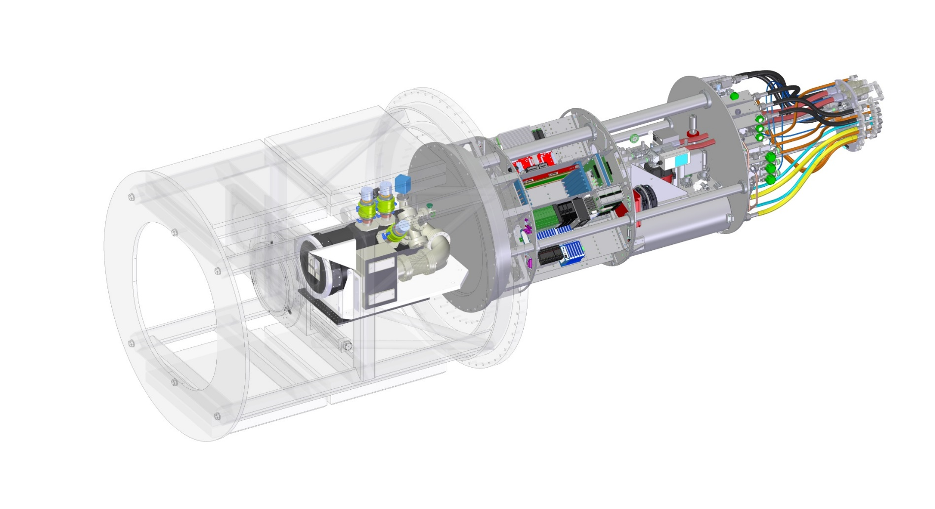
DOE ComCam and Pathfinder Scope Overview
Quad Box Assembly (ComCam support and structure from MIE)
ComCam Dewar and Raft (MIE)
Top End Assembly
Refrigeration Pathfinder
ComCam structure, optics and shutter (MREFC)
Cryostat Stage Assembly

Slide 6
Refrigeration Pathfinder
Pathfinder makes use of two (2) Cryo Heat Exchangers and two (2) Cold Heat Exchangers to test six (6) Cryo Circuits and two (2) Cold Circuits
Each pair of Heat Exchangers will cool two separate Thermal Loads
Bulkhead Plate
Refrigeration Hoses
Upper
Cold HX
Pneumatic Valve
Manifolds
Lower
Cold HX
Pathfinder Feedthrough Plate
(New and permanent)
Upper
Cryo HX
Lower
Cryo HX
Thermal
Heat Load
Cold HX
Pathfinder HX Assy
3” O.D. Support Column
Internal VCR
Connections
Temporary MID Plate
modified for shipping
2” O.D. Support Column
Thermal
Heat Load
Cryo HX
Heat Exchanger Assembly

Slide 7
Quad Box Assembly: Commissioning scope is to add hardware necessary to run non-Dewar Related items
Lower Ion Pump
Support Plate
Mounting Plate
on Insulating blocks
Coolant Distribution Manifold
New MID Plate (Permanent)
Coolant Distribution System
(Same as in the UT)
HX Inner Support Gusset
X2
HX Inner Mounting Block
X2
Lytron Heat Exchanger
(Part of Coolant Distribution System)
QUAD BOX
2” O.D. Tubular Support
3” O.D. Tubular Support
Support Ring
3” O.D. Tubular Support
Connecting to Support Ring
2” O.D. Tubular Support
Connecting to Support Ring

Slide 8
Camera (DOE) Team Shared with MIE
SLAC Management
Project Management Assurance Group
J. Tapia
LSSTCAM MIE/Commissioning Organization (FY18 – FY20)
SLAC Laboratory Director: C. Kao – SLAC
Deputy Director: N. Holtkamp
LSSTCAM Project Office
LSST Director: S. Kahn – SLAC
Project Mgr.: V. Krabbendam
LSSTCAM
Project Support
Personnel highlighted in red contribute to both MIE and commissioning in their current roles.
LSSTCAM
Sub-systems
System Engineering and Integration
System Engr. Mgr.: M. Nordby – SLAC
Chief Mech. Engr.: M. Nordby – SLAC
Chief Elec. Engr.: G. Haller – SLAC
Requirement Mgr.: C. Mendez – SLAC
Computing Coordinator.: R. Dubois – SLAC
Risk Mgr.: K. Flick – SLAC
Project Scientist: S. Ritz – UCSC
Project Mgr.: V. Riot – LLNL
Production Mgr.: L. Young – SLAC
IN2P3 Program Mgrs.: C. Vescovi – LPSC, E. Aubourg – APC, D. Boutigny – CCPM
Performance and Safety
Safety: J. Kenny – SLAC
QA: D. Marsh – SLAC
Project Administration
PMCS: C. Brackett – SLAC
Finance: C. Soldahl – SLAC
Procurement: K. Faulkner – SLAC
LSST System Engineering and Commissioning
SE manager
System Scientist
Sensors
Engr. Mgr.: T. Markiewicz – SLAC
Filter Exchange
Phys.: P. Antilogus – LPNHE
Engr. Mgr.: P. Karst – CPPM
Cryostat
Phys.: R. Schindler – SLAC
Engr. Mgr.: T. Markiewicz – SLAC
Refrig. Lead: B. Qiu – SLAC
Auxiliary Electronics
Engr. Mgr.: G. Haller – SLAC
Facility, Integration, Test and Calibration
Phys.: A. Roodman – SLAC
Engr. Mgr.: T. Bond – SLAC
Science Raft
Phys.: C. Stubbs – Harvard
Dep. Phys.: P. O’Connor – BNL
Engr. Mgr.: B. Wahl – BNL
Camera Body and Shutter
Engr. Mgr.: M. Oriunno – SLAC
Data Acquisition
Engr. Mgr.: M. Huffer – SLAC
Corner Raft
Phys.: C. Stubbs – Harvard
Engr. Mgr.: S. Herrmann – SLAC
Optics
Phys.: S. Olivier – LLNL
Engr. Mgr.: J. Wolfe – LLNL
Camera Control System
Phys.: E. Aubourg – APC
Engr. Mgr.: T. Johnson – SLAC
Commissioning
Camera AIV Lead: K. Reil – SLAC

Slide 9
Camera (DOE) Team transition from MIE effort
SLAC Management
Project Management Assurance Group
C. Strawbridge
SLAC Laboratory Director: C. Kao – SLAC
Deputy Director: N. Holtkamp
LSSTCAM Commissioning Organization (FY21)
LSSTCAM Project Office
LSST Director: S. Kahn – SLAC
Project Mgr.: V. Krabbendam
LSSTCAM
Project Support
Performance and Safety
Safety: J. Kenny – SLAC
QA: D. Marsh – SLAC
LSST System Engineering and Commissioning
SE manager
System Scientist
LSSTCAM
Sub-systems
System Engineering and Integration
System Engr. Mgr.: M. Nordby – SLAC
Chief Mech. Engr.: M. Nordby – SLAC
Chief Elec. Engr.: G. Haller – SLAC
Requirement Mgr.: C. Mendez – SLAC
Camera Project Scientist: S. Ritz – UCSC
Deputy PM Camera Comm.: V. Riot – LLNL
IN2P3 Program Mgrs.: C. Vescovi – LPSC, E. Aubourg – APC, D. Boutigny – CCPM
Project Administration
PMCS: C. Brackett – SLAC
Finance: C. Soldahl – SLAC
Procurement: K. Faulkner – SLAC
Roles in MIE subsystems get merged into the single commissioning sub-system
Commissioning
Camera AI&T Lead/Deputy: K. Reil – SLAC
Eng. In Chile: Margaux Lopez
Pierre Antilogous, Diane Hascall, Boyd Bowdish, Travis Lange

Slide 10
Technical Status

Slide 11
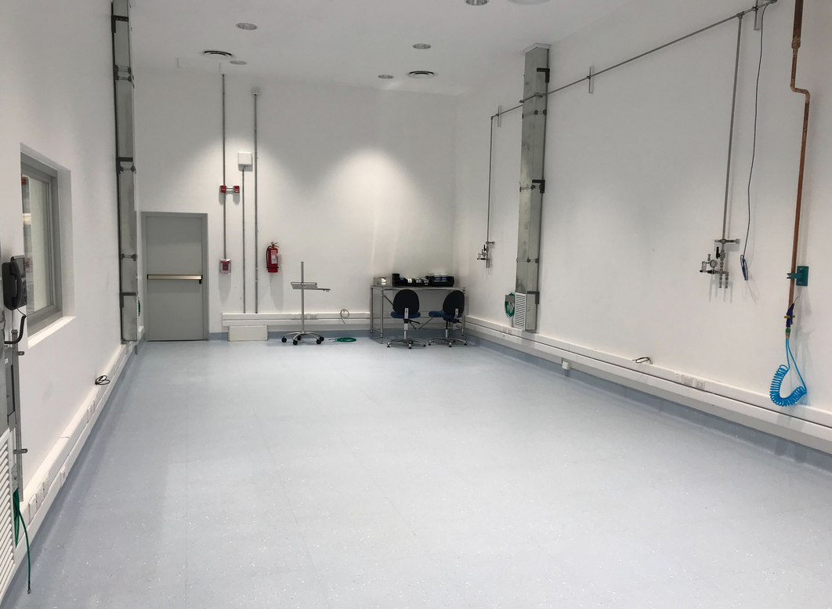
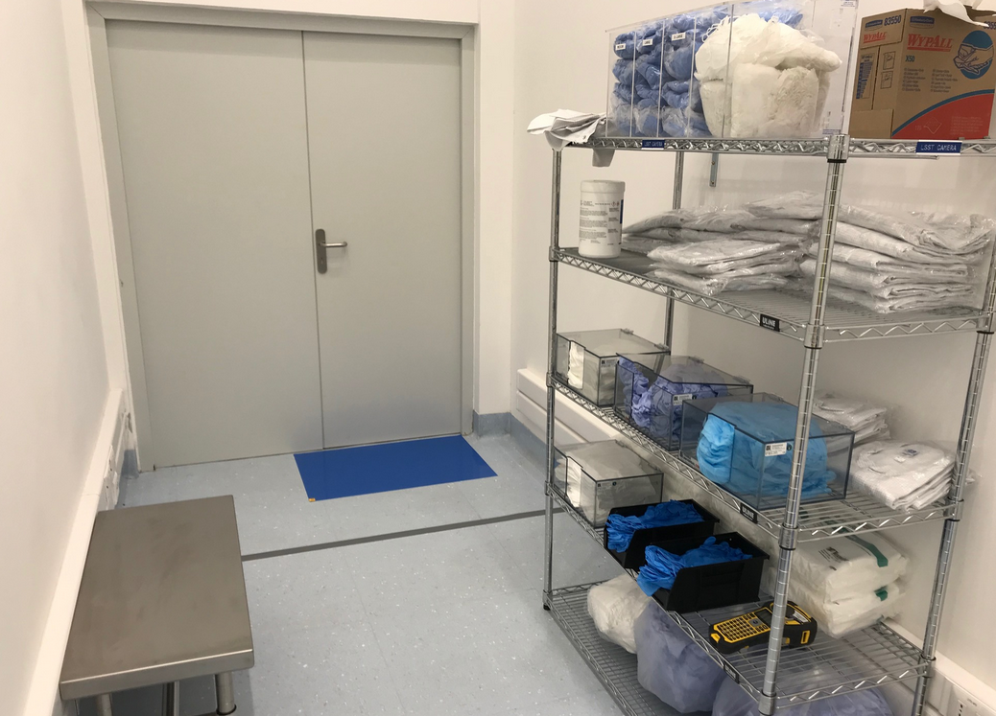
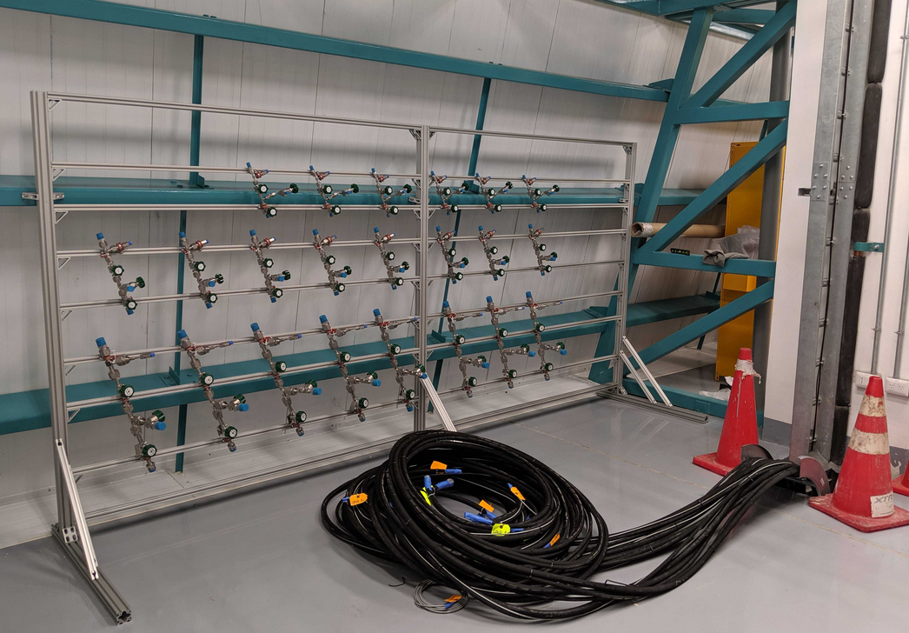
Camera summit servicing area
Recent accomplishments
Camera Auxiliary room and Clean room installation complete June 2019
Refrigeration line routing from machine room to camera clean room complete
Valve assembly complete
Upcoming work
Complete ESD training
Remaining Issues
Limited issues remaining. Past issues related to readiness of lines being available and space being available have been resolved

Slide 12
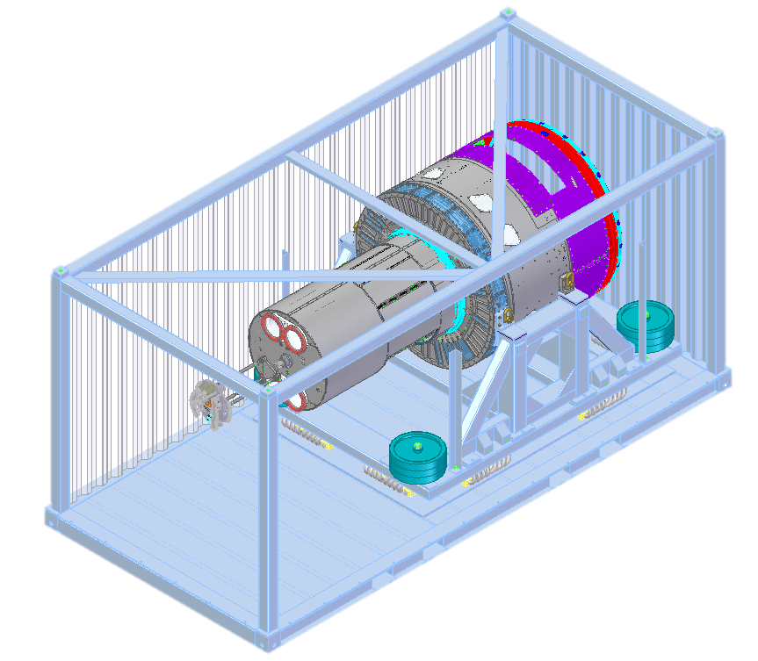
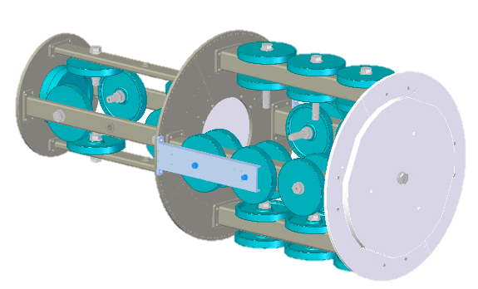
Shipping and receiving readiness status
Recent accomplishments
Preliminary Design Review completed in March 2019
Mitigation Scope in the form of a camera shipping dry run using the camera mass simulator identified and added to the baseline
ComCam Dewar successful shipping to Tucson in June 2019
Upcoming work
Shipping of the refrigeration pathfinder and refrigeration Cabinets delivered by MIE project
Final Design Review around end of Q1 FY20
Remaining Issues
Addressing shipping of L1-L2 as the MIE shipping approach from Tucson to SLAC may not be sufficient for shipping to the summit
Container Lid
Vibration
Isolation Pad
Container
Floor
Camera Mass Simulator (3825 kg)

Slide 13
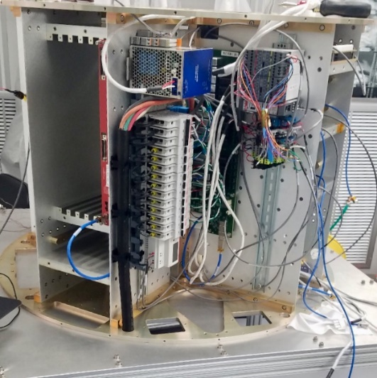
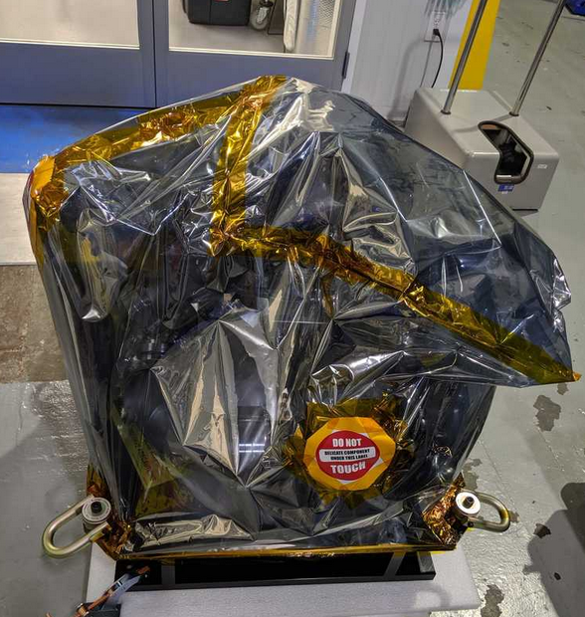
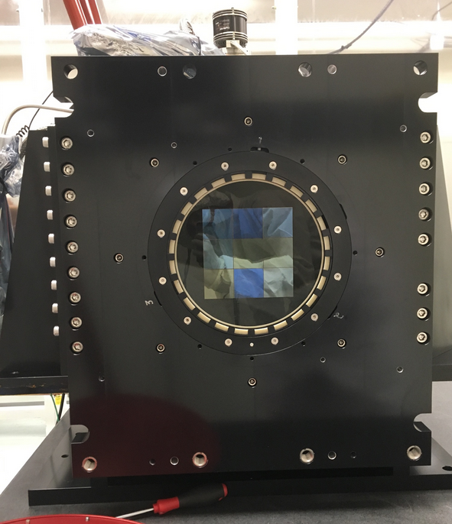
ComCam Support Status
Pathfinder Quad Box at SLAC
Recent accomplishments
ComCam Packed and Shipped in June 2019
Support of ComCam Dewar Integration in Tucson in July 2019
ComCam QuadBox support for shutter started
Upcoming work
Complete the quad box verification with all support equipment
Complete integration of ComCam in Tucson for shipment to Chile Q2 FY20
Remaining Issues
Quad Box scope was under estimated at time of the commissioning baseline due to limited maturity of the ComCam/Pathfinder assembly. Commissioning team is looking at ways to efficiently complete this scope of work
ComCam packed at SLAC
ComCam integration started in Tucson

Slide 14
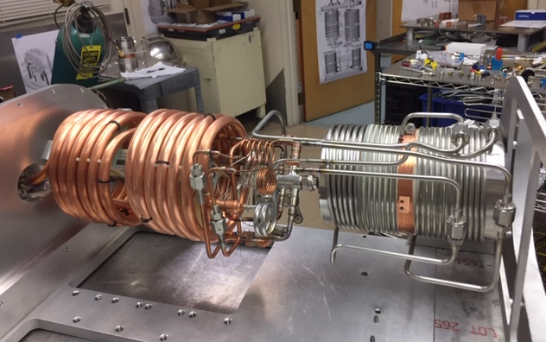
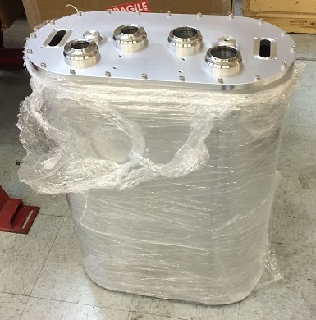
Refrigeration Pathfinder status
Recent accomplishments
Heat Exchanger vacuum vessel received in June 2019
Heat loads completed in May 2019
Heat exchanger received from Eden Cryogenics and Cleaned
Assembly under way
Upcoming work
Complete assembly and pressure/flow test of the heat exchanger
Remaining Issues
Assembly of the heat exchanger is requiring more manpower than initially planned (baseline was set prior to completion of the MIE similar heat exchanger, which has also taken more resources than planned)
Pathfinder Cold Heat Exchanger welding and braze complete
Pathfinder vacuum vessel

Slide 15
Risk and Hazard management

Slide 16
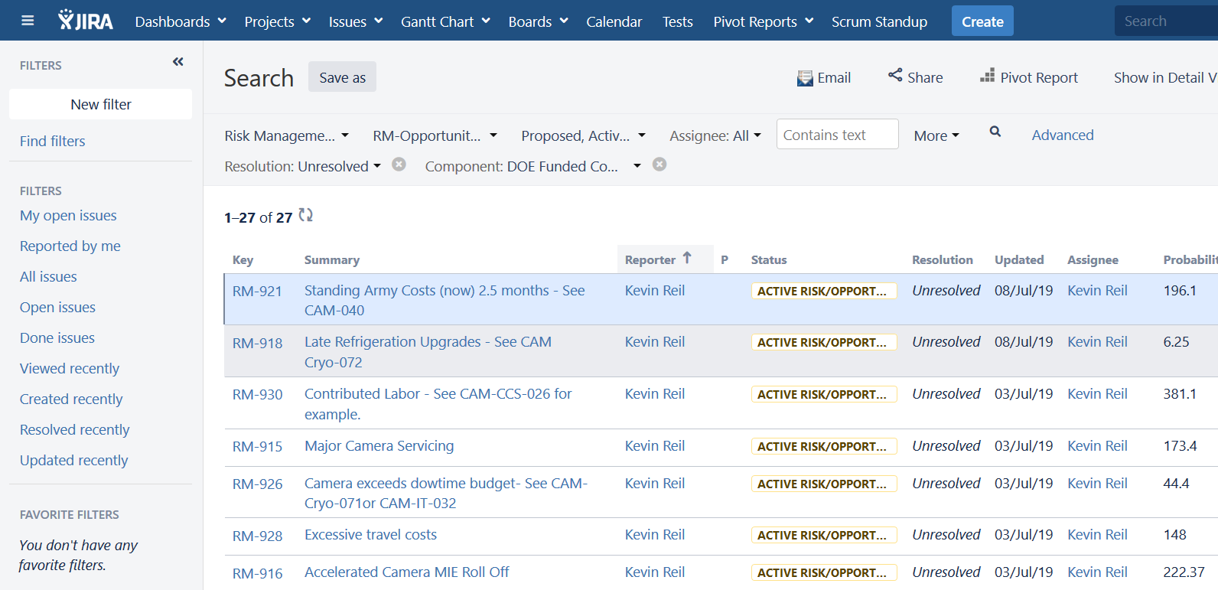
Risk Management Process
All commissioning risks are managed in an integrated manner using the project wide JIRA tool.
DOE commissioning risks are reviewed monthly jointly at the LSST project wide risk review boards
Risk exposure assessment for the DOE part only is done using a probability weighted approach
Risk transfer from MIE to commissioning are review monthly during the MIE risk review board

Slide 17
DOE Commissioning top 10 risks
Risk Title | Risk Description (if/then) | Probability | Risk Score | Probability Weighted Cost
Contributed Labor - See CAM-CCS-026 for example. | IF research funded individuals do not fill expected roles THEN new hires may be needed. | 25%-50% | 12 | 381.1
Major Camera Servicing | IF the camera needs to be removed from the telescope and work interior to the cryostat is needed to perform servicing THEN schedule contingency will be used. | 10%-25% | 9 | 173.4
ITL Integrated Performance - See CAM-049 | IF CAM-049 risks is not closed THEN commissioning will carry risk. | 25%-50% | 8 | 314.5
Camera Damage during Shipping | A poorly designed shipping container or poor logistical planning could result in shipping damage. | 25%-50% | 8 | 296
Accelerated Camera MIE Roll Off | IF the camera MIE project needs to downsize their FTE count and key persons will be lost THEN DOE commissioning may need to accelerate ramp up. | 25%-50% | 8 | 222.37
Minor Camera Servicing | IF the camera needs to be removed from the telescope to perform servicing THEN schedule contingency will be used. | 50%-75% | 5 | 129.15
Extended On Telescope Camera Work | IF the required on-telescope camera maintenance and procedures take longer than planned THEN additional down-time and resources will be needed. | 75%-100% | 5 | 79.2
Moderate Camera Servicing | IF the camera needs to be removed from the telescope and partially dissassembled to perform servicing THEN schedule contingency will be used. | 25%-50% | 4 | 151.7
Refrigeration ICD mismatch - See CAM-Cryo-056 | IF late refrigeration system changes occur THEN modification of TMA/Camera interfaces may be needed. | 25%-50% | 4 | 148
Excessive travel costs | IF all planned travel requires hotel accomodations THEN travel budget may be used before completion. | 25%-50% | 4 | 148

Slide 18
DOE Commissioning Safety
ES&H for commissioning is integrated with the project wide ES&H program.
DOE commissioning SLAC activities are integrated with the LSST Camera MIE safety program (clean room tail gates and safety notice to proceed) and SLAC’s institutional safety program
DOE personnel specifics for summit work:
Summit work requires attendance at the summit tail gate by the SLAC LSST safety coordinator and DOE personnel. Work is approved in the SLAC hosted confluence page https://confluence.slac.stanford.edu/pages/viewpage.action?pageId=242293049 as well as the project calendar at https://jira.lsstcorp.org/secure/DoItBetterCalendar.jspa

Slide 19
Cost and Schedule Status

Slide 20
DOE Commissioning Cost and Schedule performance (May19)
Camera cumulative SPI: 0.87
Camera cumulative CPI: 0.93
WBS (L2,L3) | BCWS ($k) | BCWP ($k) | ACWP ($k) | SV ($k) | SPI | CV ($k) | CPI
01C.01.01 Project Office and Support | $771 | $771 | $797 | $(0) | 1.00 | $(26) | 0.97
06C.02.01 Commissioning Management | $330 | $330 | $48 | $- | 1.00 | $283 | 6.95
06C.02.02 Commissioning Planning, Preparation, Tooling, & Simulations | $1,251 | $918 | $1,111 | $(333) | 0.73 | $(193) | 0.83
06C.02.03 Early System AI&T | $888 | $808 | $1,095 | $(80) | 0.91 | $(287) | 0.74
06C.02.04 Full System AI&T | $- | $- | $- | $- | - | $- | -
06C.02.05 Science Verification | $- | $- | $- | $- | - | $- | -
Total | $3,241 | $2,828 | $3,051 | $(413) | 0.87 | $(223) | 0.93

Slide 21
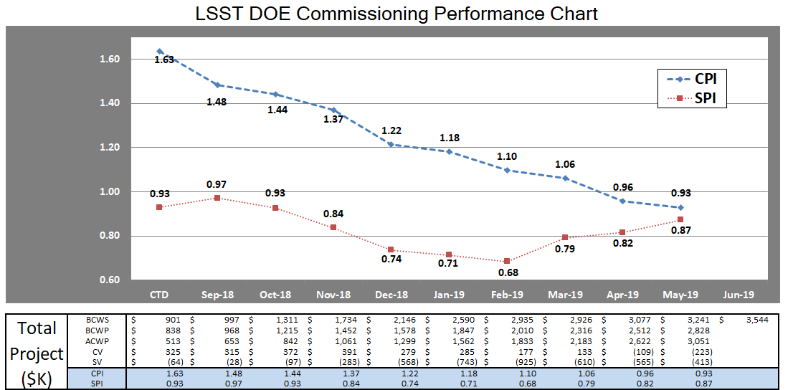
DOE Commissioning Trend Data shows the issue related to schedule delays and pathfinder heat exchanger manufacturing
Cost performance degradation is only recent (the CPI trend until February is driven by the fact that the percent complete is small)

Slide 22
DOE Commissioning key cost variance drivers
Cost Variance drivers are consistent with EAC drivers
Commissioning management underrun due to early FY19 efficiency: ~$280K
ComCam Quad Box assembly and design unrecoverable overrun: ~-$200K
Refrigeration pathfinder heat exchanger manufacturing and assembly unrecoverable overrun: ~-$290K

Slide 23
DOE commissioning has actively conducted EACs
EAC is updated monthly by taking into account past overruns and pending Change requests
Comprehensive FY20 EAC is planned for October 2019 on remaining control accounts (mostly I&T at that time)
WBS (L2,L3) | BAC | EAC | VAC | CV | % Comp
01C.01.01 Project Office and Support | $4,887 | $5,716 | $(828) | $(26) | 16%
06C.02.01 Commissioning Management | $2,409 | $2,126 | $282 | $283 | 14%
06C.02.02 Commissioning Planning, Preparation, Tooling, & Simulations | $4,733 | $4,939 | $(206) | $(193) | 19%
06C.02.03 Early System AI&T | $3,281 | $3,566 | $(285) | $(287) | 25%
06C.02.04 Full System AI&T | $2,466 | $2,466 | $- | $- | 0%
06C.02.05 Science Verification | $1,068 | $1,068 | $- | $- | 0%
Total | $18,844 | $19,882 | $(1,038) | $(223) | 15%

Slide 24
DOE Commissioning EAC key drivers
EAC/VAC key drivers
The 2-month project delay to accommodate the Telescope and mount, Dome, and camera raft refurbishment issues approved by NSF in March 2019 (loaded in 01C.01.01 as a pending Change): ~-$390K
The recent 3-month delay to accommodate recent delays on the telescope and mount and dome proposed by the Broader project (loaded in 01C.01.01 as a pending Change): ~-$410K
Commissioning management underrun due to early FY19 efficiency: ~$280K
ComCam Quad Box assembly and design unrecoverable overrun: ~-$200K
Refrigeration pathfinder heat exchanger manufacturing and assembly unrecoverable overrun: ~-$290K

Slide 25
Contingency analysis
EAC contingency is after taking the cost impact of the recent delays
Contingency after these delays is tight and commensurate with the remaining risk cost exposure
Contingency as of May 2019 EAC | $3,306K
PM liens | -
Available Contingency for probabilistic events | $3,306K
Risk Based Cost Exposure | $3,015K

Slide 26
Changes since FY18 review
BCR-004 (+$7K): 06 WBS effort was split at a lower level to explicitly separate DOE scope from NSF scope. In addition, DOE management beyond technical management commissioning effort was moved from the 06 WBS into the 01 WBS to be commensurate with the organization chart. This was implemented under change LCR-1451 at the project level. The cost impact was +$7K due to minor phasing changes
BCR-005 (+$335K): DOE safety officer was added to the project (+$276K) as this had been an error at time of baseline. A commissioning paid raft was constructed to reduce schedule issues on ComCam (+$104K). This raft is currently in Tucson with ComCam. The remaining delta is a return (-$45K) based on re-planning in the out years including removal of sprint 5. Reviewed and approved at the project level under LCR-1475 and LCR-1476
BCR-006 (+$1K): Minor phasing changes in support of MREFC Aux-Tel rodent damage repair request LCR-1497

Slide 27
Changes since FY18 review
BCR-007 (+$284K):
Add a prototype shipping run with the camera mass simulator
Additional support on the Auxiliary Telescope DAQ/CCS pathfinder exercise
Spare refrigeration compressor
Per project request LCR-1540
BCR-008 (+$465K):
missing scope for completion of the refrigeration pathfinder
Extra sprint on the summit since the May sprint could not be completed due to the refrigeration line not being ready on the summit
Purchasing a spare compressor for the refrigeration system.
Pending BCR-009 currently in EAC (+$795K) in support of schedule delays in support of LCR-1623 and pending LCR-1725

Slide 28
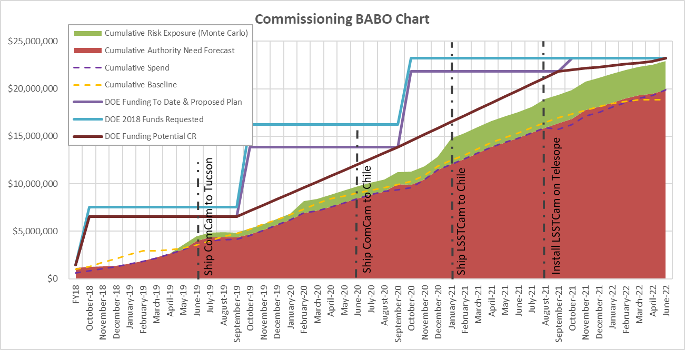
Commissioning Funding Needs and Budget
FY19 deferment to date can be managed if recovered in FY21 or earlier
Further deferment can be accommodated in FY20, as presented at the March 2019 budget briefing, with catchup in FY21
Minimum needed is consistent with 1/12th funding to be received monthly in case of potential CR
 | Original “CD-2 like” baseline | Received/Expected | Minimum Needed | Defer/Catch up
FY18 | $1,448,000 | $1,445,000 | $1,445,000 | $3,000
FY19 | $6,084,000 | $5,101,000 | $5,101,000 | $983,000
FY20 | $8,729,000 |  | $7,300,000 | $1,429,000
FY21 | $6,927,000 |  | $8,000,000 | ($1,073,000)
FY22 | 0 |  | $1,342,000 | ($1,342,000)
Total | $23,188,000 | in progress | $23,188,000

Slide 29
Upcoming Milestones and Summary

Slide 30
Milestone Chart – Level 2 (May 19 data)
Activity Name | Baseline | Forecast | Variance | Status
COMP: C_CDR - Pathfinder | 03/31/18 | 18-Jan-18 A | 52 | Completed
COMP: C_PDR - Pathfinder | 07/31/18 | 31-Jul-18 A | 1 | Completed
COMP: C_FDR - Pathfinder | 11/28/18 | 26-Oct-18 A | 24 | Completed
AVAIL: Refrigeration Pathfinder to ship | 04/02/19 | 06/28/19 | -64 | Delayed (expected early August)
NEED: Refrigeration Pathfinder on summit | 05/07/19 | 09/17/19 | -96
NEED: MIE Chile (TMA) Compressors | 08/08/19 | 01/03/20 | -107
NEED: Access to TMA Refrigeration Lines | 08/08/19 | 05/04/20 | -193
AVAIL: White Room Refrigeration System Ready for LSSTCam | 11/09/19 | 05/12/20 | -132
AVAIL: Pathfinder for ComCam | 11/09/19 | 05/12/20 | -132
COMP: Calibration Telescope Ready for Operations | 03/23/20 | 09/10/20 | -124
COMP: ComCam re-Verification Complete | 07/01/20 | 10/23/20 | -83
NEED: Pathfinder in ComCam on TMA | 11/09/19 | 11/16/20 | 24
COMP: L1/L2 recevied at summit | 01/17/21 | 01/12/21 | 4
COMP: TMA Refrigeration Tests Complete | 03/20/20 | 03/09/21 | -253
COMP: ComCam Ready for Bulk Data Production | 03/28/21 | 05/14/21 | -35
COMP: Camera Reverification Complete | 07/22/21 | 08/03/21 | -9
COMP: DMS: Pipeline Testing w/ComCam Complete | 07/13/21 | 08/04/21 | 24
COMP: Engineering Tests w/ComCam Complete | 07/14/21 | 05/24/21 | 38
COMP: LSSTCam-Tel Integration Complete | 03/29/22 | 01/26/22 | 45
COMP: DMS- Integration Complete | 04/06/22 | 02/07/22 | 24
COMP: mini-Survey 1 Data Release Complete | 08/22/22 | 05/26/22 | 63
COMP: Calibration Products Production Verified | 08/22/22 | 05/26/22 | 24
COMP: Data Release Production Verified | 08/22/22 | 05/26/22 | 63
COMP: mini-Survey 2 Data Release Complete | 08/22/22 | 05/26/22 | 63
Operation Readiness Review Complete | 09/30/22 | 06/24/22 | 71

Slide 31
Summary
The LSST DOE commissioning scope of work is progressing, although it has been impacted by construction schedule delays.
Contingency is tight after incorporating the project delay impact (20% on remaining work)
The commissioning team is ramping up and trying to use Camera MIE personnel when available
The DOE commissioning effort has addressed the recommendations from the last status review (see response report posted)

Slide 32
Backup

Slide 33
DOE Commissioning Summary Schedule for May

Slide 34
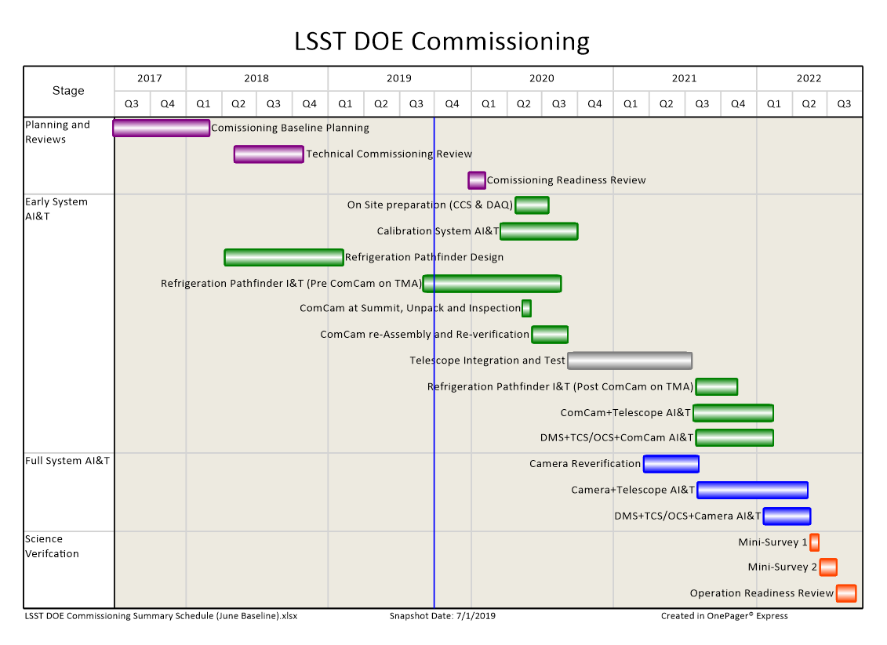
DOE Commissioning Summary Schedule for June implementing a 2.5 months delay in support of T&S issues

