Slide 1
Simulations as a Tool for Commissioning
A Case Study with ComCam
Bo Xin
Systems Analysis Scientist
LSST Commissioning Plan Review
January 24-26, 2017

Slide 2
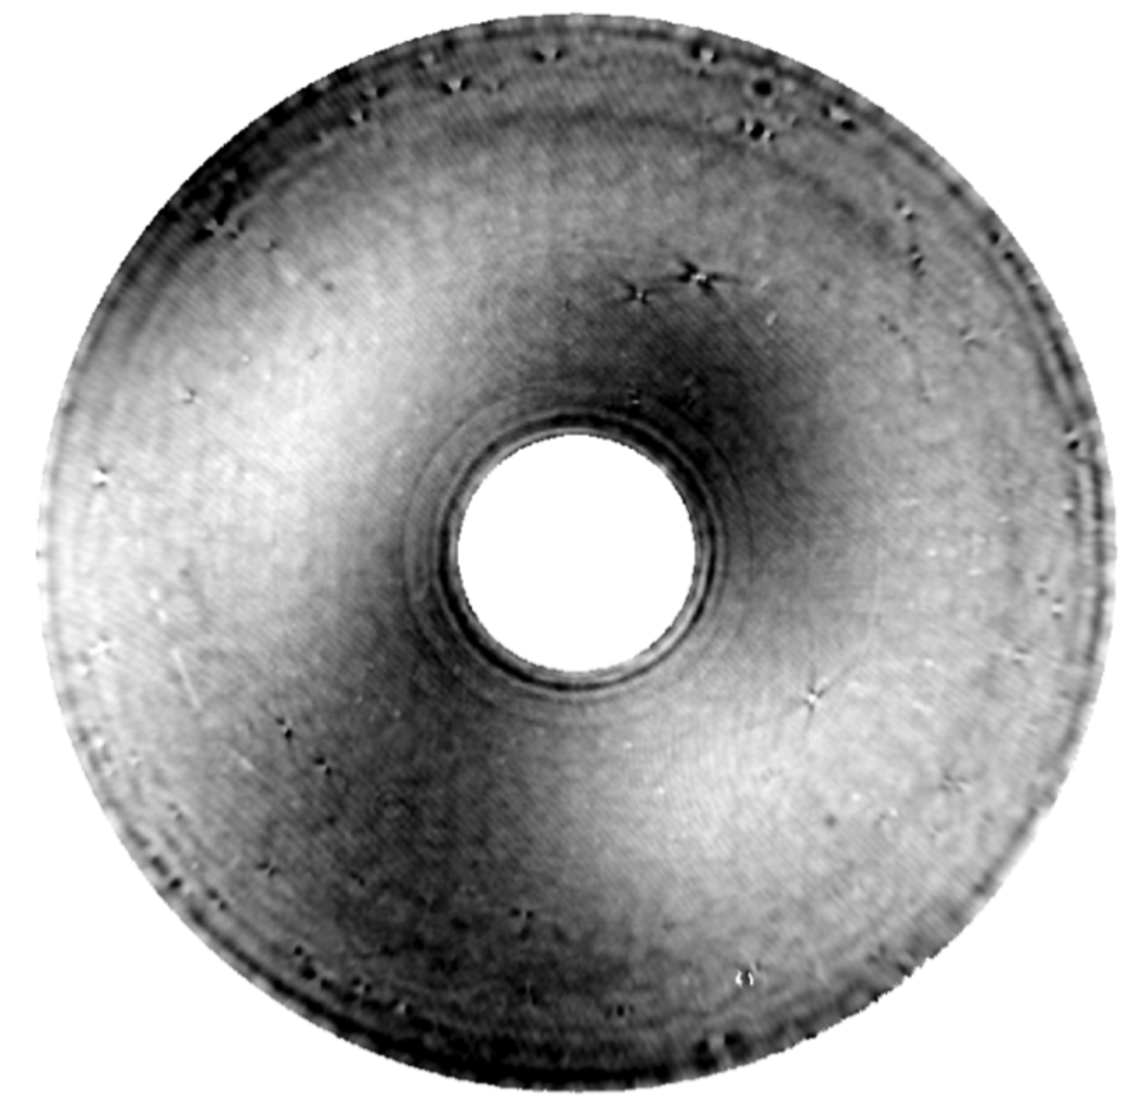
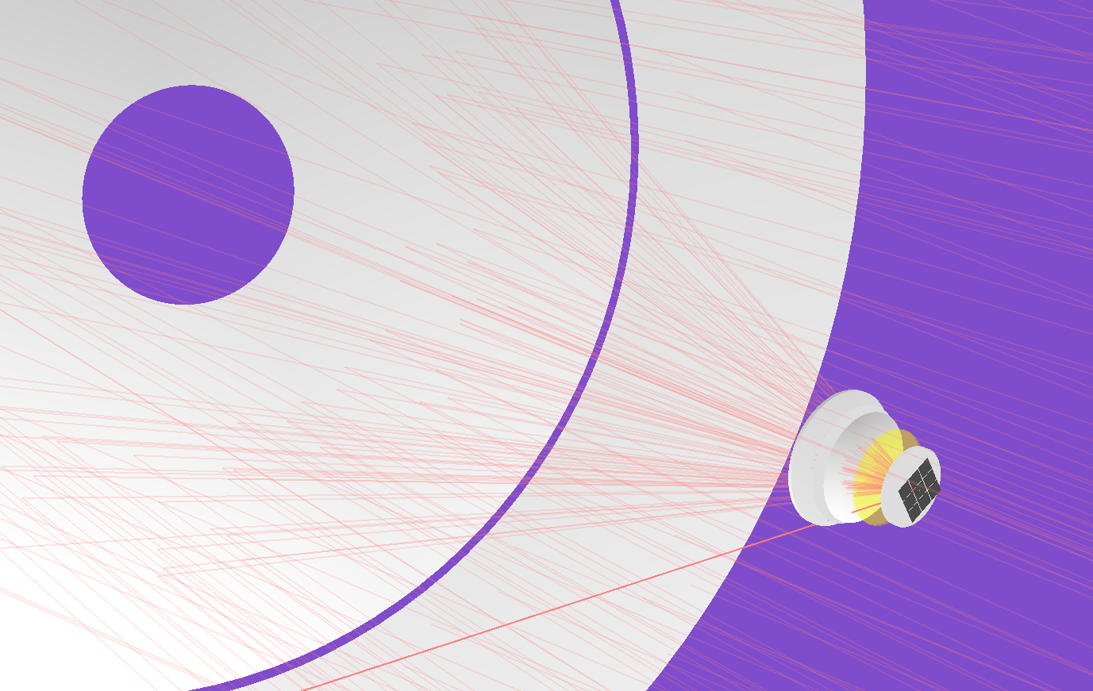
Introduction: Simulations in Commissioning
Simulations have long been an important part of the LSST project.
The LSST Integrated Model is a high-fidelity model of the to-be-built observatory.
Model inputs: technical specifications & operation parameters
Model outputs: Measures of Performance
The role of the integrated model in different phases of the project:
Construction:
  Performance estimate, compliance analysis, early verification, trade studies
Pre-Commissioning (phase 0):
  Simulation and validation of observational procedures and analyses
Commissioning (phase I, II, and III):
  A diagnostic tool for troubleshooting software & hardware problems

Slide 3
Integrated Model Overview
Temperature & its gradients, Telescope pointing, Wind and air pressure
Sky objects
TCS
atmosphere
Controller A
Structural System
Optics position & shape
Optical System
actuators
temperature
Controller B
Detector
Images & single-visit metrics
Force Balance
WF & State Estimator
temperature
WF & Guider Data
The Integrated Model is a framework, not a unified tool.
PhoSim CatSim OpSim Zemax MATLAB/Simulink FRED FEA
Other tools developed by the project (Python/Matlab/C++)
SPIE 9911, 991118 (2016)

Slide 4
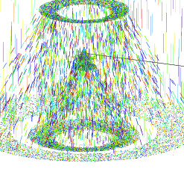
Optical Model with Perturbation Interfaces
PhoSim
  A Photon Monte Carlo Approach
  Generating photons right above the atmosphere – according to the light intensity and chromatic distribution of the sky
  Propagating photons through (i) atmosphere, (ii) optical system, and (iii) silicon
  Converting photons to electrons and to ADUs
Advantages over commercial raytracing tools:
  High speed, deployable to large clusters
  Ability to simulate full focal plane images
  Integrated with well-validated atmosphere model
  Chromatic effect comes naturally
  Charge diffusion and other sensor effects implemented (in the process of being validated)
Peterson et. al, AJS 218, 14 (2015)

Slide 5
Performance metrics: images size and ellipticity
Unambiguous definition for FWHM: Effective FWHM (FWHM_{eff})
  Size of equivalent rotationally symmetric Gaussian PSF such that n_{eff} is the same
  Directly linked to single-visit point source depth
  Directly linked to the normalized point source sensitivity (PSSN)
  App.Opt.48,5997(2009)
  PSSN is multiplicative with good precision
Single-visit ellipticity
n_{eff} – effective number of pixels that maximizes SNR (Equivalent Noise Area)
FWHM Allocation:
  Telescope 0.25”
  Camera 0.30”
  Optical design 0.08”
Requirement. on Single-visit ellipticity: Average < 4%

Slide 6
Integrated Model Successfully Used for Technical Performance Evaluation
Objective: link engineering specs/tolerances to optical performance to compare/evaluate their effects
Evaluating change/waiver requests
  TMA dynamic/control damping
  WFS intra/extra focal offset and midpoint position from science sensors
Evaluating as-built features (verification by analysis)
  M1M3 performance, including crows’ feet
Evaluating architectural decisions
  WFS algorithm validation with DECam data (in comparison to DECam algorithm)
  AOS control strategy and law – early error budget compliance assessment
  M1M3 dynamic control during slew (in progress)
Trade studies
  M1M3 actuator force accuracy requirement
  Impact of sensor height variation on ellipticity
  Impact of L1 refraction index inhomogeneity on image quality
  Analysis of dome seeing
  AOS compensation for non-actuated perturbations

Slide 7
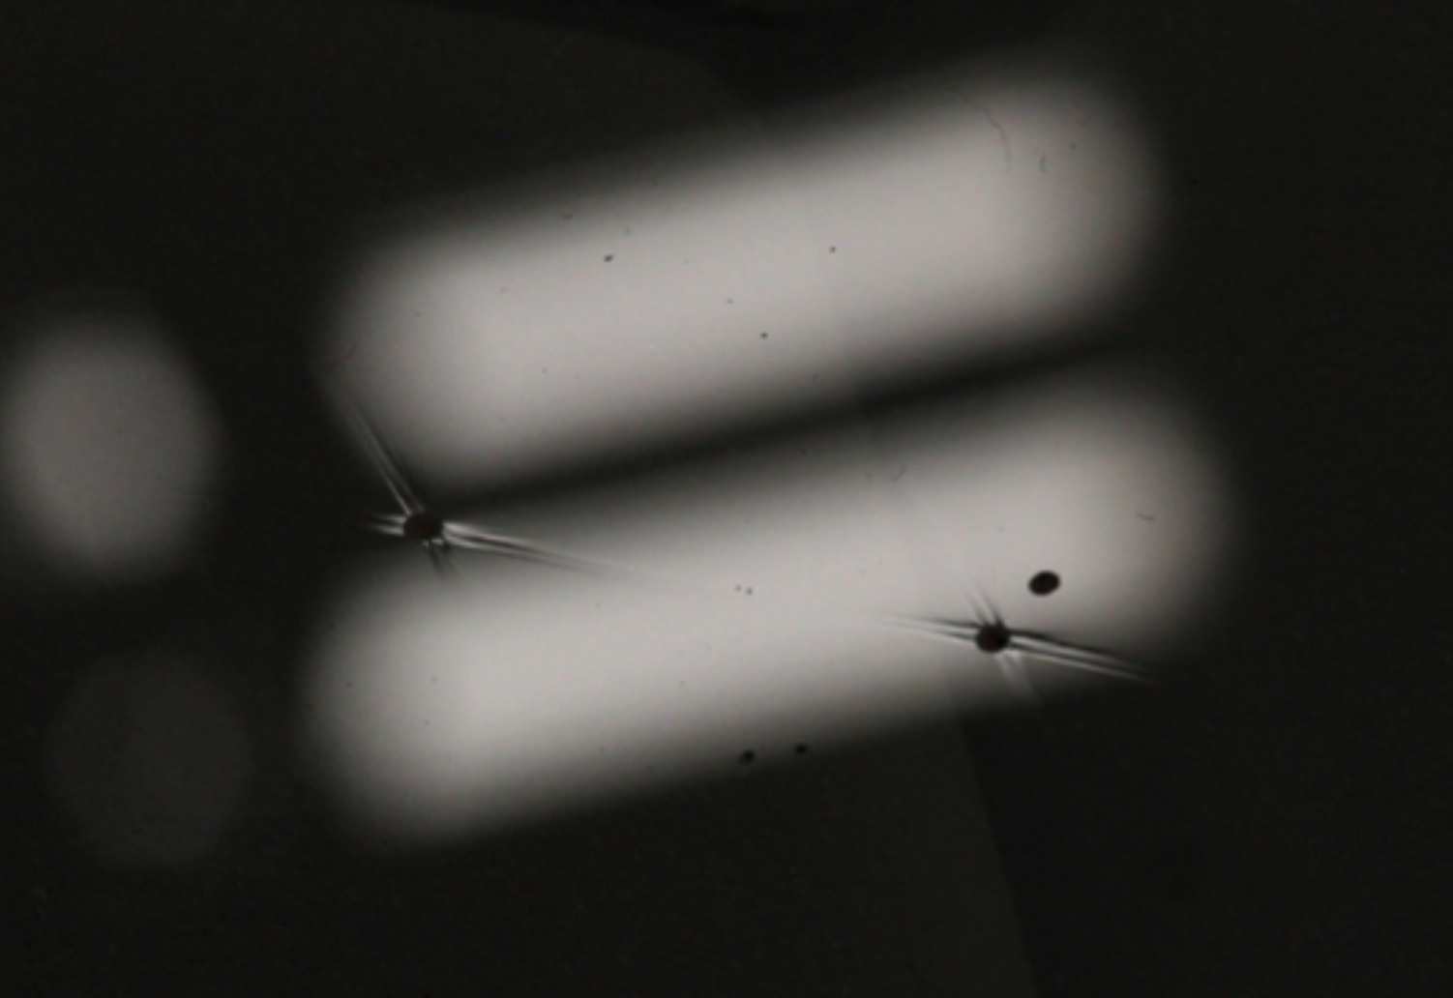
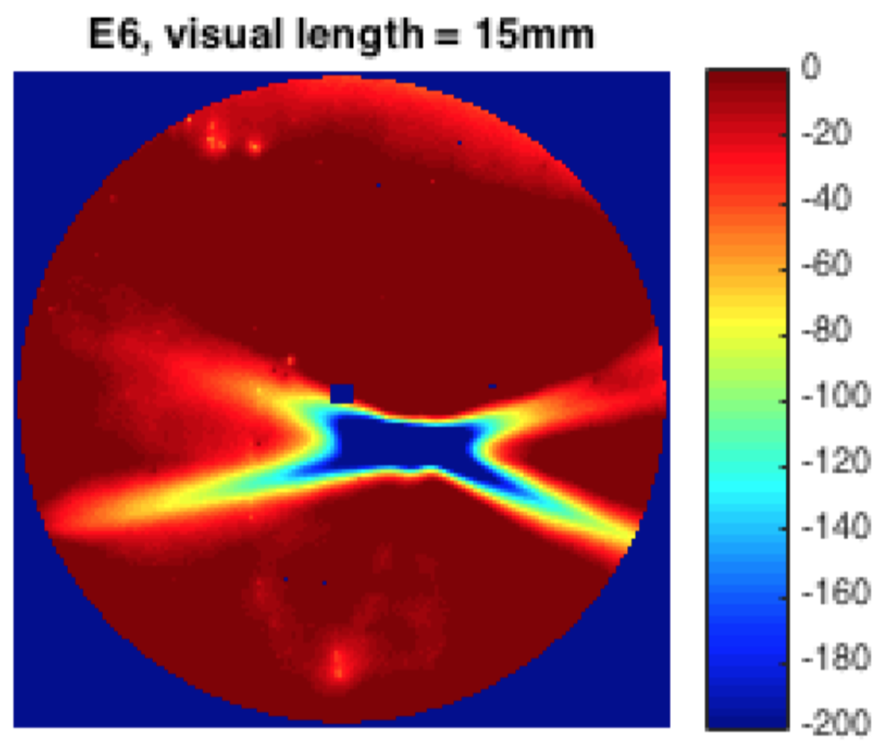
Application Example: M1M3 Performance
Crows’ feet (mostly) on M3
Polishing features due to small bubbles
SPIE 9906, 99063E (2016)
SPIE 9912, 99120X (2016)
M3 Interferometer Map
Under fluorescent room lights (separation = ~3.5cm)
Under SPOTS (Slope-measuring Portable Optical Test System)
12.5cm
nm

Slide 8
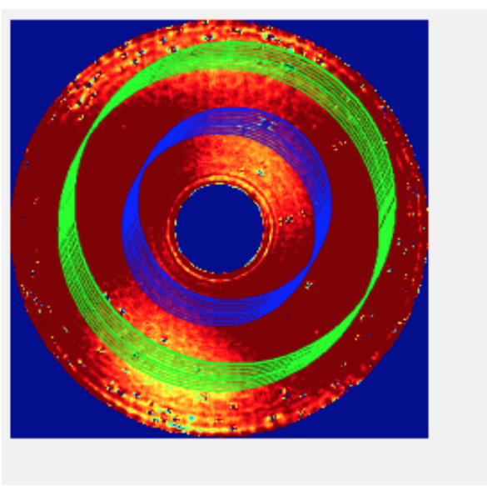
M1M3 Polishing – Image Quality & Ellipticity
Interferometer cannot resolve crows’ feet.
synthetic maps were generated by adding local measurements
Studies Effects on
  Image Quality
  Ellipticity
  Sky Background
Image Quality (PSSN)
Image depth loss due to crows’ feet is about 0.012 mag
No noticeable effect on ellipticity
~0.8% sky area loss due to increased sky background
Largest crows’ feet
Ellipticity
Impact on sky background
M3
Beam Outer boundaries
inner boundaries

Slide 9
Phase 0 procedure development: Case Study with ComCam
Question at hand:
How well can we align the system using Comcam?
Between LSSTCam & ComCam:
DAQ Interfaces are the same.
Wavefront sensor image pre-processing procedures are the same.
Active Optics Control strategies are the same.
Telescope controls are the same.
Difference:
Smaller field of view, which makes the tomographic reconstruction harder.

Slide 10
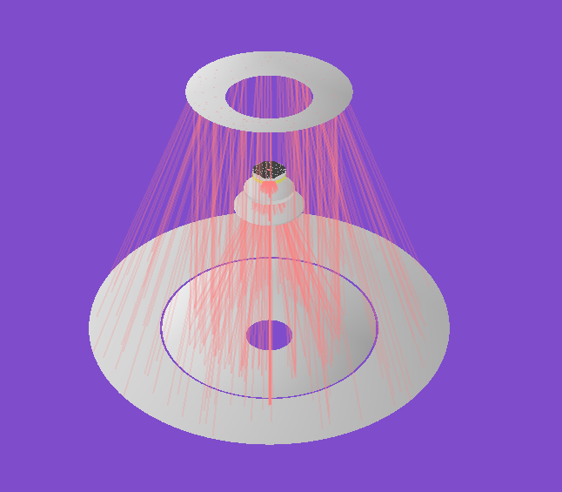
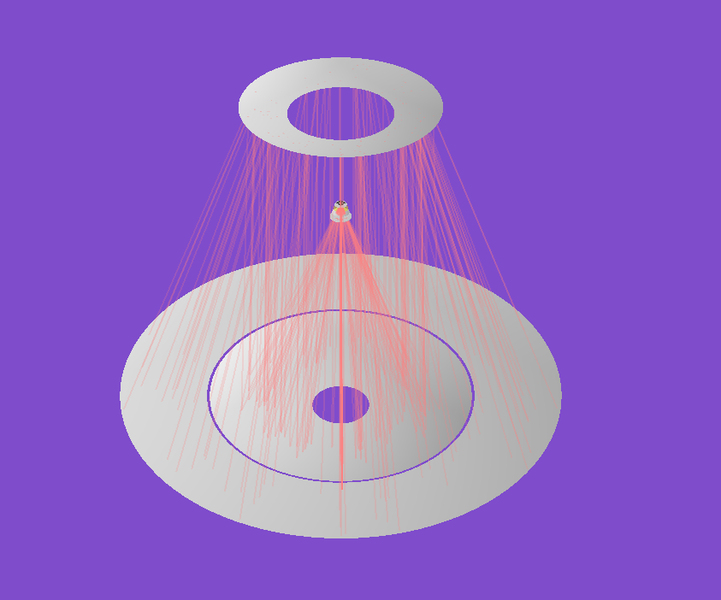
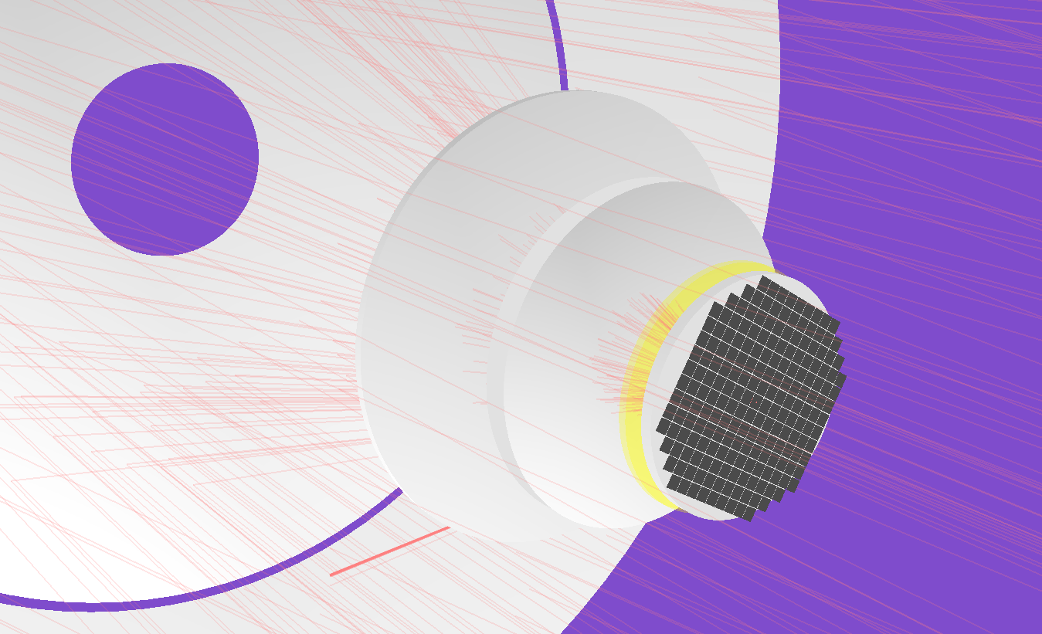
PhoSim Implementation of ComCam
LSSTCam
ComCam

Slide 11
LSST Active Optics System (AOS)
An Incomplete list of Uncontrolled DOFs:
M1M3:
  M1M3 polishing errors
  gravity print through
  thermal induced errors
  M3 position relative to M1
M2:
  polishing errors
  gravity print through
  thermal induced errors
Camera internal distortions: (only for LSSTCam)
  rigid body motions of L1/L2/Filter/L3/FPA (gravitational & thermal)
  surface distortions of L1/L2/L3 (gravitational & thermal)
  Lens polishing errors
  Lens and filter Installation errors
  Detector installation errors
Green: has been implemented
LSSTCam
or
ComCam
DOFs controlled by AOS
M2 hexapod rigid body positions (5)
Camera hexapod rigid body positions (5)
M1M3 bending modes (20)
M2 bending modes (20)

Slide 12
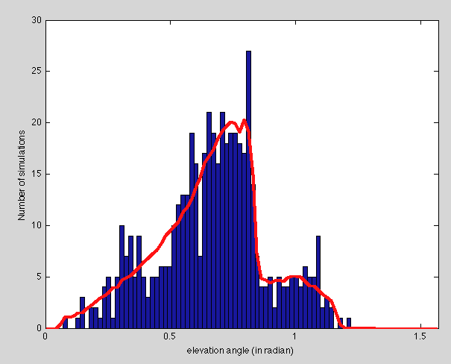
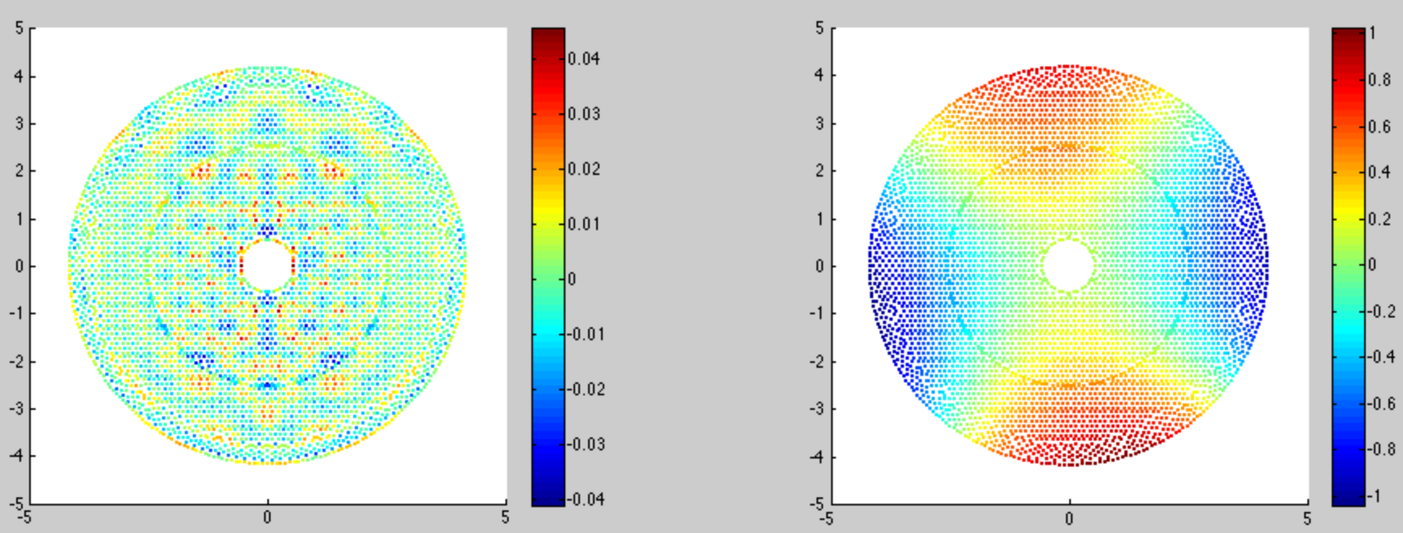
Gravitational and Thermal Deformations
This slide uses M1M3 gravitational deformation as an example.
Zenith angle is drawn randomly from OpSim.
For any given zenith an optimization is done to get the optimal mirror surface with least forces.
As a very conservative estimate, we add 5% noise on the actuator forces for imperfect Look-up Table (LUT) and actuator repeatability.
LSST
OpSim
Distribution of zenith angle
M1M3 Print through
M1M3 shape with 5% actuator noise
Zenith angle =44º

Slide 13
AOS Simulation Architecture
Aberration Generator
Astronomical sources
Atmosphere
Telescope state
DOFs controlled by AOS
M2, Camera hexapod rigid body positions
M1M3 and M2 bending modes (grid data)
optical engine
(ZEMAX or Phosim)
Uncontrolled DOFs:
M1M3 and M2 polishing errors, gravity print through, and thermal errors (grid data)
M3 position relative to M1
Camera internal distortions: rigid body motions and surface distortions of L1/L2/Filter/L3/FPA under influence of gravity and temperature (grid data)
For a complete list of perturbation we plan to implement, see document-16234, or the integrated model confluence page
Wavefront images
(image stamps & half chip images)
Science images (PSFs for performance evaluation)
Wavefront OPD (at any field position): for internal checks and system modeling
State Estimator & AOS controller
Wavefront sensing algorithm
SPIE 9150, 91500H (2014)

Slide 14
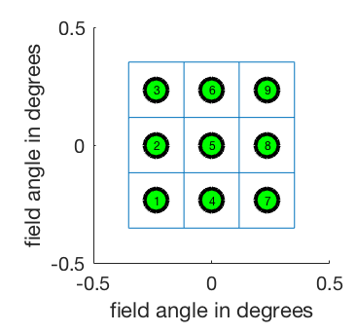
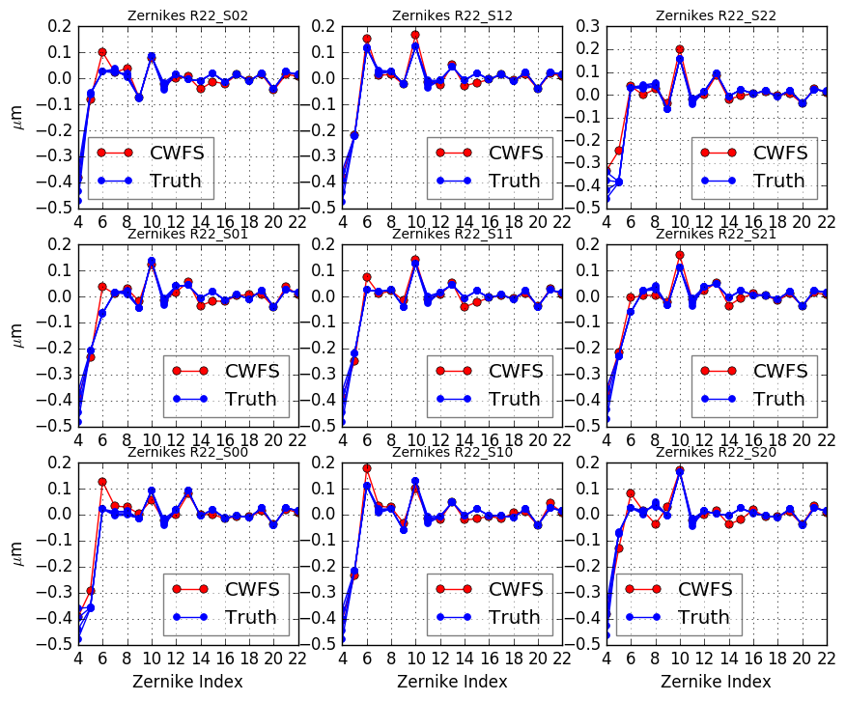
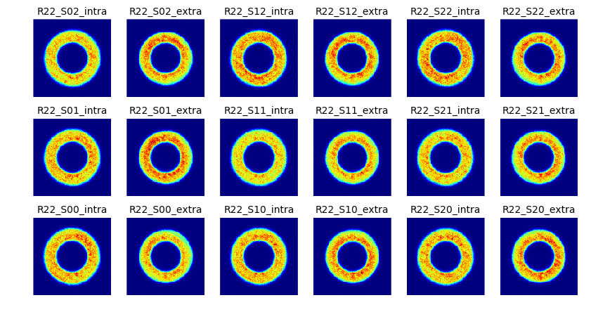
Curvature Wavefront Sensing by Pistoning ComCam
Appl. Opt. 54, 9045-9054 (2015)
9 chip centers
Simulate one star at each CCD-chip center.
ComCam is pistoned along z-axis by ±1mm.

Slide 15
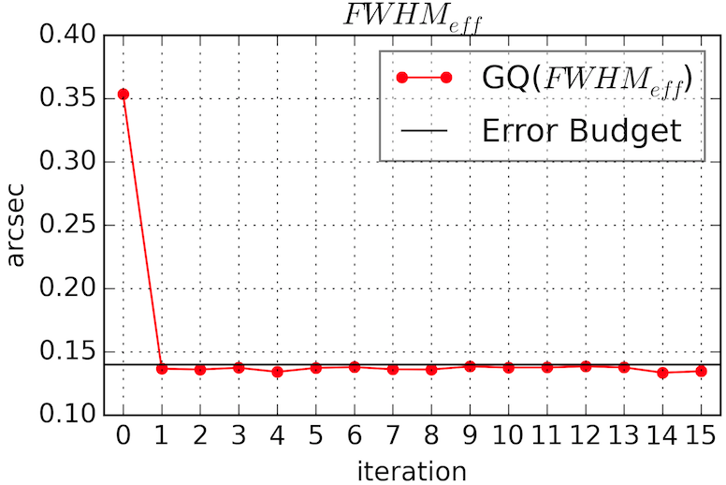
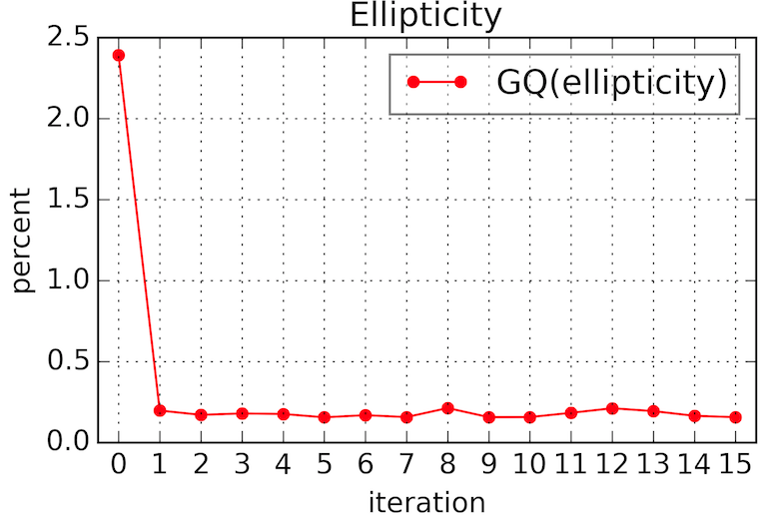
Tests of AOS strategies
State Estimator:
Sensitivity matrix is degenerate for both LSSTCam and ComCam, more so for ComCam.
We truncate singular values, or use optimal estimator.
Controller:
Baseline AOS control strategy is to optimize both the IQ across the field and the motions of the control variable
9 chip centers
AOS performance (FWHM_{eff} and ellipticity)

Slide 16
Case Study with ComCam: Conclusion
As a key pre-commissioning procedure development, we have demonstrated that we can align the telescope using ComCam.
In preparation for making simulations a diagnostic tool during commissioning, we have also implemented alternative AOS strategies.
  for example, to truncate the sensitivity matrix.
  This alternative strategy may lead to less optimal image quality, but more stable system states. It is also conceptually simpler, therefore makes identifying problems easier.
Near-term AOS-related simulation work
  To simulate wavefront sensing by pistoning LSSTCam, and map out the wavefront difference between the field center and the corner locations.
  To simulate wavefront sensor image pre-processing.
  To simulate building the AOS look-up-table.

Slide 17
Summary
The LSST Integrated Model is a high-fidelity model of the to-be-built observatory.
  The Integrated Model Links technical specifications to Measures of Performance.
  The Integrated Model has proven itself a valuable tool for performance estimate, compliance analysis, early verification.
Two ways the Integrated Model will be used in commissioning:
  Simulation and validation of observational procedures and analyses
  A diagnostic tool for troubleshooting software & hardware problems
We have demonstrated how we align the telescope using ComCam.
Between now and commissioning start, we plan to develop dozens of “pre-canned” scripts for the simulation and validation of observational procedure and analyses, and develop more diagnostic tools for commissioning.

