Slide 1
LSST System Performance
Bo Xin
Deputy Systems Scientist
System Performance Lead
NSF/DOE Joint Status Review
August 27th – 30th, 2019

Slide 2
Key Messages from This Talk
The LSST Science Requirement Document (SRD) is Captured by
  Image quality (0.72” delivered FWHM)
  Single visit depth (r = 27.5 mag, other bands sufficiently deep too)
  Total survey area (18000 deg² of sky)
  Number of visits (825 times, summed over 6 bands)
Current best estimates:
  integrated étendue = 1.3*(SRD nominal)
  image quality → 340 mas [allocation = 400mas]
How we arrive at this estimates:
  Use the as-built component information as input
  Integrated modeling for capturing technical details
  Results will be reconciled with system-level measurements

Slide 3
General Approach for Performance Tracking
The LSST project has continuously maintained its best estimates of the system performance.
In early phases of the project, we had to rely heavily on simulations to baseline LSST performance.
As construction progresses, hardware is delivered, more and more as-built information and fidelity are incorporated into the the performance baseline.
  Optical figures, coating throughput, sensor noise and diffusion
The running and evolution of our performance modeling frame is an integral part of our verification process.
Eventually, as we commission the integrated system, reconciliation of disagreements between measured performance and modeled performance is a necessary part of understanding and verifying the as-built LSST.

Slide 4
Why We Need Models?
PSE maintains an updated model of the full system, with information from subsystems, simulating and analyzing end-to-end system performance (optics, structure and control).
It provides a key tool for non-conformance analysis, trade studies, and performance tracking.
As-built information are included as available, so that the models evolve toward the real LSST.
For system optimization: understanding system performance from the component level helps us better optimize the as-built system.
For science: LSST has been designed to be systematically limited. Part of why we need to understand the differences between measured and modeled performance is to understand sources of systematic that affect the LSST science.

Slide 5
Outline
Introduction: SRD and requirements flow-down
General approach in tracking performance
Performance metrics that we track:
  Integrated étendue
  Image quality
  Other lower-level metrics
Technical tools for performance tracking
  Started with extensive simulations
  Converging toward the real LSST by including more and more as-built info.
Summary

Slide 6
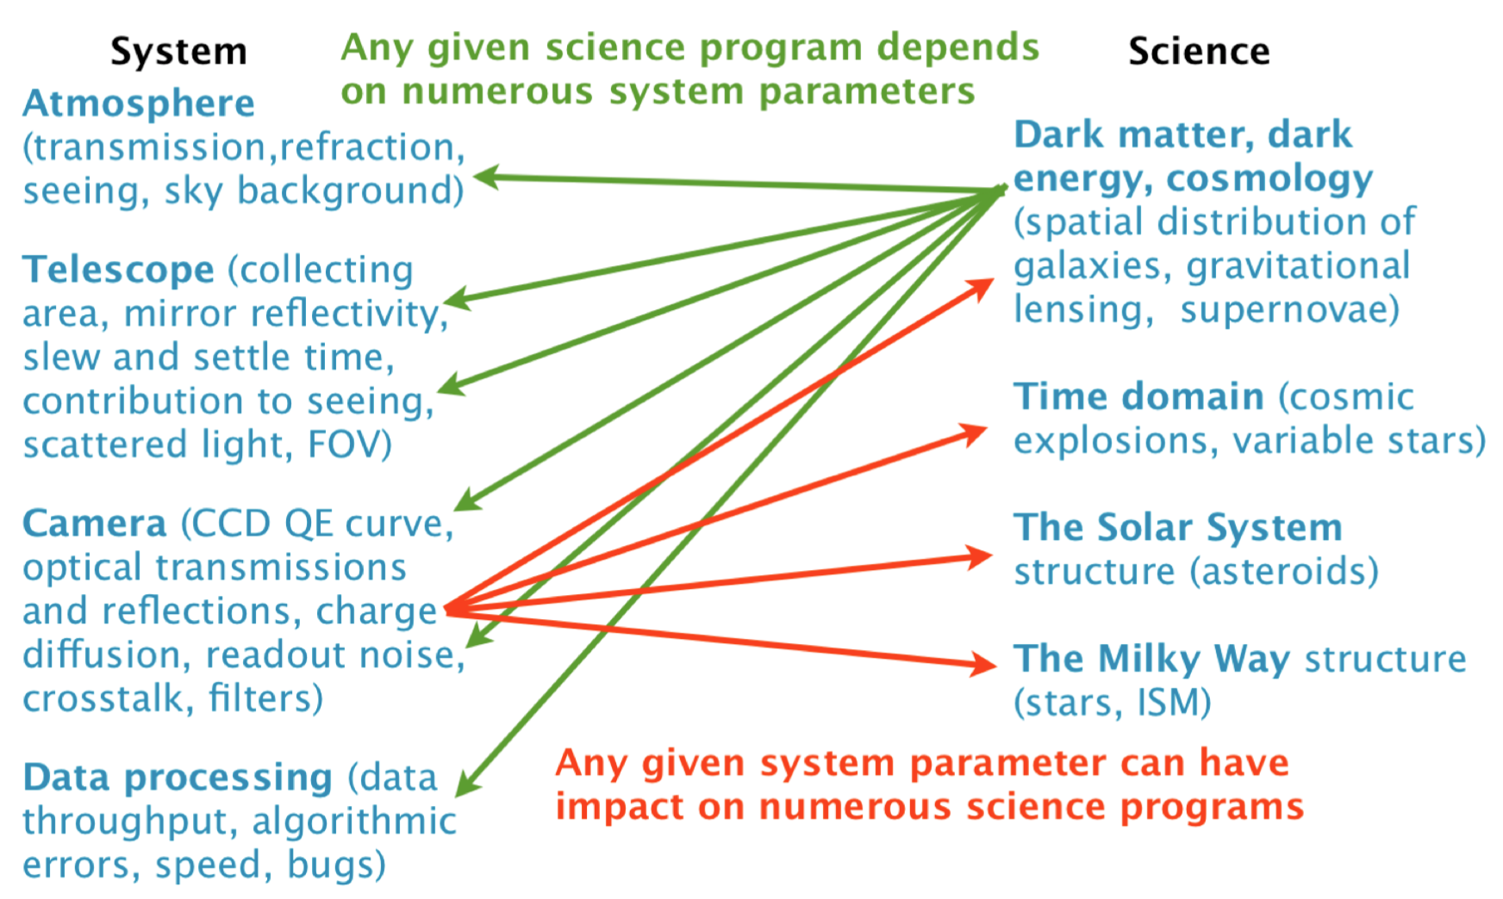
System & Science
LSST Doc-17254
SRD
By expressing the science driven requirements in terms of data properties, the SRD simplifies the complex interplay between science and system.

Slide 7
Flowing Down from the SRD
The Project Systems Engineering (PSE) Team worked with the Project Science Team (PST) and the LSST Science Collaborations, to interpret the SRD and specify the System Requirements.
Science Requirements Document
(LPM-17)
Strategic, science-based objectives
Project’s response: “to be built” system
LSST System Requirements
(LSE-29)
Obs. System Specifications
(LSE-30)
The PSE Team continues to work with subsystem teams and the PST to monitor system performance
High level design architecture
Observatory Control System
(LSE-62)
Telescope & Site
(LSE-60)
Camera
(LSE-59)
Data Management
(LSE-61)
EPO
(LSE-89)
Subsystem Systems Engineering with PSE assistance
System Interfaces

Slide 8
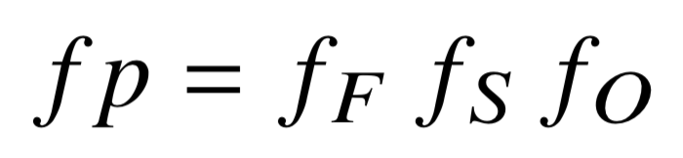
Integrated Étendue
The speed at which we can survey the sky is proportional to the étendue:
The integrated étendue simply controls the total number of captured photons.
Most science metrics scale linearly with the integrated étendue
The integrated Étendue can be expressed in a dimensionless form:
f_{F}: the fill factor
→ loss/gain in field of view due to sensor gaps, bad pixels, masks etc.
f_{S}: the sensitivity factor
→ loss/gain in sensitivity due to throughput, image size, instrument noise etc.
f_{O}: the observing efficiency factor
→ loss/gain in total open-shutter time, due to observing strategy, downtime, slew/settle time etc.

Slide 9
Two Metrics for Most (Not All) Aspects of System Performance
Summary of SRD main dataset: survey 18000 deg² of sky 825 times (summed over 6 bands), with co-added depth r = 27.5 mag (other bands sufficiently deep too)
SRD | LSR → OSS → subsystem specs
Integrated Étendue | f_{F}: Fill factor |  | focal plane geometry, bad pixels, bright star masking etc.
 | f_{S}: Sensitivity factor (single-visit image depth) | System Image Size (Effective FWHM) | Optical fabrication, alignment, gravity, thermal factors, dynamics, etc.
 |  | System throughput | Optics coating, detector QE, etc.
 |  | Instrument noise | Read noise, dark current, etc.
 |  | Exposure time, optical design, including vignetting
 |  | Atmospheric throughput, Seeing, Sky background
 | f_{O} :Observing efficiency factor |  | Observing strategy, downtime, slew and settle time, etc.
 |  |  | Weather pattern, clouds, etc.
System Image Quality (FWHM) | Optical fabrication, alignment, gravity, thermal factors, dynamics, etc.
Notes:
You might notice IQ appears twice….

Slide 10
Performance Baseline: from Simulations to Measurements
Early in construction project
Deep into construction project
As-built LSST
models
models
models
component1
As-built 1
As-built 1
component2
As-built 2
As-built 2
component3
As-built 3
As-built 3
Legends:
Model, based on design
Model, performance matches as-built
performance baseline tracking mechanism:
  We use MagicDraw, JIRA and GitHub (with Python code and Jupyter notebooks).
  Mechanism for tracking system performance metrics on per-amplifier basis is being established. DM tools will be utilized.

Slide 11
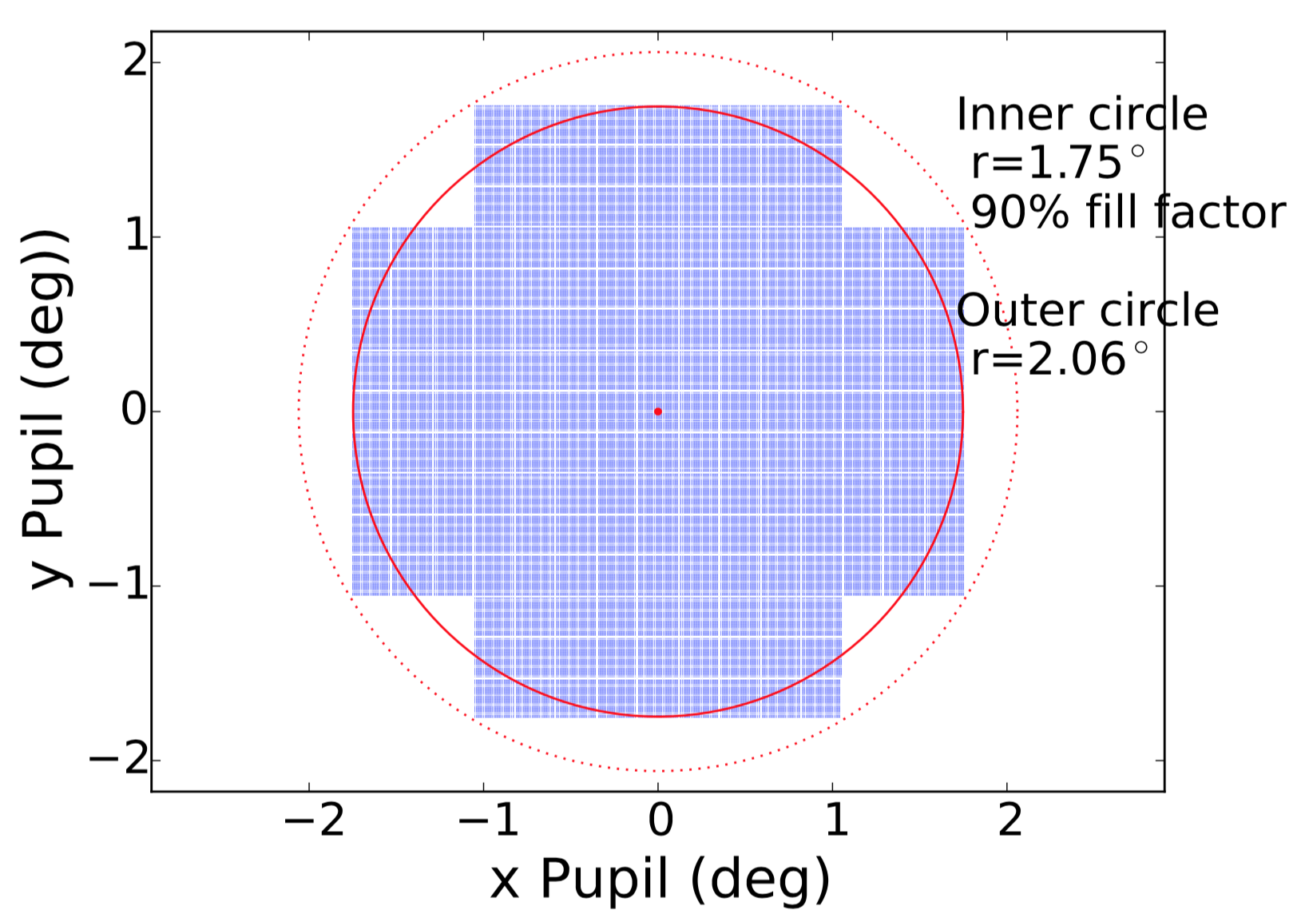
The Fill Factor f_{F}
The Fill factor f_{F} : the effective geometric FOV area paved by the science pixels, normalized to 9.6 deg².
LSST has 21 rafts
With the 13/8 e2V vs. ITL raft distribution,
  4072x4000 (ITL)
  4096x4004 (e2V)
Current estimate: f_{F} = 0.99
We do not have definite numbers for dead pixels, charge stops, or masking around bright stars yet. Based on current measurements, they should be small (no more than 1-2% effect).
Note: vignetting is taken into account in the sensitivity factor f_{S}, where effective diameter D=6.404m is used.

Slide 12
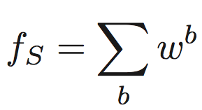
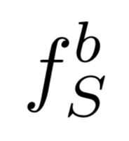
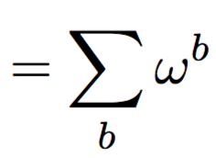

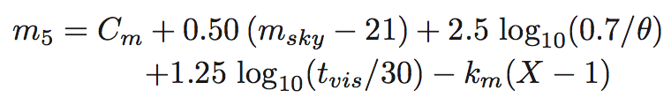
The Sensitivity Factor f_{S}
The Sensitivity factor f_{S} : the time required to achieve SRD design image depth with a fiducial signal-to-noise ratio, normalized to 30 seconds.
The limiting depth includes a complex interplay between system sensitivity and observing conditions
(LSE-40 or
LSST overview paper: arXiv:0805:2366v4)
System sensitivity:
C_{m} depends on the collecting area, the system throughput, and the system noise
Observing conditions
m_{sky} is sky brightness,
θ is delivered image size (Effective FWHM in arcsec)
km is atmosphere extinction coefficient
X is airmass
f_{S} includes seeing and sky background etc. which makes it the “effective” total throughput of the system.

Slide 13
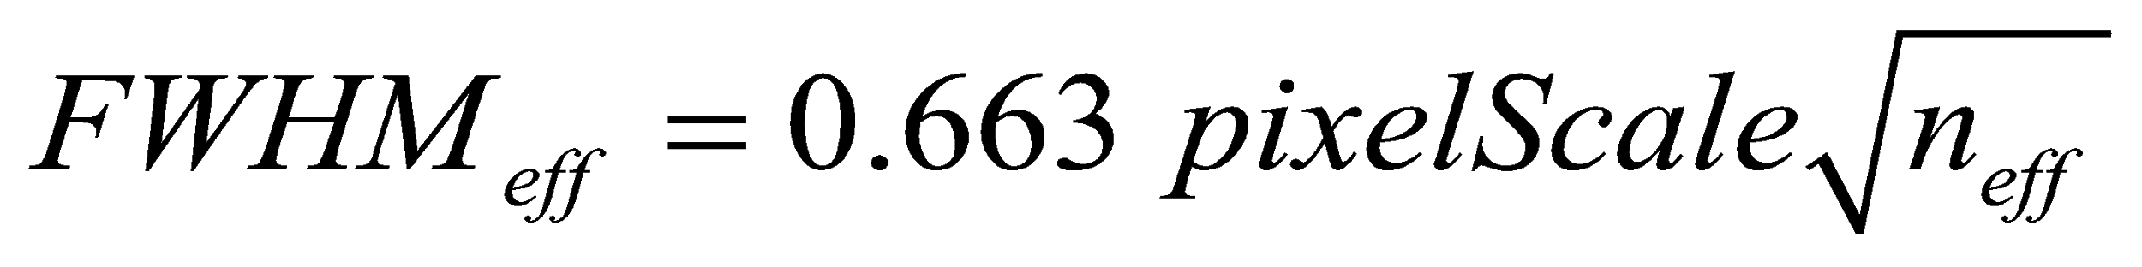
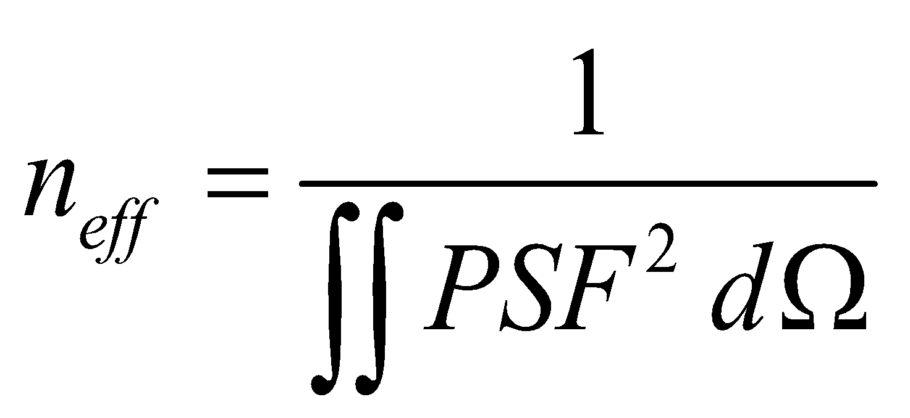
The Sensitivity Factor f_{S}: Current Status
Image size in effective FWHM: Angeli G. et. al, Proc of SPIE 9911, 991118 (2016)
Throughput will be covered later in this talk
Read noise of 9e− per exposure per pixel: consistent with Camera measurements so far
LSST fiducial sky brightness model: Yoachim P. et. al., Proc of SPIE 9910, 99101A (2016).
m5 | u | g | r | i | z | y
Current estimate | 23.74 | 24.82 | 24.37 | 23.94 | 23.36 | 22.45
SRD design spec. | 23.9 | 25.0 | 24.7 | 24.0 | 23.3 | 22.1
SRD min. spec. | 23.4 | 24.6 | 24.3 | 23.6 | 22.9 | 21.7
f_{S}=1.03
The values above are area-weighted averages over the entire focal plane where as-built camera geometry has been taken into account.
Work is under way to track gain/noise/QE/m5 etc. on a per-amplifier basis.

Slide 14
The Observing Efficiency Factor f_{O}
The Observing Efficiency Factor f_{O}: the total open-shutter time, normalized to the time required to meet the SRD specifications.
We need 1.55M visits to meet SRD requirements for the main survey
  18000 deg² corresponds to 1875 FOV (9.6 deg² each)
  Visiting 1875 FOV 825 times requires 1.55M visits (perfect dithering; field overlaps are smoothed over long time scale)
OpSim baseline run 2018a produced 2.37M visits, with 2.05M (86%) allocated to main survey.
Current estimate: f_{O} = 2.05/1.55 = 1.3
How close we can get to 1.3 remains to be seen, depending on algorithmic improvements in the scheduler, and correctness of various current assumptions about the system.

Slide 15
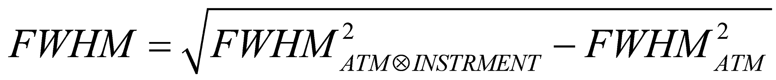
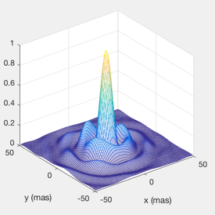
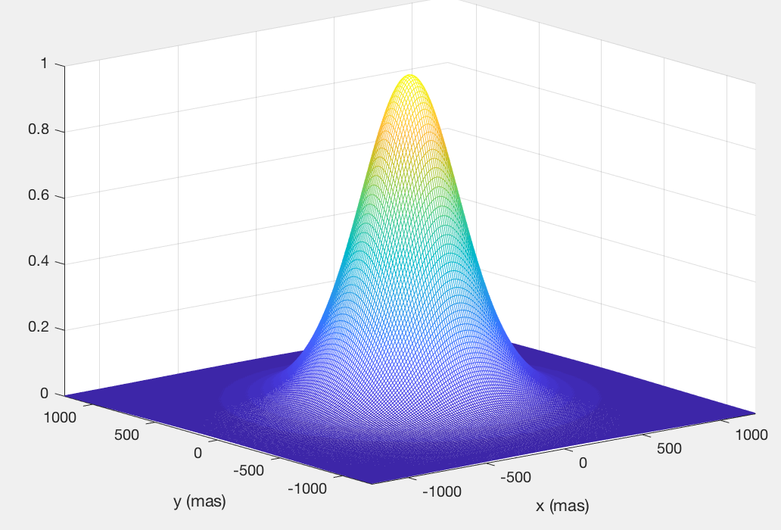
Image Quality in FWHM = Image Resolution
For image quality as a measure of image resolution, for example, in the context of the effective number of galaxies for weak lensing, we use
ATM stands for the LSST 0.6” fiducial atmosphere
⊗
-
The Image Quality error budget uses this definition.
Root-Sum-Square is used for error aggregation. Central Limit Theorem applies, given that there are many sources of error, and the dominating term (Camera charge diffusion) is Gaussian.
The SRD also has requirements on 80%, 90%, and 95% encircle energy diameters
Total system-contribution to the PSF will be evaluated in 2D using the Integrated Model (in progress).

Slide 16
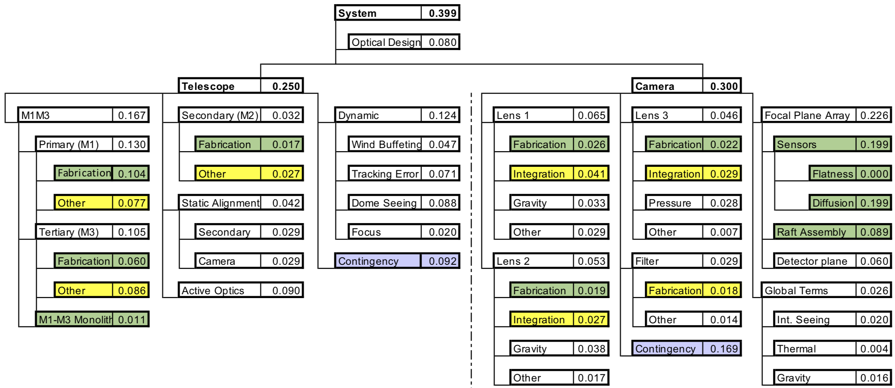
Image Quality Error Budget
FWHM Allocation:
    Telescope 0.25”
    Camera 0.30”
    Optical design 0.08”
Current projected system IQ: 0.34”
All major components have either been fabricated and accepted or close to final acceptance.
Camera measured charge diffusion better than estimated.
Telescope and Site still maintains most of its image quality contingency.
Camera is projected to do better than budgeted.
Delivered image quality maintains 0.72”, as originally allocated
Green: verified.
Yellow: partially verified.

Slide 17
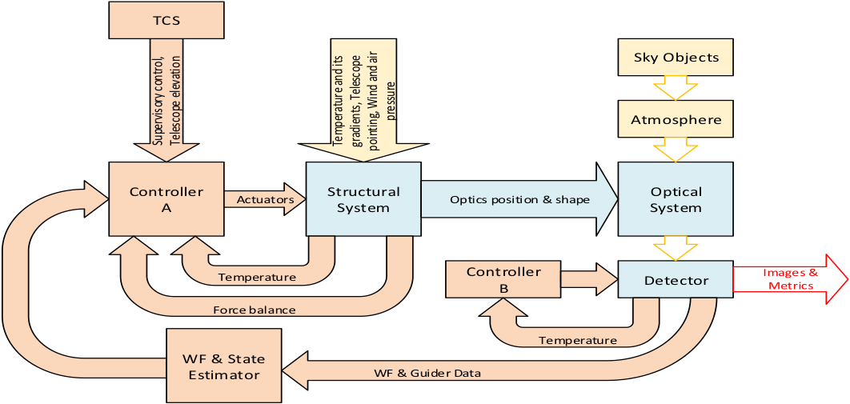
Integrated Modeling to Support Performance Evaluation
PSE maintains an updated model of the full system, with information from subsystems, simulating and analyzing end-to-end system performance.
As-built information are included when available.
Joint simulation of
Optics, structure, and control
Yellow: environment
Blue: hardware
Orange: control

Slide 18
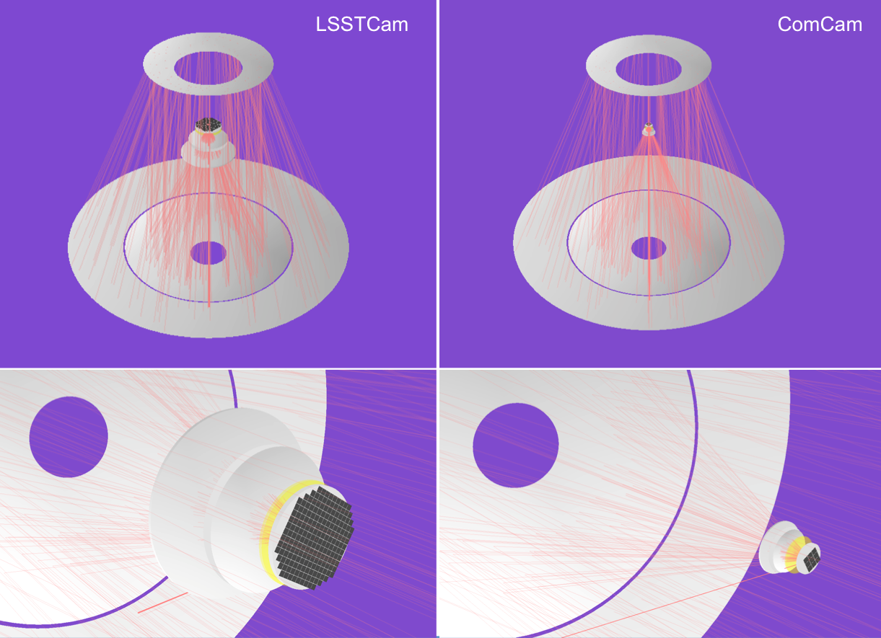
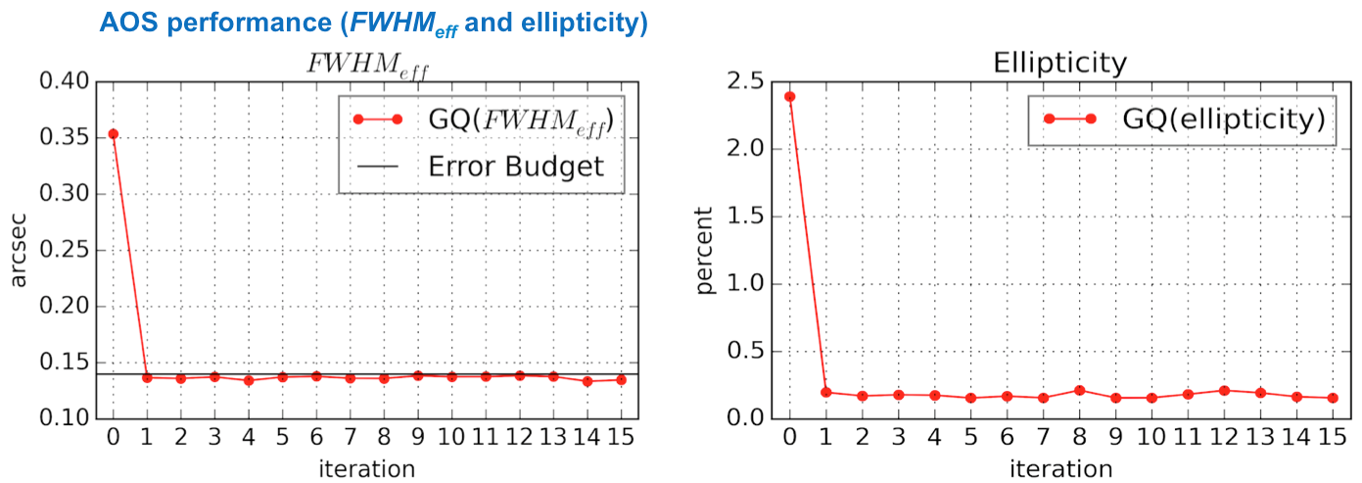
Active Optics System (AOS) Performance
Simulation Highlights
PhoSim/ZEMAX as the optical engine
Telescope pointing for each visit taken from OpSim observation history
Atmosphere continuously evolving from one visit to the next
Finite Element Model built into simulations to exercise Look-Up Table Operations
Wavefront images formed by means of raytracing, and fed to wavefront sensing software (ComCam pistoned along z)
AOS controls 2 hexapods and 20 bending modes on each mirror substrate
Currently Include optical design; AOS; Gravitational and thermal errors of M1M3, M2, camera; and focal plane flatness

Slide 19
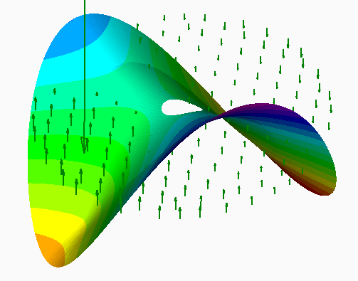
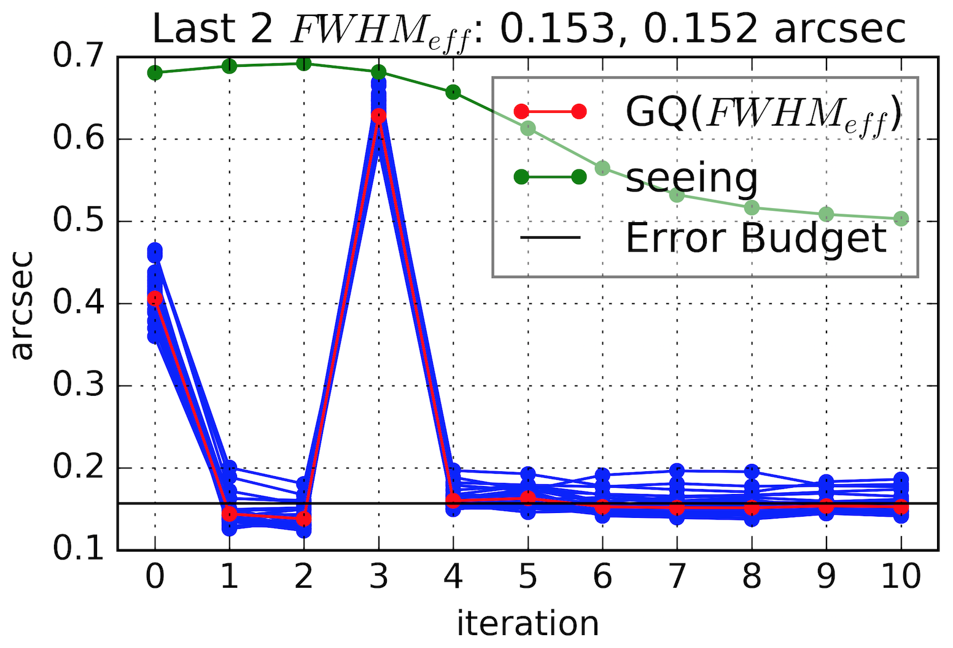
Preparing for the Unexpected
The “engineering punch list resolution” blocks approximately once every month has been built into the schedule.
Weather impacts on commissioning schedule are taken into account in planning.
Another example: simulation of a stuck/broken M1M3 actuator.
M1M3 uses pneumatic actuators which (1) are simpler therefore less likely to get stuck (2) has negligible stiffness if gets stuck (3) are attached to the mirror using low strength interface #4 screws that will break before the mirror does
A broken actuator is more common
Simulation of a broken actuator is shown on the right.
LTS-88 requires that an broken actuator can be replaced in 1 day.
The impact on system image quality will depend on location and orientation of the actuator, and elevation angle of the visits.
Force Balance

Slide 20
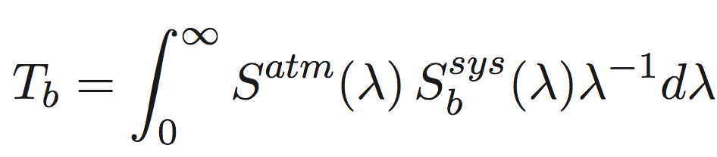
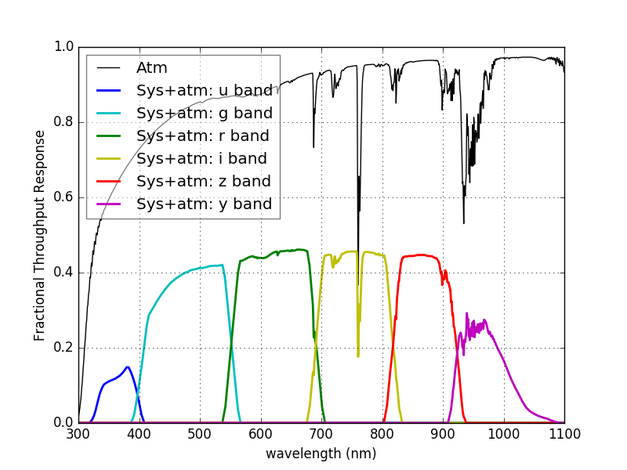
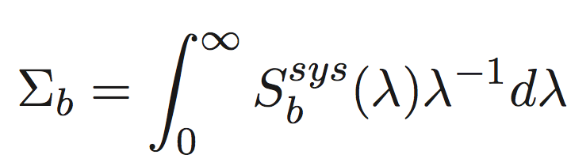
Using GitHub to Track Throughput Estimates
System throughput is directly linked to sensitivity
The current throughput estimates are maintained by PSE via a GitHub repo, and continuously updated.
Throughput Integral:
System Integral:
Band | Estimated Σ_{b} | OSS spec | status
u | 0.051 | 0.029 | ✓
g | 0.151 | 0.115 | ✓
r | 0.114 | 0.093 | ✓
i | 0.083 | 0.063 | ✓
z | 0.056 | 0.043 | ✓
y | 0.030 | 0.017 | ✓

Slide 21
Summary
The LSST project regularly tracks a number of system performance metrics, which captures the need of most science programs.
  integrated étendue
  Image quality
Our best knowledge of where we are on the metrics:
  f_{F}=0.99; f_{S}=1.03; f_{O} =1.3; → f_{P} = 1.3
  System image quality estimate maintains 400mas, with reserves on subsystem level
  Team is still working hard to further improve the metrics.
Mechanism for tracking system performance metrics on per-amplifier basis is being established. DM tools will be utilized.

Slide 22
Backup

Slide 23
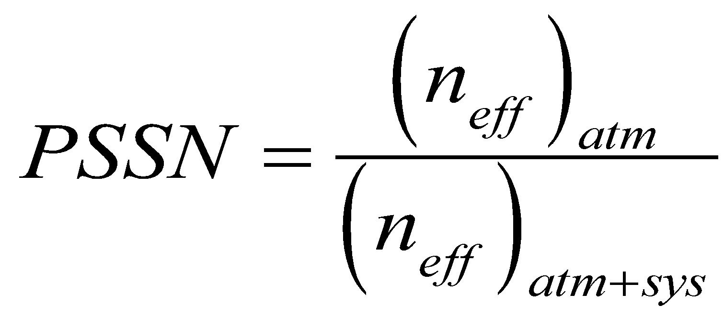
Effective FWHM = Photometric Image Size
LSST fiducial atmosphere (FWHM=0.6”) is assumed for performance evaluations
How do we define the size of a PSF, such as this one?
For evaluating the sensitivity factor f_{S} and image depth m₅, we use
Directly linked to the normalized point source sensitivity (PSSN) [App.Opt.48,5997(2009)]
Effective FWHM (photometric image size) is captured and reflected in the Integrated étendue.
Instrumental PSF due to M1M3 as-built surface
n_{eff} – effective number of pixels that maximizes SNR

