Slide 1
Transition to Operations Robert Blum Acting Director for LSST Operations NSF/DOE Joint Status Review 28 August 2019

Slide 2
Status of Transition to Operations
Pre-Operations
Connection between Construction Project, Operations, and Ops Readiness
New Operations Funding Model
Staff Transition Planning
Pre-Operations and Commissioning
Joint Operations Review

Slide 3
Status of Transition to Operations: Pre-operations
Pre-operations began 2018 October 01
Pre-operations is a 4 year program to stand up the LSST operations team and begin supporting the LSST science community in advance of the full survey by serving commissioning and science verification data.
LSST, AURA, and SLAC developed a 16 yr proposal for operations submitted to NSF in 2017 under AURA. Proposal was positively reviewed by DOE and NSF (2017 proposal = baseline plan)
NSF has awarded AURA a three year CSA for pre-operations (FY19-21) based on 2017 proposal. DOE has fully supported FY19 and is signaling full support for FY20.
We expect to have a Joint Operations Review in early CY20 to gain approval for the full survey operations

Slide 4
Status of Transition to Operations: Organization
Director’s Office
LSST Director
1.1 Directorate
1.2 Compliance
1.3 Business
Observatory Operations
LSST Data Facility
Science Operations
System Performance
Education and Public Outreach
2.1 Associate Director of Observatory Operations
3.1 Associate Director of Data Facility Operations
4.1 Associate Director of Science Operations
6.1 LSST Survey Scientist
5.1 Head of EPO
2.2 Observatory Software
3.2 Scientific Production Services
4.2 Observatory Science
6.2 Scheduling
5.2 Technical Team
Observatory Software
Observatory Software
Observatory Software
2.3 Observatory ITC
4.3 Science Platform
6.3 Community Support
5.3 Education
Observatory ITC
Observatory ITC
Observatory ITC
3.3 Data, Compute and IT Security Services
2.4 Summit and Engineering
4.4 Science Algorithms and Pipelines
5.4 Outreach
Summit and Engineering
Summit and Engineering
Summit and Engineering
6.4 Systems Engineering
3.4 Production Service Software
3.5 ITC and Facilities
Notes:
WBS level 2 = “department”, WBS level 3 = “team”
The LSST Director’s Executive Council comprises the Director, the 5 department heads, and the Deputy Directors and Program Coordinators in the Directorate.
This chart will likely change going forward

Slide 5
Status of Transition to Operations: Pre-ops Executive Team
Staffing for pre-ops (FY19+):
Bob Blum, Acting Director of Operations
Phil Marshall, Deputy Director of Operations at SLAC
Wil O’Mullane, Associate Director for Science Operations
Michelle Butler, Associate Director for Data Facility
Amanda Bauer, Head of Education and Public Outreach
Cathy Petry and Christine Soldhal, program coordinators
Other effort for FY20
Chuck Claver, John Swinbank, Leanne Guy, Michelle Butler, various pipeline and data facility scientists (NCSA, SLAC, BNL, FNAL, UW, Princeton), administrative support

Slide 6
Status of Transition to Operations: Pre-operations Connection to Construction
Agencies expect good communication between MREFC/MIE and Operations teams
Together, ensure smooth transition of staff and facilities to operations
Must ensure the system operations receives is ready for science (will meet SRD and operations readiness criteria to produce survey)
Commissioning activity is the area where operations and construction most overlap and where operations can learn about the system being delivered in order to prepare.

Slide 7
Status of Transition to Operations: Pre-operations Connection to Construction
Ops team integration in construction project
Ops Director and Deputy Director participate in NSF/DOE Joint Operations Group weekly video meetings
Ops Director and Deputy Director participate in weekly Commissioning Team video meeting
Ops Director participates in weekly project status meeting
Ops Director sits on project Change Control Board (CCB)
Ops Director attends AMCL meetings
Ops Director attends Project Science Team meetings
Operations executive team includes senior project managers
Ops team participates in annual meetings (PCW), site visits, events
Both Director and Deputy are engaged in LSST Science Collaborations

Slide 8
Status of Transition to Operations: Operations Readiness
There will be an operations readiness review (ORR).
Expect Ops team to work closely throughout pre-ops period with construction team (SIT-Com) to understand system as it approaches readiness
Following plans and iterating pre-ops activity to match commissioning schedule
CCB is particularly important early “check” on delivered system
Recent CCB example where Ops Director engaged:
Corner raft acceptance with minor waivers on performance
Worked with T&S and SIT-Com to further quantify performance and ensure the guiders would be adequate for the system requirements

Slide 9
Operations Readiness
From Project
1) Verification of Observatory System Specifications (LSE-30)
2) LSST System Requirements & SRD Verification/Validation
3) Science Validation mini-Survey
4) Data Release Processing
5) Prompt Processing (previously Alert Production)
6) Science Data Quality Assessment
7) Recording and Archiving of System State Metadata
8) Operational Procedures and Technical Documentation
9) As-Built Record, Modifications, non-Compliance and Recommendations
From Ops Team
10) Community Services and User Interfaces
11) Operations team ready (plan and staffing)

Slide 10
New NSF and DOE Funding Model
New data rights and funding model is driving transition planning:
NSF/DOE have agreed to fully support operations, but
have given guidance to LSST to seek international partners and offsets to operations costs.
This model requires
identifying AURA and SLAC effort that can be “handed off” to credible international groups, reducing the staff transferring from MREFC to Operations or hired directly for operations
A re-distribution of effort between SLAC and AURA
Need to preserve expertise

Slide 11
New NSF and DOE Funding Model: Status
LSST has produced high level models/menu of options for AURA/SLAC on in-kind operations offsets
Discussion with NSF and DOE in progress
Includes real offsets to ops costs
Includes some in-kinds for “expectations” not costed in operations proposal
Envision Call for Proposals on other resources
Host of “really good to have” added value options
Working with NSF, DOE, AURA, SLAC to move this forward

Slide 12
Status of Staffing Plan
Current plan based on 2017 proposal is well in hand
Working with VK and Construction team on resource loading through pre-operations.
Plan is still evolving due to need to re-distribute between AURA and SLAC and desire to keep best people into ops
May be able to directly move key AURA staff to SLAC/DOE funding, some others may be new DOE lab people, some non-MREFC hires (Chile)
In-kinds included as agreements are completed. Go to JOR with current snap shot.
Notes:
Comments for Bullet 2-4: Initial assignments made. Some people may find other roles. Some roles will need to be filled by non MREFC.

Slide 13
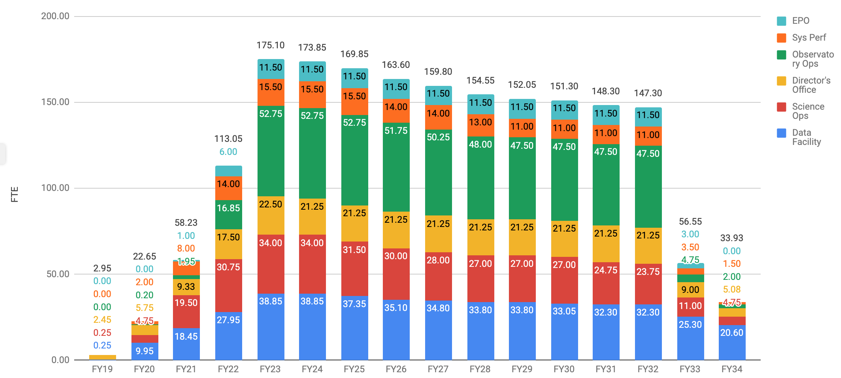
Status of Staffing Plan

Slide 14
Status of Staffing Plan
Developed detailed staff plan with all individual roles in the WBS for the 2017 plan. Current status of confirmed roles filled shown below for. Roles don’t change, but AURA/NCSA/SLAC seat will

Slide 15
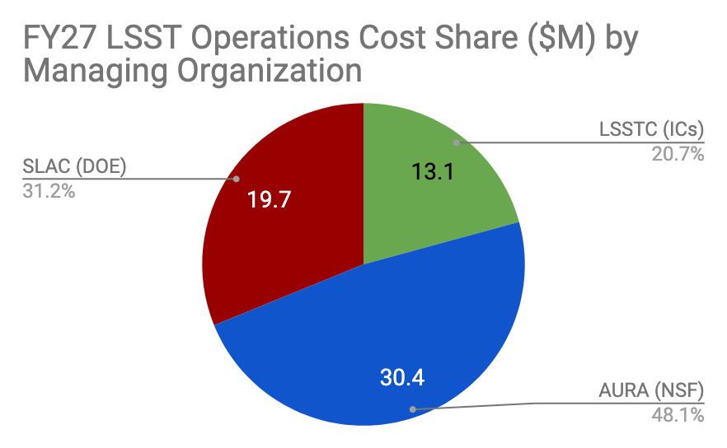
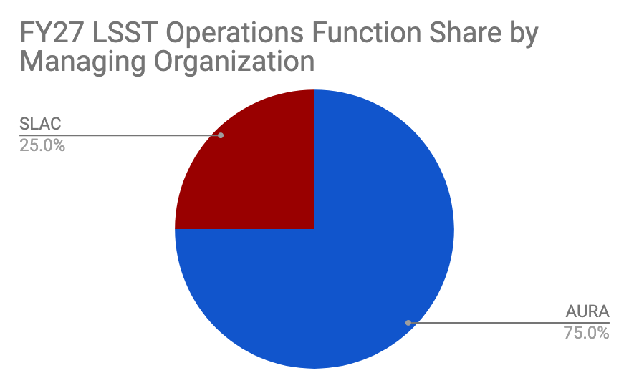
Status of Staffing Plan: Baseline 2017
Developed detailed calculator to easily test new staff models
Annual Steady State Cost ($M) | This Expt | Dec 2017 | FY27 delta | % delta | % of Total
NSF | 30.4 | 30.2 | 0.2 | 1% | 48%
DOE | 19.8 | 19.9 | -0.1 | -1% | 31%
LSSTC | 13.1 | 12.9 | 0.2 | 2% | 21%
All | 63.27 | 63.0 | 0.3 | 0.4% | 100%
Total 10-yr Cost ($M) | This Expt | Dec 2017 | 10-yr delta | % delta | % of Total
NSF | 361.6 | 364.4 | -2.8 | -1% | 48%
DOE | 229.4 | 226.1 | 3.3 | 1% | 31%
LSSTC | 156.0 | 155.9 | 0.1 | 0% | 21%
All | 746.97 | 746.4 | 0.6 | 0.1% | 100%
Now replaced by NSF and DOE
LSSTC Contribution was built into AURA

Slide 16
Pre-Operations and Commissioning
An important aspect of transition is to demonstrate the ops team is ready to run the data management system and to support users with data products.
Need to remain flexible due to evolution of commissioning plan between now and October 1, 2022.
Will do this via simulated and existing data sets and actual commissioning data products as available
Unlike other telescopes, we don’t plan for a breaking in period, but rather to run full up on day 1.
Plan to engage(d) Community on expectations at PCW2019

Slide 17
Commissioning Data for Community
The LSST Commissioning team will generate data products from the observations taken in commissioning. The Commissioning team will verify, validate, and characterize these products, in order to test for the operations readiness of the system.
The LSST Operations team plans to use the commissioning data products to develop and test its procedures for releasing, and then supporting the use of, LSST data. We will “keep up” independent of commissioning team through use of simulated and/or precursor data sets.
Preparing for each data release “scenario” in commissioning and science validation will take time and effort by the ops team.
Currently working closely with/following Commissioning team (attend weekly meetings, etc.)

Slide 18
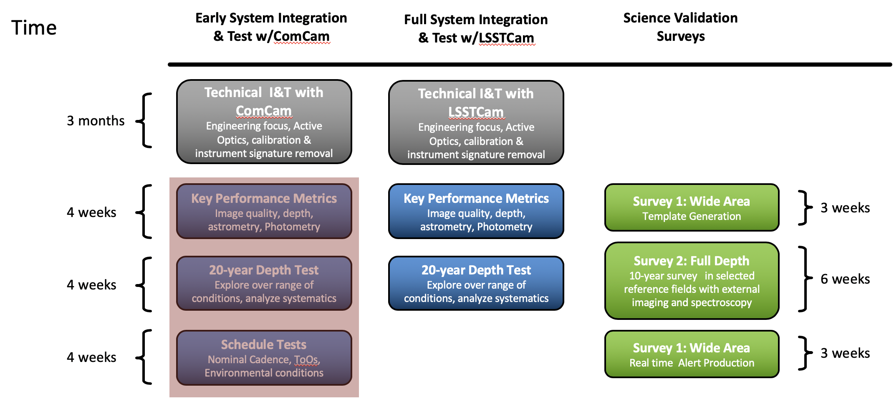
Commissioning Data Production
Three phases of commissioning
ComCam
LSSTCam
Science Validation Surveys with LSSTCam
Alerts included
SITCOM plans evolving
Ops team seeks to deliver any “science ready” data to data rights community
Notes:
For bullet 4: serving SV data (indeed having it at all) reduces risk going into operations. Will allow us to show we are ready for the survey start.

Slide 19
Alerts During Commissioning
Early alert stream data will be distributed, possibly with substantial latency, to familiarize the community with the planned format and content of the alert stream.
A best-effort alert stream will be distributed.
Alerts generated by commissioning team via prompt production
Alerts are served via community brokers; Ops team will support community in their use.
Commissioning team handles (artificial, delayed, and real) stream generation, but may be some opportunity/need to have ops team assist in “pushing out” the stream to brokers. TBD.

Slide 20
Key Data Acquisition Dates: Recent Forecast
Milestone | Forecast Date (June 2019)
Start of Tucson Integration Tests w/ComCam | Aug. 01, 2019
Start of On-Sky Data from Auxiliary Telescope | Dec. 18, 2019
Start of On-Site Integration Tests w/ComCam | Mar. 23, 2020
Start of LSSTCam re-Verification Data | Mar. 29, 2021
Start of On-Sky & Calibration Data with ComCam | Apr 23, 2021
Start of On-Sky & Calibration Data with LSSTCam | Oct. 12, 2021
Sustained Observing with LSSTCam | Dec. 30, 2021
Start of Science Validation mini-Surveys | Feb. 18, 2022
Operations Readiness Review | Jun. 10, 2022

Slide 21
Key Data Acquisition Dates: Ops Milestones
DP0 Hosting | 2020-06-30 | Host simulated images and DESC-made catalogs, for LSP testing and comparison with DP0 re-processing. Date TBD
DP0 Start | 2020-12-15 | Begin early DRP-like processing of simulated images.
DP0 Image Release | 2021-06-30 | Partial Data Preview 0 (simulated images) released to community.
DP0 Catalog Release | 2021-09-30 | Full Data Preview 0 (simulated data catalogs) released to community.
DP1 Start | 2021-08-24 | (Timing: Sustained Observing with ComCam) Begin early DRP-like processing of ComCam and/or simulated data.
DP1 Image Release | 2022-01-11 | (Timing: ComCam AI&T Completion + 3 months) Partial Data Preview 1 (ComCam and/or simulated images)
DP1 Catalog Release | 2022-04-12 | (Timing: ComCam AI&T Completion + 6 months) Full Data Preview 1 (ComCam and/or simulated data catalogs) released to community.
DP2 Start | 2022-02-15 | Begin DRP processing of LSSTCam SV images (LDF to verify)
DP2 Image Release | 2022-08-19 | (Timing: LSSTCam AI&T Complete + 6 months) Full Data Preview 2 (LSSTCam SV images) released to community.
DP2 Catalog Release | 2022-11-18 | (Timing: Science Verification Complete + 6 months) Full Data Preview 3 (LSSTCam SV catalogs) released to community.
DR1 Start | 2023-06-30 | Begin DR1 campaign processing.
DR1 Release | 2023-12-15 | Release DR1 to community

Slide 22
Joint Operations Review: Time is Short
Goal is to get NSB and DOE OS approval for full survey ops plan Q3-4 FY2020
If (JOR February 28, 2019) Then
Presentations to JOR Feb 14
Jan 20, JOR Director’s Review
Send slide presentations to JODR Jan 8
Jan 1 all documents and presentations to review team
Dec 15 AURA (NMOC) approval of Ops Budget
Dec 1 all docs to NMOC
Need NSF/DOE distribution guidance August latest!
Assume in-kinds need not be complete by JOR (scope fixed, budget is max agencies need)
Required documents or updates: Ops Plan, Ops Budget, EOP, Transition Plan, Other docs: Risk man plan, RR, Milestones, Policy docs, staff roles ...

Slide 23
Summary
Operations has begun
Now fully supported by agencies
LSST will seek important in-kind partnerships from international groups.
Transition from construction to commissioning to operations will take flexibility.
Ops team working closely with Commissioning team and building in options to stay on track even if some commissioning data production milestones move out
Ops team “embedded in construction” through meetings, committees, and CCB, setting up for smooth transition and successful ORR.

Slide 24
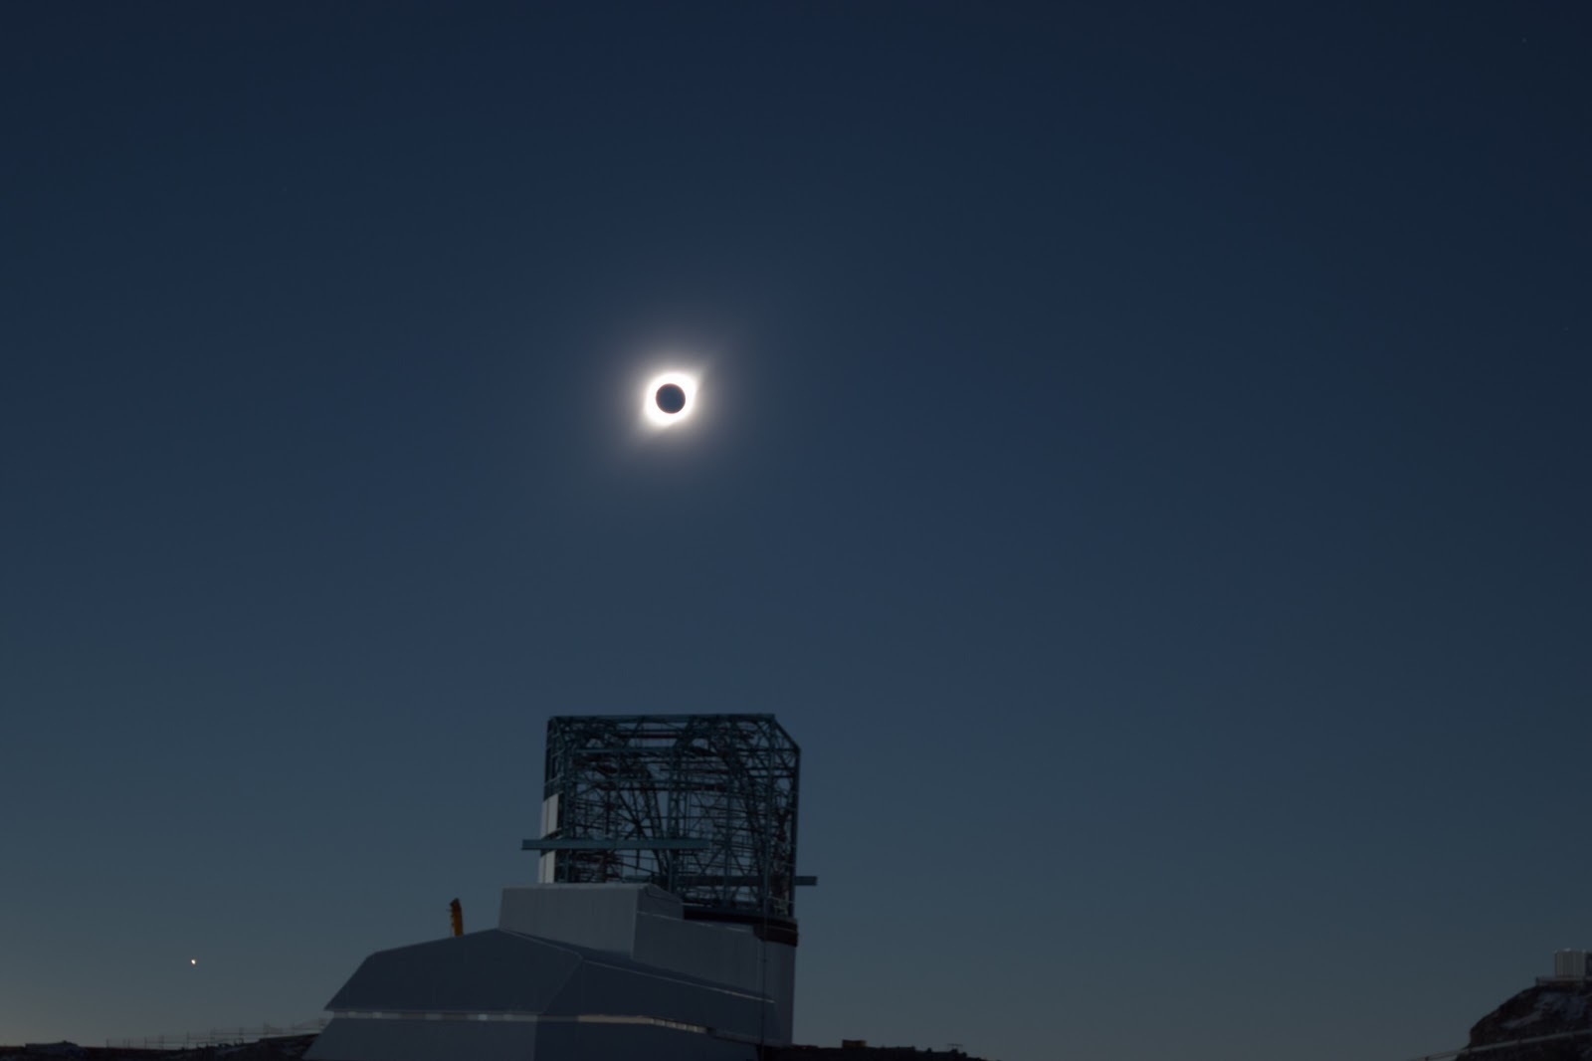
End of Presentation
Photo credit Kevin Reil

Slide 25
Detail Slides

Slide 26
History: the old LSST operations funding model
The LSST Facility will cost ~$60M per year to operate, in steady state. NSF and DOE will share the cost.
25% of the operations costs were to be covered by international contributions (ICs) collected by LSSTC, in exchange for data rights according to MOAs held by LSSTC.
The ICs were to be transferred to AURA, which was then to cover 75% of the operations scope. DOE was to cover the remaining 25% of the scope.
LSSTC succeeded in raising about half of the needed international contributions to operations. NSF and DOE decided to adopt a new model to ensure full support for operations.

Slide 27
The new LSST operations funding model is more partnership than “pay-to-play”
In May 2019, NSF and DOE (the US agencies) moved away from selling LSST data rights to international participants to a partnership model, in which they guarantee the Facility’s support but international science communities make “in-kind” contributions to offset costs and add value
“Monetary contributions to LSST operations will not be accepted for international participants to obtain rights or access to LSST proprietary data.”
The agencies will “work with international participants to explore possible in-kind contributions that might provide NSF and DOE sufficient value in exchange for rights and access to LSST proprietary data.”
“The agencies have no plans to de-scope LSST operations.”
Data proprietary for two year period

Slide 28
The US agencies outlined how the new model will work in a set of “Talking Points”, which we can use to help us prepare for it.
The data release and alert stream plans, and the size and capability of the facility operation, and US data rights, are all unchanged
Everyone who currently has LSST data rights through an international MOA will keep them while a new agreement with the US agencies is established between now and June 2021.
“The agencies (NSF and DOE) recognize the importance of the contributions of the current PIs of international participants to the development of the LSST science collaborations and the LSST project through their efforts to date.”
No change wrt status of current in-kind partners (Chile, Brazil, IN2P3)

Slide 29
The agencies’ talking points sketch out how in-kind contributions will be incorporated
“International participants may enjoy the same data access rights as US scientists in exchange for in-kind contributions to the LSST construction project, facility operations, and/or related astrophysical resources as considered and agreed to jointly by [NSF and DOE].” They will “work with NSF, DOE, and their awardees (AURA and SLAC)” to define them.
“NSF and DOE will consider most favorably proposed in-kind contributions that, for example, will offset NSF and DOE costs for operations and/or expand the resources available to the U.S. astrophysical and high energy physics communities.”
“Examples of desirable in-kind contributions to LSST might include dedicated software development staff or computing resources that offset LSST operational costs, or access to complementary data sets or follow-up facilities.”

Slide 30
Planned On-sky Observing Campaigns
Time
Early System Integration & Test w/ComCam
Full System Integration & Test w/LSSTCam
Science Validation Surveys
Technical I&T with ComCam
Engineering focus, Active Optics, calibration & instrument signature removal
Technical I&T with LSSTCam
Engineering focus, Active Optics, calibration & instrument signature removal
3 months
Key Performance Metrics
Image quality, depth, astrometry, Photometry
Key Performance Metrics
Image quality, depth, astrometry, Photometry
Survey 1: Wide Area
Template Generation
3 weeks
4 weeks
Survey 2: Full Depth
10-year survey in selected reference fields with external imaging and spectroscopy
20-year Depth Test
Explore over range of conditions, analyze systematics
20-year Depth Test
Explore over range of conditions, analyze systematics
6 weeks
4 weeks
Schedule Tests
Nominal Cadence, ToOs, Environmental conditions
Survey 1: Wide Area
Real time Alert Production
3 weeks
4 weeks
Notes:
speak to one example

Slide 31
Data Release Scenarios
Scenario (or data preview, DP) is a possible data release schedule or rehearsal timeline
Current plans include 3 scenarios for pre-operations (precursor/simulated, ComCam, LSSTCam SV data)
Release may start at flat files, will evolve to fully supported Data Access Center with LSP (LDM-554)
Plan to release data through LSP ASAP to gain operational experience and user feedback
Scenario 1, first simulated or precursor image data released. Catalogs 3 months later..
Scenario 2, 3 (ComCam, LSSTCam) data previews released 3 (images) and 6 (catalogs) months after data taking complete.

Slide 32
Steps towards agreements on in-kind contributions
The MOA holders will have Bob Blum and Phil Marshall, as representatives of DOE and NSF awardees SLAC and AURA, as points of contact to deal with establishing new agreements.
LSST operations has begun working with NSF, DOE, AURA and SLAC on identifying offsets to the facility’s operational costs, and the process for engaging the international community to secure them. This is not an “open” process. We will do what’s best for LSST, AURA, and SLAC.
We may contact individual groups or institutions that we believe are particularly well suited to a certain activity that will yield cost offsets
At the same time, we are working to define a process for soliciting other contributed resources

Slide 33
Engagement with LSST Commissioning
The Project welcomes external groups to add value and complement the existing LSST Commissioning Team’s capabilities. Possibility of in-kind contributions for internationals.
The Project reserves the right to decline any group’s offer for any reason.
The Project can terminate a group’s affiliation at any time due poor performance or undue overhead.
The Project will not rely on the contributions of external groups to fulfill the core commissioning requirements to the Operations Readiness Review.

Slide 34
Data Quality
Responsibility of commissioning team
Which data are released will be subject to Project review - e.g. not all commissioning data will be released
Data will be released as shared risk for scientific use
Feedback on data quality/issues to commissioning team will go through some TBD channel

Slide 35
Commissioning Prompt Data Products
Prompt Processing pipelines including, pre-covery, MOPS, and alert generation and distribution will be run in commissioning.
Difference images will be produced as templates become available to subtract from.
Expect to produce normal PPDB catalogs
< 12 months of DIASource records.
see DPDD for details
If Data Reduction Pipeline (DRP) data products are available in Qserv, could attempt linking - depends on DRP timeline and pre-ops plans

Slide 36
Commissioning Data Release Production
Will run improved versions of the LSST science pipelines that we run today (now: HSC reprocessing)
Expect many improvements in algorithms throughout commissioning. Expect:
improvements in quality
but the form of outputs not expected to change
improvements in QA and verification and validation processes
Catalogs in Qserv in Science Data Model format
See DPDD for table descriptions: ls.st/LSE-163

Slide 37
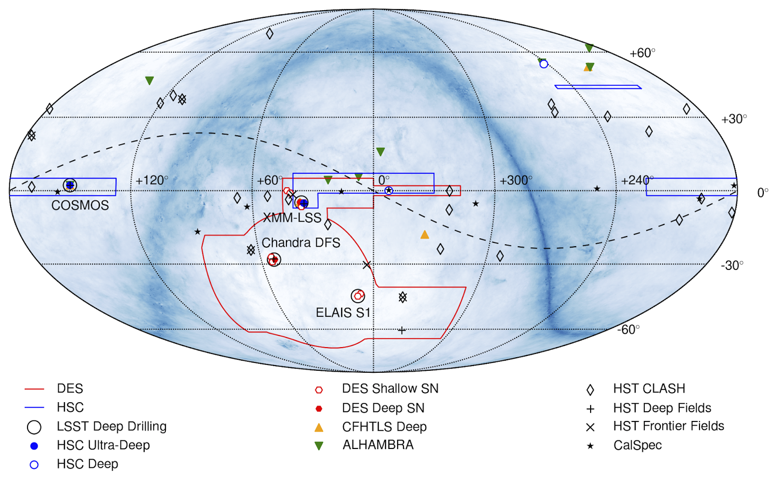
Field Identification - on going but not done

Slide 38
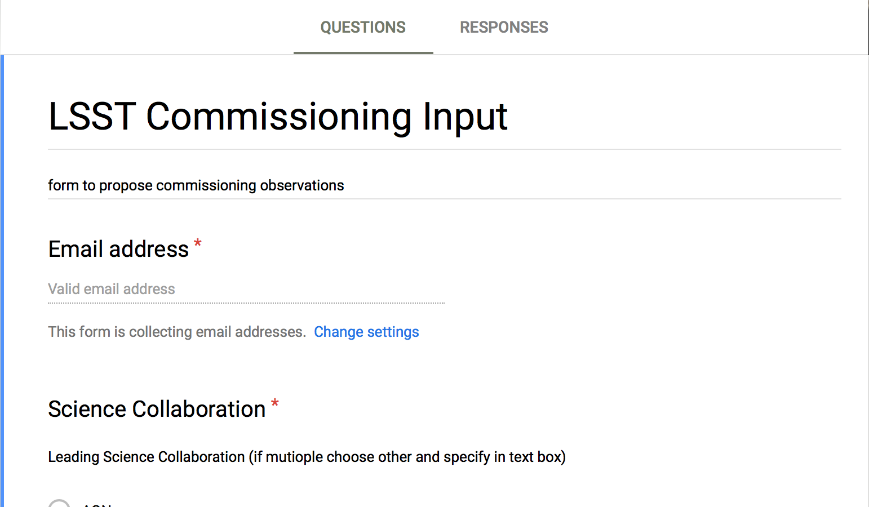
Community Commissioning Input
Input form for suggestions:
https://docs.google.com/forms/d/11FXz5noEwYPYtjqCziv7ZQhTlabFE-LFAQHVinu4jWI/edit

Slide 39
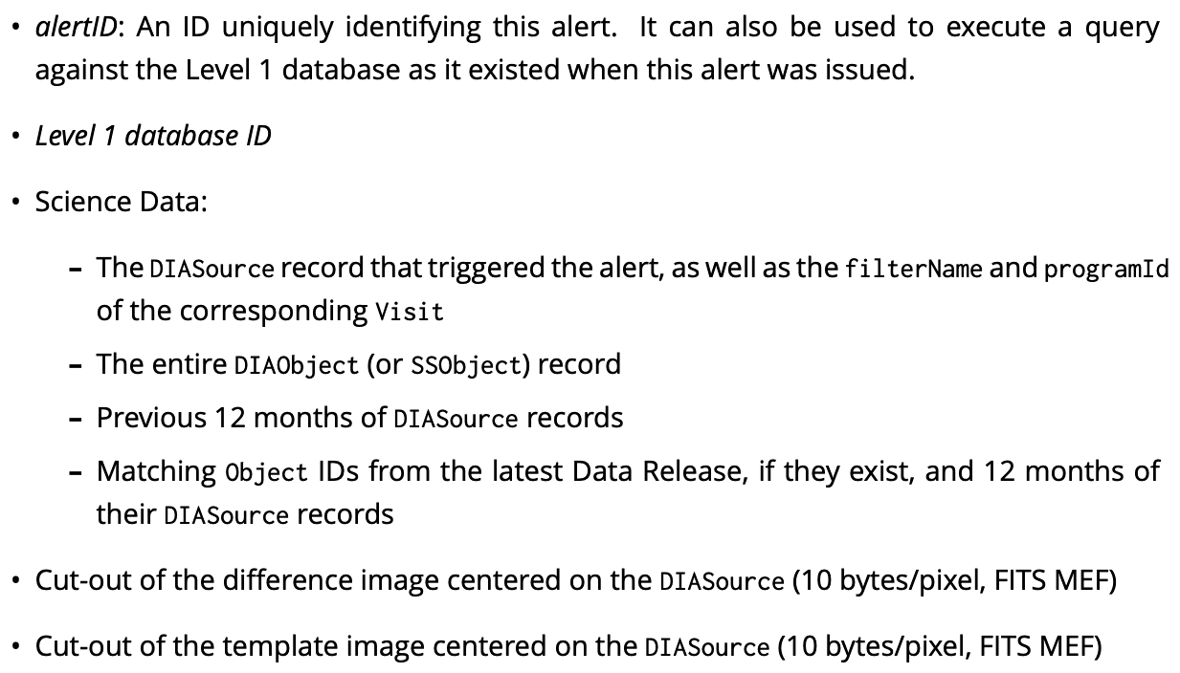
Alert packet contents in Commissioning
Each Alert (a VOEvent packet) will contain at least the following:
Probably only for known asteroids
Will be < 12 months
There will be no DR in commissioning, we will do what we can with the DRP data products

Slide 40
Moving Objects Pipeline
Expect to run MOPs in the Mini Surveys Q4 2022
Validate the the Solar System products pipeline
Test the linking software works
Test the interface to the Minor Planets Center
Prompt Data Products -> SSObject Table, see DPDD
Possibly only for known asteroids
Should not expect operations-era latencies of 24h for solar system data products in commissioning
Any discoveries can be released as a byproduct of this activity

Slide 41
Science Validation Survey 1: Wide Area
Objectives
Validate template building with Data Release Processing pipeline
Alert Processing, real-time alert generation
Monitor survey progress over wide area to test observation simulations
Observations (location and distribution on the sky TBD)
~1600 deg² x 15 visits x 6 filters x 2 phases (~30K visits, ~40 nights)
Phase 1: observations for template generation (3 weeks)
Phase 2: observations of same area for alert production (3 weeks)
Phases separated by 6 weeks to allow for astrophysical evolution and template processing (Science Validation Survey 2 scheduled between phases)
Additional Considerations
Use dithered pointings to match Wide-Fast-Deep pattern
Use large sky area to explore edge cases (bright stars, high source densities, etc.)

Slide 42
Science Validation Survey 2: 10-yr Depth
Objectives
Focus on Data Release Products at full survey depth
Data quality characterization beyond the SRD
Template generation and real-time alert production (more rapid cadence may enable unique tests)
Observations (location and distribution on the sky TBD)
~300 deg² x 825 visits across 6 filters (~30K visits, ~40 nights)
Select fields to overlap with external reference fields
Scheduler used to optimize data quality across fields
Additional Considerations
Use dithered pointings to match Wide-Fast-Deep pattern
Option to select adjoining fields to form larger contiguous full-depth regions
Alert Processing studies would benefit from early template generation

