Slide 1
Telescope and Site Status
Sandrine Thomas - T&S Project Scientist
Director’s Review
August 6th 2019

Slide 2
Outline
T&S deliverables Overview
Subsystem Progress Summary
Remaining challenges
Cost and Schedule
Risk and Opportunity, Scope Option

Slide 3
T&S Deliverables Overview

Slide 4
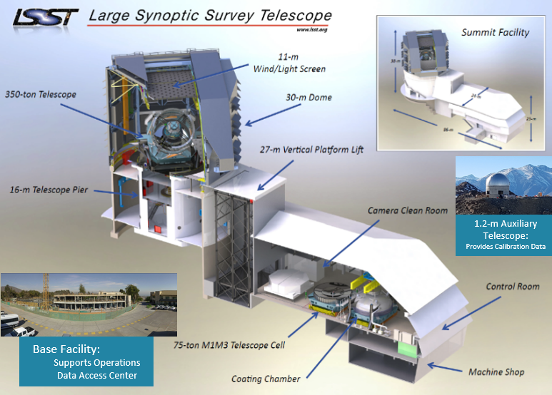
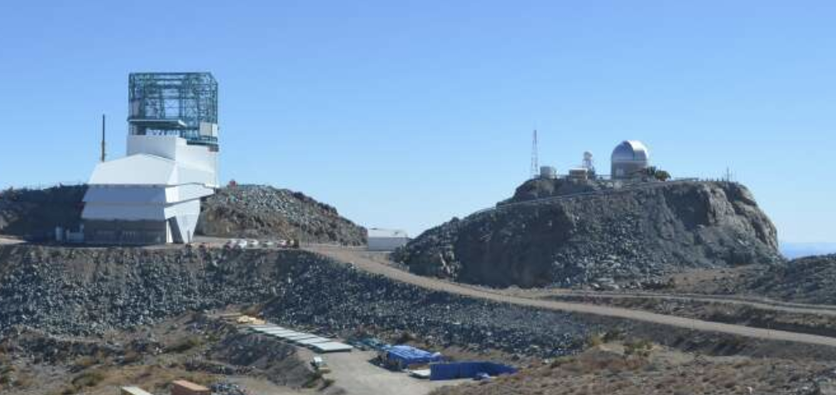
T&S deliverables include hardware (2 telescopes) and software products
Structures located on summit and at base
Acquire, calibrate, and schedule the survey
Unique design features
  M1M3 mirror
  Stiff telescope mount design
  Linear drive systems/capacitor banks
  Dome “crawl” with light screen
  80-ton vertical platform lift

Slide 5
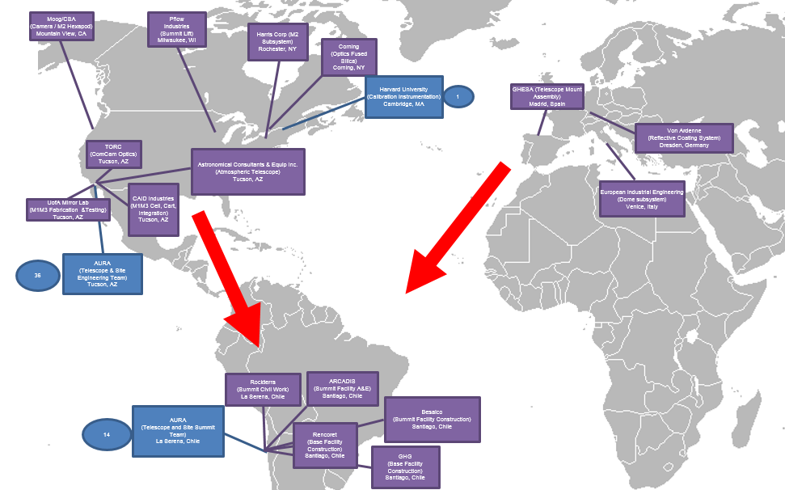
Transition of T&S from Tucson to Chile
Most of the components are now in Chile: Coating Chamber M1M3 system, M2 system, Cam Hexapods, M2 Hexapods, AuxTel, Software …..
  Soon to be delivered: AuxTel Spectrograph, Initial Optical Testing Assembly (IOTA), software
The TMA is on its way to Chile arriving in September 2019
Increase resources in Chile either by moving, hiring, or hiring of consultants

Slide 6
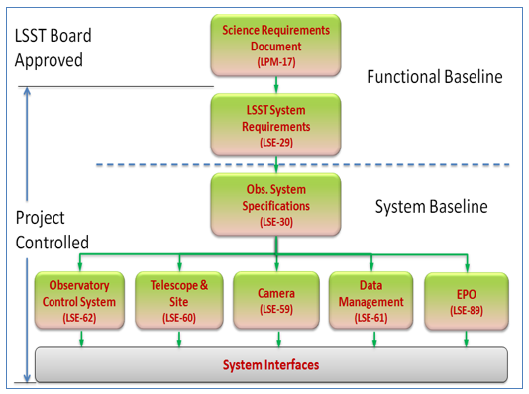


T&S system requirements
Next step: Verification of requirements in coordination with the PSE team.
T&S requirement document
(LSE-60)
OCS requirement document
(LSE-62)
Interface documents
Specification Documents
Summit Facility
LTS-52, LTS-53
Base Facility LTS-190
Dome
LTS-97
TMA
LTS-103
Hexapods/Rotators
LTS-206
Platform Lift
LTS-386
M1M3 assembly
LTS-438, LTS-89, LTS-88
M2 assembly
LTS-146, LTS-107
LTS-87
Calibration
LTS-440, LTS-337, LTS-187
Software
LSE-150, LTS 928, LTS-347, LTS-185
Coating Chamber
LTS-316. LTS-108
LTS Docs: SOW, Specifications, Verification Matrices, Procedures, Surrogates, Support Equip, Spares, etc.
See Austin Roberts’ plenary talk

Slide 7
LSST Project Organization Structure
Project Advisors
Chief Scientist: T. Tyson - UCDavis
SAC Chair: M. Strauss – Princeton
Project Science Team
LSST Director: S. Kahn – SLAC
Deputy Director: Z. Ivezic – UW
LSST Ops Director: R. Blum - AURA
Deputy Ops Director: R. Blum - AURA
Deputy Ops Director: P. Marshall - SLAC
Project Communications
Communications Mgr: R. Gill - AURA
Project Manager: V. Krabbendam - AURA
Project Scientist: Z. Ivezic - UW
Deputy PM Software: W. O’Mullane – AURA
Deputy PM Camera: V. Riot – LLNL
Deputy PM Chile: TBD - AURA
Performance and Safety
Safety: C. Gessner - AURA
Compliance: V. Kinnison – AURA
Information Security – Alex Withers - NCSA
Project Office
System Engineering and Commissioning
System Scientist: C. Claver - AURA
Commissioning Scientist: K. Reil – SLAC
Lead Systems Engineer: A. Roberts – AURA
Project Administration
Project Controls: K. Long – Longhorn
Business Manager: D. Calabrese - AURA
ITSI Manager: J. Kantor - AURA
Advisory
Project Support
Sub-systems
LSST Ops
- AURA
Data Management
DM Project Manager: W. O’Mullane – AURA
DM Project Scientist: L Guy – AURA
Camera MIE
Camera Project Manager: V. Riot - LLNL
Camera Project Scientist: S. Ritz - UCSC
Telescope and Site
T&S Project Manager: J. Barr - AURA
T&S Project Scientist: S. Thomas - AURA
Education and Public Outreach
Head of EPO: A. Bauer – AURA
Deputy Head of EPO; L. Corlies - AURA
17 July 2019

Slide 8
Updated T&S Organization
Represents Tucson Based Staff
Victor Krabbendam: LSST Project Manager
Wil O’Mullane: Deputy Project Mgr – Software
Vincent Riot: Deputy Project Mgr – Camera
Open: Deputy Project Mgr - Chile
Represents Chile Based Staff
Represents group of staff with a local lead
Doug Neill
Chief Engineer
Jeff Barr
T&S Project Manager
Sandrine Thomas
T&S Proj. Scientist
Sub-System Science Team
Wil O’Mullane Deputy PM – Software / Technical support
Engineering Group.
Enrique Figueroa
Base Team
Jacques Sebag
T&S AIV Manager
Eduardo Serrano
Site Manager
T&S Support Staff
Oscar Nunez
Deputy Site Mgr.``
Design Group
Sub-System CAMs - North
Andy Clements
Control Soft. Mgr.
Tucson Shop Fabrication .
Chile Software Team
Tucson Software Team
Optical Group Lead
Summit Electrical Group Lead
Electrics Group Lead
Mechanical Group Lead

Slide 9
Available Breakout Presentations
Summit and Base facilities
Dome
Telescope Mount Assembly (TMA)
M1M3 mirror system
M2 mirror system
M2 Hexapod and Cam Hexapod/Rotator
Coating Chamber
T&S Software
Environmental Awareness System
Calibration system (AuxTel and In dome calibration)
Assembly and Integration and Verification (AIV)

Slide 10
Subsystem Update

Slide 11
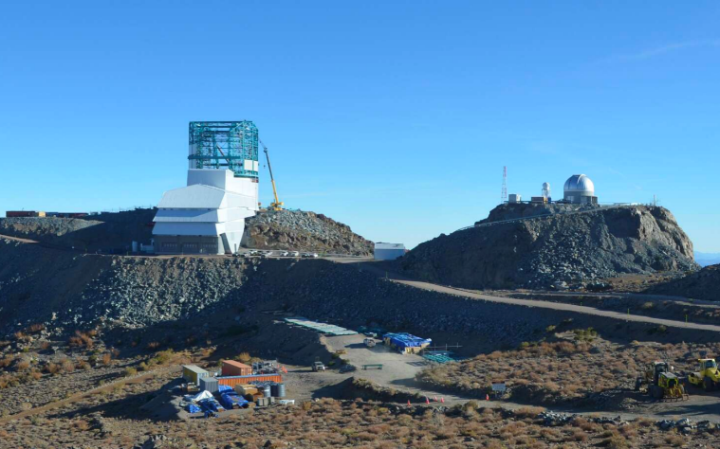
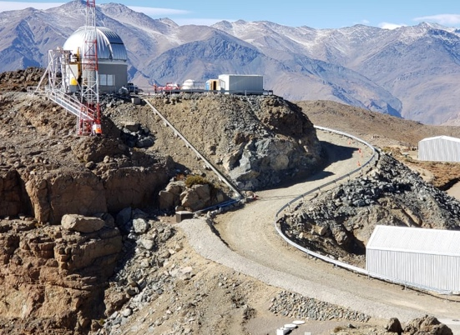
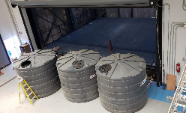
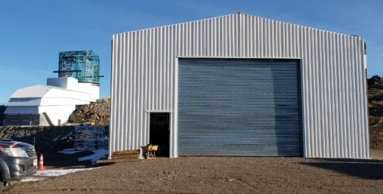
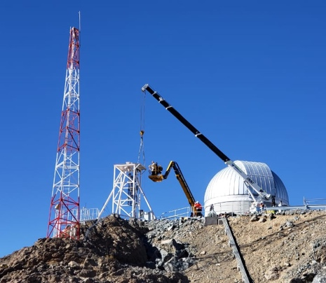
Summit Facility
Summit Facility & Dome ~July 18, 2019 UPDATE
Recent Accomplishments:
  Closeout of Besalco Contract for
  Summit Facility Construction
  Final load testing of Pflow Platform Lift
  Improvements of Clean/White
  Rooms to support Camera team Sprints
  Progress with Hotel addn. – 2 new rooms now in use
  Warehouse – completed
  Safety railing to the calibration Hill completed
  DIMM tower ready to receive the ”fixed” DIMM
Current Status/Upcoming Milestones:
  Continue to add IT support across facility
  Complete Pachón Hotel Addition & Warehouse
  Preparation of the facility for the TMA arrival
Pflow lift at dome level
HVAC Equipment fully tested
Pflow Lift Roof Final Details
New Hotel Bath
Details available in break out presentation
Warehouse for M1M3 and Future Storage

Slide 12
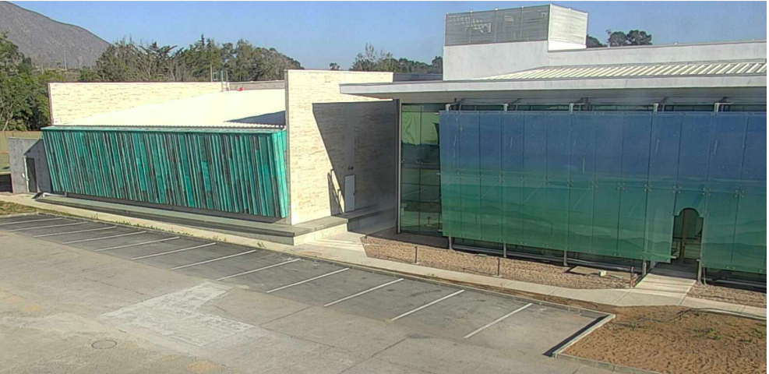
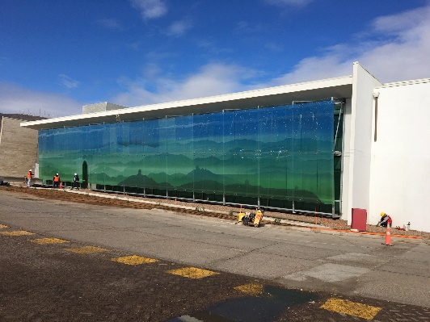
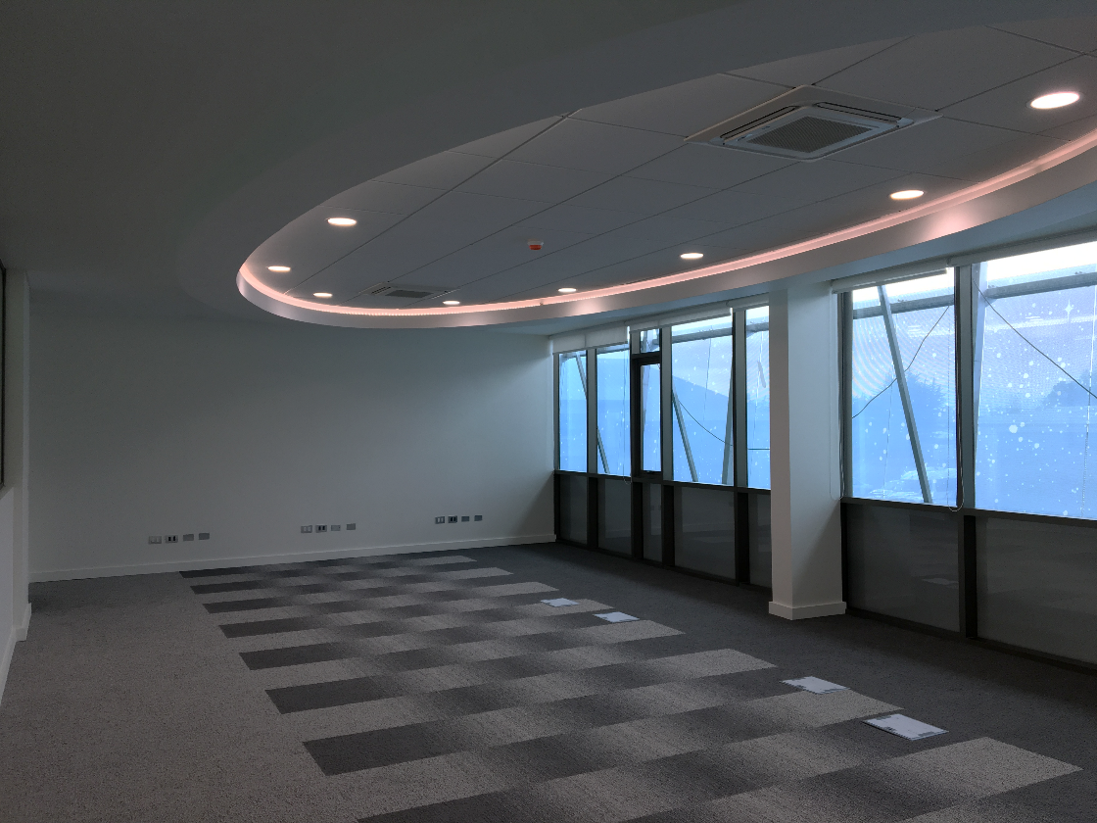
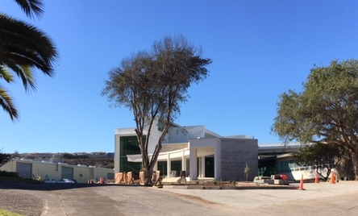
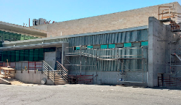
Base Facility
Recent Accomplishments:
  Phase 1 Remodeling – on hold, only remaining work conversion of old computer area to meeting rooms.
  Phase 2 New Building Contract now complete. Contract closeout, IT cabling and minor post-construction work in progress.
  Data Center beneficial occupancy achieved on March 18
Current Status/Upcoming Milestones:
  Full occupancy of new buildings
  (Data Center and Offices) in late September
  IT installation to be completed in ~October.
  Procurement of furnishings and office allocation
  for LSST finalized in September.
  Final remodeling of old computer center to begin
  in September and expected to take about 3 months.
Offices
Offices
Remote Control Room
Details available in break out presentation
Data Center Dock

Slide 13
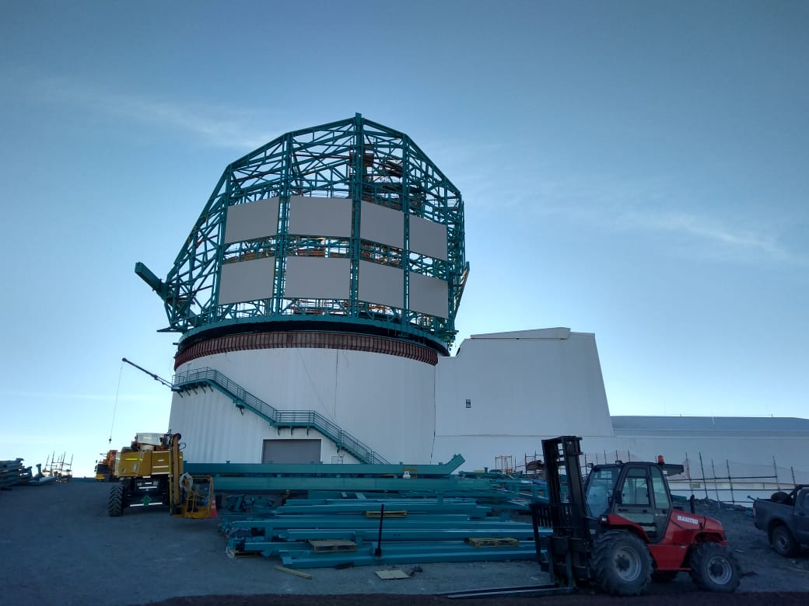
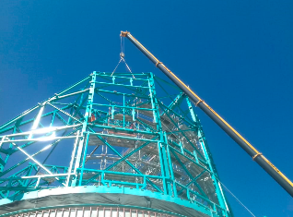
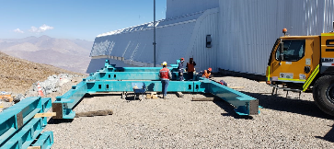
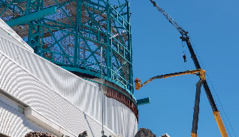
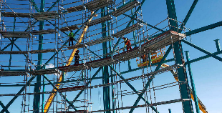
Dome
Recent Accomplishments:
  Progress done on site: major structural beams, Cladding material
  Fabrication of purlins and other materials provided by LSST in Chile.
  Additional onsite labor added to pre-assemble aperture shutter pieces
  Good progress on the software as well.
Current Status/Upcoming Milestones: getting ready for TMA by mid-September
  Integrate cladding to enclose the dome
  Provide provisional crane and means of rotation
Details available in break out presentation

Slide 14
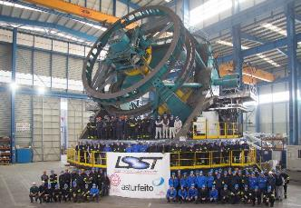
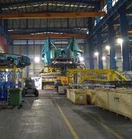
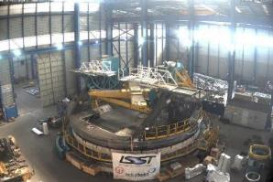
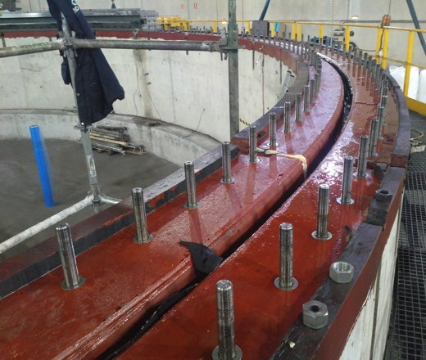
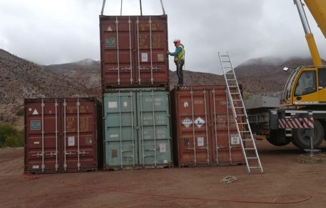
Telescope Mount Assembly (TMA)
Recent Accomplishments:
  Factory Acceptance tests happened in Fall 2018
  Subsystem disassembly and packaging done
    Initial shipments to Chile happened – containers are already on the summit
    Large loading July 29th 2019
  Software workshop in June 2019 to increase knowledge transfer. Also dedicate one developer to the TMA
Current Status/Upcoming Milestones:
  Arrival of the big shipment in September 2019
  Onsite Assembly Integration Test Plan review in Chile in September with flexibility and parallelism in mind.
Details available in break out presentation
Notes:
Update the picture of the loading of crates

Slide 15
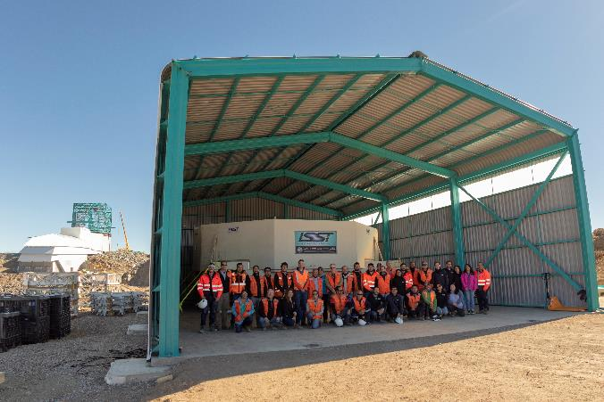
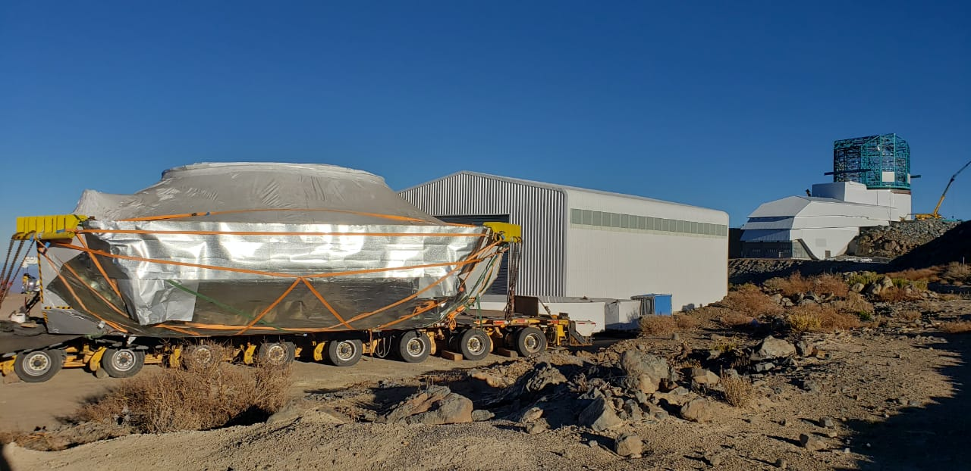
M1M3 System
Recent Accomplishments:
  M1M3 mirror + cell tested under the Tucson mirror lab test tower
  M1M3 safely in the warehouse on Cerro Pachon for the next ~1.5 years
  M1M3 Cell, surrogate and mirror cart on the summit
Current Status/Upcoming Milestones:
  Installation of actuators and functional testing
  Integration of the M1M3 software with the SAL on the summit
  Interface verification of the M1M3 cell with the coating chamber
Details available in break out presentation

Slide 16
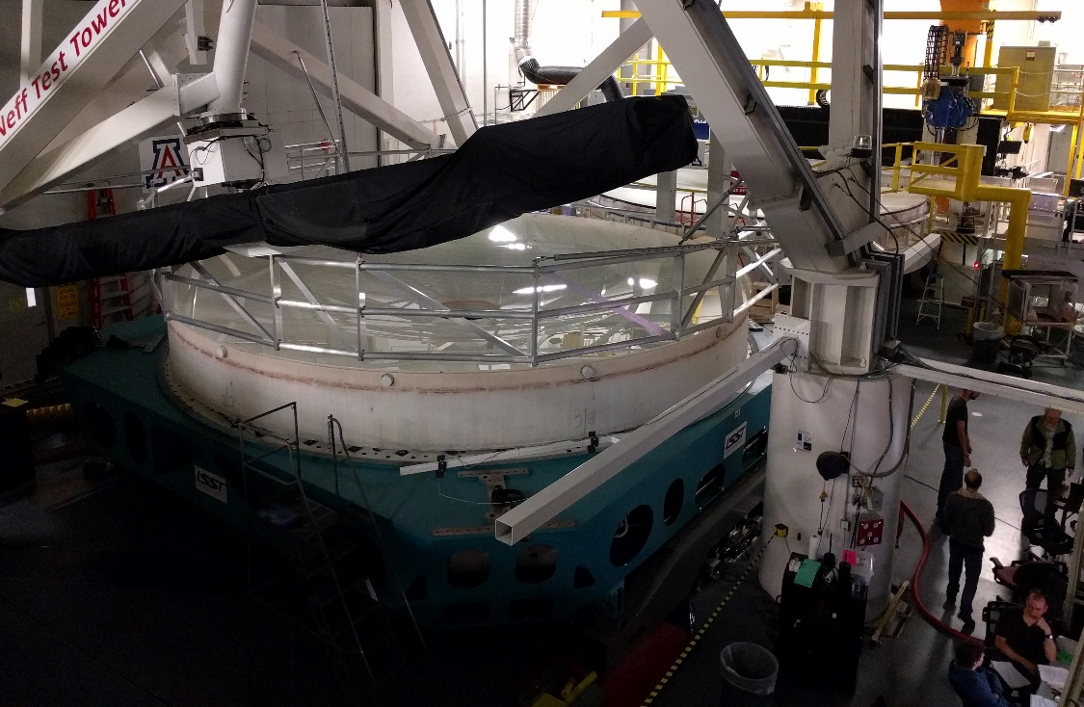
M1M3 System Mirror Lab Testing
2 test campaigns of 10 days each at the mirror lab in January and February
  mirror pointing at zenith
  Interferometric measurements of both surfaces with mirror system active
Optimization of the mirror surface to less than 30nm/30nm rms
Influence function measurements
Bending modes measurements
=> Refine the finite element model and the open loop model

Slide 17
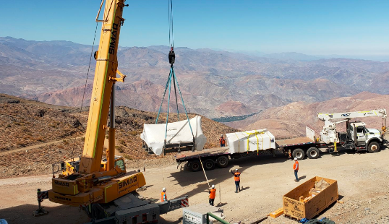
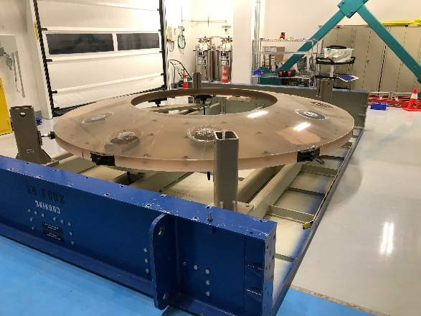
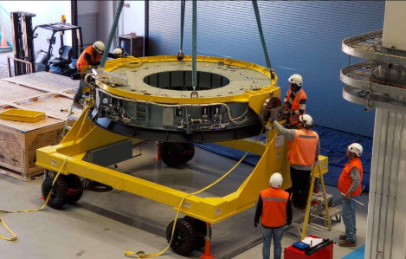
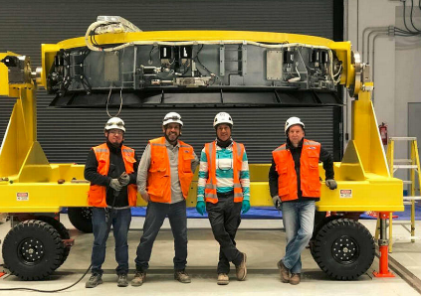
M2 Mirror Assembly
Recent Accomplishments:
  Integration on summit commenced with mating of surrogate mirror assembly and cart
  Basic active control system demonstrated
Current Status/Upcoming Milestones:
  Baffles Installation in spring 2020
  Integration with Middleware
  Extensive functional testing at different orientation using the cart

Slide 18
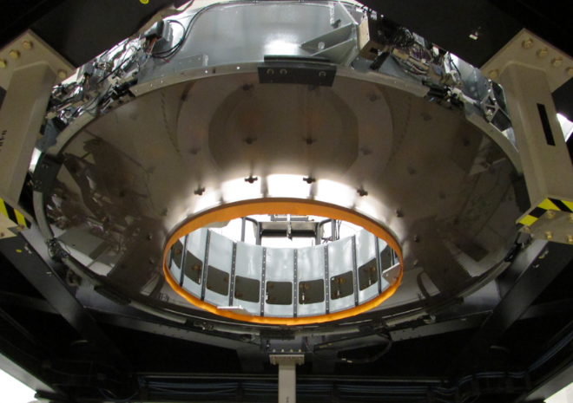
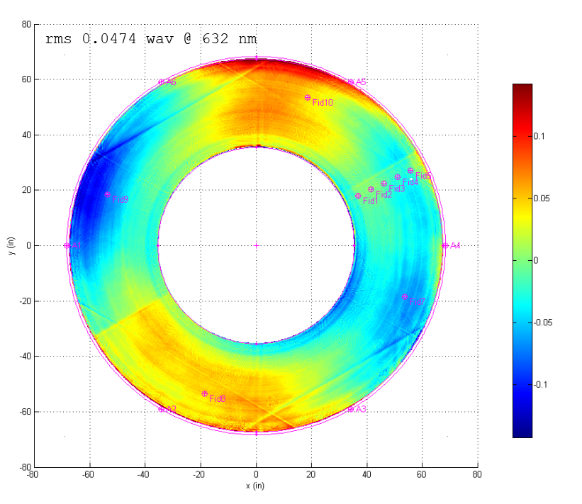
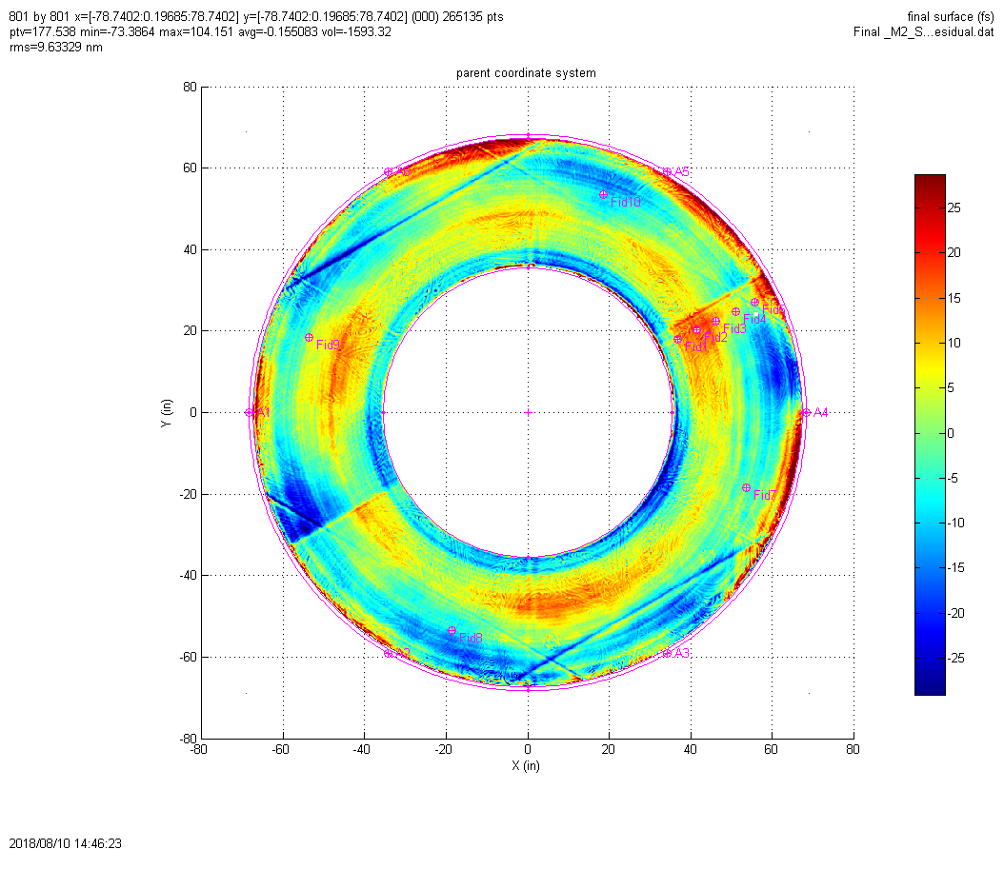
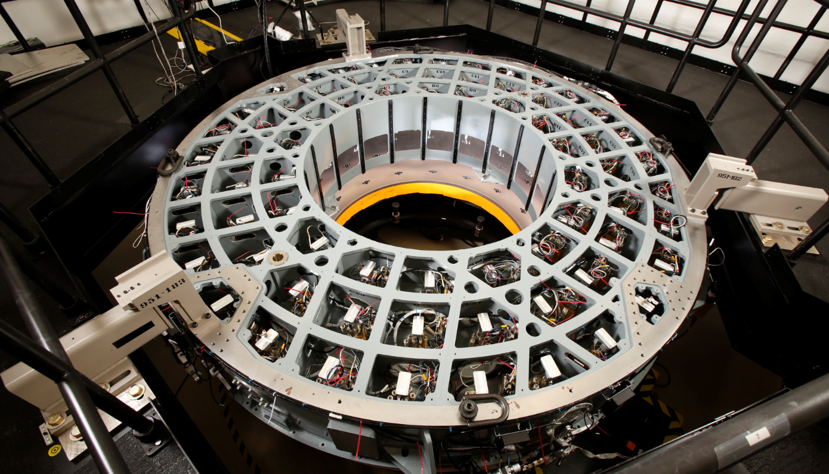
M2 Optical Testing
The final surface RMS is 9.6 nm (requirement is 20nm rms).
It was tested as mounted on the telescope
Details available in break out presentation
Notes:
Target is shown as direct subtraction of test set WSF uncertainty from spec line (conservative approach)

Slide 19
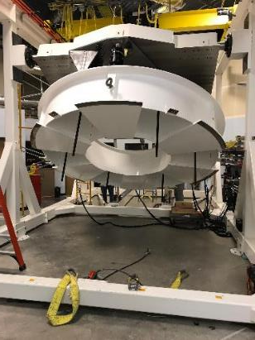
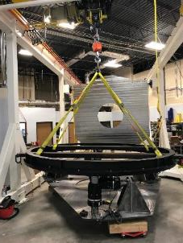
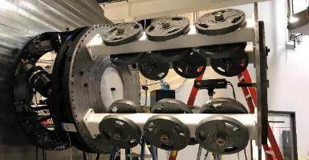
Hexapod and Rotator
Recent Accomplishments:
  Contract completed
  Final reports/documentation package delivered
  Both Hexapods now in Chile
Current Status/Upcoming Milestones:
  Spare rotator delivered to SLAC
  Functional testing in the fall
M2 Hexapod
Details available in break out presentation
Camera Hexapod/Rotator

Slide 20
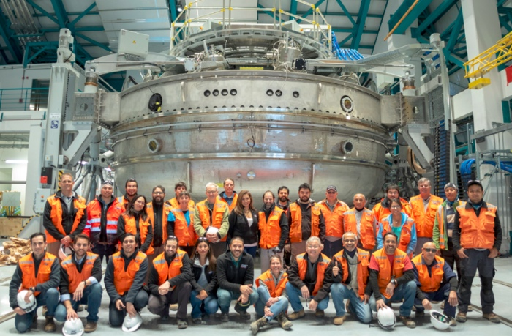
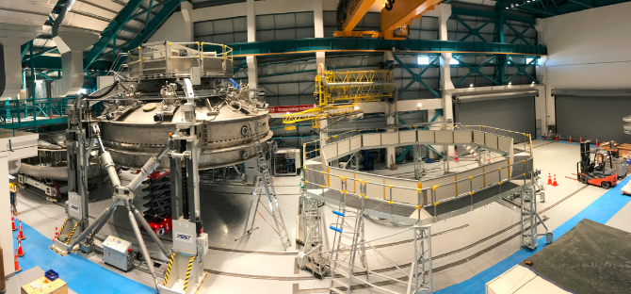
Coating Plant
Recent Accomplishments:
  Coating Plant accepted in May 2019
  Reflectivity as a function of wavelength meets spec, as well as pinhole requirements
  Coating of M2
Next Milestones:
  Mechanical fit check of the M1M3 cell with the coating chamber upper vessel
  Vacuum preparation check with the M1M3 cell
Details available in break out presentation

Slide 21
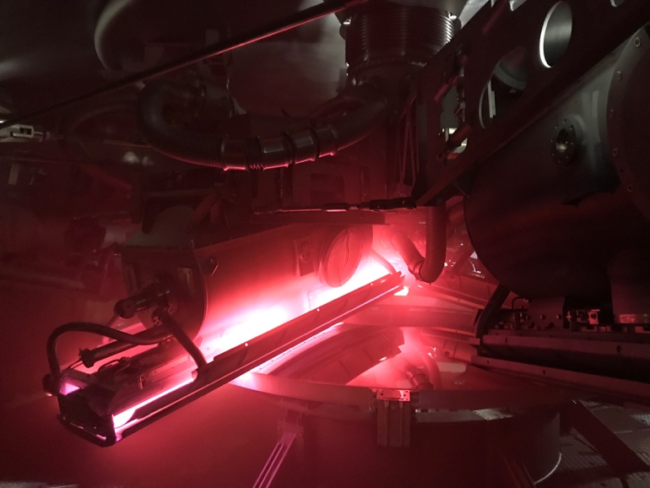
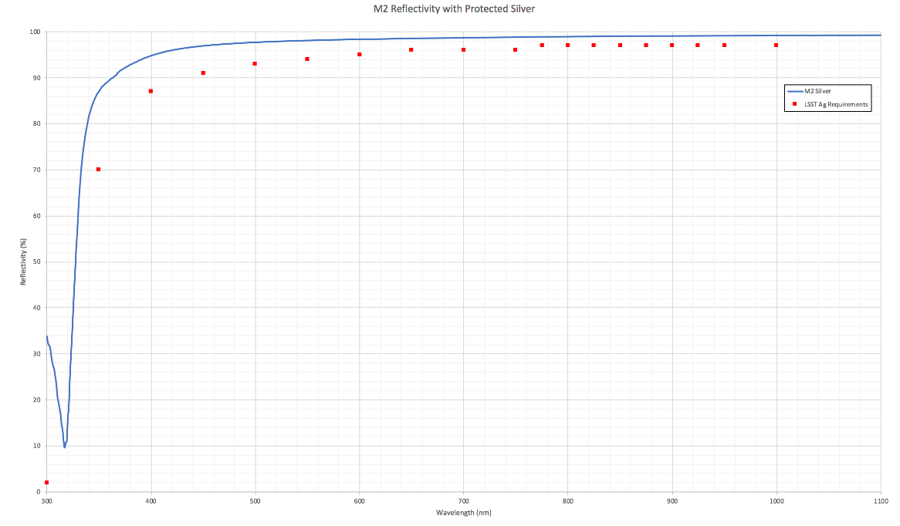
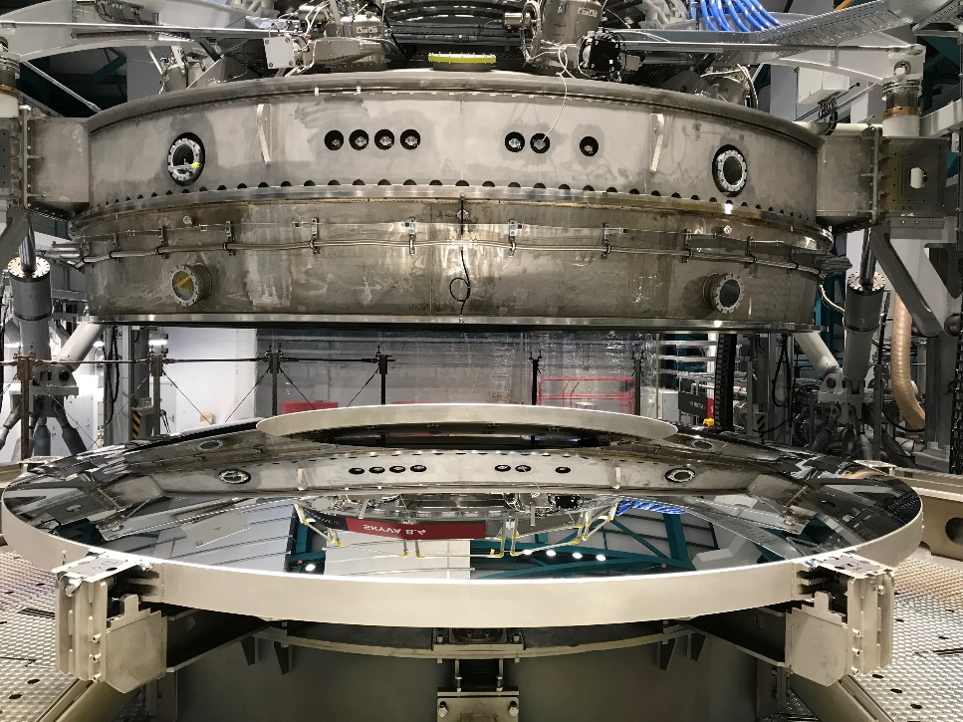
M2 Coating
Magnetron plasma arc
M2 Coating Readiness Review happened on June 18th 2019
M2 glass coating: on July 16th. Dust was controlled and measured before and during the coating
Mirror M2 is now back in its box and its coating performance checked and reported every 3 months (Reflectivity, Adhesion, esthetic)
-- M2 Protected Silver
LSST Ag Requirements
Reflectivity (%)
Wavelength (nm)

Slide 22
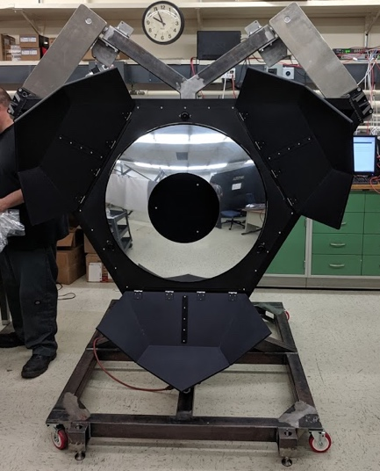
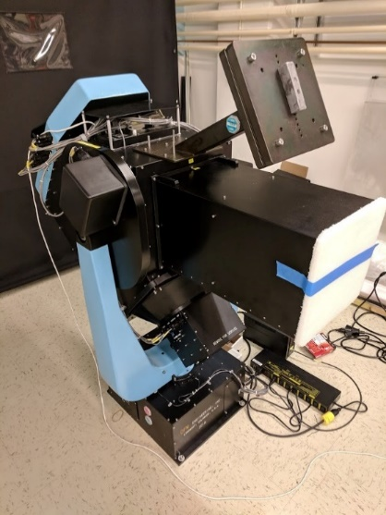
In Dome Calibration System
Recent Accomplishments
  Laser and Collimated Beam projector functional in the lab under full software control
  Ready to begin end-to-end illumination, alignment and characterization tests
Upcoming milestones:
  Verify Calibration Screen illumination system and exitance uniformity in the lab
  Illuminator reflector ready to be tested
  All illumination characterization hardware procured, software written and integrated
  Complete fabrication of Calibration screen
  Install calibration screen and Illumination system on telescope
Reflector
Collimated Beam Projector
White light laser 300-2400nm
Reflector on top of the TMA
Calibration screen on Dome
Details available in break out presentation
Light goes towards the mirrors

Slide 23
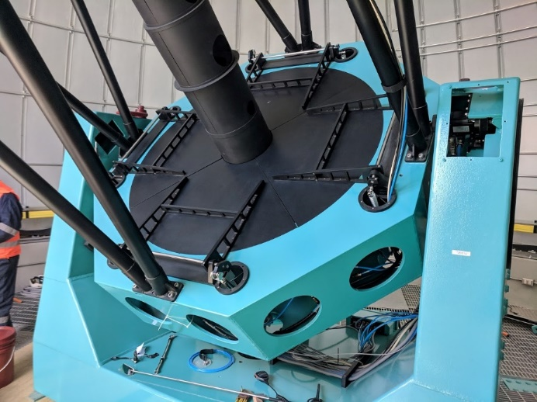
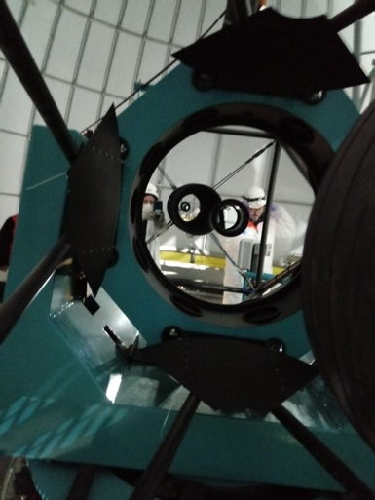
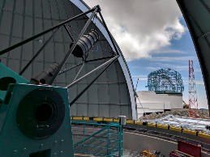
Auxiliary Telescope
Recent Accomplishment
  Engineering first light with a high speed camera
  Closed dome integration testing, using the real hardware and control network, to slew/track and build a pointing model completed
  Integration environment created in Tucson that includes full instrument and calibration equipment, plus Camera Control System, DAQ and Archiver
Future work
  Optimization of pointing model and image quality estimation
  Verify Auxiliary telescope requirements on-sky
  Ship, install and verify spectrograph + calibration equipment
Details available in break out presentation

Slide 24
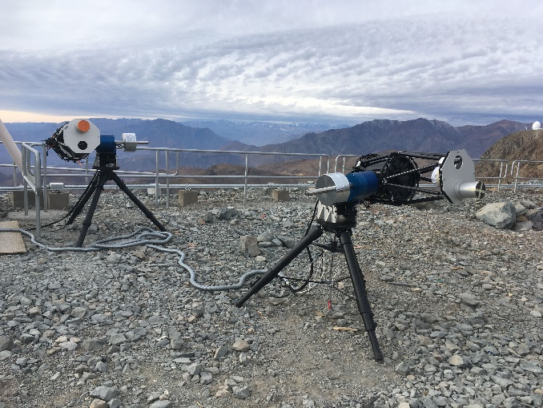
Environmental Awareness System (EAS)
Recent Accomplishments:
  HVAC system verified and accepted
  Generalized prototype sensor architecture designed, telemetry software complete and tested
  AuxTel prototype sensors ready to ship with AuxTel Spectrograph to begin Early Commissioning
  DIMM Tested on the summit
Current Status:
  Support TMA assembly in dome starting September 2019
  Install AuxTel sensors in October 2019 for start of Commissioning
  Install main dome sensors when TMA finished in 2020
  AuxTel dome sensors
      webcams
      air temperature, humidity
      vent airflow
      microphones, turbulence

Slide 25
T&S Software
Recent Accomplishments:
  Observatory Control System: Scriptqueue and watcher are almost complete
  Telescope Control: Successful control of some components through a local version of the System Abstraction Layer (SAL) -- AuxTel Dome and mount, M1M3 support system, M2 support system, Hexapods/Rotator
  Middleware: SAL/DDS version 3.10: Considerable improvements in stability, deployment, debugging tools
  Engineering Facility Database: Switched to InfluxDB and now has a working version on the summit and in the AuxTel lab
  Software architecture has been redesigned (LSE-150)
  Product Owners in charge of requirements and final product validation
  Better interaction with the Product Owners, CAMS and Stakeholders
Current Status/Upcoming Milestones:
  Use of the Auxiliary Telescope Component as an integration pathfinder still going on in Tucson
  More frequent face to face interaction between the LSST SW resources and both the Dome vendor and the TMA vendor to assess deliverable code and verification approaches
  More integration on the summit: Middleware, Environment Awareness System, AuxTel, Camera Support Assembly + ComCam Integration (see I&T session)
See C. Claver & S. Thomas’ plenary talk and T&S Software breakout presentation

Slide 26
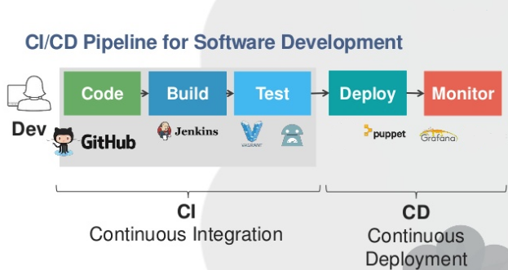
Deployment and Testing
Testing: On-going effort to integrate with Jenkins Continuous Integration:
  Integration of unit tests
  Part of build/release process
  Based on Gitflow Workflow
  Involvement of the Product Owner
Deployment:
  Deployment to be done by Puppet/Kubernetes
  Continuous Integration to be done by Jenkins
    Builds & automated testing
    Deployment & CI done in conjunction with IT, DM & Camera to ensure same technologies across project.
2018 Review recommendation
Notes:
Add the deployment document

Slide 27
Telescope Systems Engineering/Verification
Recent Accomplishments:
  All critical T&S subsystem requirements moved into requirements management tool MagicDraw help from the SE team
  System Engineering effort more integrated with the PSE team
Current Status/Upcoming Milestones:
  Phase 2 preparation underway for T&S Subsystems’
    M1M3 initial Integration & testing underway on Pachon
    TMA on site Integration & testing underway on Pachon
Subsystem | Date
Summit facilities | April 2019
M2 | October 2018
TMA | November 2018
Platform Lift | March 2019
Coating Plant | May 2019
M1M3 mirror system testing at the Mirror Lab | March 2019
2018 Review recommendation

Slide 28
Assembly Integration and Verification
Recent Accomplishments:
  Integration of components with facility: Platform lift, coating plant, Monitoring Equipment, EFD, middleware
  Coating of M2
  M1M3 cart testing with rails across the building
  AIV replan due to accommodate latest delays from the dome and the TMA
  Use of Jira for testing and requirement verification: process in place
Current Status/Upcoming Milestones:
  Continue procedures + Set-up of a Jira environment to track integration tests and requirement verifications
  Preparation Arrival TMA from Spain in September 2019: Utility installation
  Integration of M2 hexapod on the Top End Assembly
  Integration of the Camera Cable Wrap/ Cam hexapods and Surrogate mass for software testing in the fall
  Verifying all LSE-60 requirement traceability to the Telescope System incremental builds (AIV).

Slide 29
LSE-60 Requirement Verification Matrix
Requirements are mapped to applicable build in the verification matrix
Verification Tools coordinated with Systems Engineering: Using Jira for the full verification plan (more in Austin Roberts’ talk)
Req.
Now that the full suite of requirements are in a common tool (Magic Draw), we are ready to start the high T&S level requirement verification process.
First ones are related to building and software.
The latest date corresponds to the installation of IOTA on the telescope
We are in the process of working on dates for each steps
Time

Slide 30
Telescope Performance Verification
Image Quality (0.25”) – Document-29054
  Optical prescription of mirrors
  Mirror support system behavior
  M3 Optical testing at horizon
  3-Mirror system testing
  Dome Seeing
Pointing/Slew/Settle (0.2 arcsec) – Document- 34756
  Factory testing
  TMA Chile testing
  Optimization of pointing model
Throughput
  Sample testing
  M2 Mirror Coating measurements
  M1M3 Mirror Coating measurements
  Coating degradation
May 2021
May 2021
Start depend on dome completion
Partly, will be done during the Chile Testing
March 2020
June 2021
April 2021

Slide 31
Challenges Moving Forward:
Dome, TMA, Software, Integration & Tests

Slide 32

Dome and TMA Coordination
TMA on its way to Chile, with a baseline start of integration September 15th 2019 (forecast = Oct 1st)
Dome Prerequisites are being negotiated – technical solutions and timing tight so we’re looking at other option to start the progress on the TMA erection
  Enclosure: First layer put on
  Rotation with provisional friction drive system
  Dome crane: Temporary Crane
Software testing appears to be longer than anticipated. The solution would be to built a complete simulation
=> Also increase parallel activities
  Utilities integration: Oil Support System
  M2 Hexapod integration with the top end assembly
  integration of schedule of AIV activities with the commissioning activities

Slide 33
System Integration and Verification Activities
SIT-Com = System Integration and Test and Commissioning
Worked with Management in Chile and CAMs to understand the scope of work during the integration and test process
Created a new sequence of activities to realign the schedule
Activity planning at different level is now coordinated at the project level (not just at the T&S level)
Integration of T&S System Engineering with the System Engineering: Verification of T&S requirement are more imbedded into the overall Project
See C. Claver & S. Thomas’ plenary talk
Notes:
Reacting to the delay of the dome and the TMA to update the plan – LTS-104 is still valid for the integration pieces but the overall sequence still needs to be update

Slide 34

System Integration Sequence Summary
New June Baseline
Very dense schedule for the next 2 years
Opportunities
  Early commissioning activity
  Early software integration within T&S and also with the other subsystems
  Extensive M2 testing on the cart to allow for glass mirror installation
Risk:
  TMA and Dome Schedule
  Aggressive schedule
See C. Claver & S. Thomas’ plenary talk

Slide 35

T&S Software Challenges
Restructuration of the software management and leadership (LTS-928)
  New software manager since April 2019 (Andy Clements) and a new software architecture
  New hires mostly in Chile
  P6 now has the entire scope of work for the telescope more integrated with the AIV and commissioning scheduler
  => Jira planning in 3 to 6 month increments with project end-goals in mind
See T&S Software breakout presentation

Slide 36
Cost and Schedule

Slide 37

T&S Cost Summary WBS Lvl 3 (May 2019):
87% Complete, 0.98 SPI, 0.96 CPI
3 more completed WBS relative to last year
4.10+4.11 closed and opened 4.15 due to Software Replan (67% done)
AIV late due to late arrival of TMA and delays on the dome

Slide 38

T&S SPA Earned Value

Slide 39

T&S Schedule and Cost Variance

Slide 40

T&S Contingency Allocations
LCR-1342 M1M3 Schedule Update
Coating Plant, dome, All risk cargo insurance
LCR-946 M1M3 Extension
LCR-1623 and LCR1725: AIV+Commissioning replan
LCR-1608: Summit Facility overspend
Dome Amandments
LCR-361 Dome Contract Award
LCR-1016 Base Facility

Slide 41
Risk and Opportunity and Scope Options

Slide 42

Risks
Notes:
Snapshot of risk and opportunity dashboard and go through the top 10 items risks
Present mitigation

Slide 43
Risks
Dome integration delays
  Expedite contract efforts with vendor
  Provide incentive for early completion and work with contractor
  Provide and supervise summit crane and labor resources
TMA integration delays
  Investigate early completion incentives and early integration efforts
  Effective contract management of interfaces schedules
Weather impact on the schedule
  Always a risk
AIV activities under-scoped
  Replan activities

Slide 44
Descope and Opportunities
10 descopes with a total of $1100K. The main ones are
  OCS gui
  M3 optical testing
  Operation for summit only
  Reduce summit lodging
Very few opportunities
  M2 Hexapod integration with the TMA top end assembly early
  Software integration and test of the Camera Cable Wrap, the Camera Hexapod/Rotator on the camera cart before integration on the TMA
However, all these activities have started and are well along.

Slide 45
Summary

Slide 46

Summary
Telescope and Site is well underway with most of the material and work now in Chile.
The dome and TMA schedules remain a challenge but remediations are being worked out
Verification of components also either completed or underway
Focus of next year will be on integration and test
Credit: Kevin Reil

Slide 48
Telescope & Site Accomplishments/Highlights July 2019
Summit facility systems functional to support operations (HVAC, glycol, WiFi)
  Camera maintenance areas fully provided and commissioned; now in regular use Camera team
  Pflow vertical lift final acceptance testing completed at full load with movable roof
  First two summit hotel addition rooms completed;
Base facility data center transferred to LSST and offices ready for occupancy in late-Aug 2019
Coating Plant assembly of vacuum systems, vessels, and wash/dry boom and support scaffolding accepted
  Successful final acceptance test review May 20-24, 2019
  M2 glass coated
Secondary Mirror Assembly integration commenced with surrogate mirror assembly and mirror cart
  Active support of aluminum surrogate verified
  More intensive tests planned at beginning of 2020 to enable direct installation of glass on the TMA
M1M3 Cell Assembly + surrogate on the summit being assembled right now
  integrated optical testing at University of Arizona Richard F. Caris Mirror Lab (RFCM)
  Closed-loop active mirror support performed well/reliably; Real time telemetry collected in Engineering Facility Database (EFD)
  Mirror surfaces measured <30nm rms (meets requirements)
M1M3 Mirror arrived on the summit and safety in summit warehouse for storage
M2 and Camera Hexapod/Rotator systems also on the summit ready to be tested this winter
TMA disassembly and packaging done; Shipping July 29th 2019
  Telemetry issues with National Instruments (NI) hardware identified during factory testing campaign resolved in simulation; remains to be verified on site, but risk substantially reduced

Slide 49
Telescope & Site Issues/Risks Aug 2019
LSST continues to aggressively provide contract oversight of the Dome system effort:
  Trips to vendor (EIE) for executive management planning meetings and visits to suppliers to prioritize shipment schedule
  Several contract amendments to improve vendor cash flow issues and enable more LSST control
    LSST assumed Chilean contracts for summit cranes and summit labor team (including surveying)
    LSST added two 40-meter man lifts (in lieu of exterior scaffolding) to provide more flexible/more efficient access to structure
    LSST direct contract with Phase Motion Control sub-supplier to expedite azimuth drive system delivery to Chile
    Impact due to 2018 weather delays negotiated - snow/wind reduced integration efficiency
    Impact due to increase in steel structure due to application of more stringent Chilean seismic standards negotiated
    Impact due to modifications to louver designs due to ICDs to summit facility negotiated
    Impact due to increased stairs/walkways to provide safe access to bridge crane, windscreen, and aperture shutters negotiated
  LSST added temporary mechanical steel support engineer and logistics support to increase summit capability
  Provisional dome crane and means to rotate dome in support of TMA installation are being implemented
  Cladding materials on summit; priority to enclose dome to support parallel TMA integration starting in the fall 2019
T&S Software team working to improve productivity with targeted vendor consultant support
Reduction of T&S team in AZ more rapid than planned due to retirements and departures
Dome and TMA schedule delays require an extra 2.5 months of project contingency LCR-1623 Update Telescope and Site Summit Schedules & LCR-1725 Early ComCam Integration and Test

Slide 50

T&S deliverables defined in WBS elements with large systems procured from established vendor pool
Fixed price vendor contracts include final acceptance at factory (M2, Hexapod & Rotator) and onsite (Telescope Mount, Coatings)
In-house efforts for M1M3, software, Assembly Integration & Verification (AIV)

Slide 51
Image Quality Requirements
Requirement | Value | Status
The telescope shall deliver this image quality contribution | 0.25 arcsec FWHM | To do with IOTA – June 2021
The system image quality is allowed to degrade as a function of Zenith Distance (angle) as sec(ZD)0.6 |  | To do with IOTA – June 2021
  Mirror support system verification
  M3 optical testing in Chile
  First optical alignment using the laser tracker system
  Refined optical alignment using the Initial Optical Testing Assembly (IOTA)
  Image quality measurement on axis using the IOTA system

Slide 52
Pointing/Tracking Requirements
Requirement | Value | Status
Absolute pointing: The telescope should achieve the Abs_Pointing accuracy requirement for all elevation angles (measured on sky). | 2 arcsec rms | Done: Factory testing of the Telescope Mount Assembly for the relative pointing accuracy to better than 50 arcsec. To do: Mount relative pointing accuracy measurements on site
Tracking: The telescope shall have a tracking accuracy of Tel_Track_Error in open loop over a 10min interval within the tracking range | 1 arcsec fwhm | Done: Factory testing of the TMA
Rotator requirements: The rotator shall have at maximum this absolute angle error | 0.01 degree | To do:
Offset Pointing: The RMS error for offset pointing within the FOV. | 0.2 arcsec | To do: Command a move of 0.2 arcsec and measure the move on the detector (CMOS)

Slide 53
Throughput Requirements
Requirement | Value | Status
The implied mean fractional Telescope throughput in the u band is: | 44.2 % | Done: Measurement of sample coating for both protected silver and protected aluminum To do:
The implied mean fractional Telescope throughput in the g band is: | 68.0 % | Done: Measurement of sample coating for both protected silver and protected aluminum To do:
The implied mean fractional Telescope throughput in the r band is: | 69.1% | Done: Measurement of sample coating for both protected silver and protected aluminum To do:
The implied mean fractional Telescope throughput in the i band is: | 65.5% | Done: Measurement of sample coating for both protected silver and protected aluminum To do:
The implied mean fractional Telescope throughput in the z band is: | 72.2% | Done: Measurement of sample coating for both protected silver and protected aluminum To do:
The implied mean fractional Telescope throughput in the y band is: | 64.8% | Done: Measurement of sample coating for both protected silver and protected aluminum To do:
loss in reflectivity | 2% | To do:

Slide 54

Throughput results for mirrors
Sample Coating
M2 Coating Results
M2 Reflectivity with Protected Silver
-- M2 Protected Silver
LSST Ag Requirement
Reflectivity (%)

Slide 55
Scheduler Status
LSST Scheduler uses a modified Markov Decision Process
Properly dithered final footprint
Observations at reasonable hour angles
Red filters in bright time
No pointing at moon, no pointing at zenith
Open shutter fractions 71-80% (max would be ~84% with no filter changes)
Finally seems like reasonable behavior, nothing obviously wrong in pointing choices

Slide 56
Scheduler Status
Just released 87 new simulations including
Improved baseline
New survey footprints
Rolling Cadences
Variable exposure times
Deep Drilling Field variations
Description of new runs and links to data on Community
https://community.lsst.org/t/july-2019-update/3760
Or
http://ls.st/xsb
Alternate footprint from DESC
1-year of rolling cadence

Slide 57

T&S Cost Summary WBS Lvl 4 (1)

Slide 58

T&S Cost Summary WBS Lvl 4 (2)

Slide 59

T&S Cost Summary WBS Lvl 4 (3)

Slide 60

Detailed Contingency Draws

