Slide 1
Telescope mount assembly status Shawn Callahan LSST Technical manager. NSF/DOE Joint Status Review August 7, 2019

Slide 2
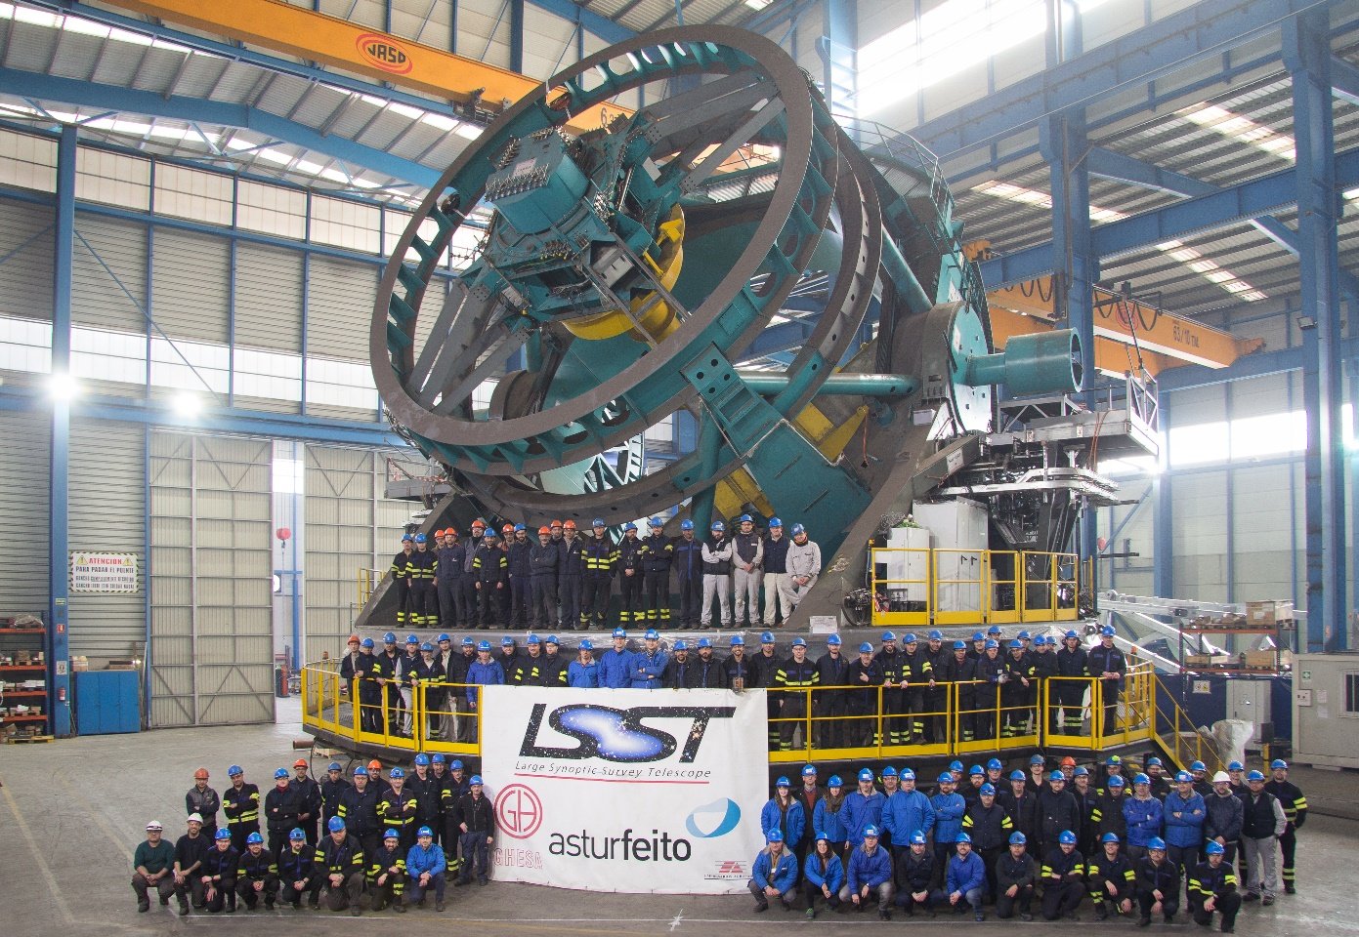
Telescope mount assembly 1/19/2019

Slide 3
Scope of the WBS
1.04C.05 Telescope mount assembly (TMA)
This element defines the Telescope Mount construction and installation effort. The telescope mount is the structure that supports the mirrors and camera at their proper conjugate positions with stiff structure and active positioning where necessary. It also positions the optical system for pointing at any part of the visible sky and tracks these positions due to their apparent motion from earth. The telescope mount also includes auxiliary systems to protect the sensitive components of the systems and to meet the demanding, stability, pointing, and tracking survey cadence requirements. This effort also includes the Camera and M2 hexapod positioning systems, Camera rotator, mount damping system, the primary/tertiary mirror cover, the stray light baffles, and the dummy masses for testing. (M2 Dummy Cell, Camera Dummy)This element defines the Telescope Mount construction and installation effort. The telescope mount is the structure that supports the mirrors and camera at their proper conjugate positions with stiff structure and active positioning where necessary. It also positions the optical system for pointing at any part of the visible sky and tracks these positions due to their apparent motion from earth. The telescope mount also includes auxiliary systems to protect the sensitive components of the systems and to meet the demanding, stability, pointing, and tracking survey cadence requirements. This effort also includes the Camera and M2 hexapod positioning systems, Camera rotator, mount damping system, the primary/tertiary mirror cover, the stray light baffles, and the dummy masses for testing. (M2 Dummy Cell, Camera Dummy)
1.04C.12 Special Utilities
This WBS element contains the scope to design, manufacture, and install the following utility systems: Dynalene, Compressed Air, Condensate Drains, Fixed temperature EGW, Oil supply system, Power (TMA, OSS, Camera compressors), Low temperature EGW, Power (staging and test area), Fiber (staging and test area), and camera compressor cabinet utilities (power, fixed temp EGW, low temp EGW, refrigeration line connections).
Message box example for short highlighted messages.

Slide 4
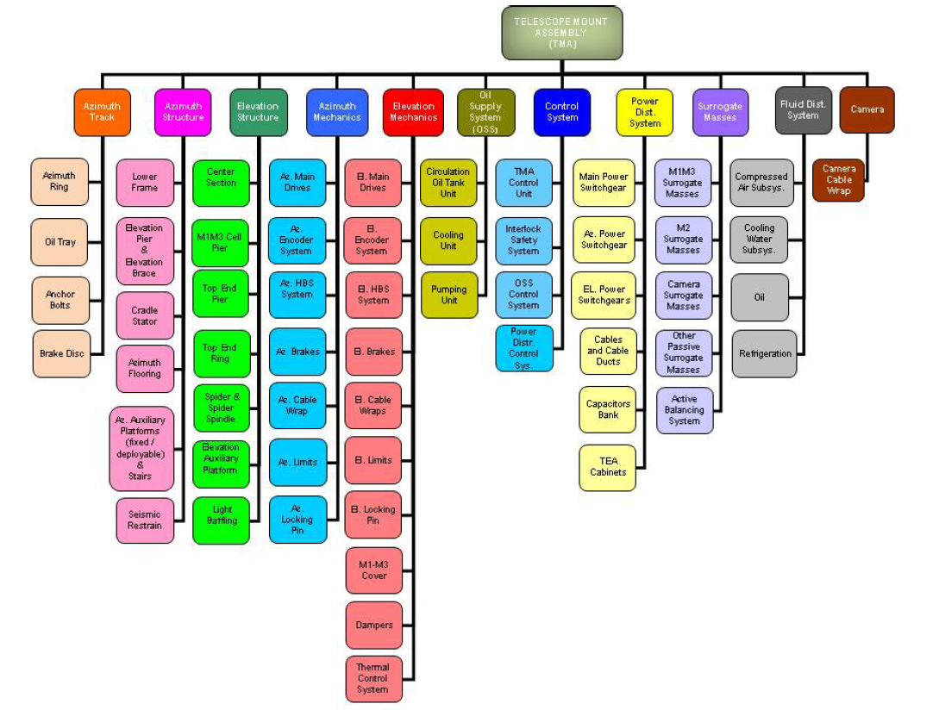
Scope of the WBS
TMA vendor breakdown by subsystems
Message box example for short highlighted messages.

Slide 5
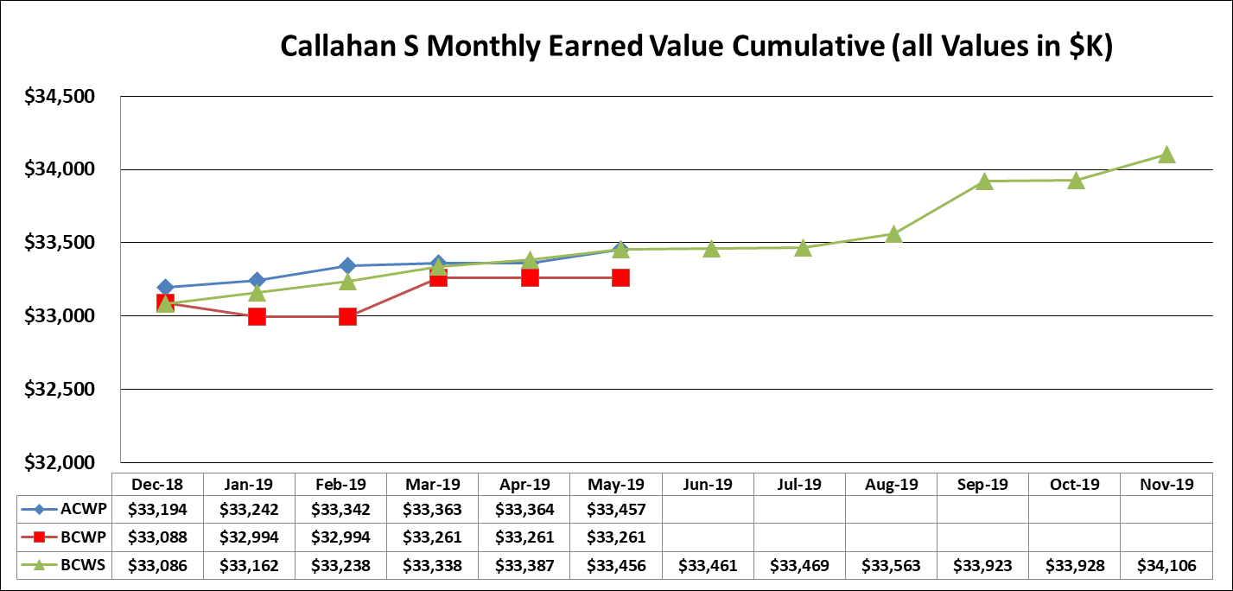
Telescope mount assembly SPA Chart
Six remaining TMA payment milestones
Final assembly of azimuth track is projected to be 30-Nov-19.

Slide 6
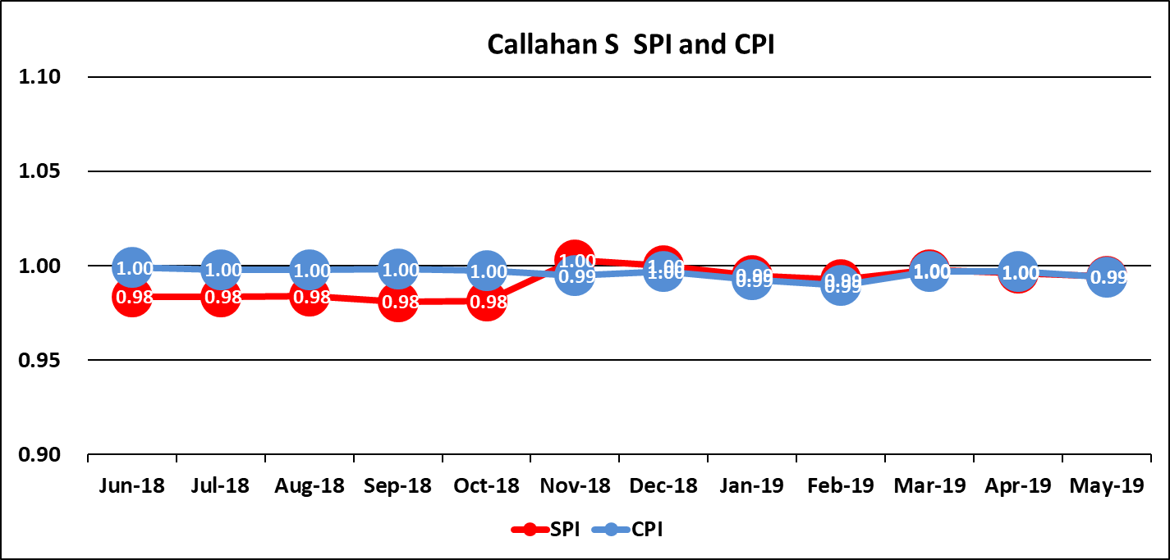
TMA CPI-SPI Chart
Factory acceptance was completed November 1, 2018
LCR 1052 updated the plan based on vendor schedule on 8/04/2017.

Slide 7
TMA and special utilities Cost Summary WBS Lvl 4
Note: the EAC for special utilities has been increased to include all required work to complete the facility utilities required by the TMA.
LCR Number: 1853
Summary Description:
The purpose of this LCR is to estimate the cost to complete all special utilities required by the TMA for KLM41219A.PROC. The planning package for these activities currently has an EAC of $189,428. The estimated cost for all of these activities is $1,312,483. This cost is based on using a combination of subcontractors ($1,182,983)and in-house staff (129,500) and includes all necessary design, procurement, installation, testing, and documentation.

Slide 8
Accomplishment to Date
At the time writing this presentation the telescope has shipped or prepared 18 shipping containers to be delivered to the port for shipment to Chile.
Between July 20-30 fourteen large pieces of the telescope will be loaded at the port of Avilés on a BBC ship.
All telescope mount should be transported to the summit by October 1, 2019.

Slide 9
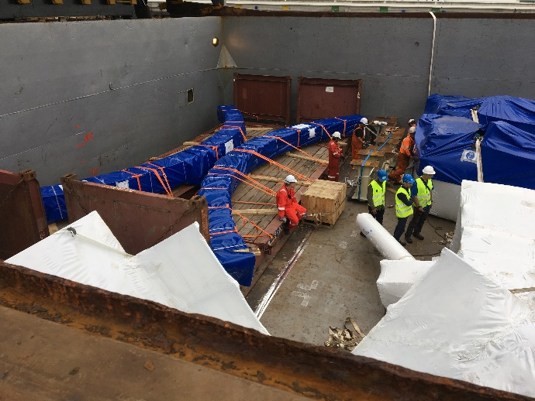
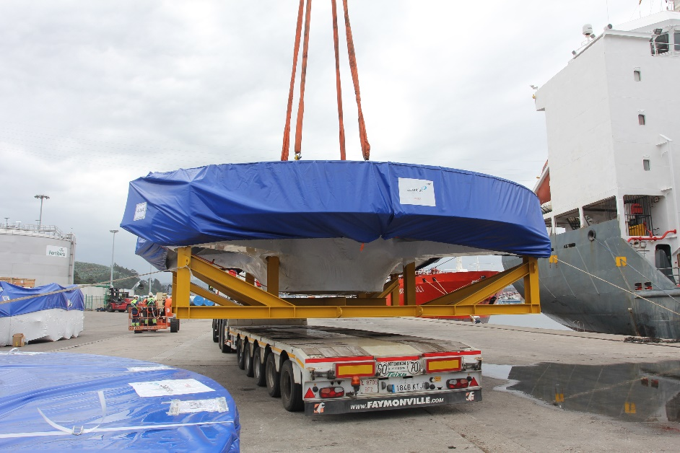
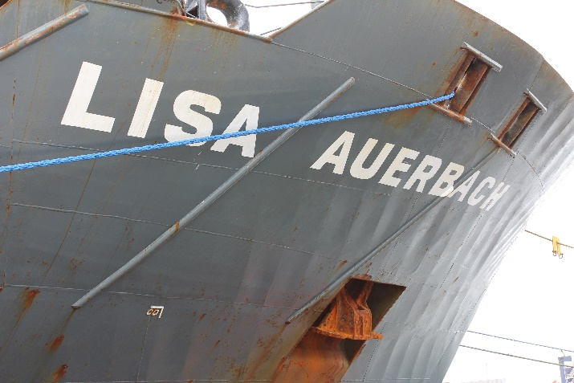
8/7/2019 TMA in transit to Chile
Currently at the port of Vigo, Spain.
Estimated arrival Coquimbo, Chile: Sep 05/06

Slide 10
Accomplishment to Date
The factory acceptance testing of the TMA was completed Nov 1, 2018.
The testing identified a limitation of the motion controller hardware and software provided by National Instruments. A hardware solution was developed and tested at Tekniker on simulated hardware. The solution and test results were reviewed in June.
Software reviews workshop June 3-7 to review integration of the telescope to the TCS and begin training of LSST staff in the deployment.

Slide 11
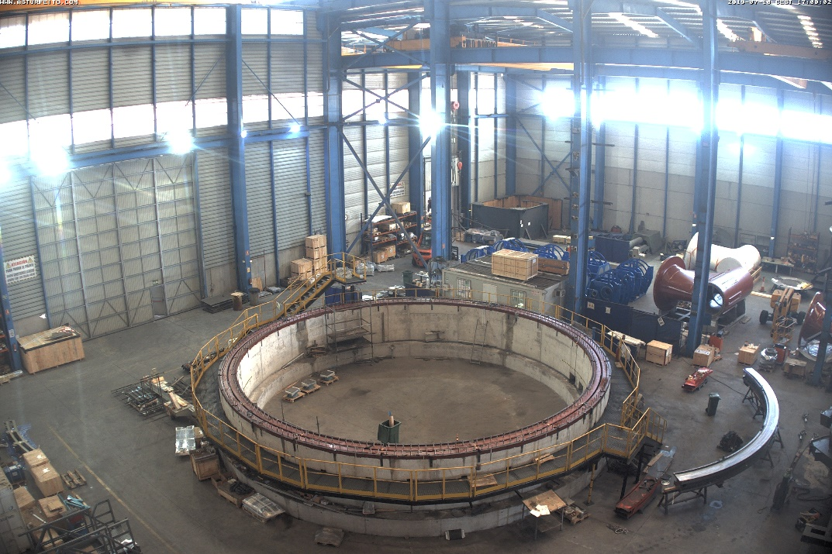
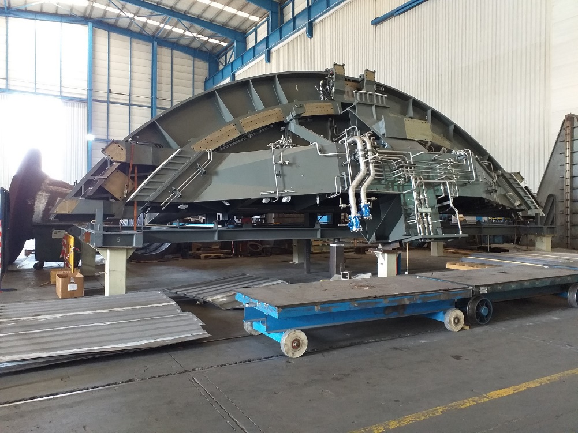
Images at Asturfeito July 11, 2019
Elevation support being prepared for shipment
Disassembled pier
Note azimuth sector on right

Slide 12
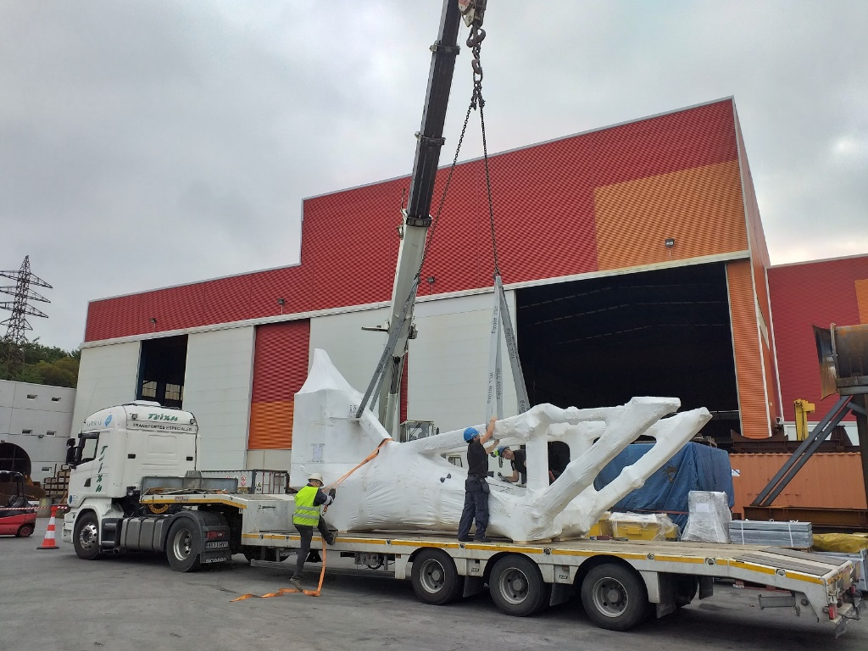
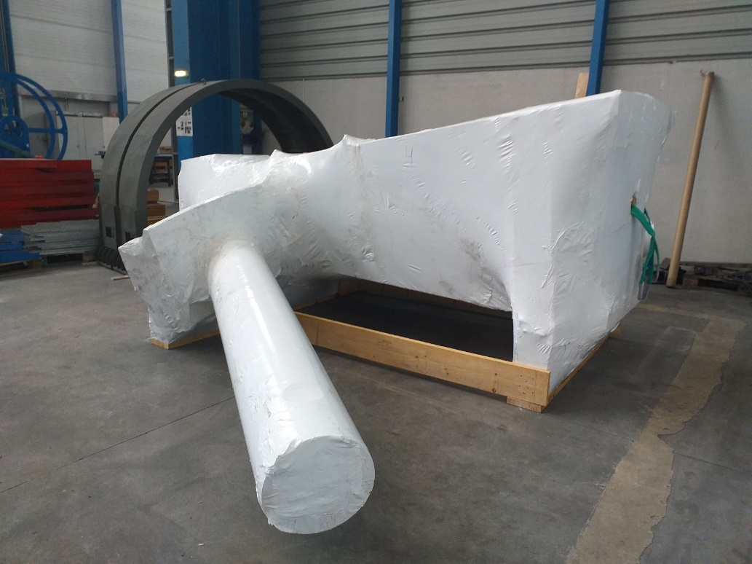
Images at Asturfeito July 11, 2019
Upper pylon marine wrapped
Camera lifting fixture being readied for transfer to port.

Slide 13
Future Work
Early integration activities will include installation of the oil supply system, installation of services and utilities (fluids and power), and preparing the pier for the azimuth track assemblies.
The integration of the telescope mount into the dome will begin ~October 1st, 2019.
Sept meeting to look for opportunity to streamline testing and verification
Sending Andrew Heyer to Spain for software training in Sep.
A software simulator proposal is being prepared by Tekniker/UTE to allow software testing during lthe telescope assembly and integration. This should substantially reduce the amount of time needed to test software control once the telescope is assembled.

Slide 14
RISKS
Since the TMA is a fixed price contract the main concern is schedule risk.
The facility and dome need to be substantially complete. This includes: dome enclosed, dome shutters operational, dome rotation operational, provisional dome crane operational, Rails in place to allow M1M3 surrogate cart to be transitioned from level 3 (maintenance floor) to level 8 (telescope maintenance platform).
The services and utilities (power and fluids) must be ready when needed.

Slide 15
Opportunities
We are planning a workshop in the fall to look for means to help and streamline the TMA vendor with testing and verification to recover schedule.
We are planning on early integration of the topple blocks, azimuth cable wrap, and oil supply system in September.
We are planning on moving the top end of the telescope onto the maintenance floor (level 3) early to allow installation of the M2 hexapod and M2 surrogate and to begin electrical connections while the TMA is being assembled.

Slide 16
Descope options
There are limited descope options for the mount other than to reduce schedule by streamlining testing.

Slide 17
Safety
Hazard registry is up to date
Mitigations in facility design (railings, scaffolds) is reviewed and in procurement. Scheduled to be in place before vendors arrives.
Mitigations are designed into the integration.
Dedicated safety profession leading the vendor hazard analysis process.
A Chilean safety professional will be provided by the TMA vendor during integration.

Slide 19
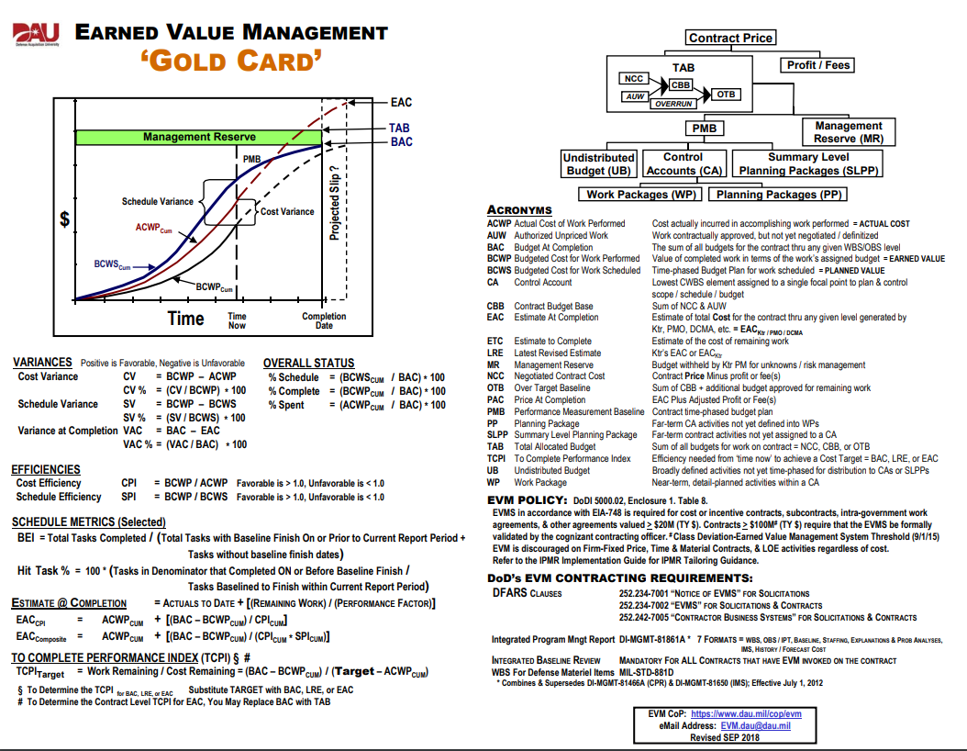
EVM terms

