Slide 1
WBS 4.9 Coating Plant
Tomislav Vucina
LSST Senior Coating System Engineer
NSF/DOE Joint Status Review
August 05, 2019

Slide 2
WBS 04C.09 Coating Plant Scope
The LSST Coating Plant elements consist of a Coating Chamber for high reflective optical coatings deposition and the Cleaning and Stripping Station for the M1M3 and M2 mirrors.
The Reflective Coating system includes the coating facility and associated cleaning facility necessary to apply the reflective coating onto the primary, secondary, and tertiary mirror surfaces. This facility includes the equipment necessary to strip a coating, clean the mirror, and apply the coating in a vacuum based coating system. This element does not provide the fixed facility assets necessary for effluent capture, facility barriers for cleanliness or the mirror transport system to convey the mirrors into the process stations.
The Coating Chamber system includes the vacuum chamber and all the ancillary equipment necessary for a turnkey coating system for depositing the specified coating on the three reflective mirror surfaces. This includes the contracted efforts for constructing the coating facility, testing, shipping, and installation on site.
The Mirror Cleaning system includes the facility to allow the removal of previously deposited reflective coatings and the cleaning of the three mirror surfaces to prepare them for the coating process. This system includes the physical hardware and the support equipment to achieve these procedures safely. Personnel access equipment, as necessary, is included in this element.
Message box example for short highlighted messages.

Slide 3

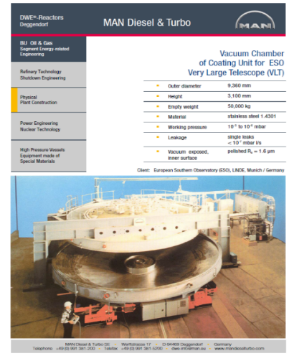
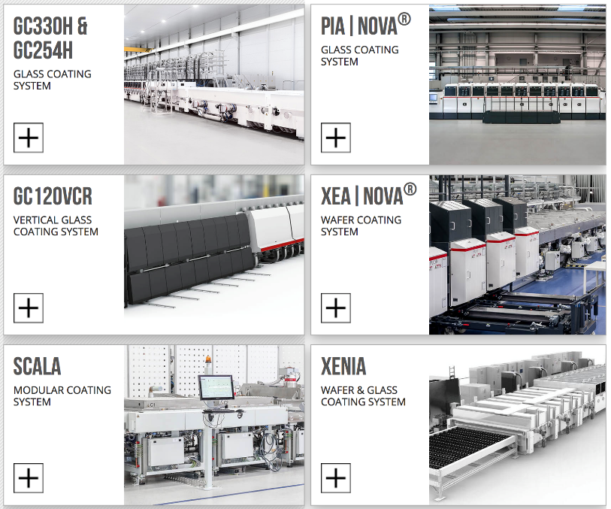
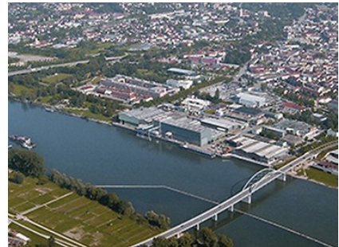
WBS 04C.09 Coating Plant Scope
Von Ardenne GmbH in Dresden, Germany was awarded the contract to fabricate the LSST coating plant.
MAN Diesel and Turbo had been previously used by Very Large Telescope (VLT) for fabrication
MAN Diesel and Turbo is Located near the Danube river
Message box example for short highlighted messages.
Message box example for short highlighted messages.

Slide 4
Accomplishment to Date
The Coating Chamber was shipped from Germany to Chile on Sept 2018.
It arrives to the summit on Nov 2018.
The assembly started on Jan 2019 and finished on May 2019.
Excellent LSST/VA logistic on site was achieved.
By May 2019 the Coating Plant was 100% commissioned, including all LSST coating requirements.
M2 mirror was successfully coated with protected Silver, exceeding the LSST reflectivity requirements.

Slide 5
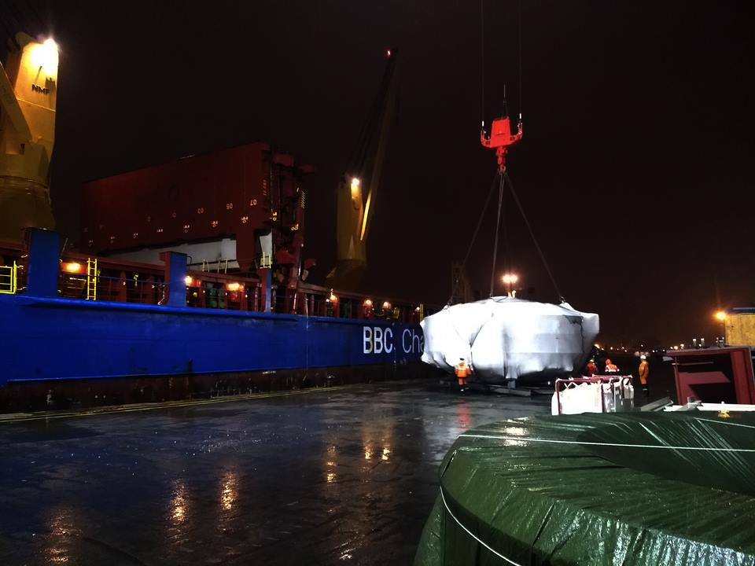
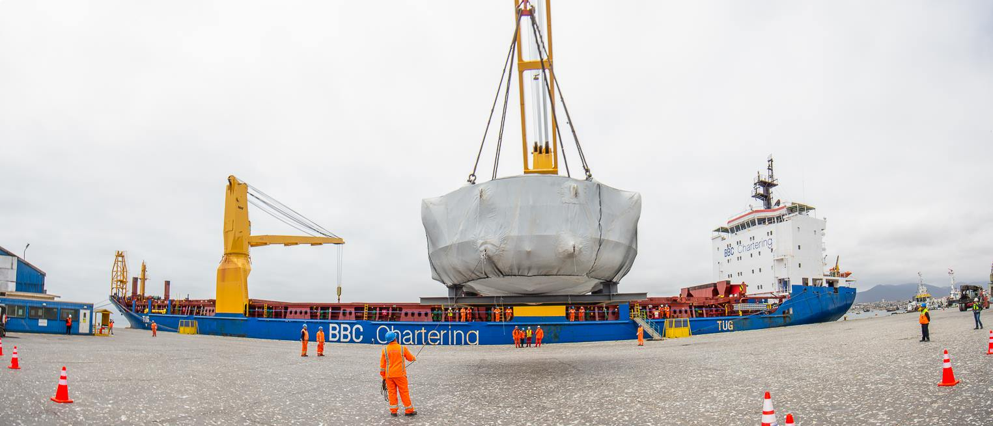
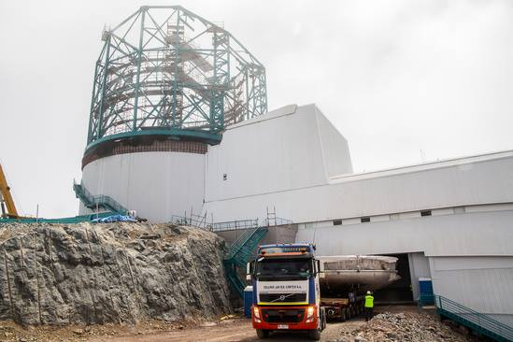
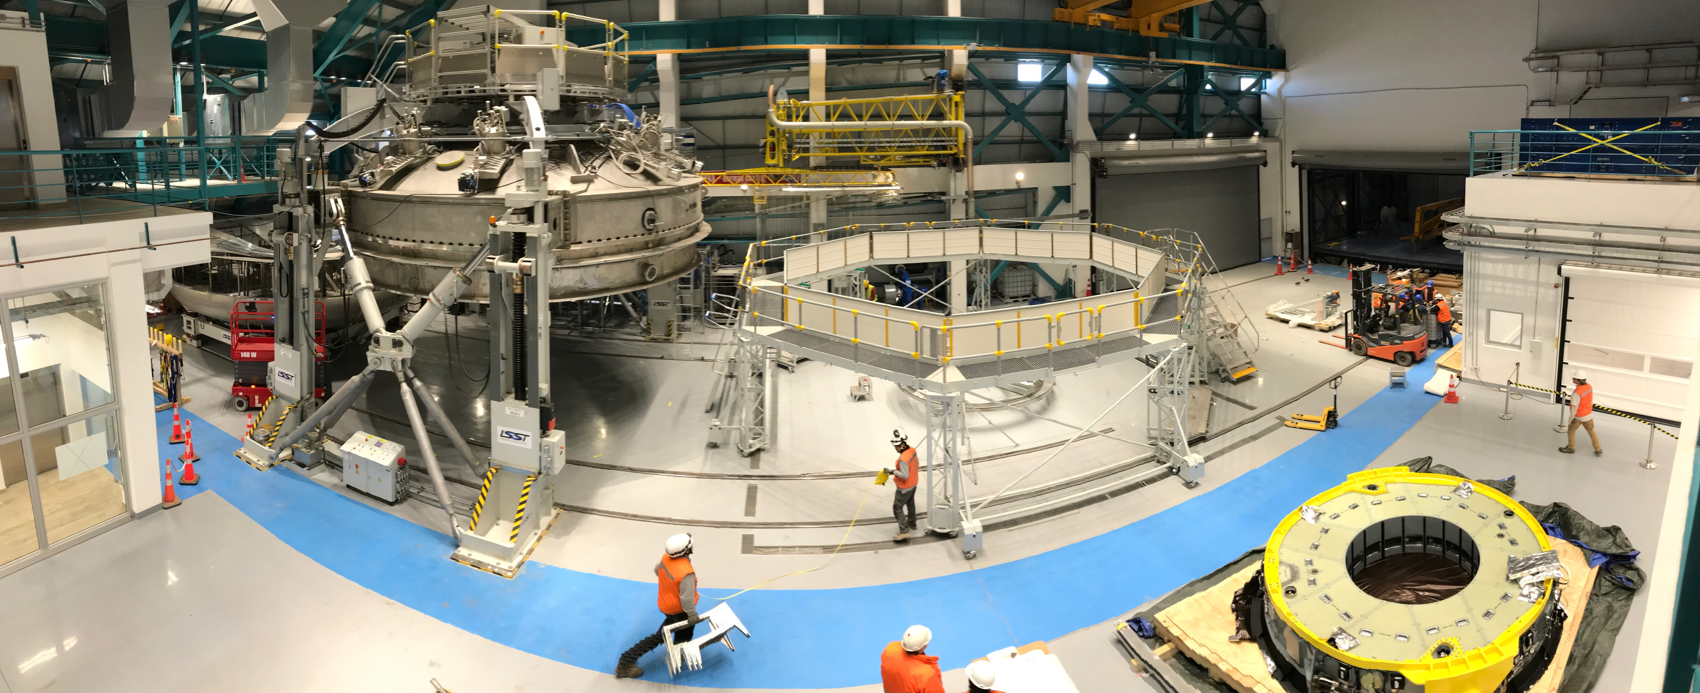
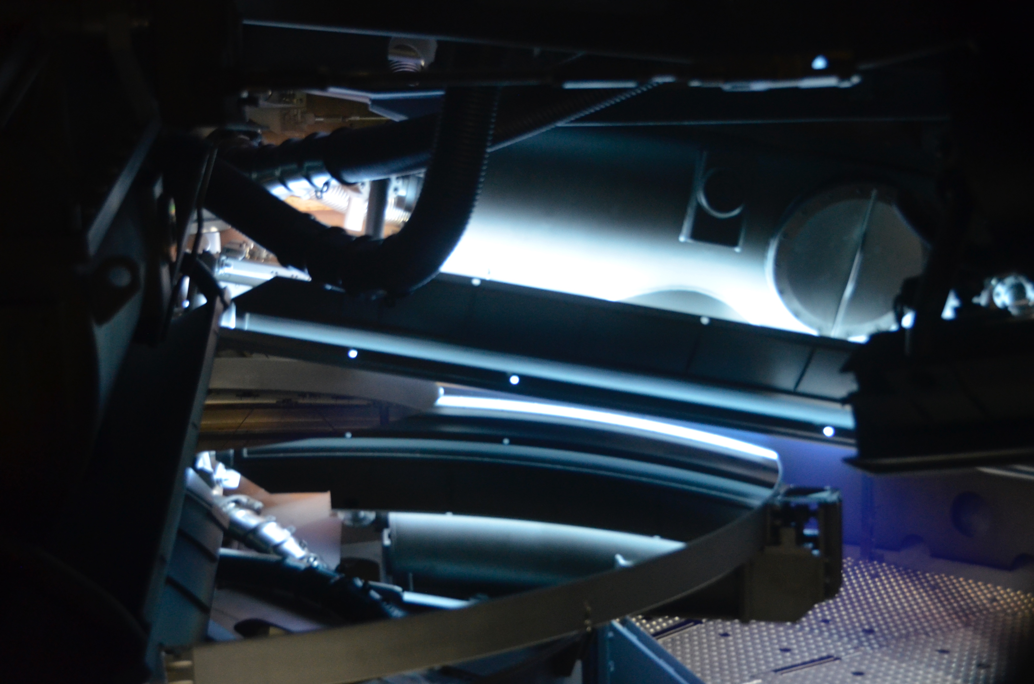
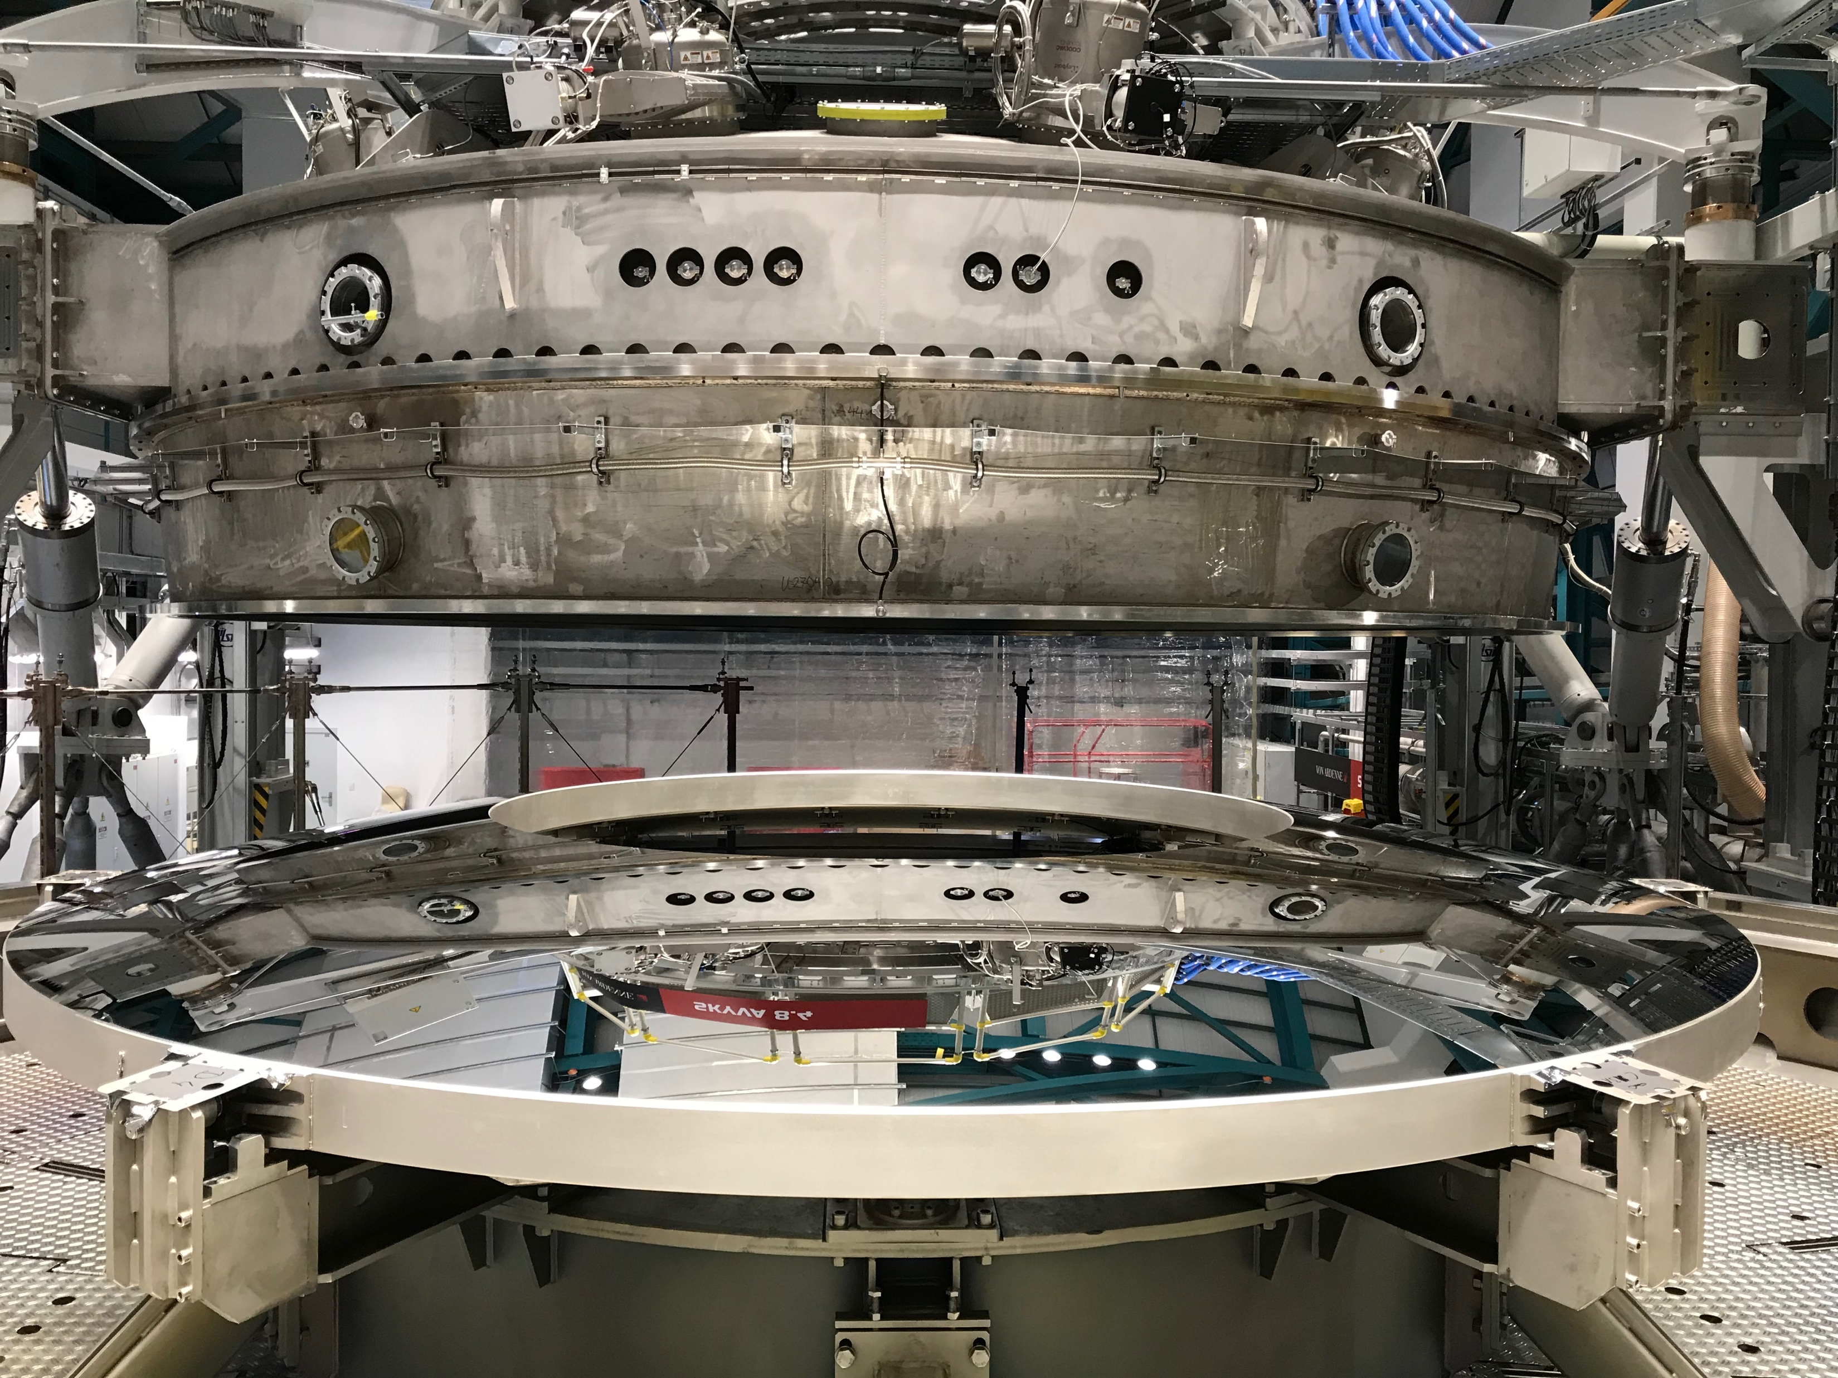
Accomplishment to Date
Coating Chamber shipped from Germany
Coating Chamber arriving in Chile
Coating Chamber arriving at the summit
Coating Plant fully assembled at the summit
M2 coated
Silver magnetron during M2 coating

Slide 6
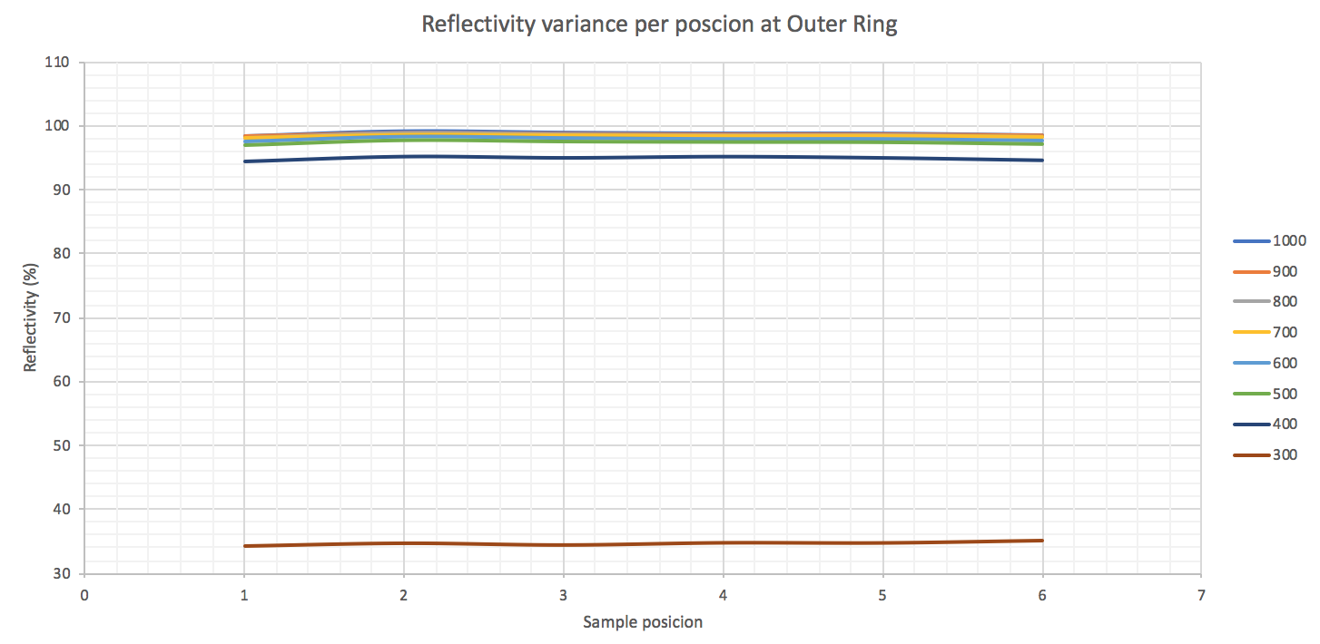
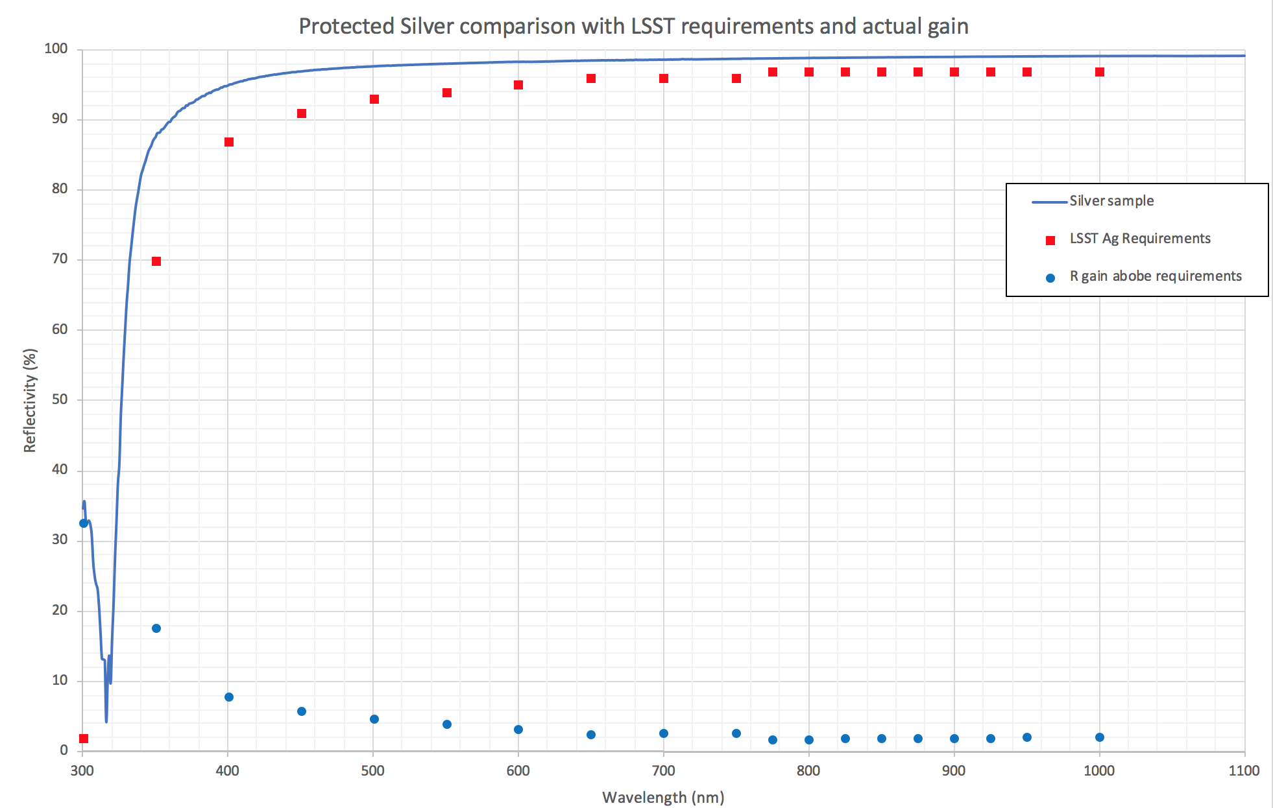
Accomplishment to Date
Challenges during this period was mainly focused in order to meet the shipping and assembly schedule. Very demanding effort by LSST and Von Ardenne also was placed also to meet the reflectivity requirements.
M2 reflectivity variance at outer ring with a 0.2% maximum from 300 to 1100nm.
M2 protected Silver reflectivity

Slide 7
Future Work of the Coating Plant
Since the Coating Plant has been fully assembled and the M2 mirror coated, now the focus is all about M1M3 coating.
Technical task by VA are still pending due the M1M3 cell, surrogate and mirror was not in placed.
VA will support LSST on Dec 2019 the M1M3 surrogate integration into the Coating Plant.
VA will support LSST by 2nd semester of 2020 the M1M3 coating with Aluminum.

Slide 8
Future Work of the Coating Plant
Schedule:
  Nov 2019: ancillary equipment at 3er floor ready to support M1M3 surrogate test.
  Dec 2019: M1M3 surrogate test at Coating Chamber (fit, coating, vacuum and coating procedures).
  Dec 2019: M1M3 surrogate test at Washing Station (fit and washing procedures).
  July 2020: Coating Plant ready to support M1M3 coating.
  2nd semester 2020: M1M3 Coating with Aluminum.
  End 2020: Coating Plant operational and maintenance procedures ready for Operation Phase.

Slide 9
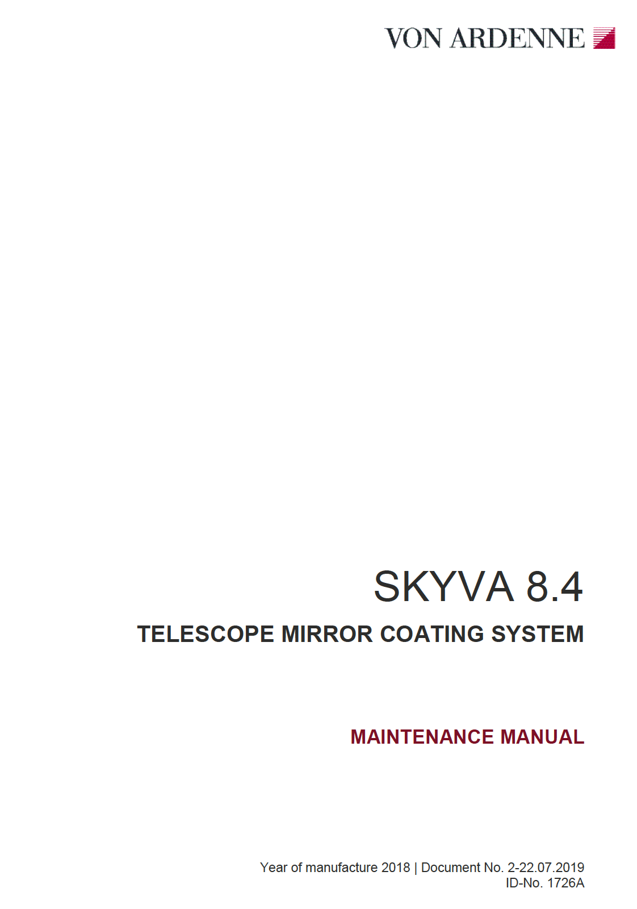
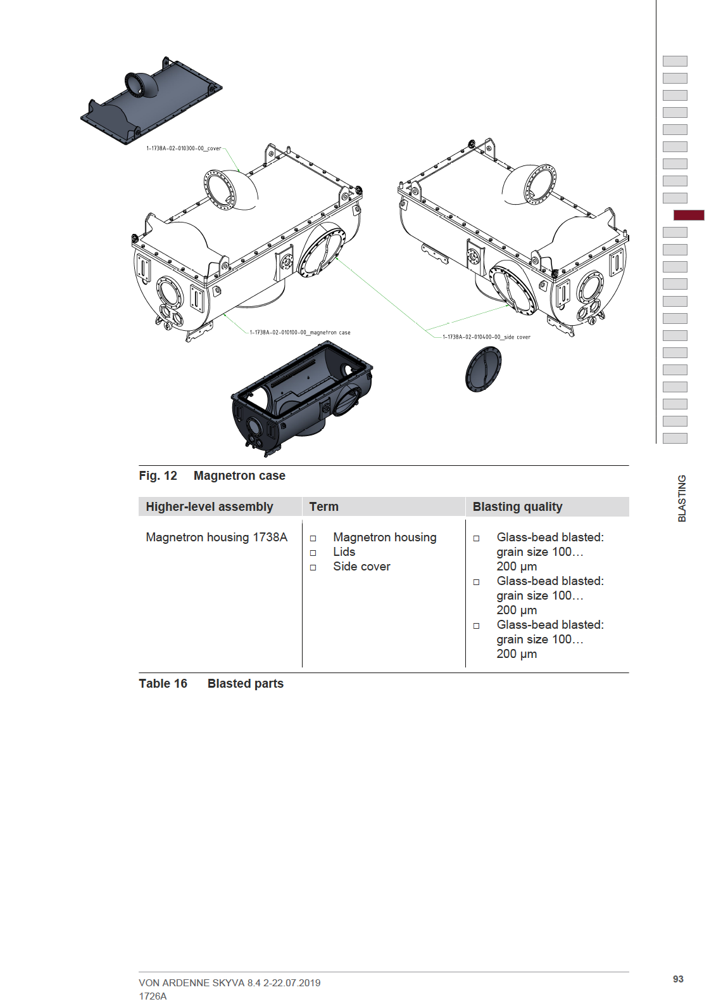
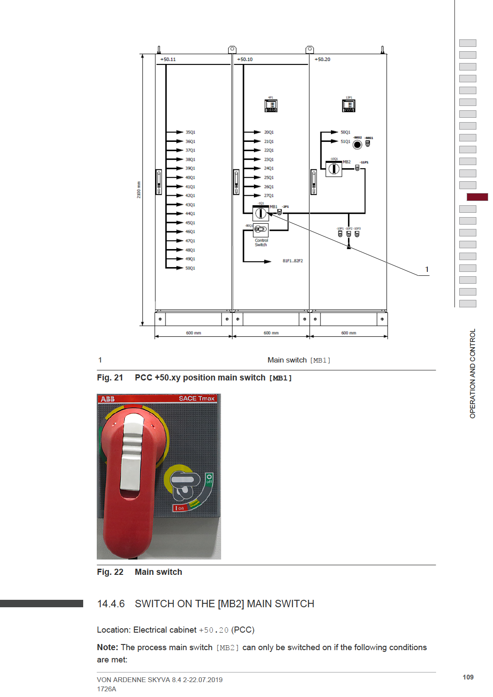
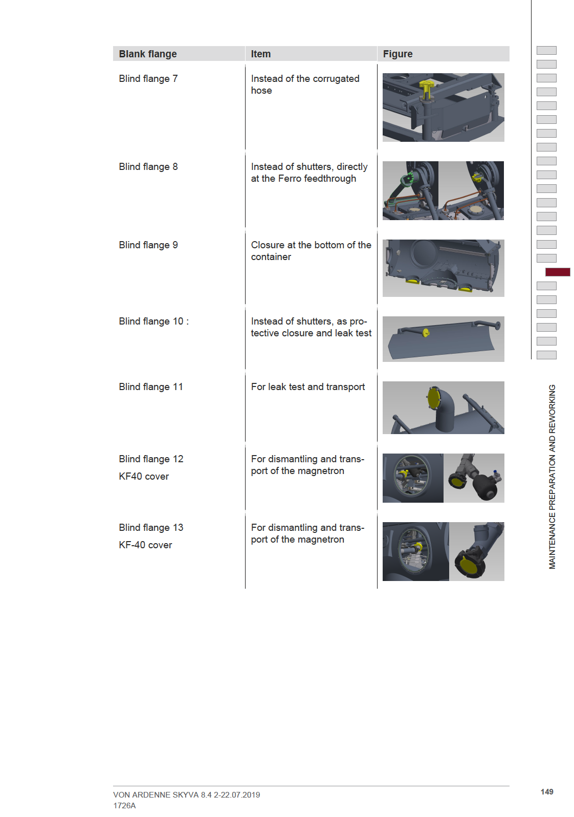
Future Work of the Coating Plant
Example of the actual procedures to be reviewed and updated for future Operations:

Slide 10
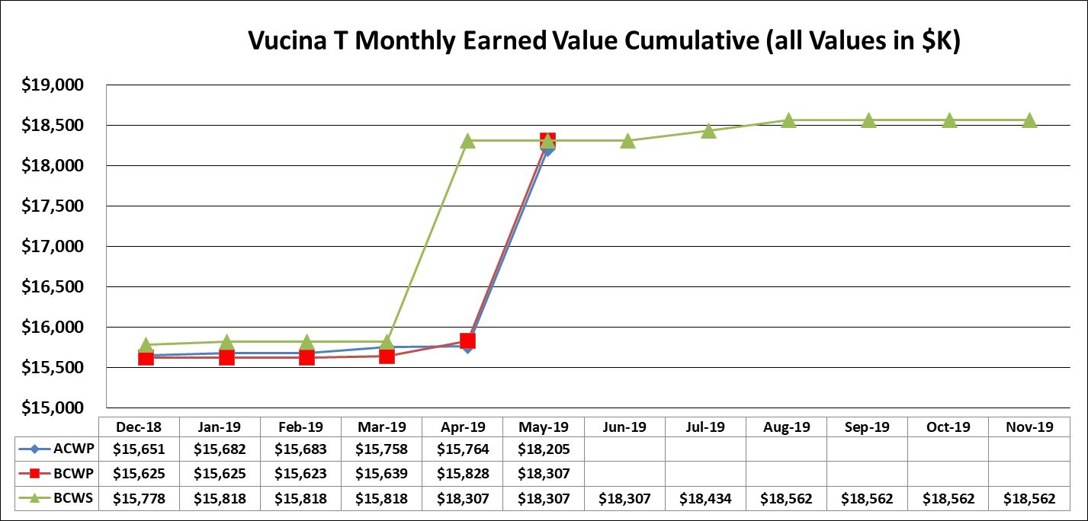
Coating Plant Cost Summary
SPA Chart
2 months of late payment to VA due a delay on the final completion date

Slide 11
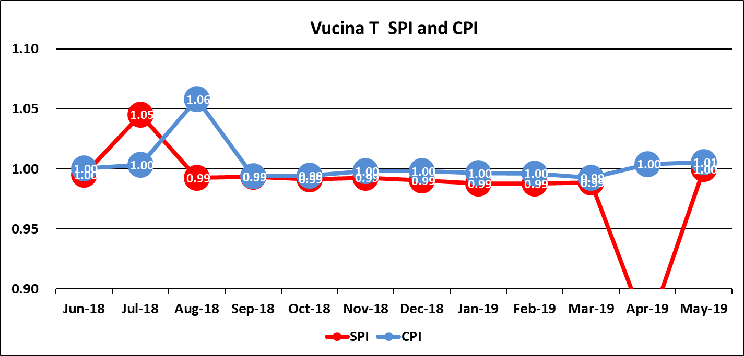
Coating Plant Cost Summary
CPI-SPI Chart
2 months of late payment to VA due a delay on the final completion date

Slide 12
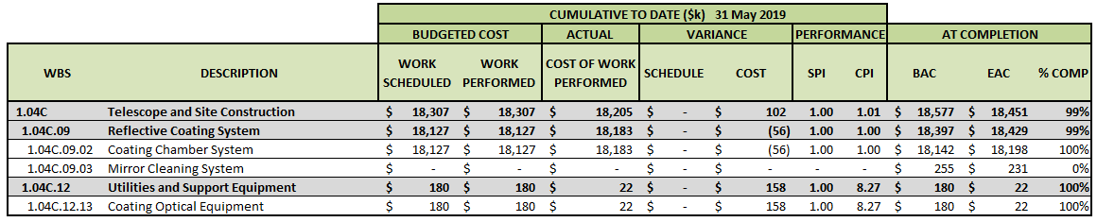
Coating Plant Cost Summary
Cost Summary WBS Lvl 4

Slide 13
Risk and Opportunity
Coating Plant Risks:
  Technical risks: High reflectivity coatings, safety/seismic and precision movements.
  Cost risks: New LCR’s will be placed to support the M1M3 Coating and later Operations.
  Schedule risks: The Coating Plant is not an isolate system. It is part of the AIV Plan.
Opportunities:
  Several internal reviews and technical reports/meeting will be placed to help avoid technical issues.
  No modifications of the requirements.

