Slide 1
Summit Facility
Jeff Barr
Project Architect LSST Telescope & Site
Control Account Manager for Facilities
NSF/DOE Joint Status Review
August 27, 2019

Slide 2
WBS 4.3 Summit Facility & 4.13 Base Facility
Summit Facility
  Plans: Arcadis -Chile, Main Construction: Besalco Construcciones
  Includes:
  Main Service Building, Lower Enclosure, and Telescope Pier
  Auxiliary Telescope Building and Dome
  Platform Lift (Pflow)
  Pachón Hotel Addition (Proyect, Ltda.)

Slide 3
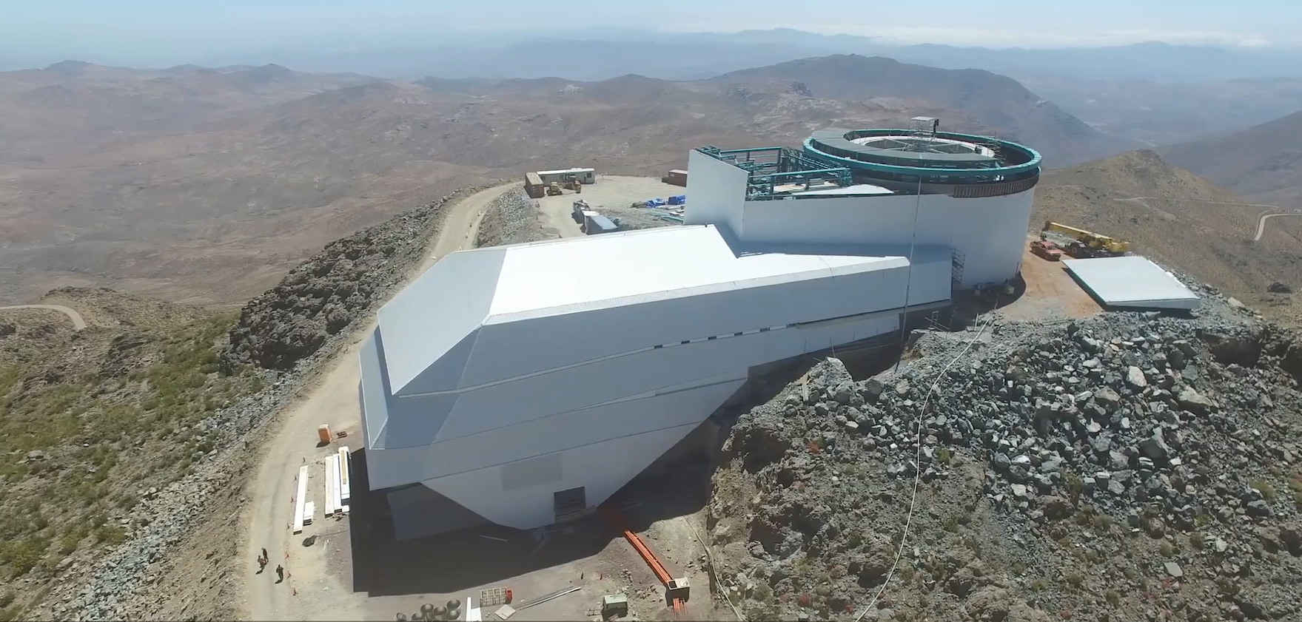
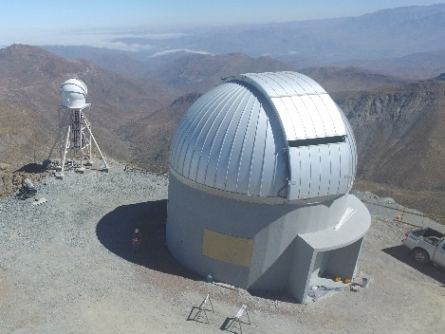
Summit Facility Scope
Drone Views (from early 2018 before Dome erection start)
Auxiliary Telescope Building
Service Building Platform Lift Lower Enclosure

Slide 4
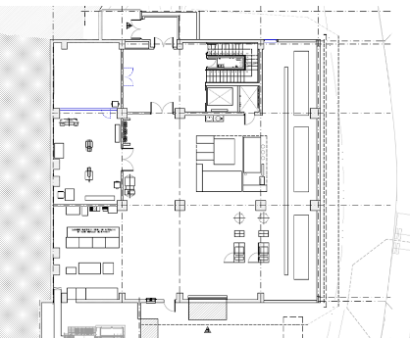
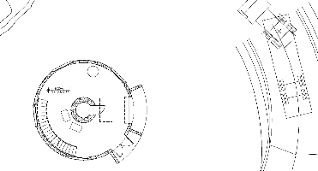
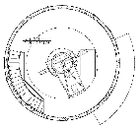

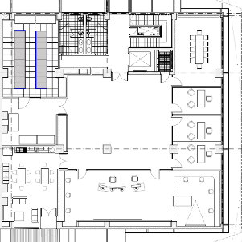
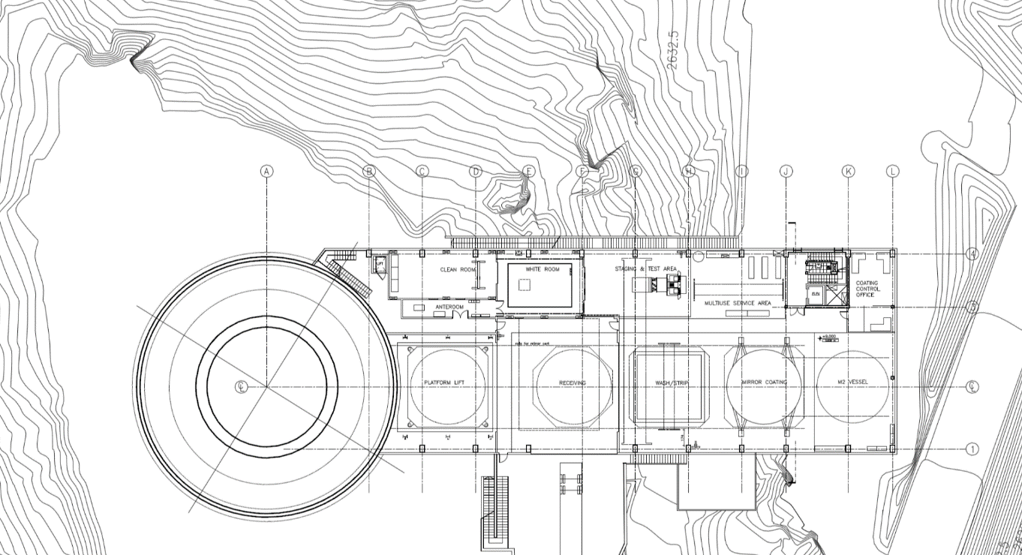
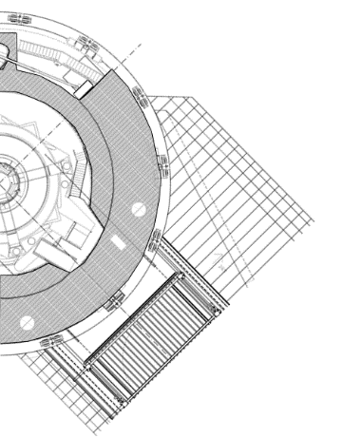
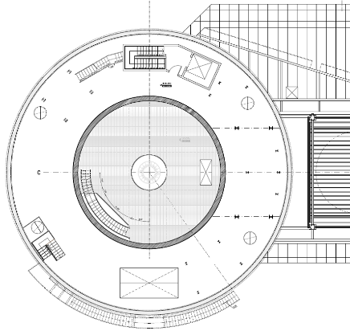
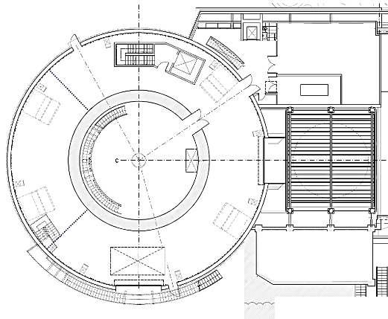
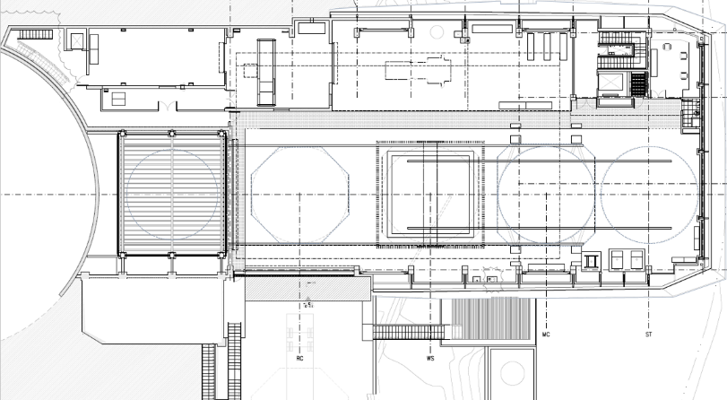

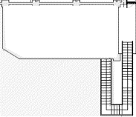
Summit Facility Scope – Telescope Enclosure/Service Bldg.
Entry
Cam
Refrig
Service Building – 2,630 m² (28,300 ft²) gross area
1 - Utility Ground Floor: main entry, shop, mech./elect. equip., camera refrigeration
2 - Control Floor: control room, computing, general office/support areas
3 - Maintenance Floor: mirror coating & camera maintenance
4 - Mezzanine Floor: elevated catwalk to telescope, staging platforms, Camera HVAC
5 - Enclosure Ground Floor/Upper Service Floor: connecting level between buildings
- Platform Lift for conveyance of mirrors & camera
Telescope Pier & Enclosure – 16m D & 30m D – 707 m² (7,600 ft²)
5 - Lower Enclosure Floor: utility access, shop, storage
6 - Pier Intermediate and Upper Floors: electrical, utility access
7 - Dome Floor: access to telescope and dome
8 - Telescope Maintenance Platform: service access to telescope
Shop
OSS
Auxiliary Telescope Facility
Level 2
Level 1
on
adjacent hill
dome & telescope
Mech.
pier
Elec.
enclosure
Utility Ground Floor Level 1
Computer
Conf.
prevailing
wind
Open Office
Break
Control Room
Control Floor Level 2
roof
general utility room
camera maintenance area
Telescope Platform
optics
rails
concrete pier & lower enclosure walls
Dome Floor
platform lift
machine shop
base of
pier
platform lift
platform lift
receiving
access road
2 pier floor levels
rails for mirror cart
mirror maintenance area
base of lower enclosure
north
hatch
Receiving door and truck ramp
deck
Telescope Platform Level 8
Dome Floor Level 7
Enclosure Ground Floor Level 5
Maintenance Floor Level 3
0 5 10 20m

Slide 5
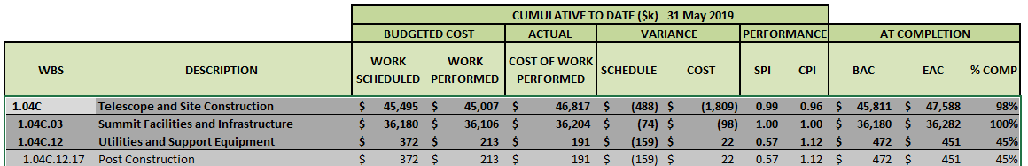
Cost Summary – Summit Facility Comprehensive
Summit Facility Construction (Besalco) 100% Complete
Contingency was requested and applied to cover an overspend of $2,600K
Platform Lift Contract (Pflow) 100% Complete
Pending final closeout & documentation
Lodging addition ~60% complete
Post Construction activities are added by LCR as work is required and executed

Slide 6
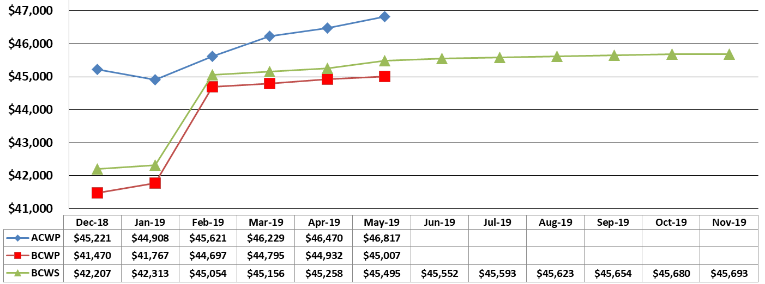
Earned Value Tracking – All Facilities (Summit and Base)
Cost Variance mainly due to accumulated change orders in Base Facility remodeling and construction
Schedule Variance reflects lateness in
Base Facility.
No project critical path impact anticipated.
Application of contingency for change orders on Summit Facility construction
(All Values in $K)

Slide 7
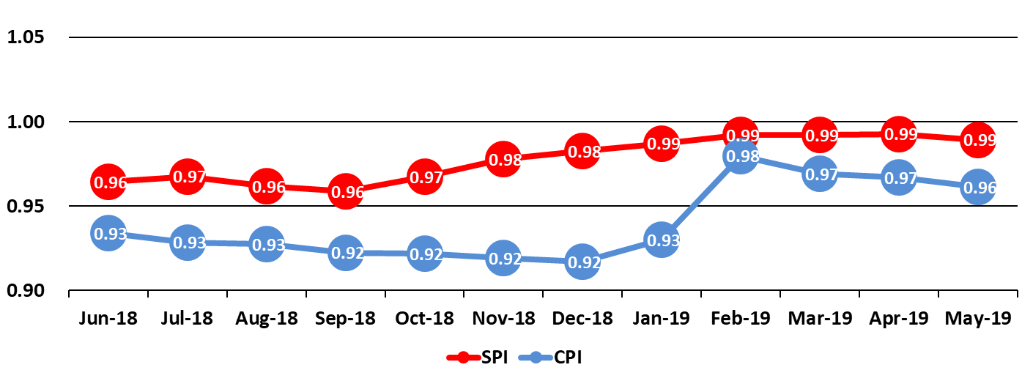
Cost (CPI) and Schedule (SPI) Performance Tracking
All Facilities (Summit and Base)
Contingency applied to cover change orders on Summit Facility construction

Slide 8
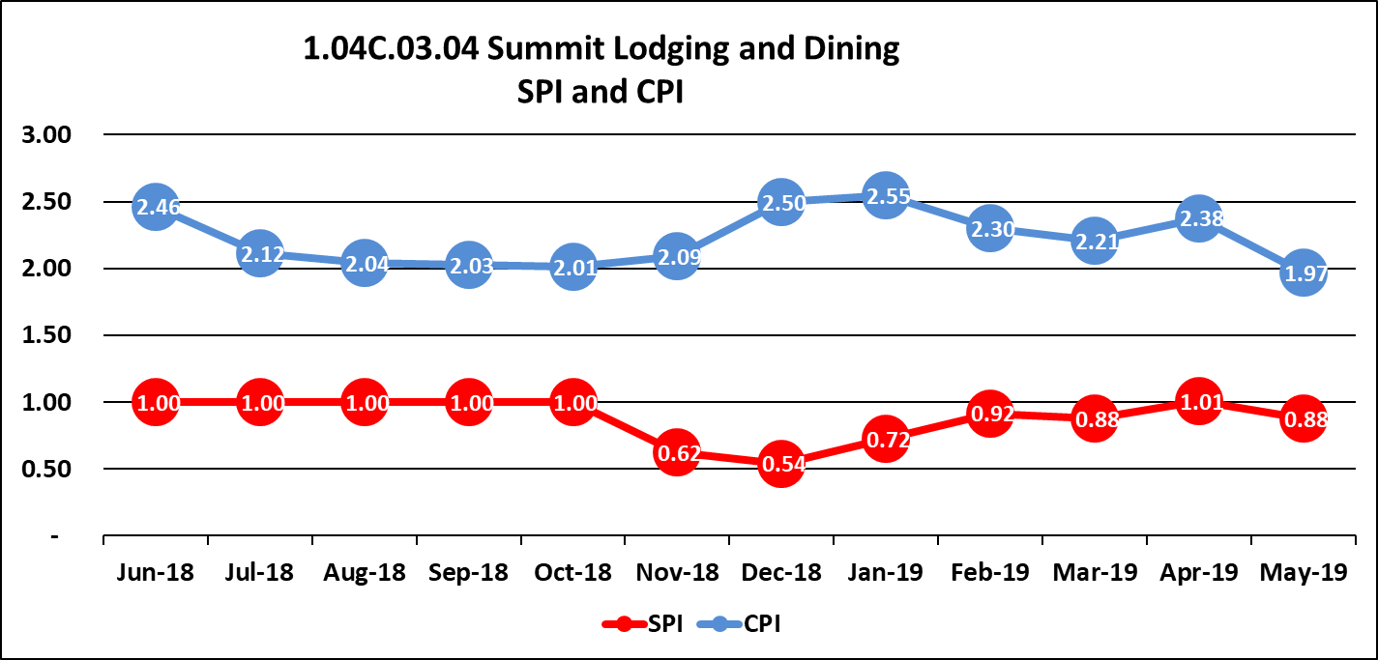
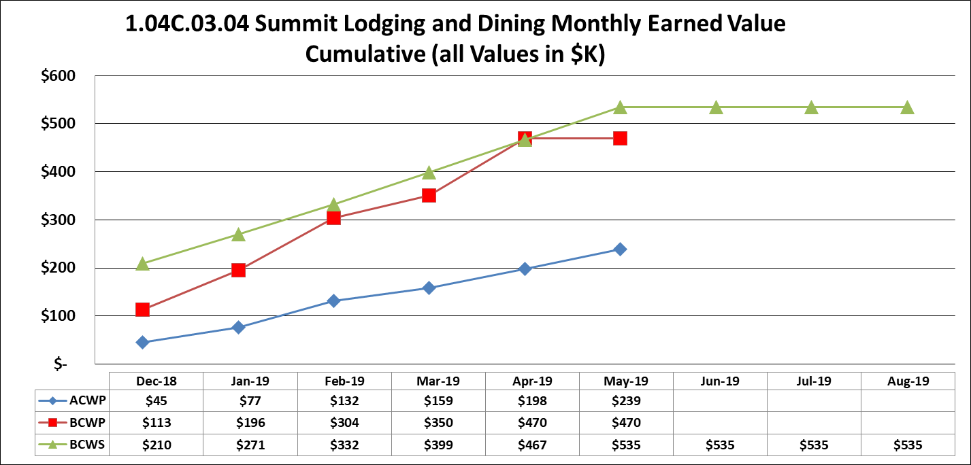
Earned Value Tracking – Pachón Lodging Addition
Only Remaining Facility Construction Work at Summit
High CPI reflects conservative under-billing by contractor
Anticipated completion
Sept.
30th
Low SPI reflects under-billing and foundation/weather delays
Contract (now 60% done) w/ Proyect Ltda. – well-managed to date by Contractor/LSST team.
Remodeling to create 2 new rooms completed on schedule in ~3 months.
4–Room Addition has been subject to unexpected soil condition and weather delays.
Final Change Order total expected to be ~$40K, less than 10% of overall contract value.
Utilizing this Contractor (Proyect Ltda.) for guard-railing and other work at main summit site.

Slide 9
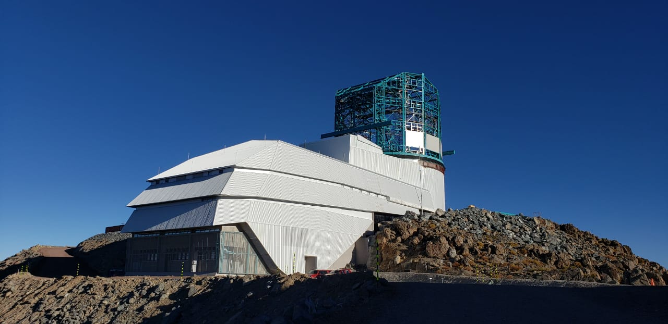
Summit Facilities – Accomplishments
Summit Facility Complete – Photo from July, 2019

Slide 10
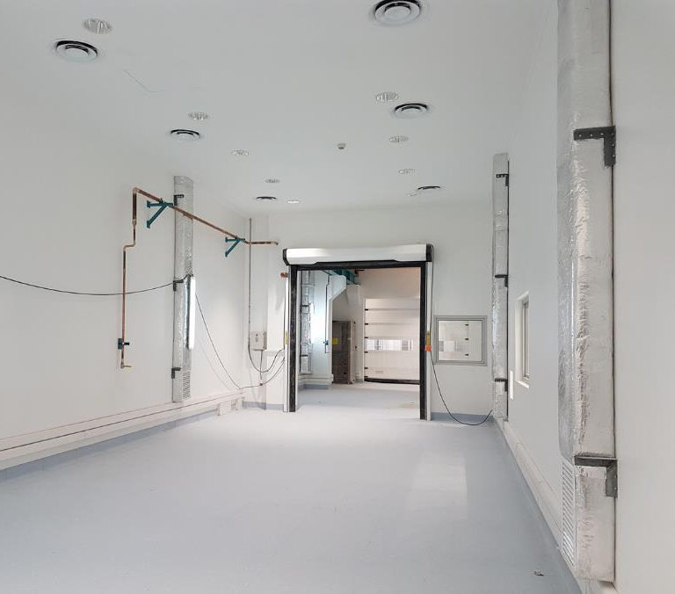
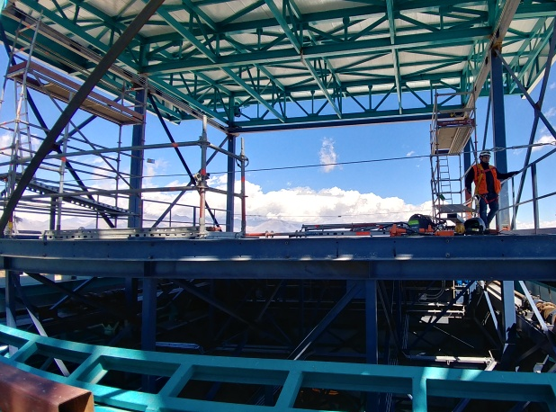
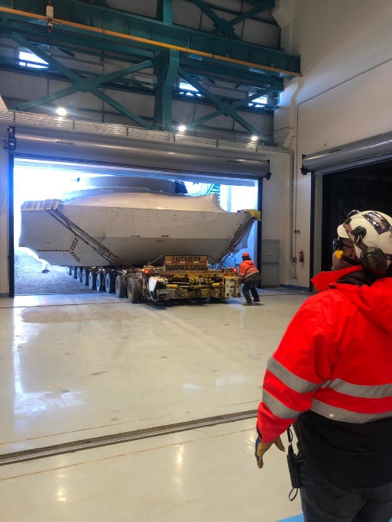
Summit Facilities – Accomplishments
Camera Clean/White Rooms
Now in use
Platform Lift Raised to maximum height and load tested March 2019
Entry of M1M3 Cell in Facility July 24, 2019

Slide 11
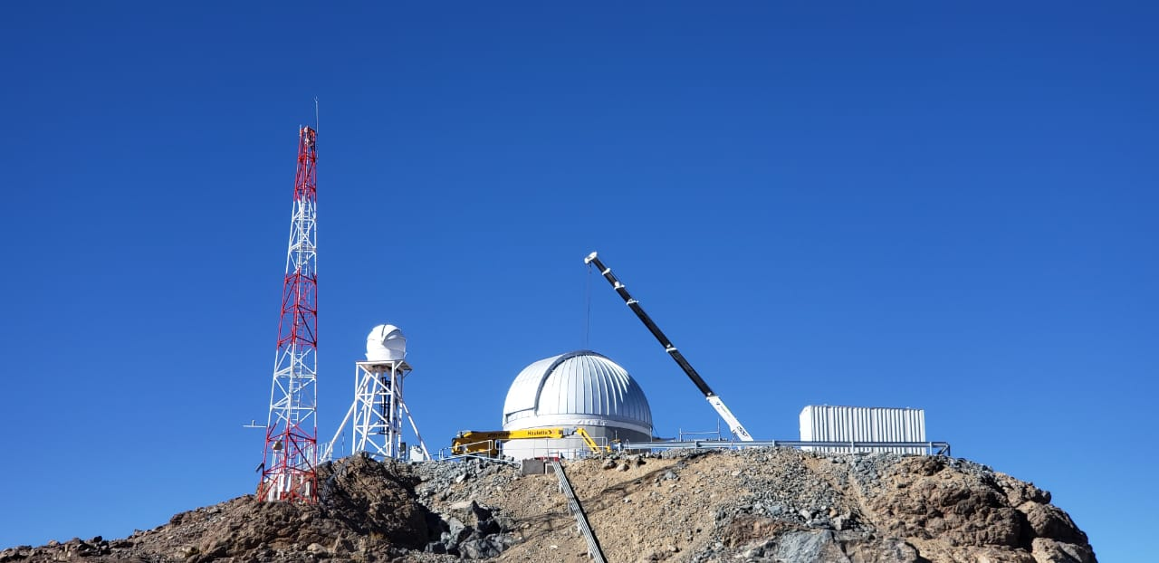
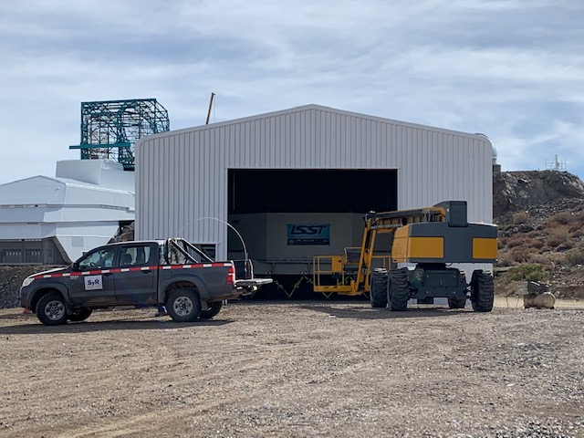
Summit Facilities – Accomplishments
Calibration Hill Facilities continue in development
Weather tower – DIMM Tower – Aux. Tel. Dome
Warehouse constructed to protect M1M3 Mirror and for future storage

Slide 12
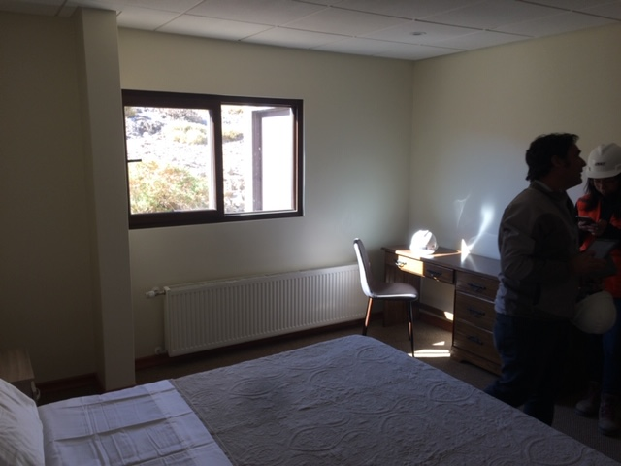
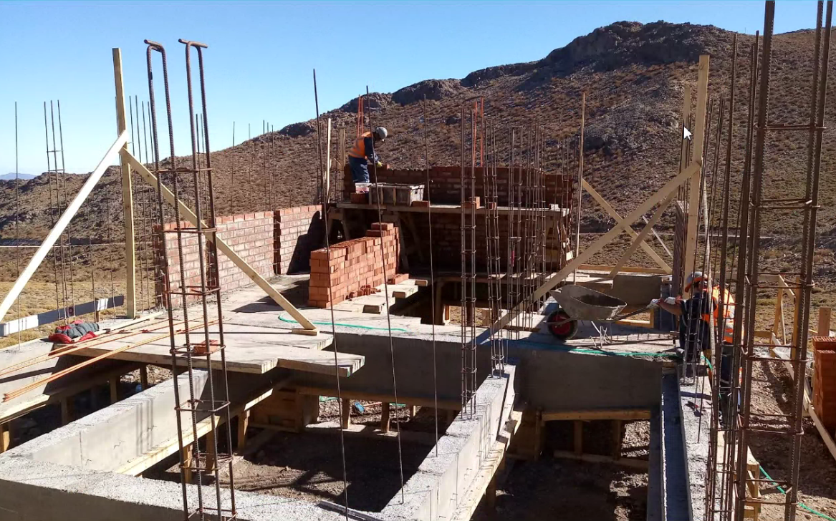
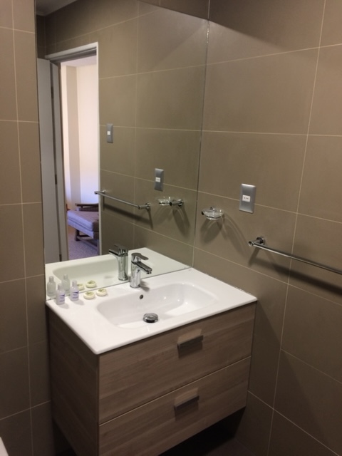
Summit Facilities – Accomplishments
Pachón Hotel Addition
4 more rooms under construction in new addition
2 LSST rooms provided by remodeling

Slide 13
Summit Facilities – Future Work
Post Construction Projects
  Enclosure of Camera Refrigeration Room at first level
  Enclosure of Dynalene Chiller room in telescope pier
  Improvements to weather-proofing of first level
  Final improvements to roads and platforms
  Installation of man-lift, pier ring platform in dome area
  Other – as defined, approved and scheduled
Completion of Hotel addition Rooms available by October 2019 to support TMA on-site work and other AIV activities.

Slide 14
Summit Facilities – Risks and Opportunities
Construction related risks substantially retired
Schedule impact risks retired. Summit Facility complete and ready for integration of all subsystems.
Scope option for constructing warehouse was identified and realized to mitigate M1M3 risk provide benefit for future operations.
Scope option for acquiring previous contractor dining facility and offices have was identified and realized with benefit to AIV efficiency and schedule.

Slide 15
Summit Facility – Safety
Summit Facility site preparation and construction completed with no major accidents or incidents.
Continued safety vigilance will continue for completion of Hotel addition project and post-construction work.
Life and health safety issues in Summit Facility have been successfully addressed by full compliance of facility with all applicable Chilean and International building codes.

Slide 16
Thank-you

