Slide 1
Dome and T&S Project Management Jeff Barr Project Architect LSST Telescope & Site Control Account Manager for Dome NSF/DOE Joint Status Review August 27, 2019

Slide 2
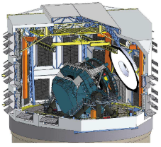
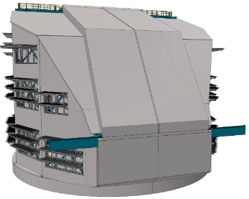
WBS 4.4 – Dome Enclosure System
Work performed under contract by EIE Group based in Venice-Mestre, Italy
Non-Co-Rotating Dome: 27 m high, 30 m diameter.
Supported on an insulated, cylindrical, concrete lower enclosure (part of Summit Facility WBS 4.3)
Oversized Aperture Shutter (APS) slit width enables continuous azimuth crawl motion
Light baffled louvers provide wind flushing and stray light attenuation
During the day the internal environment is controlled by Summit Facility thermal control system

Slide 3
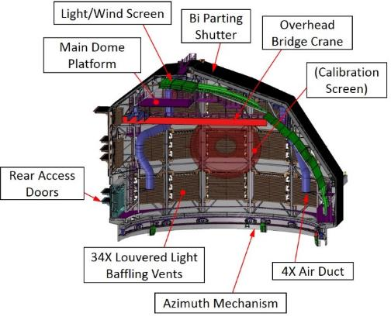
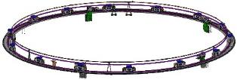
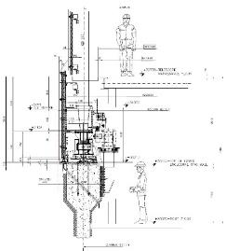
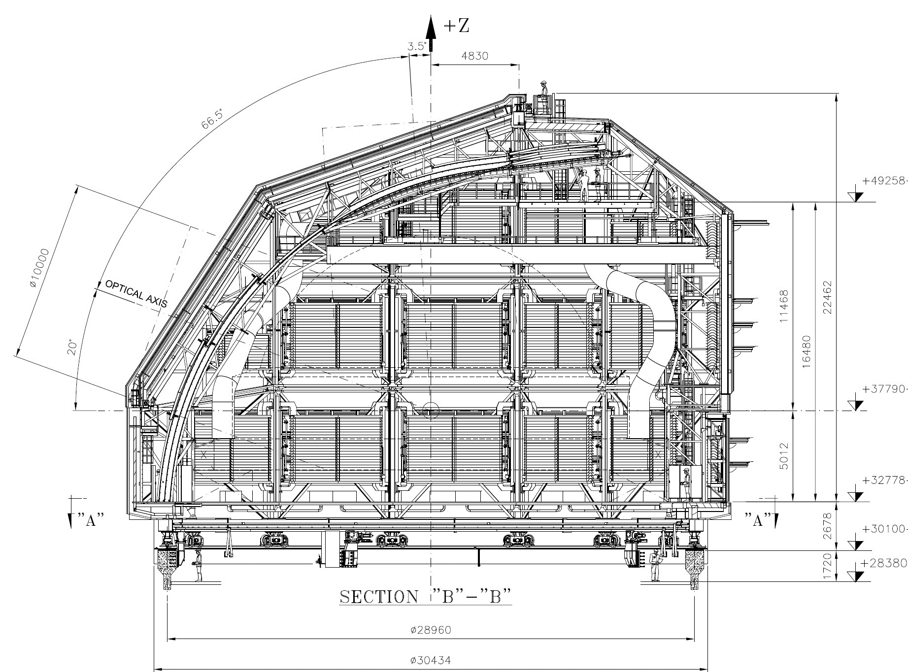
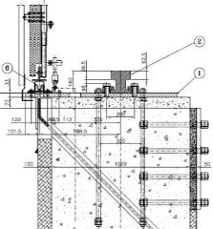
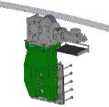
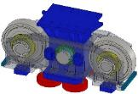
Dome – Scope – Major Components
+600 ton structure with continuous “crawl” in azimuth, wind/light screen in elevation
4 air ducts align to facility HVAC input with inflatable seal
Large internal calibration screen
14 twin wheel trolleys (1 spare)
16-section azimuth track/box beams
Rear access doors for removal of large assemblies
Vents with light baffles
Inflatable Azimuth Seal
Azimuth Mechanism

Slide 4
Cost Summary – Dome
Advance for management of this subsystem is shown as 100%, as the original period of performance and total amount budgeted has been expended. The ongoing extended time and effort is being tracked as a necessary overspend, beyond the original projected scope.
The amount for the Fabrication contract is shown at 92% complete, as payments to that amount of the original budget plus change orders has been paid to EIE. The fabrication budget, however, also included the on-site assembly which has significantly lagged in schedule.

Slide 5
Earned value tracking – Dome Fabrication
Increase in cost budgeted and paid in 2019 have been primarily change orders for scope increase
Cost Variance due to advance payments beyond completion levels to allow continued Vendor (EIE) capitalization of the project.
Extension of period of performance for fabrication and site erection is a major management concern, subject to active tracking and mitigation measures

Slide 6
Cost (CPI) and Schedule (SPI) Performance Tracking Dome
Schedule performance indicator not reflective of delay, as it is based on financial – not physical – completion
Enactment and payment of change orders results in improvement of apparent CPI

Slide 7
Financial and Schedule Mitigations
Dome Support Contracts under direct control of LSST:
Steel erection support (MILL)
Construction cranes (Simaq)
Dome erection surveyor (O. Rivera)
Scaffolding rental and modification (AyC)
Ancillary fabrications or modifications (local machine shops)
Dome Drive System purchase from Phase Motion Control directly by LSST
Weekly status review and monthly formal update of schedule
Periodic inspection of critical assemblies in production in Italy
Hired steel erection engineer in Chile (Hernan Herrera) assigned to technical coordination of Dome support.

Slide 8
Specific Mitigations to Allow Parallel TMA Work
To be Provided by EIE
Provisional friction-drive means of rotation provided by EIE, until final geared drive system can be completed.
Provisional 16-Ton overhead bridge crane in dome for TMA assembly, until final overhead crane can be installed.
Early installation of dome shutters with manual means to open/close.
Emphasis with EIE erection team on advance of thermal cladding, to allow maximum enclosure of dome at projected date of TMA, and effective separation of outside dome siding/roofing work from inside TMA work.
Provision of threshold of rear access door, to allow installation of rails for cart access from lift.

Slide 9
Dome – Accomplishments to Date
The azimuth rail sections, box beams and bogie wheel assemblies have been erected and aligned, allowing manual rotation of the dome assembly.
Steel structure of Dome has advanced to 90% complete
Cladding installation is in progress approximately 20% complete on structure and preparation of sections on ground.
Fabrication of pieces in Italy ~80% complete. Light wind screen assembly, light baffles, and overhead crane are the main elements that remain to be completed.
Software development continues, including active engagement with LSST T&S Software Team.
EIE schedule projects completion and final acceptance in June 2020.

Slide 10
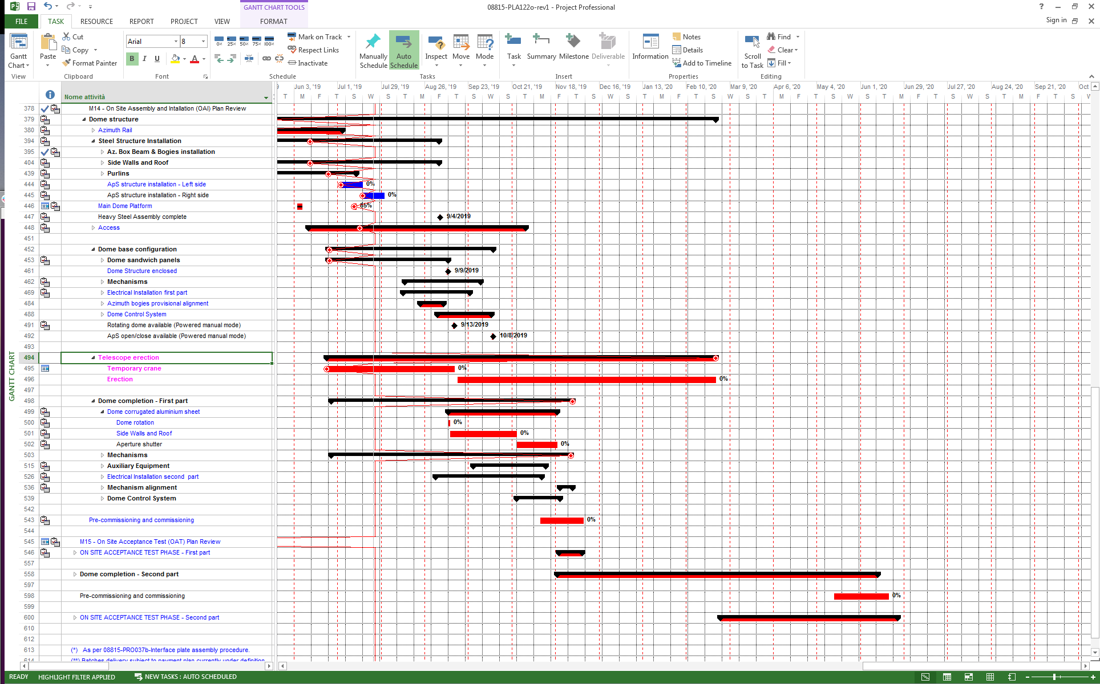
Dome – Schedule (excerpt from EIE update June 21, 2019)

Slide 11
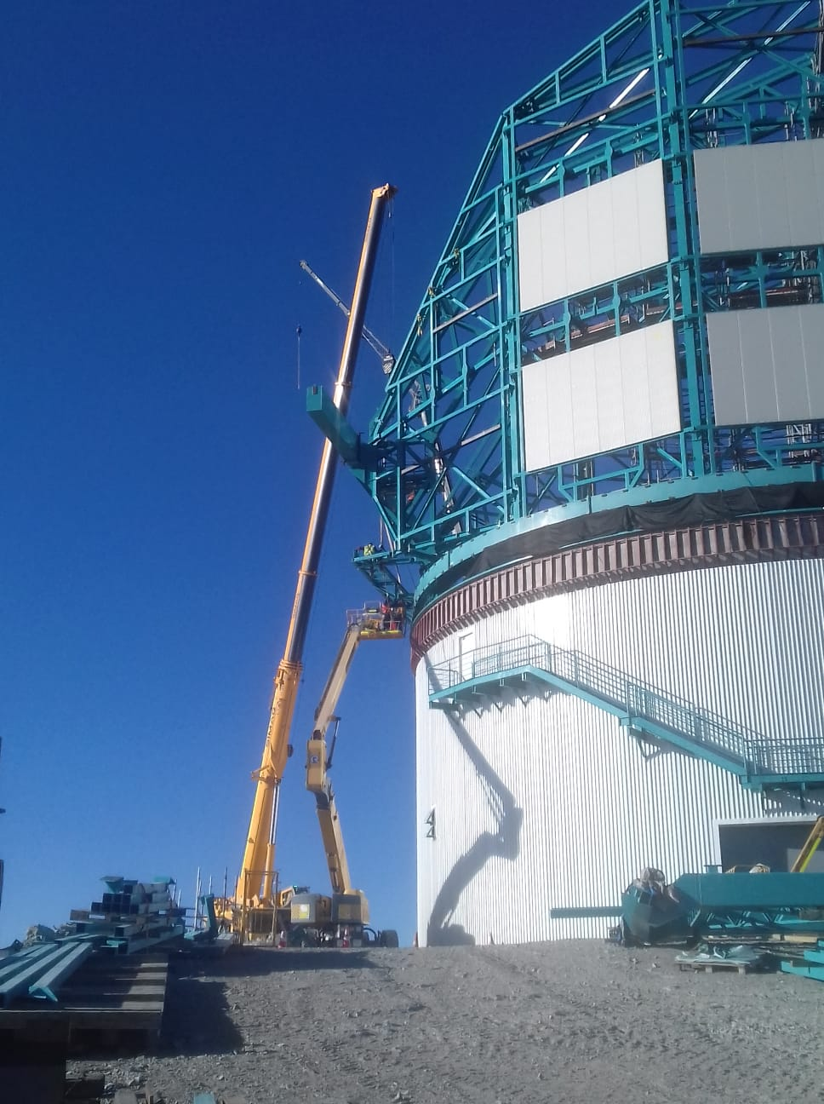
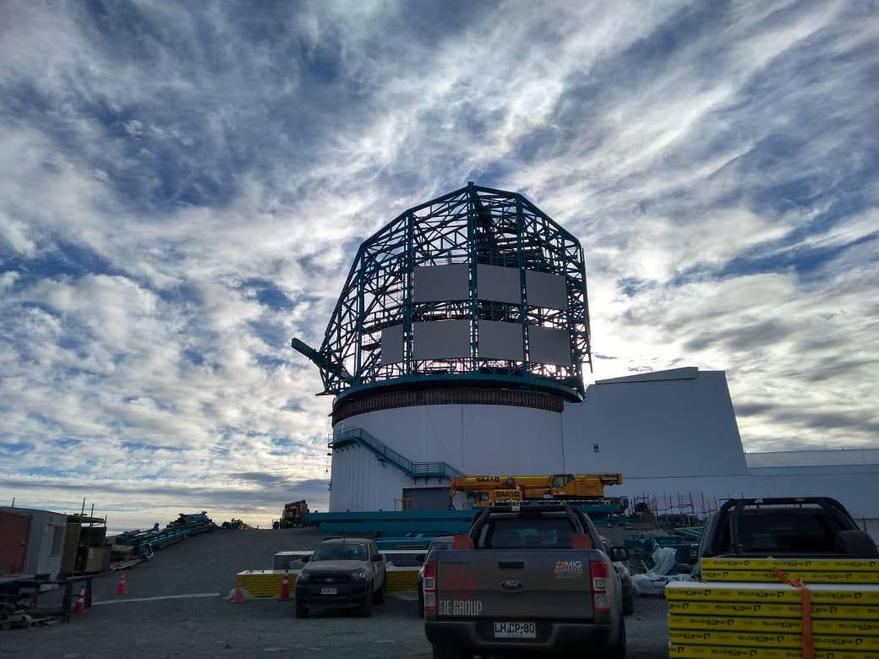
Dome – Accomplishments to Date
Dome progress with Structure and cladding July – 2019
Working with multiple cranes and other lifts

Slide 12
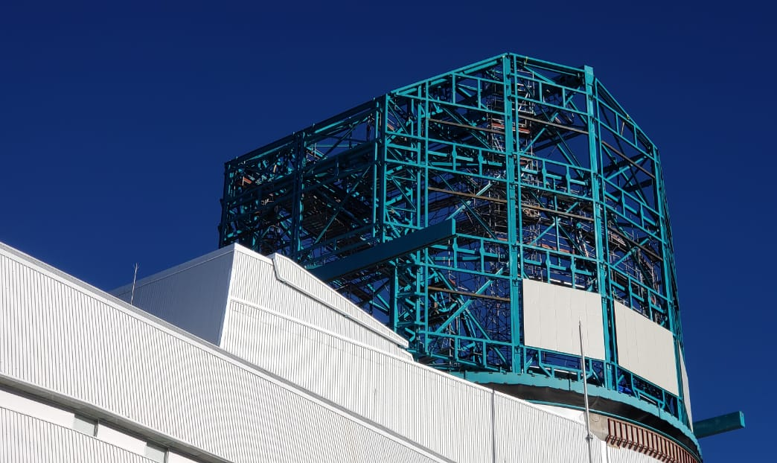
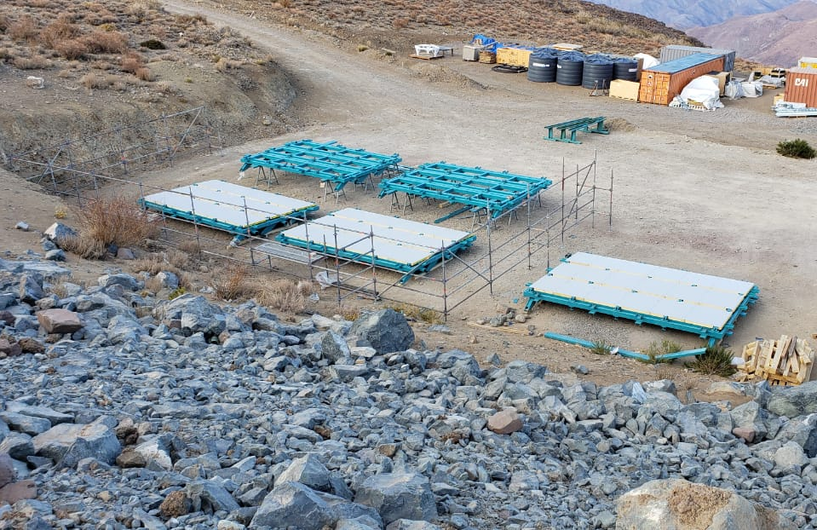
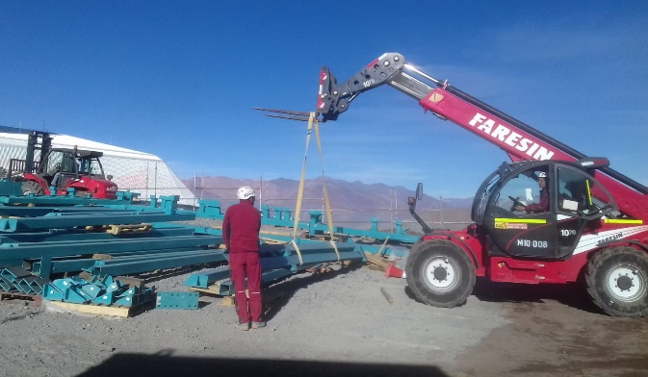
Dome – Accomplishments to Date
Also working on louvers, shutters and other large assemblies in on-ground areas
LSST providing space, equipment & labor to accelerate work

Slide 13
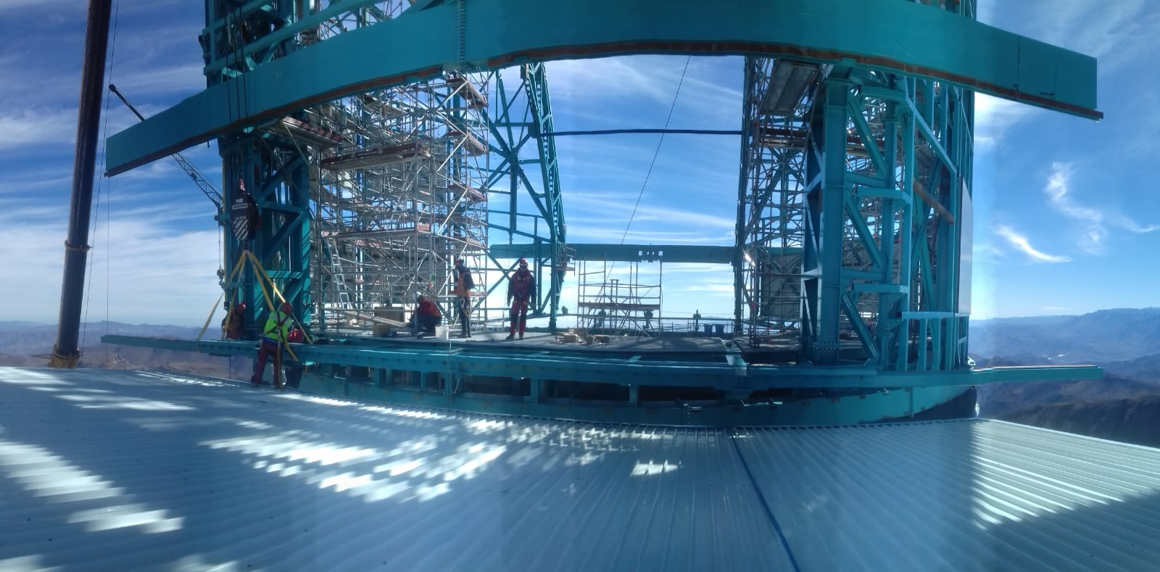
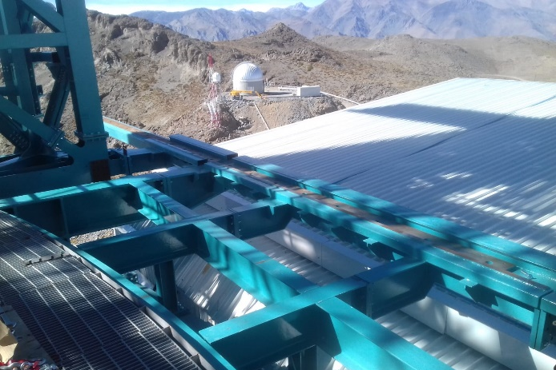
Dome – Accomplishments to Date
Concentration on critical assemblies:
Shutters and their mechanisms to allow closure
Interface to platform lift to facilitate transport of TMA assemblies

Slide 14
Dome – Future Work
Concentration on completion by October 2019 of critical work to allow start of work on TMA installation.
Rotation system in shipment form Italy to be installed Sept., 2019
Provisional crane in shop modification to be installed Oct. 2019
Cladding progress expected to accelerate when with completion of main structure and improved seasonal weather.
Completion of entire Dome enclosure and weather proofing prior to May 2020, beginning of winter.
Completion of control system, calibration screen, ducting and other interior systems by end of FY 2020

Slide 15
Dome – Risks and Opportunities
Schedule risk is to Project critical path if Dome delays TMA and subsequent subsystem integration.
Subject to active ongoing mitigation. Critical period is the next few months
Risk of further cost escalation.
Monitoring costs and applying contingency as warranted
Risk of performance to specified criteria
Dome designed and fabricated to meet performance specifications

Slide 16
Dome – Safety
Dome construction safety measures continue to be a high priority. High steel work, weather conditions, and other factors require special measures.
Multiple levels of safety oversight are in effect: LSST, Contractor (EIE) and Sub contractors all oversee safety continuously.
Dome and TMA work soon to be in parallel present special hazards that need to be preemptively mitigated – similar to the case when the Facility was still in construction and the Dome work began.
Although we are concerned about schedule and cost of the Dome, the safety of the people working on this part of the project is of utmost importance and demands our highest attention.

Slide 17
Thank-you

