Slide 1
Base Facility Jeff Barr Project Architect LSST Telescope & Site Control Account Manager for Facilities NSF/DOE Joint Status Review August 27, 2019

Slide 2
WBS 4.13 Base Facility
Base Facility (in partnership with NOAO & AURA)
Plans: Andes Arq., Remodeling: Rencoret Ltda., Construction: GHG Ltda.
Includes:
Phase 1:
Site Preparation and Remodeling of Existing Buildings
Phase 2:
Data Center
New Office Building

Slide 3
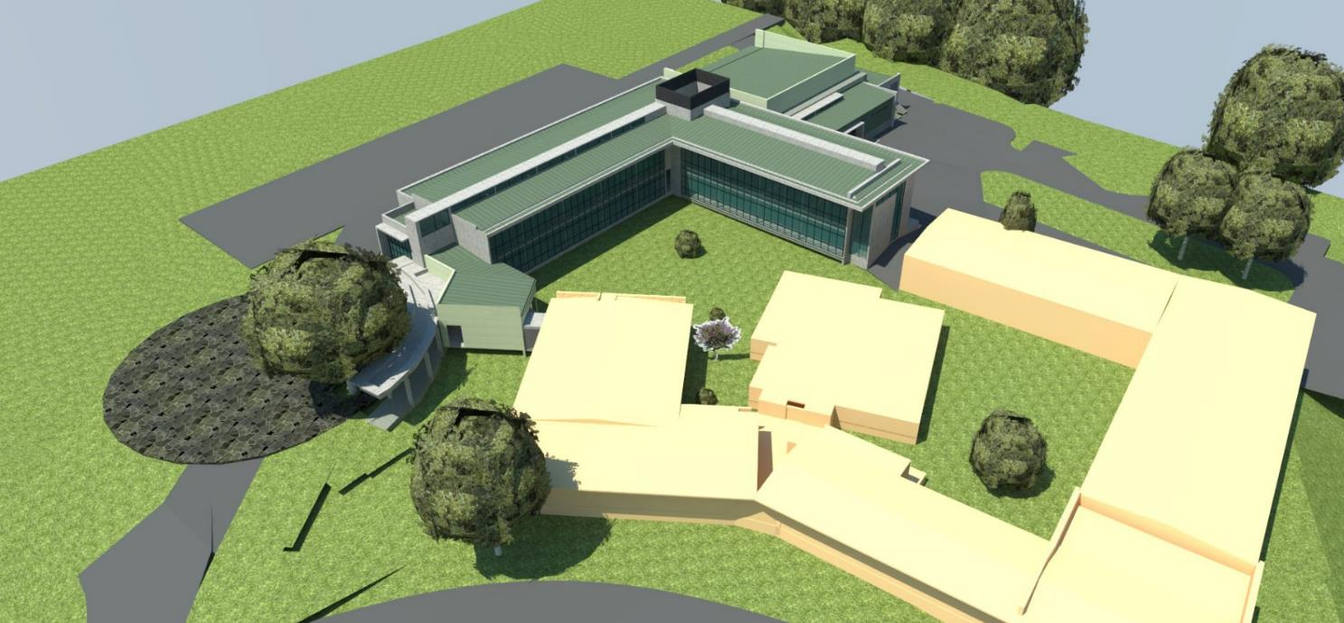
Base Facility Scope
La Serena Base Facility Addition – Birdseye View
Data Center
Existing Shops
Relocated Warehouse
NORTH
New 2-story Office Building
Reception
Exist. Building Refurbished
for Meeting
Rooms
Existing Gemini Facility
Existing Refurbished Office Building
Existing Refurbished Office/Lab Building

Slide 4
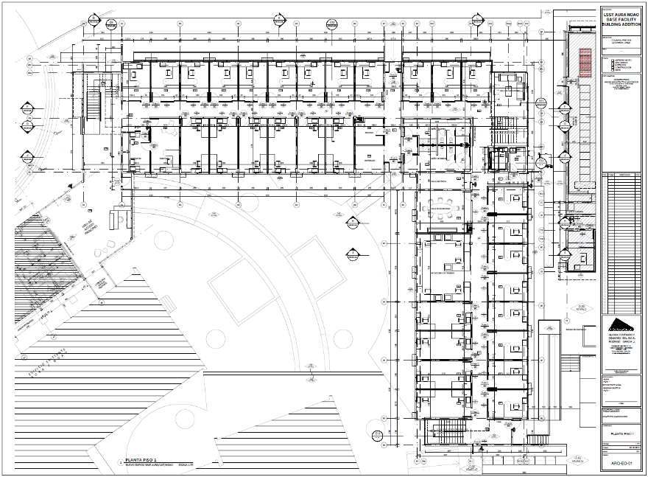
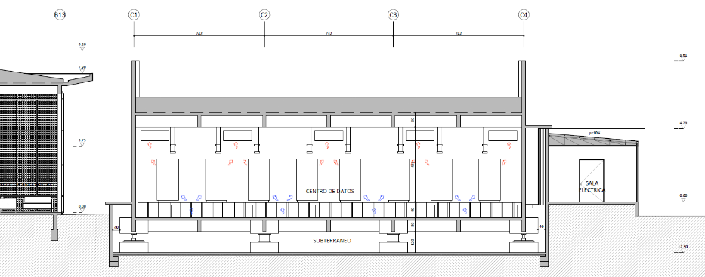
Base Facility Scope – New Buildings
Office Building 1st Floor Plan
Plans by Andes Arquitectos for buildings under construction by Constructora GHG
Data Center Section

Slide 5
Cost Summary – Base Facility Comprehensive
Phase 1 Project (Rencoret) – Base Site Preparation and remodeling 90% Complete Remaining work is remodeling of old computer rooms – anticipated completion Nov. 2019
Phase 2 Project (GHG) – Base Facility Construction 99% Complete Remaining scope is contract closeout, furnishing and occupancy
Following closeout of all work Base Facility work that is subject to the partnership agreement, the final LSST share will be determined and a contingency request will be submitted to cover accumulated change orders and other cost escalation.

Slide 6
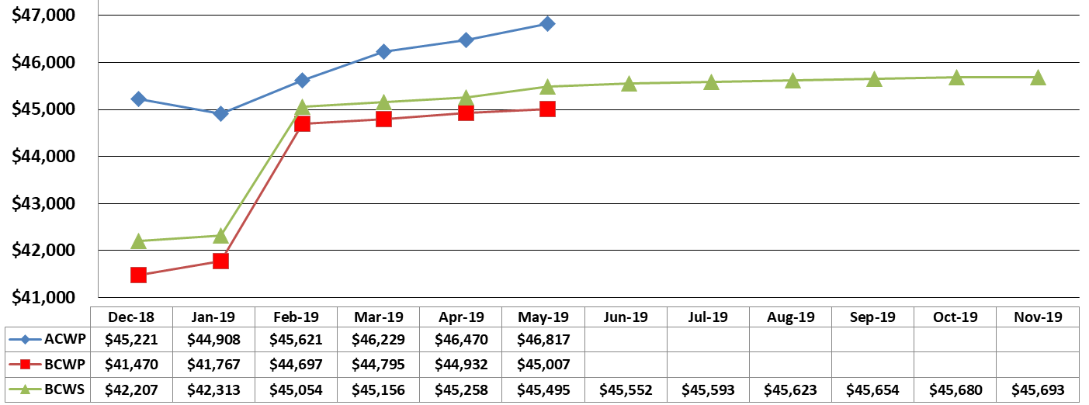
Earned Value Tracking – All Facilities (Summit and Base)
Cost Variance mainly due to accumulated change orders in Base Facility remodeling and construction
Schedule Variance reflects lateness in Base Facility.
No project critical path impact anticipated.
Application of contingency for change orders on Summit Facility construction
(All Values in $K)

Slide 7
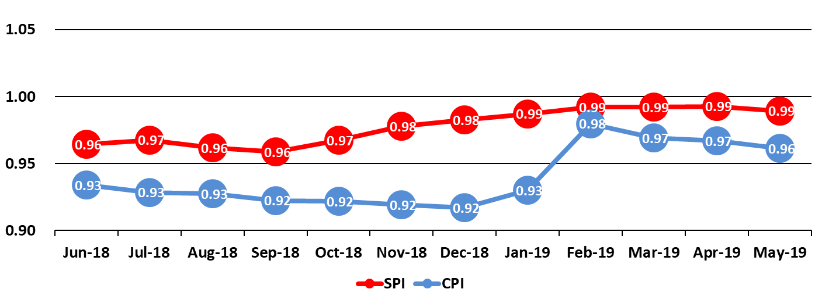
Cost (CPI) and Schedule (SPI) Performance Tracking All Facilities (Summit and Base)
Contingency applied to cover change orders on Summit Facility construction

Slide 8
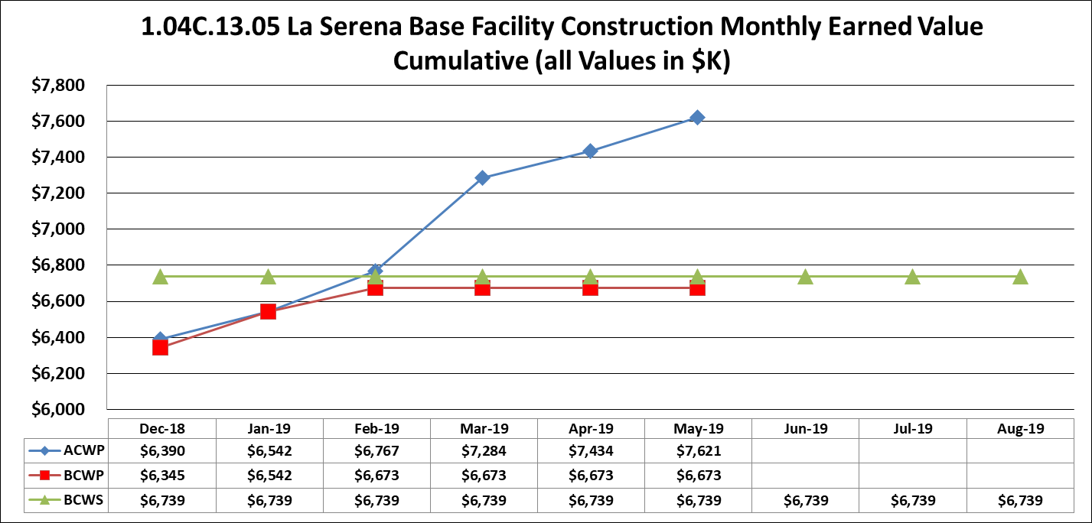
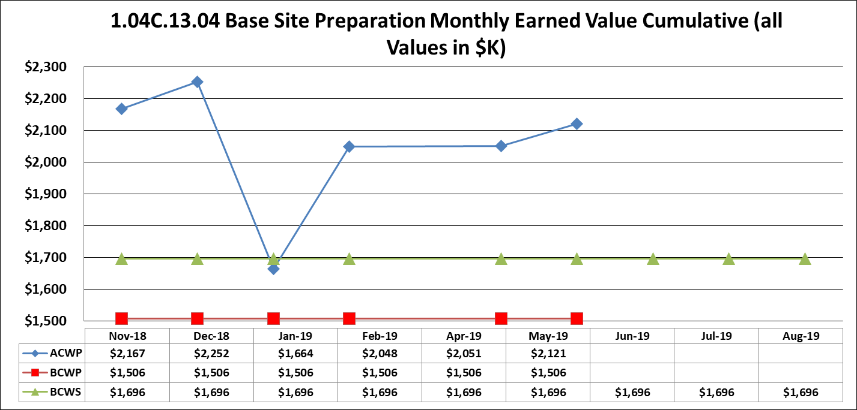
Earned Value Tracking – Base Facility Ongoing & Remaining Work
Cost Variance of ~$900K (9.5% of total contract) contingency to be requested
Phase 2 – New Building Construction
Phase 1 – Site Prep and Remodeling
Cost Variance of ~$420K (20% of total remodeling contract) to be reconciled at close
Schedule variance stable during hiatus in remodeling work
Phase 1 – remodeling contract remains to be completed by end of CY 2019. Coverage of change orders for this comprehensive contract will be reconciled at conclusion.
Phase 2 – New office building and Data Center contract to be closed out imminently
Final Cost Variances subject to calculation of partner shares of change order work

Slide 9
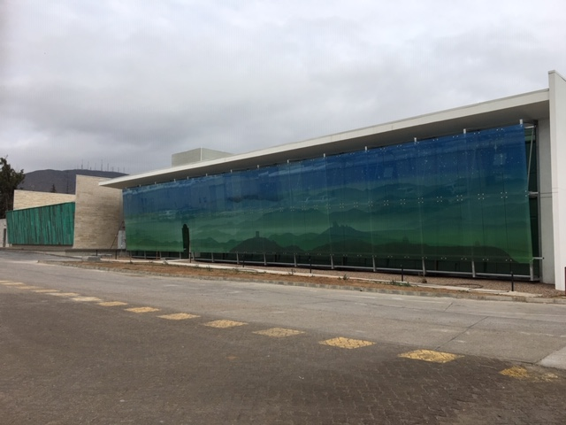
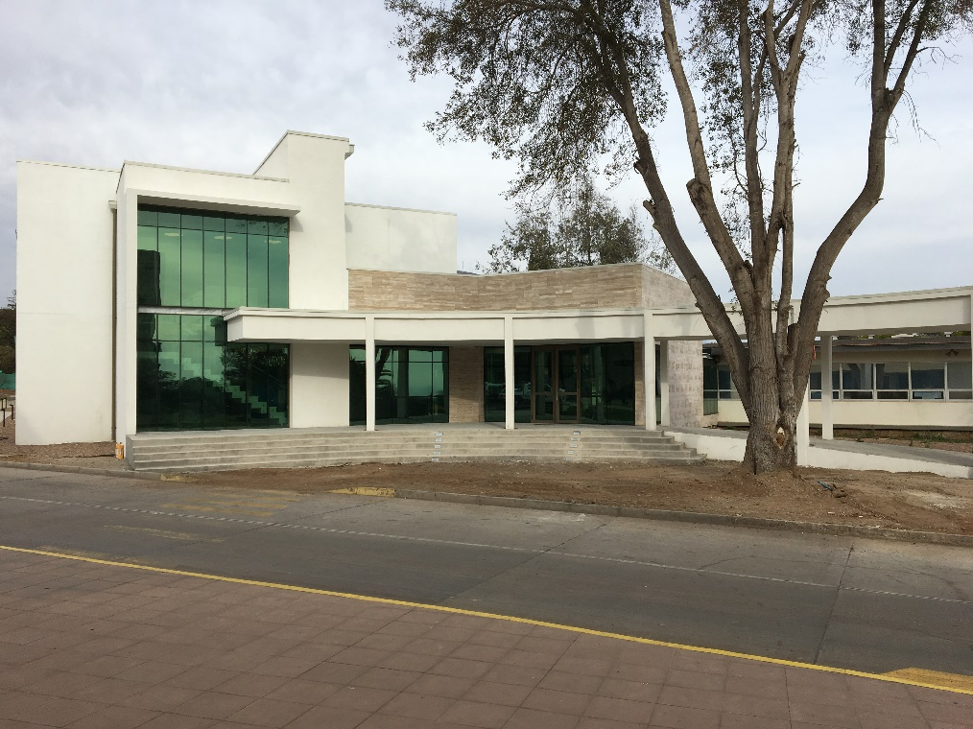
Base Facility Progress – July, 2019
Front Façade and Front Entry

Slide 10
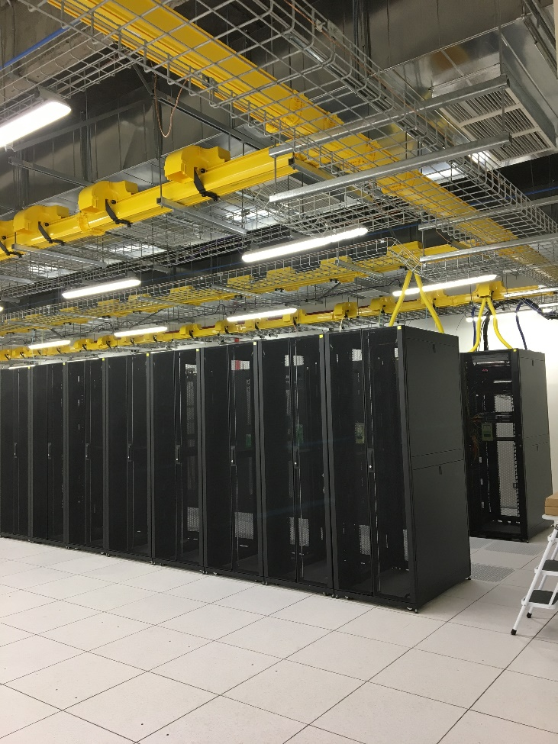
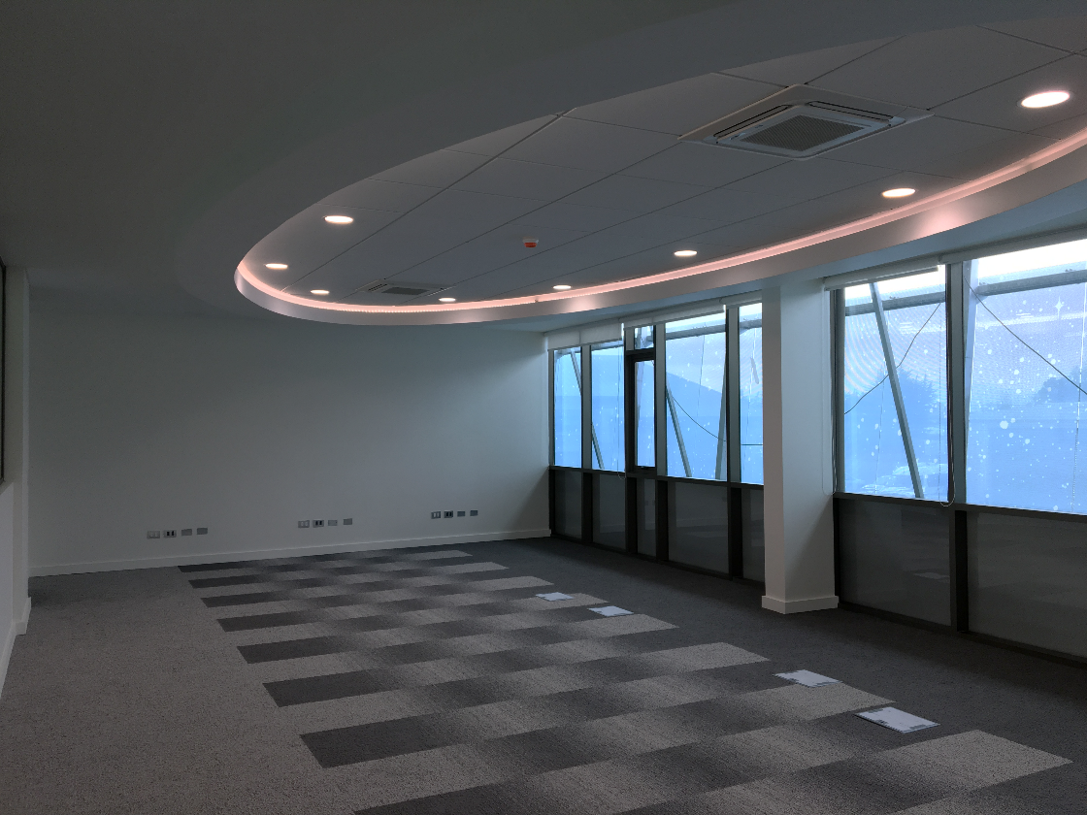
Base Facility Progress – July, 2019
LSST Remote Operations Room & Data Center Rack Room

Slide 11
Base Facility – Future Work
Complete IT cabling and infrastructure
Provide furnishings for offices, workspaces and common areas.
Complete move to new Base facility Offices – September, 2019
Complete remodeling of old computer rooms to conference rooms – December, 2019
Closeout all contracts and reconcile final AURA/LSST/NOAO partnership accounting – early 2020

Slide 12
Base Facility – Risks and Opportunities
Construction-related risks have been substantially retired.
Risk of damage to critical LSST data processing/storage equipment has been mitigated by seismic isolation of the Data Center
Risks of adequacy of Data Center space and utilities have been substantially retired, as all criteria defined in LSE-239 Base Facility Data Center Requirements have been satisfied.
Future opportunities remain for previously designed - but not implemented - options for addition of public gallery space and photovoltaic power generation panels.

Slide 13
Base Facility – Safety
Remodeling and new construction work in ~2 ½ years of work have resulted in no serious accidents or incidents.
Continued safety vigilance will be maintained regarding final remodeling to be carried out in proximity of occupied business and residential areas.
Life and health safety issues in Base Facility have been successfully addressed by full compliance of all new and remodeled facilities with all applicable Chilean and International building codes.

Slide 14
Thank-you

