Slide 1
M2 (Secondary Mirror) System Douglas R Neill - Chief Engineer Roberto Tighe - Optics Lead NSF/DOE Joint Status Review August 27-30th, 2019

Slide 2
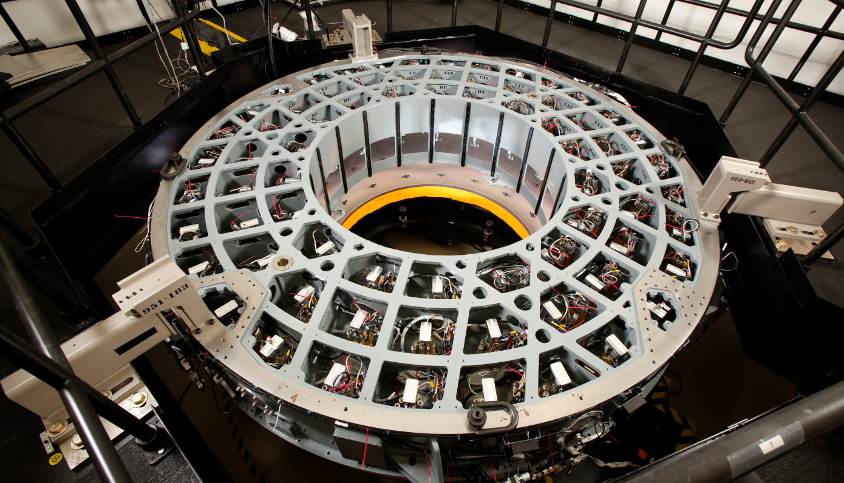
WBS 04C.06 M2 System Summary
WBS 04C.05 includes the design, analysis, fabrication, assembly and testing of the M2 (secondary mirror) Assembly.
The M2 system includes the mirror, steel mirror cell and electro-mechanical support system.
This is a “turn key” system with all associated electronics and software.
The Mirror is a 3.47 M OD 1.78 M ID ULE meniscus.
Support System:
72 axial actuators
6 tangent links actuators
M2 controller:
Underside of M2 cell showing axial actuators

Slide 3
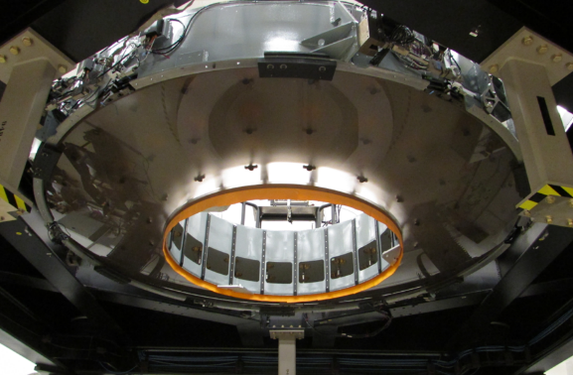
Scope of the WBS: Primary Deliverables
Deliverables
M2 mirror optically figured.
Steel M2 cell.
M2 electromechanical support system.
M2 controller (control computer).
Protective aluminum mirror cover.
4-Pt. & 6-Pt. Lifting equipment.
M2 transportation cart. (also used for testing and maintenance)
M2 mirror and cell

Slide 4
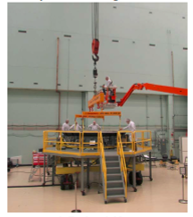
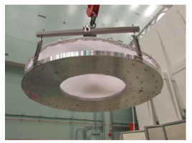
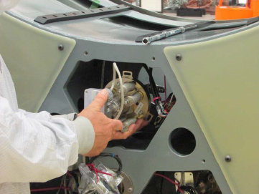
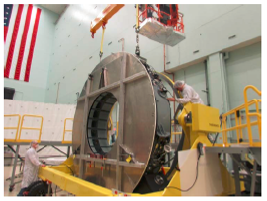
Scope of the WBS: Primary Deliverables
Deliverables - continued
Aluminum surrogate mirror.
Maintenance platform.
Spare axial and tangent link actuators.
M2 cell simulator for software integration and testing.
Documentation
M2 surrogate
M2 platform & 4-Pt. lifter
Axial actuator
M2 in cart with cover

Slide 5
Accomplishments to Date
All Hardware completed and certified.
All Electronics completed and certified.
All Software completed and certified.
All equipment delivered.
All documentation delivered.
Project closed.

Slide 6
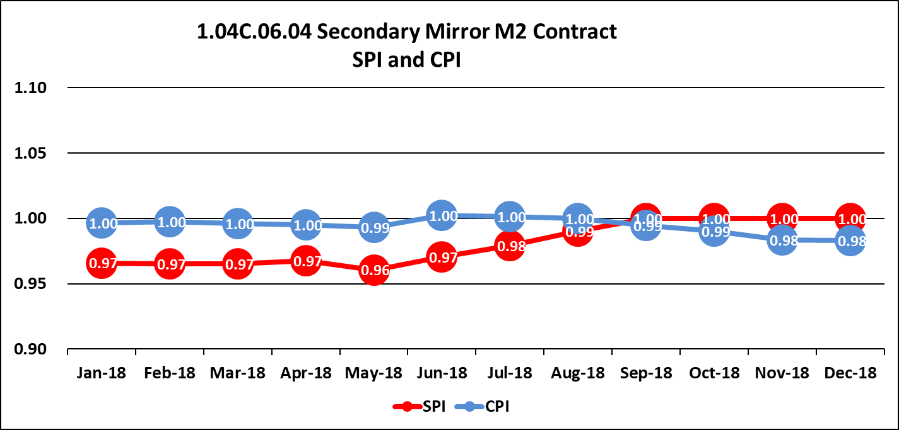
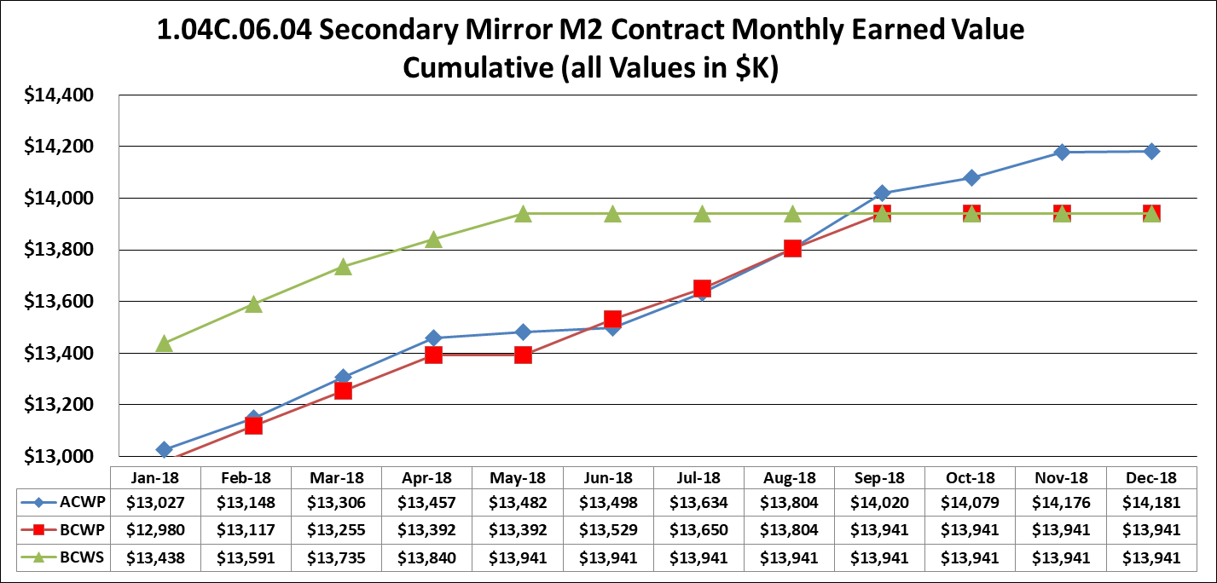
Cost Summary
The M2 system project has been closed out!
Final SPI ~ 1.0
Final CPI ~ 1.0

Slide 7
Risk and Opportunities
Since the project is completed no opportunities remain.
Some risk during installation still exist.

