Slide 1
Hexapod/Rotator System
Douglas R Neill
Chief Engineer & Hexapod/Rotator System CAM
NSF/DOE Joint Status Review
August 27-30th, 2019

Slide 2
WBS 04C.05 Hexapod & Rotator System Summary
WBS 04C.05 includes the design, analysis, fabrication, assembly and testing the hexapods/rotator system.
  The hexapods/rotator system is an integral part of the telescopes optical alignment system.
  This systems controls the camera and secondary mirror positions, and adjusts these positions, relative to the M1M3.
  The rotator counteracts the rotation on the focal plane caused by the azimuth rotation.
  These systems are “turn key” and include all hardware, software and electronics.

Slide 3
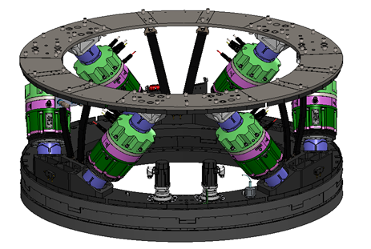
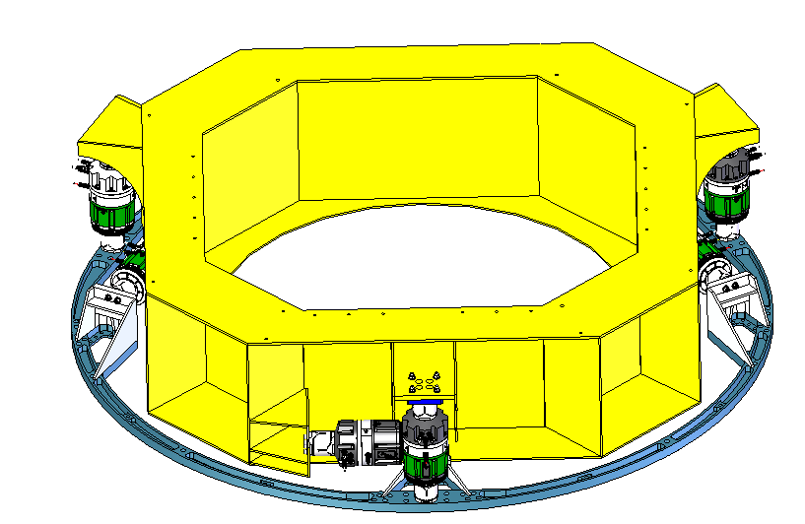
Scope of the WBS: Deliverables
Deliverables
  Camera Rotator
    De-rotates camera focal plane
    to counteract sky motion
  Camera Hexapod
    Aligns Camera optical axis
    to telescope optical axis
  M2 Hexapod
    Aligns M2 optical axis to
    telescope optical axis
  Spare Rotator (Identical to Camera rotator)
  Spare Hexapod Actuators

Slide 4
Scope of the WBS: Deliverables
Deliverables - Continued
  Hexapod and Rotator Controllers (control computers).
    Central controller
    Camera hexapod controller
    Camera rotator controller
    Spare rotator controller
    M2 hexapod controller
  Documentation
    Drawings
    Procedures
    Test results

Slide 5
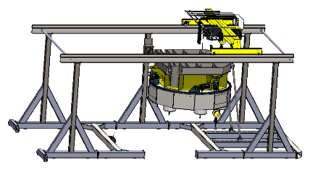
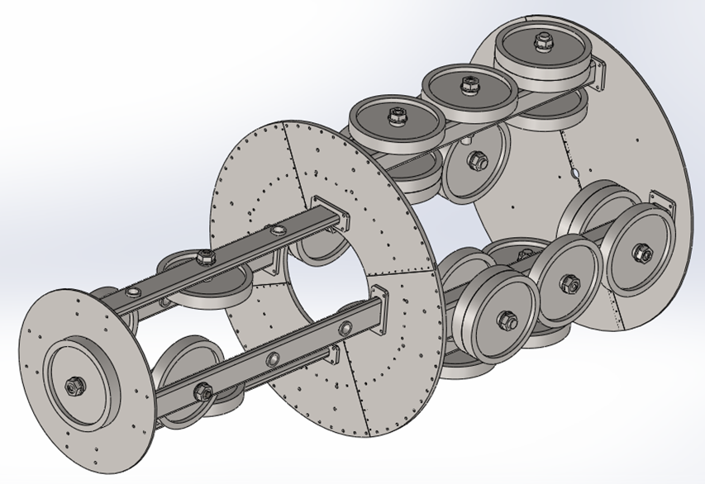
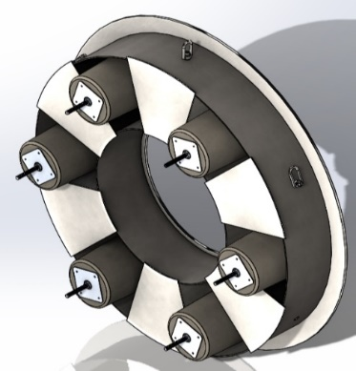
Scope of the WBS: Major Test Equipment
Major Testing Equipment is also include in the scope.
  Large Test Frame (not delivered)
    Simulates elevation changes
    Accommodates Camera Hexapod / Rotator
    Accommodates M2 Hexapod
  Camera Dummy Mass
    Simulates Camera Mass
    Fits within Camera Envelope
  M2 Dummy Mass
    Simulates M2 Mirror Cell Assembly Mass
    Fits within M2 Assembly Envelope
  TMA simulator
    Interface between M2 hexapod and test assembly

Slide 6
Accomplishments to Date
All Hardware completed and certified.
All Electronics completed and certified.
All Software completed and certified.
All equipment delivered.
All documentation delivered.
Project closed.

Slide 7
Future Work
The Hexapod and Rotator contract did not include site installation.
LSST personnel will be installing this equipment.
Some specialty installation equipment will be required.
The specialty installation equipment must still be developed.

Slide 8
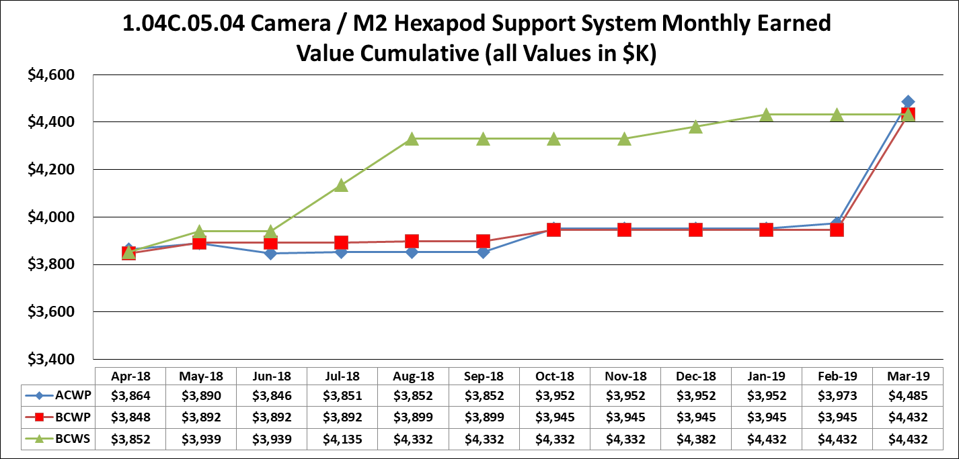
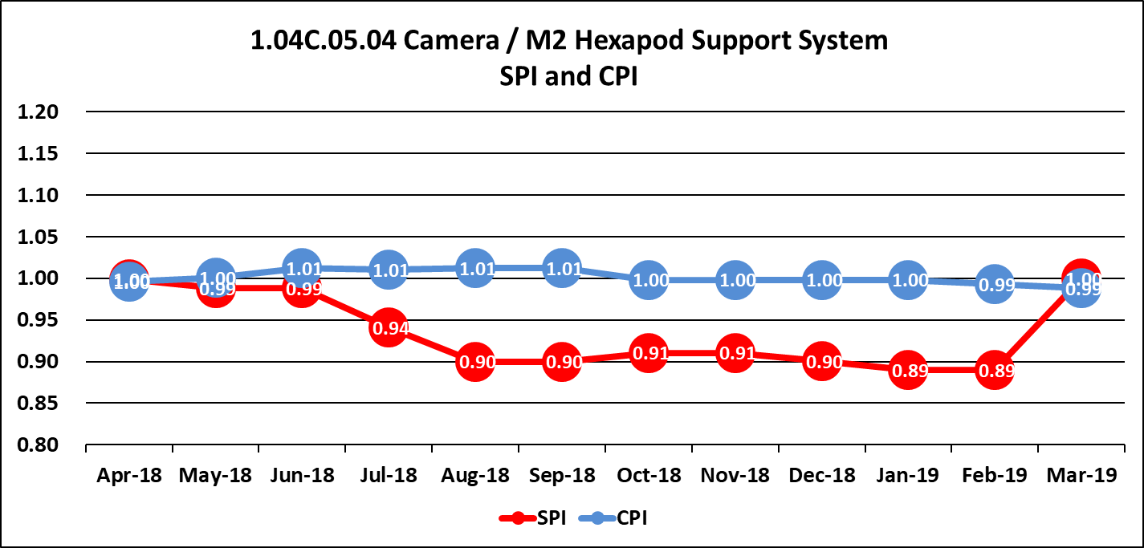
Cost Summary
The hexapod and rotator project has been closed out
  Final SPI ~ 1.0
  Final CPI ~ 1.0

Slide 9
Risk and Opportunities
Since the project is completed no opportunities remain.
Some risk during installation still exist.

