Slide 1
T&S AIV WBS 4.14 Jacques Sebag T&S AIV Manager NSF/DOE Joint Status Review August 28, 2019

Slide 2
04C.14 Telescope Assembly, Integration and Verification (AIV)
Scope: All site activities to assemble, integrate and test/verify the telescope system before the installation of the camera
Organization:
04C.14.01: Telescope Integration Mgmt and Engineering
This WBS provides the technical management of the Telescope integration effort. The Lead is provided by the Telescope and Site System Engineer and supported by the technical team responsible for the development of the constituent hardware. It also includes contracted labor for dome and mount assembly.
04C.14.02: Integration Tooling and Equipment
This WBS provides the laser tracker as facility alignment system, support system for M3 test and tools and equipment for 3-mirror optical testing identified for the telescope integration and test (IOTA, ComCam).
04C.14.03: Major Equipment Leasing and Rental
04C.14.04: Subsystem Integration and Test
TEAM
TOOLS
TASKS
Message box example for short highlighted messages.

Slide 3
Accomplishment to Date
Most large components delivered to the summit:
Coating chamber: October 29 – November 12 2018
M2 assembly: December 6 – 12 2018
M1M3 mirror: May 7 – 11 2019
M1M3 cell: June 26 – July 7 2019
TMA Transportation coordination planned for September 2019

Slide 4
Accomplishment to Date
Successful Integration and Verification of Large Components within Facility:
Platform Lift interfaces and load testing with facility
Coating Plant integration and interface with facility
Monitoring Equipment Installation (DIMM & Weather Tower, All-Sky Camera)
Testing and Coating of Mirror Assemblies:
M2 Assembly testing and interface on the summit
M2 mirror Coating on the summit
M1M3 cart testing with platform lift and coating chamber
M1M3 mirror transport and storage on the summit

Slide 5
Accomplishment to Date
Auxiliary Telescope Assembly and Testing
Integration with Facility
Closed Dome Testing
Mirror Installation and Collimation
AIV Tools development:
Laser Tracker Alignment Interfaces
IOTA: SHWFS Factory Acceptance Tests
Commissioning Camera (see ComCam slides)

Slide 6
System Integration and Verification Activities
Risk = schedule delays from the dome and the TMA vendors
Remediation: integration of schedule of AIV activities with the commissioning activities
SIT-Com = System Integration and Test and Commissioning
Worked with Management in Chile and CAMs to understand the scope of work for the integration
Created a new sequence of activities to realign the schedule
Activity planning at different level is now coordinated at the project level (not just at the T&S level)
Integration of T&S Engineering with the System Engineering: Verification of T&S requirement are more imbedded into the overall Project
Notes:
Reacting to the delay of the dome and the TMA to update the plan – LTS-104 is still valid for the integration pieces but the overall sequence still needs to be update

Slide 7
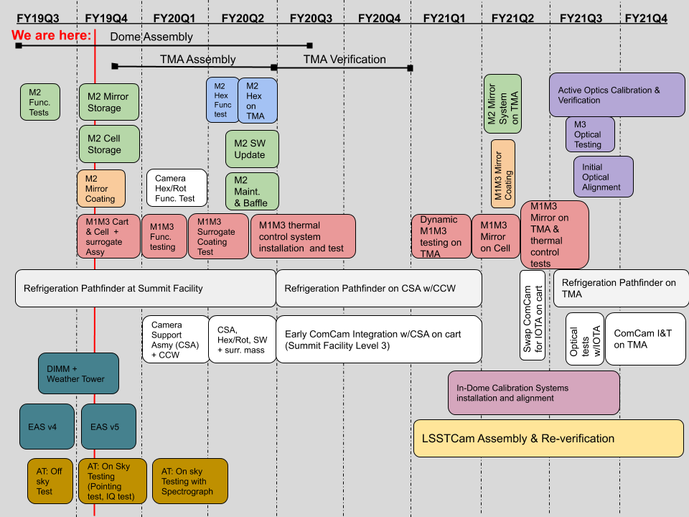
System Integration Sequence Summary
New June Baseline
Very dense schedule for the next 2 years
Opportunities
Early commissioning activity
Early software integration within T&S and also with the other subsystems
Extensive M2 testing on the cart to allow for glass mirror installation
Risk:
TMA and Dome Schedule
Aggressive schedule

Slide 8
Current Planning
M1M3 Actuators Integration = July 29th 2019 – October 18th 2019
TMA integration start = October 1st 2019
M2 Hexapod Integration with TEA = October 29th 2019
Camera Support Assembly cart ready = Oct 15th 2019
CSA + Integrating Structure #1 Camera Cable Wrap Ready = October 28th 2019
Cam Hexapod Rotator with CSA = Dec 2nd 2019
M2 Baffles Arrive & New Activities for M2 = March 19th 2020
ComCam arrival = April 1st 2020
TMA ready for mirror installation: October 1st 2020

Slide 9
Future Work
Continue Testing and Coating of Mirror Assemblies:
M1M3 testing with M1M3 surrogate ( and testing with Platform lift and Coating chamber)
Preparation M1M3 coating
Testing of M3 wavefront measurement equipment
M2 assembly testing with M2 surrogate
Start Integration and Test of Hexapods/Rotator:
M2 Hexapod integration and test on TMA Top End Assembly
Camera Support Assembly early integration & Test on camera cart to do early verification of interfaces (both mechanical and software): Camera Hexapod/Rotator, Camera Cable Wrap, Instrument (ComCam or IOTA)

Slide 10
Future Work
Preparation of TMA Integration on site:
Dynalene Chilers Installation with Pier
OSS installation in 1st level
Rails integration with Dome
Continue Camera Preparation (Mostly Camera Team Resources):
Camera Clean Rooms readiness
Camera Refrigeration Preparation
Camera Cart testing with Platform lift

Slide 11
Software Integration on the CSA
Use of the camera support assembly to start software integration of the TMA Camera Cable Wrap (CCW), the camera hexapod rotator and later ComCam.
Integration of different component to the SAL
Integration of CCW, Cam Hexapod/Rotator to the ScriptQueue
Integration of CCW, Cam Hexapod/Rotator to the Pointing Component and the Scheduler
Integration of the OCS to the TCS and the camera team and DM using ComCam on the CSA

Slide 12
Future Work: Software Integration
Increase the team in Chile
Focus on the component simulators to start virtual integration
Test-bed in Tucson using the AuxTel Spectrograph
Deployment strategy (LTS-XXX)

Slide 13
Deployment and Testing
Testing: On-going effort to integrate with Jenkins Continuous Integration:
Integration of unit tests
Part of build/release process
Based on Gitflow Workflow
Involvement of the Product Owner
Deployment:
Deployment to be done by Puppet/Kubernetes
Continuous Integration to be done by Jenkins
Builds & automated testing
Deployment & CI done in conjunction with IT, DM & Camera to ensure same technologies across project.
2018 Review recommendation

Slide 14
Telescope Performance Verification
Image Quality (0.25”) – Document-29054
Optical prescription of mirrors
Mirror support system behavior
M3 Optical testing at horizon
3-Mirror system testing
Dome Seeing
Pointing/Slew/Settle (0.2 arcsec) – Document- 34756
Factory testing
TMA Chile testing
Optimization of pointing model
Throughput
Sample testing
M2 Mirror Coating measurements
M1M3 Mirror Coating measurements
Coating degradation
May 2021
May 2021
Start depend on dome completion
Partly, will be done during the Chile Testing
March 2020
June 2021
April 2021

Slide 15
AIV Team is Key to Success
Represents Tucson Based Staff
Victor Krabbendam: LSST Project Manager
Wil O’Mullane: Deputy Project Mgr – Software
Vincent Riot: Deputy Project Mgr – Camera
Open: Deputy Project Mgr - Chile
Represents Chile Based Staff
Represents group of staff with a local lead
Doug Neill
Chief Engineer
Jeff Barr
T&S Project Manager
Sandrine Thomas
T&S Proj. Scientist
Sub-System Science Team
Wil O’Mullane Deputy PM – Software / Technical support
Engineering Group.
Enrique Figueroa
Base Team
Jacques Sebag
T&S AIV Manager
Eduardo Serrano
Site Manager
T&S Support Staff
Oscar Nunez
Deputy Site Mgr.``
Design Group
Sub-System CAMs - North
Andy Clements
Control Soft. Mgr.
Tucson Shop Fabrication .
Chile Software Team
Tucson Software Team
Optical Group Lead
Summit Electrical Group Lead
Electrics Group Lead
Mechanical Group Lead

Slide 16
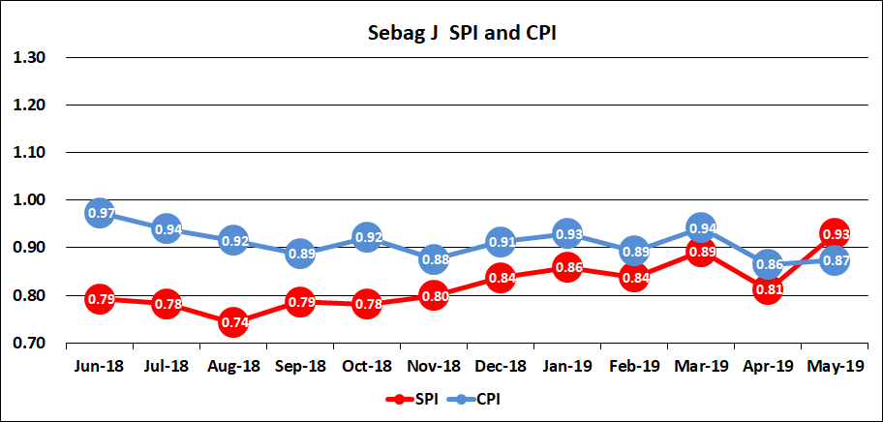
Cost and Schedule Performance Summary
Schedule Performance Index (SPI): Activities delayed by late delivery (slowly improving)
Cost Performance Index (CPI): Under spending due to reduced labor expenses

Slide 17
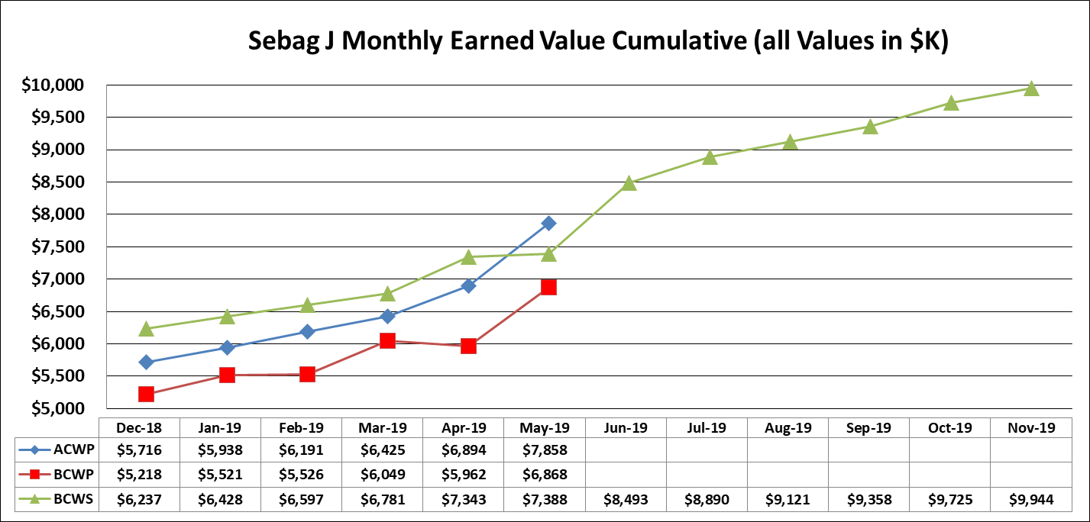
EVMS detail
Actual Cost of Work Performed (ACWP): $4.5M in May 2018 - $7.8M in May 2019. Delta = $3.3M
Budgeted Cost of Work Performed (BCWP): $4.6M in May 2018 – $6.9M in May 2019. Delta = $2.3M
Budgeted Cost for Work Scheduled (BCWS): $5.1M in May 2018 -$7.4M in May 2019. Delta = $2.3M

Slide 18
Cost Summary

Slide 19
Risks and Opportunities
Risks
Schedule Delay of activities
Dome construction progress dependent on good weather
Conflict between parallel activities
Equipment and personnel accident
Retention of personnel
Opportunities
M2 coating
M2 Hexapod integration with TMA Top-End Assembly
Integration of software using the camera support assembly

