Slide 1
T&S Utilities and Equipment WBS 4.12
Eduardo Serrano and Jacques Sebag
T&S Site Manager and AIV Manager
NSF/DOE Joint Status Review
August 28, 2019

Slide 2
04C.12 Telescope Utilities and Support Equipment
Scope: All equipment and subsystems for initial integration, operation of the facility and routine maintenance.
Organization Distributed into different Sub-WBS with specific package manager:
04C.12.01: Utilities and Equipment Mgmt and Engineering (Sebag)
04C.12.02: Safety Systems – Interlocks (Callahan)
04C.12.03: Monitoring Systems (Sebag)
04C.12.04: Facility Systems (Serrano)
04C.12.05: Summit Network (Kantor)
04C.12.06: M1M3 Cell Cart and Tools (Serrano)
04C.12.07: Vehicles and Transportation (Serrano)
04C.12.08: Shipping and Logistics (Sebag)
Message box example for short highlighted messages.

Slide 3
04C.12 Telescope Utilities and Support Equipment
Organization Distributed into different Sub-WBS with specific package manager:
04C.12.09: Camera Support Assembly Cart (Callahan)
04C.12.10: M2 Equipment (Barr)
04C.12.11: M1M3 Equipment (Andrew)
04C.12.12: Summit Equipment (Serrano)
04C.12.13: Coating Optical Equipment (Vucina)
04C.12.14: Pointing Test Equipment (Sebag)
04C.12.15: VRCAC and Roof Locks (Serrano)
04C.12.16: Dynalene Cooling System (Callahan)
04C.12.17: Post Construction (Barr)
04C.12.18: Environmental Awareness System EAS (Stalder)
04C.12.19: Special Utilities (Callahan)
Message box example for short highlighted messages.

Slide 4
Sub-WBS | Status | Comment
04C.12.02 | Interlocks Systems completed by Tekniker | Shipment to Chile expected in September
04C.12.03 | Weather Station installed | closed
04C.12.04
04C.12.05 | Summit Network initial deployment in place | Base Facility Network deployment in progress
04C.12.06 | M1M3 cart delivered to Chile
04C.12.07 | Vehicles + Minibus in use on summit
04C.12.08 | Shipment to Chile of Coating Chamber, M2 mirror, M1M3 cell and M1M3 mirror, Hexapod/Rotator Completed | TMA shipment arrival expected in September
04C.12.09 | Camera Support Assembly Cart delivered to Chile | Closed
04C.12.10 | M2 Equipment on hold | M2 Baffle fabrication expected in Feb 2020

Slide 5
Sub-WBS | Status | Comment
04C.12.11 | M1M3 rails delivered to Chile | Closed
04C.12.12 | Summit Equipment delivered to Chile | closed
04C.12.13 | Coating Optical Equipment delivered to Chile | closed
04C.12.14 | Initial pointing test equipment procured | To be tested on Auxiliary Telescope
04C.12.15 | VRCAC and Roof locks installed | closed
04C.12.16 | Dynalene Chillers installed
04C.12.17 | Post-construction in progress
04C.12.18 | Environmental Awareness System in progress
04C.12.19 | Special Utilities in progress | TMA Oil Lines installation

Slide 6
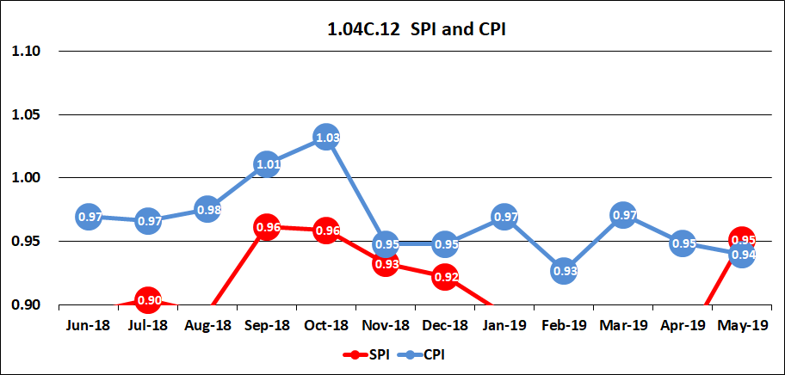
Cost and Schedule Performance Summary
Schedule Performance Index (SPI): delayed due to late shipments
Cost Performance Index (CPI): Higher cost due to undervalue estimation

Slide 7
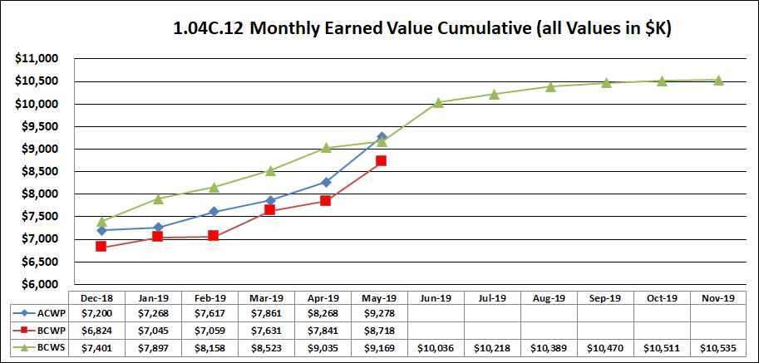
EVMS detail
Actual Cost of Work Performed (ACWP): $9.3M in May 2019
Budgeted Cost of Work Performed (BCWP): $8.7M in May 2019
Budgeted Cost for Work Scheduled (BCWS): $9.1M in May 2019

Slide 8
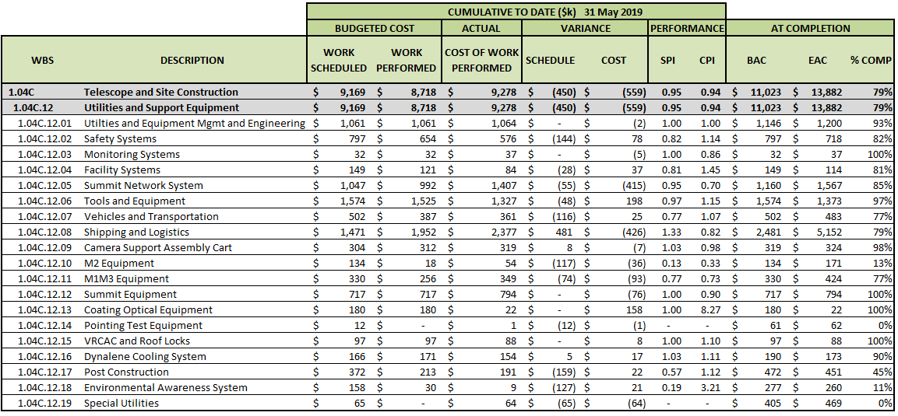
Cost Summary

Slide 9
Accomplishment to Date
Shipment of major subsystems (coating chamber, mirrors,…)
Procurement of Summit Equipment and tools
Procurement of machine shop
Procurement of DIMM
Design and Procurement of the Auxiliary Control for the platform lift
Design and procurement of the deployable roof locks
Procurement of power tug for cart
Procurement of summit vehicles

Slide 10
Future Work
Continue procurement of tools
Continue procurement of summit vehicles
Procure summit audio-visual equipment
Continue development of EAS
Install utilities for TMA

Slide 11
Risks and Opportunities
Risks
  Most major ocean shipment risks have been eliminated - only TMA shipment left
Opportunity:
  Simplification of mirror lifting procedure by removing need for hydraset after analysis and tests of facility bridge crane
  Return funds to contingency

