Slide 1
LSST Safety Performance Chuck Gessner Head of Safety & LSST Project Office NSF/DOE Joint Status Review Date in long format

Slide 2
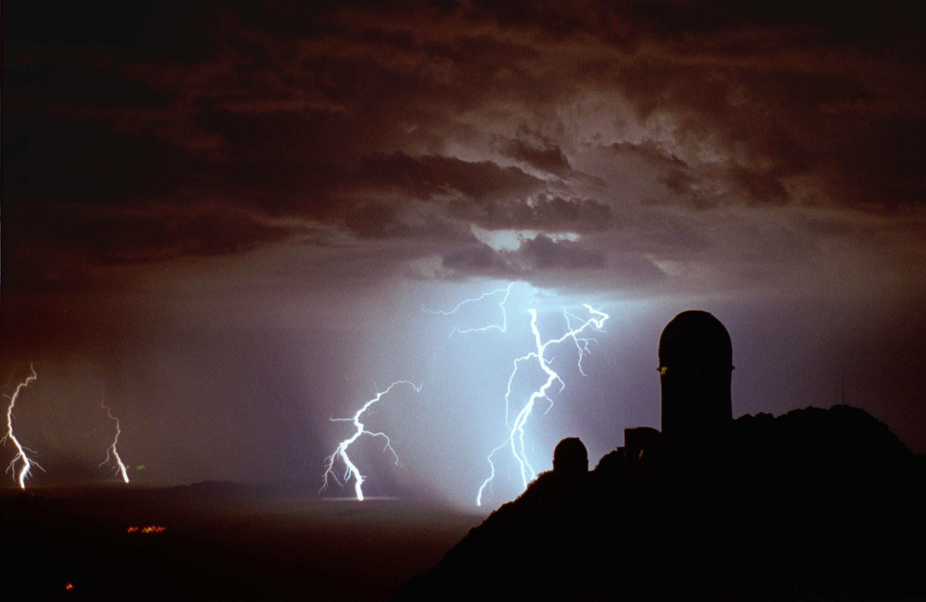
Monsoon Awareness
Excessive Heat - stay hydrated, limit time outside
Lightning – when there is thunder stay indoors
Flash Floods – don’t cross flowing water
Blowing Dust – if driving, pull over, turn off the lights

Slide 3
Housekeeping
Ask the helpful staff
Be aware of building exits.
Look around for fire extinguishers and fire alarm pull stations.
In case of a medical emergency we are at the Omni Tucson National Resort 2727 W. Club Dr. Tucson AZ 85742, (520)-575 -7540.
Message box example for short highlighted messages.

Slide 4
Safety, Health, and Environment (SHE)
Mission
The Safety Mission of LSST is to provide every individual working or visiting the LSST facilities with an environment that is free from recognized hazards that are likely to cause them harm.
The LSST Safety Policy (LPM-18) summarizes:
LSST is committed to achieving the highest performance in safety, health, and environmental management practices with the aim of creating and maintaining a safe and healthy working and operating environment.
The Safety Policy focuses on personnel and equipment safety throughout the design, construction, commissioning, and operations phases of the project.
Notes:
The objective of the policy is to make safety, health, and environmental management an integral part of the effort from initial planning and design, to construction, commissioning, and finally throughout the operation of LSST.

Slide 5
2019 LSST Annual Progress Review Safety Charge
6. ES&H: Are Environment, Safety & Health (ES&H) issues managed appropriately?
Does the project have an acceptable safety record? Are Integrated Safety Management Principles being followed?
7. Has the project responded satisfactorily to recommendations from previous reviews?
SC5 – Environment, Safety, and Health (ES&H) (2018 Review)
ES&H findings, comments, and recommendations may also be found in other sections in this report, as this aspect of the project is included in several other categories and was discussed in great detail in many of the subcommittee meetings.
ES&H RECOMMENDATIONS:
None.

Slide 6
Incident and Accidents
LSST Incidents and Accidents
June 2010 to May 2019
 |  | LSST | CONTRACTORS | SUMMIT SITE | OTHERS | Totals
Incidents | PEOPLE |  | 2 |  |  | 2
 | EQUIPMENT |  | 2 | 1 |  | 3
 | PROCESS | 1 |  |  |  | 1
Incidents Total |  | 1 | 4 | 1 |  | 6
Accidents | PEOPLE | 6 | 12 | 11 | 1 | 30
 | EQUIPMENT | 6 | 18 | 2 |  | 26
Accidents Total |  | 12 | 30 | 13 | 1 | 56
Totals |  | 13 | 34 | 14 | 1 | 62
Note: Accidents PEOPLE - 8 Medical Cases and 20 First Aids
Safety is the control of accidental loss.
An accident is an undesired event that results in harm to people, damage to property or loss to process.
Accidents result from contact with a substance or source of energy above the threshold limit of the body or structure.
An incident is an undesired event which, under slightly different circumstances could of cause an accident.
LSST - includes AURA, SLAC personnel and equipment no matter who caused it.
Others- AURA, NOAO and its contractors providing service to LSST
Notes:
This table is a summary of all incidents and accidents since 2010. Of the 30 injuries, 22 were first aid injuries and 8 of them would be considered OSHA recordable. Safety log tracks types of incidents and accidents. Three of the 8 medicals were lost time accidents. We still believe that traveling to and from the summit is the most hazardous task (21 of the 62 incidents and accidents were vehicle related).
Three were considered lost time accidents:
Summit contractor jumped out of backhoe after losing control - anxiety - medical lost time - 5 days
Base Facility contractor tripped and contusion to left knee - prescribed Rx –medical lost time- 3 days
Camera contractor IN23P caught between stationary object and filter exchanger – medical lost time requiring surgery –estimate 14 days

Slide 7
LSST Injury Rates ( May 2019)
SLAC - Camera Team, AURA - T&S, some DM, and PO .33
Summit and Base Facility Contractors .61
Total of these groups .50
(U.S. 2017 National Average 2.8, 2016 DOE average 1.3)
Notes:
Conservatively calculated about 3.2 million hours worked to date on the project of the above noted groups – with 8 recordable accidents the injury rate is .50, (Overall 2017 U.S. National Average is 2.8, most current data from BLS) Other groups like Universities and partnerships are not counted. Injury Rates (IR’s) are based on number of cases per 100 full time equivalents (200,000 hours) using OSHA definition of a recordable accident.
Conservative means not all hours worked are accounted. Not all contractors are included like IN2P3 even though we counted the accident. Only AURA and SLAC employees are counted, not partner universities.
2018 – 3 medicals, 663982 hours, IR=.44
2019 - 1 medical to date, 453675 hours, IR=.30

Slide 8
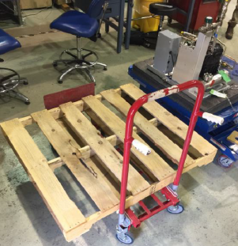
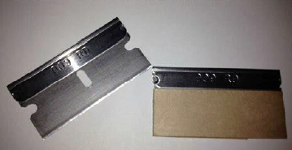
Recent LSST incidents (SLAC B33)
Refrigeration compressor sliding off pallet in May 2019
Finger cut during razor blade use in May 2019
Notes:
I am mentioning that the Camera team had a safety stand down in July 2019, mainly due to the events of the next slide.

Slide 9
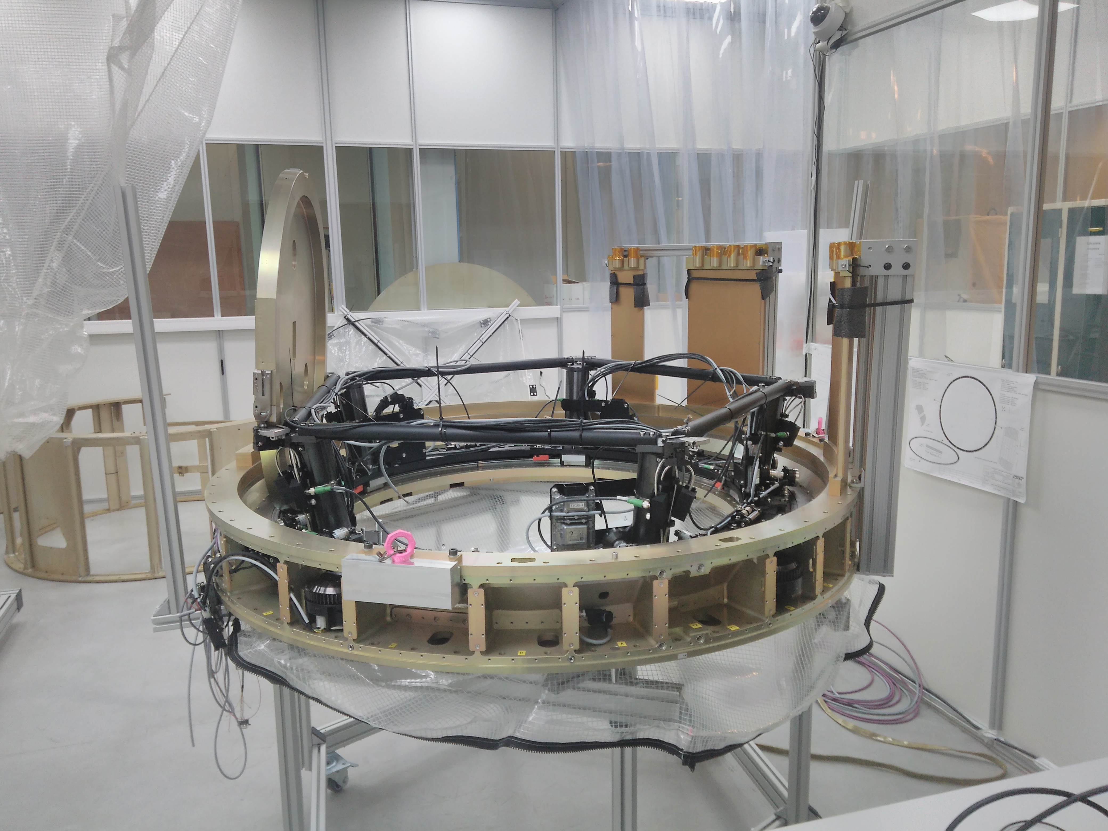
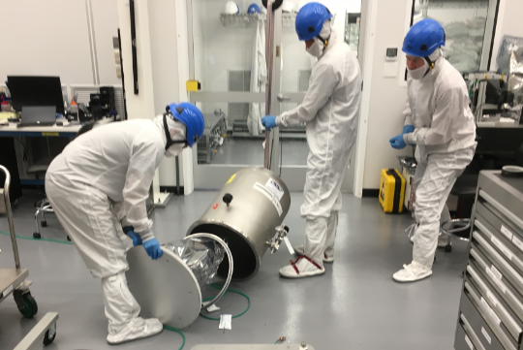
Recent LSST incidents (IN2P3 and IR2)
Injury Incident while testing the carousel in April 2019
Science raft collision with Bell Jar during removal in July 2019

Slide 10
Localized LSST Safety Staff
Safety personnel is currently supporting construction and will be engaged in installation of subsystems and later commissioning; some will transition to operations.
Safety Manager
Tucson
Chuck Gessner
Safety Coordinator
Cerro Pachon and Logistics
Sandra Romero
Safety Supervisor
All Construction
Giovanni Corvetto
Camera Safety Manager
SLAC
Joe Kenny
Safety Coordinator
Roaming
Sergio Vega
Notes:
Romero, Corvetto, and Vega rotate between summit and base facility construction sites to become familiar with both locations. Kenny focused on camera construction.
There will be multiple shifts starting with Commissioning, the primary safety coverage will be during the day activities. At times and when needed there will be safety coverage during nighttime operations if there is work being planned on the telescope floor or in the maintenance area at night. Based on observatory experience, nighttime commissioning does not require full time safety oversight.
If a major breakdown occurs during commissioning, such as hydraulic oil failure, Operators would shutdown all systems to make it safe and maintenance crews would investigate the failure the next day and plan for repairs via a procedure.

Slide 11
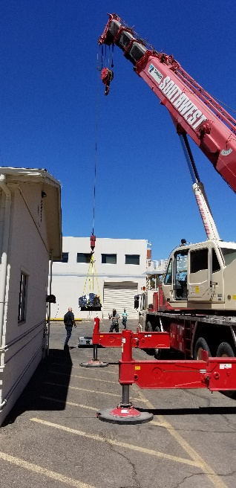
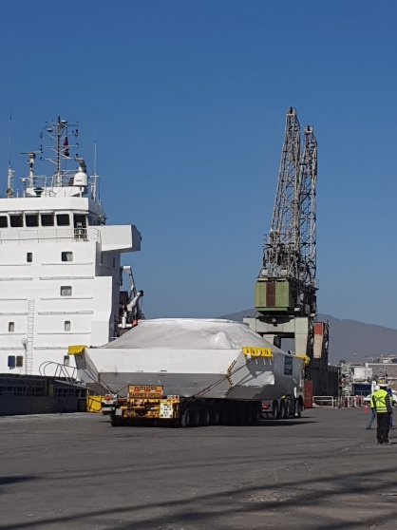
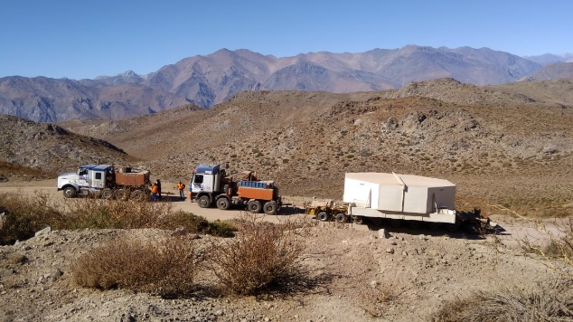
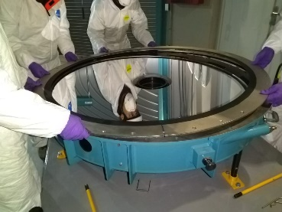
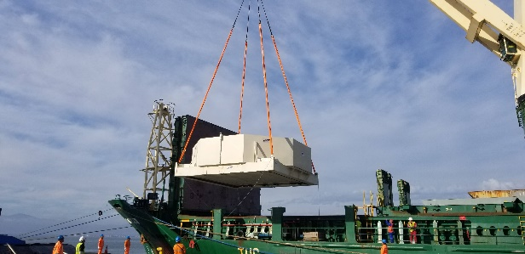
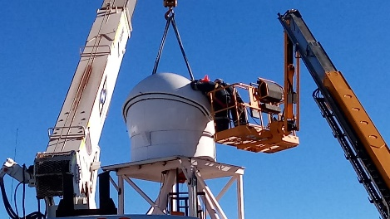
Successful and Safe Movement 2018-2019
M1M3 and M2 from U.S. to summit
Coatings Chamber from Germany to summit
ComCam from California to summit
Auxtel Primary Mirror installation
DIMM tower work
M1M3 mirror cell from Tucson to summit
Notes:
Delivery of glass and subsystems to the summit require serious logistics, coordination and safety oversight.

Slide 12
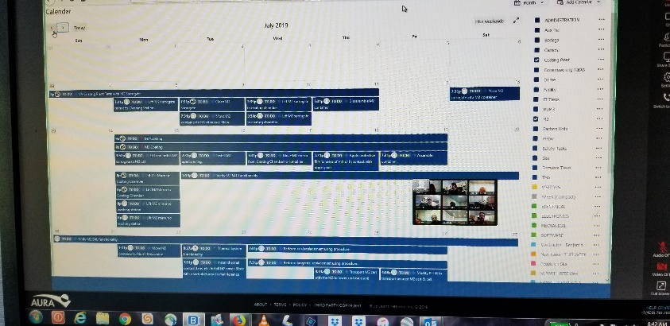
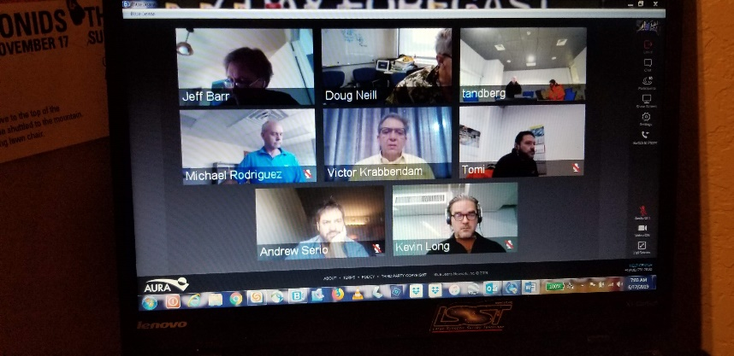
Safe Work Planning and Control
Summit Work Planning Meeting –strategic
Weekly Coordination Meeting – plans for the next week
Morning Summit Meeting - work coordination (bilingual)
(All have safety personnel participation and safety topics)
(All are managed with the same Jira tool to manage work)
Notes:
This is one of the improvements that we have made to our safe work planning and control. Everything reported last year is the same.
We have been working to tie these meetings together where the Planning meeting matches the project’s schedule and the other two meetings match the work that needs to be done and what will be done that day. The Jira tool allows us to see the strategic plan and drills down to the actual tasks of the day.
There is safety personnel presence in all these meeting and if there are LSST camera personnel working on the summit the LSST Camera Safety manager attends.
The daily summit meeting is translated in real time for English speaking participants.
Anyone can participate in these meetings as all three are live with BlueJeans.

Slide 13
Work Planning and Control
Weekly meetings with safety staff and schedule sent out to stakeholders.
Día | Base Facility | Summit Site
Lunes 17 | S. Romero Reunión TPC Reunión Prep. Review Coating M2 Imopac Safety Orientation* Safety Support to Base Facility Activities | S. Vega Cavada TV Inspección de andamios Conteiner EIE Imopac Safety Orientation* Safety Support Summit
Martes 18 |  | S. Romero Review M2 Coating Distintec Sling Review
Miércoles 19 | S. Vega Safety Support to Base Facility Activities | S. Romero Ana Zavala Casino Safety Inspection Safety Support Summit
Jueves 20 | S. Vega Safety Support to Base Facility Activities | S. Romero Presentación de Conducta en el lugar de trabajo AURA a Contratista MILL Safety Support Summit
Viernes 21 | S. Romero Safety Support to Base Facility Activities | S. Vega Safety Inspection JZ Project Safety Support Summit
Notes:
As part of our safe work planning and control we are planning safety activities on a weekly bases and we are sharing this information to the leadership to help prioritize where safety personnel should be.

Slide 14
Safety Initiatives this Year
On going procedure review before work begins
Weekly inspections - contractor and LSST
Glass moving readiness reviews and rehearsals
Safety signage for summit and base facilities
Evacuation procedures for weather and earthquakes
Working area segregation standard
Summit safety orientation
Drivers safety
Safety Rules
Continue to work on Safety Design and Hazard Analysis Verification

Slide 15
LSST SAFETY RULES #001 / LSSTsr#001
9
LSST Safety Rules LSSTsr#001
Abril 2019
ARMADO, DESARME Y MODICACION DE ANDAMIOS
ARMADO, DESARME Y MODICACION DE ANDAMIOS
Solo el personal autorizado podrá realizar tareas de armado, desarme o modificación de andamios.
Modificación de Andamios
Si tus tareas requieren de la modificación de un andamio, deberás contactar al supervisor encargado de andamios para solicitar la modificación.
Recuerda la Regla LSSTsr#001
JAMAS ARMAR, DESARMAR O MODIFICAR UN ANDAMIO, ESTAS SON TAREAS EXCLUSIVAS PARA PERSONAL AUTORIZADO
JAMAS USAR UN ANDAMIO QUE NO CUENTE CON LA TARJETA VERDE CORRESPONDIENTE AUTORIZANDO SU USO
LSST tiene como objetivo crear una filosofía donde la seguridad es un valor no desplazable, Para nosotros no existen trabajos tan urgentes que desplacen a la seguridad como valor.
Armado y desarme de Andamios Cada vez que tus tareas requieren del uso de andamios deberás hacerle saber a tu supervisor de estas. El supervisor deberá contactar al área encargada de armado de andamios para conjuntamente discutir el requerimiento. Una vez el andamio este operativo será etiquetado con una tarjeta verde que autoriza a su uso. Si en su defecto un andamio esta fuera de servicio o en proceso de desarme este será etiquetado con una tarjeta roja.
Jamás uses un andamio con tarjeta Roja
Notes:
An example of a Safety Rule in Spanish. This one is related to scaffolding safety.

Slide 16
LSST SAFETY RULES #001 / LSSTsr#001
9
LSST Safety Rules LSSTsr#001
April 2019
ASSEMBLY, DISASSEMBLY AND MODIFICATION OF SCAFFOLDING
ASSEMBLY, DISASSEMBLY AND MODIFICATION OF SCAFFOLDING
Only authorized personnel may perform tasks of assembly, disassembly or modification of scaffolding.
Modification of Scaffolding
If your tasks require the modification of a scaffold, you should contact the
of the
Assembly and disassembly of Scaffolding
Each time your tasks require the use of scaffolding you should let your supervisor know. The supervisor should contact the area in charge of scaffolding assembly to jointly discuss the requirement. Once the scaffolding is operational it will be labeled with a green card that authorizes its use. If a scaffolding is out of service or in the process of being disassembled, it will be labeled with a red card. Never use scaffolding with a Red card
supervisor in charge scaffolding to request modification
Remember the Rule
LSSTsr # 001
LSST aims to create a philosophy where safety is a non- displaceable value.
For us, there are no urgent tasks that displace safety as a
value.
NEVER ASSEMBLE, DISASSEMBLE OR MODIFY SCAFFOLDING, THESE ARE EXCLUSIVE TASKS FOR AUTHORIZED PERSONNEL
NEVER USE A SCAFFOLD THAT DOES NOT HAVE THE CORRESPONDING GREEN CARD AUTHORIZING ITS USE
Notes:
And this one is in English.

Slide 17
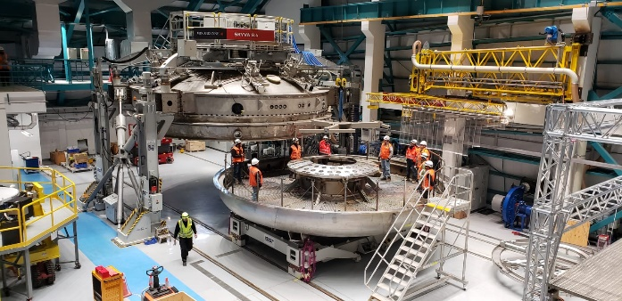
Safety Functions
Maintaining and developing SHE policies, standards, and training materials
Providing required LSST and regulatory documentation and reporting
Assisting staff to minimize loss
Conducting site safety orientation
Providing audits, inspections, and investigations for improvement
Providing physical safety oversight during critical tasks
Reviewing and safety-approving work procedures (required for all work)
Ensuring emergency response capabilities
Liaison required safety committees and contractors
Notes:
Needs new picture

Slide 18
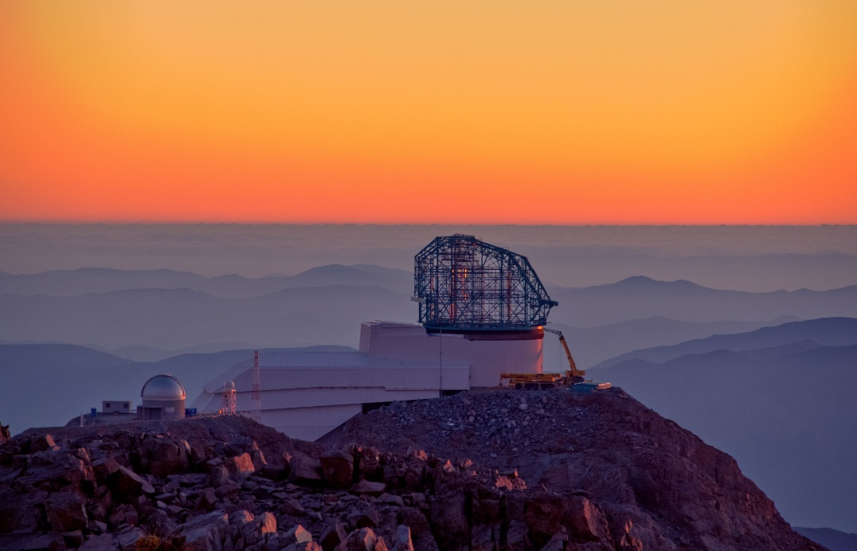
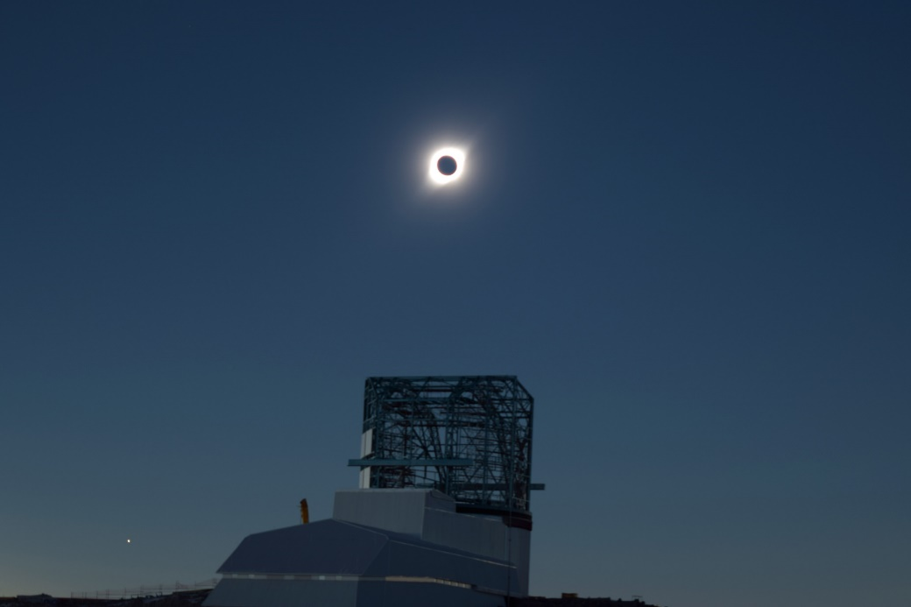
BACK-UP SLIDES

Slide 19
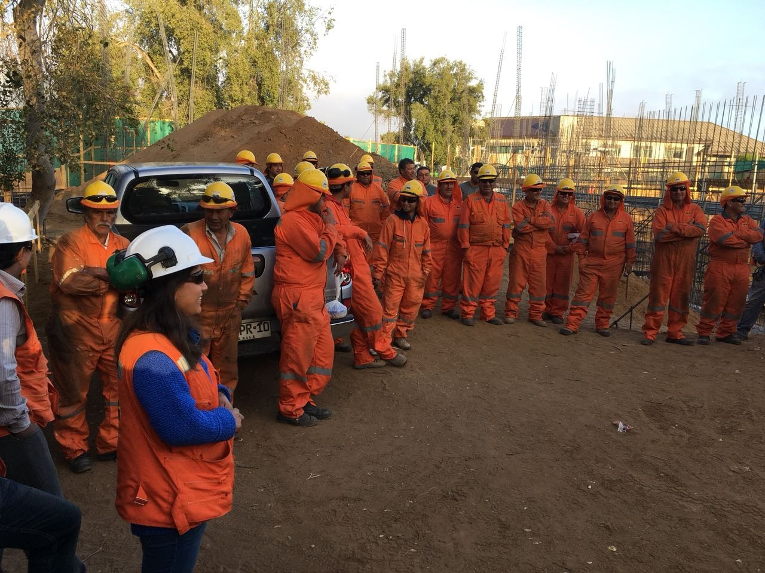
Work Planning and Control

Slide 20
Safe Work Planning and Control
LSST SHE Plan LPM-114 establishes compliance requirements and defines Stop Work Authority for all entities.
WBS Structure LPM-43 provides for safety staffing, safety budget, and other risk control efforts
LSST Hazard Analysis LPM-49 identifies hazards and mitigations and provides engineered and/or administrative controls to acceptable levels
LSST Safety Standards provides compliance for both US and Chilean requirements (copied from DOE and other organizations)
Training Standard Operating Procedure requires general safety awareness training for new hires and non-AURA workers
Site Safety Inspections help mitigate on site hazards

Slide 21
LSST Work Planning and Control
Site Safety Orientation informs of lessons learned, general workplace hazards, emergency response procedures, and other safety information
Lessons Learned are shared in weekly meetings, monthly contractor safety meetings, and monthly safety committee meetings
Recommendations - Campaigns
Administrative Controls are being established like the Global Interlock System, Signage, and Secured Access
Safety Training Matrix lists specific safety standard training and equipment training
Various Meetings are in place to coordinate and discuss safety issues
“On Boarding” safety message and other web based resources
Maintenance Procedures are being developed by vendors and those procedures must be demonstrated before acceptance

Slide 22
Work Planning and Control
All Camera work is authorized by supervisor or SLAC point-of-contact
Activity Training and Authorization (ATA) which leads to a SLAC Training Assessment for SLAC employees. ATAs are deployed to authorize an employee to perform routine work in resident areas
Job Safety Analysis (JSA), written standard operating procedure, approved eTraveler, or Work Integration Plan (WIP)
All work is released by the area manager before beginning work
All authorizations and releases are documented
Camera team will use web base training Litmos for LSST observatory mandated safety training
Observatory safety orientation has been updated and will be bilingual
Notes:
This is a slide from Joe’s presentation that also verifies that safety is integrated into the project.

Slide 23
Change Control Board
Senior managers of the project review and approve a variety of controlled documents (including safety policies and standards), interfaces, and design changes.
Actions:
Voting Items
• LCR-866: Move camera maintenance refrigeration compressors to the maintenance area
• LCR-1067: Updates to LSE-30 for EPO
• LCR-1085: Confined Space Entry Safety Standard
• LCR-1086: Lockout Tagout Safety Standard
• LCR-1087: Hot Work Safety Standard
• LCR-1089: Bloodborne Pathogen Safety Standard
Discussion
• LCR-457: Placing the machine-readable optical design under formal change control
• LCR-924: Duplicate LSR Data Performance Metrics in OSS for DM Flow Down
• LCR-931: Addition of LPM-122 Data Classification in the LPM-123 General AUP
• LCR-1004: Withdraw LSE-77, Infrastructure Interfaces Between Data Management and the Base Facility
Notes:
The text on the right is from a recent meeting minutes of a Change Control Board meeting. Note that there are several that are directly related to safety. Managers have to agree to the standards that they will have to follow.

Slide 24
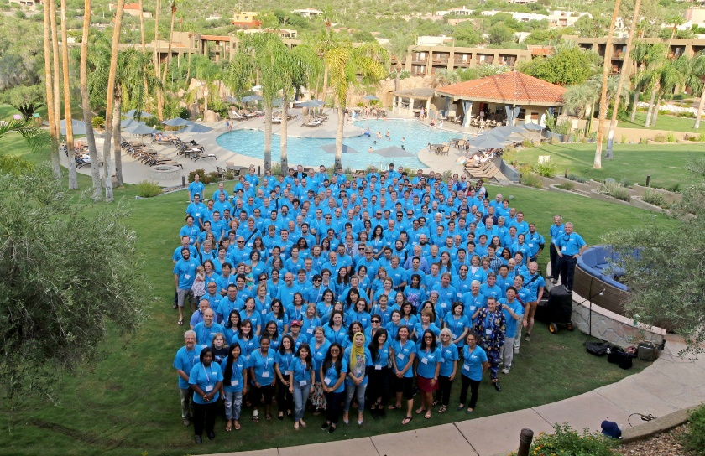
LSST Safety Council
Safety Council is a standing committee of 3 diverse professionals
Provides useful and favorable reviews
Reviews to date include Project Office Safety Management, Dome subsystem, Summit Site Safety Plan, Camera subsystem, Summit and Base Facility inspection and other observations
Observes and advises during Project and Community Workshops and Joint Technical Meetings
Physical interaction at least twice a year
Recent Review during the Project and Community Workshop, Tucson
August 13-17, 2018
Notes:
This is an example of LSST method to provide additional oversight in safety management and is envisioned to carry on into operations.
Safety Council’s Charge from LPM-18:
3.2 Safety Reviews and Hazard Analysis
LSST will conduct periodic design and procedure reviews focused on compliance to safety regulations, this program, and good practice. The frequency of the reviews will be commensurate with the stage of the project as defined in the Project management plan. Reviews will be conducted by SHE professionals and will focus on specific subsystems of the observatory, the observatory as a whole, and this Safety Policy itself. Each subsystem will conduct periodic Hazard Analyses to be included in the reviews. Hazard Registers will be maintained in standard forms for cross project review.

Slide 25
Emergency Response and Accident Investigation

Slide 26
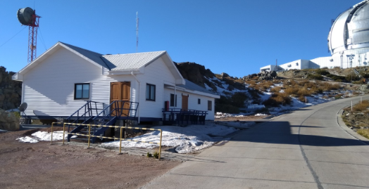
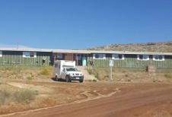
Emergency Response
Well established Medical Emergency Response and Communications:
Nurses and Paramedics: 2 paramedics, one each per summit (Cerro Pachon and Cerro Tololo) at any given time, 7 days on/7 days off, 24/7 coverage
2 Polyclinics one per summit (both supplied with medical equipment)
2 Ambulances one per summit
LSST personnel have Radios and they are also given to contractors. Telephones can direct dial to the US. Functioning Internet on the summit (both wired and microwave available), and WhatsApp “chats” one for LSST management, one for LSST safety personnel, and one for AURA safety personnel and legal representatives.

Slide 27
Accident Investigation
Written Plans and documents for ER procedures, accident investigation, and notifications:
LSST Safety web pages
Summit Visitor Safety Brochure
LSST Site Safety Orientation
LSST ESH plan (LPM-114)
AURA Emergency Plan
AURA Winter Operations
Hoja de Emergencia (Spanish and English)
Accident Notification Procedure
Accident Investigation Template
Lessons Learned

