Slide 1
Introduction and Overview Steven M. Kahn LSST Director NSF/DOE Joint Status Review July 30 – August 3, 2018

Slide 2
LSST Mission statement
LSST’s mission is to build a well-understood system that provides a vast astronomical dataset for unprecedented discovery of the deep and dynamic universe.

Slide 3
LSST in a Nutshell
The LSST is an integrated survey system designed to conduct a decade-long, deep, wide, fast time-domain survey of the optical sky. It consists of an 8-meter class wide-field ground based telescope, a 3.2 Gpix camera, and an automated data processing system.
Over a decade of operations the LSST survey will acquire, process, and make available a collection of over 5 million images and catalogs with more than 37 billion objects and 7 trillion sources. Tens of billions of time-domain events will be detected and alerted on in real-time.
The LSST will enable a wide variety of complementary scientific investigations, utilizing a common database and alert stream. These range from searches for small bodies in the Solar System to precision astrometry of the outer regions of the Galaxy to systematic monitoring for transient phenomena in the optical sky. LSST will also provide crucial constraints on our understanding of the nature of dark energy and dark matter.

Slide 4
Four Science Themes Define the Science Requirements
Taking a census of moving objects in the solar system.
Mapping the structure and evolution of the Milky Way.
Exploring the transient optical sky.
Determining the nature of dark energy and dark matter.
The techniques associated with these four themes stress the system design in complementary ways. By designing the system to to accomplish these specific goals, we ensure that LSST will in fact enable a very broad range of science.

Slide 5
The Science Requirements are Captured in the SRD
Formally adopted in July, 2011, and unchanged since that time.
Modification requires the approval of the LSST Corporation Board.
Includes a minimum specification, design specification, and stretch goals for all key parameters of the survey.

Slide 6
Summary of High Level Requirements
Survey Property | Performance
Main Survey Area | 18000 sq. deg.
Total visits per sky patch | 825
Filter set | 6 filters (ugrizy) from 320 to 1050nm
Single visit | 2 x 15 second exposures
Single Visit Limiting Magnitude | u = 23.5; g = 24.8; r = 24.4; I = 23.9; z = 23.3; y = 22.1
Photometric calibration | 2% absolute, 0.5% repeatability & colors
Median delivered image quality | ~ 0.7 arcsec. FWHM
Transient processing latency | 60 sec after last visit exposure
Data release | Full reprocessing of survey data annually

Slide 7
LSST Data Product Categories
LSST Data Product Categories & DM Data Products & Key Numbers
Previously“Level 3” data products
Notes:
From the user’s perspective
LST Data Products : https://www.lsst.org/about/dm/data-products
LSST LSST Data Product Categories (LPM-231) https://lpm-231.lsst.io/
LSST Data Products Definitions Document (DPDD): ls.st/dpdd
LSST will deliver three levels of data products and services. Prompt (Level 1) data products will include images, difference images, catalogs of sources and objects detected in difference images, and catalogs of Solar System objects. Their primary purpose is to enable rapid follow-up of time-domain events. Data Release (Level 2) data products will include well calibrated single-epoch images, deep coadds, and catalogs of objects, sources, and forced sources, enabling static sky and precision time-domain science. The Science Platform will allow for the creation of User Generated (Level 3) data products and will enable science cases that greatly benefit from co-location of user processing and/or data within the LSST Archive Center. LSST will also devote 10% of observing time to programs with special cadence. Their data products will be created using the same software and hardware as Prompt (Level 1) and Data Release (Level 2) products. All data products will be made available using user-friendly databases and web services.

Slide 8
LSST is a Public/Private, Interagency Project
The National Science Foundation:
Telescope and site facility construction, data management system, and education and public outreach.
Major Research Equipment and Facility Construction (MREFC). Total not to exceed cost is $473M.
Executed by the Association of Universities for Research in Astronomy (AURA) through Cooperative Agreement.
The Department of Energy:
Camera fabrication.
Major Item of Equipment (MIE), through the Office of High Energy Physics in the Office of Science. Total projected cost is $168M.
SLAC National Accelerator Laboratory is the lead DOE lab.
Private Support:
Total Support is ~ $40M.
Primary/tertiary mirror, secondary mirror blank, preliminary site preparation, early sensor studies.
Responsible organization is the Large Synoptic Survey Telescope Corporation.

Slide 9
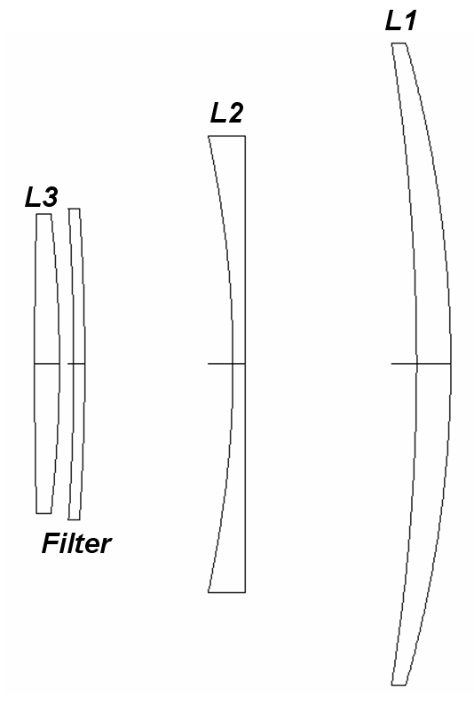
LSST Optical Design
The LSST incorporates a unique and compact Modified Paul-Baker 3-mirror optical design, with the camera located just below the secondary.
The surfaces of all three mirrors, and the six degrees of freedom orientation of the camera, are controlled by an active optics system.
There are three refractive optics in the camera (L1, L2, L3), plus a filter with very modest optical power.
The design has been optimized to reduce asphericity in the various elements, and to ease in testing.

Slide 10
Telescope Mount Assembly
The telescope mount involves a compact stiff structure, necessary to achieve the short slew and settling time allocation of < 4 s for a 3.5 degree slew.

Slide 11
LSST Camera
The 3.2 Gigapixel LSST Camera will be the largest electronic camera ever built for ground-based astronomy.
There are six optical filters, five of which are resident in the camera on any given night.

Slide 12
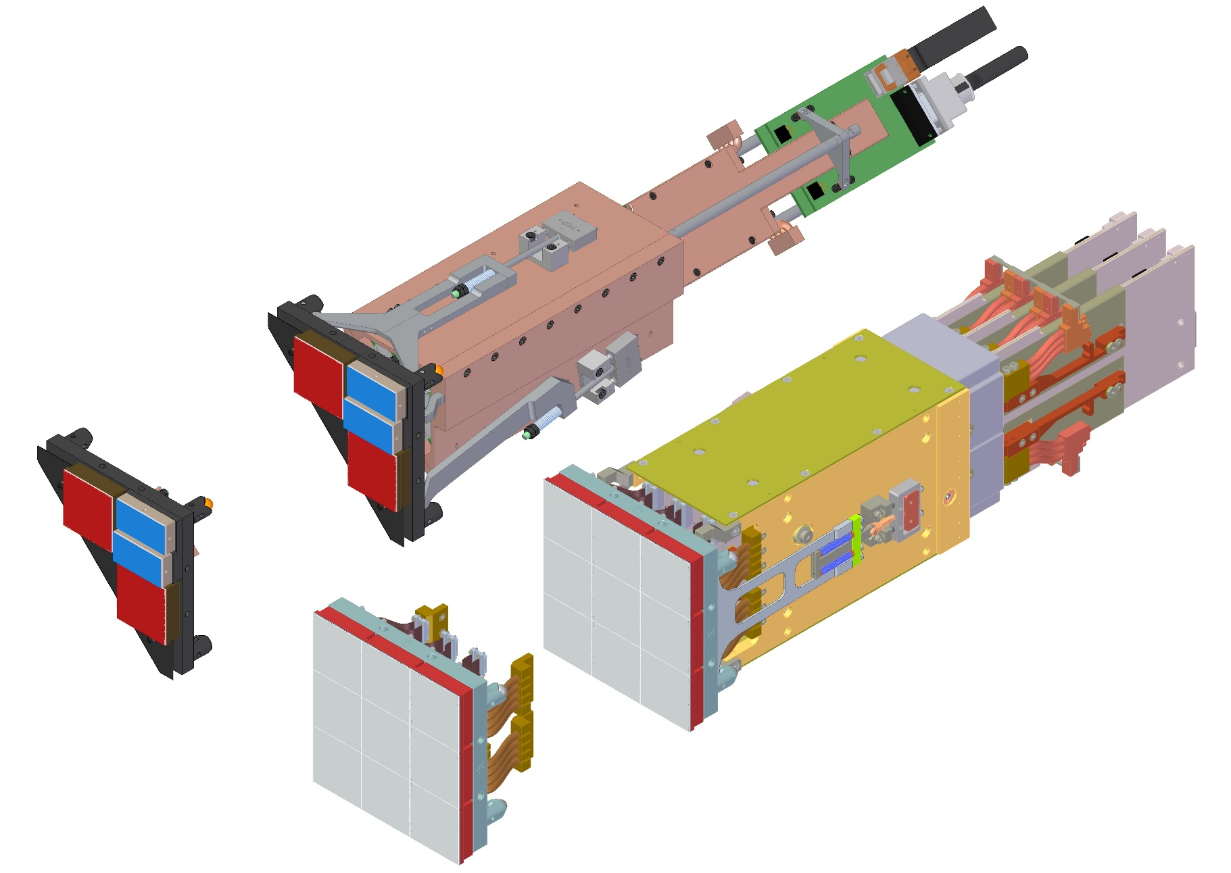
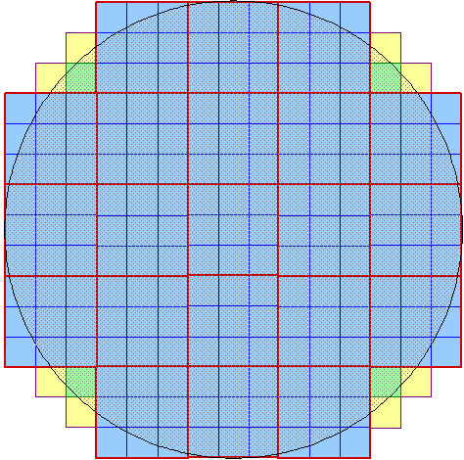
Sensor Raft Assemblies
4 Corner areas for wavefront sensing (green) and guiding (yellow).
3X3 CCD “RAFT”
8 rafts (ITL)
21 rafts make up the science array
13 rafts (e2v)

Slide 13
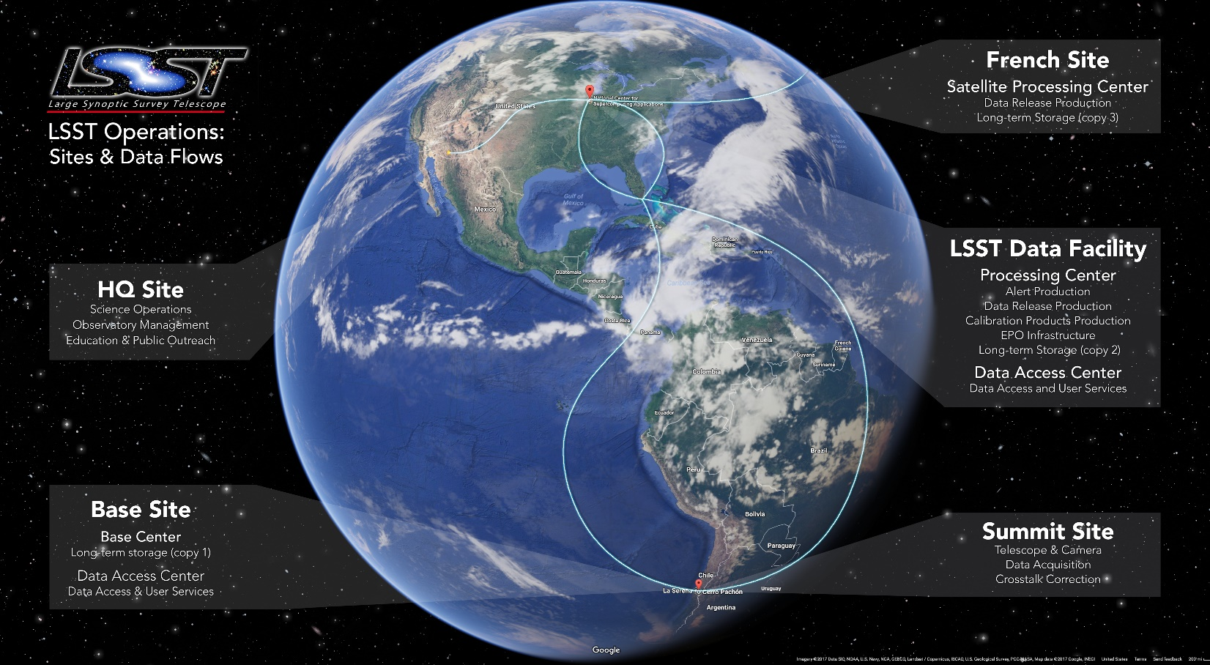
LSST Data Sites and Data Transfer

Slide 14
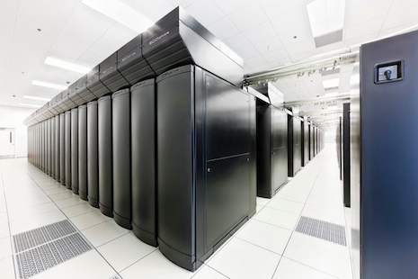
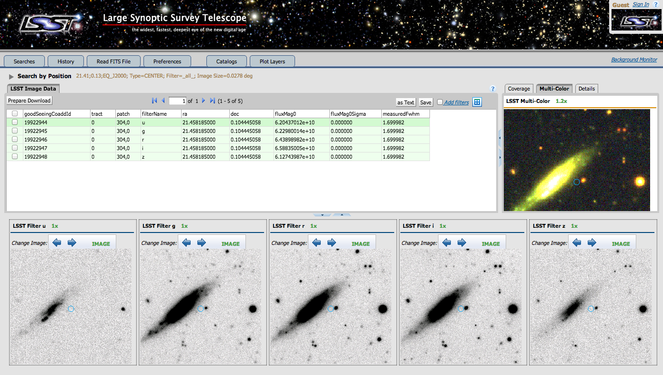
LSST Data Processing and Data Access
A petascale supercomputing system at the LSST Archive (at NCSA) will process the raw data, generating reduced image products, time-domain alerts, and catalogs.
Data Access Centers in the U.S. and Chile will provide end-user analysis capabilities and serve the data products to LSST users.

Slide 15
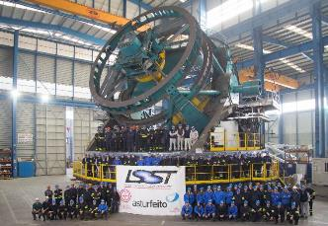
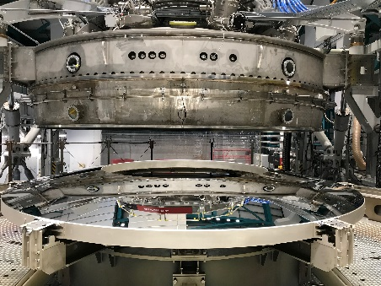
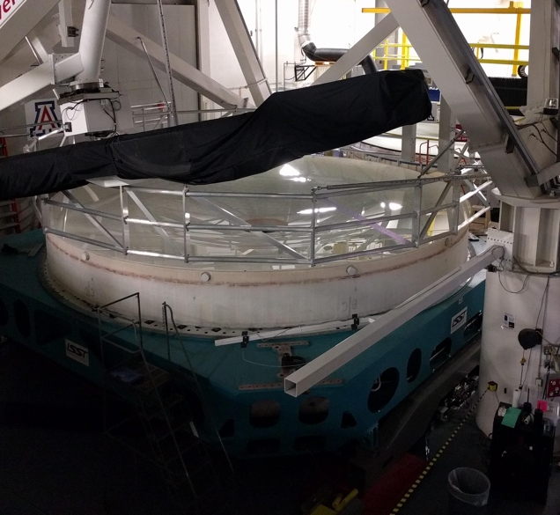
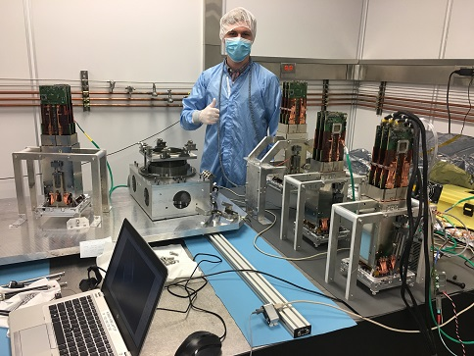
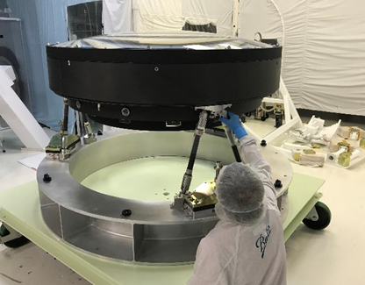
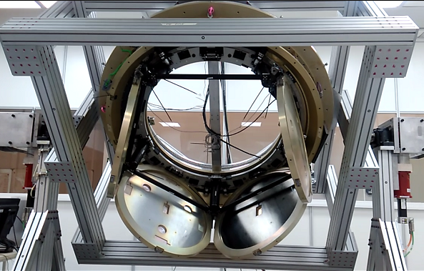
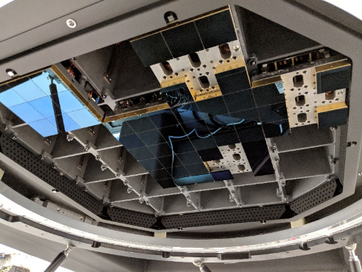
An Enormous Amount Has Been Accomplished Over the Last Year

Slide 16
Accomplishments in the Past Year
Summit facility contract completed and closed. Base facility nearly complete.
Dome still in progress, but at a much more advanced stage.
Telescope Mount Assembly constructed in Spain and verified. Now disassembled and shipment to Chile is underway.
Hexapod and rotator systems delivered.
M1M3 mounted in its cell and tested interferometrically at the U of Arizona. Both mirror and cell are on the summit.
Mirror coating chamber delivered and commissioned.
M2 delivered and successfully coated.
Camera sensor procurement complete.
Science raft production is complete.
L1/L2 assembly complete and awaiting shipment to SLAC. L3 complete and awaiting acceptance.
Camera body and shutter complete.
Filter exchange system will be shipped this summer.
Camera cryostat nearly complete. Raft insertion underway.
Commissioning camera delivered.
Science Platform FDR completed.
Camera data processing pipeline made major advances in terms of calibration, deblending, and treatment of sensor effects.
Demonstrated 100 Gbps network from base facility to NCSA.
Catalog database currently hosting 175 TB.
L2 milestones for data facility completed.
Finalized citizen science phase 1 development for EPO program.
Completed 16 short videos for planetariums.
Developed 4 formal education investigations.

Slide 17
Science Performance
We continue to update our estimates of the science performance of the system based on the measured properties of as-built components.
While there have been non-conformances on individual piece parts, the science performance remains excellent. So far, there has been no relaxation of any science requirements.
Our integrated étendue estimate is still 30% higher than the SRD requirement. Our image quality (FWHM) estimate is 15% below the SRD allocation.

Slide 18
Nevertheless, We Still Face Serious Issues!
They are primarily programmatic, not technical. They involve schedule, cost, and staffing concerns.
Schedule:
The dome completion is seriously delayed. This has significant impact on the TMA reassembly on the summit.
The TMA itself is delayed, and the schedule for assembly, integration, and commissioning is aggressive.
The camera is off the critical path now, but has suffered its own delays and has very little float.
We are now left with 3.5 mos of schedule contingency on the project.
Further delays will eat into commissioning.

Slide 19
Serious Issues (cont’d)
Cost:
The budget contingency is also very tight for both the MREFC and the MIE.
For the MREFC, we are 71% complete, and are down to 13% contingency on remaining work.
For the MIE, we are 93% complete, and have 21% contingency on remaining work.
Schedule delays are partially accounted for in the EACs, but significant further delays will seriously eat in to the contingency available.

Slide 20
Serious Issues (cont’d)
Staffing:
Maintaining our critical staff is a challenge for all parts of the Project.
The T&S team has lost a number of critical staff members. We are attempting to mitigate the situation by reassigning responsibilities, and hiring where we can.
On the camera team, we need to phase down the professional labor as subsystems become complete. In some cases, we have been able to transfer key staff gradually to other programs at SLAC. But this doesn’t work for all, and we are facing possible loss of subject matter expertise in some areas.
For the DM team, many will transition to LSST operations. However, uncertainty in some aspects of operations planning has prevented us from making firm commitments to all staff.

Slide 21
Summary and Conclusions
LSST is a large complex project. We have made enormous progress, but there is still a lot to do.
Essentially all subsystem components have been successfully fabricated and accepted. Our path ahead is primarily assembly, integration, verification and commissioning.
Our predictions of scientific performance, based on measurements of as-built hardware, remain excellent.
However, there are a number of programmatic challenges ahead, primarily involving schedule, cost, and staffing.

