Slide 1
ComCam & EAS
Brian Stalder
Commissioning Scientist, LSST
NSF/DOE Joint Status Review
August 27, 2019

Slide 2
Scope of 04C.14.02
ComCam is a smaller, less complex version of the full LSST Primary Camera (LSSTCam). It uses a single raft of 9 4K x 4K LSST Science CCDs. It has the same plate scale, and uses the same interfaces as the LSSTCam and will be used for the Project’s Early Integration and Test period. Its purpose is to aid testing and verification of the system interfaces, initial on-sky testing of the telescope, and validation of Data Management data transfer, infrastructure, and algorithms.
ComCam build responsibility is divided cooperatively between the Telescope & Site (T&S) team and the SLAC Camera team (which have now delivered to Tucson), then delivers to LSST Commissioning for testing and characterization in Tucson and Chile (T&S is responsible for shipping).

Slide 3
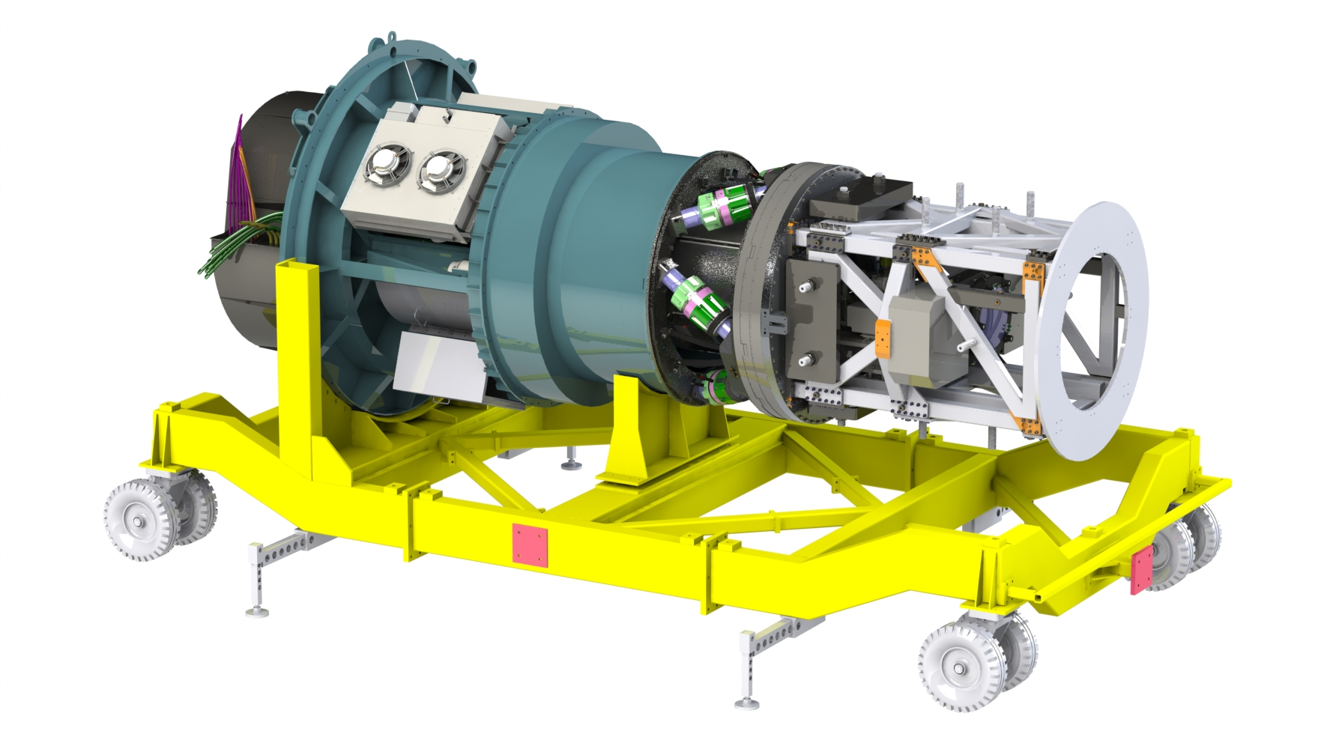
ComCam System Scope
Telescope & Site
Camera
Commissioning
Utility Box
ComCam Integrating Structure
Corrector Optics, Shutter and Filter Changer
Message box example for short highlighted messages.
Refrigeration Pathfinder Volume
Cryostat Stage Assy

Slide 4
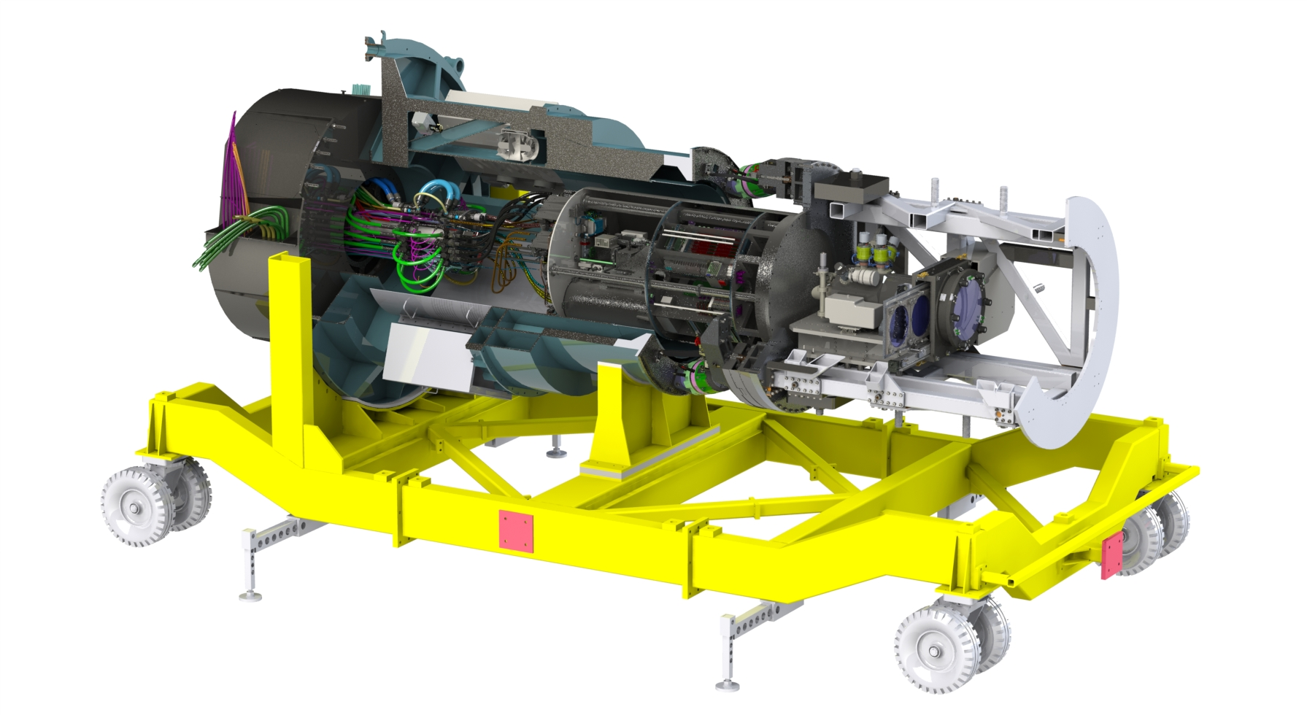
ComCam System Scope
Telescope & Site
Camera
Commissioning
Utility Box
ComCam Integrating Structure
Corrector Optics, Shutter and Filter Changer
Message box example for short highlighted messages.
Refrigeration Pathfinder Volume
Cryostat Stage Assy

Slide 5
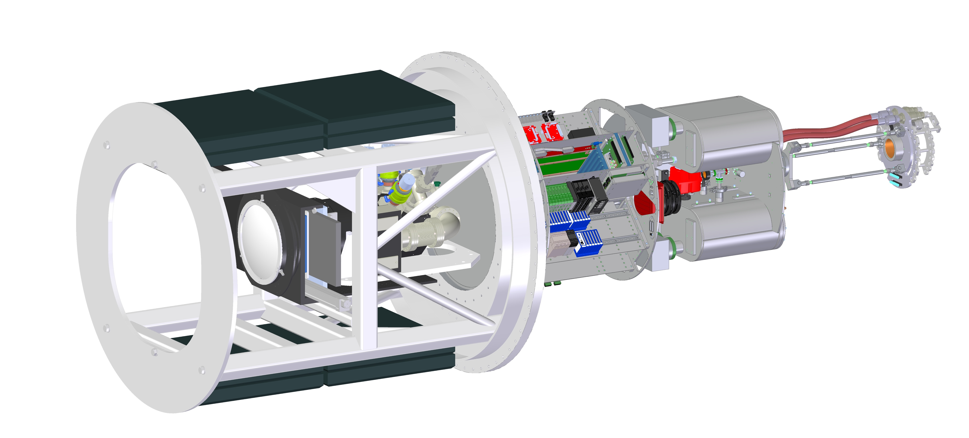
ComCam System Scope
Telescope & Site
Camera
Commissioning
ComCam Integrating Structure
Utility Box
Refrigeration Pathfinder Volume
Message box example for short highlighted messages.
Corrector Optics, Shutter and Filter Changer
Cryostat Stage Assy

Slide 6
ComCam Scope Responsibilities
Telescope & Site
Camera
Commissioning
MREFC $1.4M
MIE $2.5M
ComCam Integrating Structure
Front End Assy
L1-L2 Assy
Filter Changer
Shutter
Alignment Fiducials
OCS/TCS
Cryostat
Raft Tower
Cryotel Coolers
Ion Pump
Turbo Pump
Roughing Pump
Vacuum Quality Monitor
L3 & Cryostat Front End Flange
Utility Box
Raft Power
OTM Power
Ion Pump Pwr
Turbo Pump Controller
HCU (FT)
Network Switch (Fiber→ Eth)
MCM
Shutter Control & HCU
Filter Control &
Filter Control HCU
Utility Box Thermal Control
Refrigeration HCU
AC → DC Control
Dynalene Coolant Distribution
CCS/DAQ
Refrigeration Pathfinder
Test Dewar
Heat Exchanger (x3)
Thermal Load (x3)
L3 & Cryostat Front End Flange
Filter Controller
Message box example for short highlighted messages.

Slide 7
ComCam Accomplishments
All lenses, and filters delivered to Project
  u-band was deposited onto incorrect substrate, will be redone at no additional cost
Filter and shutter control software complete
L1L2 corrector assembly fabrication complete
Mounting sled (first interface between telescope and camera) fabricated, shipped to SLAC, and integrated
L3 corrector assembly fab finished
Cryostat was delivered to Tucson in June 2019
  L3 integrated onto cryostat and vacuum checked (second interface between telescope and camera)
  Opto-mechanics alignment fit-checked and verified

Slide 8
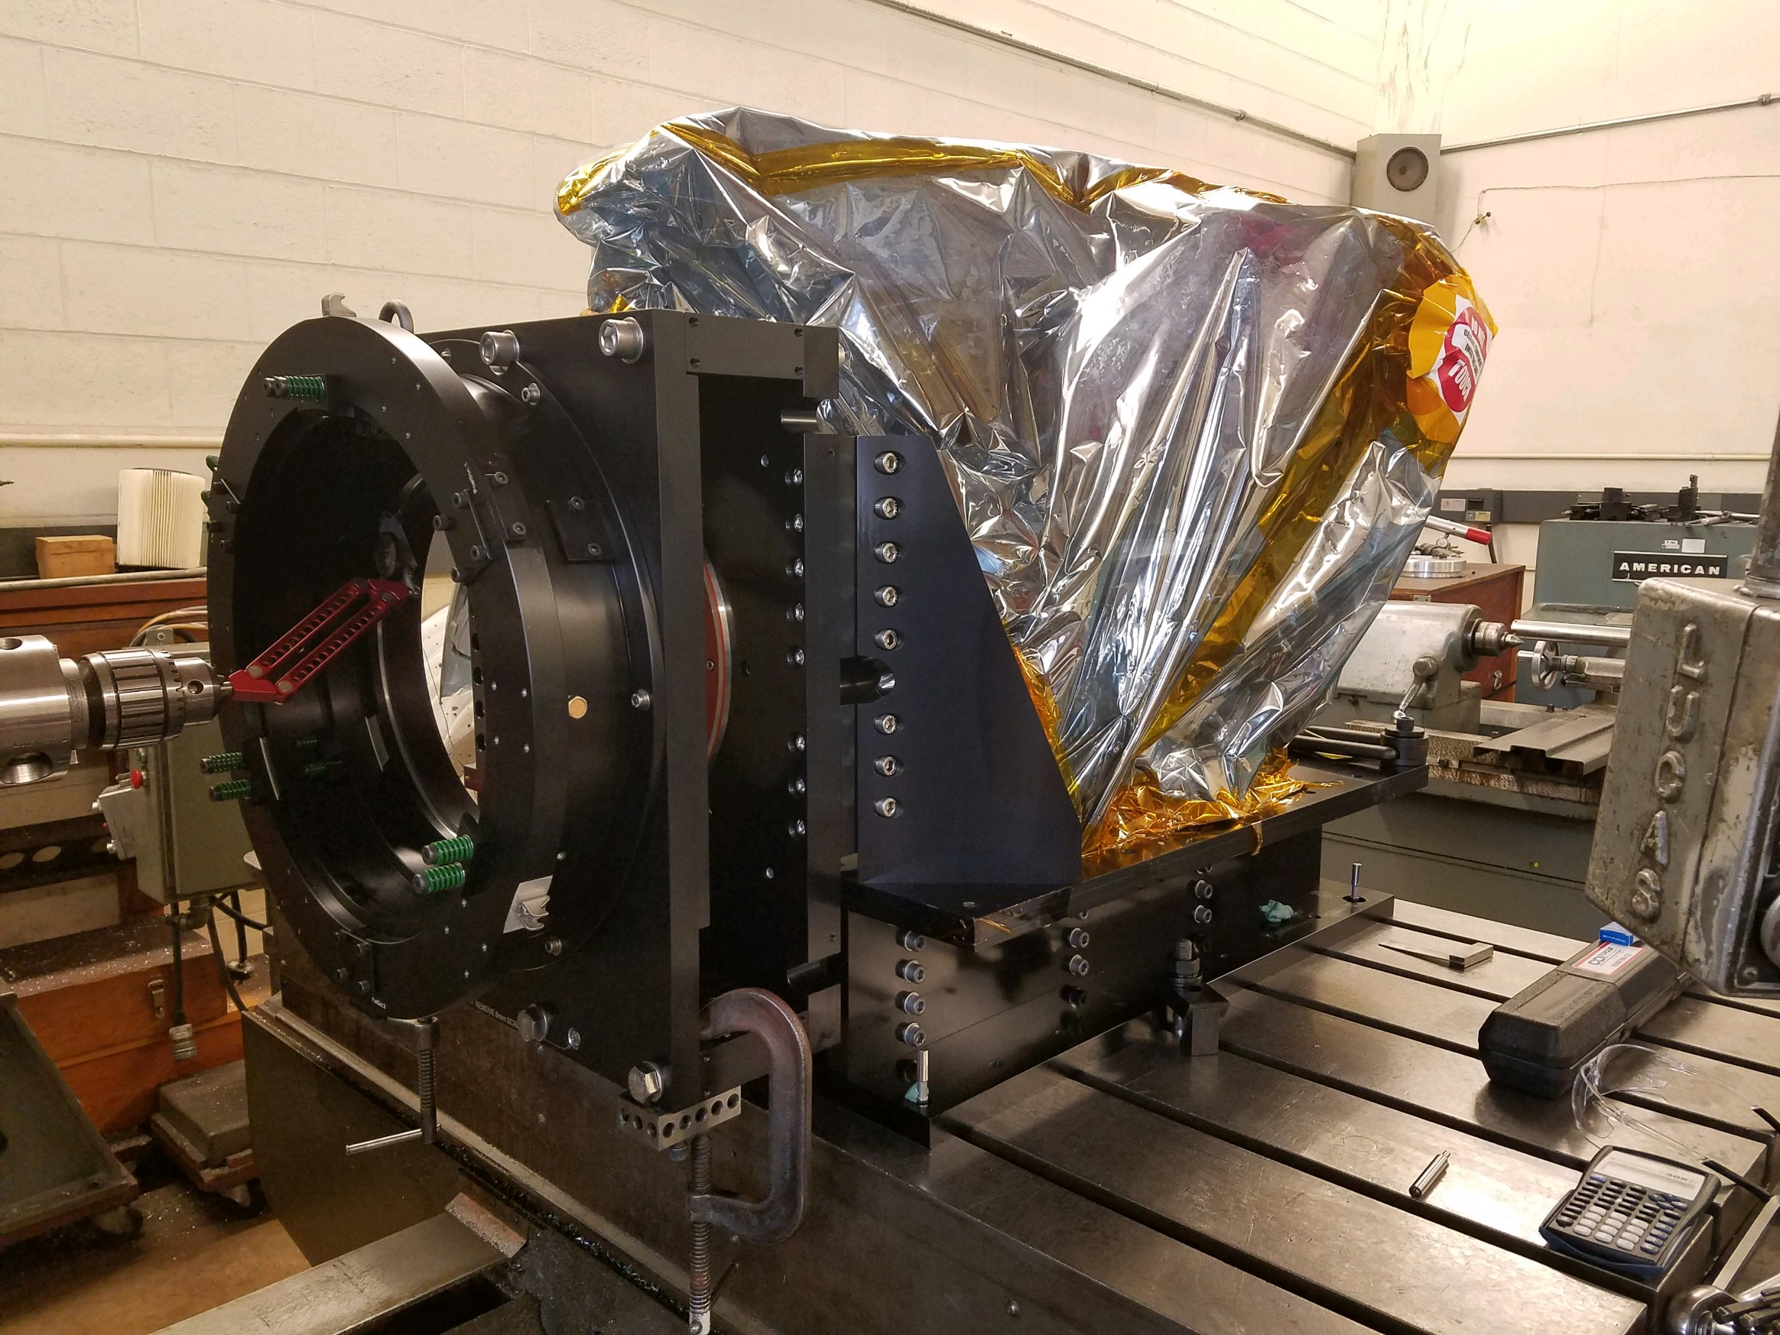
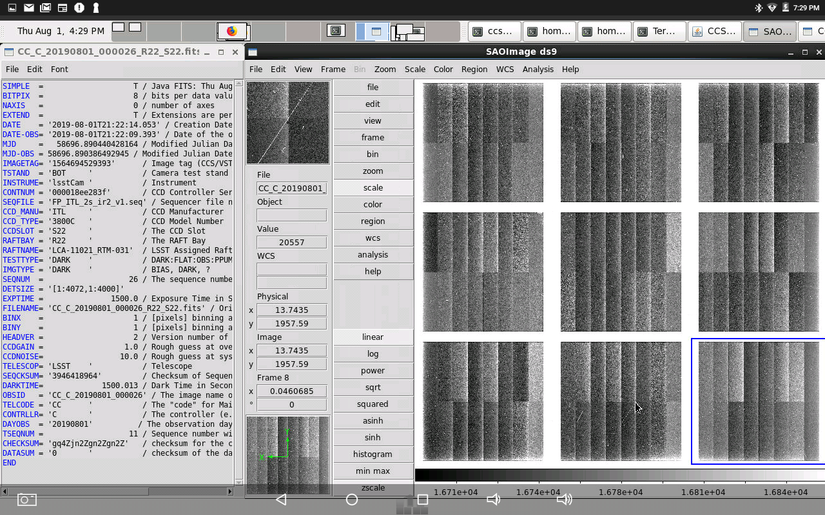
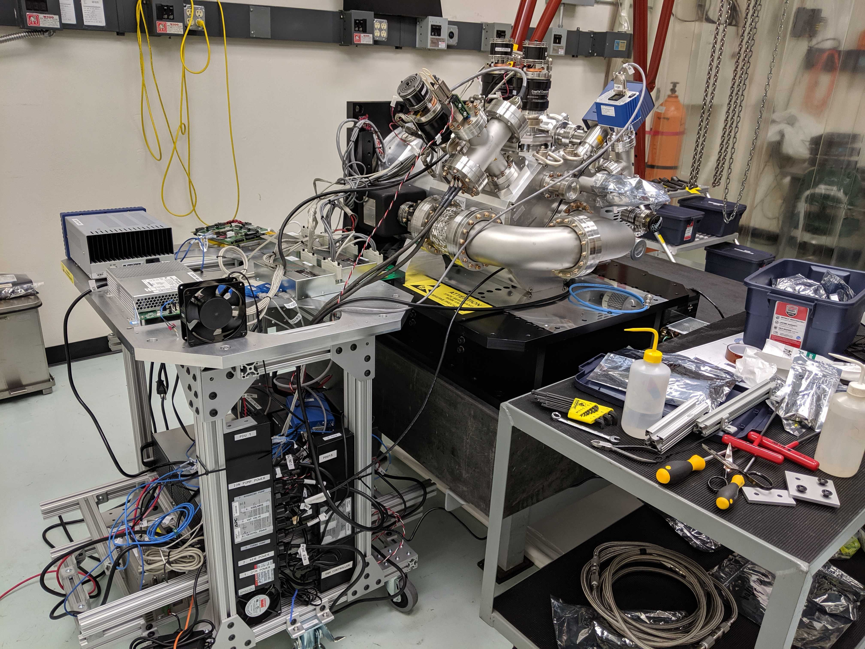
ComCam Accomplishments

Slide 9
ComCam Challenges
Challenges
  Separation of responsibilities between NSF & DOE funded groups
  Tight opto-mechanical tolerance requirements on parts supplied by two different teams (Camera and T&S)
Approaches
  Weekly video conferences, frequent cross-team member visits between SLAC and Tucson
  T&S supplied parts were machined on-site in Tucson to match measurements provided by Camera team and ensure tolerances are maintained

Slide 10
ComCam Future Work
Integrated camera performance characterization September 2019
Functional Testing with integrated observatory software October 2019
Fit check with Camera Mass Simulator November 2019 (final interface check before shipping)
Full survey ”dress rehearsal” December 2019
Pack and ship to Chile January 2020
Reverification of optical alignment and functionality March 2020
Integrate with telescope components when available as part of AIV testing starting April 2020

Slide 11
Scope of 04C.12.18
Environmental Awareness System (EAS) goal is to:
  Sense aspects of the dome and surrounding environment in order to optimize science data quality and operational efficiency to changing environmental conditions.
  Control dome environment
  Feed environmental data to other components
T&S is ultimately responsible for controlling the dome environment at all times and optimizing the air flushing during night-time operations to ensure the most efficient scientific observations for given weather conditions.
Includes dedicated temperature, humidity sensors, anemometers, and embedded HVAC system sensors.
FY19 budget is to deploy a set of prototype sensors in the AuxTel dome to gain experience on placement and dome seeing behavior on a smaller scale before moving to the main telescope dome in FY20.

Slide 12
EAS Accomplishments
HVAC system verified and accepted
Generalized prototype sensor architecture designed, telemetry software complete and tested
AuxTel prototype sensors ready to ship with AuxTel Spectrograph to begin Early Commissioning

Slide 13
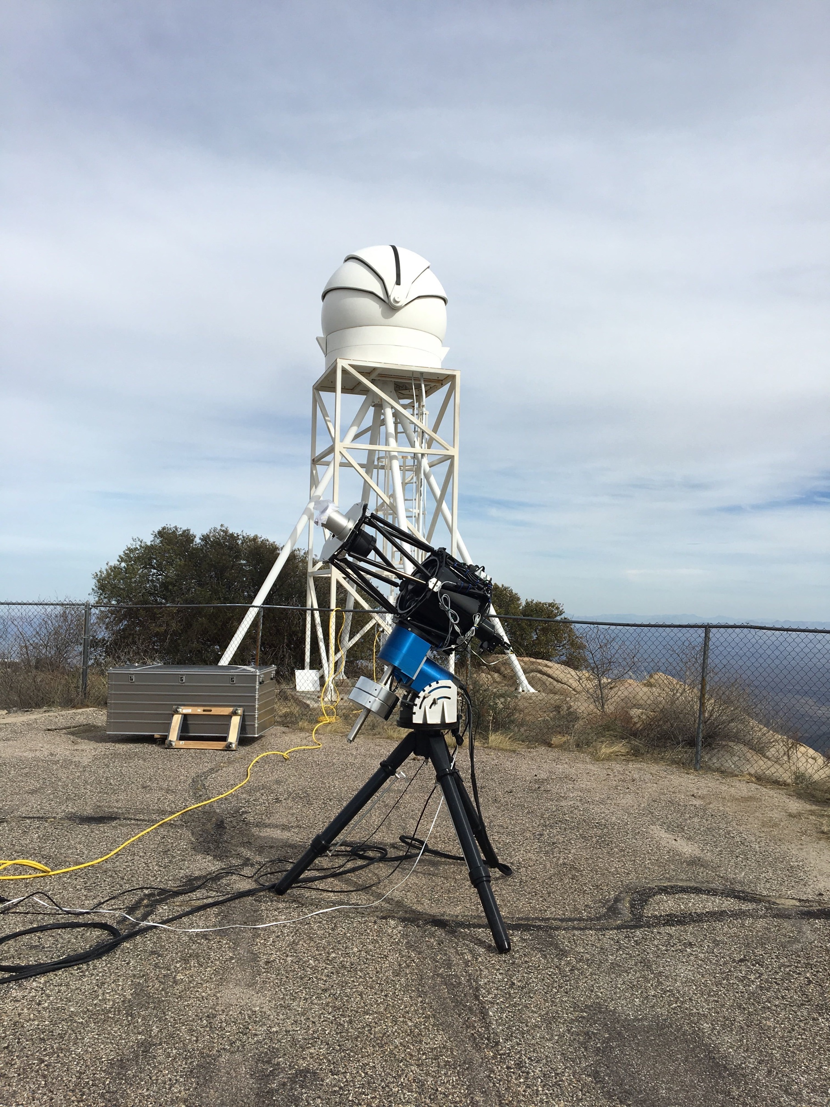
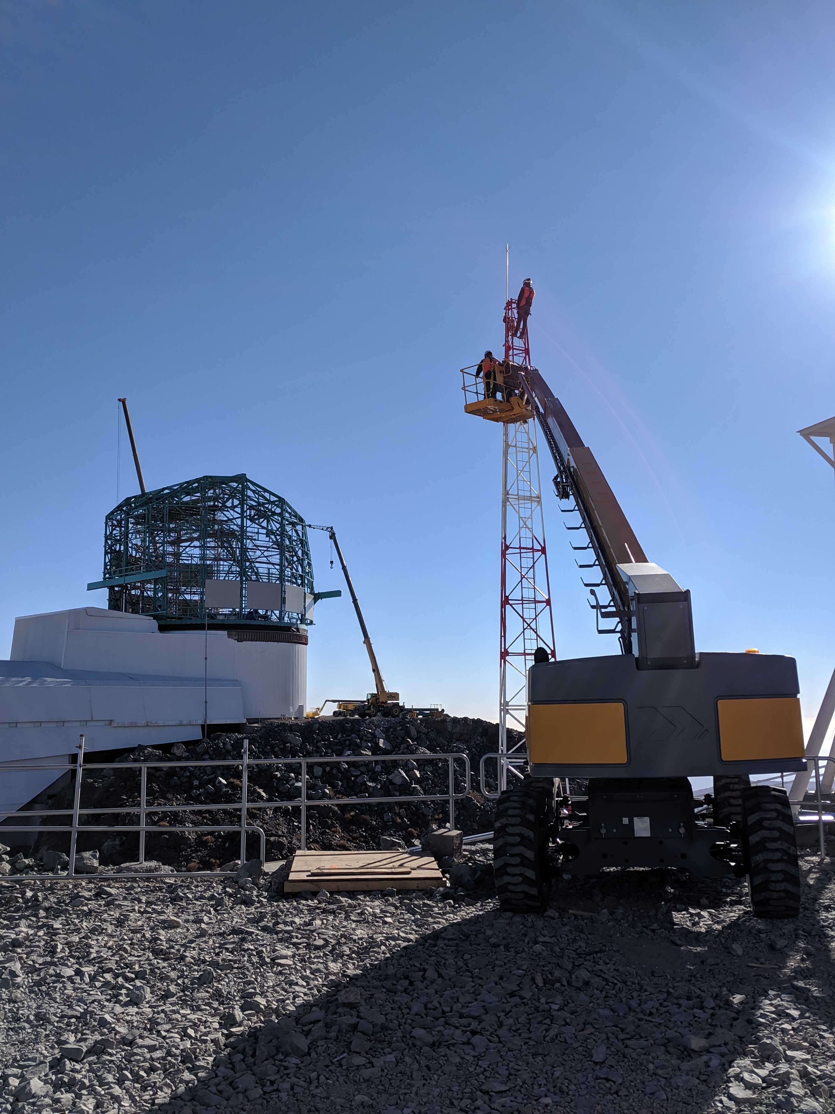
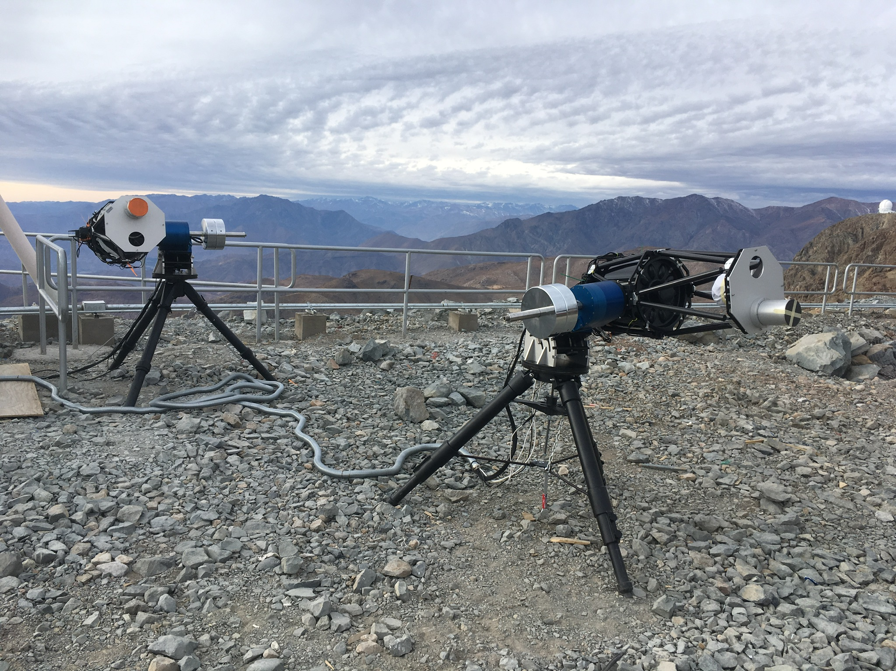
EAS Accomplishments

Slide 14
EAS Challenges
Challenges
  Limited T&S electrical, software engineering resources are being utilized on other major subsystems
  HVAC system was delivered under Windows, so software had to be migrated to Linux in order to streamline interface with observatory software
  Delays in dome completion have limited the need for these sensors until later in construction
Approaches
  Utilizing contractors to develop software and package electrical boards to meet project requirements
  Currently reviewing HVAC requirements to support TMA assembly effectively
  Planning to have more time to fully understand the AuxTel observing environment

Slide 15
EAS Future Work
Support TMA assembly in dome starting September 2019
Install AuxTel sensors in October 2019 for start of Commissioning
Install main dome sensors when TMA finished in 2020

Slide 16
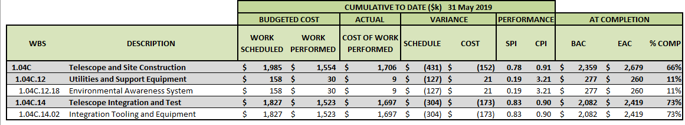
Cost Summary
12.18 schedule variance from delayed hardware procurement and integration because of delay in dome
14.02 schedule variance from delays in machine shop fabrication, recovering now as designated as a project priority
14.02 cost variance is from additional engineering and machine shop resources to recover schedule. LCR pending for additional machine shop resources, plus packing and shipping to Chile

Slide 17
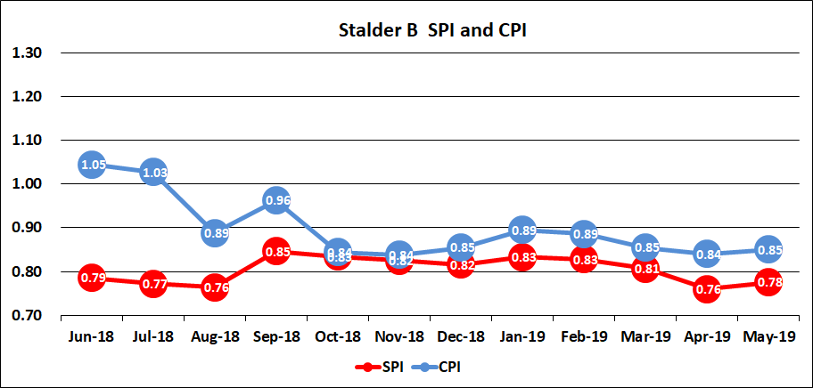
Cost Summary CPI-SPI
Decrease in CPI between Sept and Oct was from CAM change which necessitated more mechanical engineering resources
Additional machine shop fabrication resources were needed since November (LCR pending)

Slide 18
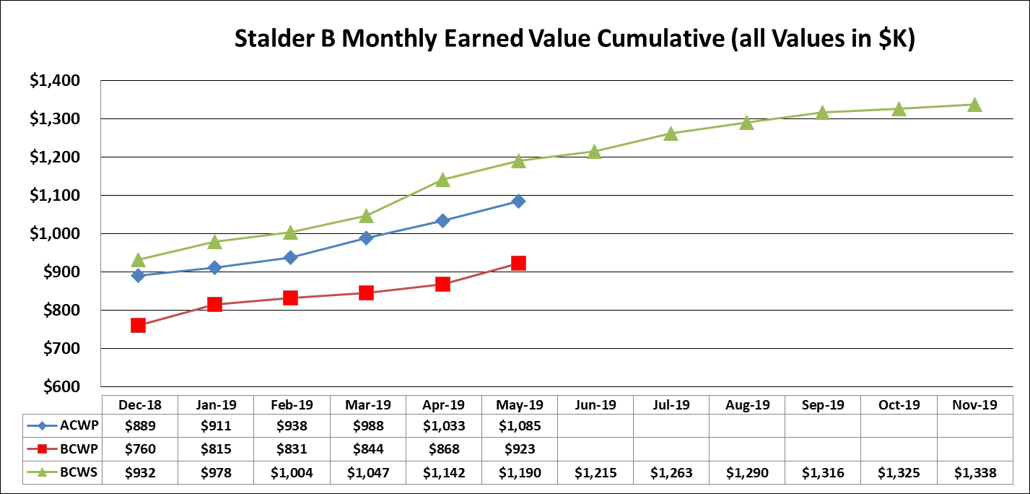
SPA Chart
ComCam deliverables projected to be finished in November, account closeout when shipped in January 2020

Slide 19
ComCam Risk and Opportunities
Risk
  Damage of equipment/optics
    software, hardware interlocks in place
    All optics plus cryostat are handled within cleanroom environment at SLAC and Tucson
    Well practiced and documented lifting procedures
Opportunities
  Significant slack between ComCam readiness and Telescope readiness
    Allows for extended software integration testing in Tucson if so desired before shipping to Chile
    Additional higher fidelity integration tests/rehearsals in Chile while waiting for telescope readiness

Slide 20
EAS Risk and Opportunities
Risk
  Dome does not perform as expected, contributing to poor image quality. EAS sensors then become critical diagnostic tools to mitigate scientific impact
  Continued schedule delays from engineering resources dedicated to other subsystems
Opportunities
  Significant slack between EAS sensor readiness and Telescope readiness
    Planning to have much more time to fully understand the AuxTel observing environment
  Collaborating with LSST Commissioning and CTIO scientists to develop experimental sensors to more specifically sample the astronomical image quality impact from the dome environment
  Initial measurements from DIMMs, weather station, all-sky camera will be able to refine expected survey simulations
  Delaying purchase of sensor hardware until needed to maintain de-scope option

Slide 21
End of Presentation

