Slide 1
Project Management Overview
Victor Krabbendam
LSST Project Manager
NSF/DOE Joint Status Review
Date in long format

Slide 2
Executive Summary
Technical progress and performance is excellent.
We have and continue to encounter technical and programmatic challenges – all are being managed.
Challenges and Risks:
  Overall Project Schedule adjusted 5 months in last 18.
  Now 3.5 months schedule contingency to planned start of survey
  Telescope Mount (Dome) now on the critical path – Camera close
  Staffing Challenges / Departures / Transitions
  Contingency Levels
Notes:
Lots of subsystem review
Since the Status Review last August

Slide 3
Project Status Agenda
Selected technical progress and status
  Critical examples of Project transformation to reality
  Focus on current and past challenges
  Details in subsystem talks and breakouts
Project management
  Requirements and Verification
  Processes and documentation
  Organization / Staffing
Project schedule and NSF financial status
Risk and Contingency management

Slide 4
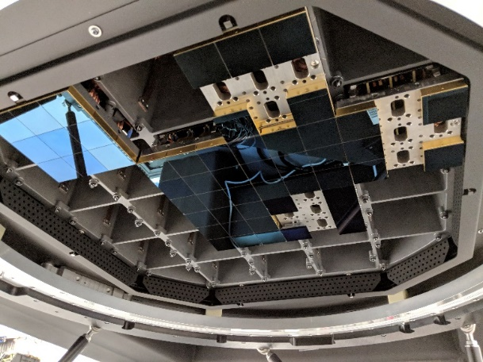
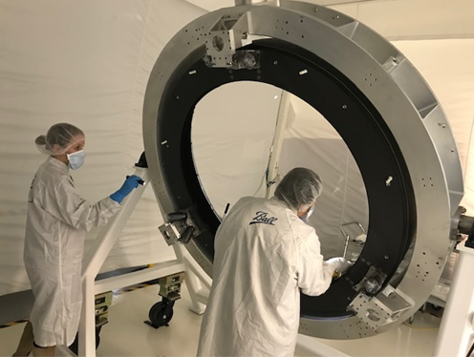
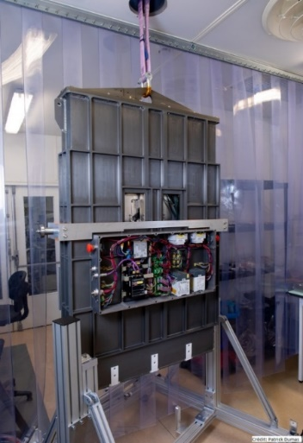
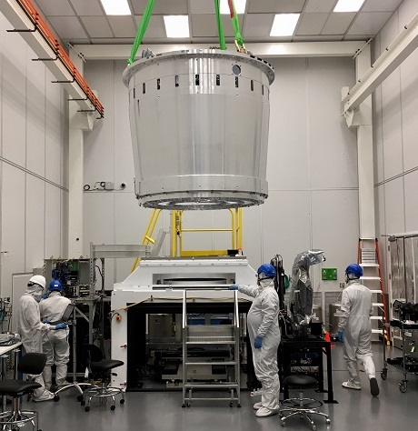
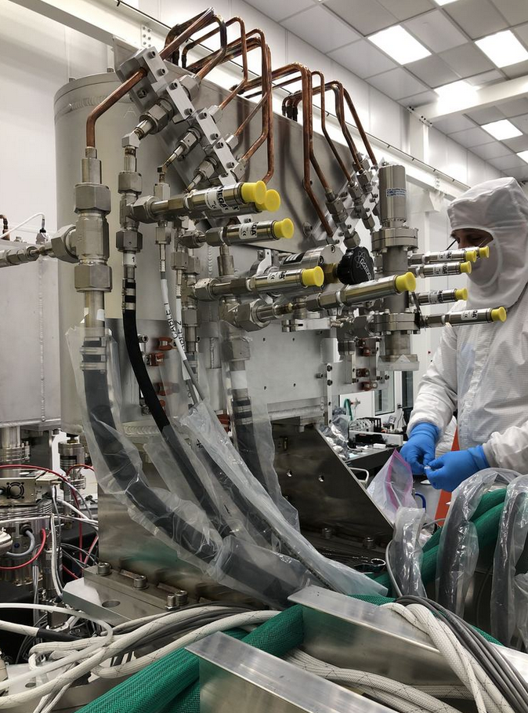
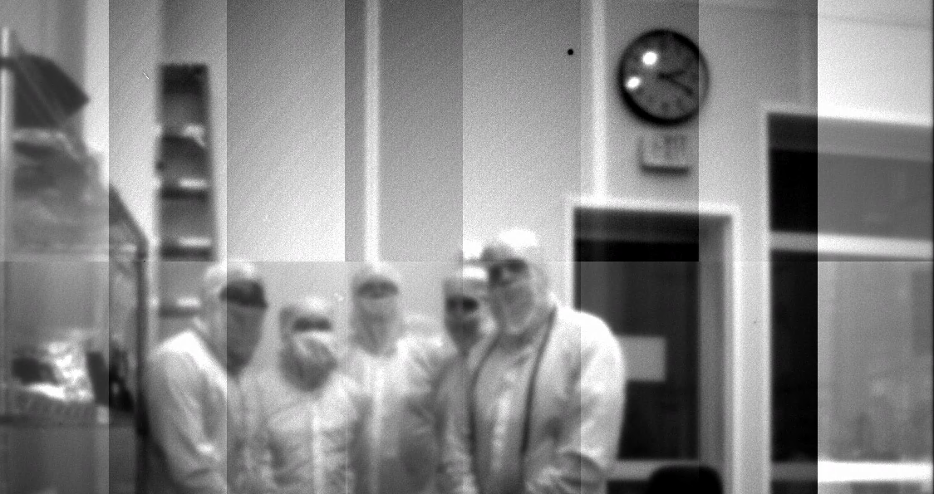
Camera Progress Summary
7 Engineering rafts inserted in the production cryostat for testing completed – Science raft insertion started
L1 Edge treatment inspection- L1-L2 assembly now completed
Production Manual Filter Loader
ComCam pin whole image - ComCam in Tucson for Optical Assembly Install and Testing
Crysotat introduced to Bench for Optical Testing (BOT)
Refrigeration system Commissioning

Slide 5
Data Management Progress Summary
Level 2 milestone LDM-503-07 “Camera Data Processing”. Demonstrated the successful transfer, ingest and processing of camera test stand data using the LSST Science Pipelines and Science Platform;
ESnet to provide two 100 gigabit/second dedicated fiber links from Atlanta to Chicago, Initial capacity under development, full capacity in FY21.
Release 18.00 of the LSST Science Pipelines.
Community Broker Interest very high - 15 letters of interest and excellent participation in Seattle Meeting.
Authentication demonstrated in all parts of the Science Portal.
Cloud computing “proof of concept” in association with Google is concluding — study went very well! Now working on costing.

Slide 6
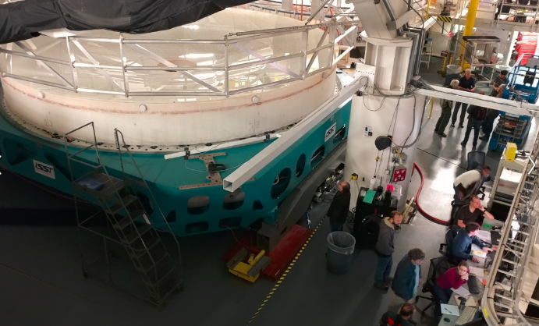
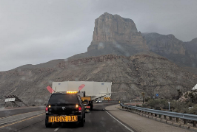
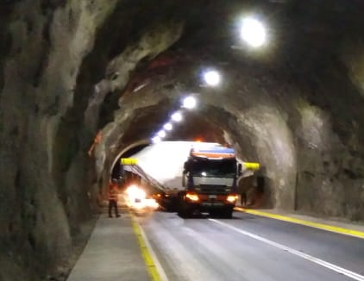
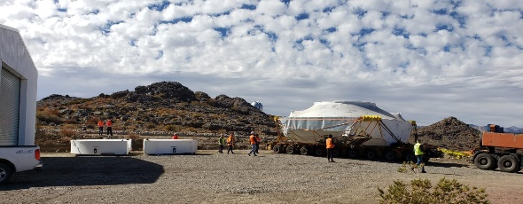
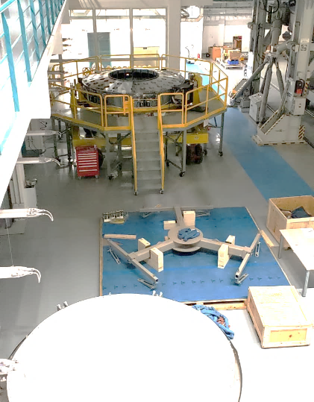
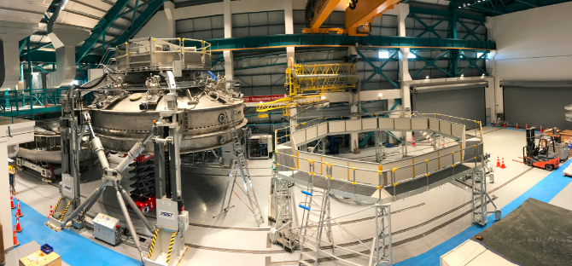
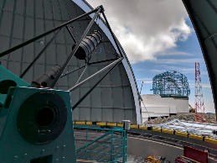
Telescope Progress Summary
M1M3 Testing completed at UofA
M1M3 trucked to Houston
M1M3 now on site
M2 Cart with cell and Surrogate mirror commissioned on Site
Coating facility completed – Protected Silver on M2 July 16
AuxTel under computer control

Slide 7
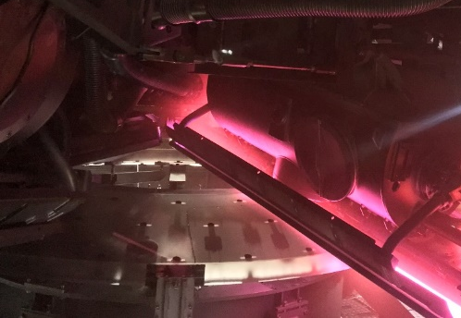
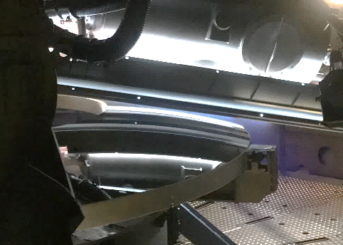
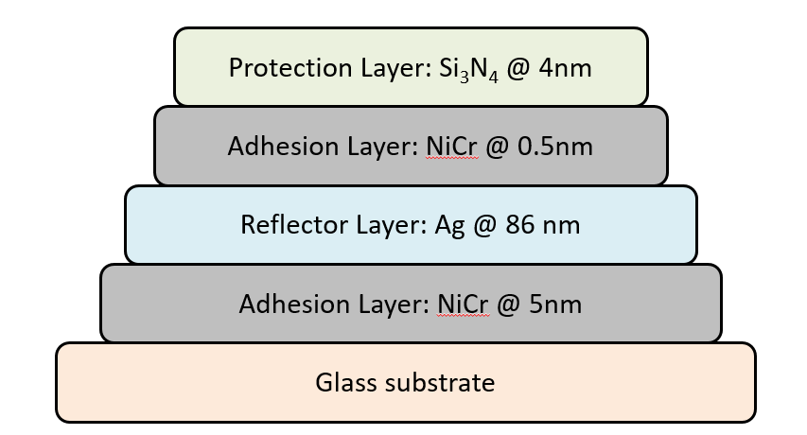
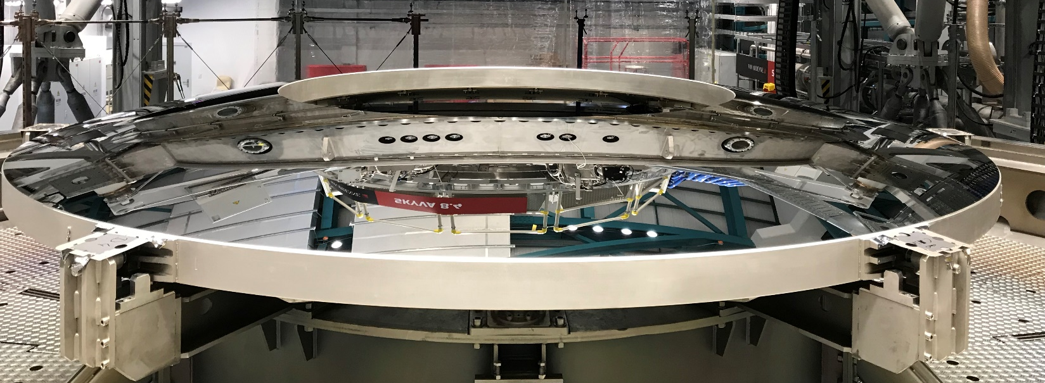
M2 Coating – 16 July 2019

Slide 8
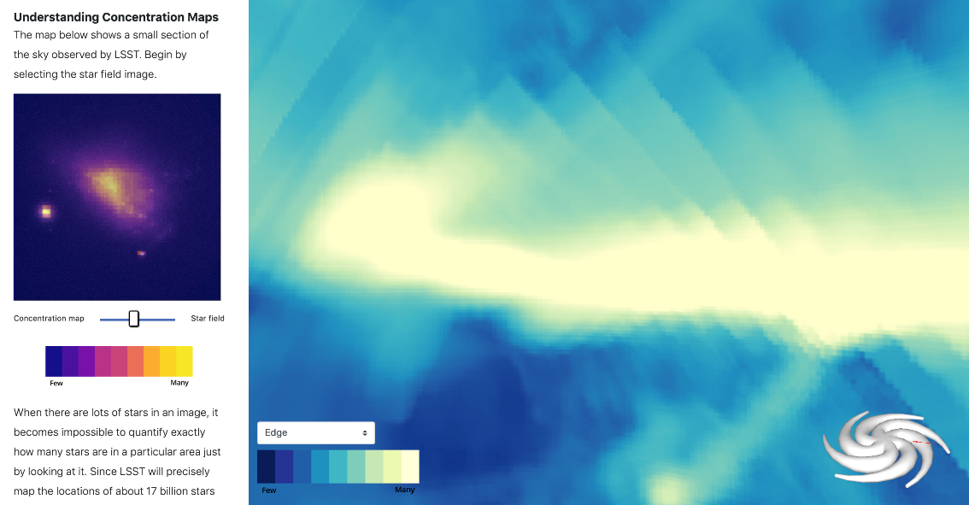
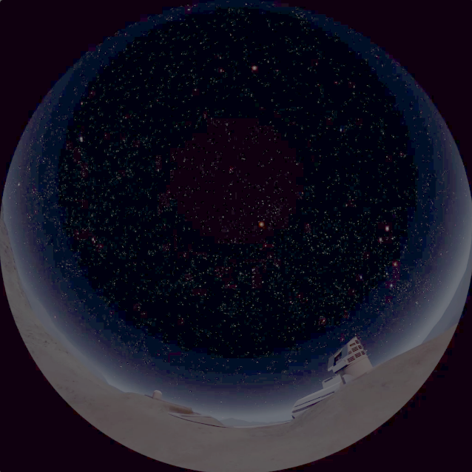
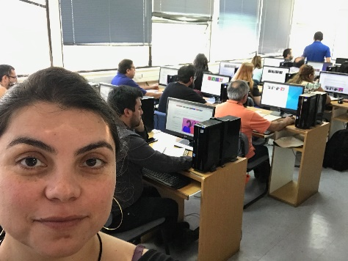
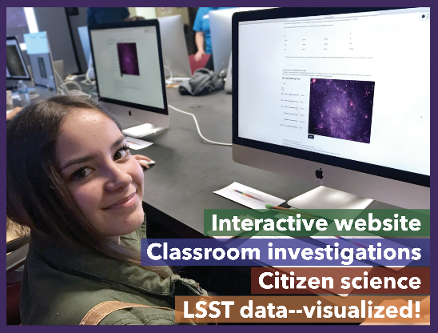
EPO work Progressing well
        Planetarium video showing LSST
In Mapping the Milky Way,
students use LSST’s extensive sky coverage and object density
to discover the shape of our Galaxy and where we live within it
First Spanish-language user testing
at Chile summer school

Slide 9
LSST Safety
We continue to provide daily oversight across project
  3 construction sites, ports, Tucson, and SLAC
  G. Corvetto promoted to Safety Supervisor
  LSST safety coordinators now cover Monday to Saturday
Detailed tracking of accidents and incidents continues
  30 Injury Accidents – 8 OSHA recordable – 3 Lost time
  21 of 62 Incidents/Accidents were vehicle related
  Injury rate very low but efforts continue to reach Zero
  Focus on awareness and training programs, improved summit inductions
Working with Sys. Eng. verifying Hazard Analysis mitigations
Movement and flawless critical lifts of the M1M3 and M2
Engineering and safety preparing for the arrival of the TMA
Notes:
Safety is working closely with contractors at the summit site as there are more individual contractors on site. We are well aware of possible overlap of areas like suspended loads. We have put into place an work access procedure to keep people informed of local activities. (barricades and signage with contact information)
There are three safety coordinators covering the construction sites. The additional person is the LSST Head of Safety C. Gessner. Gessner has taken on an additional role as the NCOA Head of Safety.
Not moving as fast as we would like but we are improving the LSST on site safety induction (moving towards a bilingual on line learning.
For Hazard analysis systems engineering, safety, and engineering are working together to validate safety mitigations that were identified in the design process. The coating chamber is our primary focus now.
We suffered three road accidents that damaged only vehicles. Two minor accidents in December: 1) hit a rock in the road and damaged the radiator, and 2) hit the berm and knocked over a sign. The other accident that occurred in February was a sewage truck that lost control after a curve. Damaged body work and broken front axle. (Strained muscle at SLAC this month)
M1M3 being transported now. M2 surrogate practice integration coming soon.
Safety will participate in this week (4/3/2019) to review the onsite and assembly integration plans held in Chile with Asturfeito.
When SLAC personnel are at the summit site the SLAC safety manager participates in the morning summit coordination meeting.

Slide 10
Communications Office
Mission: Facilitate communications between LSST and its stakeholders keeping them informed on construction progress, science opportunities, and other essential Project information.
AAS 233 booth & attendance
M1M3 activities
Coating Chamber installation
NSF LFW preparation
For scientist web pages update
TMA activities & transport
M1M3 transport
Auxtel/ Spectrograph activities
Coating Chamber commissioning
M2 reassembled and coated
ComCam SLAC to Tucson
Summit and base signage/ communications elements
communications-team@lists.lsst.org

Slide 11
Key Project Issues

Slide 12
Key Project Issues
Telescope mount schedule
Dome installation cost and schedule
Project Staffing
Contingencies

Slide 13
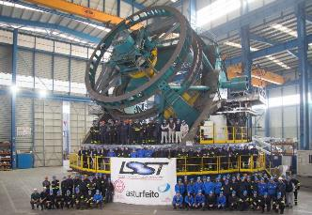
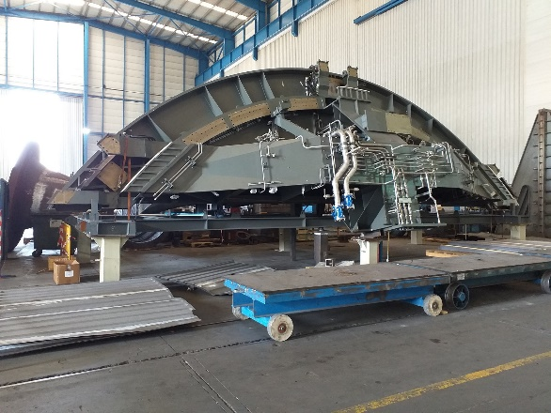
1) Telescope Mount Assembly (TMA) Issues
Elevation axis had resonance issue in Aug 2018 - SOLVED
Real-time network preventing timely execution of motion control/telemetry storage in Sept - SOLVED
  Caused significant issues with Factory acceptance plans
  Disassembly approved - hardware setup for offline debug
  National Instruments brought into investigation
  Solution: Second Real time box to share load
Shop resources (labor and space) for disassembly – DONE
  Integration delays led to overbooked shop
  LSST Management pressure to establish priorities
  LSST Container plan for swift removal of parts

Slide 14
Telescope Mount Assembly (TMA) Issues (cont’d)
Control Software Vendor – Tekniker – IN PROGRESS
  UTE team (prime contractor) underestimated software scope
  Requested $ 353K in change orders – Negotiating to $120K
  Key personnel needed for final commissioning on site
Integration Schedule will be a challenge
  Investing In system tuning routines – faster commissioning & better operations – Keeps TMA software team engaged till site work
  Parallel activities and more aggressive installation

Slide 15
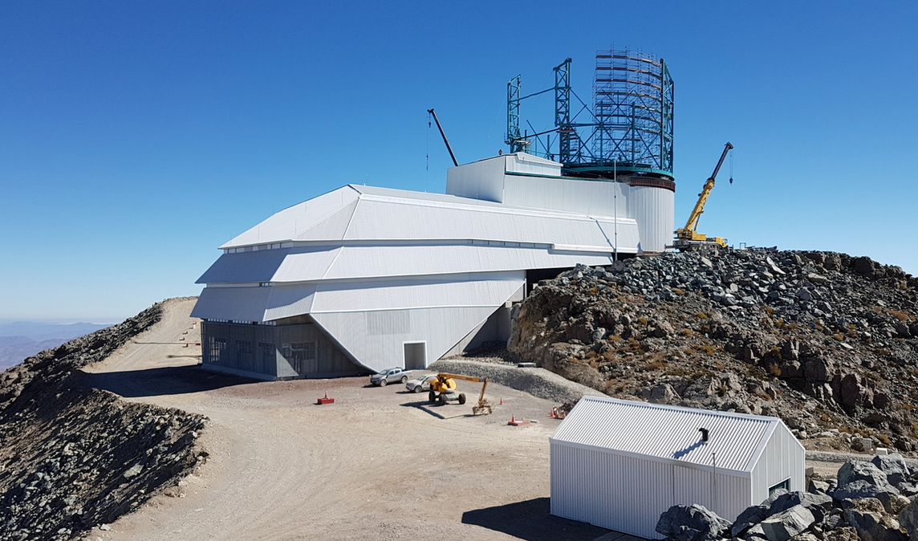
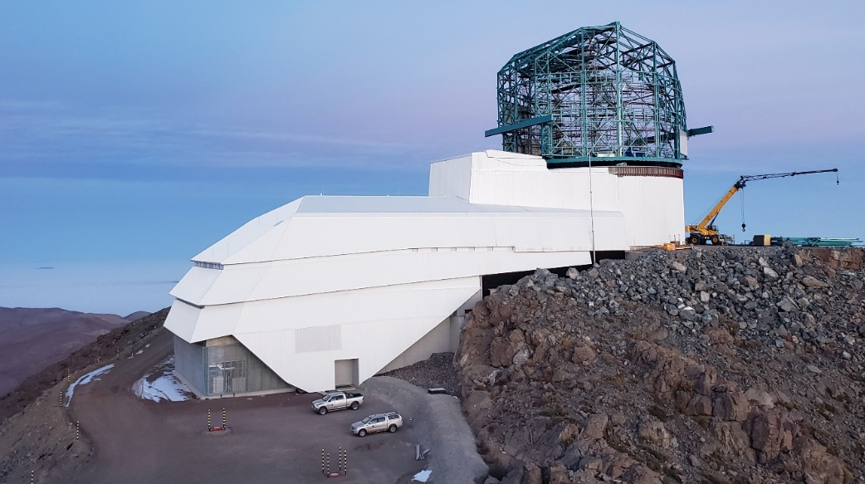
2) Dome
May 2018
June 2019

Slide 16
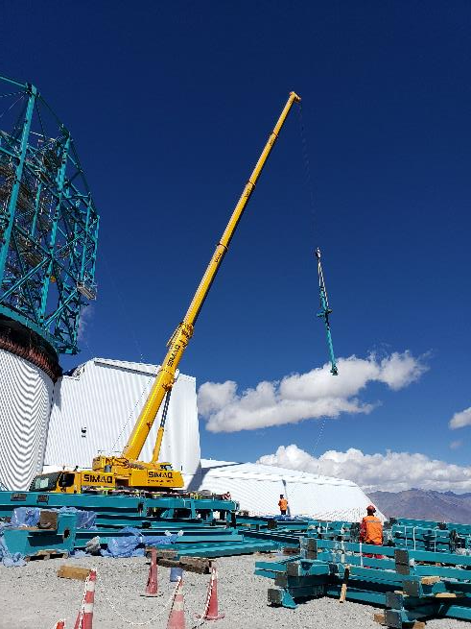
Dome
2018 Velocity of site integration severely reduced
  High winds much worse than normal – ($750K impact)
  Site team under-resourced
December 2018 – Contractor presented cash flow and contract cost problems
  November 2018 Chilean work stopped
  LSST intervention and credit line used to resume work
  EIE has a $12.5 M fixed price contract and currently predicts a $3.5M VAC.
  Company is caught-up in 8.3M Euro dispute – no cash reserves available.
  VAC for Fixed Price contract not normally a customer problem

Slide 17
Contract Issues
  Enforcement, Termination or Partnership?
    Not ready for hardline because material fabrication still incomplete in Italy; 40+ full size containers of material in Italy partially fabricated
    Best cost and schedule determined to be “Partnership”
  Dome contract changes
    All work is now pre-paid to address cash flow
    3 contract amendments for technical changes: +$1.9M
    LSST direct work: drives, local steel fabrication, cranes, scaffold, assembly crew
    Added two 150ft manlifts, more staff and a temp bridge crane
  Focus is support of TMA installation starting 15 September. Need:
    Dome enclosed (First Layer)
    Dome Rotation (Simple motor control with temp friction wheel)
    Internal Dome Crane (Refurbished temporary crane)

Slide 18
Project Staffing Issues
In Past 12 months:
  On-Boarded: 33
  Off-Boarded: 29 – each is its own story
Some key departures this year
  Brian Selvey: System Engineering Mgr. - Job opportunity
    Austin Roberts and Chuck Claver / Kevin Reil
  Ben Emmons: EPO Mgr. – Personal
    Amanda Bauer and Lauren Corlies
  Bill Gressler: Telescope and Site Mgr. – Personal / Job opportunity
    Jeff Barr, Sandrine Thomas, and Doug Neill

Slide 19
Updated T&S Organization
Key is broader local leadership of teams
Represents Tucson Based Staff
Victor Krabbendam: LSST Project Manager
Wil O’Mullane: Deputy Project Mgr – Software
Vincent Riot: Deputy Project Mgr – Camera
Open: Deputy Project Mgr - Chile
Represents Chile Based Staff
Represents group of staff with a local lead
Doug Neill
Chief Engineer
Jeff Barr
T&S Project Manager
Sandrine Thomas
T&S Proj. Scientist
Sub-System Science Team
Wil O’Mullane Deputy PM – Software / Technical support
Engineering Group.
Enrique Figueroa
Base Team
Jacques Sebag
T&S AIV Manager
Eduardo Serrano
Site Manager
T&S Support Staff
Oscar Nunez
Deputy Site Mgr.``
Design Group
Sub-System CAMs - North
Andy Clements
Control Soft. Mgr.
Tucson Shop Fabrication .
Chile Software Team
Tucson Software Team
Optical Group Lead
Summit Electrical Group Lead
Electrics Group Lead
Mechanical Group Lead

Slide 20
T&S Changes (continued)
Bill was a key element in bridging N-S leadership so additional changes needed:
  Re-organized coordination meetings
  Victor or Jeff in every daily Summit safety /coordination meeting
  Sandrine in Chile month of July – Doug in Chile month of August+
Bill and Jeff Barr were key part of Deputy PM strategy for Chile
  Victor now focused on Chile and putting people and strategies in place to off-load Tucson/Project work
  Total of 35 LSST employees in Chile full-time, each has a reporting layer but Victor engaging directly
Broader communication of strategies and decision making is common request within team

Slide 21
Summit Workflow Prioritization/Scheduling
Each “work scope” step has a scheduled meeting with objectives, owner, and participants
Extension of T&S process to Project level participation (Key for updated SIT-Com plans)
Strategic Planning
Plan Implementation
Project Drivers:
- Technical scope
- Key milestones
- Boundary conditions
Change Control
LCRs
More Detailed discussion in SIT-Com talk tomorrow
New Epics
New Tasks
Strategic Baseline Plan
(Technical Focus)
3-6mo Rolling Wave Planning
(Programmatic)
1wk- 2mo Scheduling
(Resource Alloc)
Weekly Planning
(Resource Avail)
Daily Tasking
(Resource Avail)
Work scope
Incomplete Epics
Incomplete Tasks
Emergent Issues
Tracking Tool
Primavera P6
JIRA Epics
JIRA Tickets
JIRA Tickets
JIRA Tickets

Slide 22
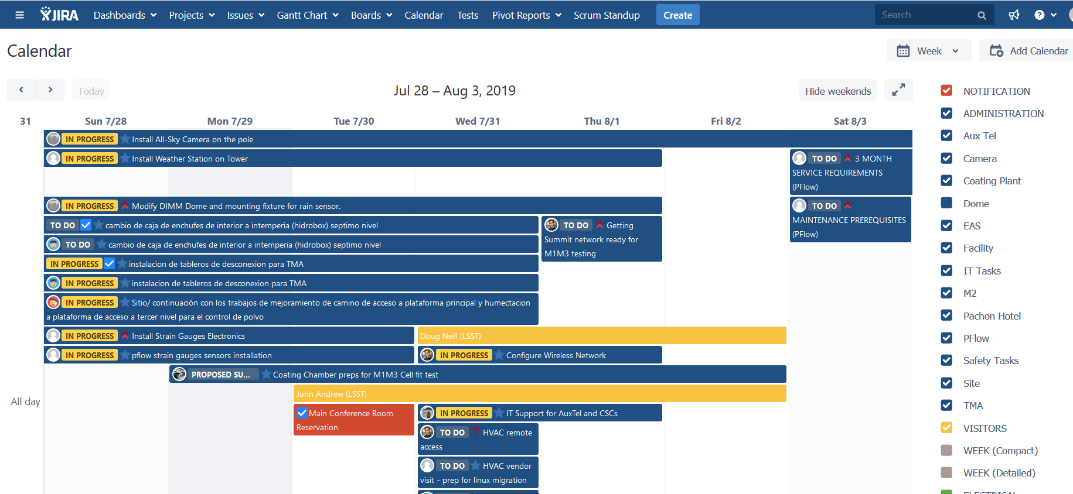
New work coordination tool

Slide 23
Staff Retention
Workplace Advocates Program
  Formerly the LSST “Ombuds” Program
  Rebranded, expanded, and clarified
  Launches this month
Retention Bonus Program in Place
  Formal process to recognize bonuses for future milestones
  Invoked 3x in first month

Slide 24
Contingencies
More Details later in talk but Cost and Schedule contingencies are getting tight
MREFC: $17.5 M remains (EAC to TPC), 13% on work remaining
MIE: $2.6 M remains, 21% on work remaining
Project has 3.5 months of schedule contingency
(Technical margins remain strong – Performance talk tomorrow)

Slide 25
Project Management – Systems Engineering

Slide 26
Requirements Traceability Well Established & Documented to support V&V and Performance Analysis
Science Requirements Document
(LPM-17)
Docushare for All controlled documents
Confluence for collaboration
SysML (MagicDraw)
  Requirements, interfaces, Use cases
  Verification plan
github
  Source code and SW docs
  Configuration information
JIRA and Syndeia
  V&V Test management (LSE-160)
Strategic, science-based objectives
Project’s response: “to be built” system
LSST System Requirements
(LSE-29)
Obs. System Specifications
(LSE-30)
High level design architecture
Observatory Control System
(LSE-62)
Telescope & Site
(LSE-60)
Camera
(LSE-59)
Data Management
(LSE-61)
EPO
(LSE-89)
System Interfaces
Hazard Mitigations

Slide 27
Interfaces Being Reviewed for Final Verification
√
Interface Management: LSE-151
√
√
√
√
√
CCB
√
√
√
√
√
√
√
√
√
√
√
√
√
CCB
√
√
Under formal change control
CCB
Submitted for change control

Slide 28
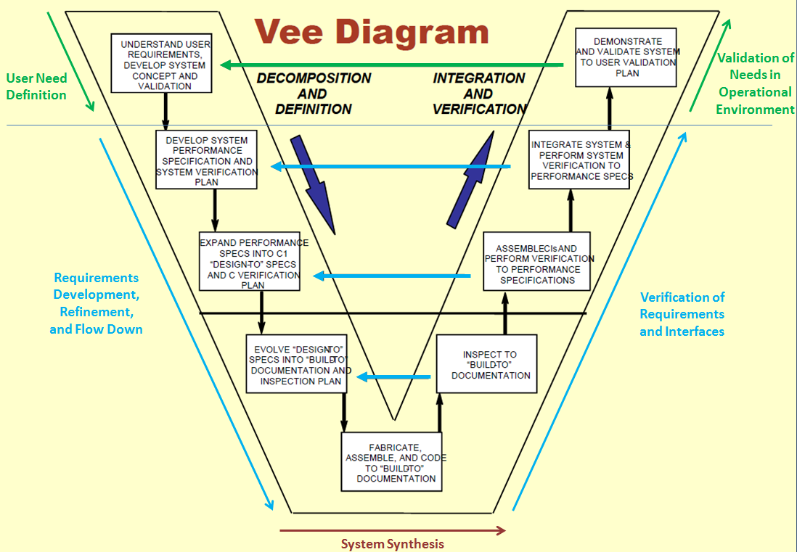
Verification and Validation Process
LSE-160 Verification and Validation Process is LSST governing document

Slide 29
Documentation
Science Requirements Document remains unchanged only minor clarification changes to top level Requirements.
Project Systems Engineering tools play key role in Verification/Documentation – Austin Roberts talk tomorrow.
  Rigorous approaches are key role in documenting processes, tests, and results.
  Currently supporting verification efforts and tooling.
  Focus on key systems with early verification opportunities
Important for Operational Readiness Review and long term operations.
Note emphasis on documentation in DM and other subsystem development planning.
3.0 Does the systems engineering team monitor progress and performance across the project using proper methodology? Is the systems engineering documentation being suitably created and refined as the project progresses

Slide 30
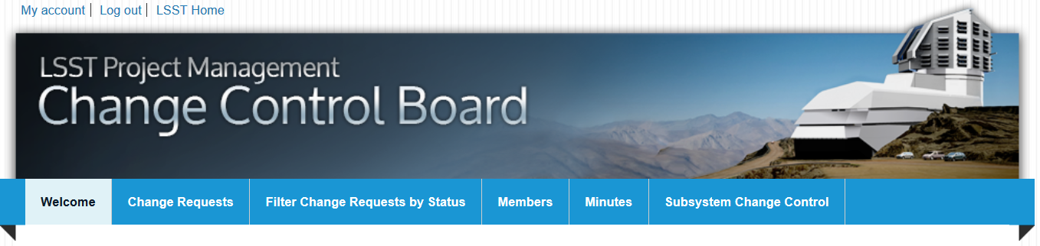
LSST Change Control Process
LCR Process is Active
  Baseline / Non-conformance
  EVMS / DOE-Commissioning
  Ranpal Gill / Rob McKercher
  Weekly / Monthly meetings
Now also processing estimates to complete for a controlled EAC
  Was annual - Now constant
CCB is key for documentation and Operations interface (Ops Dir on CCB)

Slide 31
Project Management

Slide 32
LSST Project Organization Structure
Project Advisors
Chief Scientist: T. Tyson - UCDavis
SAC Chair: M. Strauss – Princeton
Project Science Team
LSST Director: S. Kahn – SLAC
Deputy Director: Z. Ivezic – UW
LSST Ops Director: R. Blum - AURA
Deputy Ops Director: R. Blum - AURA
Deputy Ops Director: P. Marshall - SLAC
Project Communications
Communications Mgr: R. Gill - AURA
Project Manager: V. Krabbendam - AURA
Project Scientist: Z. Ivezic - UW
Deputy PM Software: W. O’Mullane – AURA
Deputy PM Camera: V. Riot – LLNL
Deputy PM Chile: TBD - AURA
Performance and Safety
Safety: C. Gessner - AURA
Compliance: V. Kinnison – AURA
Information Security – Alex Withers - NCSA
Project Office
System Engineering and Commissioning
System Scientist: C. Claver - AURA
Commissioning Scientist: K. Reil – SLAC
Lead Systems Engineer: A. Roberts – AURA
Project Administration
Project Controls: K. Long – Longhorn
Business Manager: D. Calabrese - AURA
ITSI Manager: J. Kantor - AURA
Advisory
Project Support
Sub-systems
LSST Ops
- AURA
Data Management
DM Project Manager: W. O’Mullane – AURA
DM Project Scientist: L Guy – AURA
Camera MIE
Camera Project Manager: V. Riot - LLNL
Camera Project Scientist: S. Ritz - UCSC
Telescope and Site
T&S Project Manager: J. Barr - AURA
T&S Project Scientist: S. Thomas - AURA
Education and Public Outreach
Head of EPO: A. Bauer – AURA
Deputy Head of EPO; L. Corlies - AURA
17 July 2019

Slide 33
LSST Project Organization Structure
Project Advisors
Chief Scientist: T. Tyson - UCDavis
SAC Chair: M. Strauss – Princeton
Project Science Team
LSST Director: S. Kahn – SLAC
Deputy Director: Z. Ivezic – UW
LSST Ops Director: R. Blum - AURA
Deputy Ops Director: R. Blum - AURA
Deputy Ops Director: P. Marshall - SLAC
Project Communications
Communications Mgr: R. Gill - AURA
Project Manager: V. Krabbendam - AURA
Project Scientist: Z. Ivezic - UW
Deputy PM Software: W. O’Mullane – AURA
Deputy PM Camera: V. Riot – LLNL
Deputy PM Chile: TBD - AURA
Performance and Safety
Safety: C. Gessner - AURA
Compliance: V. Kinnison – AURA
Information Security – Alex Withers - NCSA
Changes
Project Office
System Engineering and Commissioning
System Scientist: C. Claver - AURA
Commissioning Scientist: K. Reil – SLAC
Lead Systems Engineer: A. Roberts – AURA
Project Administration
Project Controls: K. Long – Longhorn
Business Manager: D. Calabrese - AURA
ITSI Manager: J. Kantor - AURA
Advisory
Project Support
Sub-systems
LSST Ops
- AURA
Data Management
DM Project Manager: W. O’Mullane – AURA
DM Project Scientist: L Guy – AURA
Camera MIE
Camera Project Manager: V. Riot - LLNL
Camera Project Scientist: S. Ritz - UCSC
Telescope and Site
T&S Project Manager: J. Barr - AURA
T&S Project Scientist: S. Thomas - AURA
Education and Public Outreach
Head of EPO: A. Bauer – AURA
Deputy Head of EPO; L. Corlies - AURA
17 July 2019

Slide 34
EVMS Executive Summary – May 2019 Data
 | MREFC - NSF | LSSTCam – DOE
% Complete (May 2019) | 71 | 93
SPI | 0.98 | 0.97
CPI | 0.98 | 0.97
Contingency (EAC) | $17.5 M | $2.6M
Contingency % Remaining Work (EAC) | 13 | 21
NSF EAC – BAC = $12.7M : EAC formality increasing but not baselined
2.0 Do the performance to-date and C&S trends give confidence that the project can complete successfully on time and within budget?

Slide 35
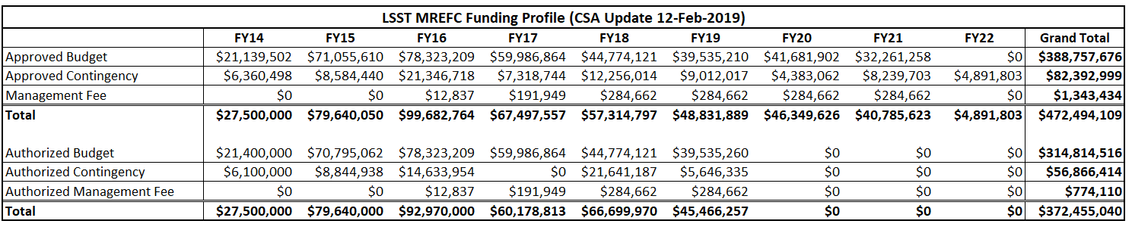
NSF Annual Funding Continues On-Plan
Continuous NSF funding since inception – No issues.
Contingency Authorizations have been smooth

Slide 36
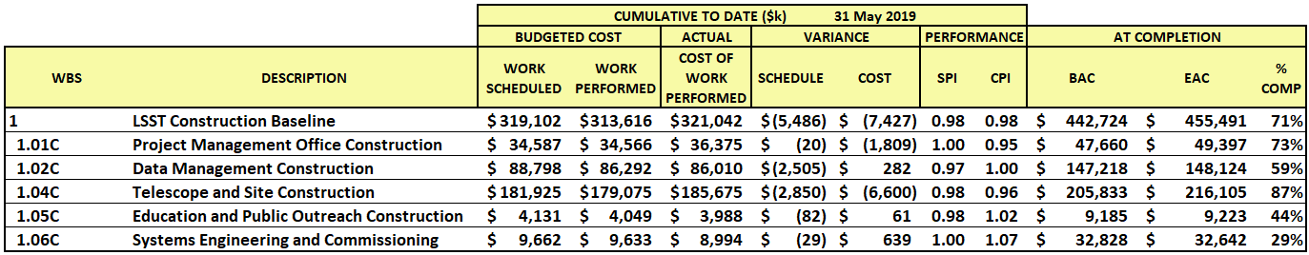
LSST Cost Summary WBS Lvl 2
Project is 71% Complete
ACWP is up $77M this year
BAC is up $11M this year
EAC is up $10M this year
May 2018

Slide 37
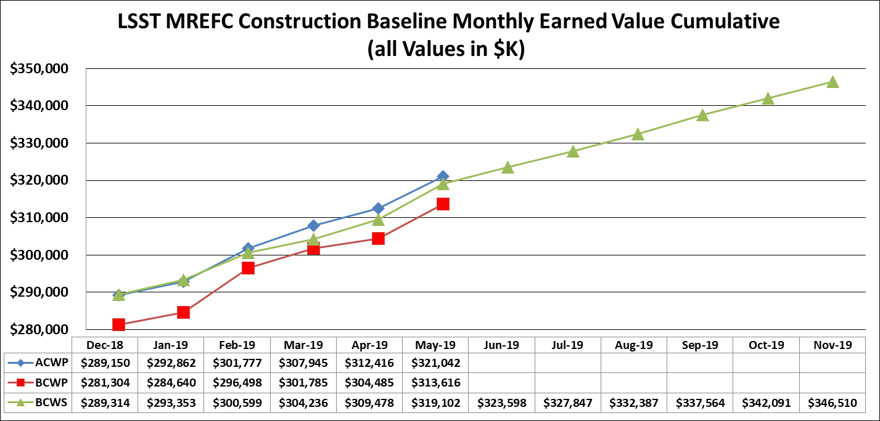
LSST SPA Chart

Slide 38
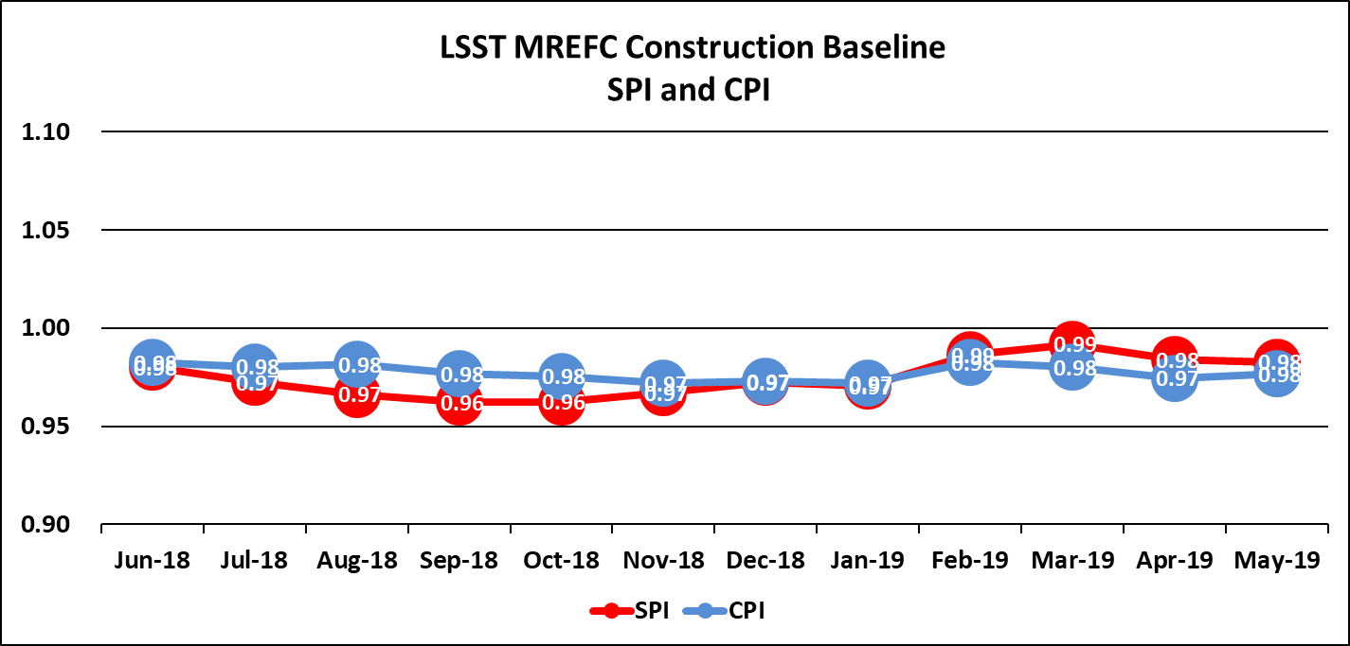
LSST CPI-SPI Chart

Slide 39
Project Schedule
Significant impacts this year from Telescope mount and Dome vendor deliveries
Two Change requests processed to stretch baseline 5 months
  LCR-1623 and LCR-1725
  Contingency draw of -$6.14M

Slide 40
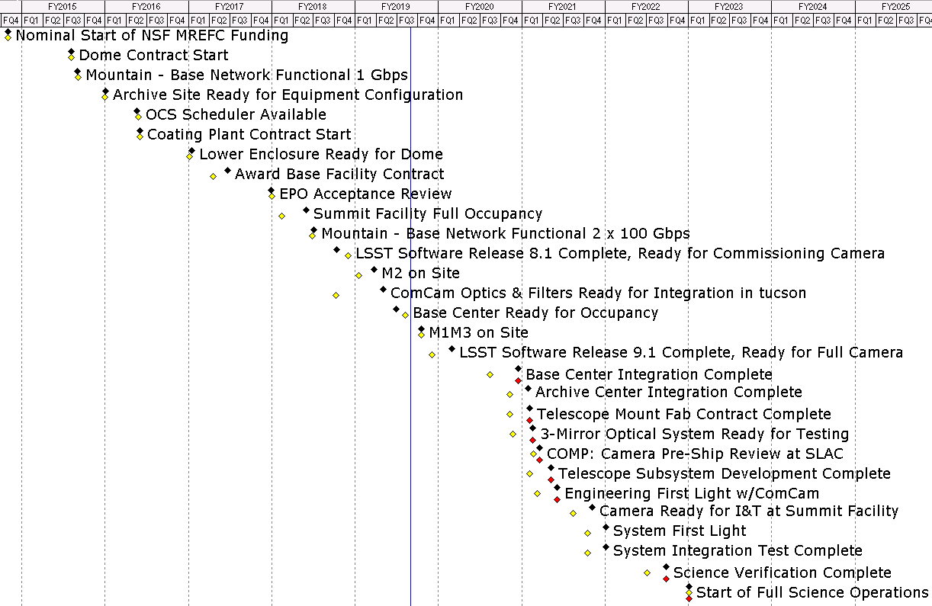

NSF Level 1 Milestones *
LDM503-06 and 07
*Level 1 Milestones are Observation milestones assigned at FDR to review Project Performance

Slide 41
Dec. 2017 Project Schedule – 8.5 Months Contingency
Cartoon Schedule baseline at JSR 2018
Data Management
Final DRP Release
Telescope & Site
Facility Support
Pre Commissioning Preparations
Early Integration & Testing
Com Cam on Summit
Engineering First Light
Camera
MIE to Ops
CD-4
NSF MREFC
Full Integration & Verification
DOE MIE
System First Light
+8.5
Schedule Contingency
Operational Readiness Review
Commissioning
Pre-
Full Operations
Operations
Construction Start
Critical Path
Now
Full System Integration “Start”
Science Operations Start
8 Dec 2017

Slide 42
LSST Schedule – 3.5 Months Contingency
LSST&crab.22
Data Management
Telescope & Site
Final DRP Release
Facility Support
Pre Commissioning Preparations
Early Integration & Testing
Com Cam on Summit
Engineering First Light
Critical Path is Dome/TMA/SIT-Com
Camera
MIE to Ops
CD-4
NSF MREFC
Full Integration & Verification
DOE MIE
System First Light
+3.5
Operational Readiness Review
Schedule Contingency
Commissioning
Pre-
Full Operations
Operations
Construction Start
Critical Path
Now
Full System Integration “Start”
Science Operations Start
17 July 2019

Slide 43
NSF Contingency and Risk Management

Slide 44
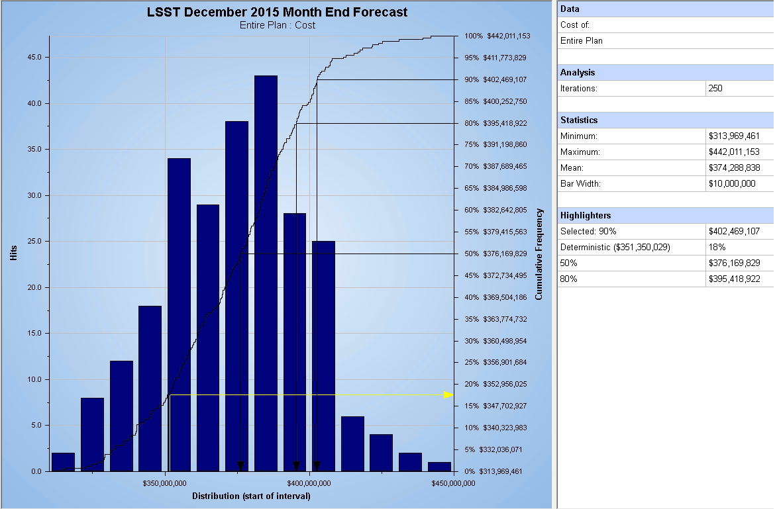
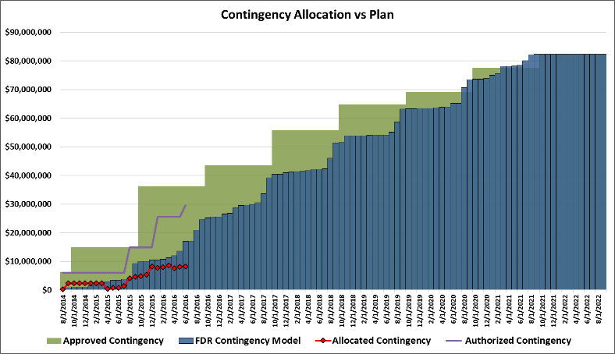
LSST Contingency Management
LSST Contingency Mgmt Plan: LPM-61
Single Project Held NSF Contingency
$82.4 M sufficient for 90% confidence
NSF Contingency Status
$54.0 M (65%) Allocated to Baseline (May 2019)
LSST Integrated MC Analysis
Activity / Risk Based Assessment from FDR provided model of use vs. schedule

Slide 45
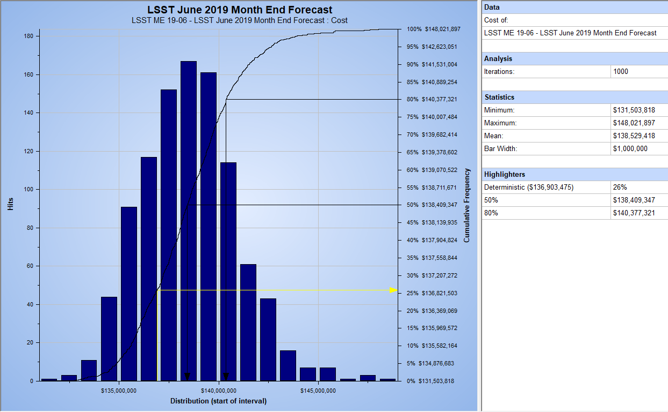
Integrated Monte Carlo Evaluation - Cost
Annual Update on P6 evaluation with cost and schedule uncertainties and top 50 risks from Risk register.
ACWP = $323.5 M
90% # = $141.5 M
$466.0 M
TPC = $473 M
90% confidence we finish on Budget

Slide 46
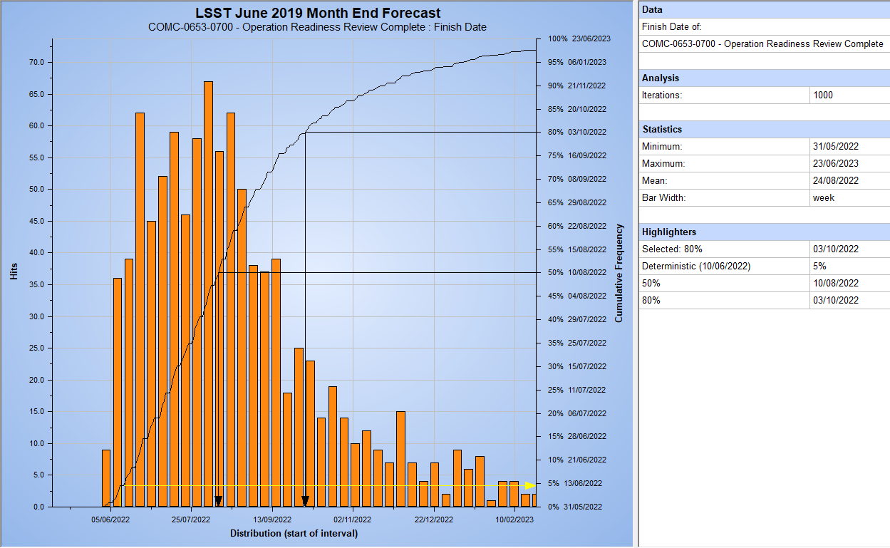
Integrated Monte Carlo Evaluation - Schedule
Annual Update on P6 evaluation with cost and schedule uncertainties and top 50 risks from Risk register.
90% confident finish 21 Nov 2022
80% confident finish 3 Oct 2022
80% confidence we finish on Schedule

Slide 47
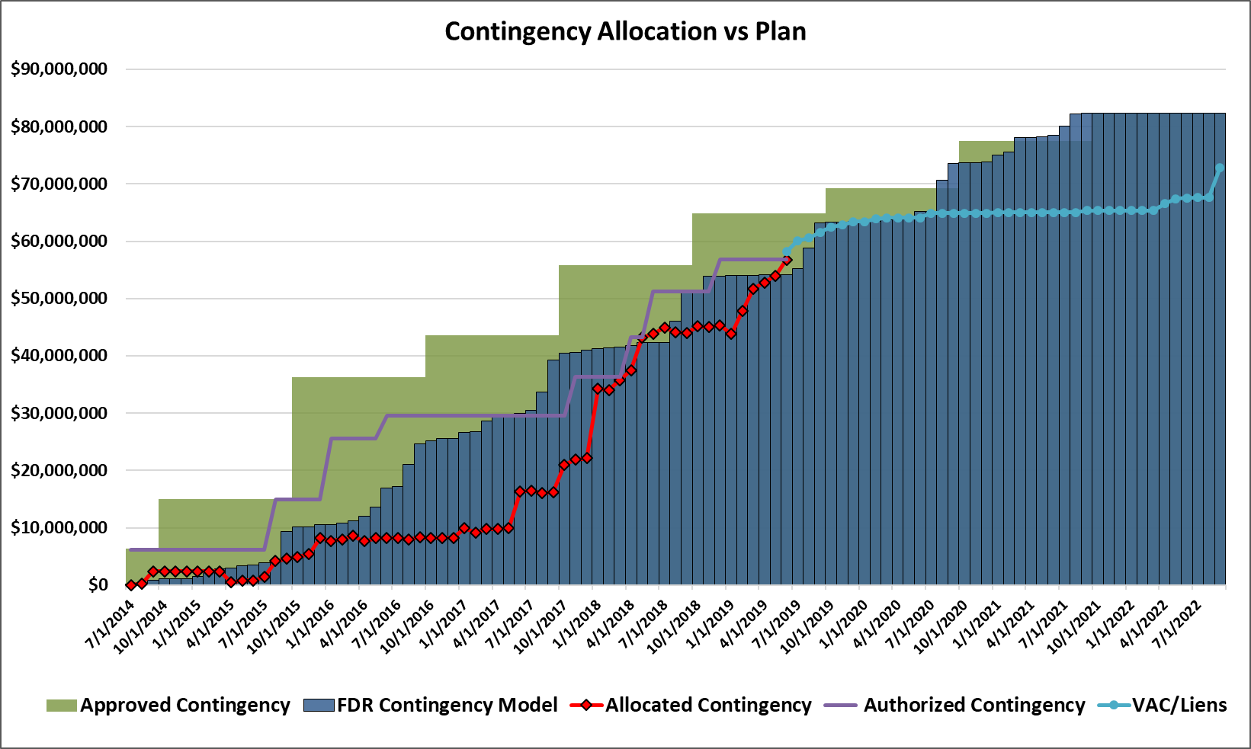
LSST Contingency Administration
Contingency authorization request submitted to NSF

Slide 48
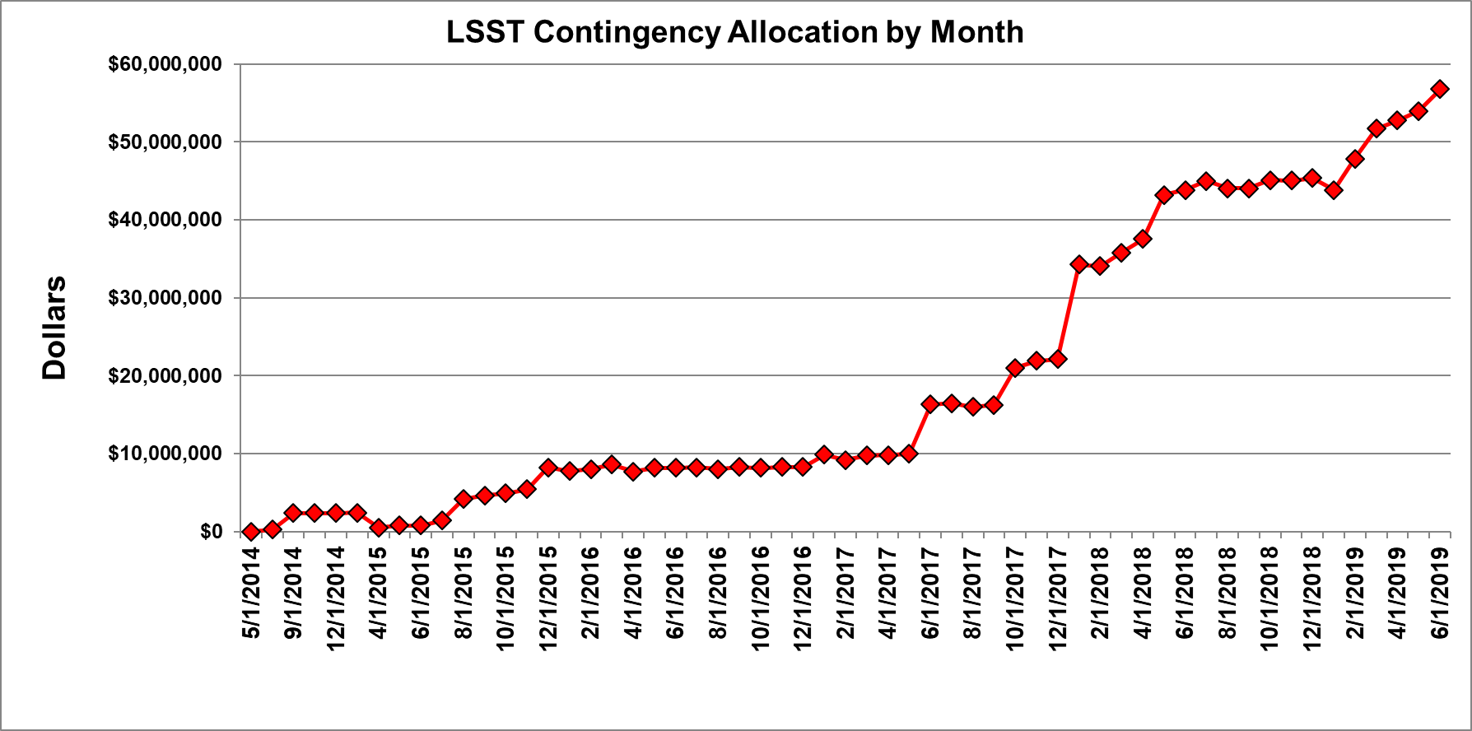
LSST Contingency Allocations
LCR-1342
M1M3 Schedule
DM LCRs
LCR-1016 Base Facility
LCR-946, 952 M1M3 Schedule and DM Mgmt
LCR-394, 414 Summit Soil and Deputy Director
LCR-215 Summit Facility
LCR-443 TMA Drive upgrade
LCR-361 Dome

Slide 49
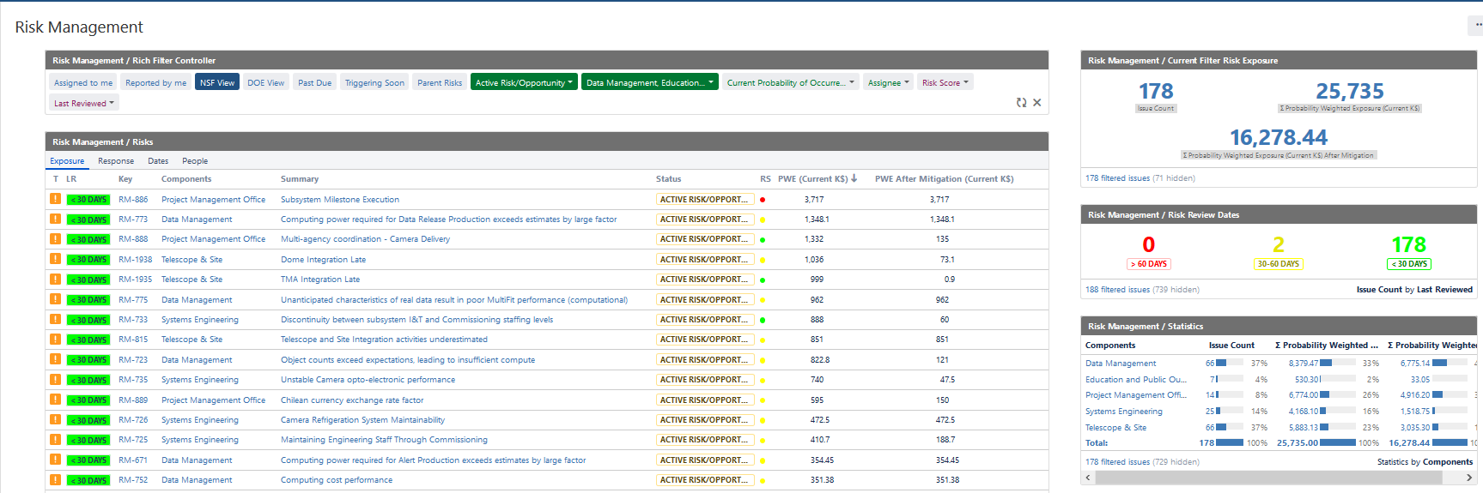
Risk Management
New Risk Management tool in place and functional – Jira
Includes DOE risks for management but not cost accounting
Many new features for reporting, parent/child, and mitigations

Slide 50
MREFC Risk Register
Sub-system | Active Risk/Opportunity | Proposed | Realized | Retired | Prob. Weighted Exposure Cost (K-USD)* | Prob. Weighted Exposure Cost After Mitigation (K-USD)*
Data Management | 66 | 0 | 5 | 18 | $8,256 | $6,637
Education and Public Outreach | 7 | 2 | 1 | 8 | $530 | $33
Project Management Office | 14 | 4 | 0 | 2 | $6,774 | $4,916
Systems Engineering | 24 | 1 | 1 | 9 | $3,280 | $1,459
Telescope & Site | 63 | 0 | 3 | 18 | $5,487 | $3,014
Totals | 174 | 7 | 10 | 55 | $24,328 | $16,059
Risks
Sub-system | Active Risk/Opportunity | Proposed | Realized | Retired | Prob. Weighted Exposure Cost (K-USD)*
Data Management | 2 | 0 | 0 | 3 | $55
Education and Public Outreach | 0 | 0 | 2 | 0 | $-
Project Management Office | 5 | 0 | 0 | 2 | $2,325
Systems Engineering | 3 | 0 | 0 | 1 | $165
Telescope & Site | 0 | 0 | 0 | 0 | $-
Totals | 10 | 0 | 2 | 6 | $2,544
Opportunities

Slide 51
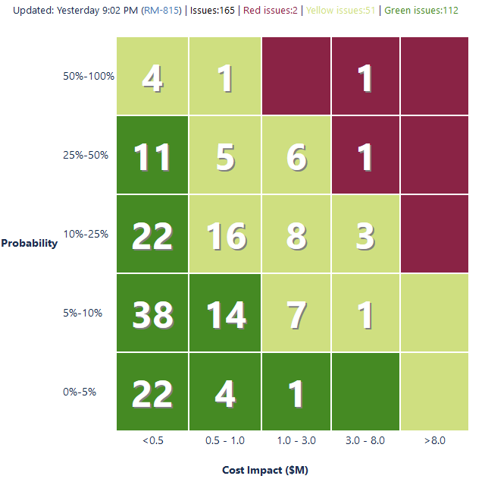
Critical Risks
Risk ID (Parent) | Subsystem | WBS | Summary | PWE ($K) | PWE After Mitigation ($K) | Proposed Management Response
RM-886 | Project Management Office | 01C | Subsystem Milestone Execution | 3717 | 3717 | Schedule and contingency will be used along with reworking the integrated plan to deal with subsystem delays
RM-888 | Project Management Office | 01C | Multi-agency coordination - Camera Delivery | 1332 | 135 | At this time the NSF efforts are on the critical path. ComCam reduces the direct dependency of late Camera delivery but this risk covers the residual impact of the camera being later than ComCam can stay efficient.

Slide 52
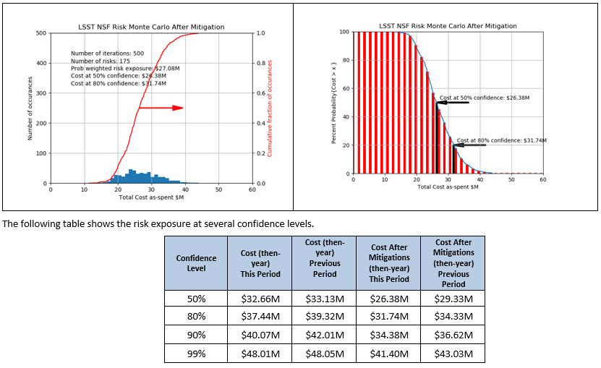
Risk Register Monte Carlo
Risk Management effort not yet lined up with ETC items
Current Remaining Contingency = $28.4M

Slide 53
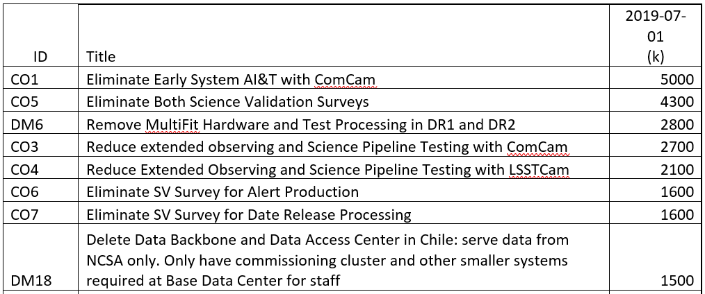
Scope Options (LPM-72)
LSST has 41 scope options for total current (1 July 2019) value of $29.8M
Eight items are $1.5M or more and total $22.6M
Quarterly updates continue and data now sorts by current value
DM10 and partial CO1 have already been taken in recent schedule re-plan

Slide 54
De-Scope Potential per Quarter (LPM-72)

Slide 55
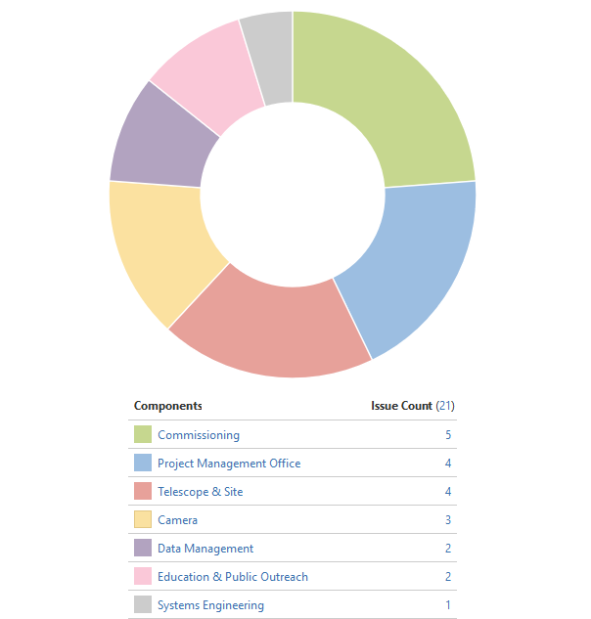
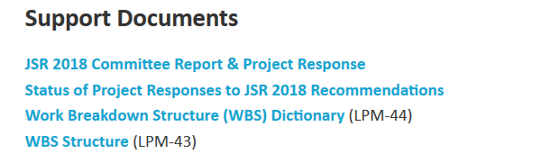
Prior Agency Reviews
Has the project responded satisfactorily to recommendations from previous reviews?
LSST maintains a Jira Project for Agency Review Recommendations (Since Feb 2016)
1 Agency Reviews in 2018 (JSR and Commissioning Combined)
  21 Recommendations
    19 Completed
    2 in Progress
JSR2018 Report Response and status in Mgmt Breakout material

Slide 56
Overview Conclusion
Technical progress continues to be excellent.
Performance predictions meet Requirements.
Project tools and processes continue to evolve to meet need.
Project status by the EV numbers is good.
Many challenges and risks remain but LSST is currently on track for successful completion.
2020 Integration success is key
Contingency is tight but sufficient to complete Project on time and within budget

Slide 57
Back-up Slides

Slide 58

Ops Director’s Office
Project Director’s Office
Director of LSST Operations
LSST Director
Science Advisory Committee
Robert Blum (Acting)
Chief Scientist
Steve Kahn - SLAC/AURA
Chair
Tony Tyson - UC Davis
Michael Strauss - Princeton U
Deputy Director
Deputy Director
Robert Blum - AURA
Communications Manager
Zeljko Ivezic – U of Washington
Project Science
Team
Ranpal Gill - AURA
Deputy Director
Project Management Office
Phil Marshal - SLAC
Project Manager
Project Scientist
Subsystem Scientists
Victor Krabbendam - AURA
Zeljko Ivezic – U of Washington
Deputy PM - Chile
Deputy PM – Software
Deputy PM Camera Comm.
Tucson, AZ
Open- AURA
Wil O’Mullane - AURA
Vincent Riot - LLNL
Menlo Park, CA
Seattle, WA
Project Support
Systems Engineering and Commissioning
La Serena, Chile
Business Manager
Urbana, IL
Daniel Calabrese - AURA
ITSI Manager
Systems Scientist
Davis, CA
Jeff Kantor (Int) - AURA
Chuck Claver - AURA
Princeton, NJ
Information Security
Officer
Safety Manager
Commissioning Scientist
Alex Withers - NCSA
Chuck Gessner - AURA
Kevin Reil - SLAC
Data Management
Camera
Telescope & Site
Education & Public Outreach
Project Manager
Project Manager
Project Manager
Head of EPO
Wil O’Mullane - AURA
Vincent Riot - LLNL
Jeff Barr - AURA
Amanda Bauer - AURA
Subsystem Scientist
Subsystem Scientist
Subsystem Scientist
Deputy Head of EPO
Leanne Guy - AURA
Steve Ritz - UC Santa Cruz
Sandrine Thomas - AURA
Lauren Corlies - AURA
27 July 2019

