Slide 1
Construction and Commissioning Safety
Chuck Gessner
LSST Head of Safety
NSF/DOE Joint Status Review
July 30, 2018 to August 3, 2018

Slide 2
Safety Charge
1.6. Are Environment, Safety & Health (ES&H) issues handled appropriately?
  Does the project have an acceptable safety record?
  Are Integrated Safety Management Principles being followed?
1.7. Has the project responded satisfactorily to recommendations from previous reviews?
Commissioning:
2.5. Are the ES&H aspects of all anticipated work being properly assessed and managed? Are Integrated Safety Management Principles being followed?

Slide 3
Safety Stats, Emergency Response, and Accident Investigation

Slide 4
Incident and Accidents
Notes:
This table is a summary of all incidents and accidents since 2010. Of the 22 injuries, five of them would be considered OSHA recordable. Safety log tracks types of incidents and accidents. We still believe that traveling to and from the summit is the most hazardous task (17 of the 44 incidents and accidents were vehicle related).

Slide 5
LSST Injury Rates (May 2018)
SLAC - Camera Team 0
AURA - T&S, DM, and PO .41
Summit Contractors .46
Base Facility Contractors .41
Total of these groups .37
(U.S. 2016 National Average 2.9, Construction 4.0)
(DOE average 1.3)
Notes:
Conservatively calculated about 2.7 million hours worked to date on the project of the above noted groups – the injury rate is .37, (Overall U.S. National Average is 2.9, just construction 4.0 -2016 –most current data from BLS) Other groups like Universities and partnerships not counted. Rates are based on number of cases per 100 full time equivalent. .37 is 1/11 of the construction rate and ¼ of the DOE rate.
Two were considered lost time accidents:
Summit contractor jumped out of backhoe after losing control - anxiety - medical lost time - 5 days
Base Facility contractor tripped and contusion to left knee - prescribed Rx –medical lost time- 3 days

Slide 6
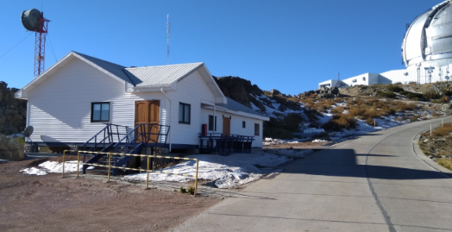
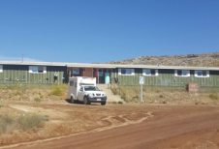
Emergency Response
Well established Medical Emergency Response and Communications:
Nurses and Paramedics: 2 paramedics, one each per summit (Cerro Pachon and Cerro Tololo) at any given time, 7 days on/7 days off, 24/7 coverage
2 Polyclinics one per summit (both supplied with medical equipment)
2 Ambulances one per summit
LSST personnel have Radios and they are also given to contractors. Telephones can direct dial to the US. Functioning Internet on the summit (both wired and microwave available), and WhatsApp “chats” one for LSST management, one for LSST safety personnel, and one for AURA safety personnel and legal representatives.

Slide 7

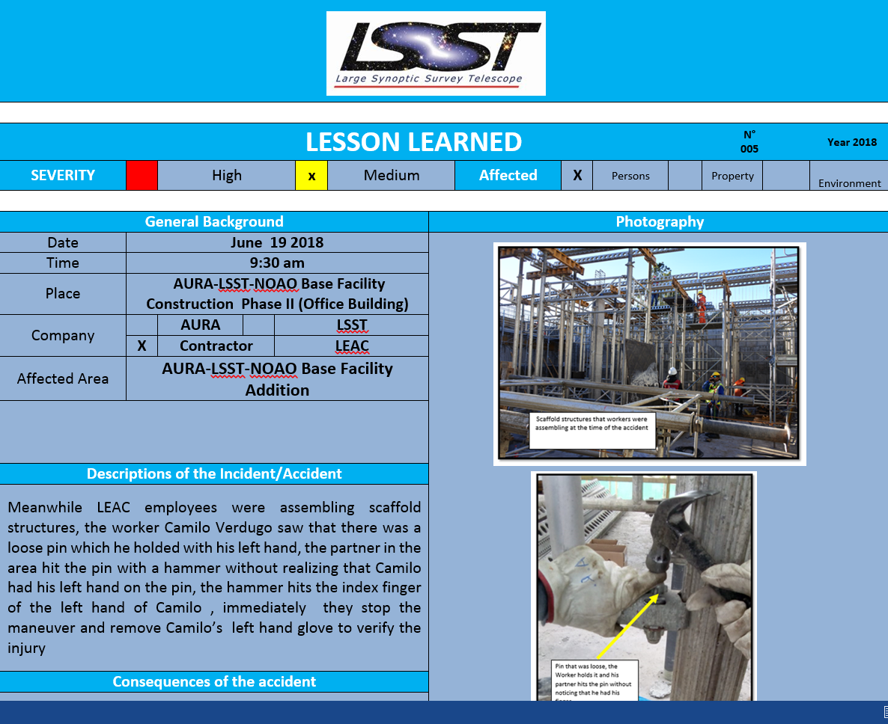
Accident Investigation
Written Plans and documents for ER procedures, accident investigation, and notifications:
LSST Safety web pages
Summit Visitor Safety Brochure
LSST Site Safety Orientation
LSST ESH plan (LPM-114)
AURA Emergency Plan
AURA Winter Operations
Hoja de Emergencia (Spanish and English)
Accident Notification Procedure
Accident Investigation Template
Lessons Learned

Slide 8
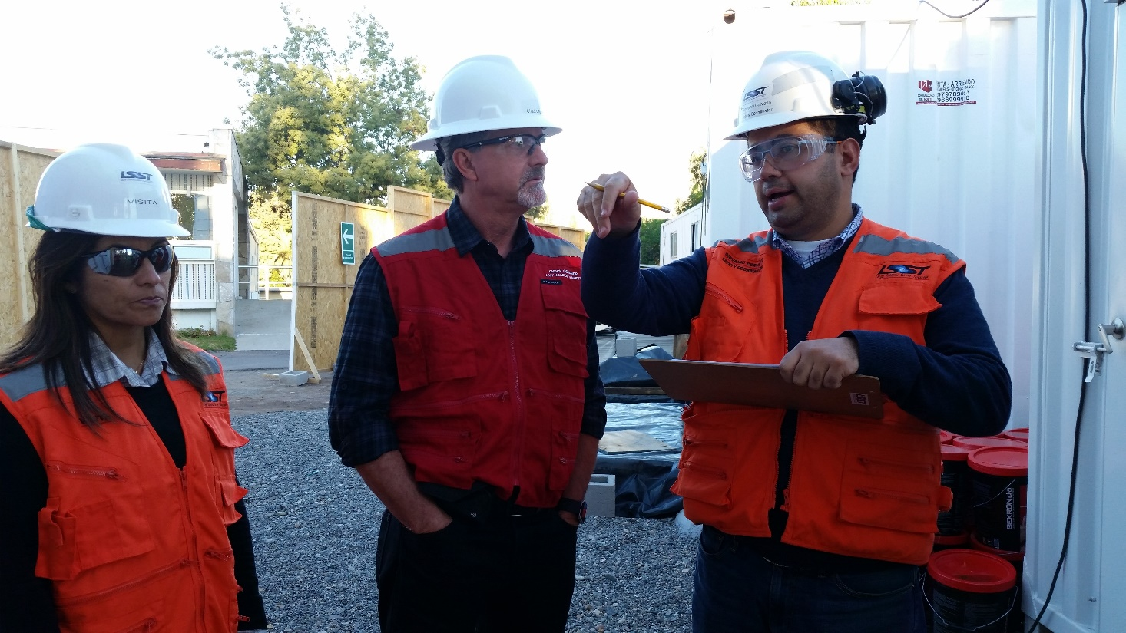
Safety Team

Slide 9
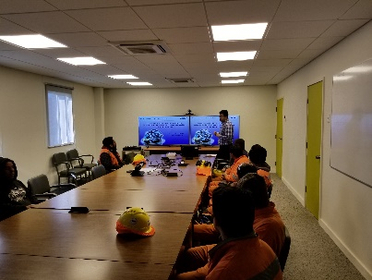
Safety Functions
Maintaining and developing SHE policies, standards, and training materials
Providing required LSST and regulatory documentation and reporting
Assisting staff to minimize loss
Conducting site safety orientation
Providing audits, inspections, and investigations for improvement
Providing physical safety oversight during critical tasks
Reviewing and safety-approving work procedures (required for all work)
Ensuring emergency response capabilities
Liaison required safety committees and contractors

Slide 10
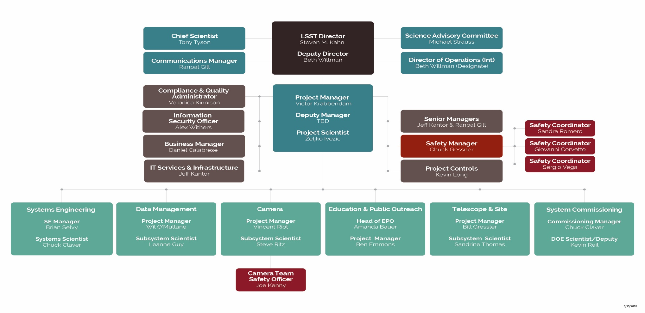
Current LSST Safety Organization
Notes:
Safety management is within the LSST Project Office, functionally reporting to the LSST Project Manager, with authority with the Director. (Explained in the Safety Policy LPM-18)

Slide 11
Localized LSST Safety Staff
Safety personnel is currently supporting construction and will be engaged in installation & commissioning; some will transition to operations.
Safety Manager
Tucson
Chuck Gessner
Safety Officer
Cerro Pachon
Sandra Romero
Safety Officer
La Serena
Giovanni Corvetto
Camera Safety
SLAC
Joe Kenny
Safety Officer
Roaming
Sergio Vega
Notes:
Romero, Corvetto, and Vega rotate between summit and base facility construction sites to become familiar with both locations.
There will be multiple shifts starting with Commissioning, the primary safety coverage will be during the day activities. At times and when needed there will be safety coverage during nighttime operations if there is work being planned on the telescope floor or in the maintenance area at night. Based on observatory experience, nighttime commissioning does not require full time safety oversight.
If a major breakdown occurs during commissioning, such as hydraulic oil failure, Operators would shutdown all systems to make it safe and maintenance crews would investigate the failure the next day and plan for repairs via a procedure.

Slide 12
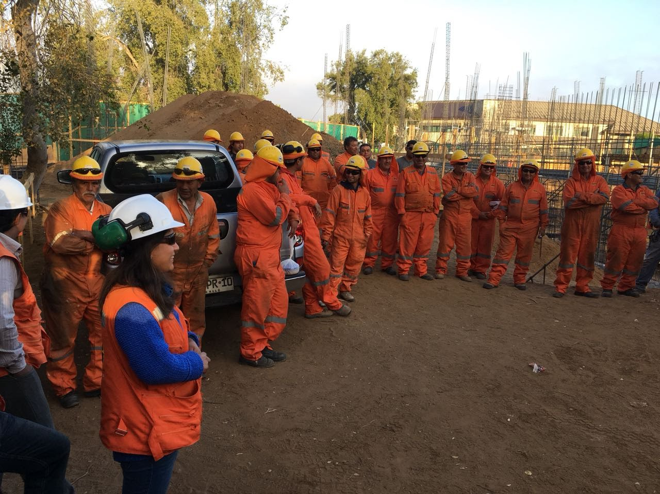
Work Planning and Control

Slide 13
Safety, Health, and Environment (SHE)
Mission
The Safety Mission of LSST is to provide every individual working or visiting the LSST facilities with an environment that is free from recognized hazards that are likely to cause them harm.
The LSST Safety Policy (LPM-18) summarizes:
LSST is committed to achieving the highest performance in safety, health, and environmental management practices with the aim of creating and maintaining a safe and healthy working and operating environment.
The Safety Policy focuses on personnel and equipment safety throughout the design, construction, commissioning, and operations phases of the project.
Notes:
The objective of the policy is to make safety, health, and environmental management an integral part of the effort from initial planning and design, to construction, commissioning, and finally throughout the operation of LSST.

Slide 14
Safe Work Planning and Control
Safety Policy LPM-18 explains the responsibility and accountability of management, team members, and contractors including participation in safety work planning and control.
Safety Policy LPM-18 defines a safety council that provides safety performance feedback
Change Control Process LPM-19 is where controlled and safety documents are approved by all senior managers of the project
Leadership Roles, Responsibilities, Authorities, and Accountabilities Document – 25321 details safety roles for LSST leadership
LSST Risk and Opportunity Management Plan LPM-20 identifies project risks
Obligation to Inform (ODI) verifies that workers have the knowledge and skills to do their jobs and informs them of the hazards of their jobs
Notes:
This is a document trail that explains how safety is integrated into the project.
Explanation of People Work Planning and Control The safety policy details the expectations of all people working at LSST locations. Managers are responsible for managing safety in their area of control. All “team members” are required to comply with local safety requirements and are clear about their duty with the Stop Work Authority!
Safety Staff Interaction and the processes that staff are required to complete and to participate for Work Planning and Control. This is being tested and refined during construction and commissioning. Job work authorization (ODI) is an added safety measure that is required by Chilean law that complements our safety processes.
Corrective actions and safety behavior coaching is how LSST currently deals with personnel that do not take safety seriously. This has been an extremely rare occurrence with current LSST construction staff.
Hazard Analysis Process during Operations. LSST engineers are currently and actively involved in the hazard analysis process for all subsystems during construction. It is expected that this process will continue within the engineering and technical groups if redesign or modifications are needed at the observatory. Again by operations, this process is a well understood and developed.
The LSST Safety Plan LPM-114 is a detailed document that defines general expected safety behaviors of personnel and specific requirements for various operations such as lifting and confined space.

Slide 15
Safe Work Planning and Control
LSST SHE Plan LPM-114 establishes compliance requirements and defines Stop Work Authority for all entities.
WBS Structure LPM-43 provides for safety staffing, safety budget, and other risk control efforts
LSST Hazard Analysis LPM-49 identifies hazards and mitigations and provides engineered and/or administrative controls to acceptable levels
LSST Safety Standards provides compliance for both US and Chilean requirements (copied from DOE and other organizations)
Training Standard Operating Procedure requires general safety awareness training for new hires and non-AURA workers
Site Safety Inspections help mitigate hazards

Slide 16
LSST Work Planning and Control
  Site Safety Orientation informs of lessons learned, general workplace hazards, emergency response procedures, and other safety information
  Lessons Learned are shared in weekly meetings, monthly contractor safety meetings, and monthly safety committee meetings
  Administrative Controls are being established like the Global Interlock System, Signage, and Secured Access
  Safety Training Matrix lists specific safety standard training and equipment training
  Various Meetings are in place to coordinate and discuss safety issues
  “On Boarding” safety message and other web based resources
  Maintenance Procedures are being developed by vendors and those procedures must be demonstrated before acceptance

Slide 17
Work Planning and Control
All Camera work is authorized by supervisor or SLAC point-of-contact
  Activity Training and Authorization (ATA) which leads to a SLAC Training Assessment for SLAC employees. ATAs are deployed to authorize an employee to perform routine work in resident areas
  Job Safety Analysis (JSA), written standard operating procedure, approved eTraveler, or Work Integration Plan (WIP)
All work is released by the area manager before beginning work
All authorizations and releases are documented
Camera team will use web base training Litmos for LSST observatory mandated safety training
Observatory safety orientation has been updated and will be bilingual
Notes:
This is a slide from Joe’s presentation that also verifies that safety is integrated into the project.

Slide 18
Change Control Board
Senior managers of the project review and approve a variety of controlled documents (including safety policies and standards), interfaces, and design changes.
Actions:
Voting Items
• LCR-866: Move camera maintenance refrigeration compressors to the maintenance area
• LCR-1067: Updates to LSE-30 for EPO
• LCR-1085: Confined Space Entry Safety Standard
• LCR-1086: Lockout Tagout Safety Standard
• LCR-1087: Hot Work Safety Standard
• LCR-1089: Bloodborne Pathogen Safety Standard
Discussion
• LCR-457: Placing the machine-readable optical design under formal change control
• LCR-924: Duplicate LSR Data Performance Metrics in OSS for DM Flow Down
• LCR-931: Addition of LPM-122 Data Classification in the LPM-123 General AUP
• LCR-1004: Withdraw LSE-77, Infrastructure Interfaces Between Data Management and the Base Facility
Notes:
The text on the right is from a recent meeting minutes of a Change Control Board meeting. Note that there are several that are directly related to safety. Managers have to agree to the standards that they will have to follow.

Slide 19
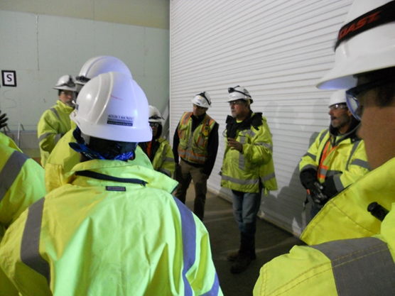
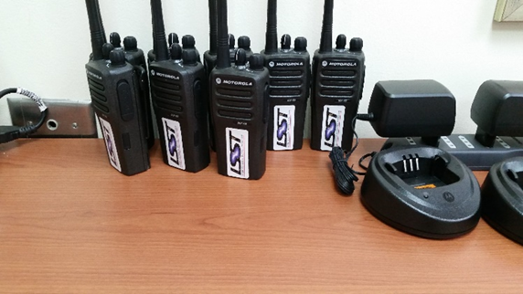
Work management occurs on multiple time scales
Monthly Work Planning Meeting
Led by Systems Scientist
Primavera P6 plan review with 2-month look ahead
Assess safety and hazard potential of planned activities
Review safety procedures for critical activities
Detailing plan for month +2 map planning activities to Jira Epics
Review Primavera P6 plan for current month and update as needed with emergent issues
Review P6 activity mapping to JIRA Epochs and weekly sprints for the current month
Weekly Site Specific Work Assignment Meeting
Led by jointly by “on duty commissioning scientist” and site manager
Review detailed work plan for current week with a 2 week look ahead
Work assignments are made to individuals for current week
Specific safety issues related to work assignments are reviewed
Daily Site Specific Work Authorization (“tailgate”) Meeting
Conducted by local site manager or designee
Focus is on safety protocols, identifying potential hazards and safe work procedures for the assigned work for the day/shift
When multiple shifts are involved, a “plan of the day” meeting will be held at the transition
Notes:
This slide is from Claver’s presentation for commissioning. We are currently following the same format, however, T&S and Camera are meeting weekly instead of monthly as there are multiple activities from various subsystems.

Slide 20
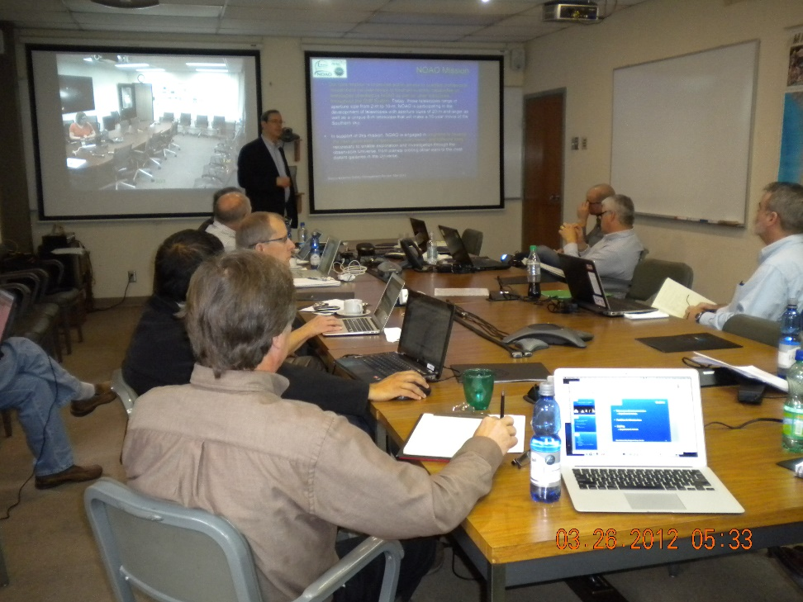
Safety Training Plan
Name of Course
The Mountain Roads
Personal Protective Equipment
Emergency Evacuation/Fire/Signs/Prevention
Blood Bourne Pathogens
Powered Working Platforms
Hearing Conservation
Hazardous Waste
Respiratory Protection
General Safety Awareness Course
Office Safety
Accident Prevention Signs and Tags
Confined Space Entry
Lockout/Tag out
Medical Services/First Aid
Powered Industrial Trucks
Welding and Cutting/Hot Work Permit
Electrical Safety Related Practices
Fall Protection
Hazard Communication
Laser Safety Awareness
Cryogenics/Refrigerants/Oxygen Displacing Hazard
Chemical Handling and Storage
Machine Guarding
Arc Flash
Cranes and Hoists
Scaffolding
Medical and Health Surveillance
Environmental Compliance
Notes:
The LSST Safety training plan is being developed and we have identified safety procedures and the required training that is needed for work at the Summit and Base facilities.

Slide 21
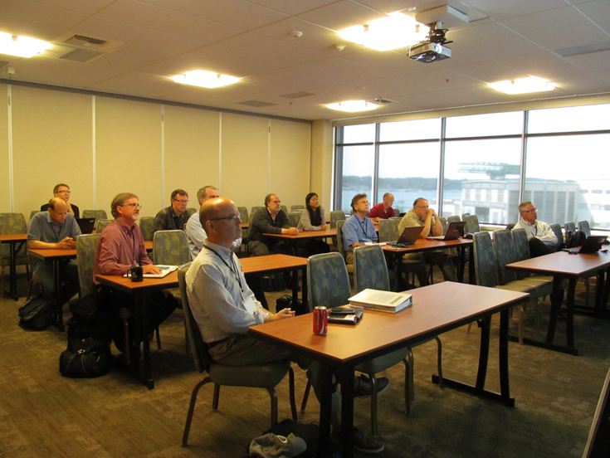
LSST Safety Council
Safety Council is a standing committee of 3 diverse professionals
Provides useful and favorable reviews
Reviews to date include Project Office Safety Management, Dome subsystem, Summit Site Safety Plan, Camera subsystem, Summit and Base Facility inspection and other observations
Observes and advises during Project and Community Workshops and Joint Technical Meetings
Physical interaction at least twice a year
Recent Review in La Serena, Chile
November 7-9, 2017
For this review, the Safety Council was asked to evaluate LSST’s base facility and summit construction sites with the objective of offering recommendations to improve safety management, work planning, and control.
Notes:
This is an example of LSST method to provide additional oversight in safety management and is envisioned to carry on into operations.
Safety Council’s Charge from LPM-18:
3.2 Safety Reviews and Hazard Analysis
LSST will conduct periodic design and procedure reviews focused on compliance to safety regulations, this program, and good practice. The frequency of the reviews will be commensurate with the stage of the project as defined in the Project management plan. Reviews will be conducted by SHE professionals and will focus on specific subsystems of the observatory, the observatory as a whole, and this Safety Policy itself. Each subsystem will conduct periodic Hazard Analyses to be included in the reviews. Hazard Registers will be maintained in standard forms for cross project review.

Slide 22
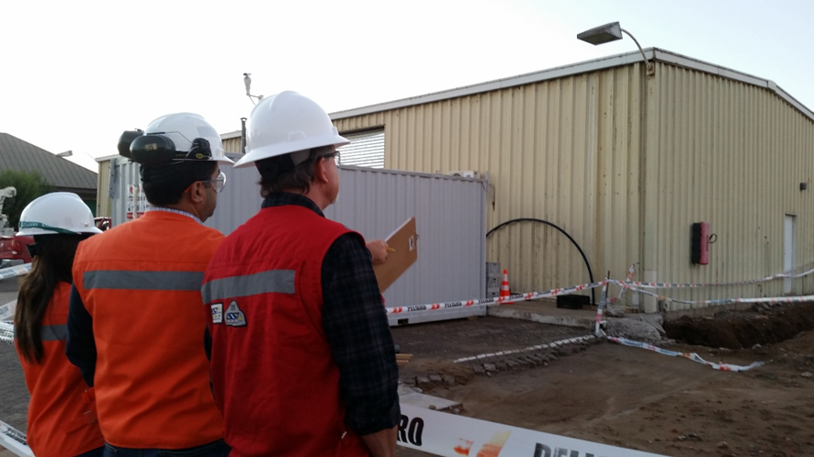
Notes:
The concept of capturing both compliant and non-compliant conditions is a great tool to assess the observation skill of the inspectors, to get a general sense of relative compliance and to see what their areas of focus are. The compliance assessment percentages are a great tool to provide a sense of balance and appreciation of areas of weakness in program implementation, thus having contractors and staff strive to improve conditions and behaviors on the site.

Slide 23
No Conformidad
After each inspection, and according to the observations found, Safety sends a notification form of deviations to the responsible person. This form indicates the areas where the deviation were found with recommendations; once the deviations have been corrected the person responsible sends back the form to safety noting how the deviation was corrected.
Safety to Responsible Person
Responsible Person to Safety
Notes:
When there is not compliance, there is follow-up by the safety coordinators to the people that are responsible for the corrective actions.

Slide 24
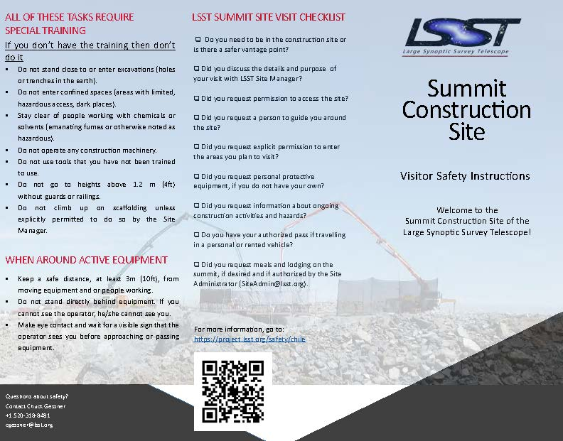
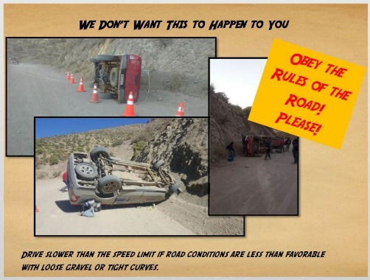
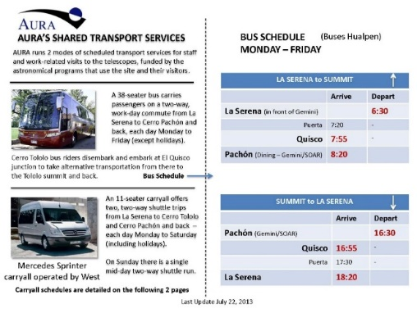
Road Safety and Summit Site Safety
LSST strives to purchase 5-Star safety rated vehicles and equip with safety gear
“0” tolerance for unacceptable driving behavior
Web based information for driving in Chile – we encourage use of the bus and carryalls – let a dedicated professional do the driving
Memo is sent to all travelers to Chile about driving hazards
GPS tracking for LSST Vehicles and AURA vehicles
Road Safety Campaigns
A goal that SLAC personnel won’t drive in Chile
Safety Brochure discusses driving hazards
Notes:
As our staff grows we are planning for additional vehicles to haul people so they don’t have to drive.
Recently we collaborated with other Chilean Centers to contract with Chile GPS to install GPS tracking in all vehicles that travel to the summits.

Slide 25
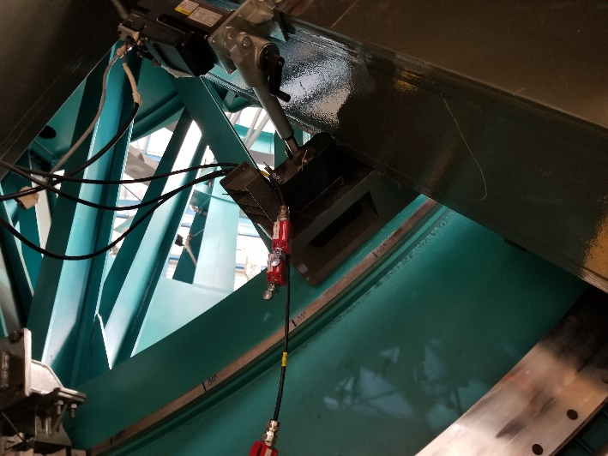
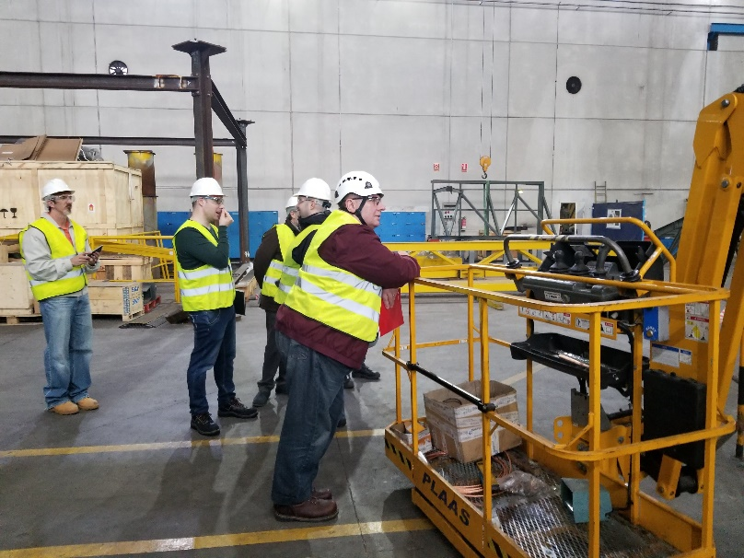
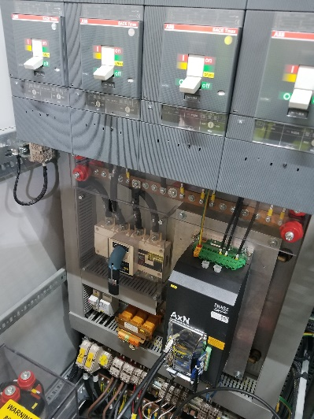
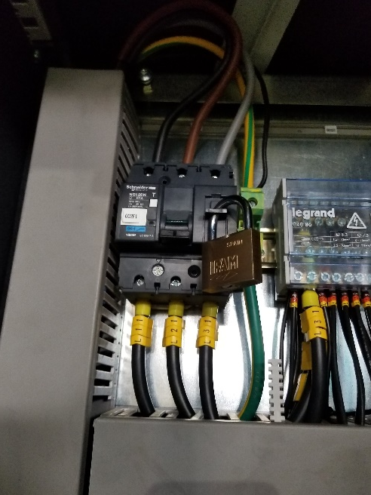
Verification of Hazard Mitigations

Slide 26
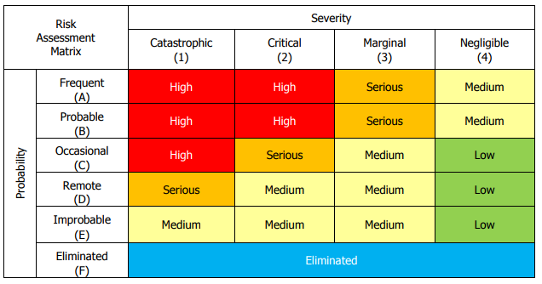
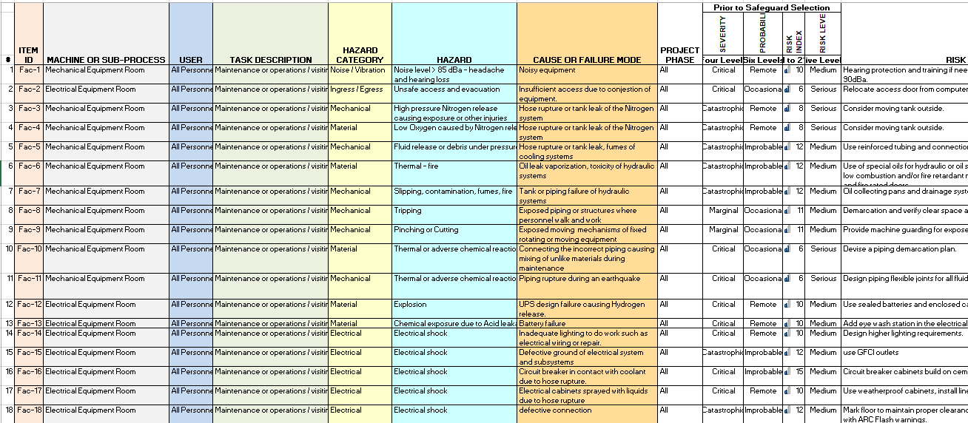
Hazard Identification and Mitigation Process
LPM-49 defines the Hazard Analysis process
Mitigation approaches include:
  Interlock
  Design
  Procedure
  Personnel
To ensure that the mitigations have been implemented, a verification step is necessary.

Slide 27
Verification of Mitigations from Hazard Analysis
Factory Acceptance Testing (FAT)
  Physical hazard mitigations verification
  Quality control verification as it relates to safe design
Construction Site Field Verification
  Contractor Safety Plans and Procedures (Most are Complete)
  Factory Acceptance (FAT),AIV, and Commissioning:
  Verification of Interlocks
  Final Check-Off on “most“ Hazard Analysis mitigations
Witness Maintenance Procedures
  Verify Plans are complete and safety precautions are included
  Witness actual maintenance procedures in the field by the contractors
Notes:
We had the forethought to require contractors to provide us with written operational and maintenance plans as well as demonstrating each of the operational and maintenance operation. Some of these plans will be validated during AIV and Commissioning.
As we expected the contractors to continue with finding additional hazards in the design we are also expecting them (safety and managers) to verify the mitigations. Very soon the contractors will have determined the mitigation was achieved then there would be a paper trail that we (T&S and P.O.) will audit and verify.

Slide 28
Verification Process for Hazard Mitigations
LSST relies upon “design build” contractors for 100% verification of all hazard mitigations
  Vendors are required to provide full verification documentation
  LSST will conduct an independent fractional percentage audit or time-bound audit, depending upon circumstances, to ensure concurrence with vendor conclusions
For “build-to-print” contractors, such as Besalco, LSST is responsible for verification and will do a 100% verification

Slide 29
Hazard Mitigation Verification via Designated Witnesses
LSST will rely upon the existing Systems Engineering V&V process developed for requirements verification and modify it slightly to verify hazard mitigations.
For each hazard, a “designated witness” will be identified to act as the verification authority.
  The “designated witness” must not be the individual(s) who were responsible for designing or implementing the hazard mitigation – there must be a level of independence.
  The “designated witness” is fully empowered to inspect the mitigations and request additional information, as needed, from the designers and implementers.

Slide 30
Hazard Mitigation Verification Methods
Verification of hazard mitigations will rely heavily upon:
  Inspection: An examination of the item against applicable documentation to confirm compliance with requirements. Inspection is used to verify properties best determined by examination and observation.
  Demonstration: A qualitative exhibition of functional performance, usually accomplished with no or minimal instrumentation. Demonstration (a set of verification activities with system stimuli selected by the system developer) may be used to show that system or subsystem response to stimuli is suitable.

Slide 31
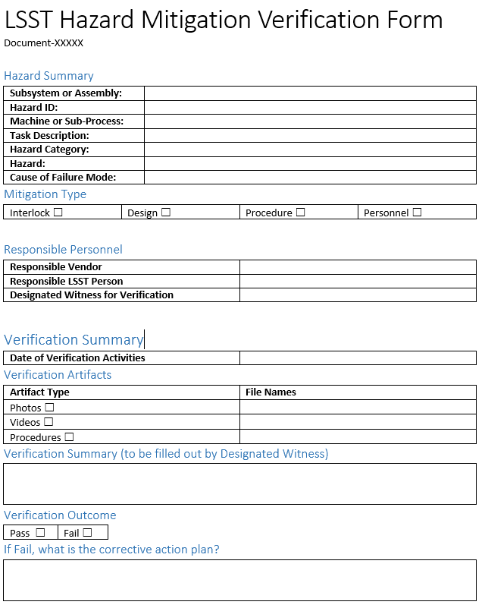
Verification Artifacts for Hazard Mitigations
Acceptable verification artifacts include:
  Photographs, videos of items mitigated by design or interlocks
  Copies of procedures, including PPE lists, for items mitigated by procedure and safety equipment
  Signed demonstration witness form for items mitigated by interlocks.

Slide 32
SHE Department December 2017 Charge Response
Have the ES&H (Environment, Safety, and Health) aspects of the operations phase been properly assessed and planned? Are Integrated Safety Management Principles being followed?
YES
Integrated Safety Management Principles have been codified in LSST Policies and Procedures and the same principles that will be applied during operations are being used.
Notes:
Many if not all safety activities that are being conducted during construction will transition into operations.

Slide 33
Safety Review Outcomes
LSST Safety Council Review November 2017:
“.... demonstrating the effectiveness with which safety has been integrated throughout the project. General conditions at the Cerro Pachon jobsite were reflective of a mature construction site safety program.
LSST Project Management continues to demonstrate a high level of commitment to safety which is reflected by the strong project safety culture and personnel engagement.”

Slide 34
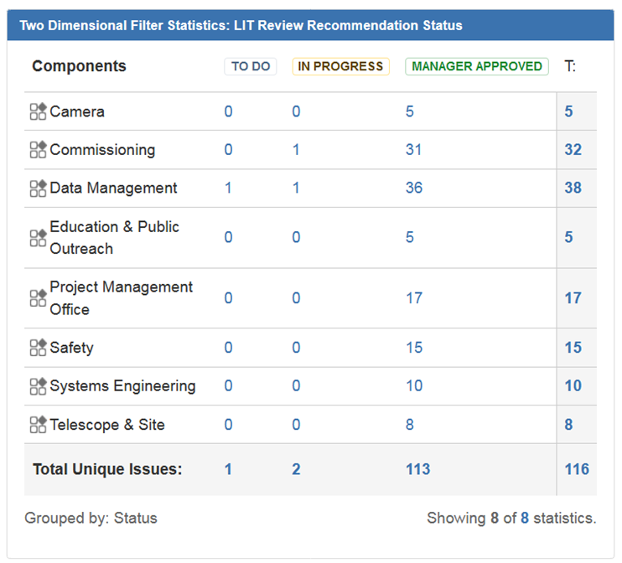
Tracking Review Recommendations
All safety recommendations from past reviews were accepted and implemented.

Slide 35
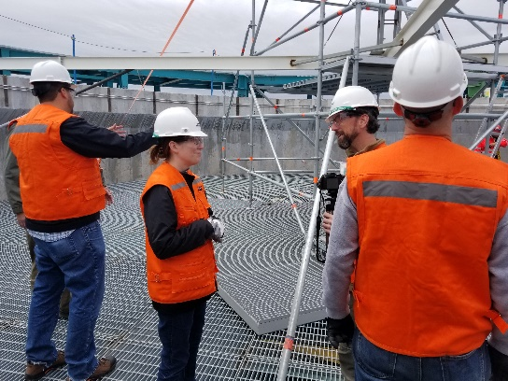
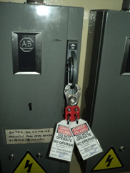
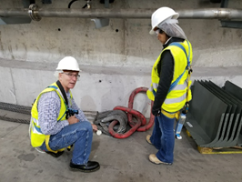
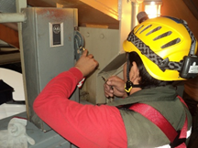
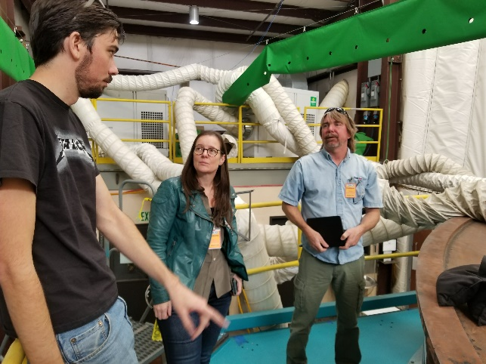
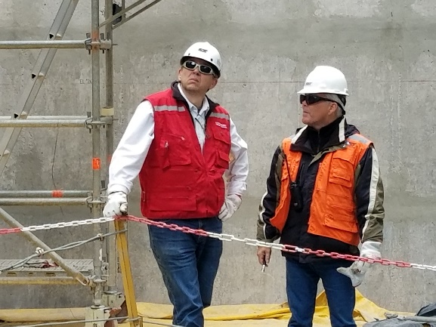
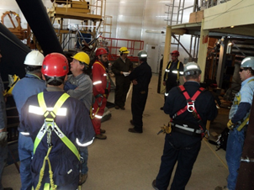
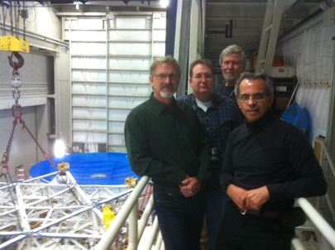
End of Presentation

Slide 36

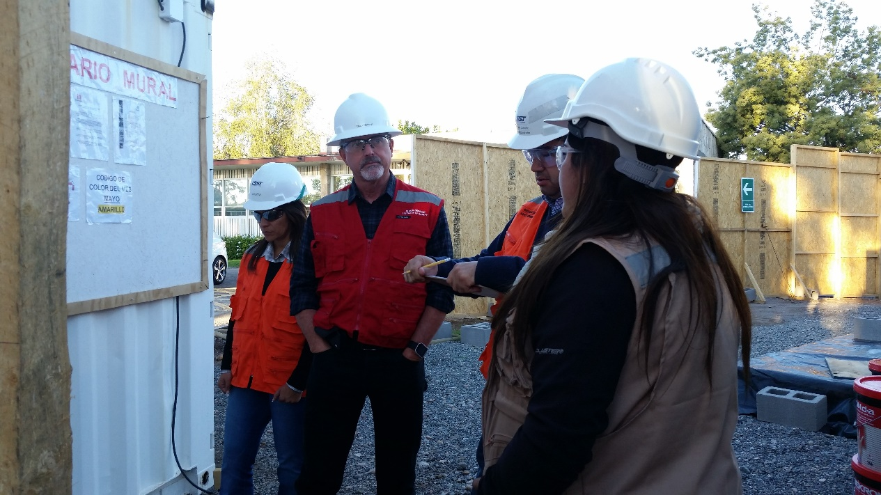

Detailed Slides for Breakout

Slide 37

AURA/LSST Transit Insurance
AURA/LSST procured insurance from Zurich for the transport of equipment and materials ($298 million) over the next three years for a premium of $150,000 per year. coverage includes:
  Transportation from the port of origin to the summit site
  $100,000 deductible for materials and equipment
  $1,000,000 deductible for mirror shipments
  All risks of loss per any one conveyance/connecting conveyance
  Limit of liability for each shipment of $20,000,000
  AURA/LSST is sole loss payee on the policy
Notes:
Property insurance is not allowable unless 1) the materials or equipment is out of AURA/LSST’s care and custody, and 2) the NSF give prior approval to procure the insurance.
In preparation to receive competitive insurance quotes LSST developed detailed Transportation Plans, Statement of Work, Critical Items List with Replacement Costs and other information for the critical logistics that include handling, loading and unloading and transport methods.
Three underwriters engaged in the competitive bid process with proposals received from Zurich, Lloyds of London - Chubb and Lloyds of London – Pembroke. Zurich quoted the lowest price with the lowest deductible and fewest additional conditions.
Total premium is $450,000. Zurich has the right to inspect shipments by their own surveyors.
Zurich covered the transportation of the M1M3 from the U of A mirror lab to it’s present storage location (Million Air). The deductible was the same at $1 million.
Camera is not included in this policy. Our strategy was to build a relationship and more importantly a reputation of good survey and loss control practices and request quotes closer to the transport of the camera.

Slide 38
Safety in Operations and under NCOA

Slide 39
LSST Safety is a Collaboration
LSST will enter Operations with established liaisons to Operations Partners
NCOA will be forming as key local group
Partner history and cooperation established during construction
LSST within NCOA (3 safety personnel)
LSST is major element in Tucson and Chile
Group can optimize around Kitt Peak Arizona, La Serena, Cerro Tololo, Cerro Pachon Chile and Hilo and Mauna Kea Hawaii
SLAC (1 safety officer assigned to Camera)
Stanford University - Environmental Health & Safety
NCSA (safety support when needed)
University of Illinois - Division of Safety and Compliance
Notes:
High-level functionality needed at each ops partner location:
In the case of NCOA,
In Arizona, nearly two city blocks in Tucson and a mountaintop at Kitt Peak of facilities, supporting more than 300 employees as well as tenants. (vehicle fleet, part AURA Corporate operations, data center, mail center, labs, maintenance and engineering staff)
In Chile, nearly two city blocks in La Serena with living quarters, two mountain tops supporting around 300 employees as well as tenants. (vehicle fleet, part AURA Corporate operations, data center, mail center, labs, maintenance and engineering staff, and AURA property roadways)
In Hawaii, office complex in Hilo, and telescope on Mauna Kea (vehicle fleet, data center, mail center, labs, maintenance and engineering staff, and AURA property roadways)

Slide 40
LSST Safety Transitions to Operations
LSST Safety Organization in Operations will have experience from an 8-year Construction Project
AURA Observatory - Chile
LSST
Construction
Safety Manager
Chuck Gessner
LSST Safety Council
Safety Manager
Mario Gonzalez
Camera Safety
SLAC
Joe Kenny
Safety Officer
La Serena
Giovanni Corvetto
Safety Officer
Cerro Pachon
Sandra Romero
Safety Officer
NCSA
Service Unit
Labor Unions
AURA Safety Committees
Safety Officer
AIV / Commissioning
2-yr Surge
Sergio Vega
Safety Officers
LSST Contractors
Construction
Notes:
Chilean Safety personnel are currently on staff. We expect these staff to transition to operations.
Operating Safety personnel currently supporting construction and will be engaged in assembly, commissioning, and the transition to operations.
Safety oversight during construction is compliance based however there is an operational benefit in knowing the systems that are being constructed and ultimately operated. In addition, the safety manager and one of the officers have over 20 years of observatory operations experience combined. There are elements of “operational like experience” during construction as there are LSST employees working now on various subsystems and the good working relationships between the safety personnel and staff has already been established. Current LSST safety staff will smoothly transition into operations.
Although there will be multiple shifts, the primary safety coverage will be during the day operations when maintenance and repairs are performed. At times and when needed there will be safety coverage during nighttime operations if there is work being planned on the telescope floor or in the maintenance area at night. Based on observatory experience, preparing for observing and observing does not require full time safety oversight.
If a major breakdown occurs during observing, such as hydraulic oil failure, Operators would shutdown all systems to make it safe and maintenance crews would investigate the failure the next day and plan for it repair via a procedure.

Slide 41
LSST Safety under NCOA
LSST remains a key Safety Priority with larger pool of safety professionals available for cross training / support / collaboration
AURA Observatory - Chile
NCOA Safety Manager
NCOA Safety Oversight
AURA-O
Safety Manager
Safety Officer
Tucson – Kitt Peak
Safety Officer
La Serena
Safety Officer
Cerro Pachon
Labor Unions
AURA Safety Committees
Safety Officer
SLAC
Safety Officer
NCSA
LSST Specific

Slide 42
LSST Safety Reporting Structure under NCOA
NCOA Directorate
NCOA Safety Manager
NCOA Safety Oversight
A.D. of Chilean Obs. Operations
Safety Officer
Tucson – Kitt Peak
Safety Officer
La Serena
Safety Officer
Cerro Pachon
Safety Officer
SLAC
Safety Officer
NCSA
LSST Specific

Slide 43
Staffing Needed for LSST Safety Functions
SLAC and NCSA (supported by indirect costs): Shared FTE among several projects
AURA-O (support paid by fees): Shared FTE dedicated to Chilean regulatory support for all AURA observatories (LSST, Gemini, CTIO) in Chile
NCOA Tucson 0.75 FTE (provides other risk management support and optimizes resources)
NCOA Chile 1.0 LSST FTE, distributed between two or more safety staff shared by LSST, Gemini, CTIO, SOAR operations.
Notes:
What is shown on this slide is a mirror of what exists today during LSST construction. All entities involved are supported by local safety staffing.
Three people add up to the 1.75 FTE budget total for LSST safety during Operations covering 4 shifts a day and 365 days a year for 10 years. The reason for this number is based on AURA observatory experience. In this case, the safety manager and the safety officers will service other NCOA operations through the duration of the LSST survey. This is a fairly usual process related to observatory safety oversight when there are multiple telescopes and multiple locations. Safety personnel will charge their time to the appropriate operating department. It is estimated that the Safety Manager at Tucson HQ will be supported by shared Tucson Safety Officer, as well as shared Safety Officer(s) in Chile. LSST’s share of the safety support in Tucson is expected to be 0.75 FTE and in Chile is expected to be 1.0 FTE. In addition, it is estimated that LSST will require more safety oversight as it is a new operation and equally complicated. (CG opinion)

Slide 44
NCOA Safety: Tucson HQ and Chilean Facilities
Tucson HQ. responsible for the development, management, and oversight of the safety, health, and environmental program for NCOA, works with managers and engineers, and the local safety managers/coordinators at each location who are responsible for the implementation of the SHE program.
Chilean Facilities. these positions work closely with local site managers and employees to manage safety priorities, approve procedures, provide and oversee inspections, perform investigations and participate in the already established safety committees.
Notes:
Details on the LSST/AURA safety needs

Slide 45
Preparing for Operations
Safety Policy, Safety Plan, Hazard Analysis are complete
Safety Standards (like confined space entry) and related safety training will be completed before operations
Hazard Analysis mitigations will be complete and procedures related to the hazards identified will be complete
Verification of safety interlocks will be complete and verified
Vendor maintenance procedures will be complete and witnessed
Road safety rules have been established along with training
Web based document repository and safety web pages are established
Notes:
Preparing the team for effective safety management during operations (established and proven to work during construction) The next two slides discuss the work already in process to prepare a smooth transition into operations.
Many of these policies, procedures and processes have been established and proven to be effective during construction.
We had the forethought to require contractors to provide us with written operational and maintenance procedures as well as demonstrating each of the operational and maintenance operation. Some of these plans will be validated during AIV and Commissioning.
As we expected the contractors to continue with finding additional hazards in the design we are also expecting them (safety and managers) to verify the mitigations. Very soon the contractors will have determined the mitigation was achieved then there would be a paper trail that we (T&S and P.O.) will audit and verify.

Slide 46
Preparing for Operations
Weekly safety planning meetings have be proven
Job work planning (ODI) will transition into operations
Work Stop Authority is known by all now
General hazards safety training is complete and web-based training is established
Medical emergency response is already established
Safety council and committees already exist and will continue
Facility safety and fire protection equipment will be ready
Site inspection process has been proven and will continue into operations

Slide 47
LSST Safety Approach
Management and team members are responsible for safety in their area of control defined in LPM-18 and R2A2 Document
Safety personnel assists and advises all personnel in safety management. Integrity in Safety Management – do as we say and be at service to all staff. Provide guidance and information to improve safety and minimize loss at work. Maintain a reputation of correct information and being helpful.
Safety Committees, External Reviews, and Safety Council provides oversight and recommendations for improvement
Notes:
Document – 25351 is a current LSST document that is titled “Leadership Roles, Responsibilities, Authorities and Accountabilities (R2A2s)” All positions from the Director to subsystem manager have safety responsibilities built into their job description. The safety manager is included in this document and has the Authority to stop work (just as any employee) and to redirect work if safety is compromised. It is anticipated that this document will morph to operations personnel.
Might be my personal goal, impressed upon the current safety staff, I assume this will continue into operations.
LSST is consistently reviewed by committees, external reviewer and the LSST Safety Council (as defined in LPM-18) The LSST Safety Council has been in place since 2013 and provided a review of the construction site in November of 2017.

Slide 48
Safety Integration
LSST Project Safety Policy, LPM-18
  Provides top level objectives, requirements, and safety program organization, management and responsibilities
  Establishes LSST Safety Manager and LSST Safety Council
Lessons Learned
  Take full advantage of the knowledge acquired by other similar projects such as DES, FGST, NOAO Managed Projects, HEP Experiments
  SLAC, DOE, ITSF, ASSE, Programs
Collaborating Institutions
  Local ES&H policy takes precedence over home institution regulations except where the employee is further restricted by their home institution
  Visitors that recognize inconsistencies between the local policy and their home institution policy will identify the issue to the local safety authority and their appropriate safety engineer - Resolution will typically require adherence to the more stringent standard
  ALL personnel working in Chile will adopt a similar strategy

Slide 49
Part of the Work Procedure Template

Slide 50
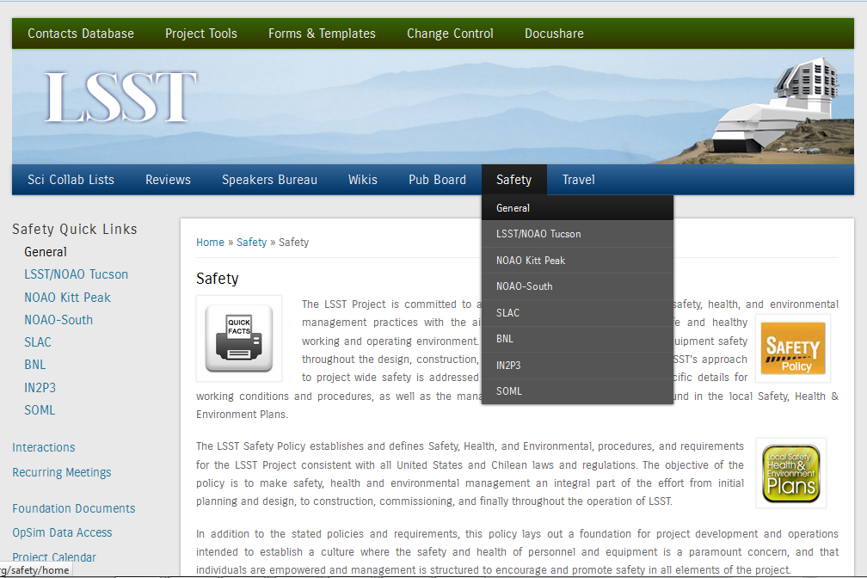
LSST Safety Policy in Action
Notes:
We have developed a intranet website that depicts LSST safety policies and standard as well as institutional policies and standards, all must meet the minimum policy that is declared by the LSST safety policy. There is other useful information when visiting various sites as well as links to other important information, such as safe travel information.

Slide 51
Safety Standards Development
Completed Documents
Lock Out Tag Out
Confined Space
Hot Work Permitting
Bloodborne Pathogens
Powered Work Platforms
Personal Protective Equipment
Fall Protection
Hearing Protection
Scaffolding
Lead (Pb) Safety
Powered Industrial Trucks
Powered Platforms
Respiratory Protection
In Progress
Electrical Safety
Working at Altitude Safety
Hazard Communication
Laser Safety Awareness
Chemical Handling
Machine Guarding
Cranes and Hoists
Environmental Compliance
To name a few.

Slide 52
Stop Work Authority
Any person can and shall immediately request termination of any activity they participate in or witness that could pose a serious threat to the life or health of people, the environment, or equipment while working on the LSST project. Such a termination request shall be communicated verbally with the individual(s) engaged in the activity or through the supervisor of the activity.
The person asked to terminate an activity shall do so immediately. Disagreements or differences of opinion about the need to terminate an activity shall occur only after the activity is stopped and people are removed from the hazard.
The appropriate local senior manager and the local safety professional shall be notified immediately to assist in the evaluation of the hazard. The activity can resume after the hazard has been corrected and after the appropriate local senior manager and the local safety professional have acknowledged that correction in writing. The appropriate local senior manager shall forward the written corrective action to the LSST Safety Manager within 24 hours of the resolution. If the resolution is not made locally, then the local senior manager shall notify the LSST Safety Manager and the LSST Project Manager to assist in possible resolutions and approvals.

Slide 53
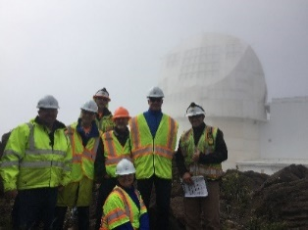
Many Different Project Safety Reviews
Safety Council at least twice a year
Contractor PDR’s, FDR’s, fabrication milestones, and site installation verification
Construction and fabrication safety management reviews
Construction site(s) inspections and oversight
Involvement continues with external safety committees Paranal, NRAO, CTIO, and DKIST
Contractor and Internal Hazard Analysis Reviews
AURA-O and Site Construction monthly safety meetings
Joint Technical Meetings and Community Workshops
AIV and Operational Plan Reviews
Site Safety Committees
Head of Safety on the LSST Change Control Board

Slide 54
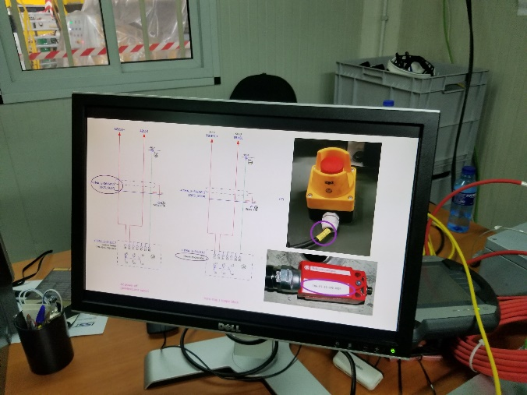
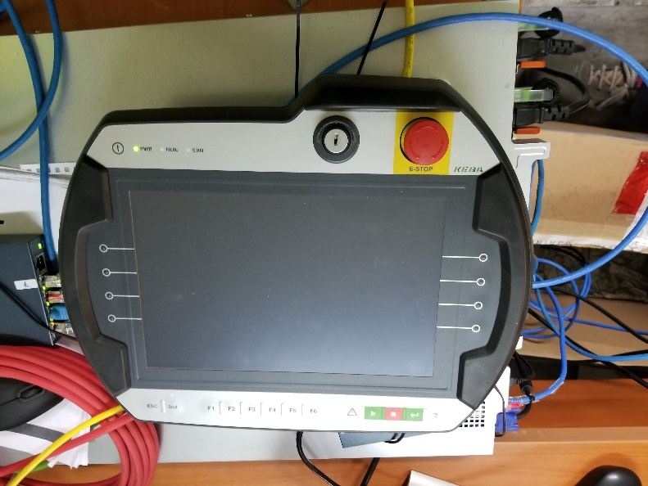
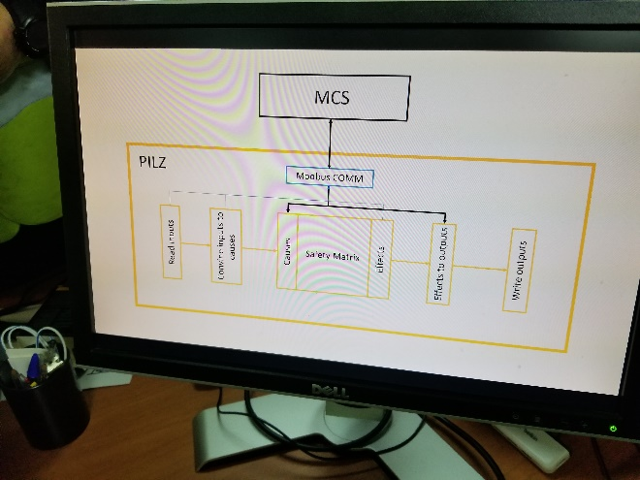
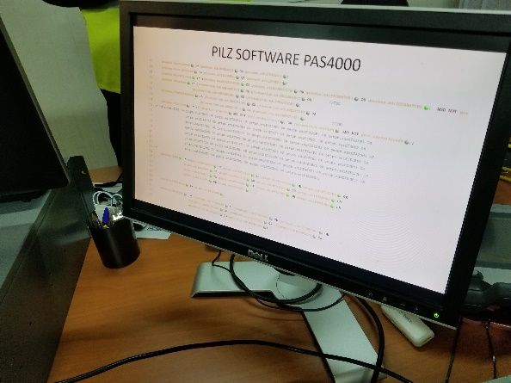
Global Interlock System

Slide 55
Global Interlock System
Pilz PNOZmulti 2 PN 772100
Autonomous Operation
Controls Safety Relay for 24 VDC Actuator Motor Pwr.
Maintains contact closure until receives an instruction to open the relay via Ethernet
Configurable control systems
Number of digital inputs: 12
Number of configurable I/Os: 8
Number of test pulse outputs: 4 (Telemetry)
Supply voltage (V): 24,0
Pilz PNOZ m ES EtherNet/IP PN 772137
Communication module

Slide 56
GIS Table Rev.4

