Slide 1
JSR2018 Commissioning CD-2 Review Recommendations Chuck Claver Project System Scientist / Commissioning Manager NSF/DOE Joint Status Review August 27-30, 2019

Slide 2
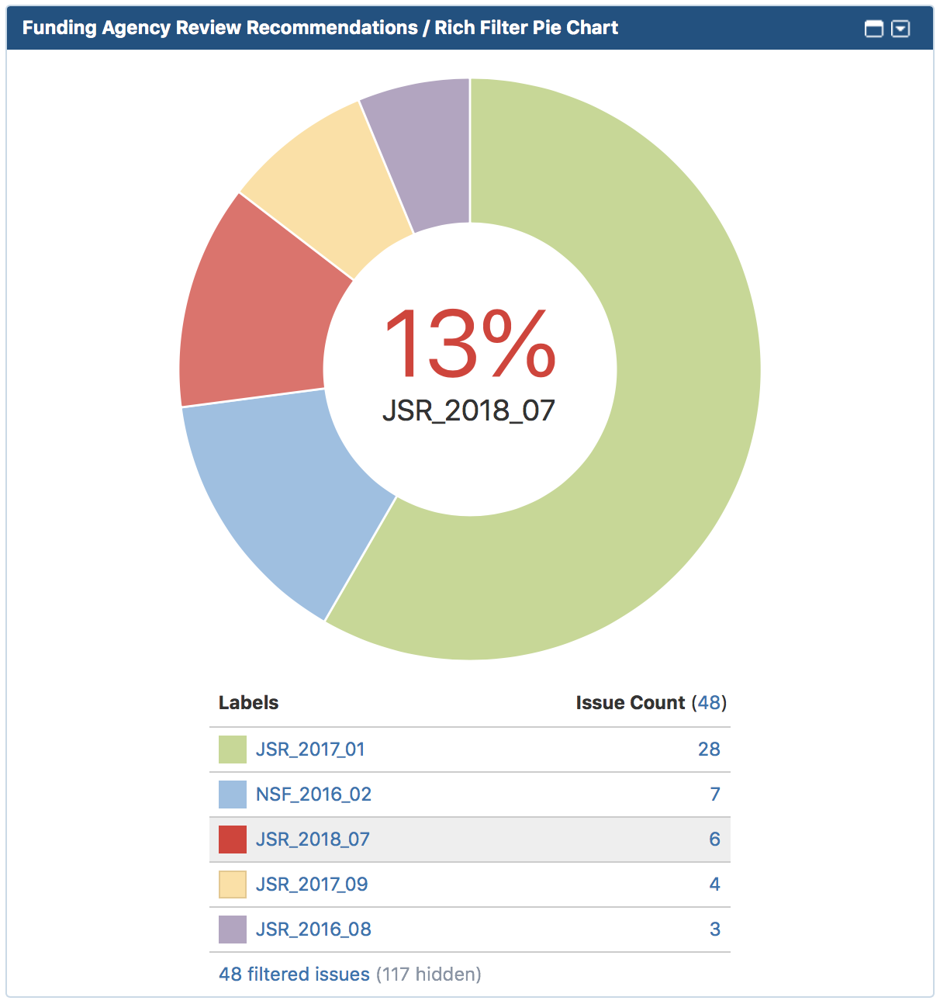
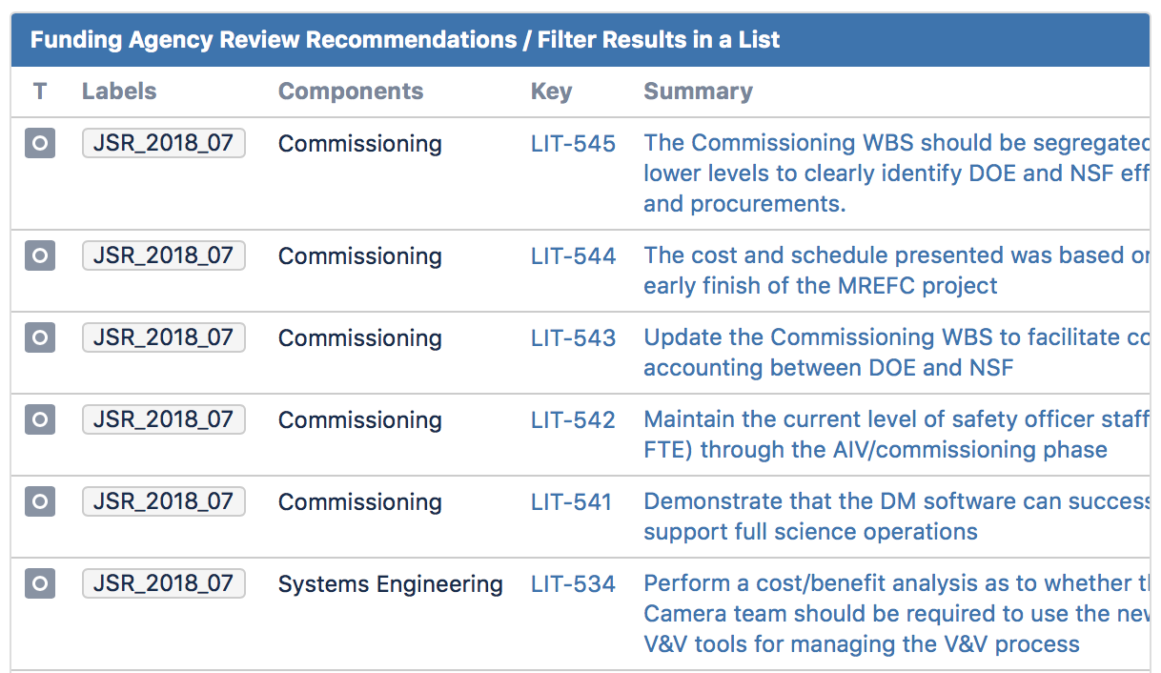
SE & Commissioning Past Reviews (agency)
JSR2018 + “CD-2 Like” review generated 6 recommendations:
5 for Commissioning
1 for Systems Engineering

Slide 3
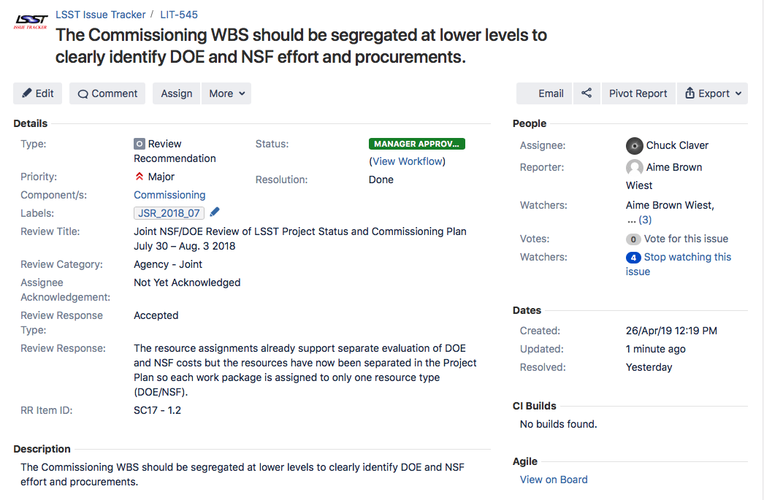
JSR2018 Recommendations 1 & 3

Slide 4
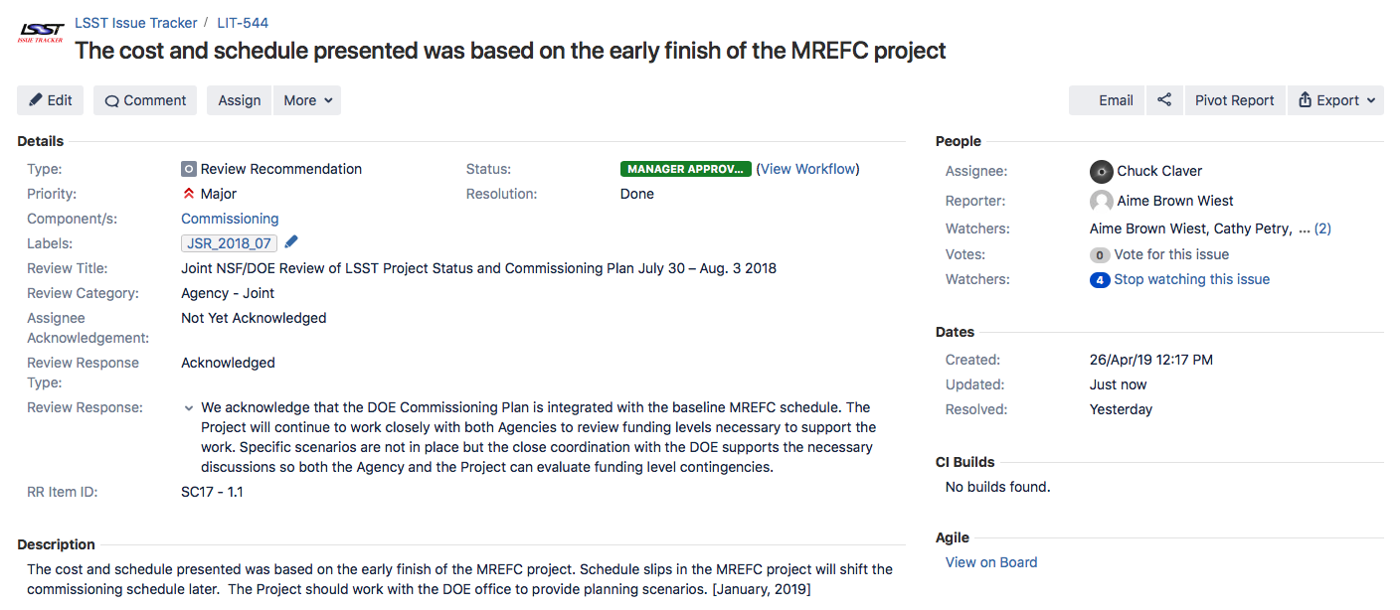
JSR2018 Recommendation 2
Several alternate scenarios were presented to both DOE and NSF. One of those scenarios has been incorporated into the recently completed AIV+Commissioning re-plan.

Slide 5
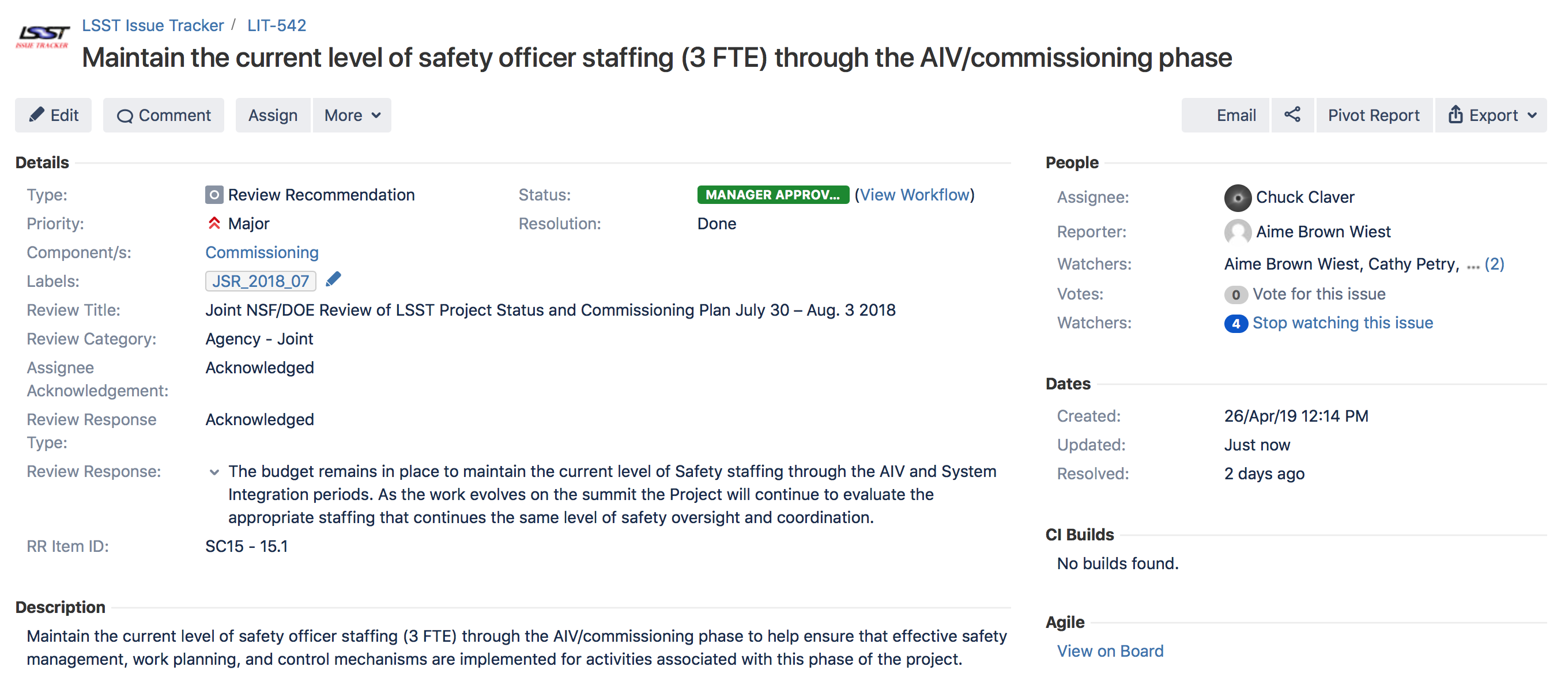
JSR2018 Recommendation 4

Slide 6
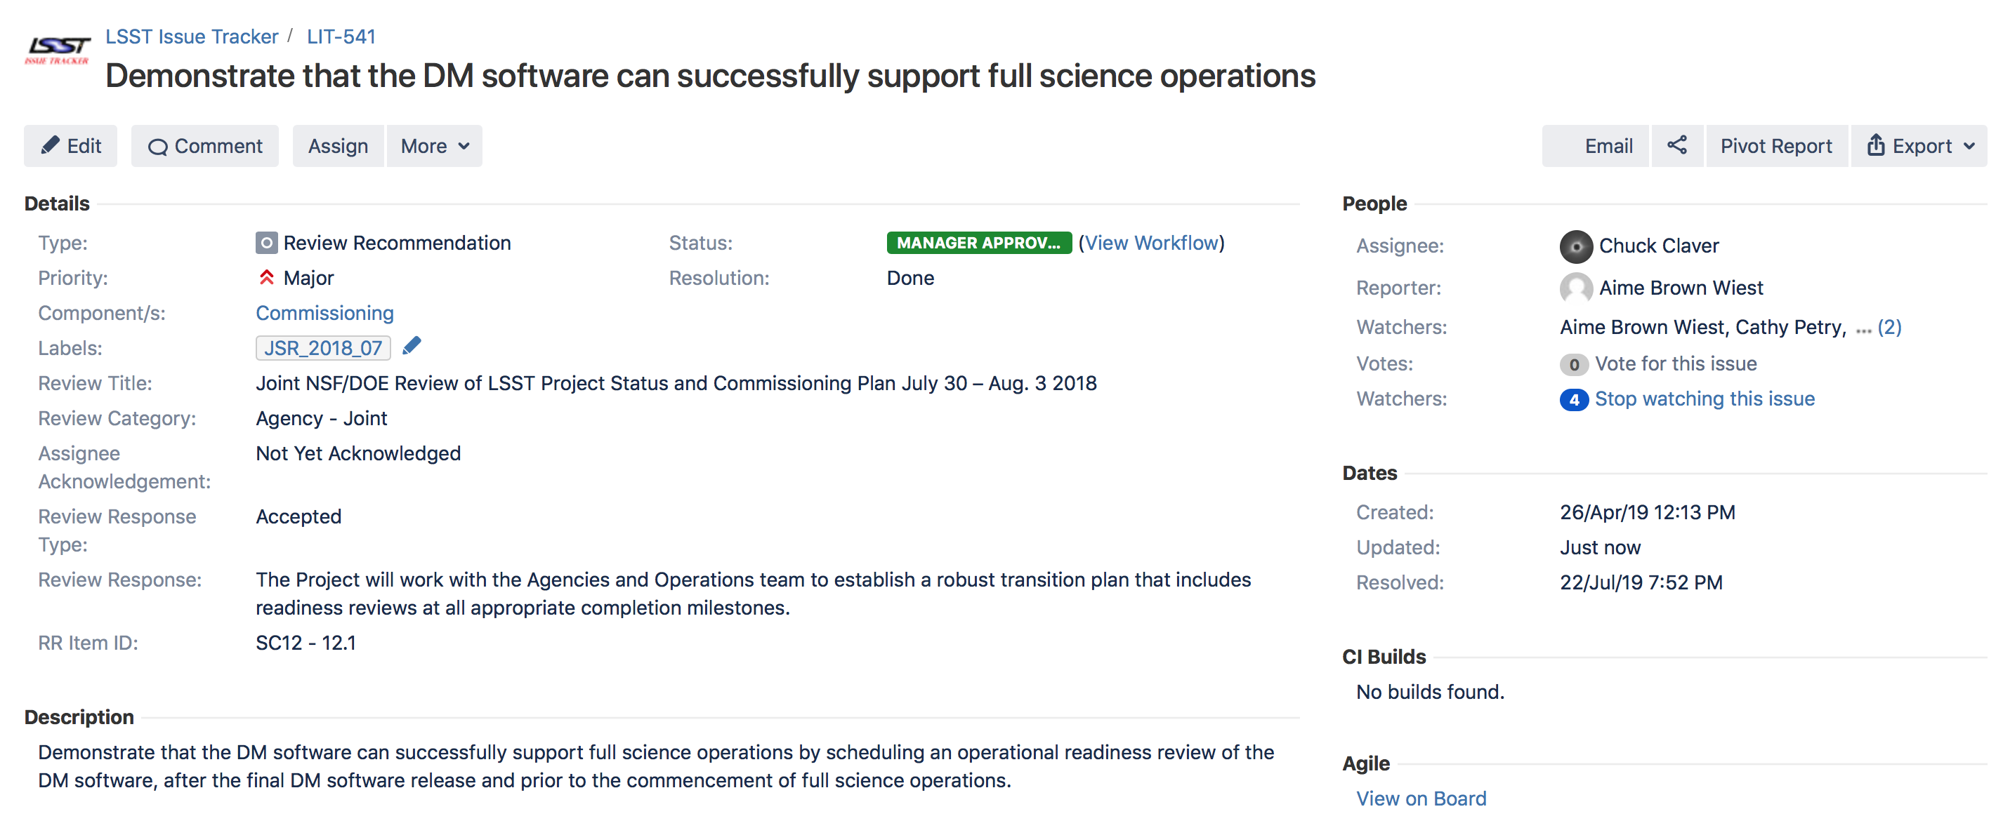
Recommendation 5

Slide 7
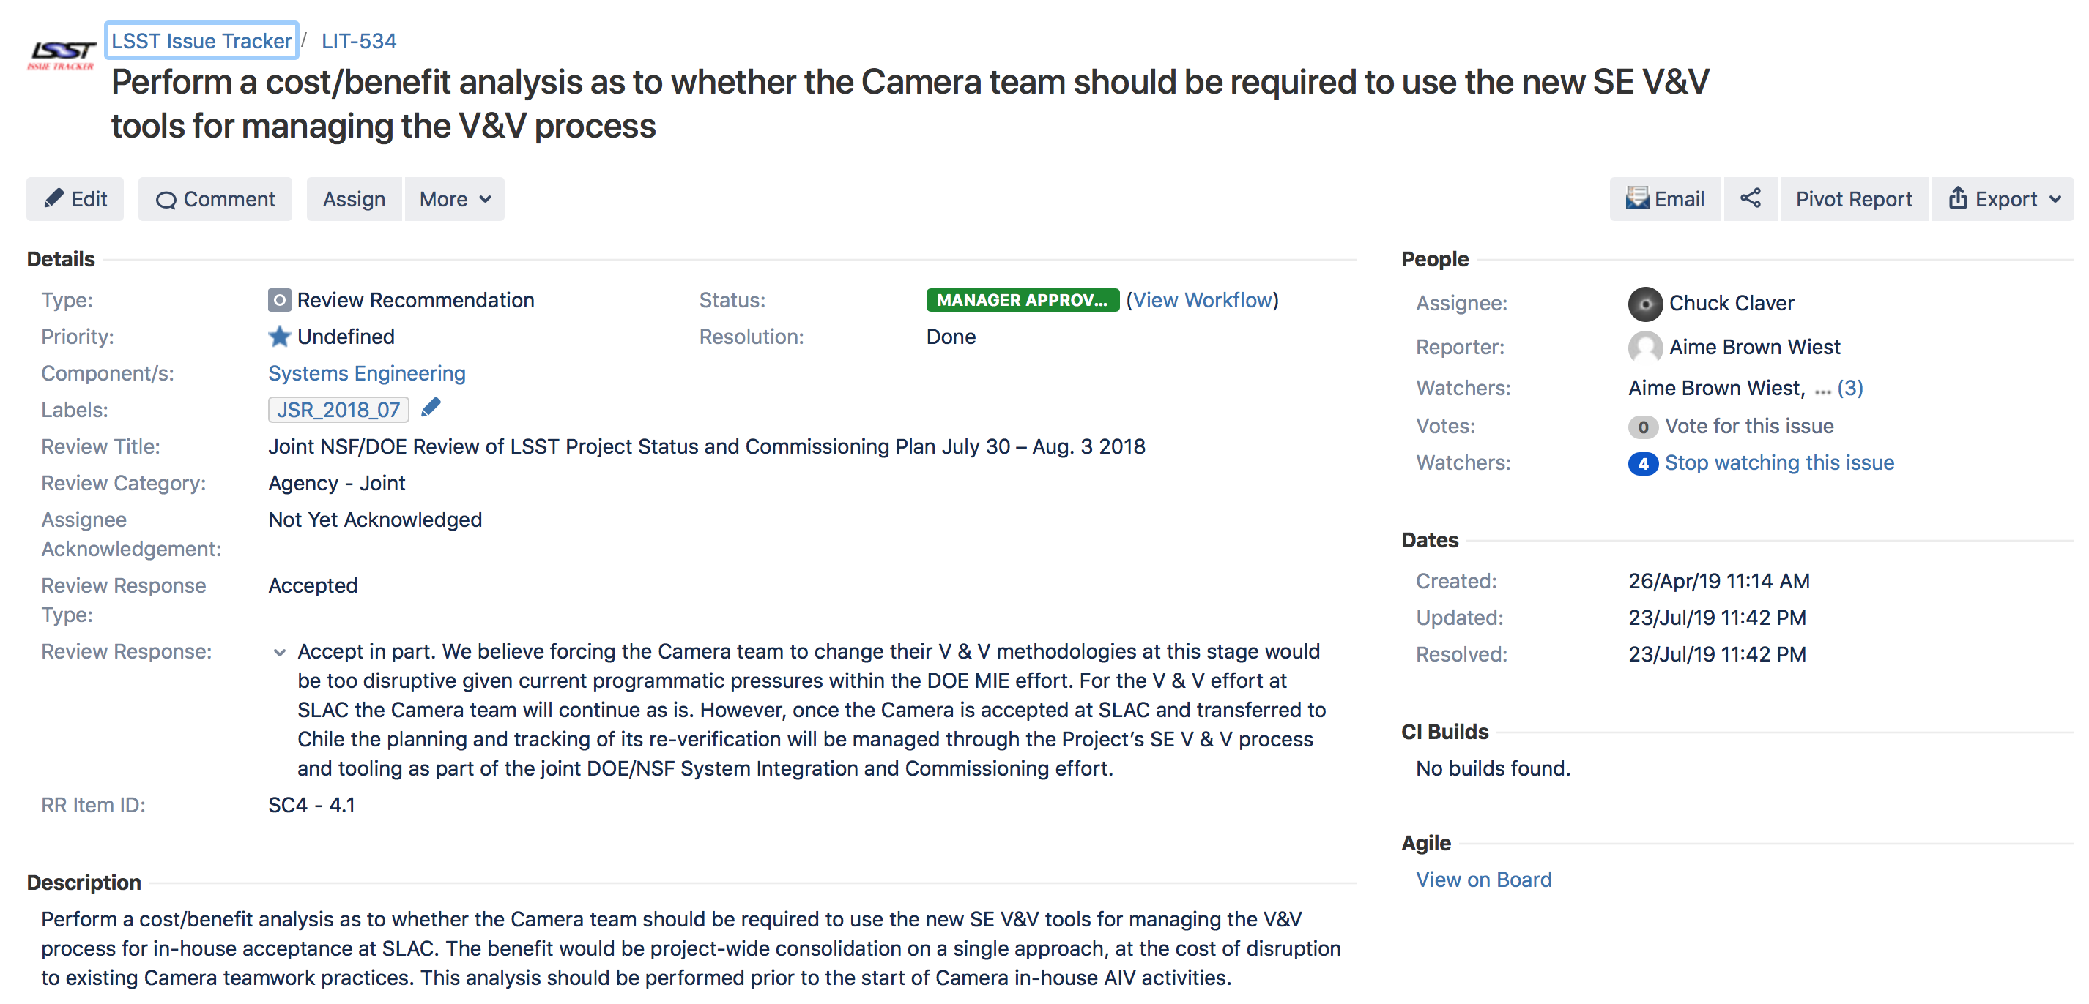
Recommendation 6

