Slide 1
Question Answers Chuck Claver Project System Scientist / Commissioning Manager NSF/DOE Joint Status Review August 27-30, 2019

Slide 2
Questions
1). Do you have a fully resource loaded schedule for the SITCom process that we could look at?
2). Can we see the org chart for T&S that Viktor mentioned with more specific information than the one attached? Chuck mentioned that Jacques has 35 people in his team for example.
3). Can we see some examples of how time is included for mitigation of issues for some of the activities or tasks in the detailed SITCom schedule?
4). What plans are there to re-evaluate the SITCom schedule later this year? i.e. after the dome has been enclosed and TMA assembly has started
5). Are there many aspects of SITCom that depend on single people?
6). Are SLAC (i.e. LSSTCAM) staff involved in ComCam testing and in ‘on-cart LSSTCAM’ testing in order to keep them engaged?
7). Have the opportunities for saving schedule mentioned in the TSU plenary presentation, slide 32, been included in the new SITCom schedule?
8). Are there AIV/SITCom tests planned for which there can be no mitigation in the near term and/or for which negative results will have little effect on beginning operations? Possibilities might be; dome seeing measurements, M3 optical testing, testing the camera refrigeration system
9). M2 equipment (1.04C.12.10) is only 13% complete. Will this impact TMA assembly and testing?
10). Does accelerating the integration of subsystems into the TMA create major risks? E.g. Chuck mentioned putting in the M1M3 instead of the concrete surrogate.
11). Is there real uncertainty in the stiffness of the telescope pier and observatory floor that could affect telescope pointing?
12). Can Test Survey 2 be eliminated? What are the aspects of external imaging and spectroscopy that may be missed? Can they be included in Survey 1?

Slide 3
Question 1
1). Do you have a fully resource loaded schedule for the SIT-Com process that we could look at?
Yes. Here is a summary of the resource loading across WBS 04C.14 and 06C.02 encompassing the majority of on-site effort for SIT-Com. There are some additional administrative resources supported elsewhere.

Slide 4
Question 2
C. Claver
System Scientist – Commissioning Manager
K. Reil (Chile)
Commissioning Scientist - Dpty. Commissioning Manager
S. Thomas
Telescope & Site Scientist
2). Can we see the org chart for T&S that Viktor mentioned with more specific information than the one attached? Chuck mentioned that Jacques has 35 people in his team for example.
Sys. Eng. & Verification
A. Roberts
Lead Systems Engineer
System I&T
M. Reuter
Software Integration Lead
K. Bechtol
Science Validation Lead
Science Validation
Andrew Serio
Sr. Sys. Eng. (Dpty. - Chile)
B Xin
Dpty. System Scientist - System Performance Lead
B. Stalder
Commissioning Sci
(ComCam)
Andy Connolly
Alert Processing Validation
M. Rodriguez
Sr. Systems Engineer
Mustafa Lufti
SE Intern
P Ingraham
Sr. Engineer
(AuxTel & Calibration)
Scott Daniel
Mansur Olaitan
SE Intern
Bryce Kalmbach
Kevin Serino
System Verification Eng.
New Hire Commissioning Support Sci
New Hire SE Intern
Andrew Bradshaw
DRP Validation
Tim Jenness
DM System Engineer
Martin Nordby
LSSTCam System Engineer
J. Sebag + AIV Team (Chile ~35)
DM Scientists (~10)
Sam Schmidt
DRP Validation
LSSTCam Team (~6)

Slide 5
Current Chile/Site Staffing
On average we have 73 staff on site daily
LSST has 35 staff stationed in Chile + 4 in transit/borrowed
3 in Safety
4 Administration
4 Information Technology
28 technical / summit support
We have 4 staffing/support contracts in place - ~ 20 People
T&S team has additional 14 staff that travel to site as necessary
Telescope Mount: vendor is responsible for TMA assembly integration and testing on site – LSST only supports and monitors

Slide 6
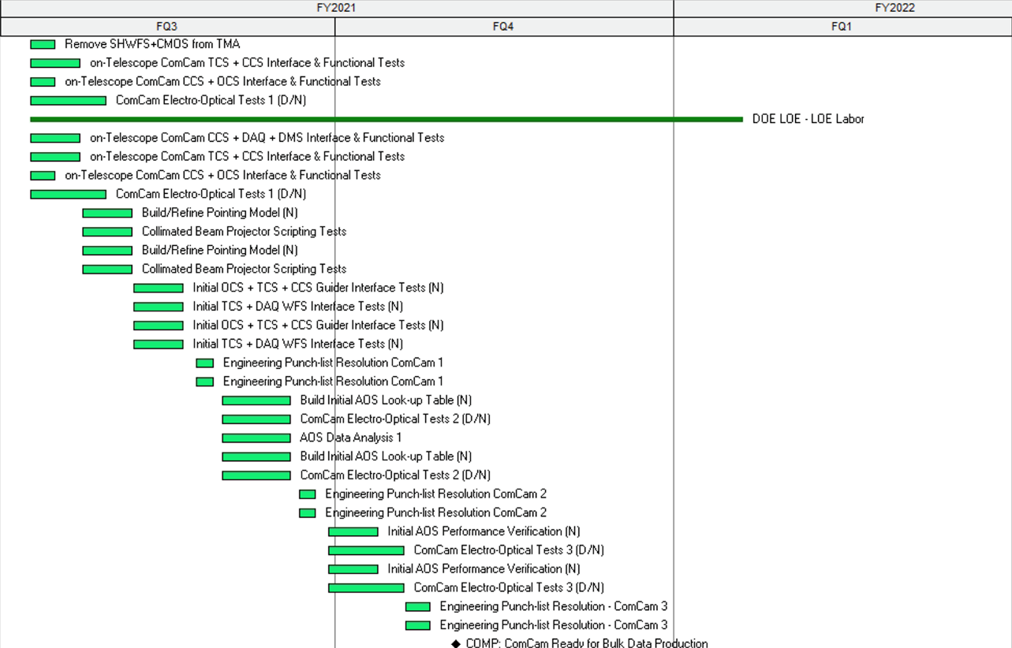
Questions
3). Can we see some examples of how time is included for mitigation of issues for some of the activities or tasks in the detailed SIT-Com schedule?
Dedicated time for “engineering punch-list resolution” is part of the plan and resourced with both MREFC and DOW support. This approach is used throughout the commissioning activity plan.

Slide 7
Questions
4). What plans are there to re-evaluate the SIT-Com schedule later this year? i.e. after the dome has been enclosed and TMA assembly has started?
We have the ability to reevaluate the future planning at any time. The work planning process (see below) is intended to make reevaluation a continuous process. Internally we are already looking at likely scenarios and once the TMA assembly starts we will refine the strategic planning going forward and update the baseline.
Project Drivers: - Technical scope - Key milestones
- Boundary conditions
Strategic Planning
Plan Implementation
Change Control
LCRs
New Epics
New Tasks
Strategic Baseline Plan
(Technical Focus)
3-6mo Rolling Wave Planning
(Programmatic)
1wk- 3mo Scheduling
(Resource Allocation)
Weekly Planning
(Resource Avail.)
Daily Tasking
(Resource Avail.)
Work scope
Incomplete Epics
Incomplete Tasks
Emergent Issues

Slide 8
Questions
5). Are there many aspects of SIT-Com that depend on single people?
The issue is related to efficiency. Over the last couple of years we have taken steps to broaden the knowledge base across the project. There are individuals who are the “black belts” in certain domains, but we are actively cross training to minimize single points of failure.

Slide 9
Questions
6). Are SLAC (i.e. LSSTCAM) staff involved in ComCam testing and in ‘on-cart LSSTCAM’ testing in order to keep them engaged?
Yes. SLAC support for integration and testing ComCam and LSSTCam has been scoped and budgeted as part of the DOE Commissioning effort. This include supporting ComCam testing in Tucson through re-verification of LSSTCam once it is in Chile and its integration on the telescope.

Slide 10
Questions
7). Have the opportunities for saving schedule mentioned in the T&S plenary presentation, slide 32, been included in the new SIT-Com schedule?
Short answer, yes. Other opportunities exist for parallel activities that are not explicitly in the schedule give their level of uncertainty.

Slide 11
Questions
8). Are there AIV/SIT-Com tests planned for which there can be no mitigation in the near term and/or for which negative results will have little effect on beginning operations? Possibilities might be; dome seeing measurements, M3 optical testing, testing the camera refrigeration system.
Yes, but… It is still the aim to deliver a “well understood” system due to the systematics limited nature of LSST science.
For the examples given:
Model estimates indicate dome seeing could be significant. Degradation in image quality from dome seeing would have significant impact on the science performance of LSST. The purpose of the dome seeing tests is to characterize the properties in the dome as the system is built up so we know where to mitigate if necessary. These tests are done in parallel with other integration activities and do not drive schedule.
M3 optical testing is a risk mitigation activity. Limiting this work could save some schedule but we transfer schedule risk to later integration activities and optical verification.
Testing of the camera refrigeration system involves are than testing functionality. Essential cleaning, purging and charging of the refrigeration lines cannot be avoided. Some time may be saved by eliminating the pathfinder effort, but then there is risk (primarily schedule) for the startup of LSSTCam.

Slide 12
Questions
9). M2 equipment (1.04C.12.10) is only 13% complete. Will this impact TMA assembly and testing?
The referenced M2 equipment consists of the M2 stray light baffle. The delay in fabrication and delivery of this item has been included in the recent SIT-Com re-plan. The expected delivery date is consistent with its need for TMA assembly and testing.

Slide 13
Questions
10). Does accelerating the integration of subsystems into the TMA create major risks? E.g. Chuck mentioned putting in the M1M3 instead of the concrete surrogate.
Yes. This is a decision that will be made when/if the opportunity presents itself. We will weigh the risks against the benefits at the time.

Slide 14
Questions
11). Is there real uncertainty in the stiffness of the telescope pier and observatory floor that could affect telescope pointing?
It is not that the pier or floor affects the uncertainty of the telescope pointing. It is that the way in which pointing was verified in Spain during Factory Acceptance Testing the factory floor was used as a reference for the laser tracker metrology. Transfer of the factory procedure to the on-site environment risks that the metrology reference is unstable beyond the level necessary for pointing re-verification. This is driven by thermal gradients between the outer wall supporting the dome and the pier supporting the TMA. The pier is stable, where the outer wall supporting the dome may move around enough to limit the measurement reference.

Slide 15
Questions
12). Can Test Survey 2 be eliminated? What are the aspects of external imaging and spectroscopy that may be missed? Can they be included in Survey 1?
The science verification mini-surveys are specifically designed around the verification of our two primary operational data deliveries.
Mini-Survey 1 is design to test and verify the production of our “real time” transient alert detection and subsequent publication. This mini-survey is divided in to two parts. The fist part is to acquire data to generate the templates used for the image difference processing used to detect transient source. The second part is deigned to apply the templates and verify the Alert Production Pipeline.
Mini-Survey 2 is designed specifically to test and verify on a limited scale the ability to process 10-year equivalent data stacks to produce the Data Release Products.
These mini-surveys are also meant to verify full operational processes and capabilities of the integrated LSST system.

