Slide 1
Requirements Verification Austin Roberts Lead Systems Engineer / LSST (AURA) NSF/DOE Joint Status Review August 28th 2019

Slide 2
Agenda
Overall Verification Approach and Architecture
High Level Subsystem Verification Status
High Level System Verification Status

Slide 3
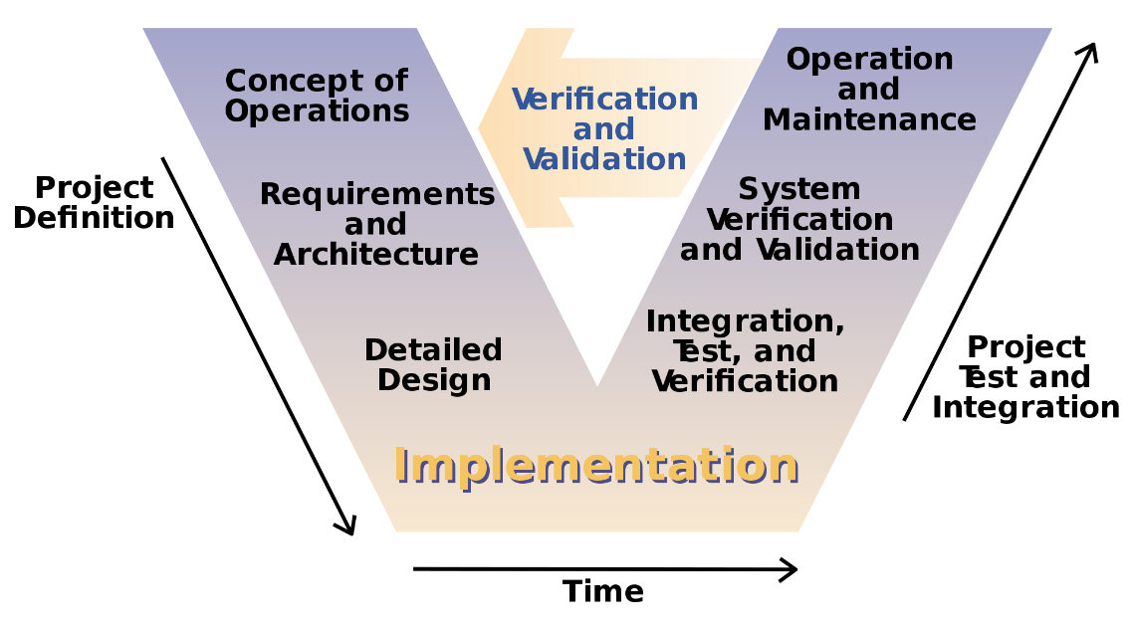
Verification Planning Approach
Parallel top-down and bottoms-up verification planning ongoing
Top-Down: System level specifications verification, performance verifications, science impacted verifications, science validation
Bottoms-up: Vendor subsystem verification, system integration

Slide 4
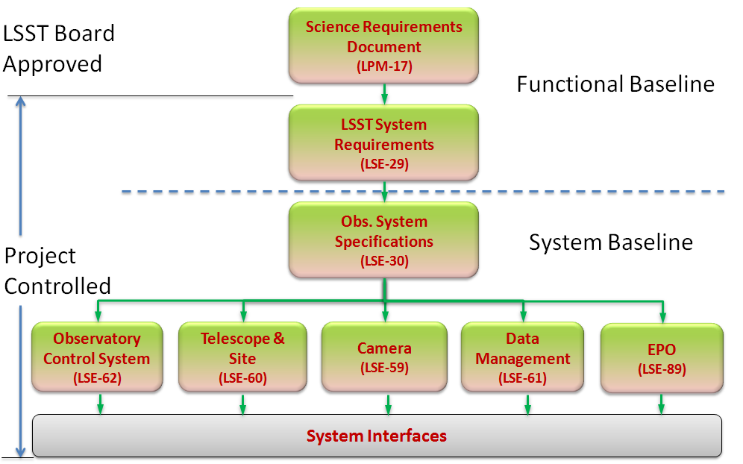
Requirement Flowdown

Slide 5
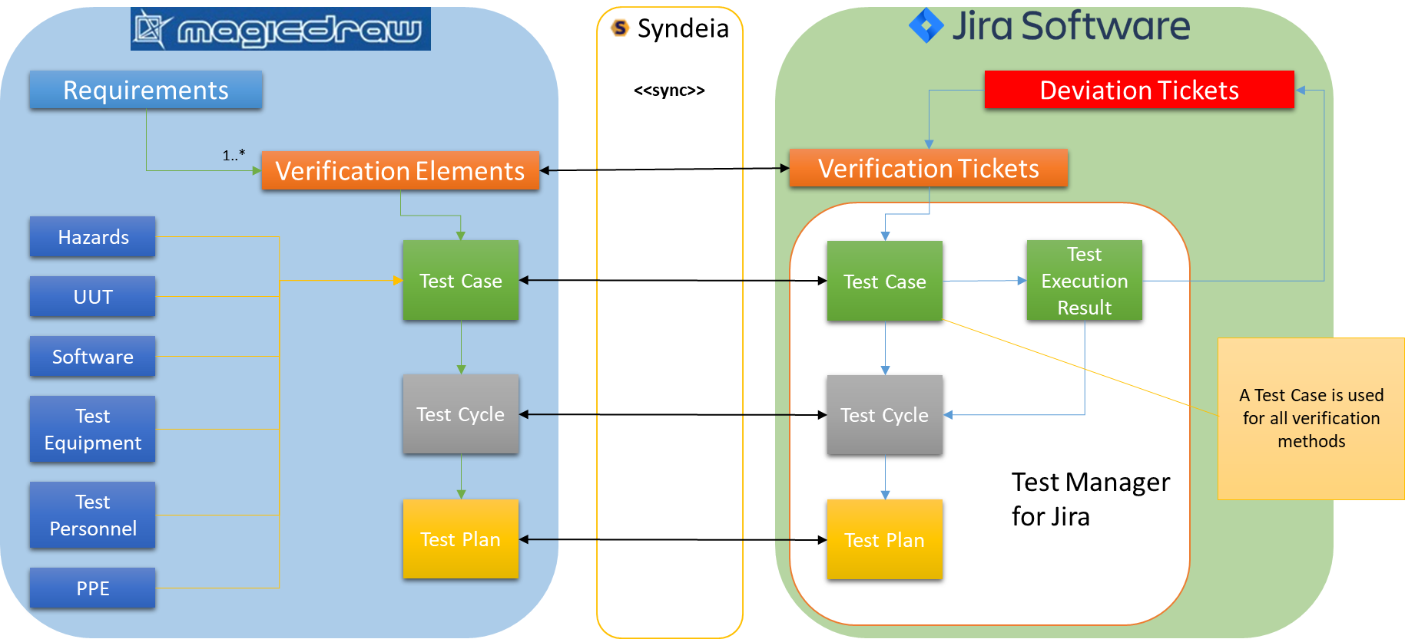
Requirement Verification Architecture Overview

Slide 6
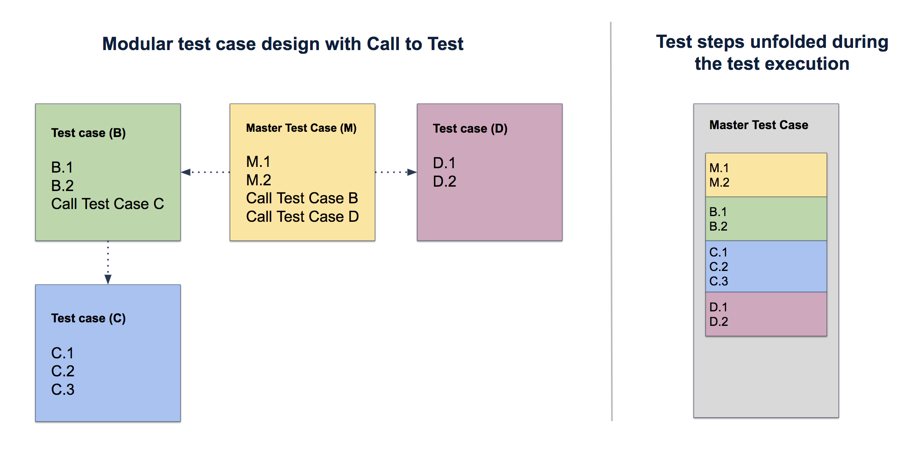
Verification Architecture Realization
The verification architecture is realized by LSST’s custom Domain Specific Language which extends the SysML language.
Utilizing both MagicDraw and Jira enables Object Oriented Design best practices with the flexibility of the Jira Test Management
The Test Management for Jira
add-on enables reuse of verification
procedures.

Slide 7
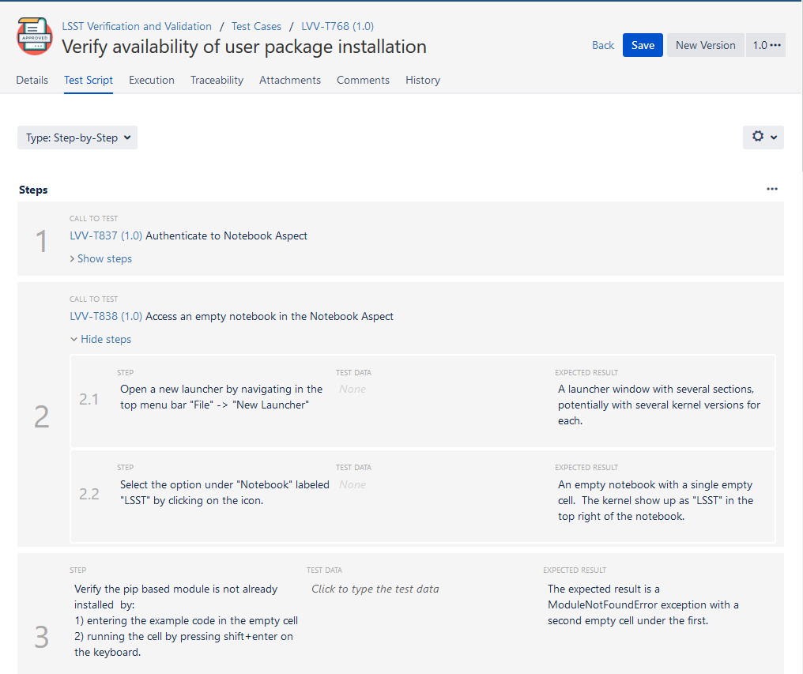
Verification Procedure Reuse Example

Slide 8
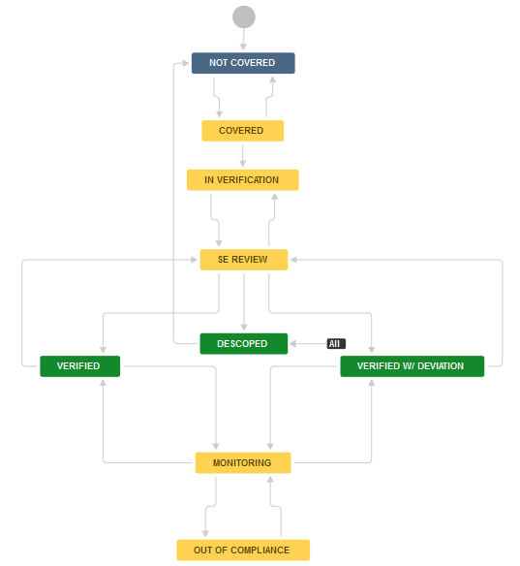
Verification Approval Process
System Verification Team (SysVT) responsible for upfront planning
Generation of Verification Plans
Mapping to Verification Events (Test Cases)
Definition of Verification Events
SysVT
SysVT
+ Systems Scientist
Sys Int. Team
SysVT works with the Systems Scientist to Schedule activities
Sys Int. Team performs the activity and analyzes the results.
SysVT Reviews the results and makes the determination on the sufficiency of results
SysVT tracks verification progress
SysVT monitors verification compliance after acceptance
SysVT

Slide 9
Verification Workflow
Jira workflow enforces LSST’s verification process
Evaluates links from Verification tickets to Test Cases and the verification status of the Test Case
Evaluates Verification tickets verified by the verification of a lower level Verification issue
Evaluates Deviation Request tickets generated during verification and their approval status

Slide 10
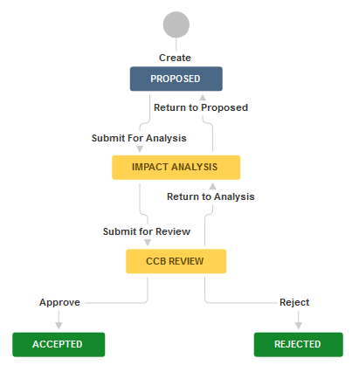
Deviations and Descope
Utilizes the existing Change Control Board concepts
If SRD requirement not met, agencies are involved
Workflow enforces process

Slide 11
Generating Reports
2 primary reports are produced
Test Specification (Example)
Test Plan and Report (Example)

Slide 12
Test Specification
This document has the function to baseline all Test Cases covering a specific project component
Software Product
Activity (like Science Verification)
The test cases are:
Written in Test Manager for Jira
Related to the Verification tickets
Automatically traced to Requirements
The document provides the details of the Test Cases and an appendix with the traceability between Verification tickets and Test Cases

Slide 13
Test Plan and Report
3 primary phases:
Planning
All information needed to start the test campaign is collected in Jira Test Plans and Test Cycles
A draft ‘Test Plan and Report’ is produced
Jira Test Plan status is set to Approved before the test campaign starts
Test Execution
The testers execute the tests following instructions in the Test Cycles
The result of each test step is reported in Jira
Report
A final ‘Overall assessment’ to the test activity is given in the Jira Test Plan
The ‘Test Plan and Report’ document is finalized and upload to Docushare

Slide 14
Subsystem Status
As vendors complete verification of their subsystems we are integrating their verification artifacts and granted deviations into our verification architecture.
As we begin to integrate major subsystems together we will verify the interfaces using our verification architecture.
Initial verification done during subsystem level verification (1 verification ticket for each side of the interface)
Final verification done during Integration/Commissioning (1 verification ticket for the integrated subsystems)

Slide 15
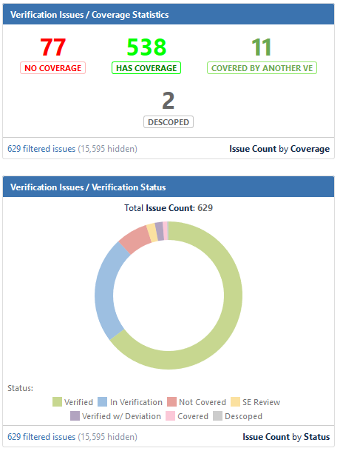
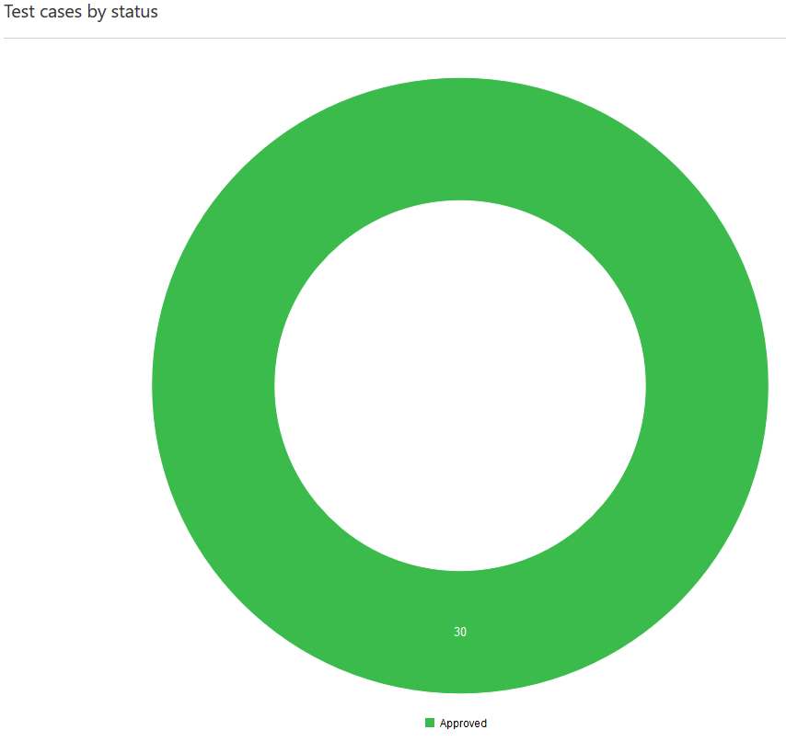
Hexapods & Rotators Status
(As of 8/5/2019)

Slide 16
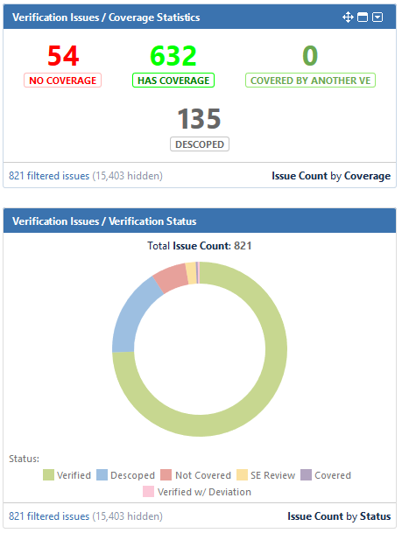
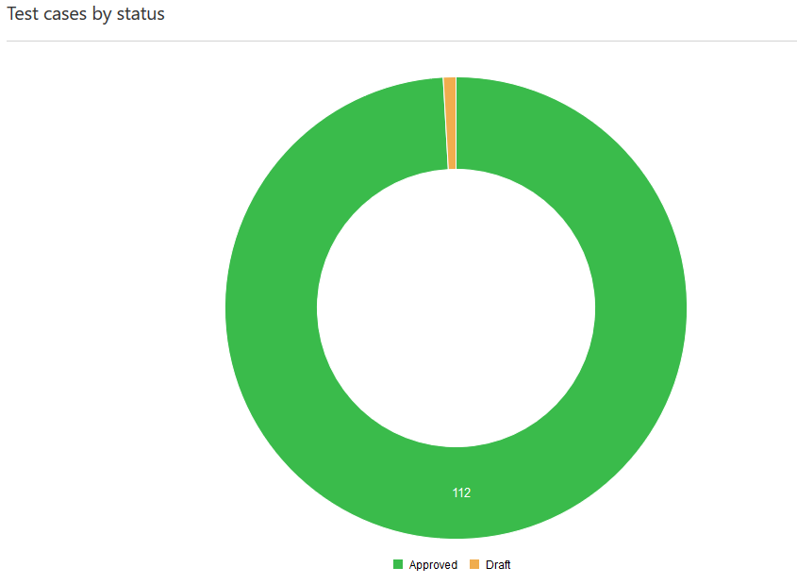
M2 Status
(As of 8/5/2019)

Slide 17
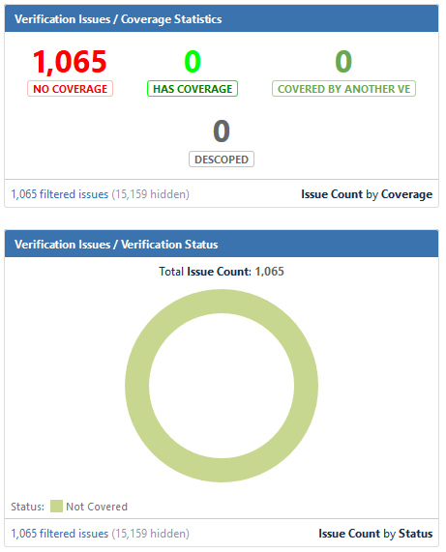
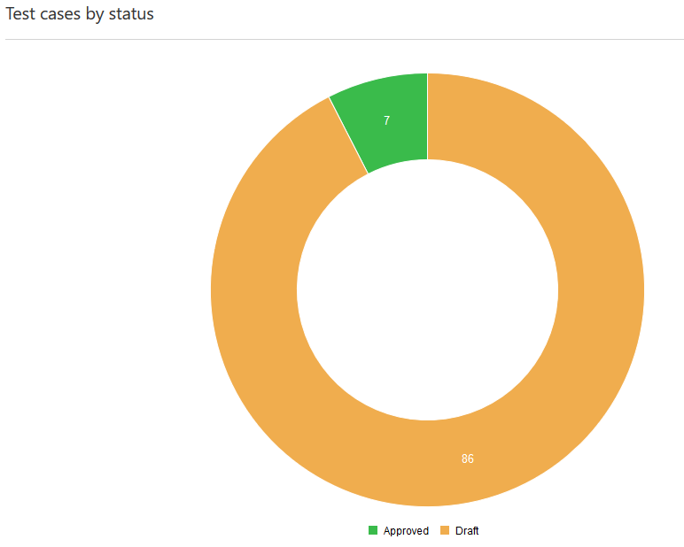
M1M3 Status
(As of 8/5/2019)

Slide 18
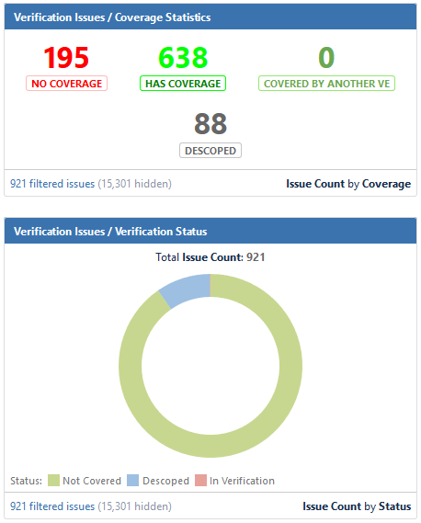
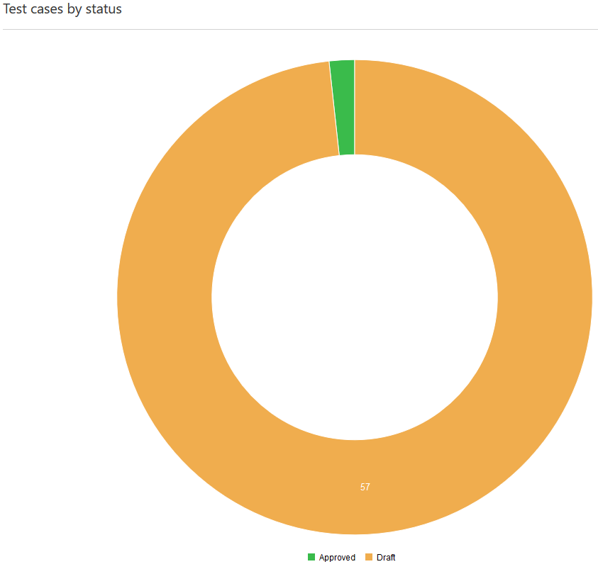
Coating Chamber Status
(As of 8/5/2019)

Slide 19
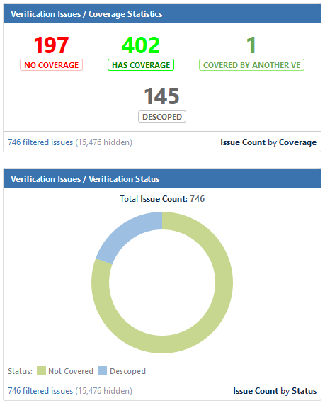
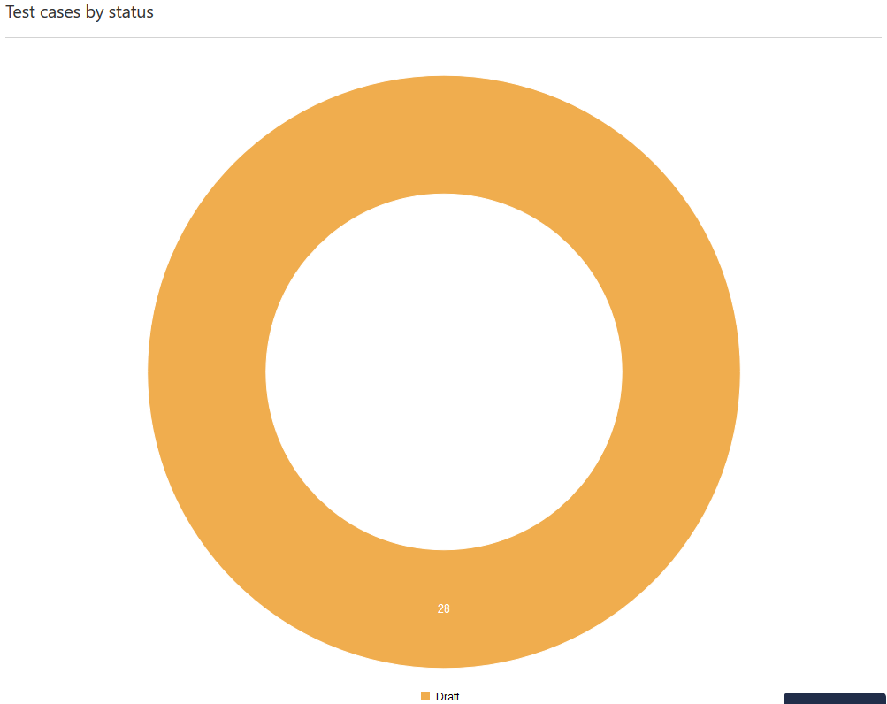
Washing Station Status
(As of 8/5/2019)

Slide 20
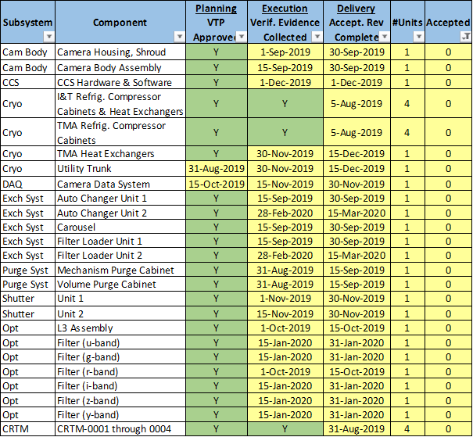
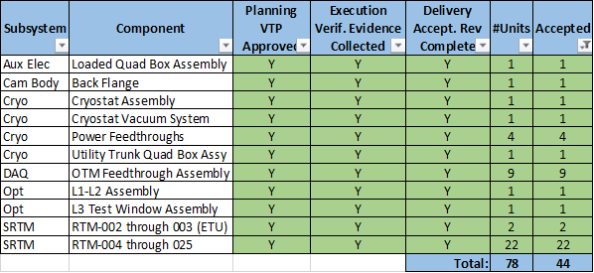
Camera Status
*Our analysis after JSR2018 determined the Camera should utilize their current verification architecture during verification activities at SLAC.
(As of 8/5/2019)

Slide 21
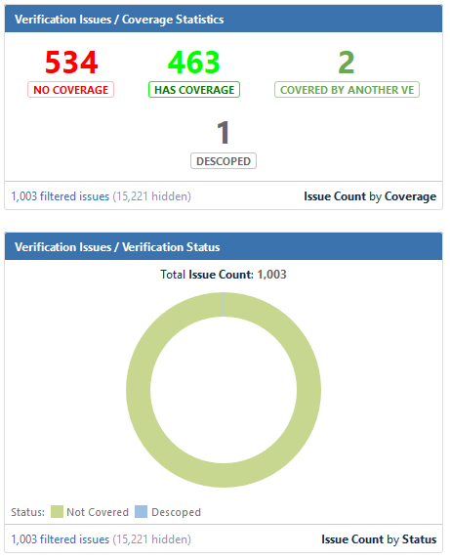
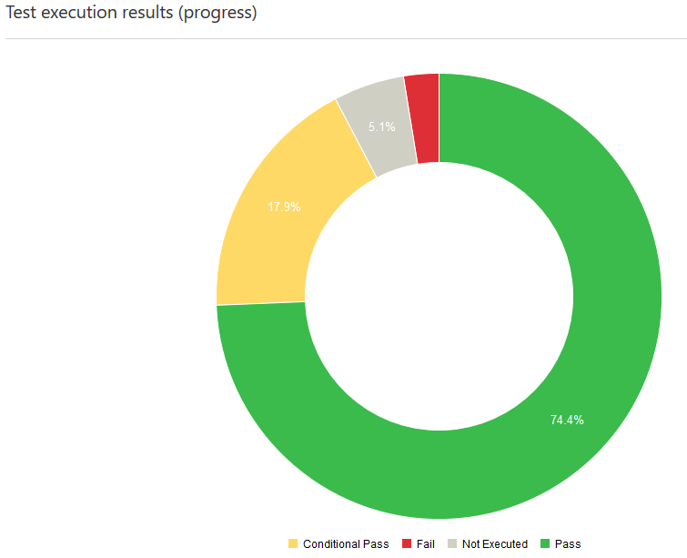
Data Management
(As of 8/5/2019)

Slide 22
System Level Status
Iterating on current verification activity planning
Looking at integration and commissioning as parallel instead of serial
Developing verification procedures for planned activities
Focusing first on Science Verification and System Performance Verification planning

Slide 23
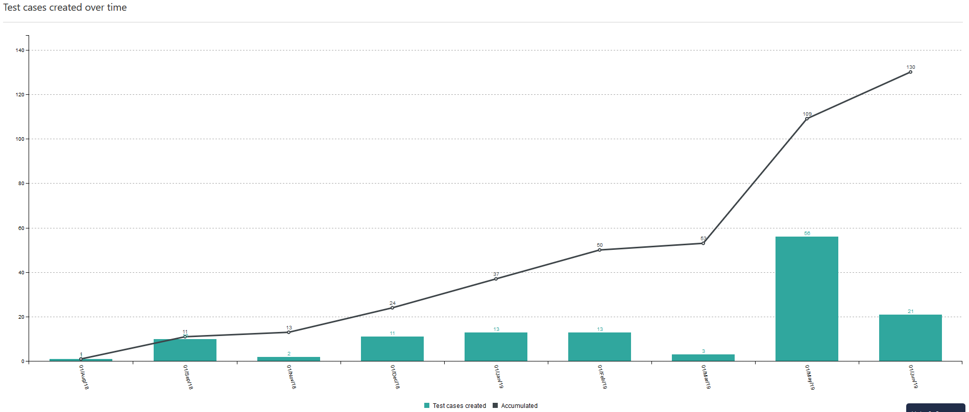
Commissioning Science Verification Status
(As of 8/5/2019)
Science Verification Workshop

Slide 24
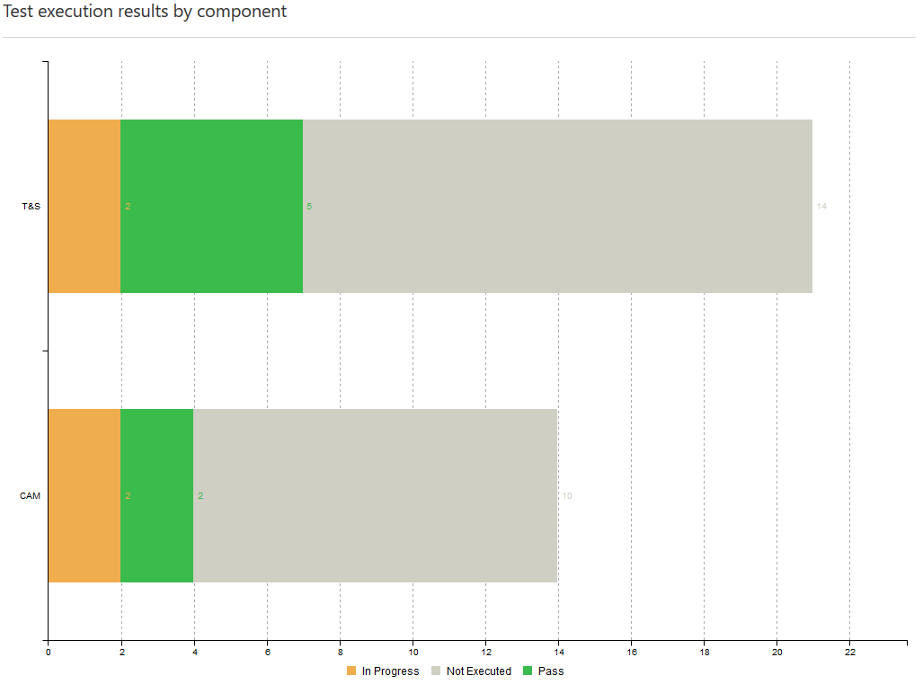
Image Quality Verification Status
(As of 8/5/2019)

Slide 25
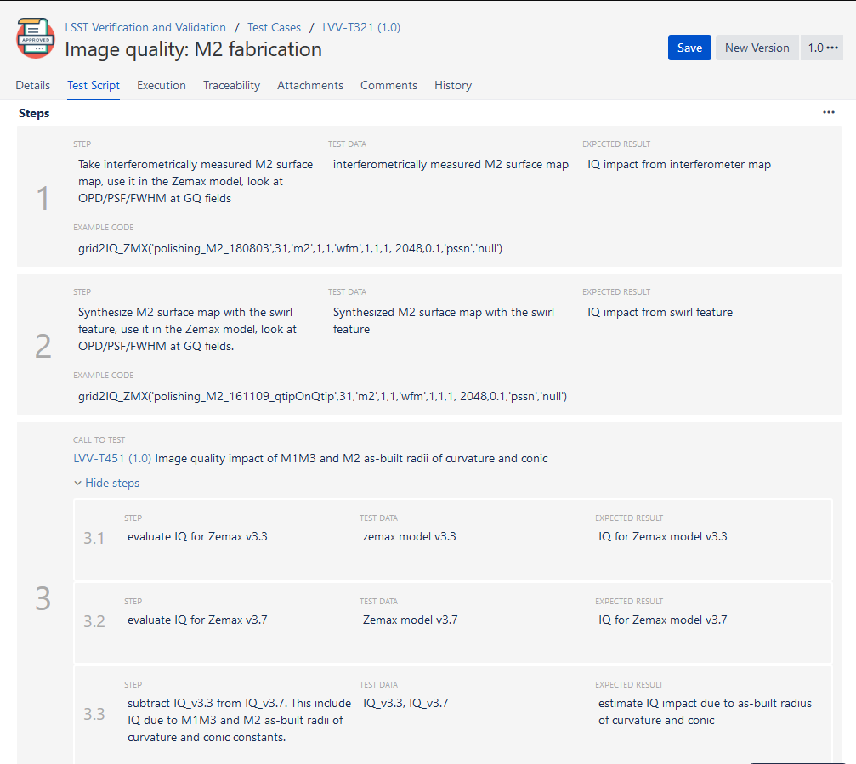
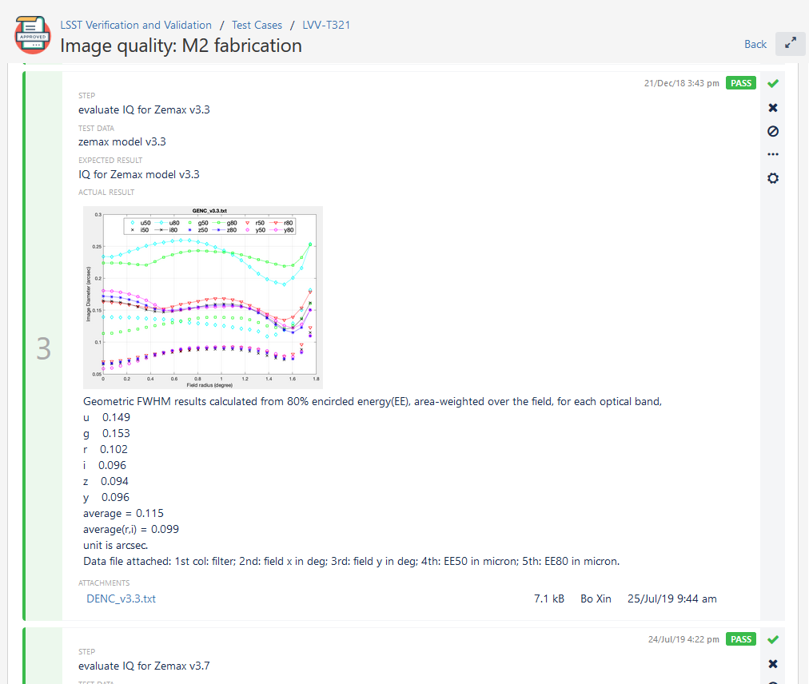
Image Quality Test Case Example

Slide 26
Backup

Slide 27
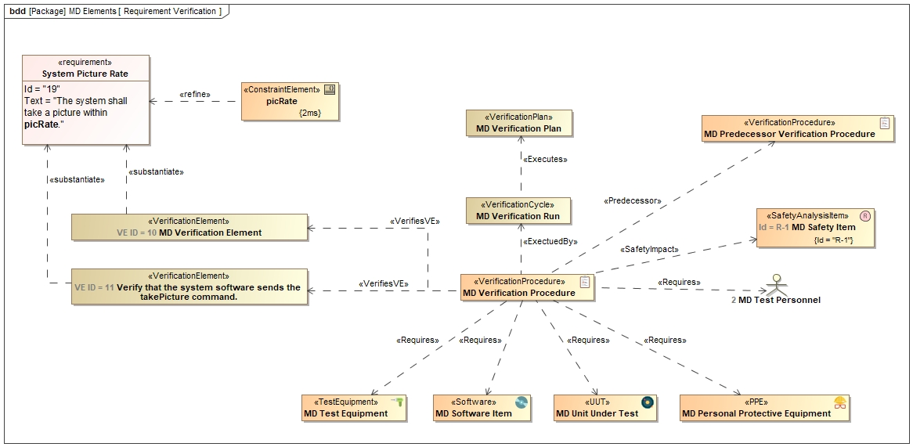
Custom MagicDraw Profile

Slide 28
Digital Thread Utilization
Utilizing Syndeia enables “Define Once, Use Everywhere” best practices.
This is often known as a “Digital Thread” connecting previously segregated models and data sources.

Slide 29
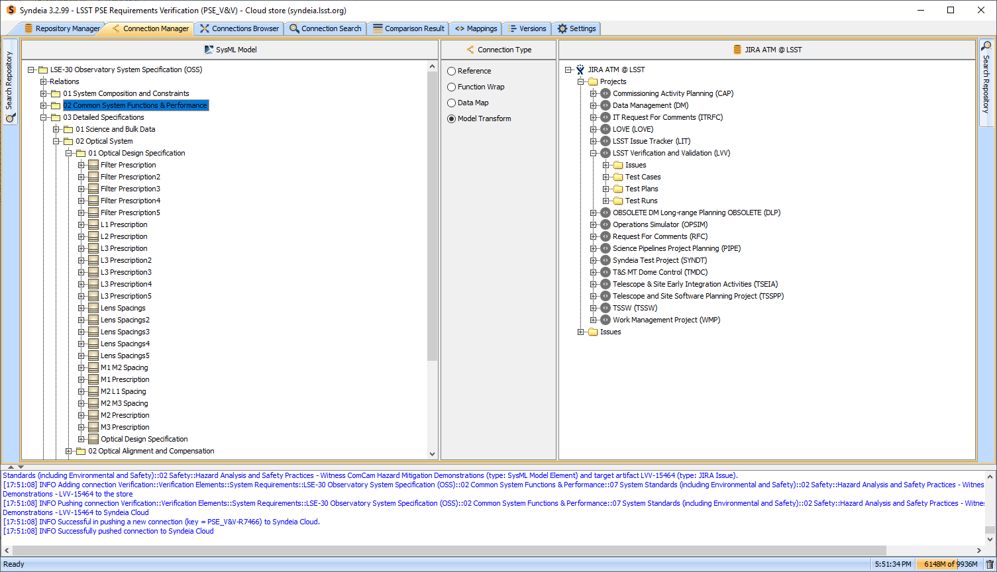
Syndeia Data Synchronization

Slide 30
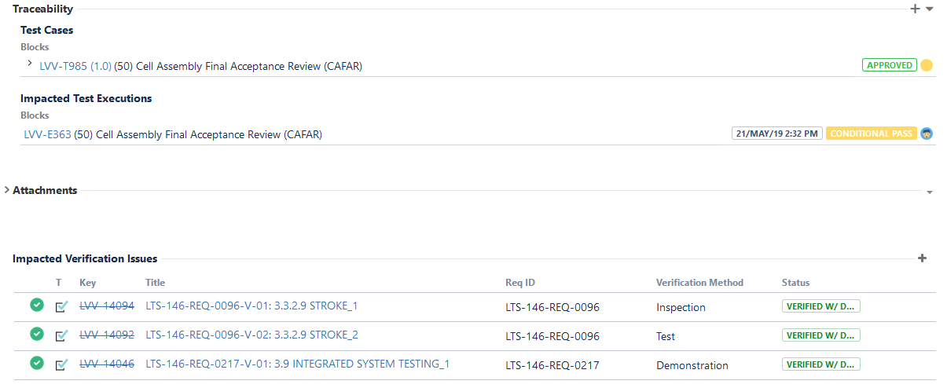
Deviation Traceability

Slide 31
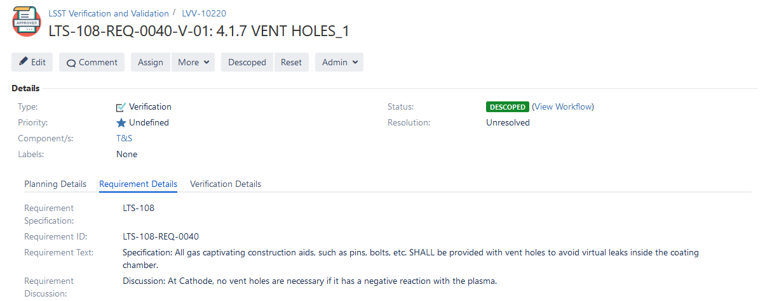
Verification Descope Example

Slide 32
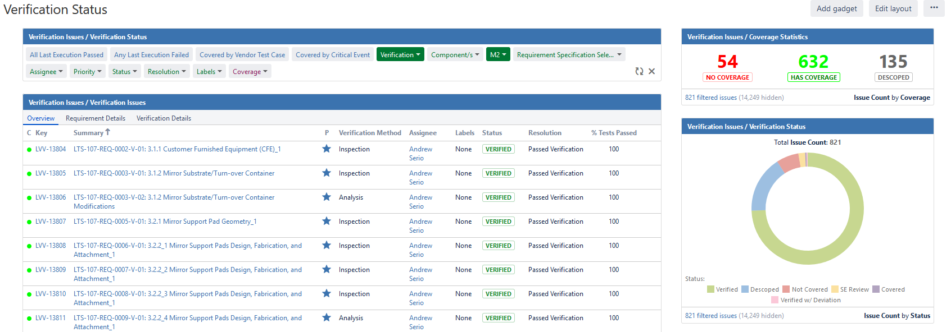
Visualizations - Jira
Jira Dynamic Dashboard to filter tickets and generate metrics

Slide 33
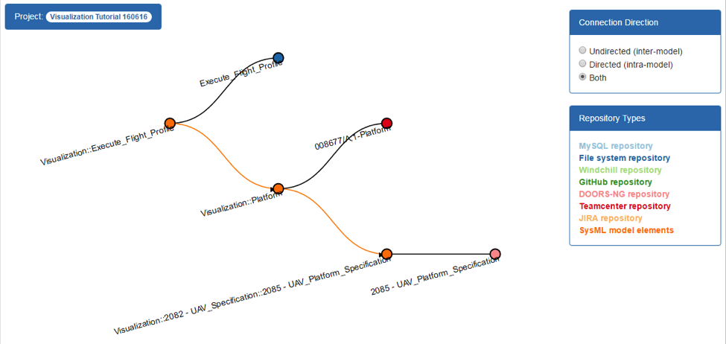
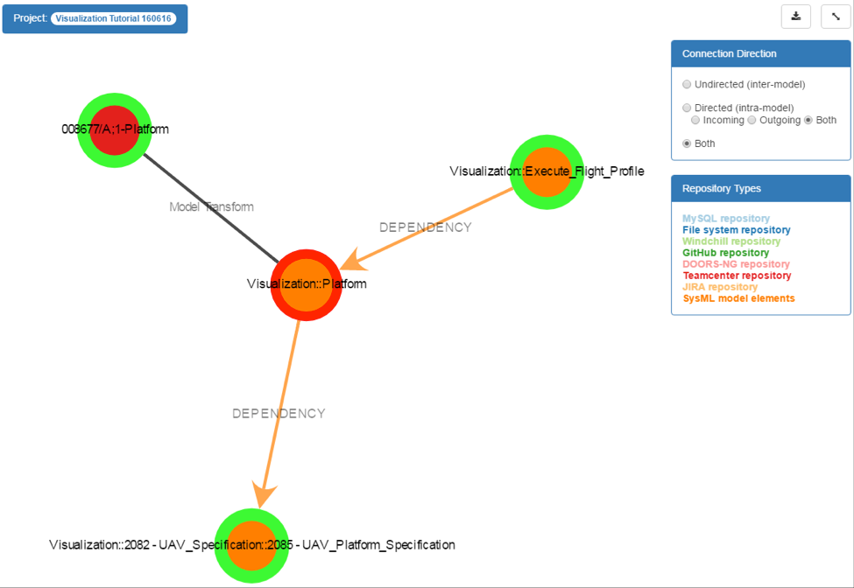
Visualizations - Syndeia
Syndeia intra-model graph queries (In-Work)

Slide 34
Report Process and Tooling
Test Activity
Jira
Extraction (Manual or in Jenkins)
Git Tex Repository
ATM plugin
docsteady (python)
DocuShare
Documents:
- Test Spec
- T. Plan&R.
lsst.io
Travis document build

Slide 35
Report Examples
Test Specification
ATM entry point: Test Cases Folder:
/Data Management/Software Products/Supporting SW/Distrib Database|LDM-552
Git repository:
github.com/lsst/LDM-552
Publication:
LDM-552.lsst.io/v
DocuShare:
ls.st/LDM-552
Test Plan and Report
ATM entry point: Test Plan
LVV-P46
Git repository:
github.com/lsst-dm/DMTR-71
lsst.io:
DMTR-71.lsst.io/v
DocuShare:
ls.st/DMTR-71

