Slide 1
Active Optics System Development Sandrine Thomas T&S Project Scientist Bo Xin Deputy Systems Scientist NSF/DOE Joint Status Review August 7, 2019

Slide 2
Outline
Introduction to AOS
Wavefront Sensing
WFS Design and Constraints
Inversion, Forward Modeling, Machine learning
The LSST Baseline Approach
Comparisons to Forward Modeling and Shack-Hartmann: DECam, Magellan
State Estimation and Control
General AOS Design Considerations
Baseline estimator and control strategies
How Good is Good Enough? Meeting Requirements
Generic Alignment Patterns, pointing, 2nd Moments in Science Fields
Increasing sophistication
M1M3 testing in operational cell
M2 acceptance
From IOTA to ComCam to LSSTCam
Schedule
Outstanding risks and mitigation

Slide 3
Active Optics System
The purpose of the Active Optics Systems (AOS) is to optimize the image quality by controlling the surface figures of the mirrors and maintaining the relative position of the three optical systems (M1M3 mirror, M2 mirror and the camera)
Open-Loop Component (or Look-Up-Table LUT): Most telescopes have an Active Optics System to compensate for intrinsic aberration of each mirrors, gravity mostly and in some instances for temperature.
This is done using an open loop model created from Finite element model and validated on sky.
Real-time Closed-loop Component: LSST’s requirements on resolution and depth pushes the AOS to add a real time feedback control to in addition compensate for temperature and hysteresis
This is done using wavefront sensors on the periphery of the detector and sending offsets to the open loop model

Slide 4
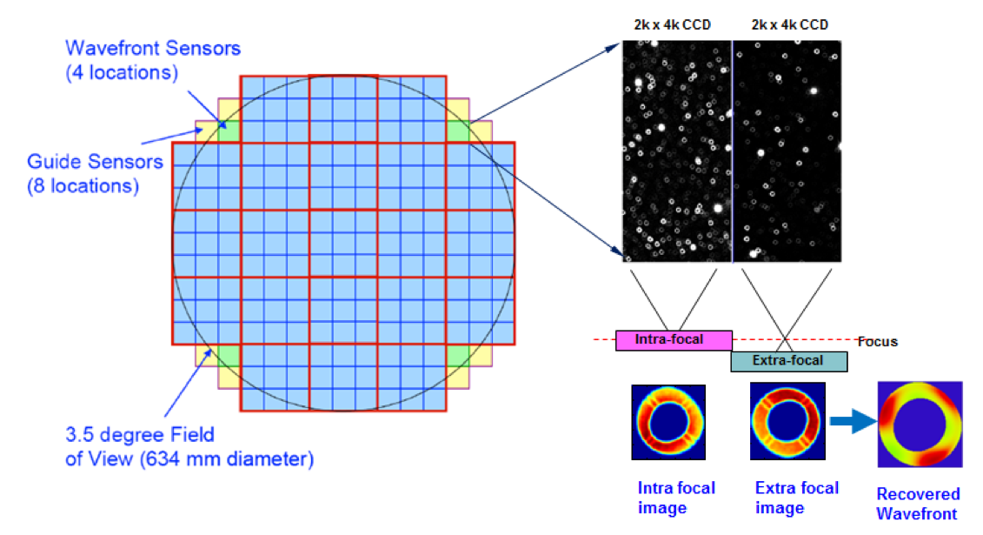
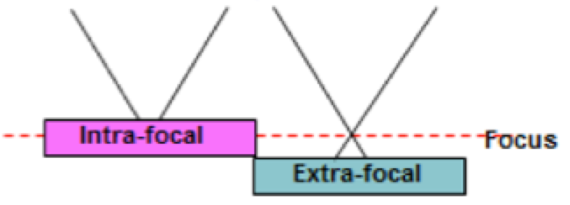
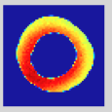
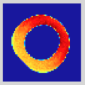
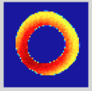
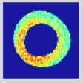
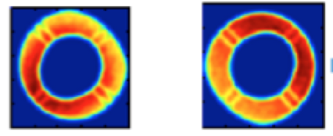
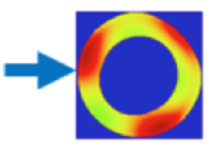
WFS Design and Constraints
Curvature sensing enables significant flexibility in selecting sources due to the large field of view of the area sensors
split sensors: because of the fast f-number (f/1.23) and crowded focal plane, using a beam splitter and delay line or physically moving the detector will not work.
Use multiple sources to increase S/N, to help average out atmosphere noise, and to alleviate problems due to vignetting.
LSST WFS challenges
61% Central Obscuration
f/1.23
Off-axis Distortion & Vignetting (~1.7º)
Field Dependence (covering 1.51° to 1.84°)

Slide 5
Inversion, Forward Modeling, Machine Learning
Forward modeling: VISTA, DECam, etc.
Curvature sensing (inversion): WIYN, Mayall, etc.
The LSST construction project has adopted curvature sensing as the baseline:
2 actively supported mirrors + 2 hexapods, the number of controlled Degrees of Freedom ~ 50.
Rapid cadence requires wavefront sensing and AOS control to be highly automated and reliable.
Validation of the curvature sensing software:
Compared performance of inversion approach with Forward Modeling approach by Aaron Roodman (SLAC/Stanford) using DECam data
Compared performance of inversion approach with Shack-Hartmann sensor at Magellan (worked with Povilas Palunas@Carnegie)
Meanwhile we have been exploring alternative approach
Emily Li and David Thomas (Stanford) implementing and testing the Forward Modeling approach for LSST.
Machine learning techniques, e.g., effort by Chris Stubbs and Jun Yin (Harvard)
Notes:
Curvature sensing as baseline:
Forward modeling with 50 DOFs can be stuck in local minima
Forward modeling with 50 DOFs can be slow and unstable.

Slide 6
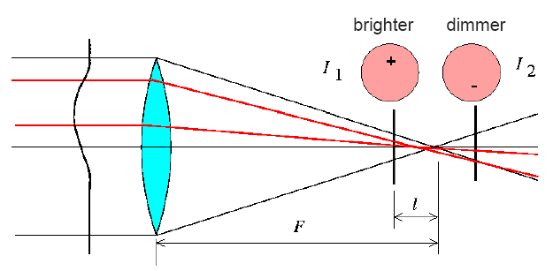
LSST Baseline Wavefront Sensing: Inversion Approach
One way of doing wavefront sensing is to solve
the transport of intensity equation (TIE):
Intensity difference between the two defocused images is proportional to the curvature of the wavefront:
Iterative FFT method:
(C. Roddier and F. Roddier, J Opt Soc Am A 10, 2277-87 (1993) )
Make use of the property of Laplacian in Fourier space
Iterative algorithm, involves repeatedly setting the boundary condition
Orthogonal series expansion:
(T. E. Gureyev and K. A. Nugent, J. Opt. Soc. Am. A 13, 1670-1682 (1996))
Non-iterative algorithm, involves integrations over the pupil
faster than iterative FFT in general

Slide 7
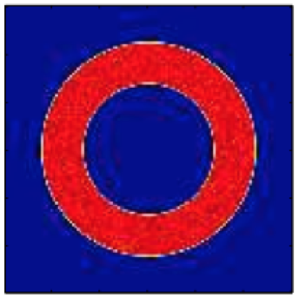
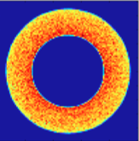
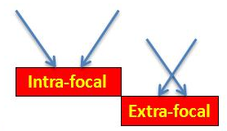
Inversion Approach: LSST modifications
LSST WFS challenges & algorithmic modifications
Large Central Obscuration (61%)
Fast f/number (f/1.23)
Off-axis Distortion and Vignetting (~1.7º)
Field Dependent Corrections
(covering 1.51° to 1.84°)
Appl. Opt. 54, 9045-9054 (2015).

Slide 8
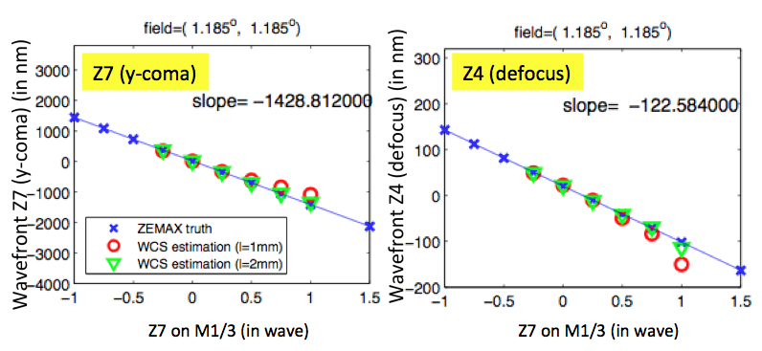
Algorithmic Linearity
Z7 on M1M3 (in wave)
Z7 on M1M3 (in wave)
Two worst-looking linearity plots
Wavelength=770nm

Slide 9
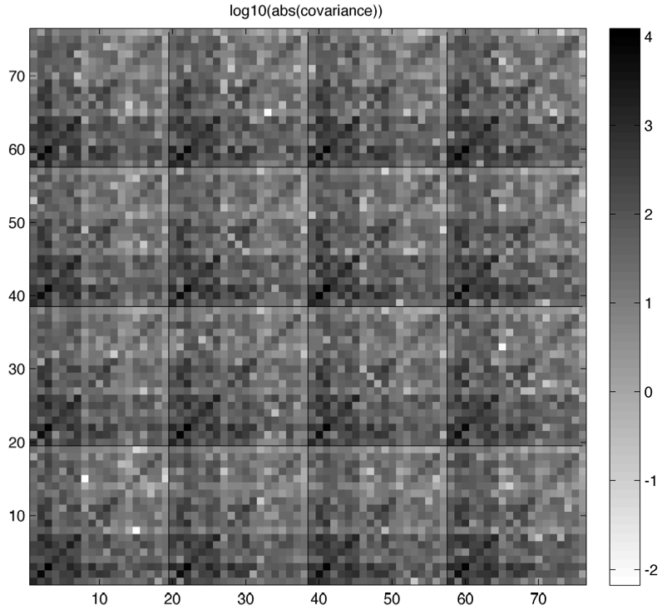
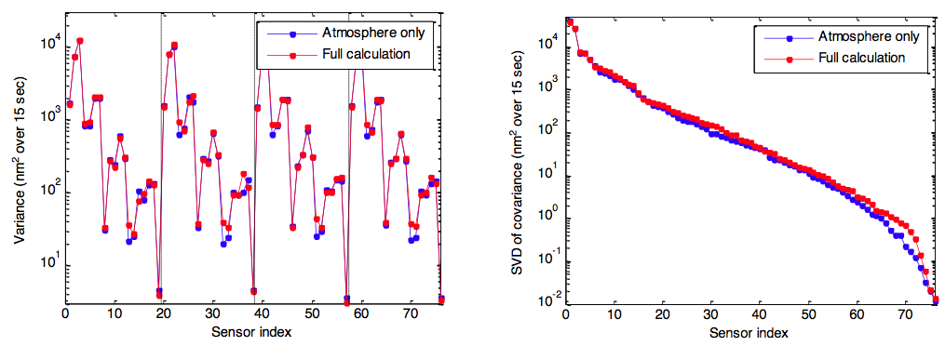
Covariance Analysis
Total covariance is almost entirely dominated by atmosphere
– Diagonal elements (lower left) similar
– Singular values (lower right) also similar; some increase for low singular values
(Algorithmic + atmospheric)
Covariance
matrix
Variance
Singular values

Slide 10
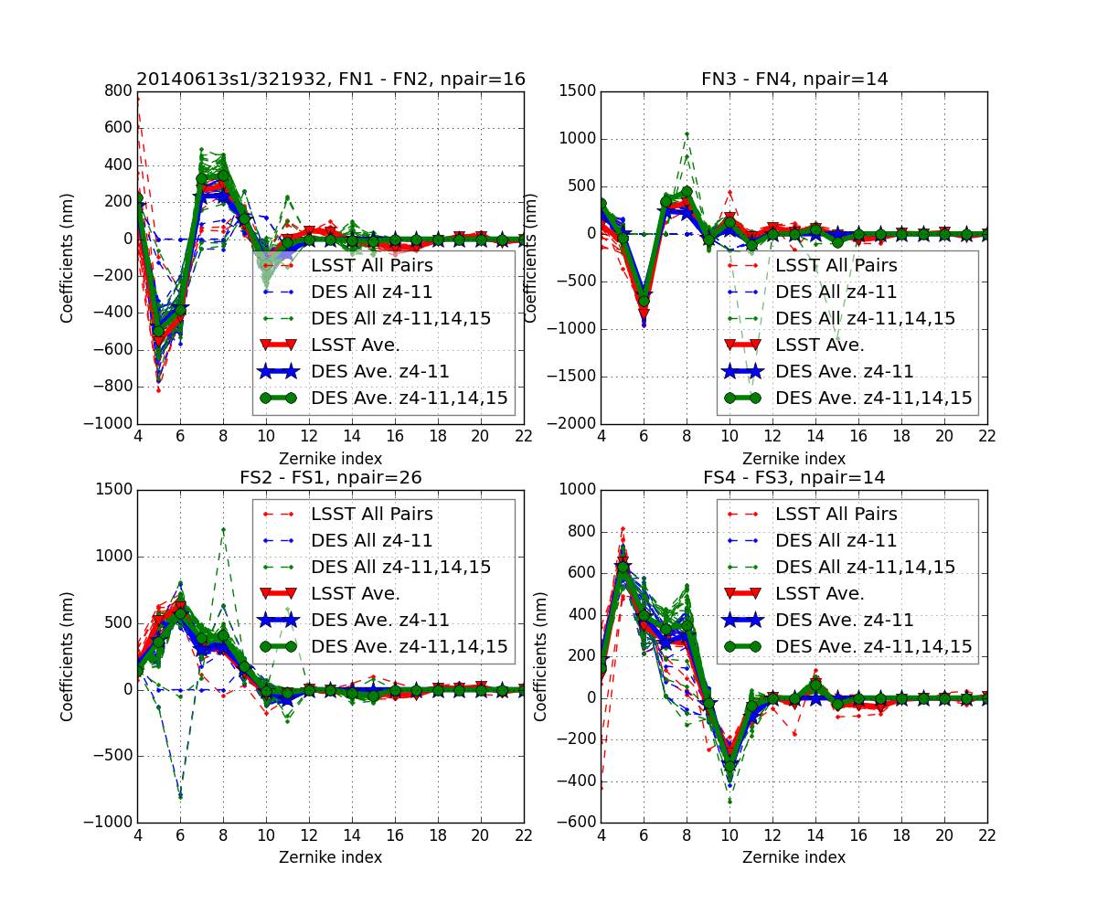
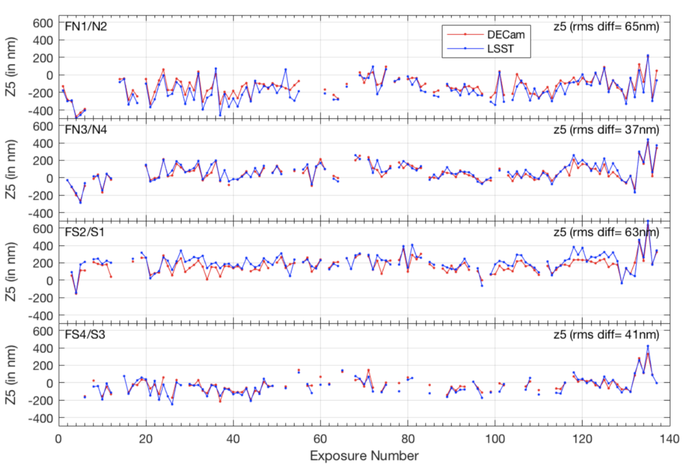
Comparison with Forward Modeling Approach using DECam Data
Very good agreement
Published as SPIE 9906, 99064J (2016)
Emily Li and David Thomas (Stanford) working on forward modeling for LSST

Slide 11
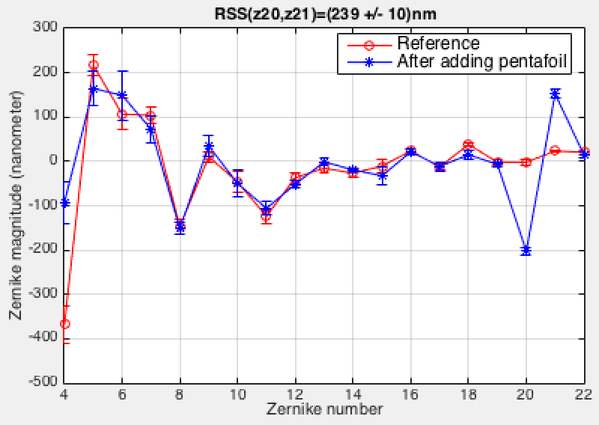
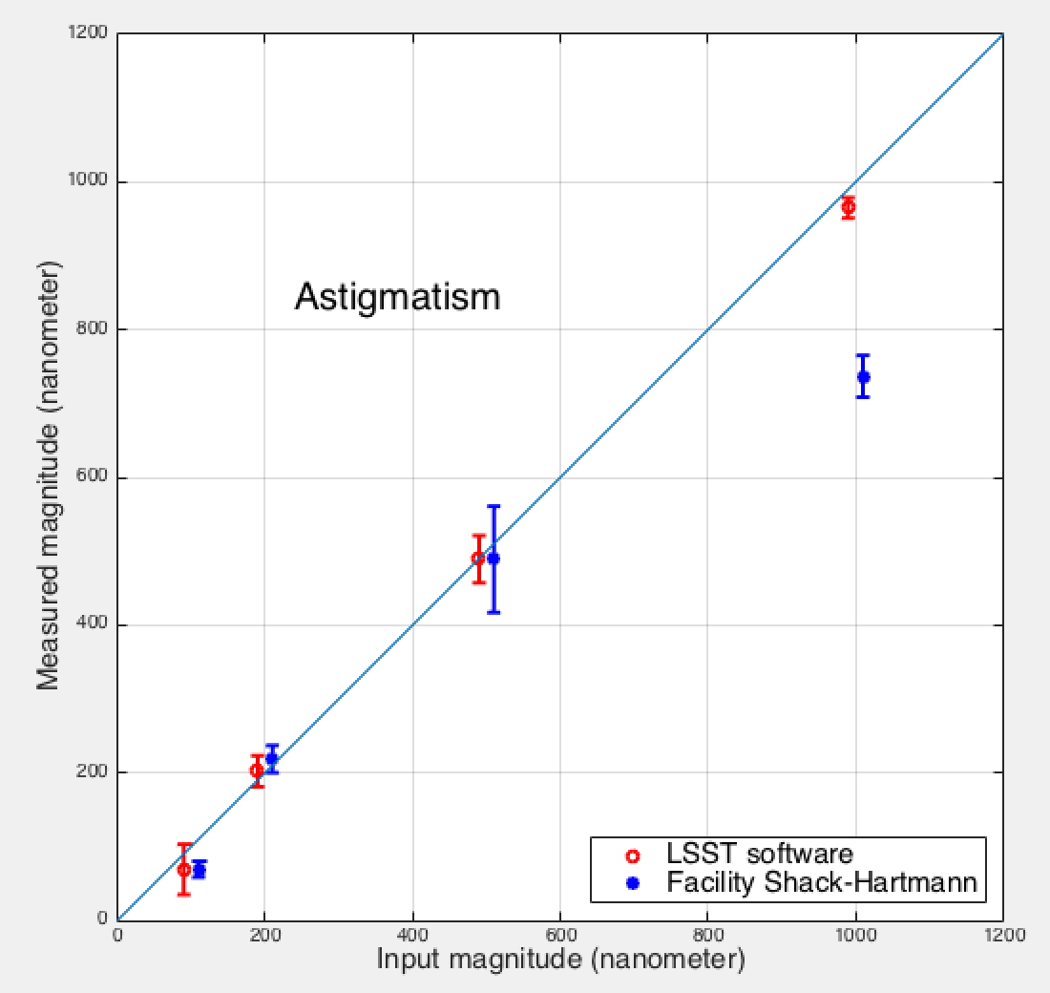
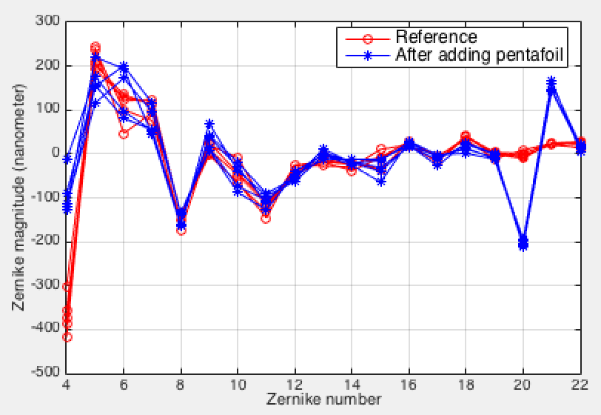
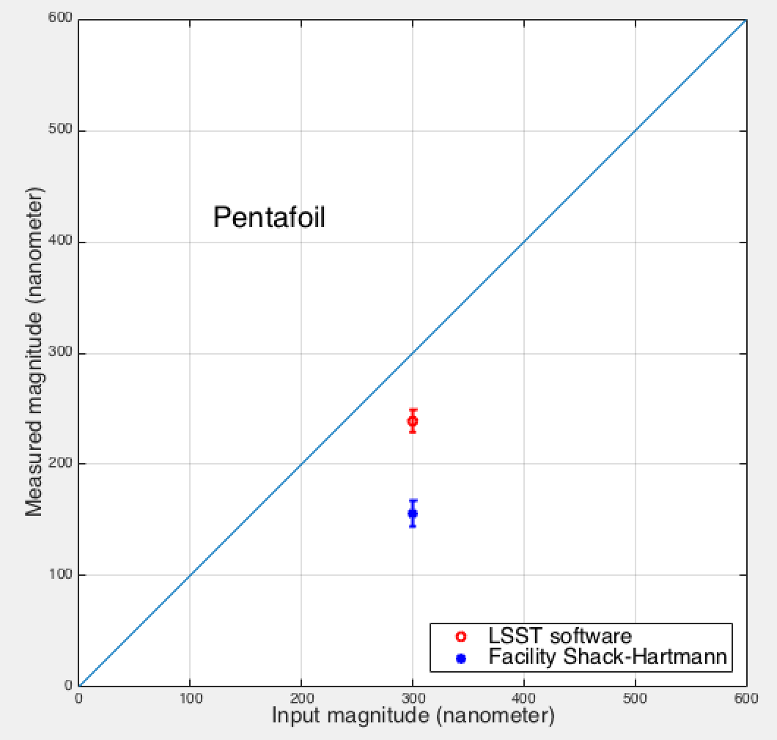
On-Sky Testing with Magellan
pentafoild
When 300um of pentafoil is put on the primary mirror
Data points shifted by ±10nm, to facilitate display
pentafoild
5 pairs of images for each color

Slide 12
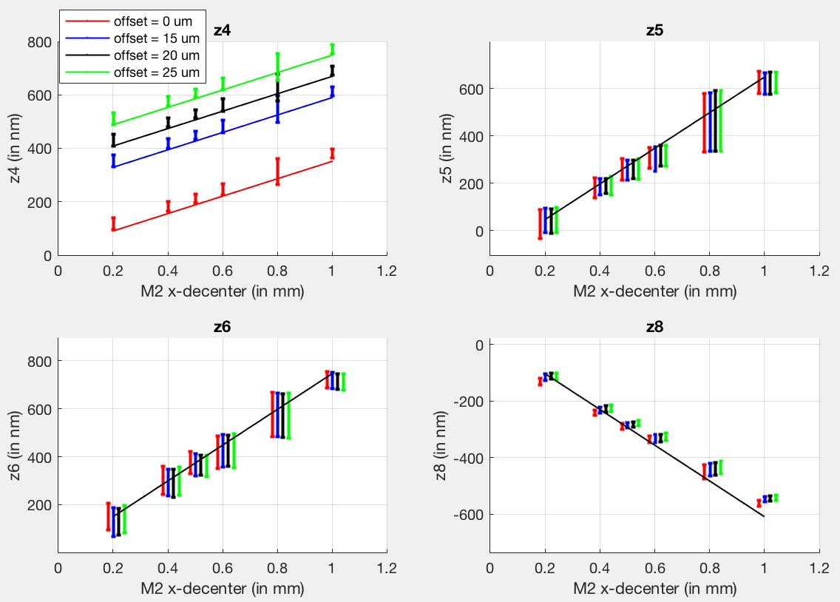
WFS Deployment Parameter Optimization
What is the acceptable position tolerance for the WFS midpoint height relative to the science sensor array?
Concerns:
Linearity in the presence of large focus
Caustic zone (TIE approach breaks down)
Monte-Carlo simulation in PhoSim
WFS readings for misalignments
Atmosphere included
Higher order Zernike estimates practically independent of focus offset
Focus
Astigmatism
Astigmatism
Coma

Slide 13
General AOS Control Design Considerations
For a 3-mirror system (LSST): 10 rigid body degrees of freedom. *
The 2 pistons can measured using defocus and spherical aberration.
We can use the 8 tilts and decenters to zero out coma, astigmatism, and curvature of field. That leaves a 2-dimensional subspace of misalignment.
Simultaneous measurement of 1st order defocus and 3rd order curvature of field requires at least 3 wavefront sensors.
The need to actively maintain two mirror figures requires measuring higher order aberrations. *
Large central obscuration (61%) makes distinguishing certain aberration patterns harder. *
The LSST optical state estimator is basically an inversion of the the optical sensitivity matrix
equivalent to a simultaneous (least-square) fit to all wavefront sensors for all the degrees of freedom.
* Reference: Schechter & Levinson, PASP 123:812–832, 2011
Notes:
At single field point, defocus and COF both manifest as defocus. For a 2D plane in a 3D space, we need 3 points to pin it down.

Slide 14
Tackling AOS Control with a full Sensitivity Matrix
Mirror state (rigid body and bending) is fully observable in the absence of sensor noise
Sensor noise (dominated by atmosphere, not algorithm) results in some “directions” being practically degenerate
Focus correction, for example (M2 & camera piston, mirror bending)
Three algorithm modifications to handle this
Reduced gain (roughly equivalent to longer integration time)
Kalman filtering; Optimal estimator
Control penalty to avoid large commands
Optimized penalty factor for balancing image quality gain and large swings
Optimized penalty matrix against DOFs canceling each other
Option to fall back to truncated sensitivity matrix
enforce relative constraints, e.g. on which degree of freedom is used to control observed focus.
Use low order aberrations for rigid body alignment and high order ones for mirror figure control.
With these modifications, both linear and nonlinear analyses predict acceptable performance

Slide 15
Optimal Control
Optimize both the IQ across the field and the motions of the control variable
ρ and the diagonal elements of H define the weights of the control motions relative to the image quality (PSSN).
The current choices are
The penalty on each bending mode is proportional to the force it requires
1N RMS actuator force = 1um piston or decenter on M2 or camera = 1arcsec tilt on M2 or camera = 0.001 gain in PSSN
Control motion for iteration k+1
Drift due to environmental condition and operation parameters
Control gain, use α<1 to integrate atmosphere over longer time.

Slide 16
Performance metrics: images size and ellipticity
Unambiguous definition for FWHM: Effective FWHM (FWHM_{eff})
Size of equivalent rotationally symmetric Gaussian PSF such that n_{eff} is the same
Directly linked to single-visit point source depth
Directly linked to the normalized point source sensitivity (PSSN)
App.Opt.48,5997(2009)
PSSN is multiplicative with good precision
Single-visit ellipticity
n_{eff} – effective number of pixels that maximizes SNR (Equivalent Noise Area)
FWHM Allocation:
Telescope 0.25”
Camera 0.30”
Optical design 0.08”
Requirement. on Single-visit ellipticity: Average < 4%

Slide 17
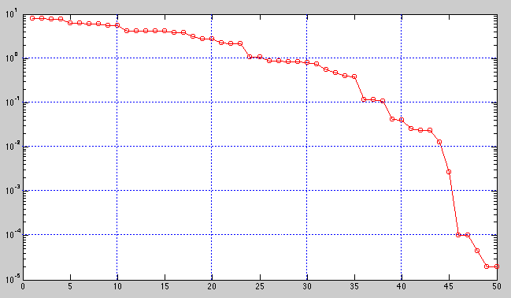
Near-Degeneracy in the A-matrix
Matrix is near-degenerate.
Small singular values allow propagation of noise
For now, we truncate the 5 smallest singular values.
Optimal estimator should be implemented if necessary
X is state covariance,
W is noise covariance
Singular values of A-matrix
Log scale!
System is nearly blind to these combinations of control motions
The 5 smallest singular values all correspond to
combinations of the M2 and camera rigid body motions that mostly offset each other

Slide 18
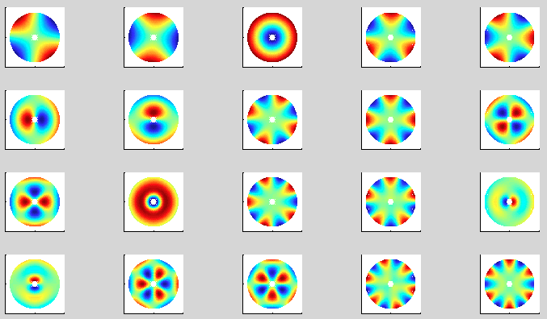
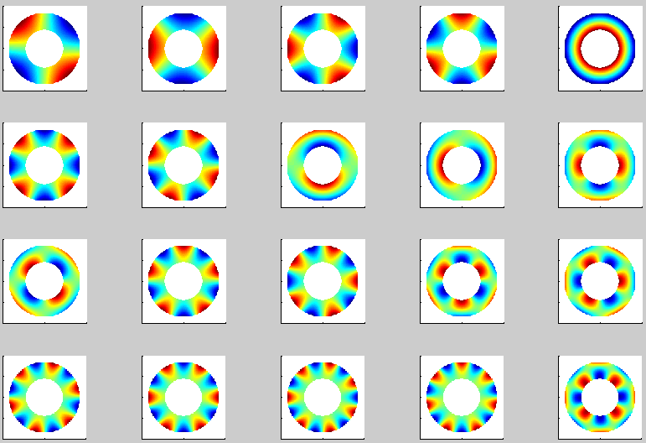
M1M3 & M2 bending modes
M1M3 bending modes are calculated based on latest FEA analyses
Based on detailed observability and controllability studies, we use
20 bending modes for M1M3 substrate
20 bending modes for M2.
For the same surface RMS, higher order bending modes require larger forces
M1M3
M2

Slide 19
How Good is Good Enough? Meeting Requirements
See Bo Xin’s performance talk on status of AOS simulations incorporating gravitational, thermal, atmospheric effects, and LSST cadence.
Normalized Point Source Sensitivity (PSSN) is used as the image quality metric in AOS control cost function.
Single-visit ellipticity is also shown to be within specification.
SRD specifies (assuming fiducial atmosphere):
delivered image quality for all optical bands.
delivered image quality homogeneity across full field
Ellipticity based on second moments
Additional time allocation after large slews accounted for in OpSim Simulations.

Slide 20
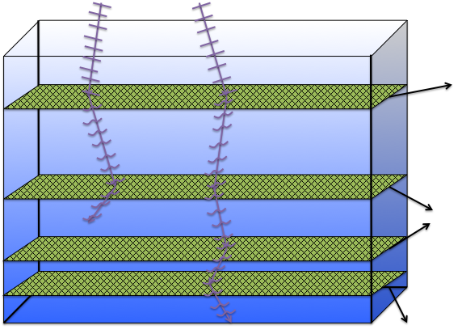
Atmospheric Model (Phosim)
7 layers between 20m and 16km
Each layer is a Kolmogorov phase screen with outer scale
Each screen is frozen and drifted by separate velocity vector
For better speed, uses geometric approach for low frequency and Fourier approach for high frequency;
Full Fourier approach is also implemented
chromatic refraction included.
The angle from the zenith is calculated for each photon individually and then
the overall refractive effect is calculated causing an angular shift that is wavelength-dependent and slightly temperature- dependent and pressure-dependent as well.
vt_{exp}
ϑh

Slide 21
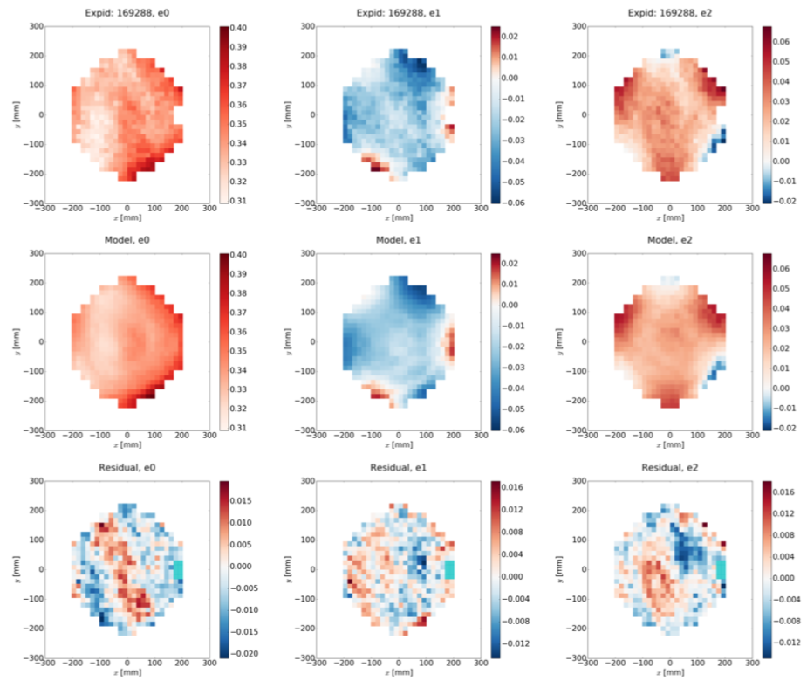
Generic Alignment Patterns, Pointing, and second Moments
Potential near-future projects which could help improve AOS performance:
Study generic alignment patterns for LSST - update Tessieres’ M.S. thesis (University of Arizona, 2003);
Use pointing information as determined by M1M3 position and telescope encoders;
Second or even third moments of stars in science fields, e.g., Davis, Rodriguez, and Roodman, SPIE 9906, 990668 (2016)
Davis, Rodriguez, and Roodman, SPIE 9906, 990668 (2016)

Slide 22
M1M3 Optical Testing at the RFC Mirror Lab
Single actuator influence function scaling factors close to 1, with small residuals
Final Optimized M1M3 Surface
Bending modes scaling factors close to 1, with small residuals
Bending mode cross-talk matrix

Slide 23
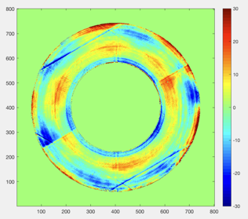
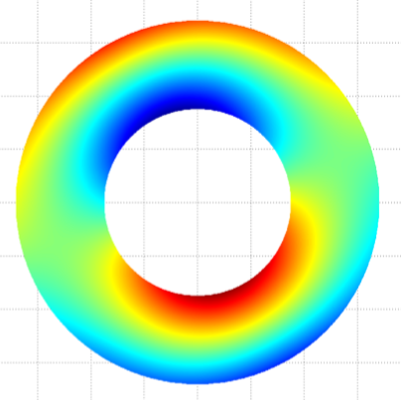
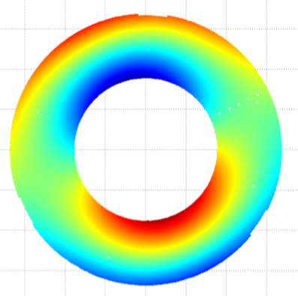
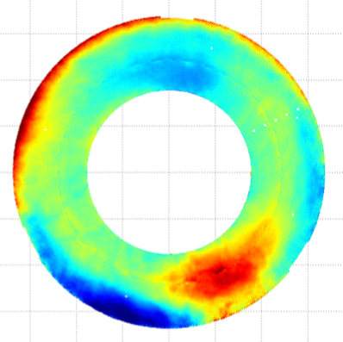
M2 Acceptance Testing at Harris
Final polished surface
Structure function
Meets spec
FEA coma, RMS=996nm
Measured coma, RMS=996nm
Difference, RMS=16nm (1.7%)

Slide 24
Commissioning the Active Optics System (AOS)
A good example of “tests of increasing sophistication” is how to commission the AOS step-by-step.
AOS AI&T is structured in phases.
Commissioning Phase 0: fully test the AOS pipeline in a simulated environment
Telescope AI&T: On-axis Shack-Hartmann tests
Telescope AI&T: CMOS camera on-axis tests (with defocused images)
Commissioning Phase 1: ComCam AOS tests, with limited FOV
Commissioning Phase 2: LSSTCam AOS tests, characterization, and optimization

Slide 25
AOS Tests on the Telescope Using IOTA
Use of an auxiliary system called the Initial Optical Test Assembly
Shack-Hartman wavefront sensor: We can send the measurement to the AOS CSC to translate the Zerniike Coefficients to force pattern
CMOS high speed camera (a few 100Hz): Use of the full AOS pipeline but only on axis
-> Using the Shack-Hartmann WFS we will verify the open loop model using different elevation and azimuth angle

Slide 26
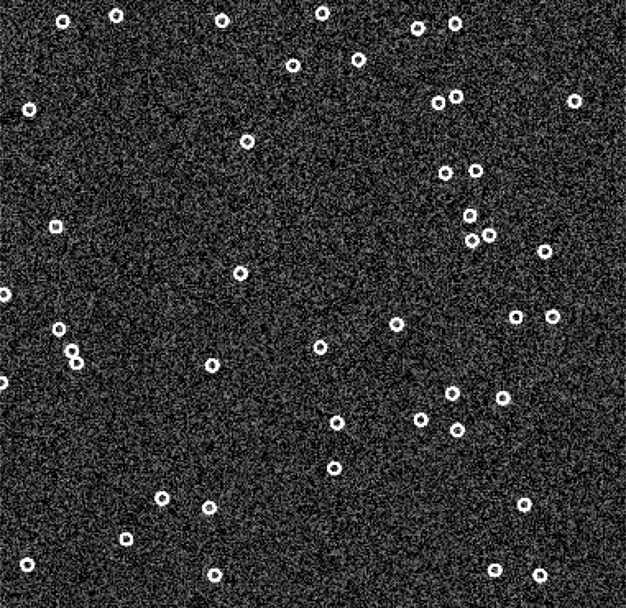
AOS with ComCam
PhoSim-simulated intra-focal chip
ComCam: A single raft camera (~45 by 45 Arcmin) operating as a surrogate of the full science camera, with its own refrigeration system.
Piston ComCam back and forth using the hexapod to create intra- and extra-focal images.
Procedures/interfaces tested:
OCS-Camera interface (LSE-71)
DM-telescope interface (LSE-75)
Testing of bright star catalog
Verification of the optical sensitivity matrix (limited FOV)
Testing of wavefront sensing pipeline, including ISR, source finding, donut de-blending, donut pairing, and the curvature wavefront sensing software(with un-vignetted donuts)
Testing of AOS control strategy (with small FOV)
Optimization of AOS Look-Up-Table
PhoSim-simulated extra-focal chip
Notes:
DM to T&S: WCS; PSF; ISR; WEP (on commissioning cluster)

Slide 27
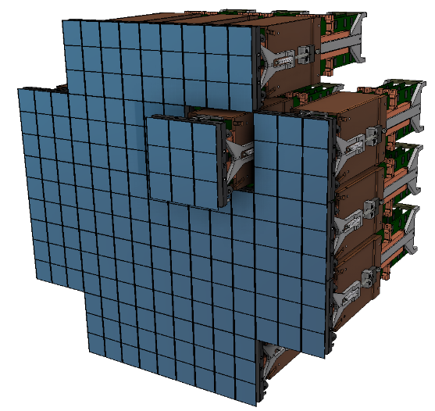
AOS with LSSTCam
AOS tests with LSSTCam has two flavors:
Full Array mode: Piston the entire science array to intra and extra focal positions
Normal operation modes: wavefront sensing with only corner rafts
Full AOS tests include:
TCS-corner raft DAQ interface (LSE-71)
DM-telescope interface (LSE-75)
Verification of bright star catalog and star availability for all regions of interest
Testing of wavefront sensing pipeline, including ISR, source finding, donut de-blending, donut pairing, and the curvature wavefront sensing software(with vignetted donuts on half-chips)
Testing of AOS control strategy (with full FOV)
Measure wavefront across focal plane and calibrate offset between field center and corners
LUT optimization over full parameter range
Full Array Mode: 189 Wavefront Sensors
Notes:
LUT (T, elevation) and check azimuth dependence
Whisker plots?

Slide 28
Wavefront Sensor Feedback Calibration
What matters is the image quality on the science detectors. We will evaluate the calibration sensitivity to the offsets between the science sensors and the WFS as follow:
➢ Measure of the wavefront error at the center of each detectors by defocusing the camera in and out of focus (using the camera hexapods) and applying the same algorithm developed for the 4 corners WFS
➢ Compare the resulting correction with the correction found with the 4 corner WFS
➢ Update the Look-Up-Table accordingly for different zenith angles
The tasks used to calibrate the wavefront sensors and those needed to verify the optical reconstruction will be interleaved. It is expected that these two activities will have to iterate with each other to achieve desired performance.
In the process, we will look for degeneracy in the system and verify our ability to reconstruct the state/perturbations of the system for both controlled and uncontrolled Degrees of Freedom

Slide 29
Current Milestones for the Closed-Loop pipeline development
Note that the wavefront sensors for closed-loop corrections will only be available with the LSST Cam.
January 20: WEP - Deblending Algorithm Coded
February 20: WEP - Source Selection Coded
April 20: WEP - Validation of the Deblending Algorithm and Source Selector
June 20: OFC - Kalman Filtering coded
February 20: Interface validation for the DAQ
August 20: OFC - Validation of the Kalman Filtering
February 20: WEP - Validation of the ISR (both from the DM team and the internal functions)
October 20: OFC - Optimal Controller Coded
December 20: OFC - Validation of the Optimal Controller
Algorithm Optimization will be done during commissioning

Slide 30
AOS integration and test plan
Beginning of 2020: DAQ interface test with real hardware with ComCam
Beginning of 2020: AOS closed loop verification using PhoSim
On sky. First use the Open Loop Model calculated from the FEA model
Spring 2021: Alignment procedure using the laser tracker (M1M3, M2 and the IOTA system)
Spring 2021: Test of the Optical Feedback Controller using the SHWFS
Spring 2021: Test of the full closed loop feedback and check of the LUT on axis using the high speed camera (by moving the detector in and out of focus using the camera hexapods)
Summer 2021: Test of the full closed-loop feedback and check of the LUT over a 42x42 arcmin FoV
Fall 2021 – Spring 2022: Test of the full pipeline using the corner wavefront sensors. Verification of the full LUT and calibration of the WFS.

Slide 31
AOS Risks
Risk Number | Details | Risks scores
RM-725 | Maintaining Engineering Staff Through Commissioning | 12
RM-780 | Active Optics Image Performance Verification | 9
RM-835 | Wavefront Estimation Algorithm Performance below requirements | 6
RM-820 | AOS Software Late Delivery | 3
RM-837 | Wavefront Sensor Offset not adequate for active optics system | 2
RM-839 | M1M3 Axial support bandwidth low | 2
RM-853 | M1M3 or M2 surface error found during summit integration due to poor AOS control | 1
RM-868 | M1M3 Hard Point performances below specifications | 1
RM-879 | M2 Active Support Control Below performances | 1
Notes:
Image pre-processing, including donut de-blending and stacking or pairing
Prototype code exist as proof of concept
David Thomas and Bo Xin working on building an robust WFS image processing pipeline
Wavefront sensor Feedback calibration
Unknown factors not captured by FEA, and correlation with environmental conditions

Slide 32
Internal AOS Miiestone
M1M3 + Cell Integration & Optical Testing at SOML (Start)
M1M3 + Cell Integration & Optical Testing at SOML (Acceptance Test)
Telescope Alignment System Available
3-Mirror Optical System Ready for Testing (on the Summit)
Image Processing (Software) Final Acceptance Testing Wavefront Estimation (Software) Final Acceptance Testing Corner Rafts Pre-Ship Acceptance
Corner Rafts (Complete)
Reconstructor Module (Software) Final Accept Testing
WFS Software Complete
Early System Integration and Test (with ComCam)
Camera Ready for Integration with Telescope (including WFS) System Integration Test Complete

