Slide 1
M1M3 Cell Felipe Daruich Senior Electronics Engineer / M1M3 CAM NSF/DOE Joint Status Review August 05, 2019

Slide 2
WBS 04C.06.03 M1M3 Cell Assembly
Mirror cell structure
Passive support system
Active support system
Thermal control system
Surrogate Mirror
Mirror Cart

Slide 3
M1M3 Cell Assembly - Structure
Mirror support system is mounted on the deck plate.
Structure prevents deformation under vacuum during mirror coating.
Deck support truss and vacuum truss are not interconnected.
Pylon interface pads to attach it to TMA.
Message box example for short highlighted messages.

Slide 4
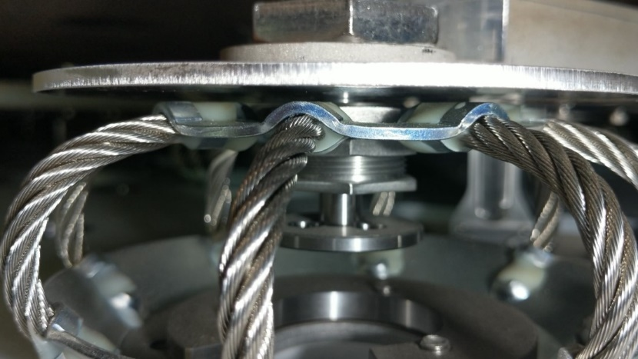
M1M3 Cell Assembly - Passive Support System
The passive support system consists of an array of wire rope isolators called static supports.
It safely supports the mirror when it’s not being supported by the active support system.

Slide 5
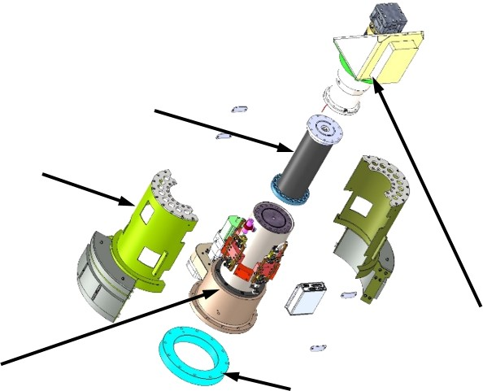
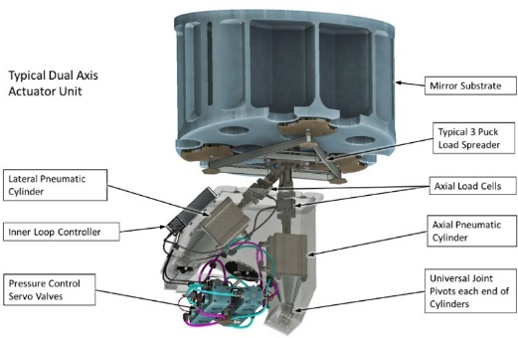
M1M3 Cell Assembly - Active Support System
The active support system provides precision mirror position through an hexapod consisting of six hard points actuators.
It also holds the weight of the mirror and provide figure control through an array of 156 pneumatic actuators.

Slide 6
M1M3 Cell Assembly - Thermal Control System
Borosilicate glass has a large coefficient of thermal expansion (CTE), relative to other optical glasses. Maintaining image quality requires limited the thermal distortion of the mirror.
The thermal control system is also required to track the mirror’s optical surface temperature with the ambient air temperature to minimize local mirror seeing effects.
The M1M3 thermal control system uses 96 Fan/Coil Units (FCU) to blow air, at a controlled temperature, into the mirror cell.
FCU are composed of a fan, water/glycol cooling heat exchanger and an electric heater.
The temperature of the water/glycol coolant in the mirror cell is controlled by a three way mixing valve that mixes the cooler facility coolant with the M1M3 coolant to maintain a temperature ~1C below ambient.
Heat Exchanger

Slide 7
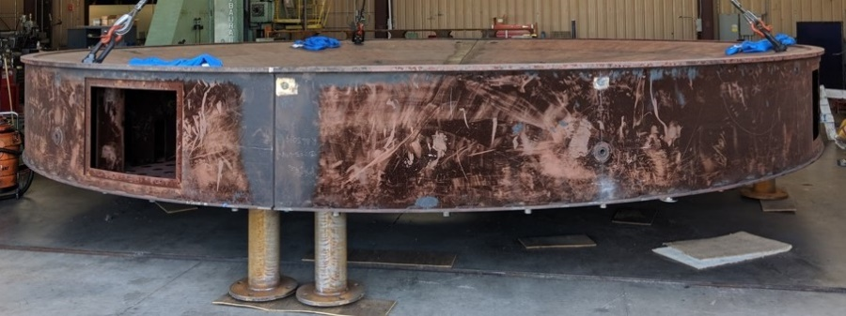
M1M3 Cell Assembly - Surrogate Mirror
The Surrogate Mirror is a welded steel assembly that matches mass, CG and shape of the glass mirror.
It is compatible with the support system and the thermal control system.
It can be installed on the mirror cell to perform various verification tests without putting the mirror into risk.
It is also compatible with the coating chamber.
Message box example for short highlighted messages.

Slide 8
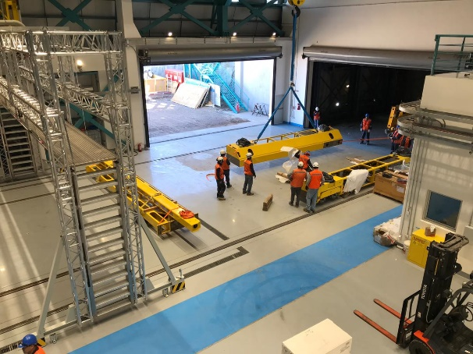
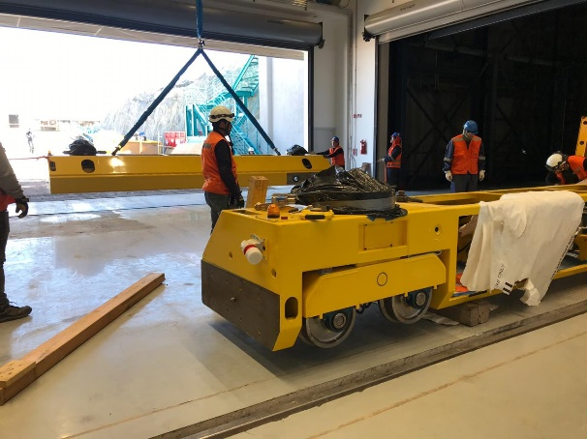
M1M3 Cell Assembly - Mirror Cart
The mirror cart can transport a fully integrated mirror cell from the maintenance floor to the TMA
Cart assembly in Pachón
Cart testing at CAID

Slide 9
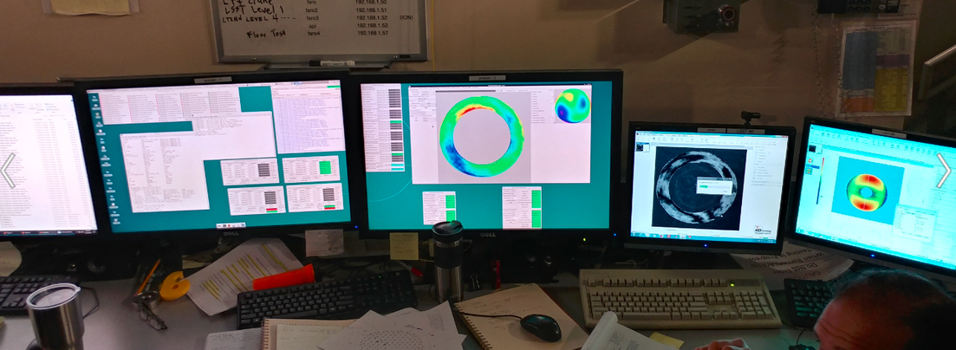
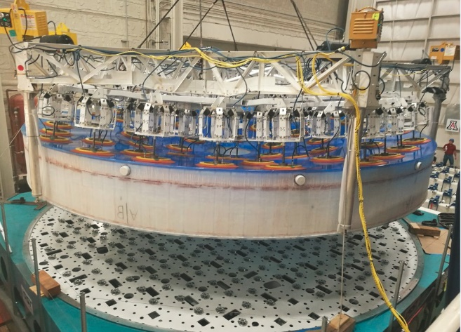
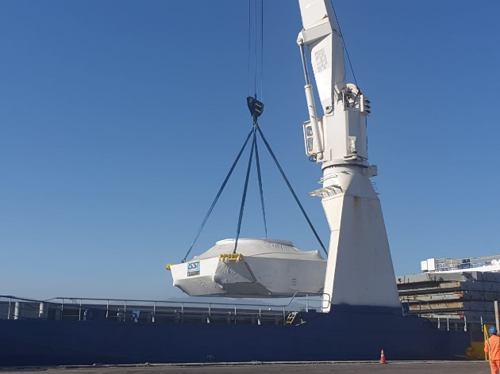
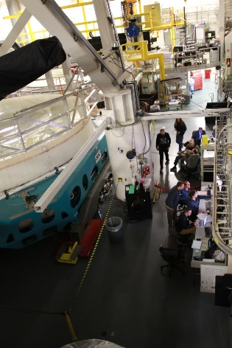
Accomplishments
Surrogate mirror painted and shipped to Chile.
Optical test performed successfully at RFCML.
Mirror removed from cell and shipped to Chile.
Cart shipped to Chile.
Mirror cell packed and shipped to Chile.
Actuators and Hard Points shipped to Chile.

Slide 10
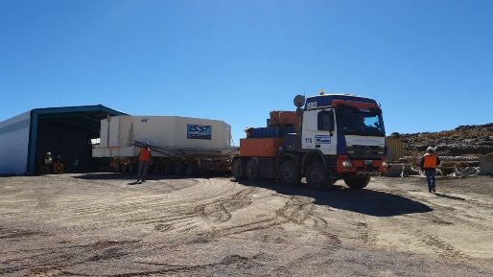
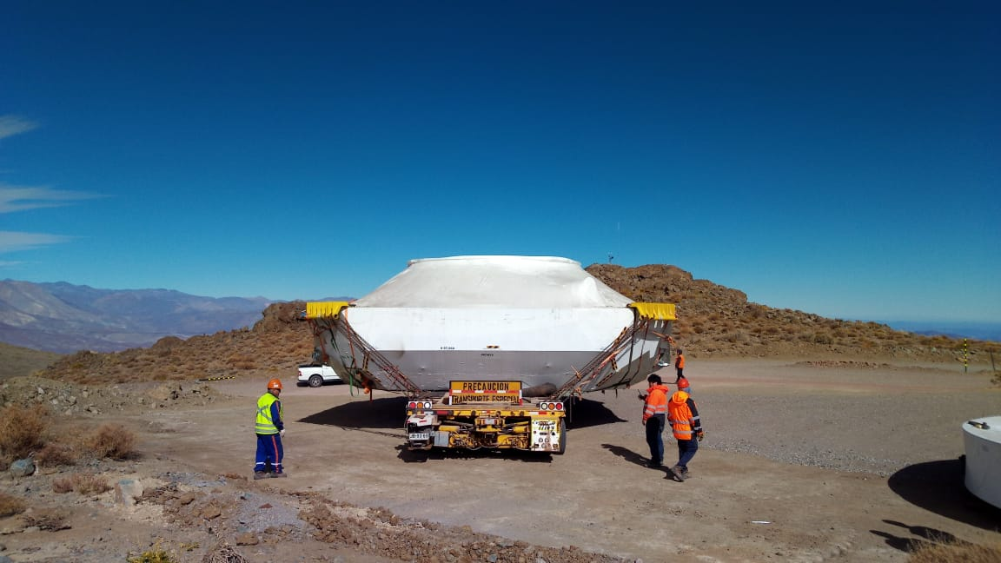
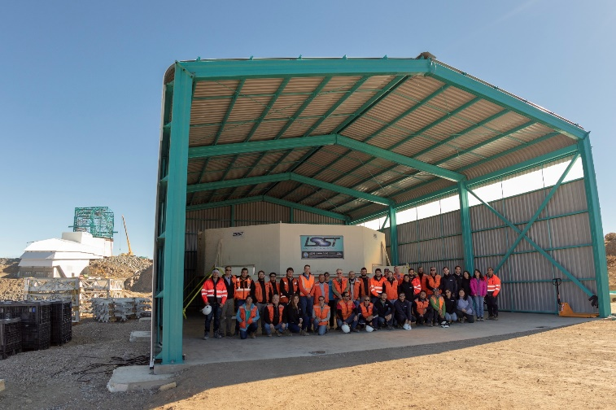
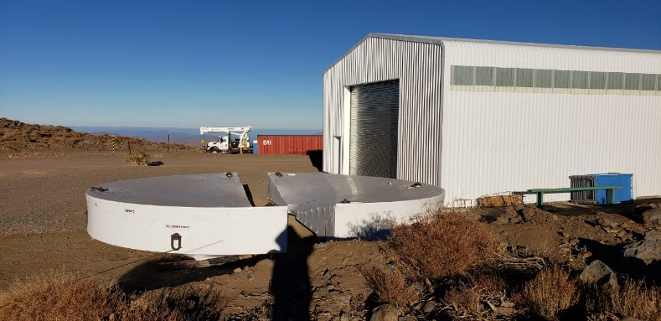
Current Status
Mirror cell assembly components delivered to Pachón:
Mirror cart. It has been assembled and tested in the maintenance floor.
Surrogate mirror
Mirror.
Mirror cell and support system components

Slide 11
Future Work – Fan Coil Units upgrade
Tasks
Add an absolute temperature sensor at the air outlet for air temperature control.
Develop an adapter board to read the sensor using the ILC.
Install the adapter board.
Build and install the wire harness for the sensor.
Schedule
Build the boards – July 2019
Install the boards – August 2019
Wire harness assembly and connection – September 2019
FCUs test in test stand – October, November 2019
Pack and ship FCUs to Chile – December, November 2019

Slide 12
Future Work – Summit surrogate integration and test
Tasks
Integrate mirror cell with surrogate mirror.
Test with cart, platform lift and coating chamber.
Test support system.
Integrate Thermal Control System.
Test Thermal Control System.
Schedule
Integrate mirror cell with surrogate mirror – July 2019
Install actuators and hard points – August, September 2019
Test support system – October 2019
Test with coating chamber – December 2019
Thermal Control System integration and tests – 2020

Slide 13
Daruich F Cost Summary WBS Lvl 4
The $1 M cost variance is mainly due to extra work performed during surrogate testing at CAID and optical tests at RFCML. This work was in our estimate to complete but was not implemented in the baseline via an LCR because of departure of previous CAM.

Slide 14
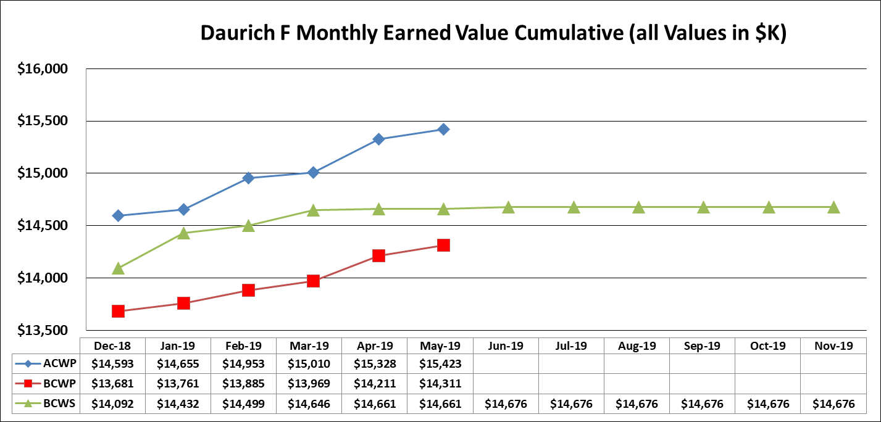
Daruich F SPA Chart
BCWP should increase as we submit LCR to reflect actual work performed by CAID and RFCML
during testing campaign.

Slide 15
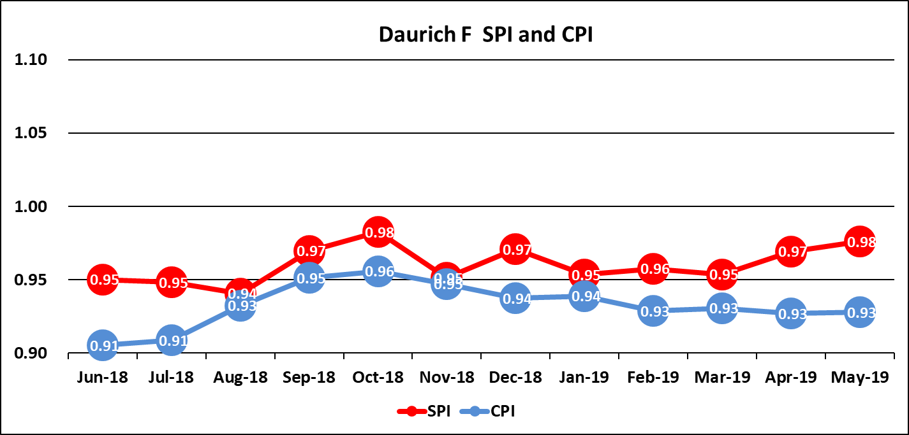
Daruich F CPI-SPI Chart
SPI increasing at the end of the period due to the shipment of the Mirror Cell to Chile and its
major components.
CPI maintained low in the second half of the period due to extra work done at CAID and RFCML
not implemented in baseline.

Slide 16
Risk and Opportunity
Risks
Key people retiring or leaving the project. Mitigation by hiring and cross training new staff.
Thermal Control System software not completed.
Opportunities
Delays in other subsystems allows for extra time to integrate and test Thermal Control System.

Slide 17
Thanks!

