Slide 1
LSST Camera
Cryostat Utility Trunk Status
Rafe H. Schindler, Camera Cryostat Physicist
Thomas W. Markiewicz, Camera Cryostat System Architect, CAM
NSF/DOE Joint Status Review
August 27-30, 2019

Slide 2
Outline
Accomplishments in the Cryostat Subsystem Since JSR 2018
  Cryostat: Power Feedthroughs & RTD/Heater system
  Refrigeration: I&T HX, I&T Compressor system, TMA Compressor system
Status of Work in Progress
  Refrigeration: TMA HX
  Utility Trunk
Programmatic Status
  Organizational structure – Changes
  Risks and Mitigations Status
  Cost and Schedule Performance Status
  Upcoming Major Milestones
Summary
Supporting Material
  Past Review recommendations
  Supporting Documents
  BCRs since JSR18
Message box example for short highlighted messages.

Slide 3
Accomplishments in the Cryostat Subsystem Since JSR 2018

Slide 4
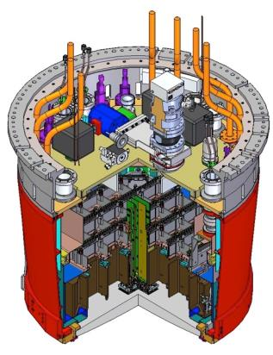
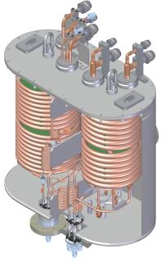
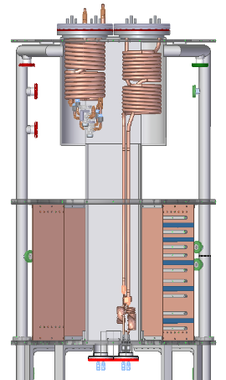
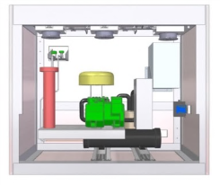
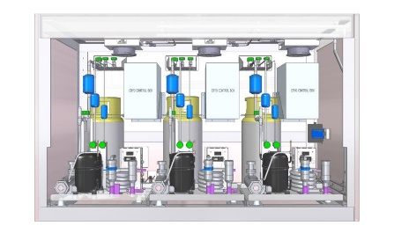
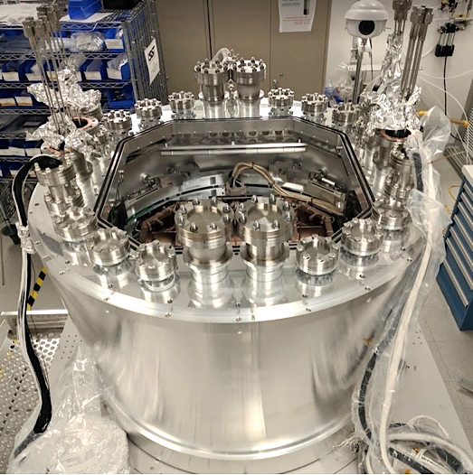
Cryostat and Refrigeration Subsystems
Cryostat with Grid, Cryo Plate, Cold Plate,
Feedthrough Plate, Pump Plate
I&T Heat Exchangers
TMA Heat Exchangers
I&T Cold and Cryo Compressor Cabinets
TMA Cold and Cryo Compressor Cabinets

Slide 5
Cryostat and Refrigeration Subsystems
Fabrication ~Complete JSR18
Design & Some Parts JSR18
Conceptual Design JSR18
Cryostat with Grid, Cryo Plate, Cold Plate,
Feedthrough Plate, Pump Plate
I&T Heat Exchangers
TMA Heat Exchangers
I&T Cold and Cryo Compressor Cabinets
Design & Parts JSR18
TMA Cold and Cryo Compressor Cabinets
Design & Parts JSR18

Slide 6
Cryostat Related Work in FY19
Cryostat delivered to IR2 summer 2018 and integrated on BOT. In FY19:
  Cold Plate AUX heaters (use before RTMs installed) installed & wired
  Four Power Feedthroughs cable assemblies fabricated and installed
    Two spare power FT assemblies fabricated
Loaded cryostat with FTs pump-down successful (I&T activity)
Cold and warm testing of 2 ETUs successful (I&T Activity)
Refrigeration related Cryostat Subsystems tested during “Verification tests” of the I&T HX and I&T Compressor Refrigeration System
  Cryo Plate and Cold Plate Trim Heater systems
  Cold Plate AUX Heater System
  Cryo and Cold Plate RTD systems
  PLC & CCS temperature monitoring, control, protection and feedback systems

Slide 7
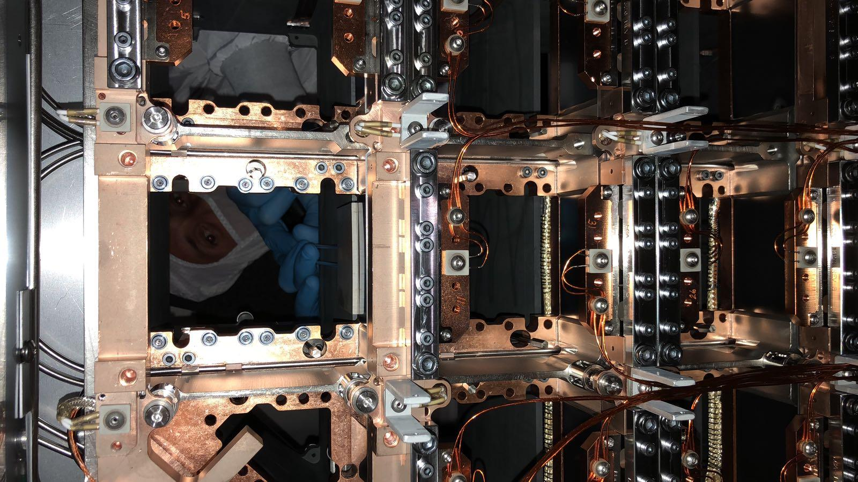
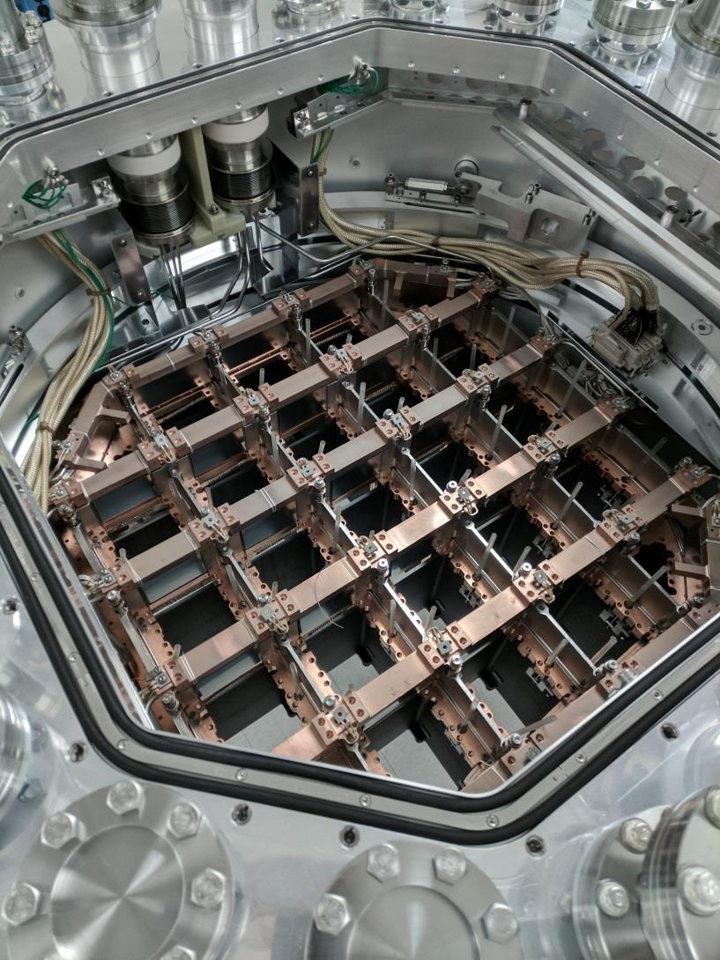
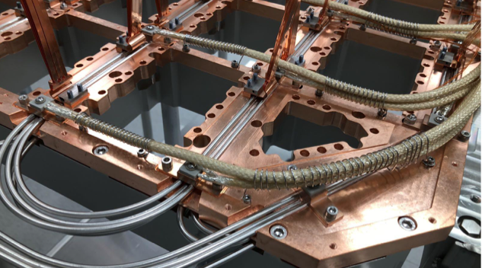
Cryostat
Cold Plate Detail w/ Trim and Aux Heaters
Aux
Heaters
Trim
Heaters
Cold Plate with Heaters Wired
Cryo Plate Detail w/ Trim Heaters & Cooling Circuits

Slide 8
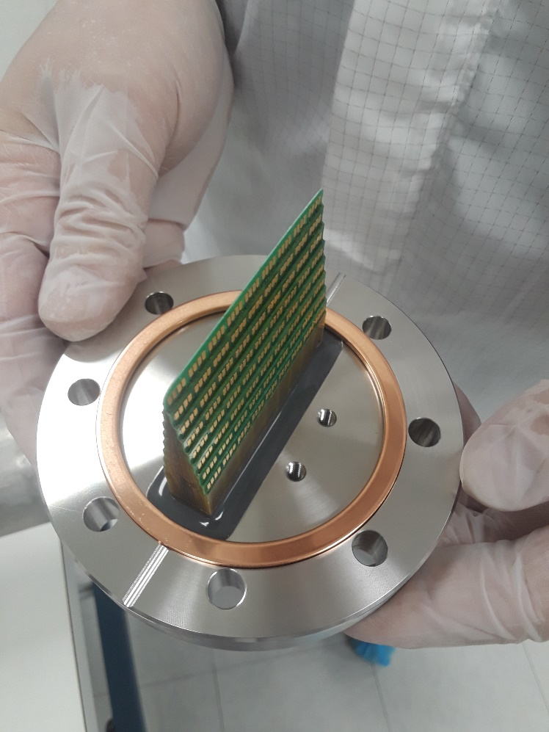
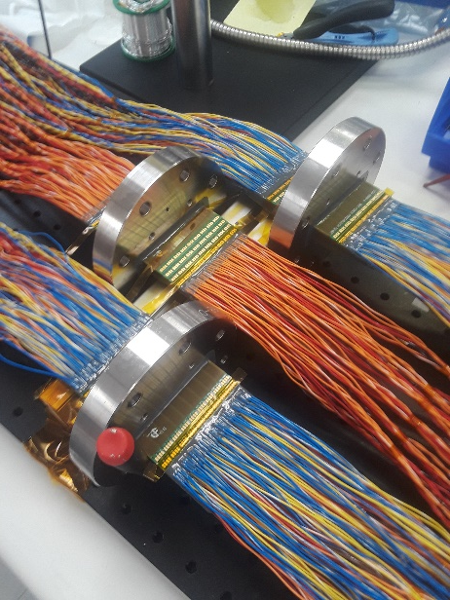
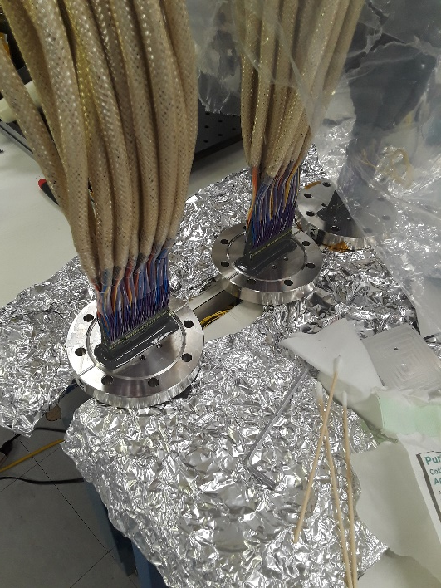
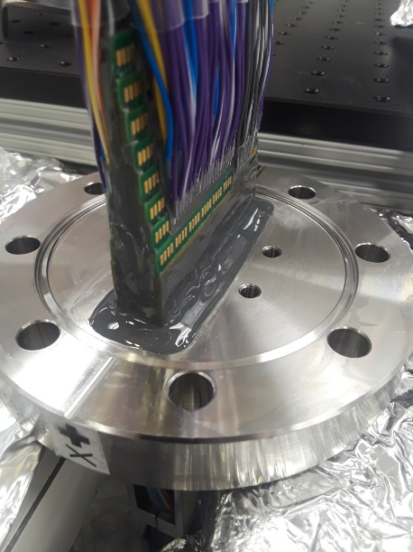
Power Feedthroughs
Vacuum & Air Side Wiring
Wires Grouped & Connectorized
PCB in Vacuum Flange

Slide 9
I&T HX and I&T Compressor Refrigeration System
Eight systems of 7-in-1 wound copper coils, small diameter capillary coils and TXV (thermal expansion) valves
  Fabricated by vendor: Dirt, leaks and metrology problems
  Assembled into 2 vacuum vessels after repairs at SLAC
  Mounted to Cryostat in IR2
Four compressor cabinets with 8 compressors and 8 control units constructed & installed outside IR2 clean room
  Two cabinets each holding a “cold” compressor system
  Two cabinets each holding 3 “cryo” compressor systems
8 refrigeration circuits connected, leak checked, & commissioned
I&T Refrigeration system passes LCA-051 verification requirements: cooling power, stability, cooling rate, …

Slide 10
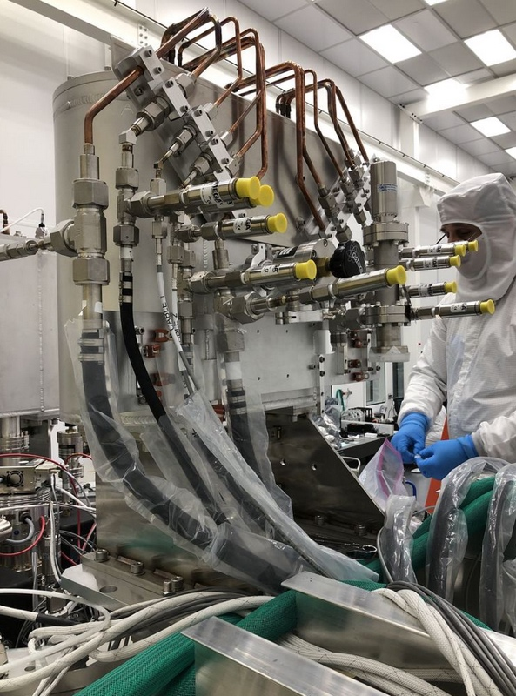
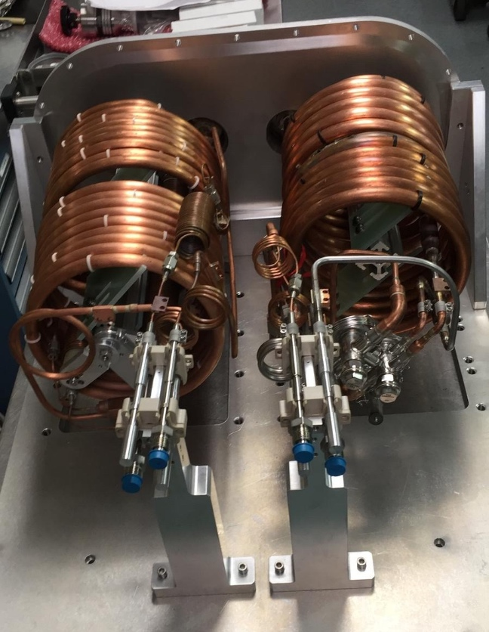
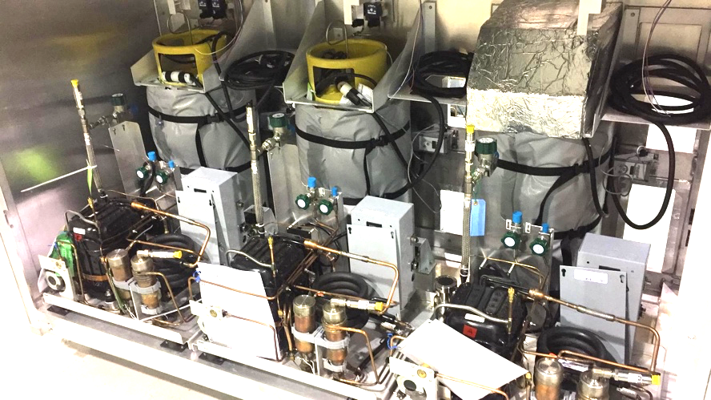
I&T Refrigeration System
1 of 2
I&T heat exchangers mounted to cryostat
Refrigeration system for I&T use was completed and tested in June 2018
Tests demonstrate that both cryo and cold systems operate with margin on their needed cooling capacity
1 of 2
I&T heat exchangers
1 of 2
I&T cold compressor cabinets
1 of 2
I&T cryo compressor cabinets

Slide 11
TMA “Chile” Compressor System
Additional 4 compressor cabinets with 8 compressors and 8 control units constructed
“Identical” to I&T Compressor system
  Slightly more robust cryo compressor used
  Filter dryer system left uninstalled from cryo circuits for shipping
Cold/Cryo cabinets pass basic “spin test” July 2/22
  Wiring verified
  Valve & controller function verified
  CCS Functions & run compressors dry for ~2 minutes
Cold & Cryo cabinet acceptance & shipping review August 5
  I&T Units “Accepted” by I&T subsystem
  TMA Units “Accepted” by Commissioning Team
Post construction mechanical “stiffening” prior to shipping

Slide 12
Status of Work in Progress

Slide 13
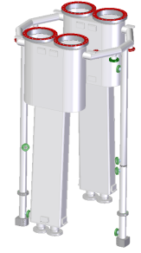
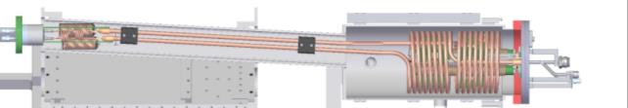
TMA ”Chile” HX System-Refrigeration
Lessons learned from I&T coils leads to vendor stop work & redesign/simplification of vendor produced parts
  Final assembly at SLAC to ensure QC
  Coils similar to I&T versions but with long “dog legs” for UT geometry
Two sets of “cold” 7-in-1 wound copper coils and TXV valves delivered June 4
  Significantly better cleanliness and metrology
  Pressure & leak tested
Six sets of “cryo” 7-in-1 wound copper coils and capillaries delivered August 1
SLAC will
  Clean, weld onto 10” flanges, braze connections, connect RTDs, pressure & leak test the 8 circuits
  Install into the UT vacuum chambers on the UT Structure at end of October
HX Vacuum Can
Isometric View
Schedule Risk!

Slide 14
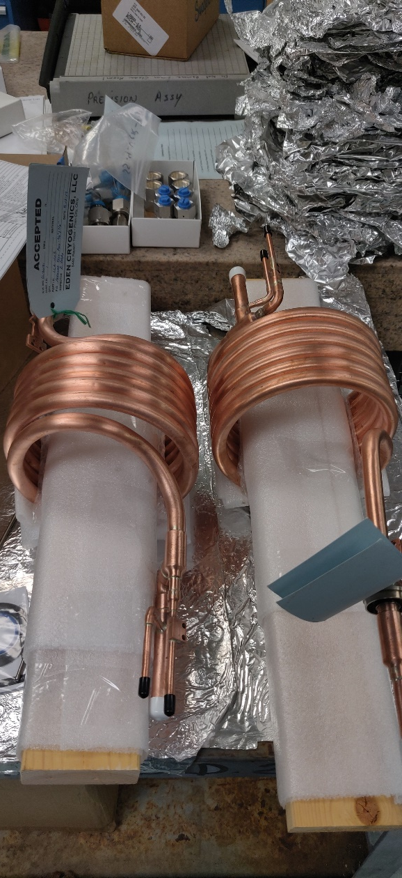
Parts for Cold TMA HX Arrive June 4

Slide 15
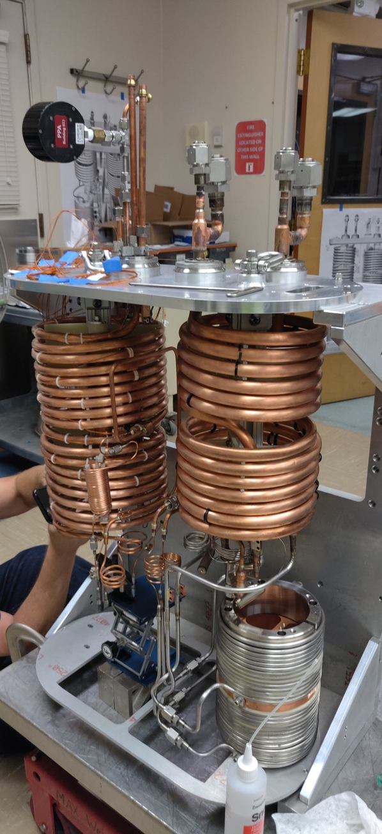
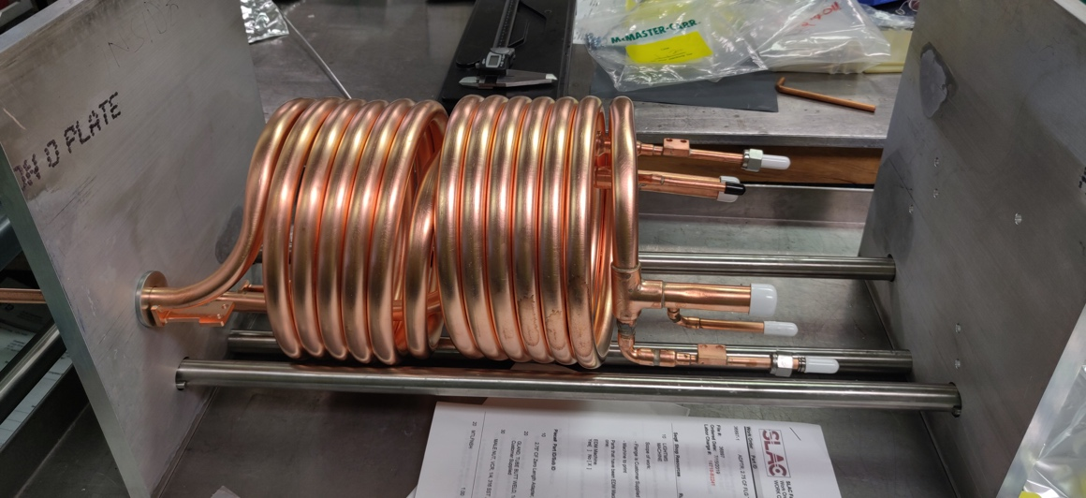
Manufacturing Status
Pathfinder: 2019-07-26
TMA Cold Fit-up: 2019-07-26

Slide 16
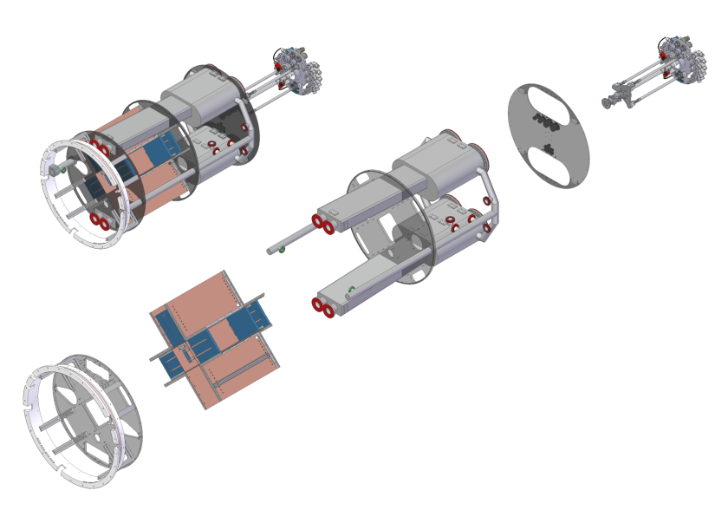
Utility Trunk Scope - Structure
Top End
UT Structure
Top End
Interface to Telescope
Top End Feedthrough Plate
Under Design
Cryo End
UT Vacuum Chamber
Interface/Housing for Refrigeration
Heat Exchanger
Quadrant Boxes
Interface/Support for Auxiliary Electronics
In-House
PO Placed
Front End Assy
Mechanical Mount to Cryostat

Slide 17
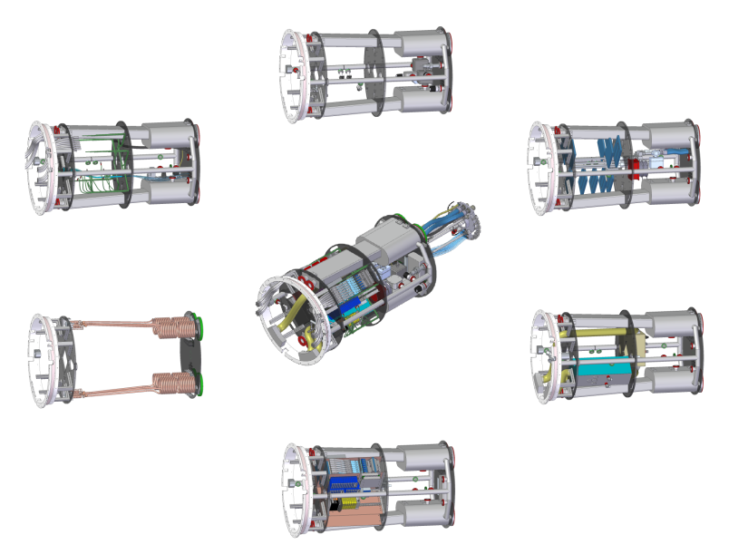
Utility Trunk: Subsystem Kits
Vacuum Hardware: UT Deliverable: In House
Cables/Compressed Air
UT Deliverable: In House
Coolant Distribution
UT Deliverable: In House
HX Coils:
Refrigeration Deliverable
Purge Cabinets
Camera Body Deliverable: On Track
UT is an integrated structure, providing support & mechanical interfaces for components from multiple subsystems
Auxiliary Electronics: External Deliverable: Quad Box in house needs wiring

Slide 18
UT Structure Procurement
Major Subassembly | DWG | PO? | Date Expected
Deck Plate | Y | Y | At SLAC
Mid Plate | Y | Y | At SLAC
HX Vacuum | Y | Y | At SLAC
O-Ring Chamber | Y | Y | At SLAC
Cryo Chamber | Y | Y | At SLAC
Support Ring | Y | Y | 9/5/19
Top End Feedthrough | Y | Y | 8/5/19
Doors & Skins | Y | Y | 9/2/19
W Counterweight | Y | Y | 9/2/19
Top End Plate | Y | N | PO+4 weeks
Bulkhead Plate | 8/1/19 | N | DWG+6 weeks
Wobble Plate | 8/1/19 | N | DWG+6 weeks

Slide 19
Major UT Machined Parts
Deck Plate & Mid Plate & Spare Quad Box
Deck Plate w/Support Ring Test
Cryo Vacuum Chamber
HX Vacuum Vessel

Slide 20
UT Assembly Kits Status
Sub-assembly parts at SLAC for:
Coolant Distribution
Vacuum Hardware
Compressed Air
UT Cables are not pre-assembled
Will be individually dressed on the UT structure
Connectors need to be ordered
Purge system to be provided on-time by “Camera Body & Shutter”
Loaded “Quad Box” being used by I&T on BOT will be transferred to UT as a last step once UT at IR2

Slide 21
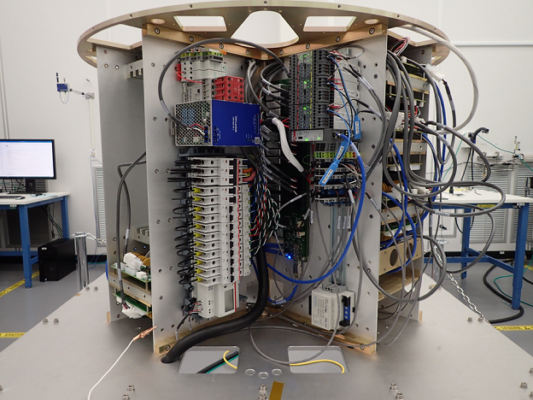
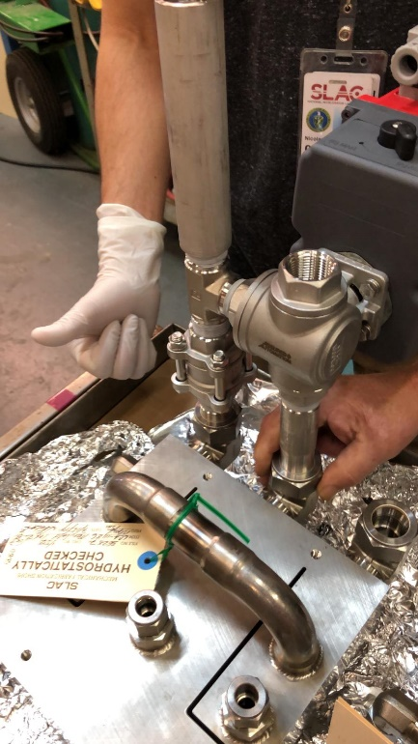
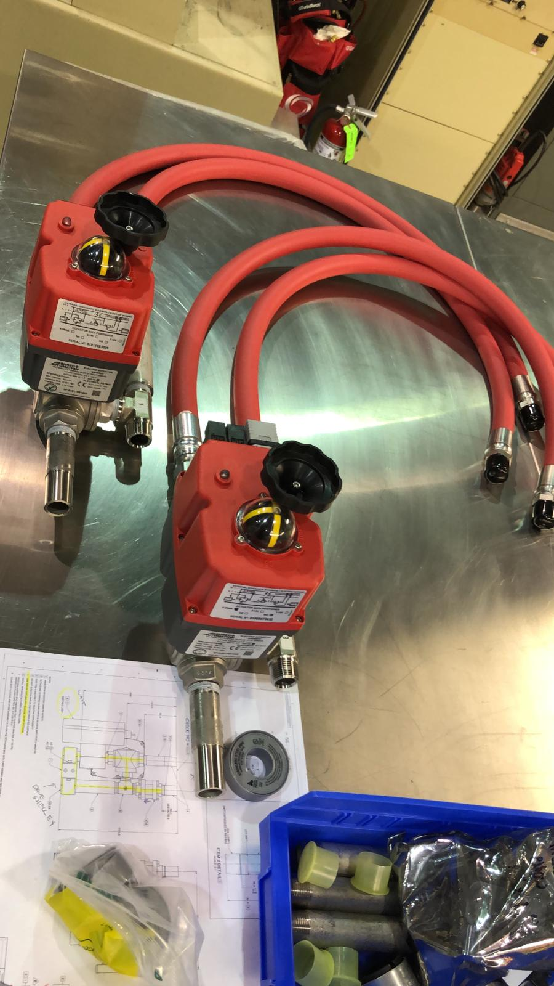
Various UT Subsystem Parts
Parts of Coolant System
Quad Box

Slide 22
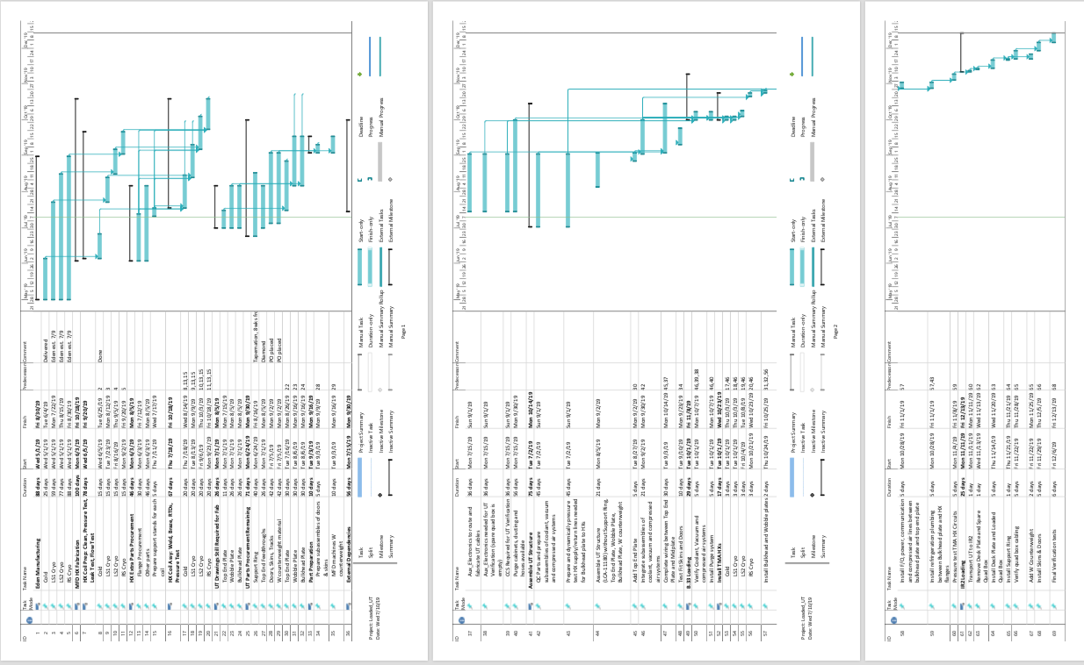
Detailed Assembly Schedule Exists

Slide 23
UT Time Line
Activity | Begin | End
Eden HX Coils | Now | July 31
MFD HX Coil Assy | Now | October 21
UT Kit Sub-assy prep | Now | Sept 30
UT Structure Assy | Aug 1 | Aug 31
Load UT Structure w/sub-assy | Sept 1 | Sept 30
Verify UT sub-assy performance | Oct 1 | Oct 7
Load 4 TMA HX coils into UT | Oct 7 | Oct 31
Plumb & leak test HX | Nov 1 | Nov 10
Transport UT to IR2 |  | Nov 11
Exchange Dummy Quad Box for loaded Quad Box & Verify Cabling | Nov 12 | Nov Nov 28
Install Skins, Doors, Counterweights, etc. | Dec 1 | Dec 7
Final Verification | Dec 8 | Dec 15

Slide 24
Programmatic Status

Slide 25
CRYOSTAT SUBSYSTEM ORGANIZATION
Systems Engineering
Martin Nordby
Pat Hascall
Cryostat Subsystem
Rafe H. Schindler, Subsystem Physicist
J. Ku, Eng. Lead
T. Markiewicz: Subsystem Architect, CAM
Safety
Joseph Kenny
Camera Safety Manager
Cryostat
John Ku
Engineering Lead
Refrigeration
Brian Qiu, Eng. Lead
R. Schindler, Physicist
Utility Trunk
Shawn Osier
Engineering Lead
Technical & Manufacturing
Dave Shelley
Lead Coordinator
Controls & Aux Electronics
Gunther Haller
Engineering Lead
Brian Qiu
Vacuum Eng.
Gordon Bowden
Eng. Physicist
Margery Morse
Mech Designer
Dave Shelley
S&E Associate
T. Johnson
Sr. Staff Scien.
Antone Bullock
Chief Mech Designer
Derek Chow
Mechanical Eng.
T. Nieland
Technician
Owen Saxton
Staff Scientist
Diane Hascall
Integration Eng.
D. Kiehl
Technician
Mark Freytag
Electrical Eng.
Tony Silva
Mech Designer
N. Linton
Technician
Sam Spector
MMR Eng. Consultant
William Little
MMR Eng. Consultant

Slide 26
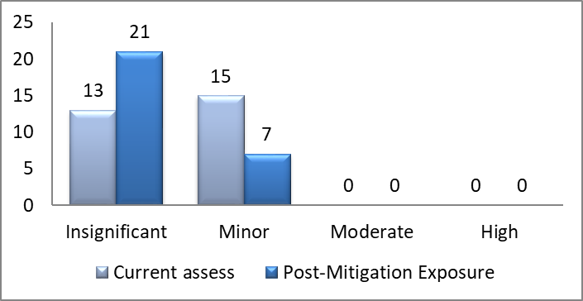
Cryo System Risk Registry
28 risks are actively being mitigated
Of 5 “Top Risks” shown in 2018
Top 2 (Maintenance time & Reduction in cooling power) downgraded from “Moderate” to “Minor” after experience in commissioning & running the I&T system
3rd “Grid Damage” retired as cryostat delivered to I&T
4th “Interference w/ Telescope” risk “accepted” as a commissioning risk, mitigated through “Pathfinder Operations”
5th “Dynalene leaks (score 8, minor) in UT” unchanged

Slide 27
CRYO Cost & Performance as of May 2019

Slide 28
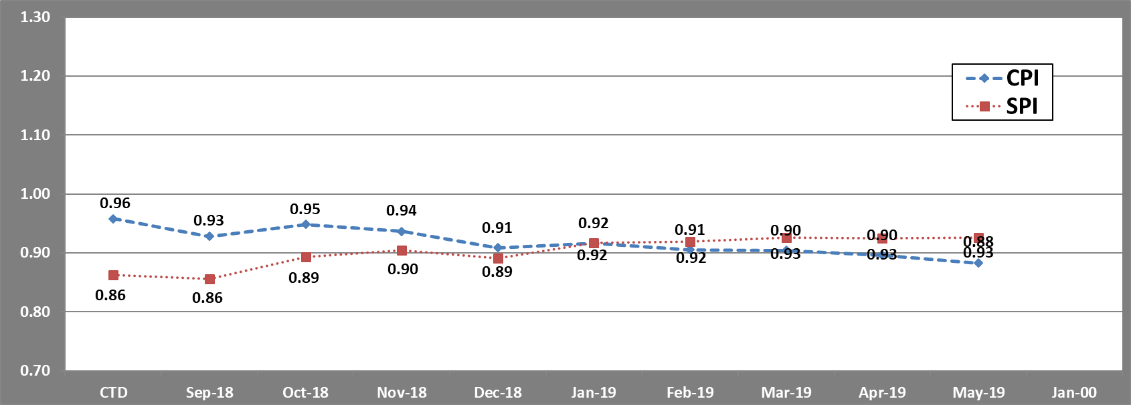
Schedule & Cost Metrics for
Refrigeration (3.06.04.06) & UT (3.06.05.02)
Cost and schedule dominated by extra labor required for assembly and test

Slide 29
Variance Analysis
Refrigeration system budgets and schedule have been over-running due to
Rework on vendor HX parts
Unbudgeted commissioning time
  Leak finding and leak repair at every step of system
    Brazed and fitted joints in each of 22 HX & compressor circuits (6*3+2*2)
    IR2 plumbing: 22 flexible lines x 2 ends plus many VCR joints for per line per end
  Recovery from wiring mistakes
  Lessons learned by commissioning the system
    Spread in RTD values used for PLC and CCS protection limits
    Rewiring heaters for more power
    Restart procedures to melt ice balls
    Improved oil monitoring and maintenance
Biggest risk to schedule is assembly of the TMA HX units and integration into UT
Availability of mechanical & electronic technical support for UT assembly a concern
More budget & maybe more schedule may be required

Slide 30
Estimate To Complete Status

Slide 31
CRYO 3.06.04 Schedule

Slide 32
3.06.05 UT Schedule

Slide 33
Major Milestones – A Historical Perspective
Actual Completion
~6-8 months after JSR18 Forecast
Milestones | Forecast Finish Date JSR18 | Actual or Forecast JSR19
3.06.04 Cryostat
COMP: IR2 Compressor Cabinets Ready for IR2 | 3-Jul-18 | 17-Jan-19
COMP: Long Lines for IR2 Installed | 19-Jun-18 | 15-Dec-18
COMP: IR2 HX System Ready | 24-Sep-18 | 15-Mar-19
COMP: Cryostat Chamber & I&T Refrigeration System Ready for Integration | 8-Nov-18 | 7-June-19
COMP: Chile Compressor System Ready for Pathfinder | 20-Nov-18 | 7-July-19
3.06.05 Utility Trunk
COMP: Cryostat Utility Trunk Ready for Integration | 25-Jul-19 | 1-Dec-19 (Forecast)

Slide 34
Summary

Slide 35
Summary
Cryostat pumps down with new power feedthrough cables
  (and HW from other systems: ETUs, MTRs, OTMs)
I&T Heat Exchanger and Refrigeration System Complete and Works as Designed
  8 Cooling circuits in 2 vacuum vessels and 8 compressor circuits in 4 cabinets
  Delivered design cooling power to cryo and cold plates at design temperatures with design stability when subjected to changes in heat load
  No major maintenance issues
TMA Compressor system finished & will be soon shipped to Chile
TMA HX Assembly just beginning at SLAC: expect completion in October 2019
  Poses greatest risk to schedule
UT Design complete
  All UT Structural and subsystem HW at SLAC or ordered
    Top end in design as of August 7, but will POs will be placed well before Aug 28
  Subsystem assembly in progress
  UT Structural Assembly to begin ~August 1
  Delivery to I&T with HX and Purge systems installed expected ~November 1

Slide 36
Supporting Material

Slide 37
Response to 2018 NSF/DOE Status Review
Increase oversight of the heat exchanger vendor for the remainder of the fabrication/testing period. Consider visiting the vendor as soon as possible to ensure the integrity and quality of the internal components prior to closing the vacuum vessel, as well as visiting immediately before shipment of the final assembly to ensure all QA/QC is completed properly. [Oct. 2018]
Visit on 2018-08-16 for I&T system
Weekly teleconference
Stop-Work for TMA HX issued Nov. 30, 2018
Modified drawing package prepared, reviewed, approved
Work Restarted May 1, 2019 after contract renegotiation with new SOW with strict assembly and test procedures
Site visit May 23, 2018
Inspection reports arrive May 26 and July 25
Cold Parts Parts arrive June 4 and Cryo Parts arrive August 1
Cold parts leak-tight and adequately clean

Slide 38
Supporting Documents
Key Documents & Reviews for the CRYO subsystem can be found at (contact the camera point of contact for access):
  https://confluence.slac.stanford.edu/pages/viewpage.action?pageId=257002743
This site contains:
  Project Documents
  Design and Allocated Baseline Documents
    Specifications
    ICDs
    Design Documents
  Cost and Schedule Baseline
  Design Reviews & Relevant Presentations
    Preliminary Design Review
    Other reviews
  Focused Topics

Slide 39
Cryostat Baseline Changes since JSR18
BCR-080: JUL18: Cryostat Power Feedthroughs ($134,000)
BCR-082: SEP18: Cryostat Power Feedthrough Cable ($60,000)
BCR-085: DEC18: Change of CAM for Cryostat & UT Control Accounts ($0)
BCR-088: MAR19: Cryostat Eden Contract Update ($41,000)

Slide 40
Backup Material

Slide 41
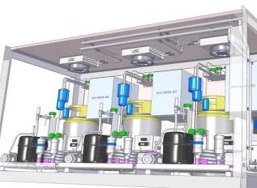
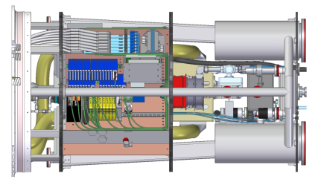
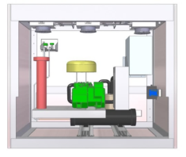
Cryostat System Scope [WBS 3.06.04/.05]
Cryostat system has three distinct elements, two of which are major integrating structures within camera as a whole.
Refrigeration Cryogenic & Cold Compressor
Chassis & Control Modules
(3.06.04)
Cryostat Body (3.06.04)
Utility Trunk (3.06.05)

Slide 42
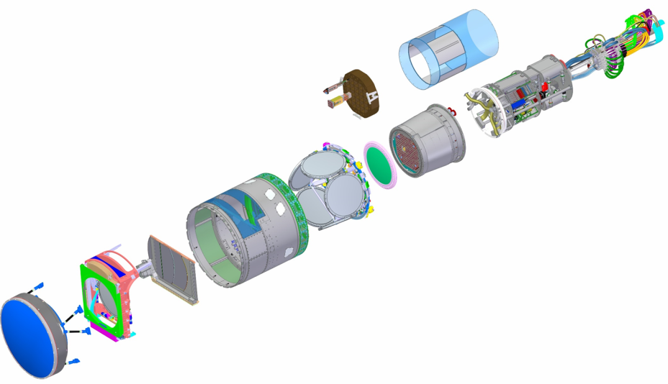
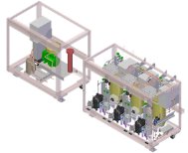

Cryostat Subsystem is responsible for three major camera components: the Cryostat, Utility Trunk & Refrigeration
Bulkhead and Cable Wrap
UT Shell
Corner Raft Tower
Science Raft Tower
Sensors
Camera Body
Housing
HeX & Vacuum
Shutter and Shutter
Assembly
Auxiliary Electronic
L1/L2
Assembly
Utility Trunk
Structure
Cryostat
Assembly
L3
Filter and Filter Changer
Assembly
On Camera & On Ground Refrigeration

Slide 43
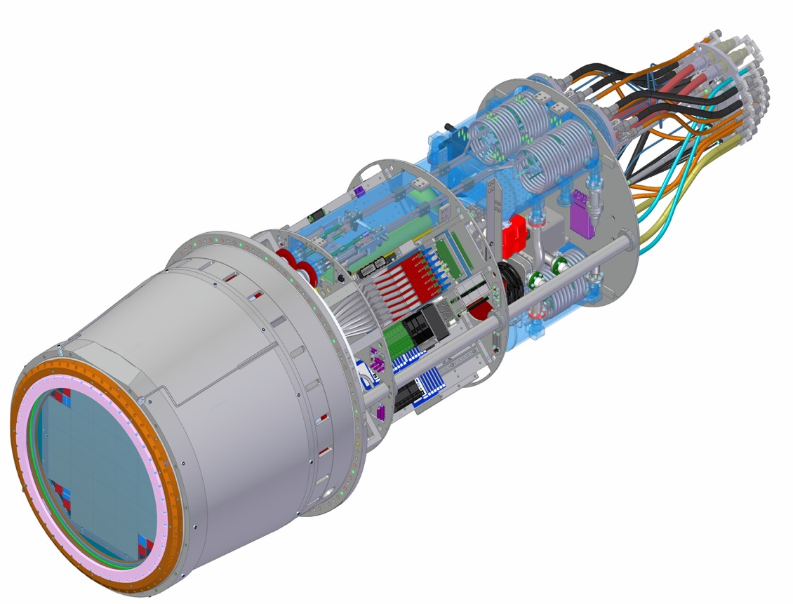
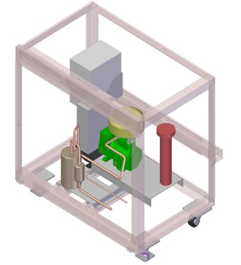
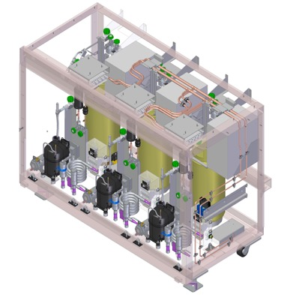
Cryostat System Scope [WBS 3.06.04/.05]
Cryo and Cold On-Telescope Heat Exchangers in integrated Utility Trunk vacuum chambers
Utility Trunk Mechanical Structure
Loaded quad box integrated into Utility Trunk (extension cables removed)
Loaded and Tested Compressor Cabinets, 2 x Cryo and 2 x Cold
Fully loaded and tested cryostat assembly
L3 assembly

Slide 44
Cryostat Vacuum Verification Testing and
Refrigeration Verification / I&T Testing on BOT
LOADED CRYOSTAT VACUUM VERIFICATION
I&T REFRIGERATION VERIFICATION AND BOT TESTING
Valved Off
Cryo & Cold
HeX
I&T HeX Vac
Canisters
Pretested Pump Plate
Cryostat Shrouds Not Shown
Refrig. Vac
Pumps
Cryostat
Support
Ring
Cryostat
Support
Ring
Cold
Plate +
Dummy
Loads
Cold Plate + Dummy
Loads
Cryo
Plate
Cryo Plate
Cryostat
Body
Raft
Towers
Cryostat
Assembly
Stand
Transfer
Lines
Cryostat
Body
GRID
Blankoff
Transfer
Lines
BOT (Bench for Optical Testing
Window
Cold &
Cryo
Maintenance
Compressor
Cabinets
Cold &
Cryo
Maintenance
Compressor
Cabinets
Umbilical
Lines
Umbilical
Lines
Near Term Goal: Verify Vacuum System With Fully Integrated Cryostat on Assembly Stand, Move to BOT and Install / Verify I&T Refrigeration System and Handoff to I&T

Slide 45
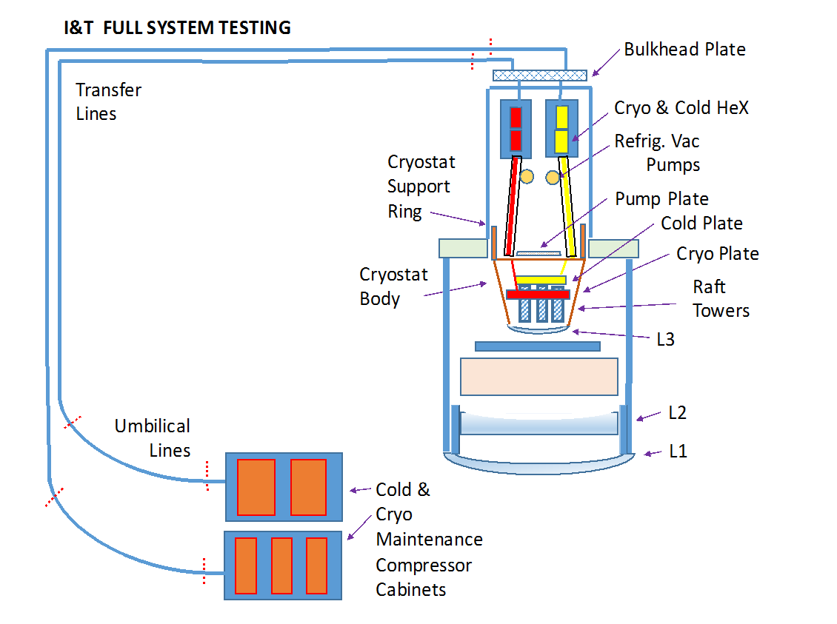
I&T Final Integrated Testing of Camera with Telescope Mount Assembly (TMA) Style “Dogleg” HeX in Utility Trunk

Slide 46
Pathfinder Commissioning of TMA Refrigeration Transfer Line System & TMA Compressor System. Final Complete Integrated TMA System

Slide 47
Highlights and Changes Since 2017 Review
Personnel and Staffing Changes
  Lost Cryostat Chief Engineer in Dec. 2017 and replaced by John Ku
    Has worked on Camera since 2009 with recent emphasis on mechanical assembly & testing of cryostat
  Lost Sr. Staff Scientist in Mar. 2018 coordinating design & implementation of cryostat vacuum & refrigeration instrumentation, misc. auxiliary electronics, protection system, etc.
    Work has been divided up amongst a number of staff in the Cryostat and Electronics group.

Slide 48
Highlights and Changes Since 2017 Review
Technical Highlights – Cryostat
  All Cryostat hardware received, and dry fitups/metrology complete.
  The Pump Plate now fully populated and standalone tested. Two gauges and a gate valve will need replaced.
  Cryostat leak checking (Incl. feedthrough flange welds & pump-outs & Feedthrus) completed.
  Pump Plate cables complete and electronics complete for vacuum system software development/test.
  Grid cleaned and Invar Raft holdowns integrated to final alignment locations.
  The Cryo and Cold plates have been, fabricated, tested, instrumented (Htr+RTD), mated, and shielded.
  Final integration of Cryostat began in May ’18
  Final cryo-feedthru welds to feedthrough flange completed and leak tested ,
  The Cryostat Housing is being integrated with all internal components [Grid, Cryostraps, Cryo/Cold Plate, Support ring, Flexures, Shrouds, misc RTD]
    Mating to pre-tested - integrated Pump-Plate, final leak check
Technical Highlights - Refrigeration
  All Refrigeration system reviews (incl. MRR’s) completed for I&T and TMA Systems.
  Cryo R&D completed Oct. 2017, Cold R&D completed Nov 2017 - systems have met all requirements.
  Compressor chassis 1st article approved - 14 chassis under fabrication at MMR.
  HeX contracts released - 20 HeX under fabrication at EDEN, [8 I&T, 8 TMA and 4 Pathfinder]
  HeX vacuum vessels contracted and the two I&T delivered (total 2xI&T + 2xTMA + 1xPF versions)
  Compressor cabinets design complete, and initial four for I&T under fabrication
  Misc support hardware for I&T fabricated [refrigerant, transfer lines, pumps, power supplies, etc]
Technical Highlights Utility Trunk
  Completed FDR review
  First Quad box for I&T completed
  80% of auxiliary electronics are loaded.

Slide 49
Technical Status - Cryostat

Slide 50

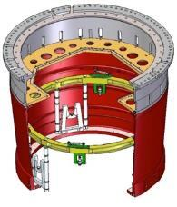


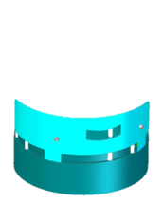


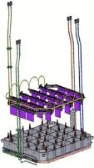


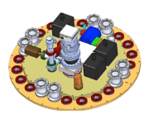





Cryostat Body Subsystem Components
Cryoplate Assembly
Feedthrough Plate, Pump Plate and Vacuum Pump/Valve/VQM Assembly
Housing, Feedthrough Plate, Support Cylinder, Cryoplate Support Ring & Cryo Flexures
Cryo & Cold Shrouds
Grid, Holddowns, Flexures & CryoStrap Assembly
Cryo Feedthrough & Bellows
Coldplate Assembly

Slide 51
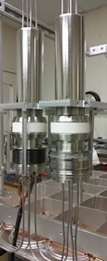
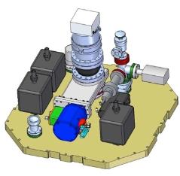
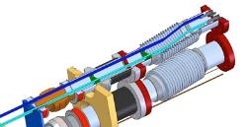
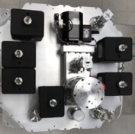
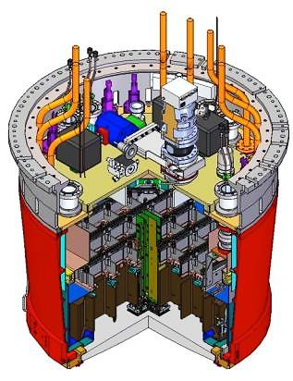
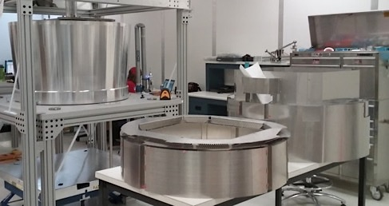
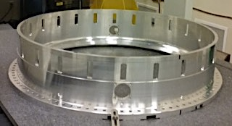
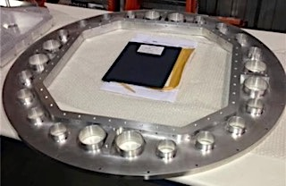





Cryostat Structure
Cryo
Feedthroughs
(3.06.04.03)
Backend pump plate
(3.06.05.04.01)
The majority of the Cryostat hardware is now assembled and tested
Support / Mount Ring
(3.06.04.02.01)
Cryostat Housing
Cryo Shroud
and Cold Shroud
Cryo & Coldplate
Support Ring
& Flexures
Feedthrough Flange
(3.06.04.05.01)
Focal Plane RSA
HB-CeSic Grid and Ti Flexures
(3.06.04.04)
L3 & L3 Flange
Raft Tower Module
Cryo Plate
(3.06.04.03)
Cold Plate
(3.06.04.03)
Cold Plate Shrouds

Slide 52



Grid Status
Grid Repair in late 2016 successful.
Grid Delivered to SLAC early 2017 -- Full metrology completed.
Grid Cleaned for UHV
  Resolved problem of residue on surfaces from grinding and first cleaning
ISM lugs clamped/epoxied in place in Grid.
Invar RSA hold downs machined, cleaned & re-positioned and final metrology completed
Grid ready for Integration with Flexures, Support Ring & Shrouds; added 8 RTD to measure temps in Cryostat
Faro Arm
Positioning
Grid
Flexure
Hold downs
Lug

Slide 53



Cryostat Housing Status
Support
Cyl.
Forged aluminum body, pump plate, support cylinder and feedthrough flange received from vendor, leak checked and measured for critical features.
Forging was electropolished & cleaned for UHV, and key-inserts installed
Support
Cylinder
Feedthru
Flange
Cryostat
Body

Slide 54


Pump Plate And Feedthrough Flange Status
Both plates electropolished
Hardware cleaned and Al-SST transitions welded on and re-cleaned for UHV.
Pump plate welds pre- leak checked on vacuum storage chamber.
Feedthru flange welds leak checked using cryostat body, L3 blankoff and the populated pump plate.
Feedthrough Plate Underside
Pump
Plate
Underside
6x Ion Pumps and
Instrumentation
Ports
Turbo Pump
Port
Cryo Feedthrough Ports
Instrumentation
& Signal Ports

Slide 55


Assembly / Test of Pump Plate
Pump Plate Assembled onto small aluminum vacuum “storage” chamber
Al-SS welds & double O-ring leak checked
Added pumps, valves & instrumentation
Pumped down to< 5x10⁻⁷ Torr/leak check
Transfer for feedthrough flange leak check
Handover to CCS debugging controls & vacuum Protection System – done 5/30
Cold Cathode Gauge
Gate Valve
Turbo Pump
250 l/sec
RGA
Burst Disc
6 Ion Pumps (20 l/sec)
System under test in Clean Room
Top View of Pump Plate

Slide 56




Leak Check of All Feedthrough Flange Welds
System pumped down warm to 3.3x10⁻⁷ Torr
Clean Cryostat Body
With O-Rings
Feedthrough
Flange Mounted
To Body
Cryo Feedthru
Ports
Raft Signal & Power Feedthrough Ports
Empty Cryostat Mated to Pump Plate
For Final Leak Checking of Welds
Cryo Heater & RTD
Port
Cryo Heater & RTD
Port
Aluminum
To SST
Transitions

Slide 57


Pumpdown of Empty Cryostat + Instrumentation Feedthru & Cables
Leak checked system under Turbo Pump and Ion Pumps goes to 3x10-7 Torr after 67 hrs.
Pressure (Torr)
System Configuration under test in clean room (no cryo bellows attached)
Time
Pump down (Turbo and Ion Pumps) for 67 hrs

Slide 58

Cryoplate and Coldplate Status
Through Early 2018
  All hardware fabrication completed.
  Dry assembly and metrology complete.
  Evaporator tubes bent and fit to plate
  Cleaned & furnace braze completed.
  Re-check flatness, leak and flow test
  Completed welding and leak checking of 16 VCR fittings to evaporator ends – these mate to the HeX in Utility Trunk
  Completed welding/leak chk of 4 seal plates thru cryo-feedthru bellows & ceramic breaks.
  Add cryo-straps, and instrument with heaters and RTD’s. Add cold/cryo – shrouds.
Final Assembly Steps (May / June 2018)
  Mate Cryo/cold plate, cold shrouds & set onto Support Ring/columns/cryo- flexure, base cryo shrouds.
  Weld cryo feedthroughs into Feedthrough Flange and leak check.
  Mate cryo straps to Grid. Add outer shrouds. Integrate into Cryostat housing.
  Make final bends on 16 evaporator tubes
Evaporator Tubes
Ceramic Break
Cryoplate
Bellows

Slide 59



Cryoplate Dry Fit – Before Furnace Brazing
Cryoplate on
Assembly
Stand
0.116” ID
0.020” Wall
Stainless Steel
Tubing

Slide 60


Coldplate bars & braze plate.
Thin walled tube bending
Initial problems with bending thin walled 0.012” tubing – creased at sharp bends
Tested and used custom 0.016” which bends satisfactorily
Cold Bars on assembly & braze plate fixture

Slide 61


Cold Plate Assembled With Cryo-Feedthrough Bellows and Ceramic Break

Slide 62




Assembling Cryostraps and RTD onto Cryoplate
Cryo Straps = 5 cu foil leaves, 2 per Grid bay. Invar plate attaches to Grid
Final assembly with 36 heaters on Cryoplate
20 RTD packages attach under one Cryo strap in each bay.

Slide 63

Cryoplate With Ceramic Break, Feedthrough Bellows, Heaters and RTDs on Front Face
Following DC power supply noise measurements, we had to go back and ground shield all the heater/RTD cables
Evaporator Tubes
Bellows and Ceramic Break
Cryo Straps = 5 copper foils leafs, 2/Grid bay
36 Ceramic heaters (White Wires)
20 RTD packages attach under the Cryostrap. (Kapton Wire)

Slide 64

Cryo and Cold Plates Mated May 19th 2018
Cryo & Cold FT
Ceramic Breaks
Back of ColdPlate
Cryo Support Flexure
Cryo Shroud Front Face
Heater and RTD Cables
(now shielded)
Cryoplate
Cryo Straps

Slide 65

Cryo and Cold Plate Mated
Ceramic Breaks
Bellows
Coldplate Bars
Coldplate
Isolating
Supports
Cryoplate
Stiffening
Ribs
Cold Plate
Shrouds
Coldplate
Heaters

Slide 66





Detail of Cryo-Feedthrough & Evaporator Interconnect
Heat Exchanger
Vacuum Chamber
Refer Interconnect
VCR fittings
Non-metallic
Spacers
Final Weld
Al Weld
Strain Relief bends
SST-AL
transitions
Added strain relief hat above seal plate
Seal Plate
Evaporator
Tubing
Refer Lines
Isolation
Ceramics
Conflat
Pair
Conflat
Pair
Leak Check
Outer SST
Standoff Tube
Temporary
Restraint
Feedthrough
Flange
Ceramic
Isolator
Bellows
Cryo-cold plate
Interconnect
Bellows Assembly

Slide 67


Final assembly of the Cryoplate in the Cryostat
16X VCR weld or braze
4X GTAW cryo feedthrough to seal plate
4X vacuum leak check
Install feed thru plate
  Support by cryostat mandrel
4X GTAW weld feedthru tube to conflat.
4X vacuum leak check
16X final bend of evaporator tubes.
VCR
VCR
Bends
Feedthrough Plate
GTAW
Ceramic
Bellows
GTAW
Seal Plate

Slide 68

Preparation for Final Cryo Feedthrough Welds to Pre-Leak Checked Feedthrough Flange
Feedthrough Flange On Stand
Cryo Feedthrough
Support Ring to
Cryostat Body
Support Ring
Cryo Flexures

Slide 69





Final Cryo Feedthrough Welds To Flange Leak Checked and Tested For Electrical Isolation
Prep For Welding
Welding
Bellows Post Weld
Leak Check
Cryo Coldplate Isolation Tests

Slide 70



Complete Connectorization of RTD and Heaters and Mate Cryo/Coldplate To Grid
GRID Ready For Mating
Instrumentation Feedthroughs
PEEK Connectors on Cryoshroud
Cryoplate Ring Support Columns

Slide 71


Cable Tray Installation
Cable Tray

Slide 72



Mating of Grid To Cryo Plate
Pre-Attach Raft
Holdown
screws in
each bay
RTM load hardware is installed. shrinking tubing are there to aid in mating the cryo and grid assemblies

Slide 73





Grid and Cryoplate Integration

Slide 74




Shrouds Status
All hardware received and metrology completed
Dry assembly of shrouds completed and metrology completed as assemblies
Verified fits & positions during cryostat dry fitup
Electro-polished, UHV cleaned & Nickel plated.
  Some rework required due to vendor handling
Appropriate surfaces blackened to reduce reflectivity
Coldplate shrouds assembled onto cold plate.
Coldplate Shrouds
Unplated Picture Frame
Shroud During Test Assembly
Blackened Picture Frame
Shroud
Unplated Cryo Shroud

Slide 75




Shrouds Installation
Shroud Assembly

Slide 76




Housing and Cryo Coldplate Grid Integration
Housing Integration

Slide 77



Housing installation and Fit Check
View Through Pump Plate
View From L3

Slide 78
To Complete Cryostat and Deliver To I&T
ELECTRICAL
  Connectorize the Feed through cables
  Build AUX cold plate heaters – in progress
  Install aux heaters (after June delivery to I&T)
  Crimp aux heaters to FT cable
ASSEMBLY
  Install rest of shrouds - Done
  Do grounding and isolation tests - Done
  Cryo/cold plate mate to the Grid - Done
  Check position of Grid to Cryo/cold (faro arm) - Done
  Install housing – Done
  Attach Grid flexures and front float shroud - Done
  Attach the front seal plate - Done
  Remove temporary support mandrel - Done
  Attach the balance of the shrouds -- Done
  Connect the lateral supports from cryo support ring to housing – Done
  Make final bend on evaporator tubes
  Weigh cryostat
  Double bag cryostat
  Move to IR-2 (if paperwork issues do not stop us)
  Attach pump plate
  Pump down
  Deliver to I&T (should be < 1.e-6 Torr by then, i.e. into the -7 scale)

Slide 79
Technical Status - Refrigeration

Slide 80


Cryo & Cold Refrigeration Scope Consists of Ground Based Compressors with HeX’s in Vacuum Canisters in UT & BOT
  Telescope Provides for TMA & Maintenance Facility:
  Power and cooling (Dynalene) for compressors.
  High pressure vapor & liquid supply lines & low pressure suction return lines traversing telescope (rigid)
  Flexible polyamide lines at telescope and camera articulations.
  Isolation valves and transducers on top end
  Compressors in temp controlled cabinets located on TMA & below the Maintenance facility.
  Isolation valves
  Control electronics
  Charge/Surge Tanks
  Filter & Drier Panel
  Recovery / circulation pumps.
  Vac/ N2 purge system
  Cryo and Cold HeX’s in UT vacuum chamber.
  HeX Vacuum can with access via rear 10” Conflats
  Vacuum pumps/valves
  Interface Plate
  Cryoplate

Slide 81


Cryogenic & Cold refrigerators developed to cool the focal plane & readout electronics
Cryo-refrigerator System
  6X parallel circuits of refrigerators utilizing mixed refrigerants (MIX 2919C)
  Nominal ~90W/circuit with setpoint between at -125°C and -135 °C at Cryoplate
  Compressor chassis include compressor, condenser, oil separation, refrigerant phase separation, oil-heaters, and desiccation. Monitoring and protection instrumentation.
  ~60m supply and return lines link the compressors to the camera
  2 supply lines (liquid & vapor) and 1 suction return line. Rigid SS & flexible polyamide line.
  Counter-flow heat exchangers & expansion capillaries in the Utility Trunk, or on I&T assembly fixture (BOT). Monitoring instrumentation.
  Evaporator tubes embedded in cryoplate
Compressor chassis with Control Module
Surge
Tank

Slide 82

Cold refrigeration system utilizes conventional R507a Refrigerant
Cold-refrigerators System
  2 circuits to meet Coldplate cooling requirement.
  Nominal ~540W/circuit, with setpoint between -30°C and -40°C
  Conventional vapor compression refrigeration.
  Employs R507A - a two component azeotropic refrigerant mixture
  Single supply line (liquid), single return line (vapor)
  Heat exchanger in UT or I&T assembly stand (BOT) and monitoring/protection instrumentation.
  Following Thermal Expansion Valve and capillary tube, cold low pressure liquid is supplied to evaporator tubes embedded in the bars of coldplate .
Not shown-Oil Separator &
Level Control

Slide 83
Overview of Status & Reviews Since Last Status Review
Descope System in 3-2017, implies construction of only 2 complete refrigeration systems:
  One for the cryo/coldplate verification and camera I&T, [I&T System]
  One for the camera when it is on the telescope [TMA System]
  The I&T System will eventually move to the Summit Maintenance Facility,
  in lieu of fabbing 3rd separate system
  Refrigeration R&D in BLD 750 ended in October 2017 as planned
    Only remaining issue will be test of R404A compressor – for TMA. will utilize the I&T system
  A separate Pathfinder System will be used for commissioning the TMA System – will take advantage of significant overlap in hardware during procurements
There have been four dedicated Cryostat Refrigeration Subsystem reviews since the 2016 DOE/NSF Status Review
  Refrigeration System PDR, November 2016
  I&T System Final Design Review, May 2017
  I&T Heat Exchanger Procurement Review, July 2017
  Summit Refrigeration System Final Design Review (October 2017)
    Followed by several Manufacturing Readiness Reviews
Focus now is on procurement, assembly and testing of all components with emphasis on what is needed for the I&T and the Pathfinder

Slide 84
Summary of Where Refrigeration Hardware Goes
I&T COMPRESSOR
CABINETS ASSEMBLY @ SLAC) R134A COMPRESSORS
INSTALL IN I&T WITH LOCAL I&T
POWER & COOLING
INSTALL IN MECH. RM BELOW MAINT FACILITY
CONNECT TO INSTALLED POWER & COOLING & NETWORK UTILITIES
USE FOR UT I&T & TESTING
SHIP TO CHILE
I&T
CUSTOM I&T HEX &
VAC HOUSING
INSTALL ON CRYOSTAT FOR
INTEGRATION
SHIP TO CHILE
STORE FOR USE FOR CRYOSTAT MAINTENACE
MISC HARDWARE INCL.
CHROMATOGRAPH & REFRIG PUMPS, VAC PUMPS, ETC
SHIP 50Hz COMPATABLE EQUIP TO CHILE
STORE FOR USE IN CRYOSTAT
MAINTENANCE
USE IN I&T WITH
CUSTOM HEX SYSTEM
50Hz REFRIG PUMPS, VAC PUMPS, ETC
TMA COMPRESSOR
CABINETS ASSEMBLED
@SLAC R404A
COMPRESSORS
CONNECT TO PRE-INSTALLED POWER, COOLING, NETWORK UTILITIES & PRE EXISTING XFER LINES
SHIP TO CHILE
TMA
INSTALL & TEST IN
UT TRUNK IN I&T
SHIP TO CHILE
WITH UT TRUNK
RECOMMISSION
IN SUMMIT MAINTENANCE
FACILITY
UT TRUNK HEX
MISC DEDICATED 50Hz HARDWARE INCL. REFRIG. PUMPS, VAC PUMPS, LEAK CHECKERS…
SHIP TO CHILE
FOR PATHFINDER
USE FOR TMA SYSTEM. SERVICING

Slide 85
Progress and Status in Cryo R&D Programs Since Last Status Review
The Subscale Cryo system ran continuously from Dec. 2016 thu October 2017.
  Determined operational parameters for compressor: power, pressure, temp.
  Critical operational observations determine future course:
    Monitoring & commercial testing of POE oil during extended running shows slow degradation of Danfoss R134a compressor (running > 7000hrs. now)
    Will use this compressor for I&T system only & test a more robust Danfoss R404a compressor for TMA system. Same footprints allow interchangeability
  Final test in Oct 2017 with new evaporator very close to actual Cryoplate was completed (used larger ID SST tubing & 25kg mass).
    Current capacity > 100W @-130⁰C @ 30⁰C amb. temp. exceeds required capacity of the system at the extreme operating conditions.
    Established methodology for rapidly adjusting the initial 2919C mixed refrigerant composition depending on geometry
    A test of the cold restarting of the system was successful
    Allowed sizing of C4 capillary before I&T HeX fab

Slide 86
Progress and Status in Cryo R&D Programs Since Last Status Review
  Extensive coordination on TMA/Facility Interface now captured in updated LSE-64 and LSE-65
    Move of compressors to TMA and Machine room approved
    All plumbing routing, valves, pumpouts & utility interfaces specified for TMA and Maintenance systems
    Fabrication and assembly of environmentally controlled compressor cabinets has begun -
      These are required for operation on TMA
      Interface to TMA plumbing and to the I&T Clean Room completed
    Re-design and test of compressor cooling jacket completed to accommodate Dynalene flow rates available at Summit Facility
      MMR has fabricated and attached new jackets to the I&T compressors following demonstration of required flow rates
      MMR has also fabricated two R404A style jackets and attached them for tests in I&T

Slide 87


Slide 88

Load Capacity vs Setpoint Temperature With Final Evaporator (Ambient Temp~20⁰C)
Load Capacity (Watts)
These measurements done at 20⁰C ambient.
A gain or loss of ~1 Watt/⁰C capacity with change in ambient temperature is typically observed in the range ~10⁰C to ~30⁰C with insulated lines in Bld 750.
Setpoint Temperature

Slide 89
Cold Restart Tests (at -130 ⁰C) – Allows Routine Maintenance to be Conducted Without Impact
# Hours System Shutoff
4 Hr
3 Hr
2 Hr
1 Hr
Load Power
(no parasitic)
Setpoint
-130⁰C
Setpoint temperature degC
Load Power (add 12W Parasitic)
Setpoint
-135⁰C

Slide 90
Progress and Status of Cold R&D Program Since Last Status Review
  Cold system was run a few months longer to the end of 2017 to verify all requirements were met and correct some operational issues.
  Development of Cold system is complete, meeting thermal budget req.
  Study effects of ambient and liquid line temperatures.
    Raised temp of liquid line ~15 C → ~25 C to minimize heat absorption from the ambient air along the 200 ft transfer line.
  Introduced commercial thermal expansion valve (TXV) to mitigate cold return line temperature during extreme load conditions.
    Allows Return line temp. to remain positive when load reduced from 100% to 40% load.
    Final R&D established model and sizing of valve and orifice, fabrication procedure and test procedure before inatallation.
  Simulated the elevation & drapes in the TMA configuration
    Introduced additional flow restrictor at the outlet of the TXV to eliminate instabilities due to sensitivity to refrigerant phase composition.

Slide 91

Example: Performance of Cold System
Power (Watts)
Temperature (Deg C) or Pressures (PSI)
Return Temperature
Load Power
(Green Curve)
Evap Coil In Temp
Evap Coil Out Temp

Slide 92
Remaining Refrigeration Verification Work During Cryoplate & Coldplate testing in I&T
  Test of Danfoss R404a compressor in one of the 6 cryo circuits for I&T
  This is the compressor we would use for the TMA system
  One of six compressors installed in I&T would be the R404a compressor
  Should give us equivalent performance with longer lifetime.
  The first of two units has been tested by the compressor chassis vendor (MMR) and yielded comparable cooling performance in their lab.
  Test of larger compressor for the cold system
    This would give us higher refrigerant flow and more headroom
    Would use this in the TMA system

Slide 93





Status of Cryo/Cold HeX and HeX Vac Canisters
Utility Trunk HeX Vacuum Cans are too tall for Summit Facility Clean Room.
The I&T refrigeration system must accommodate both the I&T clean room and the Summit Maintenance Facility clean room.
Cryostat Interface to Heat Exchangers
HX Vacuum Can Isometric View
Top View
Bottom View
93

Slide 94



Shorter vacuum canister & HeX’s needed to test Cryo/Cold plates on the BOT, to use for I&T, and then at the Summit Facility
Cryostat
Support Ring
Plumbing
Connections
I&T Cryo/Cryo HX
I&T Cold/Cryo HX
Vacuum &
Instrumentation
Upper Cryo HX
HeX on BOT
Upper Cold HX
Lower Cryo HX
The Pathfinder Will Use Same Design as I&T for
HeX and Canister
Lower Cold HX
ThermoStatic
Exp. Valves
Electrical Breaks

Slide 95


Heat Exchangers are each unique: left & right handed, top & bottom, short & dog-legged.
Utility Trunk
I&T System
Pair of Cold System
HeX’s in
Utility
Trunk
Shorter
Non-Dog-leg
Design
for I&T with Vacuum Canister
Capillaries are Inside
Thermostatic
Expansion
Valve+Orifice
Pair of Dog-Leg Cryo HeXs in Utility Trunk
Final
Cold System Routing
C3 Liquid
capillary
C4 Vapor capillary
Termination to Cryostat Cryofeedthru is Identical
Capillaries
attached with
VCR
Capillaries brazed to HeX

Slide 96


Examples: Short Upper/Lower Cryo HeX for I&T
CRYO UPPER HEAT EXCHANGER
CRYO LOWER HEAT EXCHANGER
C3 CAPILLARY
MAIN BODY ASSY
C3 CAPILLARY
MAIN BODY ASSY
C4 CAPILLARY
C4 CAPILLARY
(COIL NOT VISIBLE)

Slide 97





I&T COLD Heat Exchanger Main Components
Upper Cold Heat Exchanger
Lower Cold Heat Exchanger (Up-Side down)
Equalizer Line
Return Line
Refrigerant line to ThermoStatic
Valve port
Main HX Assy without
ThermoStatic Valve
Main HX assy without
ThermoStatic Valve
ThermoStatic Valve with
Capillary Sub-Assy attached
To main HX body
Return Line
Equalizer Line
Refrigerant Line to
ThermoStatic Valve
port
ThermoStatic Valve with
Capillary sub-assy
attached to main HX body

Slide 98

I&T Heat Exchanger Assembly Features
Example: Assembly of 2 cryo and 2 cold heat exchangers (the 2nd canister has two cryo)
Expansion capillaries have
removable on couplings for I&T
(brazed for TMA system)
RTD Platinum resistance
thermometers measure
pre and post expansion
Cold thermal expansion valve- one moving part, 15 yr life
VCR coupling
alu top plate
Silphos
field braze
Stainless
weld
alu/ss
transition
RTD temp
sensor
feedthru
Cryo HX
Cold HX
C4 expansion
capillary coil
ceramic
break
Cold expansion
valve
subassembly field brazes
field welds

Slide 99








Status of HeX Design and Procurement Strategy, Assembly Sequence
The HeX for I&T, TMA and Pathfinder have completed final design and manufacturing readiness reviews
  Procurement was bid and awarded to Eden Cryogenics in December 2018. Final drawings have been provided to vendor for all variations.
  Delivery time longer than desired (June 21 & 27, 2018) but we have worked with them to try to coordinate their production sequencing to expedite the I&T units.
  SLAC is separately procuring manufacture of some of the small piece parts.
  SLAC provided Eden necessary equipment & procedures to verify flow rates.
  The fabrication of the HeX is in the risk registry as a key risk. We have had one vendor visit and we have instituted weekly reporting and meetings with the vendor
Brazing and flow rate measurements starts on the week of June 11th
Capillary winding and assembly
TXV
Misc tubing bends
First 7 Tube HeX after
primary winding was completed at Eden.

Slide 100

Vacuum Canister Design for I&T Completed
Vacuum Vessel & Structural Analysis Completed
Flat plates 6061 Alu.
Rolled plate 5052 Alu.
Assembly ~100lbs
O-ring sealed
.5 inch thk top plate
Alu/SS
transition
Internal support
plates welded in
Rolled 5052
Alu shell
Cu gasketed
SS/Alu vac transition flanges
Full penetration
welds

Slide 101

HeX Installation Supports, Fixturing / Assembly Sequence into Vacuum Canister is Completed (see Backup Slides)
Vacuum Instrumentation, Burst disk, and Pump Ports
Refrigerant Lines
Inlets and Outlets
G-10 Supports
Vacuum Can
Top flange contains Thermal Instrumentation Feedthroughs (not shown). Vacuum provided by off-the-shelf Pfeiffer pump carts with turbo pump & oil-less diaphragm backing pump.

Slide 102




Status of HeX Vac Housing Design, Procurement, and Assembly Sequence
  Design of the I&T and TMA vacuum canisters and supports are complete. A vacuum vessel and structural analysis has been done. Drawings for I&T version have been released and contract awarded to local fabricator (Altaire).
    The two I&T Canisters were delivered in May and dimensionally checked.
    Await the delivery of HeX’s for final assembly and welding to the lid
Vacuum pumps and instrumentation is all off-the-shelf and has been order/delivered
The detailed sequence & tooling for assembly into the vacuum canister for the I&T and TMA system is complete – see slides in “Backup Slides Section”.

Slide 103


Status of Compressor Chassis Design & Procurement
Cryo compressor
1kW running, 1.4kW start
50 kg
6 units in 2 cabinets per system
Custom design/assembly by MMR
Cold compressor
0.5 kW running, 1kW start
130 kg
2 units in 2 cabinets per system
Customized Off-The-Shelf

Slide 104









Cryo Compressor Chassis
Each Cryo Compressor Cabinet contains 3 removable cryo compressor chassis with refrigerant block valves and electrical interconnect box

Slide 105






Cryo Compressor Chassis SOW’s For MMR Contains
1
20.14 in
to base
17
2
16
3
15
4
14
5
14
6
12.93 in
to base
13
7
8
9
12
Layout of Chassis
10
11
Refrigerant and Cooling Flow
1
9
2
8
3
4
5
7
6
Dual Water Jackets
Power and Instrumentation Interface

Slide 106
Status of Cryo-Compressor Chassis Design and Procurement
  The Cryo - Compressor chassis contracts were, and are being fabricated & tested by vendor [MMR]. They have built all units for SLAC Development program.
  The contracts include
    Production of all 14 dual-circuit cooling jackets required for TMA and I&T, once design validated
    Production of six I&T units with R134a 26cc Danfoss compressor we have been using
    Production and test of prototype 26cc Danfoss R404a compressor chassis
      This compressor has same footprint but should have longer lifetime.
      If successful, one more compressor chassis will be built with this compressor for verification in I&T
    Production of six TMA units with either R134a or R404a pending aforementioned tests in I&T
    Production of Mixed Refrigerant Mix2919C for I&T
    All the compressors – the longest lead time items - are already at SLAC
  Current Status
    All dual cooling jackets for compressors have been fabricated and flow tested
    Jackets & Oil Reservoirs have been attached to the six I&T R134a compressors
    MMR began procurement of parts and fabrication of 12 chassis
    First article chassis was approved in May 2018
    Fabrication of balance is proceeding, with the I&T compressors installed in 6 chassis and TMA compressors installation pending decision.
    Six tanks of Refrigerant Mix 2919C delivered to SLAC

Slide 107







Cryo Compressor Chassis Assembly Line at MMR

Slide 108



First Article Cryo Compressor Chassis Approved in May 2018
Block Valves
Electronics Interface
R134a Compressor
With Water Jacket
Oil Reservoir With
Level Gauge
Oil and Phase
Separators

Slide 109

Compressor Control Box
The compressor control, monitoring and protection system for each compressor is handled by its Compressor Control box.
One box is paired with each compressor chassis (cold and cryo) in the Compressor Cabinet and communicates via ethernet connection to a single HCU and to CCS.
Prototypes for Cryo and Cold systems have been completed and tested and we are currently starting to fabricate the 12 production units for delivery by Aug./Sept. 2018
Off the shelf components in a DIN rail architecture.
Reads Thermocouples, Pressure, Voltage and Current Transducers inside the Compressor chassis and the Compressor Cabinet

Slide 110


Status of Cold-Compressor Chassis Design/Procurement Strategy
  The Cold - Compressor chassis is a custom-design by vendor [Trenton Refrigeration] that specializes in building refrigeration products for the refrigeration industry.
  All components are off-the-shelf with delivery lead time ~30 days
  Two units for I&T have been delivered and inspected at SLAC
    A minor manufacturing error with the flow direction through the Oil Separator was found during incoming inspection and corrected.
  2 additional units for TMA will be ordered in August following I&T tests

Slide 111


Status of Environmentally Controlled Compressor Cabinets
Original compressor location
was in a remote Utility Room
Compressors were moved onto
Telescope Mount Assembly
under the mirror cell
Cabinets needed to meet Dome environmental requirements – match Dome temperature
Compressor Cabinets rotate
with Telescope to avoid
azimuth drape and long
refrigerant lines.
Cabinets for Maintenance Facility located just below it, in a dedicated room.
One common Cabinet design
for On-Telescope as well as testing
in SLAC I&T and later in Maintenance Facility.
Cabinets supported
from TMA truss & deck joist I beams

Slide 112

Example: Cryo Compressor Cabinet Layout
Refrigerant line
Block valves
Cabinet cooling
Fan/radiators
Electrical controls
box
Filter/dryers
Suction reservoirs
Ethernet Switch
Compressor chassis

Slide 113








Compressor Cabinet Assembly

Slide 114

Compressor Cabinet Structure
Cabinet frame – 3”x ¼ alu. welded angle
Cabinet panels – 1” foam core
sandwich, 1 mm alu. Facings
screwed and glued
Removable Front carries no loads
3 compressor chassis (100 lbs ea.)
rest on front ledge
Main structural loads carried by
front upper and lower
box beams
¼ alu plate reinforced panel mounts
upper box beam
lower box beam

Slide 115
Status of Design/Procurement Strategy of Compressor Cabinets
Layout of each type of cabinet is complete.
Structural & thermal analysis complete
  Still needs final seismic analysis for the TMA units
Detailed CAD models & drawings complete
  Provided the compressor chassis mount, and the location of valves & access, so procurement and fabrication of compressor chassis could start.
  Also provides detailed interface to the IR2 Clean Room and to the TMA plumbing and electrical / communications interconnects
The cabinet panels have been procured and sent out for machining of cutouts.
All internal elements that will populate the cabinets are being procured or are in – house now.
Cabinet structural assembly and integration and testing will be done at SLAC in Building 33

Slide 116
Technical Status – Utility Trunk

Slide 117

Camera at Top End of Telescope
Camera Refrigeration
Lines
(camera)
Utility Trunk
(camera)
Camera
Camera Cable Wrap
(Tel)
Camera Refrigeration Lines
(Tel)
Bulkhead Plate Interface
(Tel)

Slide 118



Top End Utilities – Telescope interface
SLAC
TMA
Cryo End
Top End
Utilities
Camera Cable Wrap
~842mm (~33in)
TMA Team Testing Limit Switches with Mock Wobble Plate
Y
Z
Top End Utilities
Actual Bulkhead Plate

Slide 119




Top End
Limit Switch
Wobble Plate
Bulkhead Plate
Rod Turn Buckle
(Hex Feature)
Universal Joint
Rod Ends
(Maintenance Free)
TMA Team Testing Limit Switches with Mock Wobble Plate
Clevis Bracket
M14 Lock Nut
Motion From Hexapod/Rotator
Bulk Head PL: +/- 15mm in Z
Wobble PL: +/- 100mm in Radial Motion
Twist Between Wobble & Bulkhead +/- 5 Degrees
Rod Ends (Ball Joint)

Slide 120



Top End Utilities
Cryo End
Top End
Validated Design with functional mock-up.
Compressed Air (Blue)
Dynalene (Red)
Power (Black)
Fiber Optics
(Black)
Top End Utilities

Slide 121



Auxiliary Electronics
Auxiliary Electronics
(Integrated)
Auxiliary Electronics (Prior to Integration)
624mm (~24.5inch)
Auxiliary Electronics
Auxiliary Electronics will be mounted to Quadrant Boxes prior to Integration.
Quadrant Boxes can be loaded individually or as a single unit.
Quadrant Box and Auxiliary Electronics Assembly

Slide 122

Quadrant Box Mechanical Structure

Slide 123
Auxiliary Electronics Quadrant Box

Slide 124




Quadrants 1 – 4

Slide 125







Auxiliary Electronics Quadrant Box Assembly
Wedges 1- 4

Slide 126

Auxiliary Electronics Access Through Hexapod/Rotator
Rotator
Hexapod
Cryo End
Top End
Utility Trunk
Hexapod/Rotator
Rotates the Camera a maximum of +/-90 degrees.
Access is only in 15 degree increments.
Limited mass allowed on the service platforms. (Max 100kg)
Accessible Area

Slide 127

Utility Trunk Air Cooling System: Overview
Forced air will recirculate throughout Utility Trunk in manner shown, providing cooling to all components in the air stream

Slide 128

Utility Trunk Air Cooling System: Air Flow Concept Walkthrough
Fan and heat exchanger assembly are directly mounted to midplate
  Two fans are stacked in series to allow for redundancy, since fans are not accessible
  Only one fan operates at any one time
Air passes and cools Wedge 3 components, through deckplate opening, and into Cryostat area
Fans stacked in series for redundancy
Heat Exchanger

Slide 129

Utility Trunk Air Cooling System: Air Flow Concept Walkthrough
Lastly, air travels back through Quadrants and Wedges, into Top End area, and back to the fan and heat exchanger assembly
Along with component cooling, the skin temperature also gets the bulk of its temperature control in this sequence

Slide 130




Ducting Routes: Mock-up Pictures
Ducting
Mechanism Purge Cabinet
Supply Manifold
Return Manifold

Slide 131





Integrated UT Structure
Top End
Camera Counter Weight 30-50kg
Vacuum Chamber Brackets (Removable)
Slots and
Struc. Washers
Relaxes MFR Tolerances
Cryo End
Bolts to Deck Plate
Aluminum Angle
(Cable & Manifold Support)
Shaft Moment Bracket (Removable)
Shaft Collar (Removable)

Slide 132





Doors & Tracks
Top End
Validated Design with mock-up.
Mechanical Stop
Track , Qty 4 per Side
Plastic (UHMW)
Sheet Metal Door 2.5mm THK
Cryo End
Tracks Bolt to Deck Plate/Mid Plate
Neoprene Wiper Seal

Slide 133



Skins
Sheet Metal Skin 2.5mm THK
Top End
Lap-Joint
PENN Engineering
Top End
FeedTHRU PL
Support Ring
Mid Plate
Cryo End
Deck Plate
Moment Support
Skins Bolt to:
Support Ring, Moment Supports, Deck Plate,
Mid Plate, Top End Feedthrough Plate
M4 Locking Heli-Coil

Slide 134



Utility Trunk Mock-up
Back Flange
Cryostat Body
Utility Trunk
Cryostat Feedthrough Flange and Pump Plate

Slide 135

Subsystem Integration
Subsystem Integration
The Utility Trunk Proper is designed to be as flexible as possible regarding the specific installation sequence for the different subsystems. There is a good chance scheduling delays could occur in one of the subsystems. If this happens our design minimizes the impact of these delays.
The Purge Cabinets could be integrated and fully tested without the need for the Quadrant Boxes. A portable cart containing only the critical items to run the Purge Cabinets could be temporarily used for testing purposes. This is a huge benefit from a scheduling standpoint.
Once the Auxiliary Electronics is ready the Front End Assembly would be removed and the electronics could be integrated as a single unit fully assembled.
(This Includes all Electrical Hardware & Intra-Quadrant Cable Routing).

Slide 136
Status of Design and Fabrication of the of Utility Trunk Components
A Preliminary Design review was conducted in May 2017
  Layout and contents of UT well advanced
Preliminary structural & thermal analysis completed
All Camera – Camera/Camera – Telescope Interfaces are complete
  UT to Cryostat
  UT To CCS
  UT To Telescope (refrigeration lines, power, networking….)
A full scale model of UT structure and contents to detail the routing and access for cables etc. has been completed.
  Review completed mock-up prior to finalizing design and FDR
A Final Design review was conducted in November 2017
First Quad Box completed – April 2018, which will be used for I&T Bench for Optical Testing
  Auxiliary Electronics assembly in the Quad Box near completion
Proceeding to finalize design drawings, fixtures, and Manufacturing Readiness Review

Slide 137
JSR 2018 Backup Slides

Slide 138
I&T Heat Exchanger Assembly

Slide 139


CRYO Heat Exchanger Assembly Steps
Upper Cryo Heat Exchanger
Lower Cryo Heat Exchanger
Return tube
Liquid Supply tube
Vapor Supply tube
C3 Capillary with VCR Fittings
HX to Cover Mounting
Disk
Main Upper HX Assy
C3 Capillary with
VCR Fittings
Main Lower HX Assy
C4 Capillary
With VCR Fittings
(Coil not visible)

Slide 140
Heat Exchanger I&T Assembly
VCR coupling
Assembly of 2 cryo and
2 cold heat exchangers
Expansion capillaries
removable on couplings
RTD Platinum resistance
thermometers measure
pre and post expansion
Cold expansion valve-
one moving part, 15 yr
life
alu top plate
Silphos
field braze
Stainless
weld
alu/ss
transition
RTD temp
sensor
feedthru
Cryo HX
Cold HX
C4 expansion
capillary coil
ceramic
break
Cold expansion
valve
subassembly field brazes
field welds

Slide 141





CRYO Heat Exchanger Assembly Steps
STEP 1:
Support Column Installation
STEP 2:
Upper HX Installation
STEP 3:
Upper HX Support Plates Installation
Cover
G-10 Support
Plates
Horizontal Fixture
STEP 4:
Upper HX C3 Capillary Installation
C3 Capillary
Support Arm
Upper HX with C3 Capillary installed

Slide 142





CRYO Heat Exchanger Assembly Steps
STEP 4: Lower HX Installation
SIDE VIEW:
OFF-CENTER MOUNTING
TO CLEAR COMPONENTS
Lower HX
END VIEW:
OFF-CENTER MOUNTING
TO CLEAR COMPONENTS
STEP 5: Lower HX mated to Cover
STEP 6: Lower HX Support Plates Installation
Lower HX
through Cover
opening

Slide 143




CRYO Heat Exchanger Assembly Steps
STEP 7: Lower HX c3 and C4 Capillary Installation
Lower HX
C4 Capillary
C3 Capillary
Support Arm
STEP 8: Upper HX C4 Capillary Installation
Upper HX
Capillary Installation

Slide 144





CRYO Heat Exchanger Assembly Steps
STEP 9: Upper and Lower HX Electrical Breaks Installation
Electrical Breaks
STEP 10: Welding HX to Cover
STEP 11: Braze Right Angle Fittings

Slide 145

CRYO Heat Exchanger Assembly Steps
CRYO HXs Installed on Vacuum Canister (Top View with Cover not shown for clarity)
Canister
2 Cryo HXs
Concentric to each other
2 Cryo HXs
Concentric to each other

Slide 146




COLD Heat Exchanger Assembly Steps
Upper Cold Heat Exchanger
Lower Cold Heat Exchanger (Up-Side down)
Equalizer Line
Return Line
Refrigerant line to ThermoStatic
Valve port
Main HX Assy without
ThermoStatic Valve
Main HX assy without
ThermoStatic Valve
ThermoStatic Valve with
Capillary Sub-Assy attached
To main HX body
Return Line
Equalizer Line
Refrigerant Line to
ThermoStatic Valve
port
ThermoStatic Valve with
Capillary sub-assy
attached to main HX body

Slide 147




COLD Heat Exchanger Assembly Steps

Slide 148



COLD Heat Exchanger Assembly Steps
STEP 9: Upper and Lower HX Electrical Breaks Installation
STEP 10: Welding HX to Cover
Electrical Breaks
STEP 11: Brazing of Right Angle Fittings

Slide 149


HeX I&T Design Assy
Pair of Shorter
Non-Dog-leg
Design
for I&T
C3 & C4 Capillaries
are Inside
I&T System
C3 Liquid
capillary
C4 Vapor capillary
Capillaries
attached with
VCR
Termination to Cryostat Cryofeedthru

Slide 150
LSST Refrigeration Heat Exchanger-TMA System
Heat Exchanger Fixtures and Tools
Tony Silva
LSST Chile/UT Refrigeration System Peers Review
April 17, 2018

Slide 151
Outline
TMA CRYO Heat Exchanger Main Components
TMA CRYO Heat Exchanger Assembly Fixture
TMA CRYO Heat Exchanger Welding Fixture for Atmosphere Side Fittings
TMA CRYO Heat Exchanger Installation Fixture
TMA COLD Heat Exchanger Main Components
TMA COLD Heat Exchanger Assembly Fixture
TMA Bellow Retracting Fixture
I&T HEAT Exchangers Over View
I&T CRYO Heat Exchanger Main Components
I&T CRYO Heat Exchanger Assembly Fixture
I&T COLD Heat Exchanger Main Components
I&T COLD Heat Exchanger Assembly Fixture
I&T Bellow Retracting Fixture

Slide 152





TMA CRYO Heat Exchanger Main Components
10” Dia. CF Flange
Liquid Line
HX to CF Flange mounting disk
Return Line
Vapor Line
C3 Capillary
Warm Collector
Return Line W /Strain Relief
Upper CRYO HX (See Note 1)
CRYO HX Final Integration
Cold Collector
Liquid Line
Return Line
C4 Capillary
Vapor Line
RTD Mounting Plate
HX to CF Flange mounting disk
Warm Collector
C3 Capillary
VCR Fittings
RTD Mounting Plate
Return Line W /Strain Relief
Lower CRYO HX (See Note 1)
NOTE 1: Suggest RTD installation and wiring be done
on each HX prior to final integration.
Cold Collector
C4 Capillary

Slide 153


TMA CRYO Heat Exchanger Installation in UT
Starting Point
HX half-way into vacuum channel
CF Flange in vacuum canister (See Note 2)
HX fully positioned
HX Jacket
~ 5 Ft
NOTE 2: The gap between the CF Flange I.D. and the HX jacket O.D. is 1/8” nominal. A mock-up will be needed to simulate and validate
the appropriate fit of HX inside vacuum canister.

Slide 154




TMA CRYO Heat Exchanger Assembly Steps

Slide 155





TMA CRYO Heat Exchanger Assembly Steps
STEP 8: Weld Electrical Breakers
STEP 9: Add Anti-Rotational case and Insulating components
C4 Capillaries Insulating cover
Dog-Leg Spacer
Electrical Breakers welded
at the end of the Capillaries
4X
Anti-Rotational/Insulating case
STEP 10: Weld HXs to cover
STEP 11: Weld CF flange side fittings
STEP 12: Connect RTD leads to Feedthrough
connector and add Strain Relief
brackets
RTD Feedthrough
3/4” VCR
Bracket
Weld HX
to CF Flange
2X
1/2” VCR
1/4” VCR

Slide 156


TMA CRYO Heat Exchanger Assembly Fixture
STEP 1:
Fixture Initial Assembly
HX Mounting Plate and
Gusset Support
Adjustable Plastic Wedges
Adjustable Vertical Plastic Support
2X
STEP 2:
CF Flange and Center Post
Installation
1” thick MIC-6
Aluminum Plate
Retractable/Lockable Plunger
10” CF Flange
Center Post

Slide 157


TMA CRYO Heat Exchanger Assembly Fixture
STEP 3:
Installation of Upper Cryo HX
And Internal Support plates
Upper Cryo HX positioned
and Supported on Wedge blocks
STEP 4:
Installation of Lower Cryo HX
Support Column
in vertical position
Lower Cryo HX in
Beginning Installation
Stages

Slide 158


TMA CRYO Heat Exchanger Assembly Fixture
STEP 5:
Installation of End Support Column
Upper and Lower Cryo HX
fully Positioned
Welding Fixture
mounting location
Removable Cover
4X
End Support Column installed
in preparation for Installing
the Electrical Breaks
Welding Fixture
SST Housing
Positioning
Screws
Electrical Break Assy
4X
Electrical Breaks Welding Fixture

Slide 159


TMA CRYO Heat Exchanger Assembly Fixture
STEP 6:
Welding of Electrical Breaks
STEP 7:
Preparation of Welding Fixture for Removal
Electrical Break
Welded to C4
And Return Capillaries
Remove Covers
4X
Anti-Rotational
Cage Bracket
Electrical Breaks
temporary Retaining Brackets
(One on each side)
Remove screws
and nuts

Slide 160



TMA CRYO Heat Exchanger Assembly Fixture
Move Each Electrical
Break and set them
on the Retaining
Plastic Brackets
Remove the Welding
fixture straight up
STEP 8:
Installation of Electrical Breaks on Anti-Rotational Cage Assembly
Install The Plastic
Anti-Rotational Assy
and snap in place
each Electrical Break

Slide 161

TMA CRYO Heat Exchanger Assembly Fixture
STEP 9:
Installation of all other insulating components
Plastic Spacers
3X
Anti-Rotational Cage
Support Components
C4 Capillary Insulating Shell
2X

Slide 162

TMA CRYO Heat Exchanger Fittings Welding Fixture
Return Tubing Locating Bracket
Seal Plate Weld
2X
Liquid Tubing Weld location
2X
Return Tubing Weld Location
2X
Vapor Tubing Weld location
2X
Liquid tubing Clocking Clamp
2X
Vapor Tubing Locating Bracket
2X
Return Tubing Clamp 2X
Vapor tubing Clocking Clamp
2X
Liquid Tubing Locating Bracket
2X
Fitting Assembly

Slide 163

TMA CRYO Heat Exchanger Installation Fixture
Hoist Ring
Connecting Rod
4X
Handling Wheel and
Counter Weight
CG at Center of CF Flange
10” CF Flange

Slide 164




TMA COLD Heat Exchanger Main Components
Return line connection
Refrigerant line
Refrigerant line to TXV Valve
Return line to TXV Valve
RTD Mounting Plate
Return line connection
Upper COLD HX (See Note 3)
Refrigerant line
Upper Cold HX
Lower Cold HX
Return line
2X
COLD HX Final Integration
Refrigerant line
2X
Lower COLD HX (See Note 3)
TXV Valve
2X
Refrigerant line
Capillaries
NOTE 3: Suggest RTD installation and wiring be done on each HX prior to final integration.
VC Fittings

Slide 165



TMA COLD Heat Exchanger Installation in UT
Starting Point
HX half-way into vacuum channel
CF Flange in vacuum canister (See Note 4)
HX Jacket
HX fully positioned
~ 5 Ft
NOTE 4: The gap between the CF Flange I.D. and the HX jacket O.D. is 1/8” nominal. A mock-up will be needed to simulate and validate
the appropriate fit of HX inside vacuum canister.

Slide 166



Cold Heat Exchanger Steps

Slide 167


TMA COLD Heat Exchanger Assembly Fixture
STEP 1:
Fixture Initial Assembly
HX Mounting Plate and
Gusset Support
Adjustable Plastic Wedges
Adjustable Vertical Support
3X
STEP 2:
CF Flange and Center Post Installation
10” CF Flange
Retractable/Lockable Plunger
Center Post
1” thick MIC-6
Aluminum Plate

Slide 168


TMA COLD Heat Exchanger Assembly Fixture
STEP 3:
Installation of Upper COLD HX
And Internal Support plates
Upper COLD HX positioned
and supported on Wedge Blocks
STEP 4:
Installation of Lower COLD HX
Lower COLD HX
positioned and supported
on its set of wedges
Support Column
still at home position
X3

Slide 169


TMA COLD Heat Exchanger Assembly Fixture
STEP 5:
Installation of Upper and Lower
Thermo-Static Valves
STEP 6:
Installation of Lower HX Supply Line
The Thermo-Static
Valve for the Upper HX must be
Installed (Braze) first
Supports positioned vertically
and locked in place to support the tubing
2x

Slide 170


TMA COLD Heat Exchanger Assembly Fixture
STEP 7:
Installation of Lower COLD HX Return Line
STEP 8:
Installation of Upper COLD HX Supply
and Return Lines
Lower COLD HX Supply
Copper Line
Lower COLD HX
Return SST Line
Upper COLD HX Return
SST Line
Anti-Rotational
Cage Bracket
Third Support vertically positioned
and locked in place
End Support Column installed
in preparation for Installing
the Electrical Breaks
Welding Fixture

Slide 171



TMA COLD Heat Exchanger Assembly Fixture
STEP 9:
Welding of Electrical Breaks
STEP 10:
Removal of Welding Fixture
Electrical Break
Welded to Supply
and Return Lines
Covers and hardware
Removed from Fixture
Removable Cover
4X
Welding Fixture
Retaining
Bracket
2X
STEP 11:
Installation of Electrical Breaks on Anti-Rotational Cage Assembly
Install The Plastic
Anti-Rotational Assy
and Snap in place
each Electrical Break

Slide 172

TMA COLD Heat Exchanger Assembly Fixture
STEP 12:
Installation of all other insulating components
Plastic Spacers
3X
Anti-Rotational Cage
Support Components
Return Line Insulating Shell
2X

Slide 173

TMA Bellow Retracting Fixture
Bellow Stabilizing
SST Bracket
1/2-13 SST Bolt
SST Retracting Plate
Spacer
X2
SST Guide Rod
X2
12.9 Lb/in
SST Compression Spring
2.2” Max. Compression
Plastic Sleeve
Bearings
Aluminum Mounting Plate

Slide 174


TMA Bellow Retracting Fixture
Retracting Tool
(Oriented 5º relative to the Bellow)
X2
Aluminum
Support Frame
Frame Weight = ~ 4.5 Lb
Frame + Tools Weight = ~ 8.0 Lb
NOTE: This tool will installed on top of the Pump Plate, directly in front of each pair of Bellows.
The same configuration will work for TMA and I&T applications.

Slide 175

TMA Bellow Retracting Fixture
Retracting Tool
Frame bolts
to existing M8 holes on
the Pump Plate
Pump Plate
Purge Supply
Manifold
Purge Return
Manifold

Slide 176

TMA Bellow Retracting Fixture
Purge Return Manifold
Non-Rotatable Bellow CF Flange.
Purge Supply and Return Manifolds
must be cleared during UT installation

Slide 177

TMA Bellow Retracting Fixture
Purge Supply Hoses
Tool Accessible form outside
(Interference Free in three locations)
Purge Return Hose

Slide 178

TMA Bellow Retracting Fixture
Interference between one of the retracting tools
and one of the Purge Supply hoses.
Potential solution could be to connect this tube last. If possible, using a
more flexible hose will be of a benefit.

Slide 179

TMA Bellow Locating and Leak Check Tool
INSTALLATION STEP 1
Bellow Locating Plate
Flanges mount
onto Locating Plate
Standoff
X3
Aluminum
Support Frame
NOTE: All components, with the exception of the Retracting Tools and Support Frame, are for temporary use. They will be removed
after the bellows have been positioned and leak checked.

Slide 180

TMA Bellow Locating and Leak Check Tool
INSTALLATION STEP 2
Leak Check Support Plate
Vacuum Bellow volume from this side
Adjustable Standoffs
Leak Check lower Bellow connection
NOTE: All components, with the exception of the Retracting Tools and Support Frame, are for temporary use. They will be removed
after the bellows have been positioned and leak checked.

Slide 181



TMA Bellow Locating and Leak Check Tool
INSTALLATION STEPS 3, 4, AND 5
STEP 3: Leak Check Support Plate removed
STEP 4: Retracting Tools engaged on Bellows
STEP 5: Bellows Locating Plate and rear standoffs removed
NOTE: All components, with the exception of the Retracting Tools and Support Frame, are for temporary use. They will be removed
after the bellows have been positioned and leak checked.

Slide 182
JSR18 Programmatic Status

Slide 183
Definition of Risk and Risk Analysis
Risk can be defined as an undesirable event during project execution that negatively affects program goals for performance, cost or schedule.
Risk management is the ongoing process of comprehensively assessing project risks.
Camera Risk Management Plan (LCA-29-A) defines the methodology to manage our risks
Definition of Risk Probability
Pts | Likelihood of Occurrence | Approximate Probability | Description of Probability
1 | Rare | <1% | Likelihood of occurrence is not credible
2 | Unlikely | 1-5% | Not reasonably expected to occur
3 | Possible | 5-25% | Possible, or difficult to assess the chance of occurrence
4 | Likely | 25-67% | Very likely that an adverse event will occur
5 | Highly Probable | >67% | High probability that an adverse event will come to pass
Definition of Risk Impact
Pts | Severity of Impact | Description of Impact
Cost Impact
1 | Insignificant | Overrun of cost of < $30K, recoverable with project contingency
2 | Minor | Overrun of cost of $30k - $200K, recoverable with project contingency
3 | Moderate | Overrun of cost of 200k - $1.5M, with significant impact on contingency
4 | High | Overrun of baseline cost of $1.5M - $10M, with re-baseline required
5 | Critical | Overrun of baseline cost of >$10M, with project in jeopardy
Schedule Impact
1 | Insignificant | Degradation of schedule margin to project critical path by < 2 wks
2 | Minor | Degradation of schedule margin to project critical path by 2 wks to 1.5 months
3 | Moderate | Degradation of schedule margin to project critical path by 1.5 to 3 months
4 | High | Degradation of schedule margin to project critical path by 3 to 6 months
5 | Critical | Degradation of schedule margin to project critical path by > 6 months
Performance Impact
1 | Insignificant | No effect on ability to meet requirements; minor design changes needed
2 | Minor | Minor excursion from subsystem requirement, but compensated elsewhere
3 | Moderate | Level 2 and/or SRD design specification exceeded
4 | High | Level 1 and/or SRD minimum specification exceeded
5 | Critical | Unable to achieve any of the primary science missions
→Quasi-quantitative process to assign objective values to probability of occurrence and impact of occurrence aspects of risk.
Total Impact:
(0.50*Cost Impact) + (0.33*Schedule Impact) + (0.33*Performance Impact)
→Risk Score:
Risk Probability * Total Impact

Slide 184
Project risk management process used to manage the Camera project
Risks are tracked in the Camera Risk registry, Document LCA-29
Risk exposure is assessed and tracked at regular interval since 2010 (initial assessment)
Actively planning mitigation to burn down risks and monitor progress
  Current status: 80 total risks identified
    29 risks are actively being mitigated
    51 are closed or accepted due to design changes or mitigation completion
Mitigations are budgeted in the scope of work
After budgeted mitigation (Post-Mitigation) is performed, residual risk is analyzed

Slide 185
Top 5 Cryostat Risks and Mitigations
Moderate
  Cryo-072: Cryo Refrigeration system degraded process power capacity (Operation Risk)
  Changing filter dryer every three months.
  If related moisture in the line, then, changing filter dryer every three months.
  If schedule and budget permit, perform additional long term running to obtain additional data for
  Cryo-071: Down time requirements for the camera (Operation Risk)
  Review all camera subsystem maintenance downtime.
  If project budget permits, then add equipment to mitigate downtime
  Cryo-044 : Grid Damage
  Develop procedures and train operators. Complete.
  Revise cleaning procedures to minimize risk. Complete, reviewed and revised procedures and process, including new tooling and tanks
Cryo-069: Dynalene leak in Utility Trunk
  Use high-integrity fittings and no synthetic hoses in the Utility Trunk
  Monitor Dynalene pressure and use a hygrometer in the Utility Trunk to detect a leak
Cryo-057: Refrigeration System and Telescope interface
  Meet regularly with TMA team
  Keep ICDs updates current
  Weight and review design options
Moderate
Minor
Minor
Minor

Slide 186
Cryostat top 10 Current Risks
Risk Title | Current Exposure | Current Exposure |  | Residual Exposure
Cryo Refrigeration system degraded process power capacity | If the Cryo system shows slow degradation of cooling capacity, THEN the camera may not be able to meet system requirements | 12.7 | Moderate | 7.0 | Minor
Down time requirements for the camera | IF the refrigeration system processing drives maintenance durations over the camera allocations, THEN the throughput for the camera operation will be impacted. | 11.7 | Moderate | 9.2 | Minor
UT Subsystem Interface | IF the interface design information from other subsystems are not provided to the UT subsystem on schedule, THEN the UT will need more time and resources to modify and completed the UT integration design. | 10.0 | Minor | 6.0 | Minor
Grid Damage | IF the Grid is damaged during assembly at SLAC THEN it will need repair or replacement | 9.5 | Minor | 5.3 | Minor
Dynalene leak in Utility Trunk | IF Dynalene leaks inside the utility trunk, THEN it could damage components and requires downtime for repair | 9.5 | Minor | 6.0 | Minor
Refrigeration System and Telescope interface | IF the telescope/observatory scope contract work is finalized before input from the refrigeration system, THEN the refrigeration system will need to develop alternative design and procure the material and parts for the change. | 9.3 | Minor | 9.3 | Minor
Refrigeration: Contamination Recovery | IF adequate and efficient processes for removing contamination from the refrigeration system cannot be developed and employed THEN plugged or frozen refrigeration units will require more time to repair then allotted for by camera subsystem requirements.. | 8.0 | Minor | 6.5 | Minor
Heat Exchanger Multi-System Testing | IF the refrigeration system has issues with operating all circuits simultaneously, THEN unplanned downtime maybe required. | 8.0 | Minor | 8.0 | Minor
Cryostat Refrigeration Integration | IF the integration fixture for the cryo and cold evaporator tubes to the refrigeration lines are too constraint by the design, THEN the fixture design will be more complex to fabricate and the integration process may take longer than planned | 8.0 | Minor | 5.0 | Insignificant
Cryo water chiller setpoint | IF the refrigeration system will not meet specifications using chilled glycol supplied by the observatory, THEN a different or modified chiller system will be needed | 7.3 | Minor | 6.0 | Minor

Slide 187
Cryostat key risks retired
Cryo-001 | Refrigeration facility performance | IF existing camera cooling technologies do not scale for the large heat loads THEN the CCD temperature requirements will not be met.
Cryo-002 | Grid distortion | IF Grid distorts thermally, THEN CCD's could move beyond their allowable position envelope
Cryo-004 | Kinematic coupling stability | IF kinematic coupling is not stable and repeatable to less than its current allocated tolerance, THEN the camera focal plane image quality requirements may not be met.
Cryo-006 | Cryostat analysis | Gravity-, vacuum-, and thermally-induced distortions could impact sensor stability
Cryo-013 | Cryostat material | Stainless steel and alum cryostat housings each have +/-'s, but net winner needs to be chosen
Cryo-014 | Cryostat feedthrough plate | There is very limited room on the feedthrough plate for vacuum feedthroughs, and little recourse for adding area without significant changes to the back end design
Cryo-015 | X-Cal wiper arms | Wiper arm operates very close to CCD's and L3 lens, and excessive vibration could irreparably damage them
Cryo-019 | Grid procurement sole source | IF the sole source vendor of the Grid cannot provide the hardware, THEN we will need to modify design and/or requirements
Cryo-029 | Refrigeration: Cold System Risk Mitigations | IF the mitigations developed to address mixed refrigeration cryo system risks are not applicable to the cold system THEN we will have to adjust or develop new mitigations
Cryo-033 | Operational recovery | If we are unable to turn on a circuit while the others are running, THEN we will impact downtime and/or increase thermal cycles.
Cryo-035 | Refrigeration system Pressure Vessel Determination | IF the SLAC Pressure Systems Program Manager changes its ruling regarding the refrigeration system, THEN cost increases and schedule delays will be incurred.
Cryo-036 | Changes to the DOE Pressure Vessel Requirements | IF the DOE Pressure Vessel Code requirements are changed, THEN cost increases and schedule delays will be incurred.
Cryo-038 | Scope addition for I&T Heat Exchangers | IF a custom heat exchanger is required for I&T, THEN cost increases and schedule delays will be incurred.
Cryo-041 | Cryoplate Design | IF the Cryoplate design needs to be changed due to the evaporator testing for refrigerator, THEN the cryoplate will be delayed or will not meet performance.

Slide 188
Risks and Critical Path
We have been implementing mitigation plans in the Cryostat Subsystem and have reduced fabrication risks.
The remaining cryostat risk will be retired after cryostat system integration, prior to IR2 camera integration in June.
The Refrigeration System is focusing on procurement and beginning assembly fixture designs.
We are working closely with the heat exchangers vendor and the compressor modules vendor to meet critical path schedule for the Refrigeration System.

Slide 189

Cryo & UT performance trend
SPI and CPI are relatively stable

Slide 190

Cryo & UT Performance as of Apr 2018
Cryo & UT cumulative SPI = 0.94
Cryo & UT cumulative CPI = 0.93
* This control account is closed and all activities are complete

Slide 191
Cost Variance Analysis
WBS | Subsystem Name | Cumulative Cost Variance | CPI | Explanation on Variance
3.06.04.02 | Cryostat Housing & Assembly | ($446,329) | 0.70 | The negative $17K cost in April is attributed to cable tray and feedthrough cable purchase, material qualification, and assembly that were addressed late in the project. The cumulative cost variance is due to electro-polishing activities taking longer than estimated.
3.06.04.02 | Cryostat Cryo and Cold Plates | ($554,423) | 0.72 | The -$42K variance in April for the cryo and cold plate are due to the RTD and Heater and EMI shielding . The noise issue has became a major concern and extra effort is needed to ensure the wires are shielded in the entire assembly. Extra time and material to were spent to qualify and assemble the shielding assembly. The noise issue is related to risk CAM-049, CCD-001, and IT-010 on sensor performance and noise performance.
3.06.04.04 | Grid Assembly | ($292,439) | 0.87 | The -$135K charges incurred in April due to Technical Planning Services performing hardcopy scanning activities after the close of this control account. Cumulative negative cost due to a series of cleaning issues, damages at the vendors.
3.06.04.05 | Cryostat Backend & Vacuum | $442,780 | 1.62 | The -$20K in April's cost variance is due to TID group's support in the vacuum PLC. This cost was not captured sufficiently in the original budget. The positive cumulative cost variance is due to the vacuum engineer re-designed the vacuum system components to include more off-shelf ION pumps and removed NEG pumps.
3.06.04.06 | Refrigeration System | ($231,142) | 0.96 | The positive $10K cost variance for April is due to lead engineer working on other subsystem. Cumulative negative cost variance is due to Refrigeration system design did not reach maturity of final design until November 2017.
3.06.05.01 | Utility Trunk Integration & Management | $51,616 | 1.88 | The positive variance is due to the following: 1) Management and lead engineer under-spent supporting other subsystem activities. 2) Underspent in travel budget.

Slide 192
Schedule Variance Analysis
WBS | Subsystem Name | Cumulative Schedule Variance | SPI | Explanation on Variance
3.06.04.05 | Cryostat Backend & Vacuum Systems | $281,615 | 1.62 | The positive $40K in the schedule in April is due to the following: 1) $20K of off-shelf parts received ahead of schedule and procurement preparation took less time. 2) $20K the ETU vacuum test were completed ahead of schedule. The positive cumulative schedule variance is due to the vacuum engineer re-design the vacuum system components to include more ION pumps and remove NEG pumps.
3.06.04.06 | Refrigeration System | ($1,016,547) | 0.85 | The -$158K schedule variance in April is due to: 1) -$35K due to designer late in resolving the Cryostat and Refrigeration integration fixture design and prepare for the Heat Exchanger MRR and the compressor subassemblies drawings and fabrication. See Risk CRYO-81. 2) -$93K due to several vendors were late delivering parts and delaying compressor cabinet activities. 3) -$30K due to engineer and designer diverted attention to IR2 utilities layout upgrade for Davis-Bacon contract work. See Risk CRYO-51. And some procurement actuals are not captured in April. Cumulative negative variance is due to the delay in the refrigeration system achieving final design maturity; the FDR was not completed until November 2017.
3.06.05 | Utility Trunk Thermo- Mechanical and Assembly | ($114,920) | 0.84 | The negative -$8K schedule variance in April is due to Risk Cryo-058 on subsystem interface with Utility Trunk was realized in April that caused schedule delay. Other subsystems, are late providing design interface information. The lead engineering had to redesign mechanical brackets and re-layout the auxiliary electronics components for the Quadrant Box several times. The delay also resulted in additional designer time to finish drawings and shop time to fabricate parts. The cumulative -$107K is due to the delay of the assembly of the BOT Quad Box: 1) An accelerated BOT Quad Box schedule is on the project's critical path. A new technician started in February with the Quad Box assembly activities. However, a new employee is less efficient and would require time to ramp up for a month or two. 2) The engineer is over allocated to support both the Quad Box mechanical and the Auxiliary Electronics layout which are both on the critical path. 3) Engineer in not available to work on the remaining Utility Trunk structure design.

Slide 193
Refrigeration Cumulative Schedule Variance
Activity | Cost | Comment
Compressor Module - IR2 System | $203,981 | First Article complete, remaining modules ready on Friday, Jun 29th for delivery to SLAC
Compressor Module - Chile System | $203,981 | Pending testing of R404a compressor
HX Main Coils & HW Cryo/Cold - IR2 System | $216,504 | Delivery delay until 7/13 & 8/10
Heat Exchanger Cryo/Cold – Cryostat – Chile system | $188,357 | PO placed
Compressor Module Control Boxes - IR2 | $85,000 | Lost Sr. Staff Scientist
Compressor Module Control Boxes - Chile System | $85,000 | Lost Sr. Staff Scientist
Procurement - Refrigerant - IR2 | $84,000 | Scheduled delivery over three quarters
Procurement - Refrigerant – Chile System | $84,000 | Not procured yet
 | $1,150,823

Slide 194

Cryo & UT Estimate to complete status
Comprehensive estimate at completion performed on 10/2017 (performed yearly)
No additional updates were done
EAC key drivers:
Savings in Cryostat Backend & Vacuum account due to vacuum system redesign ~$4210K
Increase in Cryostat housing, Cryo and Cold plates, and Grid for effort to bring fabrication, metrology validation, and assembly to completion (~$1,433,034)
Increase in Refrigeration System due to IR2 and TMA utilities design maturity (~$288,820)

Slide 195
Cryo & UT Summary Schedule

Slide 196
Utility Trunk Summary Schedule

Slide 197
Backup Slides
Additional Risks

Slide 198
BACKUP SLIDES: Additional Risks
Risk Title | Current Exposure | Current Exposure |  | Residual Exposure
Refrigeration: Contamination Recovery | IF adequate and efficient processes for removing contamination from the refrigeration system cannot be developed and employed THEN plugged or frozen refrigeration units will require more time to repair then allotted for by camera subsystem requirements. | 8.0 | Minor | 6.5 | Minor
Heat Exchanger Multi-System Testing | IF the refrigeration system has issues with operating all circuits simultaneously, THEN unplanned downtime maybe required. | 8.0 | Minor | 8.0 | Minor
Cryostat Refrigeration Integration | IF the integration fixture for the cryo and cold evaporator tubes to the refrigeration lines are too constraint by the design, THEN the fixture design will be more complex to fabricate and the integration process may take longer than planned | 8.0 | Minor | 5.0 | Minor
Cryo water chiller set point | IF the refrigeration system will not meet specifications using chilled glycol supplied by the observatory, THEN a different or modified chiller system will be needed | 7.3 | Minor | 6.0 | Minor
Refrigeration System and Camera subsystem interface | IF the refrigeration system interface with the camera subsystems are not clearly defined, THEN unplanned work will need to be added | 7.0 | Minor | 7.0 | Minor
Cold & Cryo Geometry test | Oil could stay trapped in the camera due to gravity and require major telescope plumbing changes if test not completed in time | 7.0 | Minor | 7.0 | Minor
Making up Utility Trunk vacuum and refrig lines | IF a vacuum knife-edge flange or refrig VCR fitting is damaged during mate-up of the UT, THEN a repair will be needed to fix the leak | 7.0 | Minor | 3.5 | Insignificant
Refrigeration: Contamination Control | IF adequate and deployable contamination control processes cannot be developed and employed THEN the refrigerators will plug or freeze and not provide the required cooling. | 6.7 | Minor | 2.3 | Insignificant
Compressor modules | IF the MMR compressor module cost is higher than estimated, THEN, additional budget will be need for both the IR2 refrigeration compressor modules and the Chile system compressor modules. | 6.5 | Minor | 5.5 | Minor

Slide 199
BACKUP SLIDES: Additional Risks
Risk Title | Current Exposure | Current Exposure |  | Residual Exposure
Refrigeration: refrigerant cost | IF: we cannot limit quantity and base rate for refrigerant THEN we will encounter unsustainable operations cost for the mixed refrigeration system. | 6.0 | Minor | 4.0 | Insignificant
UT Temperature Stability | IF the components in UT generate more heat than planned, THEN UT will not meet the camera temperature requirement. | 6.0 | Minor | 4.0 | Insignificant
Cryostat vacuum system | IF we cannot develop an integrated - robust vacuum pumping system THEN we may not be able to meet the contaminant control requirements | 6.0 | Minor | 4.0 | Insignificant
UT Mass | IF the total mass is greater than requirements, THEN more engineering time and complexity will be needed to reduce the weight. | 6.0 | Minor | 4.7 | Insignificant
LED lights in Auxiliary Electronics | IF the LED lights from the Auxiliary Electronic components leaks through the Utility Trunk, THEN cost increase and schedule delay will incurr to reduce the stray light | 6.0 | Minor | 3.3 | Insignificant
Refrigeration Individual System Testing | IF the refrigeration testing takes longer than planned, THEN additional resources and time will be required to complete the testing. | 6.0 | Minor | 2.3 | Insignificant
Refrigeration: Mount Top End Cap Plumbing Geometry | If the refrigeration plumbing routing through the mount top end cap creates pooling and accumulation of condensables or oil in the refrigeration system THEN the required temperature, stability or uniformity of the cryoplate / sensors will not be achieved. | 4.5 | Insignificant | 4.5 | Insignificant
Refrigeration: Long Lines Plumbing Geometry- "J"-Traps. | IF the refrigeration long lines plumbing as routed through the elevation and azimuth articulations creates pooling and accumulation of condensables or oil in the refrigeration system THEN the required temperature, stability or uniformity of the cryoplate / sensors will not be achieved. | 4.5 | Insignificant | 4.5 | Insignificant

Slide 200
BACKUP SLIDES: Additional Risks
Risk Title | Current Exposure | Current Exposure |  | Residual Exposure
Rubber hose long term reliability | IF the material choice for the hoses is not compatible with the refrigerant long term, THEN maintenance schedule could be impacted. | 4.5 | Insignificant | 4.5 | Insignificant
Telescope interface | If the agreements with the TMA impact the final design, THEN the performance of the system may be impacted as the design decisions are constrained by the interface agreements | 4.5 | Insignificant | 4.5 | Insignificant
Cold Refrigeration System Verification | IF the dummy load on the cold plate failed to provide adequate heating, THEN the system will get too cold and unable to test to the specification | 4.5 | Insignificant | 2.3 | Insignificant
Leaks in the refrigeration line | IF the refrigeration system leaks, THEN it will impact the schedule | 4.0 | Minor | 4.0 | Insignificant
Utility Trunk Refrigeration Lines on the top end | IF the refrigeration lines on the top end of the Utility Trunk cannot meet stayclear requirements, THEN additional design and mock-up will needed to resolve the issue | 2.3 | Insignificant | 2.3 | Insignificant

Slide 201
Backup Slides
Cryostat and Refrigeration

Slide 202
Background: Cryo System Development History
2012 – 2014 Early work with Dewar, small evaporator slug, and twisted fin HeX
  Developed flammable (LSST2N) and first non-flammable (KR15 with liquid R123) mixes
  Tested rigid long-lines with 25m elevation change [2 month run]
Mid 2014- 2015 Start of Subscale Tests with 1/5 scale evaporator
  First use of 7-tube HeX without Utility Trunk dogleg
  Developed non-flammable Mix 2919C based on R218 (a vapor at room temp.)
  Developed active cryoplate temp feedback system
  Demonstrate insensitivity to orientation
2015- Mid 2016 Tests of Subscale
  First observation of slow-plugging - developed mitigations (particulate filters, driers)
  Introduce dog-leg HeX in current UT design
  Measurements of pressure drops throughout system. Suggest tubing dimensional changes
  Introduce TMA length lines (60m) and drapes using rigid and corrugated SS
  Observe oil-starvation attributed to large volume corrugated lines & insufficient liquid refrigerant -- return to all rigid long lines. Investigate options for lines.
  Switch to larger ID SS tubing in evaporator reducing pressure drop – improved performance
Mid 2016 – May 2017 Extended Tests of Subscale Meeting Thermal Requirements With Long Lines
  Replace flex sections of 60m lines with smooth bore polyamide tube – small liquid volume
  Run Subscale tests with two parallel circuits including warm and cold – startups
  Develop quantitative cleaning, charging and cooldown procedures with 60m lines
  Develop quantitative running parameters for compressors (power, pressures, temps)
  5 mo run from 10-Dec 2016 to present – meets cooling and stability requirements. Evidence of finite lifetime of R134a compressor motivating change to R404A compressor
  Limitations of cooling system in Summit Facilities requires small re-design/test of compressor cooling jacket to meet available flow

Slide 203
Background: Cold System Development History
October 2015- Feb 2016 Refrigeration Cycle Design
  Determined the proper compressor displacement from cycle calculation
  Determined the components at the compressor module.
  Searched vendors and acquired quotes on condensing unit and off-the-shelf heat exchangers
  Designed the evaporator for ETU
April 2016- July 2016 Tests of Prototype Unit with full heated length evaporator
  Off-the-shelf heat exchanger and needle valve and capillary tube expansion
  Evaporator outlet temperature met temperature requirement with 750 W load with full heated length of evaporator coil (25’ L x ¼” OD x .010” Wall)
August 2016 – October 2017 Tests with more representative evaporators
  Evaporator coil with 21 sections of heater and evaporator coil with 5 sections of heater (21.5’ L x ¼” OD x .010” Off-the-shelf heat exchangers and needle valve and capillary tube expansion
  Colder than 0deg C return line temperature when load reduced.
  Data presented at the PDR.
October 2016 – January 2017 Tests of SLAC control Chassis and Software
  SLAC Control Chassis and Software installed and debugged.
  System now safe to run over the winter closure
Feb 2017 – March 2017 Tests of various expansion valves
  Return line temperature remained positive when load reduced from full load to 40% load.
April 2017 – May 2017 Tests of various expansion valves and SLAC-made heat exchanger
  Return line temperature remained positive when load reduced from full load to 40% load.
  Heat exchanger designed to fit inside both the I&T and TMA heat exchanger vacuum can
  Met the latest thermal budget requirement
July 2017 Study effects of ambient and liquid line temperatures.
  Raised temp of liq. line ~15 C → ~25 C to minimize heat absorption from ambient air along 200 ft transfer line.
July 2017 to present Simulated the elevation & drapes in the TMA configuration
  Introduced additional flow restrictor at the outlet of the TXV to eliminate instabilities due to sensitivity to refrigerant phase composition.

Slide 204
I&T Refrigeration System
Major Elements of the Cryo system for I&T:
  2 Compressor Cabinets (incl. Compressor Control Module)
  6 Cryo Compressor Chassis
  6 Cryo Heat Exchangers
  2 Vacuum Insulating Support Cans (for 6 cryo and 2 cold HeX)
  2 Vacuum pump carts (Turbo and Oil-less diaphram pump) + vac gauges/burst disk
  Rack mounted electronics [=UT] for Protection System, pressure transducer and RTD readout.
  Misc. vacuum and refrigerant pumps for refrigerant line cleaning/conditioning
  Refrigerant transfer line system – flex hose – dessicators – filters - valves
  Misc. fixtures for vacuum can support and hose strain relief
Major Elements of the Cold system for I&T:
  2 Compressor Cabinets (incl. Compressor Control Module)
  2 Cold Compressor Chassis
  2 Cold Heat Exchangers

Slide 205
LCA-10156 Defines Operating Requirements
The thermal requirements are presented in the form of
  A Nominal condition, for the nominal (target) heat loads,
  A Working range, from expected variations in heat loads, which include calculational uncertainties.
  And a Survival range from extreme cases (eg: loss of electronics process power etc.)
  In practice, trim heaters on the cryo and cold plates are driven in a feedback loop to stabilize the cryoplate temperature at a chosen setpoint temperature, as the total load varies.
    It is then only necessary to demonstrate that there is enough cooling capacity to accommodate the operating load ranges, effects of ambient conditions and trim, when the trim heaters are applied to stabilize temperature
    Nominally about 5 to 10 Watts trim heat per cryo circuit is adequate for cryo and coldplate control to << 1degC

Slide 206
Heat flow within the cryostat: Cryoplate thermal zone
From LCA-10156B-Draft 2
Does not include parasitic heat load from refrigeration transfer lines nor trim heat—this is load at the cryo plate
This is the nominal heat load per cryo circuit ].
Requirement is maintaining cryoplate temperature/stability at fixed temp setpoint over the Working Qmin to Qmax heat load range.

Slide 207
Heat flow within the cryostat: Cold plate thermal zone
From LCA-10156B-Draft 2
Does not include parasitic heat load from refrigeration transfer lines—nor trim heat. This is load at the cold plate
This is the nominal heat load per cold circuit.
Requirement is maintaining cryoplate temperature/stability at fixed temp setpoint over the Working Qmin to Qmax heat load range..

Slide 208
Key Requirements of the Refrigeration System (from LCA-51-D-DRAFT 9)
Highest level CRYO refrigeration-currently are
  Performance [From LCA-51]:
    With a setpoint between -135⁰ C to -125⁰C the Cryo-thermal heat extraction working range is : 60W → 87 W per circuit
    Cryoplate Temp. variation in the 136W working heat load range is +/-1.5 ⁰C around setpoint
    Cryoplate Temp. stability <1⁰C in the working range

Slide 209
Key Requirements of the Refrigeration System (from LCA-51-D-Draft 9)
Highest level COLD refrigeration- requirements currently are
  Performance :
    With a setpoint between -30⁰ C to -40⁰C Cold-thermal heat extraction range is Qmin (377W) → Qmax (421 W) per circuit
    Cold Plate Temp. variation in the 89⁰C working heat load range is +/-2 ⁰C around the setpoint
    Cold Plate Temp. stability <2⁰C. in working range

Slide 210
Key Requirements of the Refrigeration System (from LCA-51-D-Draft 9)
Highest level refrigeration- requirements currently are written
  Operational:
    Refrigeration functions under facility conditions (camera orientation & motion, flexible sections, mount/dismount…)
    Cryo/Cold systems must meet performance in dome environment (-5⁰C to +30⁰C)
    Cryo/Cold systems must function/survive in extreme dome environ. (-15⁰C to +40⁰C)
      These environmental conditions introduce impact primarily through the insulated transfer line system, and Compressor Cabinets in TMA. The Subscale test in Bld 750 typically sees +8 ⁰C to +32 ⁰C ambient temperatures.
      System capacity improves further as ambient temperature falls further.
  System Interfaces Consistency:
    Telescope provides utility lines to camera, including refrigeration system supply & return, valves, wall power, glycol coolant to compressors, networking etc. (LCE-64,LCE-65 etc.)
C-CRYO-335 | Ambient working temp range | Cryostat components exposed to ambient environment shall meet all requirements over ambient temperature range from -5 ⁰C to +30 ⁰C | Components in UT, on telescope, & in summit facility | Test Analysis
C-CRYO-336 | Ambient survival temp range | Cryostat components exposed to the ambient environment shall survive the ambient temperature range from -15 deg C to +40 deg C | Components in UT, on telescope, & in summit facility | Test Analysis
C-CRYO-383 | Ambient turn-on temp range | Cryostat components exposed to the ambient environment shall be capable of turning on and providing status and control capability within the ambient temperature range from -10 deg C to +30 deg C | Components in UT, on telescope, & in summit facility | Test

Slide 211

Example: Cryo System Load Requirements Test
If we choose a setpoint of -135deg C we have a measured capacity at 20⁰C of 95W
The Trim can be set to 12 W to get to 83W, the max working load, or
The Trim can be set to 35W to get to 60W, the min working load
Temperature stability under the feedback is a few tenth ⁰C RMS
Temp variation across the cryoplate should remain unchanged (by thermal design)
Load Capacity (Watts)
However, with a setpoint of -135⁰C, If the ambient temperature rises to ~30⁰C we would need to reduce trim by ~10 W to 2W
Setpoint Temperature

Slide 212
Cryostat Baseline Changes since CD-2
  BCR-001: FY15 Rate Update (-$33K)
  BCR-021: FY16 Resource conversion and Rate update (-$127K)
  BCR-044: FY17 rate updates ($71K)
BCR-004: Scope increases for refrigeration ($129K)
BCR-009:
  Grid Procurement award ($341K)
  Refrigeration System ($222K)
BCR-012: Cryostat Refrigeration System Scope ($112K)
  BCR-018: CRYO assy/alignment (-$317K)
BCR-019: CRYO assy/alignment ($359K)
BCR-020:
  Cryo Cold Plate ($72,984)
  Refrigeration System ($491K)
BCR-048: Cryostat Refrigeration Replan ($1,086K)
BCR-053: Utility Trunk Replan and Scope ($332K)

Slide 213
Hazard Analysis
Hazards can be defined as a failure of a component, system or function that could lead to personnel injury or damage to hardware.
  Hazards are NOT risks.

Slide 214
Hazard are fully identified and mitigated
Type | Title | Hazard Description | Severity | Probability | Risk Value | Risk Category | Mitigation Strategy | Mitigation Description | Severity | Probability | Risk Value | Risk Category | Verif Method | Verification Plan
Struc | Overpressure failure of cryostat | Structural failure of cryostat due to overpressure during a purge-venting operation | 1 | D | 8 | Serious | Procedure, training | 1-Design cryostat for overpressure loads with recommended safety factors 2-include burst disk and or pressure relief valve on cryostat vacuum system 3-restrict purge and backfill connection to low pressure systems 4-restrict purge and backfill connection to low volume bottles and or dewars. | 1 | E | 12 | Medium | Audit | 1-Proof test cryostat to overpressure 2-proof test pressure relief valve 3- verify that burst disk parameters are consistent with design specifications. test representative burst disc for proper function. 4-review documentation and training to ensure only approved bottles and components will be connected to system 5-design and or select interconnect hardware to minimize risk of unapproved hardware connections
Matl's | Asphyxiation due to release of refrigerant | Release of refrigerant in Utility Room may displace air, causing asphyxiation of personnel entering the room | 1 | D | 8 | Serious | Warning device | 1-provide ventilation of room sufficient to remove limited refrigerant quantity of system charge 2-employ oxygen deficiency monitor in utility room | 1 | E | 12 | Medium | Test | 1-test ventilation system for adquate (as designed) performance for air change rate -Test ODM periodically, verify alarm setpoint 3- ensure training is adequate and retrining frequency is consistent with needs.
Struc | Cryostat vacuum-pressure failure | Cryostat vacuum envelope structural failure due to total differential pressure | 2 | C | 6 | Serious | Control Hazard | 1- Complete sturctural analysis using maximum differential pressure possible with inclusion of safety factor | 2 | E | 15 | Medium | Review | 1-Complete full design review
Press/Vac | Uncontrolled venting of cryostat | Failure of a vacuum seal in the cryostat leads to uncontrolled venting of the cryostat, possibly introducing contaminants and water vapor into the cryostat which could damage the detectors | 2 | D | 10 | Medium | Control hazard | 1-Use double O-ring seals with an intermediate vacuum groove at all bolted joints. Failure of one seal can be detected. 2-use of all metal seals wherever possible 3-ensure all valve are normally closed / fail to safe configuration 4-ensure redundant valve for all critical locations, 5- implement control system with valve sequencing ensuring proper operation 6-tst and verification of vacuum control system with double check function confirmation to enusre no unintended vent &- implement emergency purge and backfill with clean dry gas ensures that very clean and dry gas would be ingested into the cryostat | 2 | E | 15 | Medium | Test | 1-Test vacuum-tightness of each of the double O-ring seals 2-design reviews of system to ensureproper component selection
Struc | Cryo Plate structural failure | Damage to the Cryo Plate can result from contraction of the plate as it cools down | 3 | D | 14 | Medium | Eliminate hazard | 1-Use flexures to allow for differential motion between the cold cryo plate and warm cryostat wall 2-test and verify flexure rigidity / flexibilty per spec 3-verify thermal performance and differential motion per spec in cryotest facility | 4 | E | 20 | Low | Test | 1-Analyze and test cryo plate and flexures to maximum differential (survival) temperatures
Top 5 Hazards

