Slide 1


Transients and Variable Stars
Science Collaboration
Speaker: Sara (Rosaria) Bonito
Questions/Discussion: Igor Andreoni

Slide 2




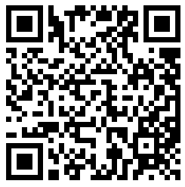
Reminder - Code of Conduct
Check name-tags for these contact comfort level stickers.
Wear a mask if you want to!
Harassment and unprofessional conduct (including the use of offensive language) of any kind is not permitted at any time and should be reported to:
Andrew Connolly (ajc@astro.washington.edu),
John Franklin Crenshaw (jfc20@uw.edu), and/or
Alysha Shugart (ashugart@lsst.org).
Use the confidential email rubin2023-covid@lists.lsst.org to request a test, report your test results, or ask questions.
If someone is wearing a pin like this, and it indicates a low social battery, please give them their space or offer to restart the conversation at a later time.
Rubin Observatory adheres to the principles of kindness, trust, respect, diversity, and inclusiveness in order to provide a learning environment that produces rigor and excellence.
full code of conduct
If you feel unsafe at any time send an email to rubin2023-helpline@lists.lsst.org

Slide 3


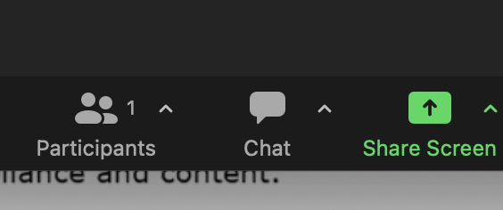


Reminder - Virtual Participation
Virtual participants should be muted when they’re not speaking.
In-person participants should speak into the room microphone(s), or the chair should repeat all questions into the microphone, so that the virtual participants can hear what is said.
In Zoom, use the chat to:
- request to unmute to ask a question, or
- type your question so someone can speak it aloud.
The Zoom “raise hand” feature is generally harder for moderators to track, and is not preferred, but may be used at the discretion of the session chair.
In the Rubin2023_PCW Slack Space, all participants can use the session’s channel for Q&A and discussion.
The channel name convention is, e.g.:
#day1-mon-slot3a-intro-to-rubin

Slide 4
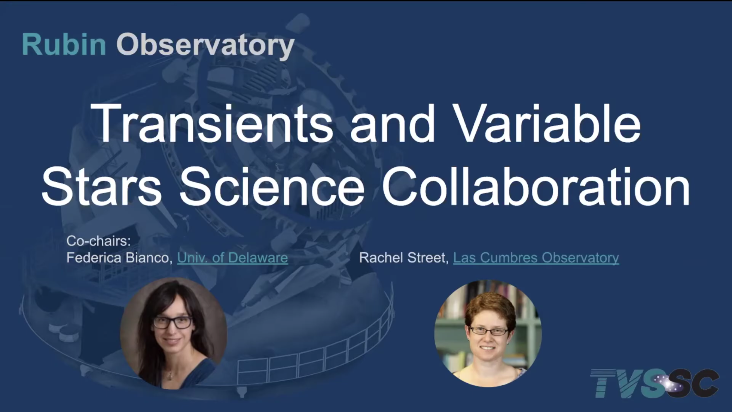

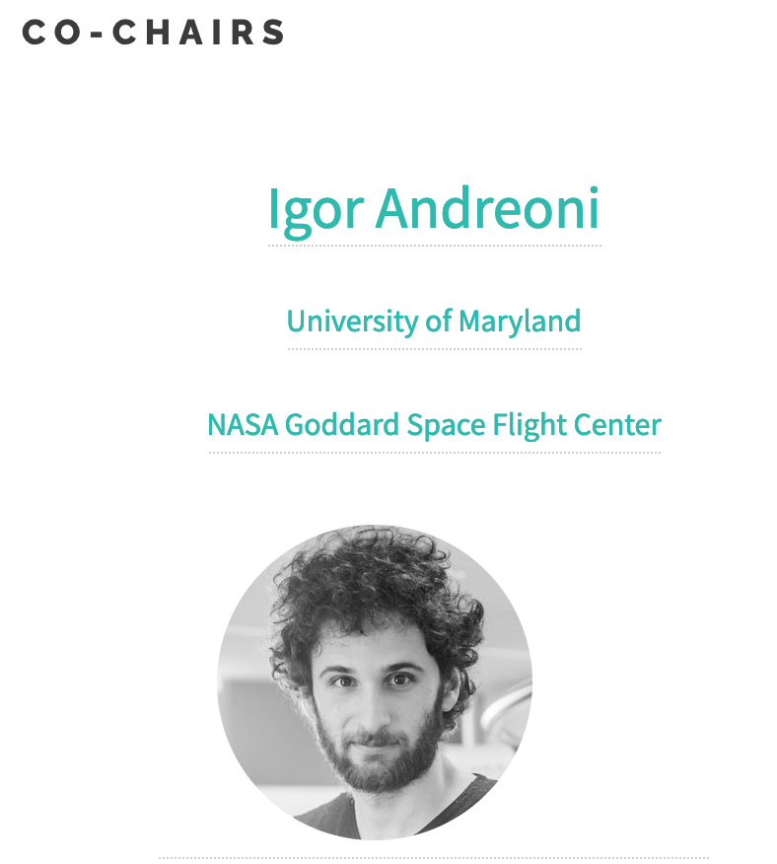
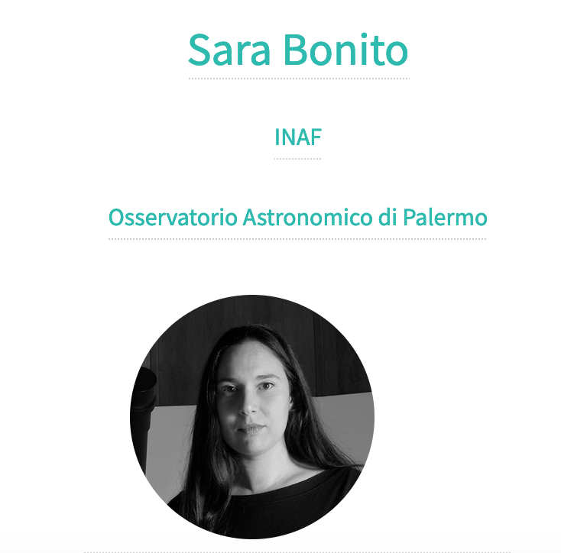
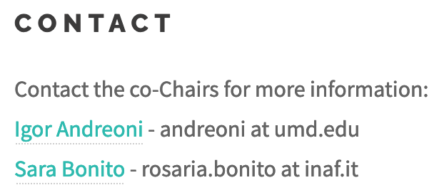

https://youtu.be/MXQQzbC5HxY
https://lsst-tvssc.github.io/
Rosaria (Sara) Bonito – INAF - Observatory of Palermo (Italy)
Sara (Rosaria) Bonito – INAF – Osservatorio Astronomico di Palermo (Italy)

Slide 5
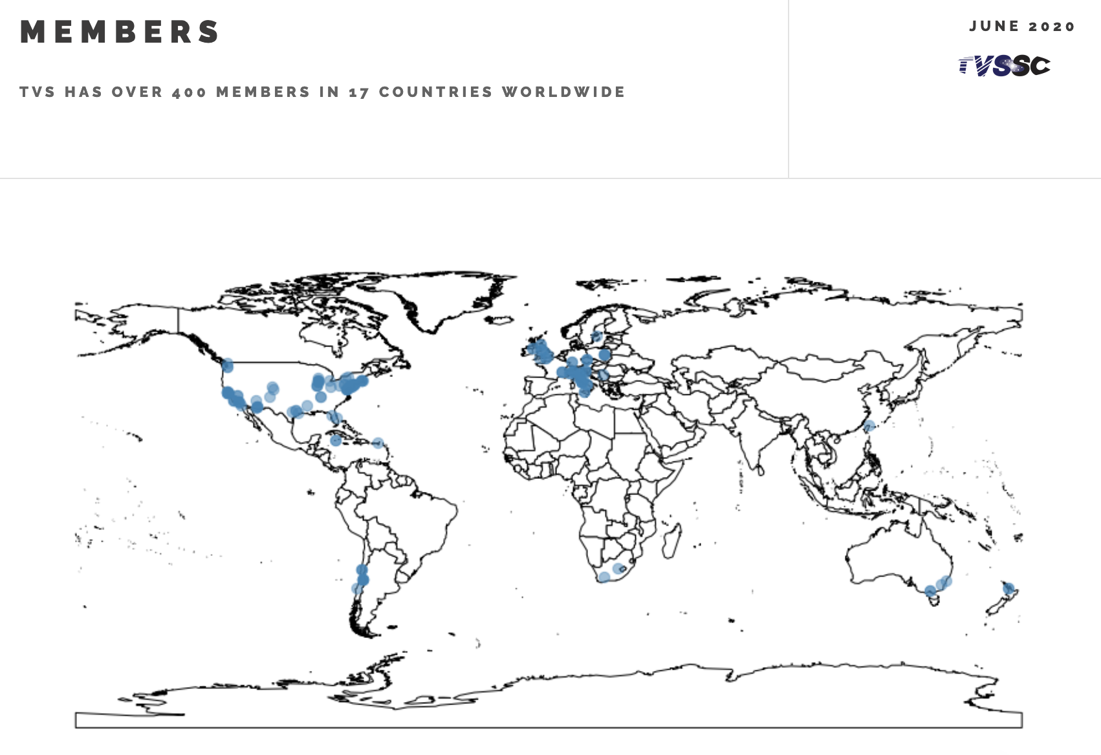
INTERNATIONAL COLLABORATION
Sara (Rosaria) Bonito – INAF – Osservatorio Astronomico di Palermo (Italy)

Slide 6
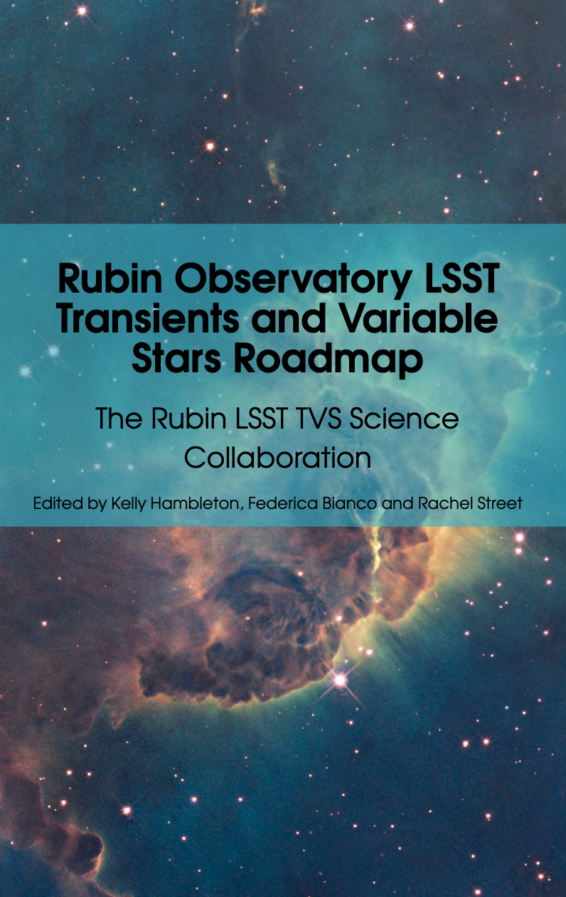
TVS ROADMAP
Microlensing
Eclipsing Binary Stars
Cataclysmic Variables
Neutron Star Binaries
Black Hole Binaries
Supernovae
Intermediate-Luminosity Optical Transients
Light Echoes of eruptions and explosions
EM counterparts of GW events
Tidal Disruption Events
TVS science highlights:
https://docs.google.com/presentation/d/10bVERZ5bGpXq1n6EgDKkvYhSr7YYVg95Vz_yrubODeA/edit?usp=sharing
Stars Milky Way and Local Volume
Young stellar objects
Pulsating Stars
Cepheids and RR Lyrae Stars
Long Period Variables
Brown Dwarfs
GRB
Blazars
Transiting Exoplanets
Alert Brokers
SETI
Stars Milky Way and Local Volume
https://arxiv.org/pdf/2208.04499.pdf
Sara (Rosaria) Bonito – INAF – Osservatorio Astronomico di Palermo (Italy)
Notes:
6

Slide 7
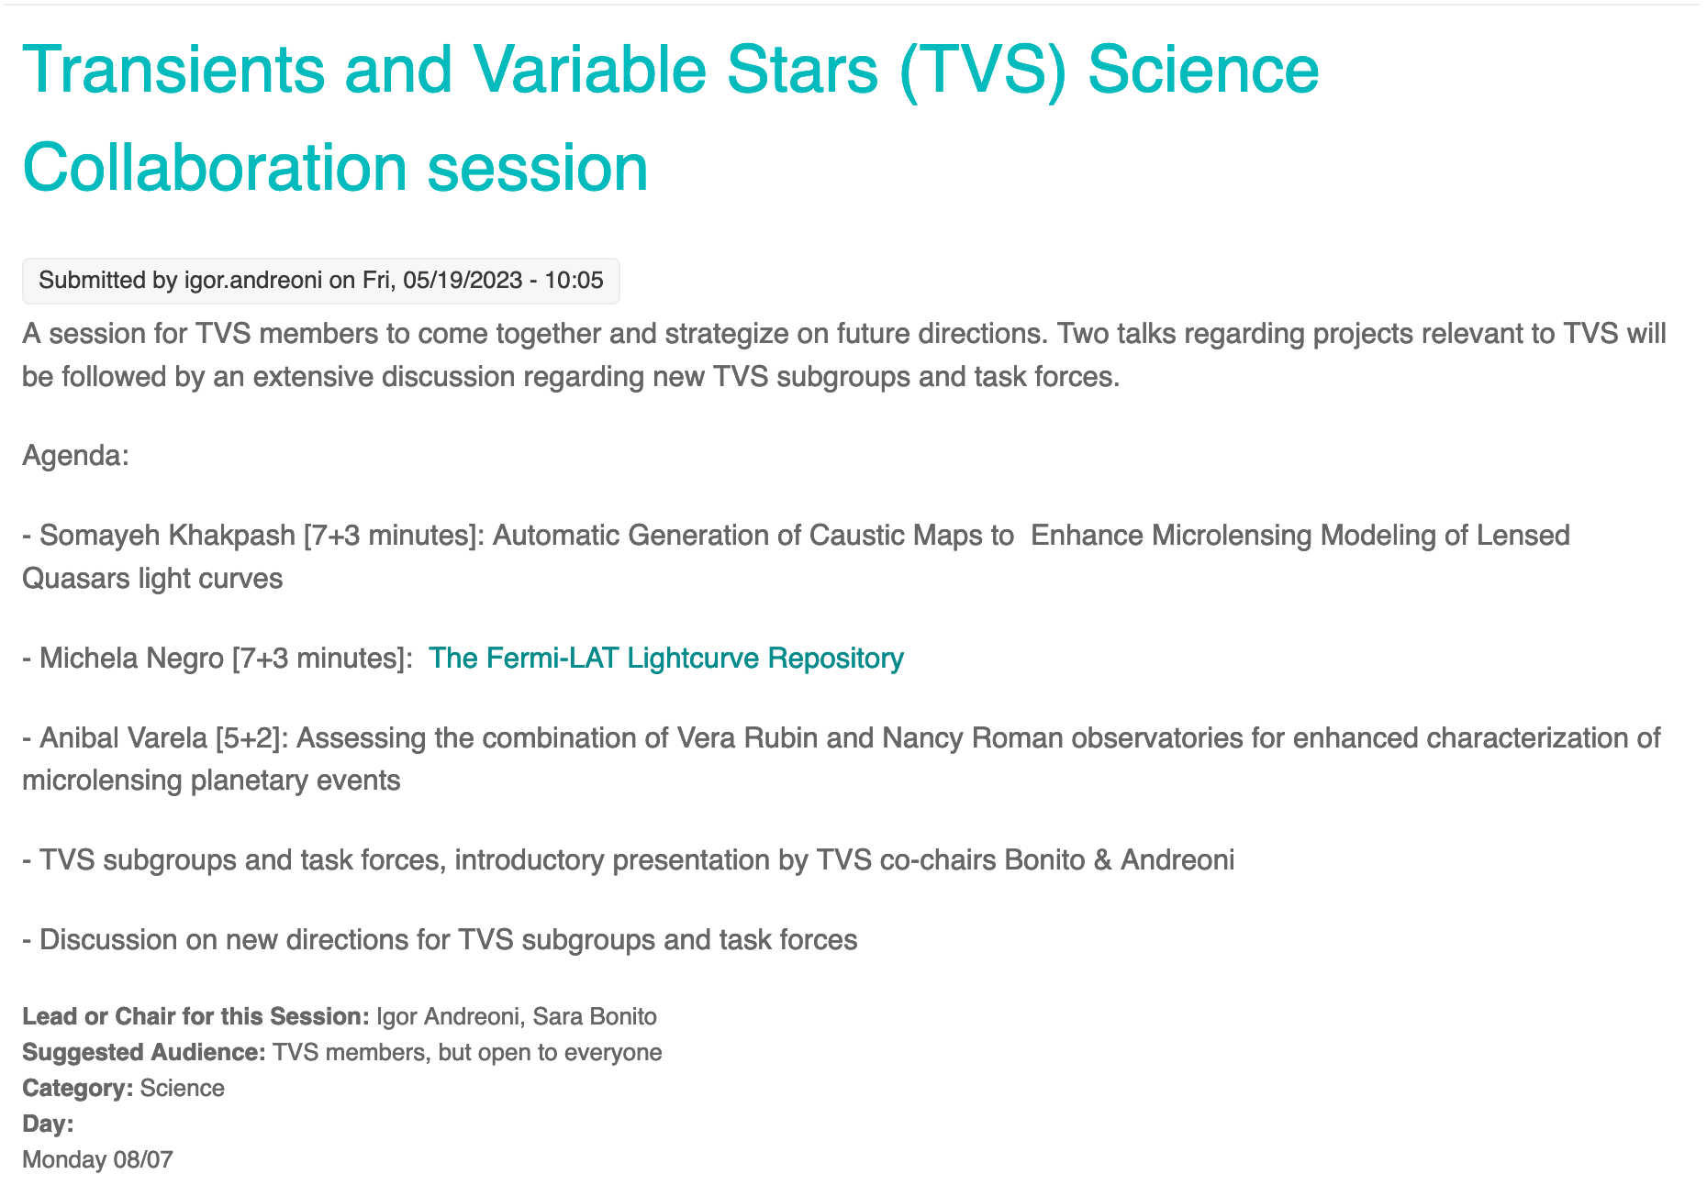
Sara (Rosaria) Bonito – INAF – Osservatorio Astronomico di Palermo (Italy)

Slide 8
TVS ROADMAP
Microlensing
Eclipsing Binary Stars
Cataclysmic Variables
Neutron Star Binaries
Black Hole Binaries
Supernovae
Intermediate-Luminosity Optical Transients
Light Echoes of eruptions and explosions
EM counterparts of GW events
Tidal Disruption Events
Stars Milky Way and Local Volume
Young stellar objects
Pulsating Stars
Cepheids and RR Lyrae Stars
Long Period Variables
Brown Dwarfs
GRB
Blazars
Transiting Exoplanets
Alert Brokers
SETI
Stars Milky Way and Local Volume
https://arxiv.org/pdf/2208.04499.pdf
Sara (Rosaria) Bonito – INAF – Osservatorio Astronomico di Palermo (Italy)
Notes:
8

Slide 9
SUBGROUPS VS. TASK FORCES
Sara (Rosaria) Bonito – INAF – Osservatorio Astronomico di Palermo (Italy)

Slide 10
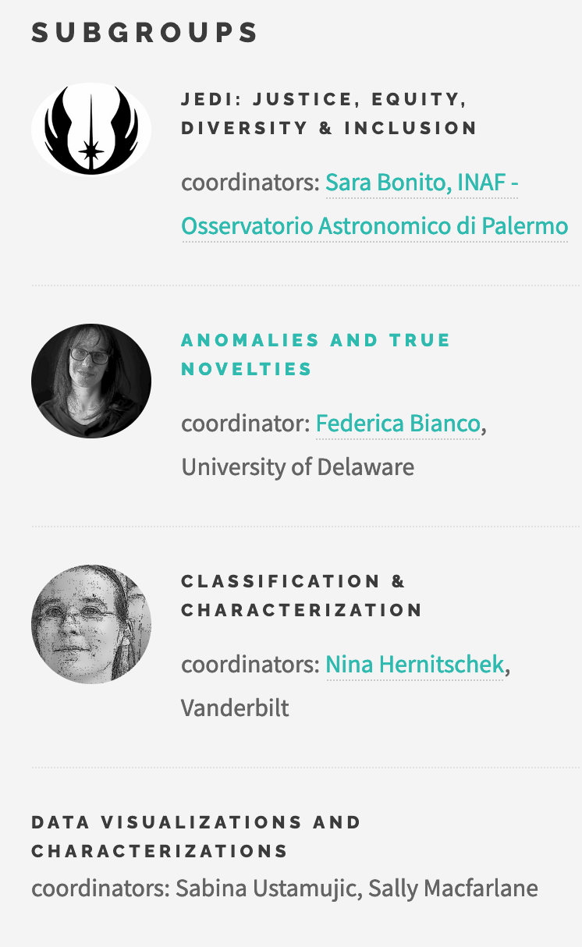
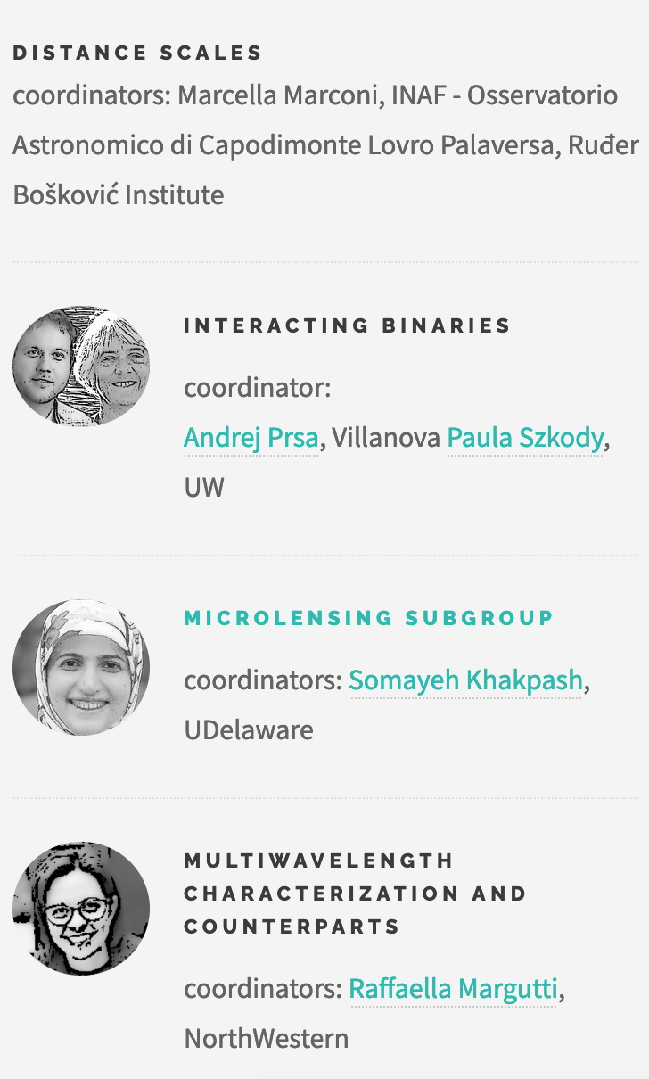
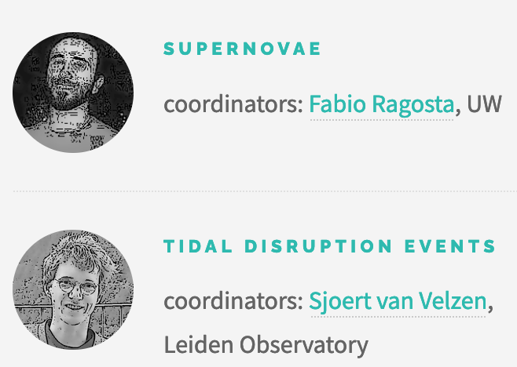
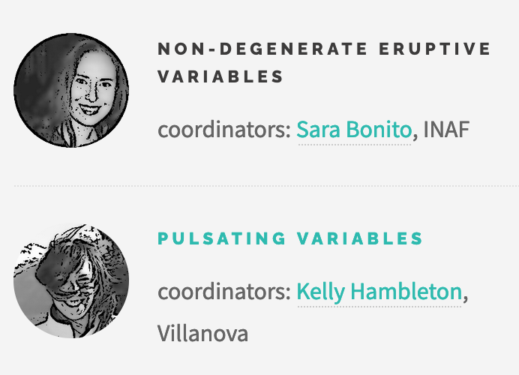
Sara (Rosaria) Bonito – INAF – Osservatorio Astronomico di Palermo (Italy)
Notes:
10

Slide 11
Sara (Rosaria) Bonito – INAF – Osservatorio Astronomico di Palermo (Italy)
Notes:
11

Slide 12
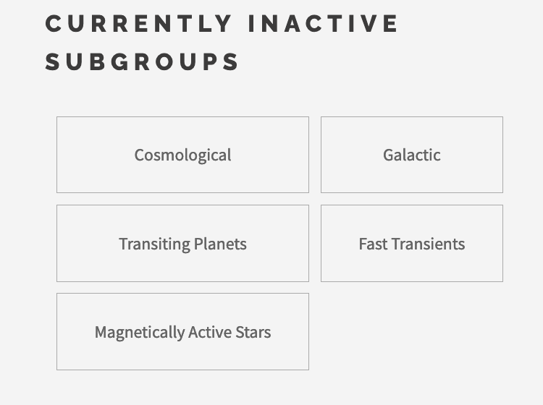
Sara (Rosaria) Bonito – INAF – Osservatorio Astronomico di Palermo (Italy)
Notes:
12

Slide 13
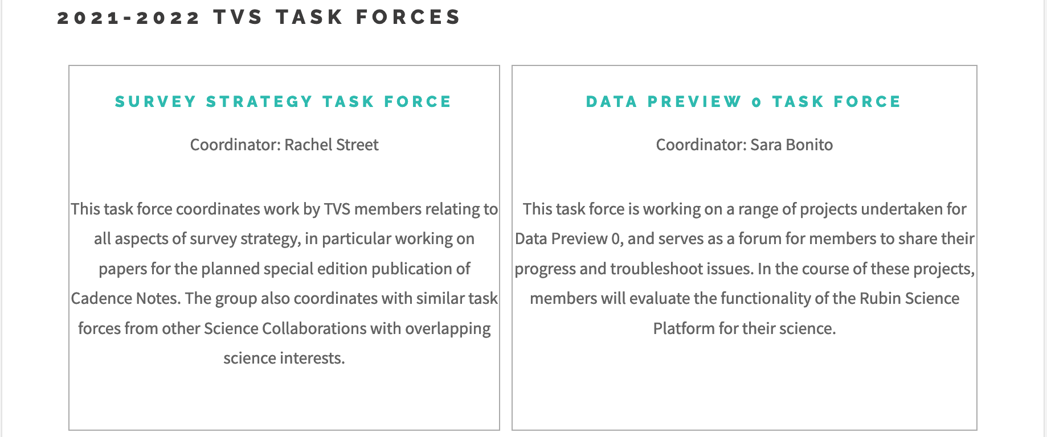
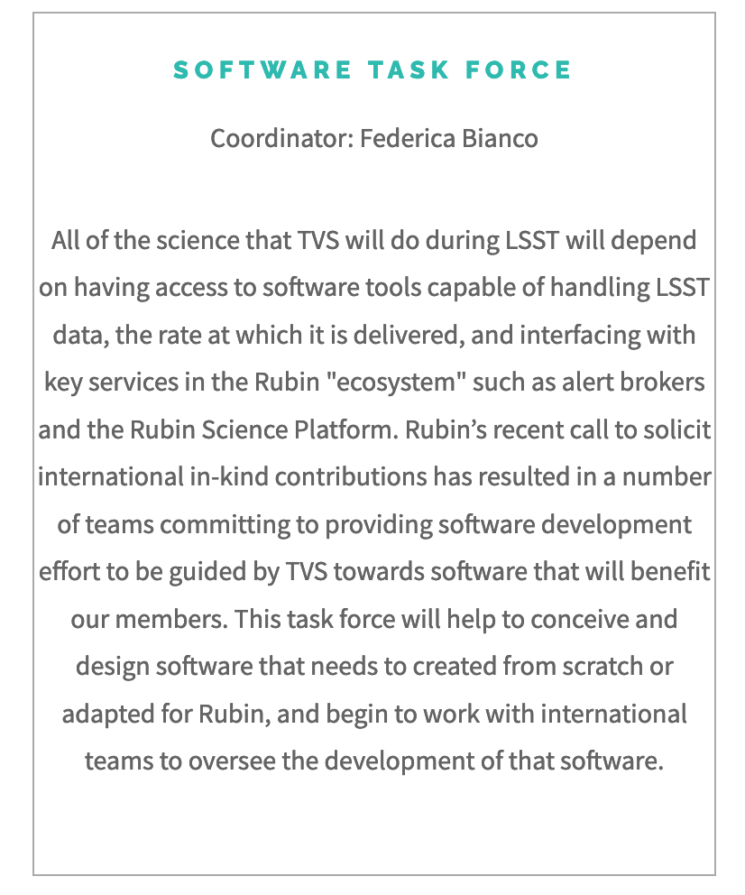
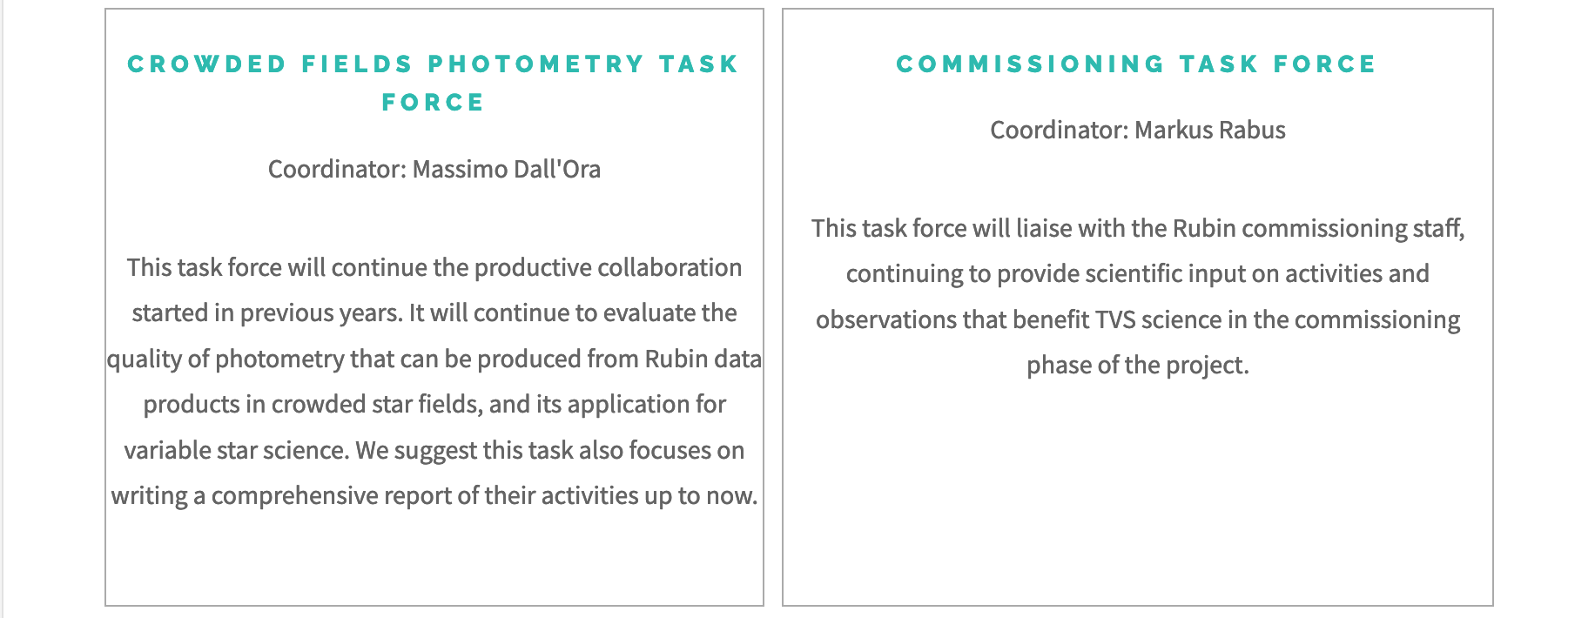
TASK FORCES
Vincenzo Petrecca
Sara (Rosaria) Bonito – INAF – Osservatorio Astronomico di Palermo (Italy)

Slide 14
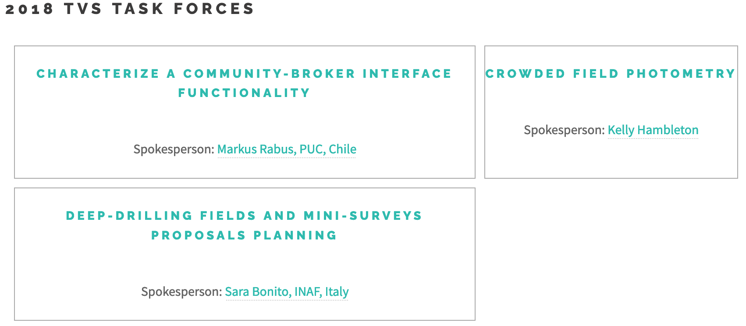
TASK FORCES
Sara (Rosaria) Bonito – INAF – Osservatorio Astronomico di Palermo (Italy)

Slide 15
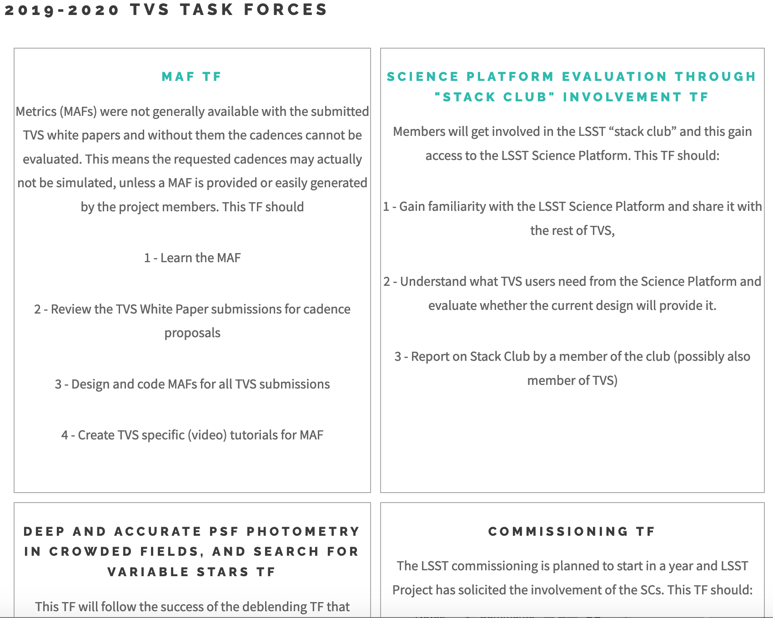
TVS Task Forces
Sara (Rosaria) Bonito – INAF – Osservatorio Astronomico di Palermo (Italy)

Slide 16
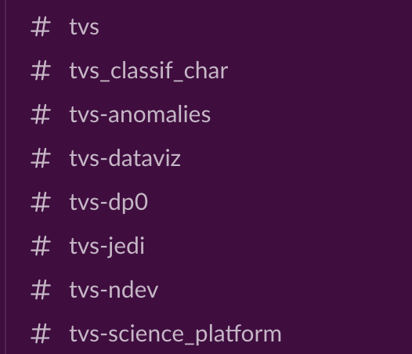

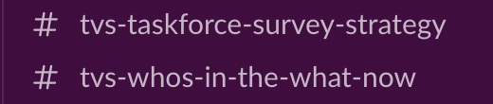
GROUPS/TASK FORCE INFO
GROUPS/TASK FORCE INFO
Get in the conversation on Slack:
Join a TVS Task Force and subgroup : https://lsst-tvssc.github.io/

Slide 17
DISCUSSION
Some input:
What is working and what is not working in the subgroup and task force structure, in general?
Which new subgroups do we need, if any?
Do you see it useful to consider merging some existing subgroups?
Do you feel that the scope of some subgroups, perhaps also reflected in their name, should be updated? (some subgroups have been around for a decade and the landscape could have changed)

