Slide 1
Rubin Observatory
Science Advisory Council
Michael Strauss, Chair
PCW, Monday, August 7

Slide 2
The Rubin Science Advisory Committee represents the Rubin scientific community.
It gives advice to the leadership of the Rubin Project and the Rubin Operations team, and will continue for the extent of the 10-year survey.
It was stood up in 2014; it now is operating under a proper charge.
SAC members are appointed for two-year terms, renewable.

Slide 3
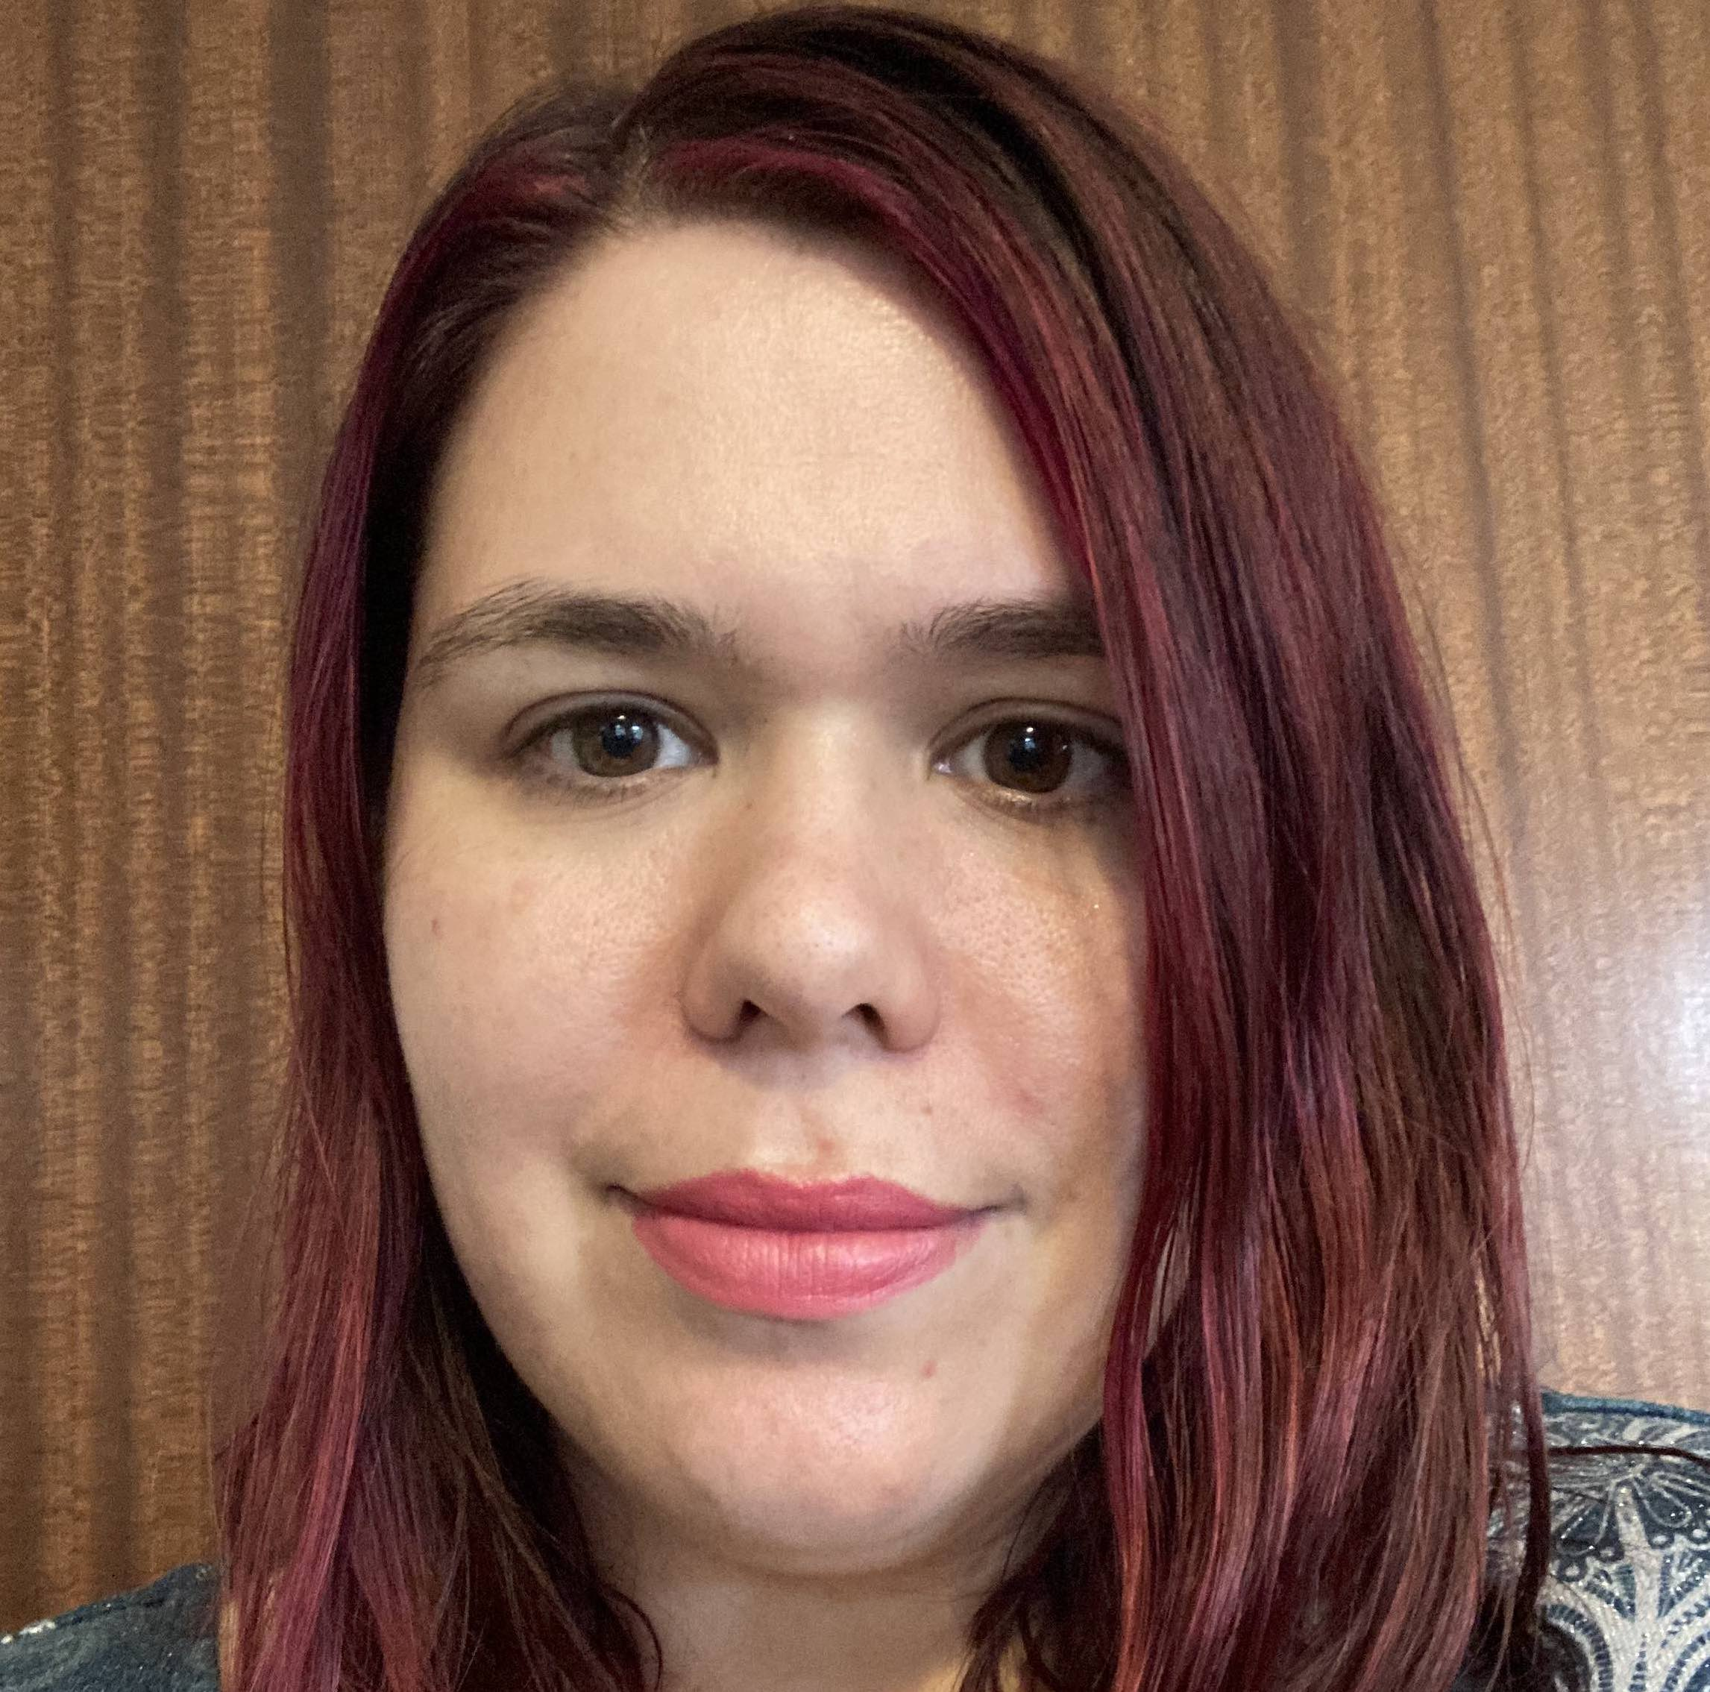
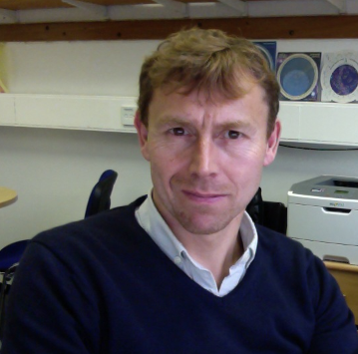
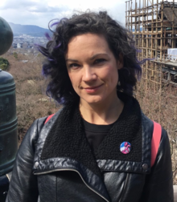
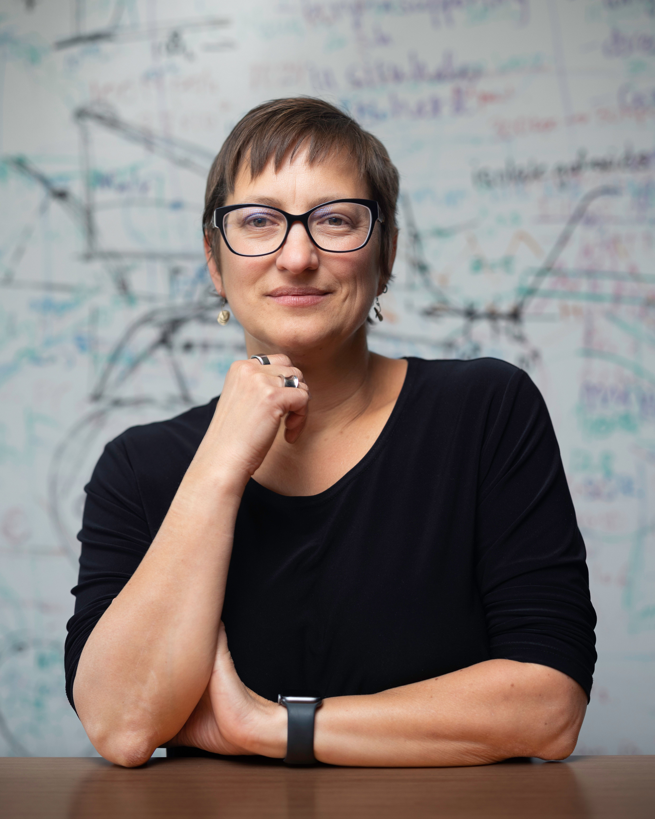
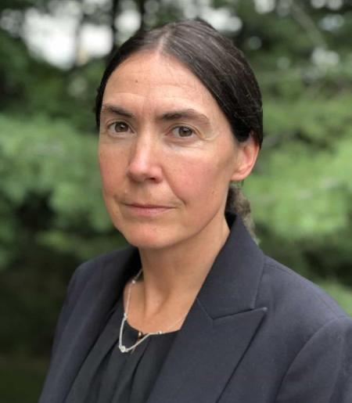
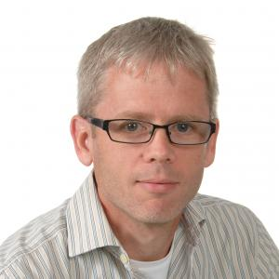
Thank you to those who have stepped down from the SAC
Rachel Bean David Kirkby Meg Schwamb Stephen Smartt Lucianne Walkowicz Risa Wechsler

Slide 4
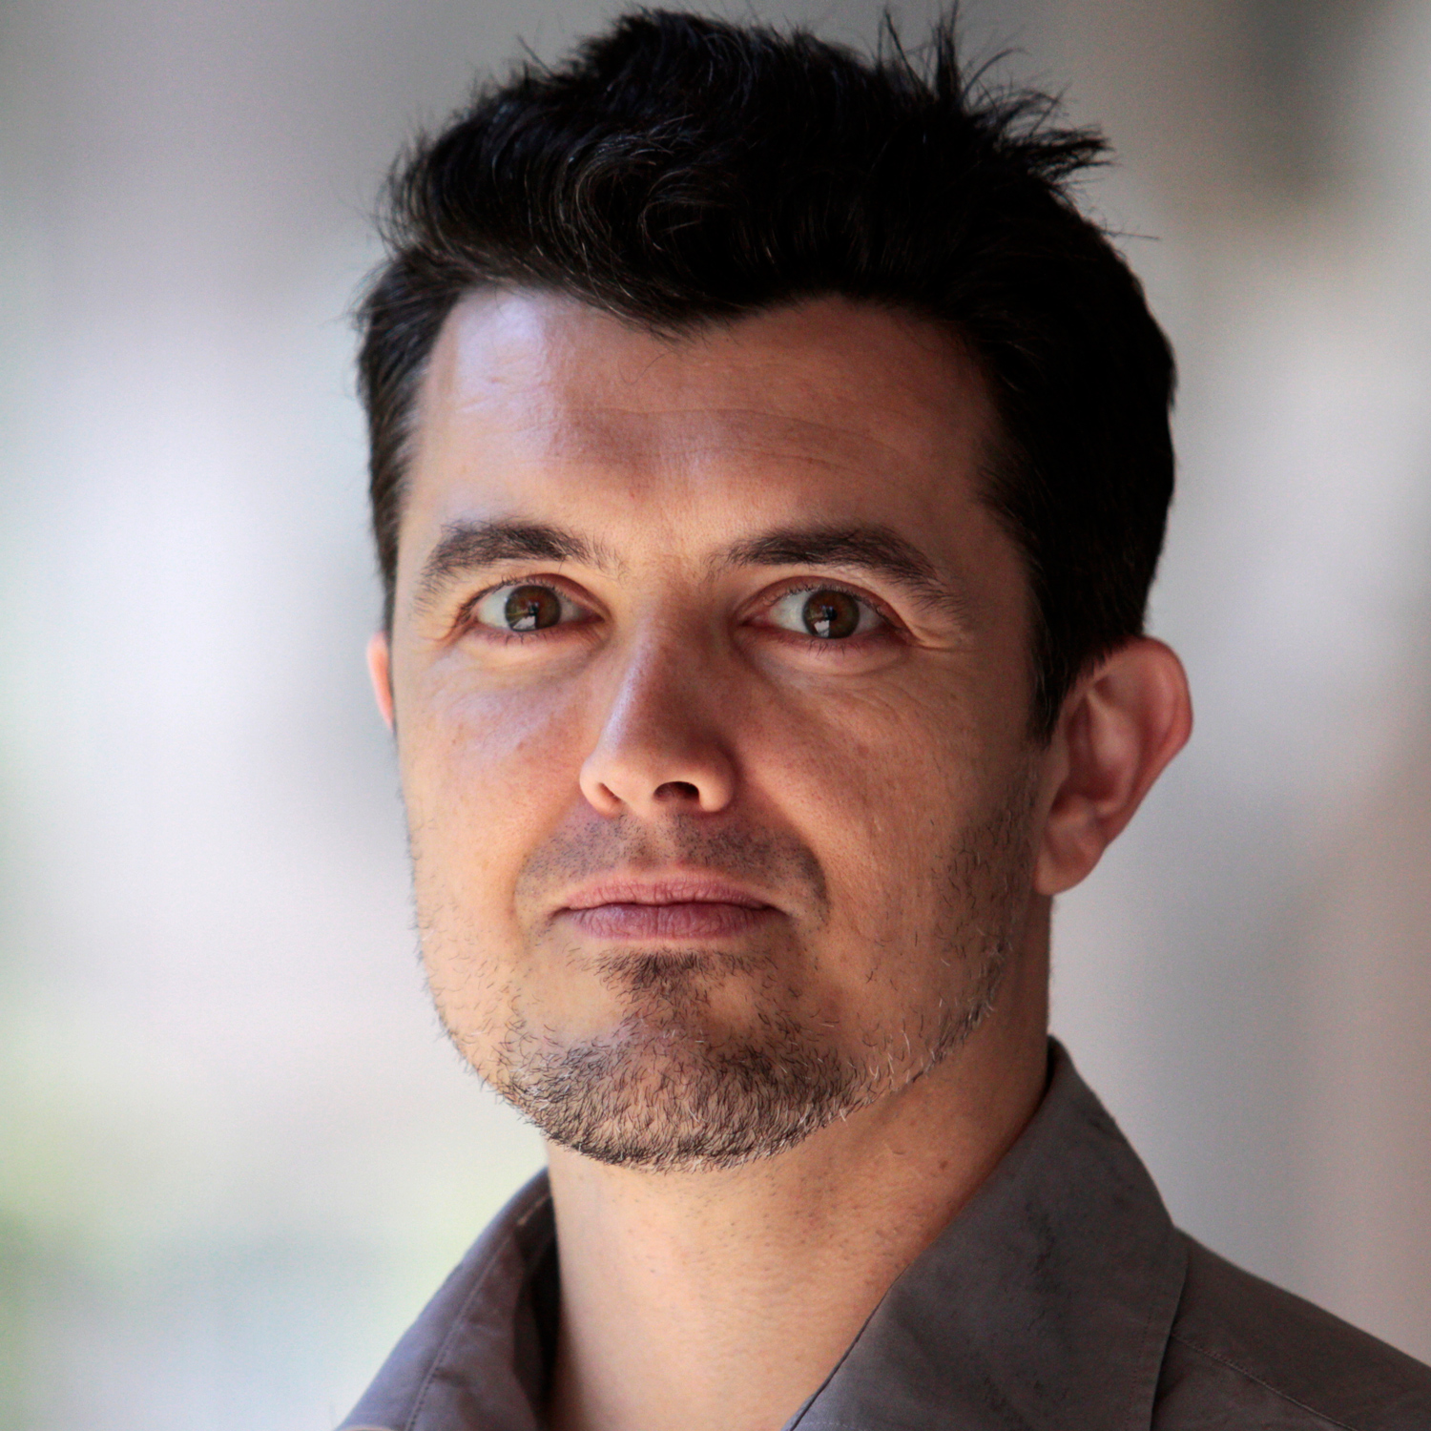
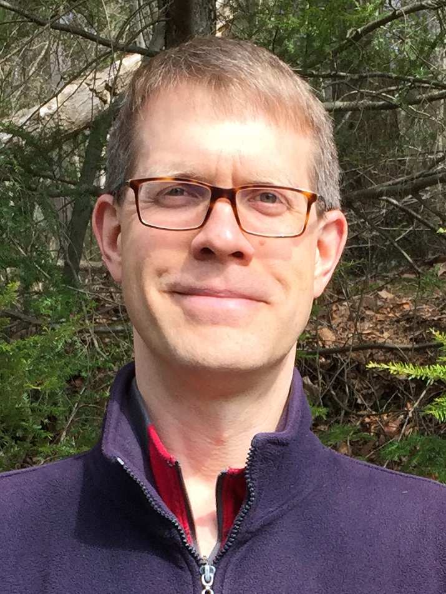
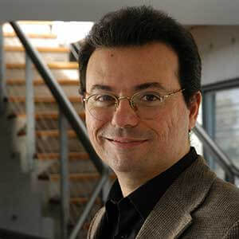
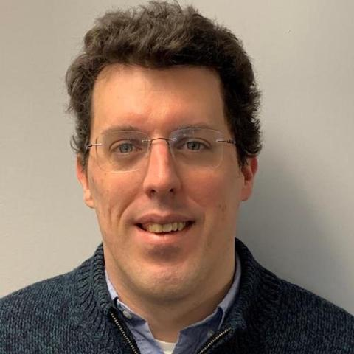
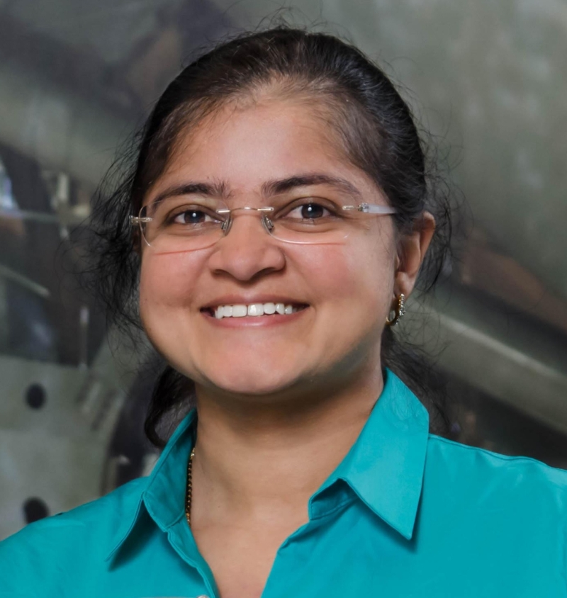
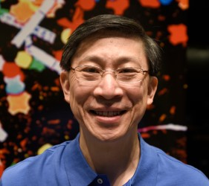
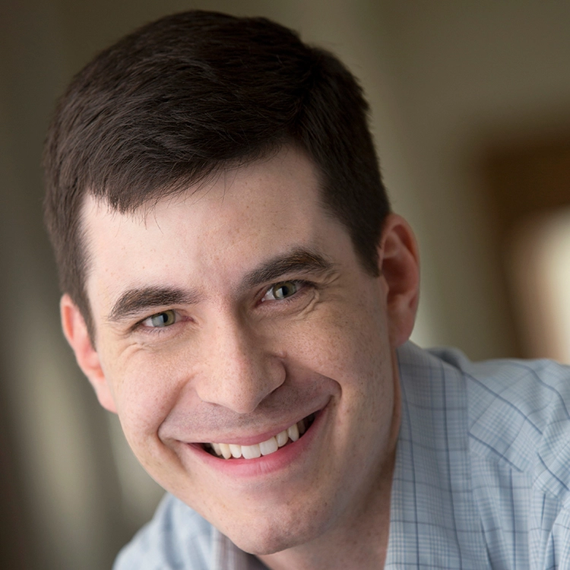
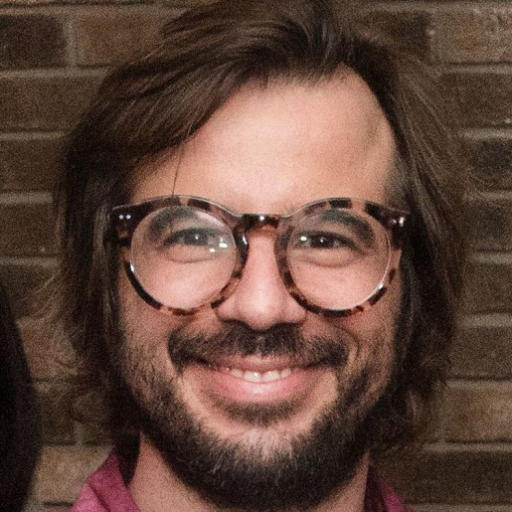
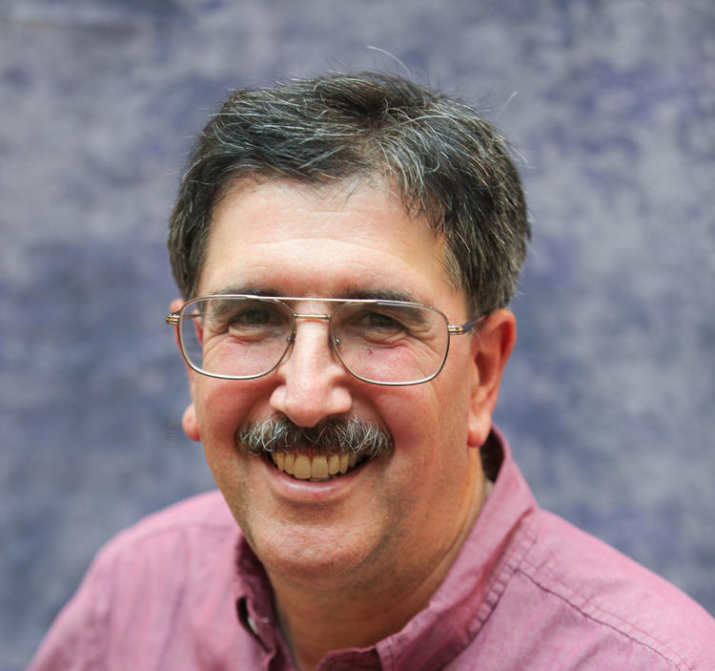
The current membership of the SAC
Franz Bauer Niel Brandt Márcio Catelan Will Clarkson Mansi Kasliwal
Charles Liu Josh Simon Anže Slosar Michael Strauss

Slide 5
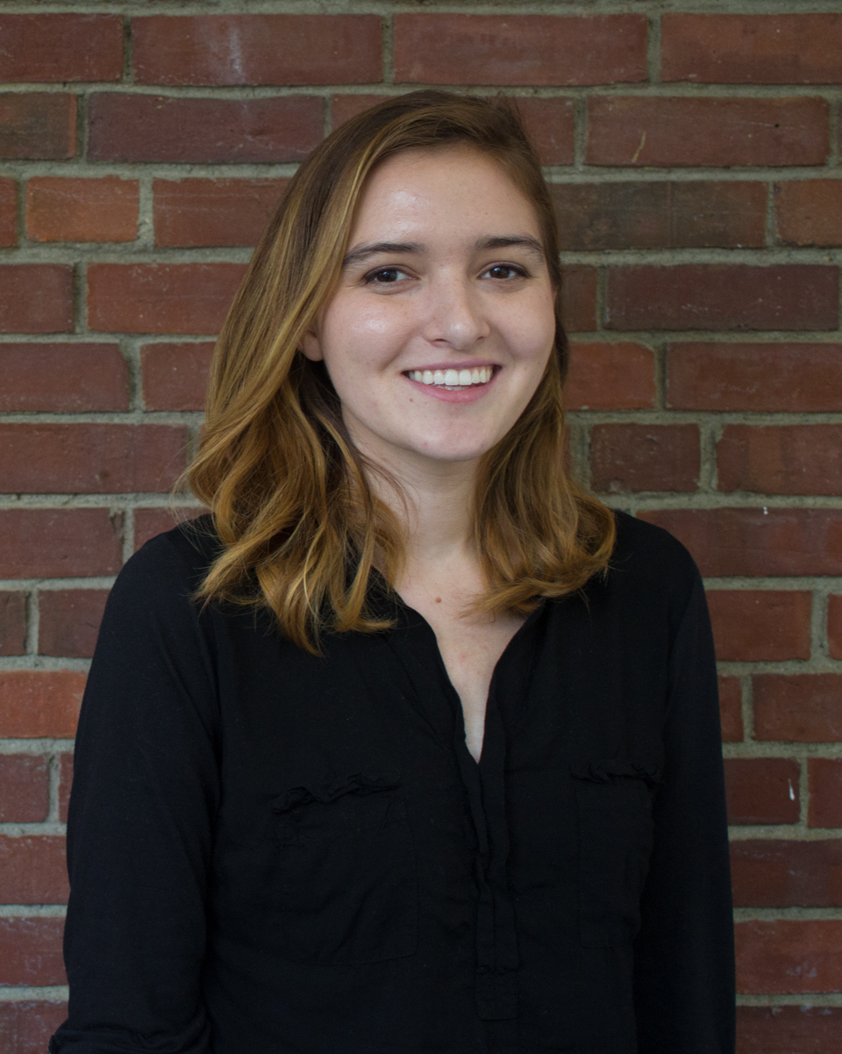
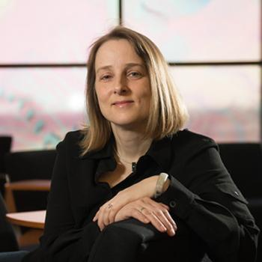
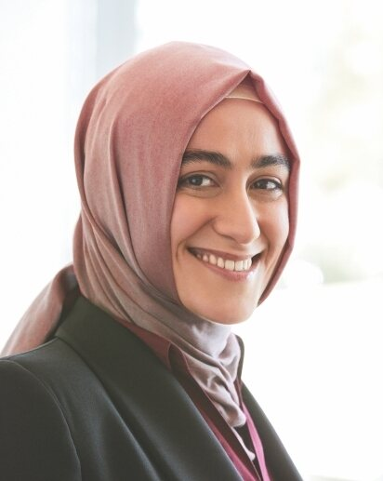
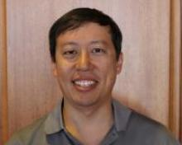
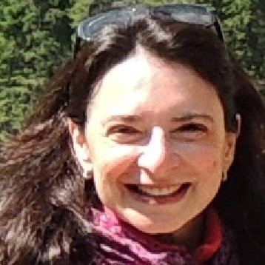
New members!
Ashley Villar Katrin Heitmann Burçin Mutlu-Pakdil Henry Hsieh Simona Mei
Harvard U. Argonne Nat’l Lab Dartmouth Planetary Science Institute IN2P3x
Discussions are underway with several other candidates.

Slide 6
Agenda for today
9:00-9:15: Welcome and Introductions; the role of the SAC and its charge
9:15-9:45: Plans for early science, the science verification activities, and the distinction between the end of Construction and the start of the survey
Discussion led by Leanne Guy
9:45-10:00: The schedule of data release, including nightly images: who can see which data when?
Discussion led by Bob Blum and Phil Marshall
10:00-10:30: Joint processing of Rubin, Euclid, and Roman data
Discussion led by Bob Blum

Slide 7
10:30-11:00: Break
11:00-11:30: The evolution of the Rubin websites
Discussion led by Kristen Metzger, Blake Mason, and Ranpal Gill
11:30-12:00: The status of the in-kind program
Discussion led by Aprajita Verma and Phil Marshall
12:00-12:30: SAC meets in executive session

