Slide 1
Auxiliary Telescope – A Rubin system pathbreaker, plus early imaging and spectroscopy Christopher Stubbs Harvard University stubbs@physics.Harvard.edu
Vera C. Rubin Observatory | PCW 2023 AuxTel. | August 10 2023

Slide 2
How to select the dark theme?

Slide 3
Auxiliary telescope’s primary mission is monitoring variable atmospheric transmission by taking spectra of stars that back-light the atmosphere. Additional value for imaging survey testing and early systems integration.
What’s that bump on the hill down there?
Hi!
I’m Aux Tel

Slide 4
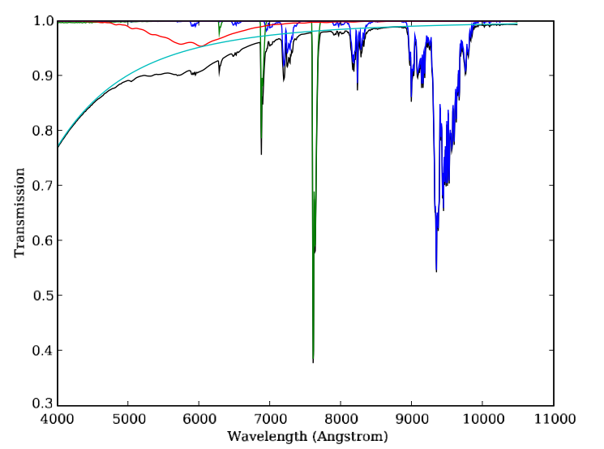
Water Vapor, Ozone, and Aerosols insert time-variable optical filters into our beam
Red- ozone, O₃
Blue- water vapor molecular absorption
Cyan – Rayleigh scattering
Green- O₂ molecular absorption
Rayleigh scattering is deterministic, from barometer pressure and zenith angle
A combination of measurements and modeling will be used to determine this filter, for each Rubin image.
Ozone in Dobson units
Precipitable Water Vapor (PWV) in mm Aerosol optical depth τ∼τ₅₀₀ (λ/500)^{α}

Slide 5
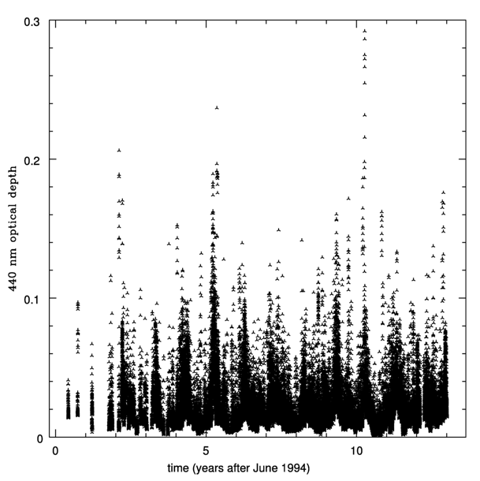
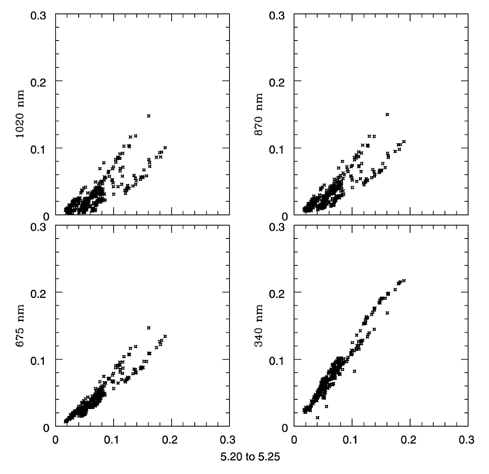
Aerosols exhibit both time and λ dependence
AERONET data from Mauno Loa
from Stubbs et al 2007 PASP 119 1163
!!

Slide 6
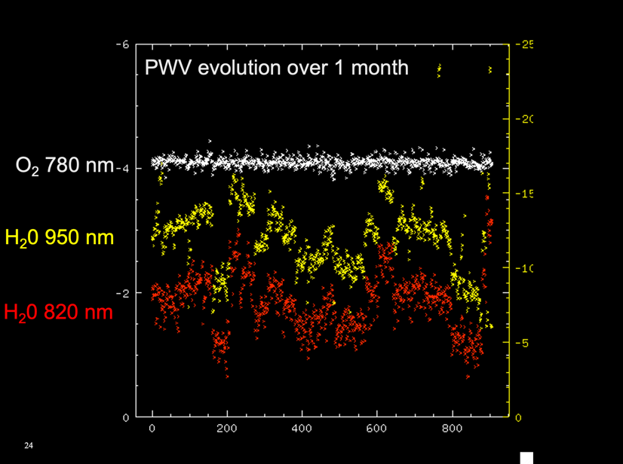
PWV variation on long timescale
We don’t yet know the angular and temporal correlation functions of these variable elements of atmospheric transmission.
This is a goal for Aux Tel observations, currently limited by the limited number of nights we collect data.
PanSTARRS- Haleakala
(Stubbs & Tonry, unpublished)

Slide 7
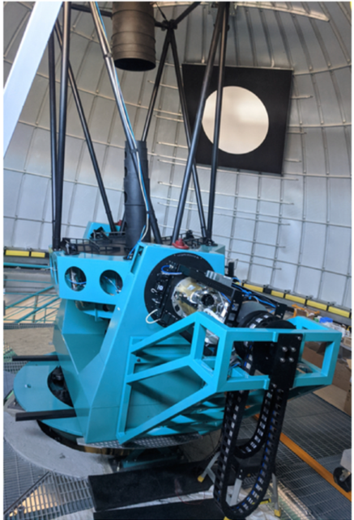
Converging-beam slitless dispersed imager
1.2m primary
f/18 RC configuration
2 Nasmyth ports
Rubin 4K x 4K ITL sensor
Rubin readout electronics
Rubin scheduler
Rubin AO system
Alt-Az-Rotator axes
Shutter
Filter, 3 pos.
Disperser, 3 pos
Detector
Also Shack-Hartmann and other instruments on other instrument port

Slide 8
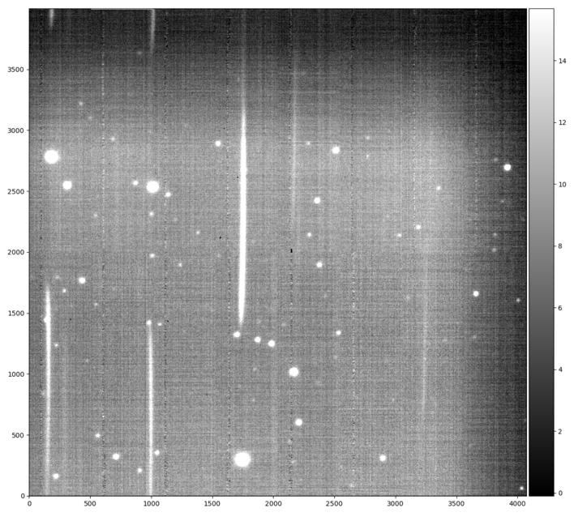
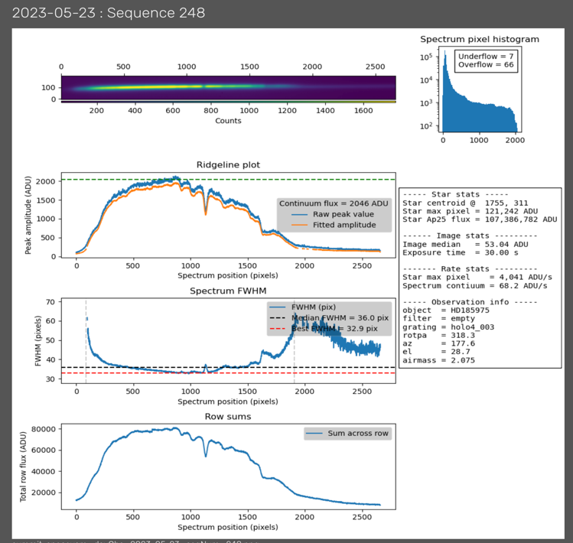
Typical slitless dispersed image and 1-d spectrum
Red end
M=1 order
Blue end
m=0 order

Slide 9
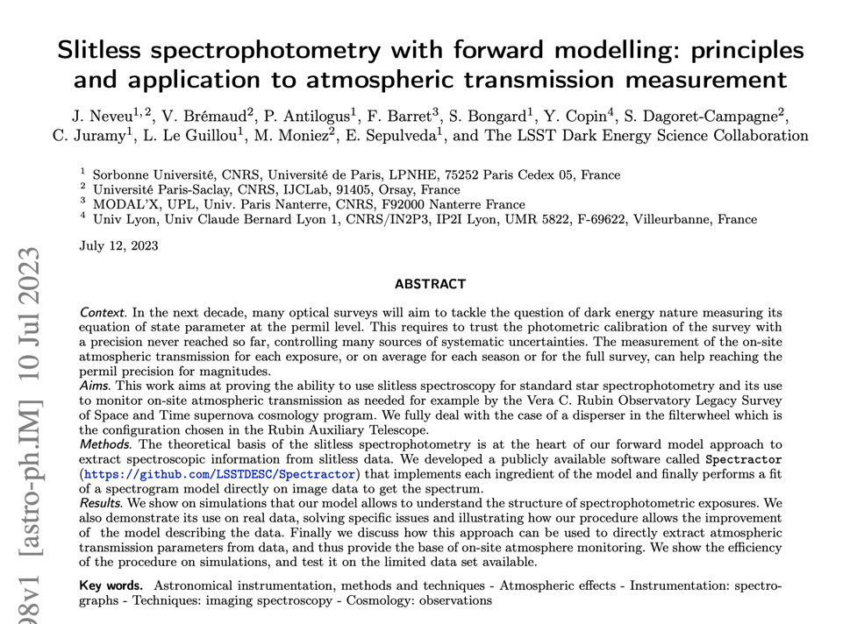
Thorough paper describing Aux Tel spectroscopy:
J. Neveu et al, arXiv:2307.04898, July 2023

Slide 10
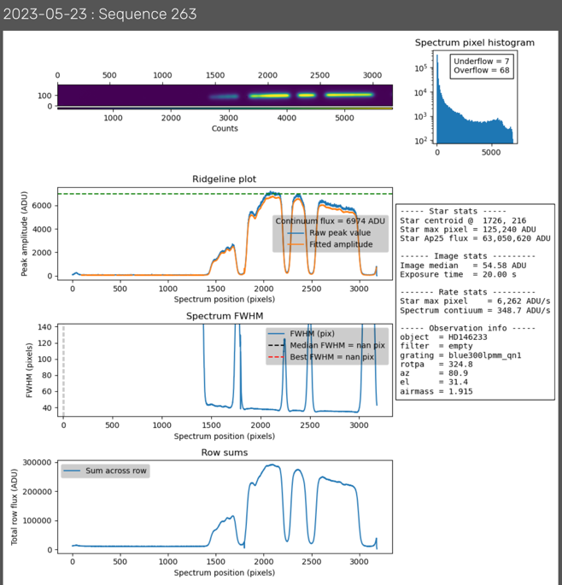
Band-limited disperser (quad-notch)
Combination of disperser plus multiband filter
Prospect for using photometric analysis tools rather than spectroscopy
Straightforward wavelength calibration
Lower sky background
No second order contamination
Specifically useful for aerosols
Eske Pedersen’s talk

Slide 11
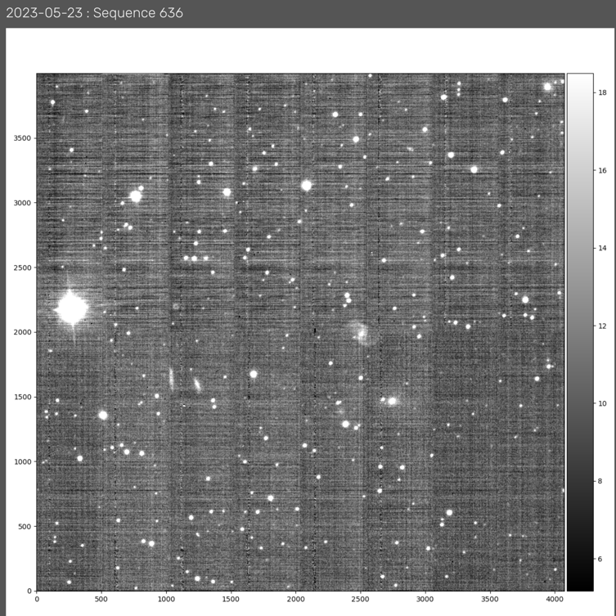
Imaging surveys
6 arcmin x 6 arcmin field, grizy
Instrument signature removal faces up to idiosyncrasies of Rubin sensors and electronics
Parker Fagrelius’ talk
Photometry and astrometry must contend with fatter-brighter effects, etc.
Being used to tune up DM pipelines.
Testbed for photometric and astrometric performance.
Eli Rykoff’s talk

Slide 12
Aux Tel as systems engineering platform & pathbreaker
Telescope operations, and summit-to-USDF data transfer.
Scheduler optimization and validation
Software integration- camera controller, obs. control system, data xfer system….
Image quality diagnostics and methodology.
Active Optics system validation and testing.
Data Management pipeline, end-to-end tests with Rubin sensor and electronics.
Observer training and real-time data visualization tools (Rubin TV).
Instrument signature removal
Commissioning testbed.
….

Slide 13
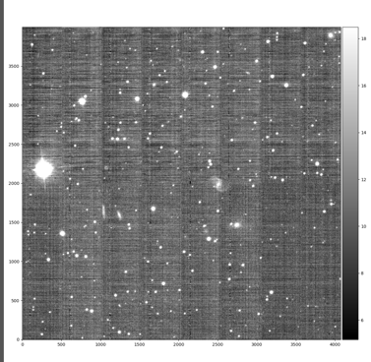
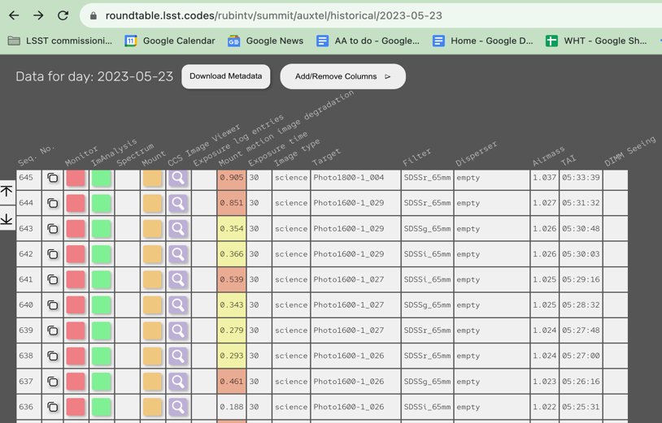
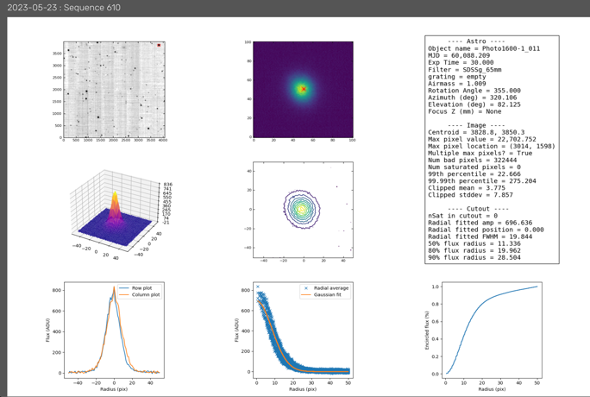
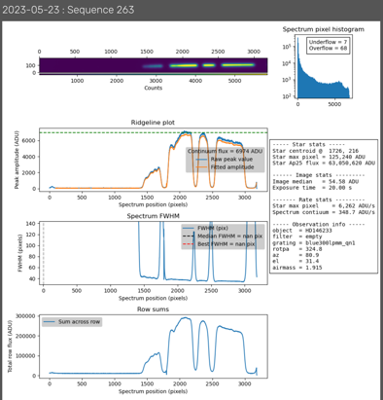
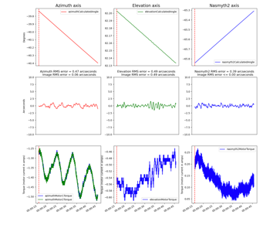
Rubin TV!

Slide 14
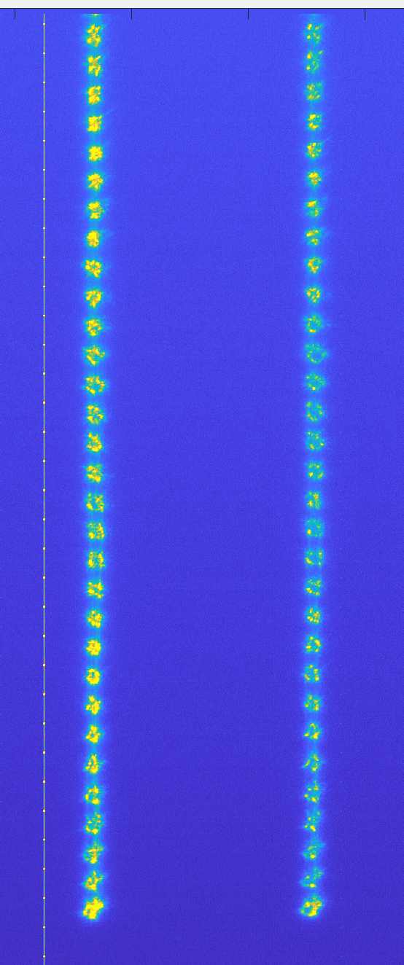
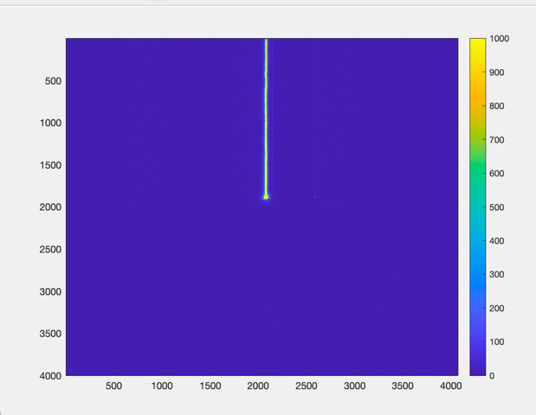
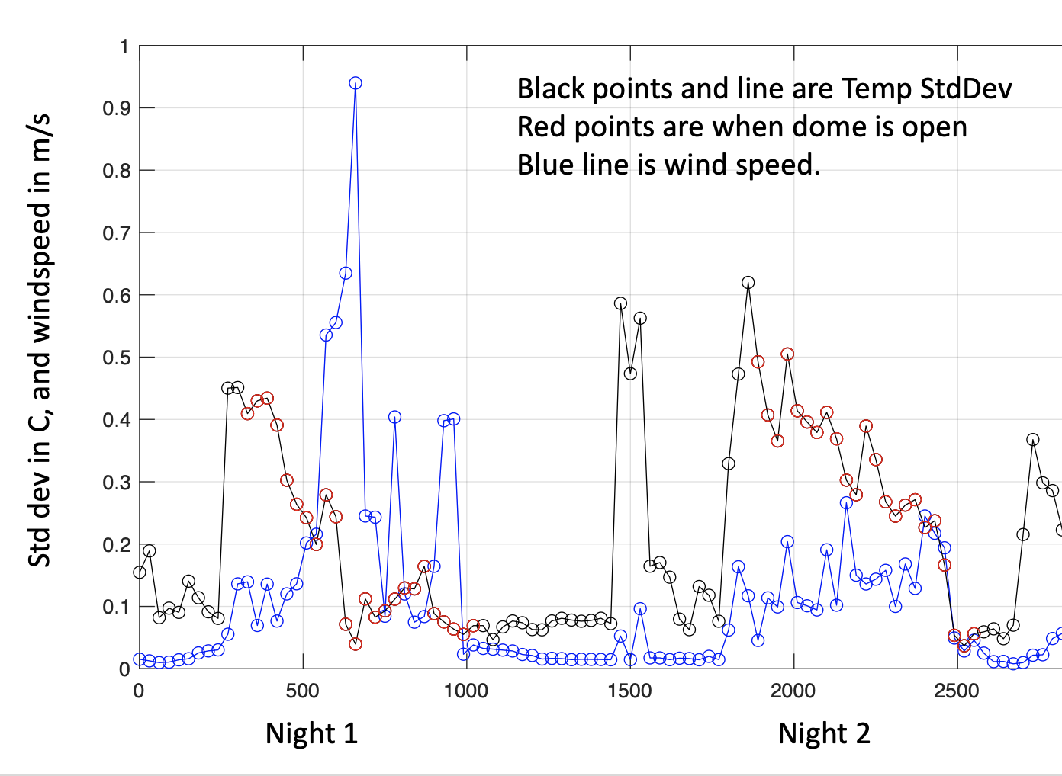
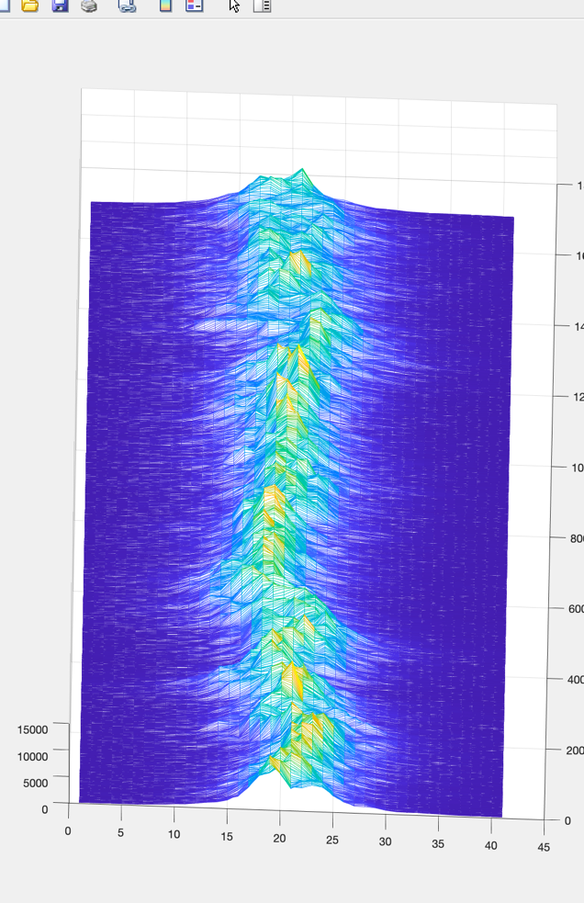
Image quality diagnostics testbed
Streaked Stuttered Dome Seeing Imaging Imaging Monitoring
Plus Shack-Hartmann imaging as seeing diagnostic
Elana Urbach’s talk

Slide 15
Vera C. Rubin Observatory | PCW 2023 AuxTel. | August 10, 2023

Slide 16
Our Session’s agenda

Slide 17
Links and references
Rubin TV (requires USDF credentials) https://roundtable.lsst.codes/rubintv
Atmospheric Transmission review: https://iopscience.iop.org/article/10.1086/522208/meta
Paper on Aux Tel as engineering pathbreaker: https://www.spiedigitallibrary.org/conference-proceedings-of-spie/11452/114520U/Vera-C-Rubin-Observatory-auxiliary-telescope-commissioning-as-a-control/10.1117/12.2561112.short?SSO=1
Preprint on spectroscopic reductions: https://arxiv.org/abs/2307.04898
Relevant Slack channels:
# desc-pc-auxtel
# rubinobs-sitcom-image-quality
# auxtel-operations

