Slide 1
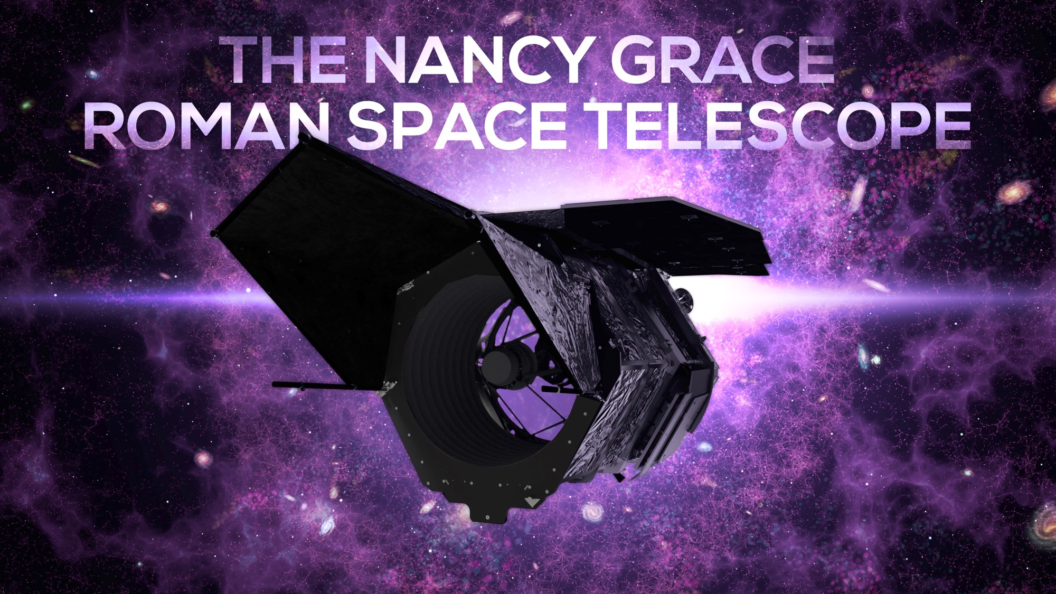

Slide 2
Plan for this session
Roman Overview and Status – Julie McEnery
Roman Core Community Survey Definition Process – Karoline Gilbert
Galactic Bulge Time Domain Survey – Anibal Varela
High Latitude Time Domain – Igor Andreoni
High Latitude Wide Area – Tim Eifler, Aaron Meisner

Slide 3
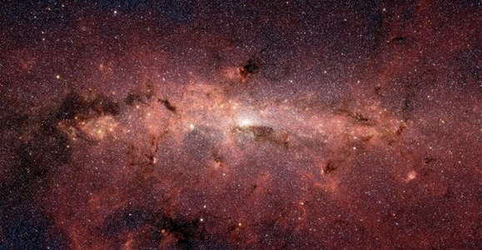
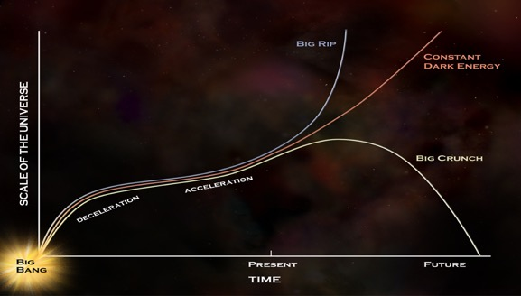
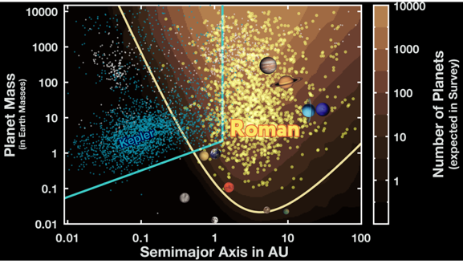
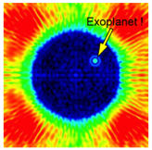
Roman Mission Objectives
Wide Field Infrared survey
  Imaging and spectroscopy to >26.5 AB mag
Expansion history of the Universe
  Using supernova, weak lensing and galaxy redshift survey techniques
Growth of Structure in the Universe
  Weak lensing, redshift space distortions and galaxy cluster techniques
Exoplanet Census
  Statistical census of exoplanets from outer habitable zone to free floating planets
General Astrophysics Surveys
  Devote substantial fraction of mission lifetime to peer reviewed program
Coronagraph technology demonstration
  Demonstrate exoplanet coronagraphy with
  active wavefront control
Wide-Field Infrared Surveys of the Universe
Dark Energy and the
Fate of the Universe
Exoplanet demographics

Slide 4
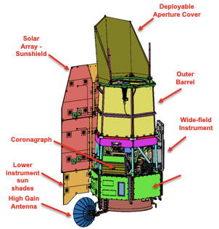

Roman Observatory and Instruments
Telescope: 2.4m aperture
Two Instruments:
Wide Field Instrument
  Vis/Near IR bandpasses (0.48 – 2.3 micron)
  Field of view 0.281 deg² (~200× HST WFC3-IR)
  18 4k × 4k detectors (288 Mpixels)
Coronagraph Instrument
  Visible bandpass
  Contrast 10⁻⁸-10⁻⁹
Data Volume: 11 Tb/day
Orbit: Sun-Earth L2
Launch: before May 2027 (Currently Oct 2026)
Mission Duration: 5 yr, 10yr goal
https://roman.gsfc.nasa.gov/science/technical_resources.html

Slide 5
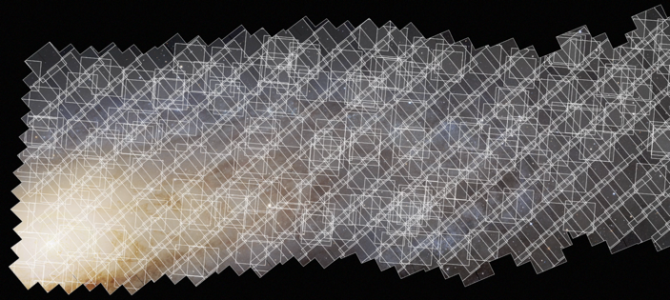
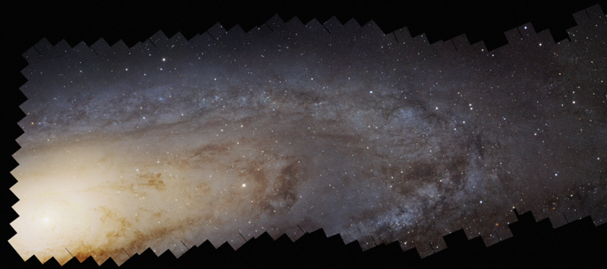

Roman as a Precise Survey Facility
The power of Roman is not just that it has a large field of view:
  Very efficient observations
    Rapid slew & settle
    no Earth occultations
    no South Atlantic Anomaly
  Well understood and stable PSF
    Stable thermal environment (L2 orbit, thermal control of all parts of the optical system)
    Rigid optical structure with vibration isolation from the spacecraft
    Stable attitude control
  Excellent flux calibration
    Relative calibration system
For details, see Akeson et al. 2019 https://arxiv.org/abs/1902.05569

Slide 6
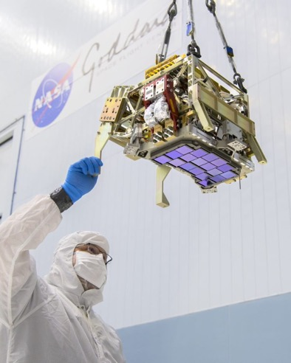
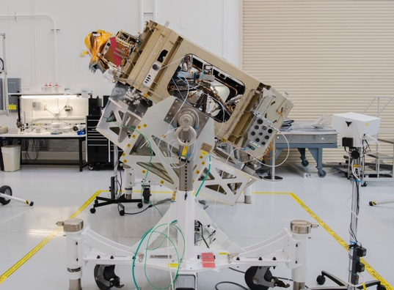
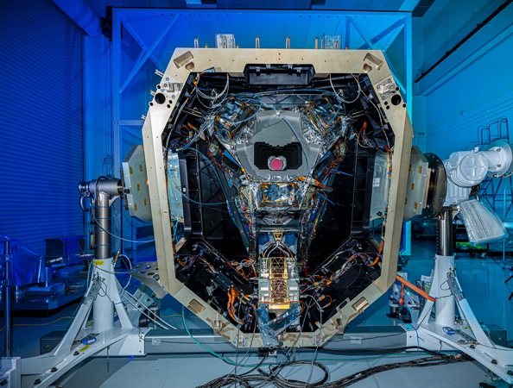
Hardware Status
Wide Field Instrument
  Focal Plane System delivered to Ball Aerospace and integrated into WFI, completed ambient testing
    Replaced 3 detectors that had exhibited performance degradation during environmental testing of focal plane system
  Integration of thermal control system is underway
  WFI environmental testing starts in September

Slide 7
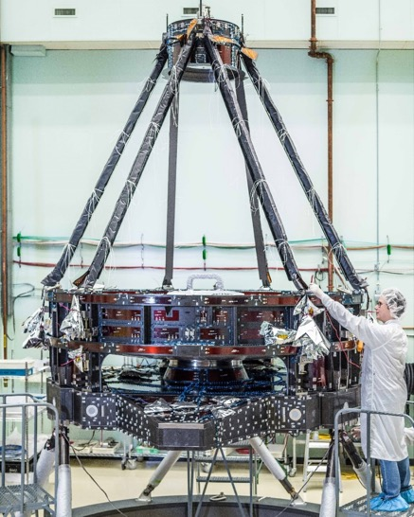
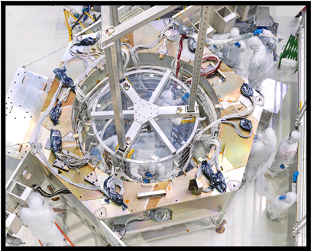
Hardware status
Coronagraph Instrument: Optical bench fully populated. All flight hardware delivered to I&T.
Telescope (L3Harris): Forward optical assembly complete (primary and secondary mirrors and associated structures), now working on implementation of tertiary optics.
Spacecraft/I&T: Spacecraft harness now in the flight Bus. Solar array flight panel circuit bonding has begun at the cell laydown vendor.

Slide 8
Hardware Status
Telescope, Wide Field Instrument, Coronagraph instrument will be delivered to Goddard for Observatory integration commencing in 2024
On track for launch in Oct 2026 (and no later than May 2027)

Slide 9
Roman Observations
Three Core Community Surveys address the 2010 Decadal Survey science goals while providing broad scientific power
  High Latitude Wide Area Survey
    Wide area multiband survey with slitless spectroscopy
    Enables weak lensing and galaxy redshift cosmology mission objectives
  High Latitude Time Domain Survey
    Tiered, multiband time domain observations of 10s of deg² at high latitudes
    Enables Type Ia supernova cosmology mission objectives
  Galactic Bulge Time Domain Survey
    ~<15 min cadence observations over few deg² towards galactic bulge
    Enables exoplanet microlensing mission objectives
Minimum 25% time allocated to General Astrophysics Surveys
90 days for Coronagraph technology demonstration observations, within first 18 months of mission

Slide 10
Early Survey Definition Call
Issued a call for white papers to provide science case for defining one of the General Astrophysics surveys early
  Up to 1 month survey to be executed within the first two years of the mission
    Allows for a substantial survey but doesn’t lock down early observations
  Survey will be defined via community process (similar to the core surveys), no PI
Review panel convened, meets biweekly
  Goal is to 1) recommend whether to proceed with an Early Definition Survey and 2) rank survey options (NOT white papers)
  The panel have discussed each white paper, next meeting with focus on recommendations
Survey options (determined based on topics in received white papers)
  Deep field (0.3-1 sq. deg, depth of ~30 mag) (+grism)
  Intermediate depth/wider area survey + enabling synergy with other facilities (~20-50 sq. deg, ~27 mag)
  Survey enabling observation of Solar System small bodies
  High time cadence, small field of view survey
  Galactic Plane survey
Committee have reviewed all the white papers, starting discussions on overall recommendations

Slide 11
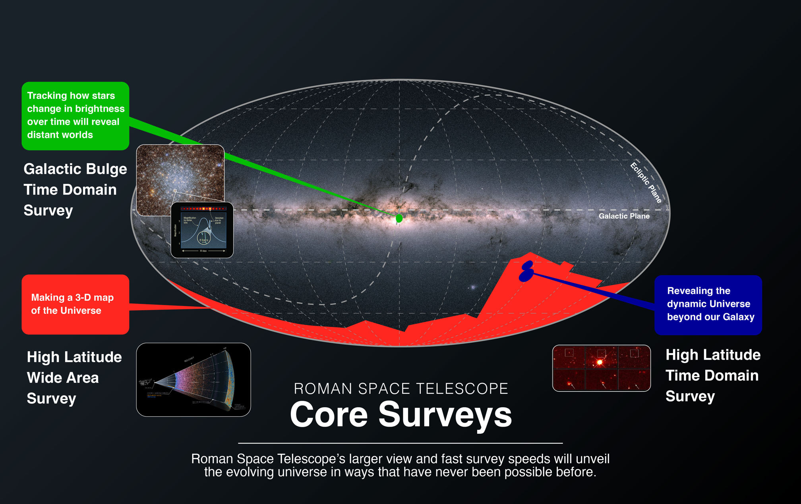

Slide 12
Keeping in touch with Roman
Join the Roman news mailing list
  sign up to the mailing list by sending an e-mail to Roman-news-join@lists.nasa.gov (no text in the body is required, put Roman in subject)
Monthly Roman Community Forum
  4TH Wed of each month at 4pm EDT
  https://asd.gsfc.nasa.gov/roman_forum/
Monthly Roman Virtual Lecture Series
  https://roman.ipac.caltech.edu/Lectures.html
Got a question?
  roman-help@bigbang.gsfc.nasa.gov (This will send your question simultaneously to the help desks of both Roman Science Centers (help@stsci.edu and roman-help@ipac.caltech.edu).

Slide 13
Backup

Slide 14
Working together with the WFI Science Community
Technical working groups that cut across all science areas
  Forum for people to work together on topics/methods that cut across science areas
  Brings together Science community, science centers, and project
  Have been very successful over past 5 years, recently broadened access, will add new groups soon
  Join by signing up here: https://asd.gsfc.nasa.gov/roman_signup/
Software
Calibration
Community-led Science Collaboration – starting later this year
  Facilitate the formation of a quasi-independent community-led collaboration
    With multiple working groups in specific science areas
  Enable people to engage with Roman science independently of NASA-selection
  Foster coordination and a sense of working as a single community
  Supported by science centers and project infrastructure teams
Planning a kickoff science meeting in October or early November
Notes:
The collaborations will be supported by the science centers and PITs, and will be led by the community

Slide 15
ROSES Selections Announced!
Wide Field Science - 18 selections
Coronagraph Community Participation - 7 selections
WFI Project Infrastructure Teams - 5 selections
Titles, abstracts, PI posted here:
  https://nspires.nasaprs.com/external/viewrepositorydocument?cmdocumentid=950761&solicitationId={1BD0AA55-40BB-1419-EEA1-64FF5B4269D3}&viewSolicitationDocument=1

Slide 16
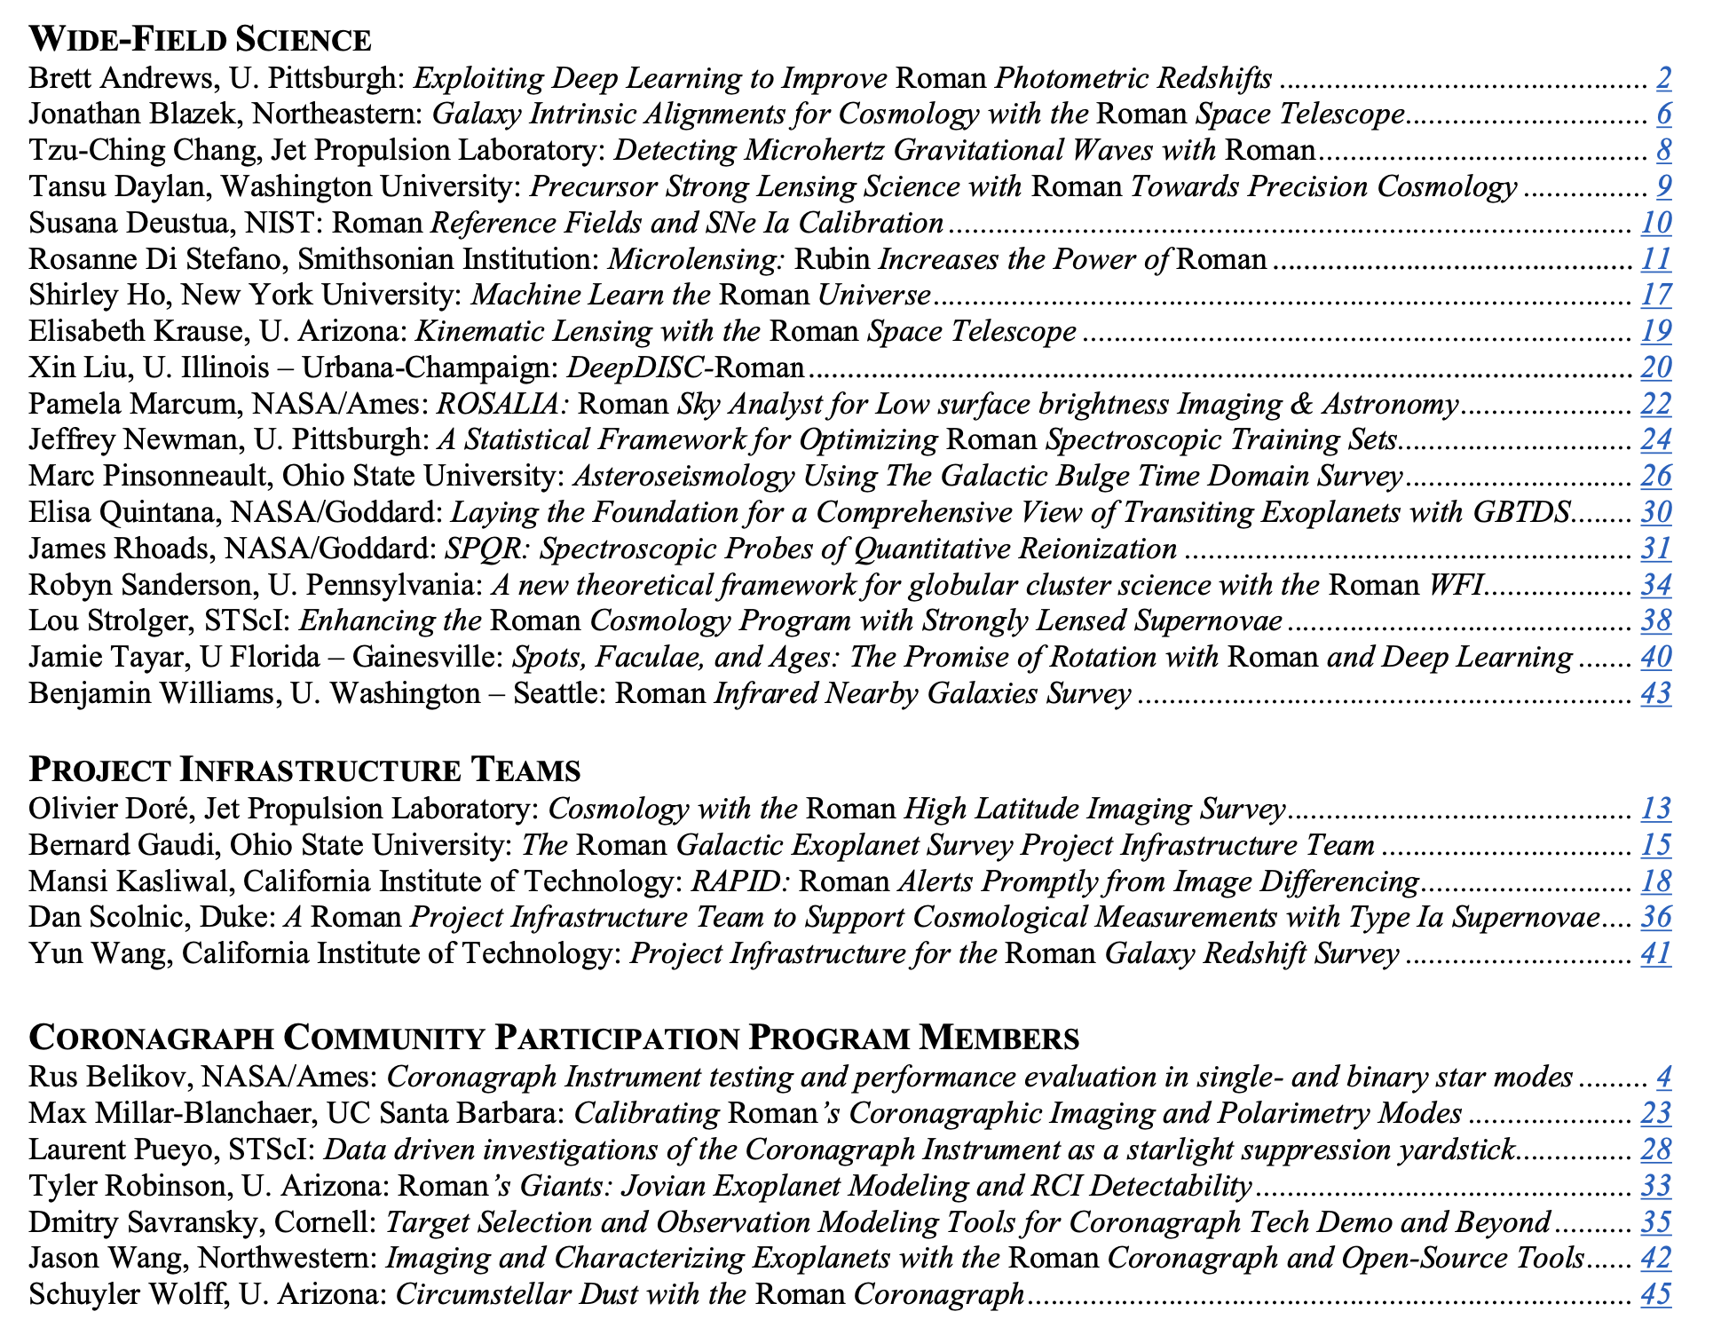
Forming Implementation Science Working Group soon: PIT PIs, CPP chairs, selected WFS members and project/science center representatives.
Chaired by project scientist

