Slide 1
EPO’s Rubin Component Library
Why we made it and how it could maybe help you too

Slide 2
Who is in our audience?
Have an application you’d like
to make a little more Rubin-y
Developers?
Looking for a talk you could check emails in?
Do you have developers
on your team?

Slide 3
What is EPO’s
Rubin component library?

Slide 4
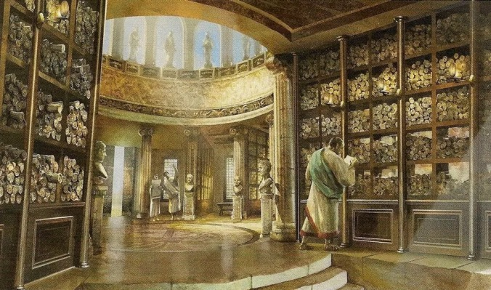
A modular library for rapid application development
Developed for React applications.
Primitive components, complex layouts, styling utilities, and astronomy widgets.
One-stop dependency to bootstrap a Rubin Observatory branded project.
EPO’s Rubin
Component Library
developers

Slide 5
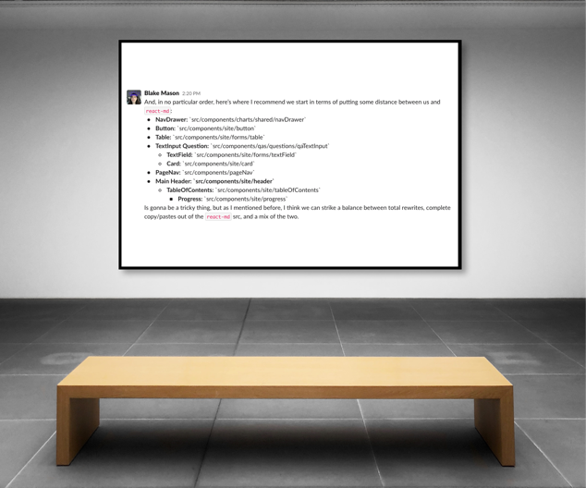
Why did we decide to make it?
At the end of FY2022, EPO planned development of multiple projects in FY2023
  Summit Status Dashboard
  Classroom Investigations 2.0
  Ongoing rubinobservatory.org improvements
Existing projects had fragmented dependencies and styling. Some UI libraries were at end of support.
Large number of branded component primitives were developed for rubinobservatory.org
“EPO React Library, origins”
December 20, 2021
medium: Slack

Slide 6
Aren’t there already libraries out there you could use?

Slide 7

You just have to re-style the components yourself
…and live with importing all their other code you don’t use…
…and hope the styles don’t change…
…and wait for maintainers to resolve issues…
…and make sure the library has
accessible features for each component…
…and that you won’t get left behind on the next big version…

Slide 8
Is it useful?

Slide 9
New projects have an entire suite of components with 0 setup time
More complex layouts benefit from the baseline accessibility provided by library components
Vendors can be handed libraries and begin development of Rubin-branded applications
Projects receive unified styling

Slide 10
Should I make my own library too?

Slide 11


Slide 12
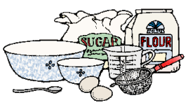
Ingredients
React
TypeScript
  Generating type interfaces for libraries is useful even if it’s used in JavaScript projects, IDE’s will still type-hint.
  Using TypeScript libraries is also a great starting point for converting projects to TypeScript.
styled-components
  CSS-in-JS solution that can easily style and restyle primitive components.
Storybook 7
  Display components in a React sandbox
Jest
  Write unit tests for each story
Vite
  Quick bundling tool
  Try out Turborepo, tell us how it is

Slide 13
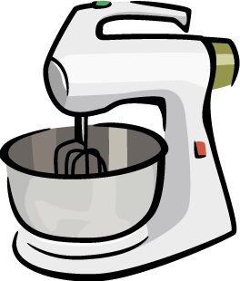
Recipe
Identify any reusable atomic/primitive components as a starting point
  button, link, image
  Make primitives especially very re-styleable, they are your building blocks!
Develop components in Storybook
  make use of addons to test responsiveness, accessibility, themes, unit tests
Build more complex components using your primitives
Bundle into a single module, or a module for each component (or both)
Release as a package and version, version, version
Optional: Structure your repository as a monorepo and add new
packages to your project.

Slide 14
That’s a bit of work… should I use yours?

Slide 15



Slide 16
React User Interface Components
38 React components ranging from primitives like buttons and links to complex layout modal, table, and carousel components.
  Includes Storybook examples, TypeScript interfaces, and unit tests.

Slide 17
Styling Tokens & Fonts
Global styling system based on Rubin Observatory visual identity. Includes basic CSS, CSS variables, font files, and JavaScript tokens.

Slide 18
Icons
66 icons used across Rubin EPO platforms, available from a single composer component.
Want to add your own icons? You can extend the Icon component with icons for your own project and still display all your icons with the same interface.

Slide 19
Astronomy Widgets

Slide 20
Web Interface
Public interface to browse EPO’s Rubin component library using Storybook.js. Includes examples, playground controls, unit test results, and callback logging
https://lsst-epo.github.io/epo-react-lib/@rubin-epo/epo-react-lib

Slide 21
Good candidates to use EPO’s Rubin component library
React and Next.js web applications oriented toward presenting textual and graphic information relating to the Rubin Observatory
Small development teams or solo developers looking to get started quickly
Teams interested in restyling web applications to follow the Rubin visual identity
Teams that use external contractors and want an easy styling handoff

Slide 22
Get it!
User interface components
npm install @rubin-epo/epo-react-lib
yarn add @rubin-epo/epo-react-lib
Widgets
npm install @rubin-epo/epo-widget-lib
yarn add @rubin-epo/epo-widget-lib

Slide 23

Contribute!
EPO’s Rubin component libraries are open source, open an issue or pull request to address bugs and features.
GitHub repository:
https://github.com/lsst-epo/epo-react-lib

Slide 24

alternatively, some planned discussion

