Slide 1
DOE Office of High Energy Physics
Cosmic Frontier
Funding Opportunities
August 9, 2023
Kathy Turner, Kathy.Turner@science.doe.gov
Bryan J. Field, Bryan.Field@science.doe.gov
Christopher Jackson (detailee) Christopher.Jackson@science.doe.gov

Slide 2
Research Funding Opportunities
As described in my slides shown on 8/8/23 in the Operations Plenary, the traditional/primary Funding Opportunity Announcements (FOA) used to fund scientific Research at universities are:
HEP Research FOA: This will no longer be the primary avenue for university faculty to request support for scientists starting with the FY2024 cycle and instead people should apply to the SC Open Call FOA.
SC Open Call FOA: This is SC’s annual, broad, FOA that covers all research areas in SC and is open throughout the Fiscal Year. HEP used to use it primarily for conferences, supplements to existing grants, and experimental operations. Starting in FY2024, it is now going to be used to collect HEP Research proposals, which will be then comparatively reviewed.
SC Early Career FOA: This is a highly competitive program open to faculty within 10 to 12 years of their PhD’s (used to be 10 years and expanded to 12 years during the pandemic)
In the next few slides, I will cover other funding opportunities, including for underserved people and institutions. You can see the full list of FOA’s at https://science.osti.gov/hep/Funding-Opportunities
→ FOA’s change often (e.g. PIER plan) – important to read and follow instructions carefully!
Notes:
As background for this crowd, what types of things the review panels look for in proposals
how effort aligned with HEP priorities
they can request funding for their full roles on a project can be described – doing effort to support HEP roles on the project, commissioning, operations in addition to data sims/analysis
Making critical, timely contribution to HEP project or exp operations and/or collaboration (e.g., writing software that is used by whole collaboration; participating in Rubin project or commissioning efforts, etc.), i.e., some “service” work, not just join collaboration and wait until data arrives
If you’re part of a group, explain your role in the group and what you bring to the table
Any leadership roles (head of the xyz committee or abc working group, lead commissioning efforts concentrating on the Camera)
How much of your research time throughout the whole year is on this; if you have 5 other grants, we assume you’re spending time on those too so need to explain how you will have time to make critical contributions for HEP research
We fund PI’s and their groups; need to make the case for why you need a postdoc, grad student and what they will do to get a rounded education (not just data analysis)
Pls call out if you’re doing AI/ML, how it helps your research, what fraction of your time, or of a grad stud or postdoc
PIER plans last year were criticized if ppl just pointed to what their univ is doing; reviewers wanted to know what the PI’s were actually doing.

Slide 3
SC Efforts in Broadening Participation
– Promoting Inclusive and Equitable Research (PIER) plans
SC is deeply committed to:
Supporting diverse, equitable, inclusive, and accessible work, research, and funding environments that value mutual respect and personal integrity;
Promoting people of all backgrounds, including individuals from groups and communities historically underrepresented and minoritized in STEM fields;
Advancing scientific discovery by harnessing a diverse range of views, expertise, and experiences to drive scientific and technological innovation.
As a reflection of this commitment, starting in FY2023, all SC Funding Opportunity Announcements (FOA) now require applicants to submit a Promoting Inclusive and Equitable Research (PIER) Plan as part of their proposal.
It is appropriate that we consider the effectiveness of an applicant’s record and plans for conducting research in an inclusive and equitable manner and for recruitment and mentoring in the allocation of research funds.
PIER plans should describe the activities and strategies applicants will incorporate in their own research groups to promote diversity, equity, inclusion, and accessibility in their individual research projects beyond the policies of the laboratory and/or university.
Notes:
see SC Statement of Commitment: https://science.osti.gov/SW-DEI/SC- Statement-of-Commitment and The Roadmap to Equity and Justice at the Department of Energy | Department of Energy

Slide 4
SC Efforts in Broadening Participation
– Promoting Inclusive and Equitable Research (PIER) plans
PIER plans will be evaluated as part of the merit review process:
  Scientific and/or Technical Merit of the Project;
  Appropriateness of the Proposed Method or Approach;
  Competency of Applicant’s Personnel and Adequacy of Proposed Resources;
  Reasonableness and Appropriateness of the Proposed Budget; and
  Quality and Efficacy of the Plan for Promoting Inclusive and Equitable Research
    Is the proposed Promoting Inclusive and Equitable Research (PIER) Plan suitable for the size and complexity of the proposed project and an integral component of the proposed project?
    To what extent is the PIER plan likely to lead to participation of individuals from diverse backgrounds, including individuals historically underrepresented in the research community?
    What aspects of the PIER plan are likely to contribute to the goal of creating and maintaining an equitable, inclusive, encouraging, and professional training and research environment and supporting a sense of belonging among project personnel?
    How does the proposed plan include intentional mentorship and are the associated mentoring resources reasonable and appropriate?
Notes:
see SC Statement of Commitment: https://science.osti.gov/SW-DEI/SC- Statement-of-Commitment and The Roadmap to Equity and Justice at the Department of Energy | Department of Energy

Slide 5
Reaching a New Energy Sciences Workforce for High-Energy Physics (RENEW-HEP)
RENEW initiative – started in FY2022
Reaching a New Energy Sciences Workforce (RENEW) provides research opportunities to historically underrepresented groups in STEM to diversify American leadership in the physical and climate sciences through internships, training programs, and mentor opportunities.
  https://science.osti.gov/Initiatives/RENEW
The HEP RENEW FOA ($4M in FY2022, $8M in FY2023, $10M requested for FY2024) is to support training and research experiences in high energy/particle physics for members of underserved communities, with the goals of supporting investigators and building research infrastructure at institutions which have not traditionally been part of the portfolio and encouraging underrepresented populations to pursue STEM careers.
  $50K - $500K per year; 3-year awards
  https://science.osti.gov/hep/Funding-Opportunities/-/media/grants/pdf/foas/2023/SC_FOA_0002949.pdf
This is the FY2023 FOA. There will certainly be changes for FY2024.
Notes:
$50K - $500K per year; 3-year awards

Slide 6
Funding for Accelerated, Inclusive Research (FAIR)
FAIR initiative – started in FY2023
Funding for Accelerated and Inclusive Research (FAIR) is aimed at undergraduate students and faculty to address place-inspired R&D and loss points of personnel in the field.
FAIR supports mutually beneficial relationships between Minority Serving Institutions (MSIs) and Emerging Research Institutions (ERIs) with partnering institutions to perform basic research in fields supported by the Office of Science.
  https://science.osti.gov/Initiatives/FAIR
  https://science.osti.gov/hep/Funding-Opportunities/-/media/grants/pdf/foas/2023/SC_FOA_0002931.pdf
This is the FY2023 FOA. There will certainly be changes for FY2024.

Slide 7
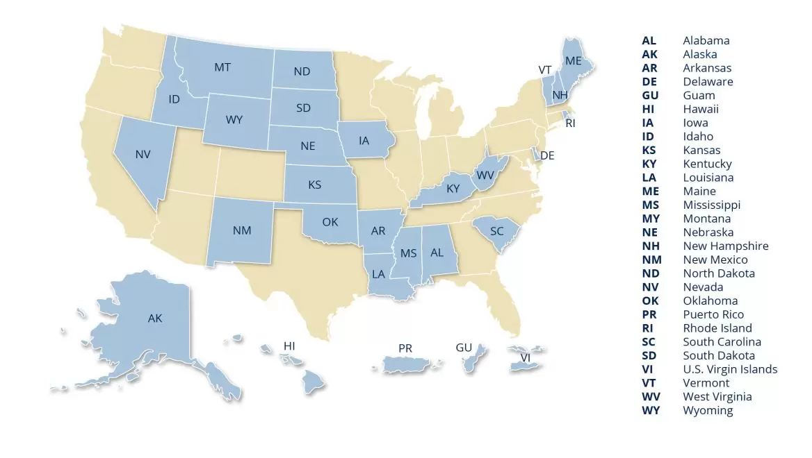
Established Program to Stimulate Competitive Research (EPSCoR) Implementation Grants
A federal-state partnership program designed to enhance the capabilities of designated states and territories to conduct sustainable and nationally competitive energy-related research.
EPSCoR topics vary year to year
For HEP, don’t apply for this directly
EPSCoR-State/National Laboratory Partnership Grants. A maximum period of three years. Award size is up to $750,000.
Implementation Grants. Renewable with a total maximum award period of 6 years. Up to $2.5M per year.
DOE Office of Science Early Career Awards
Office of Science Annual FOA (open call)
Currently limited to one proposal per institution per year
Alabama, Alaska, Arkansas, Delaware, Guam, Hawaii, Idaho, Iowa, Kansas, Kentucky, Louisiana, Maine, Mississippi, Montana, Nebraska, Nevada, New Hampshire, New Mexico, North Dakota, Oklahoma, Puerto Rico, Rhode Island, South Carolina, South Dakota, Vermont, US Virgin Islands, West Virginia, and Wyoming.
Notes:
For research efforts to HEP FOA is that people can *also* apply for an EPSCoR grant thru the General Open Call. This goes to a central SC office which reviews it; if it reviews well *and* we have funds, it would typically be funded partially by these special EPSCOR funds and partly by the HEP research funds.
We (HEP) do a cost sharing, typically 10%

Slide 8
Workforce Development for Teachers and Scientists (WDTS)
Workforce Development Programs
Programs to work at a DOE lab:
  Community College Internships (CCI); Science Undergraduate Laboratory Internships (SULI); SC Graduate Student Research fellowships (SCSGR); Visiting Faculty Program; Albert Einstein Distinguished Educator Program (K-12)
  https://science.osti.gov/wdts
  https://science.osti.gov/wdts/scgsr
DOE Scholars Program – Work at DOE or a lab
  https://orise.orau.gov/doescholars/
HEP traineeship FOA’s in Instrumentation, Accelerator R&D, and Computing – to address critical, targeted workforce development in areas of interest to our mission.
Lab Programs
DOE labs have specific workforce development & community programs aimed at a diversity of educational levels.
HEP Traineeships
Notes:
The goal of the Office of Science Graduate Student Research (SCGSR) program is to prepare graduate students for science, technology, engineering, or mathematics (STEM) careers critically important to the DOE Office of Science mission, by providing graduate thesis research opportunities at DOE laboratories.
Community College Internships (CCI): Supports students to work at a DOE laboratory, encouraging STEM careers
Science Undergraduate Laboratory Internships (SULI): Supports undergraduate research at a DOE lab, 10 to 16 weeks
SC Graduate Student Research fellowships (SCSGR): Supports grad student research at a DOE lab, 3 to 12 months
Visiting Faculty Program: Summer research support for faculty/students from historically underrepresented institutions
Albert Einstein Distinguished Educator Program: K-12 educators in STEM fields work in Federal agencies or US Congressional Offices; applying their knowledge to the national education program.

Slide 9
Notes, Reminders:
DOE, SC, and HEP are mission oriented
HEP proposals for research support that review well are typically those in which the PI’s are carrying out critical, timely roles in our program, aligned with our roles and responsibilities, and as part of a scientific collaboration.
HEP’s annual PI meeting will be held next week (virtually). There will be talks on the overall HEP program, on the Cosmic Frontier, and on specifics of the FOA’s. You also have the opportunity to set up a one-on-one meeting with the Cosmic Frontier program managers (send email to Bryan.Field@science.doe.gov to set up a meeting)
➔You need to register ASAP on the meeting www site: https://www.orau.gov/heppi2023
When applying for funding:
READ the FOA CAREFULLY.
You are responsible for addressing all requirements, which often have changes year to year, e.g.
  Some require a Letter of Intent, some don’t.
  A PIER plan is required (as of FY2023).
Have questions? We are here to help.
→Send an email to one/more of the program managers.

