Slide 1
New Cosmology Constraints from HSC Year 3 Weak Lensing Data:
Lessons Learned for Rubin Observatory
Roohi Dalal and the HSC Weak Lensing Working Group

Slide 2
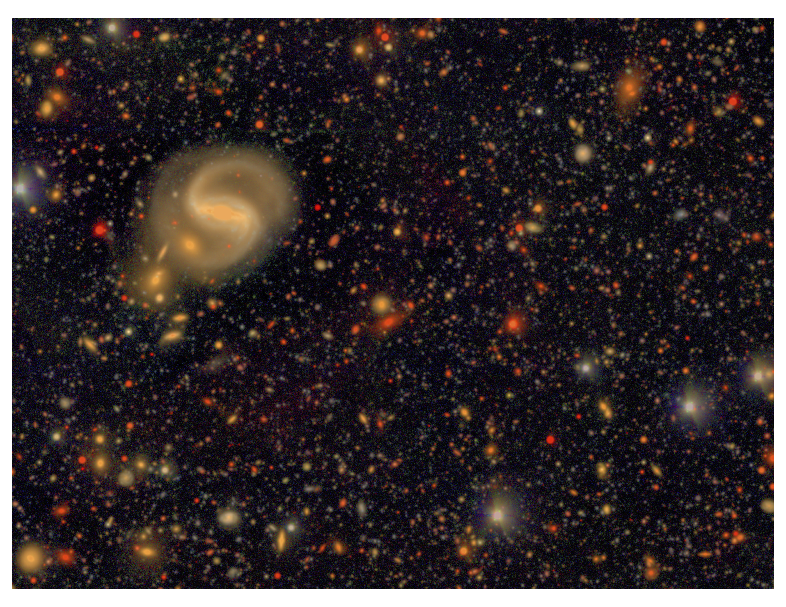
Hyper Suprime-Cam Survey
Imaging survey using the 8.2 m Subaru telescope.
1.5 degree FOV
5 band survey (grizy)
Depth ~ 26 mag
i-band median seeing: 0.6 arcsec
Data processed with hscpipe fork of Rubin Science Pipelines.
Y3 data release covers ~450 deg²
HSC COSMOS Ultra-Deep Field
Notes:
Depth enables us to probe high redshifts, seeing gives us excellent image quality

Slide 3
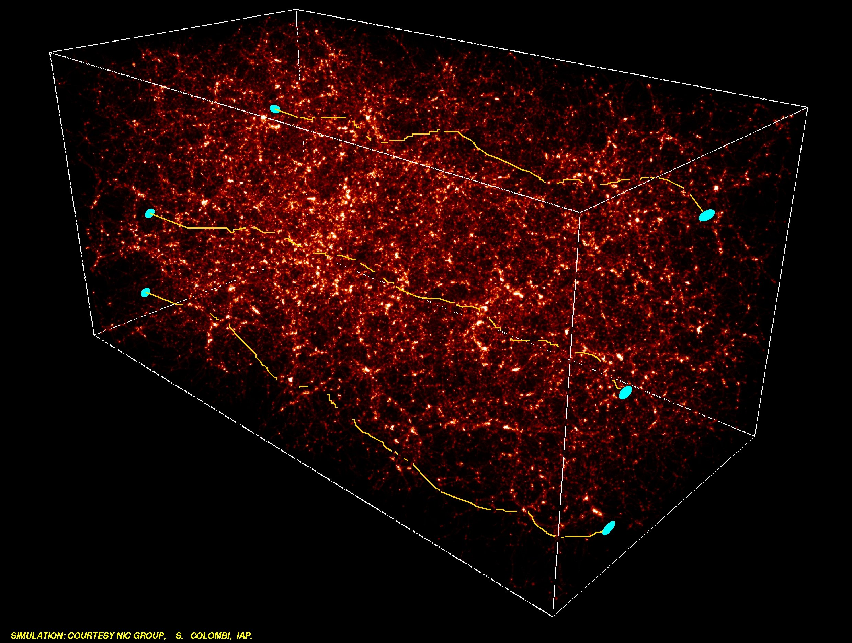
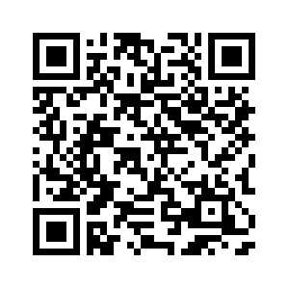
HSC Y3 Cosmological Analyses
Cosmic shear power spectra (Dalal et al. 2023)
Cosmic shear two-point correlation functions (Li et al. 2023)
3x2pt measurement (More et al. 2023)
3x2pt analysis, large scales (Sugiyama et al. 2023)
3x2pt analysis, small scales (Miyatake et al. 2023)
In addition to many other ongoing analyses!
Galaxy-galaxy lensing
Clustering
Cosmic
shear
All HSC Y3 cosmology papers can be found here:

Slide 4
Cosmic Shear Power Spectra
A high-significance measurement of the auto and cross-correlation power spectra in four tomographic redshift bins between $z=0.3$ and $z=1.5$ (SNR ~ 26.5).
We fit cosmological parameters by modeling the power spectra using 23 free parameters:
  5 cosmological
  6 astrophysical – accounting for baryonic feedback and intrinsic alignments
  12 observational systematics – point spread function, shear calibration, source redshift distribution
← Increasing redshift
Increasing redshift →

Slide 5
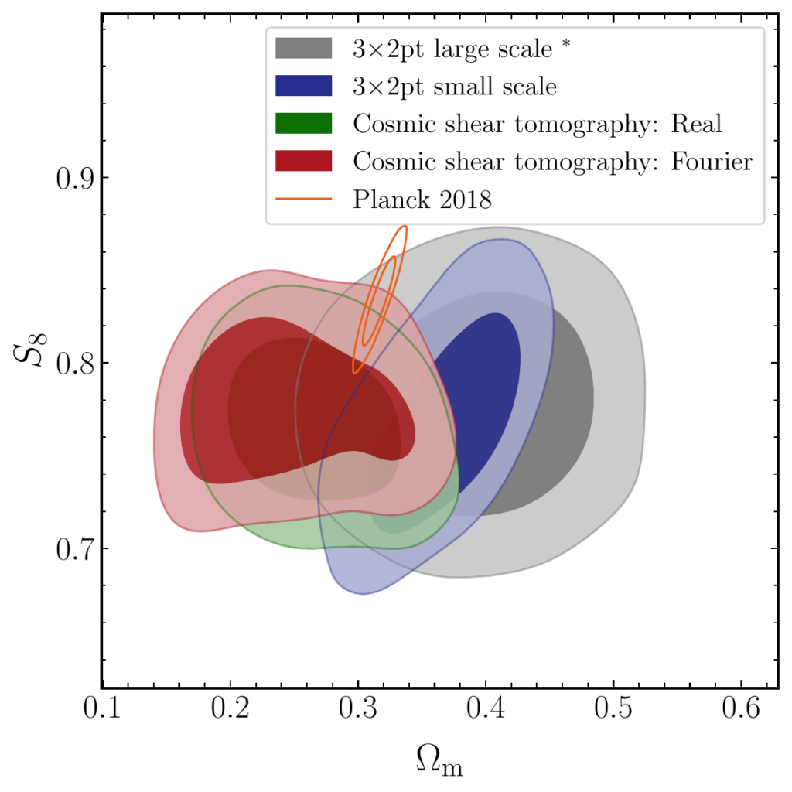
Results
Cosmic shear power spectrum analysis obtains a 4% precision constraint on the clumpiness of the matter distribution:
$$S_{8}≡σ_{8}\sqrt{Ω_{m}/0.3}= {0.776}_{−0.033}^{+0.032}$$
This is in $2σ$ tension with the constraint from cosmic microwave background anisotropies (Planck 2018).
All four HSC Y3 analyses get consistent constraints on the $S_{8}$ parameter.

Slide 6
Lessons Learned

Slide 7
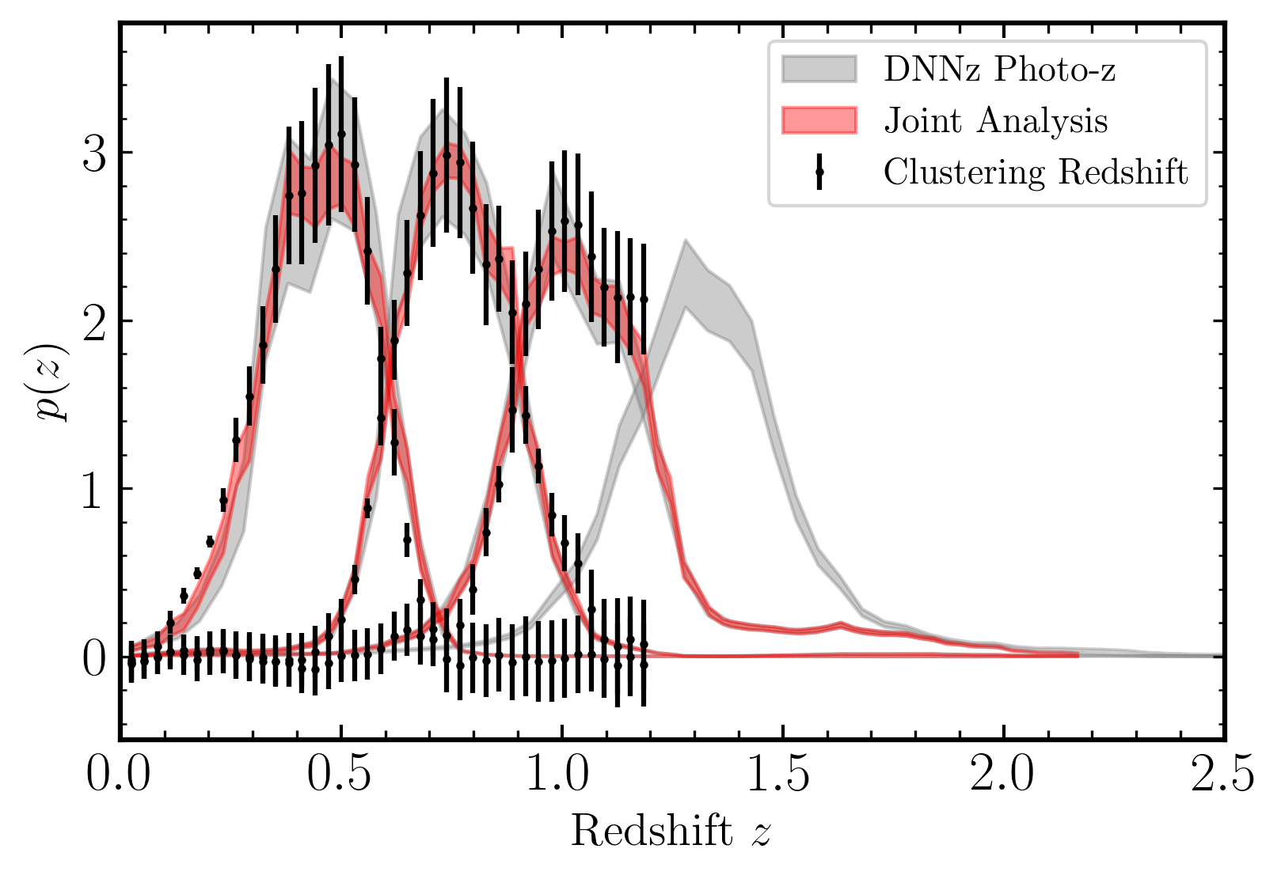
High redshift photo-z calibration is a limitation
Redshift bin 3 ($0.9<z≤1.2$) is only partially calibrated by clustering redshifts and bin 4 ($1.2<z≤1.5$) is not at all calibrated.
We find that bin 3 is biased low by $∆z \sim 0.08$, and bin 4 by $∆z \sim 0.16.$
Improved photo-z training and calibration data will be necessary for Rubin.
Source Redshift Distribution Inference (Rau et al. 2023) combines photometric information with clustering redshift from an LRG sample.

Slide 8
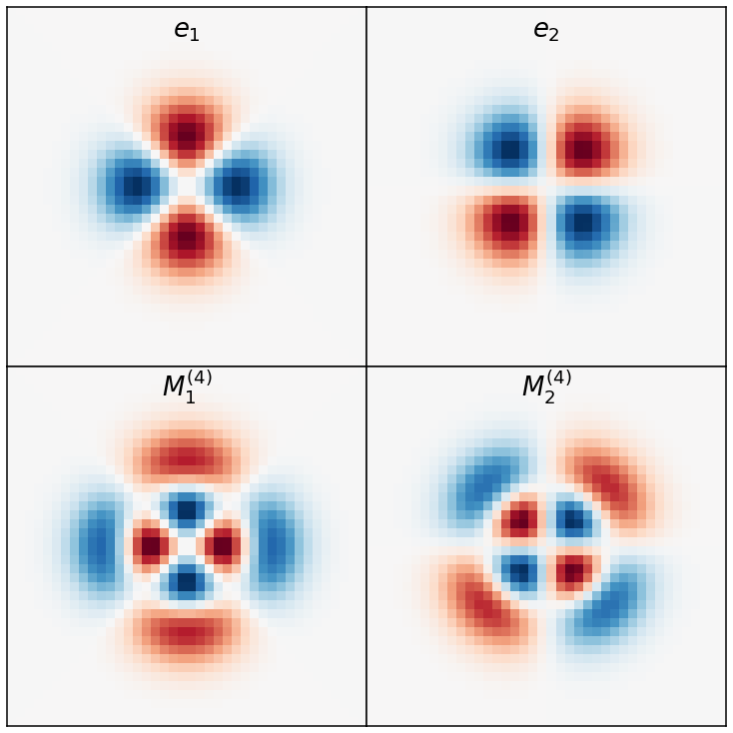
Higher order PSF moments matter
The point spread function (PSF) can contaminate measured galaxy shapes if the PSF model is incorrect, or if the PSF deconvolution is imperfect.
Most cosmic shear analyses only account for systematics due to the second moments of the PSF.
We find that the fourth moments of the PSF are the dominant contribution to the bias in the measured shear (Zhang et al 2023).
Rubin will need to model fourth moments and test the impact of even higher order moments.
Image response to the second (top row) and fourth (bottom row) moments of the PSF.

Slide 9
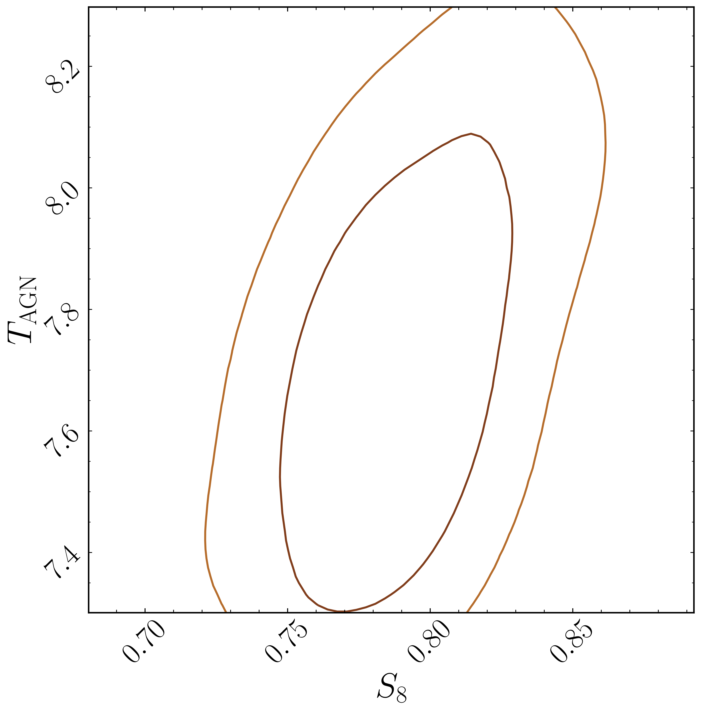
We need improved models of baryonic feedback
Detection of baryonic feedback in our analysis:
$T_{AGN}= {7.68}_{−0.25}^{+0.27}$ (similar level of feedback as owlsAGN simulations).
Not modeling baryons leads to a 0.5σ shift in $S_{8}$ to a lower value – likely to be more significant for Rubin.
Modeling feedback will be necessary for Rubin to make use of the data it collects at small scales.
I’m currently working to develop a principled methodology to select the optimal scale cuts + baryon model to jointly constrain cosmology and feedback.
Stronger baryonic feedback →

Slide 10
For more information:
Come find me or email me at rdalal@princeton.edu.
Get in touch with other members of the HSC Weak Lensing Working Group (junior members include: Xiangchong Li, Markus Rau, Sunao Sugiyama, Tomomi Sunayama and Tianqing Zhang).
See https://hsc-release.mtk.nao.ac.jp/doc/index.php/wly3/ (QR code below)

