Slide 1
DIA on DC2
Artifact Analysis and Algorithm Improvement
Shu Liu
Advisor: Michael Wood-Vasey
University of Pittsburgh

Slide 2
This talk will cover
Run AL algorithm with different configuration parameters on DC2
Analyzing DIA Source table
  How to use flags from diaSrc table to identify subtraction artifacts
Artifact Morphology
  Postage stamps of subtraction artifacts
  Possible causes of artifacts
Future Work

Slide 3
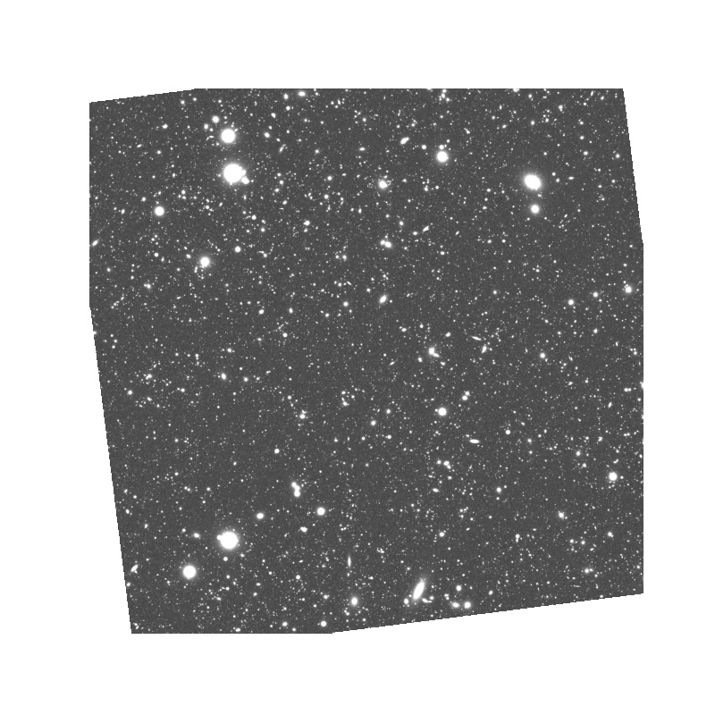
What is image difference?

Slide 4
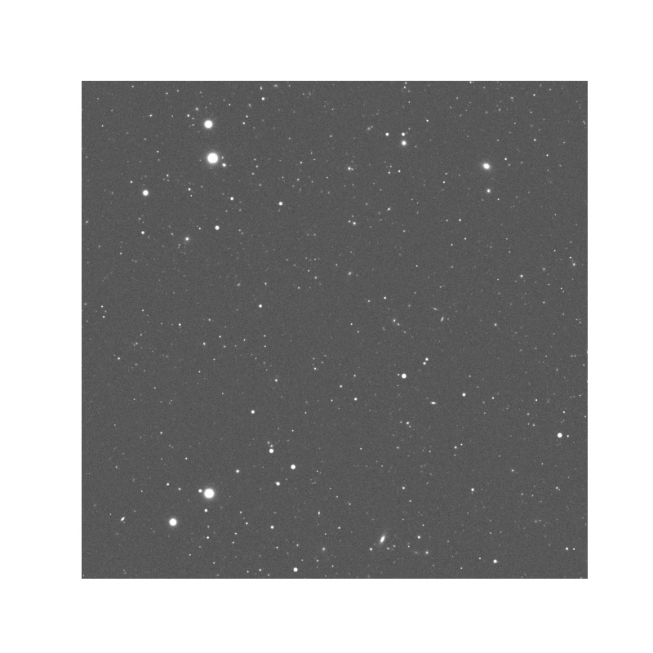
What is image difference?

Slide 5
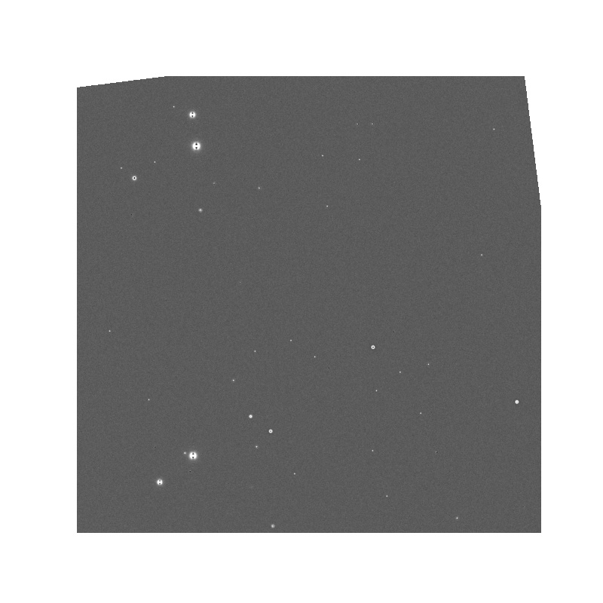
What is image difference?

Slide 6
DIA Analysis
We evaluate the LSST Science Pipelines Difference Image Analysis (DIA) pipeline using synthetic source injection technique.
Dataset: DC2 Dataset, Run 2.2i, i band
Stack Version: v23.0.0
Software: dia_pipe (DESC → Rubin)
Subtraction Algorithm: Alard-Lupton (AL) algorithm
Injected Magnitude: MAG20, MAG23
We choose 7 deepCoadds as templates. For each deepCoadd, we select 10 calexp exposures which overlap with the coadd. We have 70 image pairs in total.

Slide 7
Flags from diaSrc Table

Slide 8
Base Pixel Flags
Flag | Efficiency (MAG20) | Artifact Rate (MAG20) | Efficiency (MAG23) | Artifact Rate (MAG23)
no flag applied | 1.000 | 695 | 0.847 | 700
base_PixelFlags_flag_saturated | 1.000 | 337 | 0.847 | 343
base_PixelFlags_flag_saturatedCenter | 1.000 | 340 | 0.847 | 345
base_PixelFlags_flag_edge | 1.000 | 556 | 0.847 | 561

Slide 9
Dipole Flags
Flag | Efficiency (MAG20) | Artifact Rate (MAG20) | Efficiency (MAG23) | Artifact Rate (MAG23)
no flag applied | 1.000 | 695 | 0.847 | 700
ip_diffim_DipoleFit_flag_classification | 0.999 | 474 | 0.846 | 480
ip_diffim_DipoleFit_flag_classificationAttempted | 0.999 | 472 | 0.846 | 478

Slide 10
Shape Flags
Flag | Efficiency (MAG20) | Artifact Rate (MAG20) | Efficiency (MAG23) | Artifact Rate (MAG23)
no flag applied | 1.000 | 695 | 0.847 | 700
base_SdssShape_flag | 1.000 | 161 | 0.791 | 157
base_GaussianFlux_flag_badShape | 1.000 | 161 | 0.791 | 157
slot_Shape_flag | 1.000 | 161 | 0.791 | 157

Slide 11
Union of Flags
Flag | Efficiency (MAG20) | Artifact Rate (MAG20) | Efficiency (MAG23) | Artifact Rate (MAG23)
no flag applied | 1.000 | 695 | 0.847 | 700
Union of Flags | 0.999 | 69 | 0.791 | 68

Slide 12
Artifact Morphology

Slide 13
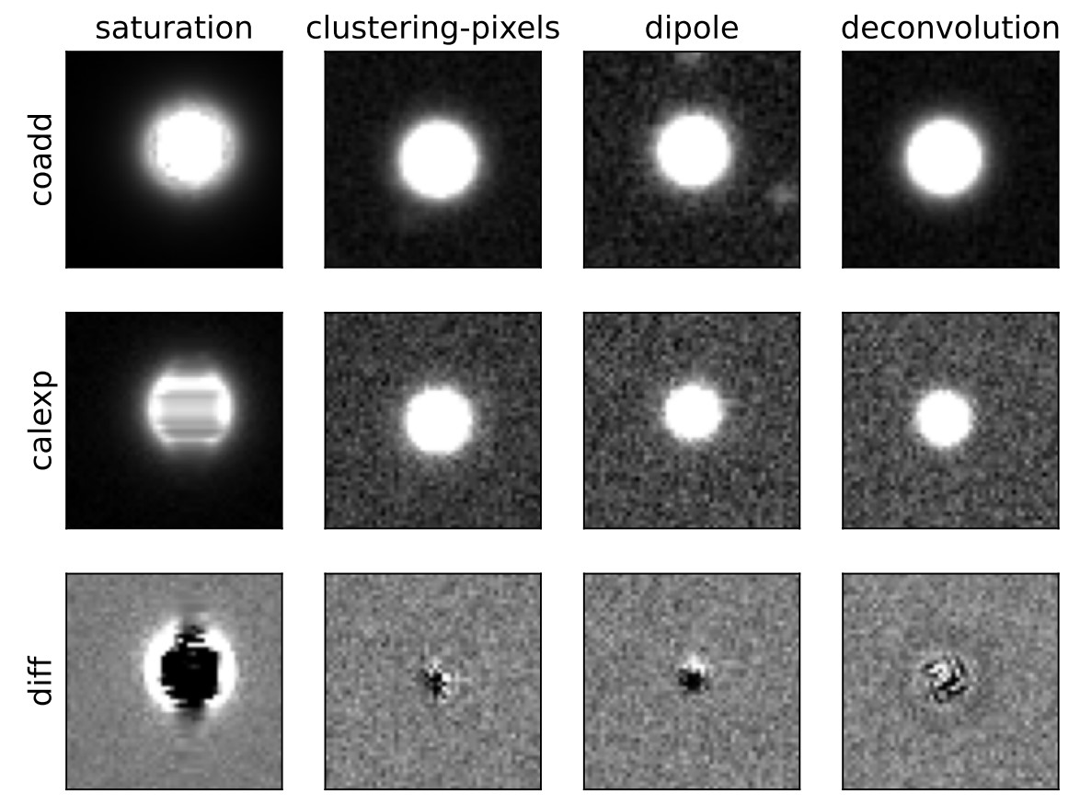
Artifact Morphology

Slide 14
PSF Full Width at Half Maximum (FWHM)
To study what causes subtraction artifacts, we split image pairs into three groups based on the difference between the calexp PSF fwhm and coadd PSF fwhm. We define the PSF ratio as,
PSF Ratio (r) = ( Calexp FWHM - Coadd FWHM ) / Coadd FWHM
The three groups are defined as
Group Name | PSF Ratio
Broad | r >= 0
Near | -0.05 < r < 0
Sharp | r <= -0.05

Slide 15
Artifact Fraction
 | Broad MAG20 | Near MAG20 | Sharp MAG20
Saturation Flags | 51.9% | 47.6% | 53.3%
Dipole Flags Only | 1.5% | 2.9% | 3.1%
Shape Flags Only | 25.1% | 24.8% | 21.8%
Both Dipole Flags and Shape Flags | 12.3% | 12.7% | 12.1%
Remaining | 9.3% | 11.9% | 9.7%

Slide 16
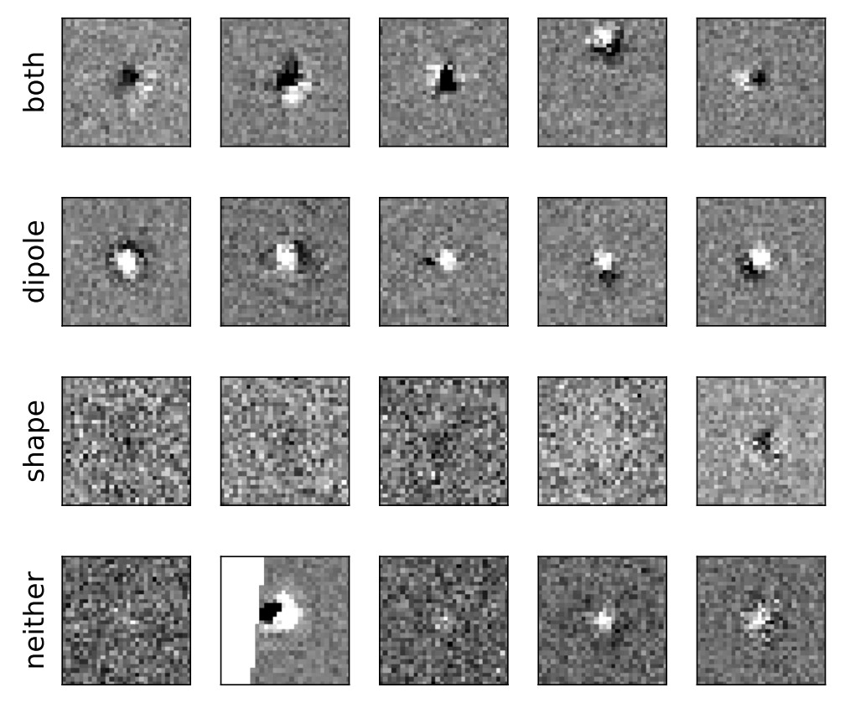
Postage Stamps: Broad

Slide 17
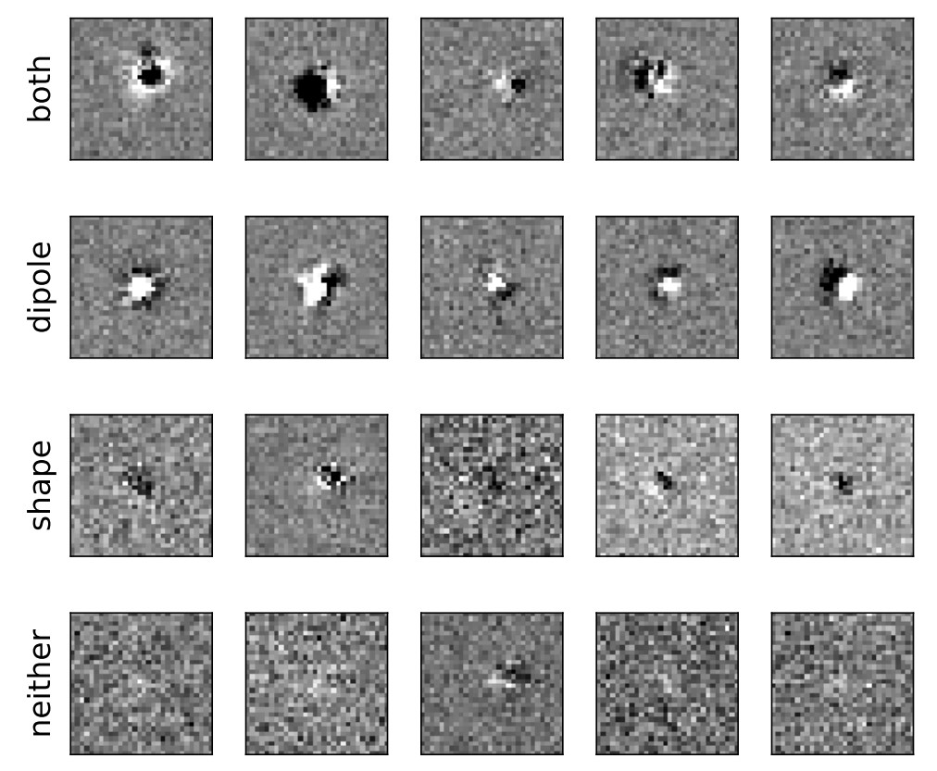
Postage Stamps: Near

Slide 18
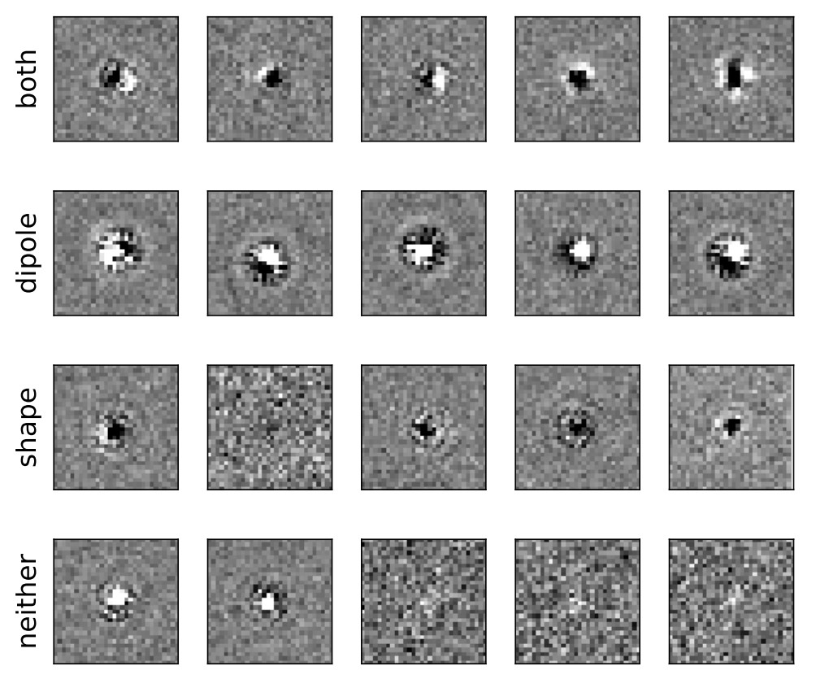
Postage Stamps: Sharp

Slide 19
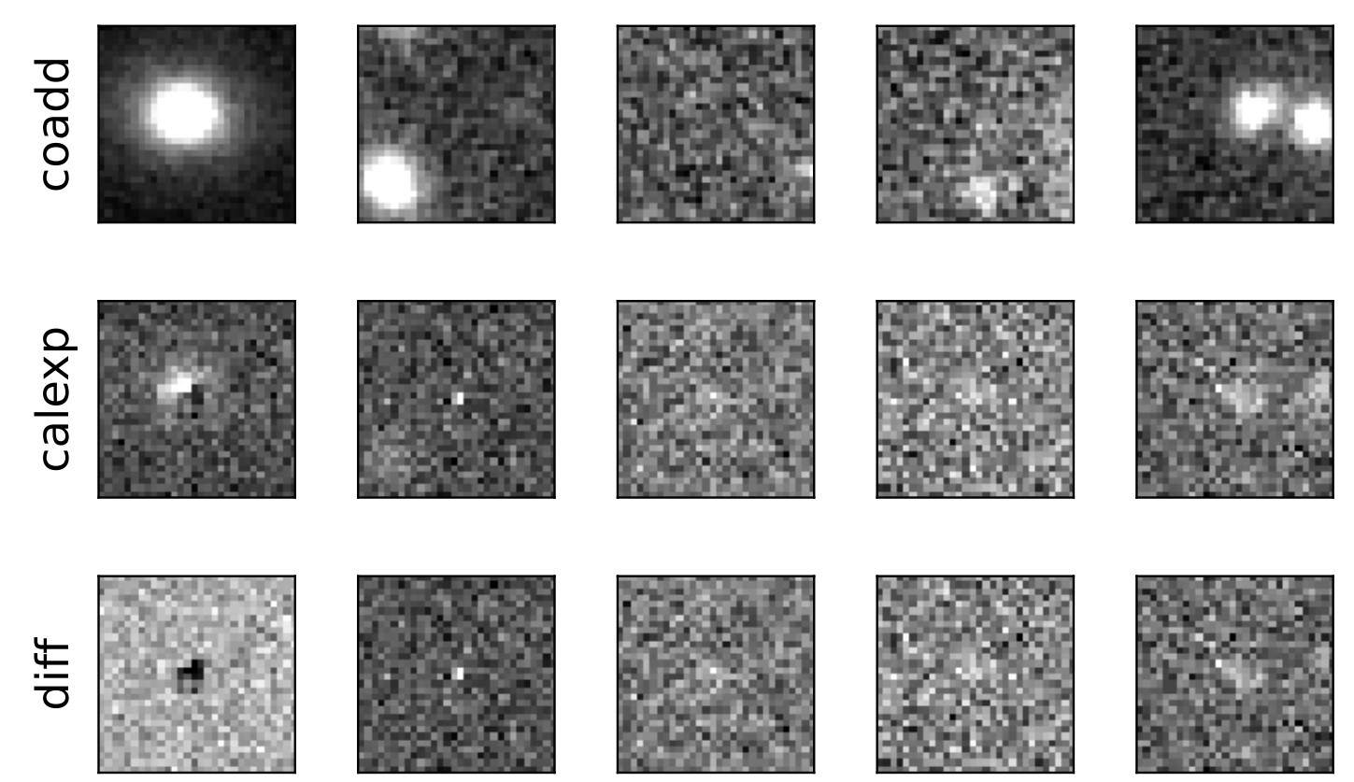
Postage Stamps: Faint Host

Slide 20
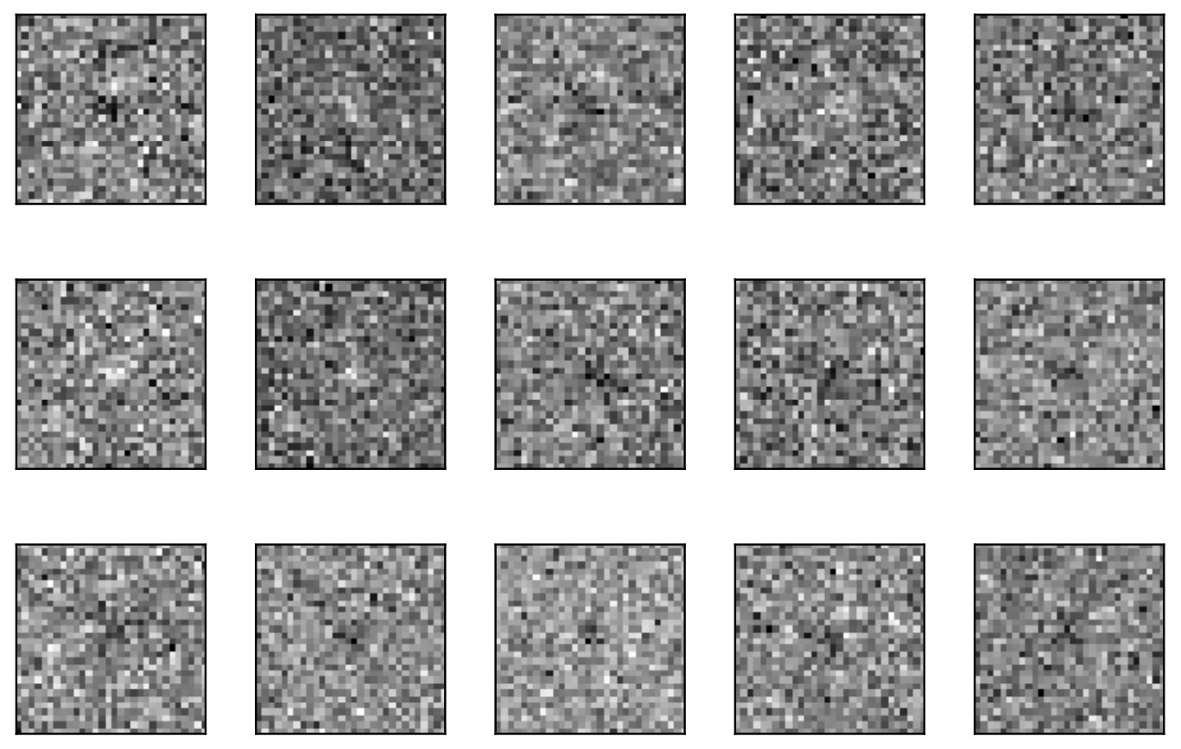
Postage Stamps: Background noise

Slide 21
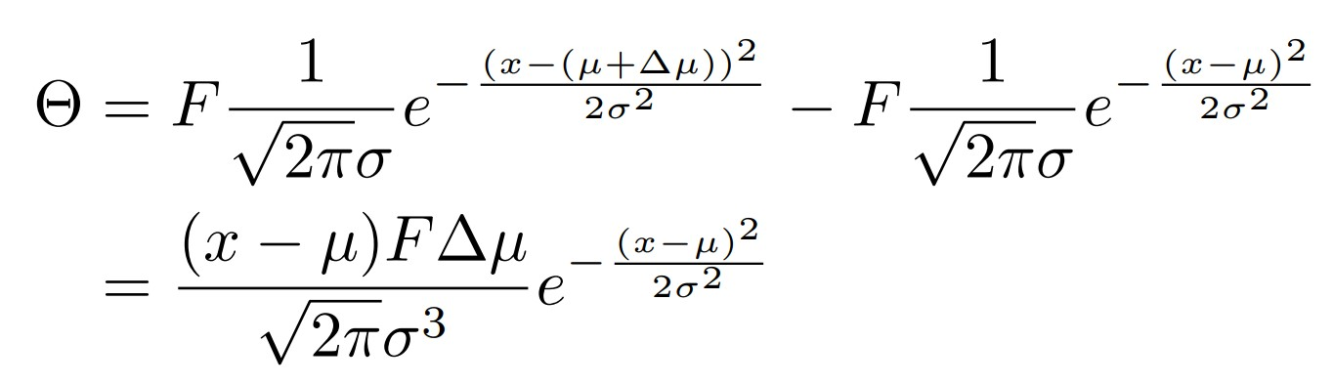
Dipole Artifacts
1st order

Slide 22
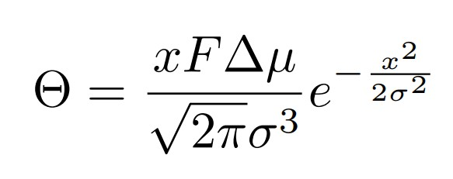
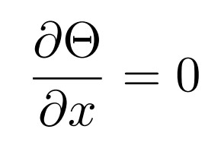

Dipole Artifacts
Flux and star separation are degenerate. Bright and closely separated stars can produce the same artifact as the faint and largely separated stars.
Even small perturbation can produce visible artifact if the stars are bright.
The distance between peak pixels are always 2 sigmas. The detected dipole artifacts have the same shape.

Slide 23
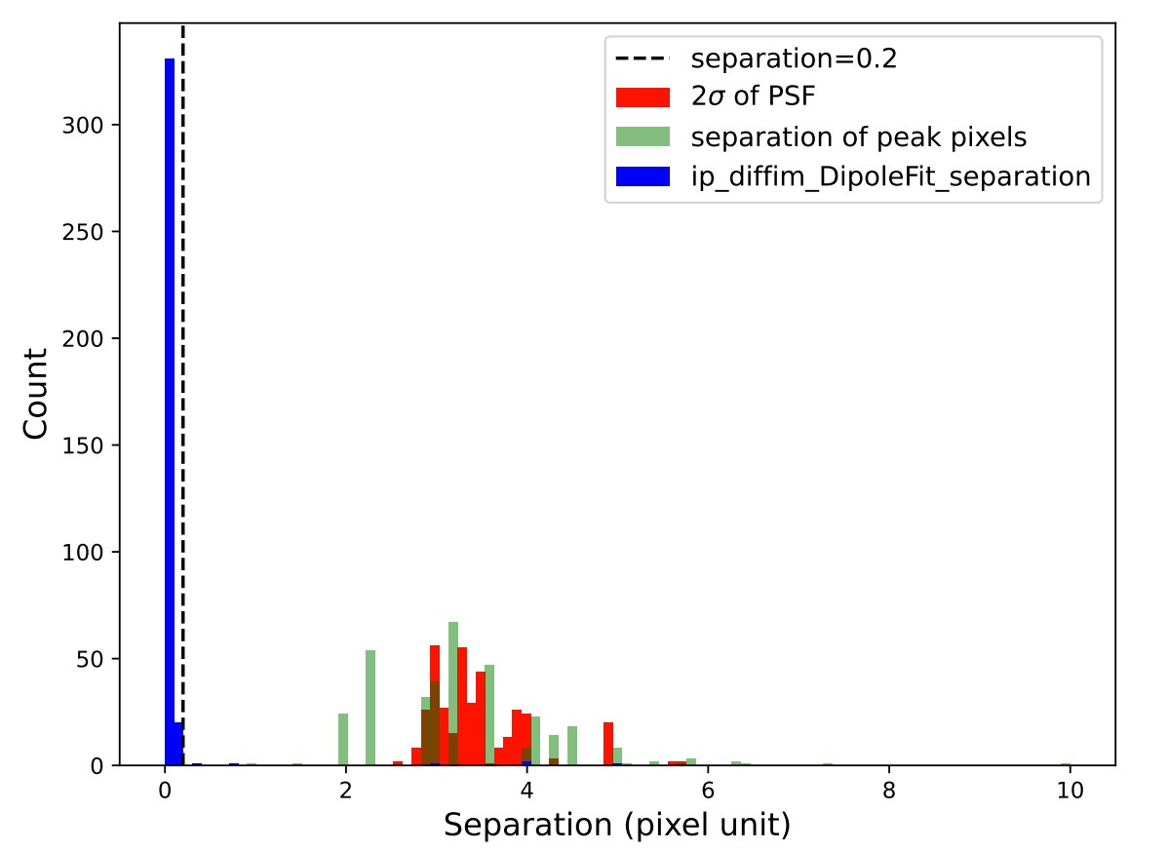
2-sigma distribution

Slide 24
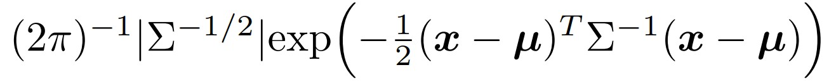
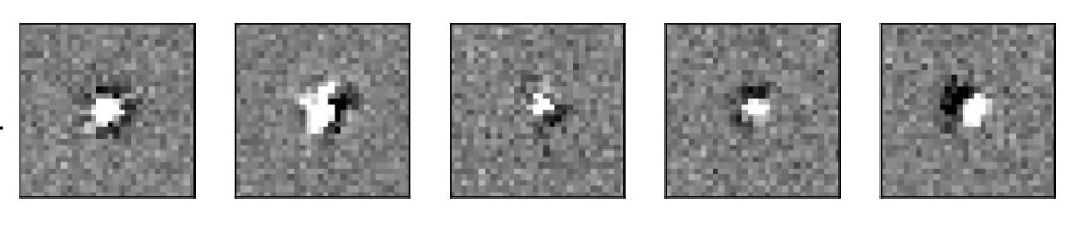

Slide 25
Future Work

Slide 26
Possible Improvements
Include more bright sources for kernel fitting
Most artifacts are subtraction residuals of bright background sources. Including more bright sources for kernel fitting could help the kernel to fit the sources more accurately. Also, small perturbations are only visible in the bright region. We need bright sources to help us correct the fitting error.
Use higher spatial degree of freedom
Due to the warping and resampling of the template image, and the spatial variation of the PSF, the perturbation of the background sources would vary spatially. We need higher spatial degree of freedom to find the optimal kernel.

Slide 27
Possible Improvements
3. Use Delta bases with regularization
Traditional Gaussian-Polynomial basis requires us to select hyperparameters of the kernel bases.
Using the shape-free delta bases can avoid this issue. However, Delta bases may overfit the noise due to the flexibility of the kernel. We should consider regularization to avoid overfitting.
4. Use a second kernel to fit the difference image
Traditional DIA uses only one kernel k to fit the template image (T) to the science image (S).
D = S - k * T （*: convolution）
We can use a second kernel k’ to fit T to D as
D’ = D - k’ * T = S - k*T - k’T = S - (k+k’) * T
The second kernel might also inadvertently fit true transient sources.
We need to carefully test this method by tracing the detection efficiency of synthetic sources.

Slide 28
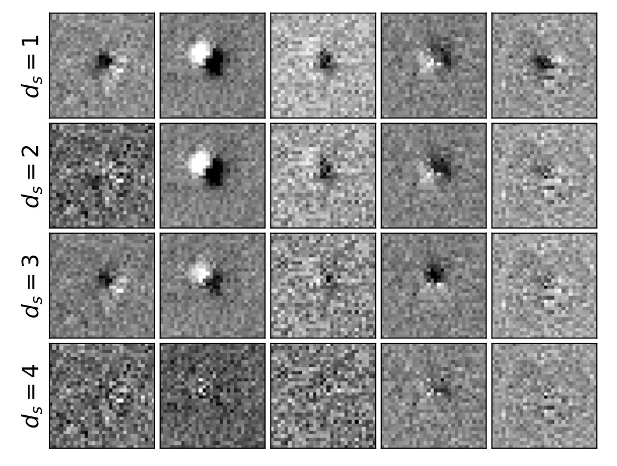
Kernel Spatial Degree of Freedom

Slide 29
Spatial Degree of Freedom (MAG23)
SDoF | Mean | Std | Efficiency | Artifact Rate
1 | 0.096 | 1.000 | 0.847 | 700
2 | 0.090 | 0.999 | 0.840 | 693
3 | 0.088 | 1.011 | 0.843 | 651
4 | 0.092 | 1.006 | 0.852 | 608

Slide 30
Conclusion
The LSST Science Pipelines subtractions on DC2 data look very good.
The DIA source catalogs are comprehensive and include flags to identify most subtraction artifacts
Half of the subtraction artifacts are saturation artifacts, which can be easily identified by flags.
Other artifacts are clustering-pixels, dipoles, and deconvolution artifacts. Some identified by flags.
Most artifact are subtraction residuals of bright sources. These artifacts can be explained using perturbation theory. For Gaussian sources, its residuals are polynomial-scaled Gaussians.
Including more bright sources for fitting, using more flexible kernel bases with spatial variation, and fitting a second kernel may help us reduce subtraction artifacts.
Thank You!

