Slide 1
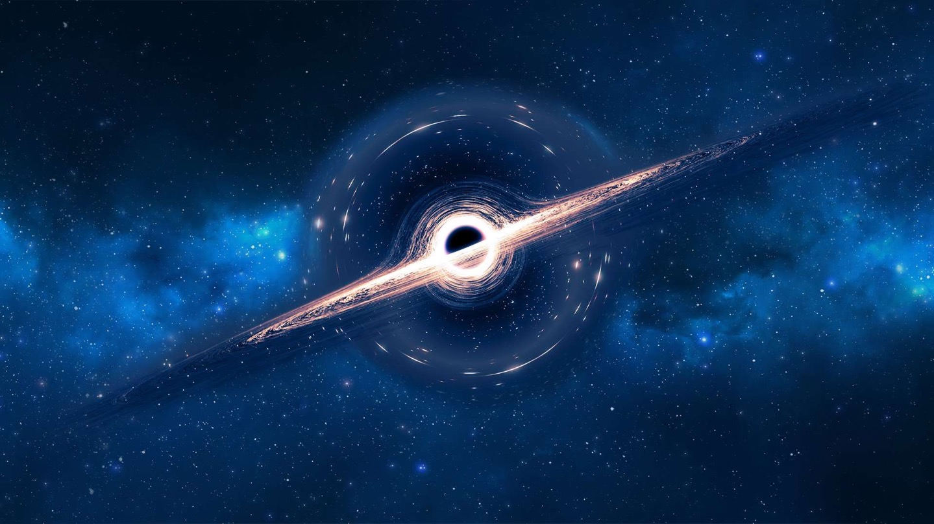
Black Hole Hunters: A Future Microlensing Search for Quiescent Black Holes With LSST?
Adam McMaster
The Open University

Slide 2
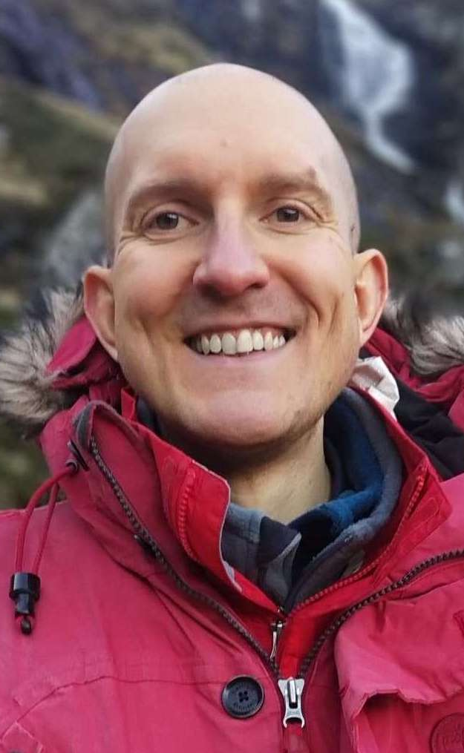
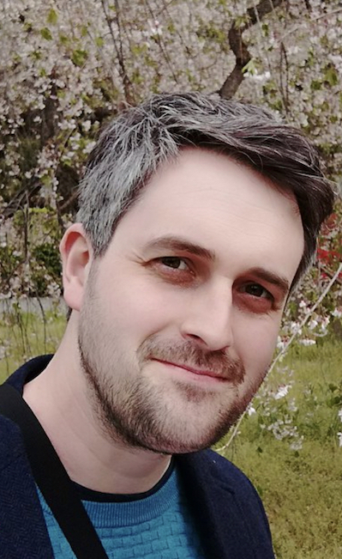
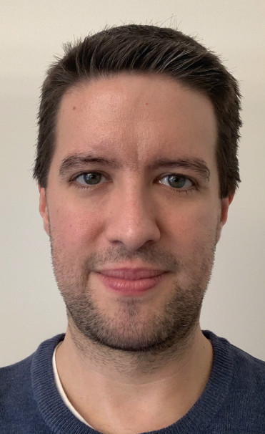
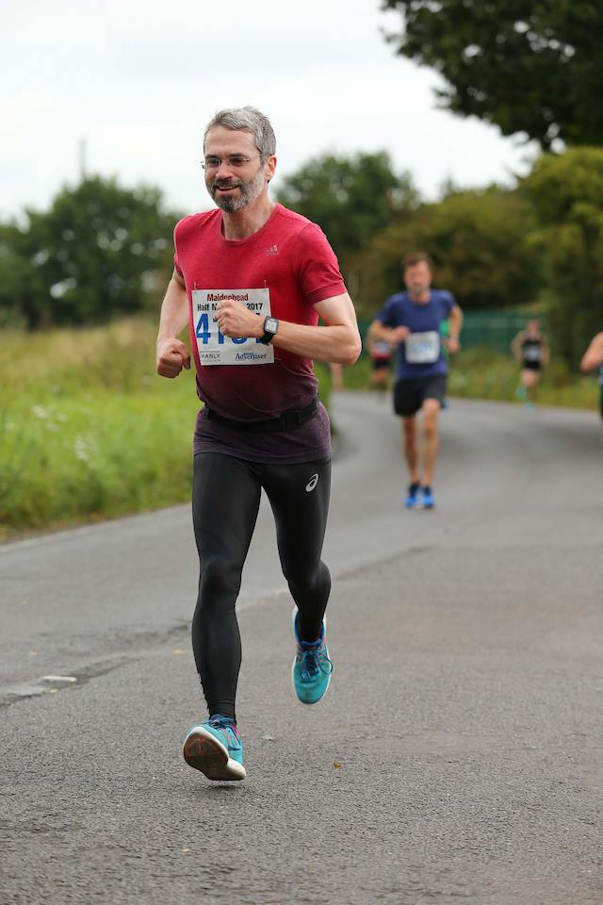
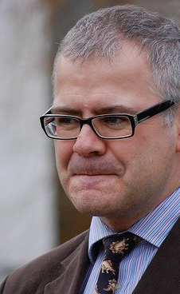
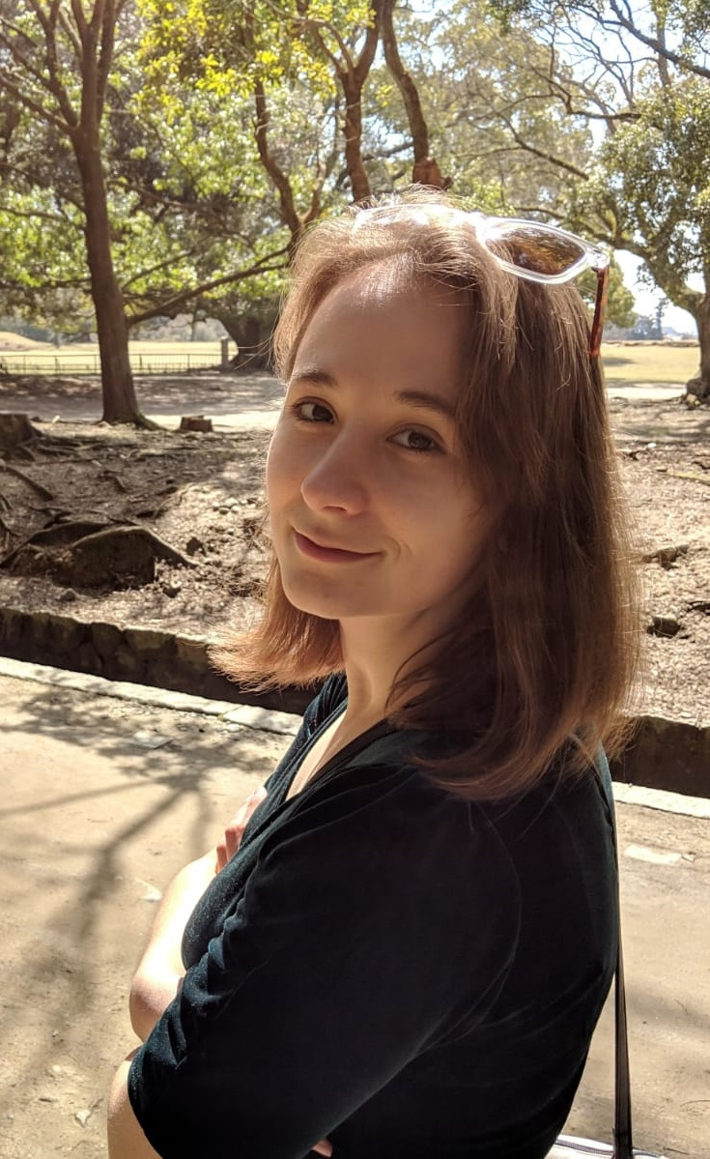
The Black Hole Hunters Team
Hugh Dickinson
Matthew Middleton
Adam McMaster
Stephen Serjeant
Andrew Norton
Heidi Thiemann

Slide 3
The Undiscovered Black Hole Population
Estimated numbers from El-Badry+ 2023, arXiv:2302.07880

Slide 4
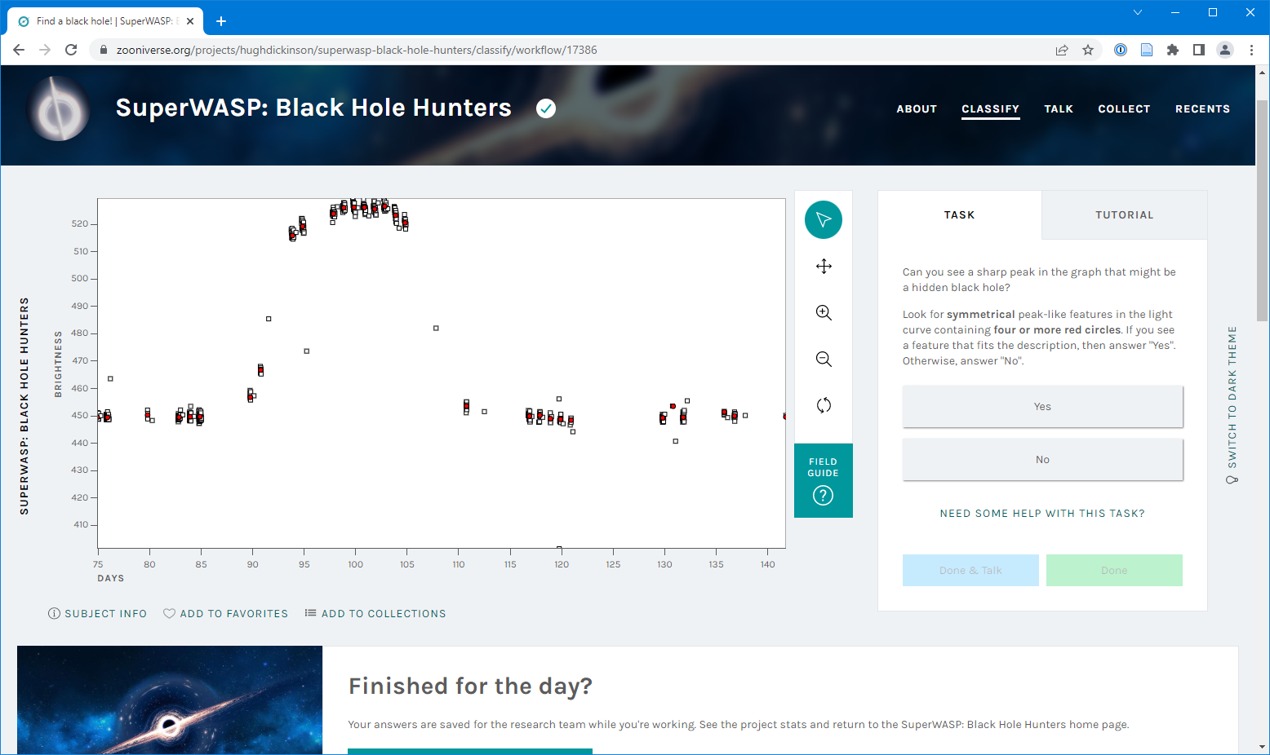

Slide 5
5,652 volunteers
2.1 million classifications
208,700 completed subjects

Slide 6
Candidate Analysis
Aggregate Zooniverse classifications
Manually remove false positives
Fit computer models
Follow up on promising candidates (can we find supporting evidence?)
I am currently here

Slide 7
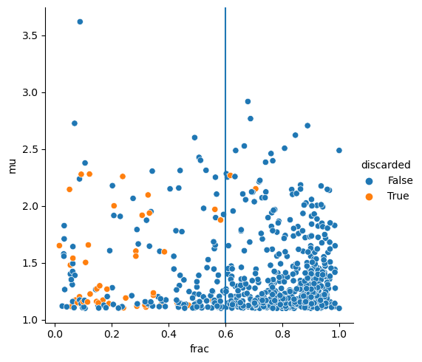
Recovery of Simulated Events

Slide 8
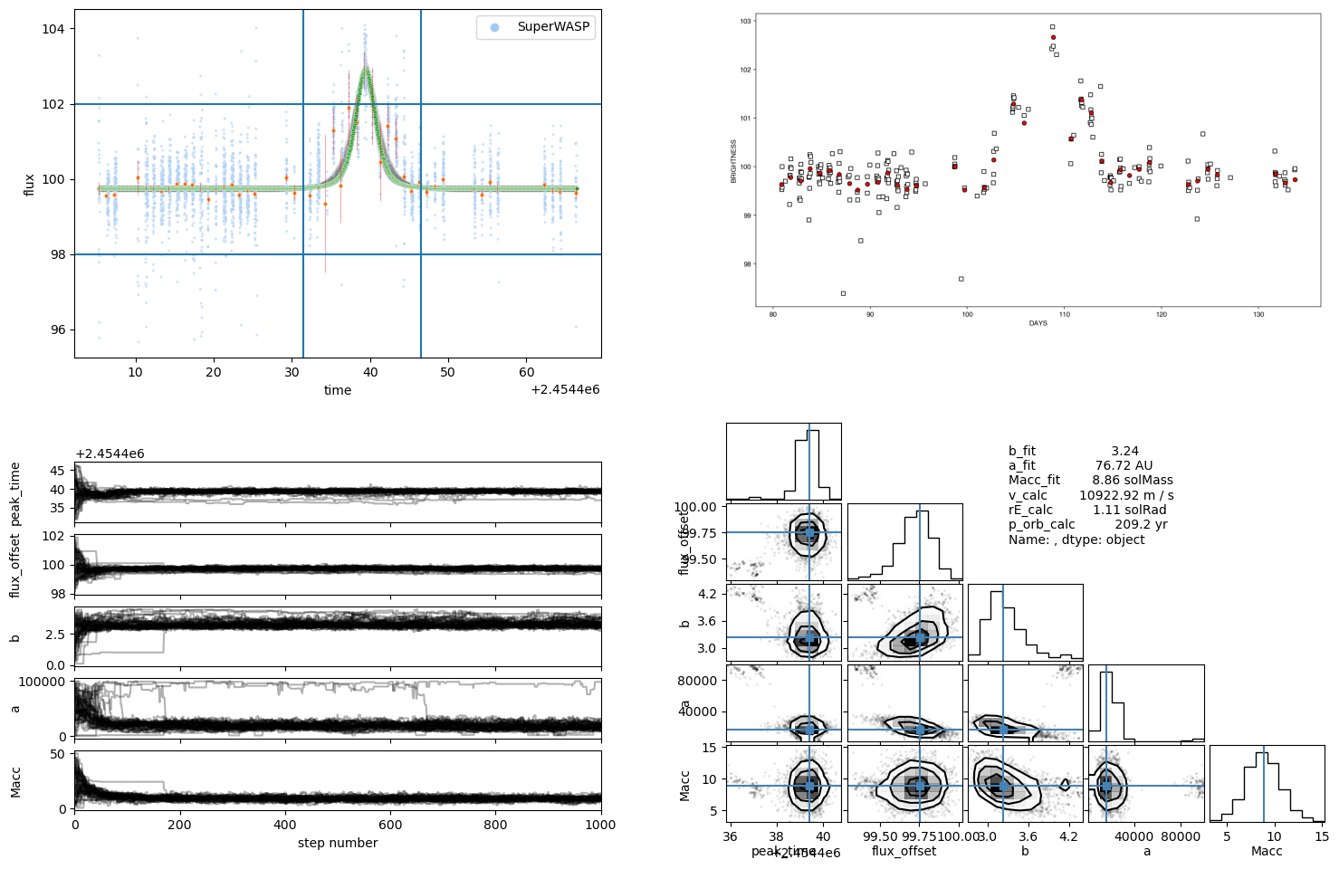
An Example Candidate
Warning: Contains early results! These may change before publication.

Slide 9
Ideas for candidate follow up
Corroborate with photometry from other surveys (ASAS-SN)
Radial velocity (where feasible)
Excess astrometric noise in Gaia
Supernova products in spectrum
Kick velocity from supernova

Slide 10



Future Projects
Planning
Later

Slide 11

What’s next
Paper with first candidates soon
More projects in planning
Following up on promising candidates
adam.mcmaster@open.ac.uk
adam-mcmaster.com
superwasp.org/get-involved

