Slide 1
Camera Summit Reverification Travis Lange Camera I&T Engineer NSF/DOE LSST Commissioning Review August 2, 2018

Slide 2
Outline
Schedule, Budget, Risks and Hazards
Reassembling the Camera
Re-Verification of Requirements

Slide 3
Schedule, Budget, Risks, and Hazards

Slide 4
Schedule
Scope
This WBS takes the LSSTCam from delivery at the summit to ready for installation on the telescope
Duration
June 2020 → November 2020

Slide 5
Budget
Reverification-related FTEs
7.2 FTEs average per month during reverification process
Primarily DOE
Procurements - $5k (all DOE)
Miscellaneous tools and hardware

Slide 6
Risks
Inherited from Camera I&T
IT-035 Refrigeration expertise required
IT-036 Optical engineer expertise required
DOEC-004, Accelerated Camera MIE rolloff
DOEC-010, Refrigeration preparation time
DOEC-012, Optical filter delays (affects ability to perform throughput testing)
DOEC-013 / CRYO-057, Refrigeration ICD mismatch
DOEC-015, Refrigeration Technician training

Slide 7
Hazards
Inherited from I&T during their verification process
DOE personnel on summit for first time will require additional training

Slide 8
Camera Assembly and Re-verification

Slide 9
Introduction
The LSST Camera needs to be delivered from SLAC to the Cerro Pachon Summit
See presentation by Margaux Lopez
To mitigate hazards to the Camera hardware, the optics are being removed and shipped separately
Plan for reassembly at the summit is required
Subset of camera requirements need to be re-verified

Slide 10
Reassembly of the Camera after shipping

Slide 11
3rd Floor Camera Maintenance Facility
White Room
Camera Staging and Test Area
Clean Room
Utility Area
Walkway
Mirror Coating Facility

Slide 12
Receiving the Camera and Prepping for Install
Camera Integration Stand
BOT
Camera Staging and Test Area
Clean Room (class 10,000)
White Room (class 100,000)

Slide 13
Receiving the Camera—LCA-13420
Remove Camera from Shipping Container and move into White Room

Slide 14
Camera Staging and Test Area
Camera Integration Stand

Slide 15
Receive Camera from SLAC on Saddle Stand
Camera on Support Stand

Slide 16
Move Camera Into White Room

Slide 17
Camera in White Room
Camera in Support Stand
L1-L2 Support Stand

Slide 18
Bring L1-L2 Container into White Room
L1-L2 Shipping Container
L1-L2 Support Stand

Slide 19
Prep L1-L2
L1-L2 Shipping Container
L1-L2 on Support Stand

Slide 20
Remove L1-L2 Shipping Container

Slide 21
Integrate L1-L2 and Shroud to Camera

Slide 22
Move Camera into Staging Area

Slide 23
Prep Filters for Camera
Filter Loader on Cart
Bench Top Stand
Filter Clean Storage Box
Holds 6 filter assemblies
Manually move filters from individual shipping container into bench top stand.
Use filter loader to move filters from bench top stand to filter storage box, fully automated.

Slide 24
Prep Camera for Move to Integration Stand

Slide 25
Install Filters in Camera
Filter Clean Storage Box

Slide 26
Camera Testing & Alignment

Slide 27
Prep Hexapod/Rotator Assembly
Camera Integration Assembly Stand/Cart

Slide 28
Camera Integration Assembly on Cart

Slide 29
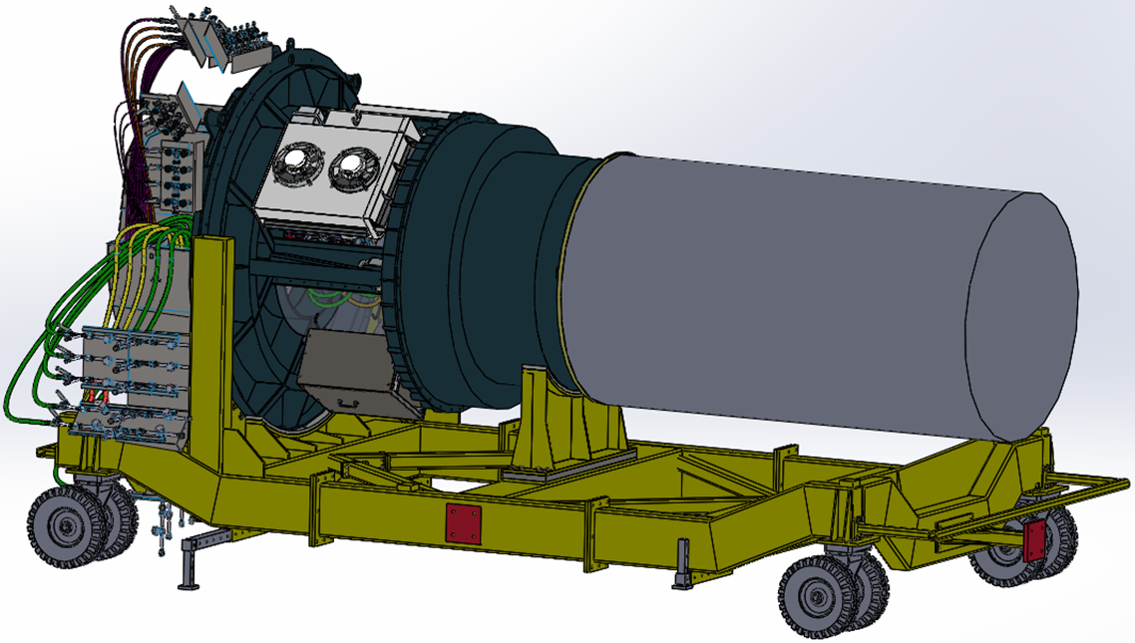
Integrate Camera on Hexapod/Rotator Assembly
Complete Camera Integration Assembly on cart, ready for move to telescope

Slide 30
Re-Verification of the Camera Requirements

Slide 31
Functional and Performance Tests
Subset of functional tests re-verified before L1-L2 assembly is installed
CCS Control
Hardware Protection System
Shutter
Auto Changer
Filter Exchange with Carousel (no filter present)
Cryostat vacuum—leak check
After Camera reassembly:
Refrigeration temperature control
Camera body temperature control (purge air system)
Data Acquisition

Slide 32
Alignment and Performance—After Reassembly
Survey and Alignment
Placement and verification of Best Fit Optical Axis
Darks
Noise Level
Bad Pixels
Traps (potentially)
Flat Field (photon transfer)
Gain
Linearity
Full Well
Calibrated Optical Beam Projector (CCOB) Narrow Beam
Optical filter throughput (for new filters)
Optical alignment re-verification
Focal Plane metrology check—relative height of raft CCDs

Slide 33
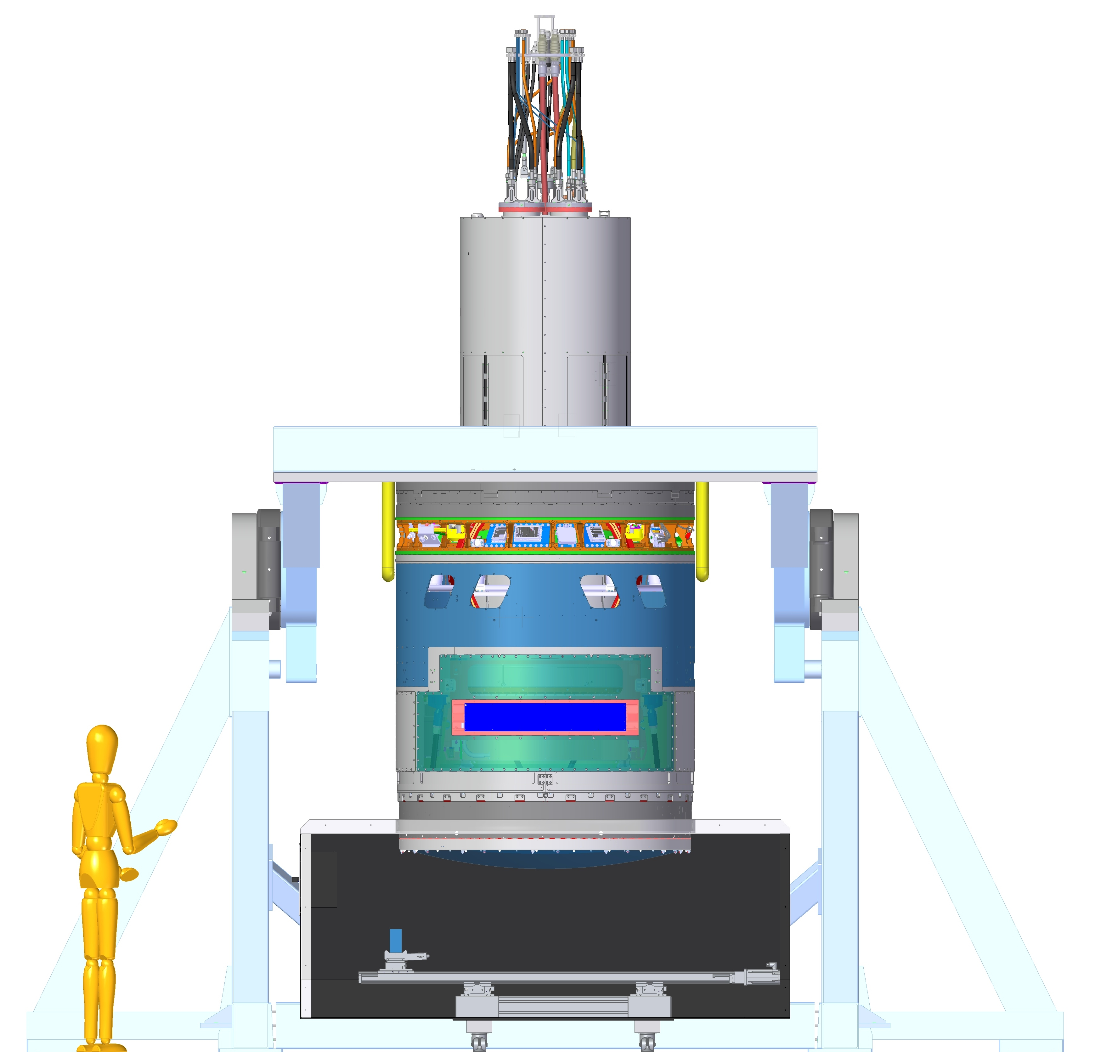
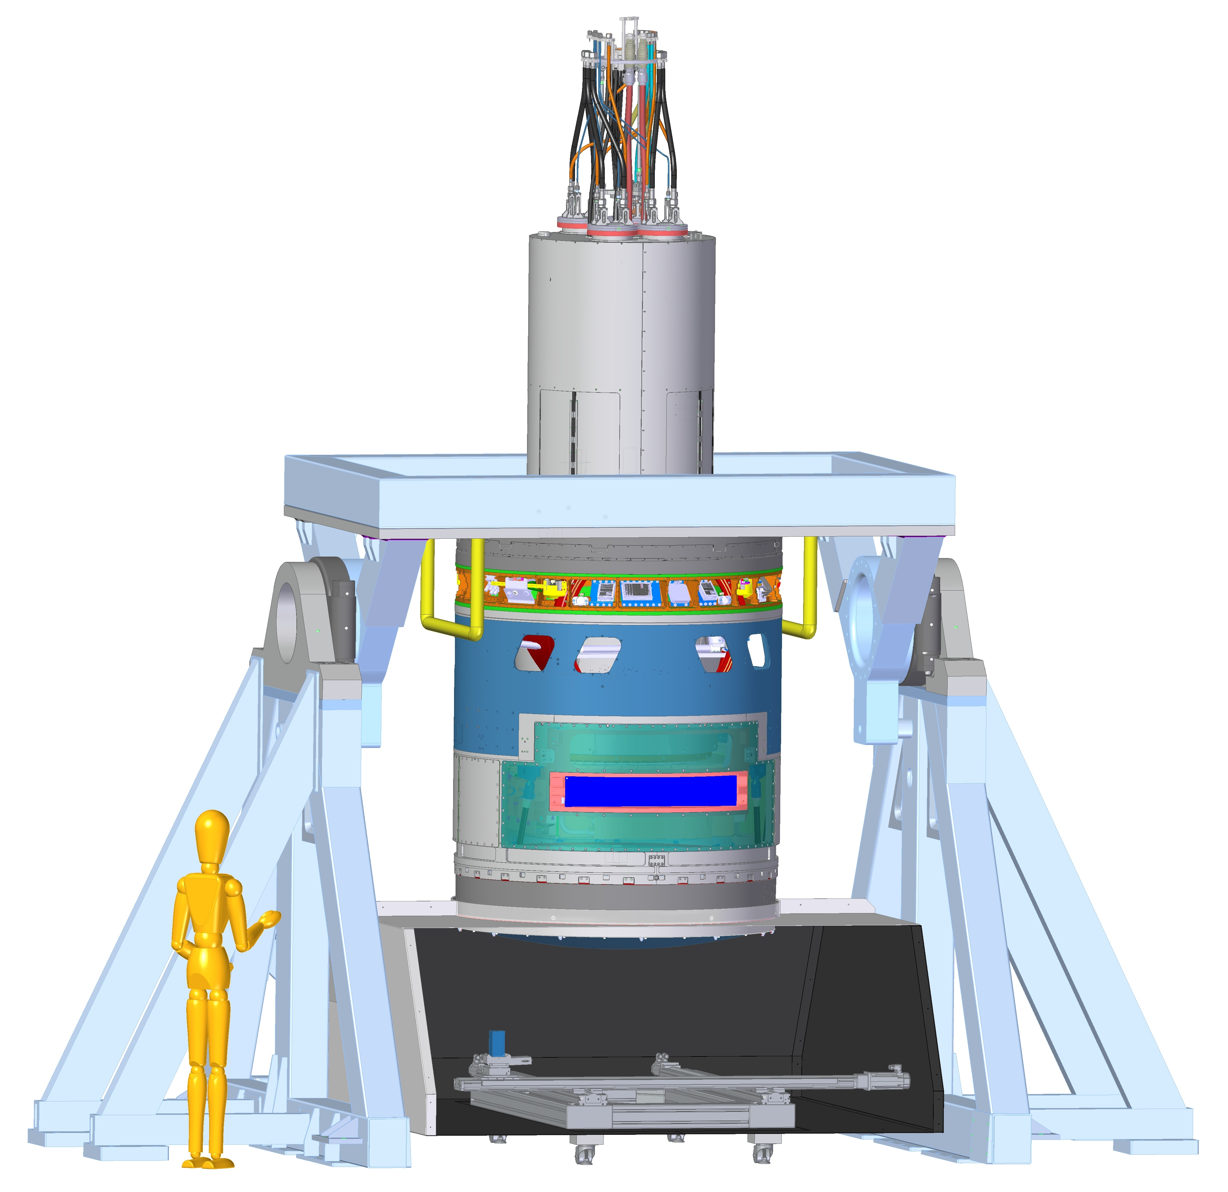
Re-verification Equipment
Survey and Alignment on Camera Integration Stand
Throughput Measurements on CCOB Narrow Beam

Slide 34
Summary
Extensive planning has been completed for logistics of camera reassembly
Flow Diagrams for high level details
CAD layouts to verify movement logistics
Requirements from these plans are flowed to camera fixture hardware
Re-verification plan (LCA-14954) has been created to identify what tests need to be reconfirmed at the Cerro Pachon summit

Slide 35
End of Presentation

Slide 36
Re-verification Contingency
The Camera will be outfitted with shock monitor data loggers during shipping
If shock loads are recorded at values higher than allowable, there are concerns about the integrity of the focal plane
Will require re-verification of focal plane flatness requirement
Significant task would require:
removing cryostat from camera body (leave UT attached to cryostat)
constructing clean tent in staging area
setting up BOT in clean tent to verify focal plane metrology requirement

Slide 37
Long term RAFT Maintenance
We expect to never need to replace a RAFT tower
MIE provides one spare RAFT
If spare RAFT is installed then the removed RAFT will be shipped back to SLAC for repair
All RAFT construction fixtures will be maintained at SLAC
Skills needed for refurbishment will be transferred from BNL to SLAC personnel as part of commissioning budget
Both commissioning and operations would need contingent funding to rebuild a RAFT
Note:
SLAC plans to maintain camera expertise by retaining key personnel on new projects

Slide 38
Camera Maintenance (Receiving the Camera from the Telescope)

Slide 39
Maintenance Flow Diagram: Disassembly

Slide 40
Maintenance Flow Diagram: Raft Integration

Slide 41
Maintenance Flow Diagram: Cryostat and Camera Integration

Slide 42
Maintenance Flow Diagram: Final Integration and Test

Slide 43
Prep for Camera Removal from Integrated Assembly
Prep Camera Support Assembly for transfer of camera to saddle stand

Slide 44
Remove Filters from Camera & Store in Clean Box
Filter Storage Clean Box

Slide 45
Move Camera into White Room

Slide 46
Camera in White Room

Slide 47
Remove Camera Shroud, Auto Changer and Shutter
Cryo Support Stand
Utility Trunk Support Stand

Slide 48
Move Cryostat Assembly to Cryo Support Stand
Auto Changer in Clean Box on Cart
Cryo Support Stand

Slide 49
Move Utility Trunk to UT Support Stand
Utility Trunk Support Stand

Slide 50
Move Cryostat into Clean Room

Slide 51
Move Cryostat into Clean Room

Slide 52
Clean Room Layout
BOT
Single-bay Raft Metrology
TS8
Portable Crane
Not Shown:
Alum-a-lift
Utility Trunk-in-a-rack
Computers for BOT, Raft Integration, TS8 & Single-bay Raft Metrology stands
TS8 cryostat cart
Parts storage / Shelving

Slide 53
Prep Cryo for move to Raft Integration Stand

Slide 54
Remove Raft from Cryostat
Utilities Needed:
Power for temporary Utility Trunk
Power for stages/pumps/compressors
DAQ Fibers
Refrigeration
Nitrogen gas
Compressed dry air

Slide 55
Camera Equipment Storage Needs

Slide 56
Storage Needs In Camera Maintenance Facility
Remains in Camera Staging & Test Area
Camera Integration Stand
Remains in White Room
Saddle Stand
Cryo Support Stand
Shutter Service Stand (2m x 1m)
Auto Changer Service Stand
Remains in Clean Room
Raft Integration Stand
Bench for Optical Testing (BOT)
Single-bay Raft Metrology Stand
Single-bay Raft Electro Optical Test Stand (TS8)
Crane

Slide 57
Storage Needs Outside of Camera Maintenance Facility
Used During Telescope Operations
Filter Loader with cart, 2x (1.2m x .75m)
Filter Storage Clean Box (1.7m x 1.2m)
Filter Bench Top Stand
Spare Auto Changer (in clean box)
Auto Changer Clean Box Cart, 2x (1.7m x 1.7m)
Auto Changer Lift Fixture
Filter Shipping Container, 6x
Filter Covers, 12x
Spare Shutter (in clean storage box)
Shutter Installation Rails
Shutter Lift Fixture

Slide 58
Storage Needs Outside of Camera Maintenance Facility, cont’d
Used Only During Camera Maintenance
UT Support Stand (2m x 2m)
Camera Lift Fixture
Cryo Lift Fixture
Cryo Spreader Bar
Seldom Used (Only for Receiving the Camera from SLAC)
L1-L2 Shipping Container (3.2m x 3.2m)
L1-L2 Support Stand (2.75m x 2.2m)
L1-L2 Lift Fixture (on support stand)
Camera Shipping Container (6m x 2.5m)

