Slide 1
Creating a More Equitable and Inclusive Future in Astronomy
Co-Chairs: Ellen Bechtol
Keith Bechtol
Lauren Corlies
Chris Montgomery
August 13, 2019

Slide 2
Welcome!
Session Purpose: share recent and current diversity and inclusion initiatives happening at the LSST Project and similar organizations. Small group discussion time will allow opportunity for participants to identify initiatives that can be amplified or expanded to other locations.
Session Format
  9 Lightning Talks (~30 minutes)
  Small Group Discussion (30 minutes)
  Whole group discussion and wrap-up
Respectful Conversations

Slide 3
Lightning Talks

Slide 4
Thank you!

Slide 5
Speaker: Andrés Plazas

Slide 6
Speaker: Andrés Plazas

Slide 7
Speaker: Andrés Plazas

Slide 8
Speaker: Andrés Plazas

Slide 9
Speaker: Andrés Plazas

Slide 10
Speaker: Andrés Plazas

Slide 11
Thank you!
Speaker: Andrés Plazas

Slide 12
The Multimessenger Diversity Network
Keith Bechtol
Commissioning SV Lead / Assistant Prof.
Creating a More Equitable and Inclusive Future in Astronomy
August 13, 2019

Slide 13









The Multimessenger Diversity Network is a community of representatives from multimessenger astronomy research collaborations focused on increasing diversity in the field.
The MDN shares knowledge, experiences, and
training and develops resources and practices around broadening participation.
Speaker: Keith Bechtol

Slide 14
Impact
MDN representatives receive training in community engagement.
Important information exchange between members
  Collaborations are trying new diversity, equity, and inclusion efforts based on what other collaborations are doing or have done in the past.
The MDN wrote an Astro2020 white paper “Pursuing diversity, equity, and inclusion in multimessenger astronomy collaborations over the coming decade” https://arxiv.org/abs/1907.06970
Message box example for short highlighted messages.
Speaker: Keith Bechtol

Slide 15
Future & Next Steps
Continuing to grow the network.
  4 -> 7 observatories/collaborations
Starting to build an online presence through website (under construction) and social media #AstroMDN.
Website will include repository for sharing diversity, equity, and inclusion resources amongst collaborations.
  YOU can contribute!
Message box example for short highlighted messages.
Speaker: Keith Bechtol

Slide 16
Thank you!
Speaker: Keith Bechtol

Slide 17
An Inclusive Project & Community Workshop
Ranpal Gill
Communications Manager
Creating a More Equitable and Inclusive Future in Astronomy
August 13, 2019

Slide 18



Creating an inclusive Project Community workshop
Diverse OC
Diverse speakers
CoC page
Credit organizers
Presenter guidelines
Pronouns on badge
Alternative names on badge
Male & Female T-shirts
Exit survey question
Nursing room
Dietary accommodations
Inclusive photos
Be green
Chile care reimbursement
Wheel chair access?
Gender neutral restroom?
Microphones & speakers
Speaker: Ranpal Gill

Slide 19
Impact
Attendees feel more comfortable at the meetings
LSST reputation as a project that does care
Increased diversity across project
Others observe and repeat at their meetings
Speaker: Ranpal Gill

Slide 20
Future/Next Steps/Resources
Next steps
  Feedback on inclusivity of meeting through question on survey
  Improvements for next year
https://500womenscientists.org/inclusive-scientific-meetings#inclusive-sci-meetings-before
Future output from this meeting https://outerspace.stsci.edu/display/IA2
Speaker: Ranpal Gill

Slide 21
Thank you!
Speaker: Ranpal Gill

Slide 22
LSST Workplace Culture Advocate
Sandrine Thomas
T&S Project Scientist
Creating a More Equitable and Inclusive Future in Astronomy
August 13, 2019

Slide 23
Overview: Workplace Culture Advocates
  Started in 2016 as Ombuds program to help people deal with potential issues appearing in the workplace both at individual or inter institutions
  WCAs will advocate for workplace diversity by promoting inclusive behaviors during meetings, by respectfully correcting unacceptable behaviors and by helping in properly reporting alleged bullying.
  In the case of formal complaints, WCAs can be a useful intermediary to the directorate, offering opinions to management about the validity and severity of the complaint, after an investigation has been conducted, and providing the complainant with confidentiality if they so requests.
  WCAs are a conduit to Human Resources but not a replacement for it. In the case of criminal or legal issues, it is our management’s responsibility to ensure a healthy and safe workplace culture by reporting these types of issues to Human Resources.
Speaker: Sandrine Thomas

Slide 24
Impact
The impact was seen at various level
  Better communication, relationships
  Tension relief
  Better reporting to HR
Connection with the communication team: We also look at the project surveys and based on the data, take actions
  Management training was a result of the 2017 survey
Message box example for short highlighted messages.
Speaker: Sandrine Thomas

Slide 25
Future/Next Steps/Resources
We just relaunched the program to better represent what we have done so far.
We want even more connection with Communication
Focus on Chile and its increasing very diverse staffing: Carol Chirino is a new addition to the team and we’re looking for another Chilean based person.
https://project.lsst.org/workplace-culture-advocate
Speaker: Sandrine Thomas

Slide 26
Thank you!
Speaker: Sandrine Thomas

Slide 27
A Web for Everyone
Blake Mason
Senior Web Developer for EPO
Creating a More Equitable and Inclusive Future in Astronomy
August 13, 2019

Slide 28
Overview
Responsive Web Design
  One web many devices.
Web Accessibility (a11y)
  No Screen. No mouse. Same(-ish) content.
    Testing: Linters, Auditors, Close your eyes and press tab
Localization (l10n)
  Same UI. Same UX. Different(-ish) content.
    How to: Internationalization (i18n)
Message box example for short highlighted messages.
Speaker: Blake Mason
Notes:
Responsive Web Design
Desktop, tablet, phone, and everything in between
Supporting touch
So many browsers
70% of all internet users use the Chrome browser.
Firefox and Internet Explorer each account for about 10% of users.
Safari and Opera account for the remainder, about 5% and 2% respectively.
On mobile Chrome and Safari more or less evenly split the field.
Accessibility
According to 2005 survey 6.8% of people > 15 years old accessing the Internet in the US have sight or vision impairments (15 million people)
20.8% of people > 65 years old (7 million people)
8.2% of people have trouble using a mouse
Linters: Show you what’s wrong while you’re coding
Auditors: Show you what’s wrong in the browser
Screen Reader: It’s the real deal
Localization
Language
Numeric, currency, date and time formats
Keyboard usage
Collation and sorting
Symbols, icons, and colors
Text and graphics containing references to objects, actions or ideas which, in a given culture, may be subject to misinterpretation or viewed as insensitive.
Legal requirements: GDPR
Google translate
Internationalization
Identify Region via IP
Invite user to select their preferred language: All text has to be variable and conditional on this selection

Slide 29
Impact
Future-proofing our web apps
Blazing those trails!
Collaborating across borders
Message box example for short highlighted messages.
Speaker: Blake Mason
Notes:
Future-proof
The processes involved in building a responsive, accessible, localized web tend to engender a more modular, flexible, robust, and stable, and generally customizable web
Better for developers: better for users
Blaze those trails
In the U.S., government websites which must meet Section 508 regulations, but there are no enforceable ADA legal standards to follow for website accessibility, and even the 508 regulations are murky
Showing a ton of data in a meaningful way to a general audience is really hard, presenting it visually is really hard, visualizing data without a screen is harder still. So no one does it. The Web is completely cut and paste. If we do this right, if we try at all, other likeminded institutions will model their websites after ours
Across Borders
Our telescope doesn’t even speak English. It’s hanging out with all the locals down there in and if the telescope meets someone cool and gives them our website, the telescope is going to be so embarrassed if their new friend can’t read about LSST. Our telescope is going to be doing things I truly am not qualified to describe. But I do know that a lot of the people who can describe what it does don’t speak English as their primary language.

Slide 30
Future/Next Steps/Resources
How do you create rad data visualizations for people who don’t use a screen or mouse?
Accessibility Auditor: deque.com/axe/
Web Content Accessibility Guidelines: w3.org/WAI/WCAG21/quickref
Message box example for short highlighted messages.
Speaker: Blake Mason

Slide 31
Thank you!
Speaker: Blake Mason

Slide 32
Tucson Topical Interest Group for DEI
Lauren Corlies
Deputy Director EPO
Creating a More Equitable and Inclusive Future in Astronomy
August 13, 2019

Slide 33
Overview
We aim to create a self-organizing community of practice for all interested colleagues to feel supported and discuss topics and experiences around diversity, equity, and inclusion in the workplace and in science more broadly.
LSST/NOAO --> NCOA ultimately have needs unique from our colleagues in university settings
  Hiring/ recruitment
  Workplace culture
  Evaluations / job requirements
Growth for ourselves as individuals
How to affect change in our organization
Speaker: Lauren Corlies

Slide 34
Impact
Kickoff brought Heather Metcalfe of the Association for Women in Science to Tucson for a great talk on Creating Diverse STEM Workplaces
  Recording posted in the #inclusion channel on Slack!
Intending to begin monthly meetings this Fall!
Ultimately, the structure will be defined to suit the needs of the group so come help guide that process if you’re interested!
Speaker: Lauren Corlies

Slide 35
Thank you!
Speaker: Lauren Corlies

Slide 36
Inclusive LSST
Robert Blum
Acting Director for LSST Operations
Creating a More Equitable and Inclusive Future in Astronomy
August 13, 2019

Slide 37
Overview
LSST Operations Leadership committed to a diverse and inclusive environment
I am committed to working with NCOA DA’s and AURA WDC and others to implement actions and programs they recommend
Diversity is a better way to do science; not just fairness
Message box example for short highlighted messages.
Speaker: Bob Blum

Slide 38
Impact
10 years in NOAO Directorate
Regular meetings with DA’s. Continuing that for LSST Ops + NCOA
Enabling positive progress from front office
  Unconscious bias training in recruitment
  Funding modest initiatives
  Anonymous proposals
  Committee gender balance
Message box example for short highlighted messages.
Speaker: Bob Blum

Slide 39
Future/Next Steps/Resources
Continue supporting DA’s and their initiatives
Work with all staff in LSST Operations to get off on the right foot as we start Operations Program
We have an opportunity to build some programs into the LSST Operations plan now
Message box example for short highlighted messages.
Speaker: Bob Blum

Slide 40
Thank you!
Speaker: Bob Blum

Slide 41
Code of Conduct (Inclusion)
Chris Montgomery
Training Coordinator, LSST
Creating a More Equitable and Inclusive Future in Astronomy
August 13, 2019

Slide 42
Overview
LSST2018 Project & Community Workshop provided an opportunity to take closer look at the LSST Code of Conduct.
  The feedback from the session revealed that project members have created a multitude of documents highlighting required behaviors collectively known and “Codes of Conduct”, yet there is no central place to find them.
  The action identified from the session was to centrally locate these documents and to draw upon the preferred language from the various documents to enhance the LSST Code of Conduct.
Speaker: Chris Montgomery

Slide 43
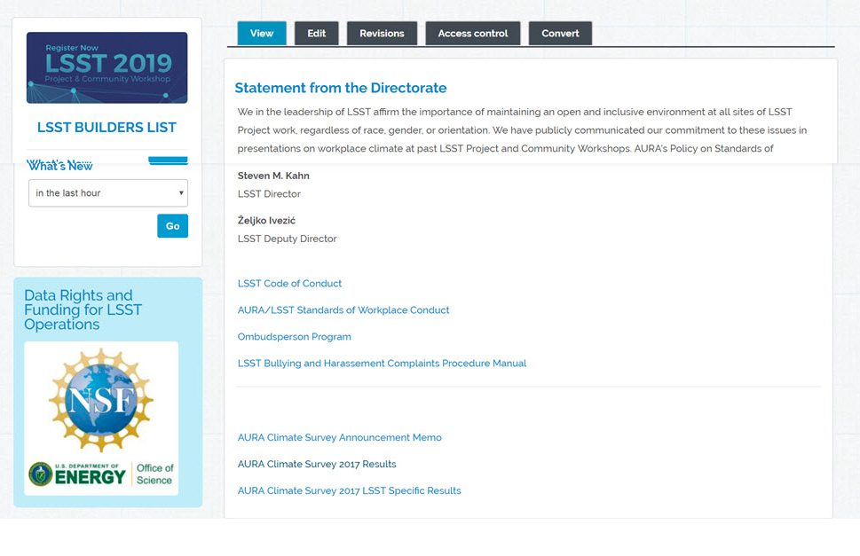
LSST Code of Conduct
The LSST (Large Synoptic Survey Telescope) project is made up of members from around the globe with a diverse set of skills, personalities, perspectives, backgrounds, and experiences. We value the contributions of every LSST project member, and we recognize a shared responsibility, as participants within a larger community, in maintaining the health of LSST’s working environment as a positive, inclusive, supportive, and successful community. While culture is best transmitted by daily example, having some formal standards for conduct can aid newcomers and reinforce good patterns. All employees, vendors, and visitors are expected to comply with this policy and to take appropriate measures to ensure that their conduct reflects our values of civility, respect, and inclusiveness and that prohibited conduct does not occur.
Since LSST is an AURA center, the AURA Standards of Workplace Conduct provides a starting point…
Speaker: Chris Montgomery

Slide 44
Impact
Consolidation the best versions of each section from multiple codes of conduct into a Drupal block provides a refined, centrally located resource.
Any committee or meeting can now link to these elements. In doing so, they would always be publishing the most updates material.
Message box example for short highlighted messages.
Speaker: Chris Montgomery

Slide 45
Future/Next Steps
NCOA Transition Project Diversity and Inclusion Working Group.
  Alysha Shugart (Gemini South) leads the group
  Delivering a Diversity, Equity, and Inclusion Plan for NCOA (which includes LSST Operations)
Message box example for short highlighted messages.
Speaker: Chris Montgomery

Slide 46
Thanks!
Speaker: Chris Montgomery

Slide 47
Building an inclusive department culture
Risa Wechsler
KIPAC / Stanford / SLAC
Creating a More Equitable and Inclusive Future in Astronomy
August 13, 2019

Slide 48
Equity & Inclusion activities
Formed Equity & Inclusion Committee in Summer 2016
Started with 7 faculty; added staff, postdocs, graduate and undergraduate students as full members of the committee -- this was critical!
Charge: take a comprehensive look at department diversity and climate and make recommendations to the department
Some key activities:
  Developed Equity & Inclusion strategic plan
  Education: Quarterly seminars, monthly reading group
  Community discussion and engagement
  Expanded external summer research program with a focus on providing opportunities for students from underrepresented groups
Physics E& I website includes plan, resources, references, events
Message box example for short highlighted messages.

Slide 49
Impact
Much more frequent discussions about inclusive environments and practices across the department, have raised the general level of awareness.
Significant changes in teaching practices for many undergraduate courses.
Student groups help build community for people from underrepresented groups.
Changes to graduate admissions, recruiting, mentoring processes.
Demographics of undergraduate physics majors
  Now: 29% women, 6% Black/Latina women
  2016: 20% women, 0 Black/Latina women
Summer research for external students
  Due to proactive outreach, physics applicants for Leadership Alliance SR-EIP up by a factor of 10; host 10+ students/year from underrepresented groups
POISE (Physics Outreach through Inclusive Science Education) program led by two undergrads led 10 students in a spring break program focused on EPO and building community.

Slide 50
Future/Next Steps/Resources
Take a look at our Physics E& I website and strategic plan for ideas, and feel free to send questions and suggestions.
Lots of opportunities to work on summer research at Stanford & SLAC on LSST
  Summer programs for students: CAMPARE and Leadership Alliance SR-EIP programs
  SLAC Visiting Faculty program
  Alonzo W. Ashley Internship Program
Message box example for short highlighted messages.

Slide 51
Thank you!

Slide 52
Small Group Discussion
(30 minutes)

