Slide 1
Engaging Students with LSST Data Ardis Herrold Education Specialist, LSST Education & Public Outreach LSST2019 Project & Community Workshop August 13, 2019

Slide 2
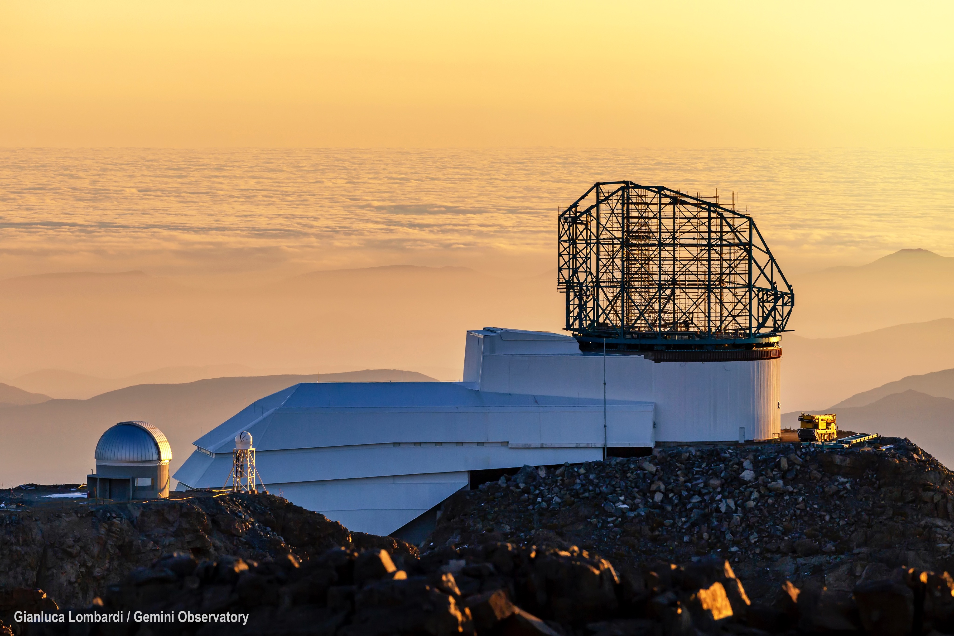
Mission of LSST EPO
24 pt Bold in
either blue or black
Guidelines
Delete notes and save this template as your presentation
No drop shadows
Only use the font Calibri or Carlito
Please do not alter template
To offer accessible and engaging online experiences that provide non-specialists access to, and context for, LSST data so anyone can explore the Universe and be part of the discovery process.
Message box example for short highlighted messages.

Slide 3
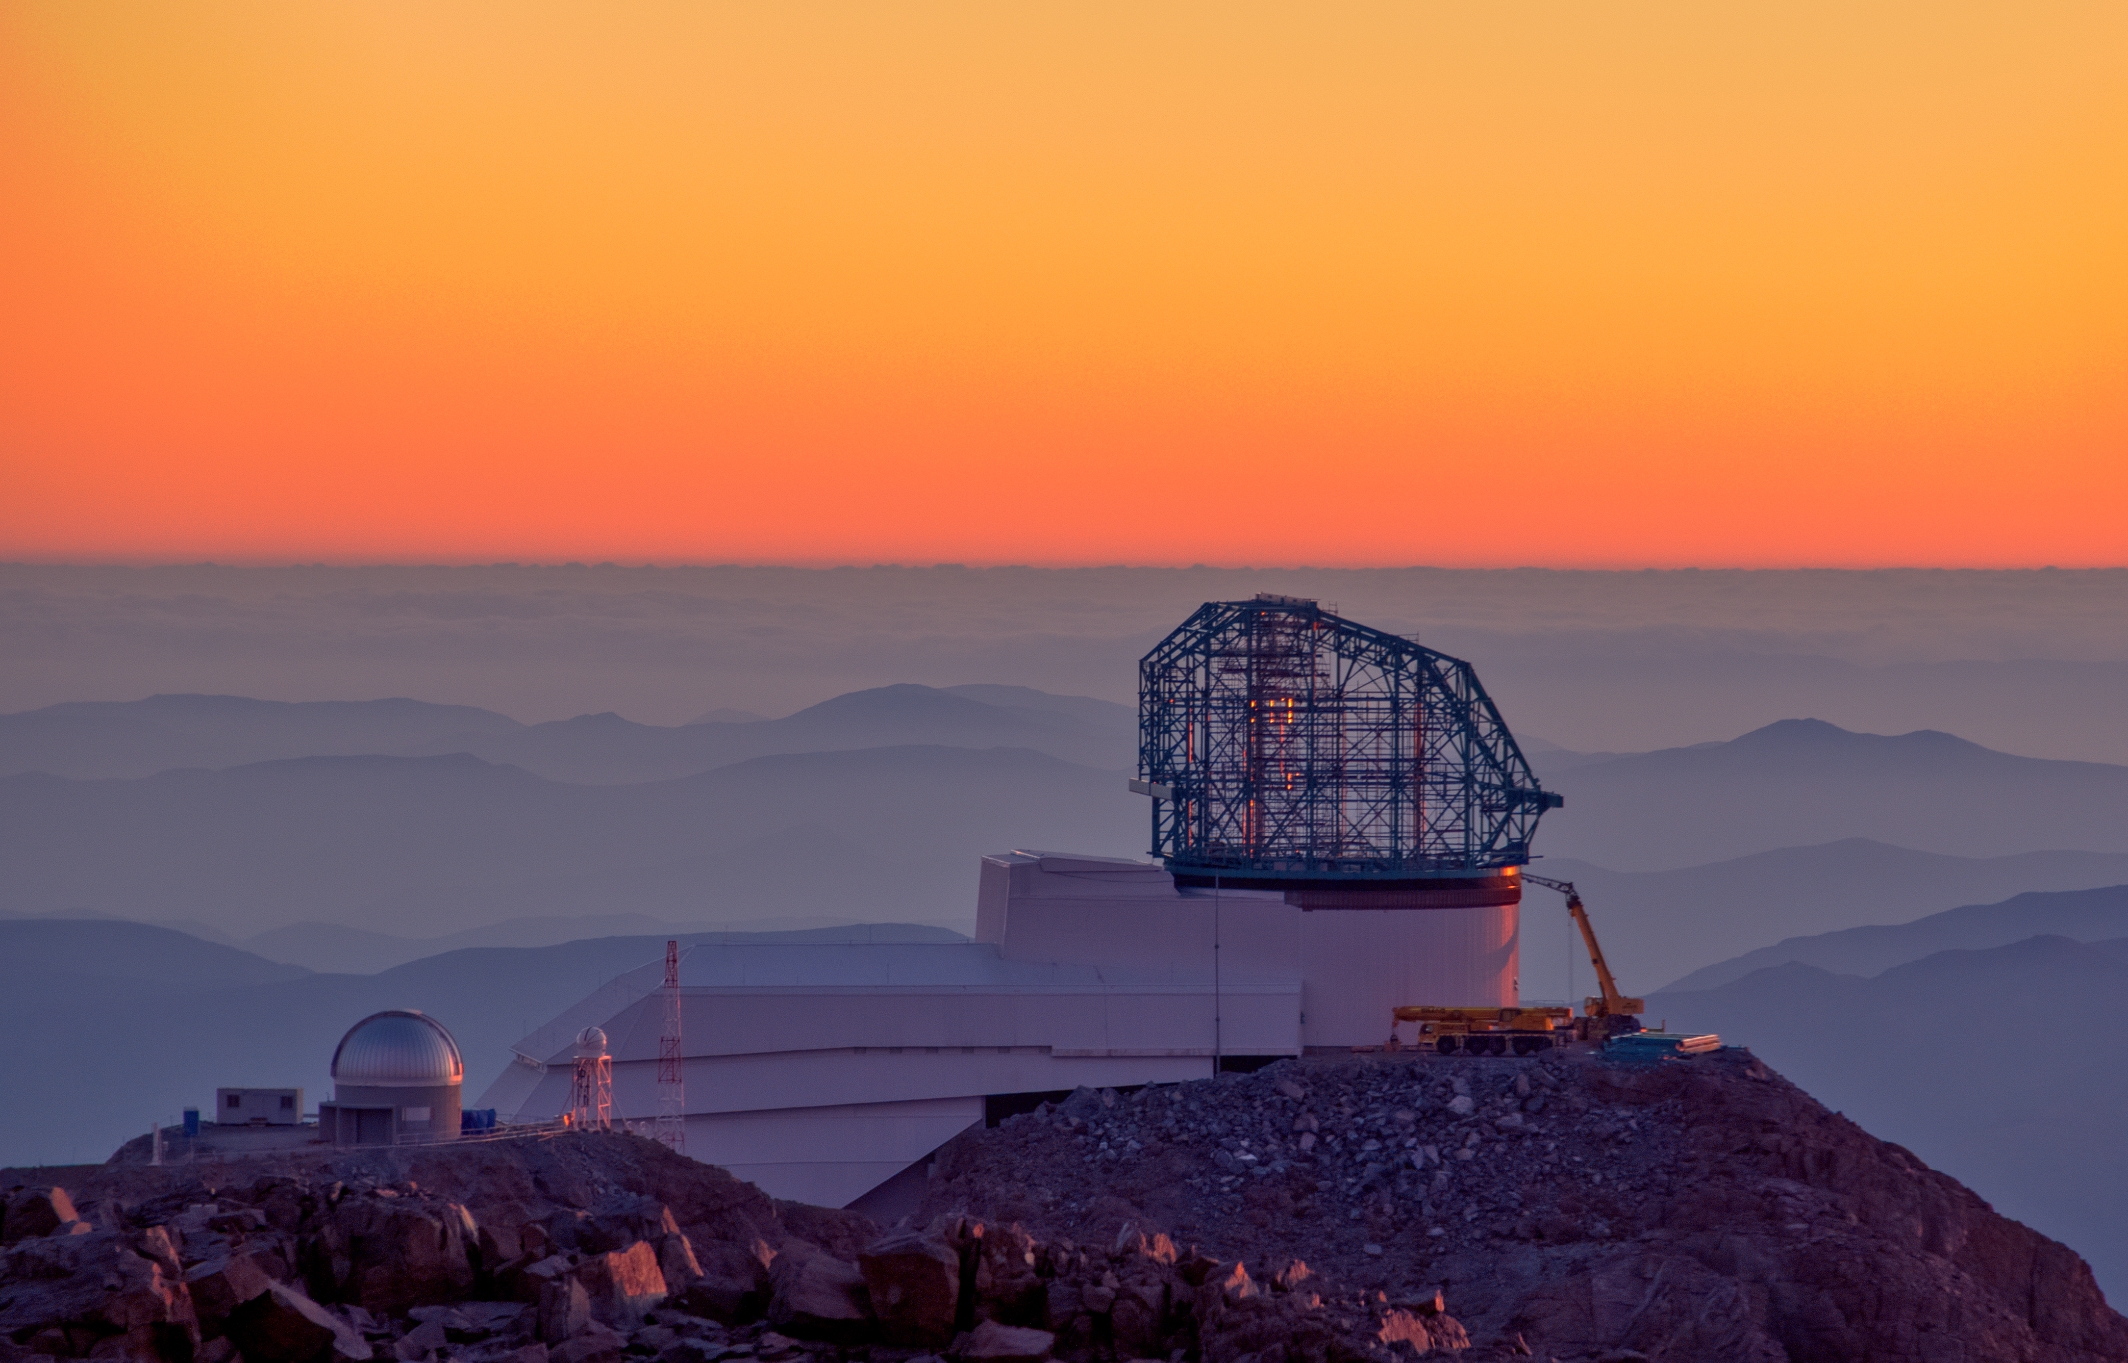
Vision of the Education Team
24 pt Bold in
either blue or black
Guidelines
Delete notes and save this template as your presentation
No drop shadows
Only use the font Calibri or Carlito
Please do not alter template
To create educational experiences that:
Are engaging and easy to use for the typical student
Provide a progression of tasks and questions that leads to learning
Are well-supported for the typical teacher
Leverage the unique aspects of LSST data sets
Photo: LSST Project/NSF/AURA

Slide 4
Formal Education Audience
Primary outreach is to the United States and Chile.
Educators at the advanced middle school through college levels.
LSST is committed to working with partners, programs and institutions to develop materials that are relevant, accessible and engaging to diverse audiences, especially to those who are traditionally underrepresented in STEM.
Photo: Bob Blum/NSF/AURA

Slide 5
24 pt Bold in
either blue or black
Guidelines
Delete notes and save this template as your presentation
No drop shadows
Only use the font Calibri or Carlito
Please do not alter template
Message box example for short highlighted messages.

Slide 6
Education Investigation Title | Summary
Coloring the Universe | Students construct a color image from LSST’s filters and gain intuition for wavelength-dependent properties of a variety of astronomical objects.
A Window to the Stars | Students compare properties of the Sun and other stars using H-R Diagrams.
Mapping the Milky Way | Students explore density maps to determine what type of galaxy the Milky Way is, and where we are located within it.
Expanding Universe | Students construct Hubble plots to evaluate the expansion and acceleration of the Universe over time.
Exploding Stars | Students use light curves to determine the type of supernova, the progenitor star, and to calculate the distance to a galaxy.
Surveying the Solar System | Students make observations of newly-discovered solar system objects using an orbit visualizer to determine the object type.
Variable Stars | Students analyze Cepheid variable light curves to learn about how they vary with time (temperature, size, luminosity), and use the information to calculate distances to galaxies.
Hazardous Asteroids | Students evaluate the potential threat of an Earth impact by making repeated observations of a newly-discovered Near-Earth Object.
Exploring the Observable Universe | Students explore large-scale structure using photometric redshifts and galaxy density maps.

Slide 7
Investigation Design
Message box example for short highlighted messages.

Slide 8
Investigation Design
24 pt Bold in
either blue or black
Guidelines
Delete notes and save this template as your presentation
No drop shadows
Only use the font Calibri or Carlito
Please do not alter template
Message box example for short highlighted messages.

Slide 9
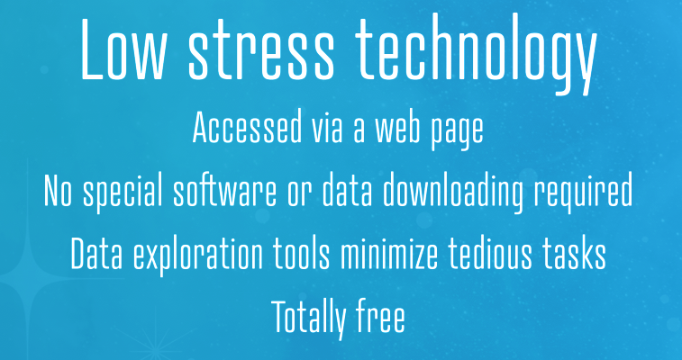
Investigation Design

Slide 10
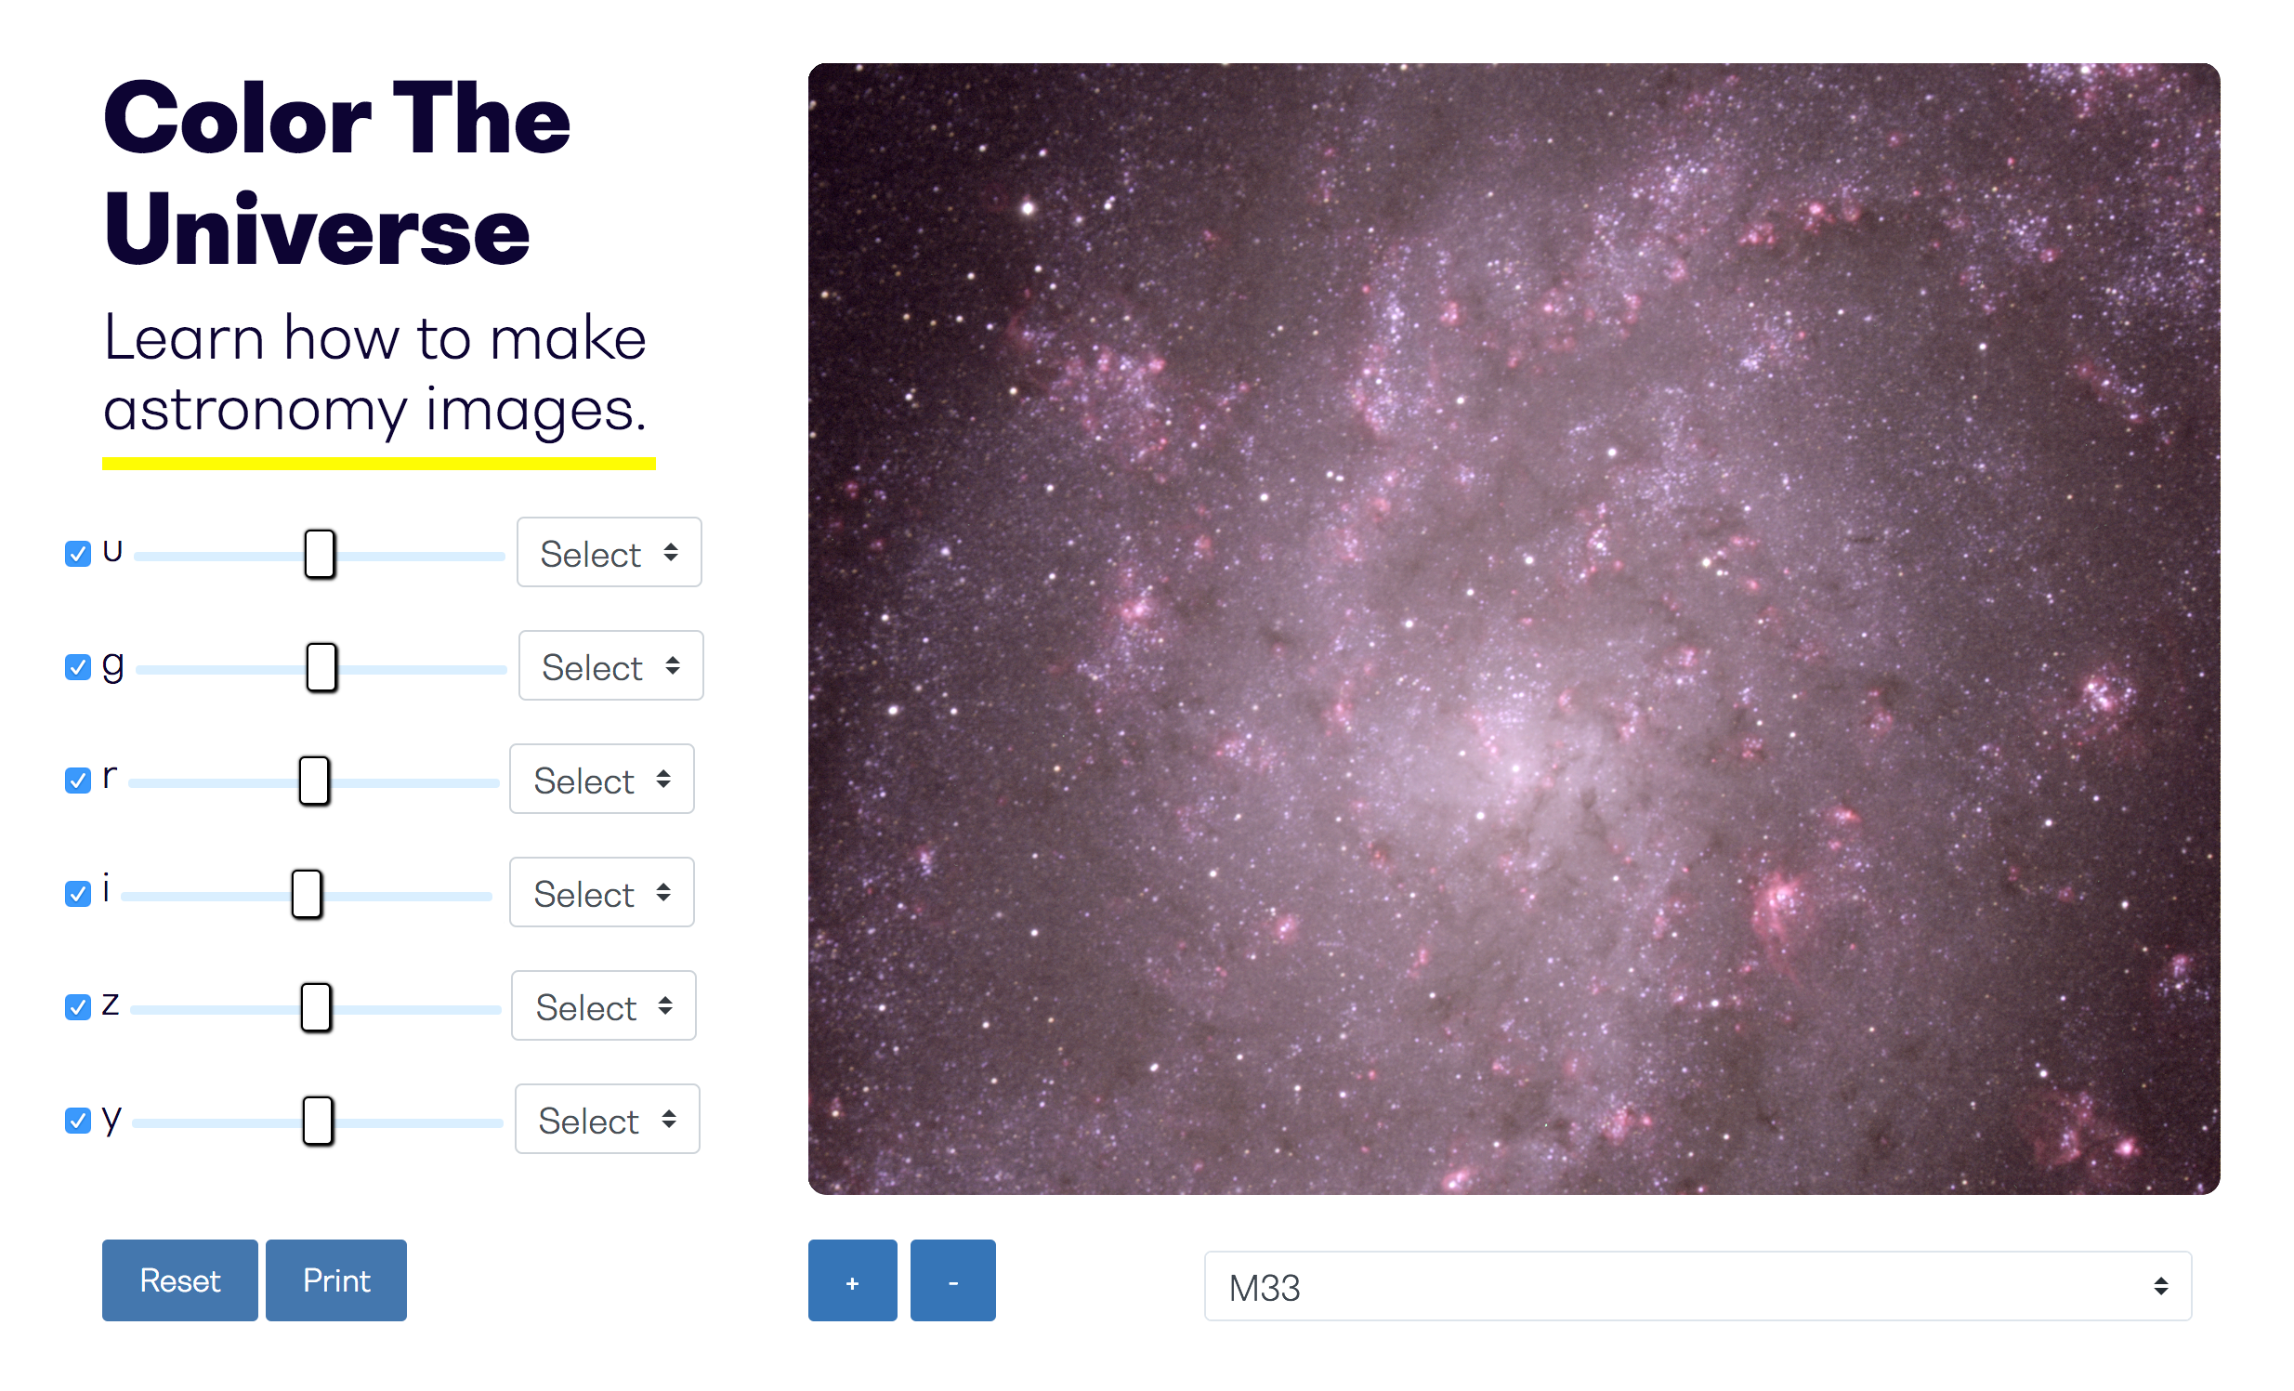
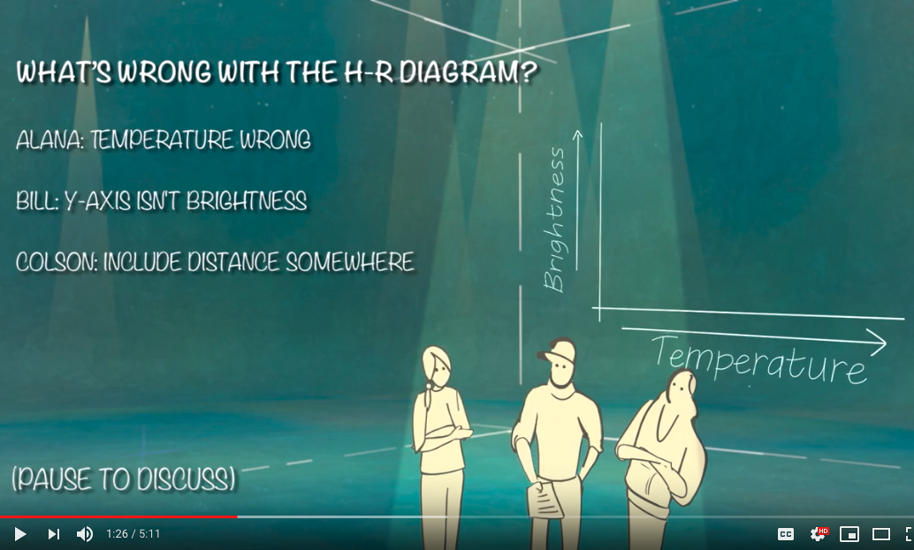
Investigation Components
Web application
Teacher guide
Investigation videos*
*for a subset of investigations
Assessment materials
Website support materials
Message box example for short highlighted messages.

Slide 11
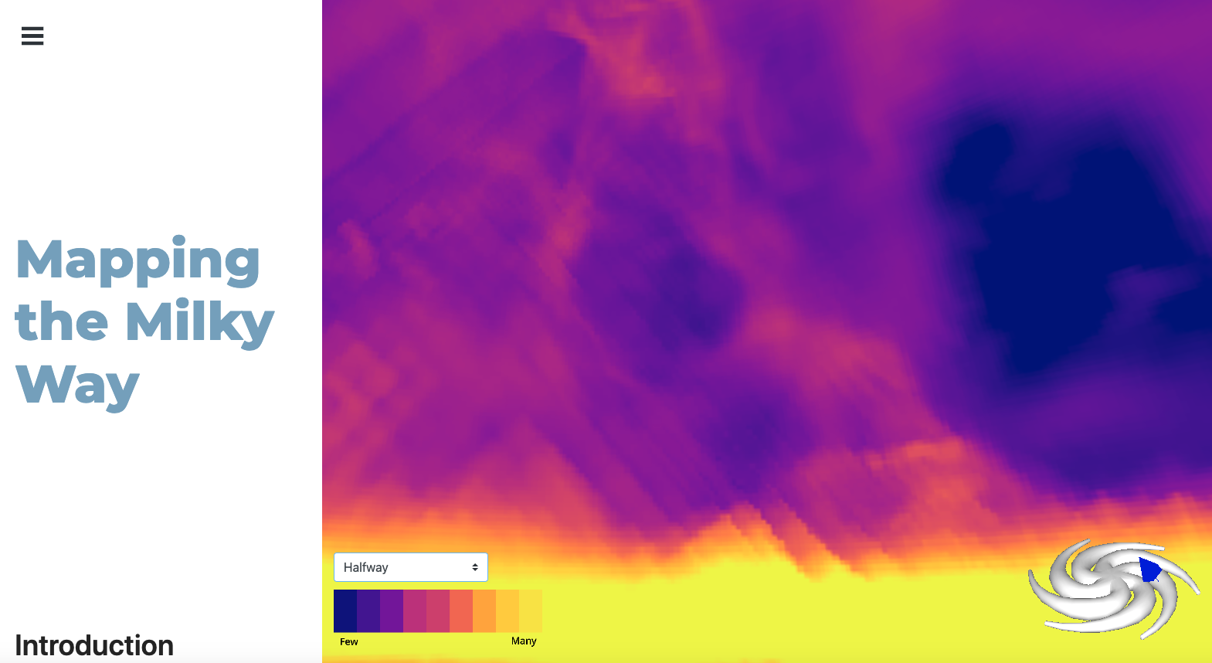
Web Applications
Accessible through a website
Embedded tools for data interaction & analysis
Designed to support NGSS standards in the U.S.
and the Curriculum Nacional in Chile
Message box example for short highlighted messages.

Slide 12
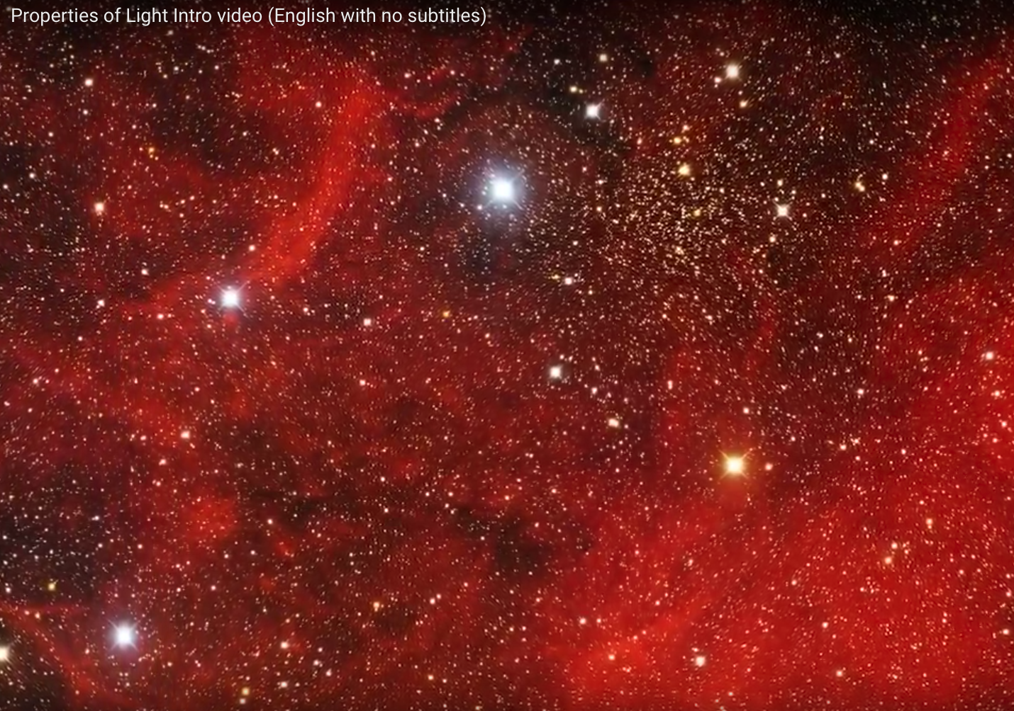
Investigation Videos
Introductory video
A short (2 min.) visually-compelling video that is meant to engage students in the topic and elicit observations and questions.
Assessment video
A short (5 min.) video with pauses that depicts a group of (fictional) students discussing what they have learned, with correct and incorrect answers. At each pause, students are asked to decide which answer is correct.

Slide 13
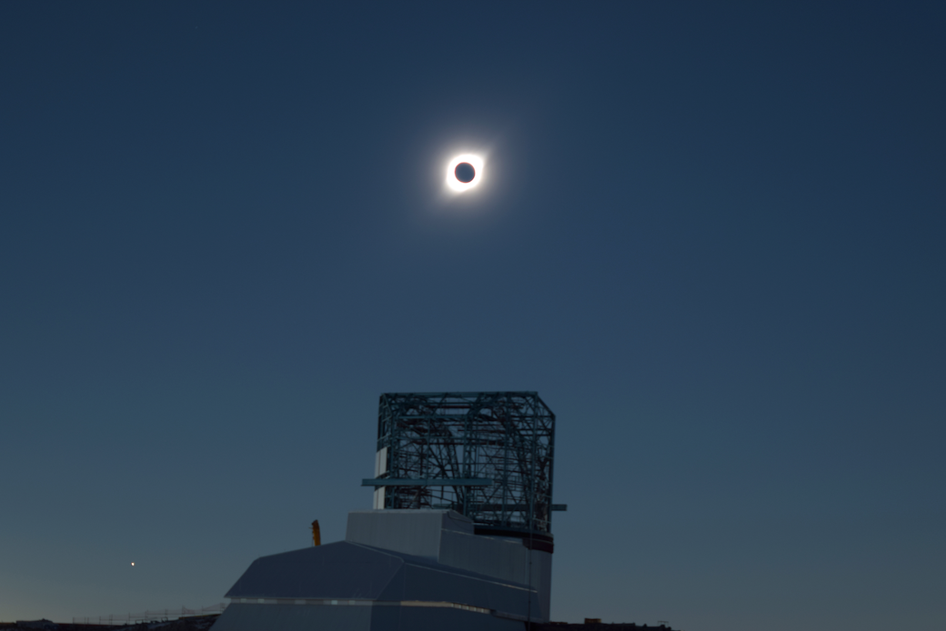
Working with the Science Community
Help with code, formulae, questions
Provide precursor data and LSST Simulated data
Share networks for user testing, particularly with minority-serving institutions and those traditionally under-represented in STEM
Act as local resource agents / mentors for regional educators
(Future) Host instructors for professional development training
Ideas for “Broader Impacts” for NSF grants
Photo: K. Reil LSST/AURA/SLAC/NSF/DOE

Slide 14
Education Investigation Title | (pre-LSST) Data Needs
Coloring the Universe | DONE!
A Window to the Stars | Need help in identifying the white dwarfs in our star cluster data and in calculating the luminosities/temperatures to place them on the HR diagram.
Mapping the Milky Way | DONE!
Expanding Universe | data of Type Ia SNe and host galaxies – need distance measurements and redshifts/velocities for large sample to construct Hubble diagram
Exploding Stars | Time series of images of Type Ia and Type IIp SNe with corresponding light curve photometry, including near peak
Surveying the Solar System | Comet orbital information is reported in ways differing from the asteroids. Need help/advice in calculating orbits as a function in time in Cartesian (x,y,z) space, including starting positions.
Variable Stars | Time series of images of Type I (classical) Cepheid variables with corresponding light curve photometry, including near peak
Hazardous Asteroids | Need uncertainties in the orbital parameters (not in MPC – in MOPS?)
Exploring the Observable Universe | Need redshifts from large, deep survey. Need a way to visualize the cube of (RA,Dec,z)
ASK: need scientists to assist with gathering data listed above from existing datasets

Slide 15
Links to investigation prototypes
A Window to the Stars http://ls.st/0ed
Mapping the Milky Way http://ls.st/l9d
Coloring the Universe http://ls.st/rqk
Sample teacher guide (Mapping the Milky Way) http://ls.st/62n
Sample Assessment video (HRD English) http://ls.st/k1o
(HRD Spanish) http://ls.st/bam

Slide 16
Contact us with your ideas
As we continue construction, please contact us with your ideas and questions: education@lsst.org
www.lsst.org/about/epo
Thank you!
Earthcam photo/LSST/NSF/AURA

