Slide 1
HSC Supernova Survey
Naoki Yasuda (Kavli IPMU / U.Tokyo)

Slide 2
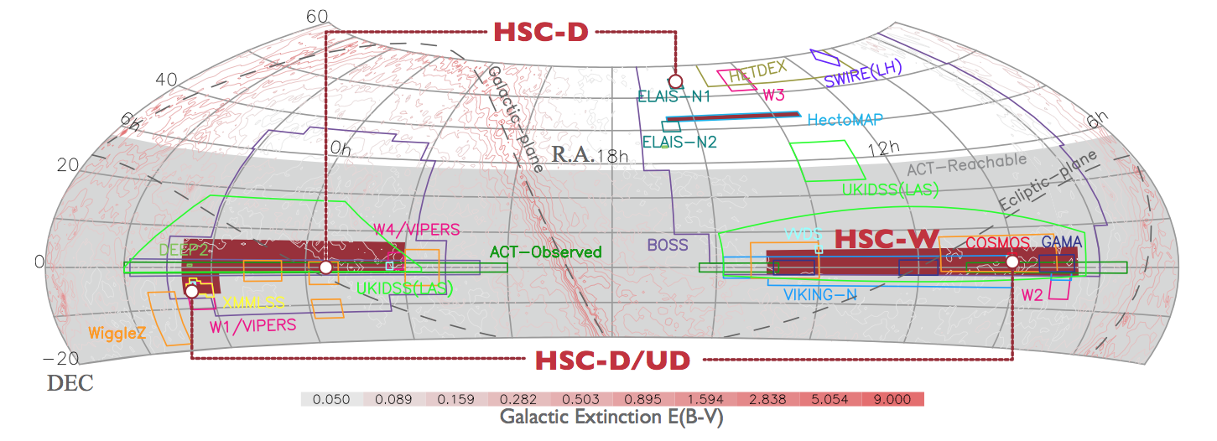
HSC SSP Survey
HSC (Hyper Suprime-Cam) Wide field camera of Subaru telescope Field of view : 1.77 deg² 104 CCDs
Subaru Strategic Program 300 nights survey (+30 additional nights)

Slide 3
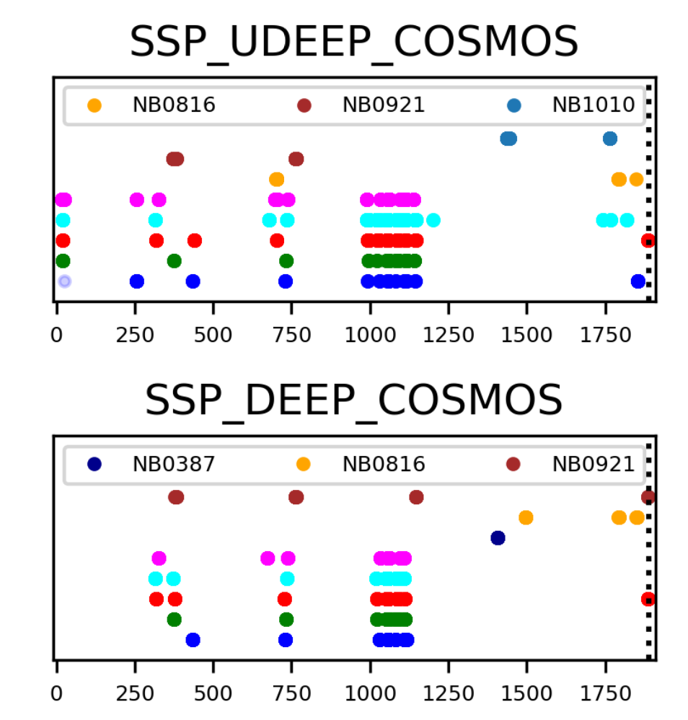
Transient Survey at COSMOS
2016 Nov – 2017 Apr
Data is public as PDR2 of HSC survey https://hsc-release.mtk.nao.ac.jp
Ultra Deep for 6 months 26.0, 25.6mag for i and z Deep for 4 months ~0.6mag shallower

Slide 4
Successfully identified ~1,800 SN candidates
~400 seems to be SN Ia at 0.3 < z < 1.5

Slide 5
Basic data flow of transient pipeline
Standard Pipeline
Raw image
(HSC-[visit]-[ccd].fits)
The version of HSCpipe is a bit old (v4.0.5)
CORR image
(CORR-[visit]-[ccd].fits)
Developed
Warped image
(warp-[filter]-[tract]-[patch]-[visit].fits)
Warped diff image (diff-[filter]-[tract]-[patch]-[visit].fits)
dateObs as different directory
dateObs as different directory
Coadd image
(calexp-[filter]-[tract]-[patch].fits)
Coadd diff image
(diff-[filter]-[tract]-[patch].fits)
DB
deepCoadd_diffsrc
Variable / Transient
(Multiple detections)
deepCoadd_forced_diffsrc
Coadd diffsrc catalog
(diffsrc-[filter]-[tract]-[patch].fits
Coadd forced diffsrc catalog
(forced-diffsrc-[filter]-[tract]-[patch].fits

Slide 6
Using ip_diffim
I have been mainly using ImagePsfMatchTask in ip_diffim for image subtraction of HSC data
It works pretty well especially for single visits
Note that HSC has Atmospheric Dispersion Corrector within Wide Field Corrector
We do not need to worry about dipoles
Relative astrometry is applied and warped to the same coordinate system.

Slide 7
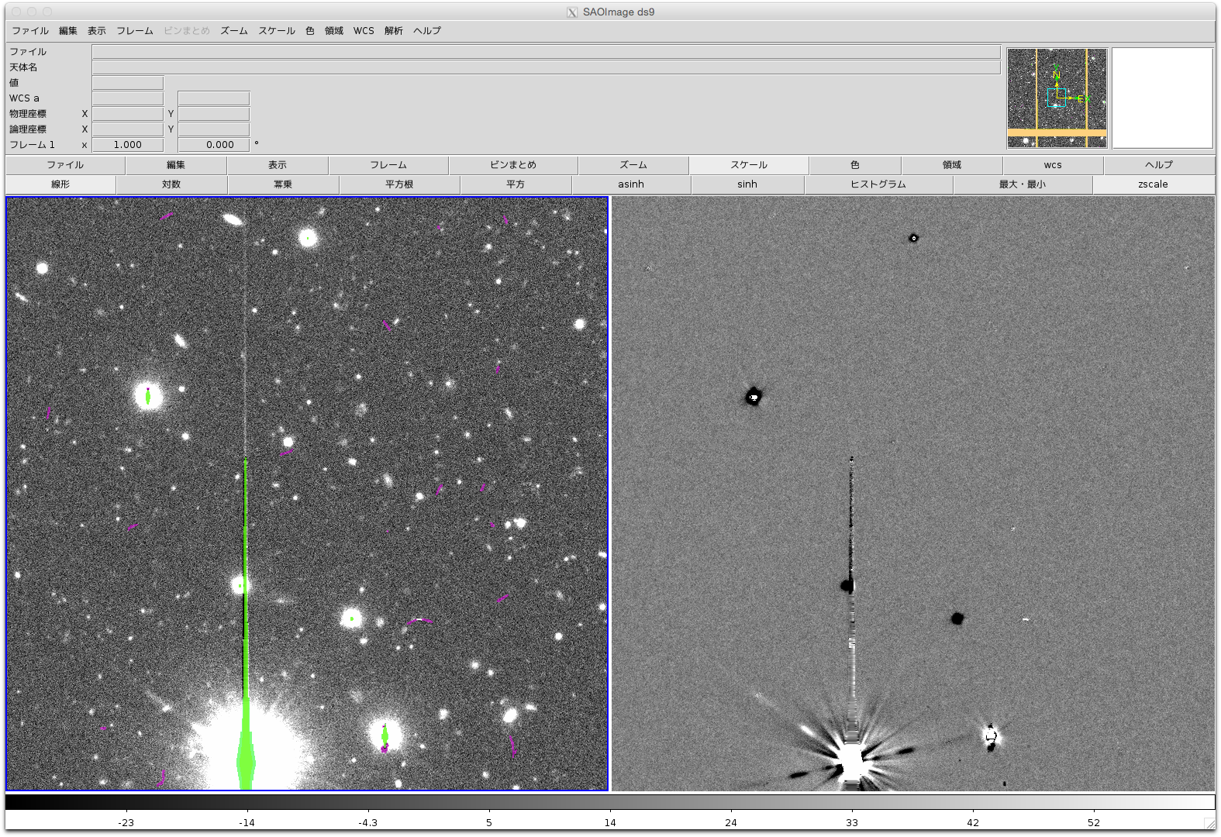
Blank field

Slide 8
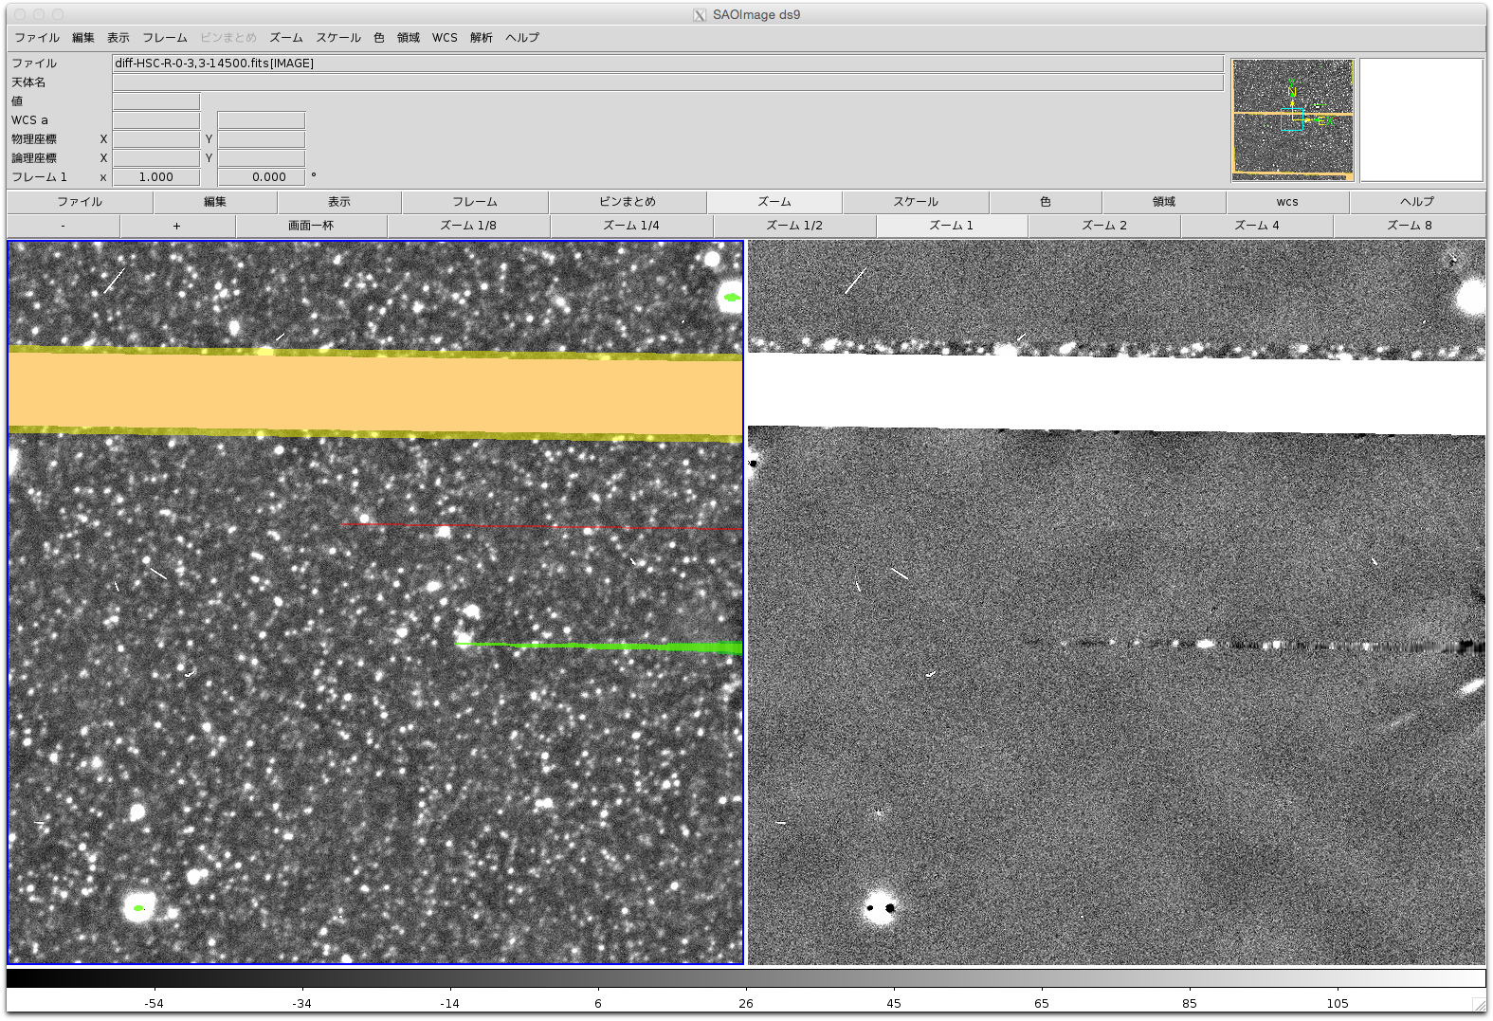
Crowded field (M31)

Slide 9
Using ip_diffim
I have been mainly using ImagePsfMatchTask in ip_diffim for image subtraction of HSC data
It works pretty well especially for single visits
But for coadded data, bad residuals increase.
Some of these seem to be caused by PSF discontinuity on coadded images.
Do subtraction on single visits and coadd them instead to make coadded images and do subtraction for them.

Slide 10
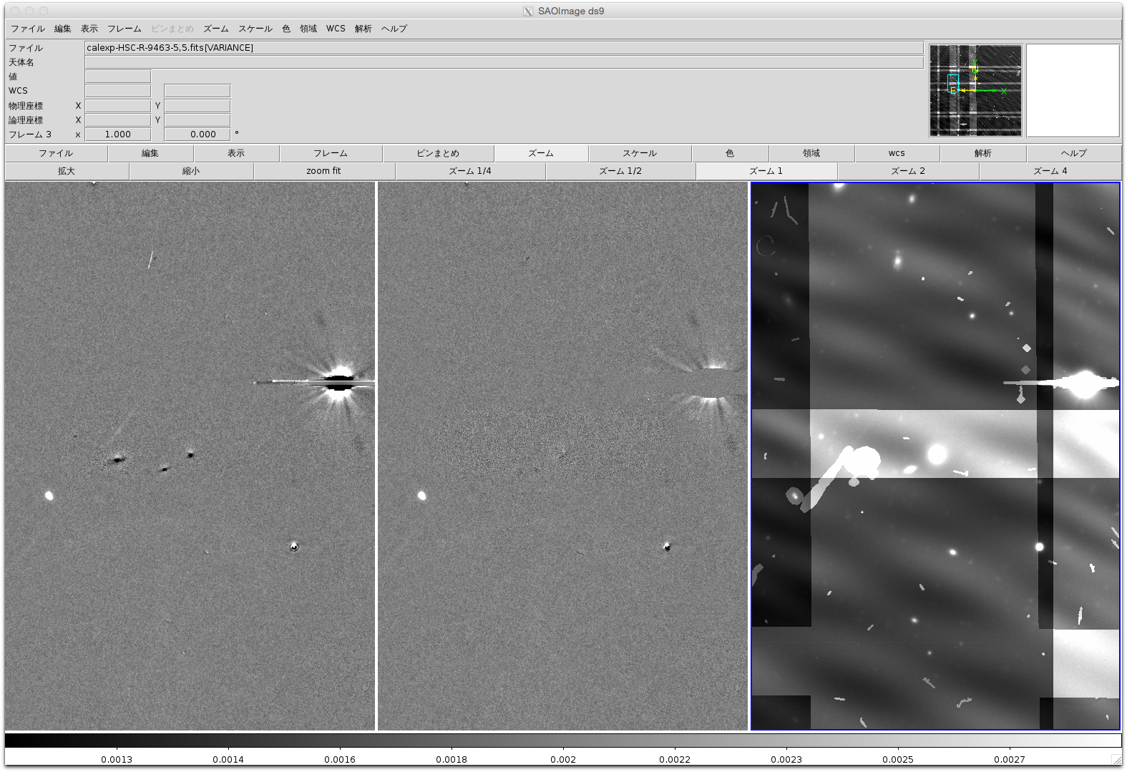
Coadd of
(warp–coadd)
coadd-coadd
variance

Slide 11
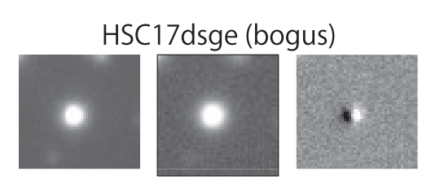
Bad subtraction for bright stars
Almost all bright stars show bad subtraction
Possible cause may be
Astrometric error due to atmosphere at small scale? Average relative astrometry is good to ~5mas
Non-linearity / brighter-fatter correction may not be accurate enough?
Need more study

Slide 12
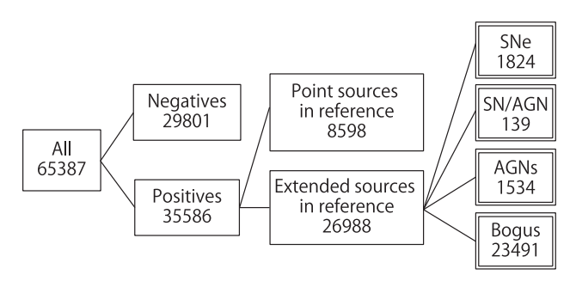
Bogus detections
Total number of detections : 11,551,397
CNN real/bogus classifier : 1,021,301
We applied loose classifier to prevent missing interesting objects
More than 2 detections at the same place 65,387
Mainly coming from
filter mismatch in i-band
Visual inspection

Slide 13
Summary
Although there are small issues,
PSF uniformity
Bright stars
Real / Bogus
Difference imaging module of LSST stack was successfully used for HSC Supernova Survey
We are planning next HSC Supernova Survey on XMM-LSS / SXDS field from next September

