Slide 1
M1M3 Logistics
Michael R. Logue
Principal Surveyor, Marine Transportation
LSST Project and Community Workshop
12th -16th August, 2019

Slide 2
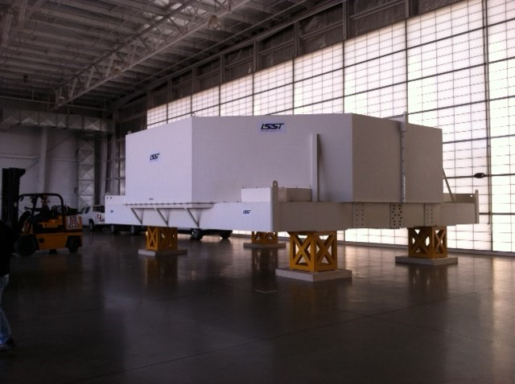
M1M3 Mirror in Shipping Container

Slide 3
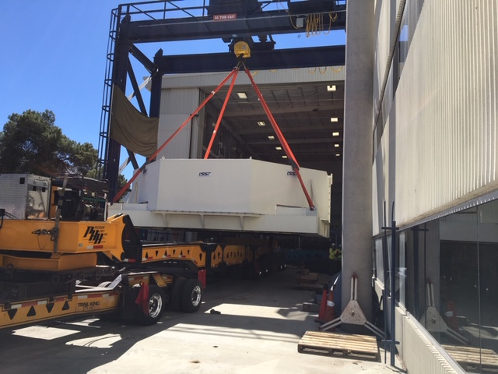
Mirror Laboratory

Slide 4
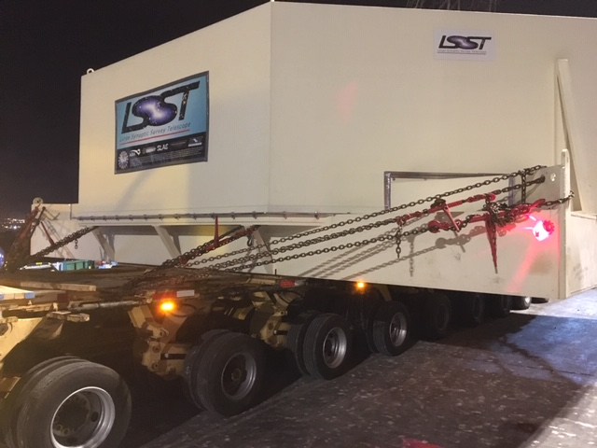
Typical Tie Down Specification

Slide 5
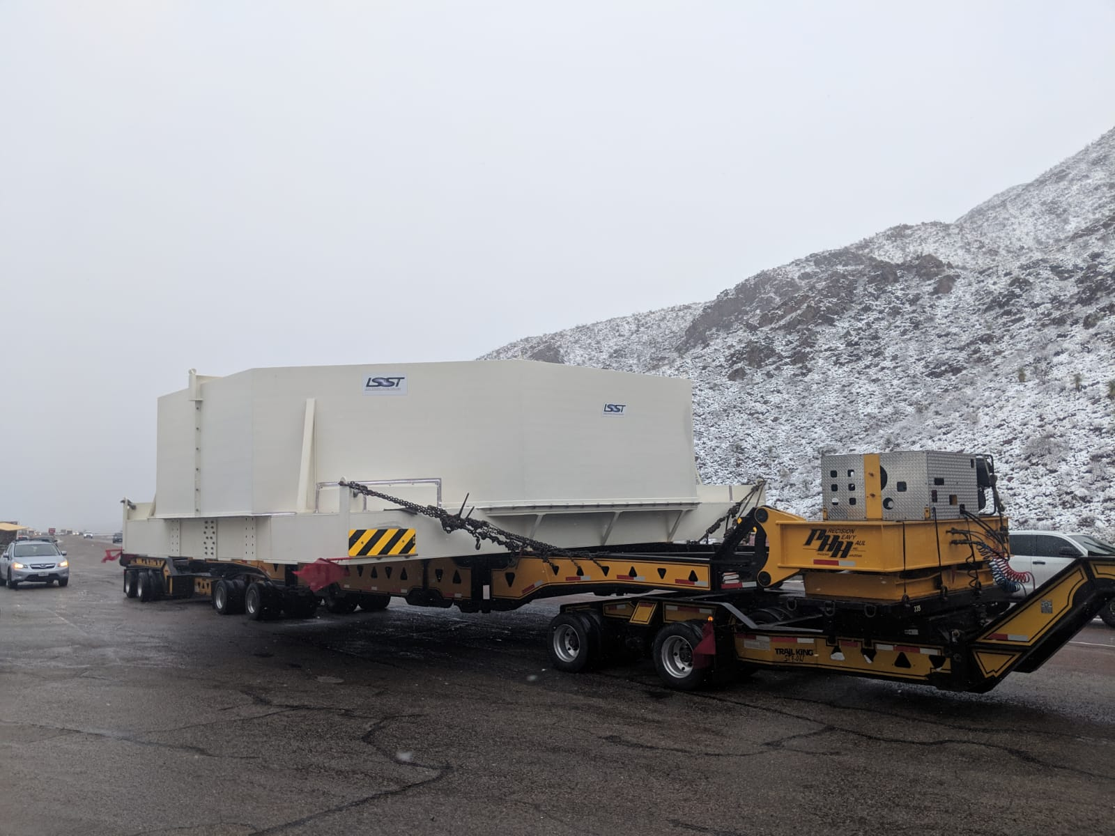
Road Transit to Houston

Slide 6
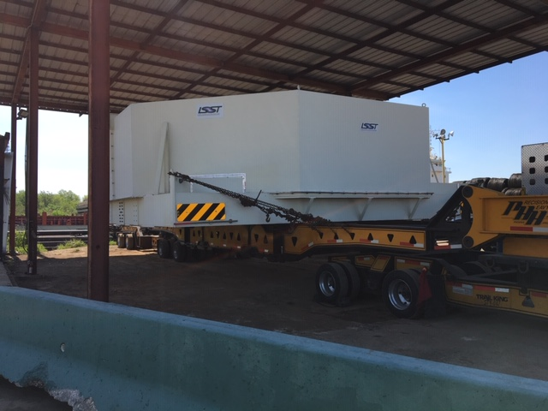
M1M3 Mirror at Houston

Slide 7
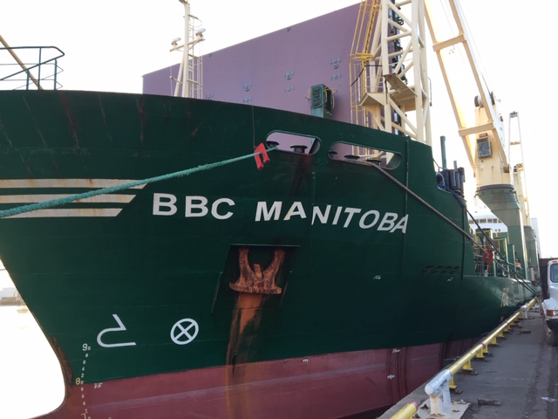
Heavy Lift Ship with Cranes

Slide 8
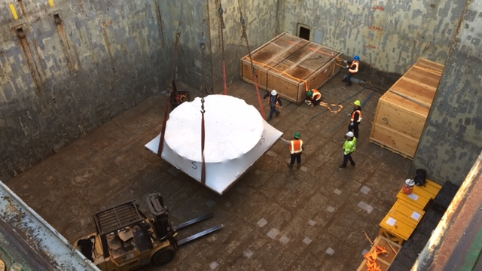
Dedicated Hold

Slide 9
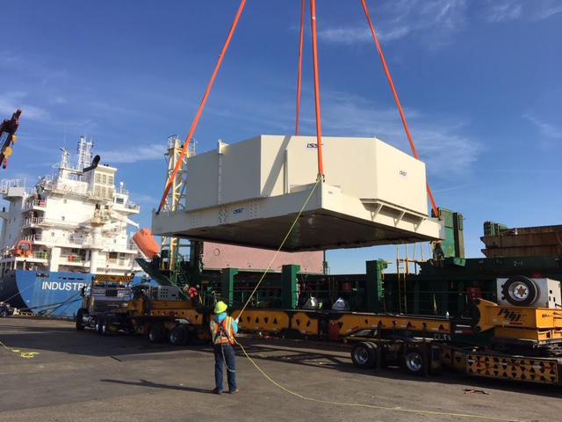
M1M3 Mirror Loading

Slide 10
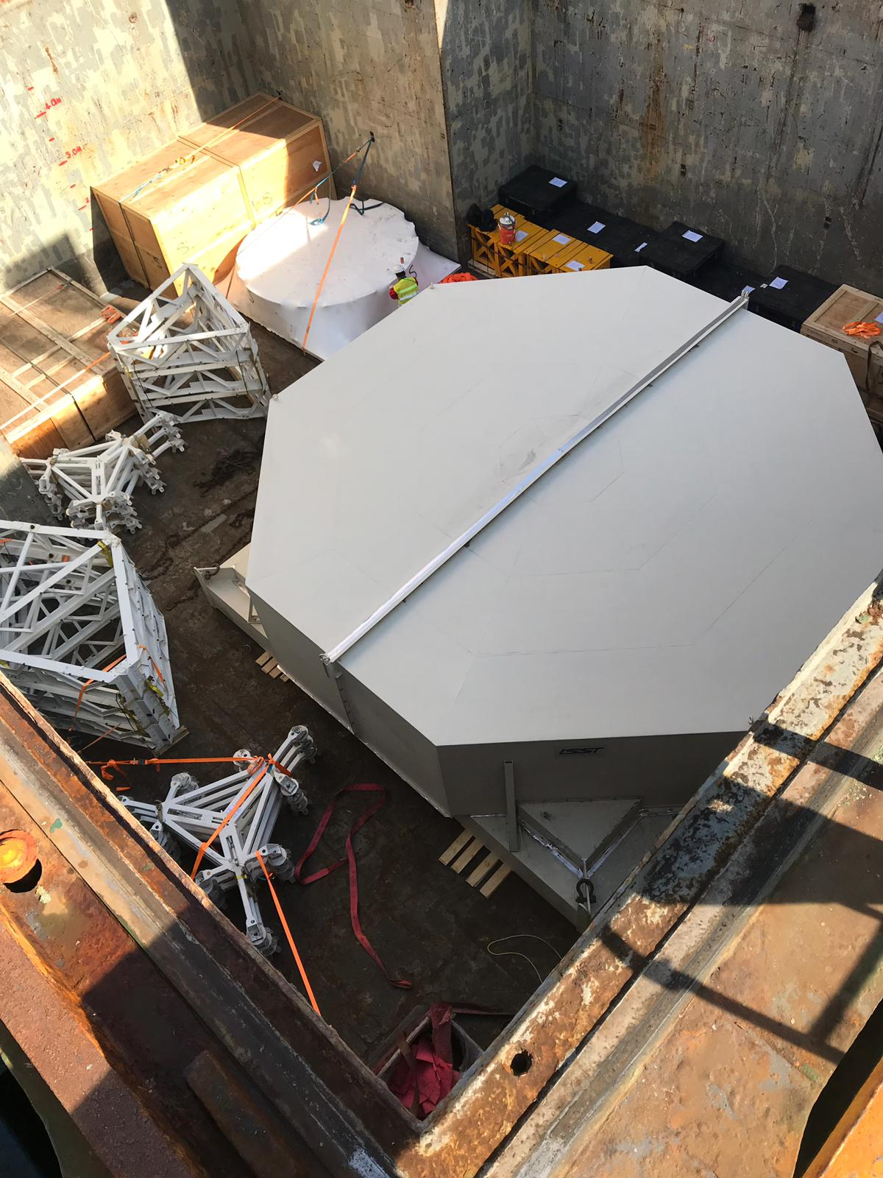
Hold No.1

Slide 11
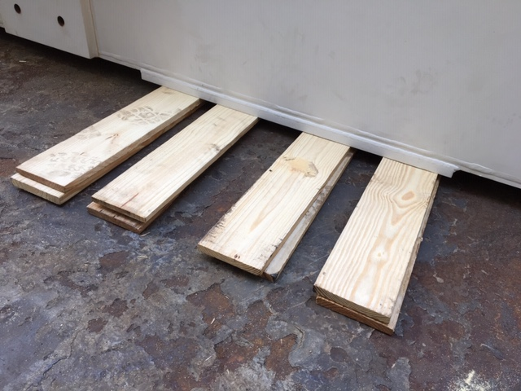
Dunnage Mats

Slide 12
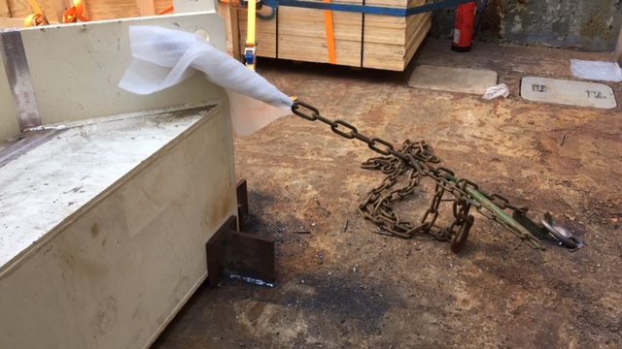
M1M3 Mirror Securing Specification

Slide 13
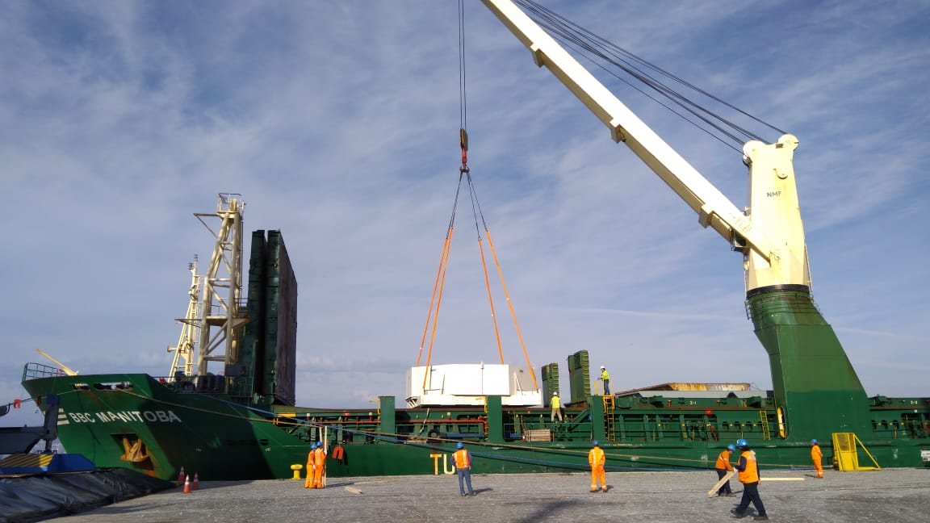
Arrival at Coquimbo

Slide 14
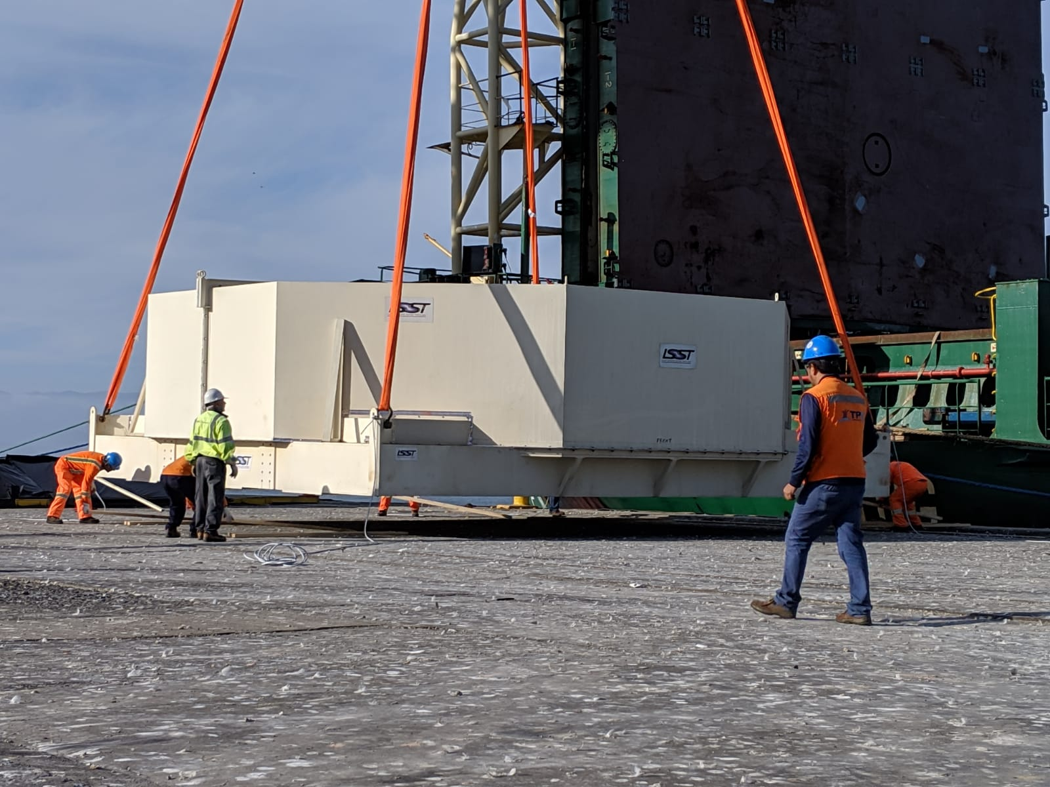
Lifting & Discharge

Slide 15
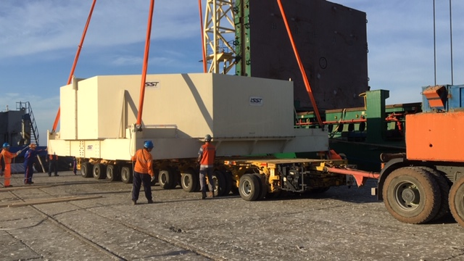
Loading to Platform Trailer

Slide 16
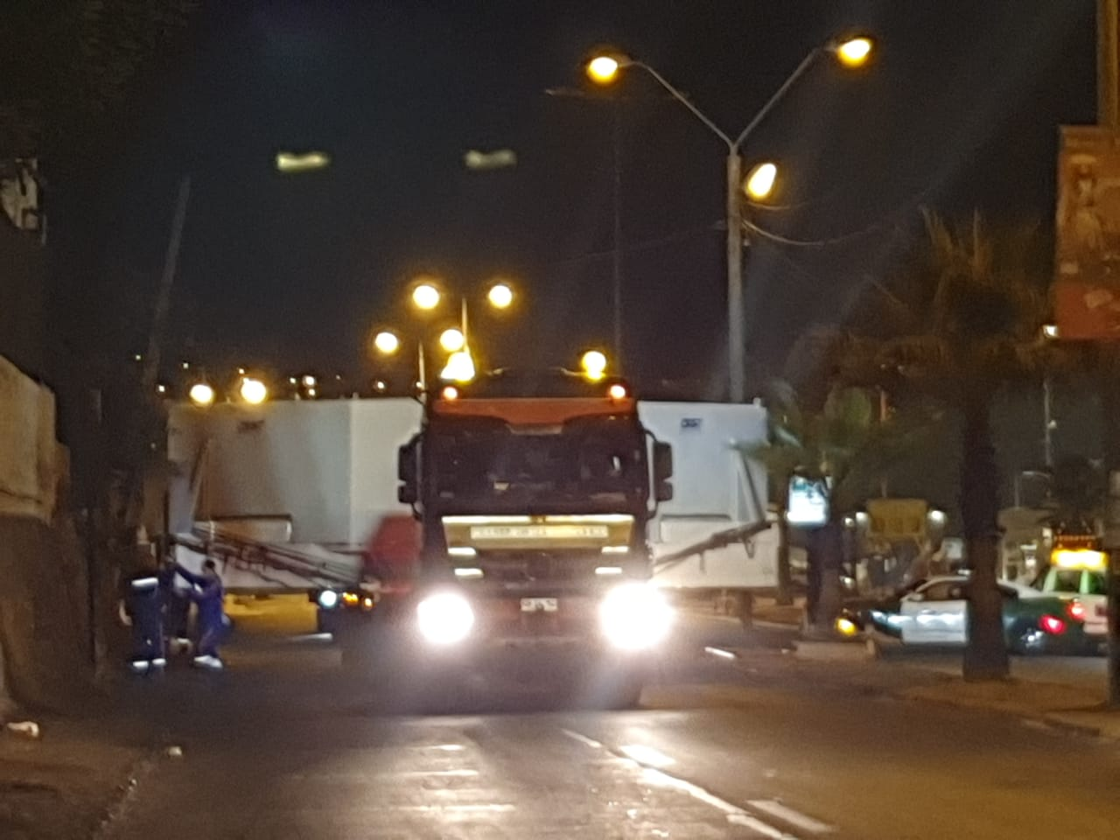
Coquimbo by Night

Slide 17
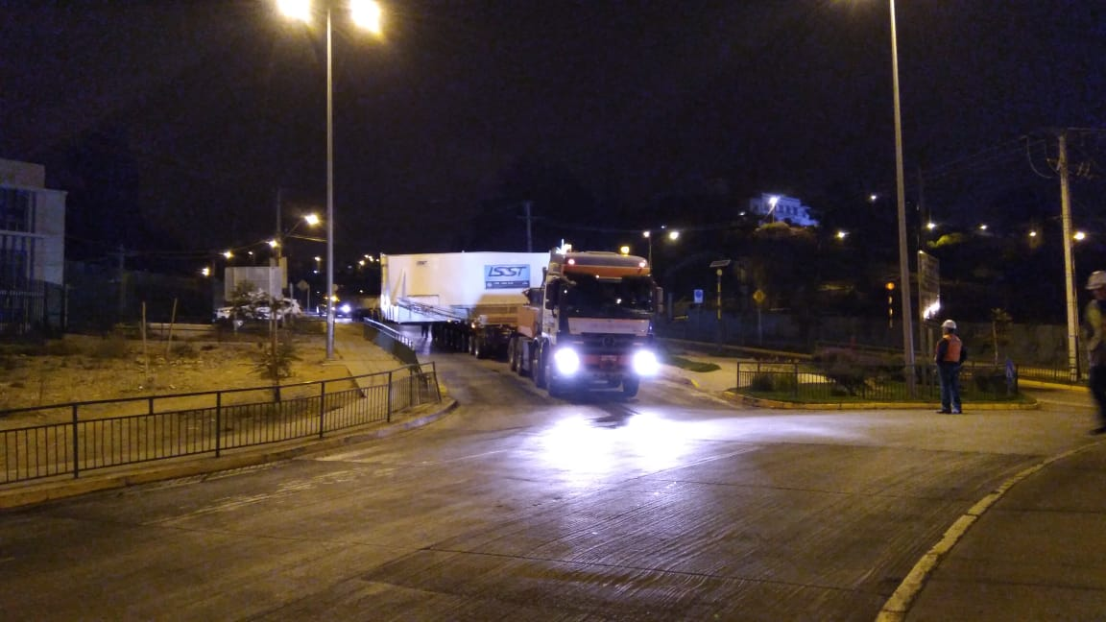
Gradients & Cambers at La Serena

Slide 18
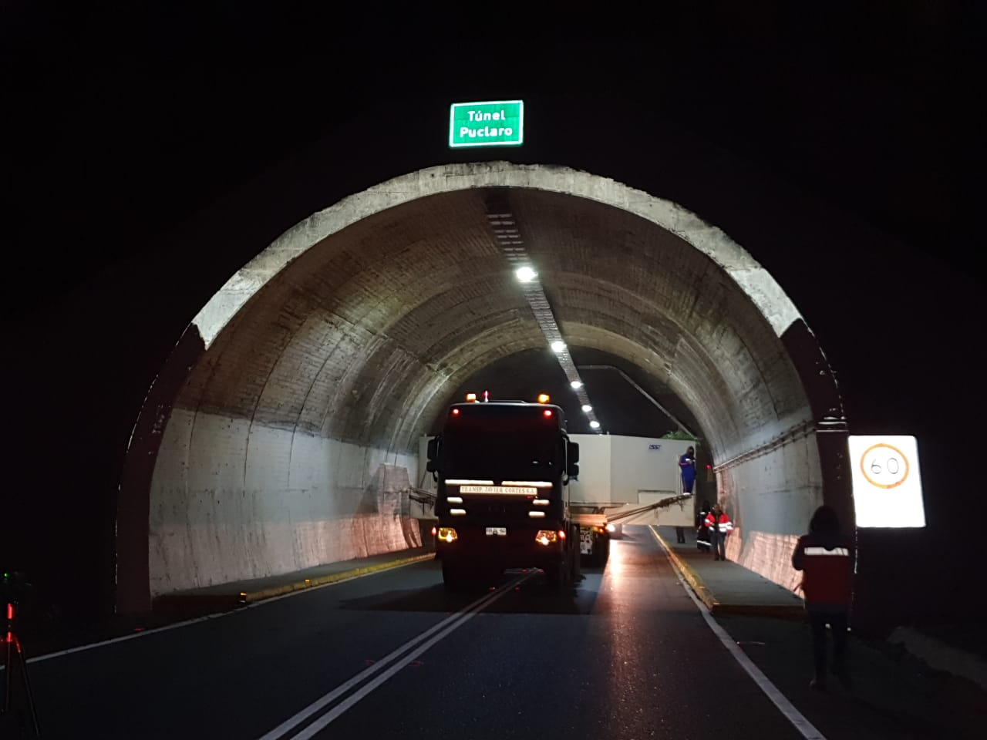
Puclaro Tunnel Transit

Slide 19
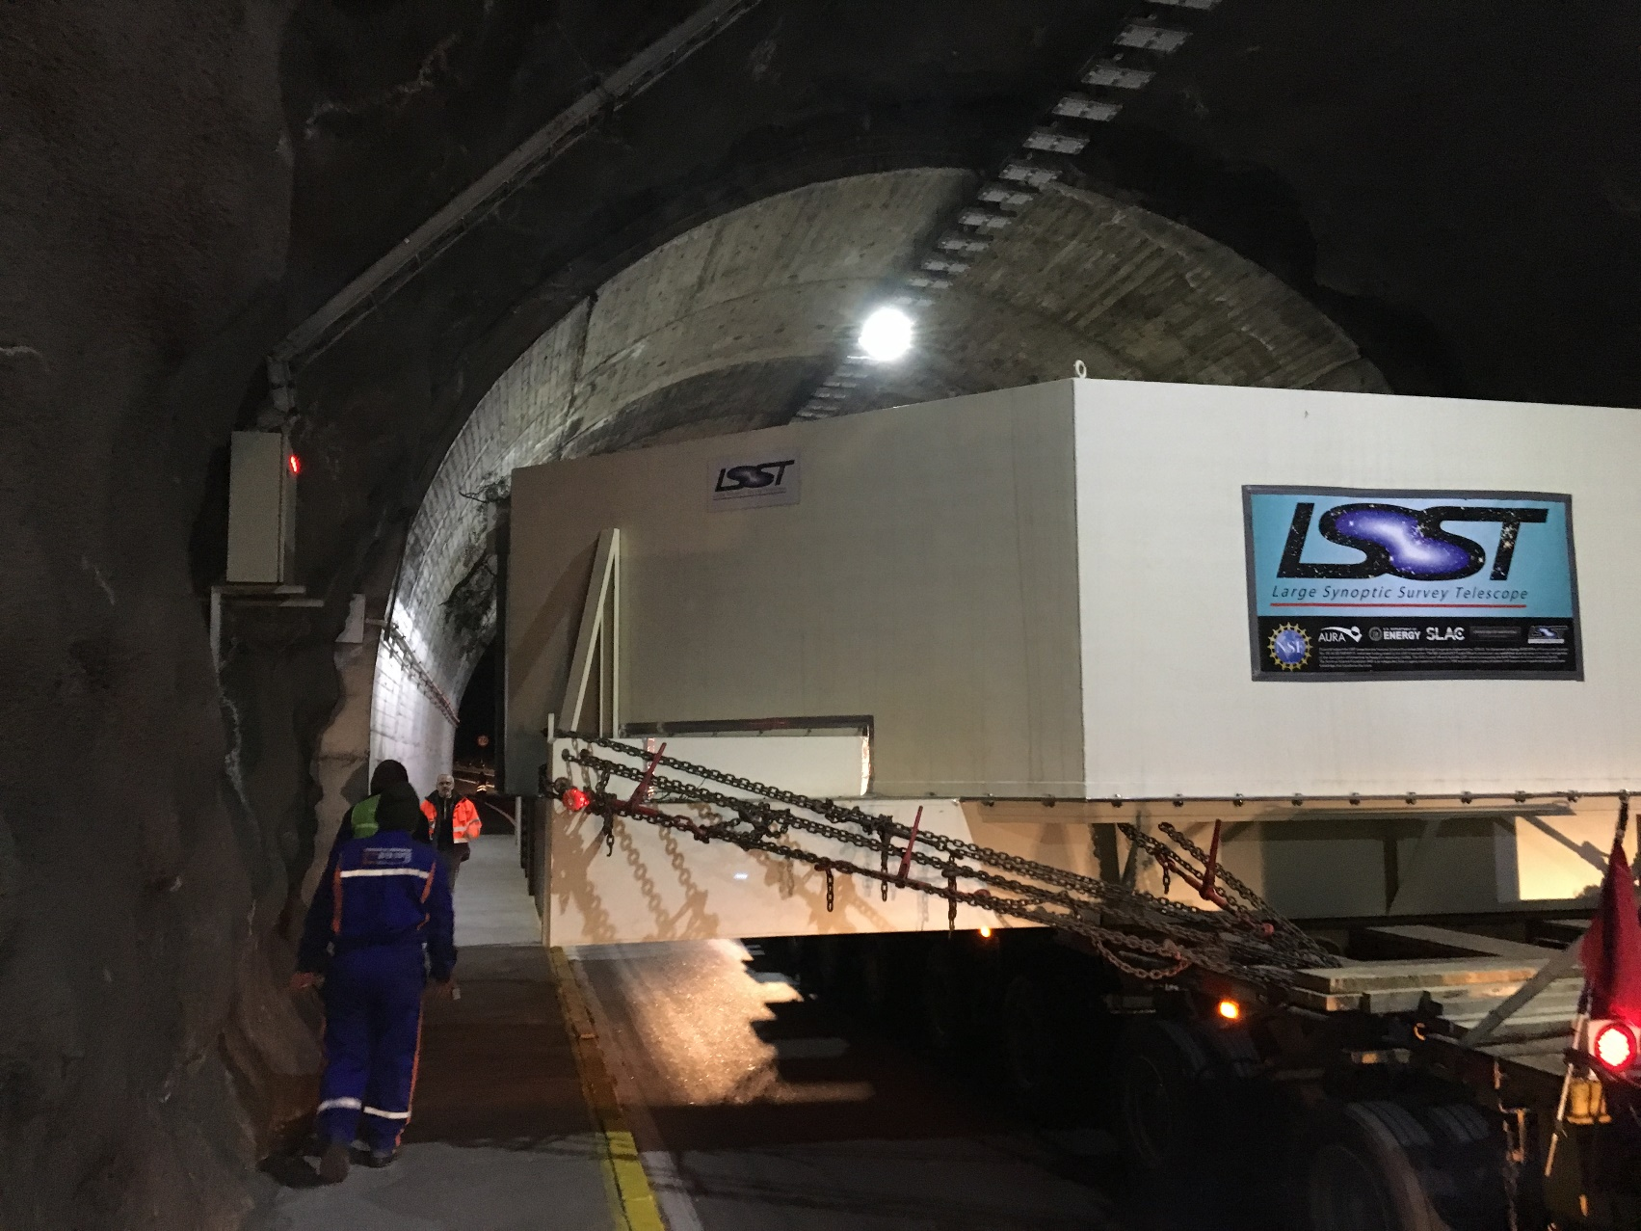
Limited Clearances

Slide 20
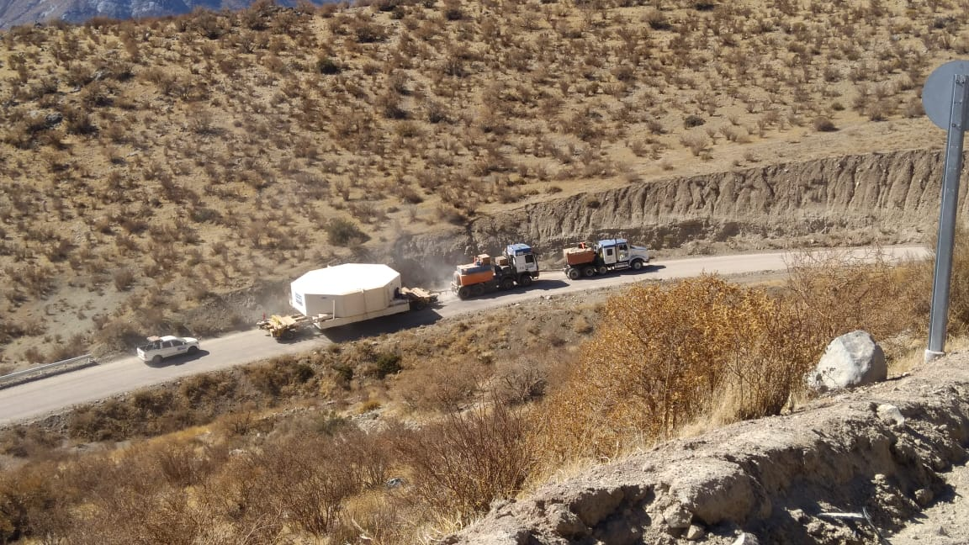
Dual Tractors

Slide 21
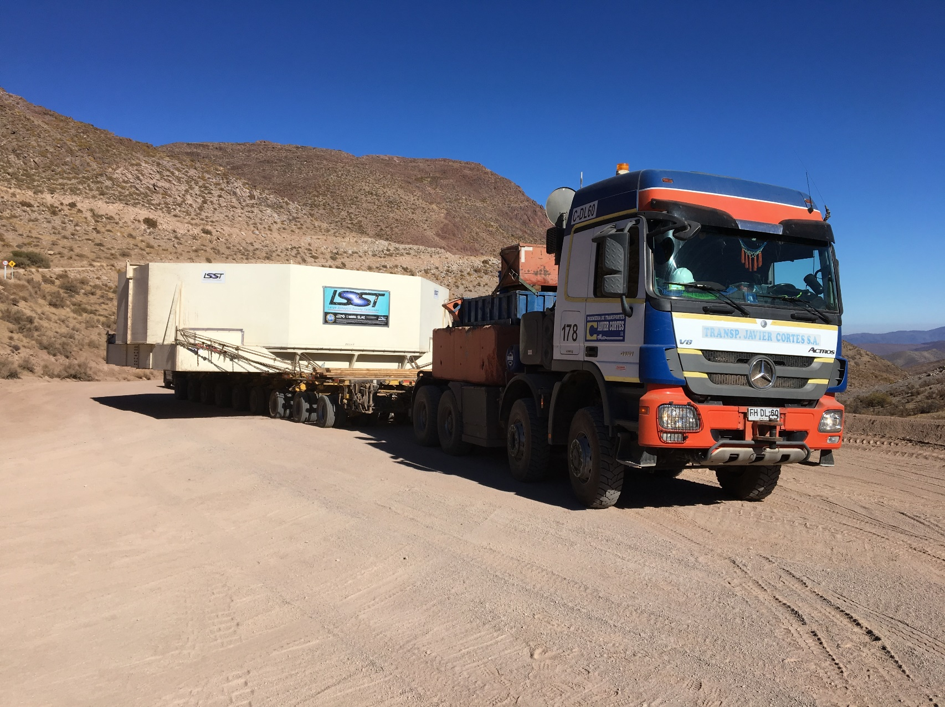

Slide 22
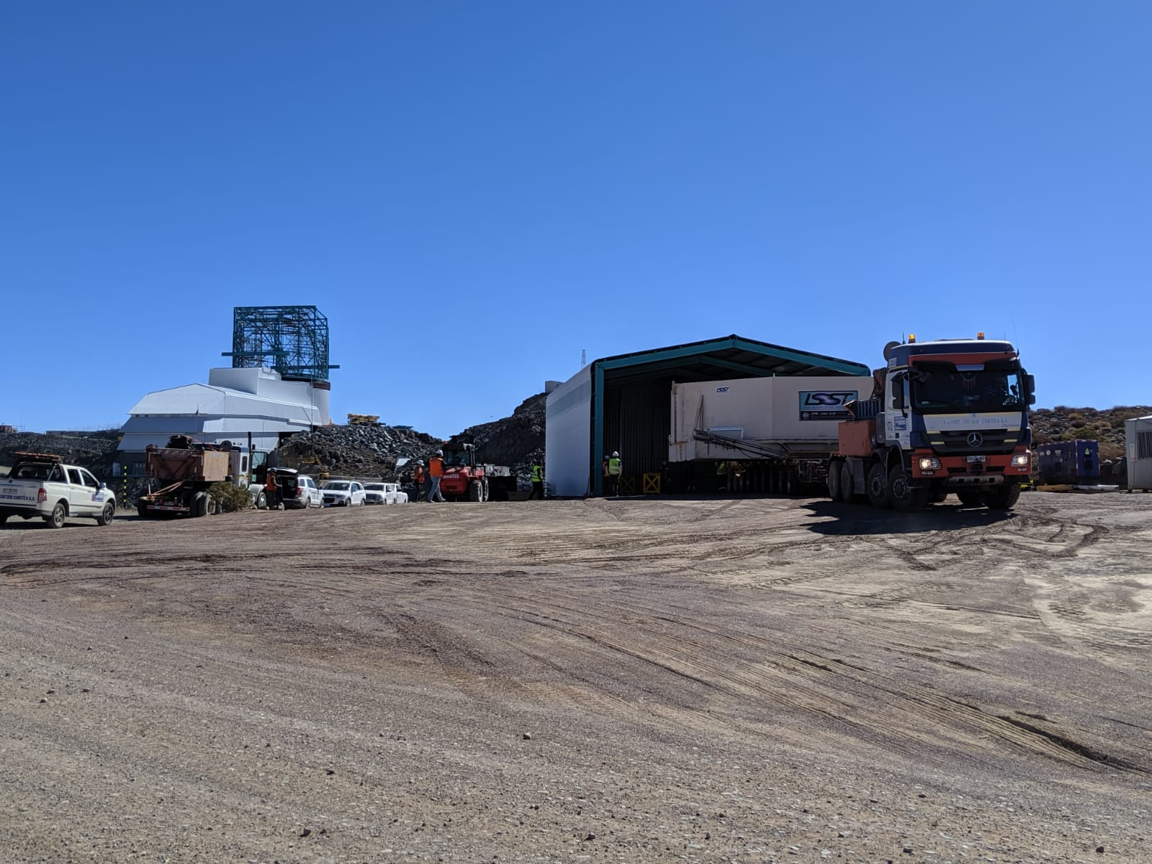
Summit Arrival

Slide 23
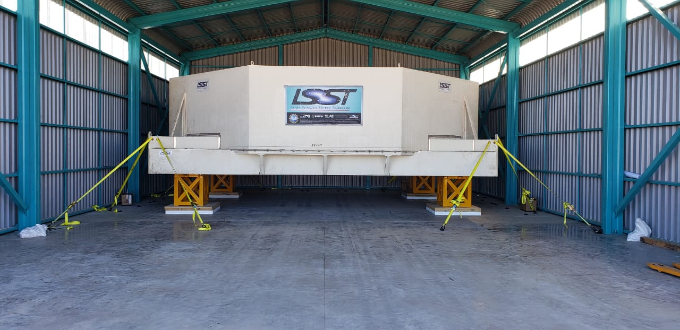
M1M3 Mirror Replaced on Stands

Slide 25
M1M3 Mirror Logistics Key Processes
Critical Item Identification
Vendor & Contractor Selection
Packaging, Handling, and Transfer Points
Process & Procedure
Contingency & Mitigation
Limited Liabilities
Unforeseen Circumstances & Events
Cargo Marine Risk Management
Monitoring & Validation

Slide 26
Logistics Planning
Cargo Characteristics
Dynamic Forces
Route Analysis
Lifting, Loading, & Securing
Key Transfers & Interactions
Documentary Requirements
Statutory Requirements

Slide 27
Logistics Planning

Slide 28
Dynamic Forces Data Sheet

Slide 29
M1M3 Mirror Securing

Slide 30
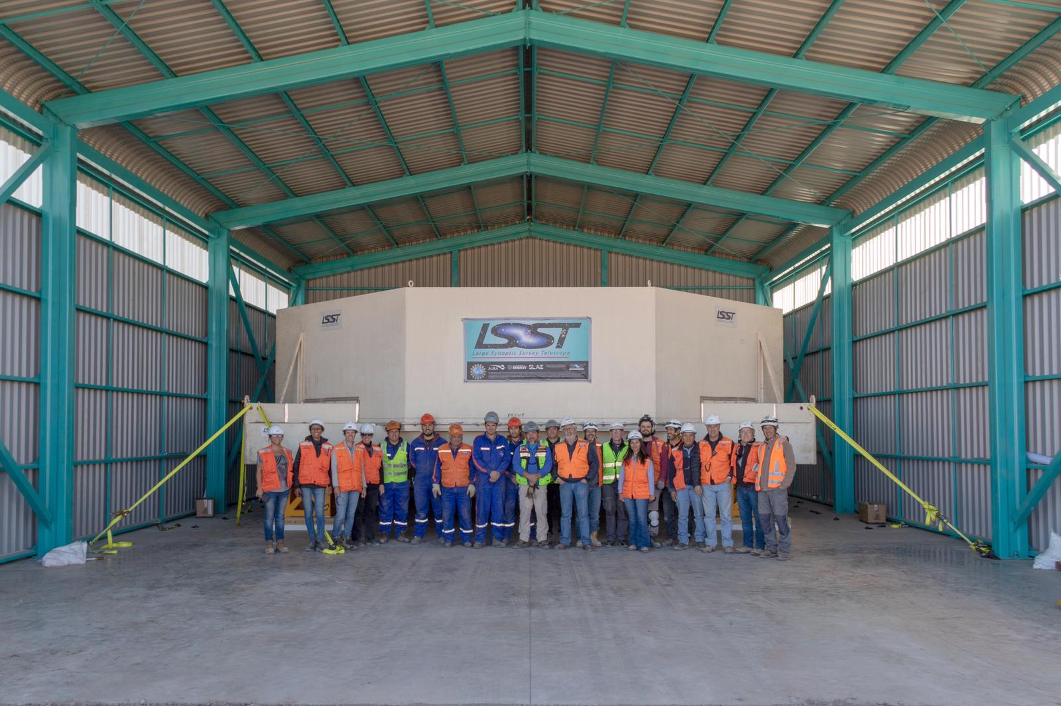
Congratulations to the LSST Team

